Slide 1
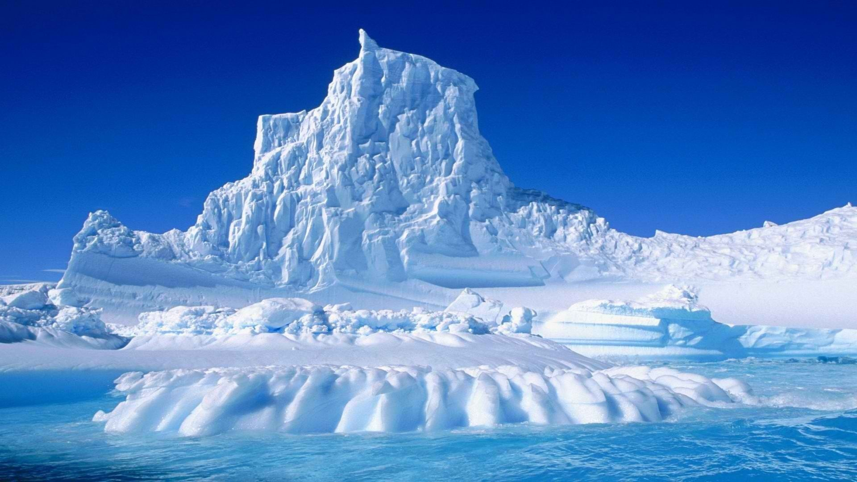
Antihydrogen experiments: addressing the challenges of ultra-low temperatures
Sebastian Gerber¹ , on behalf of the AEgIS collaboration²
INSTR-17 conference, 27th February - 3rd March 2017
¹ CERN, Route de Meyrin 385, 1217 Meyrin, CH
² http://cern.ch/aegis

Slide 2
Collaboration

Slide 3
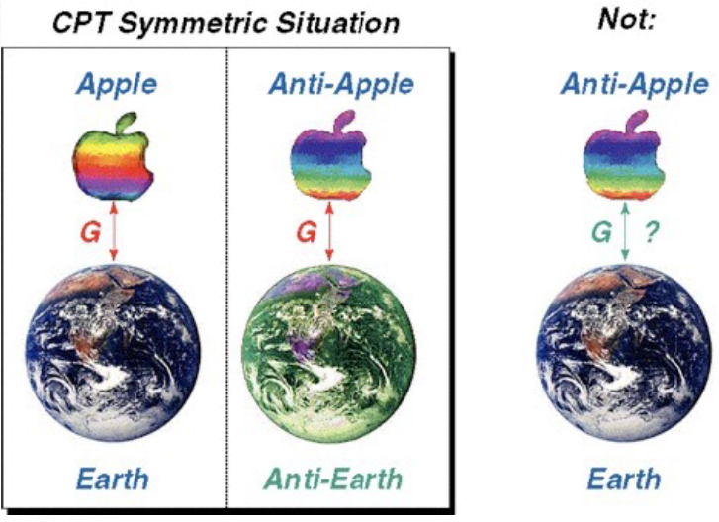
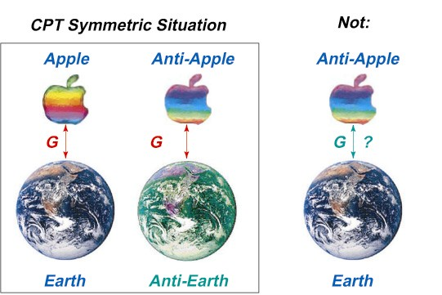
Motivation
Currently no experimental WEP test available for antimatter with high precision
normal matter Δg/g:
normal matter WEP:
Hypotheses of gravitational interaction
of matter with antimatter:
normal gravity, supported by EP
graviphoton/graviscalar in quantum gravity theory,
interaction with slightly different magnitude.
Kaluza Metric:
→ Neutral antimatter ($\overline{H}$) suitable to reach high precision
Currently hampered by absence of directionally emitted or trapped production in sufficient quantity
H. Mueller et al., Nature 463, 926 (2010)
S. Baessler et al., Phys. Rev. Lett. 83, 3583 (1999)
N. Ramsey et al., Quant. Electrodynamics, 673, (1990)
L. L. Williams, J. of Gravity 6, 901870 (2015)
→Physics goal of AEgIS: measurement of gravitational interaction between matter and antimatter, $\overline{H}$spectroscopy,…

Slide 4
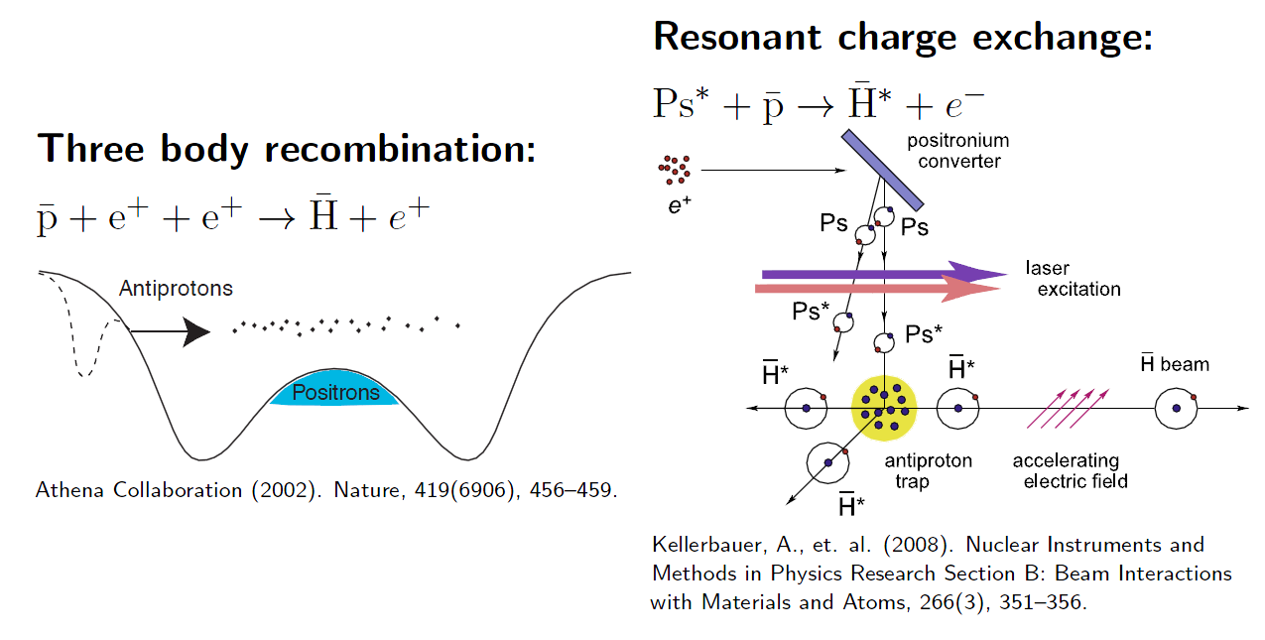
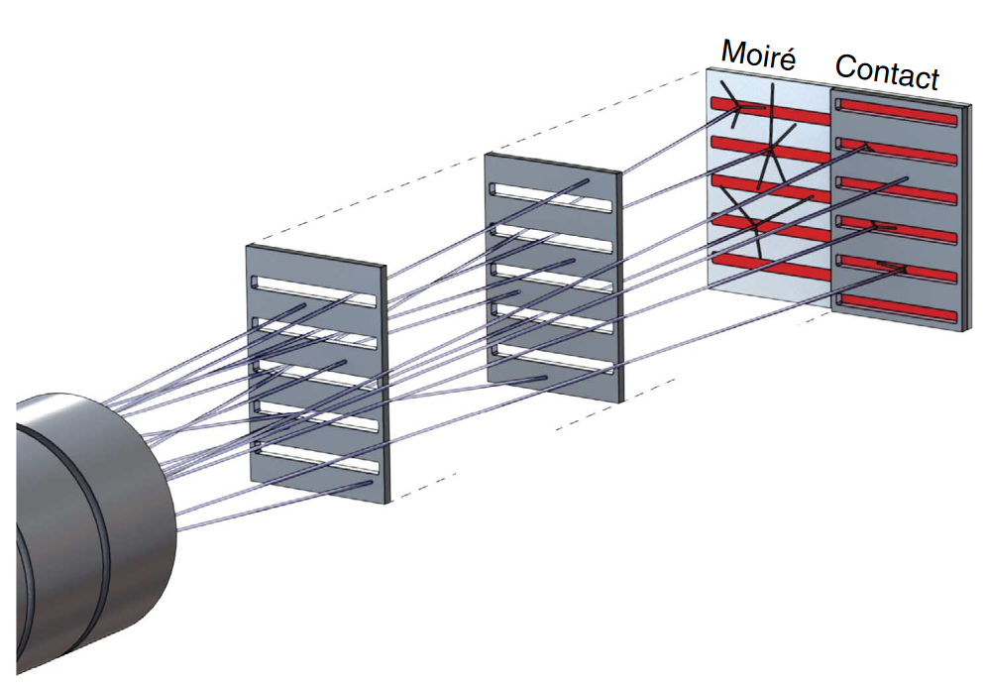
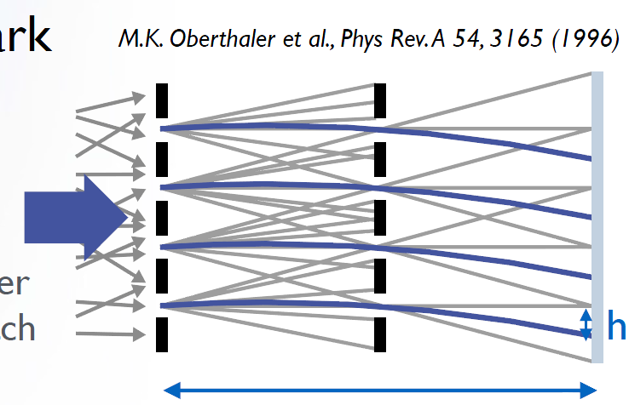
Method
AEgIS proposal: http://cdsweb.cern.ch/record/1037532
${\overline{H}}^{∗}$ formation via resonant charge exchange
Advantages:
Pulsed ${\overline{H}}^{∗}$ production (time of flight)
laser-excitation to Ps*
Colder potentially than via mixing
$T_{{\overline{H}}^{∗}}$ defined by $T_{\overline{p}}$ + momentum of Ps*
Measure g for $\overline{H}$in Moiré deflectometer
Falling height:
Requires velocity information of $\overline{H}$ and t₀
Requires high detector resolution
$$h=gτ2=g{\left(\frac{L}{v_{{\overline{H}}^{∗}}}\right)}^{2}$$
, $L\sim T_{{\overline{H}}^{∗}}^{−1/2}$
S. Aghion et al., Nat. Commun. 5, 4538 (2014)
$${Ps}^{∗}+\overline{p}→{\overline{H}}^{∗}+e^{−}$$
$${Ps}^{∗}+\overline{p}→{\overline{H}}^{∗}+e^{−}$$
$$L$$
$$\overline{H}$$
M. Oberthaler et al., Phys. Rev. A, 54, 3165 (1996)
$${\overline{H}}^{∗}$$
$$L$$
L
L
$${\overline{H}}^{∗}$$
$$S=A τ2$$
Aghion, S. et al., Nat. Commun. 5:4538 (2014).

Slide 5
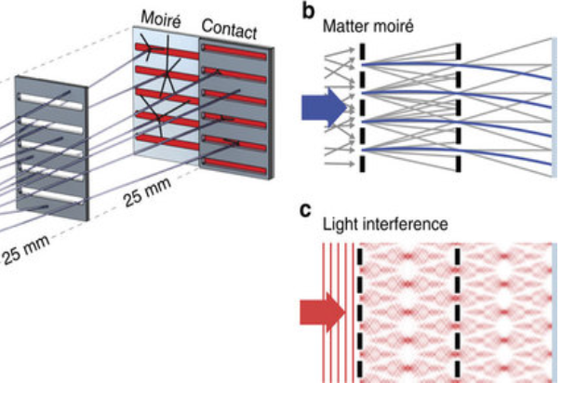
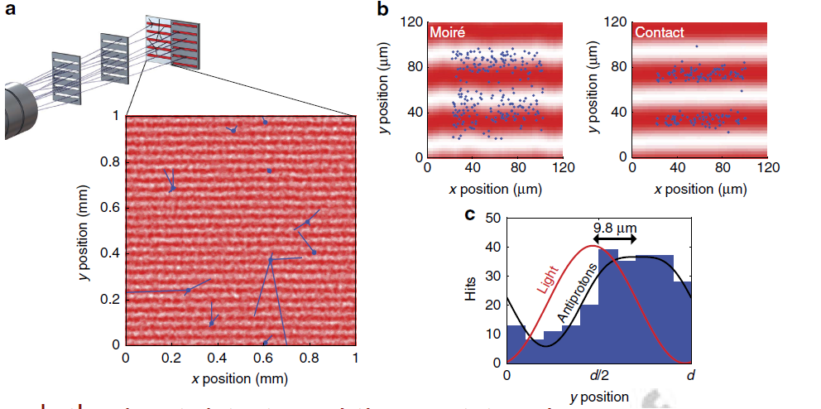
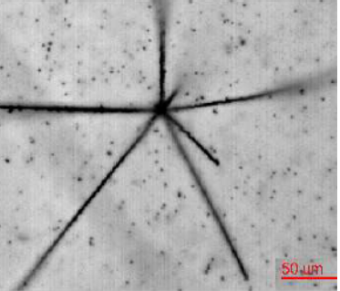
Proof of principle with $\overline{p}$...
…Moiré deflectometer to measure deflection
of $\overline{p}$ beam (~100 keV) provided by CERN AD facility
Annihilation vertex positions of 241 $\overline{p}$ :
$$L$$
$$L$$
9.8 um upwards shift
Shift between light and $\overline{p}$:
$∆y=9.6±$0.9 (stat.) $±$6.4 (syst.) μm
Visibility of 71%; mean force of ~530 aN
(Compatible with a Lorentz force from 1 mT or 30 V/cm)
Emulsion detector with vertex resolution ~2 μm
P. Scampoli et al., J. Instr. 9, C01061 (2014)
S. Aghion et al., Nat. Commun. 5, 4538 (2014)
Crucial step towards direct detection of the gravitational
acceleration of antihydrogen with the AEgIS experiment Δz = g t²
Crucial step towards the direct detection of the gravitational
acceleration of antihydrogen with the AEgIS experiment Δz = gτ²
Notes:
Detector=2.5 cm,
12 um slit width, 40 um periodicity.
Goal: distinguish between annihilation on detector and on interferometer grating:

Slide 6
Proof of principle with $\overline{p}$...
…Moiré deflectometer to measure deflection
of $\overline{p}$ beam (~100 keV) provided by CERN AD facility
Annihilation vertex positions of 241 $\overline{p}$ :
$$L$$
$$L$$
9.8 um upwards shift
Shift between light and $\overline{p}$:
$∆y=9.6±$0.9 (stat.) $±$6.4 (syst.) μm
Visibility of 71%; mean force of ~530 aN
(Compatible with a Lorentz force from 1 mT or 30 V/cm)
Emulsion detector with vertex resolution ~2 μm
P. Scampoli et al., J. Instr. 9, C01061 (2014)
S. Aghion et al., Nat. Commun. 5, 4538 (2014)
Challenges:
1) Position sensitive detector that can distinguish $\overline{H}$ annihilations from secondaries.
2) Production of cold $\overline{H}$ required for precision measurements on g.
Crucial step towards direct detection of the gravitational
acceleration of antihydrogen with AEgIS experiment Δz = g t²
Crucial step towards the direct detection of the gravitational
acceleration of antihydrogen with the AEgIS experiment Δz = gτ²
Notes:
Detector=2.5 cm,
12 um slit width, 40 um periodicity.
Goal: distinguish between annihilation on detector and on interferometer grating:

Slide 7
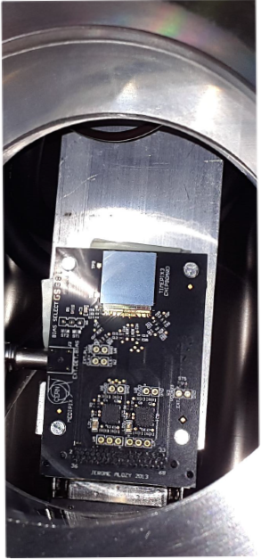
Timepix3 detector for $\overline{p}$ (and $\overline{H}$)
Timepix3
Detector and readout provided by courtesy of
the CERN Medipix3 collaboration [1]
Very good time resolution (1.5 ns on ToA and ToT)
High density pixel matrix (55 μm) 256 x 256
5 Gbit/s data rate through Spidr readout (VHDCI connector)
Sensor employed:
675 μm Si, p-on-n, depletion @ 200 V by [2]
[1] Timepix3: T. Poikela et al., J. Instrum. 9, C05013 (2014), doi: 10.1088/1748-0221/9/05/C05013
Timepix: X. Llopart et al., Nucl. Instrum. Meth. A 581, 485 (2007).
[2] ADVACAM http://www.advacam.com
P at 8 keV, on 300 um sensor

Slide 8
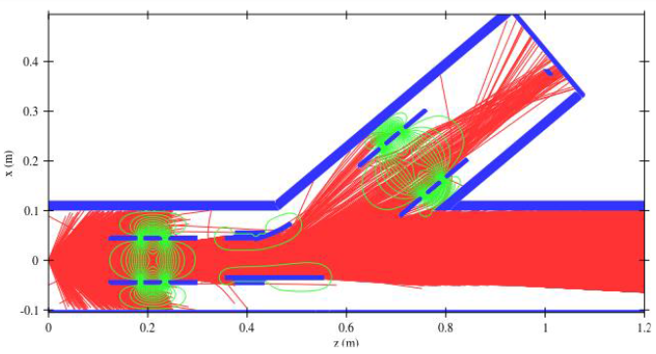
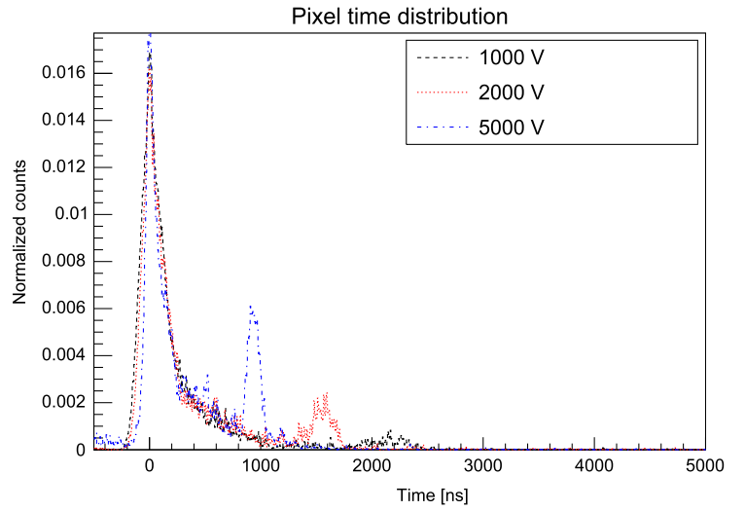
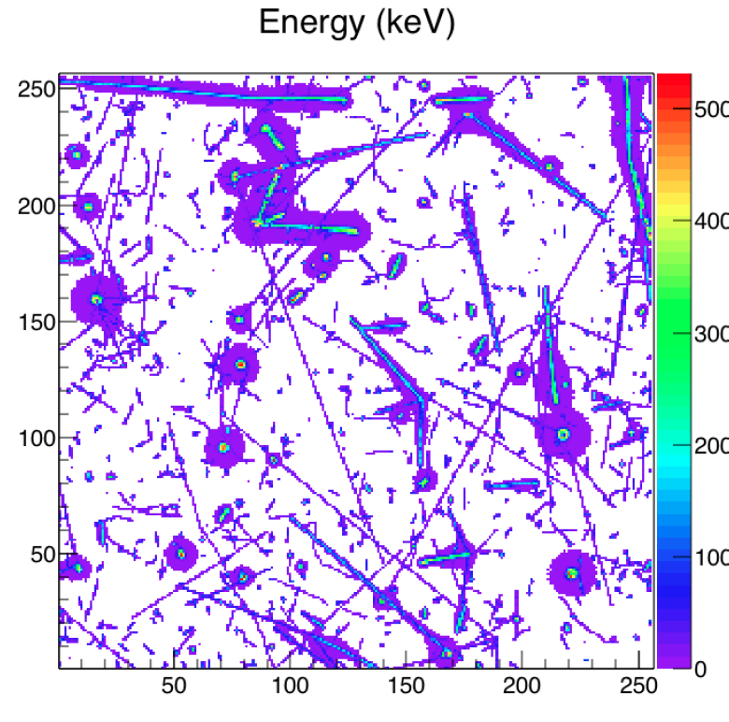
Test run with Timepix3 detector
Test setup with electrostatic deflector and Einzel-lenses
At ~ keV $\overline{p}$, about 2 GeV get redistributed
to ~100 MeV products (only $π$ MIPs)
tunable 1-16 keV $\overline{p}$ [1]
bunch width 200 ns
$\overline{p}$
nucleus
AD shot 5 MeV
moderated with
Al foil (46 μm)
to 0-100 keV
$π^{±,0},K^{±,0}$,..
$$α, …{}_{z}^{}X$$
$$A$$
$e^{−}$ $e^{+}→γγ$
Test run using Timepix3 detector
Pixel time distribution for different bending voltages
Importance of tagging:
Pixel time distribution
ToA:
<700 ns main burst from
annihilations in moderator
3x annihilation events of slow $\overline{p}$
(1 μs~ 10 keV, 2 μs ~ 2.5 keV)
Normalized counts
Time (ns)
4 keV threshold (MIP pass over 55 μm pixel ~14 keV)
N. Pacifico et al., Nucl. Instrum. Methods Phys. Res. A 831, 12–17 (2016).
[1] Ion Beam Simulator http://ibsimu.sourceforge.net
Notes:
2GeV get redistriuted Average energy of annihilation products is ~100 MeV
Average energy of annihilation products ~100 MeV
Our case the detection threshold was set at 4keV, well below the expected charge released by a MIP in a sideway spath through a 55 μm pixel(∼14keV).

Slide 9
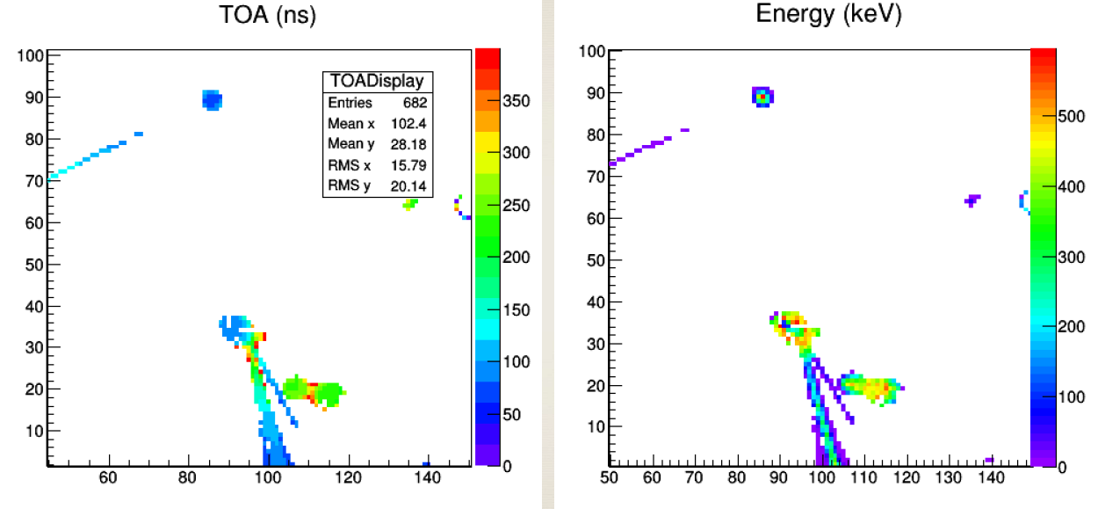
Test run with Timepix3 detector
Test setup with electrostatic deflector and Einzel-lenses
At ~ keV $\overline{p}$, about 2 GeV get redistributed
to ~100 MeV products (only $π$ MIPs)
tunable 1-16 keV $\overline{p}$ [1]
bunch width 200 ns
$\overline{p}$
nucleus
AD shot 5 MeV
moderated with
Al foil (46 μm)
to 0-100 keV
$π^{±,0},K^{±,0}$,..
$$α, …{}_{z}^{}X$$
$$A$$
$e^{−}$ $e^{+}→γγ$
Test run using Timepix3 detector
Pixel time distribution for different bending voltages
Pixel time distribution
Importance of tagging:
ToA:
<700 ns main burst from
annihilations in moderator
3x annihilation events of slow $\overline{p}$
(1 μs~ 10 keV, 2 μs ~ 2.5 keV)
Normalized counts
Time (ns)
4 keV threshold (MIP pass over 55 μm pixel ~14 keV)
N. Pacifico et al., Nucl. Instrum. Methods Phys. Res. A 831, 12–17 (2016).
[1] Ion Beam Simulator http://ibsimu.sourceforge.net

Slide 10
Test run with Timepix3 detector
High dynamic range of ASIC allow for tagging of MIPs and heavy fragments
to distinguish between fragments leaving annihilation site
Pixel time distribution for different bending voltages
Pixel time distribution
~1 keV $\overline{p}$
bunch width 200 ns
ToA:
<700 ns main burst from
annihilations in moderator
3x annihilation events of slow $\overline{p}$
(1 μs~ 10 keV, 2 μs ~ 2.5 keV)
Normalized counts
Topologies of annihilation events of ~1 keV $\overline{p}$
Average energy of annihilation products ~100 MeVs
Time (ns)
Sample topologies of annihilation events of ~1 keV $\overline{p}$
TOA
300-700 ns main burst
3x annihilation events of slow pbar
Energy (keV)
Energy (keV)
Energy (keV)
Time tagging allows to distinguish initial MIP shower from annihilation events on detector
pixel #
pixel #
pixel #
pixel #
pixel #
pixel #
2 heavily ionizing particles | 3 MIPs, 1 heavily ionizing | 3 MIPs, 1 heavy fragment, 5 heavily with Bragg peak particle ionizing particles with Bragg peak
Topologies of annihilation events of ~1 keV $\overline{p}$
N. Pacifico et al., Nucl. Instrum. Methods Phys. Res. A 831, 12–17 (2016).

Slide 11
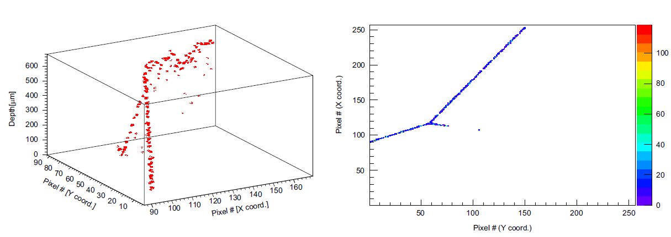
Test run with Timepix3 detector
High dynamic range of ASIC allow for tagging of MIPs and heavy fragments
to distinguish between fragments leaving annihilation site
Isometric view of annihilation event.
z coordinate by correlating carrier drift time with the generation depth.
Hole drift velocity parametrization in Si from [1].
~1 keV $\overline{p}$
bunch width 200 ns
Energy (keV)
Topologies of annihilation events of ~1 keV $\overline{p}$
Average energy of annihilation products ~100 MeVs
TOA
300-700 ns main burst
3x annihilation events of slow pbar
Time tagging allows to distinguish initial MIP shower from annihilation events on detector
Distinction of pions (MIPs) and heavy fragments with time tagging and energy profile
Timepix3 successfully tested down to temperatures of 210 K
Topologies of annihilation events of ~1 keV $\overline{p}$
N. Pacifico et al., Nucl. Instrum. Methods Phys. Res. A 831, 12–17 (2016).
[1] Jacoboni parametrization for hole mobility: C. Jacoboni et al., Solid State Electron. 20, 77 (1977).

Slide 12
$\overline{H}$beam - $\overline{p}$ cooling
1) Precision gravity measurement benefit from low $T_{{\overline{H}}^{∗}}$
2)
$T_{{\overline{H}}^{∗}}$ defined by $T_{\overline{p}}$ + momentum of Ps*
Goal for $\overline{H} beam$ $T_{{\overline{H}}^{∗}}\sim 100 mK$(axial: $T_{\overline{p}}\sim 10$mK + $T_{Ps}\sim 100$ K momentum transfer from Ps)
$\overline{p}$ cooling mechanism:
Sympathetic radiation electron cooling (Limit ~30 K with trap temperature ~ 10 K)
Evaporative / adiabatic cooling (limited by $\overline{p}$ numbers and axial confinement)
Resistive cooling (proven for single ions, difficult on low-Q plasma modes)
Sympathetic laser cooling with anions :
$${Ps}^{∗}+\overline{p}→{\overline{H}}^{∗}+e^{−}$$
$$\overline{p}+e^{+}+e^{+}→{\overline{H}}^{∗}+e^{+}$$
formation currently limited to tens of K [1]
S. L. Andersen et al., Eur. Phys. J. D. 68, 124 (2014)
Os⁻ spectroscopy:
U. Warring et al., Phys. Rev. Lett. 102 043001 (2009)
→ Investigation of
La⁻ spectroscopy:
E. Jordan et al., Phys. Rev. Lett. 115 113001 (2015)
C₂⁻ proposal:
P. Yzombard et al., Phys. Rev. Lett. 114 213001 (2015)
[1] G. B. Andersen et al., Nature Physics 7, 558 (2011).
Laser cooling in Penning trap, Picture: D. Dubin, O’Neil, http://sdpha2.ucsd.edu/

Slide 13
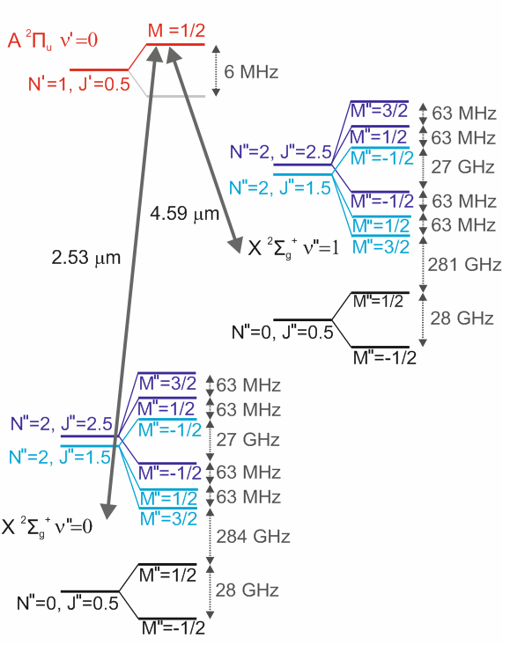
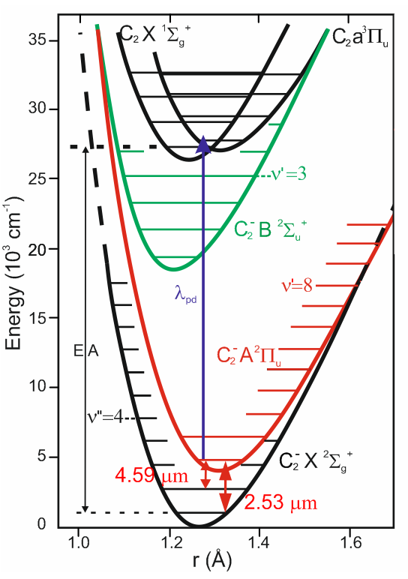
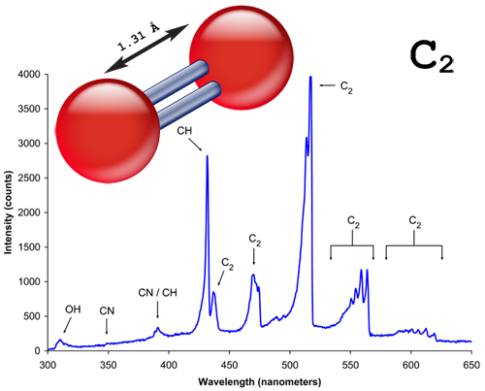
The anion candidate C₂⁻
Ro-Vib level structure and molecular potential energy of C₂⁻ in B=1 T
Homonuclear molecule
C₂
C₂⁻ benefits:
Known level scheme to ν/dν ~100 MHz [1]
Commercial lasers at 2.54 μm and 4.53 μm
Production in gas form
C₂⁻ challenges:
16 transitions for closed laser cycle including Zeeman splitting
20 kHz linewidth
[1] e.g. M. Tulej et al., J. Raman Spectrosc. 41, 853 (2010).

Slide 14
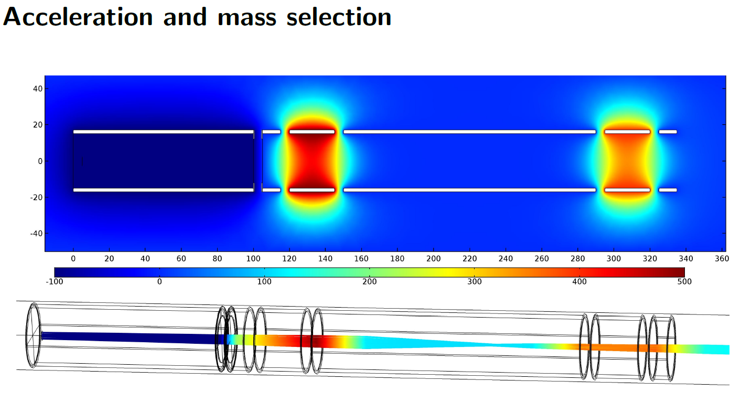
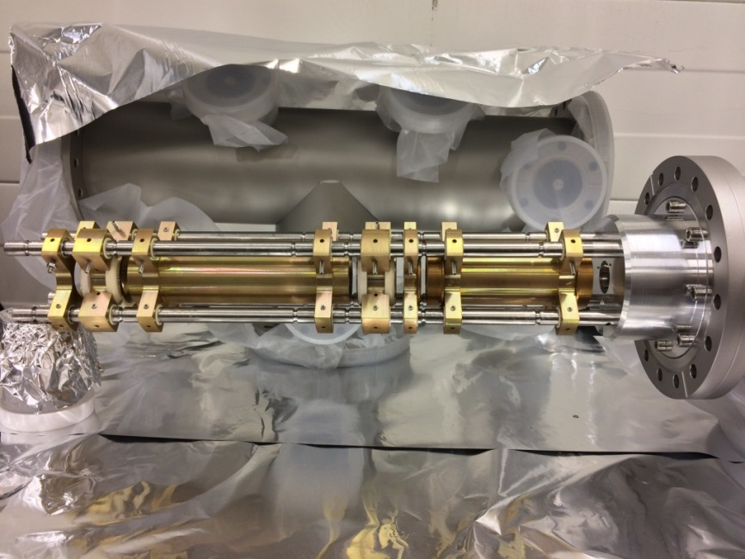
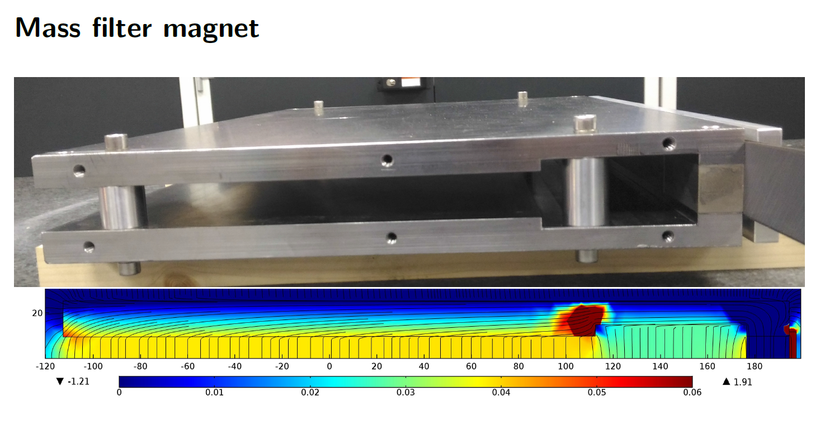
C₂⁻ production and beam
AEgIS
Supersonic expansion simulation of C₂⁻
by U. Even, Tel Avis University, Israel
Setup specifications:
Supersonic expansion valve
estimated ~10 meV internal
ground-state occupation [1]
Mass spectroscopy for
100 eV C₂⁻
Einzel-lens telescope
Beam diagnostics
(Faraday cups, MCP)
Acceleration and mass selection
Mass filter magnet
[1] U. Even et al., EPJ Techniques Instr. 2, 17 (2015).

Slide 15
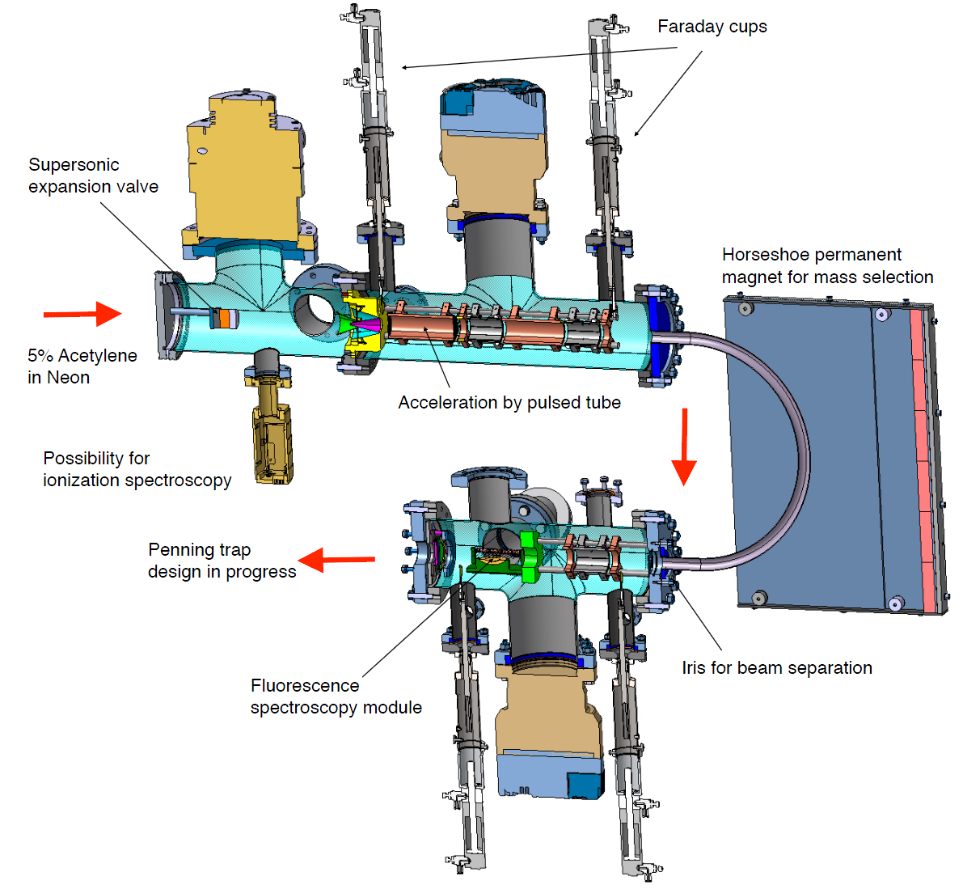
C₂⁻ production and beam
Setup specifications:
Supersonic expansion valve
estimated ~10 meV internal
ground-state occupation [1]
Mass spectroscopy for
100 eV C₂⁻
Einzel-lens telescope
Beam diagnostics
(Faraday cups, MCP)
to Penning trap
[1] U. Even et al., EPJ Techniques Instr. 2, 17 (2015).

Slide 16
Towards $\overline{p}$ cooling...
Three step-plan to reach mK $\overline{p}$ with coolant C₂⁻ :
1)…
2)…
3)…

Slide 17
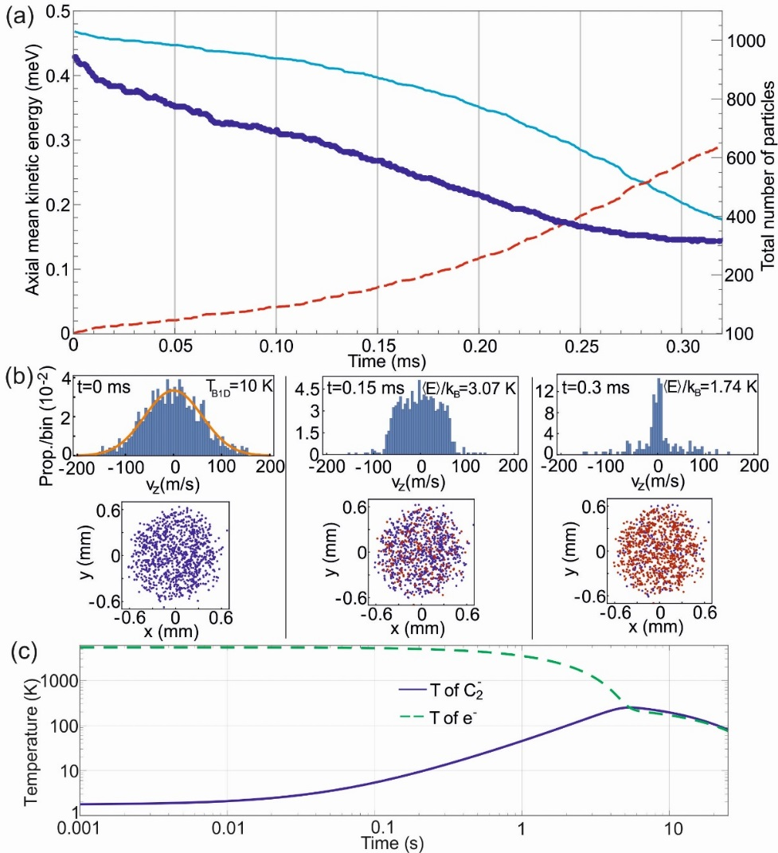
Cooling C₂⁻
1) Photo-detachement cooling, simulation
GPU based simulation of 1000 C₂⁻ [1]:
$n_{C_{2}^{−}}$=5x10⁶ cm⁻³ , B=1 T
C₂⁻ simplified level scheme:
C₂
380 nm
$n_{C_{2}^{−}}$=5x10⁶ cm⁻³ , B=1 T
C₂⁻ |e>
2.5 μm
C₂⁻ |g>
rate of photo-detachement [2] for 1 W @ 380 nm :
$Γ=\frac{I}{h ν}σ\sim 65 kHz$
T₀= 0.47 eV binding energy
T₀= 0.47 eV binding energy
$σ/{cm2}\sim {1×10}^{−17}$
[1] GPU framework Simbuca: S. Van Gorp and P. Dupre (2013): http://dx.doi.org/10.1063/1.4796087
[2] Cross-section calculation by: Viatcheslav Kokoouline, Uni. Orlando, USA (2016).

Slide 18
Cooling C₂⁻
1) Photo-detachement cooling, simulation
GPU based simulation of 1000 C₂⁻:
$n_{C_{2}^{−}}$=5x10⁶ cm⁻³ , B=1 T
Simulated temperature evolution:
Factor ~5 temperature reduction,
Photo-e⁻ are released with binding energy
of 0.47 eV: C₂⁻ + hν → C₂ + e⁻
e⁻ equilibrate with C₂⁻ [1], then thermalize
with 4 K environment in 1 T.
$n_{C_{2}^{−}}$=5x10⁶ cm⁻³ , B=1 T
T₀= 0.47 eV binding energy
T₀= 0.47 eV binding energy
Simple to implement
but doesn’t cool enough…
~10 ms experimental time window at lower temperature
[1] Electron cooling rate equations: S. Rolston, G. Gabrielse, Hyperf. Int. 44, 233 (1988).
publication submitted

Slide 19
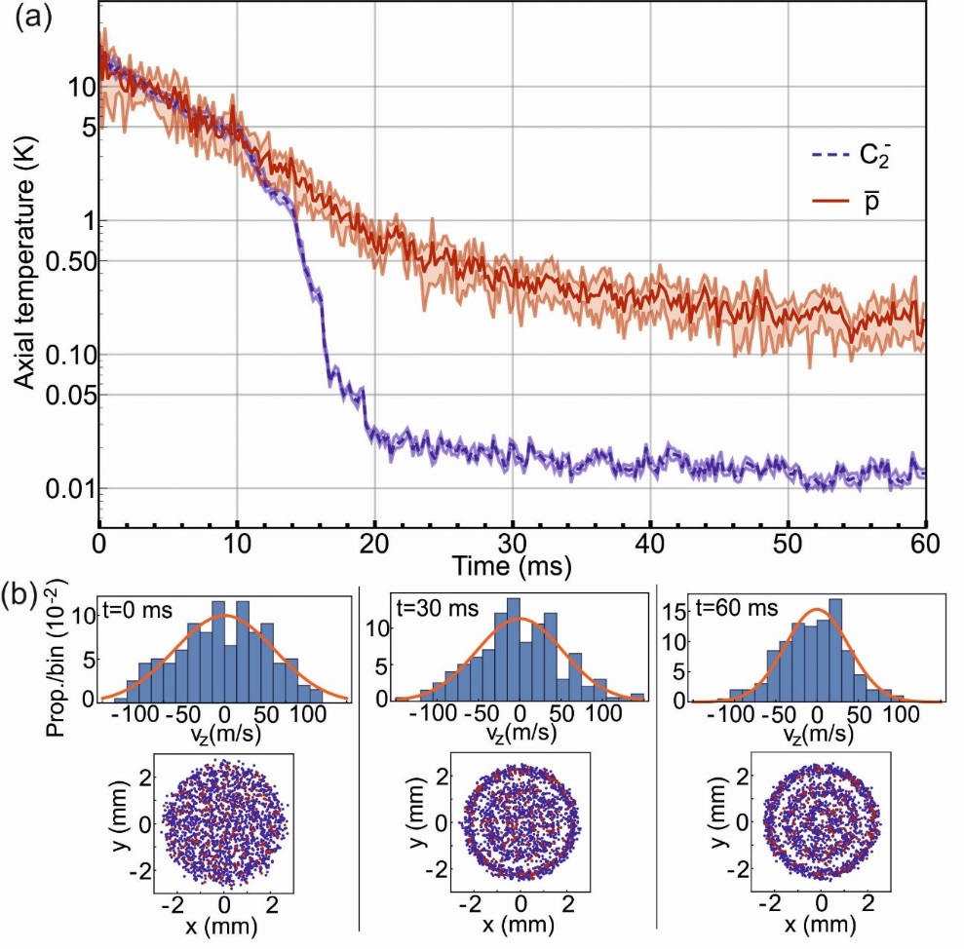
Cooling C₂⁻ / $\overline{p}$
2) Doppler cooling, simulation
Simulation of sympathetic cooling
of 1000 C₂⁻ / 100 $\overline{p}$ in 1 T Penning trap.
Time axis scaled (cooling forces) by ~10³
2 x Doppler-selective 2.5 μm laser
6 x Repumper lasers at 2.5 μm and 4.5 μm
Low Doppler limit ~ $0.3 μK$
Reach ~10 mK temperature within minutes
Crystallization effects at low T
Possible photo-detach $C_{2}^{−}$ before $\overline{H}$production
Initialized at $n_{C_{2}^{−}}$=10⁷ cm⁻³ and 11 K
Dense plasma:
Debye length (20 um)
<< plasma dimension (500 um)
Thermodynamic state of plasma:
H. Totsuji et al., AIP Conf. Proc., 498, 77 (1999)
Possible, but challenging in Penning tap
(scatter ~10⁶ photons, 8 lasers plus sidebands to <MHz stabilized)

Slide 20
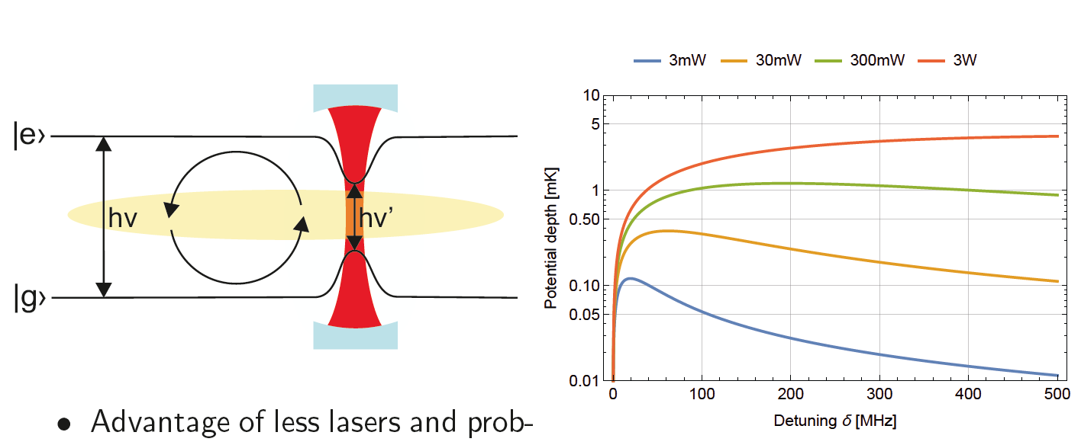
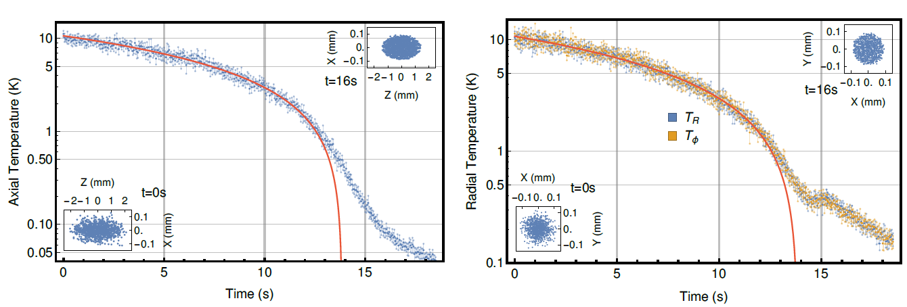
Cooling C₂⁻ / $\overline{p}$
3) Dipole Force Sisyphus cooling, simulation
1 x 2.5 μm ~1.5 GHz detuned dipole laser ($Udipole$=7 mK)
Spontaneous decay τ_{spon}=50 μs > axial trap motion
5 x lasers at 2.5 μm and 4.5 μm
Simulation of 1000 C₂⁻ in 5 T Penning trap
P=2.5 W
Pump=10 mW
w=0.2 mm
Cavity:
L=100 mm
FSR=1.5 GHz
delta=0.75 MHz
F=1000
τ_{spon}
ω_{z}
parameters: $n_{C_{2}^{−}}$=10⁷ cm⁻³ , B=5 T, Dipole laser=2.5 W,
Pump laser=10 mW, waist=0.2 mm
Sisyphus scheme: J. Dalibard and C. Cohen-Tannoudji, J. Opt. Soc. Am. B, 2, 11 (1985).
Sisyphus cooling in magnetic traps: S. Wu, W. Phillips, J. V. Porto et al., Phys. Rev. Lett. 106, 213001 (2011).

Slide 21
Cooling C₂⁻ / $\overline{p}$
3) Dipole Force Sisyphus cooling, simulation
1 x 2.5 μm ~1.5 GHz detuned dipole laser ($Udipole$=7 mK)
Spontaneous decay τ_{spon}=50 μs > axial trap motion
5 x lasers at 2.5 μm and 4.5 μm
τ_{spon}
ω_{z}
Simulation of 1000 C₂⁻ in 5 T Penning trap
P=2.5 W
Pump=10 mW
w=0.2 mm
Cavity:
L=100 mm
FSR=1.5 GHz
delta=0.75 MHz
F=1000
publication submitted
Sisyphus scheme: J. Dalibard and C. Cohen-Tannoudji, J. Opt. Soc. Am. B, 2, 11 (1985).
Sisyphus cooling in magnetic traps: S. Wu, W. Phillips, J. V. Porto et al., Phys. Rev. Lett. 106, 213001 (2011).

Slide 22
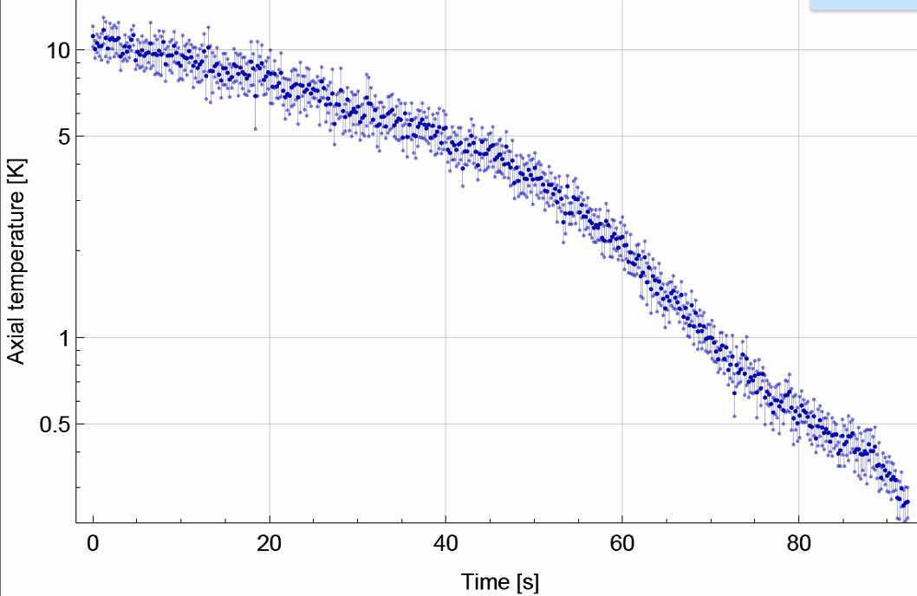
Sympatheic cooling with C₂⁻
3) Dipole Force Sisyphus cooling, simulation
Simulation of sympathetic cooling of 1000 C₂⁻ / 100 m’ in 5 T Penning trap
Preliminary
Time axis (Cooling force ) scaled by ~100 to simulate 1 u cyclotron motion
publication submitted
→mK $\overline{p}$feasible (scatter ~10⁴ photons, 6x lasers drift stabilized to cell/wavemeter)
→sub-K $\overline{H}$ production becomes feasible with current Ps technology
→production of trapped sub-K negative ions (impacts on many fields of physics)

Slide 23
Conclusion and Outlook
Timepix3 coupled to 675 μm Si sensor is suitable as an $\overline{p}$ annihilation detector (and for future $\overline{H}$).
Strategy and simulated plan for reaching mK $\overline{p}$ at hand using sympathetic cooling schemes with anions (C₂⁻, La⁻, Os⁻).
Not presented in this talk:
Many procedures required for pulsed production of antihydrogen atoms are now working (Ps formation, Ps excitation into Rydberg states, $\overline{p}$ cooling and compression
in 4.5 T to r=260 µm).
...but challenges remain (and antihydrogen beam formation still looms).
We should be in a position for (precision) studies of gravitational interaction of antihydrogen very soon…
_
We should be in a position for (precision) studies of antihydrogen (and Ps) very soon...

Slide 24
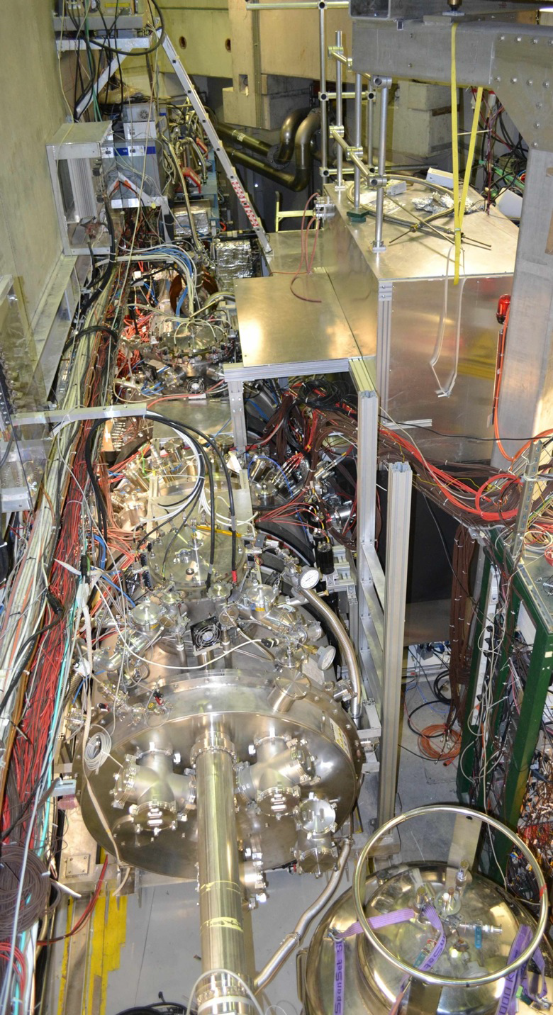
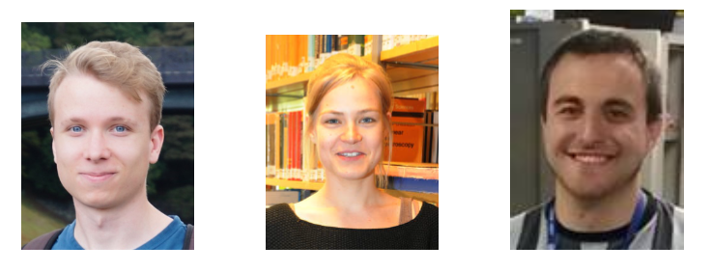
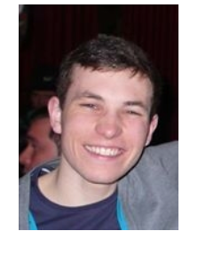
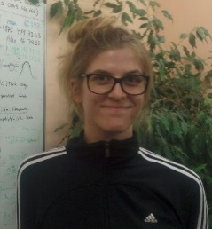
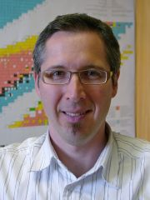
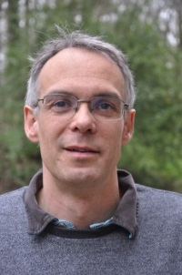
Conclusion and Outlook
AEgIS
GRACE
Work on Timepix3
Work on C₂⁻ cooling
_
Thank you very much for your attention!
We should be in a position for (precision) studies of antihydrogen (and Ps) very soon...

