Slide 1
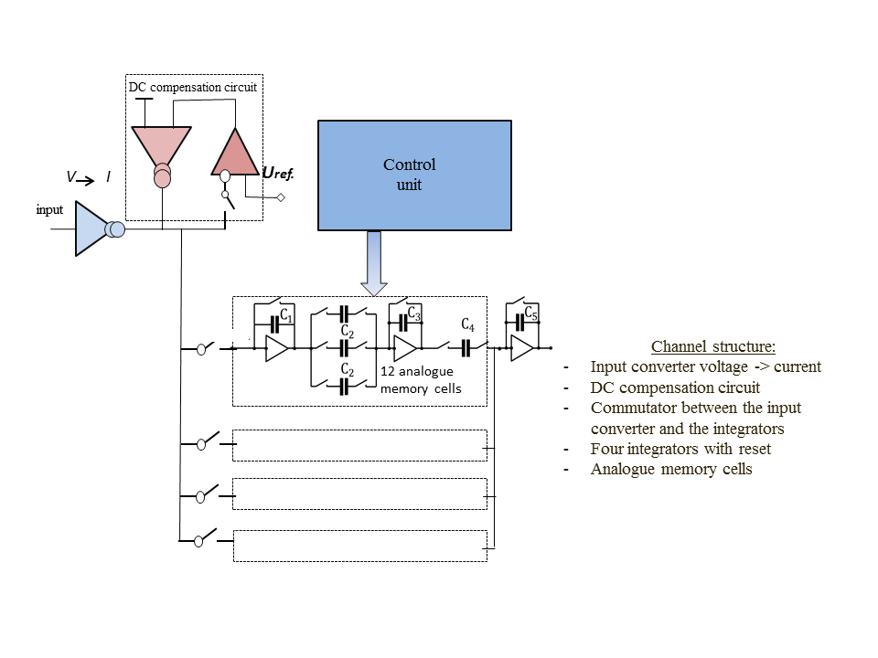
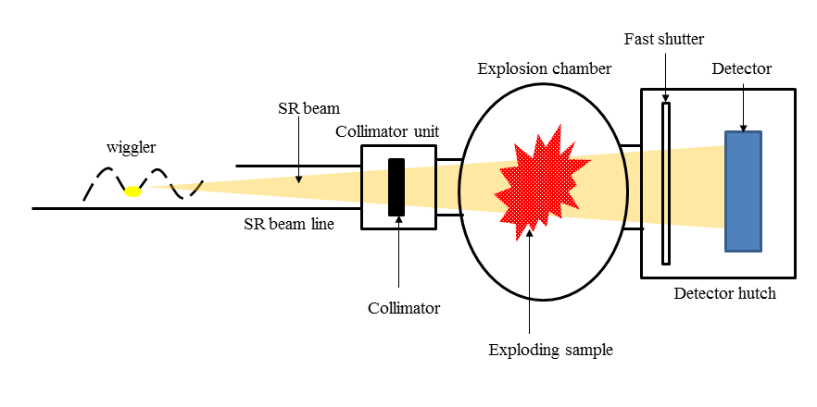
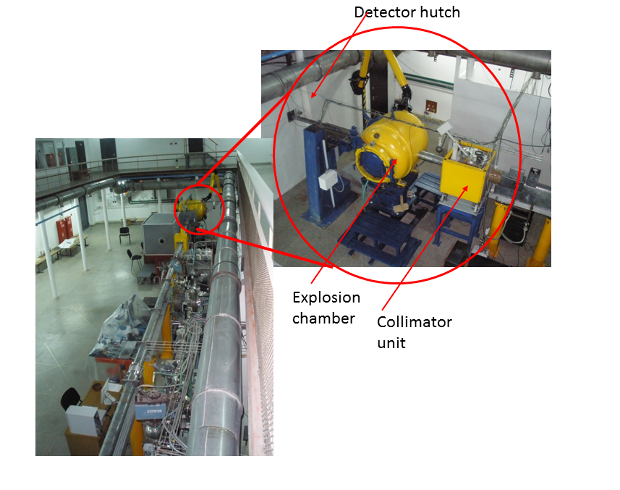
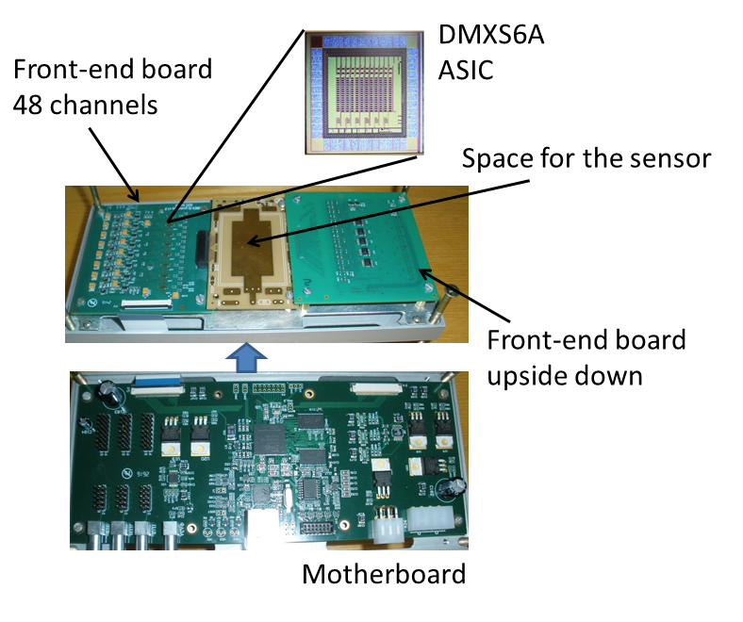
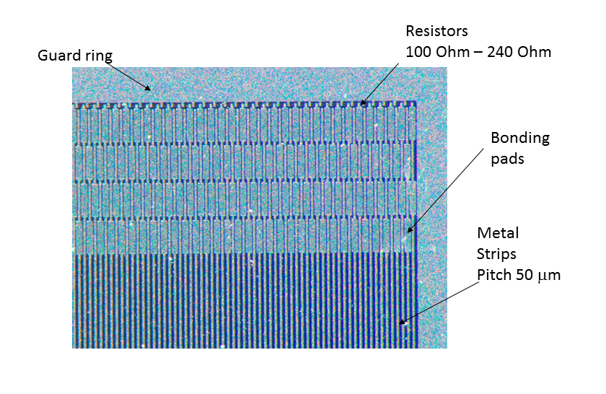
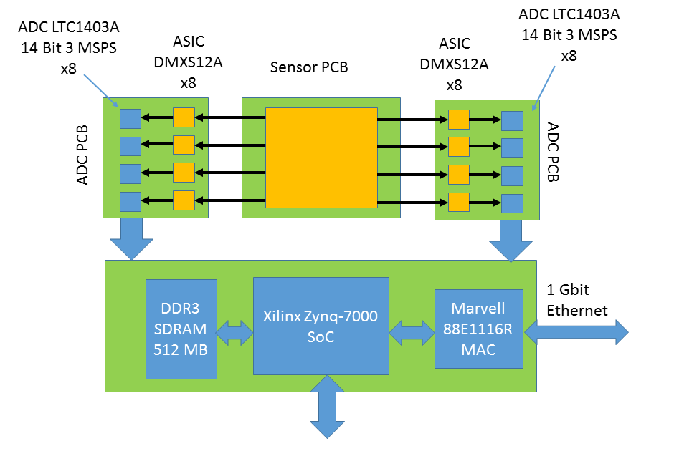
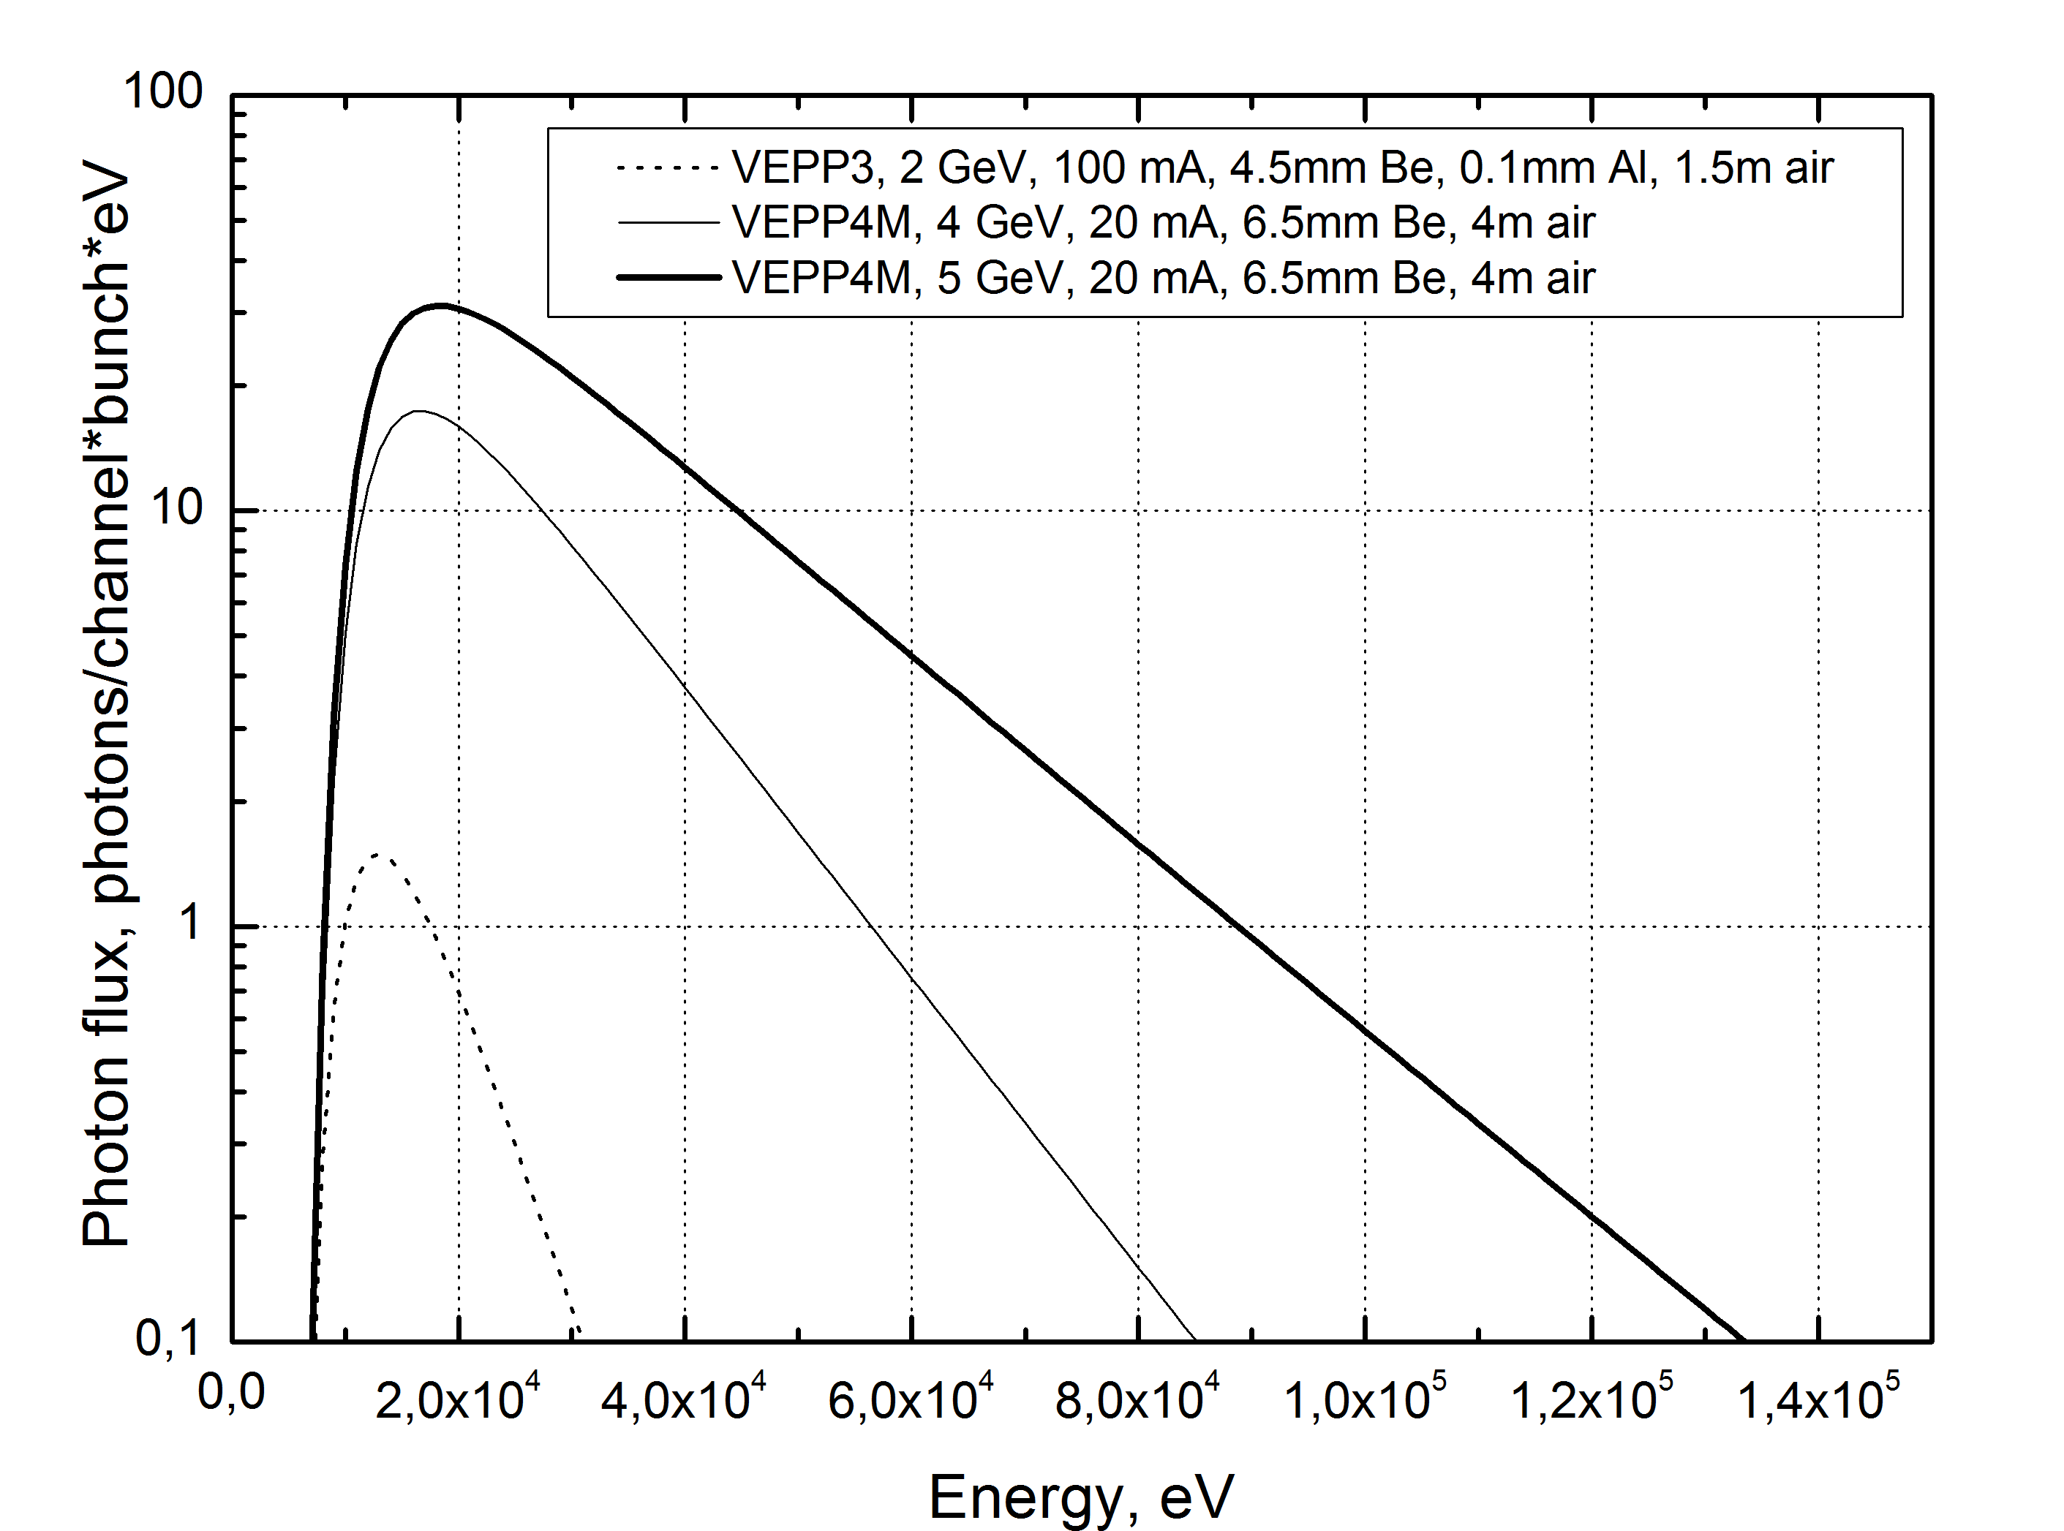
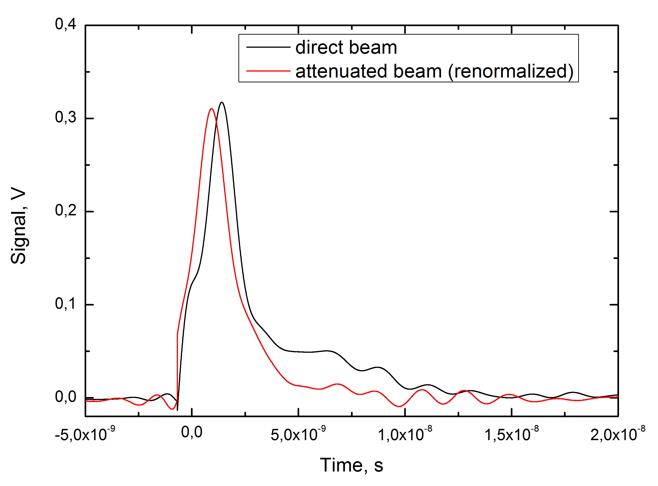
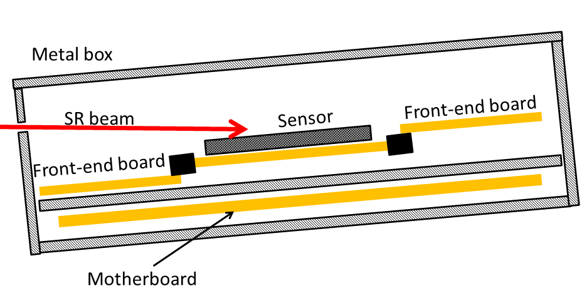
Silicon microstrip detector for imaging of fast processes at high intensity synchrotron radiation beam.
Budker INP
V.Aulchenko^{1,2}, L.Shekhtman^{1,2}, B.Tolochko^{3,2}, V.Zhulanov^{1,2}
Budker Institute of Nuclear Physics, 630090, Novosibirsk, Russia
Novosibirsk State University, 630090, Novosibirsk, Russia
Institute of Solid-State Chemistry and Mehanochemistry, 630090, Novosibirsk, Russia
Abstract
The technique of imaging of fast processes at high intensity synchrotron radiation (SR) beam is developed in the Budker Institute of Nuclear Physics since the beginning of 2000s. The DIMEX (Detector for Imaging of Explosions) based on gas ionization chamber is working at the channel 0 at the VEPP-3 storage ring and at the channel 8 at the VEPP-4M storage ring. However, the gaseous detector can not provide the necessary parameters for the experiments at the channel 8 at the VEPP-4M, where photon flux is up to 100 times higher than at the channel 0 at the VEPP-3. In particular the rate capability of gaseous detector is far not enough due to the space charge effects induced by slow positive ions. The Si micro-strip detector is proposed for high rate experiments at the VEPP-4M storage ring. The first Si sensors were produced by Hamamatsu Photonics and included 1024 p-strips on n substrate with DC metal strips. The strip pitch is 50 μm and the strips length is 30 mm. Each metal strip is connected to the guard ring through ~400 Ohm polysilicon resistor in order to drain high current from the sensor to ground. The front-end electronics will measure the voltage drop on such resistor. A dedicated ASIC is developed for this detector that is able to measure signals from each strip in the range equivalent to 1000 to 10$^6$ photons with 30 keV energy and store them in the analogue memory with the frame rate up to 50 MHz. The first prototype of such detector that will include 96 channels equipped with the prototype ASICs is assembled now.
Experiments on imaging of fast dynamic processes (explosions, combustion) with a synchrotron radiation beam are performed in the Budker INP at the VEPP-3 storage ring for more than 10 years [1]. The DIMEX (Detector for IMaging of EXplosions) based on gas technology is used for this purpose [2]. The DIMEX allow to measure photon flux up to ~5000 photons/channel (channel area is 0.1x0.5 mm², average photons energy ~20 keV), with spatial resolution of ~0.2 mm and frame rate of 10 MHz. In order to improve all detector parameters, namely, maximum measured photon flux up to 10⁶ photons/channel, spatial resolution down to 50 μm and maximum frame rate up to 50 MHz, a new development was started based on Si microstrip technology. A new beam line with ~100 times higher flux and higher X-ray energy is constructed for this purpose at the VEPP-4M storage ring.
Schematic view of the experimental set-up is shown in Fig.1. The SR beam is provided by a 7-pole wiggler with 5 poles having 1.2 T field and the first and the last poles having 1.0 T field. The beam passes through the collimator block forming a flat narrow beam, the explosion chamber that can withstand an explosion of 200 g of thrinitrotoluene (TNT) and then passes to the detector hutch .
Si microstrip detector with a thin sensor aligned at a small angle with respect to the beam plane and with the strips parallel to the beam direction can meet all requirements. Calculated interaction probability and DQE obtained by the simulation for monochromatic beams and for the beams with the energy spectra shown in Fig.3 are presented in Fig.4 for a sensor with 10 mm sensitive Si depth and 10 μm dead zone before the sensitive material. Such depth of the sensitive region can be obtained if a 0.3 mm thick sensor would be inclined at an angle of 1.5 degrees with respect to the beam plane.
A dedicated ASIC was developed for this detector that allows to measure the signal at the resistor at each strip with 20 ns duty cycle. The block diagram of one channel of this ASIC is shown in Fig.7. It contains voltage to current converter at the input that transfer voltage pulse at the input resistor to the current pulse at the output, DC compensation circuit, commutator to four integrators with reset circuit and analog memory. In order to provide the fastest operation, the integrators are switched to the output of the voltage to current converter by turns one at a time, because the reset circuit of the feedback capacitor can not discharge it within 20 ns. The prototype ASIC was manufactured with 6 channels, each containing 4x8 analogue memory cells.
8 analogue
memory cells
Fig.4. Interaction probability and DQE of the sensor with 10 mm of sensitive Si depth and 10 μm of dead material before the sensitive region. Open squares are the DQE for the spectra shown in Fig.3 pointed at the energies from Table 1 (see for 10 mm Si).
Fig.7. Block-diagram of one channel of the DMXS6A ASIC for the Si microstrip detector for imaging of explosions.
SR beam produces very high peak and average currents in a Si sensor (Table 2). In order to draw this current out of the sensor, sufficiently low resistors should be provided between the strips and the guard ring that is connected to ground.
The prototype, based on Si micro-strip sensor with 400 Ohm resistors between the strips and the guard ring and 16 DMXS6A ASICs, is being mounted now (see Fig.8). It consists of the board for the sensor with 48 strips bonded to the connectors from each side. The sensor board is connected to two front-end boards each containing 8 DMXS6A chips. Output signal from each chip is digitized by 14-bit 3 Msps ADC and then the digital data are transferred to the memory at the motherboard (Fig.9). The data are readout a computer through 1 Gbit Ethernet connection. The motherboard provides the trigger signal and all control sequences that allow proper operation of the ASICs and ADCs.
Fig.1. Schematic view of the station for the experiments on imaging of explosions.
Table 2.Calculated peak and average currents induced by a SR beam from an electron beam of 20 mA and 5 GeV.
Several p-on-n 300 μm thick sensors with DC-coupled metal strips of 50 μm pitch and with polysilicon resistors in the range of 100 Ohm to 1000 Ohm introduced between each strip and the guard ring were manufactured for us by the Hamamatsu Photonics company. The sensors are 55x35 mm² in size and contain 1024 30 mm long strips each.
Fig.2. Photo of the beam line 8 at the VEPP-4M storage ring with the station for the experiments for imaging of explosions.
Fig.8. Components and layout of the 96 channel prototype of the Si detector for imaging of explosions (the ASICs and the sensor are not mounted).
The VEPP-4M storage ring operates at present with electron beam energy up to 4 GeV and beam current up to 20 mA (in two bunches). In future the energy will be increased to 5 GeV and the beam current will be increased to 20 mA in each bunch. The bunches can be grouped in trains of 4-5 bunches with 20 ns time gaps. Calculated energy spectra at the entrance of the detector in comparison with the spectrum in the VEPP-3 beam line are shown in Fig.3.
Fig.5. Photo of the prototype sensor with low value resistors between the strips and the guard ring produced by the Hamamatsu Photonics company.
DMXS6A
DMXS6A
When the silicon sensor is exposed to SR beam a very short pulses of current are detected from each bunch. In Fig.6 the signal from oscilloscope at 50 Ohm load is shown recorded from a single strip. The black curve corresponds to the open beam with the current of 10.4 mA in the machine and beam energy of 4 GeV. Total charge injected into the sensor by a single SR flash is around 10⁸ electrons. The sensor was installed perpendicular to the beam axis in this measurement. The red curve in Fig.6 corresponds to 5 times attenuated beam. The curve was renormalized to the peak value of open beam curve in order to compare the curves shapes. We can see that some slow component of the current appears in case of open beam that corresponds to the beginning of space charge effects in Si (plasma effects).
Fig.9. Block-diagram of the 96 channel prototype of the DIMEX-Si.
Fig.3. Energy spectra of the SR beam before the detector in the beam line 8 of the VEPP-4M storage ring (at 4 GeV and 5 GeV in the storage ring) in comparison with the spectrum in the VEPP-3 beam line 0.
Fig.10. Schematic view of the prototype of the DIMEX-Si installed at the SR beam.
The prototype detector will be installed at the beam at an angle of ~1.5˚ in order to provide higher efficiency (Fig.9). We plan to complete mounting of the prototype and start testing it in the beam in the first half of 2017.
References:
Titov V. M.; Pruuel E. R.; Ten K. A.; et al., COMBUSTION EXPLOSION AND SHOCK WAVES V.47 (2011), 6, P.615-626
V.M. Aulchenko, O.V. Evdokov, L.I. Shekhtman, et.al., J. of Instrum. 2008. V. 3. P05005.
Table 1. Main parameters of the beams: total fluxes before the detector and absorbed in the detector and average energy of the beam for different beam conditions. Beam currents are the same as in Fig.3. Detector channel is 0.05x0.5 mm² in all cases.
Fig.6. Pulse shape from SR flash measured from a single strip. The shapes from an open beam and 5 times attenuated beam (renormalized to a peak value) are shown. Beginning of plasma effect is observed .

