Slide 1

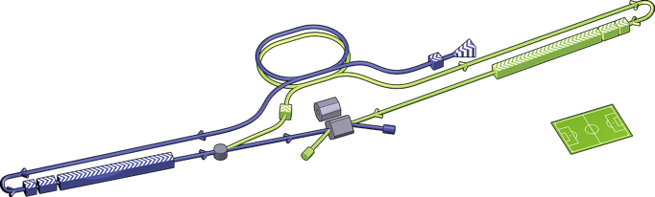
ILC Project
Tsunehiko OMORI
LCC/KEK
INSTR-17, Budker INP, Novosibirsk, Russia, 27 February 2017

Slide 2

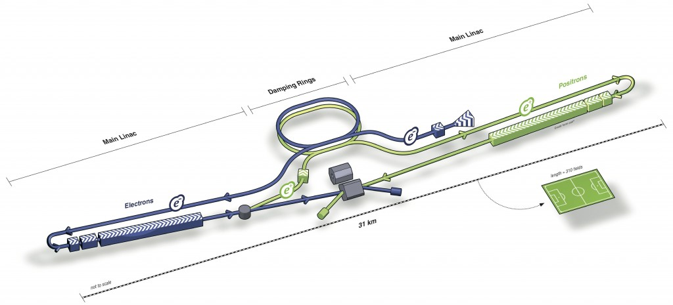
ILC (International Linear Collider)
Main linac
Damping ring
Positron beam
Main linac
31 km
electron
e⁻e⁺ collider
500 GeV CM with 31 km -> upgrade later to ~ 1TeV CM with 50 km
IP beam size : 6 nm high, 500 nm wide, 300 μm long (@500 GeV CM)
Luminosity 2 x 10³⁴ /cm²s (@500 GeV CM）
First stage : 250 GeV Higgs Factory

Slide 3

Why Liner Collider ?
pp collider (LHC)
proton proton : composite
p
3 quarks and gluons
(partons = quarks and gluons)
p
e⁻e⁺ : elementary particles
e⁻e⁺ collider (ILC)
CMS energy = 2 x beam energy
(well defined)
Total momentum = 0 (balanced)
e⁻
e⁺

Slide 4
Why Liner Collider ?
pp collider (LHC)
proton proton : composite
p
3 quarks and gluons
(partons = quarks and gluons)
p
e⁻e⁺ : elementary particles
e⁻e⁺ collider (ILC)
CMS energy = 2 x beam energy
(well defined)
Total momentum = 0 (balanced)
e⁻
e⁺

Slide 5
Why Liner Collider ?
pp collider (LHC)
proton proton : composite
p
3 quarks and gluons
(partons = quarks and gluons)
p
e⁻e⁺ : elementary particles
e⁻e⁺ collider (ILC)
CMS energy = 2 x beam energy
(well defined)
Total momentum = 0 (balanced)
e⁻
e⁺

Slide 6
Why Liner Collider ?
pp collider (LHC)
proton proton : composite
p
3 quarks and gluons
(partons = quarks and gluons)
p
e⁻e⁺ : elementary particles
e⁻e⁺ collider (ILC)
CMS energy = 2 x beam energy
(well defined)
Total momentum = 0 (balanced)
Small back ground
Mostly full reconstruction
e⁻
e⁺

Slide 7
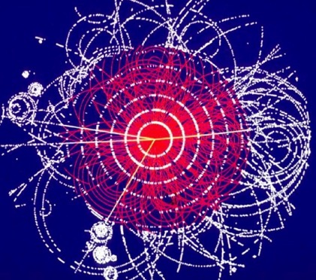
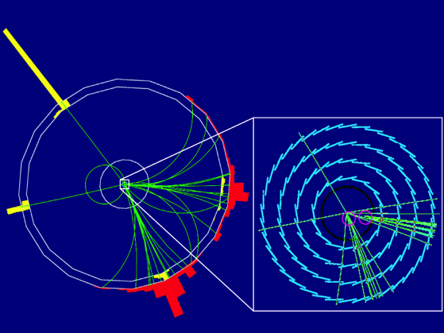
Why Liner Collider ?
pp collider (LHC)
proton proton : composite
3 quarks and gluons
(partons = quarks and gluons)
e⁻e⁺ : elementary particles
e⁻e⁺ collider (ILC)
CMS energy = 2 x beam energy
(well defined)
Total momentum = 0 (balanced)
Small back ground
Mostly full reconstruction
e⁺
All from Higgs

Slide 8
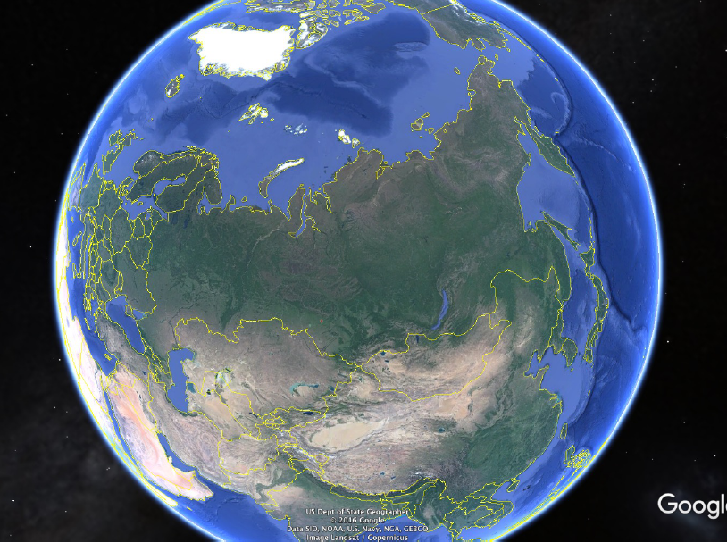


International Linear Collider
at Kitakami Hills
ILC
Candidate site
•
Moscow
Russia
Kitakami
•
Tokyo
Novosibirsk
•
•
Japan

Slide 9
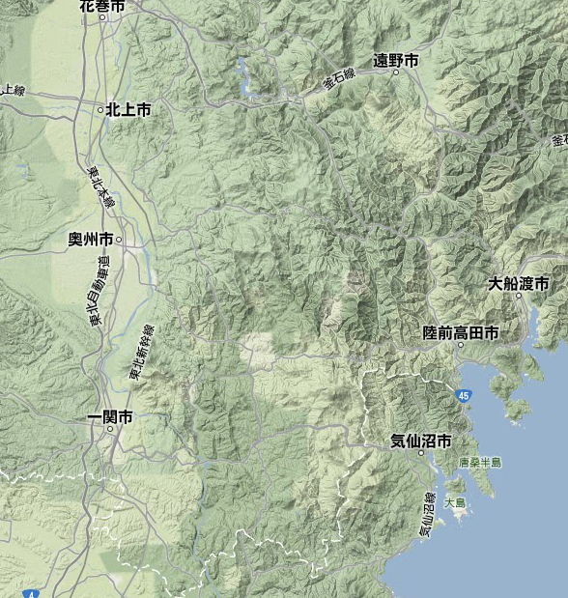
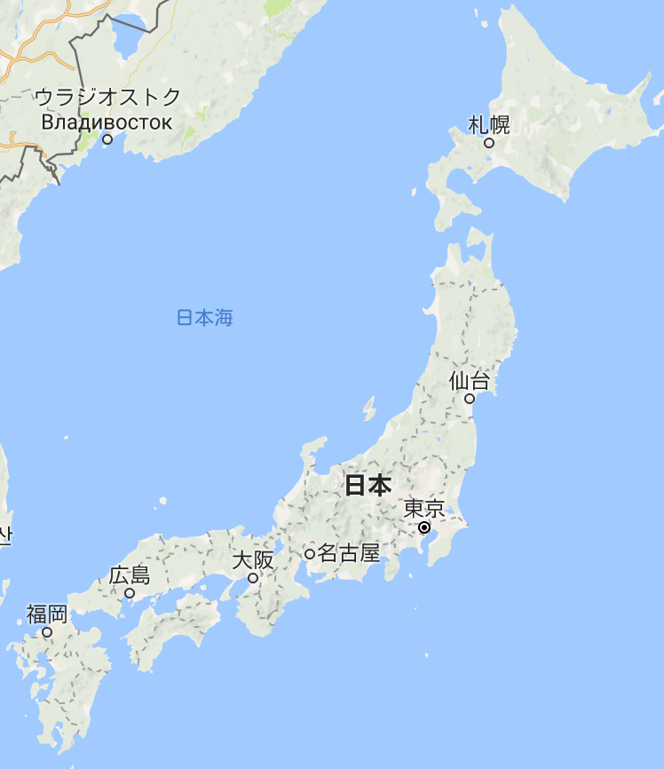
ILC Site Candidate : Kitakami
Good Access to Big/Middle-sized Cities, Ports, and Airports
Confortable Living Environment
Russia
Google Map
Google Map
Earthquake-proof stable bedrock of granite.
No faults cross the line.
Vladivostok
e⁻
Oshu
Ofunato
Morioka
Kitakami
Shinkansen
ILC
Expressway
Sendai
Japan
Shinkansen
Super express train
Ichinoseki
Kesen-numa
Tokyo
•Shinkansen
  Tokyo→Kitakami 2hours
•Flight
  Narita→Sendai 1h
Kitakami
e⁺

Slide 10
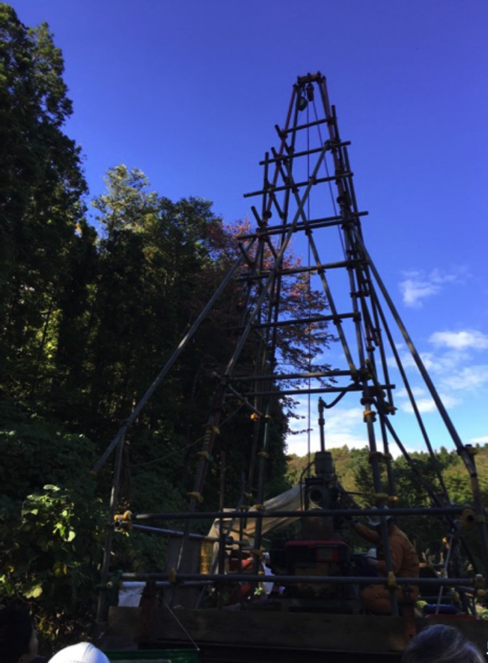
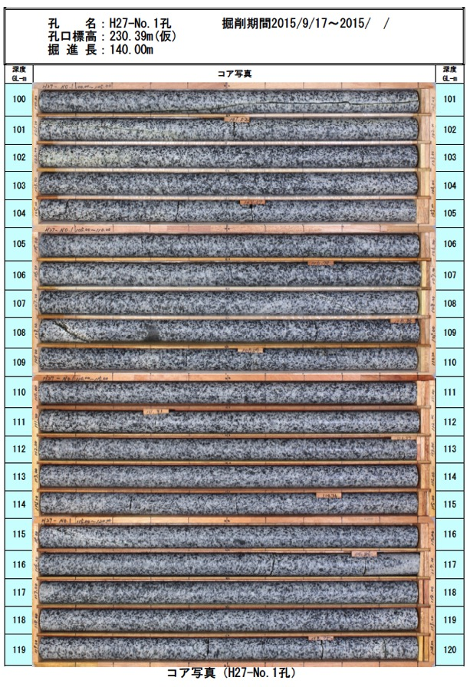
Boring Exploration
T. Sanuki
Boring Core
Extremely Good Granite Geology

Slide 11

ILC Physics
Physics case for ILC is
very simple and strong

Slide 12
Higgs, top, new physics
• Only two particles not studied precisely at
e⁻e⁺ so far: Higgs & top
• Higgs first of a kind (no spin), most important
particle in today
• top can talk to new physics, controls the
fate of the Universe
• of course look for (uncolored) new physics
Hitoshi Murayama (UC Berkeley), ILC Summer Camp 2016

Slide 13
Spin
• every elementary particles spin forever
• electrons, photons, quarks, ....
• only Higgs boson doesn’t spin
• a new breed
• Is it the only one? (SM)
• does it have brothers? sisters? (SUSY for example)
• maybe composite? (Higgs is NOT elementary particle)
Hitoshi Murayama (UC Berkeley), ILC Summer Camp 2016
Slightly modofied by TO

Slide 14
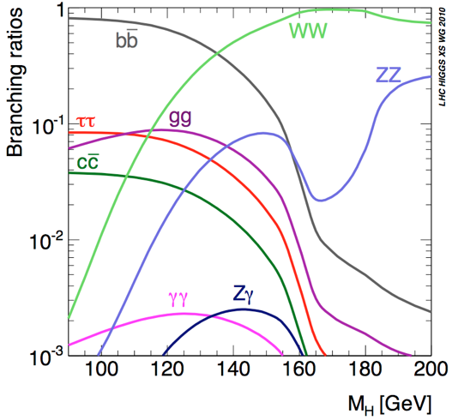
Higgs mass
dream case for experiments
125 GeV
Hitoshi Murayama (UC Berkeley), ILC Summer Camp 2016

Slide 15
Higgs coupling measurements
10

Slide 16
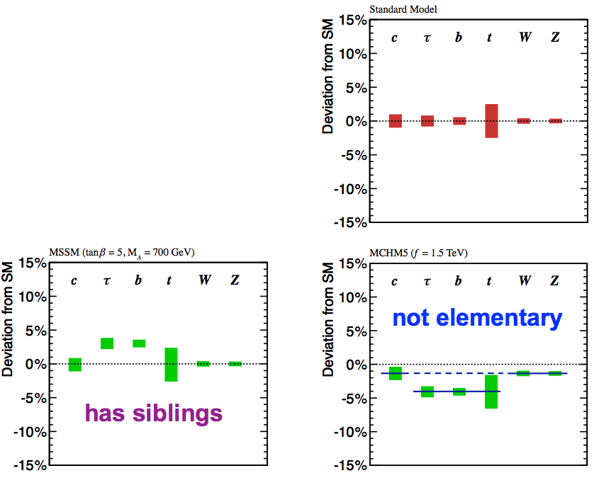
What is Higgs really?
• Only one? (SM)
• has brothers? sisters? (2HDM)
• not elementary? (composite)
Couplings:
deviation from SM
only one
(SM)
Lumi 1920 fb-1, sqrt(s) = 250 GeV
Lumi 2670 fb-1, sqrt(s) = 500 GeV
Couplings:
deviation from SM
Couplings:
deviation from SM
has
brothers, sisters
(SUSY)
not elementary
(composite)
Hitoshi Murayama (UC Berkeley), ILC Summer Camp 2016, modified by TO

Slide 17
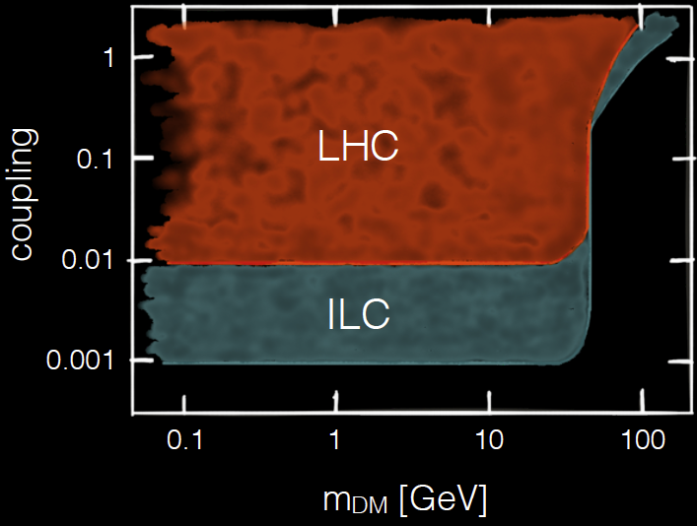
Dark matter & the Higgs
An example: dark matter interacting via the Higgs force
LHC
q
X
h
q
X
ILC
X
e⁺
h
X
e⁻
Z
Nathaniel Craig (UC Snta Barbara), LCWS2016

Slide 18
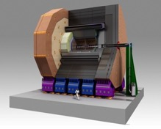
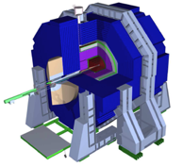
Accelerator
and
Detectors

Slide 19

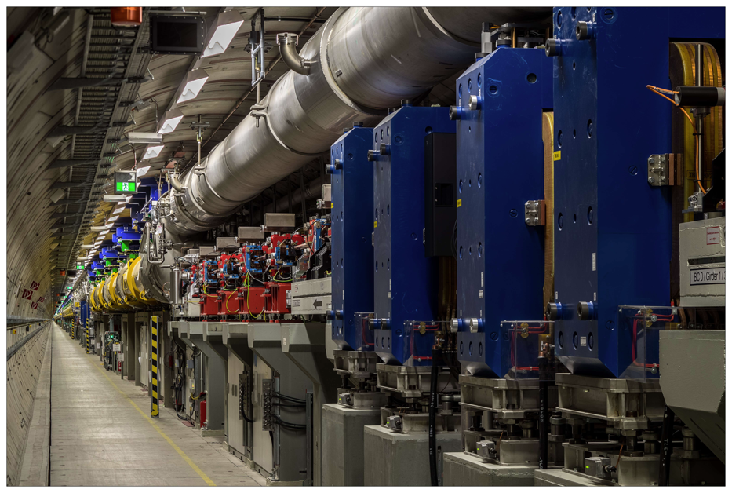
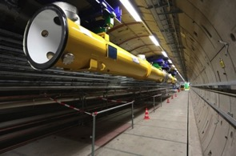
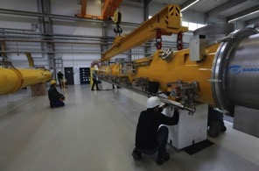
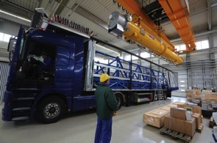
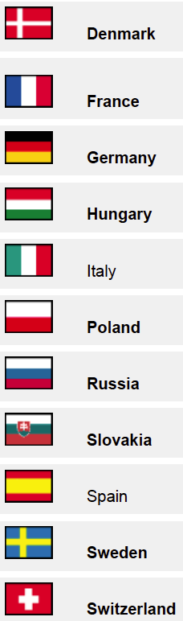
European XFEL
Denmark
France
XFEL based on 17 GeV SRF Linac
Denmark
Germany
France
Hungary
Germany
Italy
Hungary
Poland
Italy
Poland
Russia
Russia
Slovakia
Slovakia
Spain
Spain
Sweden
Sweden
http://www.xfel.eu/
Denmark
Switzerland
Switzerland
• Now the commissioning of XFEL is ongoing.
France
• XFEL Superconducting Linac:
Essentially the same as ILC, Number of modules&Cavities 1/20 of ILC
Germany
• ILC will follow all experiences of the XFEL.
Hungary
Italy
Poland
Russia
Slovakia
Spain
Sweden
Switzerland

Slide 20
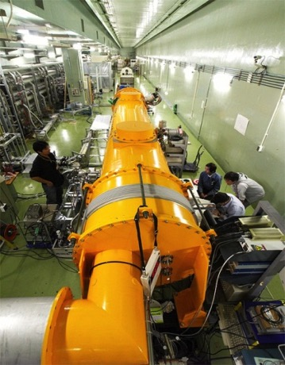
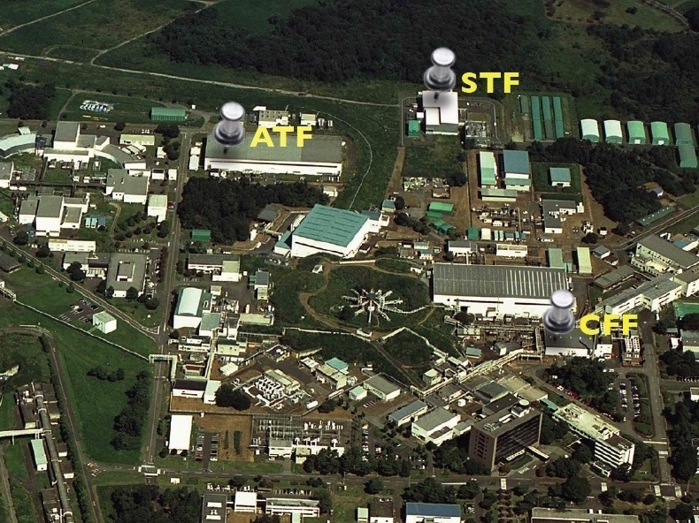
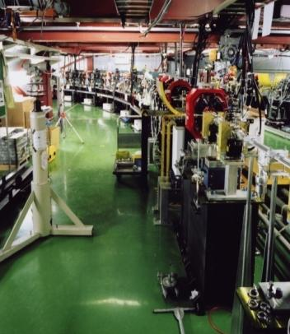
ILC R&D at KEK
STF
ATF
CFF

Slide 21
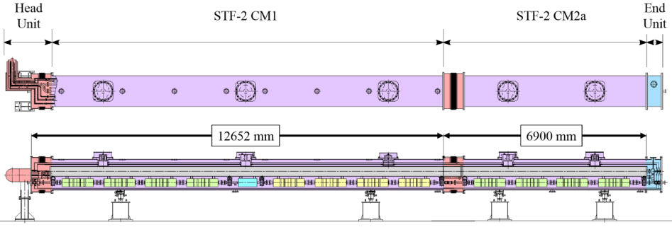
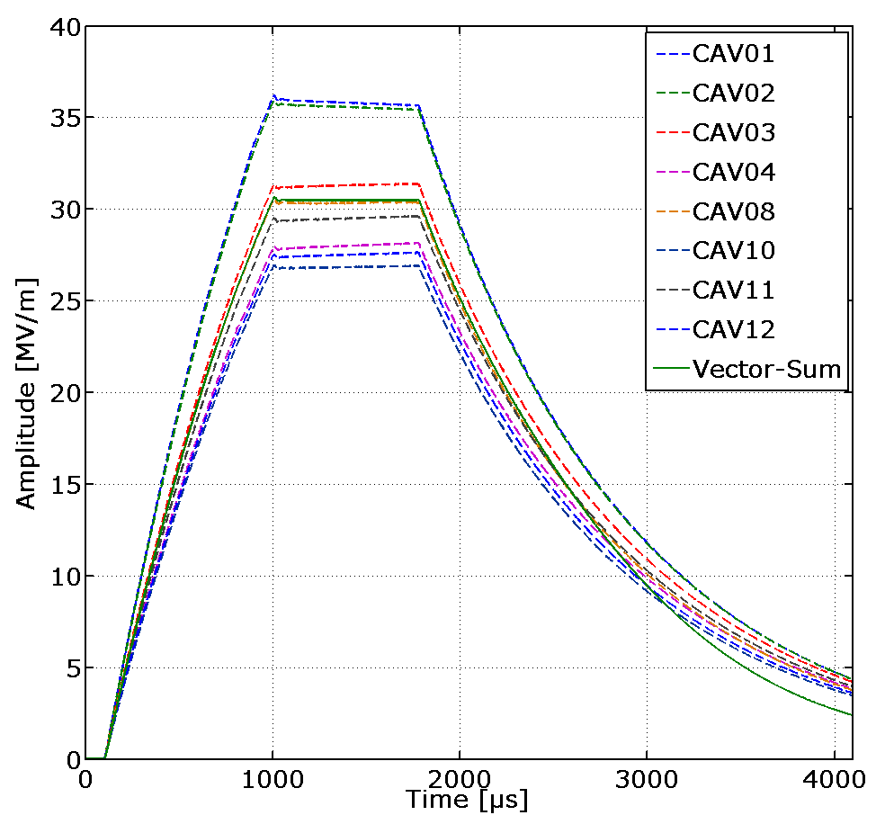
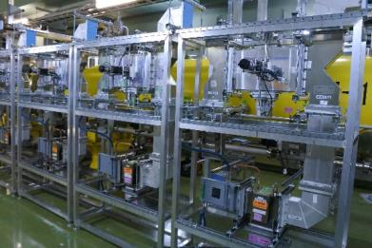
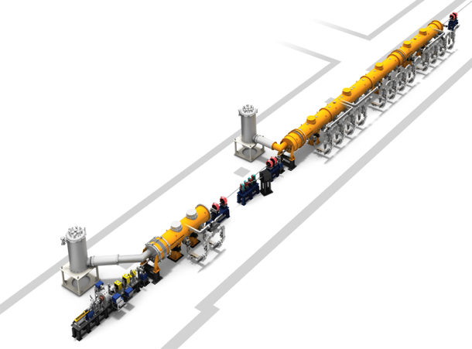
STF: Accelerator Cryomodule Test
8 Cavities were tuned on resonance by piezo,
and vector-sum operation was done at
31MV/m.
CM2a
Waveguide system
STF at KEK
Cold box
CM1
Capture CM
View from upstream
Cold box
To be constructed
RF Gun

Slide 22
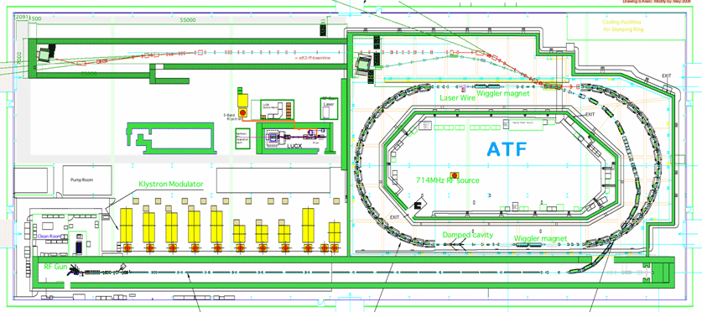
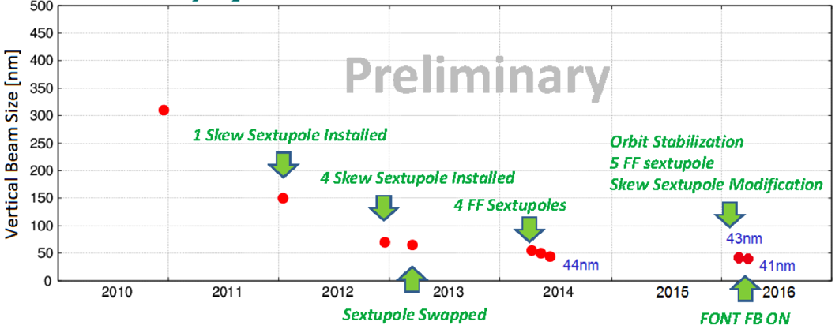
Nano-meter Beam Size at ATF
Prototype Final Focus
Establish the ILC final focus method with same optics and comparable beamline tolerances
• Goal : 37 nm < - - - > ILC 6 nm
(ATF: 1.3 GeV ILC: 250 GeV)
  • Achieved(ATF) 41 nm (2016)
Prototype DR
History of ATF2 small beam
ATF at KEK

Slide 23
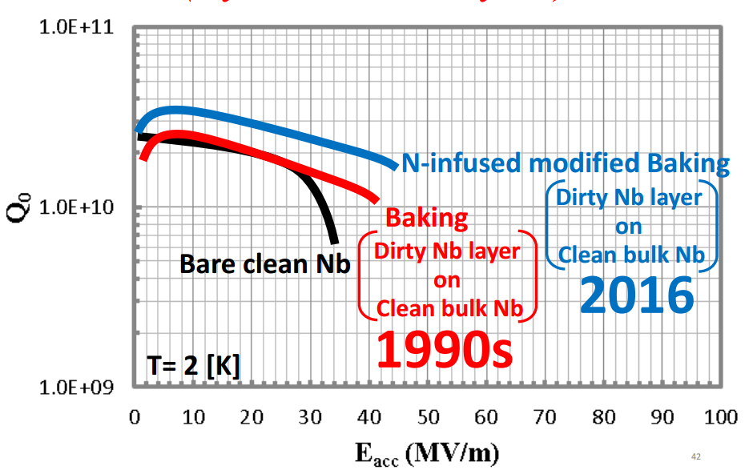
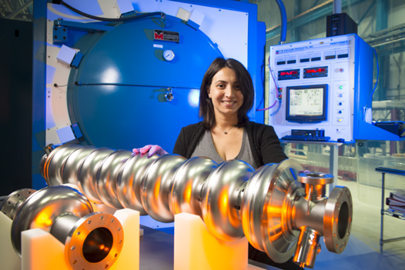
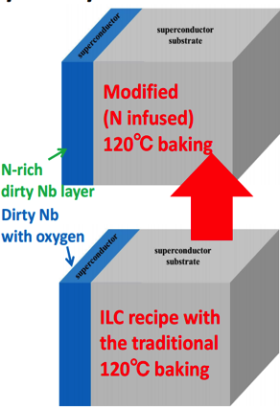
Possibility of Higher Gradient in Future
Recent Progress in FNAL
FNAL: Dr. Anna Grassellino
http://news.fnal.gov/2016/05/anna-grassellino-receives-2016-ieee-particle-accelerator-science-technology-award/

Slide 24

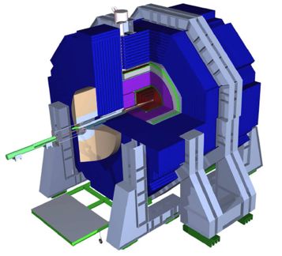
Two Detector Concepts
~13m
~13m
~14m
~12m
ILD | SiD
Both optimized for PFA PFA Performance ~B･R_{ECAL,inner}² (two-track separation @ ECAL)
B = 3.5 T | B = 5 T
R_{ECAL,inner} = 1.8 m | R_{ECAL,inner} = 1.27 m
Si + TPC tracking | Tracking: Si only
Share interaction point via push-pull
push-pull
24

Slide 25
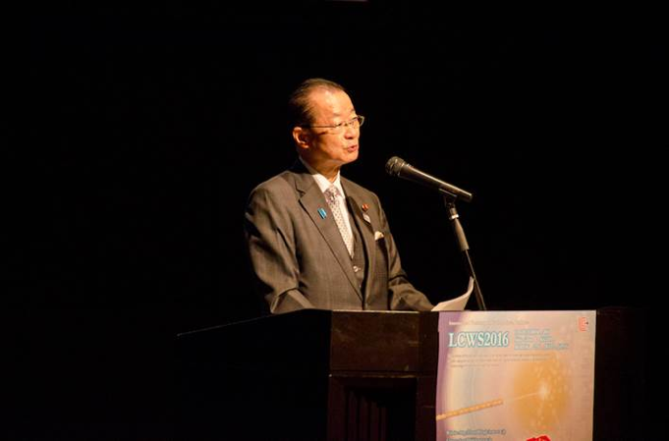
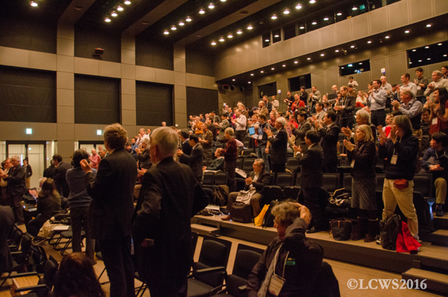
Status of the ILC Project
Keynote by Hon. Takeo Kawamura, at LCWS 2016
a member of the House of Representatives,
President of the Federation of Diet members for ILC
Participants of LCWS2016

Slide 26
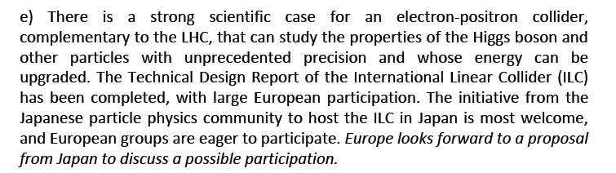
Supports from the World
• European Strategy approved by CERN Council, June 2013
Chair: Tatsuya Nakada (Swiss Federal Institute of Technology Lausanne)
• Asia ACFA-HEP Statement on ILC
Chair: Mitsuaki Nozaki (KEK) July 2013
• USA Particle Physics Project Prioritization Panel (P5) Report
Chair: Steve Ritz (UC Santa Cruz), May 2014
26

Slide 27
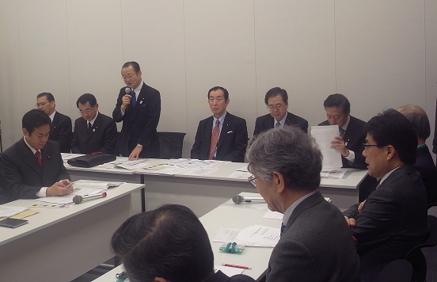
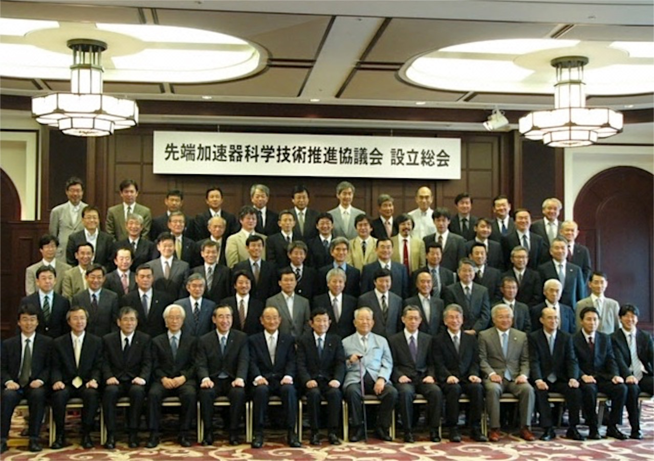
Supports from Policy Makers and Industries in Japan
• Federation of Diet members
to promote ILC
160 Diet Members
(both the Upper and Lower Houses.)
Supreme advisor Kaoru Yosano
President Takeo Kawamura
Secretary-general Ryu Shionoya
• Advanced Accelerator Association, AAA
100 Companies and 30 Universities
Honorary Chairman Masatoshi Koshiba
Supreme advisor Kaoru Yosano
Chairman Takashi Nishioka
Vise-Chairman Atsuto Suzuki

Slide 28
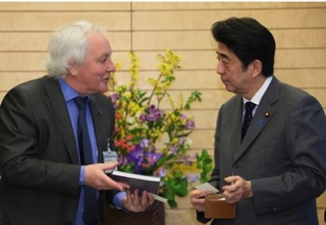
LCC Director Lyn Evans’ Courtesy visit
to Prime Minister Shinzo Abe
March 2013, Tokyo
Photo: Office of Prime Minister
There is very strong interest to host ILC
in Japan
Dr. Lyn Evans, LCC Director
Prime Minister Shinzo Abe
Photo: Prime Minister’s Office
http://japan.kantei.go.jp/96_abe/actions/201303/27ilc_hyokei_e.html

Slide 29
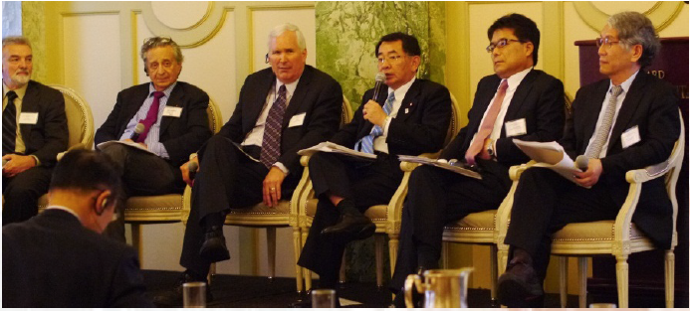
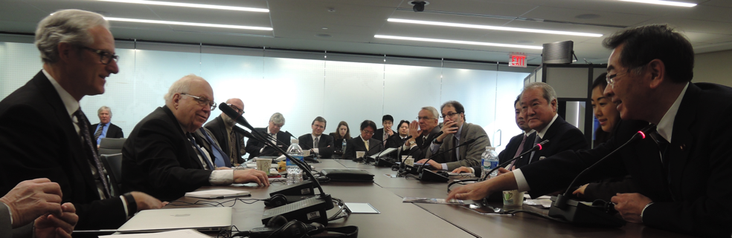
US-Japan dialogues
“Federation of Diet members for ILC”
is successively dispatching delegations to US.
2013 Joint Symposium
at Washington DC
The first visit
Hon. R. Shionoya
Secretary-general of the Federation
2016 Meeting
at Hudson Institute
It was proposed to form
US-Japan discussion group
by both governments
It was formed soon later.
Hon. S. Suzuki
Hon. R. Shionoya
Hon. T. Otsuka

Slide 30
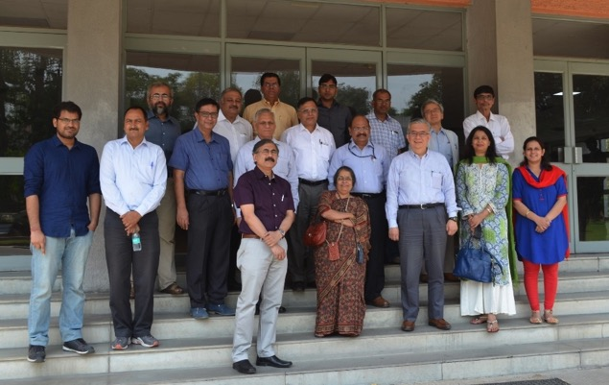

ILC Collaboration with Indian Physicists
Representatives from 10 Indian accelerator labs and KEK had a meeting to discuss Indian involvement in ILC.
Agreed to set up “Indo-Japan Centre for Accelerators and Detectors” in Banaras Hindu University as a base of Indian participation in ILC.
April 29, 2016, IUAC, Delhi
Jan 30th, 2017
MoU was signed by both by Banaras Hindu University and KEK

Slide 31
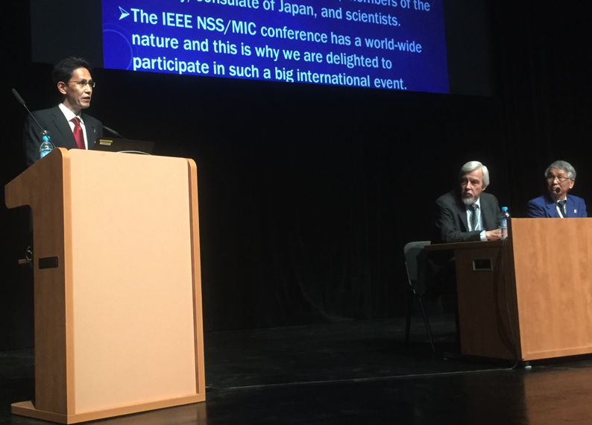
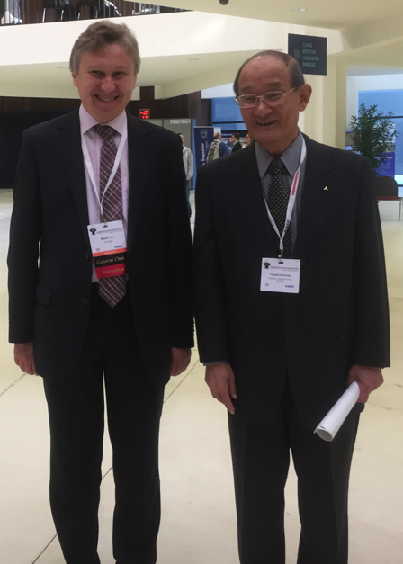
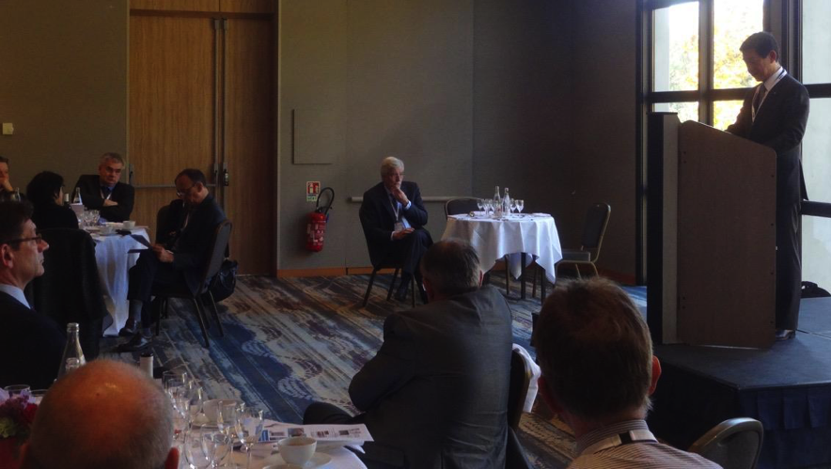
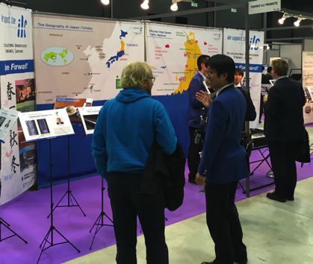
IEEE NSS/MIC Conference, Strasbourg, France
29 Oct 2016 - 6 Nov 2016
Industrial Exhibition
Dr. M. Titov
Conference Chair.
Mr. T. Nishioka
AAA Chair.
IEEE NSS/MIC Plenary
Hon. T. Shina
Federation of Diet members for ILC
EU-Japan VIP meeting Hon. S. Ito
Federation of Diet members for ILC
Industrial Exhibition

Slide 32

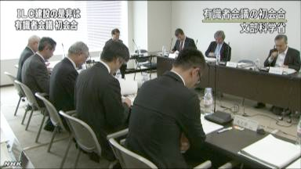
Official government-level consideration
is ongoing in Japan
MEXT: Ministry of Education, Culture,
Sports, Science, and Technology
Science Council of Japan
MEXT
Recommendation
in 2013
ILC Taskforce
formed in 2013
Commissioned Survey by NRI
(in 2014, and 2015)
ILC Advisory Panel
in JFY 2014
First meeting
8-May-2014
Particle & Nuclear Phys. WG
in 2014 - 2015
TDR Validation
WG
in 2014 - 2015
Human Resources
WG
in 2015 - 2016
Management
WG
(coming soon)
in 2017

Slide 33
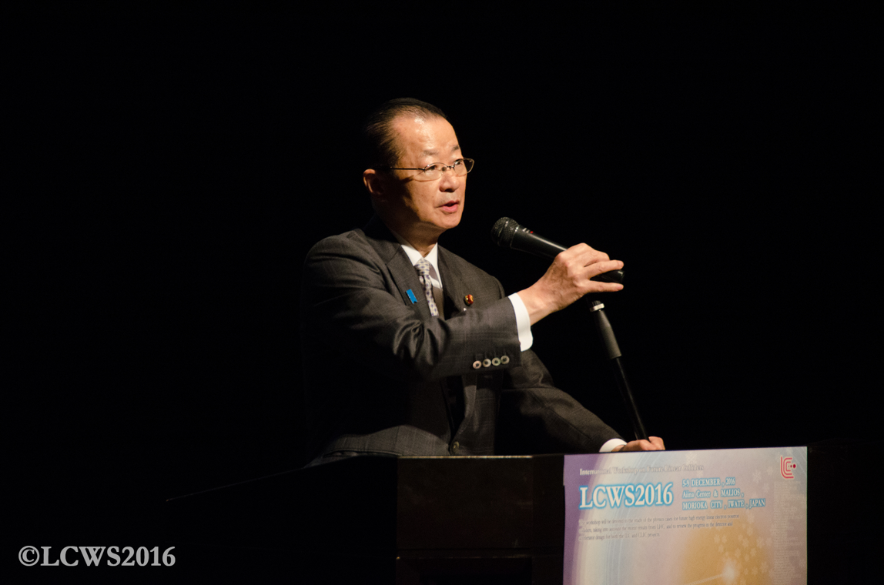

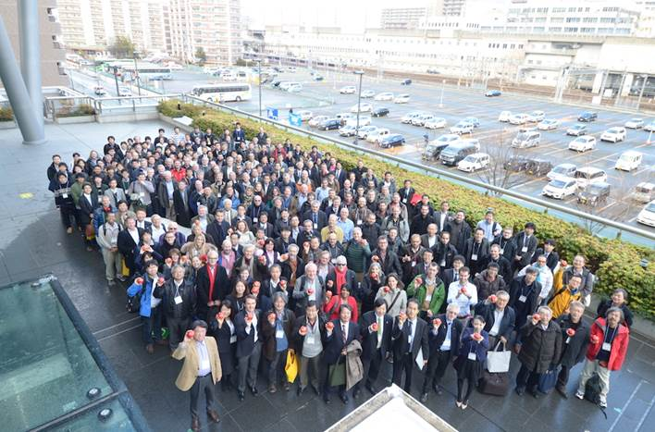
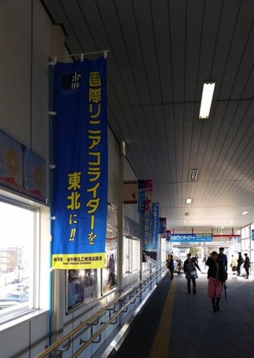
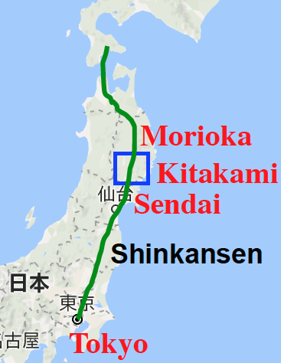
LCWS2016 at Morioka Japan
Dec 2016
Keynote by Hon. Takeo Kawamura,
a member of the House of Representatives,
President of the Federation of Diet members for ILC
Standing ovation
Japan
About 350 participants

Slide 34

LCB/LCC Organization 2017
New LCC managements
Press Conference
at Morioka Japan
Dec 2016
S. Stapnes
J. Brau
S. Stapnes
J. Brau
L. Evans
H. Murayama
S. Michizono
FALC
Chair: N.N.
ICFA
Chair: J. Mnich
International Committee
For Future Accelerators
Funding Agencies
for Large Colliders
LCB
Chair: T. Nakada
Linear Collider Board
2012-
LCC organized in 2013
New 3-year mandate from 2017
KEK ILC Promotion
Office
LCC
Linear
Collider
Collaboration
LCC Director
Lyn Evans
Deputy
Hitoshi Murayama
CLIC
Collaboration
Public Relations
ILC
Associate Director:
Shin Michizono
CLIC
Associate Director: Steinar Stapnes
Physics & Detectors
Associate Director:
Jim Brau

Slide 35
Summary
Physics case for ILC is very simple and strong.
  Higgs, top, new physics.
ILC accelerator design is ‘ready’.
The ILC detectors are pushing the state of the art of particle detection technologies.
There are strong supports by the international science community.
Official government-level consideration is ongoing in Japan

