Slide 1
A T0/Trigger Detector for the External Target Experiment at CSR
Dongdong Hu
University of Science and Technology of China
State Key Laboratory of Particle Detection and Electronics, China
INSTR-2017
February, 27 - March,03,2017

Slide 2
Outline
➢Introduction
➢Experiment
➢MRPC module
➢Electronics
➢Cosmic Ray Test
➢Heavy-ion Beam Test
➢Summary

Slide 3
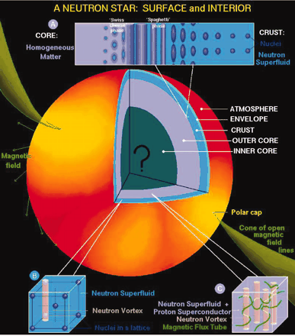
Introduction
► The equation of state (EOS) of iso-spin asymmetric nuclear matter, particularly the density dependence of the nuclear symmetry energy, is an important question in nuclear physics.
Knowledge on this is crucial to understand
The nuclear structure of heavy nuclei
Form and evolution of compact star
Heavy-ion reaction dynamics and system evolution
J. M. Lattimer and M. Prakash, Science 304, 536 (2004)
Notes:
to determine the isospin dependence of the in-medium nuclear effective interactions and the equation of state (EOS) of isospin asymmetric nuclear matter, particularly its isospin-dependent term, i.e., the density dependence of the nuclear symmetry energy. The latter has been identified explicitly as one of the most outstanding questions in the 2007 US Nuclear Physics Long Range Plan by the NSF/DOE’s Nuclear Science Advisory Committee
弱束缚晕核，接近滴线区域原子核基本性质以及对于极端丰中子核核碰撞的动力学研究,发展适用于远离稳定线的核结构理论
宇宙中的核素合成;重星体塌陷;超新星爆炸和中子星形成、结构及演化;中子星中的介子凝聚

Slide 4
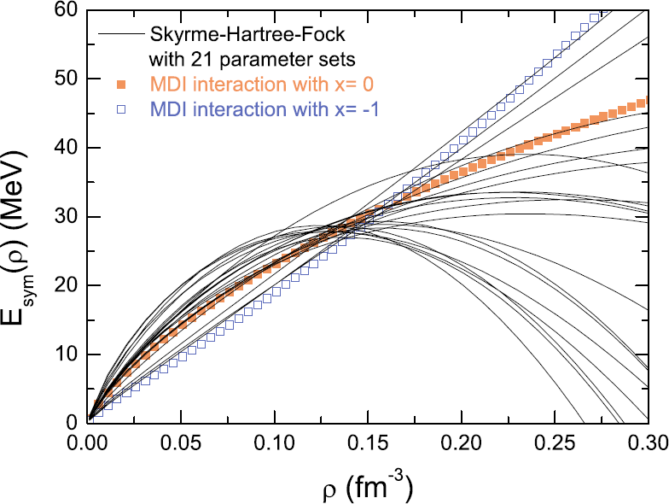
Nuclear EOS at high density
► The density dependence of the nuclear symmetry energy has big discrepancy at supra-saturation region.
  ► Heavy-ion experiment will help clarify the big theoretical uncertainty
► π⁻/π⁺ in heavy-ion collision can be a sensitive probe
  → Require heavy-ion beam at several hundred AMeV energy
  → HIRFL-CSR (Lanzhou), where core density up to ~2ρ₀ a suitable machine for this study
Bao-An Li, Lie-Wen Chen, Che Ming Ko, Physics Reports 464 (2008) 113–281
Notes:
Probes for EOS study: ratios of neutron/proton and/or light mirror nuclei, N/Z ratios of intermediate mass fragments, Neutron–proton correlation functions, and The K0/K+ and pi−/pi+ ratios
HIRFL-CSR is a suitable facility to perform this study

Slide 5
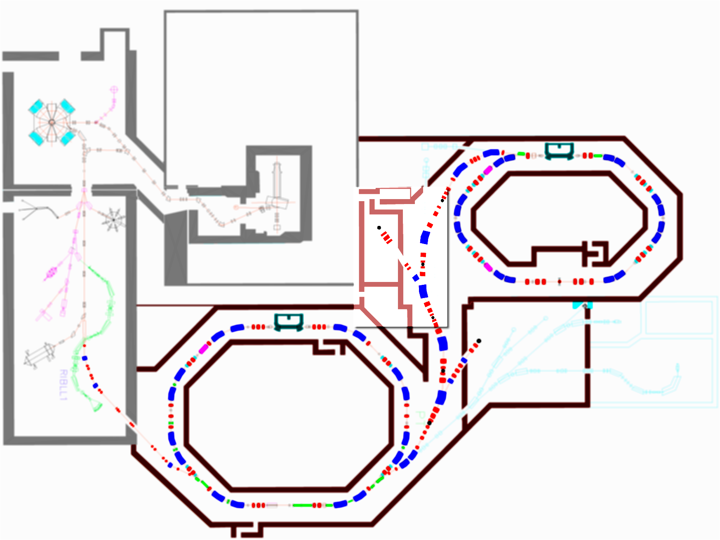
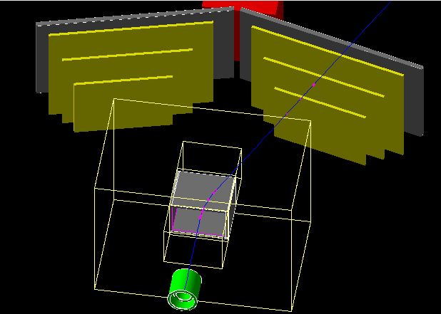
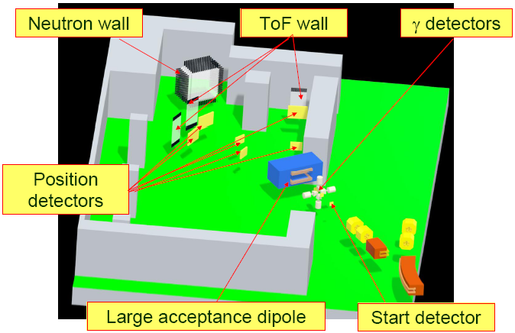
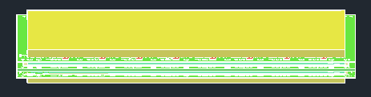

External-target Experiment at CSR
Heavy-Ion Research Facility at Lanzhou (HIRFL) complex
HIRFL-CSR has the ability of accelerating heavy-ion, from Helium to Uranium, to a kinetic energy of around 0.5-1AGeV
External Target Experiment
Cooling Storage Ring (CSR)
tracking detector
Outer
Inner
Multi-gap Resistive Plate Chamber
  the START detector (T0) and tracking detector be upgraded
T0 detector
Notes:
The left plot shows the layout of the Heavy-Ion Research Facility at Lanzhou (HIRFL) complex. The Cooling Storage Ring (CSR) at HIRFL is a heavy-ion facility that can accelerate nuclei up to Uranium with a kinetic projectile energy of several hundred MeV to GeV. Detector upgrades are needed to carry out the heavy-ion collision experiment (to study EOS at high density), including a event START (T0) detector and large acceptance tracking detectors. In my talk I will talk about the T0 detector.

Slide 6
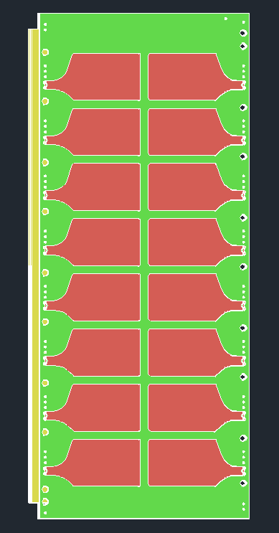
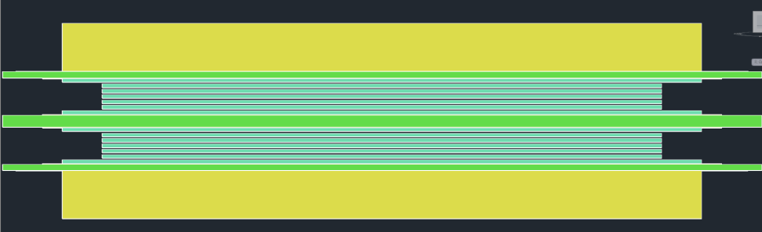
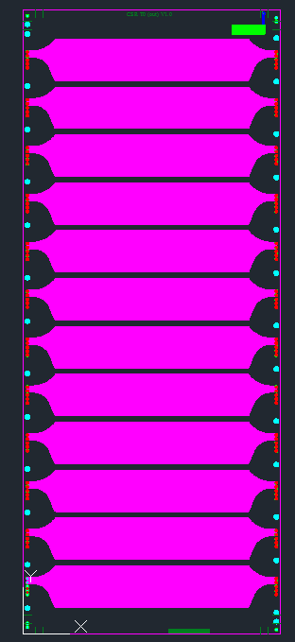
Structure of MRPC
Inner MRPC has 16 pads.
22.9cm×9.5cm×2.45cm
Outer MRPC has 12 strips.
39.1cm×16.1cm×2.45cm
Multi-gap Resistive Plate Chamber (MRPC):
Gaseous detector,
Avalanche mode
Each gap is 0.22 mm

Slide 7
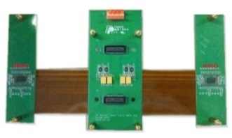
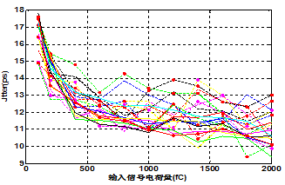
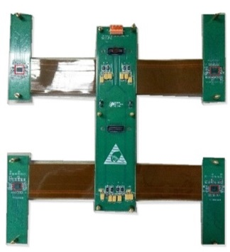
Electronics && FEE Module
Inner FEE
Charge of input signal fc
Inner and outer FEE module time resolution
Outer FEE
NINO is an ultra-fast and low-power front-end amplifier/discriminator ASIC designed for the multigap resistive plate chamber , by the group of TOF of ALICE
Inner FEE module，2 NINO chips，16 channels
Outer FEE module，4 NINO chips，24 channels
Through the TOT technology , FEE put the analog signal convert to pulse width LVDS signal (the leading time). Pulse width LVDS signal is the quantity of electric charge signal
Time resolution of all channels are less than 20 ps

Slide 8
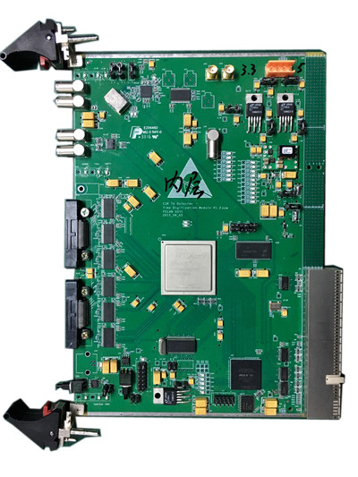
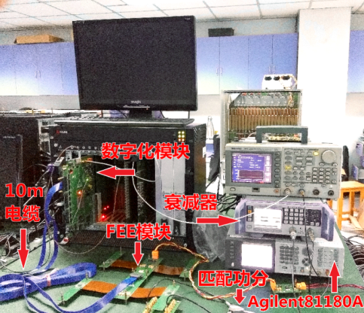
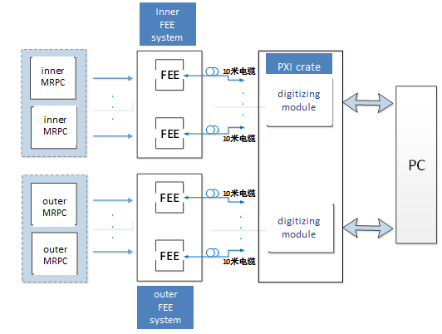
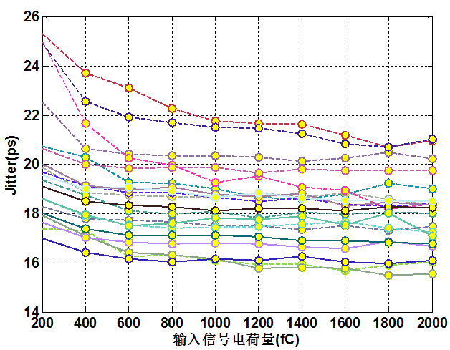
Electronics && FPGA TDC
Electronics platform test system
FPGA TDC
Based on Xilinx’s Artix 7, the FPGA TDC can achieve both leading and trailing edge time measurement; this FPGA also integrates trigger match and other functions
TDC module base on PXI 6U standard is installed in the PXI crate
All channel leading time jitter less than 30ps
Charge of input signal fc

Slide 9
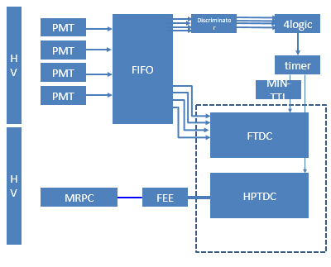

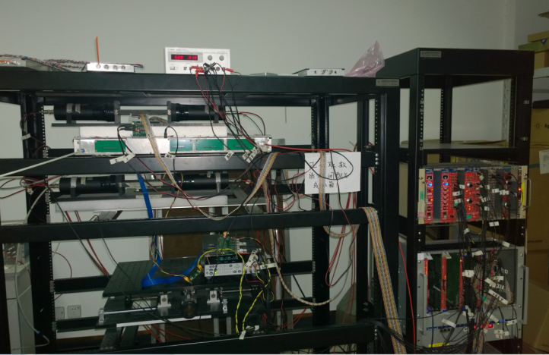
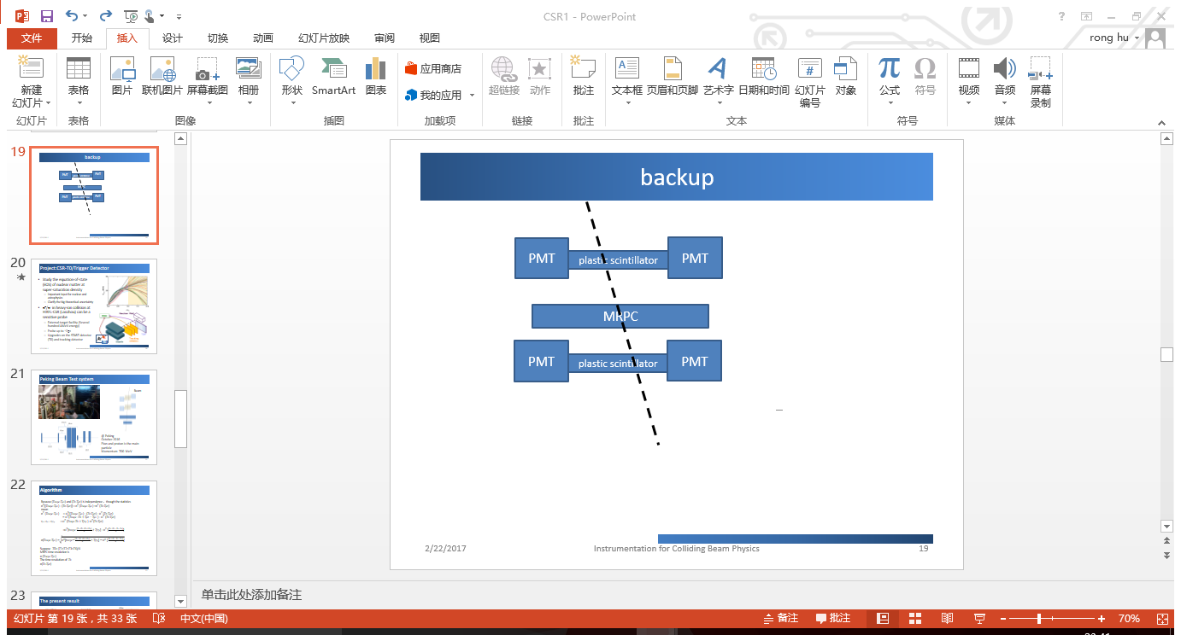
Cosmic Ray Test
NIM-TTL
PMT
PMT
PMT
MRPC
PMT
aluminum
Trigger signal
cosmic ray through the scintillation detector
coincidence signal of the 4PMTs

Slide 10
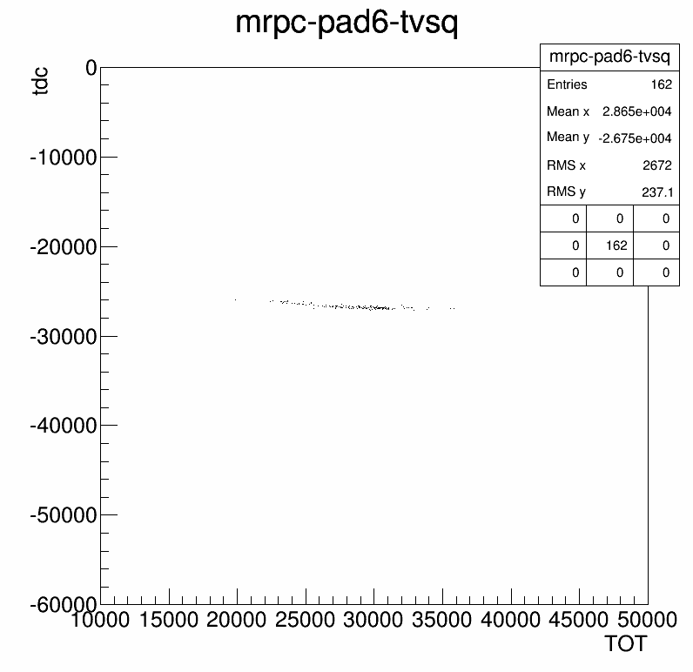
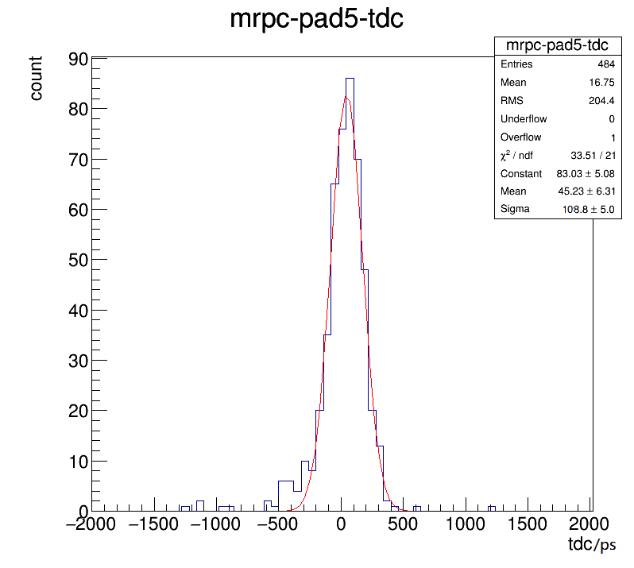
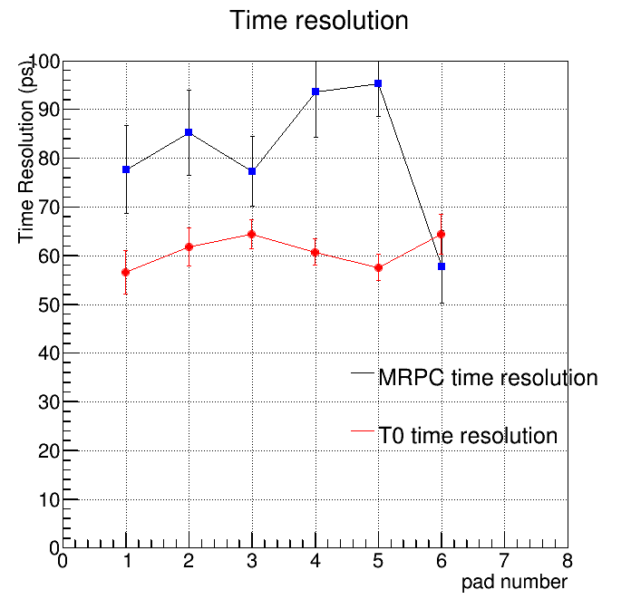
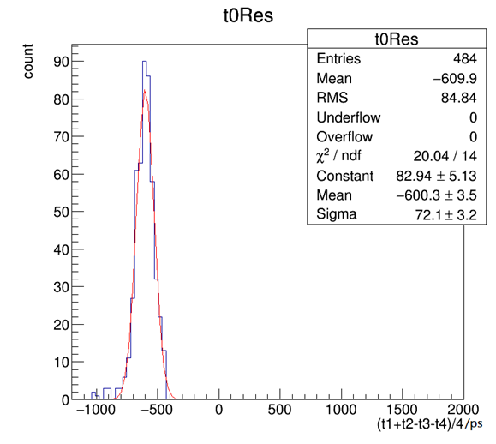
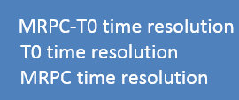

The result of the MRPC time resolution
HPTDC
T-TOT Correlation
MRPC-t0 time resolution
Different pads time resolution
+
FPGA TDC
Results from HPTDC and FTDC are consistent
The time resolution of MRPC is around 80 ps.

Slide 11
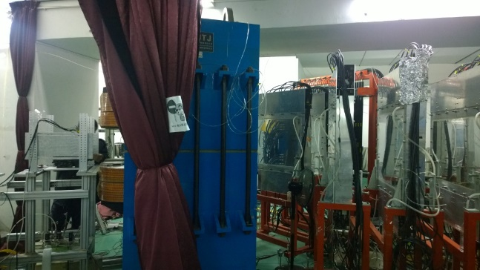
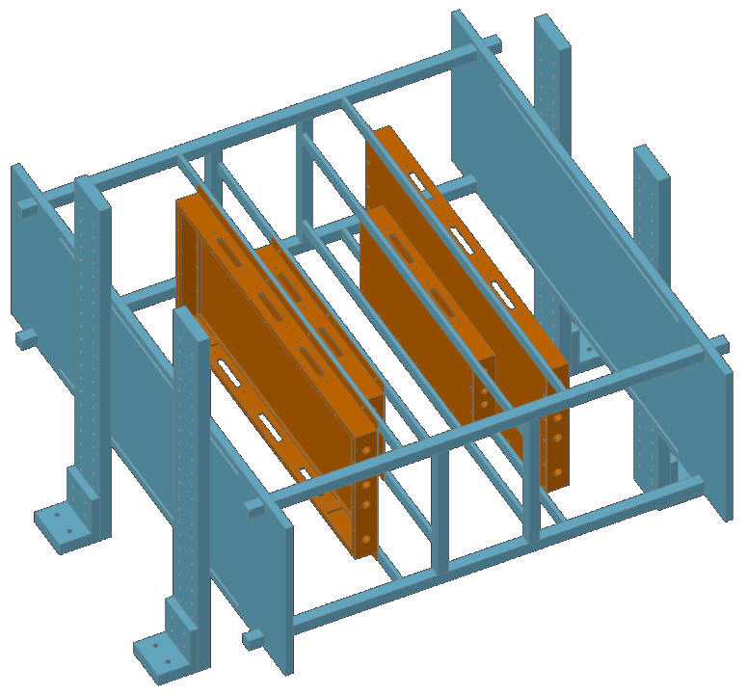
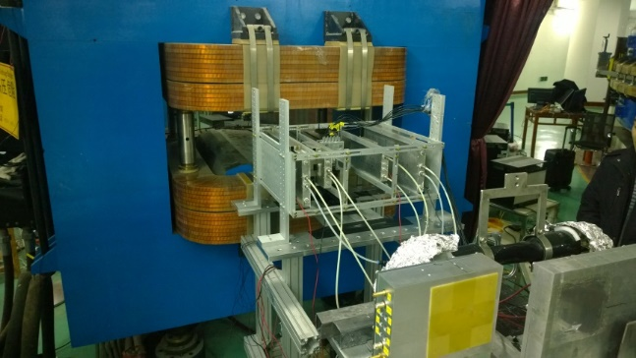
Lanzhou Beam Test system@HIRFL CSR November, 2016
Dipole Magnet (CSR ETF)
T0
Pb/C target
Tracking Detector
MRPC System
Ar Beam
2*6 0.22mm gas gap - MRPC
90%F134a+5%C₄H₁₀+5%SF₆
HV：~7kV
Stand-alone self-trigger
Total 80 channels – 40 FTDC, 40 HPTDC
In total ~300k events recorded
Ar40 beam 300 AMeV kinetic energy
Target Pb and C12
Ar+C Ar+Pb

Slide 12
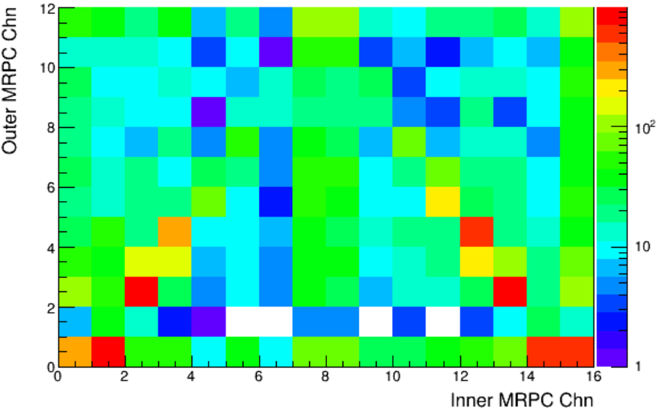
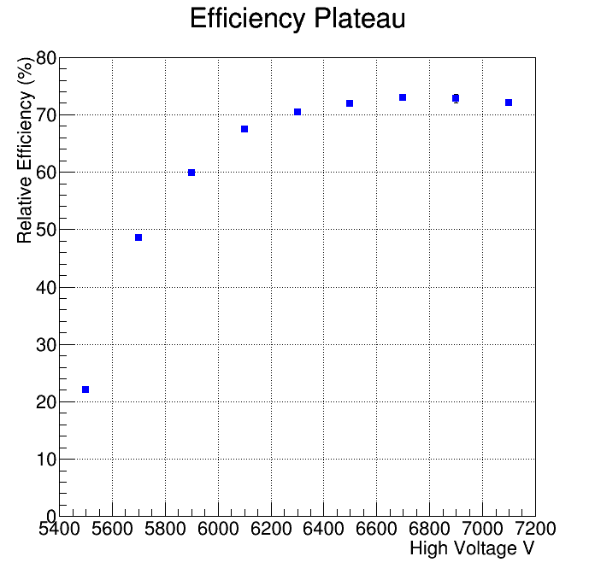
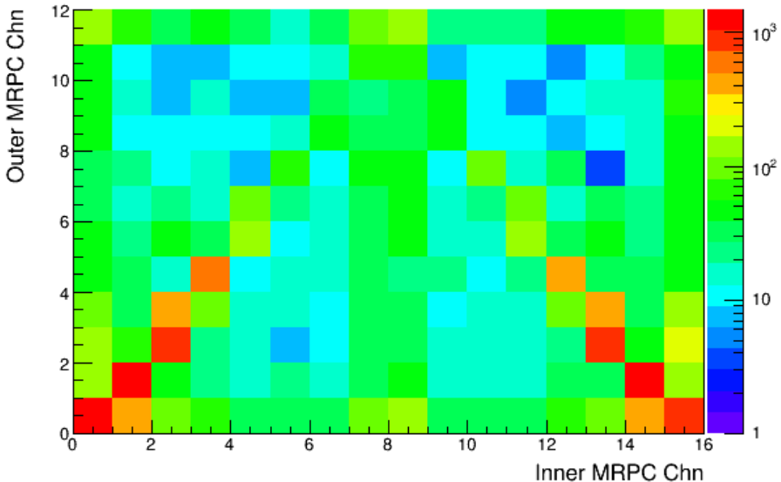
Efficiency Plateau && Typical Hit pattern

Slide 13
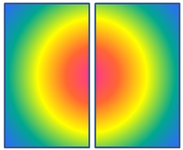
Calibration Strategy
Self-triggered, no tracking, no momentum info, no event vertex, no magnetic field map
Calibration must be carefully applied
We try to calibrate each channel by comparing signals from neighboring pads
time offset
TOT slewing correction (iterative)
Velocity correction
with chosen “clean” event
Outer MRPC
Inner MRPC
Target

Slide 14
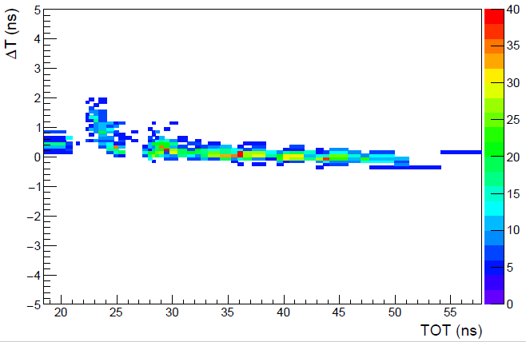
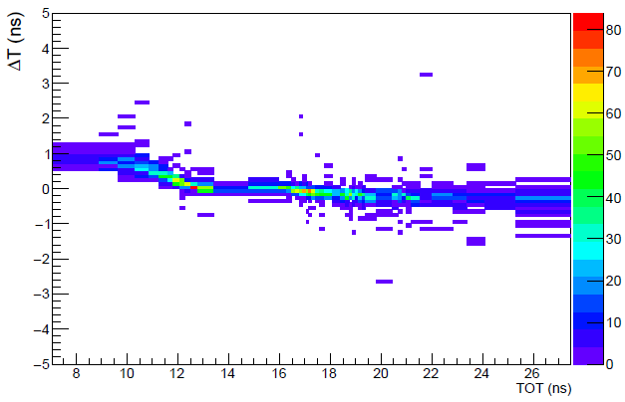
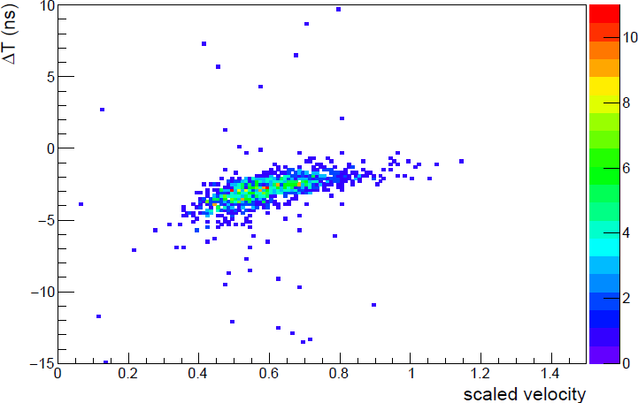
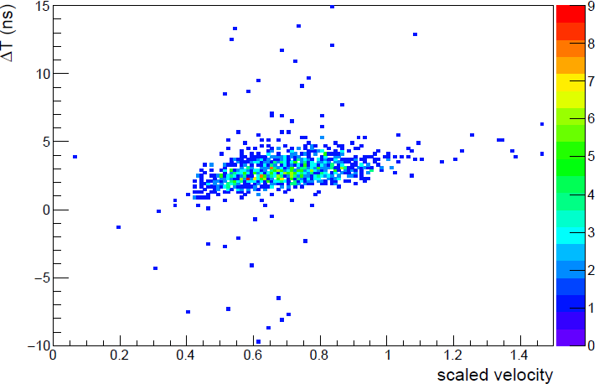
Correction (Velocity)&(TOT)
With HPTDC
With FTDC

Slide 15
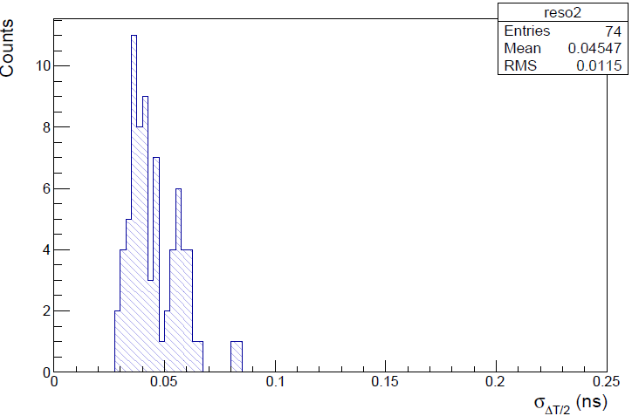
Typical time resolution
Collision time mainly determined by inner MRPC timing and particle path-length/momentum spread
Analysis still on-going
HPTDC
135 ps
FTDC
σ_{T0}

Slide 16
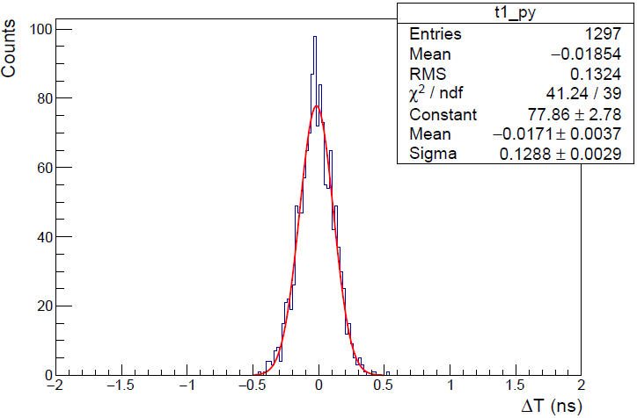
Simulation study of CSR-T0
Monte Carlo (MC) simulation based on GEANT4 toolkit, with practical detector (MRPC etc.) model
Event generator:
  UrQMD3.4, kinetic energy 300AMeV ⁴⁰Ar+¹²C collision
Beam spread σ_{xy}=3mm
MRPC timing uncertainty
  σ_{t}=50ps,75ps,100ps tested
Particle flight trajectory taken from MC
The time resolution of MRPC may be around or even better than75 ps
σ_{T0}
With time smearing σ_{t}=75ps,
the experiment result and the simulation result are consistent

Slide 17
Summary
We have designed and produced the inner and outer MRPC. Tested their performance
Designed the FPGA TDC , FEE electronics System for this experiment , time jitter of electronics System is less than 30 ps
From the Comics ray test, MPRC’s time resolution to be around 80 ps
From the preliminary result of the heavy-ion beam test at the CSR, the performance of the MRPC has met our expectation. The T0 time resolution seems promising.
thanks
Analysis is in progress

Slide 18
backup

Slide 19
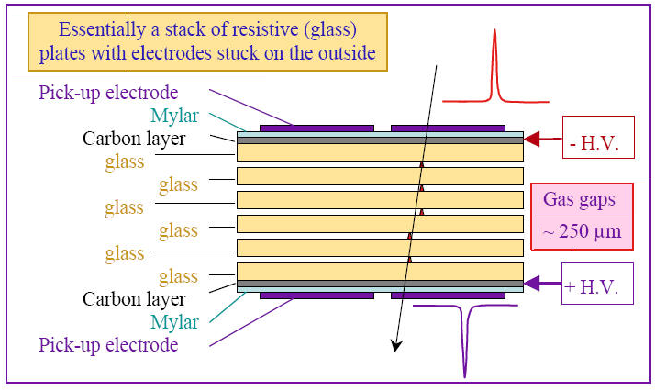
MRPC
MRPC (Multi-gap Resistive Plate Chamber) is a gaseous detector technology first developed by the ALICE experiment.
Characteristic:
1) MRPC is basically a stack of parallel resistive plates with a bulk resistively of around 10¹²~10¹³Ω cm and create a series of gas gap of 0.2 - 0.3 mm. The narrow gaps will decrease the fluctuation of avalanche development time and thus improves the time resolution.
Nucl. Instr.& Meth. A374 (1996) 132 by M.C.S.Williams et al.
2) A strong electric field is generated in each gas gap by applying a high voltage across the external electrodes . A signal induced on pickup pad is the sum of signals from all the gas gaps since the resistive plates are electrically floating when charged particle going through the chamber generates avalanches in gas gaps.
Good candidate for time measurement !

Slide 20
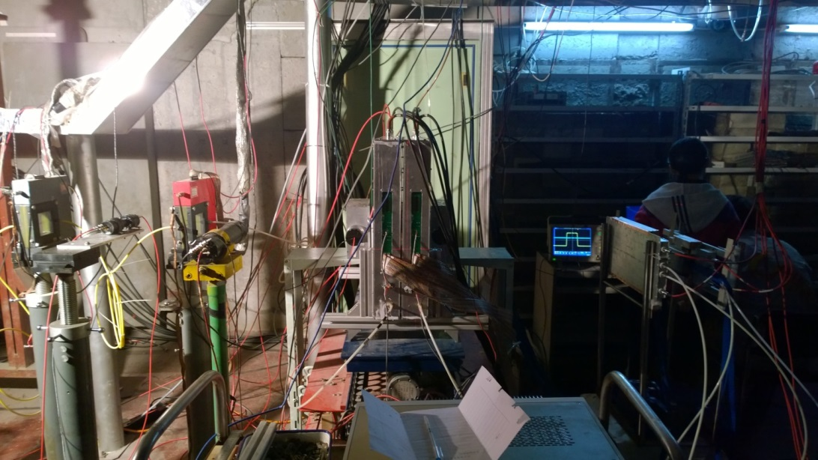
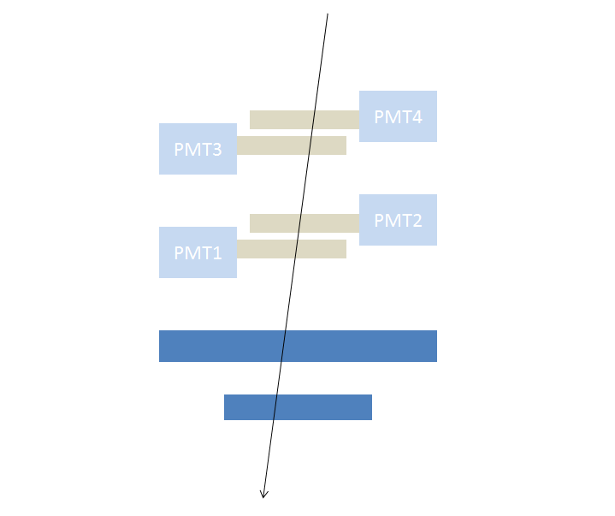
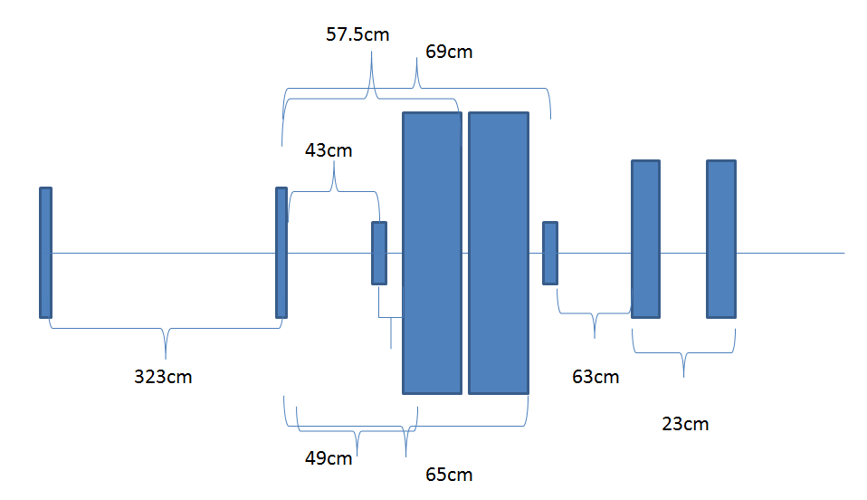
Peking Beam Test system
Beam
@ Peking
October 2016
Pion and proton is the main particle
Momentum 700 MeV

Slide 21
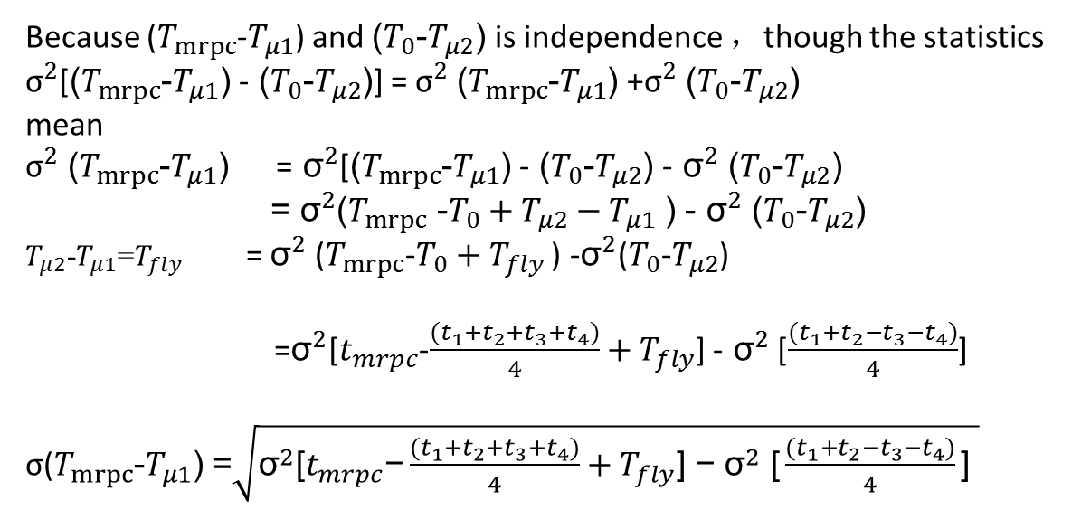
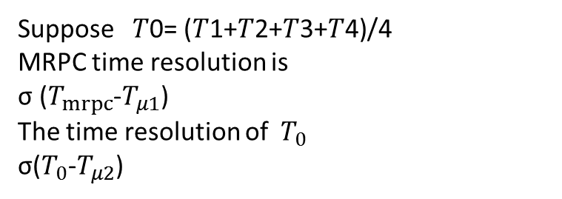
Algorithm
Because ($T_{mrpc}$-$T_{μ1}$) and ($T_{0}$-$T_{μ2}$) is independence ，though the statistics
${\text{σ}}^{2}$[($T_{mrpc}$-$T_{μ1}$) - ($T_{0}$-$T_{μ2}$)] = ${\text{σ}}^{2}$($T_{mrpc}$-$T_{μ1}$) +${\text{σ}}^{2}$($T_{0}$-$T_{μ2}$)
mean
${\text{σ}}^{2}$ ($T_{mrpc}$-$T_{μ1}$) =${ \text{σ}}^{2}$[($T_{mrpc}$-$T_{μ1}$) - ($T_{0}$-$T_{μ2}$) -${ \text{σ}}^{2}$ ($T_{0}$-$T_{μ2}$)
=${ \text{σ}}^{2}$($T_{mrpc}$ -$T_{0}+T_{μ2}{ − T}_{μ1}$ ) -${ \text{σ}}^{2}$ ($T_{0}$-$T_{μ2}$)
$T_{μ2}$-$T_{μ1}$=$T_{fly}$ = ${\text{σ}}^{2}$($T_{mrpc}$-$T_{0}+T_{fly}$ ) -${\text{σ}}^{2}$($T_{0}$-$T_{μ2}$)
=${\text{σ}}^{2}$[$t_{mrpc}$-$\frac{(t_{1}{+t}_{2}{+t}_{3}{+t}_{4})}{4}+T_{fly}$] -${ \text{σ}}^{2}$ [$\frac{(t_{1}{+t}_{2}{−t}_{3}{−t}_{4})}{4}$]
σ($T_{mrpc}$-$T_{μ1}$) =$\sqrt{{\text{σ}}^{2}\text{[}t_{mrpc}\text{−}\frac{(t_{1}{+t}_{2}{+t}_{3}{+t}_{4})}{4}+T_{fly}\text{] −}{ \text{σ}}^{2}\text{ [}\frac{(t_{1}{+t}_{2}{−t}_{3}{−t}_{4})}{4}\text{] }}$
Suppose 𝑇0= (𝑇1+𝑇2+𝑇3+𝑇4)/4
MRPC time resolution is
σ ($T_{mrpc}$-$T_{μ1}$)
The time resolution of ${ T}_{0}$
σ($T_{0}$-$T_{μ2}$)

Slide 22
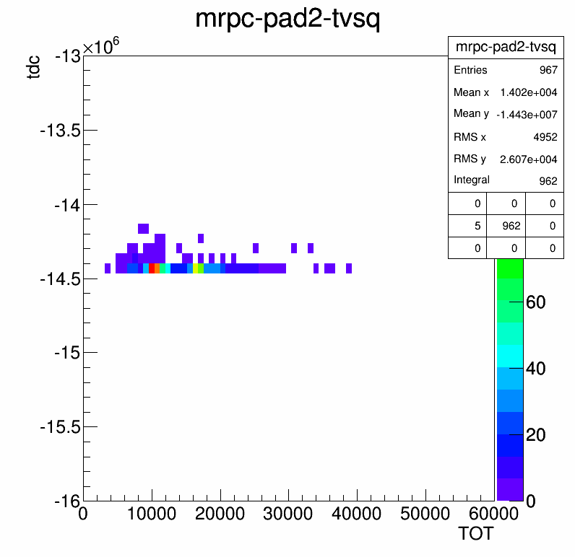
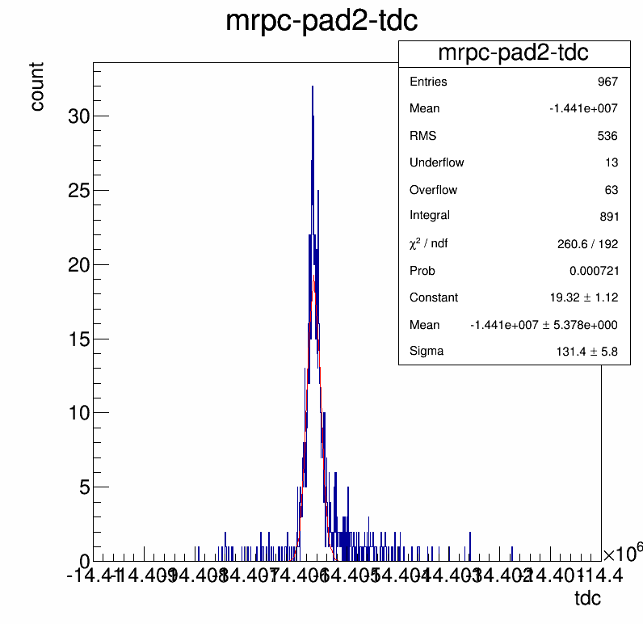
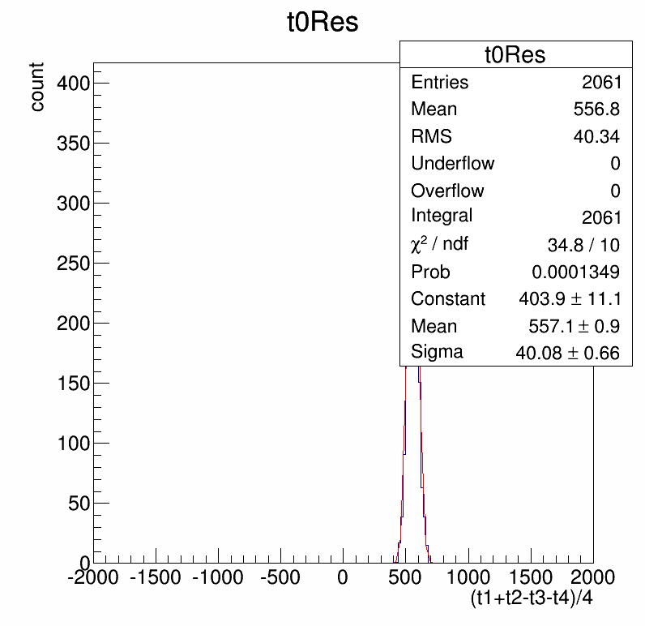
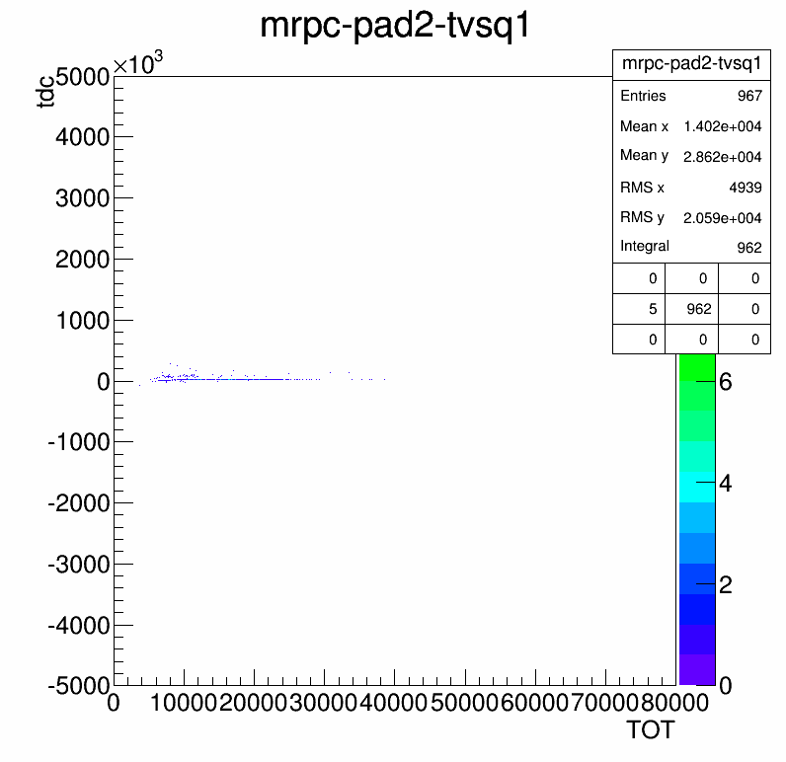
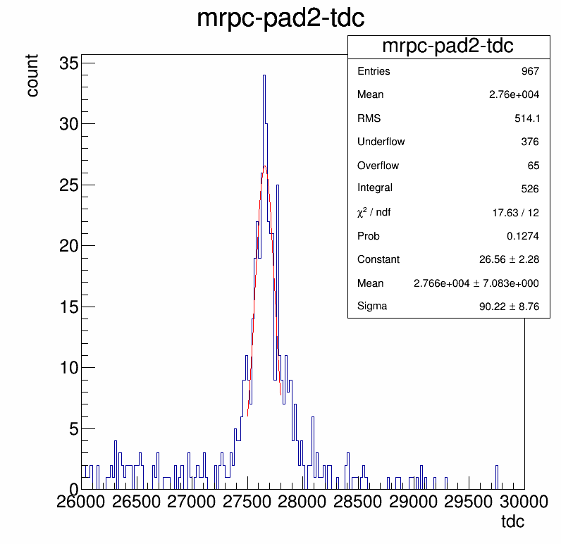
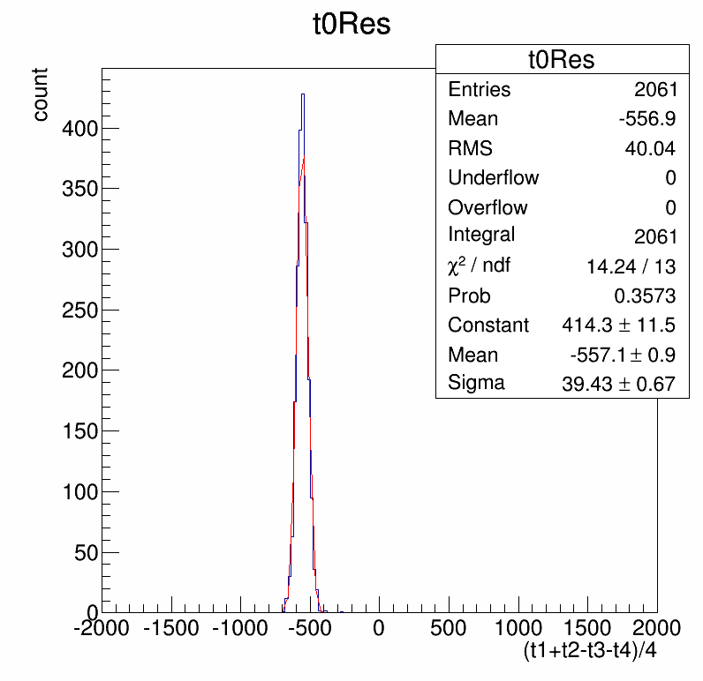
The present result
T-A correction
Before calibration
After calibration
After Slewing correction

Slide 23
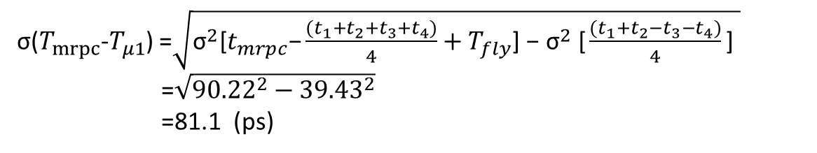
The present result
The MRPC time resolution is 81.1PS
σ($T_{mrpc}$-$T_{μ1}$) =$\sqrt{{\text{σ}}^{2}\text{[}t_{mrpc}\text{−}\frac{(t_{1}{+t}_{2}{+t}_{3}{+t}_{4})}{4}+T_{fly}\text{] −}{ \text{σ}}^{2}\text{ [}\frac{(t_{1}{+t}_{2}{−t}_{3}{−t}_{4})}{4}\text{] }}$
=$\sqrt{{90.22}^{2}−{39.43}^{2}}$
=81.1 (ps)

Slide 24


MC simulation – event plane
T0 detector can also be used to determine event plane
0.5AGeV AuAu collision, simulated by UrQMD3.4.6
Q-vector reconstruction to determine event plane
Event plane resolution
1st order Q-vector
T0 acceptance

Slide 25




CSR-T0/Trigger Detector
—CSR Trigger/T0 Detector simulation and design optimization
ART1.0, Xe+Xe 700AMeV
By inner MRPC itself to decide the starting time is inaccuracy.
We can Slewing correction momentum dispersion eliminate the time error , through inner and outer layer MRPC time difference.
v'=L2/(T2-T1)/c
w/o MRPC resolution
w/o field
Track-length from MC
target
Notes:
T0 = T1-L1/v = T2-L2/v
V can be estimated by T1,T2 and L1,L2
v’= L2/c/(T2-T1)其中T1、T2 分别为同一带点粒子在内、外桶上的击中时间，L1、L2 为内、外桶击中位置到靶点的直线距离。由于末态带电粒子动量较低，在飞行过程中有明显的能量损失，为了得到好的T0 定时精度，需要根据粒子动量（或速度）加以刻度。定义约化粒子速率为
v'=L2/(T2-T1)/c
T2-T1 为两次击中的时间差，c 为真空中光速。

