Slide 1
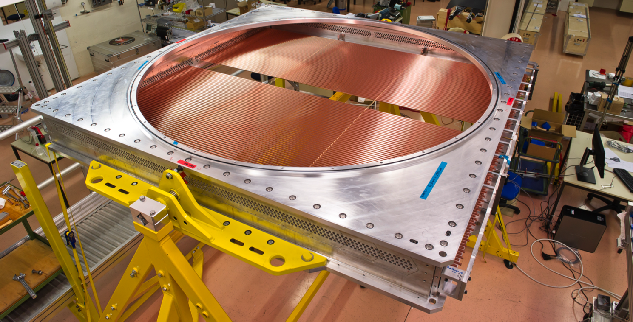
NA62 Straw Tracker
Enik Temur (JINR,Dubna)
on behalf of the NA62 collaboration
Notes:
1
First of all I wish to thank for the invitation and the good reception the Conference organizer. I want to took about NA62 straw tracker

Slide 2
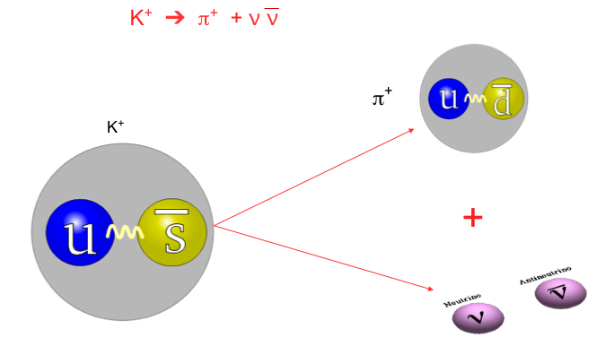
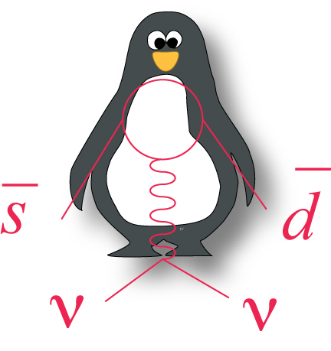
The study of Kaons
Notes:
A new generation of kaon experiments NA62 at CERN are tackling the measurement of K + → π +νν¯ . NA62 aims to perform a 10% measurement of the branching ratio or better by collecting O(100) SM events
NA62 was designed and built to study the decay in-flight in order to exploit the high momentum secondary beam of the CERN SPS. In-flight decays offer the possibility of good suppression of kaon decays with photons and muons that could mimic the signal, and no interactions with the stopping target material.

Slide 3
Set up
Notes:
Protons from the SPS at 400 GeV/c interact with a beryllium target and produce a secondary charged beam.
A secondary positive beam have 75 GeV/c with 1% momentum resolution and a divergence below 100 μrad, in the x and y projections. Around 6% of secondary particles are K+, the others π+ and protons. The beam has a square shape of 60x27mm2 area and a total flux rate of about 750 MHz at the end of the beam line.
The kaon decays rate about 5 MHz in fiducial region or 4.5x1012 decays per year. The fiducial region have 65 m length and located the vacuum tank with preassure 10-6 mbar
Upstream detestors
The Gigatracker(GTK) is comprised of three Si micro-pixel stations measuring, time, direction and momentum of the beam particles before entering the decay region.
The differential Čerenkov (CEDAR) counter identifies the K+ component in the beam;
The ‘guard-ring’ counters (CHANTI) surrounding the last GTK station and detects unwanted interactions in the 3rd station of the GTK.
Downstream detestors
The STRAW measures the coordinates and momentum of secondary charged particles originating from the decay region.
RICH separate Pi from mu. Measure the pion crossing time with a resolution of about 100 ps or better. Produce the L0 trigger for a charged track.
A system of Photon-Veto detectors provides hermetic coverage from zero to ~50mrad angles from the decay region.
The Muon-Veto Detectors (MUV).
The charged-particle hodoscope (CHOD)
Sergey Kholodenko took about CHOD later. I want to took about NA62 straw tracker

Slide 4
The straw chamber in NA62
The main requirements to the straw spectrometer are:
Spatial resolution ≤ 130 μm per coordinate and ≤ 80μm per space point
radiation length (X₀) for each chamber - ≤ 0.5%
Installation inside the vacuum tank - P = 10⁻⁵ mbar with minimum gas load for the vacuum system
Operation in a high rate environment - up to 500 kHz/straw
Notes:
The straw detector should be operete in vacuum beter than 10⁻⁵ mbar.
The maximum particle rate is 15 MHz.
For straws near the beam, operation in a high rate environment the maximum rate is 500 kHz
The mean rate 60 kHz.
The material budget must be less then 0.5% of a radiation length for each chamber. Use of ultra-light material along the particle trajectory in order to minimize multiple Coulomb scattering.
A resolution on the pion momentum better than 1% at 30 GeV/c and a resolution of angle between K and pi of 50-60 mkrad.
Spatial resolution ≤ 130 mkm per coordinate and ≤ 80 mkm per space point

Slide 5
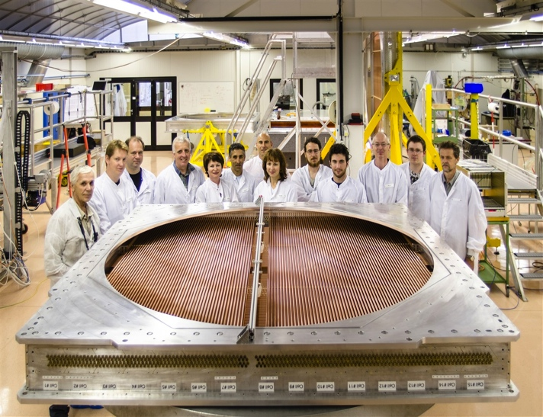
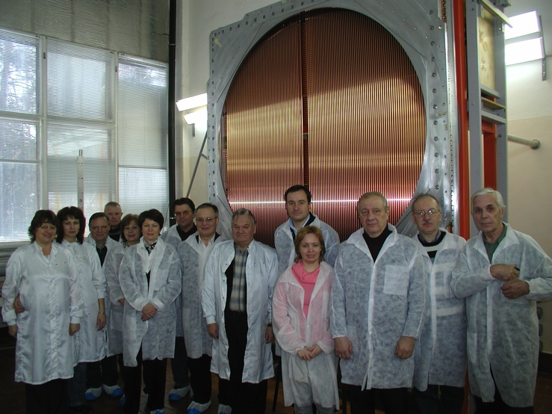
The NA62 Straw Collaboration
CERN
PH/DT: Design, development, prototyping, procurement, coordination, assembly…
PH/ESE: development electronics, readout
Dubna: straw production , module assembly, software
Notes:
5
The NA62 Straw Collaboration consist of two teems: from CERN and from Dubna.

Slide 6
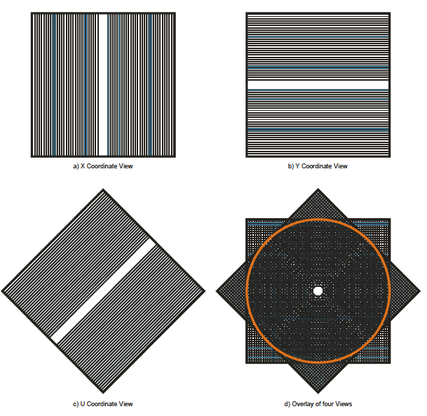
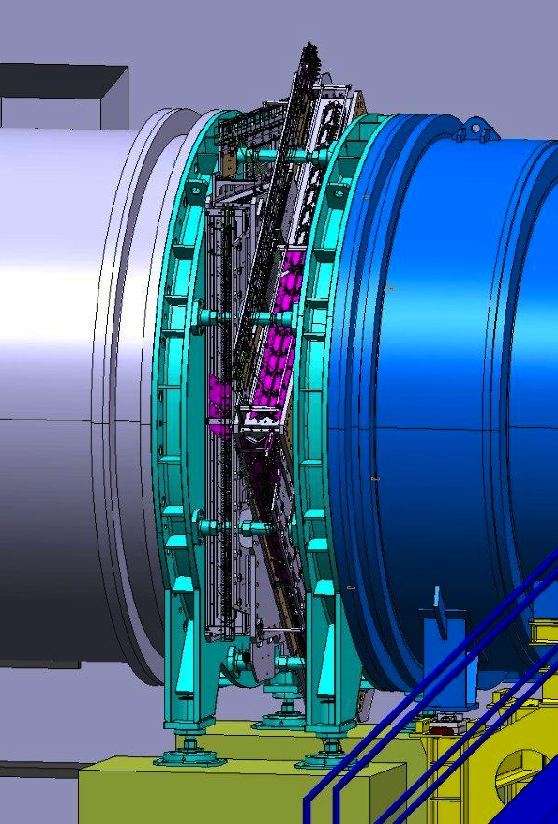
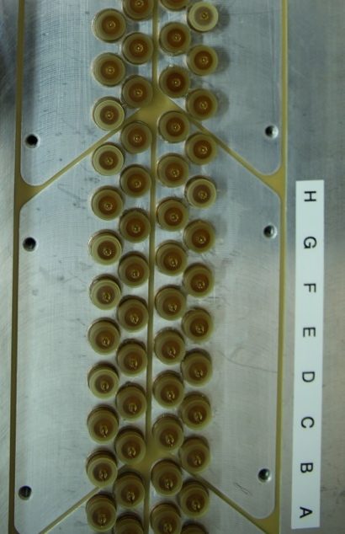
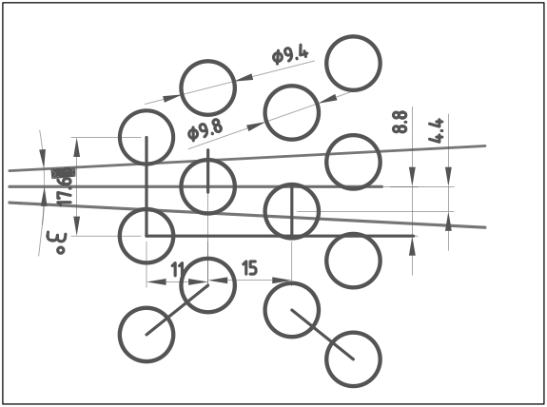
The detector layout
4 views: x,y,u,v
The straws are mounted individually in “views”
Each view has 4 planes and a plane has 112 straws
There are 4 views in each chamber(1792 straw) and 4 chambers in total
The total number of straws is 7168
Each view (448 straws) gives one coordinate
x
y
2.1m
u,v
Straw layout in one view
π⁺
Notes:
The spectrometer consists of four chambers intercepted in the middle by a high aperture dipole magnet providing a vertical magnetic field of 0.36 T and 270 MeV/c momentum kick in the horizontal (x-z) plane. Each chamber is equipped with 1792 straw tubes. The diameter of the straw tubes is 9.8 mm and lenght 2.32 m.
A full chambers consist four coordinate views. The active area of the chamber covers a diameter of 2.1m. The gap near the middle of each layer is kept free for the beam passage.
The straw layout in a section of one view is shown in picture. To solve the right-left ambiguity, each view has four layers. There are 112 straws in each layer. The layout of the tubes give at least two hits per view and be efficient for track angles from -3 to 3 degrees.
The straws mounted individually in view.
The effective region each straw 9.4 mm.

Slide 7
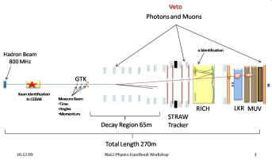
The straw
Straw construction
2.1 m long tube with a diameter of 9.8 mm
The base material is Poly Ethylene Terephthalate (PET) with thickness of 36 μm
The foil is coated on the inside with 50 nm of Cu and 20 nm of Au by sputtering
The electrical properties and operation
The anode wire is 30 μm in diameter and made from gold-plated tungsten
Resistivity of anode: 50 Ohm, cathode: 65±5 Ohm, wave resistance: 350 Ohm
HV 1750 V and gas mixture: Ar (70%)+ CO₂ (30%)
36 μm PET
50 nm Cu
20 nm Au
Notes:
Straw is 2.35m long tube with diameter of 9.8 mm. The base material is Poly Ethylene Terephthalate (PET) with thickness of 36 μm. The foil is coated on the inside with 50 nm of Cu and 20 nm of Au by sputtering.
The anode wire is 30 μm in diameter and made from gold-plated tungsten. Resistivity of anode: 50 Ohm, cathode: 65±5 Ohm, wave resistance: 350 Ohm. HV 1750 V and gas mixture: Ar (70%)+ CO₂ (30%)

Slide 8
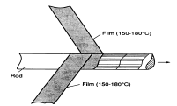
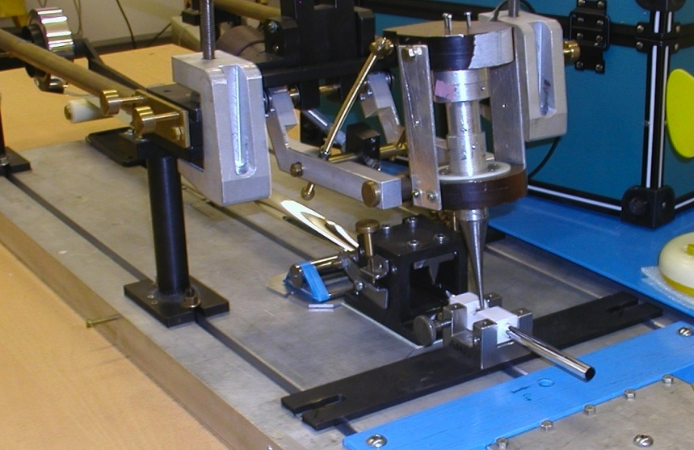
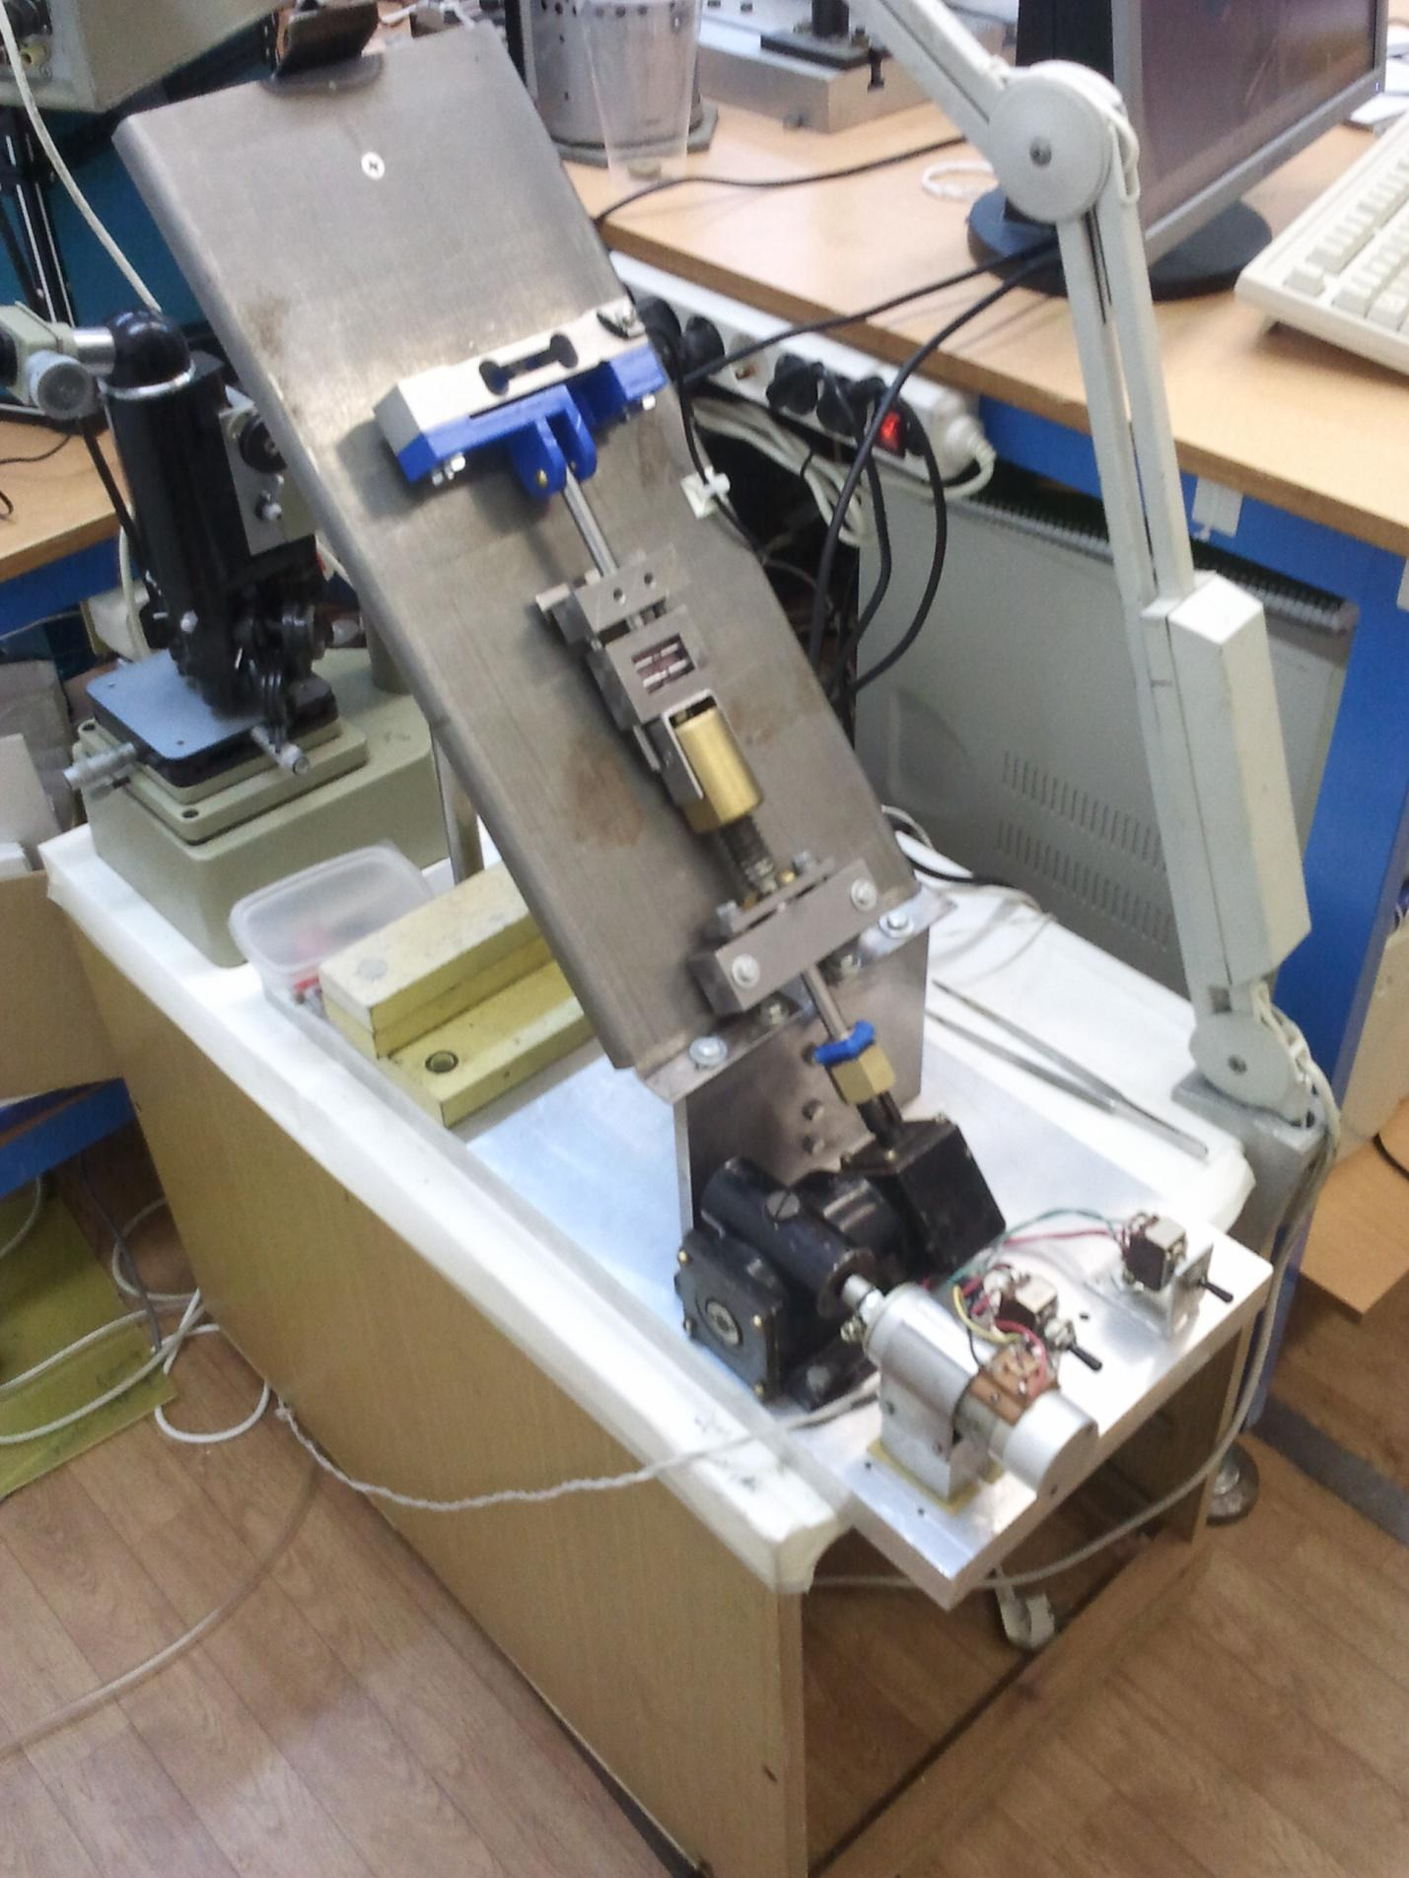
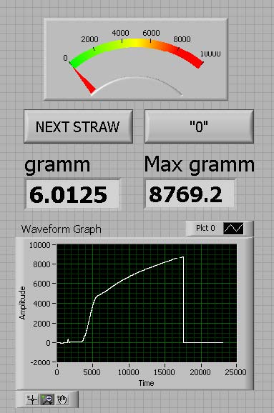
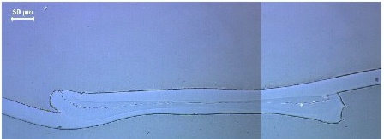
Ultrasonic welding of straws
“Classical straw winding”
Ultrasonic welding
Microscope pictures of a straw cross- section for quality control of the weld
600 μm
Straw Quality Control:
All straws are leak tested after a short (15 min) pressure test at 3 bar
The strength of the weld is verified at both straw ends (traction test)
The electrical conductivity between the two straw ends is measured
Notes:
The most popular two ways to manufacture straw. Wilding and ultrasonic welding. Two films revolve and stick together among themselves.
This method has several drawbaks. One of which is elongation straw and falling tension.
We chosed ultrasonic welding and produed about 15km straw tube.

Slide 9
Quality control and testing during assembly
Leak testing at different stages
The Aluminum frames and the straws are leak tested before wire installation
Specifications: 1mbar x cm³/min/straw (mainly diffusion of CO₂)
Straw step and straightness measurement
Straw tension verification
An infrared emitter/receiver measures the natural frequency of the straws and the straw tension is calculated
A straw is replaced if tension is < 70% of its nominal value
Wire tension measurement
A mechanical test of the wire tension is used by applying a fixed force (F) on the crimp tube (visual inspection)
High Voltage (HV) tests
A first HV test is carried out once the web are installed and a second HV test after the wires are inserted. The current is measured. In a second test, the front-end cover board is read out in order to look for micro discharges.

Slide 10
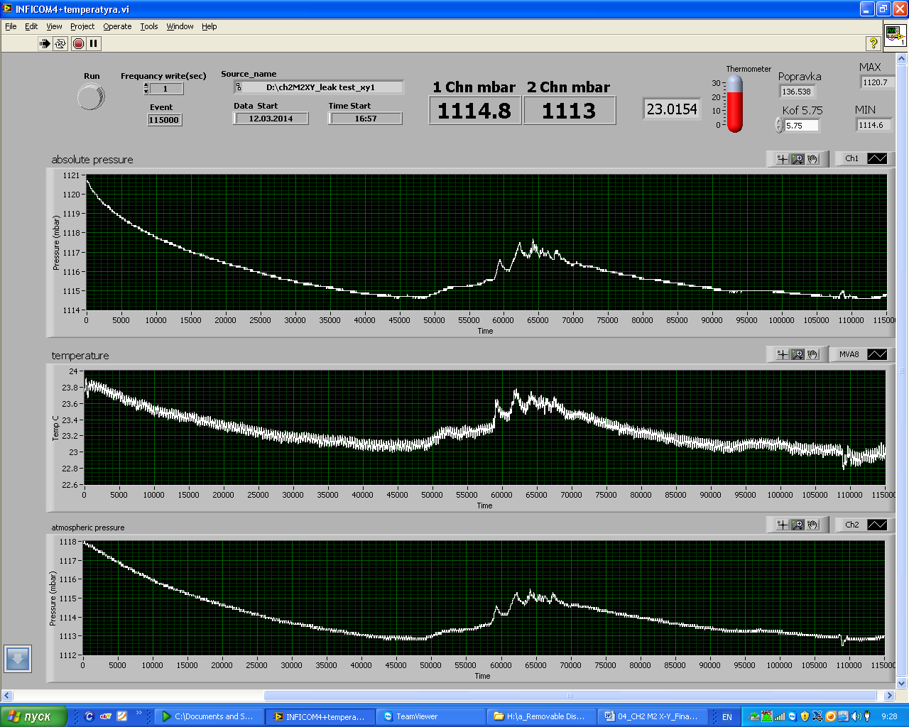
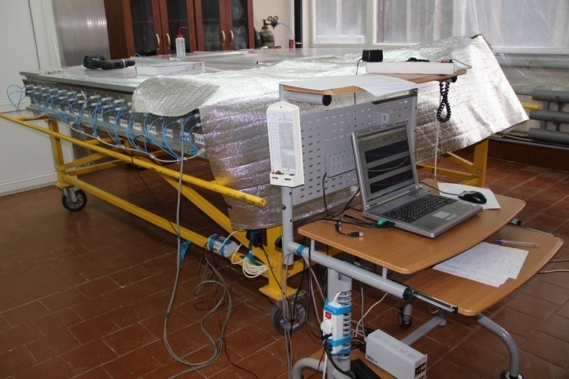
Leak test
X-view
vacuum test
< 0.8 mbar/min CO₂ per one module
Temp.
Y-view

Slide 11
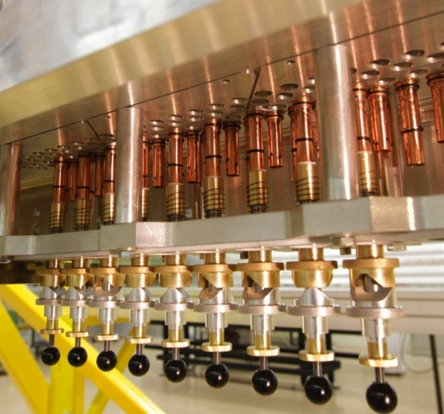
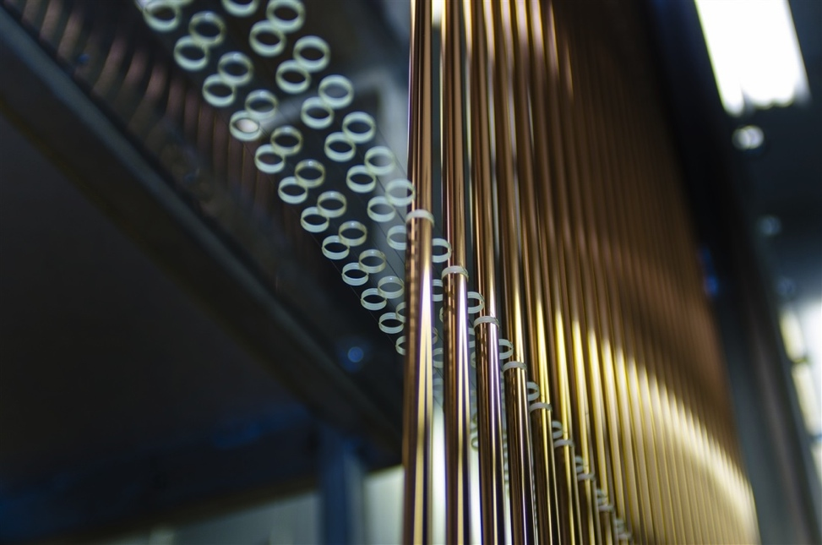
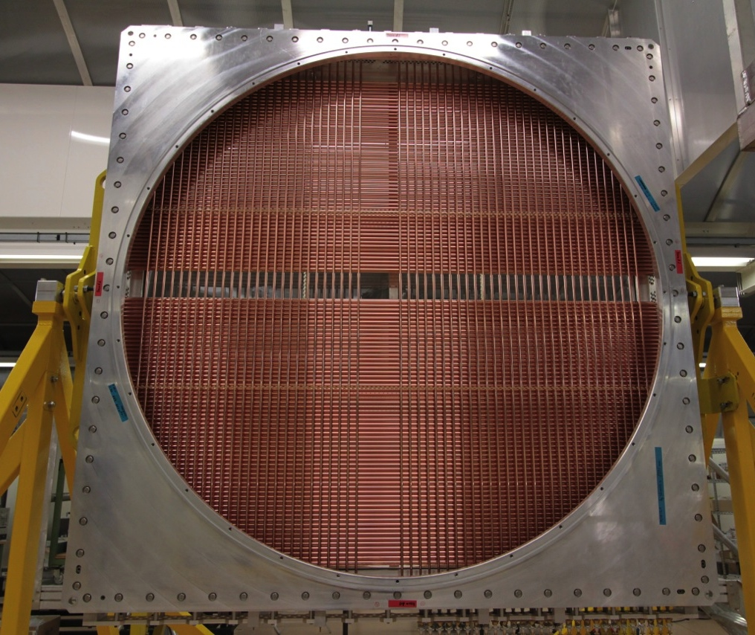
Straw pretension verification
The straws are inserted straight in horizontal position and glued in vertical position
Dedicated tooling keep the straws under tension, during the gluing process ~2kg
Each straw is guided in two points along its length by light weight spacers anchored in the module frames.
The straws are floating with respect to the spacer and are positioned with a precision of ~ 20μm

Slide 12
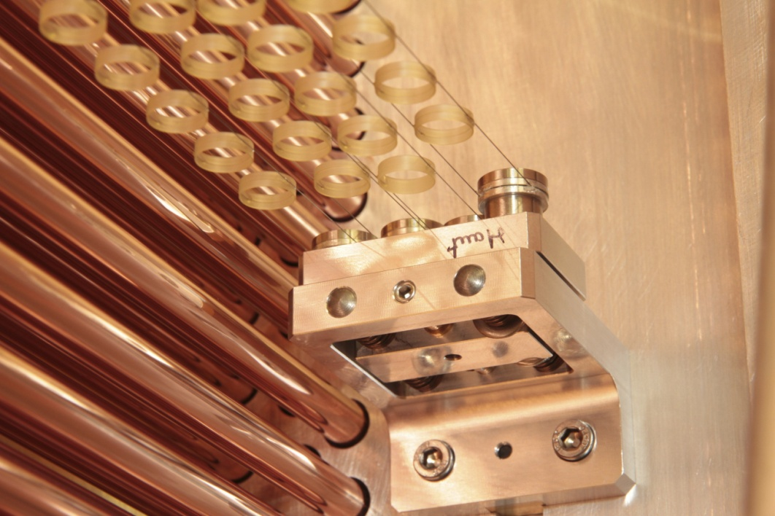
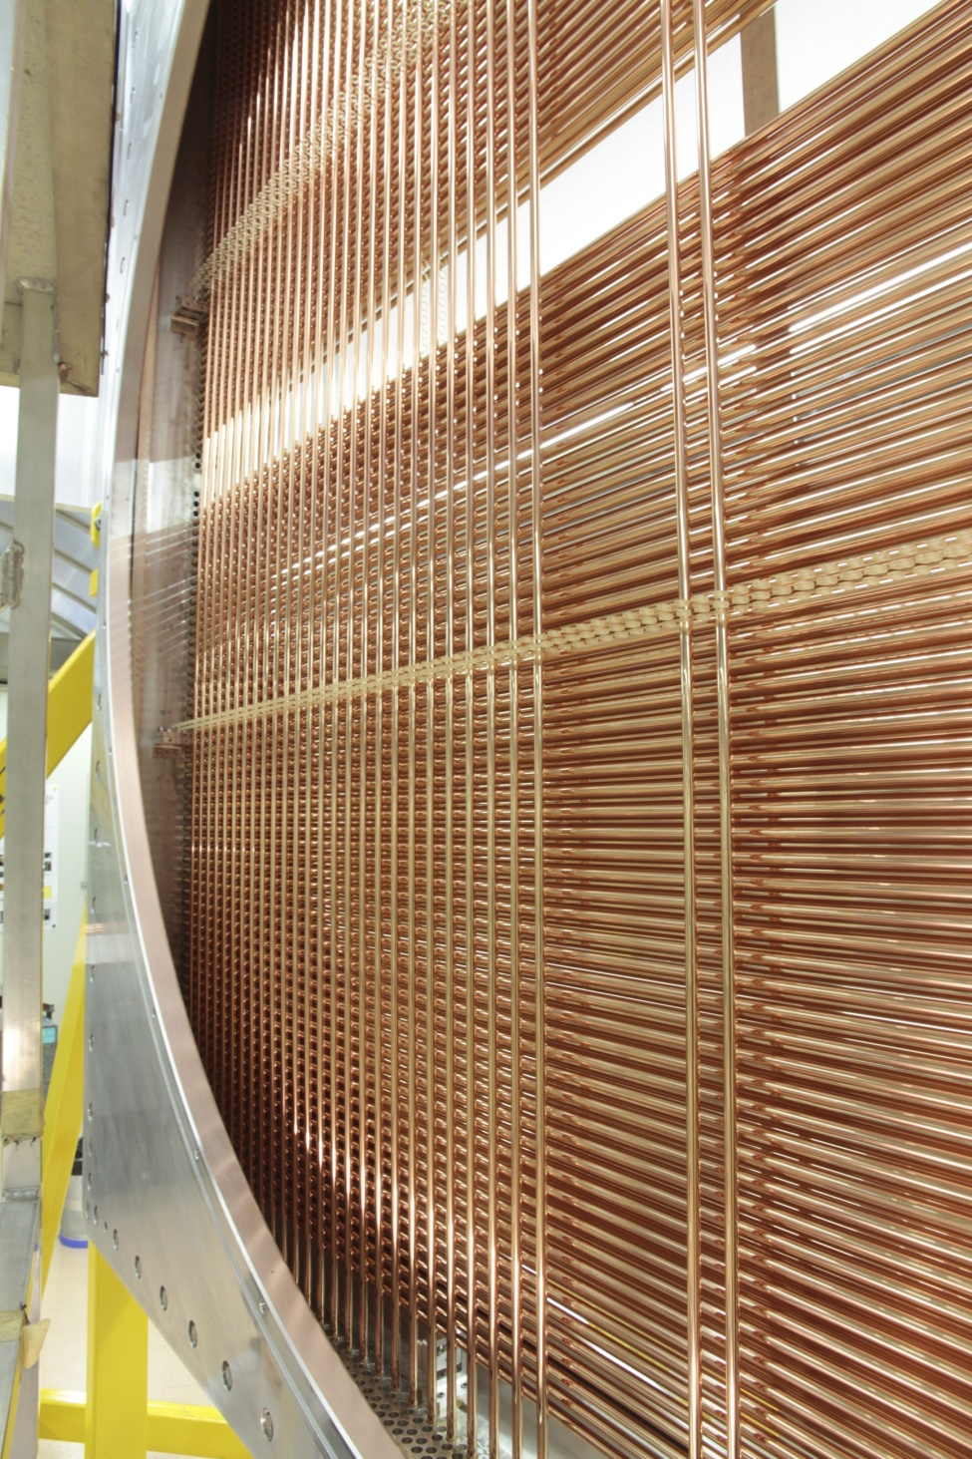
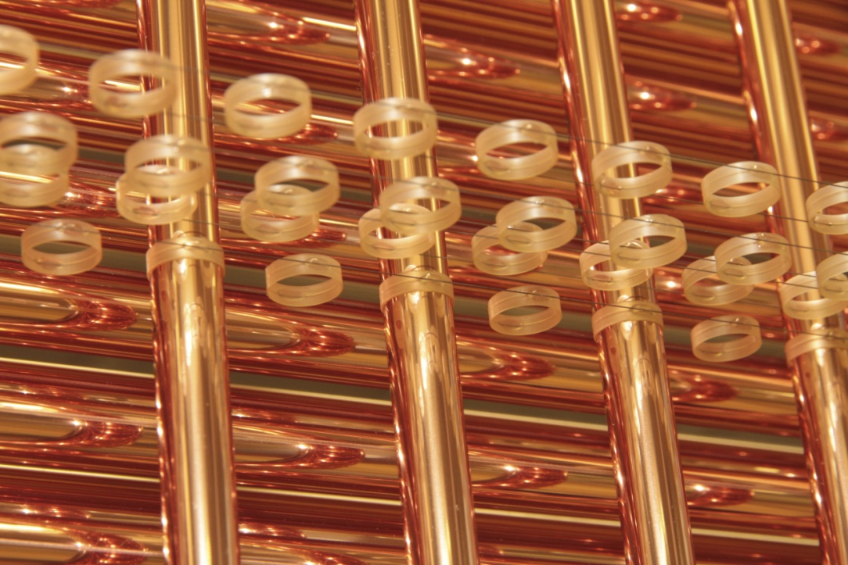
The Spacers
128 spacers (15360 rings)
7200 straws for 8 modules

Slide 13
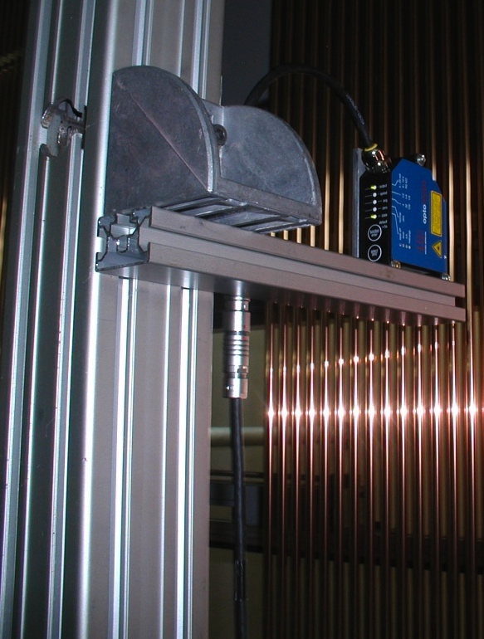
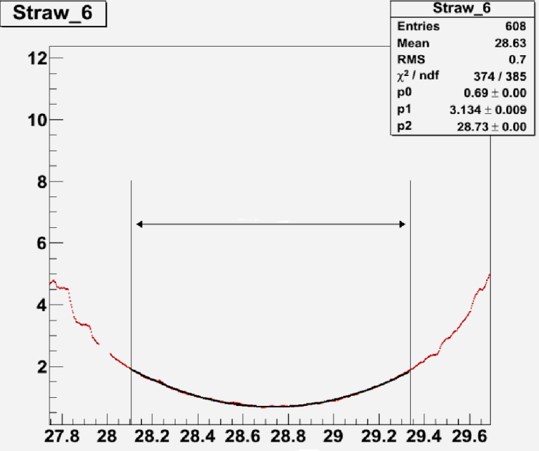
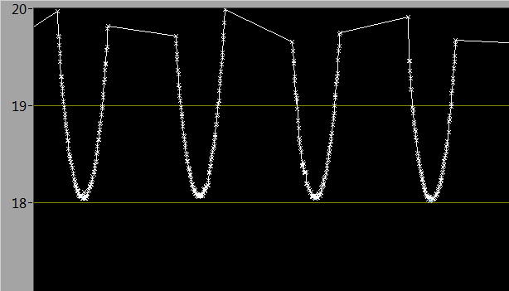
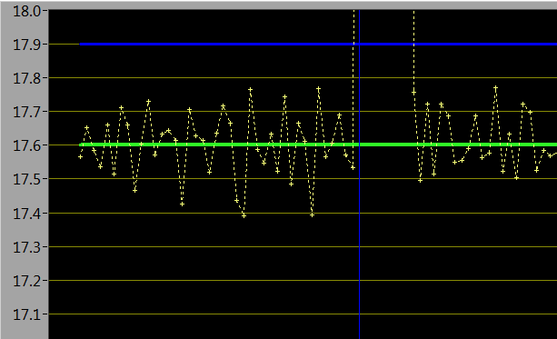
Straw straightness and step
A laser device measures the distance to the straws and the x-position of the center is found
A decoder measures the x-position in each straw layer (top, center and bottom position)
The nominal distance between two adjacent straws is 17.6 mm

Slide 14
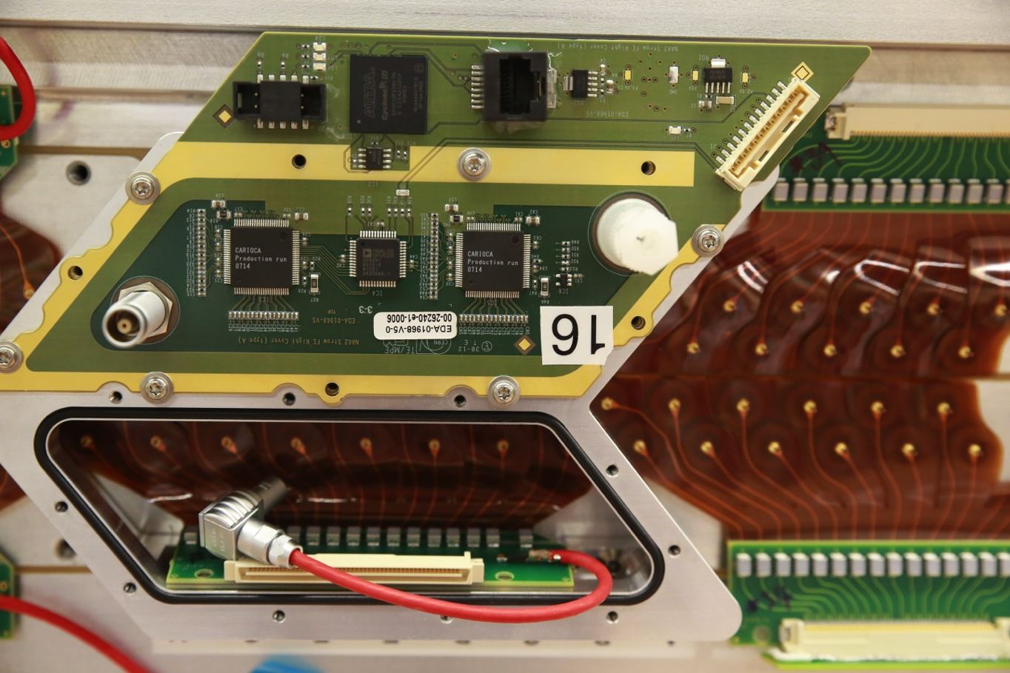
Module assembly - connectivity
Custom made gold-plated crimp-tubes to connect the wires which are gold-plated Tungsten 30 mkm in diameter
For the high-voltage and signal connection a flex-rigid circuit board (web) is used. The web contains HV capacitors, signal connector and HV connectors
The Dismountable manifolds supports the cover and provides the modularity for the gas distribution (16 straws)
The PCB host the front-end electronics and closes the gas manifolds. The modularity is 16 straws and the PCB can withstand the ambient pressure in case of a broken straws
Notes:
Front-End board (cover) have two CARIOCA chips which was developed for LHCb. The cover is mounted on partition serves as a leak-tight roof for the gas manifold and feed through for gas, high-voltage and signal connections to the straws.
The FEE board («Cover») must be able to:
Provide precise timing with resolution 0.23ns
Provide a fast readout and data handling.
Provide vacuum tightness in case one of the straw breaks
Fast link to the Readout Board
Front-End Electronics is connected to the anode trough a flexible PCB (printed circuit board) connector called «Web». The web carries the high voltage to the wire and transmits the signal back to the front-end electronics. The web has two connectors; one for HV and one for the signals. The web connects to the backside of the cover.
The Straw Readout Board (SRB) is designed to handle the data coming from 16 Covers and match them with the Level 0 trigger. Extra logic is foreseen in order to monitor the detector activity and behavior. Data are then sent to the PC farm to be used in the Level 1 trigger logic and stored.

Slide 15
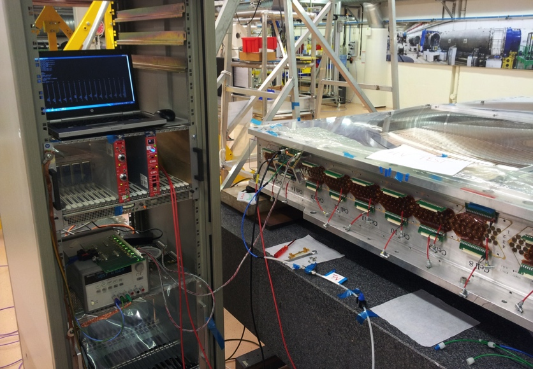
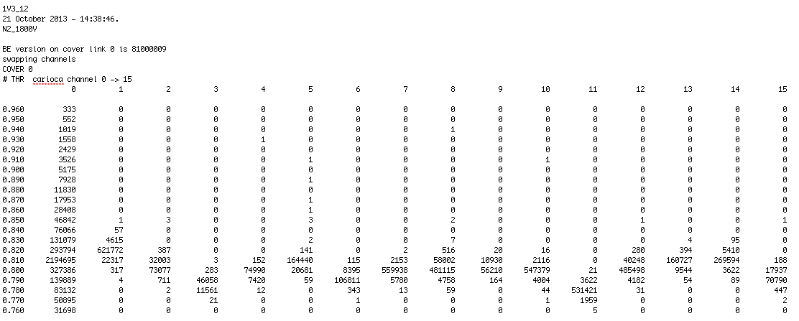
High Voltage measurement the with FE cover
The final high voltage test is performed with the front-end cover installed
A threshold scan is performed to detect activity on individual channels. Noisy wires are replaced
Time: 1s/ch

Slide 16
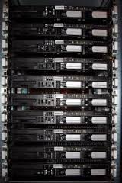
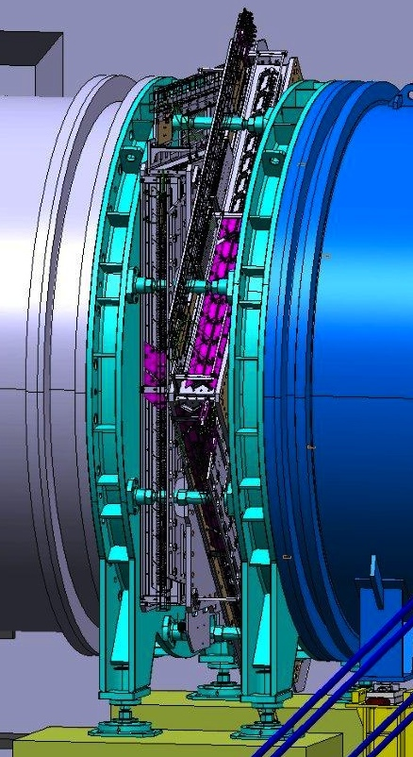
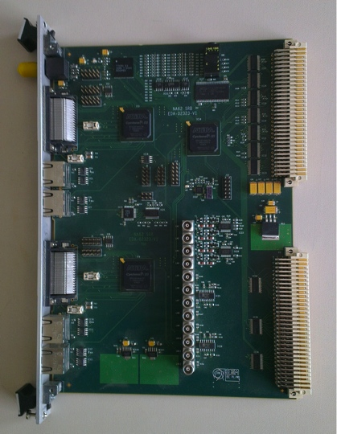
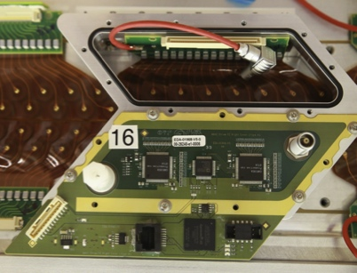
NA62 straw tracker data flow
1 Chamber contains 2 modules
1 Module contains 2 views
1 View is a smallest readout system
PC farm
Straw
Readout (+control) Boards
2 SRB/view
30 Front-End “covers”/view
2 Fibers
2 Gbit/s
Serial link
Each “cover” has two 8-channel front–end chips, “CARIOCA”, developed for the LHCb muon tracker (MWPC).
On-detector TDC based on FPGA with a <1ns intrinsic resolution
Notes:
Front-End board (cover) have two CARIOCA chips which was developed for LHCb. The cover is mounted on partition serves as a leak-tight roof for the gas manifold and feed through for gas, high-voltage and signal connections to the straws.
The FEE board («Cover») must be able to:
Provide precise timing with resolution 0.23ns
Provide a fast readout and data handling.
Provide vacuum tightness in case one of the straw breaks
Fast link to the Readout Board
Front-End Electronics is connected to the anode trough a flexible PCB (printed circuit board) connector called «Web». The web carries the high voltage to the wire and transmits the signal back to the front-end electronics. The web has two connectors; one for HV and one for the signals. The web connects to the backside of the cover.
The Straw Readout Board (SRB) is designed to handle the data coming from 16 Covers and match them with the Level 0 trigger. Extra logic is foreseen in order to monitor the detector activity and behavior. Data are then sent to the PC farm to be used in the Level 1 trigger logic and stored.

Slide 17
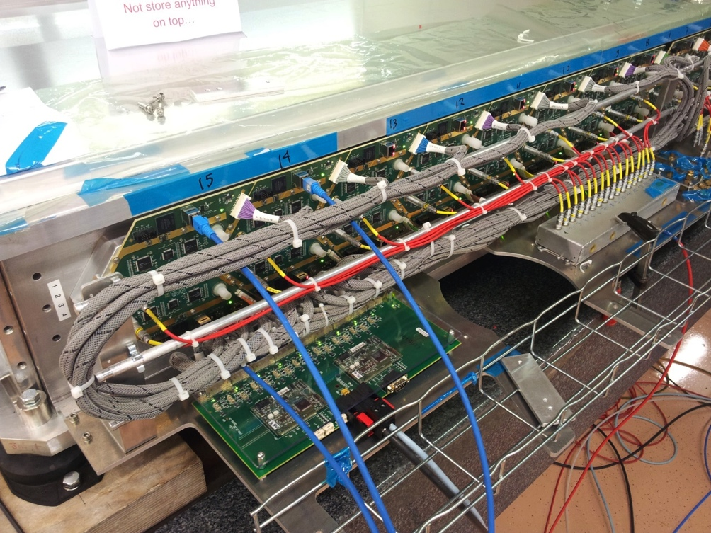
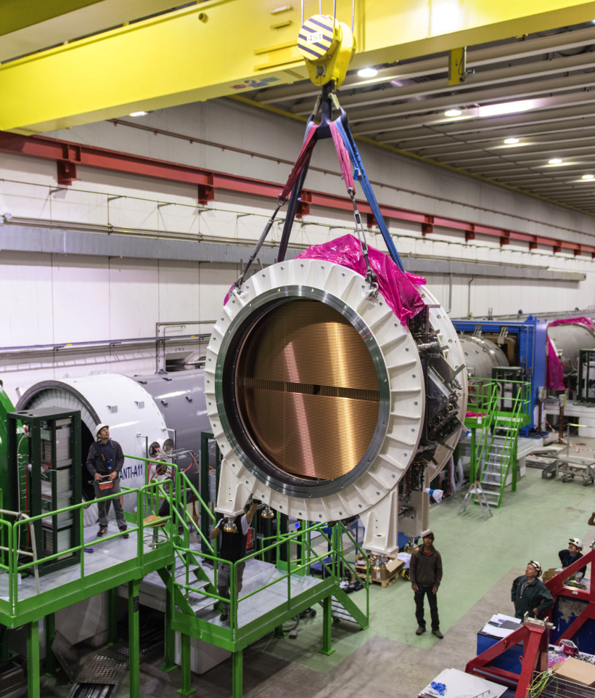
Installation and integration
ECN-3

Slide 18
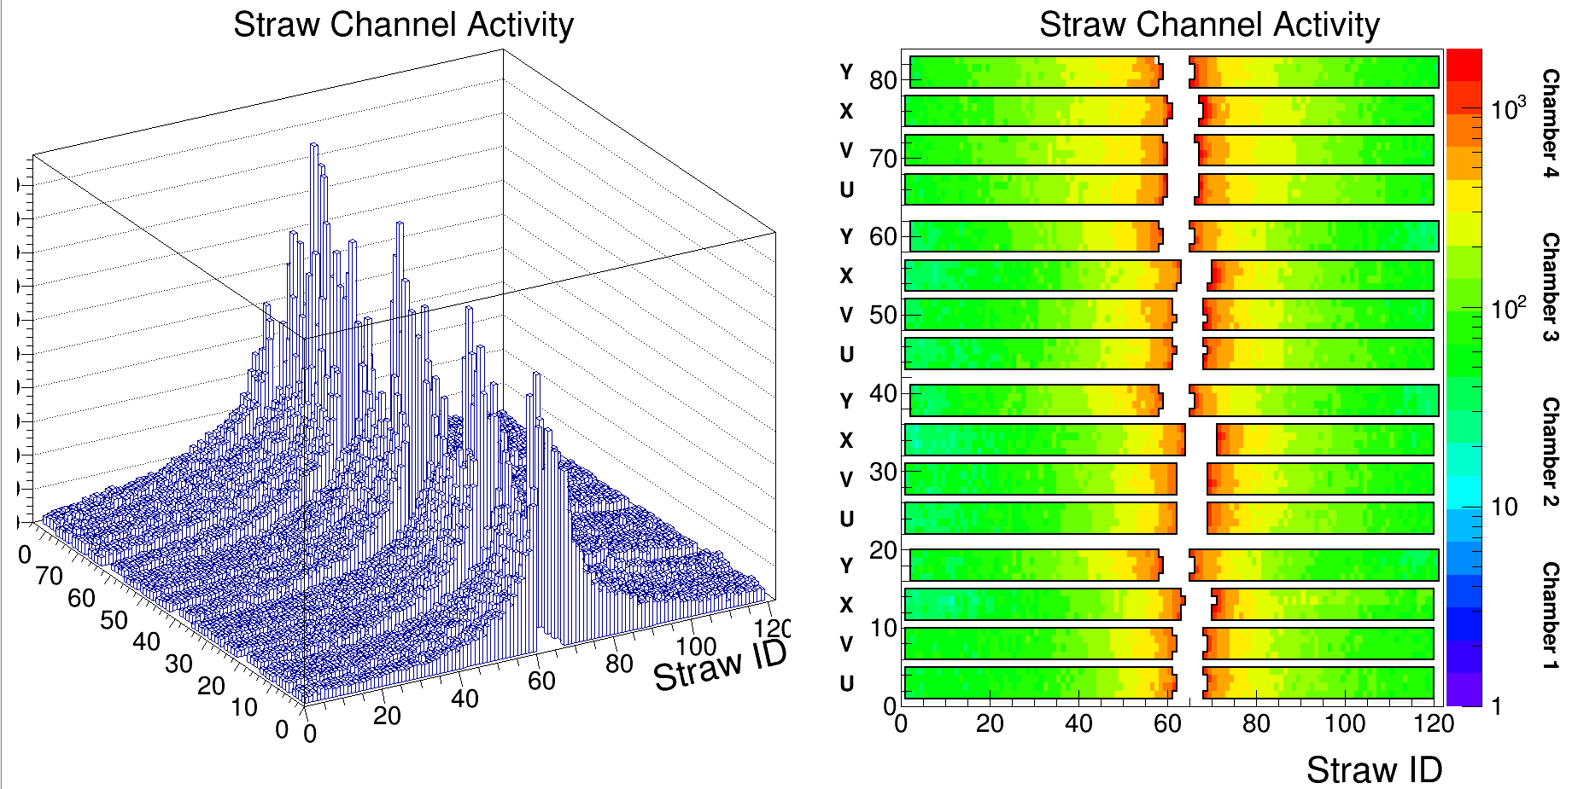
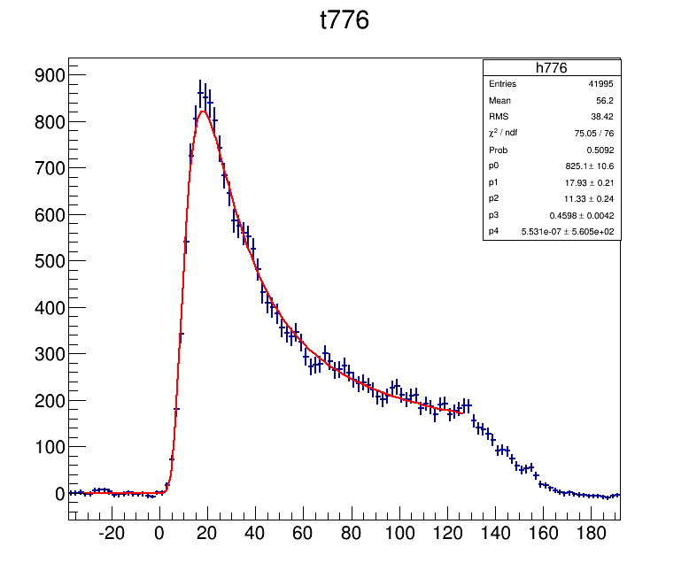
On-line monitoring: hit rate in straw

Slide 19
Conclusions
The STRAW detector is fully commissioned and operational.
The system of the control, monitoring and data collection work fully ensure operation of the STRAW detector.
The Straw detector operating conditions satisfy the requirements of the experiment.
Physics run in 2016
Data taking will continue in 2017 and 2018.

Slide 20
Thank you for your attention

