Slide 1
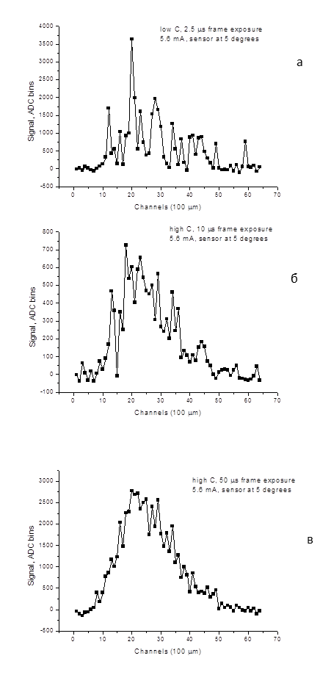
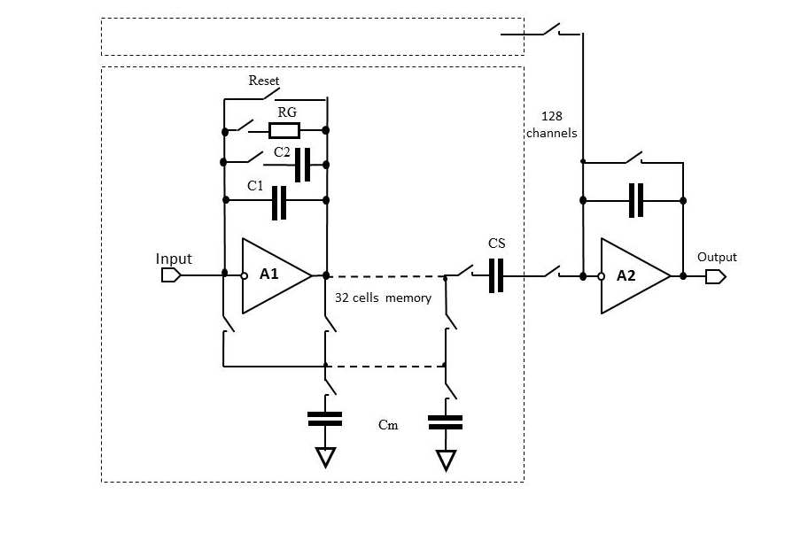
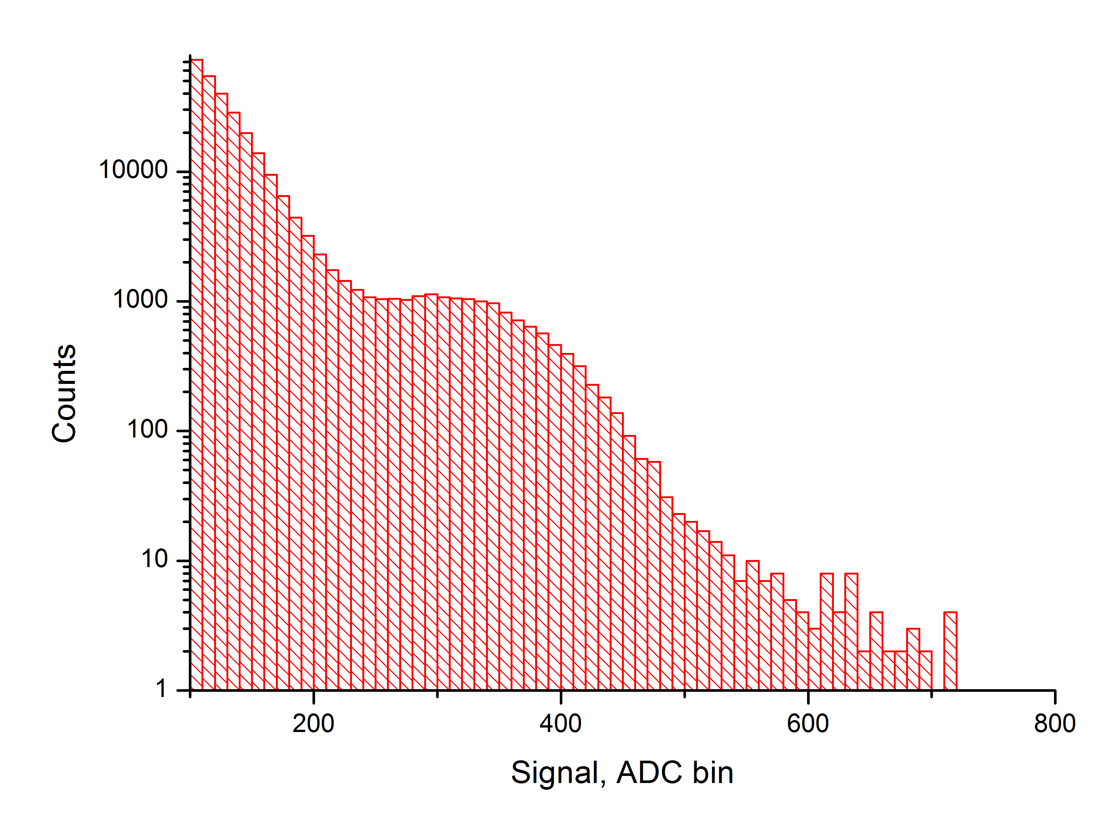
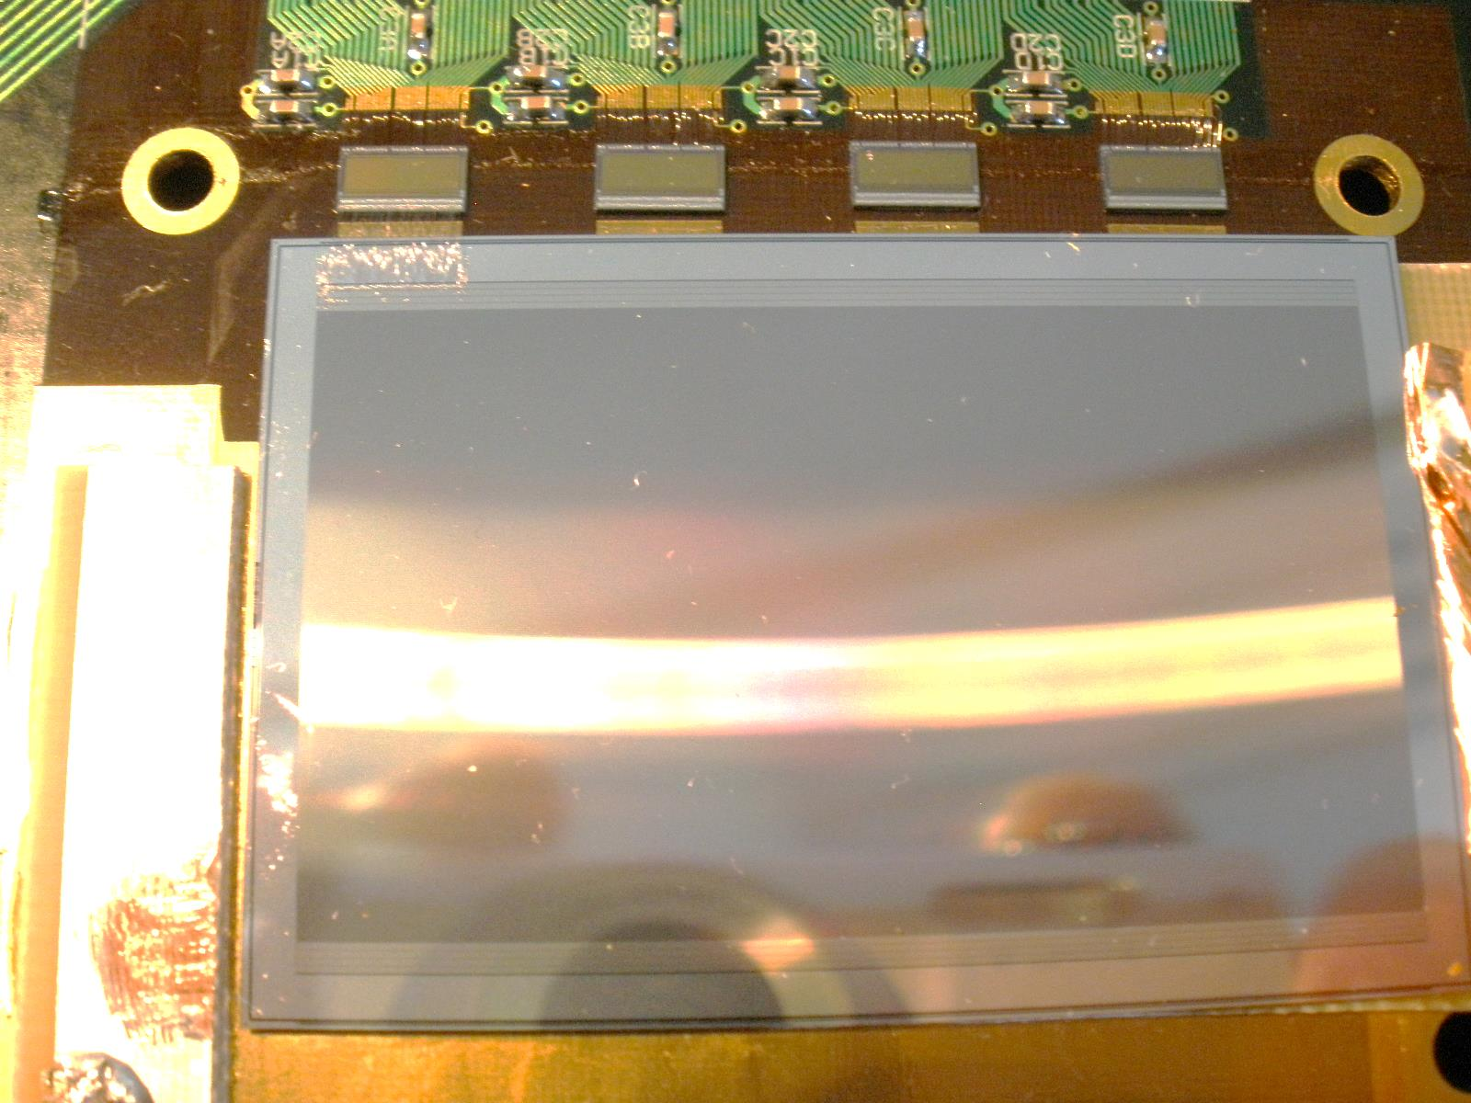
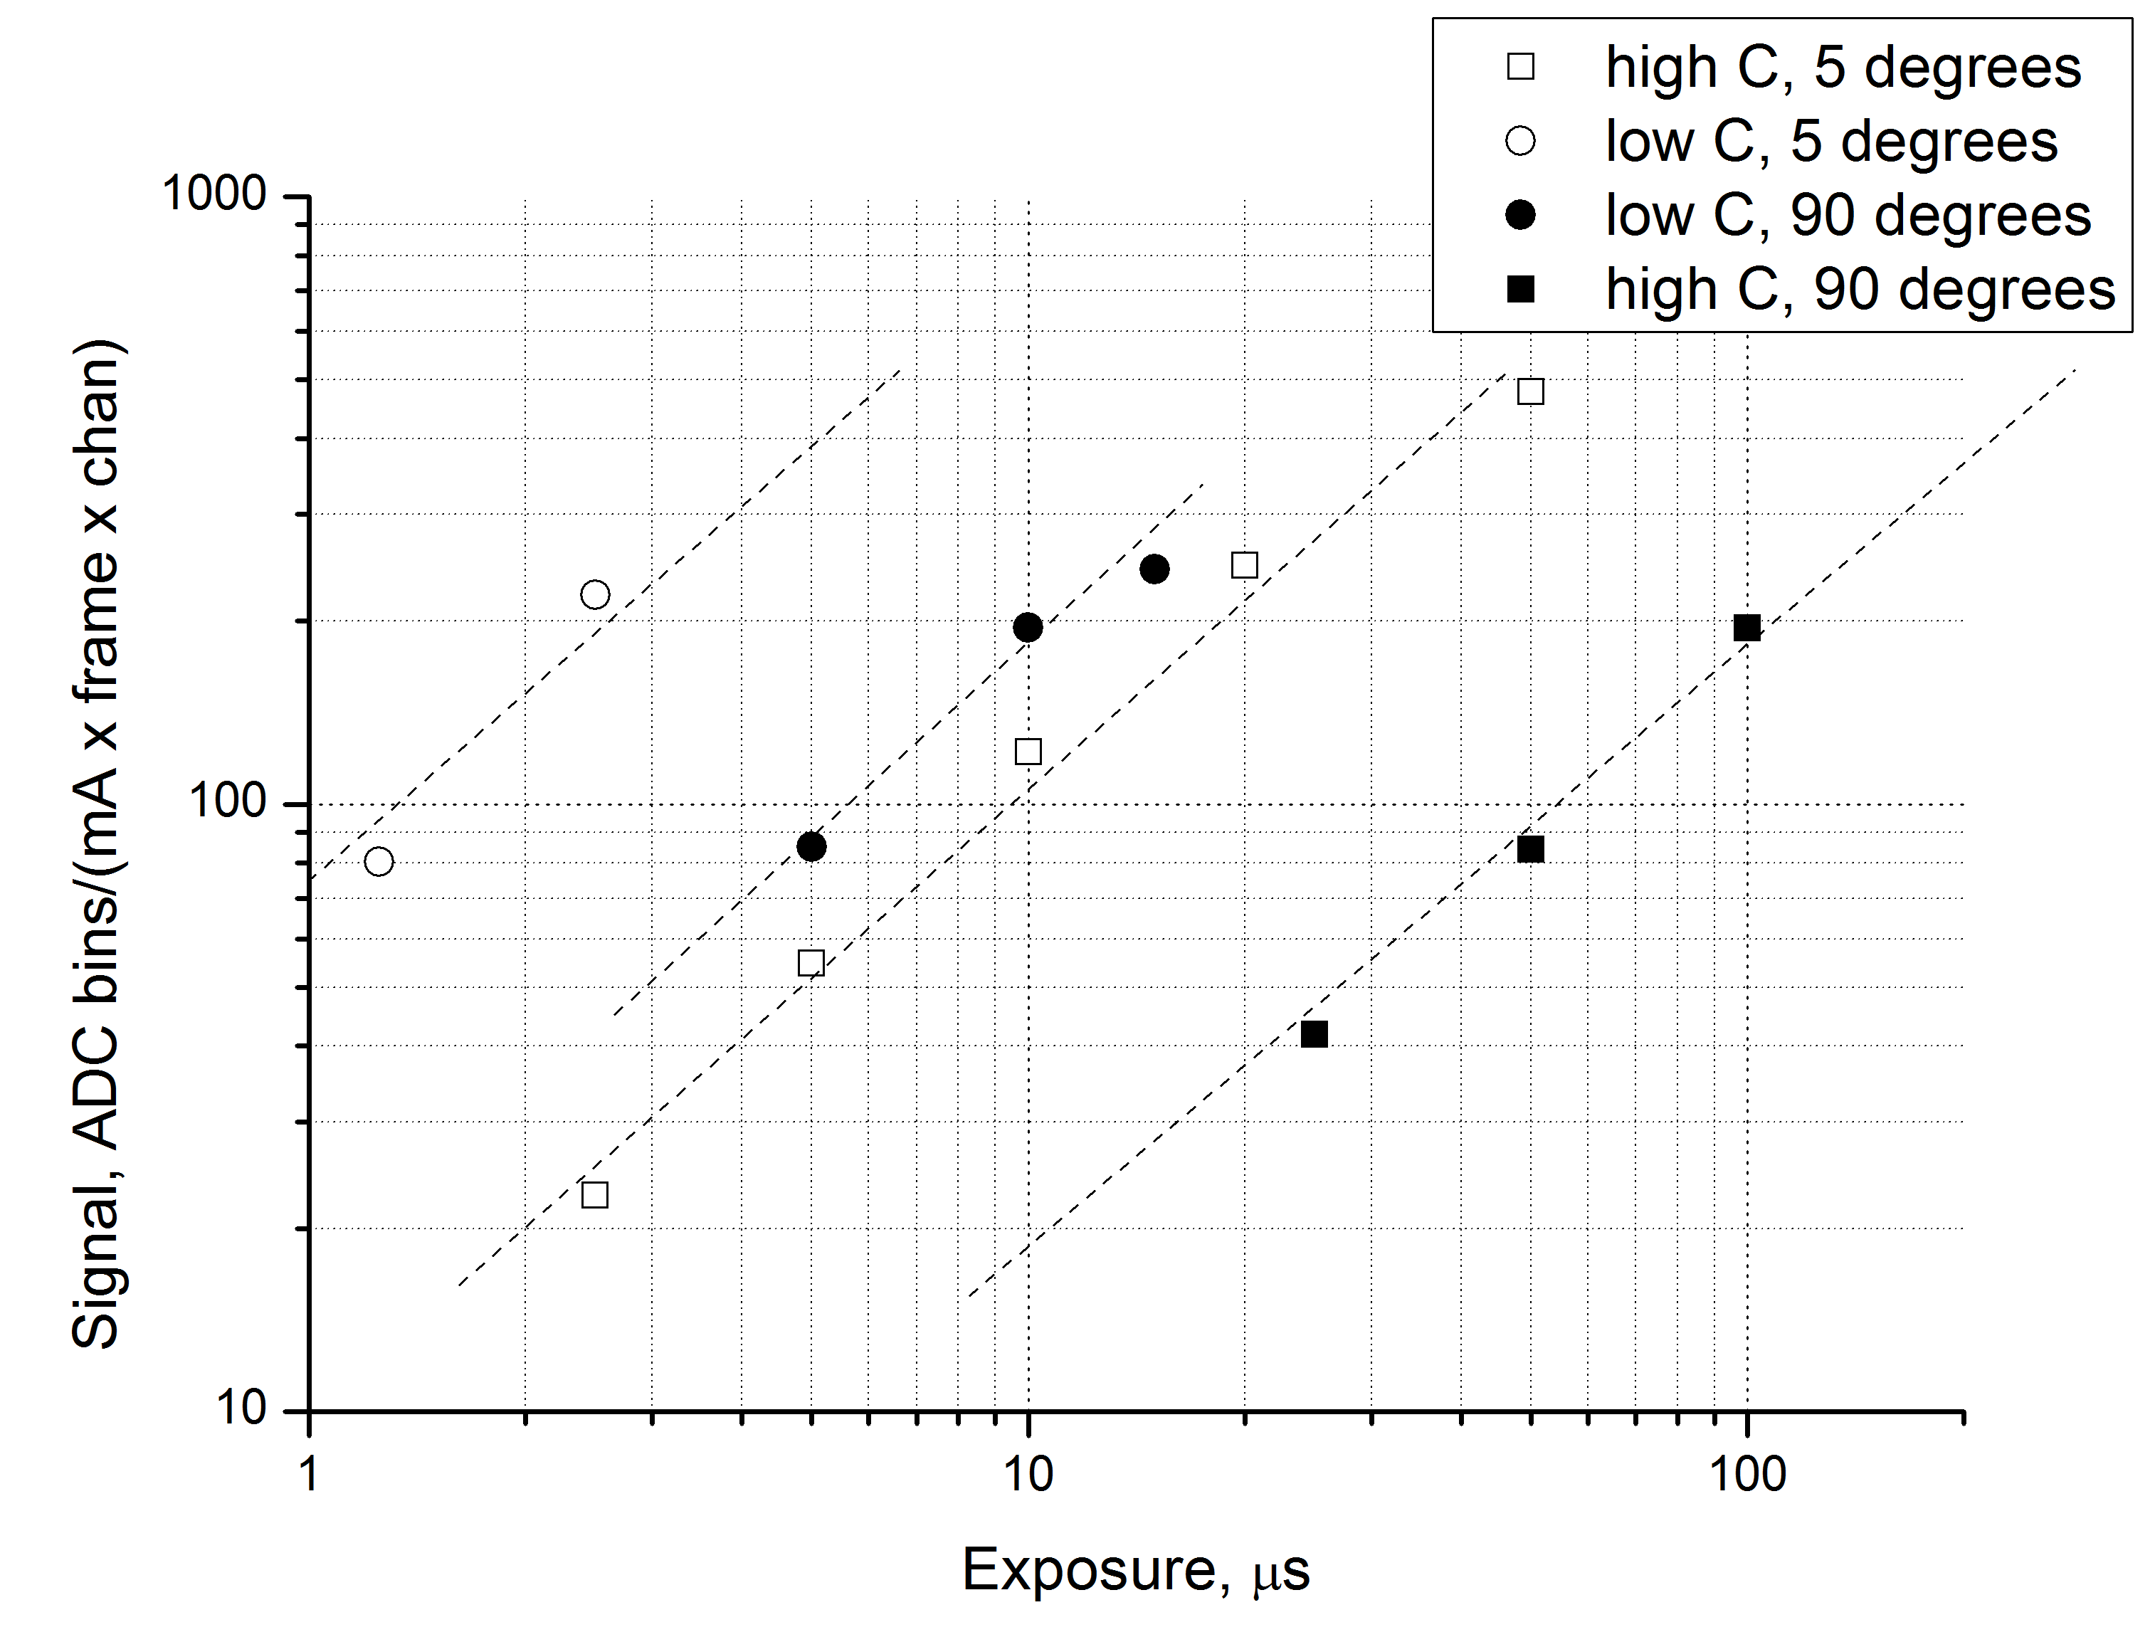
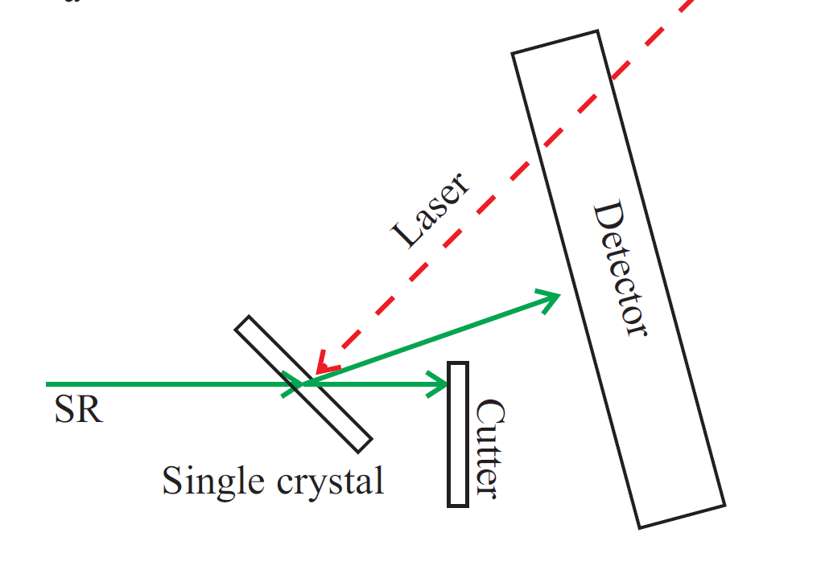
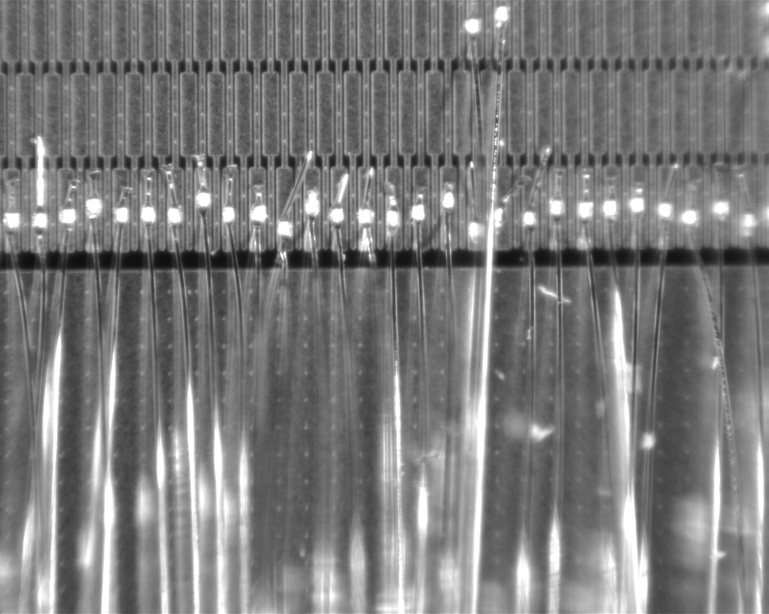
Development of a silicon microstrip detector with single photon sensitivity for fast dynamic diffraction experiments at a synchrotron radiation beam.
Budker INP
A.Arakcheev^{1,2}, V.Aulchenko^{1,2}, D.Kudashkin ^{1,2}, L.Shekhtman^{1,2}, B.Tolochko^{3,2}, V.Zhulanov^{1,2}
Budker Institute of Nuclear Physics, 630090, Novosibirsk, Russia
Novosibirsk State University, 630090, Novosibirsk, Russia
Institute of Solid-State Chemistry and Mehanochemistry, 630090, Novosibirsk, Russia
Abstract
Time resolved experiments on the diffraction of synchrotron radiation (SR) from crystalline materials give information on the evolution of a material structure after a heat, electron beam or plasma interaction with the material. Changes in the material structure happen within a microsecond scale and a detector with corresponding parameters is needed. SR channel 8 of the VEPP-4M storage ring provides radiation from the 7-pole wiggler that allows to get up to several tens photons within 1 μs from a W crystal for the most intensive diffraction peak. In order to perform experiments that allow to measure the evolution of W crystalline structure under the impact of powerful laser beam, a new detector is developed, that can provide information about the distribution of scattered SR flux in space and its evolution in time at a microsecond scale. The detector based on the silicon p-on-n micro-strip sensor with DC metal strips. The sensor contains 1024 30 mm long strips with 50 micron pitch. 64 strips are bonded to the front-end electronics based on APC128 ASICs. The APC128 ASIC contains 128 channels that consist of low noise integrator with 32 analogue memory cells. The integrator equivalent noise charge is about 2000 electrons and thus the signal from individual photons with energy above 40 keV can be observed. The analogue memory can be readout with 10 MHz rate. The first measurements with the beam scattered from W crystal with energy near 60 keV demonstrated the capability of this prototype to observe spatial distribution of the photon flux with the intensity from below one photon per channel up to ~10 photons per channel with frame rate from 1 MHz up to 10 kHz.
Diffraction time resolved experiments with a synchrotron radiation (SR) beam can give information about the evolution of a material structure after an impact of photon or electron beam or plasma with a material under study [1]. These studies need a detector with time resolution in a microsecond scale and with integrating rather than photon counting electronics, because more than one photon can hit individual channels of a detector from one bunch of a SR source. The prototype of such detector was developed by combining the silicon microstrip sensor with p-on-n strips with DC metal contacts with APC128 ASIC [2] that is used in the DIMEX detector for imaging of explosions at a SR beam [3].
APC128 ASIC (Fig.1) consists of 128 channels each containing an integrator with a possibility to change the feedback capacitance (C1, or C1+C2) and 32 analogue cells that can be used to store an output voltage of the front-end integrator. The analogue memory can be readout by switching the cells to the input integrator and then through the output driver A2.
Results of irradiation of the detector with ¹⁰⁹Cd source (photons 87 keV) is shown in Fig.4,5
c) frame exposure is 50 μs, APC128 is in low sensitivity regime, signal at the maximum corresponds to ~25 photons.
Fig.4. Three events with signals from 87 keV photons. Signal from photon corresponds to ~24000 e, while the noise rms corresponds to ~3000 e.
b
Fig.1. Circuit of the APC128 ASIC [2].
The prototype of the detector for time resolved diffraction studies was made by gluing a silicon sensor with 1024 30 mm long strips with 50 μm pitch to the electronics board of the DIMEX detector that contains four APC128 chips. 64 strips of the sensor is connected to one chip with a pitch of 100 μm (Fig.2,3)
c
Fig.5. Spectrum of signals after exposure to 87 keV photons from ¹⁰⁹Cd source.
Single photon peak can be distinguished at ~350 ADC bins.
Fig.7. Images of the tungsten diffraction peak at three different frame exposures and different electronics regimes. a) frame exposure 2.5 μs, high sensitivity regime (see text); b) frame exposure 10 μs, low sensitivity regime; c) frame exposure 50 μs, low sensitivity regime. Detector at 5 degrees to the beam, VEPP-4M beam current 5.6 mA.
The prototype detector was tested at the “Plasma” station at the channel 8 of the VEPP-4M storage ring [1]. The layout of the experiment is shown in Fig.6. The crystal of tungsten is illuminated with white SR beam. The angle of the crystal is chosen such that the main diffraction peak is getting to the detector. The energy of scattered photons is ~60 keV. In order to get higher efficiency the detector was installed at an angle of 5 degrees with respect to the scattered beam.
Side view
Fig.2. Si sensor glued to the electronics board of the DIMEX and bonded to the APC128 ASIC at the left side.
Top view
Fig.8. Signal normalized to the beam current as a function of frame exposure for the high and low sensitivity regime and for two positions of the detector with respect to the beam (5 degrees and 90 degrees).
Signal as a function of frame exposure for different regimes of electronics and for different angle of the detector with respect to the beam (different efficiency). Linear fits going through (0,0) point with direct proportionality are superimposed with the data. Comparing the data and corresponding fits for similar detector positions and different sensitivity it is clear that the ratio of sensitivities is close to factor 10. Comparing the data of the same sensitivity with different detector positions we can see that the signal is higher by a factor of ~5 for the position at small angle between the detector and the beam due to the increase of efficiency.
The results obtained with the prototype demonstrates that the combination of Si microstrip sensor with low noise integrator ASIC provides the necessary signal to noise ratio and dynamic range for the dynamic diffraction experiments in microsecond scale.
Fig.6. The layout of the experiment at the “Plasma” station at the SR channel 8 at the VEPP-4M storage ring. Side view: white SR beam hits the tungsten crystal and the main diffraction peak is directed to the detector. The detector measures position and shape of the diffraction peak. Top view: the detector can be turned in such a way that the sensor plane is installed at an angle of 5 degrees with respect to the scattered beam in order to increase the efficiency.
Fig.3. Bonding pads of the Si sensor. Connections to the APC128 ASIC are made from each second strip with a pitch of 100 μm because the distance between the sensor pads and the ASIC pads is too long to make bonding with 50 μm pitch.
The results of the first measurements at SR beam are shown in Fig.7,8. In Fig.7 the image of diffraction peak is shown at three different frame exposures: a) frame exposure is 2.5 μs, APC128 is in the regime of high sensitivity with only C1 capacitance connected (see Fig.1), single photon signals can be observed at the sides of the image; b) frame exposure is 10 μs, APC128 is in the regime of low sensitivity with C1+C2 capacitances connected both during exposure and during reading, signal in the maximum corresponds to ~5 photons;
References:
A.S.Arakcheev, et.al., Physics Procedia,V.84, 2016, pp.184–188
R. Horisberger and D. Pitzl, NIM 1993, V. A326, p. 92.
V.M. Aulchenko, et.al., J. of Instrum. 2008. V. 3. P05005.

