Slide 1
WA105 experiment at CERN: large demonstrator of Dual Phase Liquid Argon TPC detector for DUNE
INSTR - 2017
Wladyslaw Henryk Trzaska on behalf of WA105 Collaboration

Slide 2
DUNE – Deep Underground Neutrino Experiment
The aim: broad physics program including CP violation, mass hierarchy, precision neutrino oscillation measurements, search for nucleon decays, and supernova neutrino observation
The method: a long-baseline neutrino experiment that will observe neutrino oscillations with a 40 kton underground far detector and upgradeable 1.2 MW neutrino beam
Logistics: Fermilab beam → far detector in South Dakota, USA
Detector technology: a 4 x 10 kton (fiducial) LAr TPC
Timescale: first beam in 2026, first 10 kton detector in 2024

Slide 4
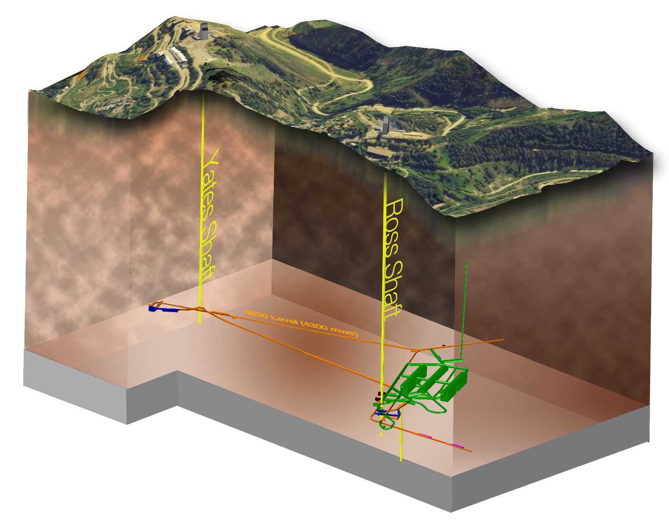
4 x 10 kton (fiducial) Liquid Argon
Time Projection Chamber

Slide 5
4 x 10 kton (fiducial) LAr TPC

Slide 6
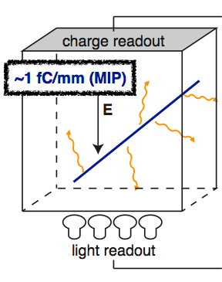
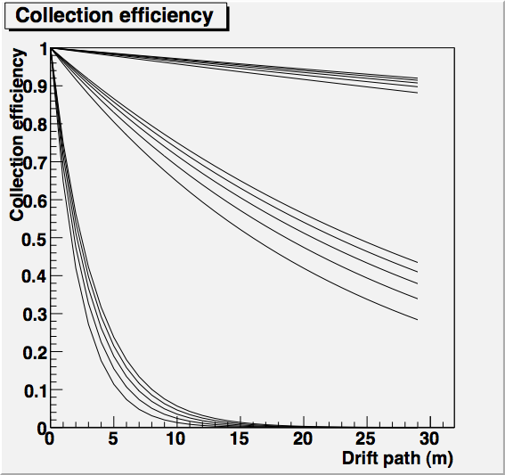
Principle of operation of a LAr TPC
2 ppt O2
20 ppt O2
1.5 kV/cm
1.25 kV/cm
1 kV/cm
0.75 kV/cm
0.5 kV/cm
0.2 ppb O2

Slide 7
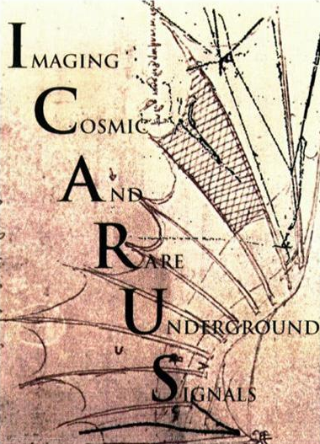
LAr TPC: the “electronic bubble chamber”
800cm
ICARUS T600 (2 x 300 ton) at Gran Sasso

Slide 8
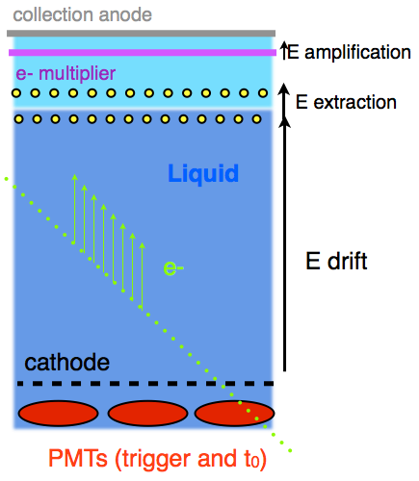
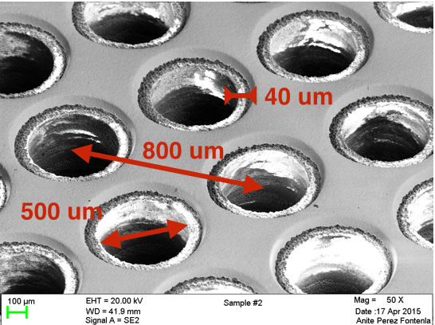
Dual Phase LAr TPC
Large Electron Amplifier (LEM)
0.5 – 1 kV/cm

Slide 9
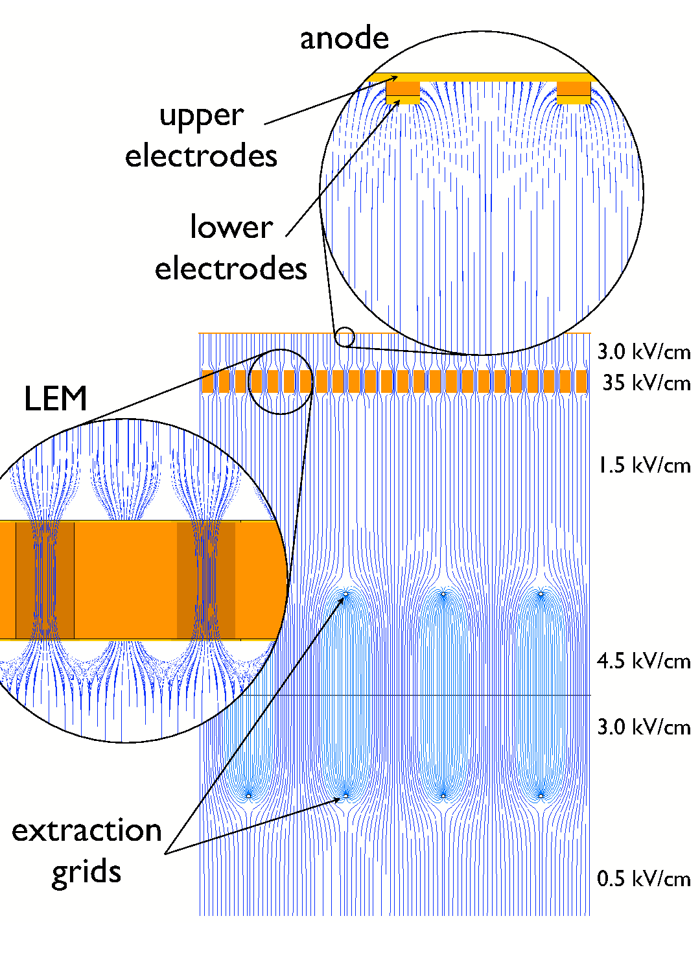
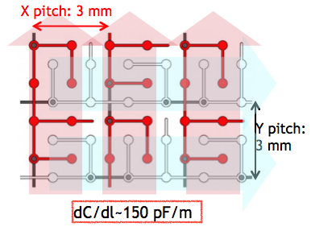
E-field configuration
Stable gain of x 27
Signal-over-noise ratio > 200
2D readout anode
Badertscher, A. et al. NIM A641 (2011) 48-57 arXiv:1012.0483 [physics.ins-det]

Slide 10
Advantages of DP vs. SP LAr TPC
Amplification in the gas phase
Improved signal to noise ratio
Improved imaging capabilities
Key instrumentation (Charge Readout Planes) on the top
Fiducial volume completely free of interfering objects
Scalable and cost-effective
Good accessibility / service
Not yet tested on a large scale (~300 ton)
This is the task of WA105

Slide 11
WA105 → DUNE
Large demonstrator at CERN (pilot) 3 x 1 x 1 m³
Starts operation in Spring 2017
ProtoDune DP 6 x 6 x 6 m³ at CERN
Scalable design, underground-like installation
Measurements with charged particle beam in 2018
Detector calibration & reconstruction algorithms
Detector module underground 60 x 12 x 12 m³
It is likely that already the 2nd 10 kton module will be DP

Slide 12
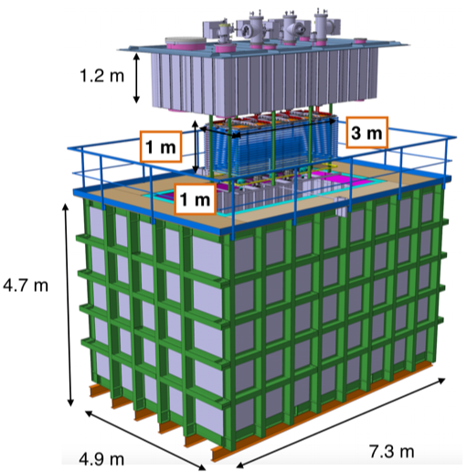
WA105 3 x 1 x 1 m³ demonstrator
First large-scale dual phase TPC
Total LAr mass 25 ton
Active mass 4.2 ton
readout pitch 3 mm
2 views
1920 readout channels
(3+2) 8” PMTs
Membrane tank (LNG technology)

Slide 13
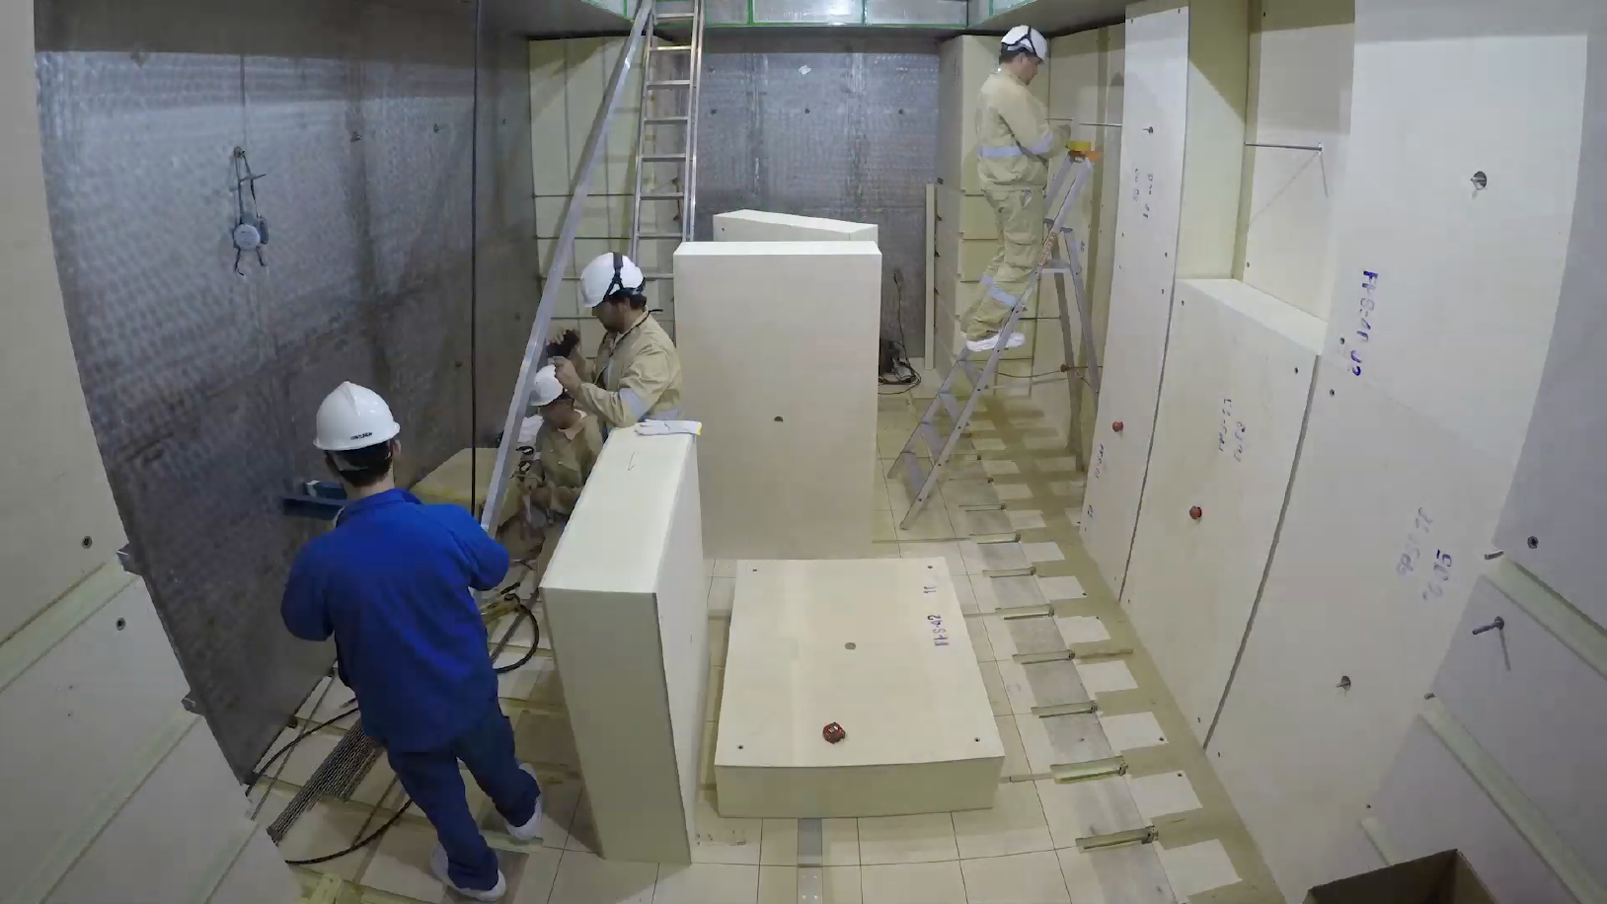
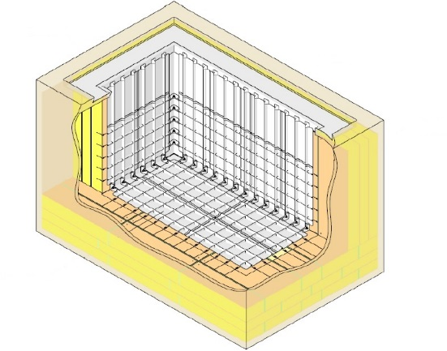
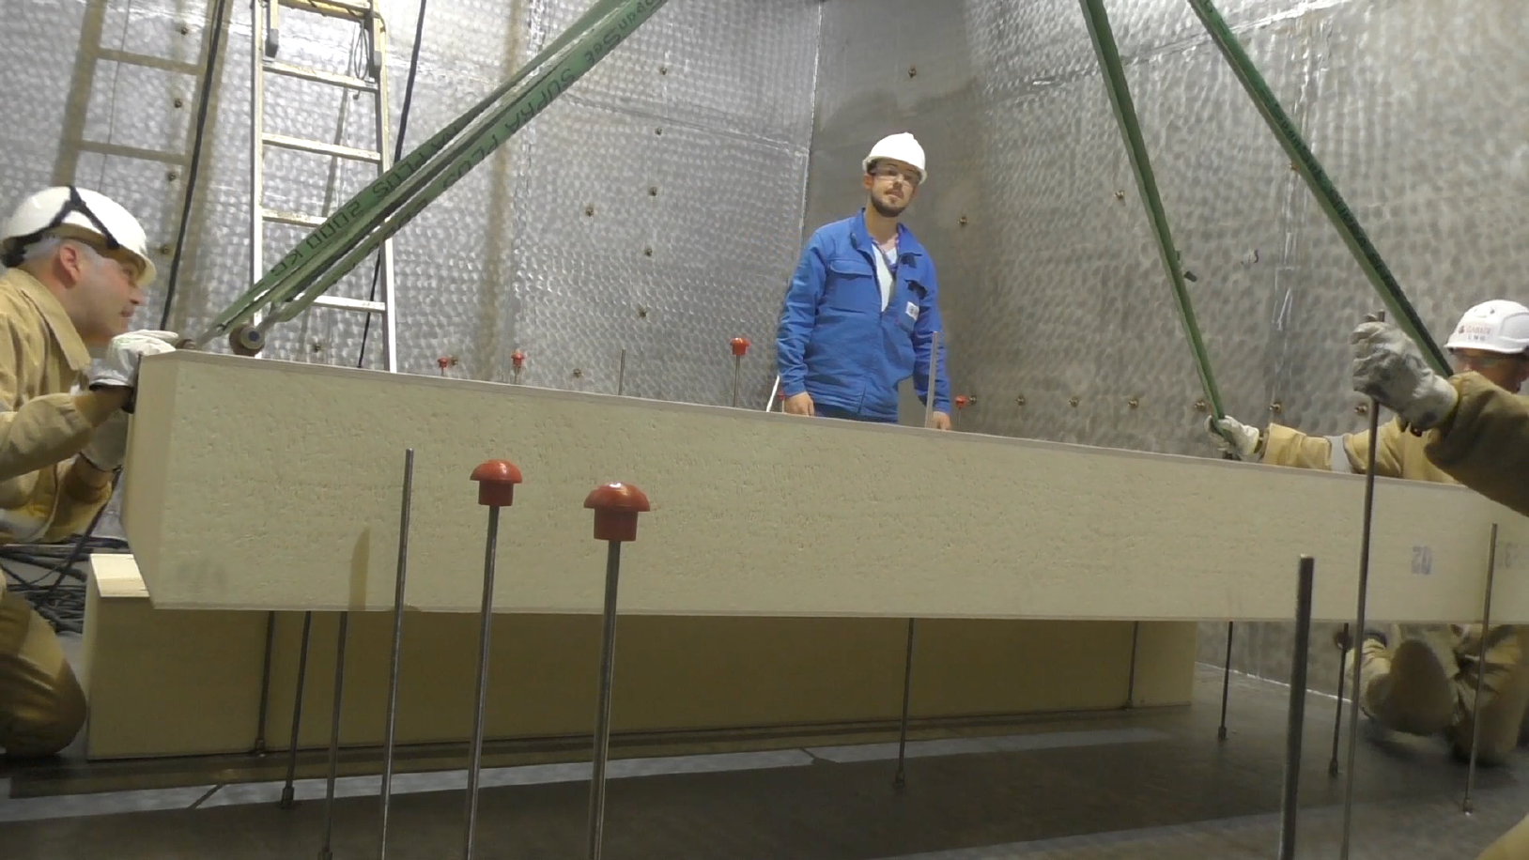
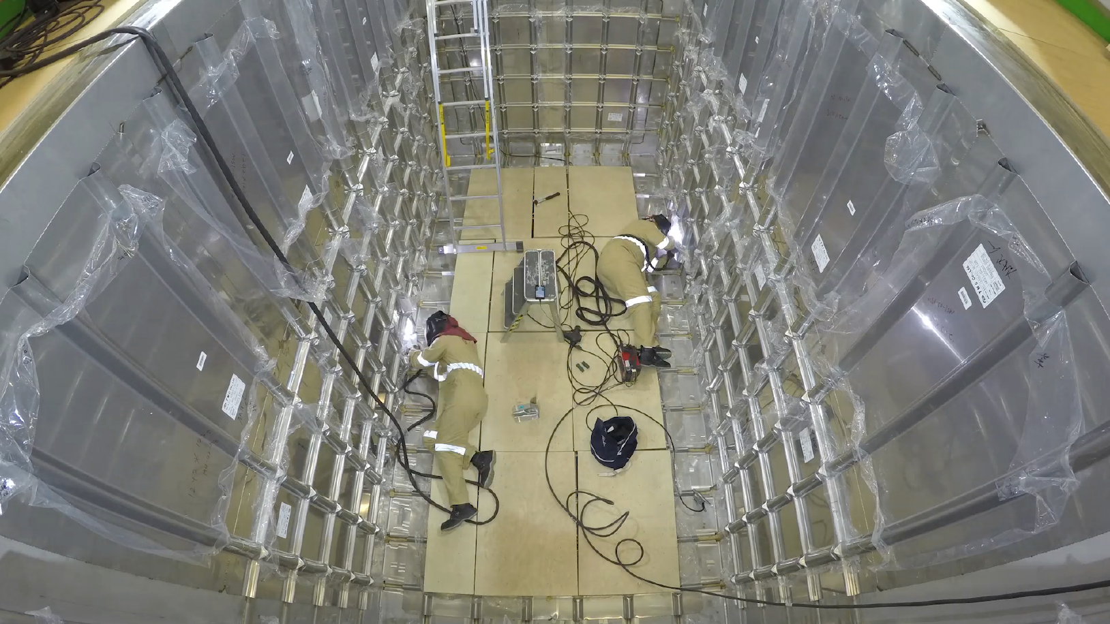
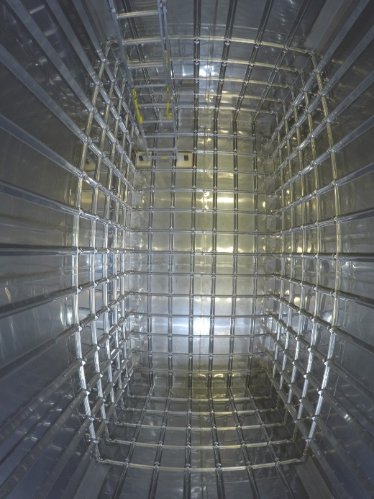
3x1x1 membrane tank LNG-type

Slide 14
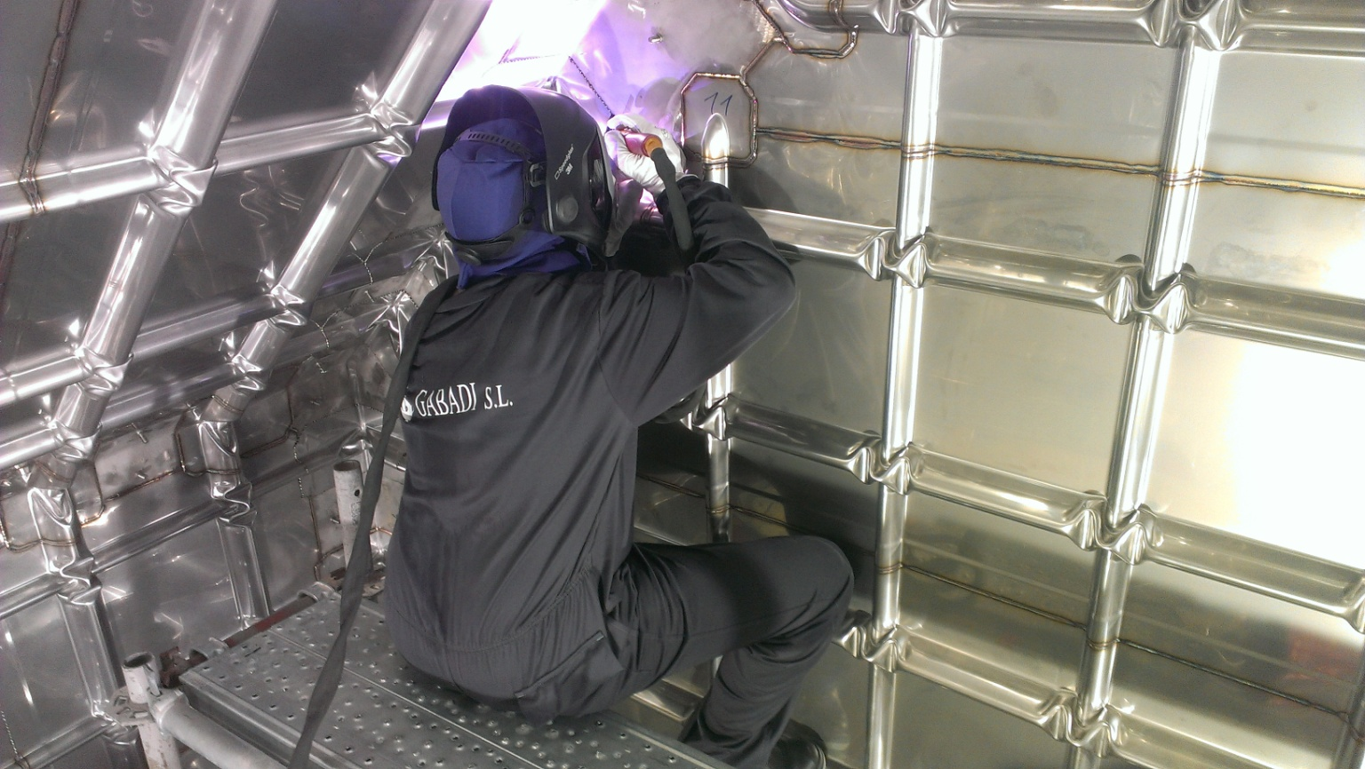

Slide 15
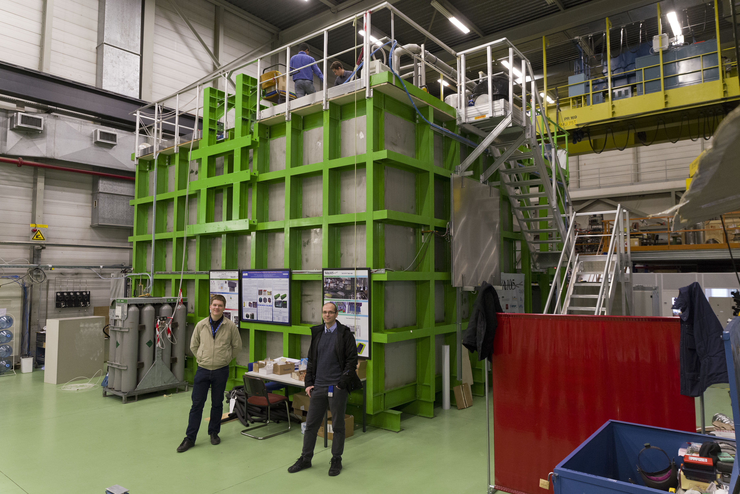

Slide 16
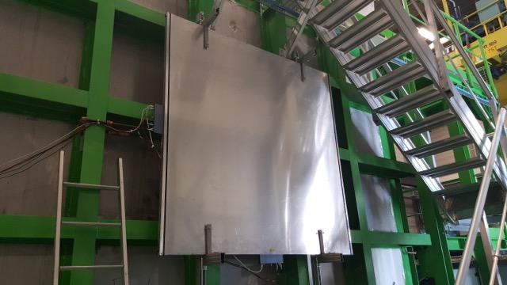
Cosmic Ray Trigger

Slide 17
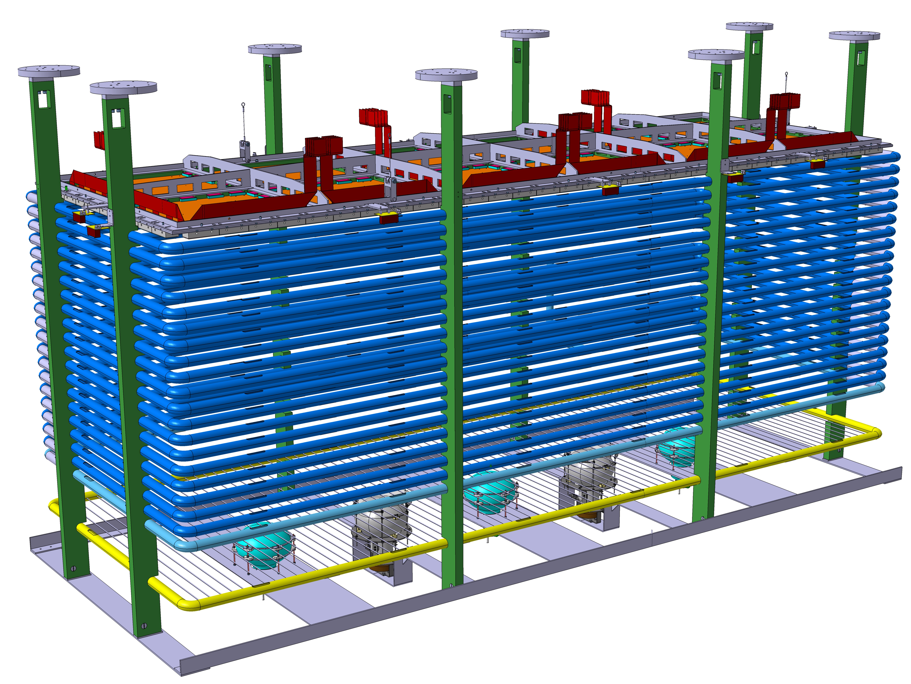
Charge Readout plane (CRP)
CRP suspension.
1 m
3 m
Drift cage (500 V/cm or 1kV/cm)
1 m
TPB coated photomultipliers

Slide 18
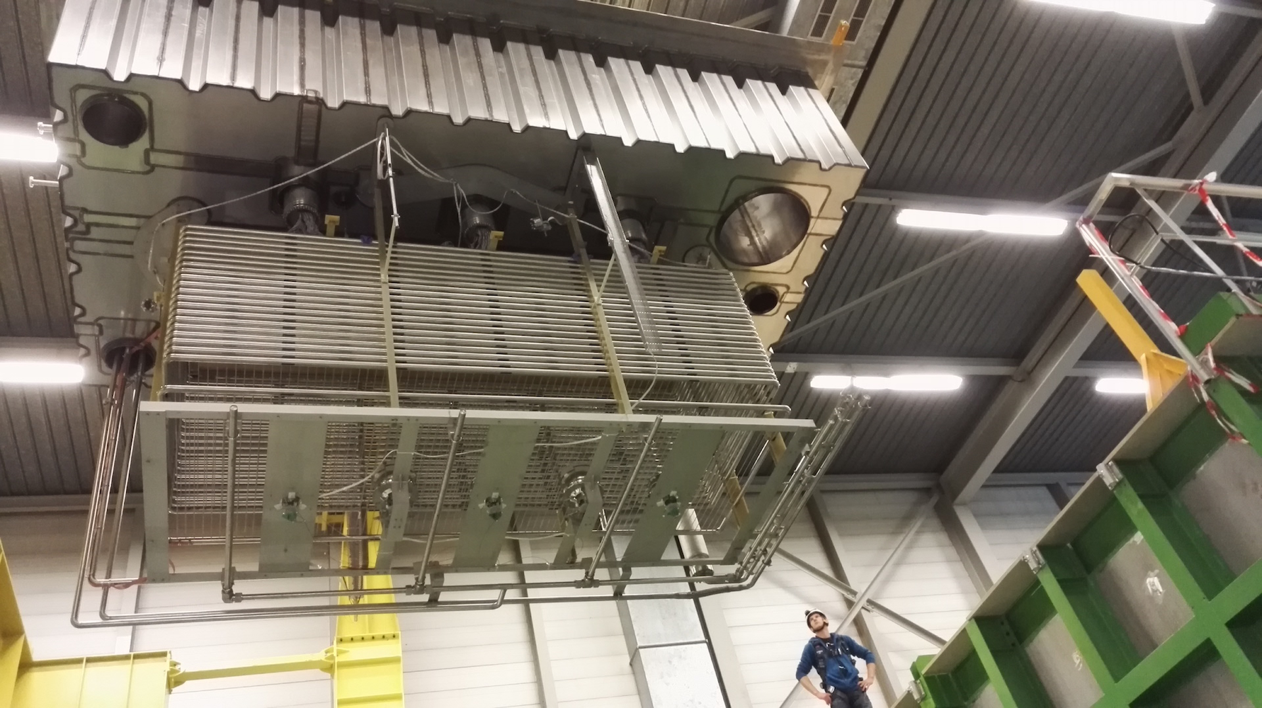
4 July 2016

Slide 19
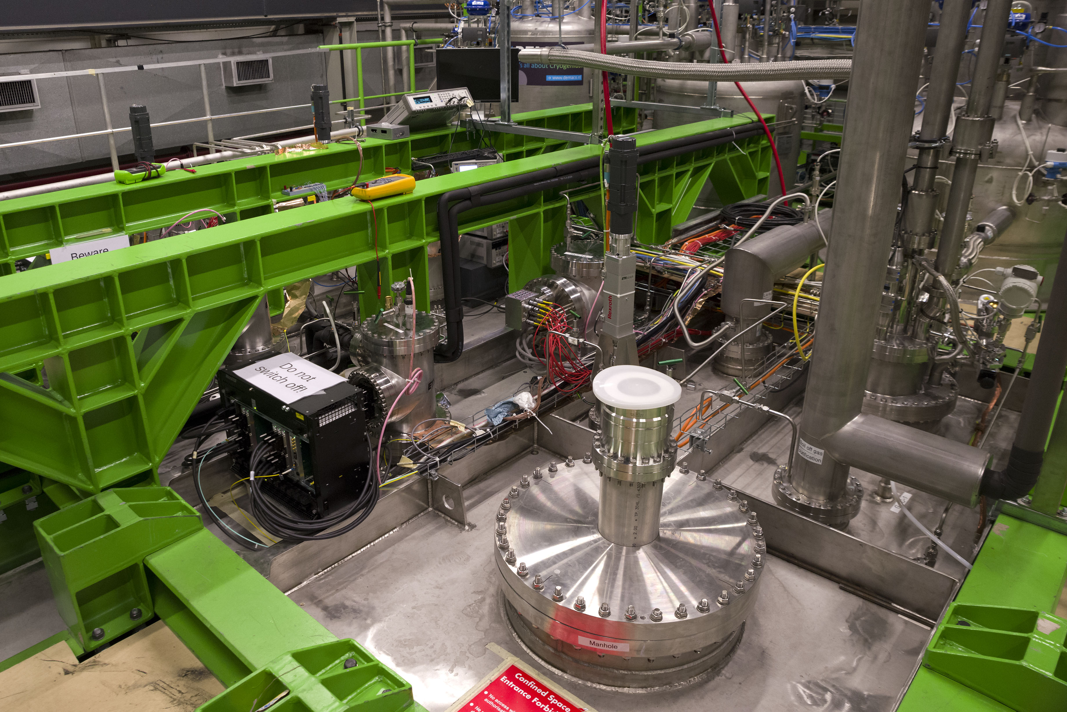

Slide 20
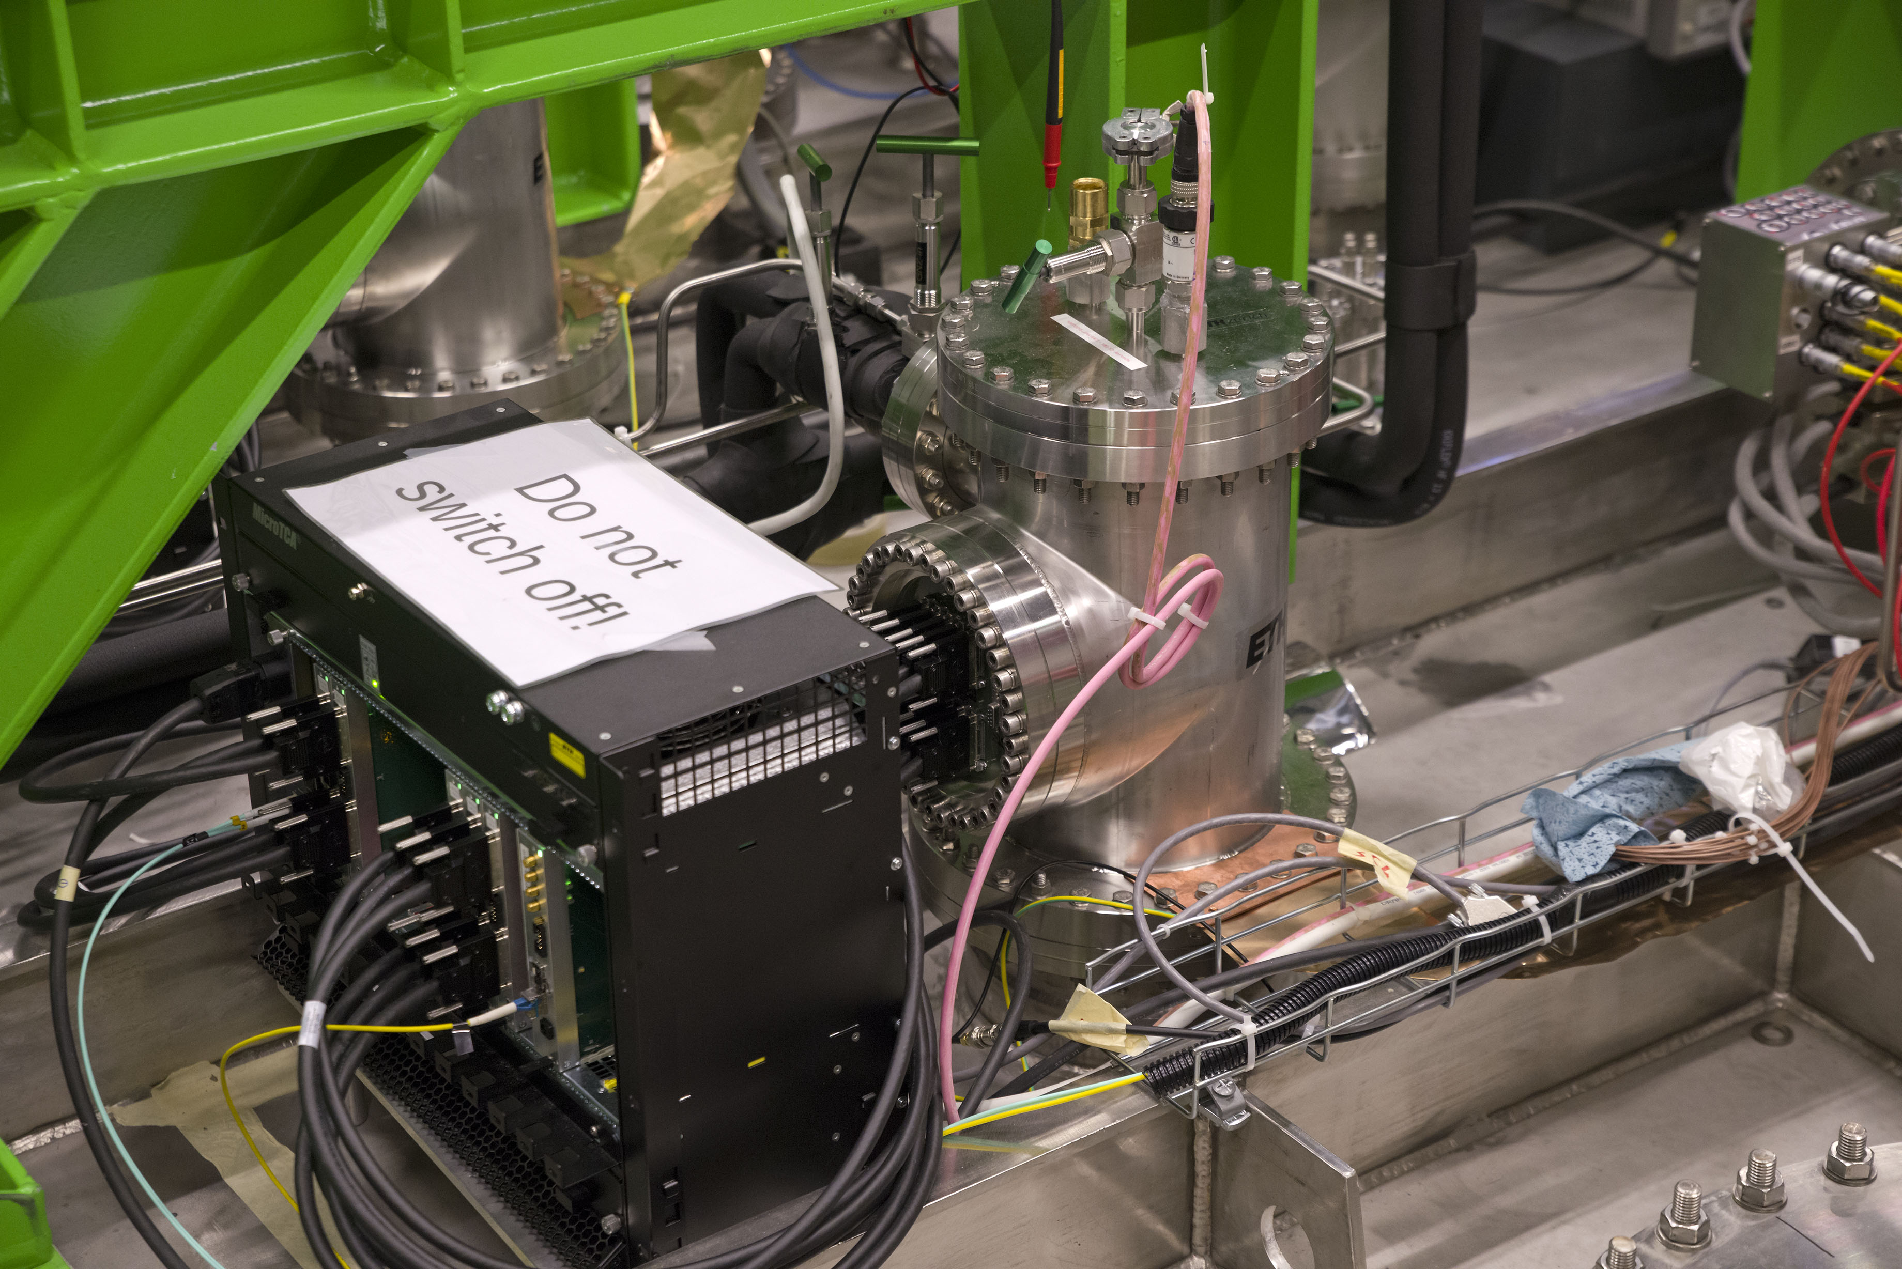

Slide 21
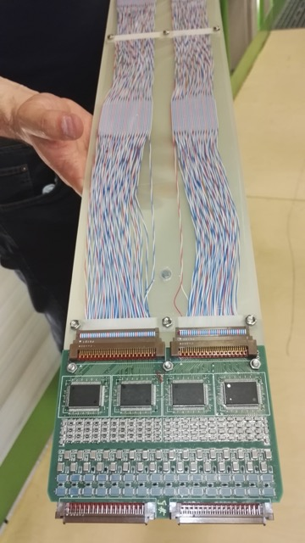
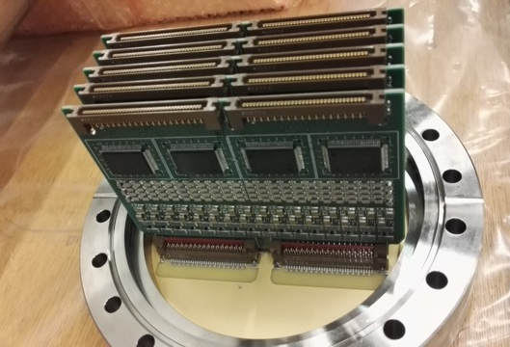
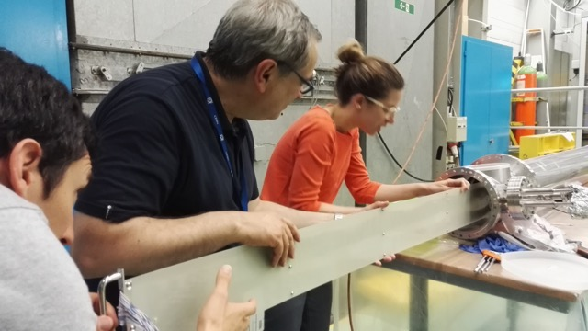

Slide 22
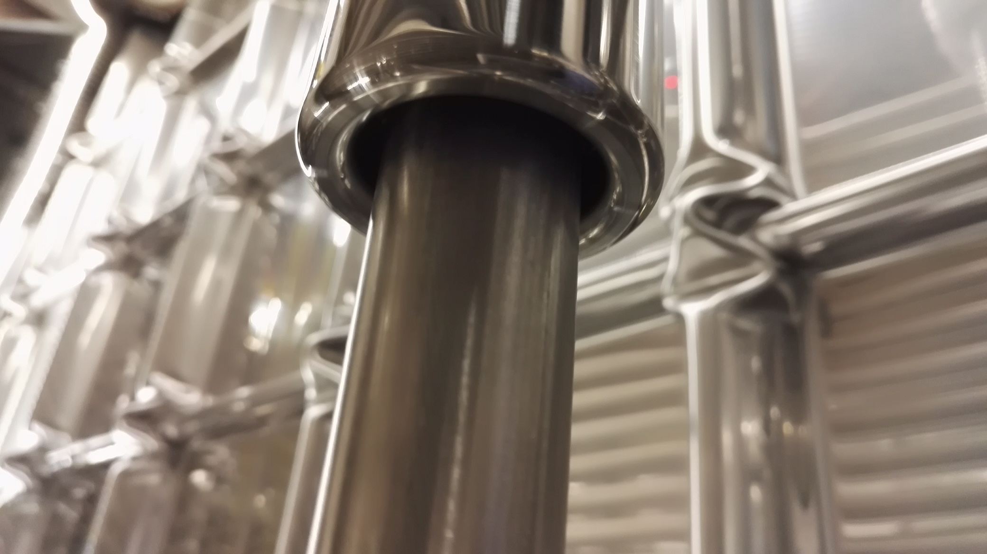

Slide 23
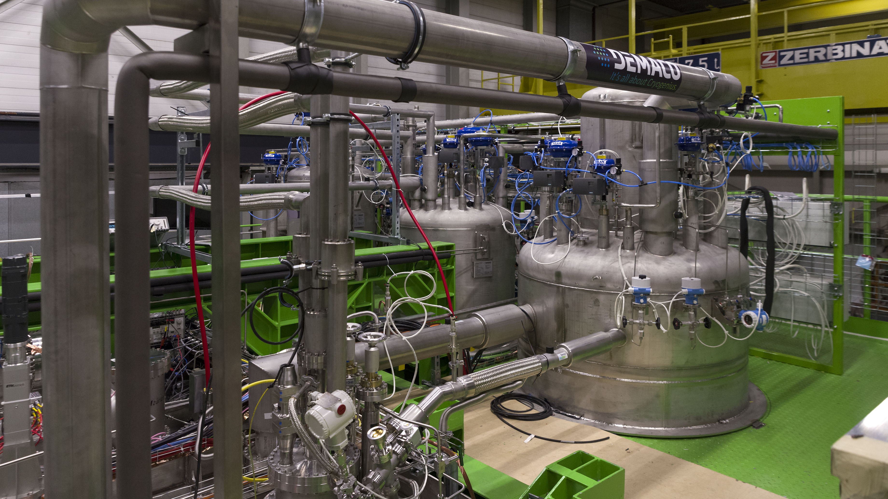

Slide 24
WA105 → CENF NP02 → protoDUNE DP
2012: proposal submitted to CERN → WA105
the main outcome of LAGUNA-LBNO
Long-term goal in 2012: LBNO with CERN to Pyhäsalmi beam
2014: new CERN strategy
No neutrino beam from CERN; instead
CERN Neutrino Platform (CENF) was established,
WA105 6x6x6 became part of CENF as NP02
2015: DUNE Collaboration formed
WA105 6x6x6 → ProtoDUNE Dual Phase

Slide 25
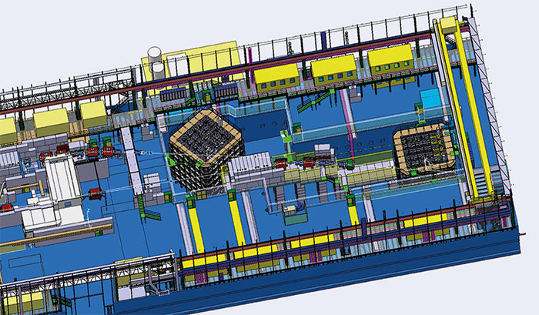
EHN1 – new building to house
6 x 6 x 6 ProtoDUNE SP
6 x 6 x 6 ProtoDUNE DP

Slide 26
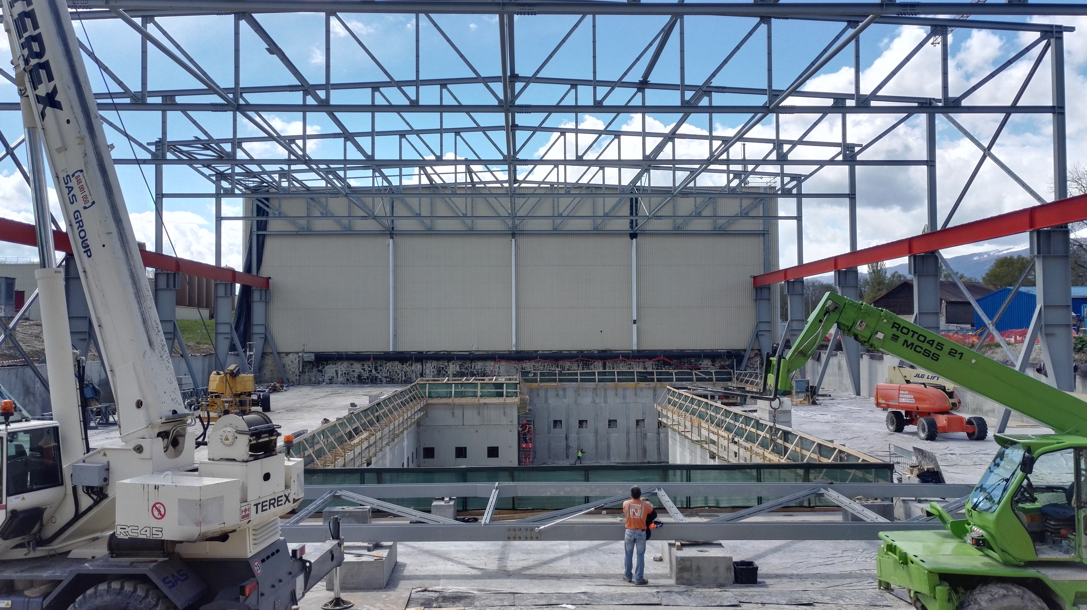
April 2016

Slide 27
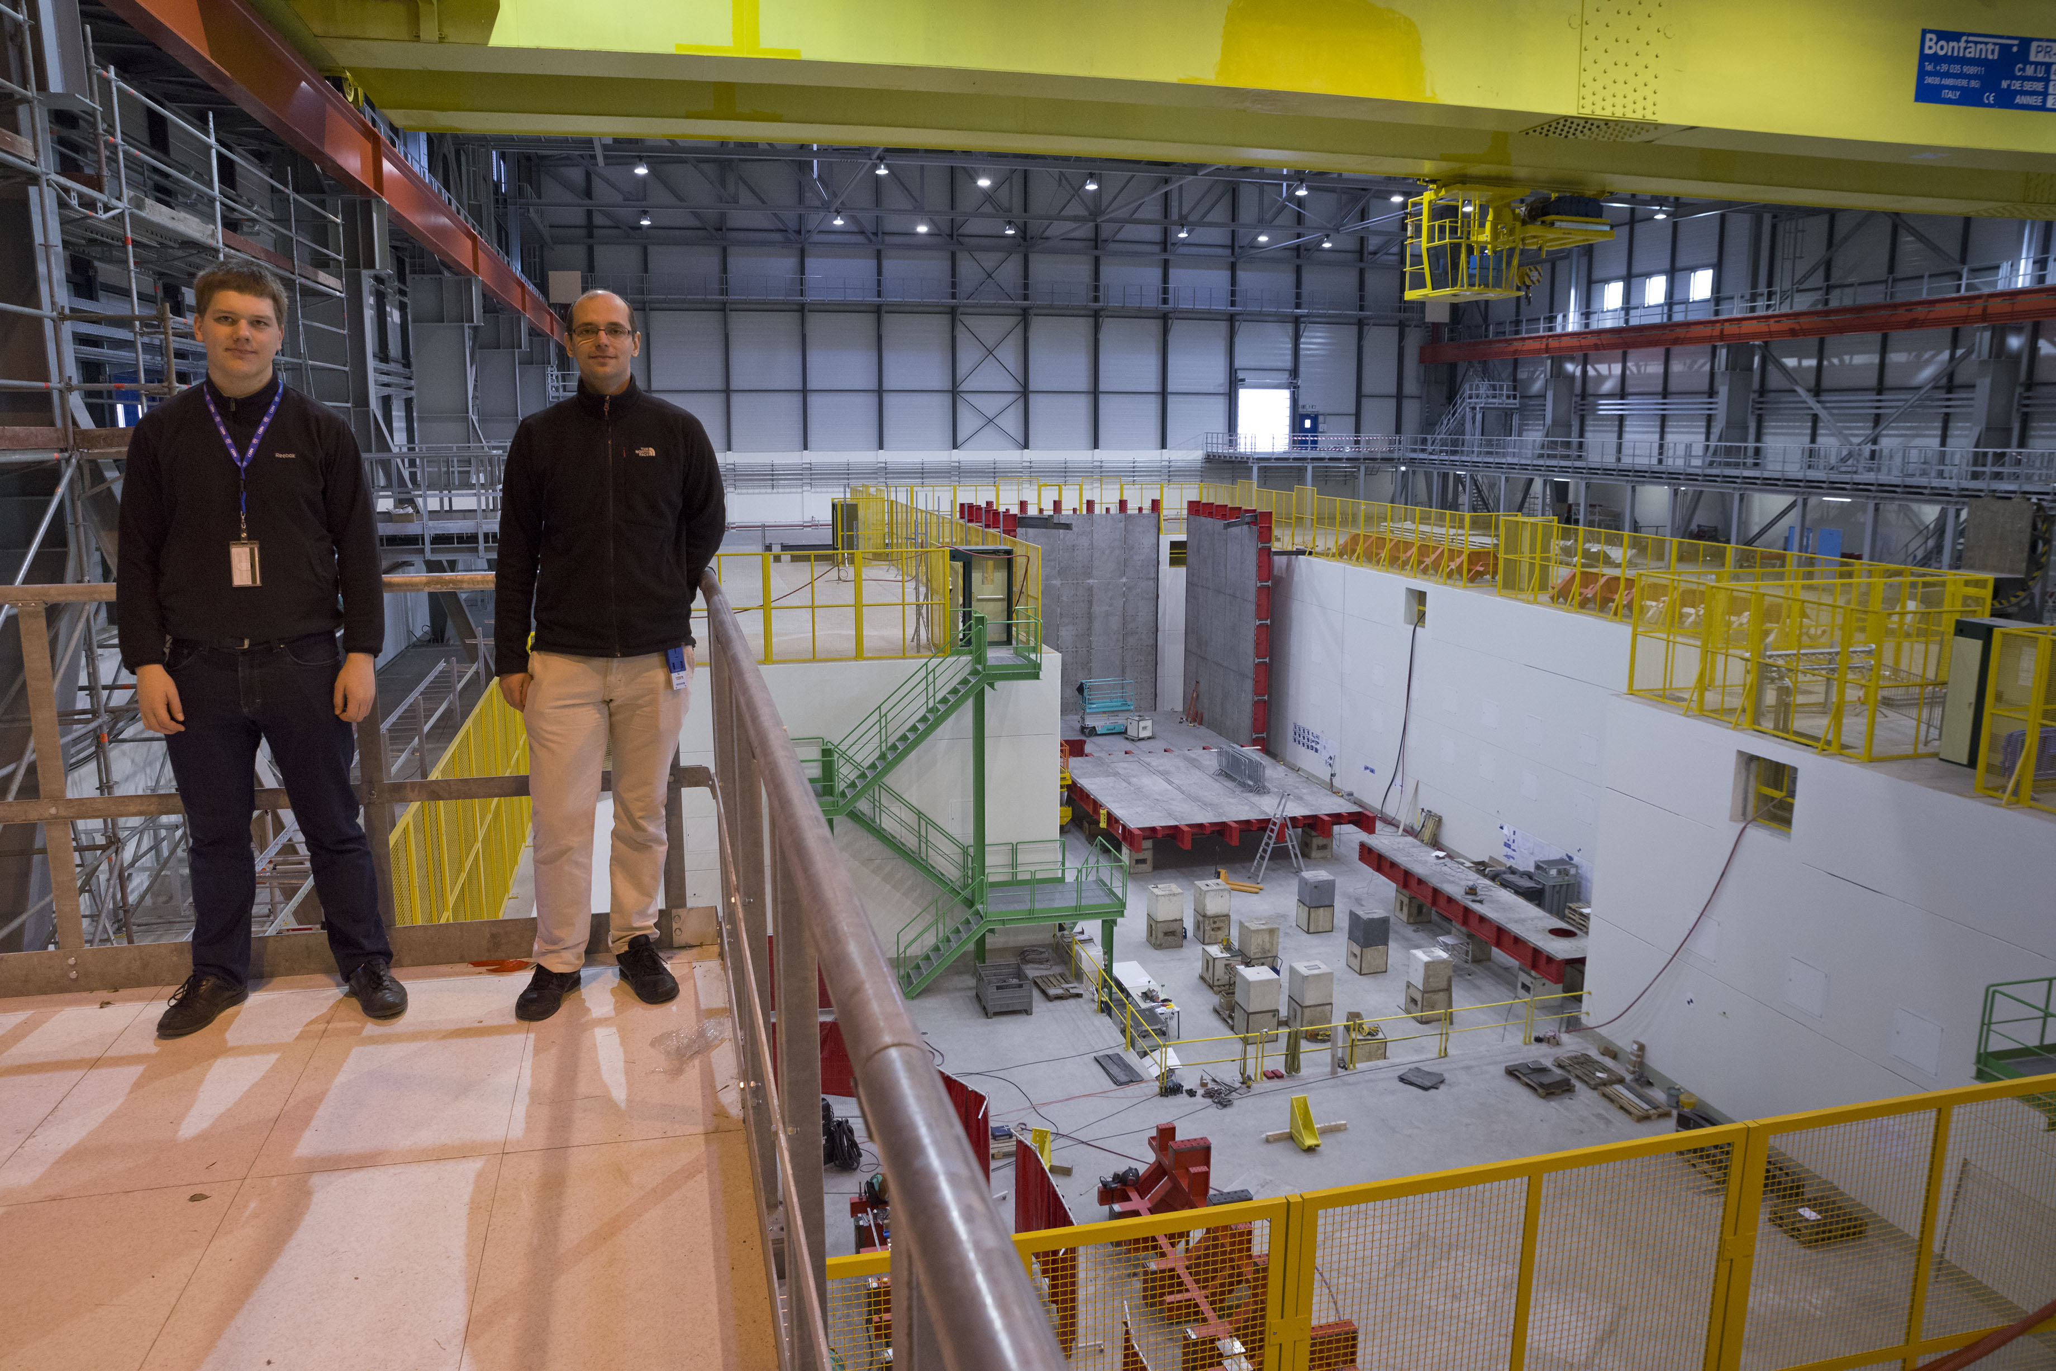
October 2016

Slide 28
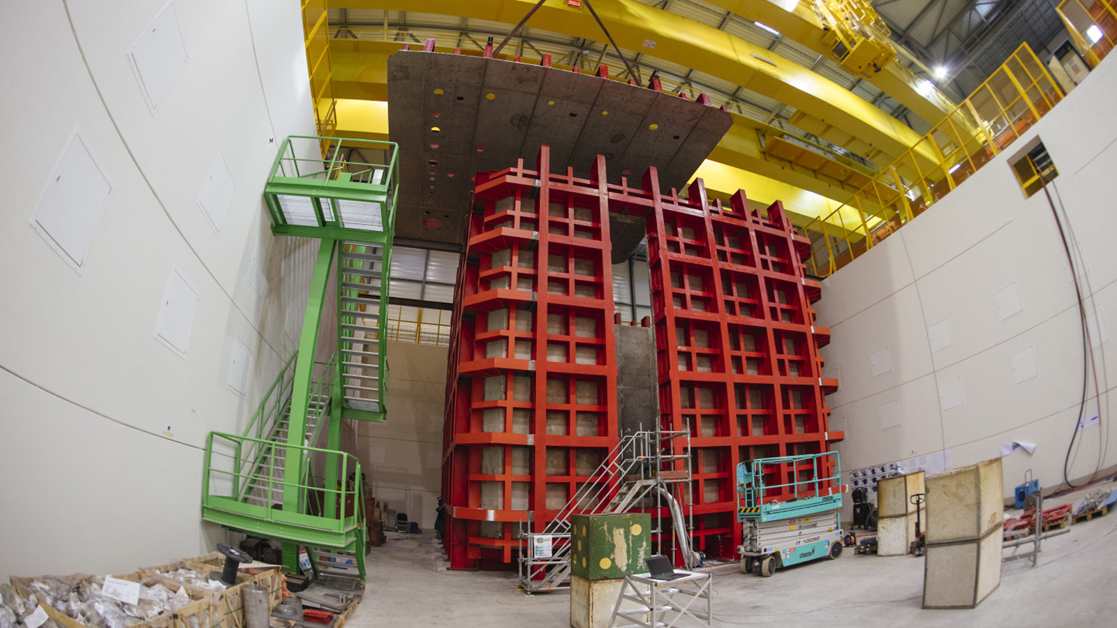
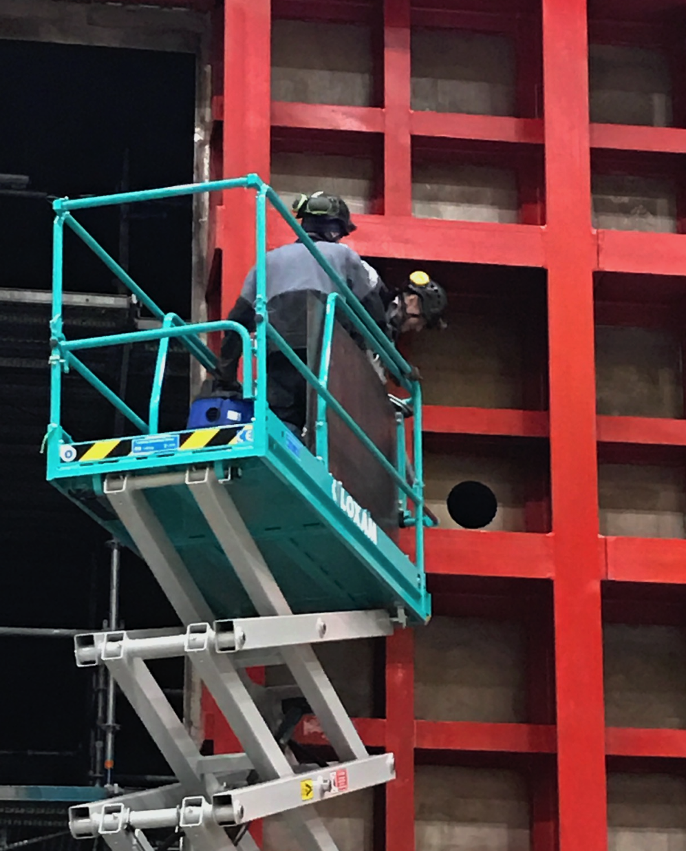
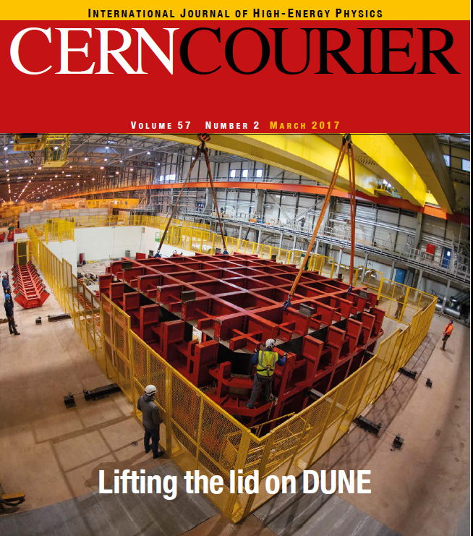
2 December 2016

Slide 29
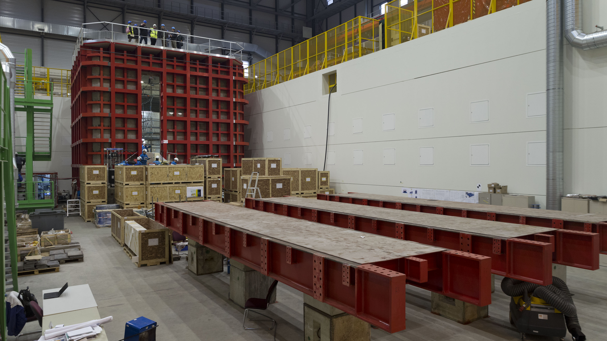
NP04 January 2016

Slide 30
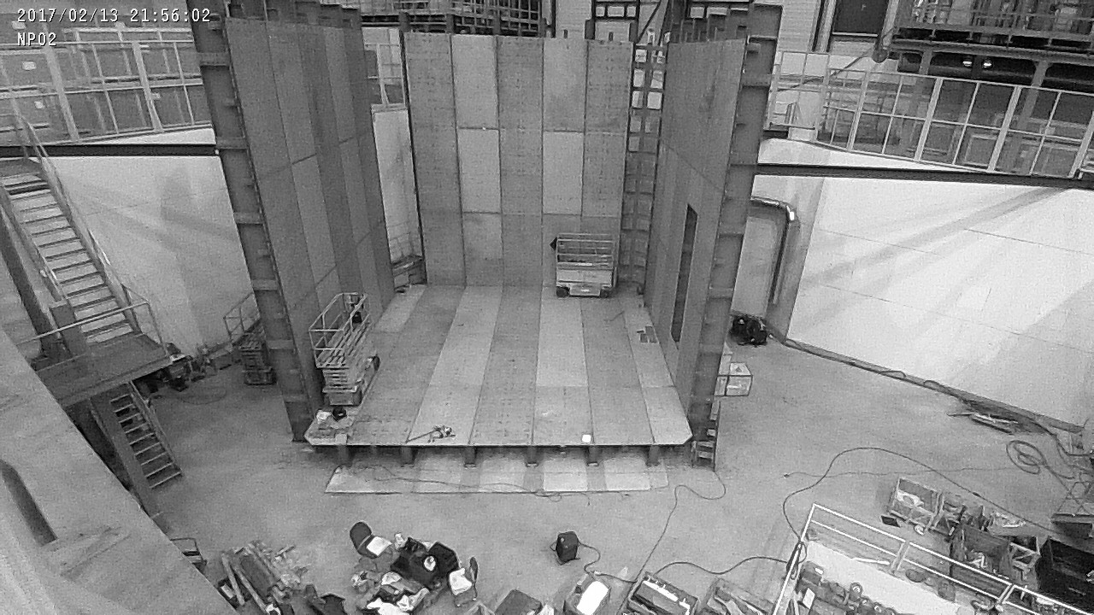
http://cenf-ehn1-np.web.cern.ch/multimedia/images

Slide 31
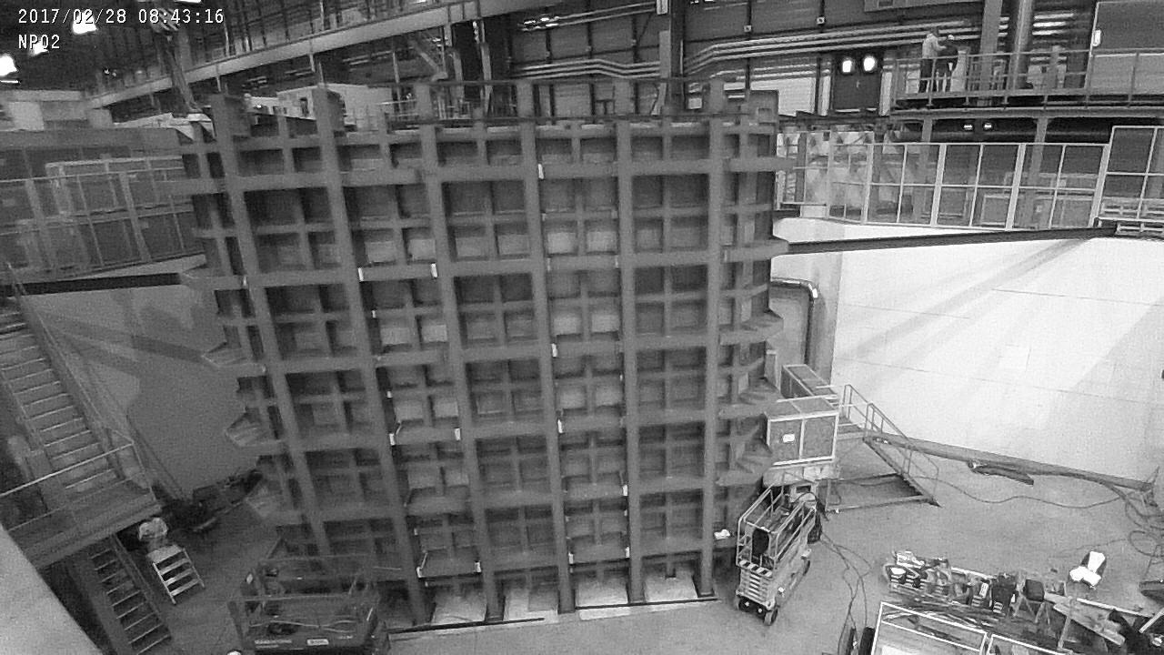

Slide 32
Dual phase liquid argon TPC
6 x 6 x 6 m³ active volume
Event size estimation
X and Y charge collection strips
3.125 mm pitch, 3 m long → 7680 readout channels
Segmented anode
in gas phase with
dual phase amplification
3 m
E=0.5-1.0 kV/cm
Drift coordinate
6 m = 4 ms
sampling 2.5 MHz
(400 ns), 12 bits
10000 samples
per drift window
Event size:
drift window of 7680 channels x 10000 samples ⇒ 146.8 MB
LAr volume
Drift
dE/dx → ionization
Prompt UV
light
10 kton DUNE 5.872 GB/event
Cathode
6 m
6 m
Photomultipliers

Slide 33
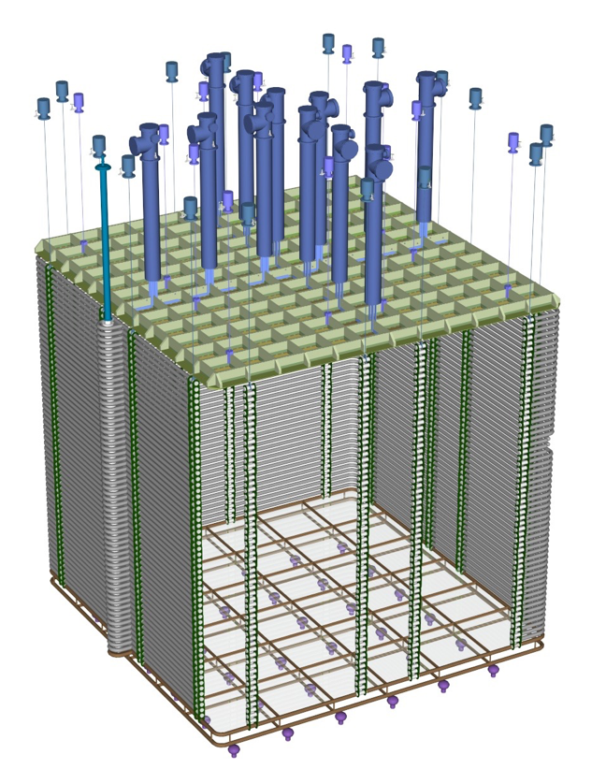
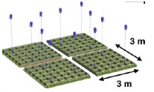
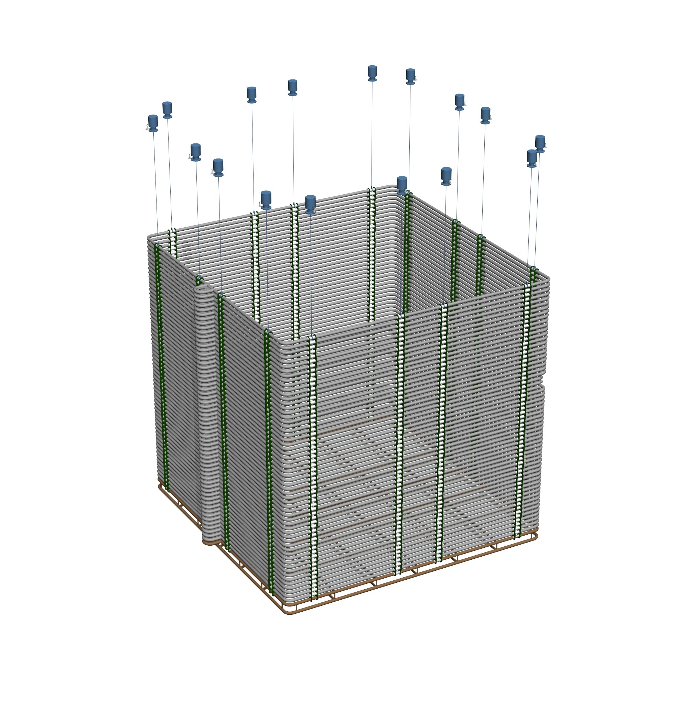
6 x 6 x 6 Modular & scalable construction
6 m

Slide 34
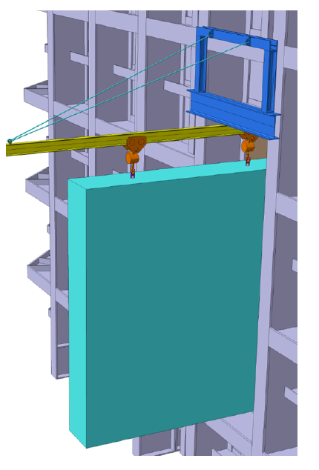
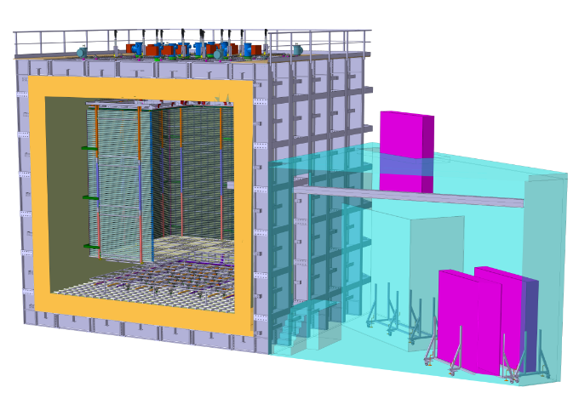
Underground-like installation scheme
CRP 3x3 m² units in 3.2x3.2x0.5 m³ boxes inserted via TCO using a rail system

Slide 35
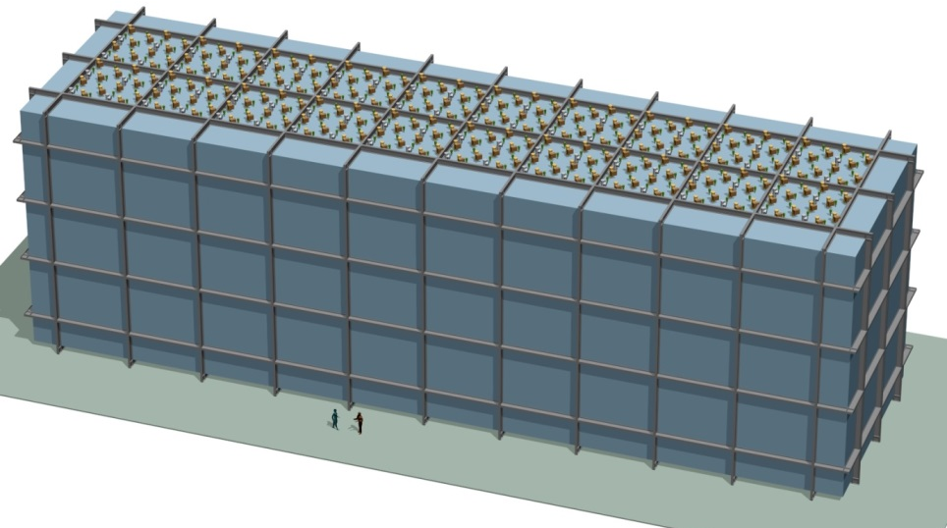
ProtoDUNE → DUNE 10 x longer, 2 x wider, 2 x taller
6 x 6 x 6
60 x 12 x 12

Slide 36
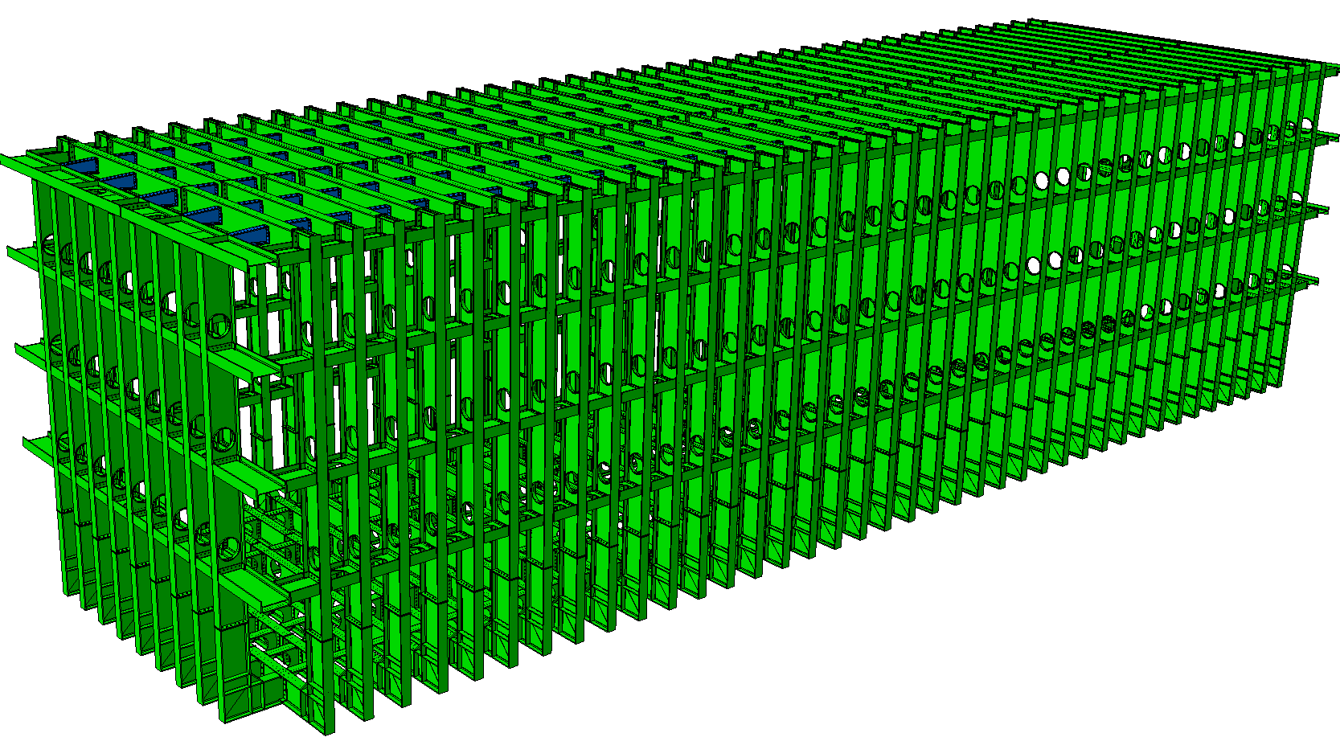
18.94m
65.84m
Membrane tank for a 10 kton detector
39 frames (1.6m)
8frames (1.6m)
17.84m

Slide 37
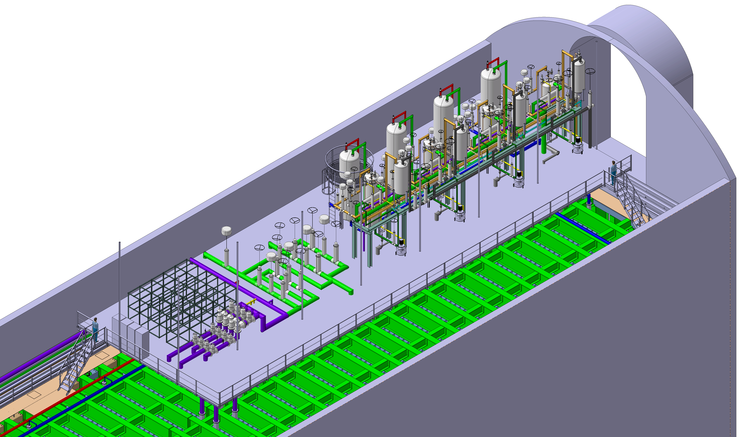
Cryogenics will be installed on top of each 10 kton detector unit
7.7 m
2.3 m
35 m
12 m

Slide 39
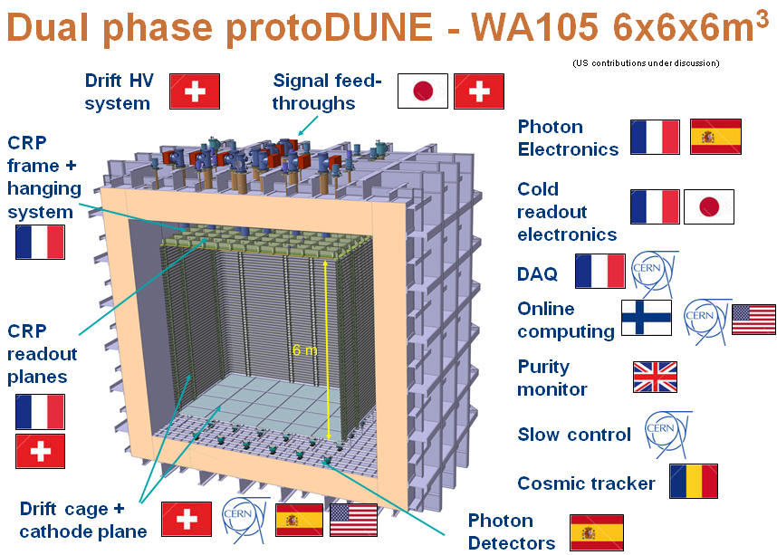
WA105: 122 scientists, 21 institutes, 8 countries
All are also members of DUNE Collaboration!

Slide 40
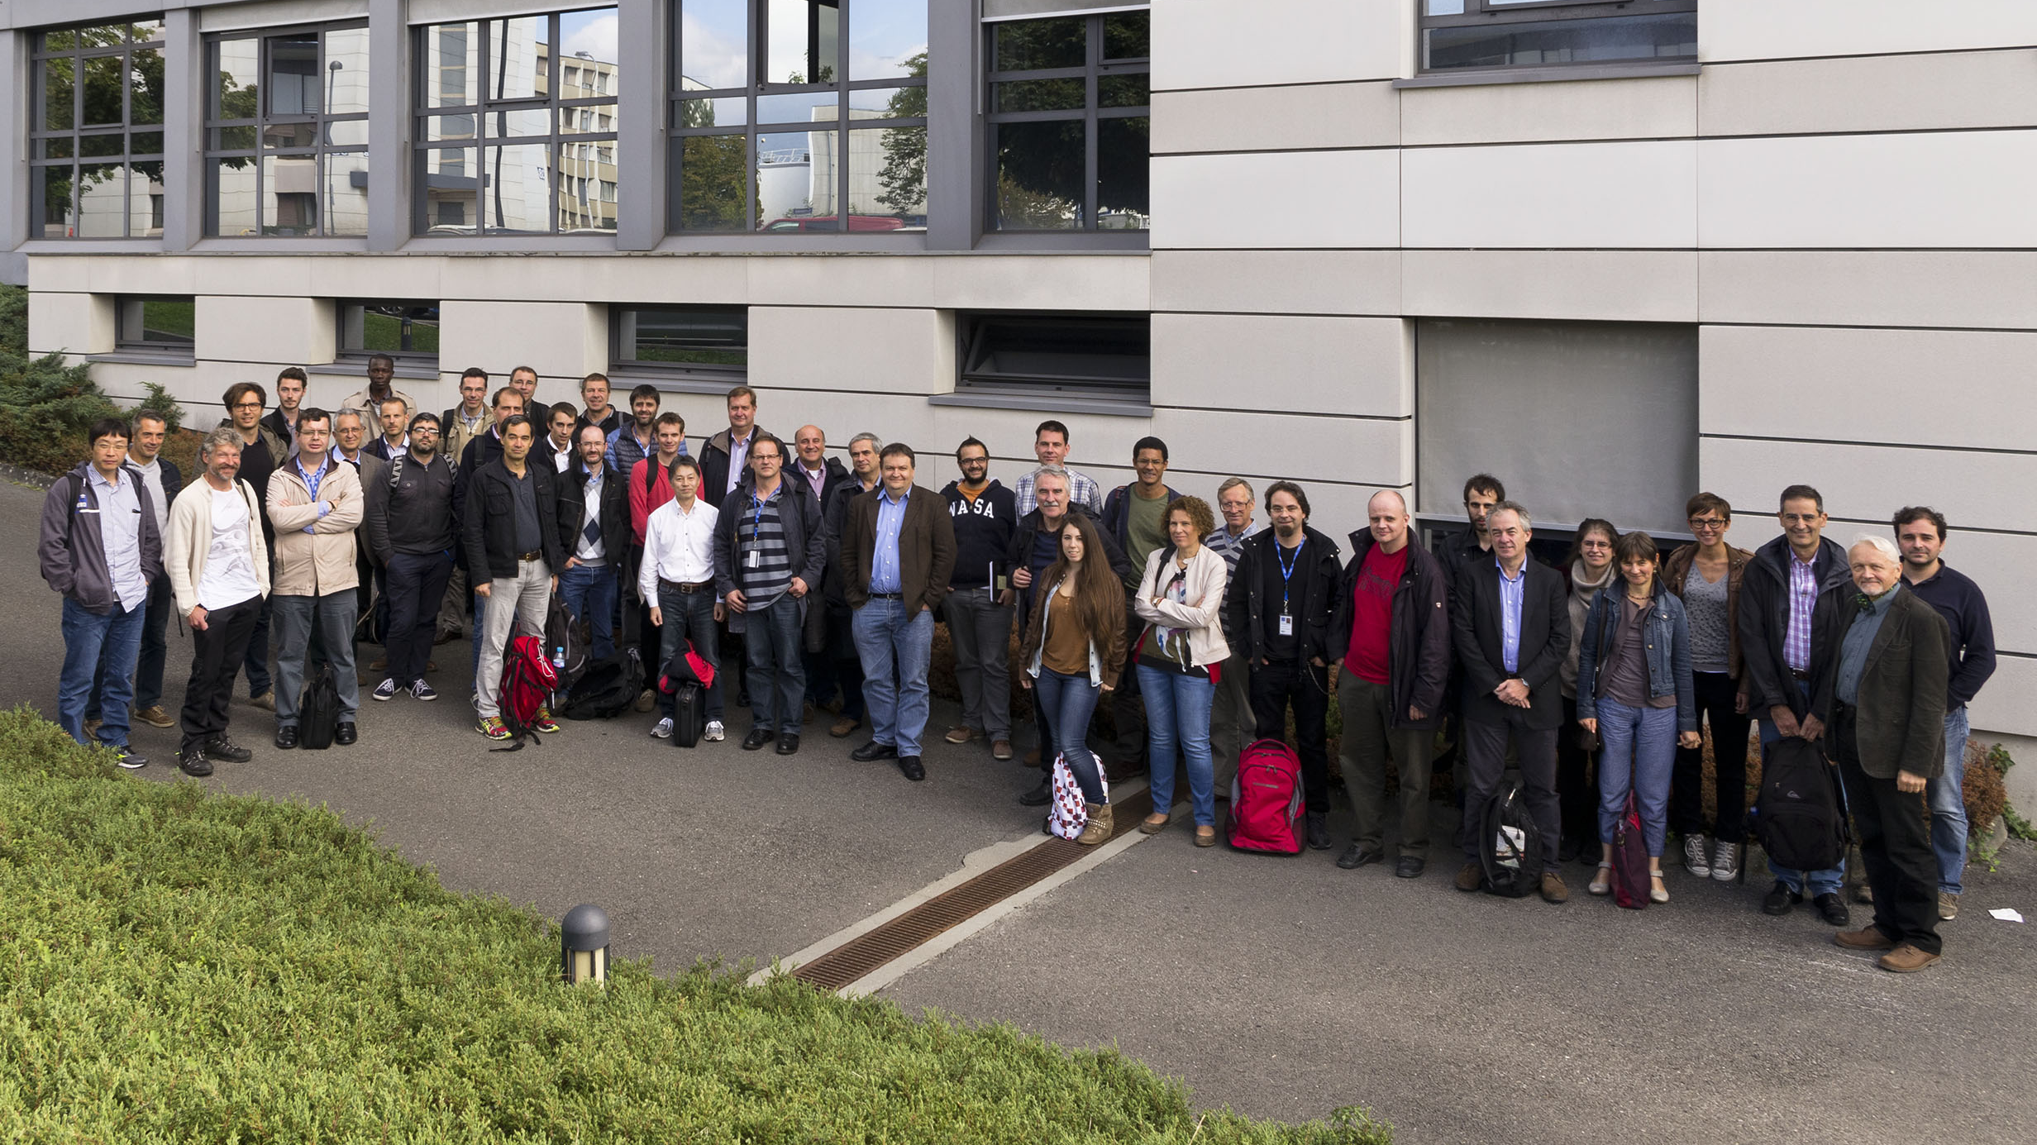
Thank you for your attention!

