Slide 1
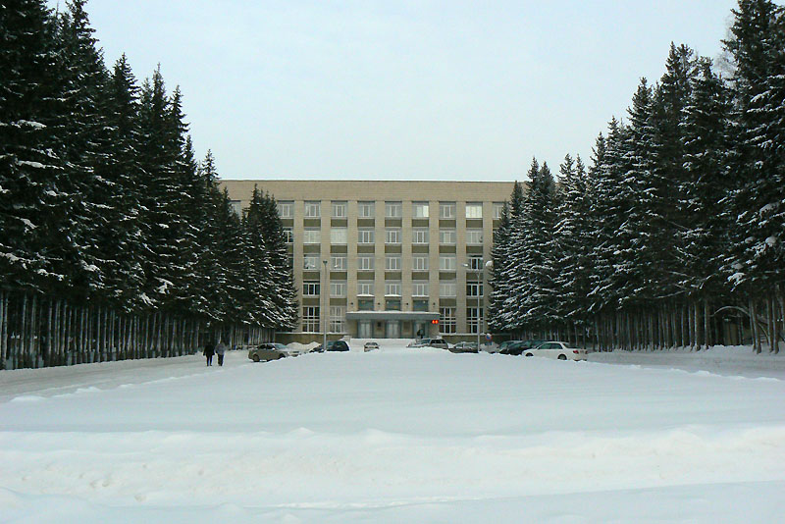
Neutrino detectors
for oscillation experiments
Yury Kudenko
Institute for Nuclear Research, Moscow
INSTR17, Novosibirsk, Russia, 1 March 2017

Slide 2

OUTLINE
Neutrino oscillations
Current experiments
- Accelerators: T2K, NOVA
- Plans for upgrade
- Reactors: Daya Bay, RENO, Double Chooz
Future projects
- JUNO
- DUNE
- HyperKamiokande

Slide 3
Talks
W. H. Trzaska
WA105 experiment at CERN: large demonstrator of Dual Phase Liquid Argon TPC detector for DUNE
V.Berardi
The Hyper-Kamiokande detector: R&D studies of a new
generation of Photosensors
Y.Heng
The Instrumentation of JUNO
Posters
I.Anfimov
Testing methods for 20 inches PMTs of the JUNO experiment
Z.Wang
JUNO PMT system
Mefodiev
Developing of segmented neutrino detector Baby-MIND

Slide 4
ν oscillations and mixing
Standard Model: neutrinos are massless particles
U parameterization:
three mixing angles θ₁₂ θ₂₃ θ₁₃
CP violating phase δ_{CP}
3 families
atmospheric
link between
atmospheric and solar
solar
iδ
SuperK, K2K,
MINOS, T2K
T2K
MINOS
Daya Bay, RENO
Double Chooz
Solar experiments, SuperK
KamLAND
θ₂₃~45⁰
θ₁₃ ≈ 9⁰
θ₁₂≈34⁰
two independent Δm²

Slide 5
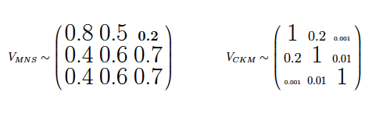
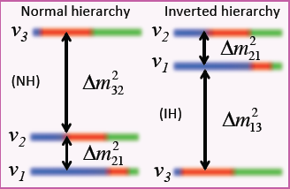
Main goals of accelerator
and reactor LBL experiments
neutrinos
quarks
- CP violation in lepton sector
Strength of CP violation in neutrino oscillations
J_{CP} = Im(U_{e1}U_{μ2}U∗_{e2}U∗_{μ1}) = Im(U_{e2}U_{μ3}U∗_{e3}U∗_{μ2})
= cosθ₁₂sinθ₁₂cos²θ₁₃sinθ₁₃cosθ₂₃sinθ₂₃sinδ_{CP}
Quark sector J_{CP} ≈ 3×10⁻⁵
Lepton sector J_{CP} ∼ 0.02×sinδ_{CP}
all mixing angles ≠ 0 →
→ J_{CP} ≠ 0 if δ_{CP} ≠ 0
First indication from T2K: δ_{CP} = -π/2 ??
- Neutrino mass hierarchy
- θ₂₃ – maximal? If not, what octant (θ₂₃ > π/4 or θ₂₃ < π/4)?
- Neutrino cross sections
- Sterile neutrinos

Slide 6
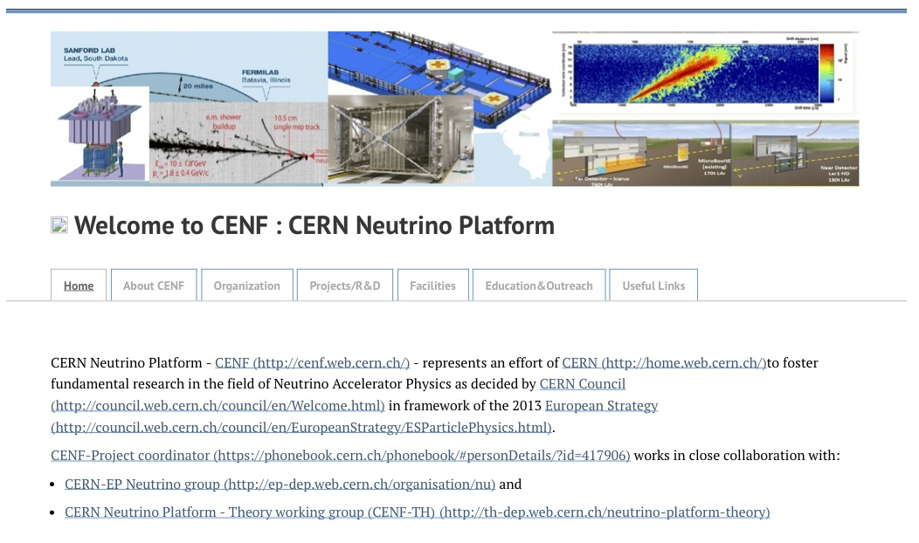
CERN Neutrino Platform
Following 2013 European Strategy for Particle Physics recommendations
Initial Mandate
…assist various groups in their R&D phase (detectors and components)….
…bring R&D at the level of technology demonstrators…
… support the long and short baseline activities (infrastructure & detectors)

Slide 7
Current experiments

Slide 8
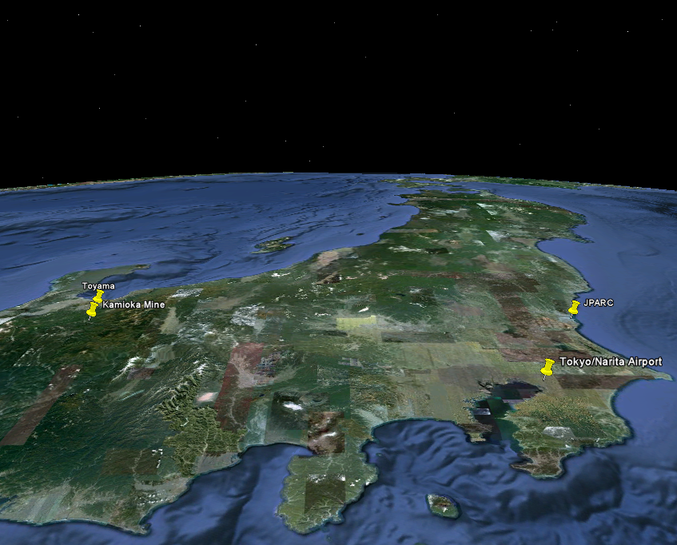

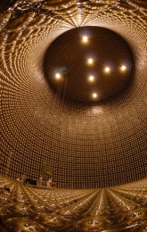
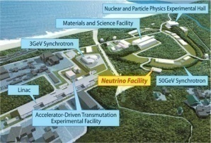
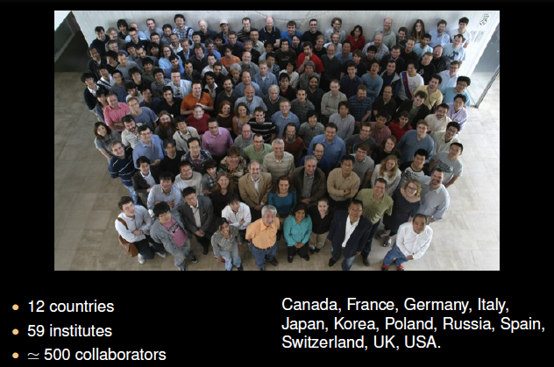

Long-Baseline Neutrino Oscillation Experiment
about 500 members
59 institutions
from 11 countries
Super-K
ν
ν
ν
ν
ν
ν
ν
ν
Tokai
Tokyo
JAPAN

Slide 9
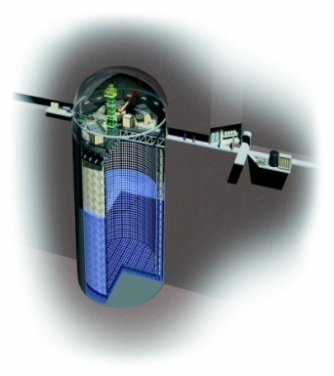
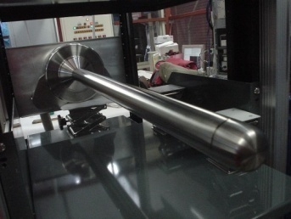
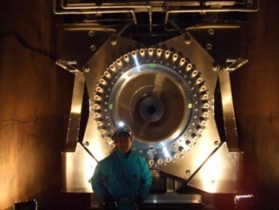
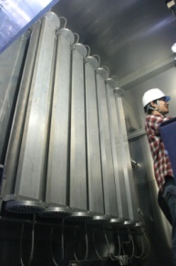
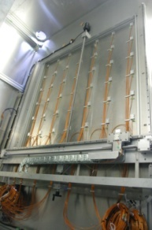
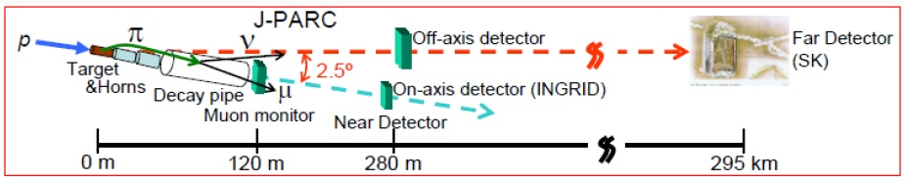
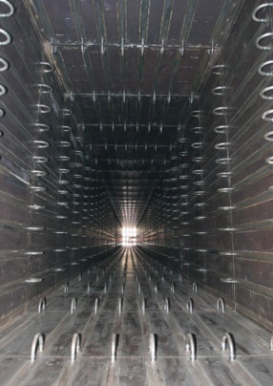
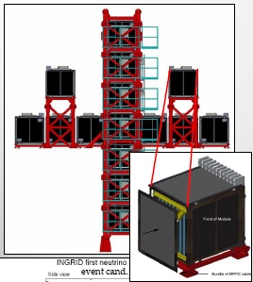
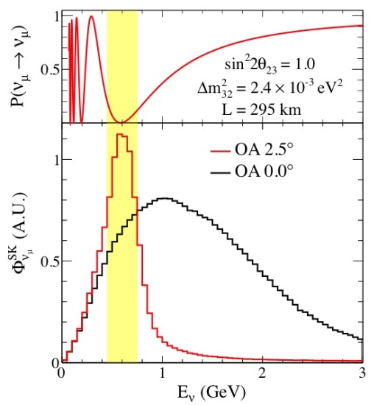
T2K experiment
Far neutrino detector SuperKamiokande
Off-axis neutrino
beam
Neutrino monitor
INGRID
ND280
Off-axis
near neutrino detector

Slide 10
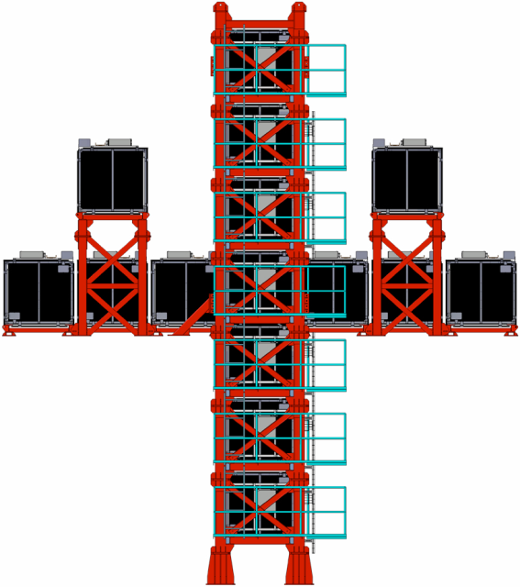
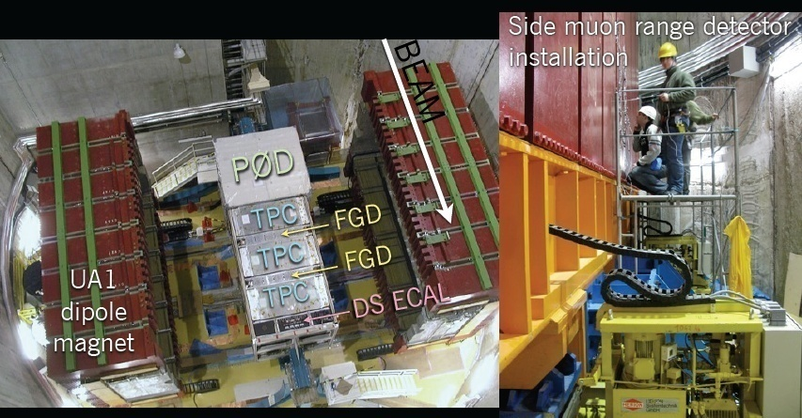
T2K near detector ND280
280 meters from pion production target
On-axis
Off-axis (2.5 deg)
~10m
Beam center
1.5m
- Tracker: 2 FGD + 3 TPC
- POD, ECAL
- SMRD
Measurement of unoscillated ν beam
~10m
16 identical modules (14 in cross)
Iron/scintillator layers
Monitor ν beam direction, profile, rate
T2K Systematics (ν mode) w/o ND280 with ND280
Appearance 11.9% 5.4%
Disappearance 12.0% 5.0%
2-3%

Slide 11
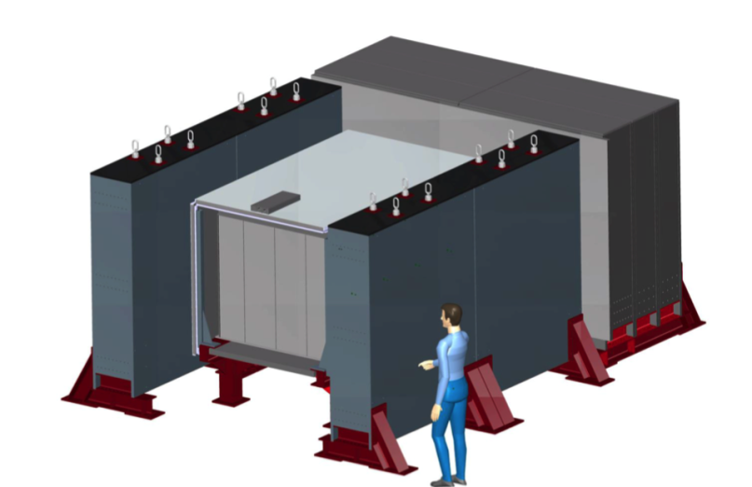
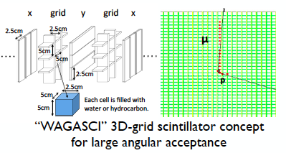
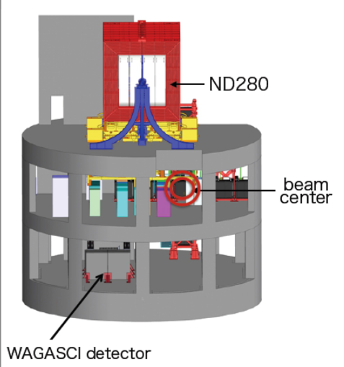
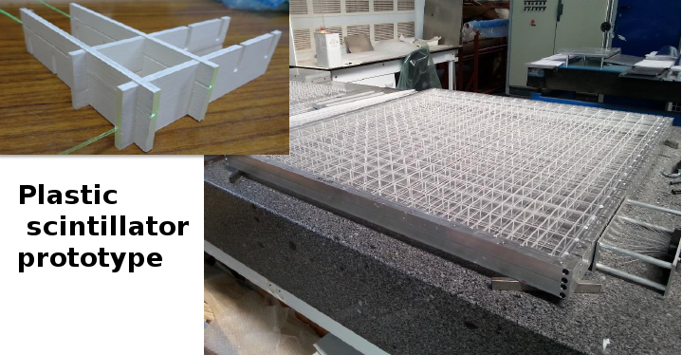
WAGASCI + Baby-MIND
WAGASCI detector
Neutrino cross sections – the main source
of systematic uncertainties
ND280 → CH neutrino target
SuperKamiokande → H₂O neutrino target
Baby-MIND
MRD
active
target
MRD
ν
active target filled
with H₂O and scintillator
80%:20% (H₂0:CH)

Slide 12
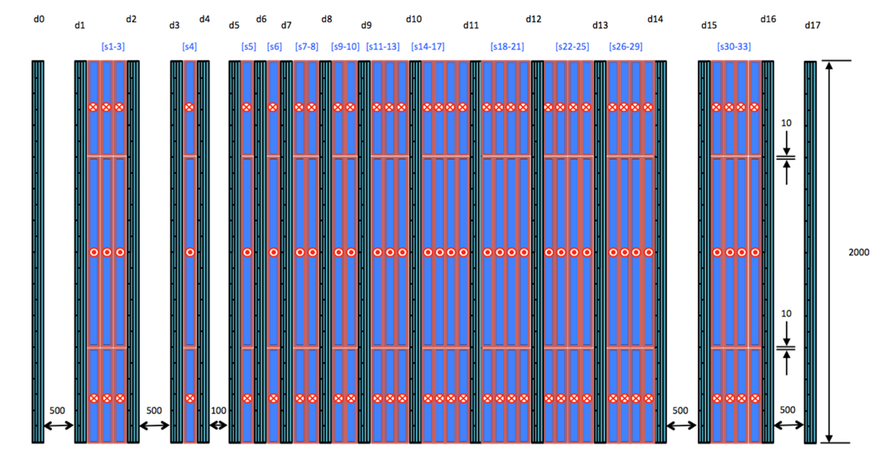
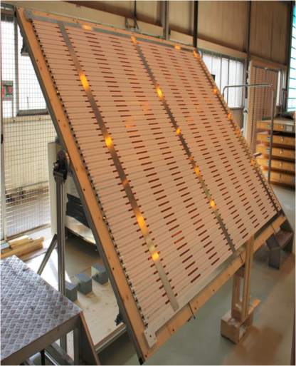
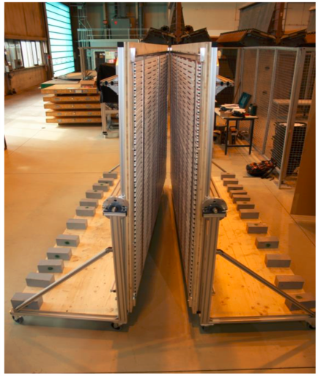
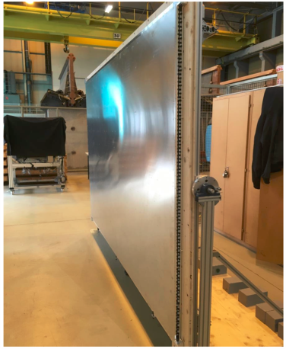
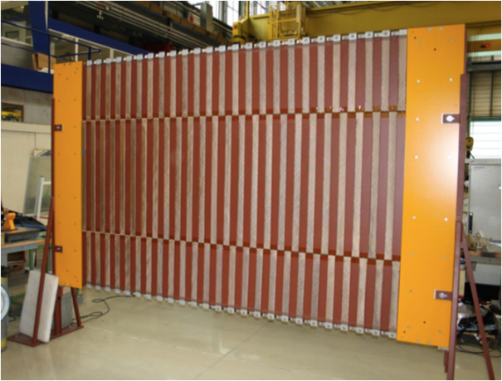
Baby-MIND
Neutrino magnetized detector Baby-MIND - NP05 project in framework of CERN Neutrino Platform
Baby-MIND has 18 active modules
Active elements – scintillator detectors
with WLS/SiPM readout
Each module: 95 horizontal bars
and 16 vertical bars
Horizontal bar: 2900(L)x30(W)x7(t) mm³
Vertical bar: 1950(L)x210(W)x7(t) mm³
In total ∼1800 horiz and 250 vert sci bars
and 3-cm thick 33 magnetized iron plates
A spectrometer to measure muon momentum
and charge identification.
Scintillator plane
Two half-modules
Complete module
Magnetized iron plate
B = 1.5 T
Reconstruction efficiency > 95%
Charge identification > 90%
Start data taking with WAGASCI target in
Autumn 2017

Slide 13
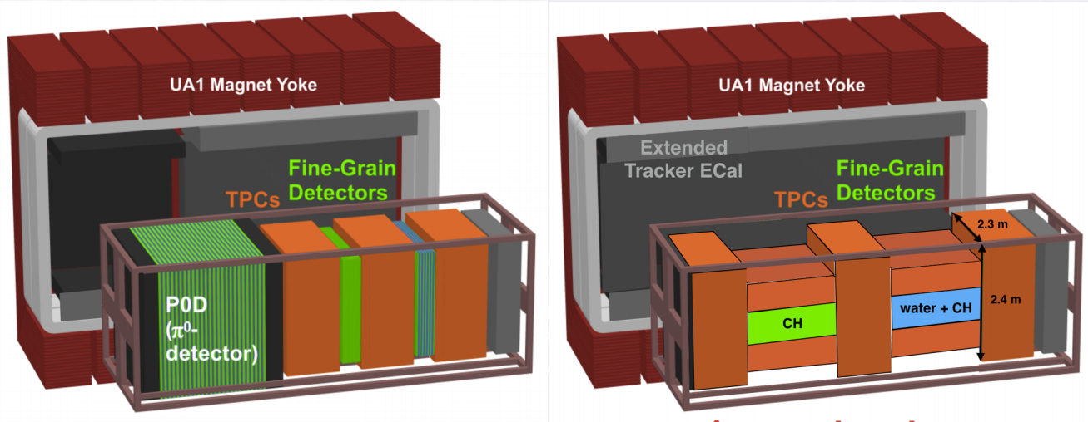
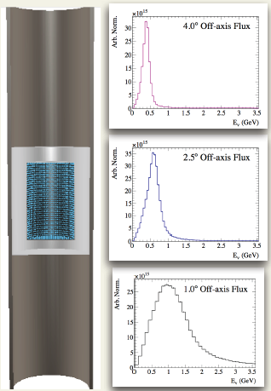
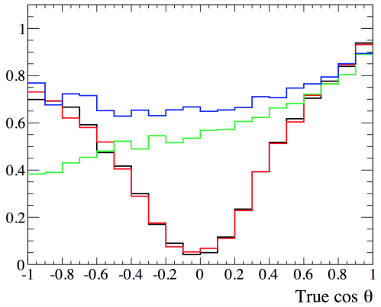
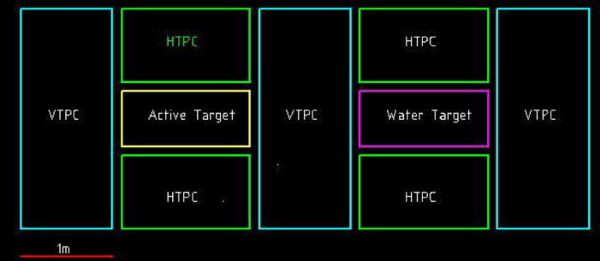
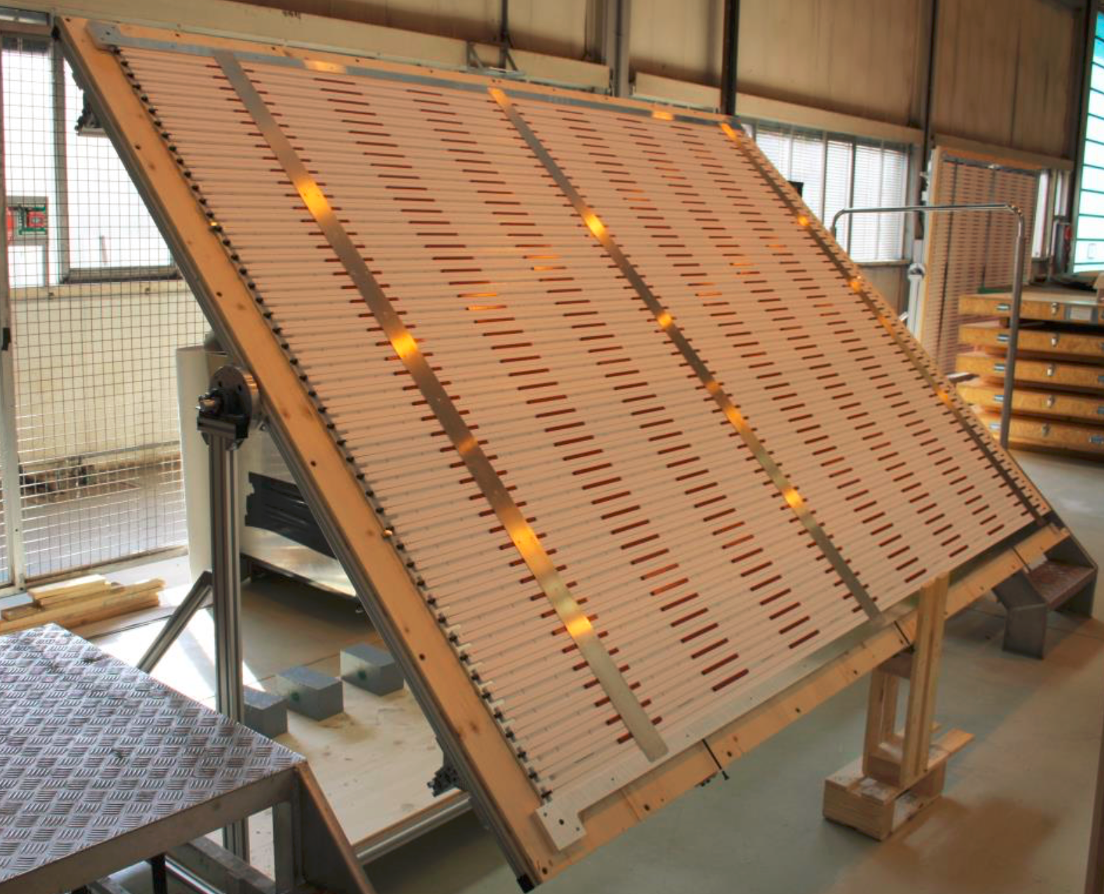
Upgrade of T2K near detectors
For T2K-II phase and HyperKamiokande
NuPRISM: arXiv:1412.3086
T2K systematic errors of ∼ 5-6%
Need to improve to ≤3%
Intermediate (∼1 km)
Water Cherenkov
detector NuPRISM
Span several
off-axis angles
Current ND280
Concept for Upgrade
B=0.2T
- new tracking target
- new TPS for high angle tracks
ε_{μ}
MC
Upgrade
ND280
Measurement of σ(Eν)
Plan: TDR -2017, Commissioning -2020

Slide 14
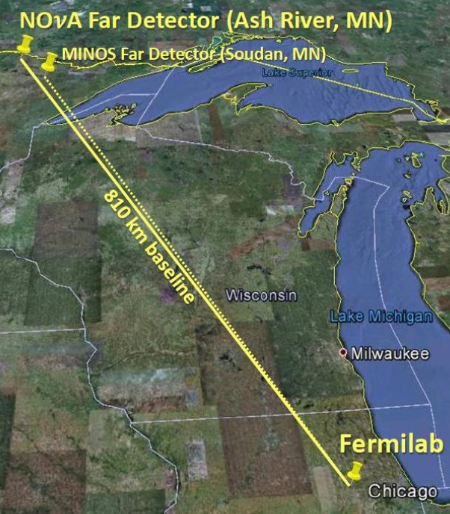
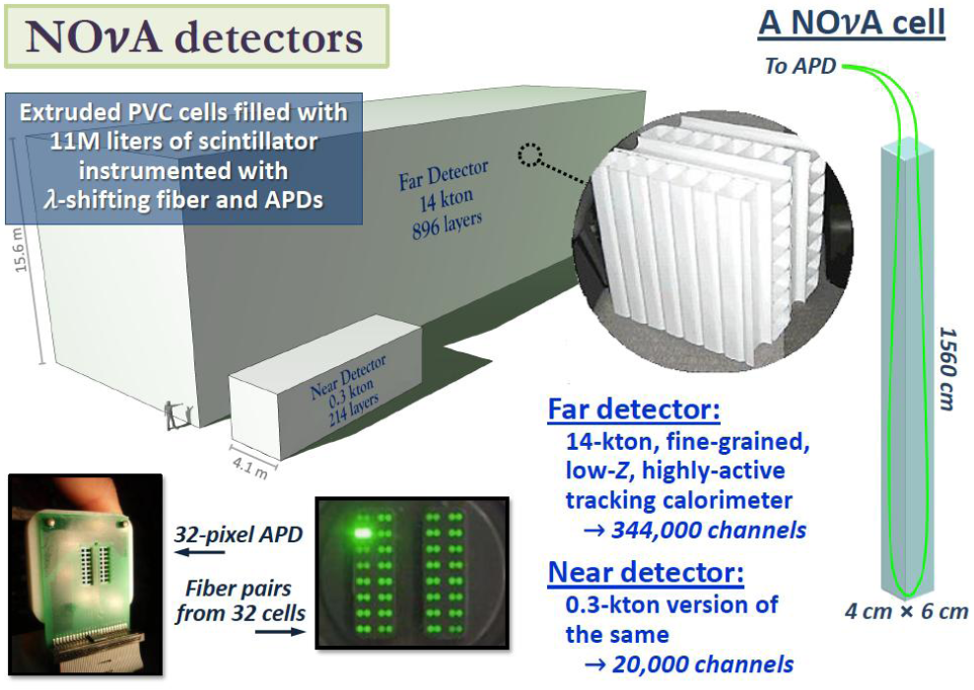
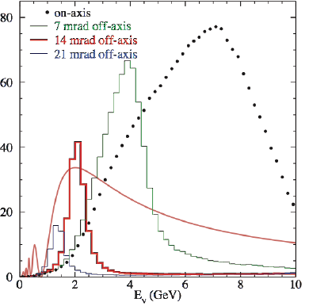
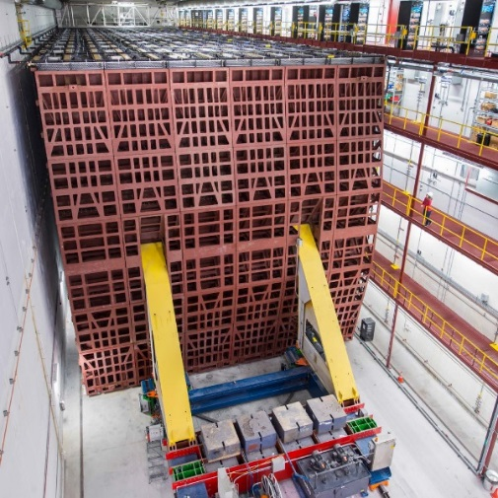
NOVA
Neutrino beam from FNAL to Ash River
Baseline 810 km
Neutrino beam 14 mrad off-axis
Far detector : 14 kt fine-grained calorimeter
65% active mass
Near Detector: 0.3 kt fine-grained calorimeter
Taking data since Summer 2014
Study of ν_{μ}→ν_{μ} and ν_{μ}→ν_{e} oscillations

Slide 15
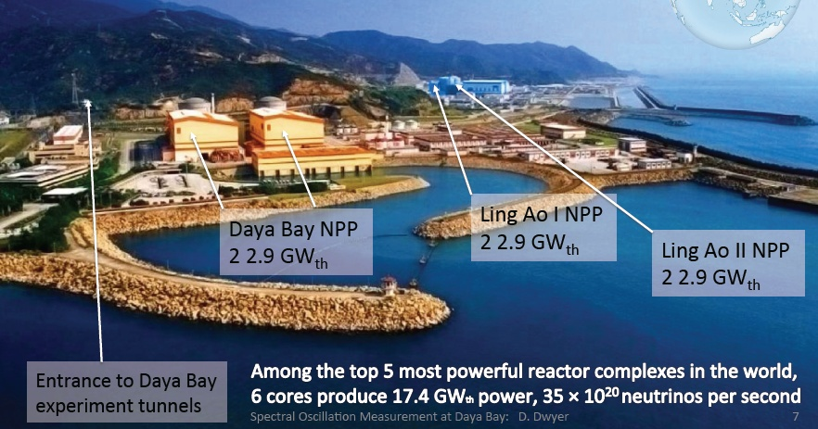
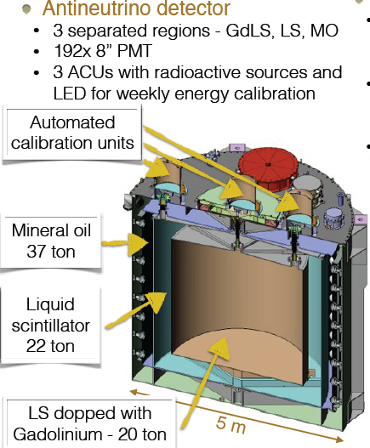
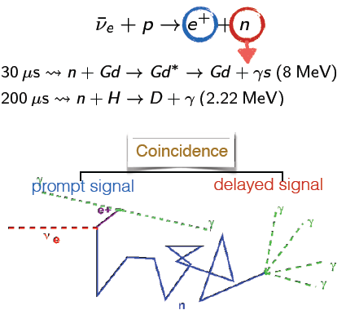
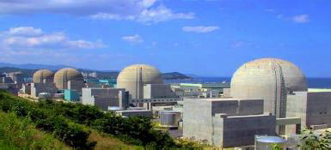
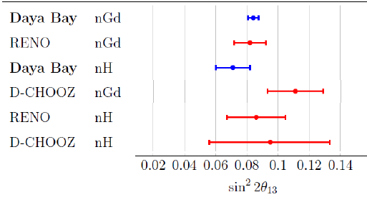
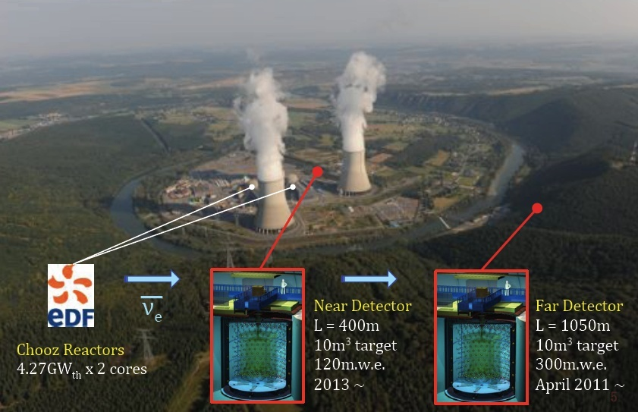
Reactor experiments
Daya Bay, China
Detector Daya Bay
Principle
RENO, Korea
Typical energy resolution
σE ∼ (6-8)%/√E
Double Chooz, France
θ₁₃ = 8.4 deg
Next generation: experiment JUNO

Slide 16
Future LBL Projects
- Reactor experiment JUNO
- Accelerator LBL experiment DUNE
- HyperKamiokande and T2HK

Slide 17
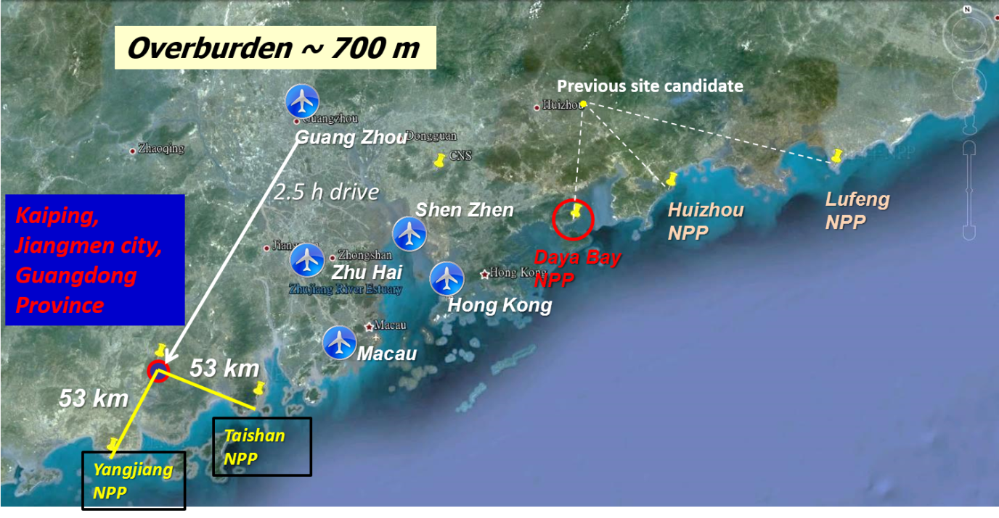
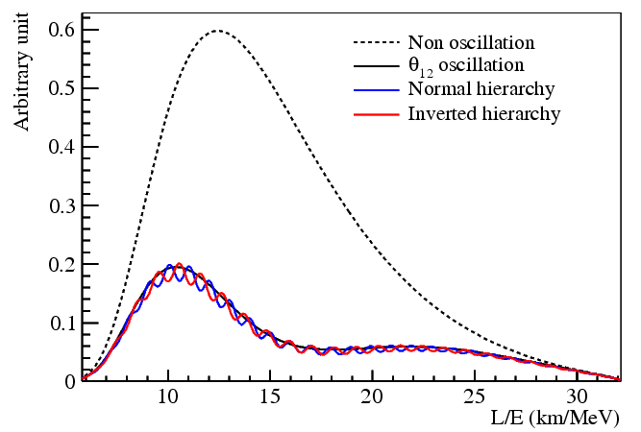
Reactor experiment JUNO
China
66 institutions
> 400 collaborators
Main target:
Measurement of
neutrino mass hierarchy
700 m deep underground
36 GW reactor power
53 km baseline -> oscillation
maximum θ₁₂
20 kton LS detector
3% energy resolution at 1MeV
<1% energy scale uncertainty
!?
Start data taking in 2020

Slide 18
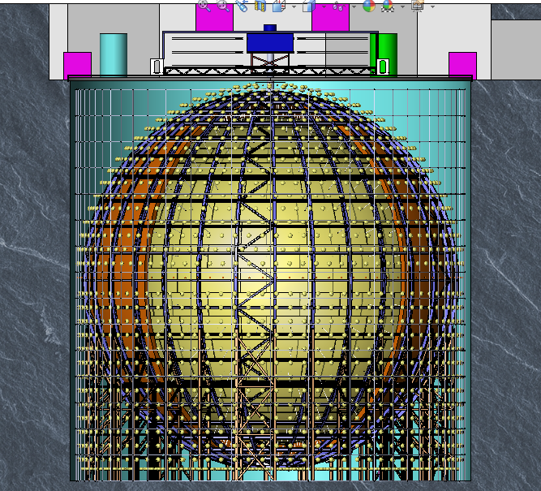
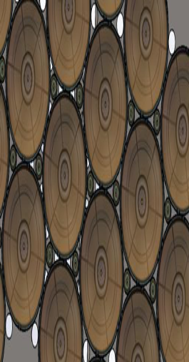
Detector JUNO
Requirements:
- PMT coverage
75% of total surface
- QE ∼ 35%
- Sci. att. length >20 m
Calibration
Top Tracker
3” PMT
h=44 m
Central detector
Acrylic sphere+
20kt Liquid Scin+
~17000 20’’ PMT+
~36000 3’’ PMT
Water Cherenkov
~2000 20’’ PMT
d=43.5 m
20” PMT

Slide 19
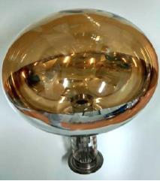
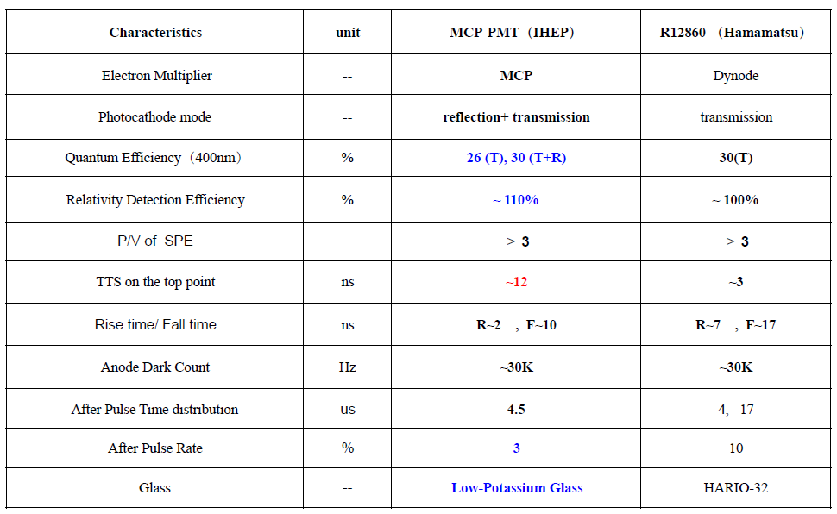
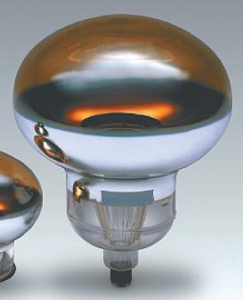
PMT’s for JUNO
20” PMT’s
Transmission and reflection photocathode:
QE (400 nm) ∼ 30%
Sen Qian, talk at NNN16
15000
NNVT MCP-PMT
5000
Hamamatsu R12860

Slide 20



LBNF/DUNE Project
Flagship FNAL project
Main goals: - discovery of CP violation in leptonic sector
- neutrino mass hierarchy at >5σ level
- neutrino astronomy
- proton decay search
30 countries
161 institutions
∼1000 collaborators
E_{p} = 60-120 GeV
Beam power 1.2 -> 2.4 MW
On axis neutrino beam
Eν ∼ 1- 6 GeV
L=1300 km from FNAL to
SURF, S.Dakota
Sensitivity to CP violation
Far detector 40 kt (4 x 10kt) LAr TPC
Single
and
Dual
phase
detectors
2021 – installation of 1st far detector
2024 – 2 modules operational
2026 – deliver neutrino beam

Slide 21



Single-phase LAr TPC
APA
APA
APA
CPA
CPA
58 m
3.6 m
1st 10 kt module of DUNE - single-phase TPC
6m x 2.3 m anode and cathode planes 3.6 m spacing
Photon detectors – light guides + SiPMs embedded in APAs
J.Insler, talk at LLWI2017

Slide 22


Dual-phase LAr TPC
12 m
12 kt LAr
60 m
12 m
- Electrons extracted from LAr to gaseous volume
- Signal amplified by LEM
- Drift (vertical) 12 m
- Signal/Noise 100:1
- Photon detectors: PMTs + WLS
- Small number of channels
- No dead material inside the active volume

Slide 23



DUNE Near Detector
T.Kutter, talk at HINT2016

Slide 24




LAr detectors at CERN Neutrino Platform
NP02: WA105, DP demonstrator + ProtoDUNE DP
S.Murthy, talk at TPC-2016
ProtoDUNE DP: 6x6x6 m³
300 tons active mass
Demonstrator: 3x1x1 m³ – 5 tons
μ
LEM
Measurements with test beam in 2018
Cosmic data taking gas begun

Slide 25


LAr detectors at CERN Neutrino Platform
NP04: ProtoDUNE SP
400 tons active mass
Tests:
- Full size of APAs, CPAs
- Drift regions
- >15000 TPC channels
- Photon detectors

Slide 26



HyperKamiokande
12 countries
70 institutes
∼300 members
Expected data taking start 2026
Japan
HyperK: 2 water tanks
- Upgrade of JPARC to
1.3 MW beam power
New/upgrade of near
neutrino detectors
Main goals:
- Search for CP violation
- Proton decay
- Neutrino astrophysics
1 tank
60 m(H)x74m(D)
Total volume 260 kt
Fiducial volume 190 kt
∼10xSuperK
PMT coverage 40%
40000 PMTs
CP
10 years of running:
- 8σ for δ_{CP} = - π/2
- 80% coverage of
δ_{CP} parameter space with >3σ
- p → π⁰ e⁺ >10³⁵ y

Slide 27






PMTs for HyperKamiokande
Multi-PMT option
KM3NeT module
Acrylic 15mm
Implosion tests
at 60 and 80 m depth
No chain implosion observed
Stainless steel
3mm
Performance of new photosensors

Slide 28
Conclusion
Very intense R&D for neutrino detectors
Current experiments: detector upgrades to reduce systematics
- active neutrino targets
Cherenkov detectors
magnetized detectors
Main goals of new projects: CP violation, MH
oscillation parameters
proton decay
Next generation detectors
Reactor experiment JUNO under construction
Accelerator experiment DUNE approved
HyperKamiokande and T2HK approval in progress

Slide 29
Thank you!

