Slide 1
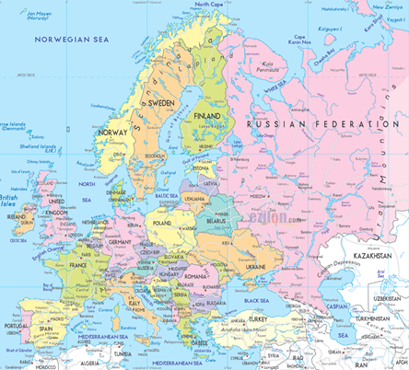
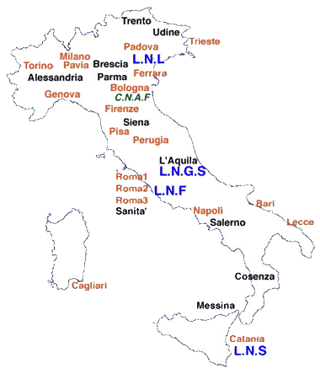
Status and perspectives for the INFN Frascati national laboratory
Laboratori Nazionali di Frascati (LNF) is the oldest (1955) Italian research infrastructure for fundamental research.
It is also the biggest lab of Istituto Nazionale di Fisica Nucleare (INFN), the institution that in Italy funds and coordinates the research for Nuclear and Particle Physics.

Slide 2
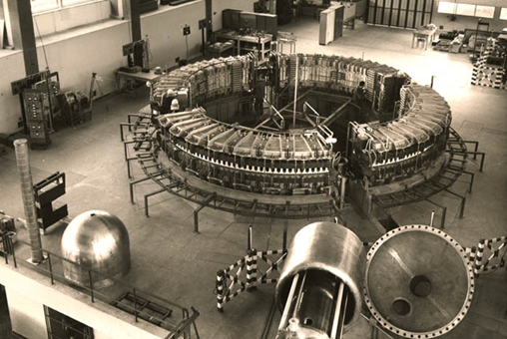
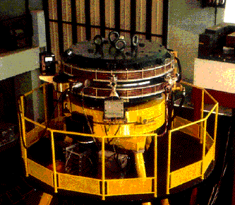
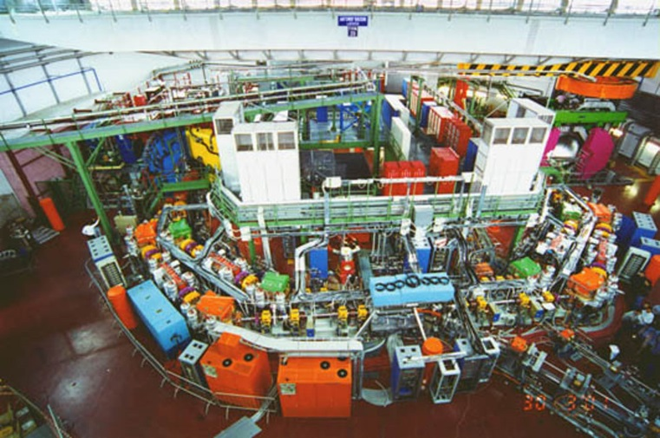
LNF History
The tradition of the lab has been always in the field of hadron physics:
1959 – 1975 Electro-Syncrotron (max energy 1.1 GeV);
1960 Anello di Annichilazione First particle collider (beam energy 200 MeV);
1969 – 1993 ADONE e⁺e– collider (c.m. energy up to 3 GeV);
2001 – today DAΦNE e⁺e– collider (c.m. energy 1.120 GeV);
ADA
DAΦNE

Slide 3
LNF activities
Developments
of new accelerator
technique
CTF3
CLIC
Research and
Developments
of
Detectors
Hadron
therapy
CNAO
Medical Application
DAΦNE
KLOE
data taking this year
Syncrotron
light
LdS
X-ray
Laboratory
Free Electron
Laser (FEL)
SPARC
ATLAS-CERN
CMS-CERN
LHC-b-CERN
NA62-CERN
BES3-BEPC
BABAR-SLAC
Belle2-KEKB
FINUDA
end of data taking in 2007
SIDDHARTA
new of data taking in 2015
High intensity
laser
FLAME
Cryogenic
antenna
NAUTILUS
Physics in
space
Astro-particles
Physics

Slide 4
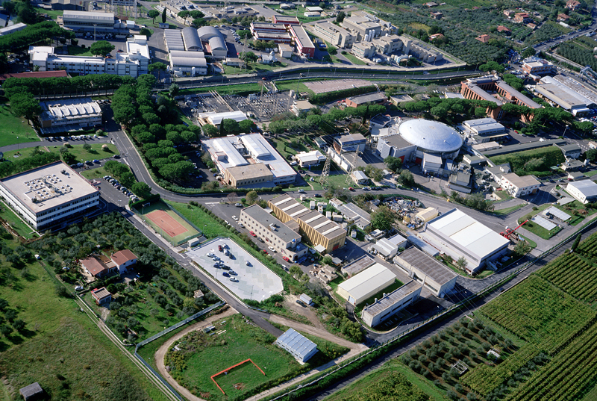
Accelerator Complex
DAΦNE-light
DAΦNE
LINAC
BTF
FLAME

Slide 5
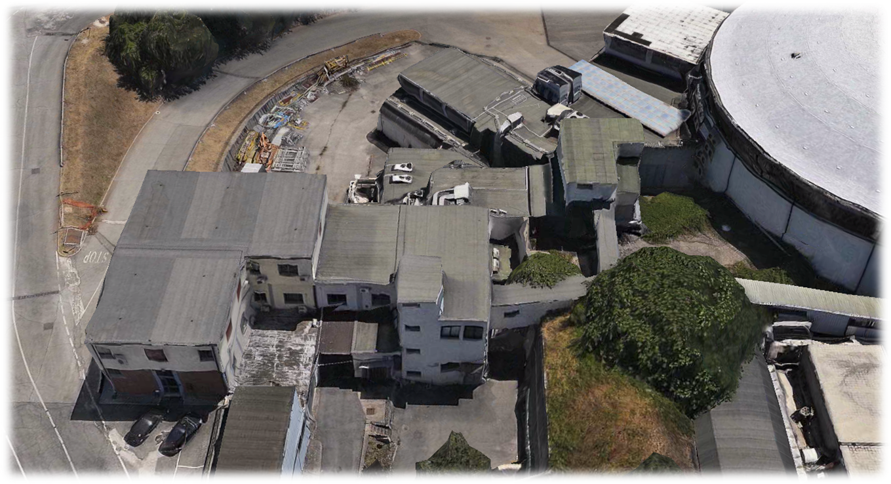
A better view of the BTF Complex
KLOE
DR hall
DR pumping
DR
power
BTF
hall
DAFNE hall
Nuclear Physics
building
BTF
control room
Linac tunnel
Modulators
hall

Slide 6
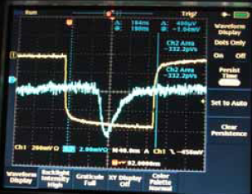
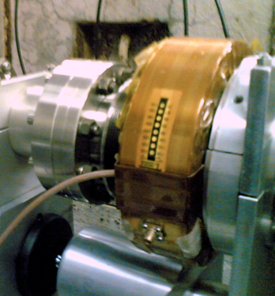
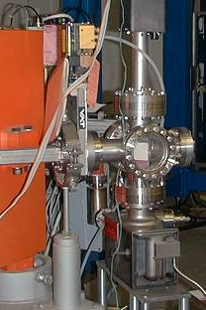
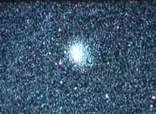
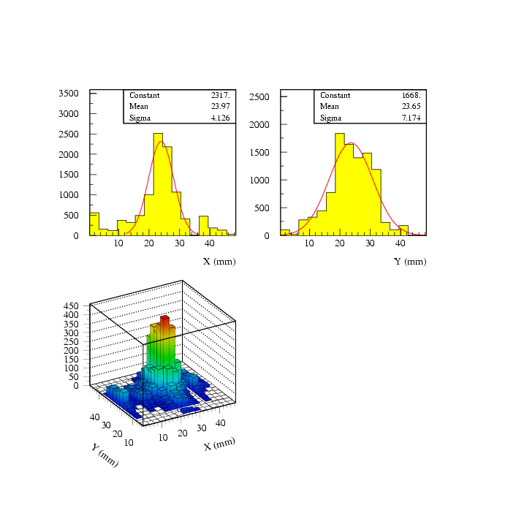
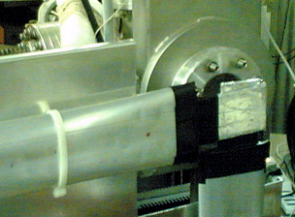
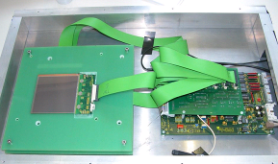
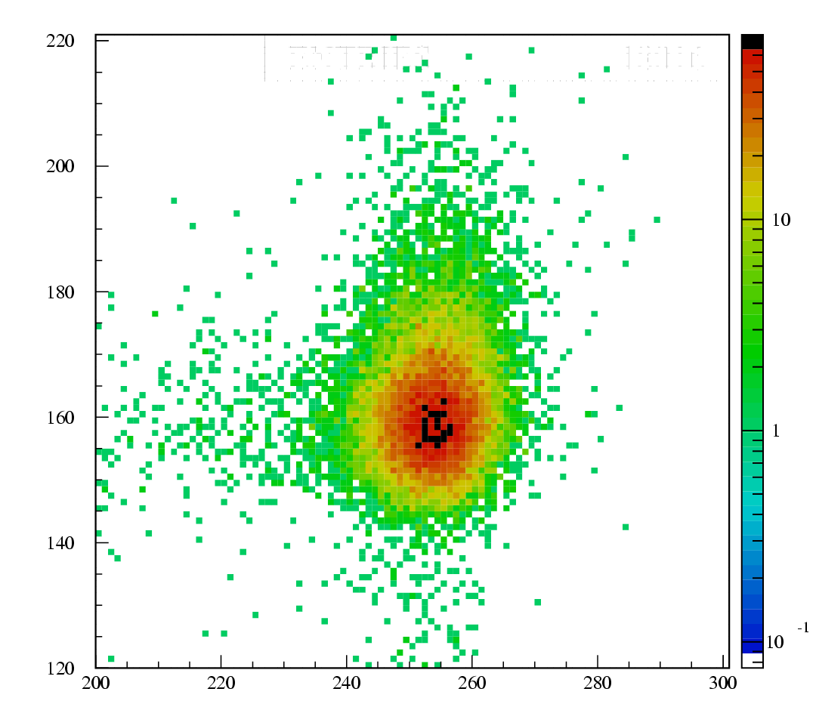
BTF Diagnostics
High intensity
Integrating current toroid
Fluorescence flag
Medium-low intensity
Scintillating fibers hodoscope
Silicon micro-strip detectors (currently under maintenance]
GEM Time-projection chambers

Slide 7
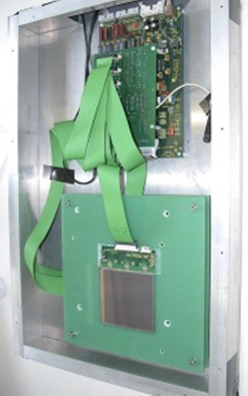
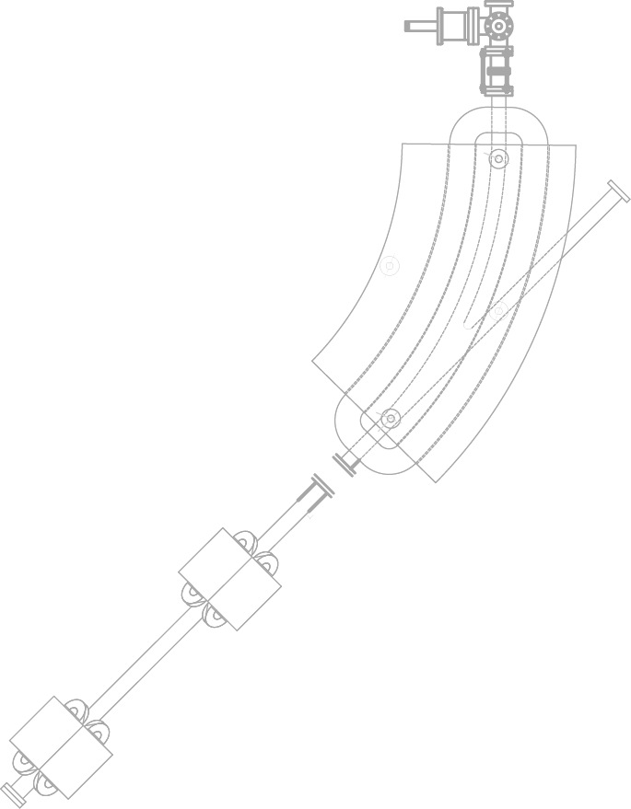
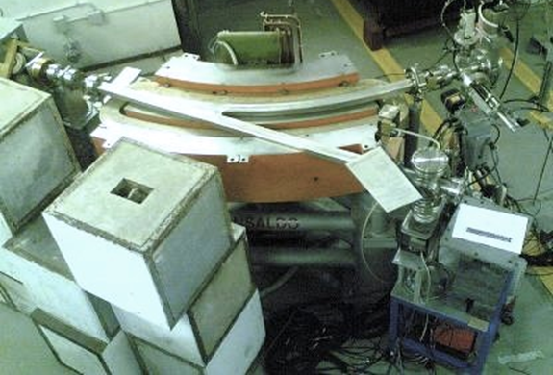
Photon tagging
Bremsstrahlung
photon
silicon detectors
silicon tagging
target
dipole magnet
Incoming electron
Be window
Designed and built in close collaboration with the AGILE collaboration with the main purpose of the AGILE scientific payload calibration:
  Silicon trackers + calorimeter

Slide 8
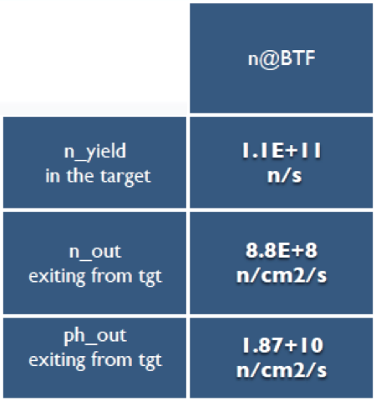
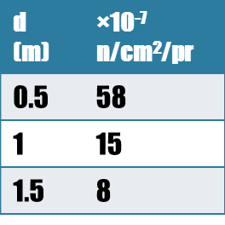
And…Neutron source
At 1.5 m distance:
Total neutron flux: 8×10⁻⁷ n/cm²/pr ±3%
Flux = 4.5×10⁵ n/cm²/s
Equivalente dose = 45 mSv/h
d (m) | ×10⁻⁵ n/cm²/pr
0.5 | 63
1 | 5.7
1.5 | 1

Slide 9
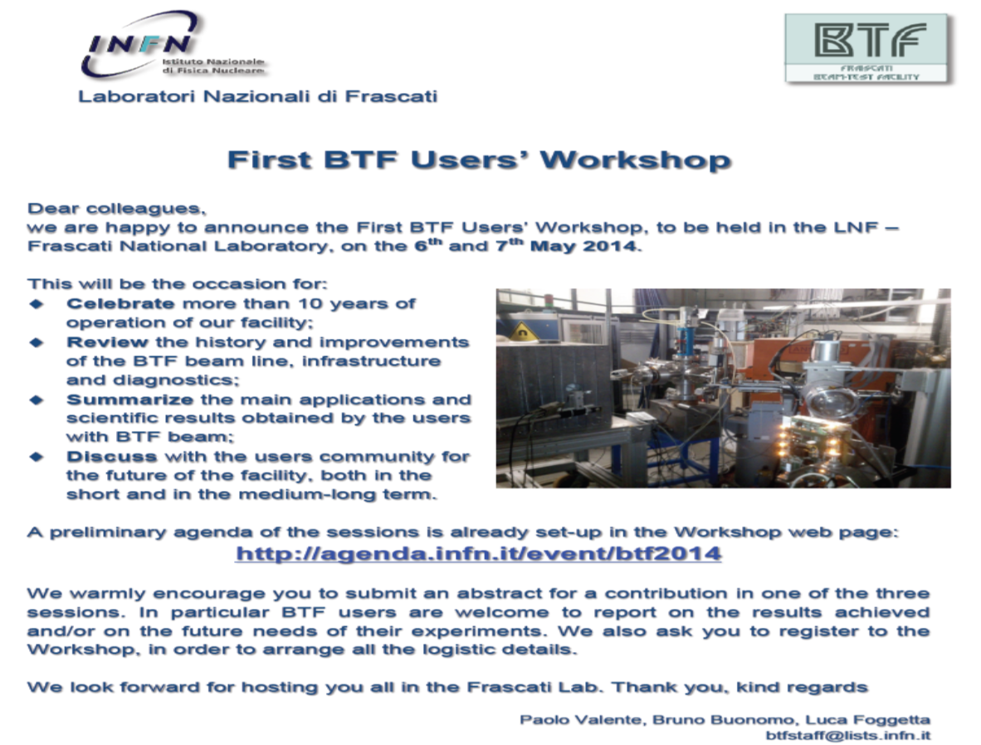
In the future.. New btf lines
  Keep using 0° line for ‘standard’ testing
  Use 45° line to drive beam to a new “target area”
    This allows to have a target station dedicated to neutron production and
    A space for neutron experiments
  Add 90° to build a “low energy” line
    This allows to use the Linac groundwork and tunnel as additional shielding

Slide 10
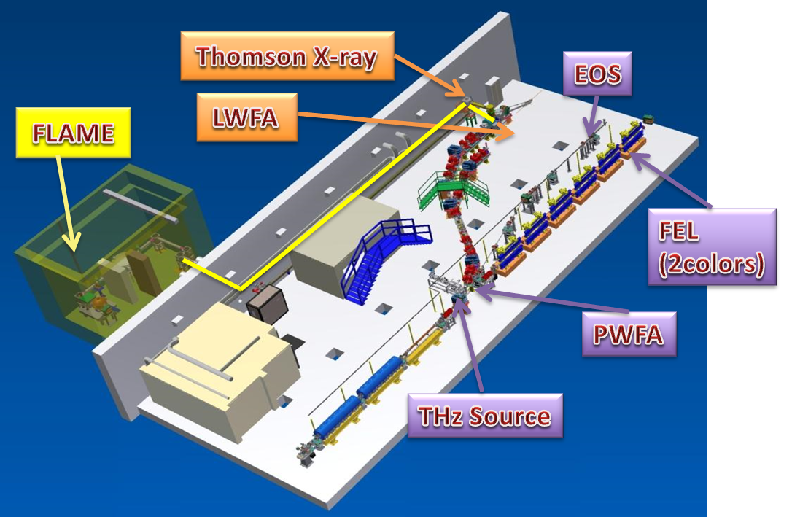
Advanced Acceleration at SPARC_LAB
Sources for Plasma Accelerators and Radiation Compton with Lasers And Beams

Slide 11
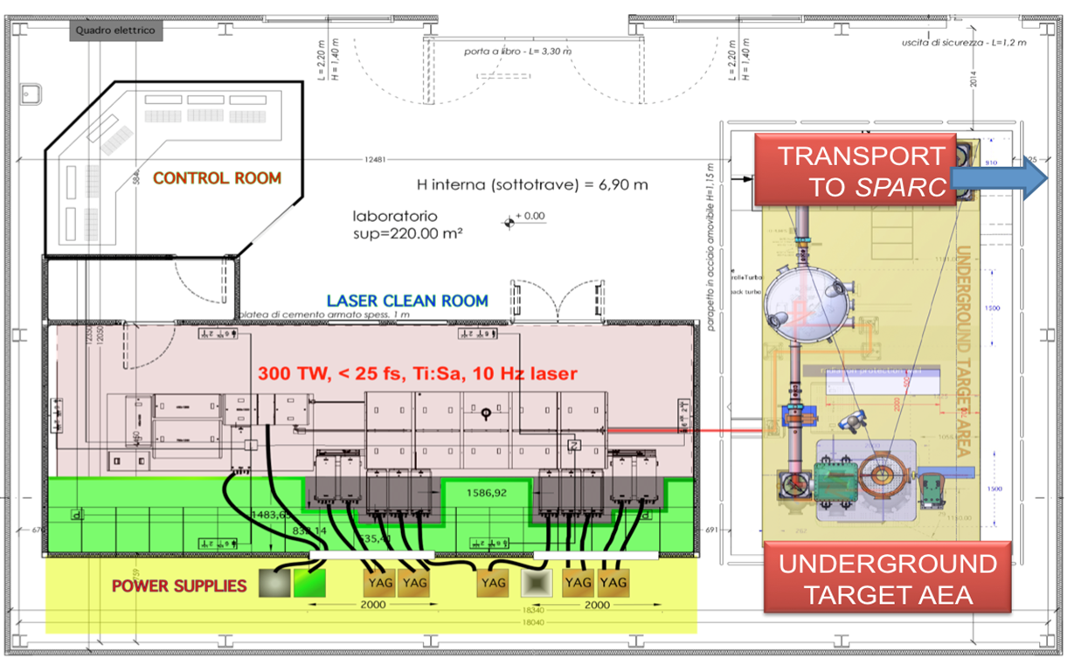
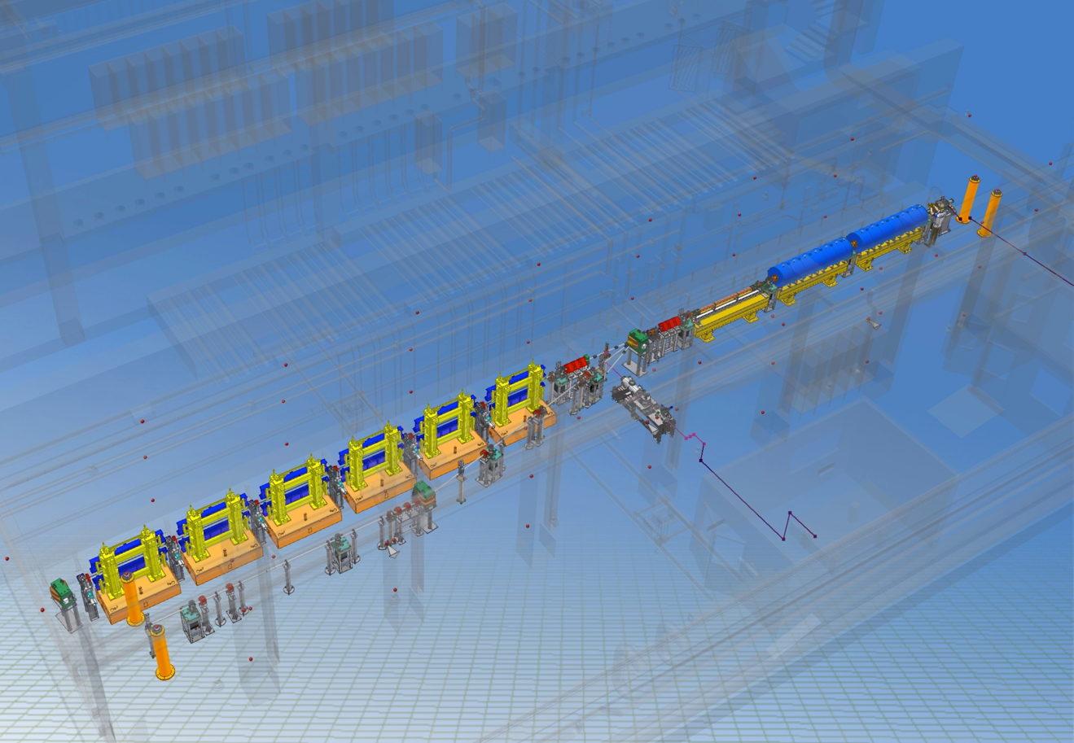

Advanced Acceleration at SPARC_LAB
150 MeV S-band linac
Undulators
λ_{u} = 2.8 cm
K_{max} = 2.2
λ_{r} = 500 nm
Diagnostic and Matching
12 m
15 m

Slide 12
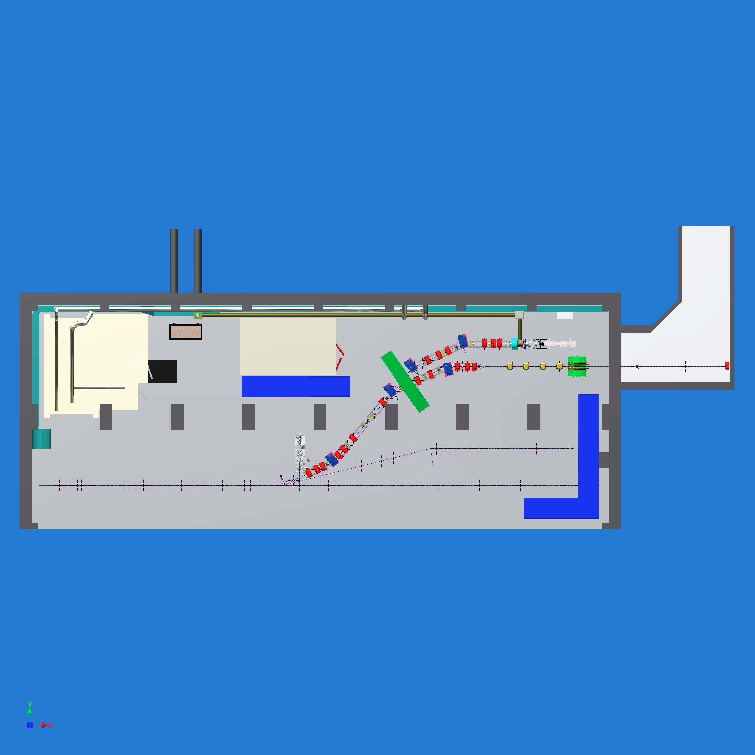
New installations
Thomson source
Plasma acceleration

Slide 13
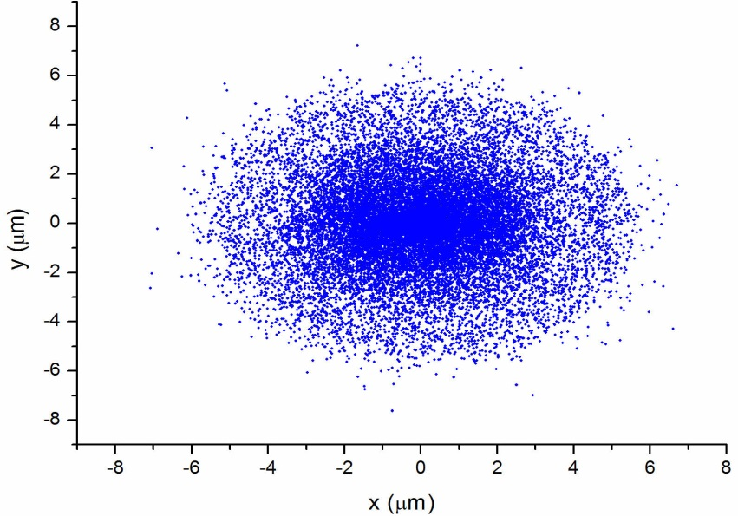
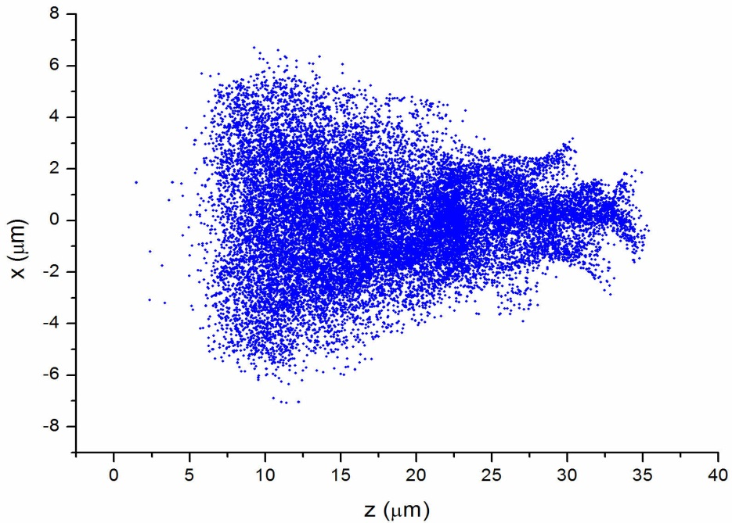
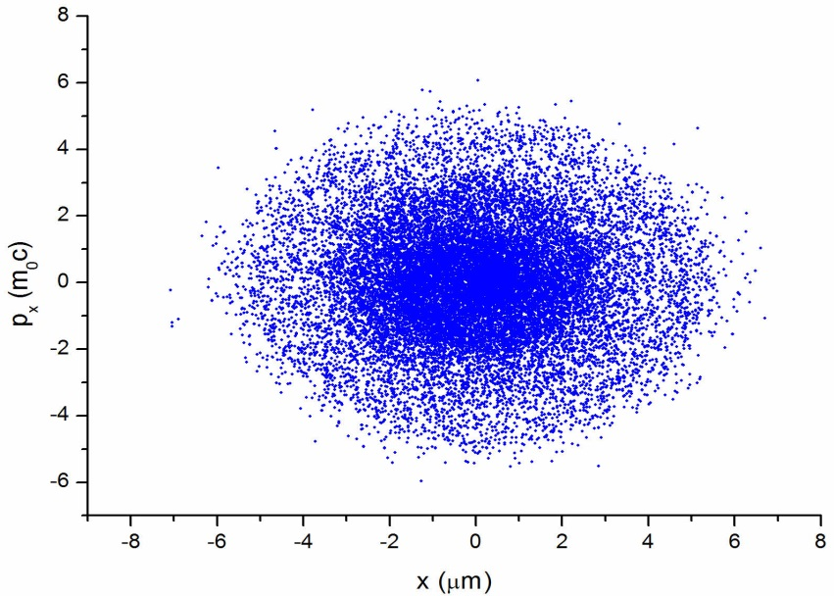
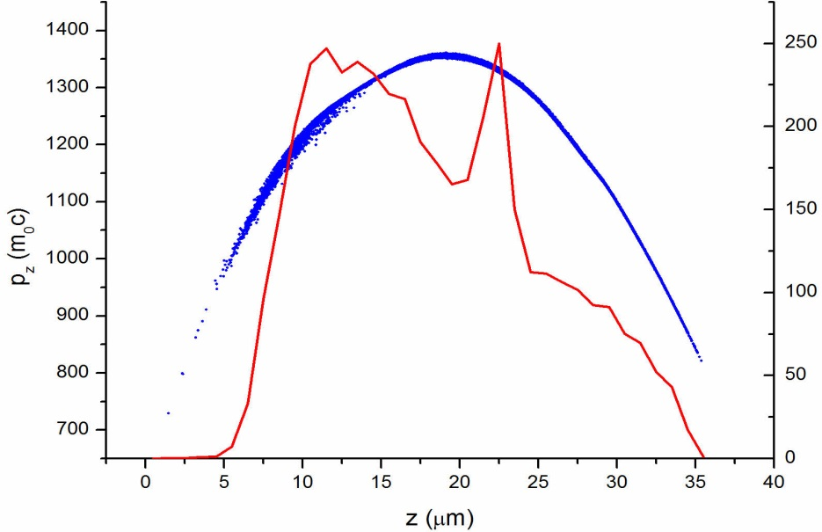
The External Injection Experiment@SPARC_LAB (Simulation results)
Best beam: Δt = 182 fs, σ_{x} = 3.8 μm.
EXIN goals:
Produce High brilliance e-beam peak
or global.
Stability
Reproducibility.
Everything in the easiest way
σ_{x} = 2.0 μm
E = 630 MeV
ε_{nx} = 3.5 μm
Δγ/γ= 7.7 %
The plasma is created by the laser pulse which also drives the beam
Experiment will take place in 2-3 years from now

Slide 14
Particle Wakefield acceleration
Resonant plasma excitation by a Train of Bunches
Laser Comb to produce high Brightness electron bunches?
High quality bunch preservation during acceleration and transport. preservatiort?

Slide 15
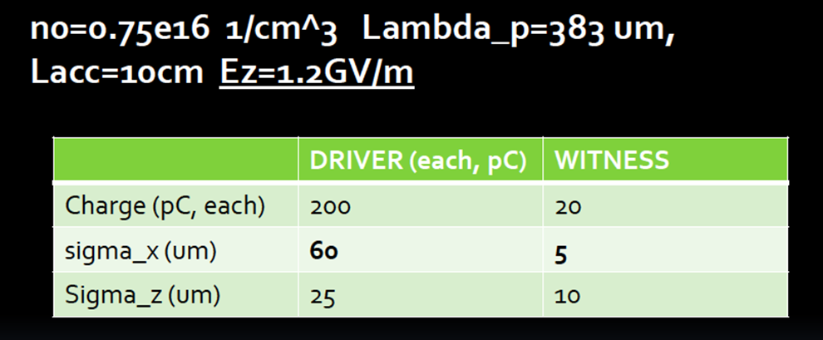
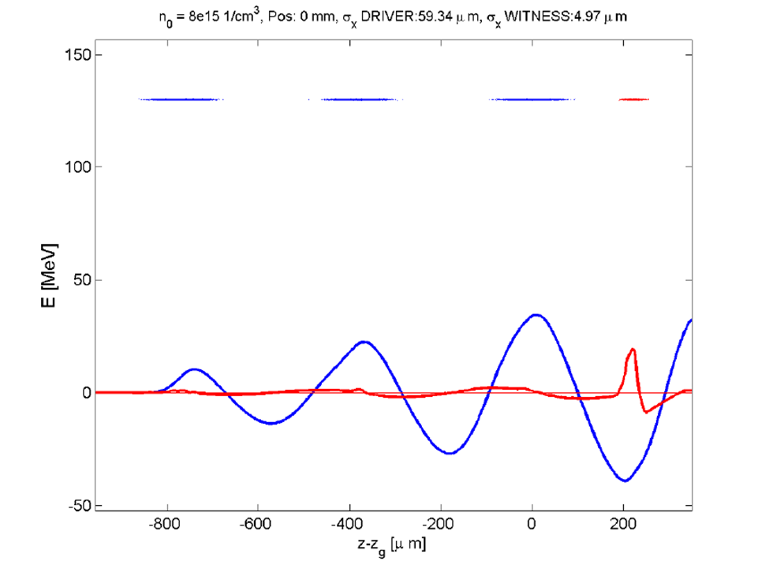
First test results
Resonant plasma excitation by a Train of Bunches
In this case plasma is created by
a discharge in Hydrogen and driven by the
first 3 driver beams.
2015-2016 first experiment results

Slide 16
IRIDE: Interdisciplinary Research Infrastructure with Dual Electron linacs&lasers
aims and potentials (The Future)
Science with Free Electron Lasers (FEL) from infrared to X-rays,
Nuclear photonics with Compton back-scattering g-rays sources,
Science with THz radiation sources,
Advanced Neutron sources by photo-production,
Fundamental physics investigations with low energy linear colliders
Physics with high power/intensity lasers,
R&D on advanced accelerator concepts including plasma accelerators and polarized positron sources
ILC technology implementation
Detector development for X-ray FEL and Linear Colliders
R&D in accelerator technology and industrial spin – off

Slide 17






IRIDE
I R I D E is a large infrastructure for fundamental and applied physics research. Conceived as an innovative and evolutionary tool for multi-disciplinary investigations in a wide field of scientific, technological and industrial applications, it will be a high intensity “particle beams factory”.
n,π^{ο}
10¹⁴
e⁺
10⁹
PWA
γ
10³²
GeV
GeV
GeV
10³⁰
2K-CRYO
2K-CRYO
Based on a combination of a high duty cycle radio-frequency superconducting electron linac (SC RF LINAC) and of high energy lasers it will be able to produce a high flux of electrons, photons (from infrared to γ-rays), neutrons, protons and eventually positrons, that will be available for a wide national and international scientific community interested to take profit of the most advanced particle and radiation sources.

Slide 18
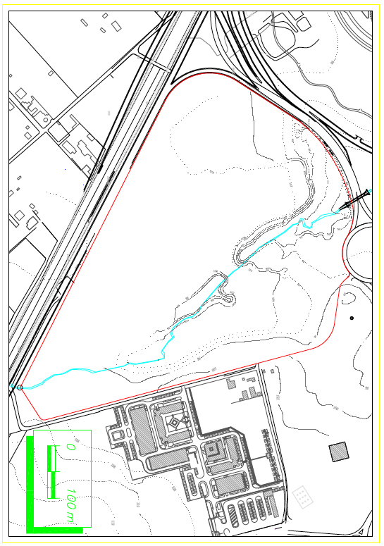

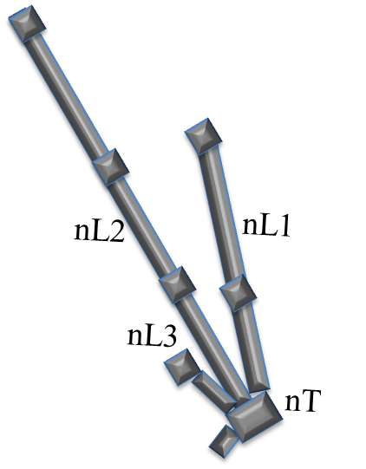


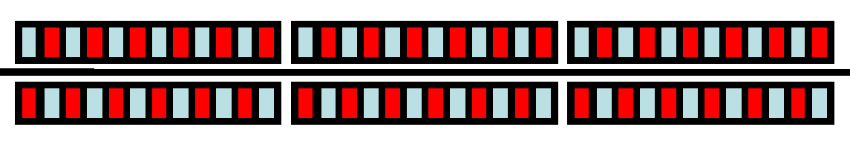








IRIDE
FEL2
L2
Inj2
FEL1
FF
CS
L1
THz
Inj1

Slide 19
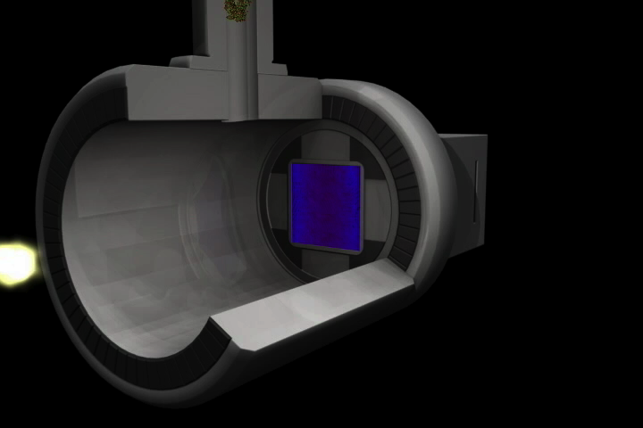
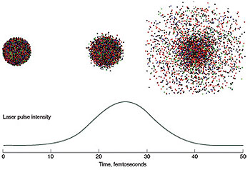
There is also room for Protein imaging
Using extremely short and intense X-ray pulses to capture images of objects such as proteins before the X-rays destroy the sample.
Single-molecule diffractive imaging with an X-ray free-electron laser.
Individual biological molecules will be made to fall through the X-ray beam, one at a time, and their structural information recorded in the form of a diffraction pattern.
The pulse will ultimately destroy each molecule, but not before the pulse has diffracted from the undamaged structure.
The patterns are combined to form an atomic-resolution image of the molecule.
The speed record of 25 femtoseconds for flash imaging was achieved.
Models indicate that atomic-resolution imaging can be achieved with pulses shorter than 20 femtoseconds.
Lawrence Livermore National Laboratory (LLNL)
P. Branchini on behalf of LNF

Slide 20
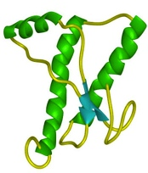
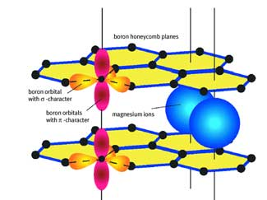
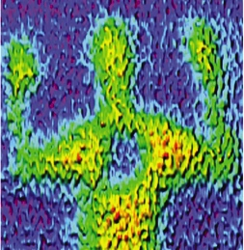
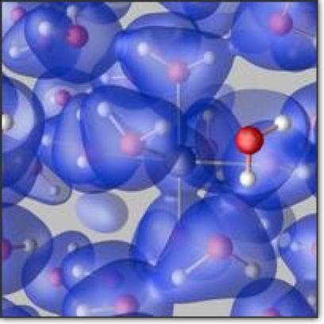
THz radiation source
Life Sciences
Condensed Matter Physics
Superconductivity
Energy gap
Symmetry of the order parameter
Direct determination of the superfluid density Dynamics of Cooper pairs
Low-dimensional materials
Dimensionality crossover
Non-Fermi liquid normal states
Broken symmetry ground states
Coherent Phase Transitions
Polarons
Structural Phase Transitions
Magnetic sub-ps Dynamics
Macromolecules conformation
Secondary and tertiary structure
Coherent dynamic development
Imaging
3D tomography of dry tissues
Near-field sub-wavelenght spatial resolution
New Technologies
THz technologies
Array THz detectors
Metamaterials
Medical diagnostic
Skin cancer detection
Industrial production
Material inspection
Production line monitoring
Defense industry/Homeland security
Detection of explosives and biohazards
Physical and Analytical Chemistry
Polar liquids
Hydrogen bond
Van der Waals interactions
Acoustic-Optic phonon mixing in water
Solutions
Static and dynamic interactions between solvated
ions and solvent
P. Branchini on behalf of LNF

Slide 21
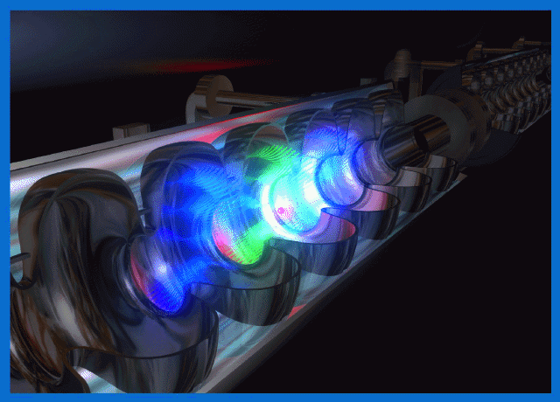
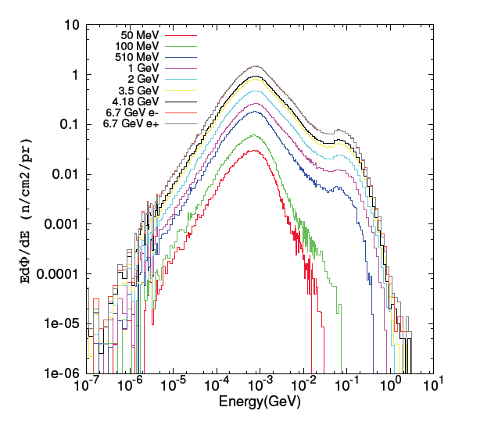
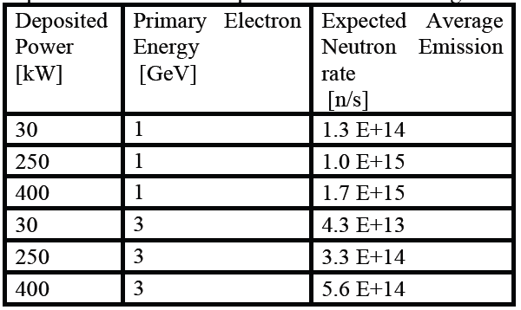
Neutron source
This source may be suitable for multiple applications, ranging from material analysis for industrial and cultural heritages purposes to chip irradiation and metrology. These applications envisage the development of properly designed beam lines with neutron moderation and possibly cold/thermal neutron transport systems. The proposed new facility will represent a great opportunity for research and development of neutron instrumentation (e.g. detectors) as well as training of young scientist in the use and development of neutron techniques.
P. Branchini on behalf of LNF

Slide 22
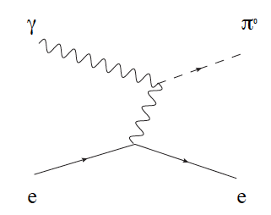
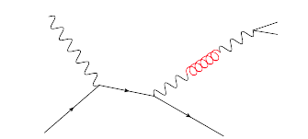
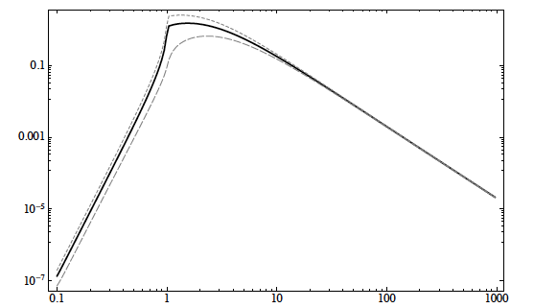
e-γ, γ-γ Collider options
And last but not least: Particle physics opportunities
Nuclear and Particle Physics will benefit from the availability
of these new generation γ-ray beams for:
studies of the nucleus structure at the Pigmy and Giant Dipole Resonance with unprecedented resolution in the reconstruction of the nuclear states;
electron-photon collision can be a source of π⁰ produced via the Primakoff effect having an electron as a “target” instead of a nucleus;
search for beyond-standard-model (BSM), weakly interacting boson “U”;
The elastic photon-photon scattering offers unique opportunities to probe the nature of QED vacuum. An experiment to observe photon-photon scattering in the range 1 MeV – 2 MeV CM energy, i.e., near the peak of the QED cross-section will be performed.
e⁻
γ
U
e⁺
γ
e⁻
e⁻
P. Branchini on behalf of LNF

Slide 23
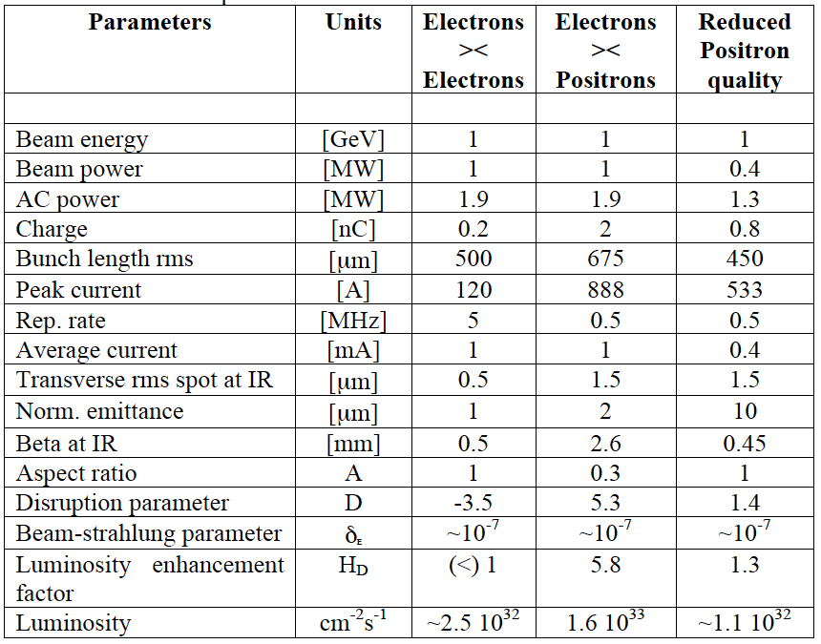
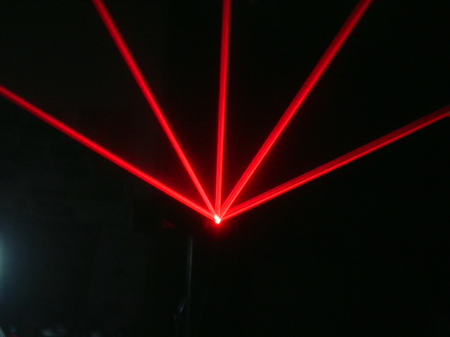
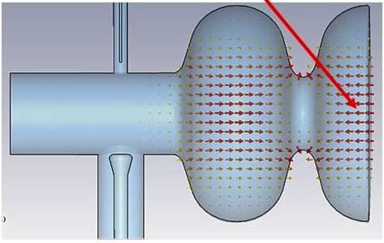


e⁺ e⁻ Linear Collider
And last but not least: Particle physics opportunities
An electron-positron collider with luminosity of 10³² cm⁻²s⁻¹ with c.m. energy ranging from the the φ-resonance up to ∼3.0 GeV, would allow many fundamental measurements.
Precision measurement of muon (g-2);
Precise measurement of the fine-structure constant α_{S};
Study of scalar resonances;
Spectroscopy of baryon form factors
e⁺
3 GeV
1.5 GeV
1.5 GeV
CRYO
CRYO
P. Branchini on behalf of LNF

Slide 24
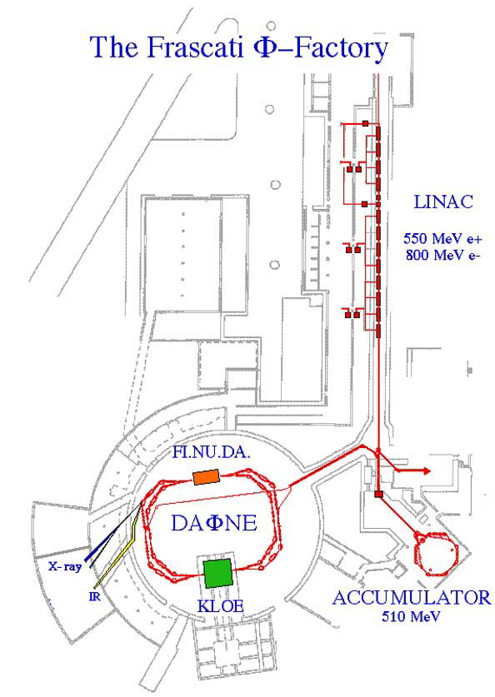
The Frascati Φ factory
Production of Φ particles via the
annihilation of electrons and positrons
at the energy of the resonance.
 | DAΦNE upgrade SIDDHARTA Crab Waist collision scheme | DAΦNE KLOE | DAΦNE FINUDA
L_{peak} [cm⁻²s⁻¹] | 4.53•10³² (5.0•10³²) | 1.5•10³² | 1.6 •10³²
L_{∫day} [pb⁻¹] | 14.98 | 9.8 | 9.4
L_{∫1 hour} [pb⁻¹] | 1.033 | 0.44 | 0.5
Syncrotron ligth from DAΦNE
LNF are part of the European
Infrastructure
for syncrotron light
UV 2 - 10 eV
X-ray 900 - 3000 eV
IR 1.24 meV - 1.24 eV

Slide 25





Daφne Luminosity 2001-2009
Design Goal
Crab-Waist COLLISION SCHEME
KLOE
FINUDA
SIDDHARTA (DEAR)

Slide 26


KLOE at DAΦNE
The experiment has taken data from 2000 to 2006, collecting 2.5 fb⁻¹ at the Φ peak, plus additional 0.25 fb⁻¹ at 1000 MeV.
KLOE is multi-purpose detector optimized for KL physics
Drift Chamber
E.M. Calorimeter
Huge, transparent Drift Chamber
in 5.2 k Gauss field of a SC coil;
Carbon fiber walls, 55000 stereo wires,
2 m radius, 4 m long, He/CO2 gas mixture;
Momentum resolution: σ(pT)/pT ~ 0.4%.
Pb-Scintillating Fiber Calorimeter with excellent timing performance
24 barrel modules, 4 m long and C-shaped End-Caps for 98% solid angle coverage
Time resolution = 54 ps / √E(GeV) ⊕ 50 ps;
Energy resolution = 5.7% / √E(GeV)

Slide 27
Large Crossing Angle, Small x size
1) Head-on,
Short bunches
Overlap region
2) Large crossing angle,
long bunches
(1) and (2) have same Luminosity, but (2) has longer bunches and smaller σ_{x}
σ_{x}
σ_{z}
σ_{x}
σ_{z}
Vertical waist has to be a function of x:
Z = 0 for particles at –σ_{x} (- σ_{x}/2θ at low current)
Z = σ_{x}/θ for particles at + σ_{x} (σ_{x}/2θ at low current)
Large Piwinski angle:
Φ = tg(θ)σ_{z}/σ_{x}
y waist can be moved
along z with a sextupole
on both sides of IP
at proper phase
“Crab Waist”
KLOE
FINUDA
β_{Y}

Slide 28

Crab-Waist Scheme
Crab sextupoles OFF: Waist line is orthogonal to the axis of other beam
Raimondi, Shatilov, Zobov http://arxiv.org/abs/physics/0702033
KLOE
FINUDA
Crab sextupoles ON: Waist aligned with path of other beam
particles at higher ß do not see full field of other beam
no excessive beam-beam parameter due to hourglass effect

Slide 29




september 2013
I ~ 460 mA
I_{1b} ~ 7.3 mA
Beam current limited by collective effects:
  Transverse beam size grows with the current due to ion trapping
  transverse instabilities appear above ~ 460 mA.
Further improvements required:
  recovering optimal vacuum condition
  tuning transverse feedbacks
100 bunches
September 26th 2013

Slide 30



From september up to now
Natural coupling of the positron beam
After much work on collider consolidation
we are gettiing close to the DAΦNE design
parameters.
We could store:
I+ ~ 1.1 A
I- ~ 1.4 A
Coupling of the electron beam

Slide 31

Feb 10th 2014
Daily integrated luminosity
As measured by KLOE.
Obtained:
A week after restarting collisions
With Crab-Sextupoles off
The uptime is close to 100%

Slide 32












Het Status
Modification/Improvement of the mechanics of the movement system
New Detector BOX in order to locate Front End board very close to the PMT essentially to reduce the noise

Slide 33



Test of the HETs
Noise without Beam :
A threshold of about 20 mV reduce the noise at level of few Hz
Data with e⁻ or e⁺ beams on DAFNE :
We clearly identify and distinguish contiguous bunches (2.7 ns)

Slide 34



Low Energy Tagger
Integration with QCALT
Installation completed in June 2013
W shields
LET
QCALT
Window in the
beam-pipe support

Slide 35



Calibration with cosmics
Track selection with
EMC
Z [cm]
track intersection with
the horizontal plane ⇒
X [cm]
MIP examples
⇒
TDC spectrum [counts]

Slide 36





QCALT Installationand tests
Both QCALT installed
on May 2013
750 ps time resolution after slewing correction LY 26 pe/mip/tile
Results already satisfying for QCALT requests
LET housing and shileding
26pe/mip

Slide 37


Ccalt installation and performances (Timing)
We determined it at BTF of Frascati, with a single crystal (20x20x15 mm²) read out by a 10x10 mm² Hamamatsu APD
Time resolution:
250 (90) ps @ 500 MeV
290 (120) ps @ 100 MeV

Slide 38




IT final assembly
The final assembly of the KLOE-2 Inner Tracker, with the insertion of all the triple-CGEMs one into the other took place in March 2013

Slide 39




IT integration
Protection shell installation
Interaction region movement
Kapton protection on the HV boards
IR positioning

Slide 40


Results from first KLOE-2 runs
Number of strips hit for event on all the layers for both views
Efficiency
Layer 1 | 75%
Layer 2 | 89%
Layer 3 | 90%
Layer 4 | 57%
Cosmic-ray muon sample selected with EMC info
Operational parameters not yet optimized
To be investigated

Slide 41
KLOE-2 Physics Program
Kaon Physics
  Test of CPT (and QM) in correlated kaon decays and test of CPT in KS semileptonic decays
  Test of SM (CKM unitarity, lepton universality)
  Test of χ_{PT} (K_{S} decays)
Spectroscopy of light mesons
  η,η’,f₀,a₀,σ in φ radiative decays
Hadronic cross section from 2m_{π} to 2.4 GeV
  α_{em}(M_{Z}) and (g-2)_{μ}
γγ Physics
  Study of Γ(S/PS→γγ), test of χ_{PT}, existence and properties of σ meson………
Dark Matter searches (light bosons at at O(1 GeV))

Slide 42
SIDDHARTA future plans
SIDDHARTA Physics program will continue for next years with SIDDHARTA-2.
The detector will be placed in the IP2 after the KLOE-2 data taking.
Kaonic deuterium measurement - 1st measurement
Kaonic helium transitions to the 1s level
3) Other light kaonic atoms (KO, KC,…)
4) Heavier kaonic atoms measurement
(Si, Pb…)
5) Kaon radiative capture – Λ(1405) study
6) Investigate the possibility of the measurement of other
types of hadronic exotic atoms (sigmonic hydrogen?)
7) Kaon mass precision measurement at the level of <10 keV

Slide 43
Conclusions
DAΦNE accelerator scientific life is almost at the end.
LNF is exploring new exciting possibilities and can evolve
into a multi-disciplinary laboratory.
SPARC, IRIDE and space science together with the particle physics (a traditional activity at LNF) science will play an important role in the years to come.

