Slide 1
The Multi-Purpose Detector for JINR heavy ion collider
Stepan Razin
on behalf of the MPD Collaboration at NICA
INSTR14 Novosibirsk February 2014

Slide 2
Heavy ion physics at JINR
A new scientific program on heavy-ion physics is under realization at JINR
( Dudna).
It is devoted to study of in-medium properties of hadrons and nuclear matter equation of state including a search for signals of deconfinement phase
transition and critical end-point. Comprehensive exploration of the QCD diagram will be performed by a careful energy and system-size scan with ion species ranging from protons to over c.m. energy range √s_{NN} = 4 - 11 GeV.
The future Nuclotron-based heavy Ion Collider fAcility ( NICA )
will operate at luminosity of ions up to 10²⁷ cm⁻²s⁻¹ .
¹⁹⁷Au⁷⁹⁺
¹⁹⁷Au⁷⁹⁺
INSTR14 Novosibirsk February 2014

Slide 3
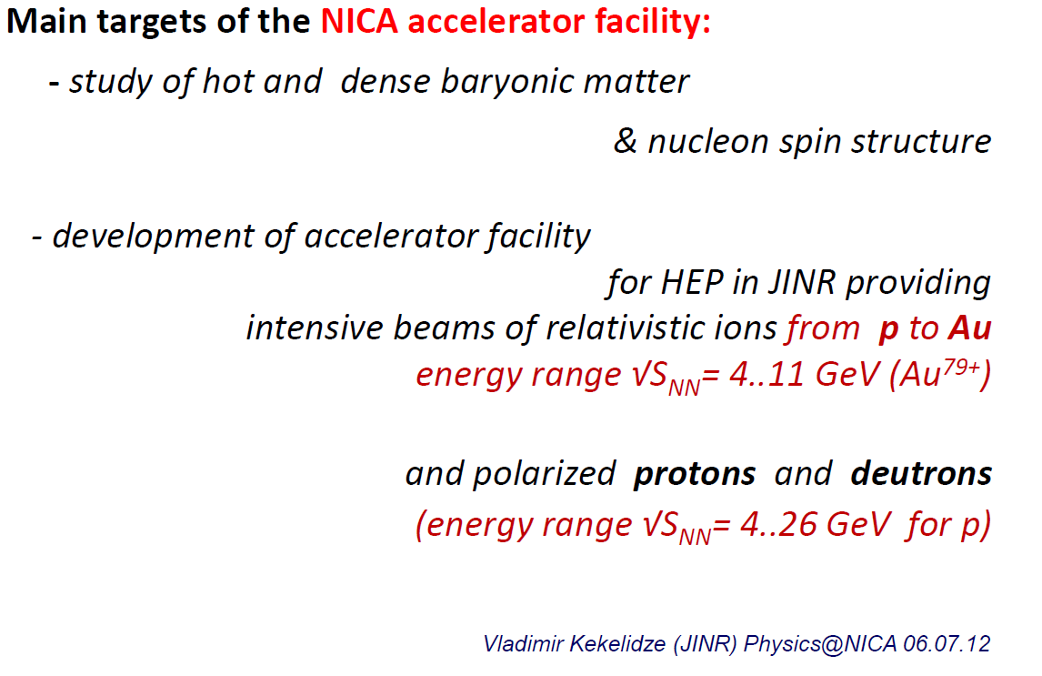

Slide 4
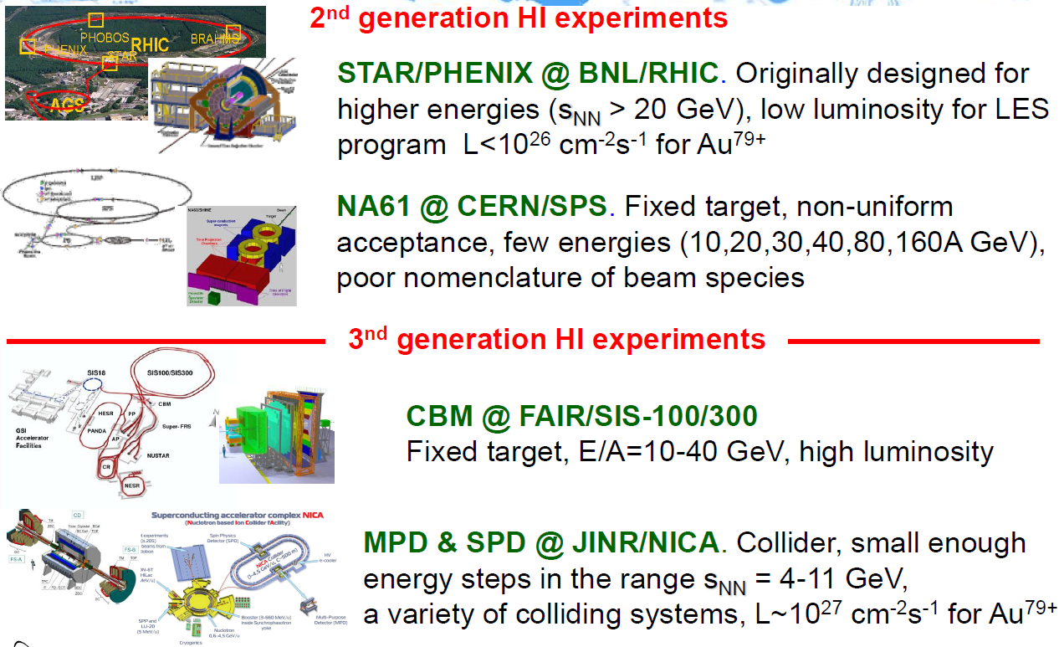
INSTR14 Novosibirsk February 2014

Slide 5
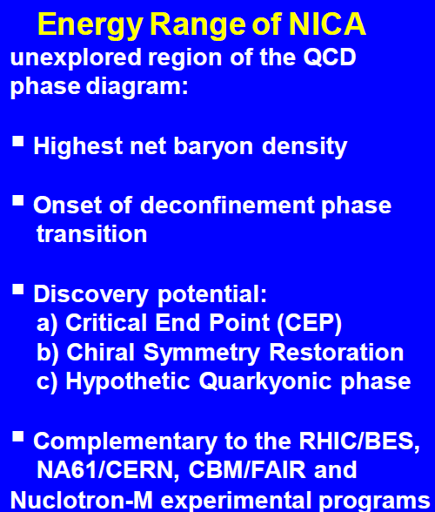
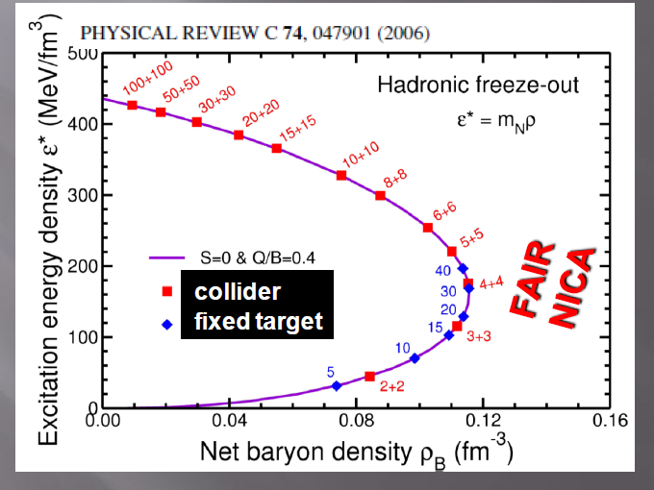
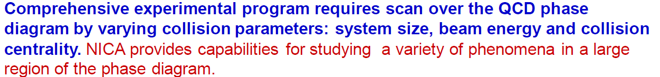
Scanning net baryon densities
J. Randrup and J. Cleymans
INSTR14 Novosibirsk February 2014

Slide 6
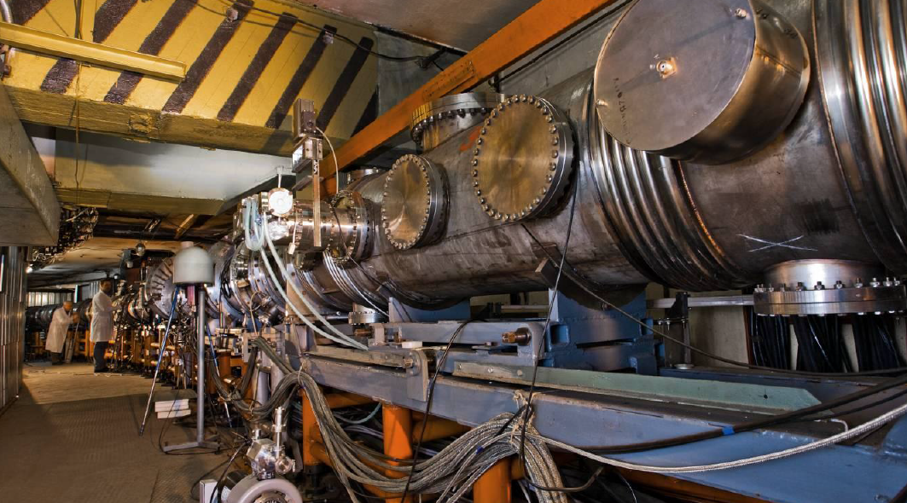
The Nuclotron is the basic facility of JINR for high energy physic research . Acceleration of proton, polarized deuteron and nuclear (or multi charged ion) beams can be provided at the facility. The maximum design energy is 6GeV/u for the particles with charge-to-mass ratio Z/A=½. The Nuclotron was built during 1987-92 and put into operation in 1993. This accelerator based on the unique technology of superconducting fast cycling magnetic system, has been proposed and investigated at the JINR
Parameter | working | planned
Accelerated particles | 1<Z<36 | 1<Z<92
Max Energy ( GeV/n) | 4.2 | 6(A/Z=2)
Magnetic field (T) | 1.5 | 2.0
Slow extraction system
Time extraction (sec) | Up to 10 | up to 10
Energy range (GeV/n) | 0,2-2,3 | 0.2-6.0
INSTR14 Novosibirsk February 2014

Slide 7
NICA operation regime and parameters
Injector: 2×10⁹ ions/pulse of ¹⁹⁷Au³²⁺
at energy of 6.2 MeV/u
Booster (25 Tm)
1(2-3) single-turn injection,
storage of 2 (4-6)×10⁹,
acceleration up to 100 MeV/u,
electron cooling,
acceleration
up to 600 MeV/u
Collider (45 Tm)
Storage of
32 bunches × 1⋅10⁹ ions per ring
at 1÷4.5 GeV/u,
electron and/or stochastic cooling
Stripping (80%) ¹⁹⁷Au³²⁺ ⇒ ¹⁹⁷Au⁷⁹⁺
IP-1
Two superconducting
collider rings
Nuclotron (45 Tm)
injection of one bunch
of 1.1×10⁹ ions,
acceleration up to
1÷4.5 GeV/u max.
IP-2
2 x 32 injection cycles (~ 6 min)
Option: stacking with BB and S-Cooling
~ 2 x 300 injection cycles (~ 1 h)
7
INSTR14 Novosibirsk February 2014
Bunch compression (RF phase jump)

Slide 8
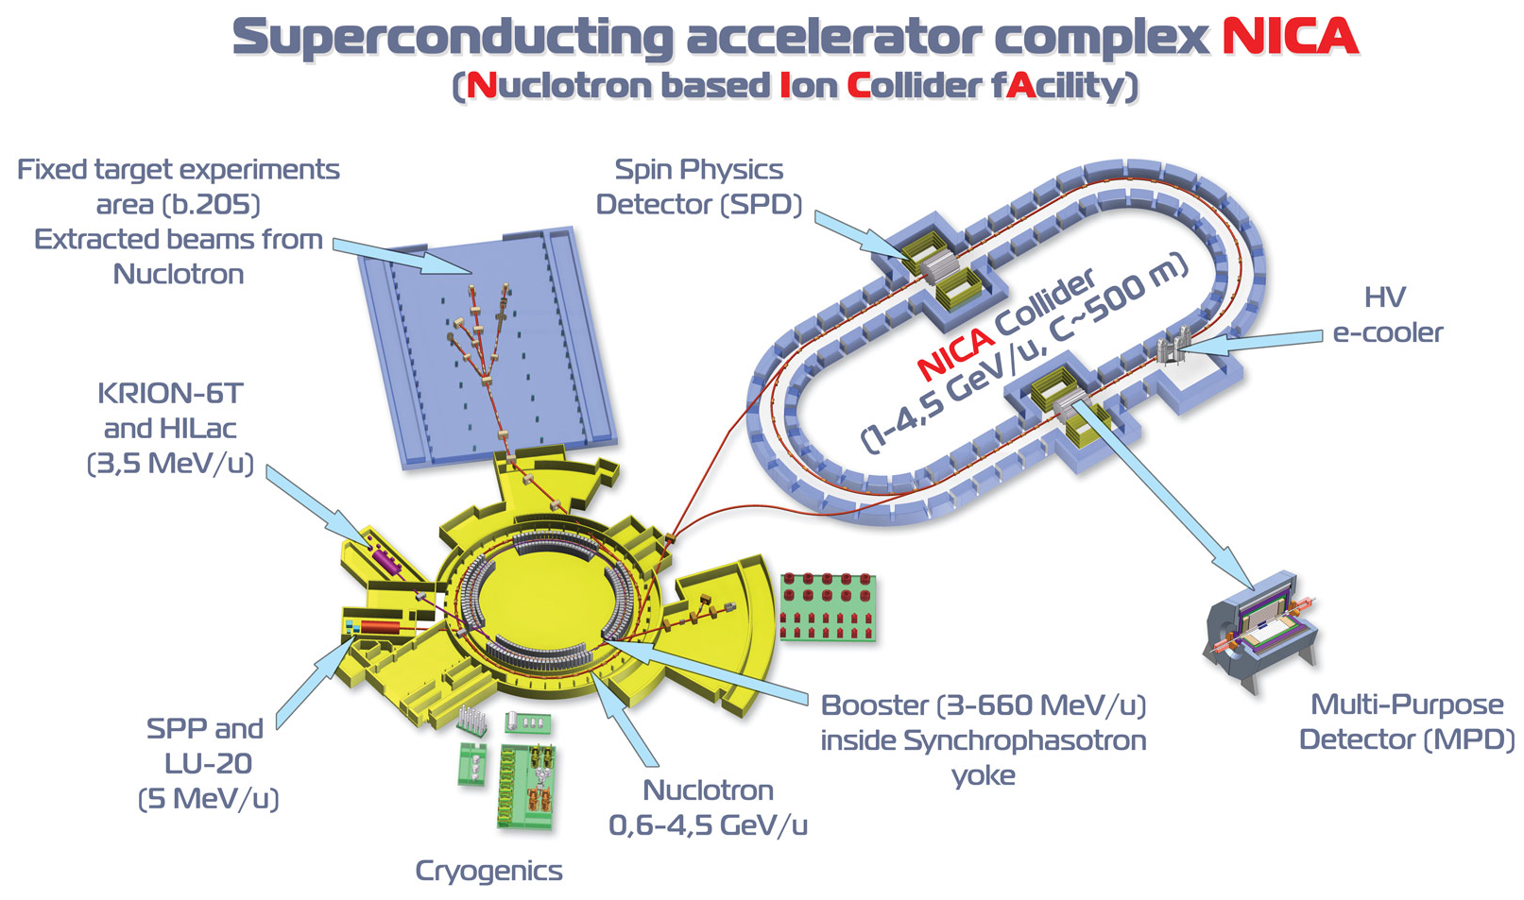
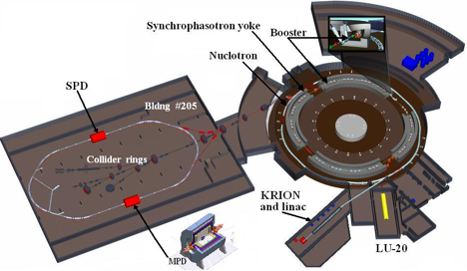
2-nd IP - open for proposals
NICA Collider parameters:
Energy range: √s_{NN} = 4-11 GeV
Beams: from p to Au
Luminosity: L~10²⁷ (Au), 10³² (p)
Detectors: MPD; SPD-> Waiting for Proposals
INSTR14 Novosibirsk February 2014

Slide 9
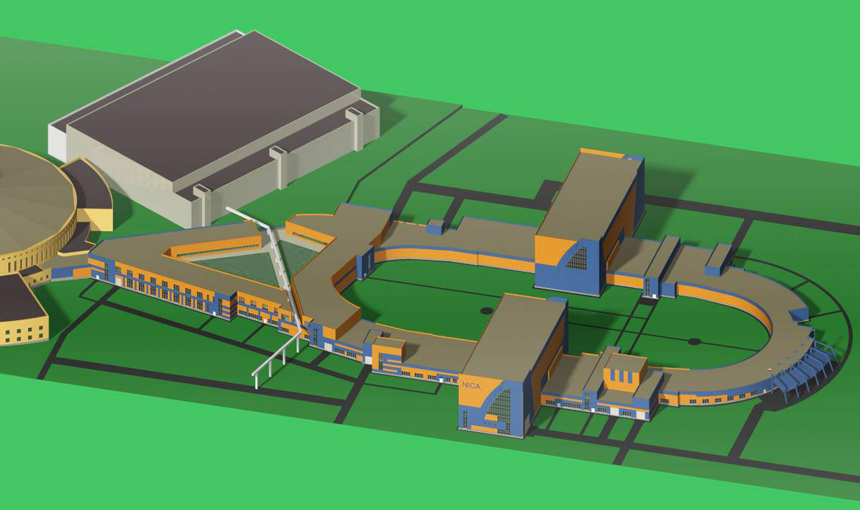
Build. 205
Booster,
Nuclotron
SPD
Collider
MPD
INSTR14 Novosibirsk February 2014

Slide 10
Detector overview
Major physics point for the conceptual design:
deconfinement phase transition: measurements of hadron yields including
multi-strange barions
fluctuation and correlation patterns in the vicinity of the QCD critical end-point:
solid angle coverage close to 4π, high level of particle identification
- in-medium modification of hadron properties: measurements of the dielectrons
invariant mass spectra up to 1 GeV/c2
The MPD is designed as a 4π spectrometer capable of detecting of charged hadrons,
electrons and photons in heavy-ion collisions in the energy range of the NICA collider.
The detector will compromise 3D tracking system and high-performance particle
identification system based on the time-of-flight (TOF) measurements and calorimetry.
At the design luminosity the event rate in the MPD interaction region is about 7 kHz;
total charge particle multiplicity exceeds 1000 in the most central AuAu collisions.
INSTR14 Novosibirsk February 2014

Slide 11
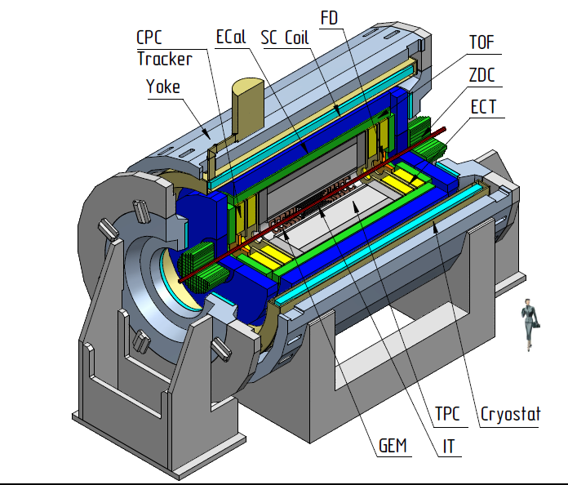
Start up configuration of the MultiPurpose Detector (MPD)
Magnet: 0.6 T SC solenoid
Basic tracking: TPC
ParticleID: TOF, ECAL, TPC
T0, Triggering: FFD
Centrality, Event plane: ZDC
FFD
MPD required features:
hermetic and homogenous acceptance (2π in azimuth), low material budget,
good tracking performance and powerful PID (hadrons, e, γ),
high event rate capability and detailed event characterization
INSTR14 Novosibirsk February 2014

Slide 12
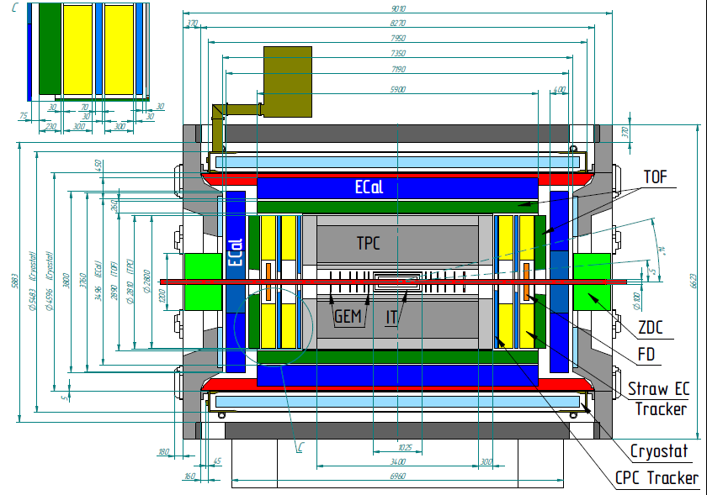
INSTR14 Novosibirsk February 2014

Slide 13
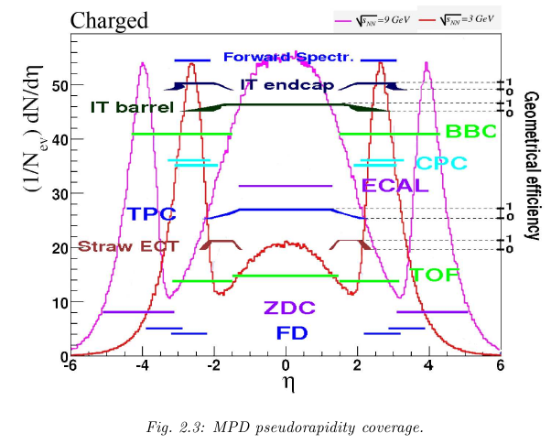
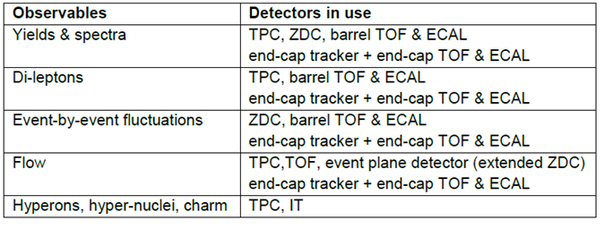
The scientific program of the MPD includes the following topics:
> Particle yields and spectra ( π, K, p, clusters, Λ, Ω )
> Event-by event fluctuation
> Femtoscopy with π, K, p, Λ
> Collective flow of identified hadron species
> In-medium modification of vector mesons
√s=9GeV
√s=3GeV
INSTR14 Novosibirsk February 2014

Slide 14
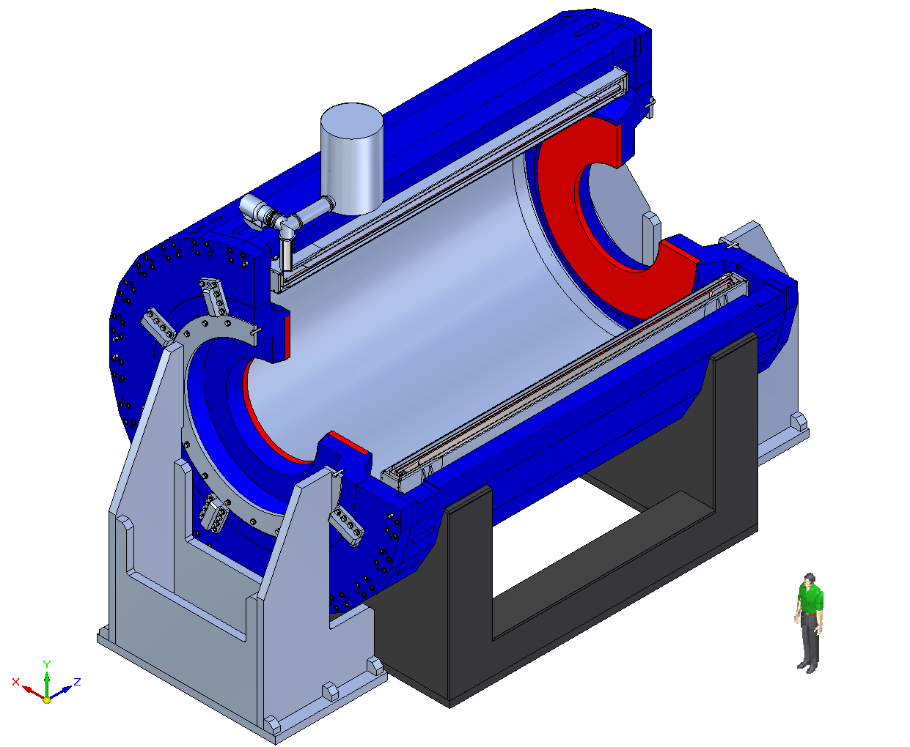
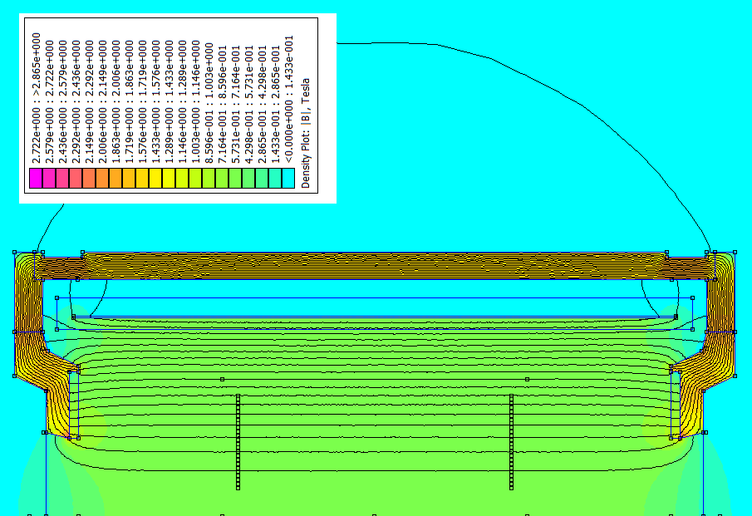
MPD Superconducting solenoid: challenging project
- to reach high level (~ 10⁻⁴) of magnetic field homogeneity
B₀=0.66 T
The design – close to completion;
Survey for contractors:
the cold coil / cryostat;
cryo infrastructure;
engineering infrastructure:
the yoke;
the warm coil
PS etc.
Correction coil (warm)
TPC position
Design by “Neva-Magnet” (Russia)
simulated map of magnetic field
INSTR14 Novosibirsk February 2014

Slide 15
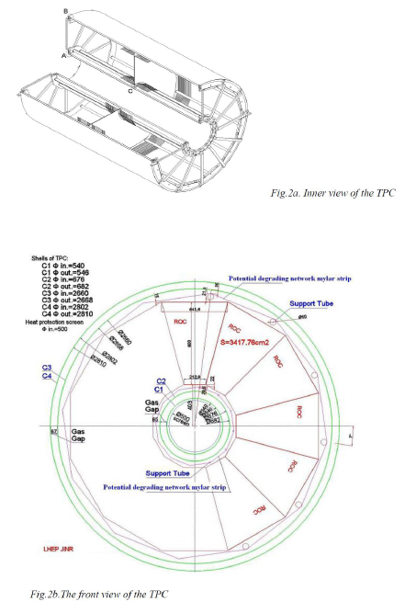
Basic parameters of the MPD TPC:
TPC length – 340cm
Outer radius – 140cm
Drift volume outer radius – 133cm
Inner radius – 27cm,
Drift volume inner radius – 34cm
Length of drift volume – 170cm
Electric field strength – 140V/cm
Magnetic field strength – 0.5 Tesla
Drift gas – 90% Argon + 10% Methane
Readout: 2x12 sectors (MPWC cathode pads
Number of pads ~ 100000
Pad size – 5x12mm, 5x18mm
INSTR14 Novosibirsk February 2014

Slide 16
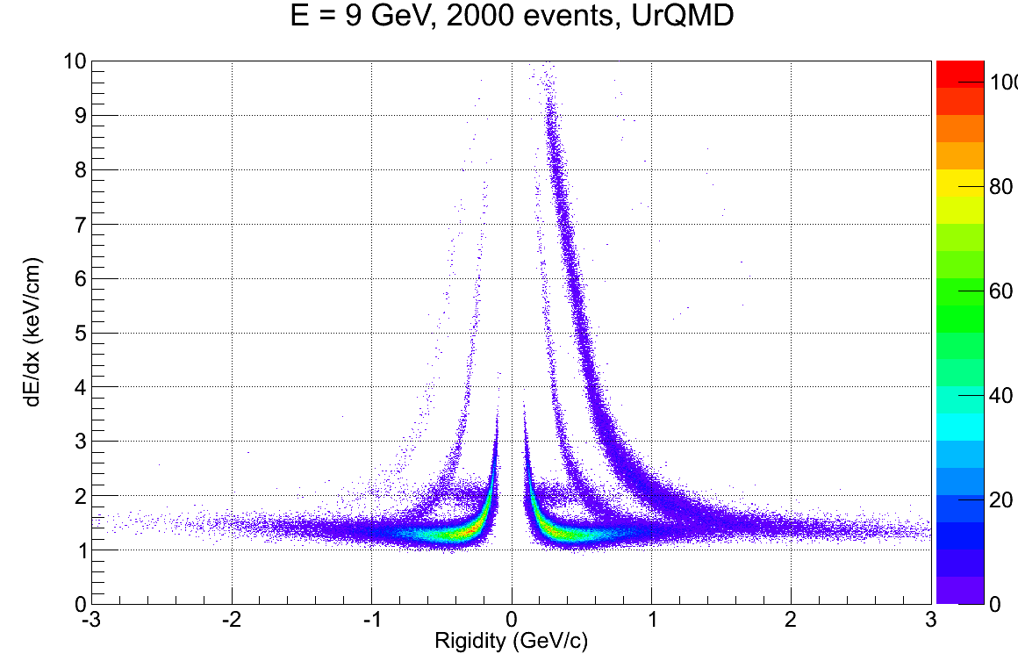
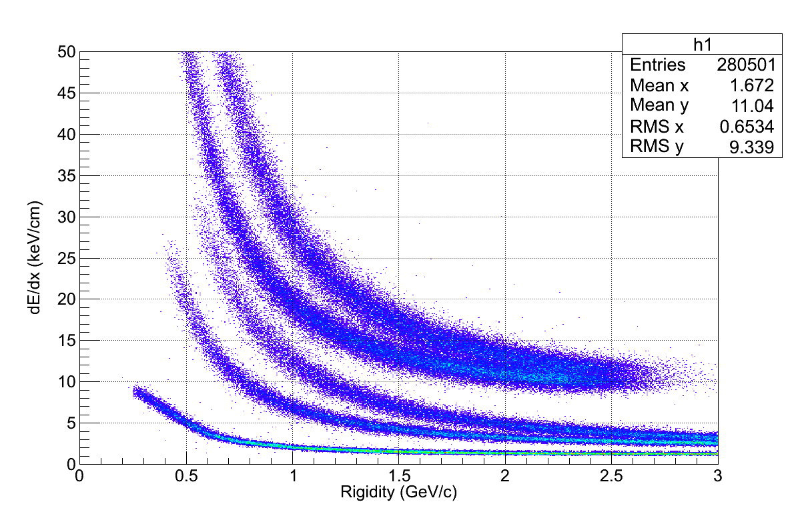
ENERGY LOSS
He3
He4
P
H3
K
D
π
P
e
TPC FEE input full scale amplifier ~ 200 fC
It is ~ 30-40 MIP energy loss
The energy loss distribution in the MPD TPC
PID: Ionization loss (dE/dx)
Separation:
e/h – 1.3..3 GeV/c
π/K – 0.1..0.6 GeV/c
K/p – 0.1..1.2 GeV/c
QGSM Au+Au central collision
9 GeV, b=1fm
INSTR14 Novosibirsk February 2014

Slide 17
Time-of-Flight System
The TOF system is intended to perform particle identification
with total momenta up to 2 GeV/c. The system includes the barrel part
and two endcaps and covers the pseudorapidiry │η│< 2. The TOF is based
on Multigap Resistive Plate Chambers with high timing properties and
efficiency in high particle fluxes. The 2.5-m diameter barrel of TOF has
length of 500cm and covers the pseudorapidity │η│<1.4.
All MRPC are assembled in 12 azimuthal modules providing the overall
Geometric efficiency of about 95%.
The Fast Forward Detector (FFD) will provide TOF system with the start signal.
INSTR14 Novosibirsk February 2014

Slide 18
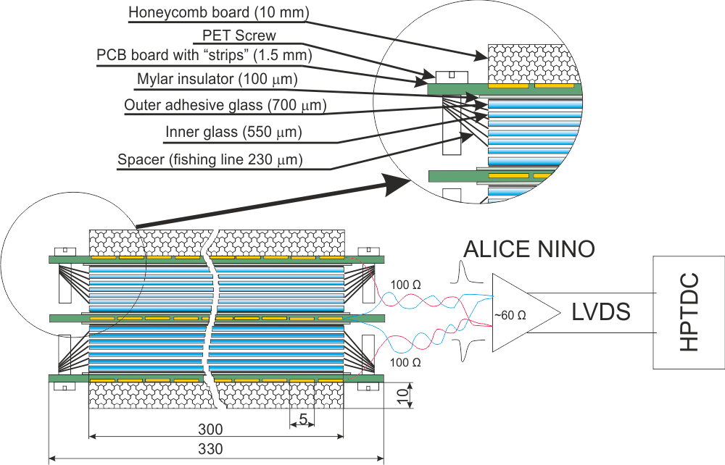
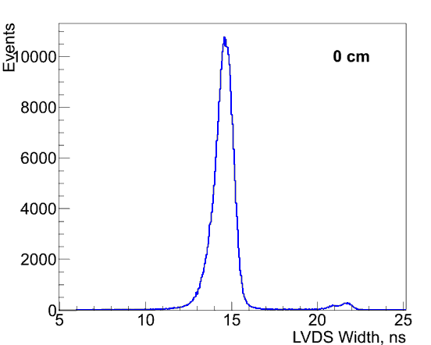
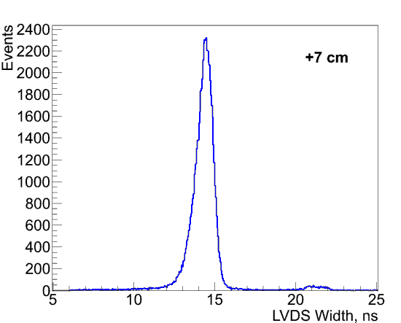
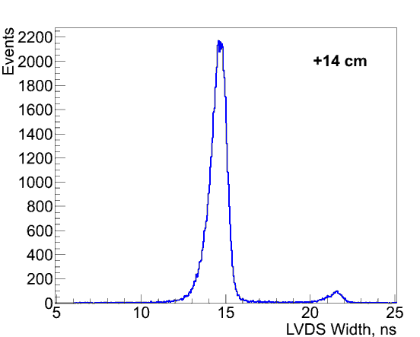
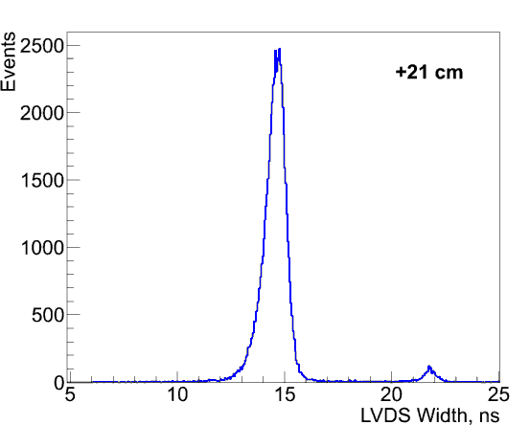
Double stack MRPC with 5 mm strip readout
Double stack prototype characteristics:
Overall dimensions | 700х400 mm
Active surface | 600х300 mm
Channels number | 48
Strip dimensions | 600х5 mm
Thickness of glass (inner, outer) | 550, 700 µm
Gaps number (2 stack) | 6x2 = 12
Gap width | 230 µm
Width spectra for double stack MRPC with 5 mm strip readout (over double parallel twisted pair). The chamber moved perpendicular to the beam on four positions 0 , +7, + 14 and +21 cm.
INSTR14 Novosibirsk February 2014

Slide 19
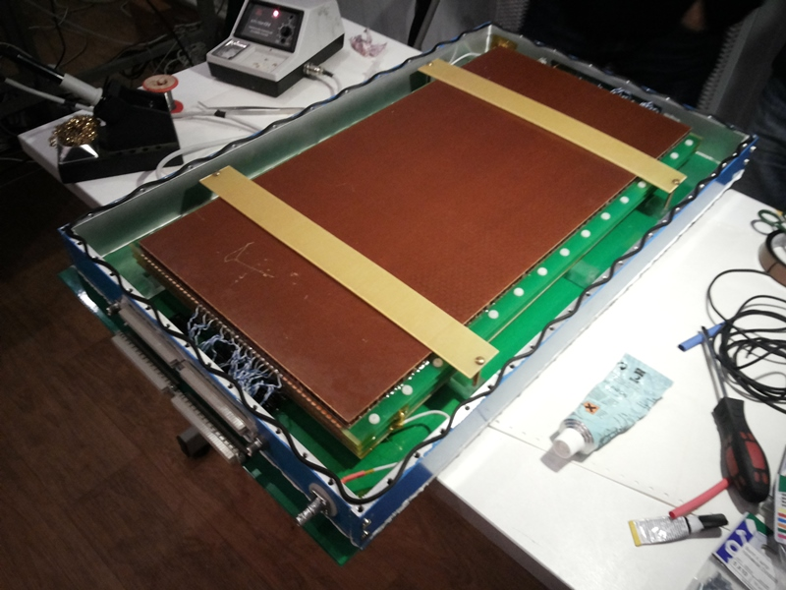
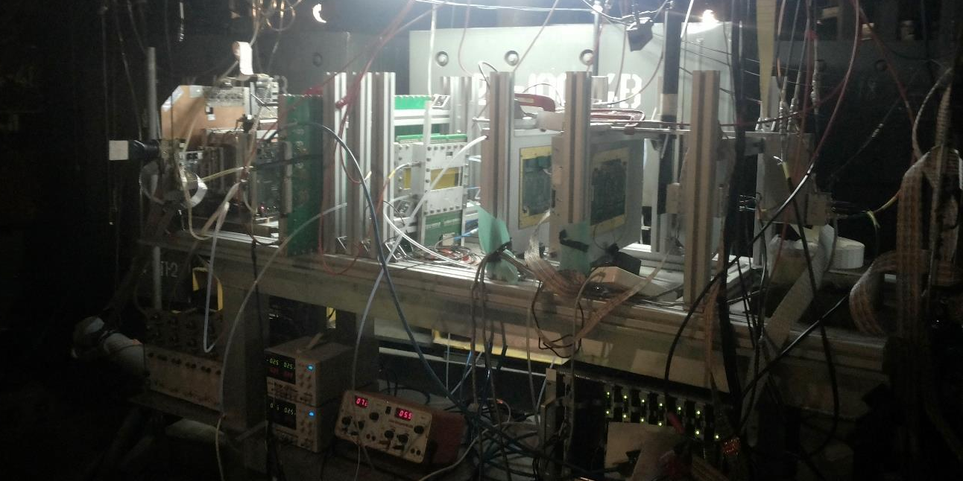
MPD Time-Of-Flight (TOF). Progress in 2013
JINR + Hefei,Beijing(China). Team leader - V. Golovatyuk (VBLHEP)
Main goals in 2013:
Optimization of the TOF geometry and
read-out scheme
Technological development aimed in
achieving better mRPC performances
Experimental study of rate capability for
several prototypes of TOF modules
TOF TDR finalizing (draft is ready)
A full-scale double-stack mRPC prototype
Experimental setup
for mRPC tests
(March’13, Nuclotron))
INSTR14 Novosibirsk February 2014

Slide 20
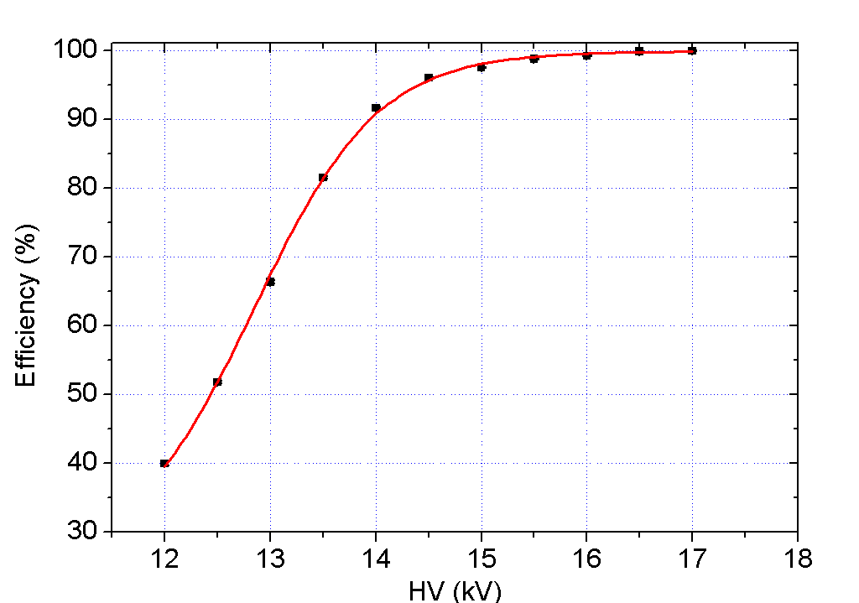
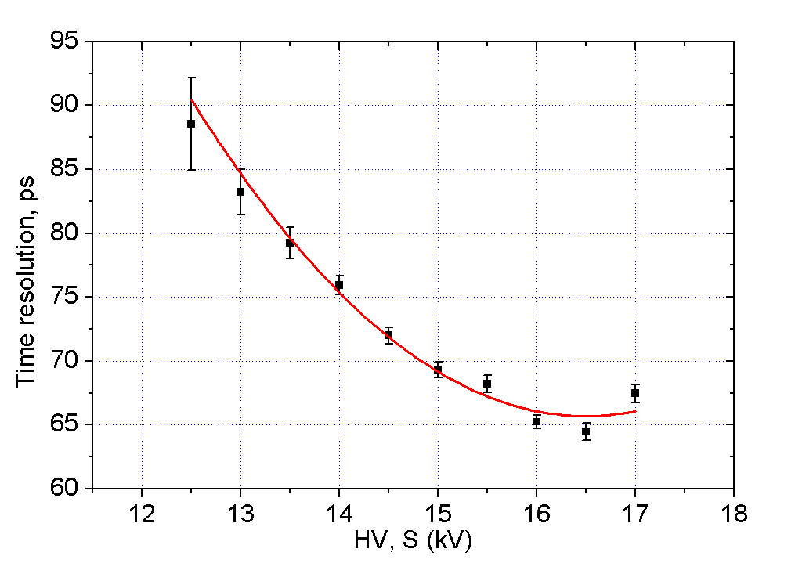
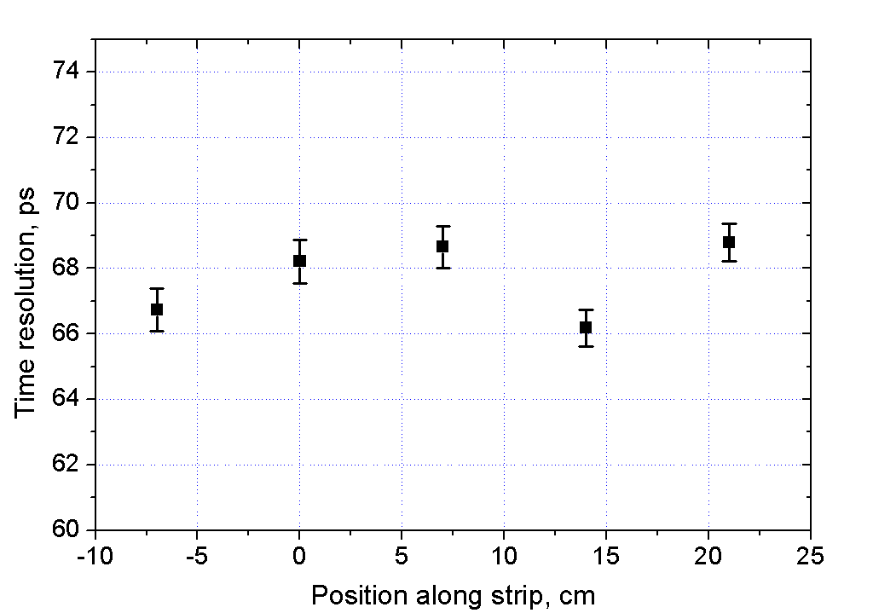
TOF mRPC. Beam tests at Nuclotron (March 2013)
Time resolution of a mRPC
Efficiency of a double-stack
mRPC module
mRPC resolution
along strip length
Timing resolution σ < 70 ps achieved for a
double-stack mRPC module
The resolution does not depend on coordinate
Results of the beam tests will be published soon
INSTR14 Novosibirsk February 2014

Slide 21
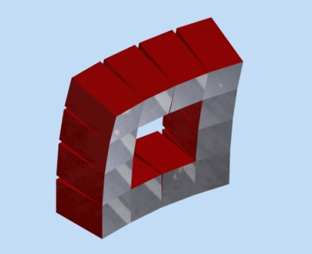
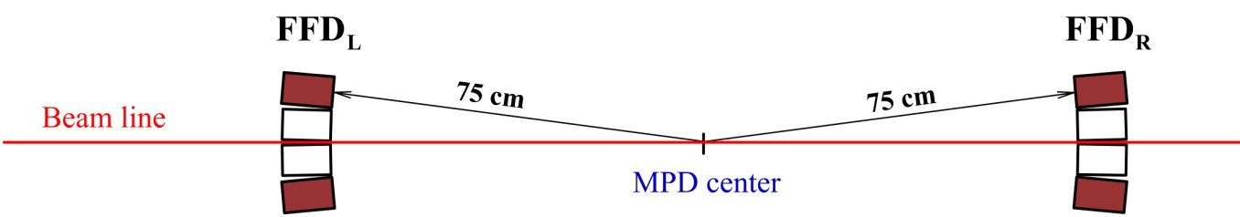
FAST FORWARD DETECTOR
FFD – two-arm picosecond Cherenkov detector of high-energy photons
2.3 < |η | <3.1
Each array consists of 12 modules based on
MCP-PMT XP85012 (Photonis) and it has
granularity of 48 independent channels
Granulated Cherenkov
counters
Problem with ps-timing
Similar fast detectors at RHIC and LHC:
Charged particle velocities β < 1 due to
relatively low energies of NICA
PHENIX BBC Cherenkov quartz counters 52 ps*
PHOBOS Time-zero Cherenkov detectors 60 ps*
STAR Start detector upVPD 80 ps*
ALICE T0 Cherenkov detector ~30 ps*
Solution
Concept of FFD is based on registration of
high-energy photons from neutral pion decays
and it helps to reach the best time resolution
* single detector time resolution
INSTR14 Novosibirsk February 2014

Slide 22

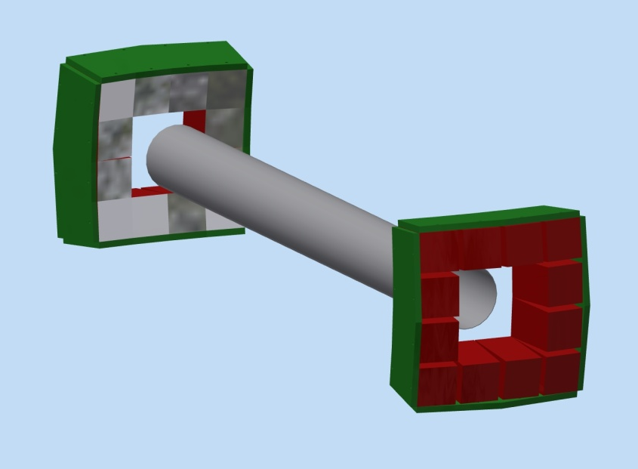
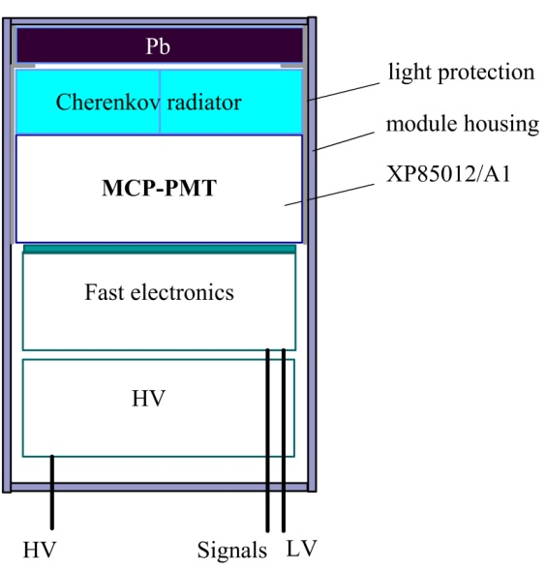
Detection of Cherenkov photons
The high-energy photons are registered by their conversion to electrons inside a lead plate (1.5–2 X0).
The Cherenkov light, produced by the electrons in quartz radiator, is detected by MCP-PMT XP85012/A1-Q (Photonis).
Planacon MCP-PMT XP85012 (Photonis)
Photocathode of 53 × 53 mm occupies
81% of front surface
Sensitive in visible and ultraviolet region
8 × 8 multianode topology
Chevron assembly of two MCPs (25-μm)
Typical gain factor of ~10 – 10
Rise time 0.6 ns
Transit time spread σTTS ~ 37 ps
High immunity to magnetic field
5
6
FFD module
Beam
pipe
FFD
L
FFD
R
Two FFD arrays and beam pipe
INSTR14 Novosibirsk February 2014

Slide 23
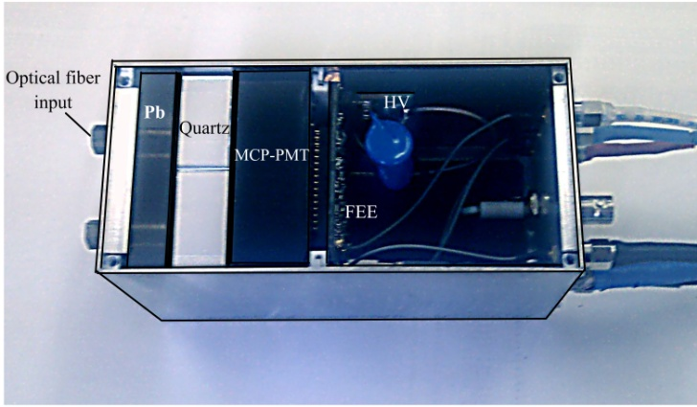
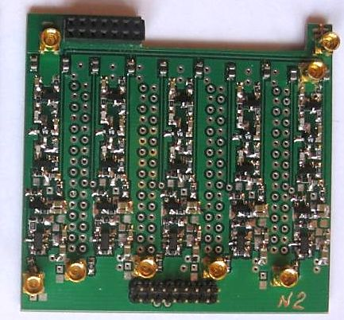
Monte Carlo Simulation
The UrQMD NICA plus GEANT3 code was applied for Monte Carlo simulation of Au + Au collisions for study of FFD performance.
Au + Au
Photon multiplicity
for FFD array
= 5 GeV
7-mm Pb converter
Energy spectrum of photons in FFD acceptance
Distributions of photons in FFD acceptance as
function of impact parameter for Au+Au at
energy = 9 GeV
Efficiency of FFD array with bias of 30 pe as
function of impact parameter at four different
energies
= 5, 7, 9, and 11 GeV
FFD module prototype
The module contains of aluminum housing, Pb converter with thickness of 7-10 mm, Cherenkov radiator with
4 quartz bars (bar dimensions 29.5 × 29.5 × 15 mm),
MCP-PMT XP85012, FEE board, and HV divider.
The anode pads of XP85012 are joined into 2 × 2 cells.
The module FEE has 4 channels processing pulses from anode pads and single channel for pulse from MCPs output. Each the chain consists of amplifier, shaper, and discriminator and it produces output analog and LVDS signals.
A view of FFD module
A view of FEE board
INSTR14 Novosibirsk February 2014

Slide 24
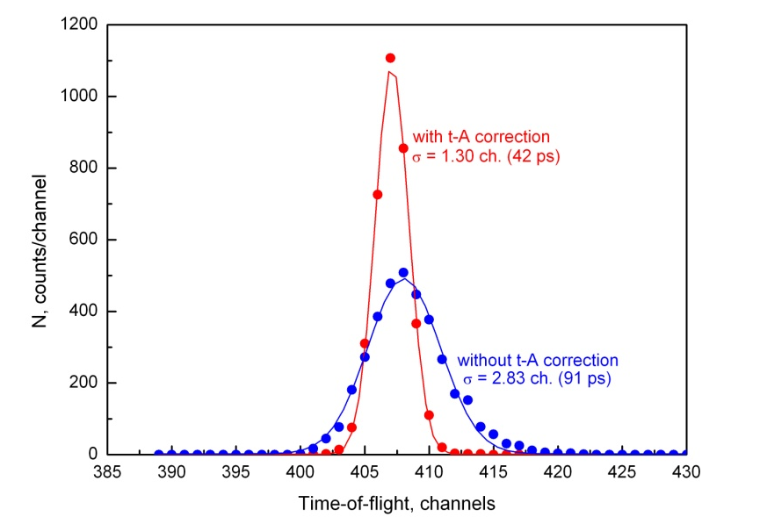
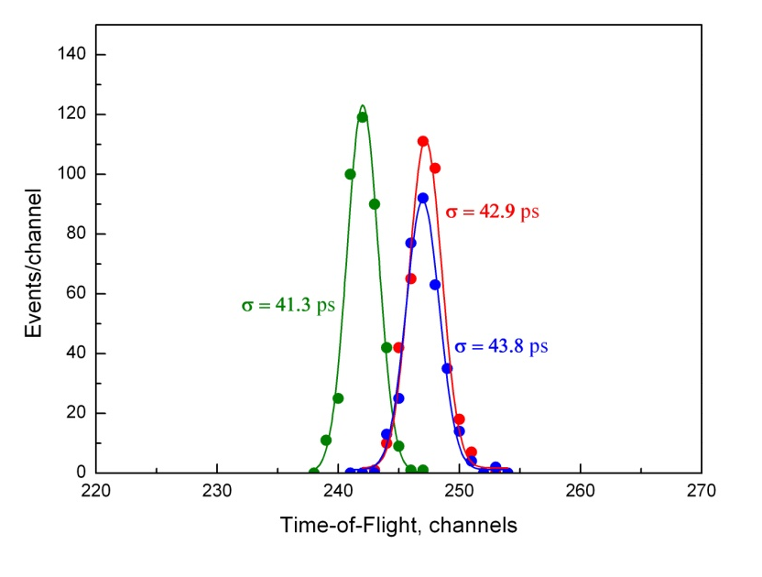
TOF measurements with two FFD modules
2-GeV protons
Cosmic muons
TOF distributions without and with t - A correction
TOF results for three different pairs of FFD channels
The time resolution σ ≈ 30 ps has been obtained for single channel in experimental tests with FFD prototypes. Better results are expected with new FEE in the nearest future.
t
Expected time resolution of start signal for TOF measurements
The time resolution of start signal depends on a number of independent channels of FFD arrays detecting photons in each event.
For example, the FFD with 10-mm Pb converter for Au + Au collisions at = 9 GeV will provide the time resolution
Central collisions (b = 2 fm) < Nph > ≈ 28 < σ > ≈ 5.7 ps
Semi-central collisions (b = 7 fm) < Nph > ≈ 14 < σ > ≈ 8 ps
Peripheral collisions (b = 11 fm) < Nph > ≈ 3.5 < σ > ≈ 16 ps
t
t
t
INSTR14 Novosibirsk February 2014

Slide 25
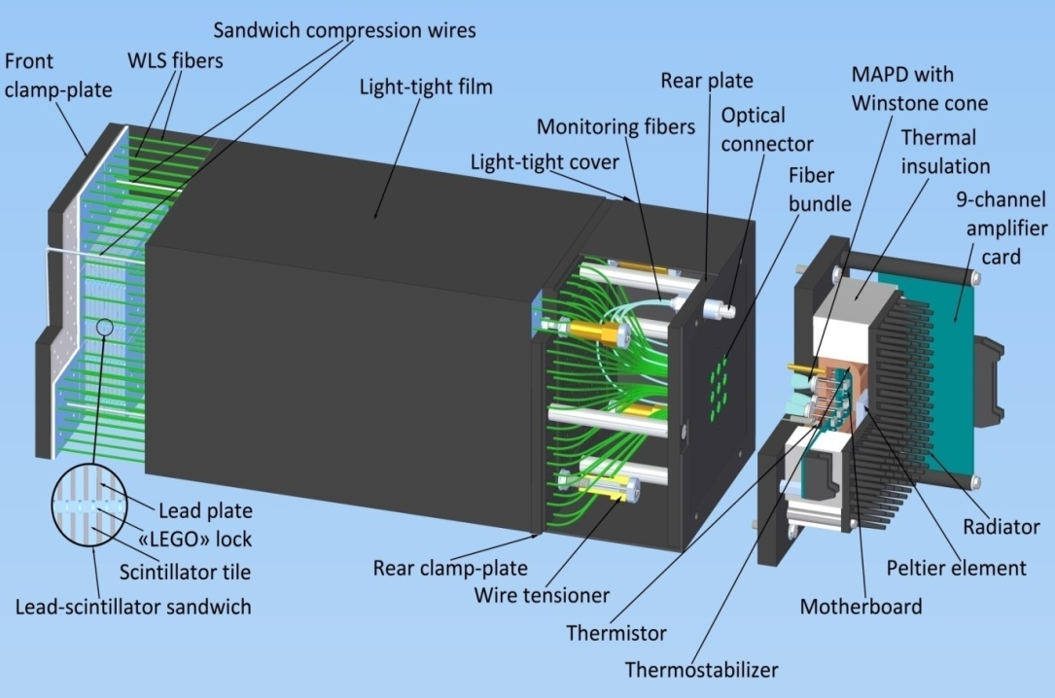
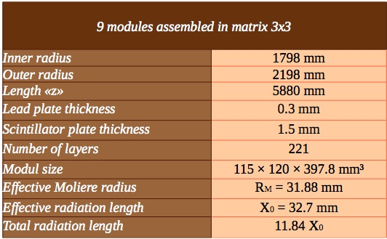
Electromagnetic Calorimeter
The main goal of EMC is to identify electrons, photons
and neutral hadrons and measure their energy and position.
High multiplicity environment of heavy ion collisions implies a fine
calorimeter segmentation (the transverse size of the cell should be
of the order of the Moliere radius and cell occupancy nor more 5%).
Requirements:
-high granularity, minimum dead
space
-sufficient energy resolution
-low cost, flexible production
Chosen EMC technology (fulfills most of the requirements):
Shashlyk-type sampling Pb-Scint. calorimeter with WLS fibers and MAPD read-out
INSTR14 Novosibirsk February 2014

Slide 26
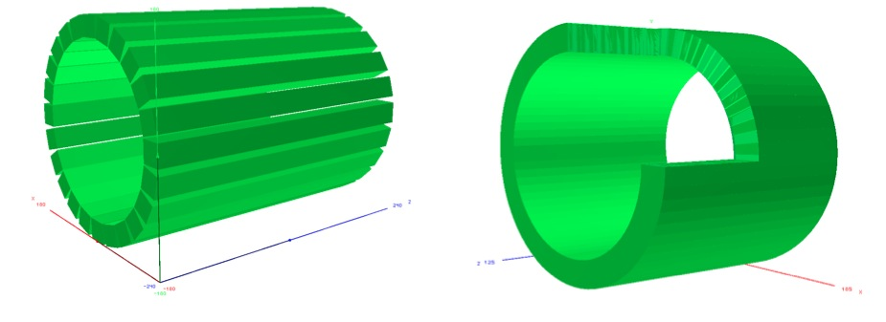
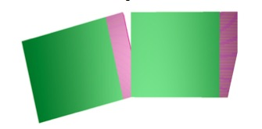
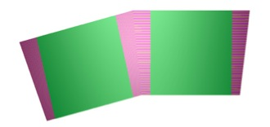
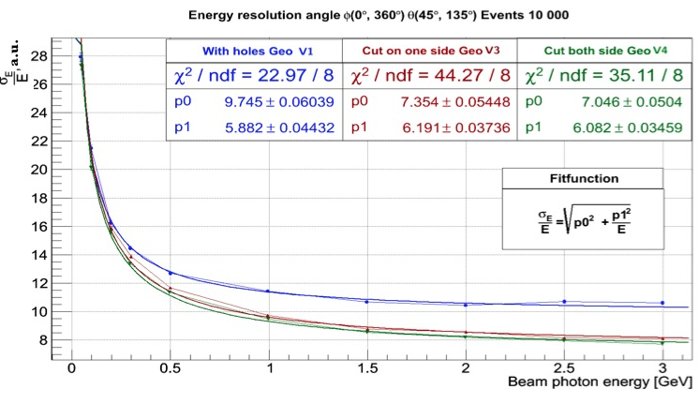
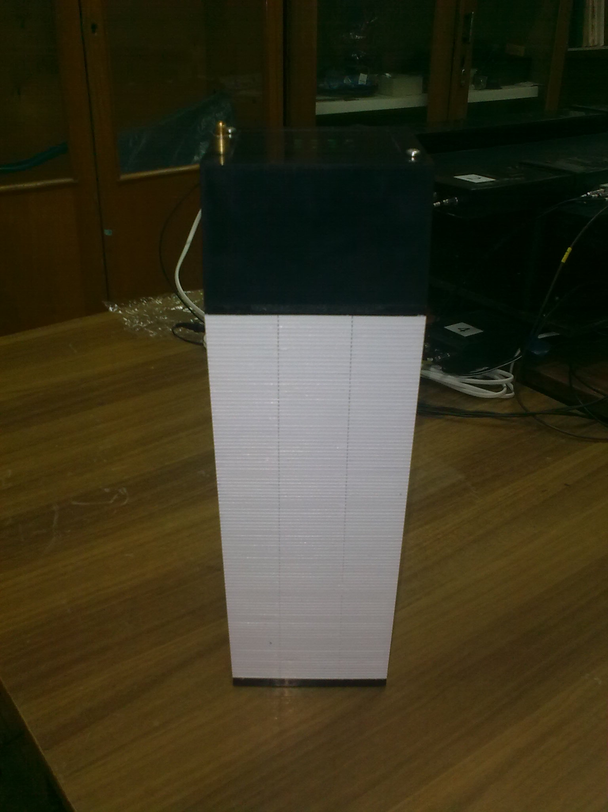
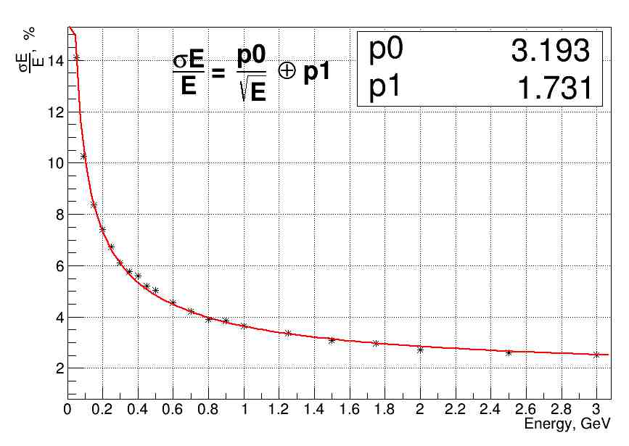
INSTR14 Novosibirsk February 2014
EMC geometry simulation
Rectangular (V1)
Trapeziform
Semi-Trapezoid (V3)
Trapezoid (V4)
Gaps affect on the energy resolution
Semi or full trapezoid shape - is not significant!
ISMA can product trapezoidal modules!
ECAL barrel
Geant 4
Geant 3
INSTR14 Novosibirsk February 2014

Slide 27
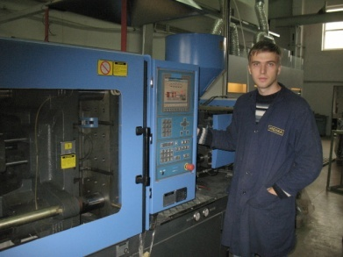
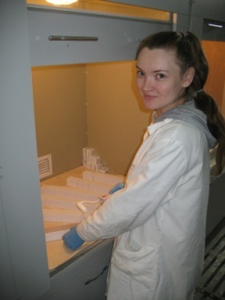

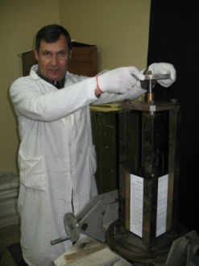
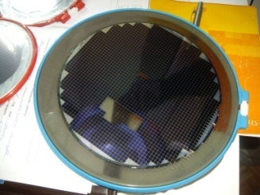
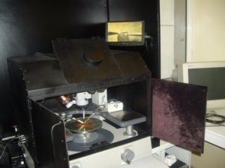
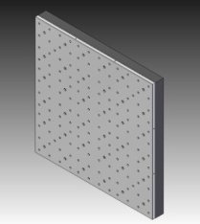





MPD ECAL. Progress in 2013
INSTR14 Novosibirsk February 2014
Injection-molding of
scintillation plates
Painting of scintillators
Manufacturing facility has been established by JINR and Institute for Scintillation Materials (Kharkov, Ukraine)
Technology for production of trapezoidal EMC modules
has been proven
Certification procedure for MAPD wafers was developed
Production of photo-detector units was organized
Feasibility of mass production of EMC modules was investigated
First study of EMC performance with particle beams and
cosmic rays was performed
A trapezoidal ECAL
Assembling of ECAL modules
MPD EMC assembling (schematic)
Wafer of MAPD-3N
Setup for wafer tests
INSTR14 Novosibirsk February 2014

Slide 28


Zero Degree Calorimeter (ZDC)
measures the energy deposited by spectators.
event centrality determination (offline b-selection)
.
Requirements:
transverse dimensions determined by the spectator spot size (~ 40 cm at √s=9 GeV)
measure of assymetry in athimuthal distribution → fine φ-segmentation
energy resolution < 60%/ √E
5x5 cm²
L=1.2 m
Pb(16mm)+Scint.(4mm) sandwich
60 layers of lead-scintillator (1.2 m, 6λ)
1 mm WLS fibers + micropixel APD
produced by INR, Troitsk, Russia
similar to ZDCs for NA61 and CBM
INSTR14 Novosibirsk February 2014

Slide 29

MPD Collaboration

Slide 30



Slide 31
Concluding Remarks
The MPD/NICA program is well integrated into world experimental high energy ion
investigations
The MPD collaboration is growing and getting international recognition
MPD project is well progressing: main goals of the R&D stage achieved
Continuation of detailed project evaluation by MPD Detector Advicery Committee
Status of the MPD TDR
Completed (under evaluation) : TPC, FFD
Under completion : TOF, ECAL, ZDC
Link: http://nica.jinr.ru/files/MPD/mpd_tdr.htm

Slide 32
Thank you for attention

Slide 33
Back up slides

Slide 34

Experiments on dense nuclear matter
INSTR14 Novosibirsk February 2014

Slide 35


Slide 36
Inner Tracker (IT)
4 cylindrical & disk layers
300 μm double-sided silicon
microstrip detectors, pitch = 100 μm
Thickness/layer ~ 0.8% X₀
Barrel: R=1- 4 cm, coverage |η|<2.5
806 sensors of 62x62 mm²
Disks: design under optimization
resolution: σ_{z} = 120 μm, σ_{rφ} = 23 μm
INSTR14 Novosibirsk February 2014

Slide 37



V0 performance (TPC+IT)
TPC+IT
No PID
Central Au+Au @ 9 GeV
TPC
Improved Signal-to-Background
ratio (S/B) with the vertex IT detector
INSTR14 Novosibirsk February 2014

Slide 38

EndCap Tracker
The tracking capability of the TPC for
the pseudorapidity │η│> 1.2 will be enhanced by an endcap tracking system.
The straw tube EndCap Tracker located between the TPC and endcap TOF is considered as
an option. The ECT consist of 2x60 layers
of 60 cm length straw tubes and covers
the pseudorapidiry region 1 < │η│ <2.5.
Straw full sector prototype

Slide 39


EMC tests with beams and cosmic rays
Preparation for tests with electron beams
(DESY, December’13)
Program of EMC beam tests:
Performance study of two EMC modules with different WLS-fibers
Tests of the EMC read-out electronics (amplifiers and ADCs)
Energy scan with electrons (E_{e} = 1..6 GeV)
Analysis of the data recorded in beam tests
is ongoing
EMC response to 4 GeV electrons
Test of EMC modules with cosmic rays
INSTR14 Novosibirsk February 2014

Slide 40


ECAL – “shashlyk” type modules with APD readout
(Lead plates (0.275 мм) and plastic scintillator (1.5 мм), the radiation length of tower 18Х₀ (40 см))
The active area of APD- 3x3 мм; Density of pixels in APD – 10⁴/мм²
The primary role of the electromagnetic calorimeter is to measure the spatial position and energy of electrons and photons produced in heavy ion collisions. It will also play a major role in particle identification due to high time resolution. The first prototype of EM-module (shashlyk type) for EMC MPD-NICA with MAPD readout on beam tests at CERN and at DESY are presented. The MAPD combines a lot of advantages of semiconductor photodetectors: it is insensitive to magnetic field and has a compact dimension. It also has a high gain which is close to that of the PMT. Novel types of MAPD with deep micro-well structures have super high pixel densities of up to 40000 mm⁻² which provides wide dynamic range and high linearity. The main characteristics of the novel deep micro-well MAPD which are Gain and Photon Detection. Energy and time resolution of individual EM-module with MAPD readout were measured and also presented. The EM-module with the MAPD readout looks very promising. With some improvements it will serve as an EMC of the future detector MPD for NICA experiment. We used ADC with 12 bits and 100 MHz.
Responses and energy resolutions of the prtototype NICA module readout by PMT EMI 9814B and MAPD-3A at T=15º C versus electron beam energy.
Time resolution of the prototype NICA module readout by MAPD-3A versus the number of collected photoelectrons (Nph.e)

Slide 41



EMC-ReadOut
MPD EMC
Fig. 2
Fig. 1
Fig. 2
Fig.1. Design of the EMC module
Fig.2. ECAL “tower”
Fig.3. Setup for testing ECAL prototypes
Pb(0.35 mm)+Scint.(1.5 mm)
4x4 cm² , L ~35 cm (~ 14 X₀)
read-out: WLS fibers + MAPD
Fast Timing workshop, Erice, 19 - 23 November 2013
21

Slide 42


Zero Degree Calorimeter (ZDC)
INR (Troisk) + VBLHEP(JINR) . Team leader - A. Kurepin (INR)
ZDC prototypes (JINR)
Pb-scintillator sampling (5λ)
Read-out: fibers+ AvalanchePD
ZDC coverage: 2.2<|η|<4.8
2013 - 2014
Construction of several ZDC modules at INR
and JINR
Preparation for beam tests @ Nuclotron
Extensive ZDC simulation
ZDC TDR finalizing (draft is ready)
Positioning device
INSTR14 Novosibirsk February 2014

