Slide 1
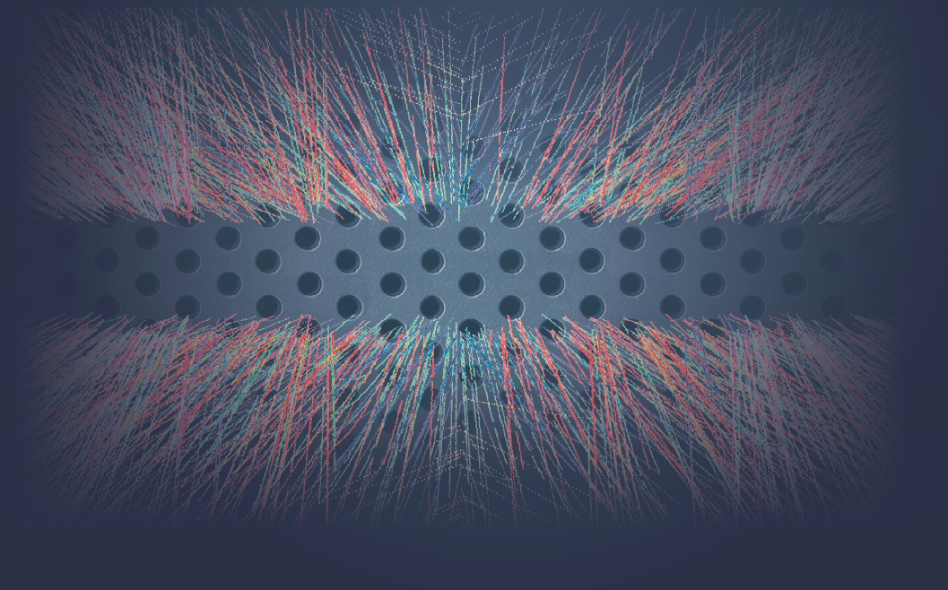




The Upgrade of the ALICE TPC
Bernhard Ketzer
Universität Bonn
On behalf of the ALICE TPC Collaboration
26 February 2014
Instrumentation for Colliding Beam Physics 2014

Slide 2
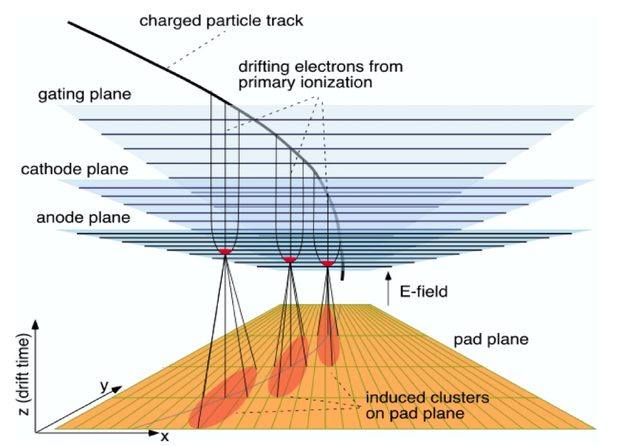
Time Projection Chamber
Time Projection Chamber [D.R. Nygren et al., Phys. Today 31, 46 (1978)]
Combination of MWPC and Drift Chamber: 3-D tracking device
  long drift path (~m) in gas-filled volume  z coordinate
  MWPC + pads perpendicular to drift path  x,y coordinates

Slide 3
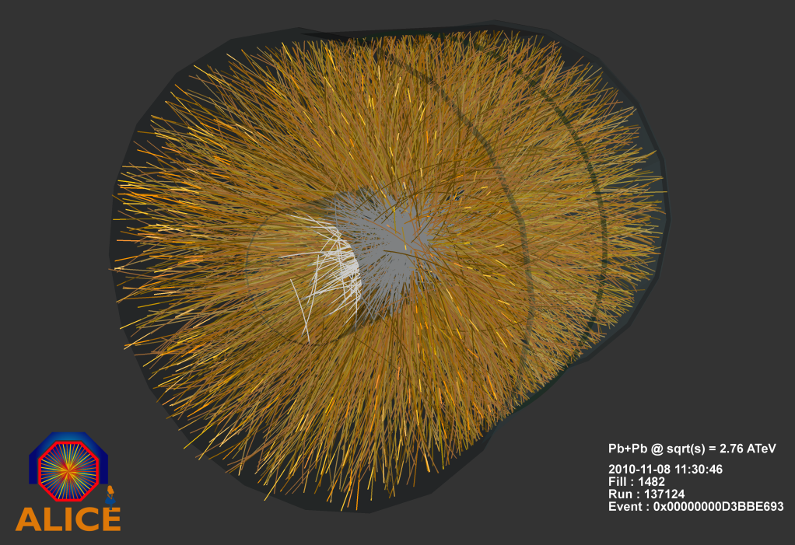
Advantages and Limitations of a TPC
An (almost) ideal tracking detector:
Large acceptance
Large active volume
Low material budget
3D hits  simple pattern recognition
Extremely high particle densities
 heavy ion experiments
Good momentum resolution
Particle identification
Limitations:
No redundancy
Calibration very demanding
Drift distortions due to ion backflow
Gating  low trigger rates
Examples:
STAR (420 cm × 400 cm)
ALICE (500 cm × 500 cm)

Slide 4
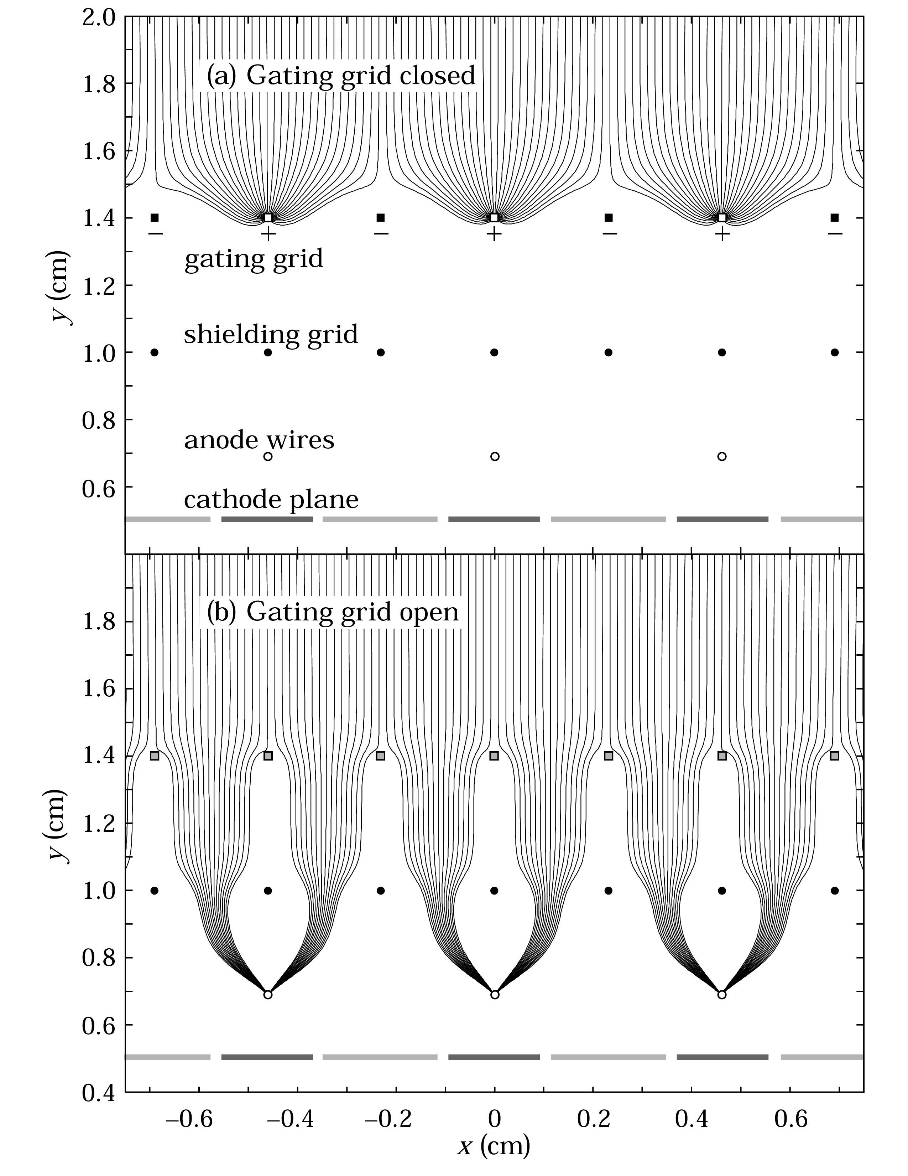
Advantages and Limitations of a TPC
Limitations:
No redundancy
Calibration very demanding
Drift distortions due to ion backflow
Gating  low trigger rates
Examples:
STAR (420 cm × 400 cm)
ALICE (500 cm × 500 cm)

Slide 5
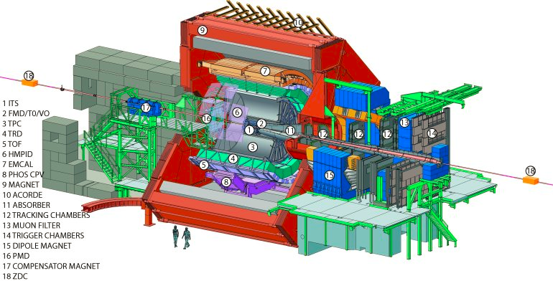
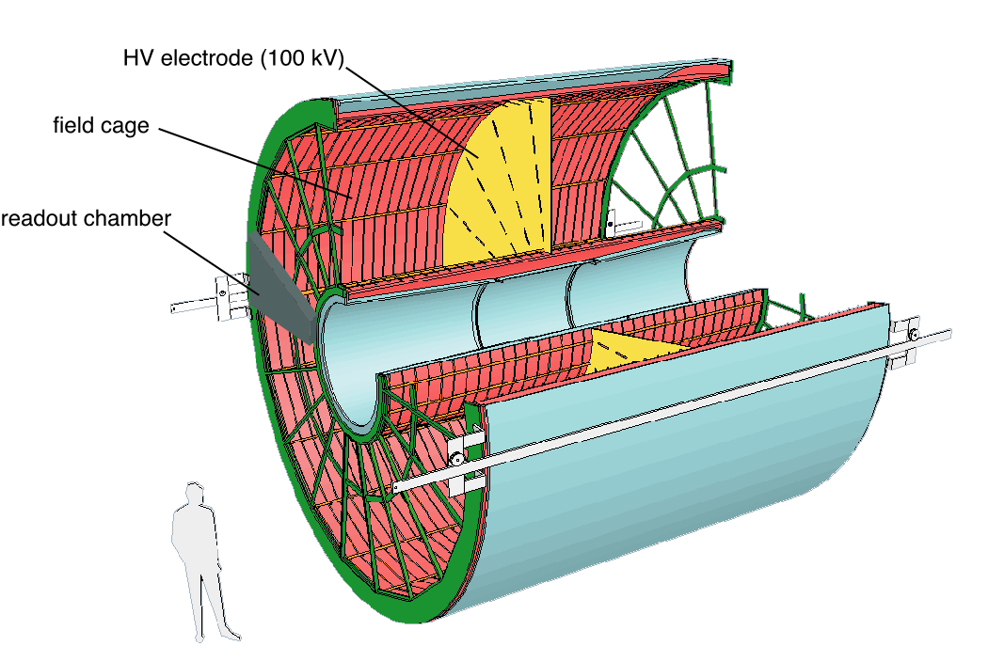
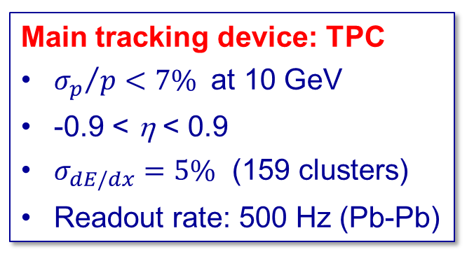
The ALICE Detector
Main tracking device: TPC
${σ_{p}}/{p<7\%}$ at 10 GeV
-0.9 < η < 0.9
$σ_{dE/dx}=5\%$ (159 clusters)
Readout rate: 500 Hz (Pb-Pb)
Volume: ~ 90m³
Gas: Ne/CO₂(/N₂) (90/10/5)
Drift voltage: 100kV, 94μs drift time
72 MWPCs with 557768 readout pads

Slide 6

ALICE Upgrade
- Small diameter beam pipe

Slide 7
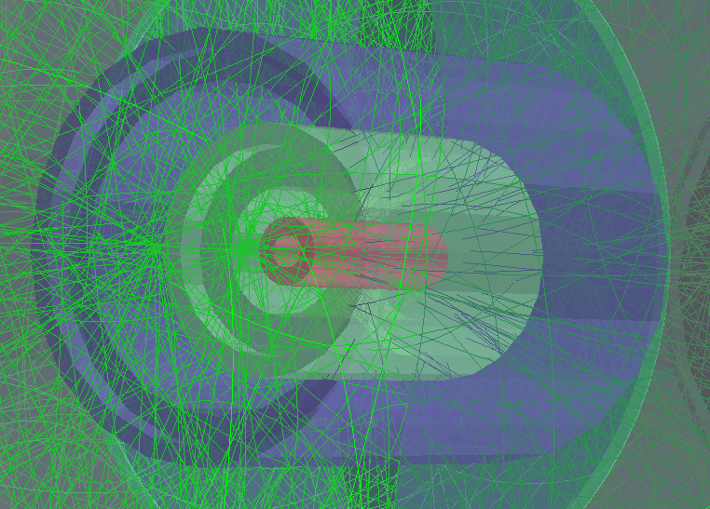
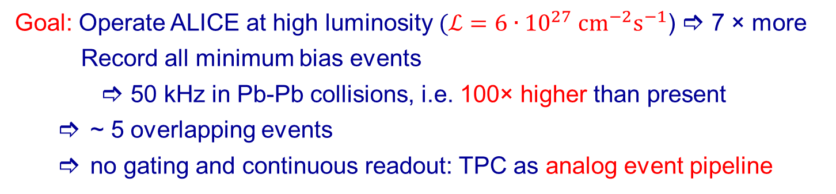
Operation at High Rates
  Goal: Operate ALICE at high luminosity $(ℒ=6∙{10}^{27} {cm}^{−2}s^{−1}$)  7 × more
  Record all minimum bias events
       50 kHz in Pb-Pb collisions, i.e. 100× higher than present
  ~ 5 overlapping events
  no gating and continuous readout: TPC as analog event pipeline
Event from
2013 p-Pb
Run

Slide 8
Outline
Introduction
Ion Backflow in GEM Detectors
Prototype Detectors
  FOPI TPC
  ALICE Full Size Prototype
The TPC Upgrade
Expected Performance
Conclusions and Outlook

Slide 9
Outline
Introduction
Ion Backflow in GEM Detectors
Prototype Detectors
  FOPI TPC
  ALICE Full Size Prototype
The TPC Upgrade
Expected Performance
Conclusions and Outlook

Slide 10
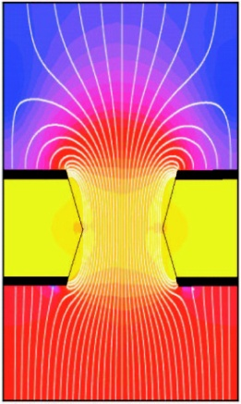
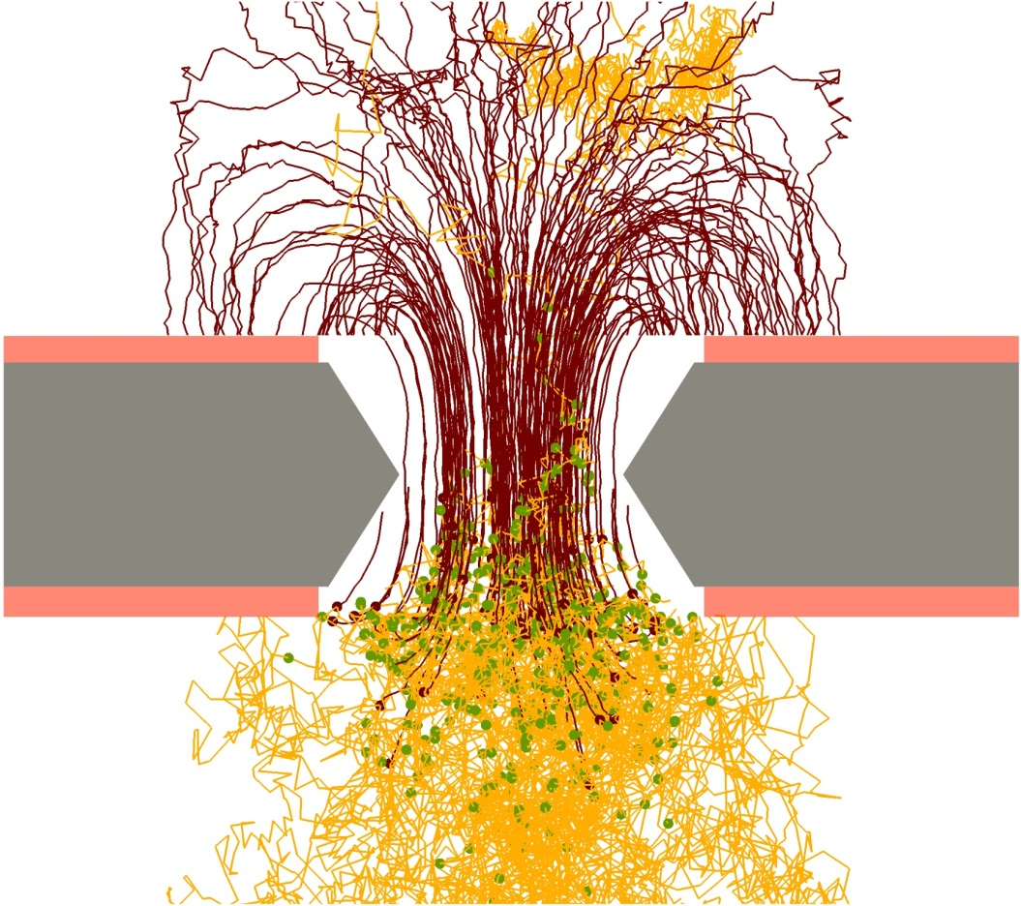
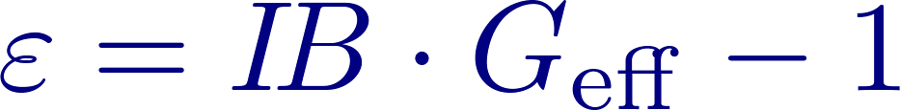


Ion Backflow Suppression in GEM
$$E_{drift}=250 V/cm$$
$$E_{trans}=3.75 kV/cm$$
Low ion density in drift region requires
  low primary ionization
  low gain
  low ion backflow

Slide 11
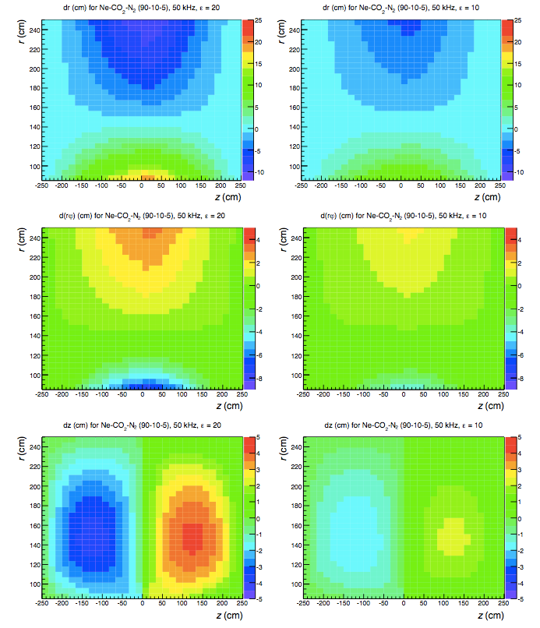

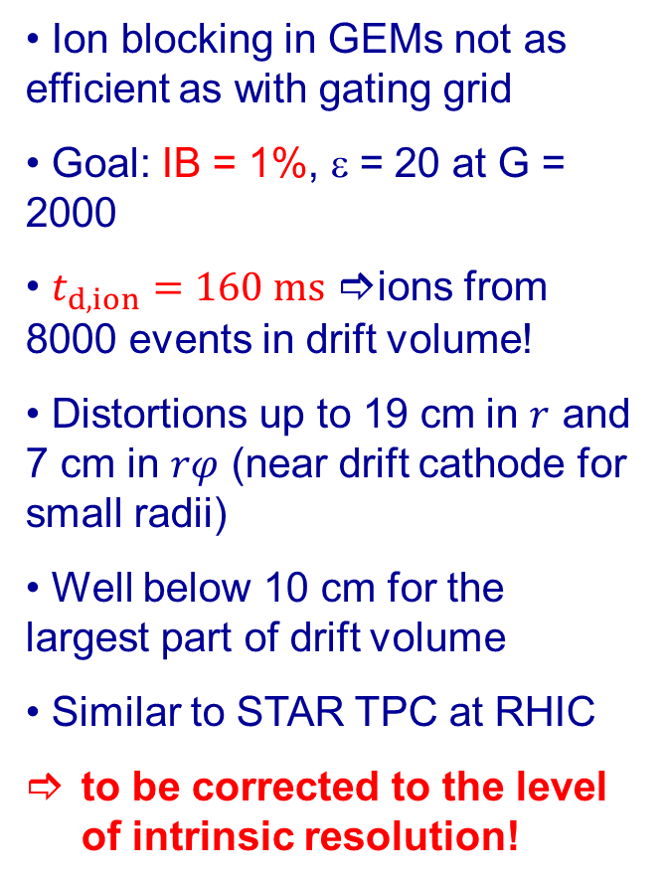
The Space Charge Challenge
Ion blocking in GEMs not as efficient as with gating grid
Goal: IB = 1%, ε = 20 at G = 2000
$t_{d,ion}=160 \text{ms}$ ions from 8000 events in drift volume!
Distortions up to 19 cm in $r$ and 7 cm in $rφ$ (near drift cathode for small radii)
Well below 10 cm for the largest part of drift volume
Similar to STAR TPC at RHIC
to be corrected to the level of intrinsic resolution!

Slide 12
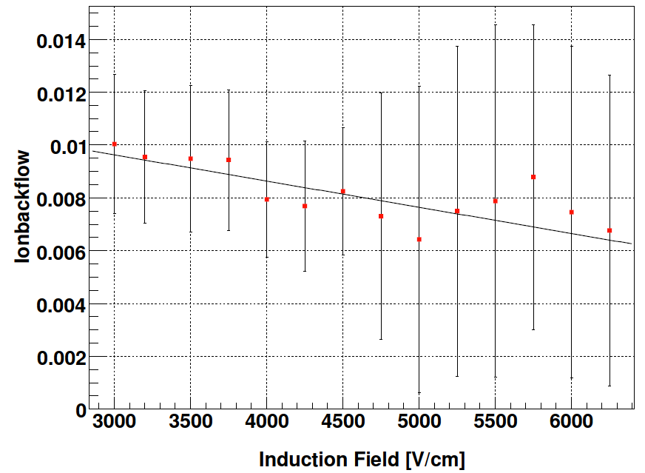
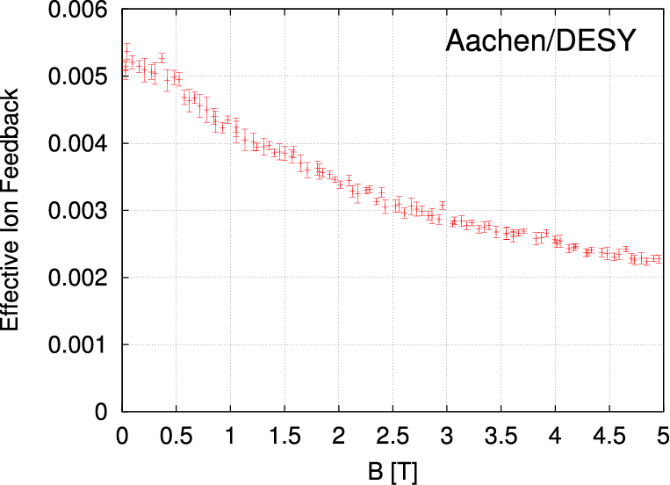
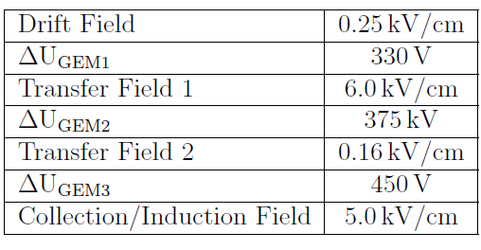
Ion Backflow – Early Measurements
Ar/CO₂ (70/30)
Ar/CH₄/CO₂ (93/5/2)
TUM
E_{drift}=200V/cm
U_{GEM1,2}=310V
U_{GEM3}=350V
E_{trans1}=6kV/cm
E_{trans2}=60V/cm
E_{ind}=8kV/cm
IB ~ 1% easy to achieve!
Low ion backflow requires
    low drift field
    very asymmetric transfer fields
    highest amplification in last GEM
Magnetic field helps:
  Electron extraction from holes improved

Slide 13

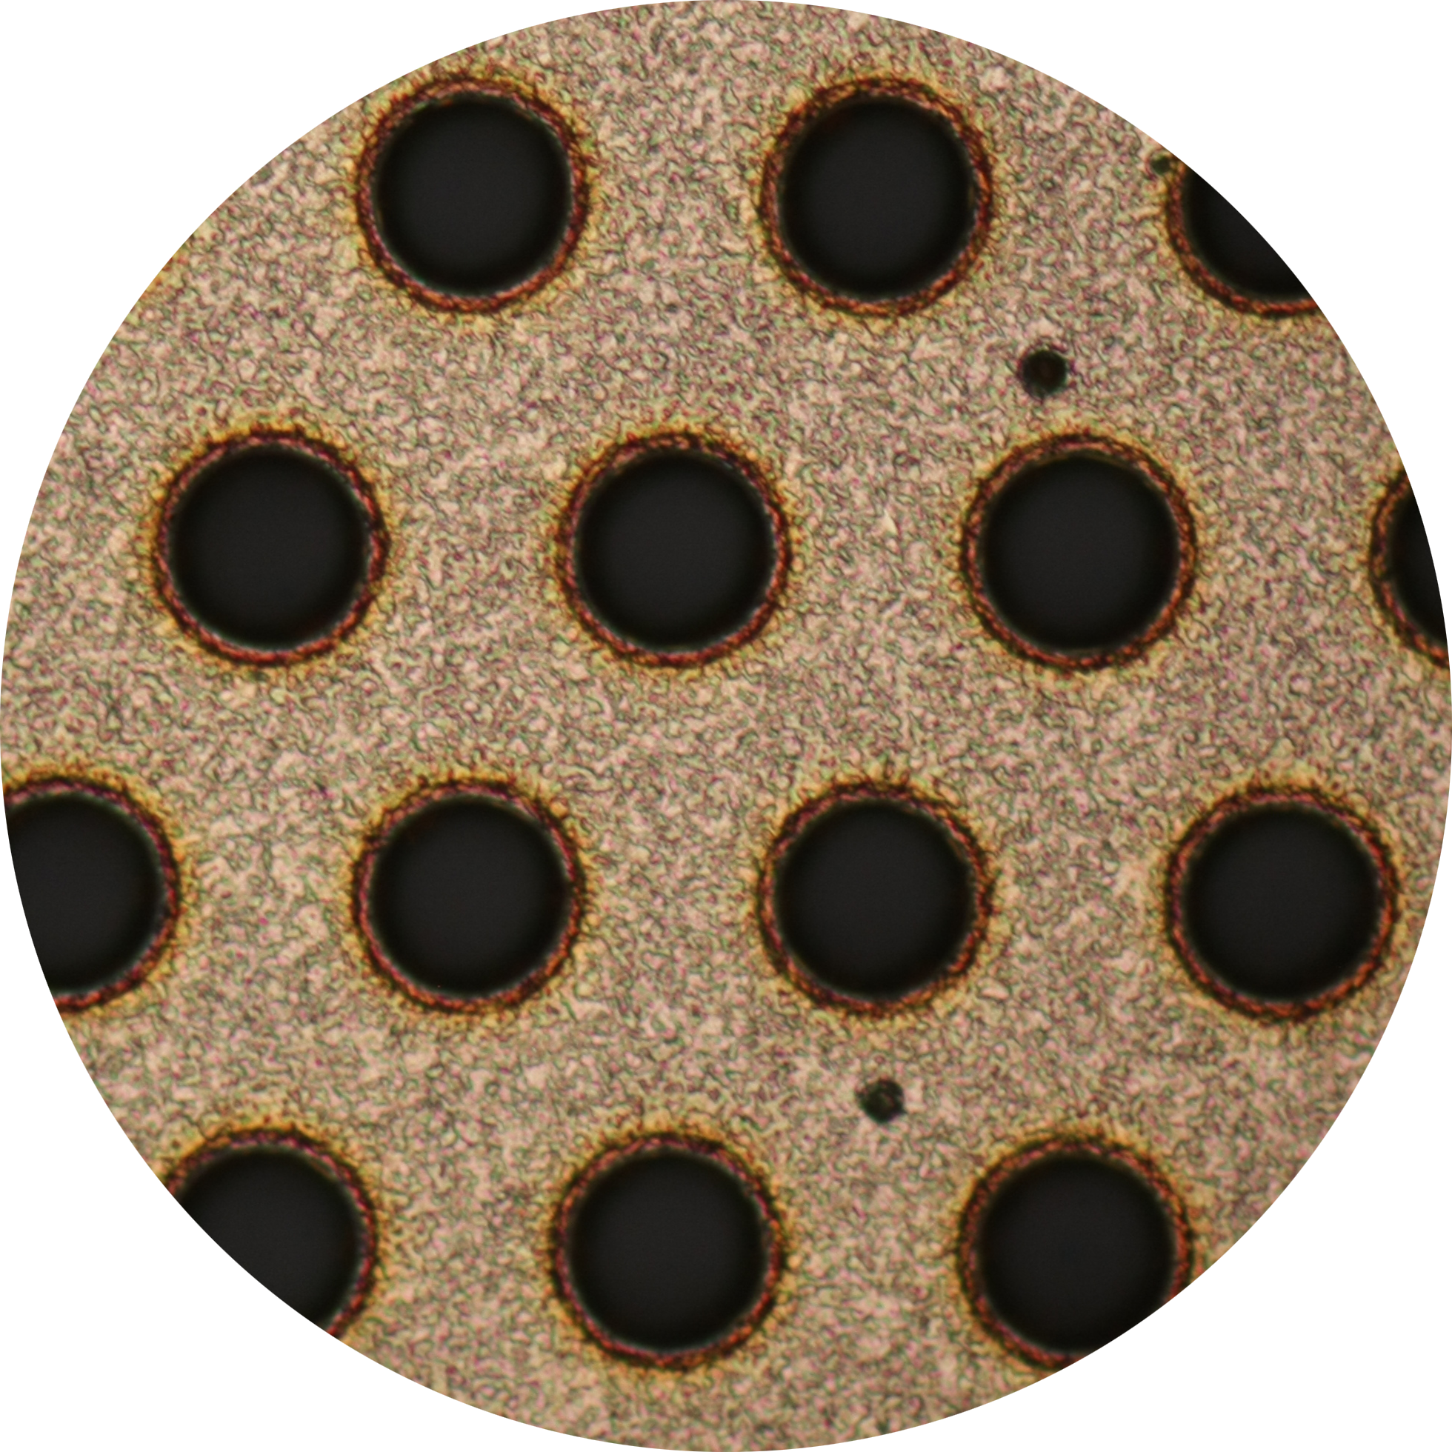
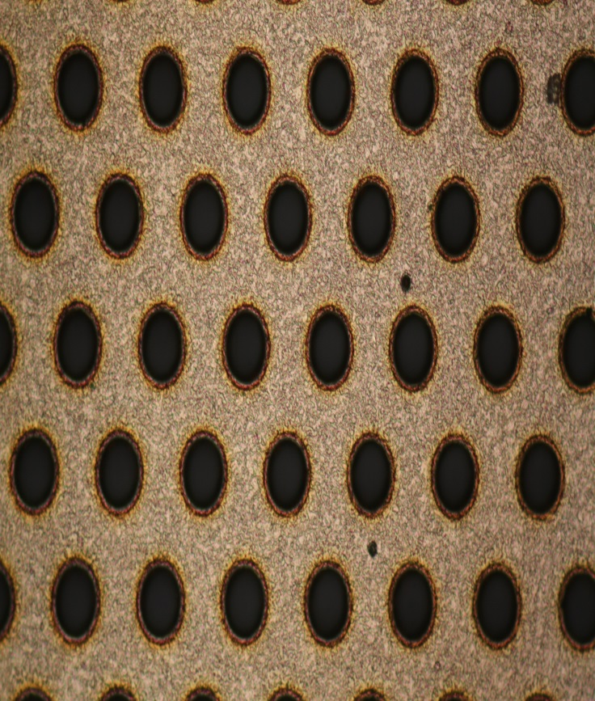
Ion Backflow – Early Measurements
Ar/CO₂ (70/30)
Ar/CH₄/CO₂ (93/5/2)
TUM
E_{drift}=200V/cm
U_{GEM1,2}=310V
U_{GEM3}=350V
E_{trans1}=6kV/cm
E_{trans2}=60V/cm
E_{ind}=8kV/cm
IB ~ 1% easy to achieve?
Low ion backflow requires
    low drift field
    very asymmetric transfer fields
    highest amplification in 3rd GEM
Magnetic field helps:
  Electron extraction from holes improved

Slide 14
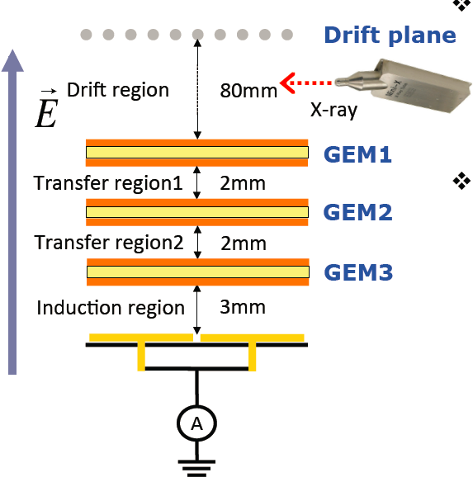
Ion Backflow – Rate Dependence
Ar/CO₂ (70/30)
CERN
Rate dependence of IB !

Slide 15
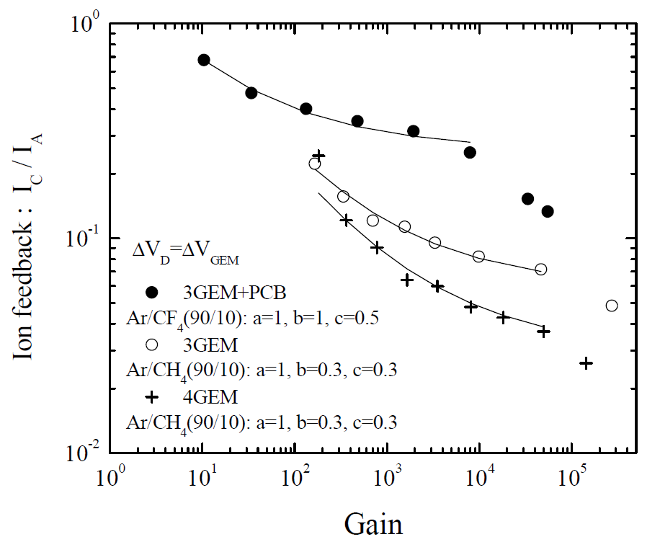
Ion Backflow – Rate Dependence
[A. Bondar et al., NIM A 496, 325 (2003)]
Gain dependence of IB !

Slide 16
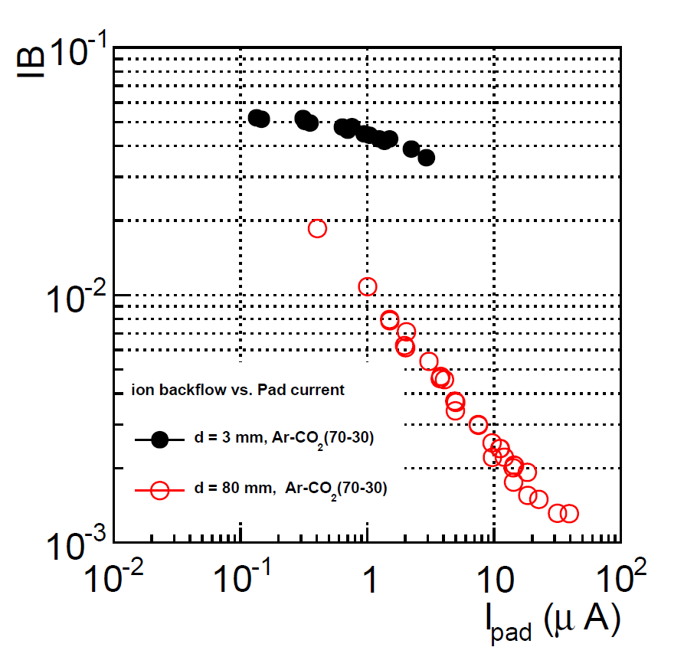
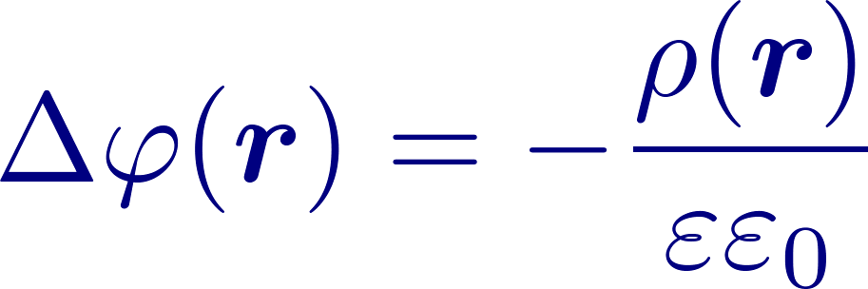

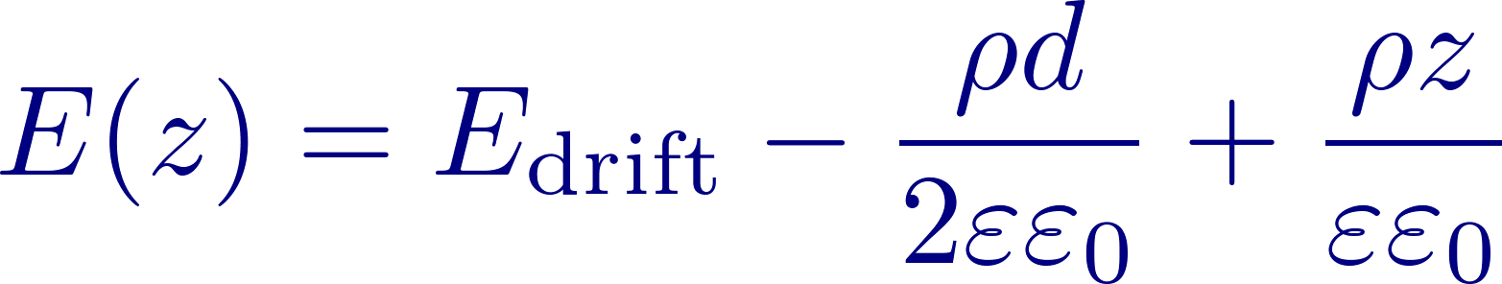
Ion Backflow – Rate Dependence
Ar/CO₂ (70/30)
Poisson equation:
For homogenous space charge density and parallel plate boundary conditions:
z
d
Dependence of IB on drift gap!
drift

Slide 17
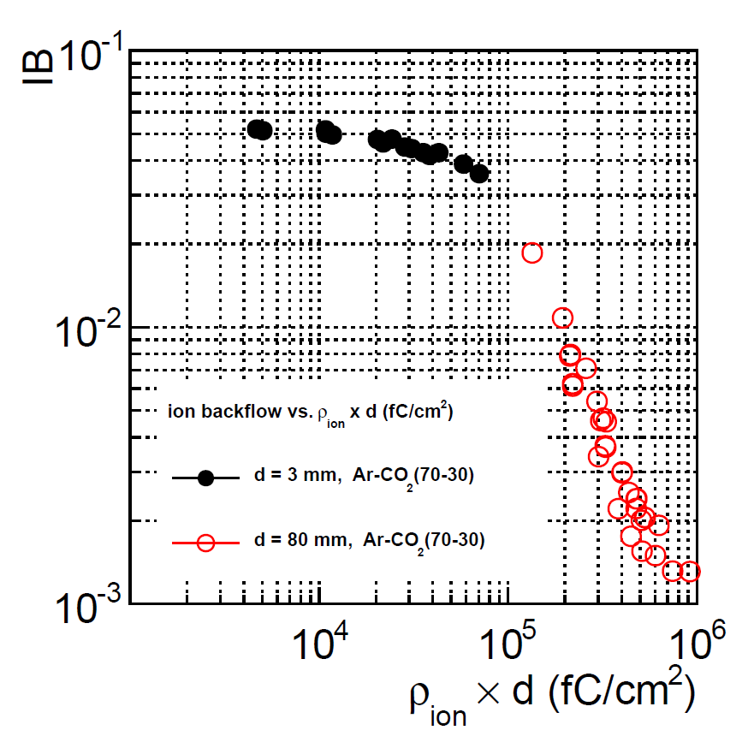
Ion Backflow – Rate Dependence
Ar/CO₂ (70/30)
Poisson equation:
For homogenous space charge density and parallel plate boundary conditions:
z
d
Expected after LS2: 5000 fC/cm²
drift

Slide 18
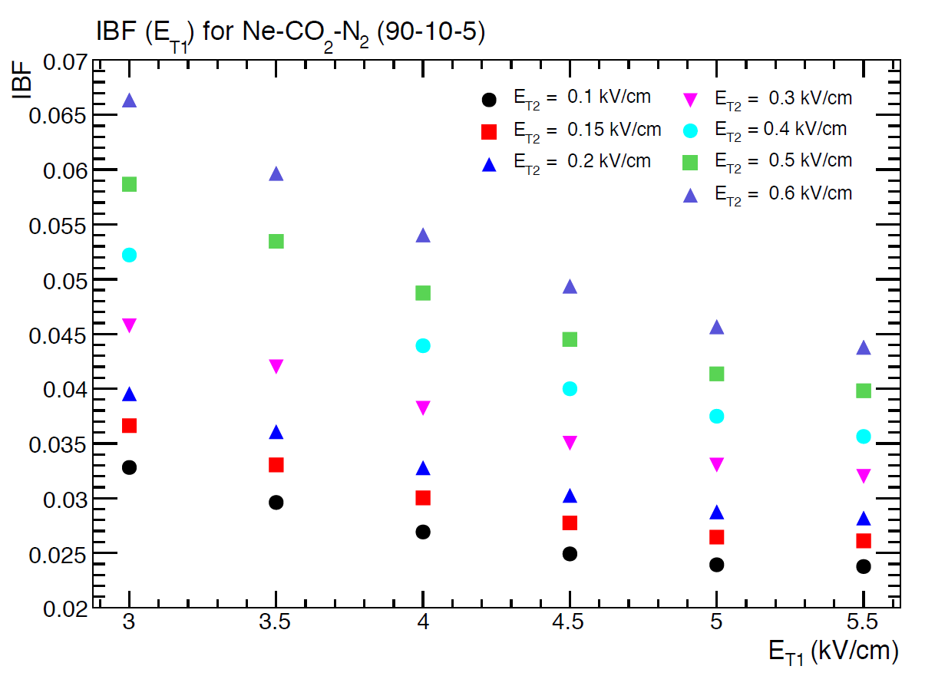
Ion Backflow – Triple GEM
Ne/CO₂ (90/10)
Further issues to be considered:
Ne-based mixtures:
  Higher drift field
  α vs E steeper
 Add N₂ to gas to avoid gap amplification
High electron collection efficiency (first GEM!)
Stability of operation
 Three GEMs not sufficient!
Add 4th GEM, try different aspect ratios:
standard (S) vs large-pitch (LP)
[F. Sauli et al., NIM A 560 (2006) 269]

Slide 19
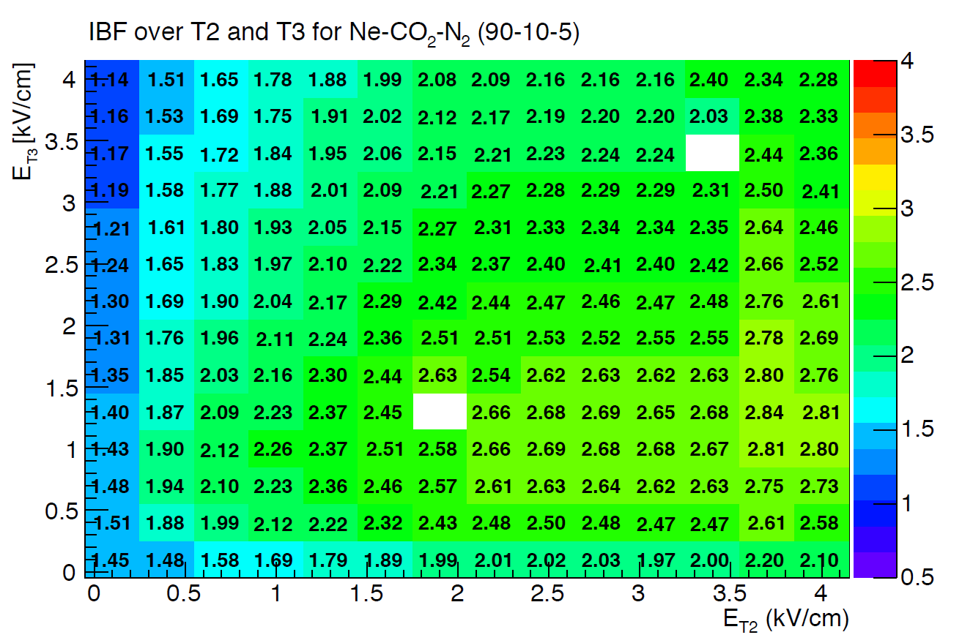
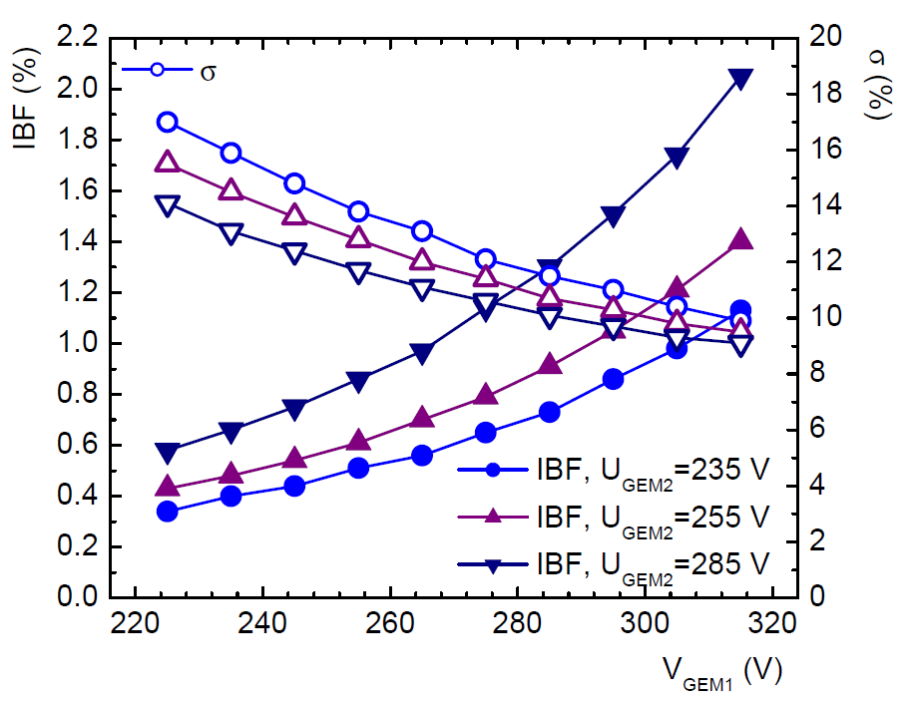
Ion Backflow – ALICE Solution
S-S-LP-S
S-LP-LP-S
Quadruple GEM stack, block ions by high-low combinations of fields
Use large-pitch GEMs to misalign holes
Optimize energy resolution at the same time
 IB = 0.6 – 0.8%, σ = 11 – 12 % achieved

Slide 20
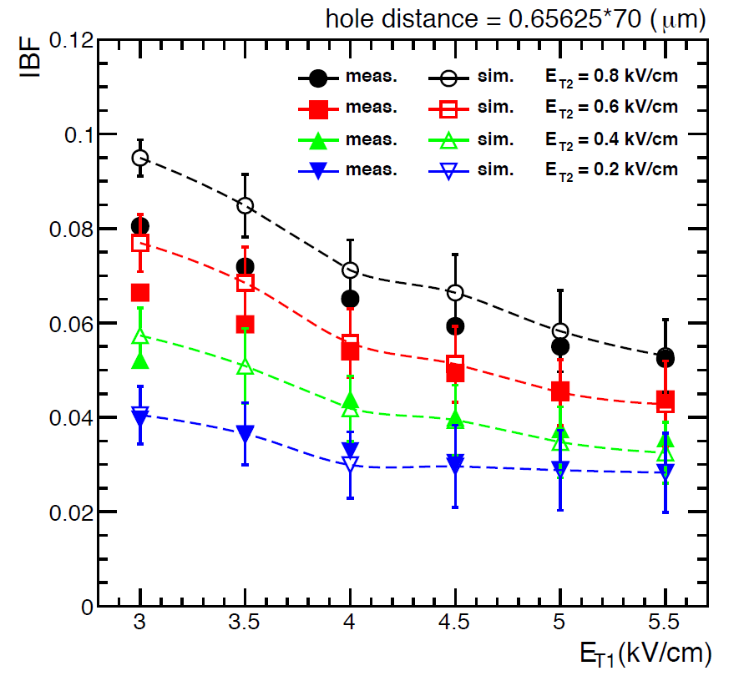
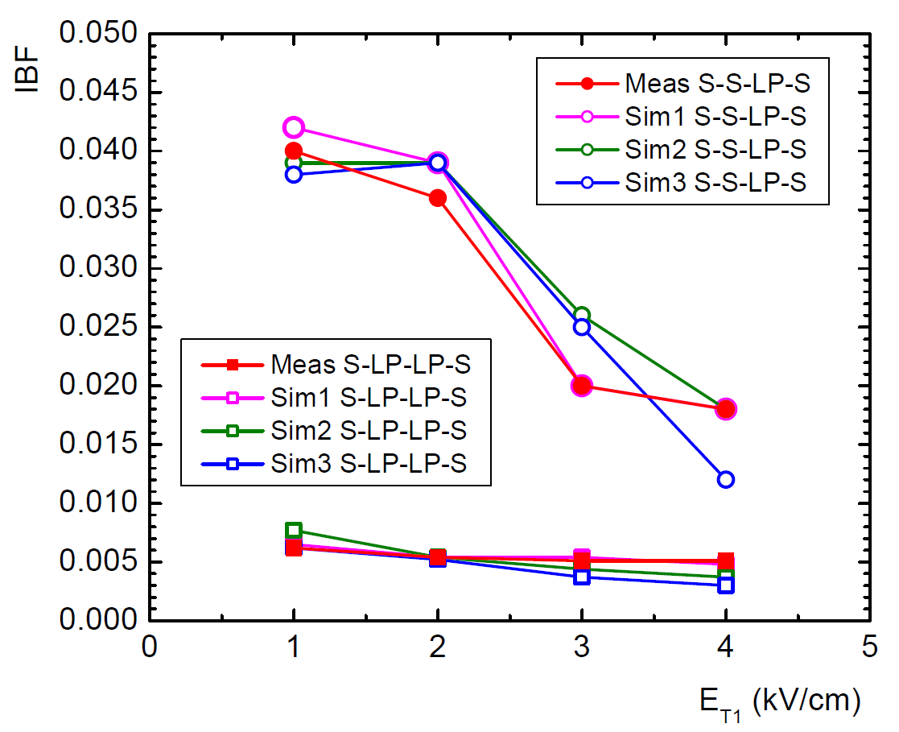
Ion Backflow - Simulations
ANSYS + GARFIELD/MAGBOLTZ: Systematic scan of parameter space
    Gas composition
    Three / four GEMs, different geometries
    Tuning of simulations by adjusting hole alignment
3 GEM
4 GEM

Slide 21
Outline
Introduction
Ion Backflow in GEM Detectors
Prototype Detectors
  FOPI TPC
  ALICE Full Size Prototype
The TPC Upgrade
Expected Performance
Conclusions and Outlook

Slide 22
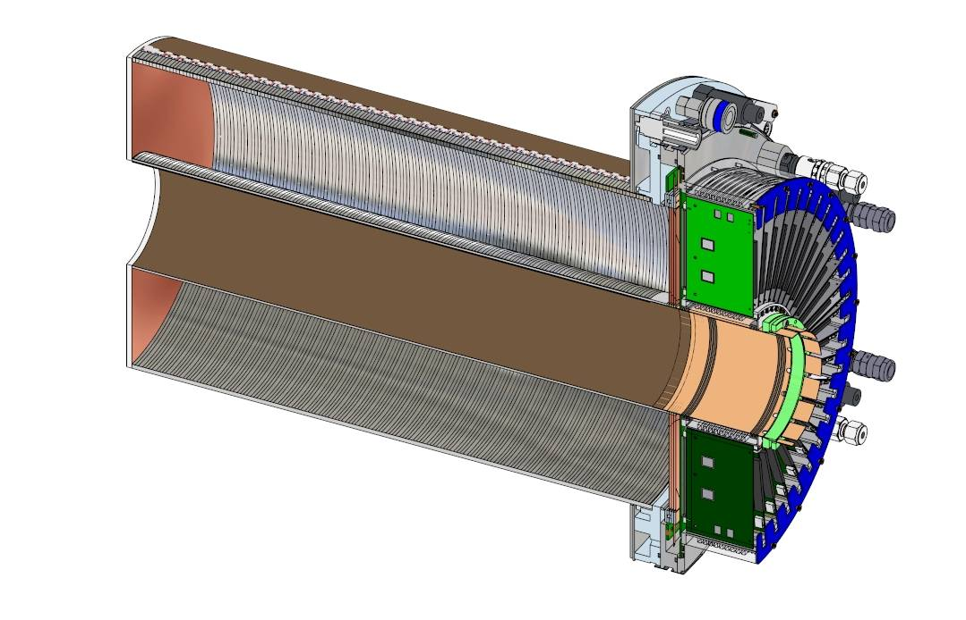



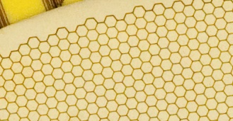
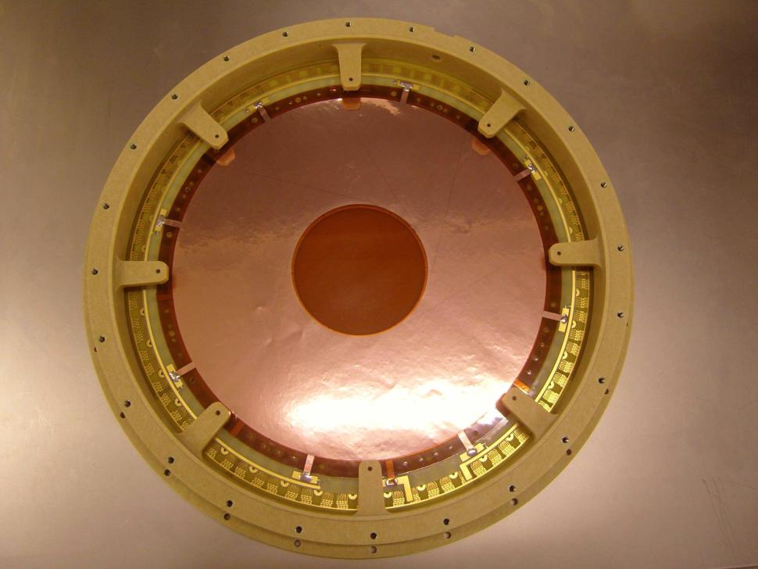
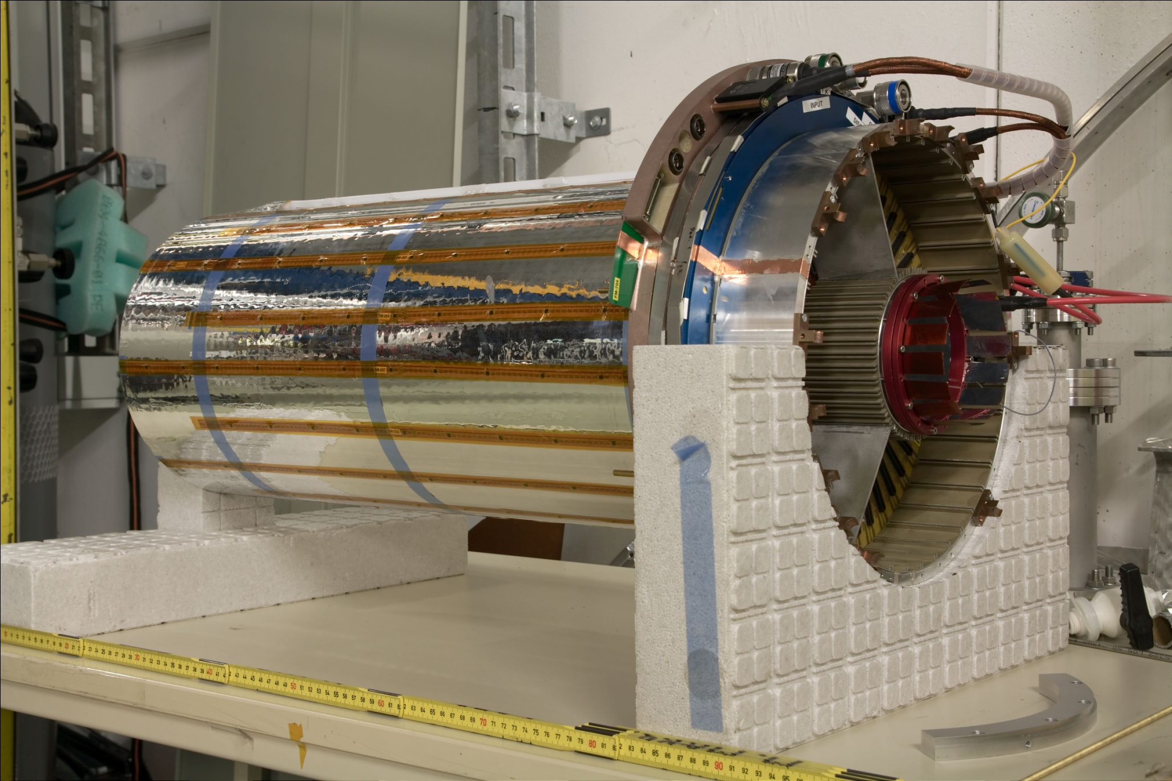
FOPI GEM-TPC
Light-weight field cage
Drift length 725 mm
Ø 105-300 mm
Triple GEM amplification
10254 ch., AFTER ASIC
Gas: Ar (Ne)/CO₂ (90/10)
[L. Fabbietti et al., NIM A 628, 204 (2011),
M. Ball et al., arXiv1207.0013, 2012]

Slide 23
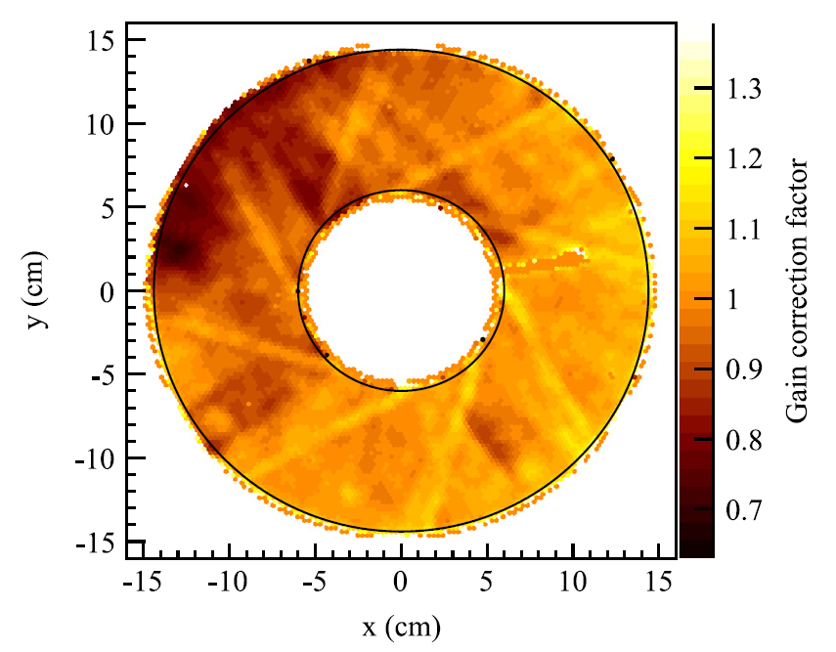
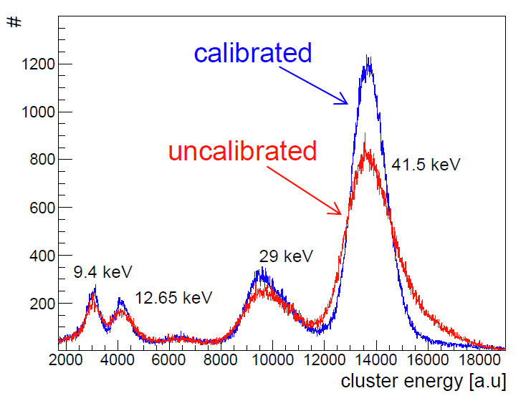

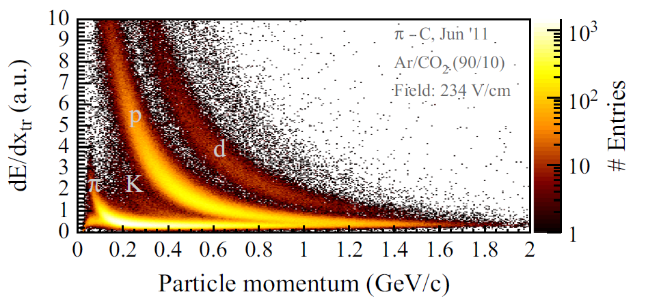
dE/dx Resolution
Gain equalisation using ^{83m}Kr:
  Main peak 5.1%
PID using dE/dx:
  Resolution ~ 18%
  in agreement with expectation
  no density correction yet
First dE/dx measurement
with GEM-TPC!
[F.V. Böhmer et al., NIM A 737, 214 (2014)]

Slide 24
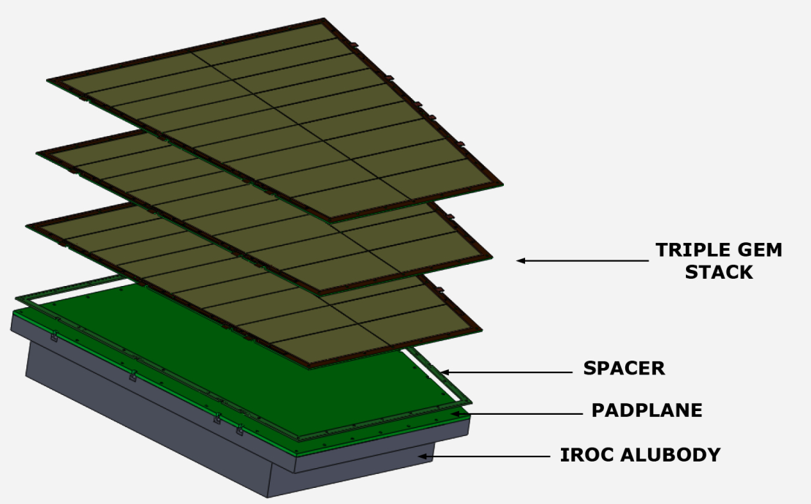
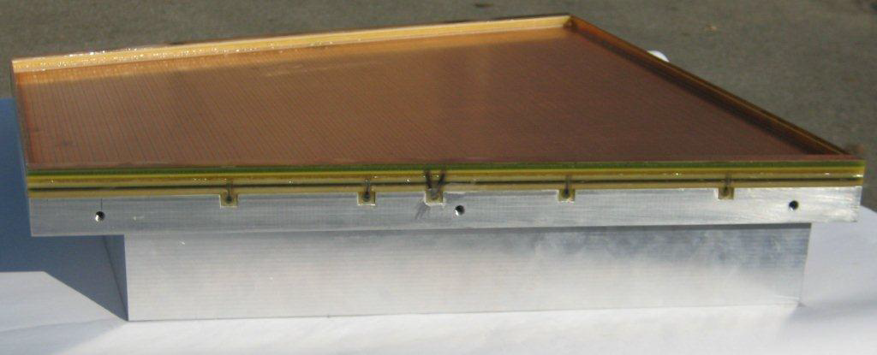
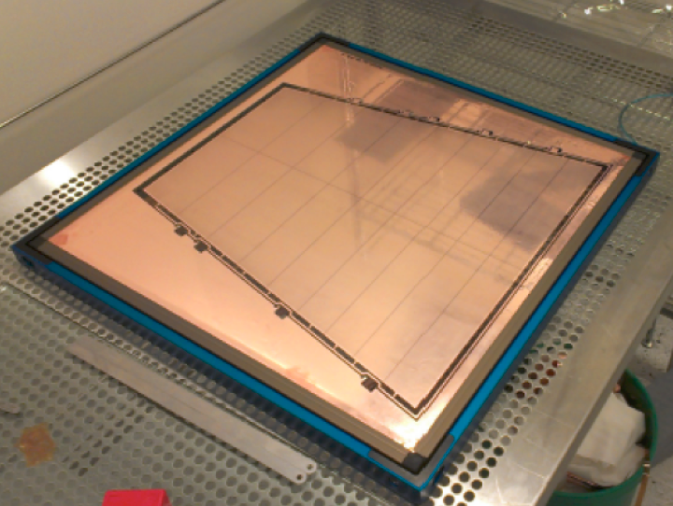
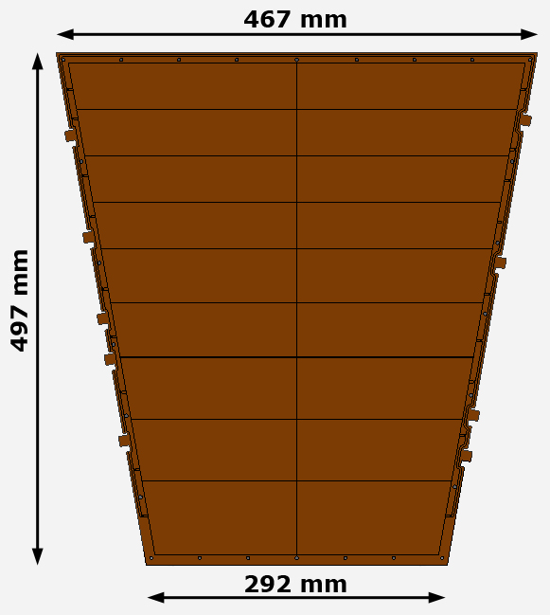
ALICE Full Size Prototype
3 large-size GEM foils: single-mask
18 sectors (top side), ~ 100cm² each
bias resistors 10 / 1MΩ
2mm frames glued on bottom side
spacer grid: 400μm thickness
additional frame for induction gap: 4mm

Slide 25
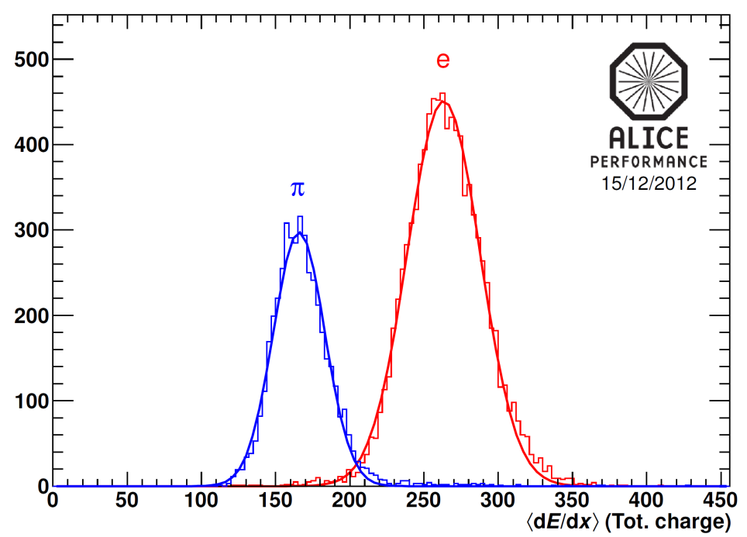
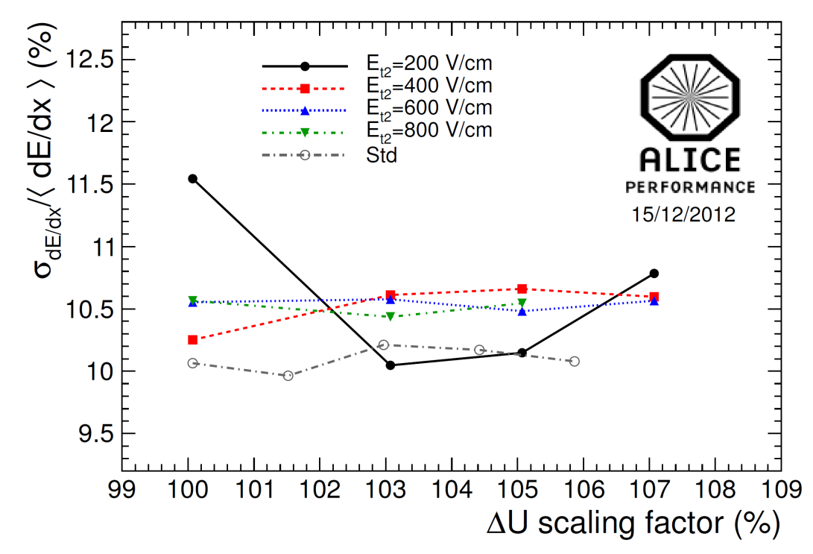
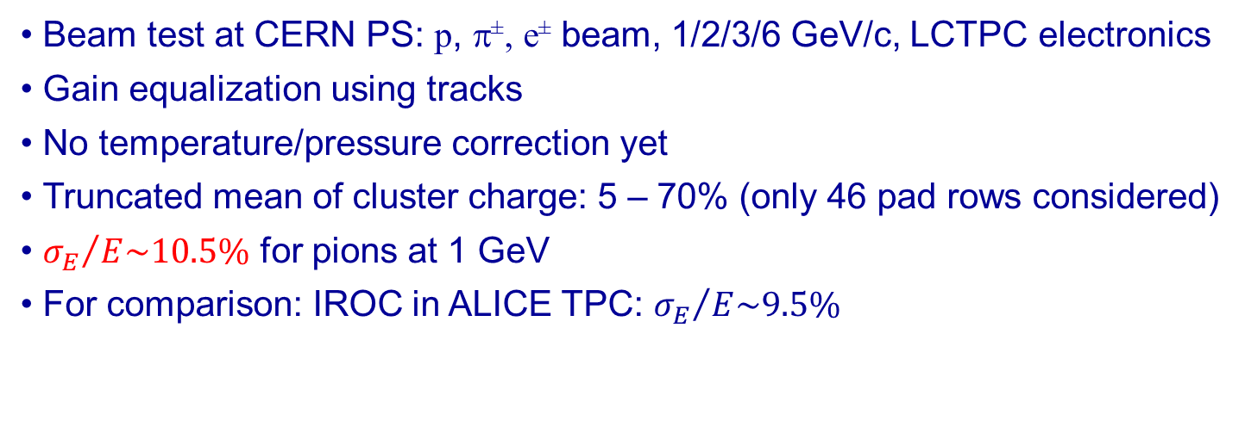
dE/dx Resolution
p=1 GeV/c
G=5000
Beam test at CERN PS: p, π±, e± beam, 1/2/3/6 GeV/c, LCTPC electronics
Gain equalization using tracks
No temperature/pressure correction yet
Truncated mean of cluster charge: 5 – 70% (only 46 pad rows considered)
${σ_{E}}/{E\sim 10.5\%}$ for pions at 1 GeV
For comparison: IROC in ALICE TPC: ${σ_{E}}/{E\sim 9.5\%}$
[B. Ketzer et al., NIM A 732, 237 (1013)]

Slide 26
Outline
Introduction
Ion Backflow in GEM Detectors
Prototype Detectors
  FOPI TPC
  ALICE Full Size Prototype
The TPC Upgrade
Expected Performance
Conclusions and Outlook

Slide 27
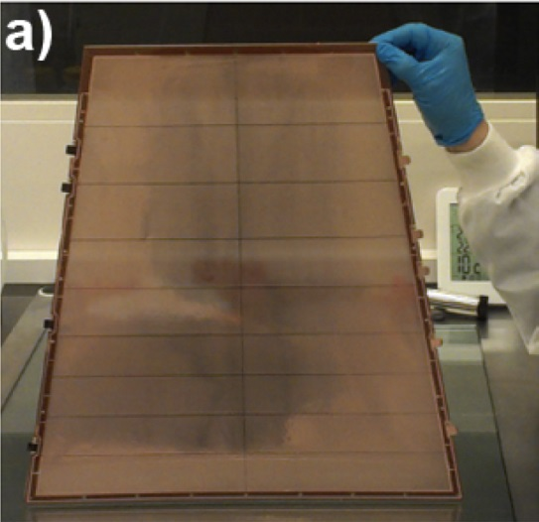
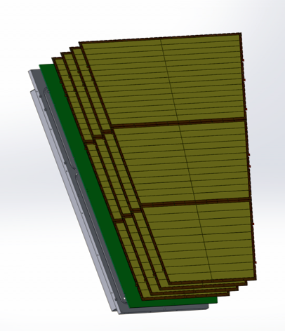
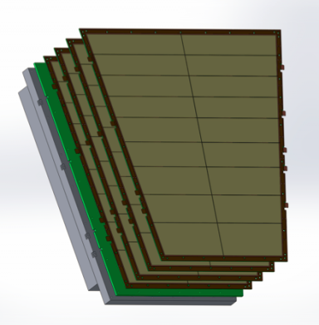
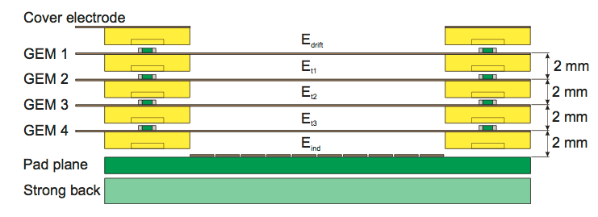
Upgrade of the ALICE TPC
47cm
87cm
50cm
114cm
IROC
Single-mask technology
Quadruple GEM stack
Std + large-pitch foils
OROC

Slide 28
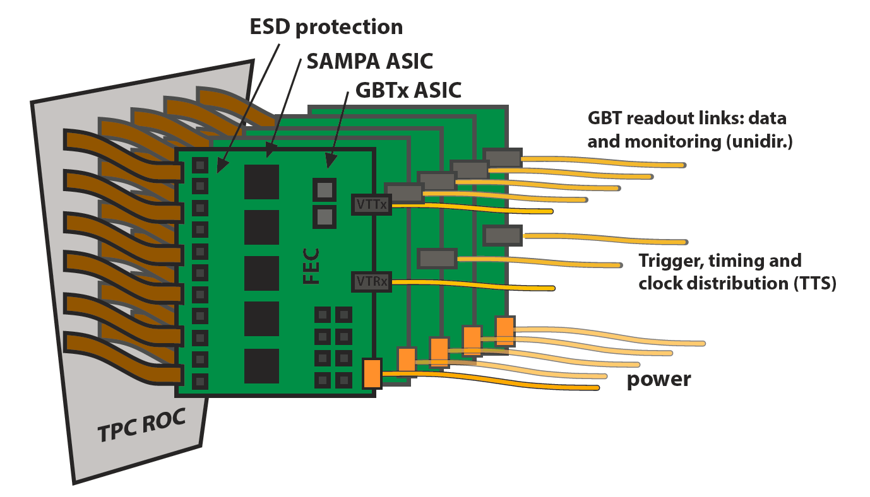
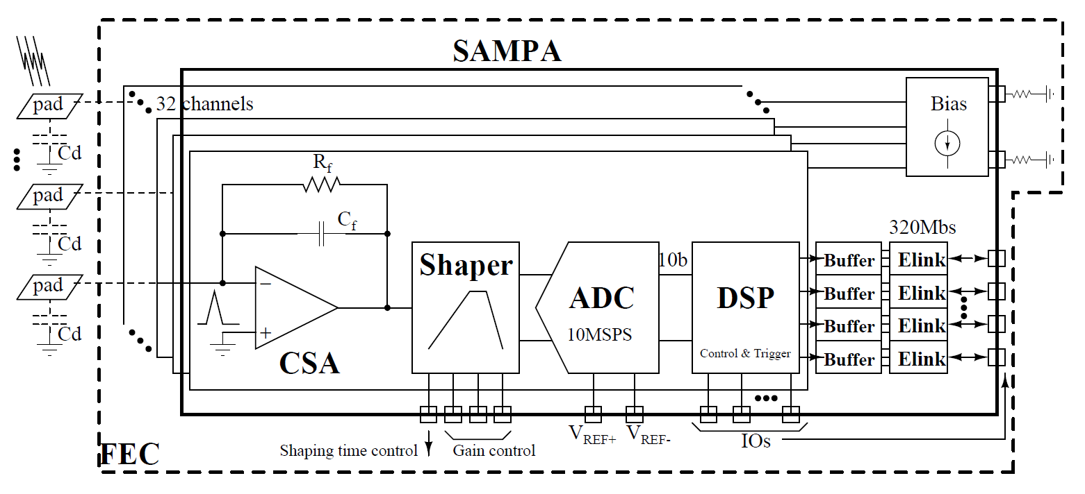

Front-end Electronics
Requirements
Polarity opposite wrt MWPC
Continuous readout  simultaneous sampling and data transfer
Data throughput: $50 \text{kHz} ×20 \text{MB}\text{=1 }\text{TB}\text{/}\text{s}$ (of FEE, not written to disk)
Triggered mode for calibration

Slide 29
Outline
Introduction
Ion Backflow in GEM Detectors
Prototype Detectors
  FOPI TPC
  ALICE Full Size Prototype
The TPC Upgrade
Expected Performance
Conclusions and Outlook

Slide 30


Expected Spatial Resolution
GEM pad response function smaller than MWPC  pad size adequate?
Resolution diffusion-dominated for $z<200 \text{cm}$, ~10% worse for GEMs
Cluster size ~20% smaller for GEMs  smaller occupancy
Increasing number of single-pad clusters for shorter drift length,
but partially outside barrel acceptance (|η|<0.9)

Slide 31


Expected Momentum Resolution
Intrinsic performance:
GEMs slightly worse than MWPC due to space-point resolution
Recovered by vertex constraint + ITS
Performance with GEMs and pileup:
As good as present system with vertex constraint and ITS
Very little effect of pileup tracks (small PRF leads to less merged clusters)

Slide 32


Reconstruction Strategy
Two-stage reconstruction scheme:
Cluster finding, cluster-to-track association: 1 TB/s  50 GB/s
  Scaled average space charge distortion map, $u_{d}$, gain eq.  $𝒪(1 \text{mm})$
Tracking, ITS-TRD track matching
  High-resolution space charge correction  $𝒪(200 \text{μ}\text{m})$ in $rφ$

Slide 33

Reconstruction Strategy

Slide 34


Conclusions
ALICE physics program for RUN3 requires an upgrade of the detector
TPC will be operated in continuous mode at 50 kHz interaction rate
GEM detectors instead of MWPCs to reduce the ion backflow
  4 GEMs with different aspect ratios needed to meet requirements
  IB < 1%, energy resolution σ < 12% achieved
  Room to optimize operational stability
Distortion corrections applied in two steps
  online using average map  resolution $𝒪(1 \text{mm})$
  offline using high-resolution space charge map (~ ms)  $𝒪(200 μ\text{m})$
Performance of TPC can be fully maintained at 50 kHz
TDR ready for submission

Slide 35


Thank you for your attention!

