Slide 1
An APD sensor with extended UV response for readout of BaF₂ scintillating crystals
David Hitlin
INSTR2014
February 28, 2014

Slide 2
Background and motivation
When the cost of LYSO reached unaffordable levels, Mu2e needed a fast, radiation hard crystal with reasonable light output
Barium fluoride is a potentially interesting candidate, but it presents unique problems
  It has a very fast scintillation component, which is attractive, but it is accompanied by a much larger slow component
  Both components are in the UV
Making use of BaF₂ in a practical experiment requires a photosensor that
      discriminates between fast and slow scintillation components
      has a fast time response
      works in a magnetic field
      is stable over time
      is radiation hard
The development of such a sensor is the subject of this talk

Slide 3
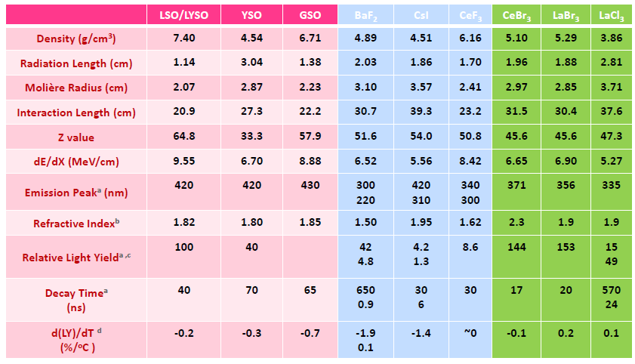
Fast scintillating crystals
Ren-yuan Zhu

Slide 4
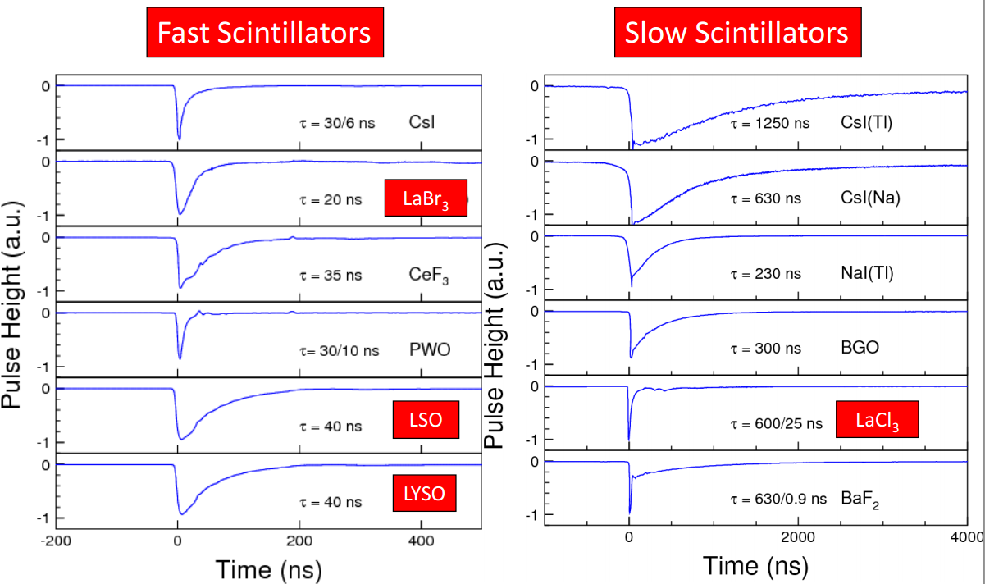
Scintillation pulse shapes
LaBr₃
LSO
LaCl₃
LYSO
BaF₂
Ren-yuan Zhu

Slide 5
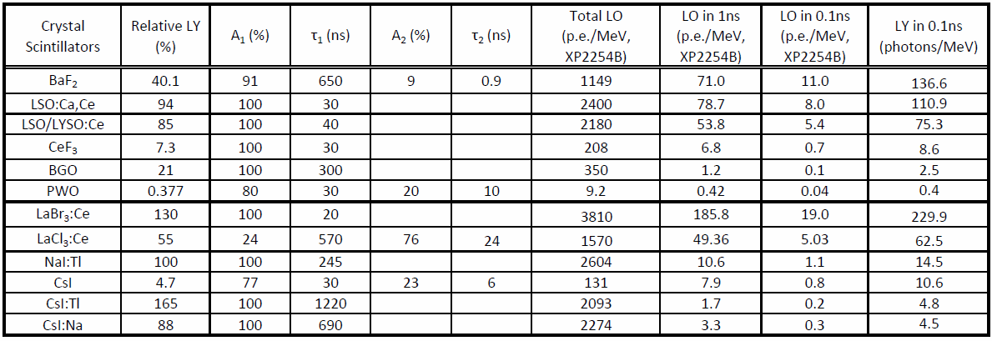
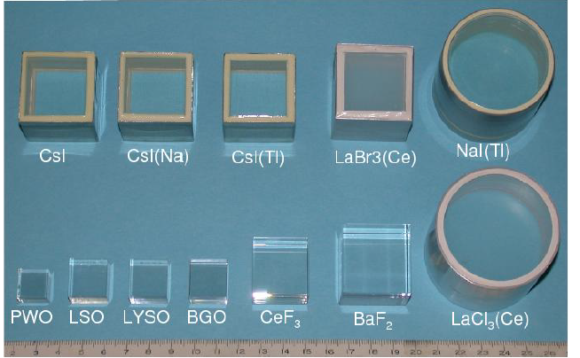
A fast crystal “figure of merit”
Motivates R&D on fast
crystals and appropriate
solid state readout
Ren-yuan Zhu

Slide 6
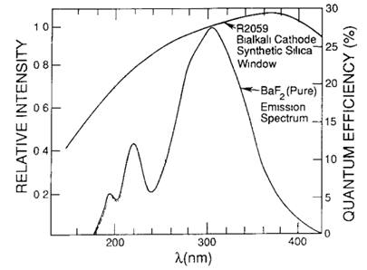
BaF₂ is a potentially attractive high rate crystal
BaF₂ is among the fastest scintillating crystals (0.9ns), but there is a much larger, slower, component (650ns)
In order to take full advantage of the fast component, it is necessary to suppress the slow component
85%
650 ns
Total light output
1.2 x 10⁴ photons/MeV
15%
900 ps

Slide 7
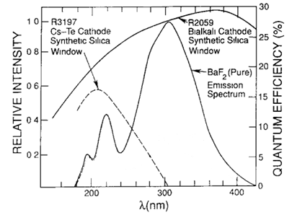
BaF₂ is a potentially attractive high rate crystal
BaF₂ is among the fastest scintillating crystals (0.9ns), but there is a much larger, slower, component (650ns)
In order to take full advantage of the fast component, it is necessary to suppress the slow component:
  Need a “solar-blind” photosensor

Slide 8
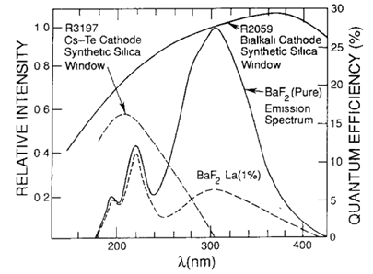
BaF₂ is a potentially attractive high rate crystal
BaF₂ is among the fastest scintillating crystals (0.9ns), but there is a much larger, slower, component (650ns)
In order to take full advantage of the fast component, it is necessary to suppress the slow component
  La doping of pure BaF₂ suppresses the slow component by ~4
  Other dopings can be explored

Slide 9
Solar-blind photosensors
Solar-blind PMTs exist
  Large area, fast, but expensive, and do not work in a magnetic field
Solar-blind solid state devices also exist
  SiC APDs (100μm diameter)
  AlGaN APDs (< 1mm diameter)
There are several potential approaches to fast, large area, solar-blind, magnetic field insensitive photosensors
  A variant of the LAPPD channel plate under development by U Chicago/Argonne
  SiPMs with or without antireflection coatings (e.g., Hamamatsu)
  Large area delta-doped APDs with AR ALD (Caltech/JPL/RMD)

Slide 10
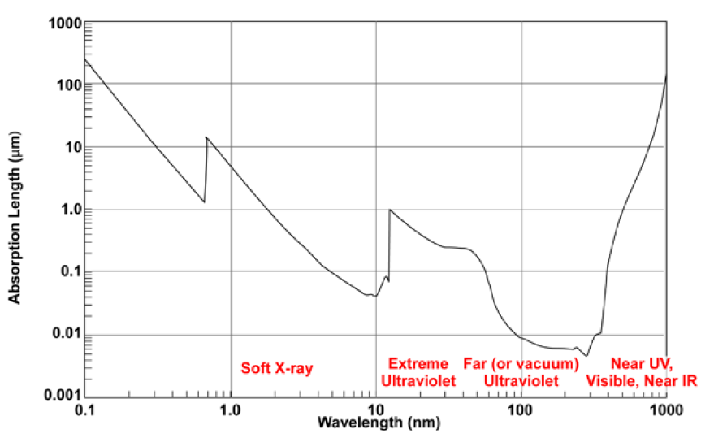
How to achieve best possible QE in the 200-300 nm regime?
Absorption length at 220 nm in silicon is less than 10 nm
  Protective epoxy coating on an APD or SiPM has a strong effect on QE
  Sensitive region of device must be very close to the surface

Slide 11
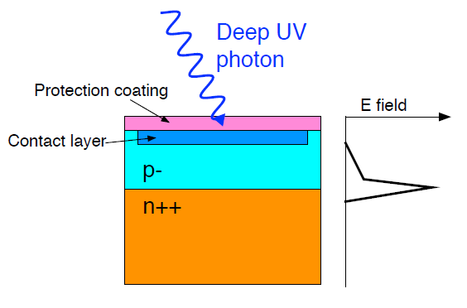
UV sensitive MPPC
Hamamatsu Photonics/MEG
Requirements
  Sensitivity to liquid xenon scintillation (λ = 175 nm)
  Large active area (12×12 mm²)
  Single photon counting capability
  Moderate trailing time constant (τ ＜ 50 ns)
In order to improve sensitivity
  Remove protection layer
  Match refractive index
  to liquid xenon
  Apply anti-reflection coating
Cross-sectional image of MPPC

Slide 12
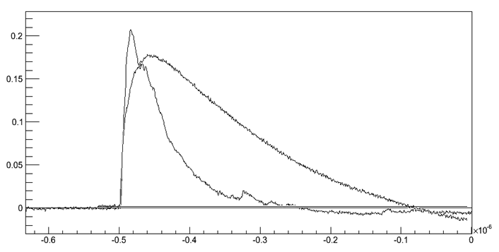
IEEE/NSS Seoul
Hamamatsu UV sensitive MPPC
Performance of UV-Sensitive MPPC for Liquid Xenon Detector in MEG Experiment
D. Kaneko
ICEPP, The University of Tokyo, Tokyo, Japan
On behalf of the MEG Collaboration
Large area MPPC sensitive to the liquid xenon scintillation light ( λ = 175 nm) 12×12 mm active area Detection efficiency (PDE) of 17% Pixel gain around 10⁶ Version with improved pixel structure is under development
P. Murat

Slide 13
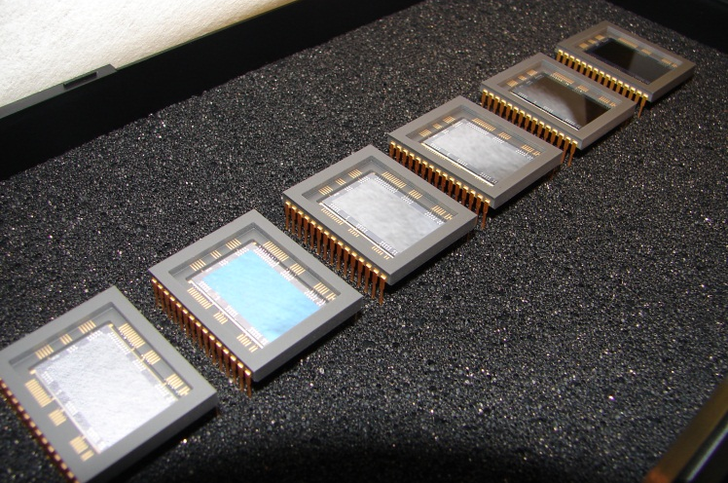
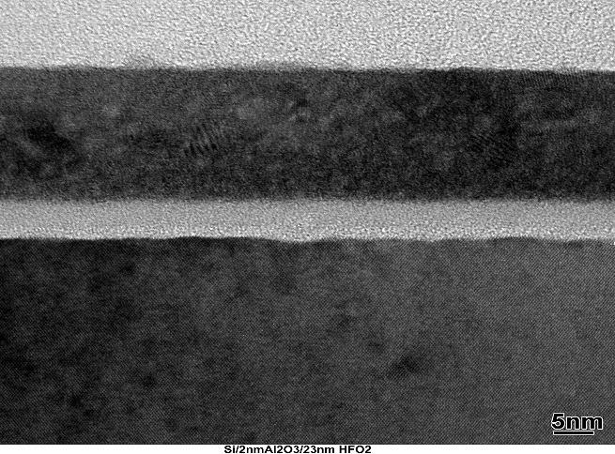
Far ultraviolet, visible-blind coatings
“Ultraviolet antireflection coatings for use in silicon detector design,”
Erika T. Hamden, Frank Greer, Michael E. Hoenk, Jordana Blacksberg, Matthew R. Dickie, Shouleh Nikzad, D. Christopher Martin, and
David Schiminovich
Applied Optics, Vol. 50, Issue 21, pp. 4180-4188 (2011)
“Delta-doped electron-multiplied CCD with absolute quantum efficiency over 50% in the near to far ultraviolet range for single photon counting applications”
Shouleh Nikzad, Michael E. Hoenk, Frank Greer, Blake Jacquot,
Steve Monacos, Todd J. Jones, Jordana Blacksberg, Erika Hamden,
David Schiminovich, Chris Martin, and Patrick Morrissey
Applied Optics, Vol. 51, Issue 3, pp. 365-369 (2012)
“Atomically precise surface engineering of silicon CCDs for
enhanced UV quantum efficiency,”
Frank Greer, Erika Hamden, Blake C. Jacquot, Michael E. Hoenk,
Todd J. Jones, Matthew R. Dickie, Steve P. Monacos, Shouleh Nikzad
J. Vac. Sci. Technol., A 31, 01A103 (2013)
HfO₂
World record deep ultraviolet quantum efficiency
  QE > 5x Galex
  Stable
  Visible blind coatings are possible
Al₂O₃
Native SiO₂
Silicon

Slide 14
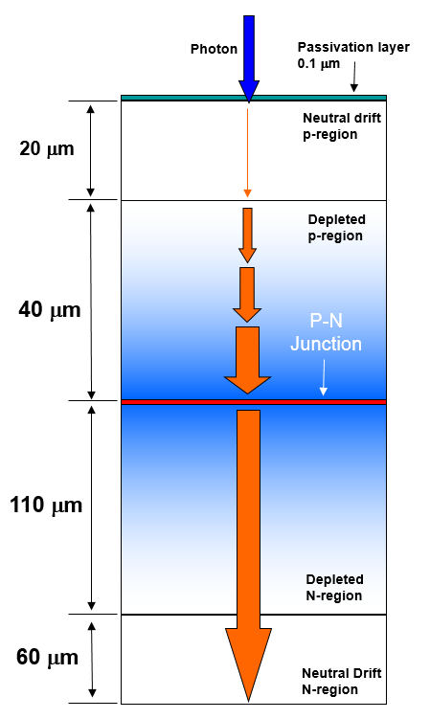
APD structure
Deep-diffused architecture (RMD)
Photoelectrons created by UV photons at the sensing surface must survive trapping at the SiO₂/Si passivation surface interface and recombination in the undepleted p-side neutral drift region (tens of μm) to reach the depletion region where the avalanche takes place
  The thickness of the undepleted p-side region is engineered for efficient conversion of visible photons
    This is undesirable for high UV QE
The result is that UV QE is reduced and the device speed is determined by the ~10 ns drift time as well as by capacitance
This structure can be modified, using proven techniques, to improve both UV quantum efficiency and device timing characteristics

Slide 15
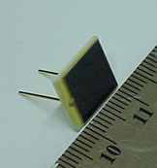
Visible-blind, superlattice-doped silicon detectors
  Eliminating the potential well at the surface
  and reducing (or removing) the drift region
  improves the detector UV QE and speed
  The process is executed on modified RMD
  APD wafers, using an extrapolation of existing
  technology at Caltech’s Jet Propulsion Laboratory (JPL)
    Molecular Beam Epitaxy
      > 50% QE at 220 nm
      Low dark current
      High conductivity
      Radiation tolerance
    Atomic Layer Deposition
      Chemically passivated interface
      Visible-blind antireflection coatings: < 1% QE at 300 nm
RMD 9x9mm

Slide 16
The process
  Wafers are thinned on the p-side (sensing side) to remove the undepleted region
  Drift region is replaced by 3μm vapor phase epitaxial layer
  Monolayer of boron atoms is deposited ~2.5nm below the surface, eliminating the trapping well
Delta-doped layer
(dopant in single atomic layer)
original Si
circuitry
Native oxide
1 nm
MBE growth
3 nm

Slide 17
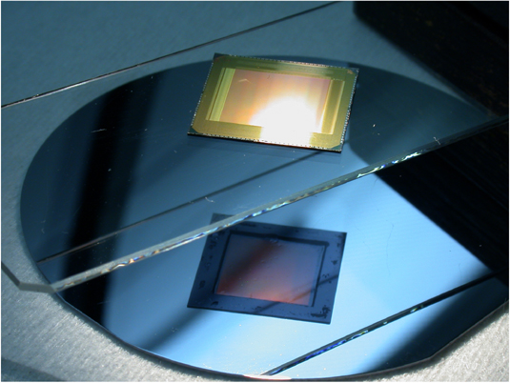
Delta-doping has been applied to CCD detectors
Thinned CMOS Array
front surface
Back surface
S. Nikzad, “Ultrastable and uniform EUV and UV detectors,”
SPIE Proc., Vol. 4139, pp. 250-258 (2000).
J. Trauger (PI WF/PC2) – No measurable hysteresis in delta-doped CCDs

Slide 18
Delta doping and quantum exclusion
Surface
Bulk
  Delta-doping creates a “quantum well” in the silicon
  Majority carriers are confined to quantized subbands
  Quantum exclusion eliminates trapping
  Peak electric field is ~10⁷ V/cm
Positively charged surface @ 10¹³ cm⁻²

Slide 19
Superlattice doped surface with delta doping
5 nm, 8x10¹⁴ cm⁻²
2.5 nm, 2x10¹⁴ cm⁻²

Slide 20
Thinning improves timing performance
3 μm epitaxial layer deposited on thinned RMD APD (3x3 mm²)
Illumination with 405 nm laser pulse

Slide 21
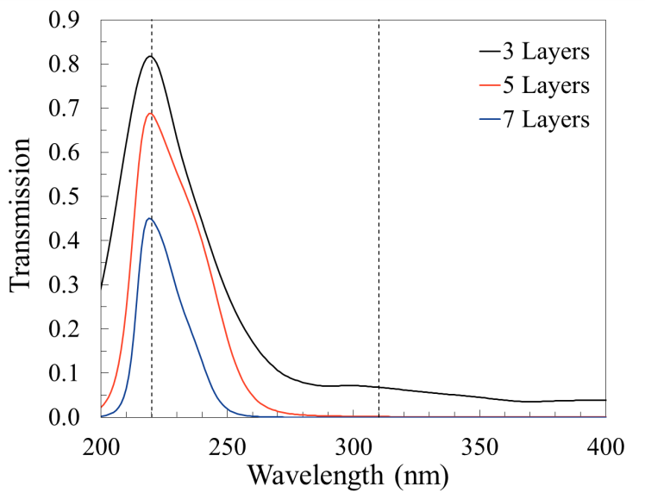
Experimental tests for Al₂O₃/Al Blocking Filters (220 nm)
Design Approach:
  Develop optical model for stand-alone Al₂O₃ layers (these were deposited at 200°C, Oxford ALD w/ O₂ plasma)
  Using this model and Al reference model
  (Palik data) calculate for target layer thickness
  Designs roughly based on original rejection targets for three or five layer metal/dielectric stacks (target peak @220 nm)
  Feedback from ellipsometry data to modify thickness targets (i.e. due to Al layer oxidation duration processing, etc.)
  Will eventually develop a refined optical model to be more predictive about the expected transmission and reflection, simple discrete layers appear insufficient especially for the five layer tests
J. Hennessy

Slide 22
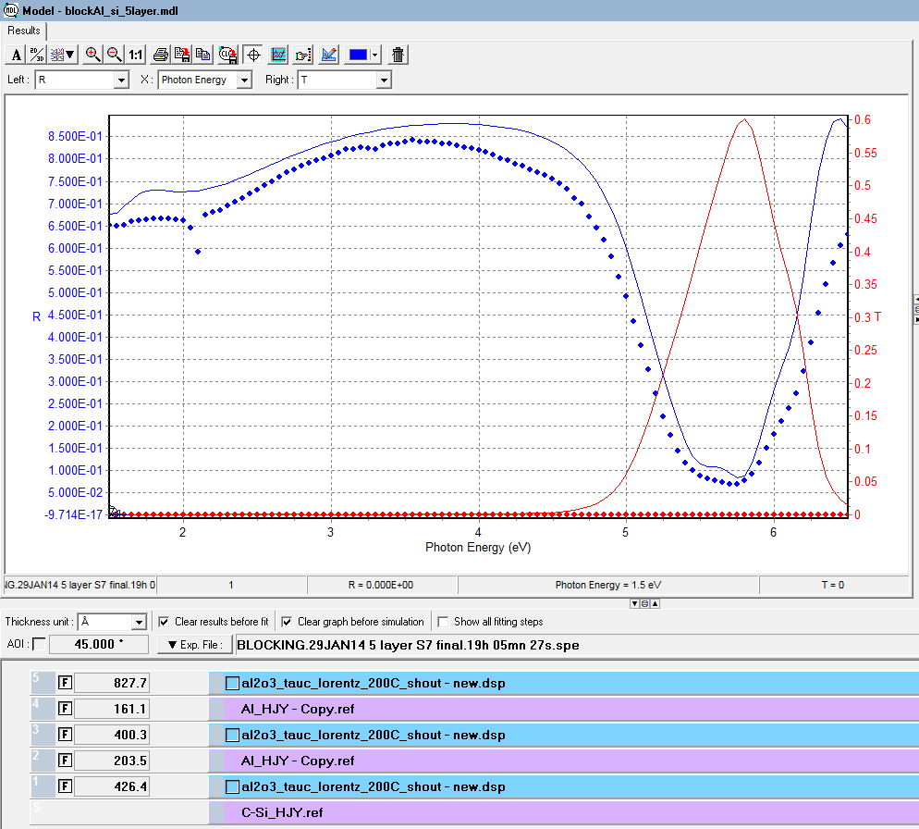
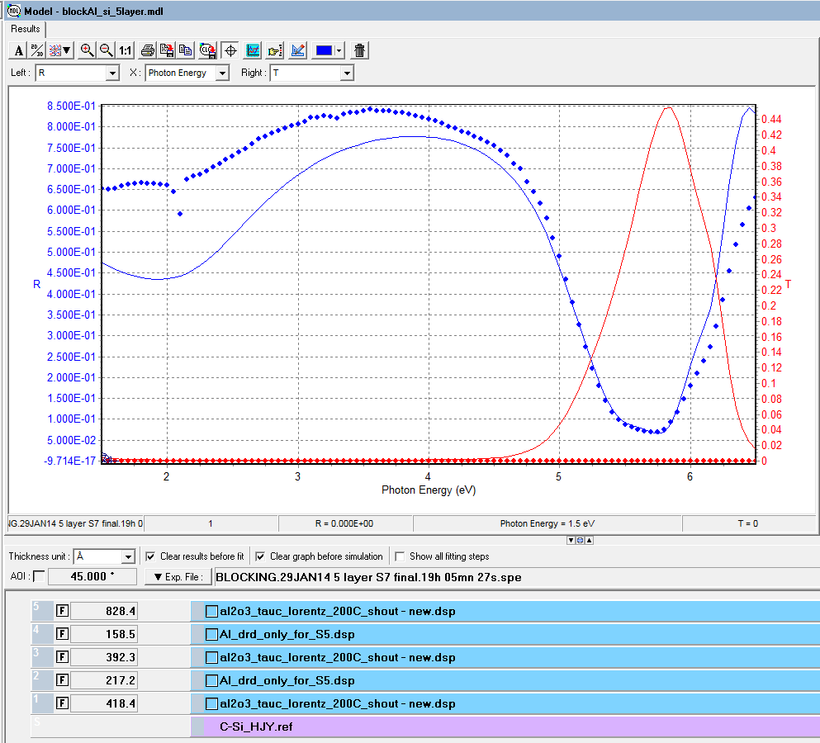
Five Layer Test (Si-DMDMD)
Solid Red = model transmission
Solid Blue = model reflection
Models based on best-fit to ellipsometric data
Symbols = measured reflection
*All 45° incidence
Five layer w/ ideal Al parameters
Best fit χ²= 25.6 (L1 = 426Å, L2=204Å, L3=400Å, L4=161Å, L5=828Å)
Model T @220nm = 53% (45°) , 68% (normal)
Model T @310nm = 0.13% (45°) , 0.16% (normal)
Predicted T_{peak} (normal) = 69% @ 218 nm
Five layer w/ new Al parameters
Best fit χ² = 9.61 (L1 = 418Å, L2=217Å, L3=392Å, L4=158Å, L5=828 Å)
Model T @220nm = 38% (45°) , 53% (normal)
Model T @310nm = 0.16% (45°) , 0.20% (normal)
Predicted T_{peak} (normal) = 55% @ 218 nm
J. Hennessy

Slide 23
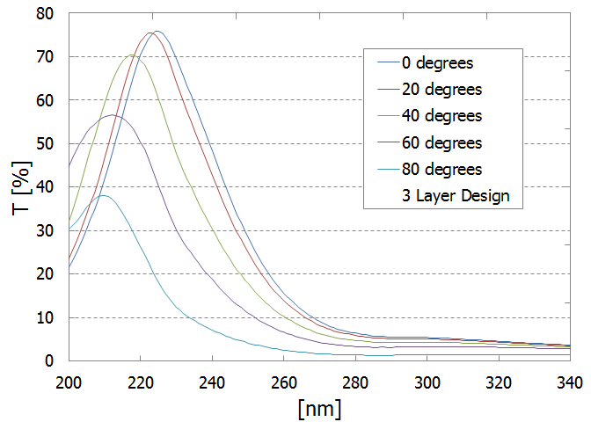
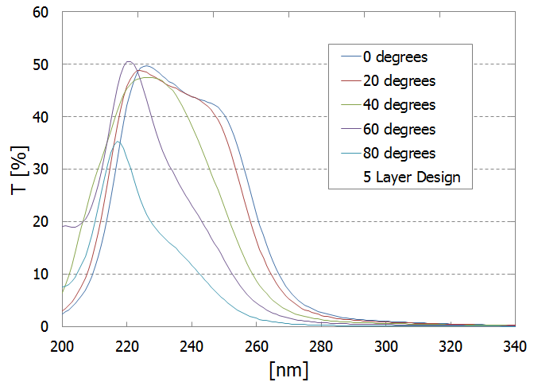
Angular dependence of integrated interference filter
J. Hennessy

Slide 24
Current status
  RMD has furnished six thinned APD wafers to JPL for processing
      Two stage development plan
        I: Extended UV response
        II: Integrate AR interference filter
  Processed wafers have been probed and diced at RMD
    Devices work as APDs, with somewhat increased noise but fast pulse response
      Noise has been traced to a contaminated epitaxial vapor deposition source at JPL, which is being disassembled and cleaned
    JPL will process and AR coat several unpackaged chips and return both coated and uncoated chips to RMD for packaging
    Chips will undergo full characterization and then tests with BaF₂
  A second batch of wafers is being readied
    Will explore different depths and density of the superlattice MBE and delta doping
  Goal is to have full size prototype devices for a beam test at MAMI in the fall

Slide 25
Conclusions
Full utilization on the fast component of BaF₂ requires development of an appropriate sensor
Existing large area UV sensitive APDs or SiPMs have ~20% quantum efficiency, slow time response and offer no discrimination between the BaF₂ fast and slow scintillation components
The Caltech/JPL/RMD collaboration is developing a 9x9mm superlattice thinned, delta-doped APD with integrated AR coating and filter
  This device promises to have >50% quantum efficiency at 220 nm, strong discrimination of the 300 nm slow component, and excellent timing characteristics

Slide 26
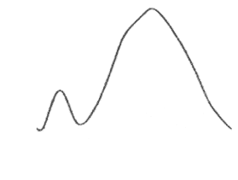
The proverbial bottom line

Slide 28
Scintillating crystal calorimeter for mu2e
Two disk geometry
Hexagonal BaF₂ crystals; APD or SiPM readout
Provides precise timing, PID, background rejection, alternate track seed and possible calibration trigger.

Slide 29
Calorimeter crystal history
Initial choice PbWO4: small X₀, low light yield, low temperature operation,
temperature and rate dependence of light output
CDR choice LYSO: small X₀, high light yield, expensive (→very expensive)
TDR choice: BaF₂: larger X₀, lower light yield (in the UV), very fast
component at 220 nm, readout R&D required, cheaper,

Slide 30

Reach-Through Avalanche Photodiode (RTAPD)
Reverse biased photodiode with p⁺πpn⁺ structure
contact
Avalanche gain in pn+ junction
P+
N+
P+
e-
e-
e-
e-
e-
e-
e-
e-
e-
e-
Electric field drives electrons toward junction
e-
e-
pn+ junction
Multiplication
Drift: velocity 10 ps/μm
$π$ silicon
Recombination
Absorption
e-
p+ implant
e-
e-
Deep implant
UV QE Low, unstable
e-
No background rejection
Dead layer formed by p+ implant
Signal
220 nm
Background
330 nm
Ultraviolet light is absorbed near the surface

Slide 31
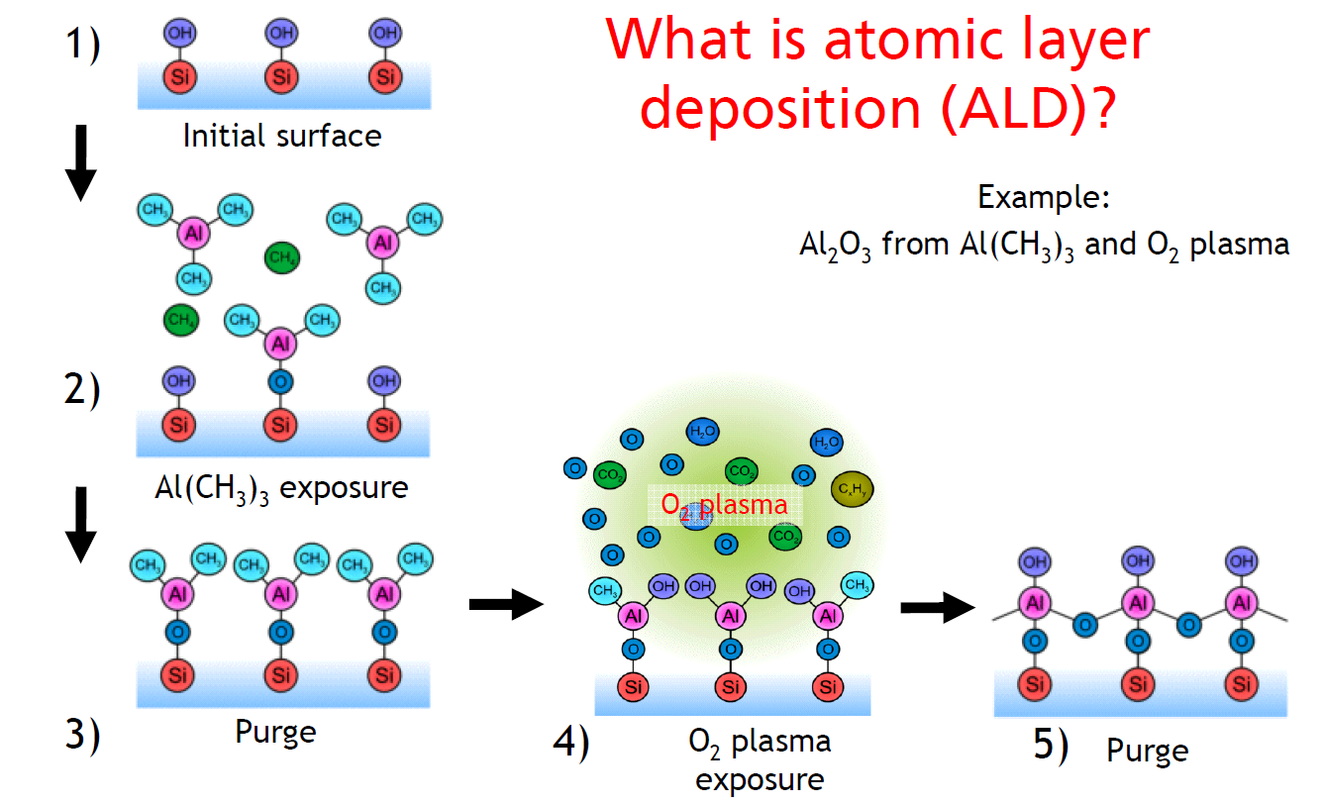
Atomic Layer Deposition (ALD)
Achieves layer-by-layer growth of films with Angstrom-level control over arbitrarily large surface areas
Wide suite of materials metals, oxides, and nitrides with excellent film properties
Can be directly integrated into existing detectors/instruments to vastly improve performance
Key advantages of ALD
TEM images of ultra-thin (3.5nm), conformal ALD film
Fully complements the surface engineering capabilities of Si MBE with atomic control of ALD
Thickness can be specified with Angstrom resolution
  Enables precise, repeatable targeting of bands e.g. 16.5 nm vs. 23 nm of Al₂O₃
Process is completely independent of device size
Silicon Substrate
3.5 nm
ALD
Silicon Substrate
3.5 nm
ALD
Glue for sample mount

