Slide 1
Плазменное кильватерное ускорение
Константин Лотов
Институт ядерной физики им. Г.И.Будкера СО РАН
Новосибирский государственный университет

Slide 2
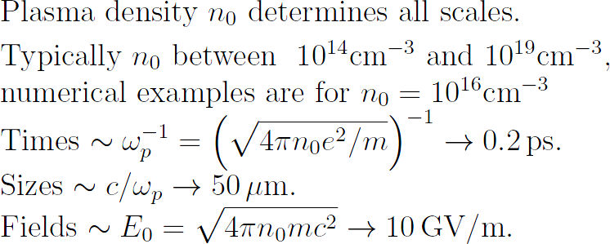
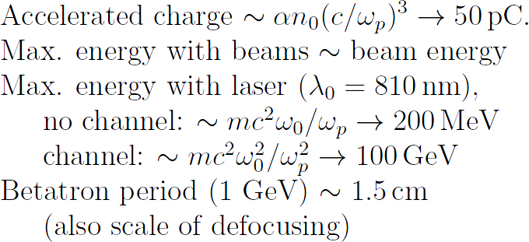
K.Lotov, RuPAC, 11.09.2023, p.2 of 11
What is plasma wakefield acceleration?
(this is an example of a nonlinear plasma wave driven by an electron bunch)
driver, creates wave
witness,
is accelerated
plasma electrons
That’s why it is so difficult
That’s why it is so interesting

Slide 3
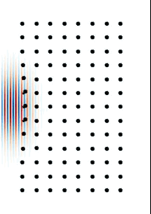
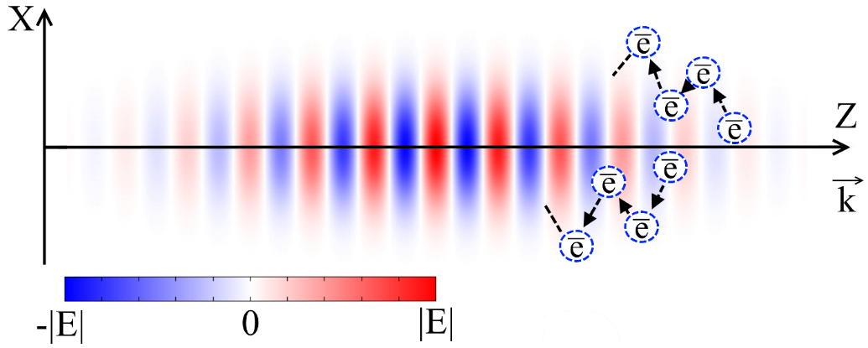
K.Lotov, RuPAC, 11.09.2023, p.3 of 11
More illustrations of wakefield generation
Plasma electrons are pushed by the ponderomotive force (that pushes charged particles out of the region of a strong electric field):
(these are examples of plasma waves driven by electromagnetic pulses of different strength, from website of Lancaster University)
Electrons are pushed out by a stronger force,
and pulled in by a weaker force
Weak driver: almost elliptical
trajectories
Strong driver: the wave quickly breaks, and some plasma electrons can be even trapped by the wave
ħω
p
e
plasma wakefield acceleration

Slide 4
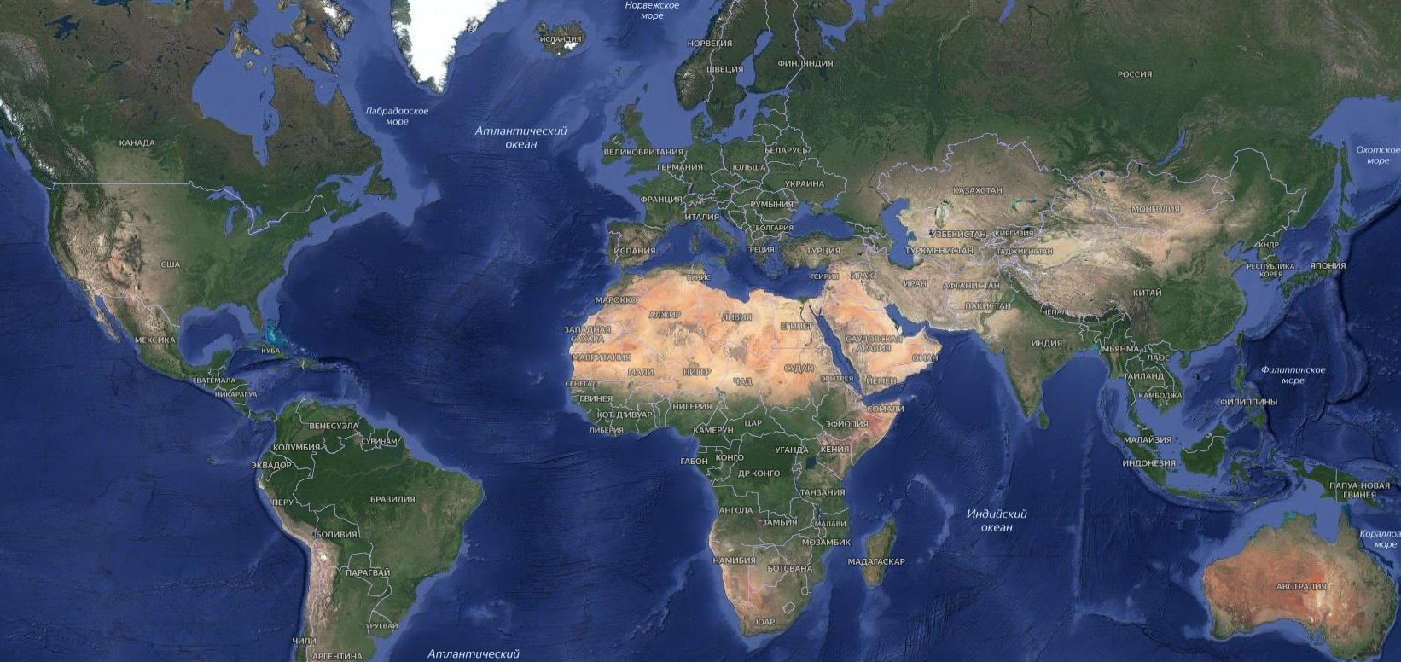
K.Lotov, RuPAC, 11.09.2023, p.4 of 11
Plasma-based wakefield acceleration in the world
LWFA
PWFA
LWFA+PWFA
PDPWFA
U.Strathclyde
U.Lund
MSU
IAP
ILP
DESY
Edmonton
Daresbury
U.Oxford
DESY-Zeuthen
RAL
Jena
HZDR
U.Duesseldorf
IoP Prague
U.Quebec
SOLEIL / LAL / LOA
KIT
MPQ Garching
U.Michigan
CERN
U.Nebraska
LLE
BNL
Pisa
Tsinghua U.
LBNL
LLNL
U.Colorado
ANL
Frascati
IoP
Peking U.
SLAC
U.Maryland
U.Lisboa
Ansan, KERI
Tsukuba
Mianyang
Daejon, KAERI
Kyoto
UCLA
U.Texas
Weizmann
Gwangju, GIST
Osaka
SIOM
Jiao Tong U.
RRCAT
Taiwan
Porto Alegre

Slide 5
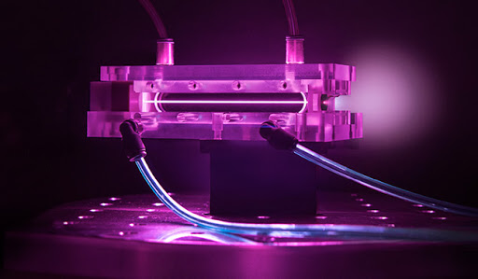
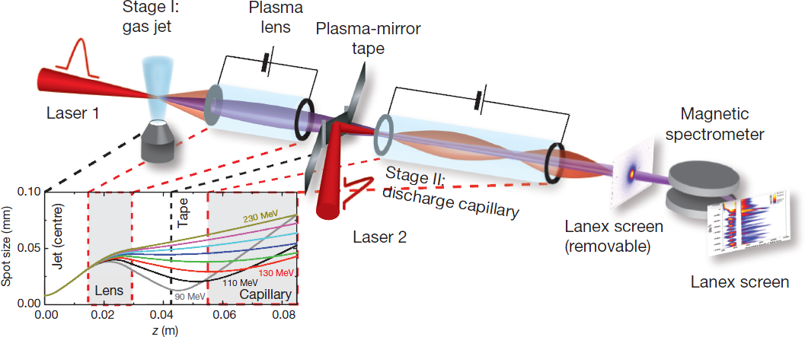
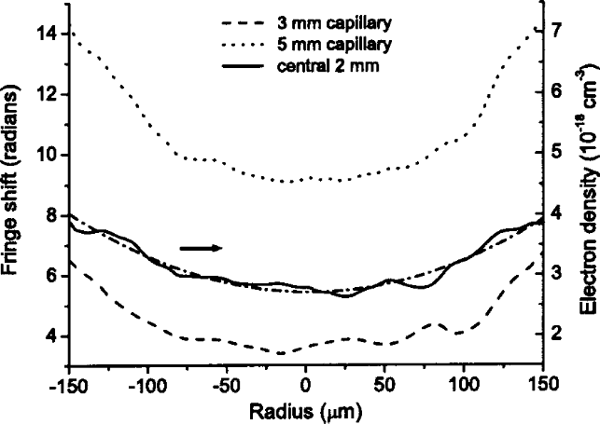
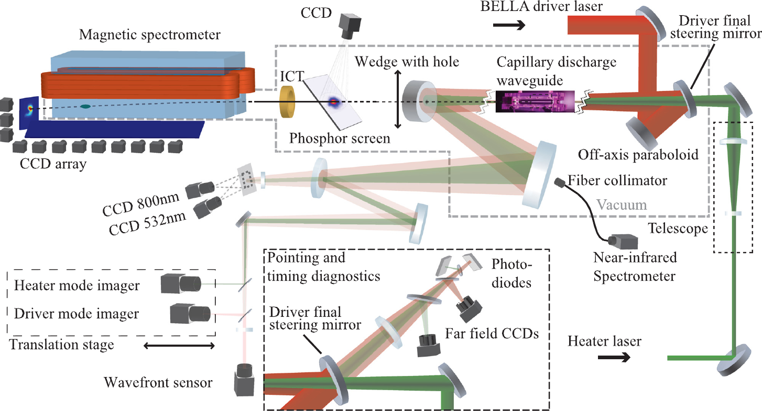
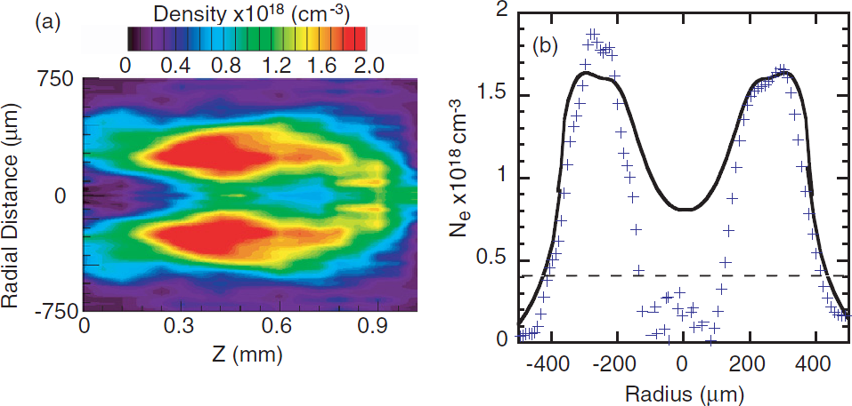
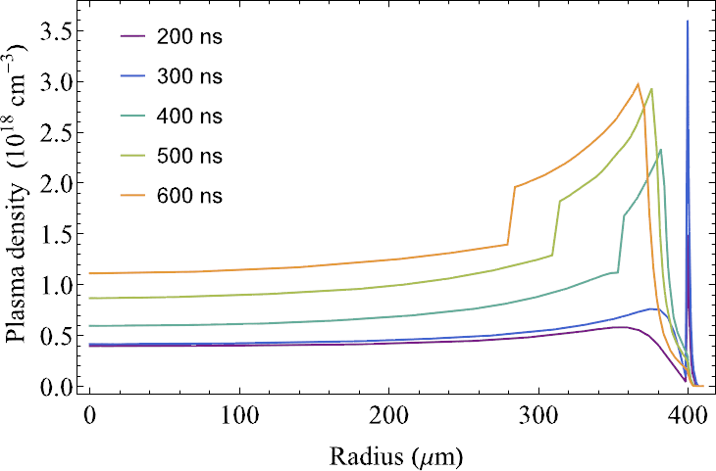
K.Lotov, RuPAC, 11.09.2023, p.5 of 11
Milestones achieved: energy (laser drivers)
LBNL (Bella): 8 GeV in 20 cm
Improvements expected from staging (far future):
A. J. Gonsalves, et al., Phys. Rev. Letters
122, 084801 (2019).
S. Steinke, et al., Nature 530, 190 (2016).
>10 groups obtained >1 GeV
Improvements expected from better channeling:
Capillary discharges
Heater laser
Wall ablation
Magnetic field
D.J. Spence, et al. J. Opt. Soc. Am. B 20, 138 (2003).
D.H. Froula, et al. PPCF 51, 024009 (2009).
A.J. Gonsalves et al., Phys. Plasmas 27, 053102 (2020).
K.K. Swanson et al., PRAB 24, 091301 (2021).

Slide 6
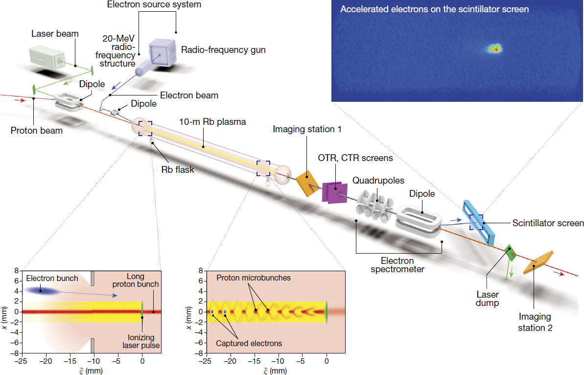
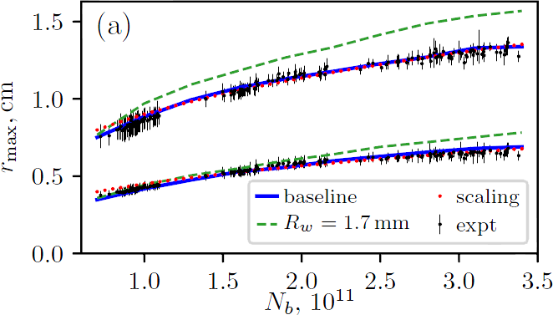
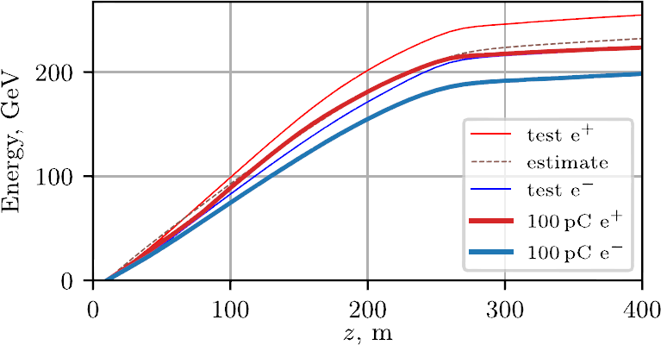
K.Lotov, RuPAC, 11.09.2023, p.6 of 11
Milestones achieved: energy (proton drivers)
AWAKE (CERN): 2 GeV in 10 m, …
… and quantitative agreement with simulations:
Ti:Sapphire, 780 nm,
120 fs, 450mJ
20 MeV, 650 pC,
15 mm mrad, 2 ps
A. J. Gonsalves, et al., Phys. Rev. Letters
122, 084801 (2019).
10¹⁴–10¹⁵ cm⁻³
400 GeV
σ_{z}~7 cm
σ_{r}~0.2 mm
ε_{n}~3 mm mrad
A.A.Gorn et al. (AWAKE Collaboration), Plasma Phys. Control. Fusion 62, 125023 (2020).
Simulated with LCODE.
Simulations show that 200 GeV are achievable:
K.V. Lotov and P.V. Tuev, Plasma Phys. Control. Fusion 63, 125027 (2021).
from E.Adli et al. (AWAKE Collaboration), Nature 561, 363 (2018)

Slide 7
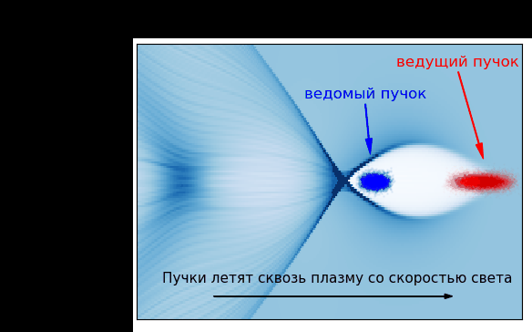
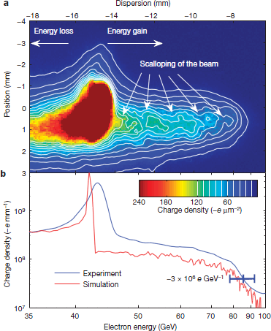
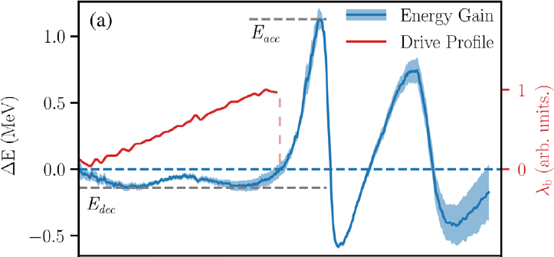
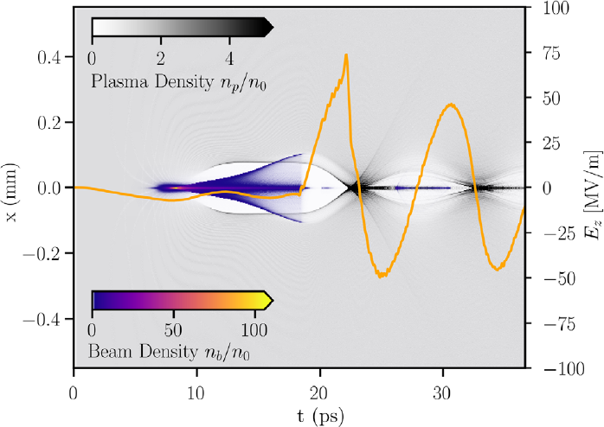
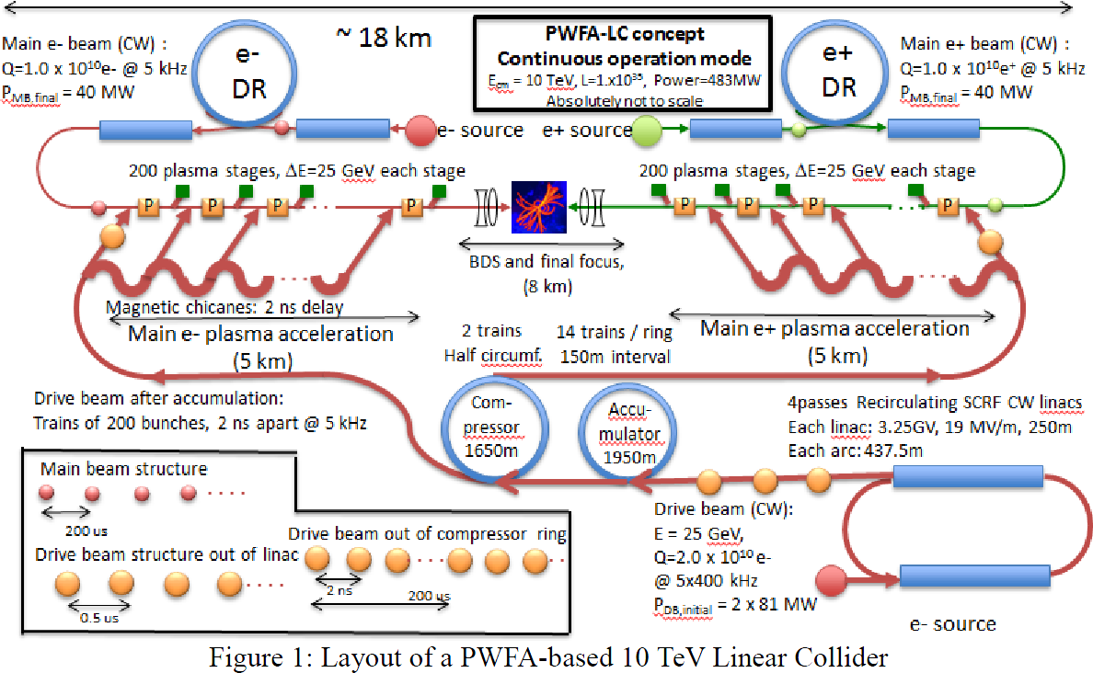
K.Lotov, RuPAC, 11.09.2023, p.7 of 11
Milestones achieved: energy (electron and positron drivers)
Record (+42 GeV at 85 cm) still holds.
The reason – transformer ratio limit, R~1:
The world-leading facility FACET-II (SLAC) operates with 10 GeV beams, new energy record possible only with R>>1. But beam stability is an issue.
Illustration from LCODE website
I.Blumenfeld, et al., Nature 445, 741 (2007).
R. Roussel, et al., Phys. Rev. Lett. 124, 044802 (2020).
Staging has a high entry threshold, so unlikely break the record soon
J.P.Delahaye et al., IPAC-2014, p.3791.

Slide 8
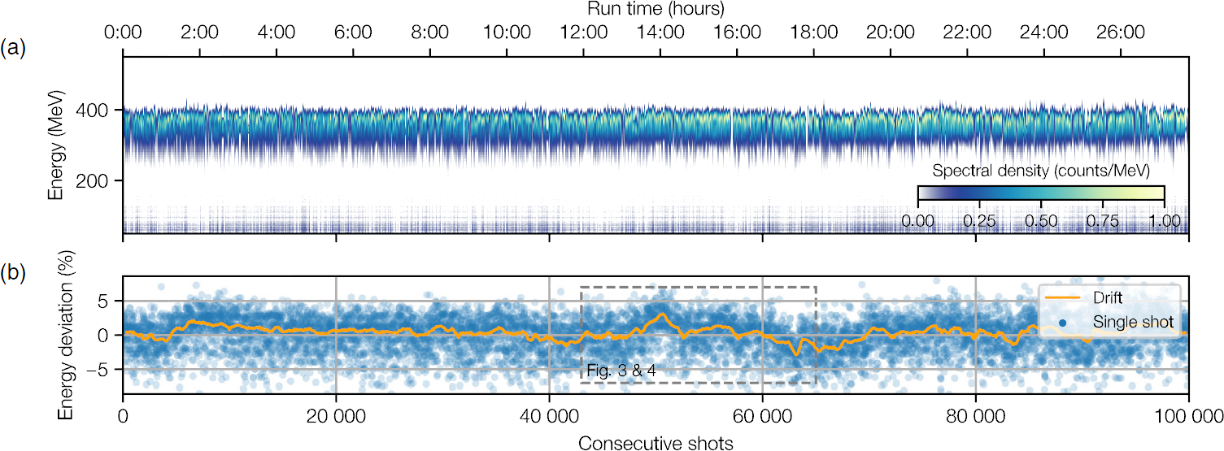
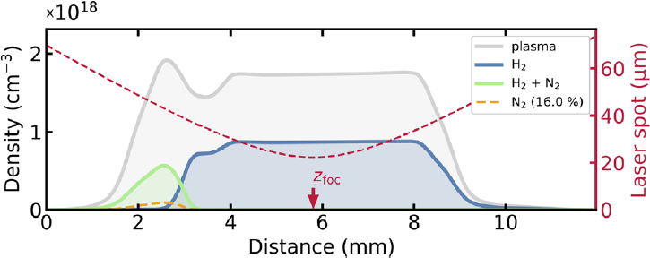
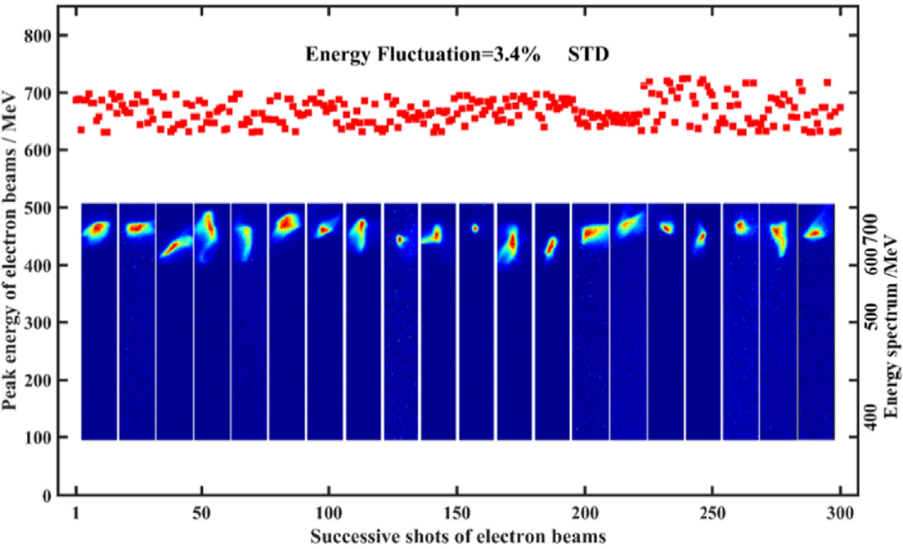
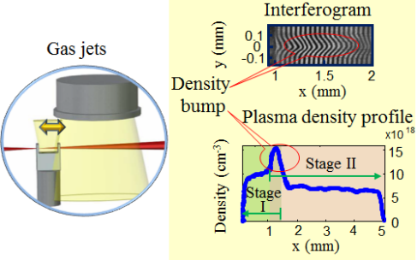
K.Lotov, RuPAC, 11.09.2023, p.8 of 11
Milestones achieved: reproducibility, which allows to improve quality
S.A. Antipov, et al., Phys. Rev. Accel. Beams 24, 111301 (2021).
DESY: 28 h, 1 Hz,
400 MeV, 25 pC,
energy spread < 4%
stability < 2.5%
A.R. Maier, et al., Phys. Rev. X 10, 031039 (2020).
M. Kirchen, et al., Phys. Rev. Lett. 126, 174801 (2021).
SIOM: 1.5 h, 1 Hz, energy stability ~3%
F. Wu,et al., Optics and Laser Technology 131, 106453 (2020).
W.T. Wang, et al., Phys. Rev. Lett. 117, 124801 (2016).

Slide 9
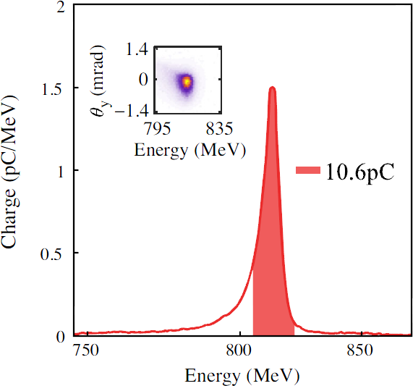
K.Lotov, RuPAC, 11.09.2023, p.9 of 11
Milestones achieved: beam quality
S.A. Antipov, et al., Phys. Rev. Accel. Beams 24, 111301 (2021).
DESY:
S.A. Antipov, et al., Phys. Rev. Accel. Beams 24, 111301 (2021).
Studied as possible injector to PETRA IV
M. Kirchen, et al., Phys. Rev. Lett. 126, 174801 (2021).
SIOM:
~800 MeV, energy spread 0.4%,
~20 pC, emittance ~1 mm mrad,
6d brightness ~ 10¹⁶ A/m²/(0.1%)
L.T. Ke, et al., Phys. Rev. Lett. 126, 214801 (2021).
W.T. Wang, et al., Phys. Rev. Lett. 117, 124801 (2016).
Free-electron lasing at 27 nm demonstrated

Slide 10
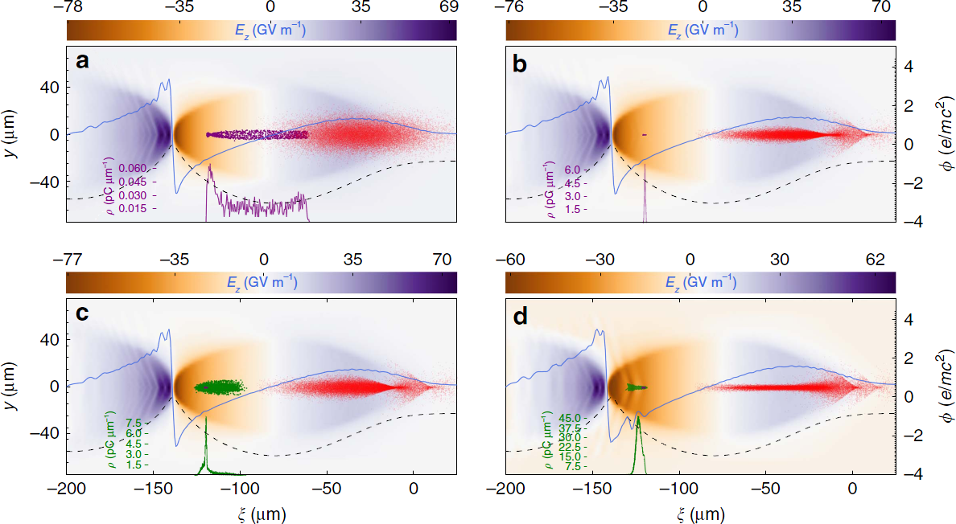
K.Lotov, RuPAC, 11.09.2023, p.10 of 11
New ideas (one of many)
G.G. Manahan, et al. Nat. Comm. 8, 15705 (2017).
Well controlled escort bunch reduces correlated energy spread
(to below 0.1% at 3 GeV, simulations)

Slide 11
Thank you

