Slide 1




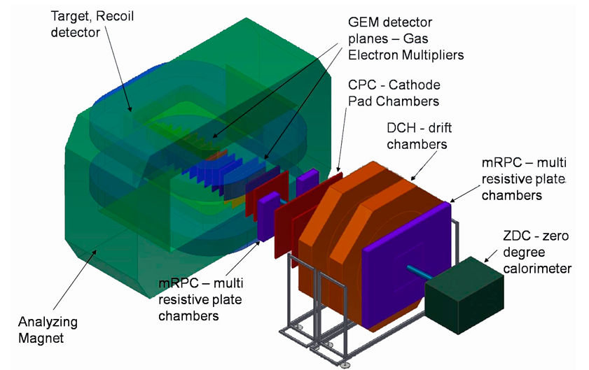
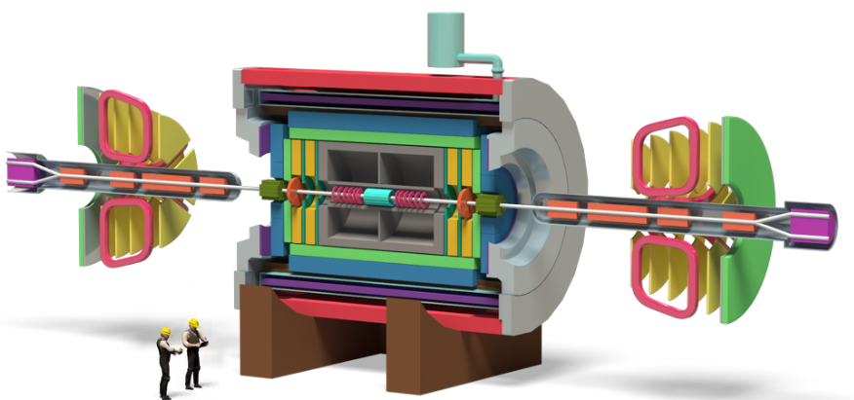
Large Aperture Silicon Tracking Systems for NICA
Dementev Dmitrii, Yu. Murin
For JINR STS team & CBM Collaboration
JINR LHEP
CREMLIN WP7 "Super c-tau factory workshop"
Novosibirsk , 26 May 2018

Slide 2
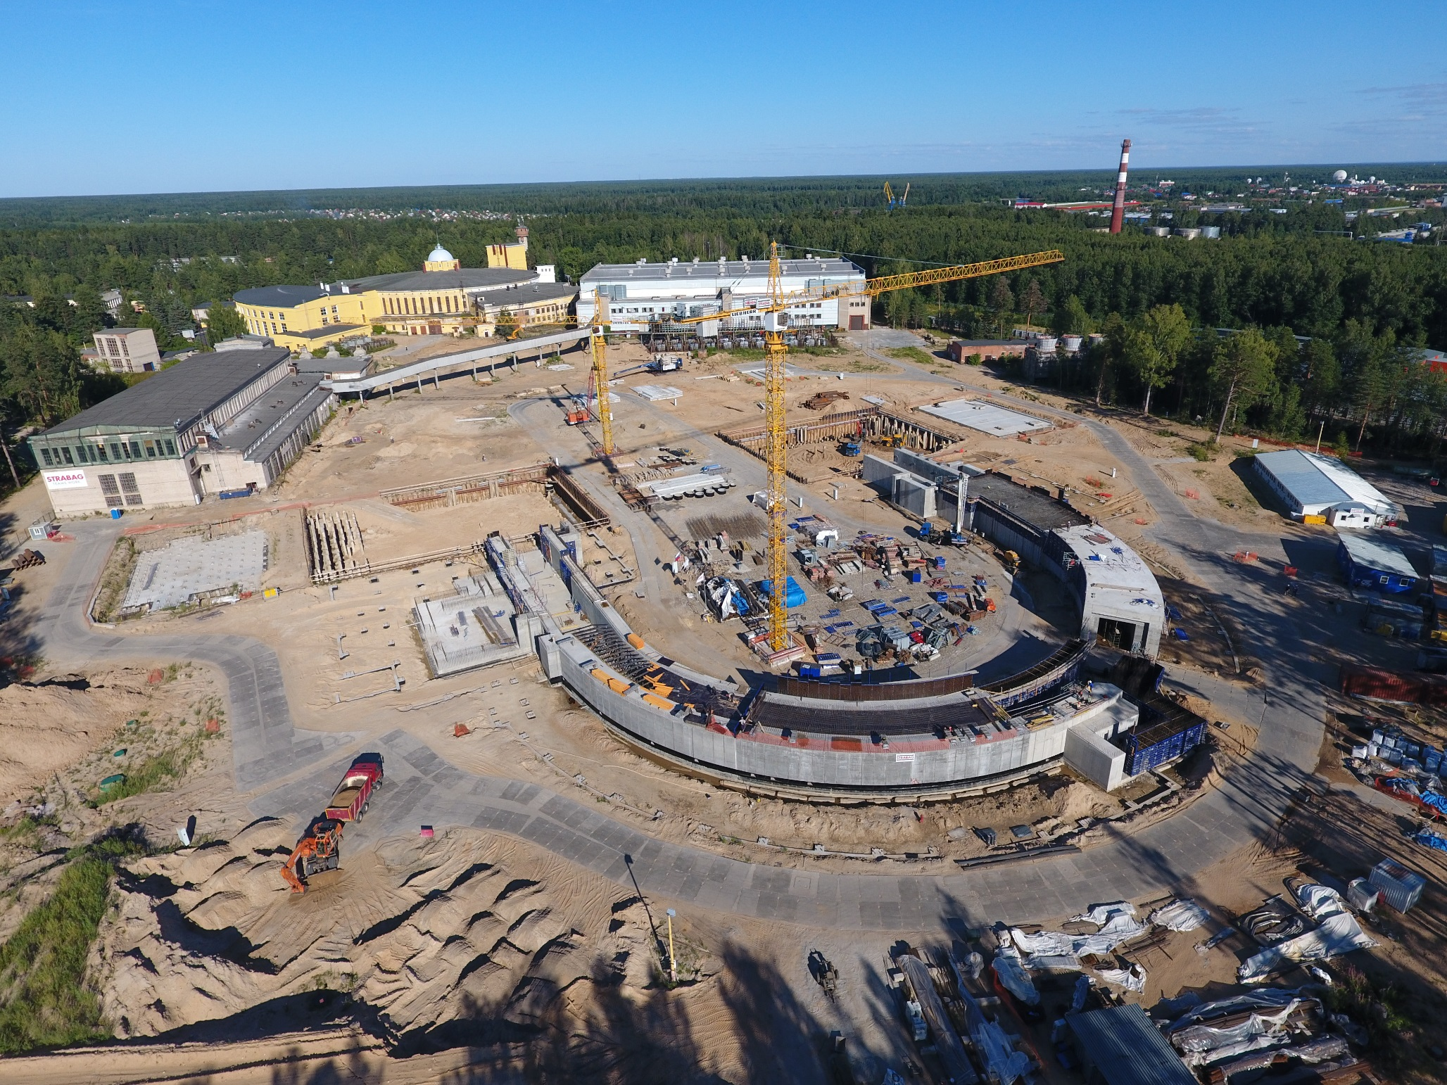
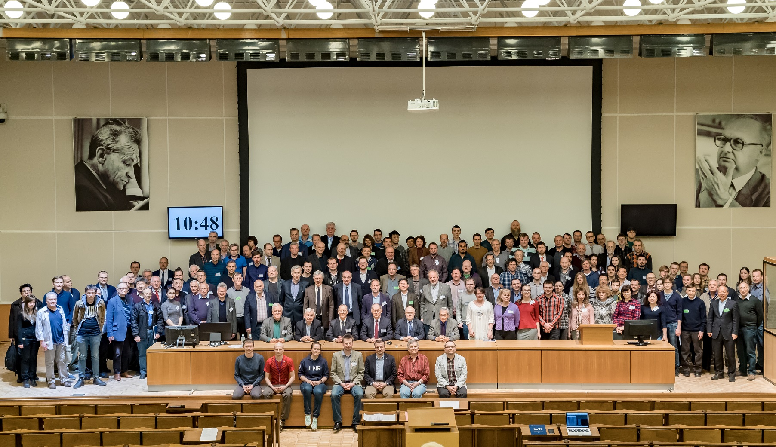
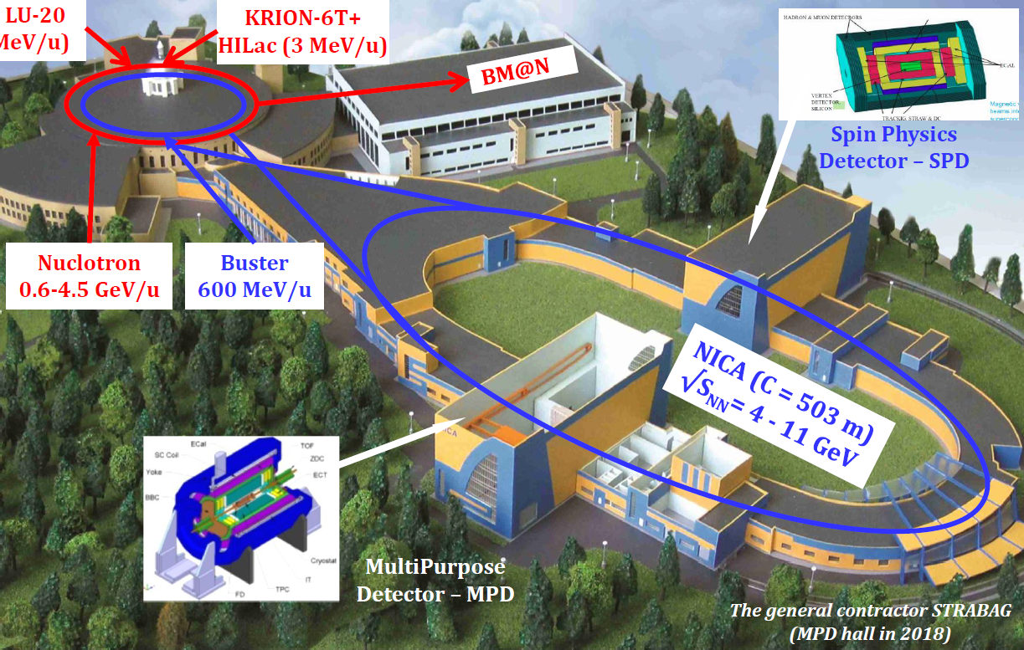
NICA (Nuclotron Based Ion Collider fAcility)
√$s_{NN}$ = 4 - 11 GeV; ion beams p … Au @ L ~ ${10}^{27}{cm}^{−2}s^{−1}$ (${Au}^{79+}$),
√$s_{NN}$ = 6 - 26 GeV; polarized beams p↑ and d↑ @ L ~ ${10}^{32}$ ${cm}^{−2}s^{−1}$
IS + LU-20
(5 MeV/u)

Slide 3
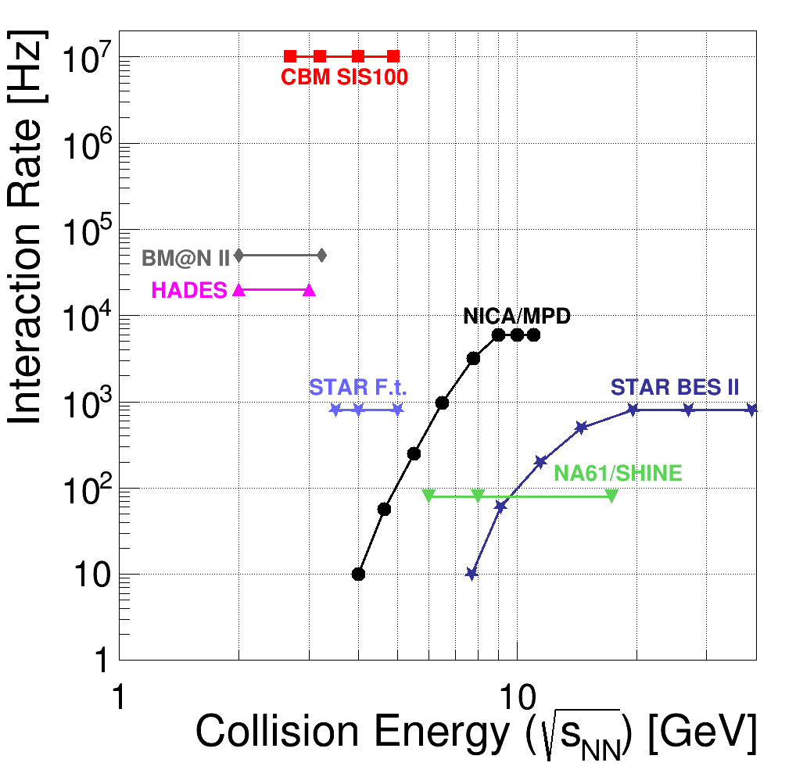
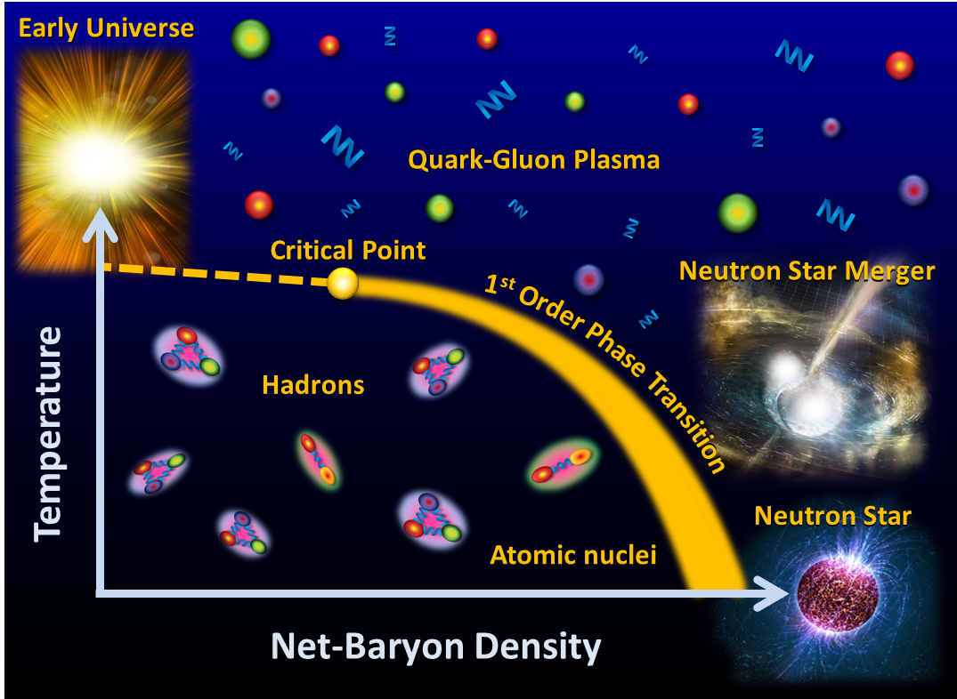
Physics goals
main goal
study of hot baryonic matter at the region
of max baryonic density
through the tasks
equation of state
onset of deconfinement
onset of chiral symmetry restoration
first order phase transition observation
search for critical end-point
polarization phenomena

Slide 4
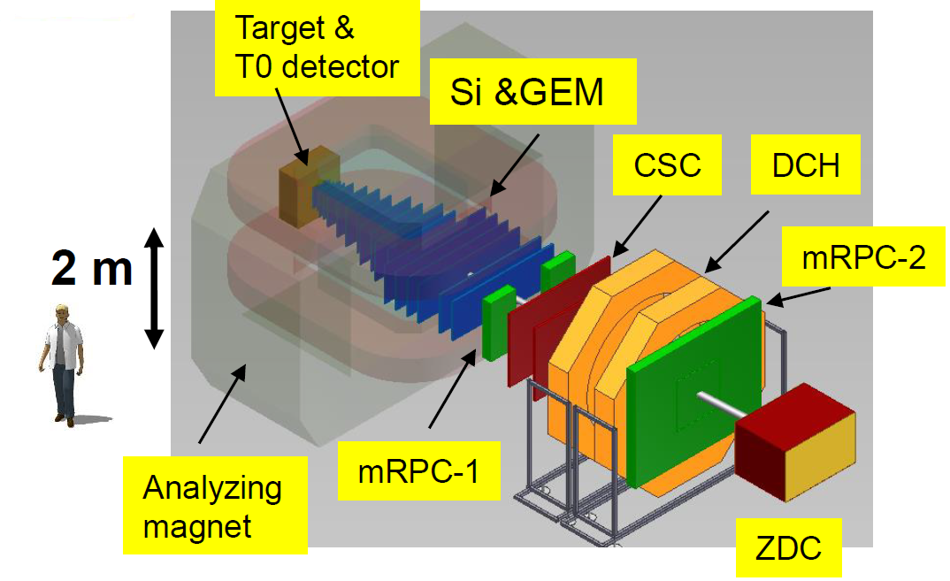
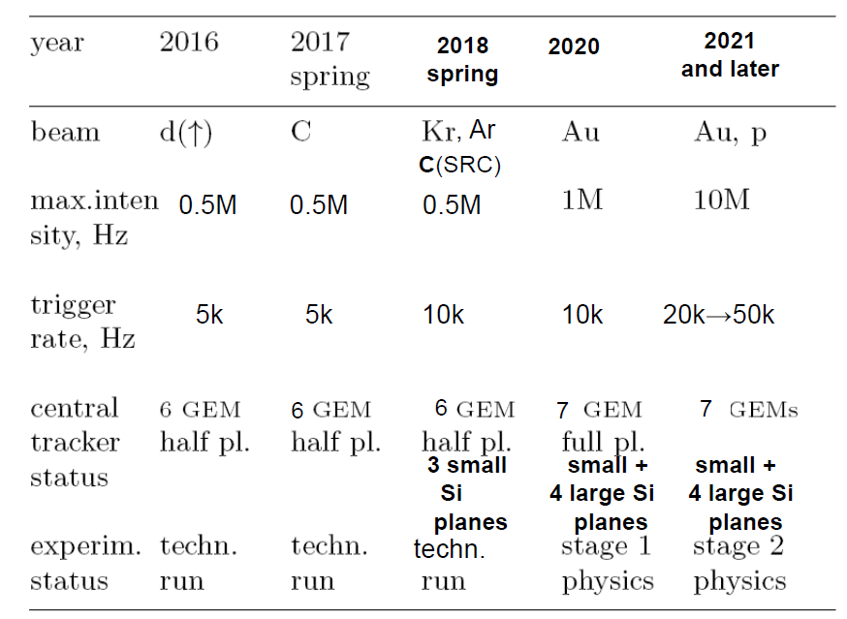
BM@N (Baryonic Matter at Nuclotron)
Beam parameters and setup at different stages of the experiment
BM@N advantage: large aperture magnet
(~1 m gap between poles)
→ fill aperture with coordinate detectors
which sustain high multiplicities of particles
→ divide detectors for particle
identification to “near to magnet” and “far
from magnet” to measure particles with low
as well as high momentum (p > 1-2 GeV/c)
→ fill distance between magnet and “far”
detectors with coordinate detectors

Slide 5
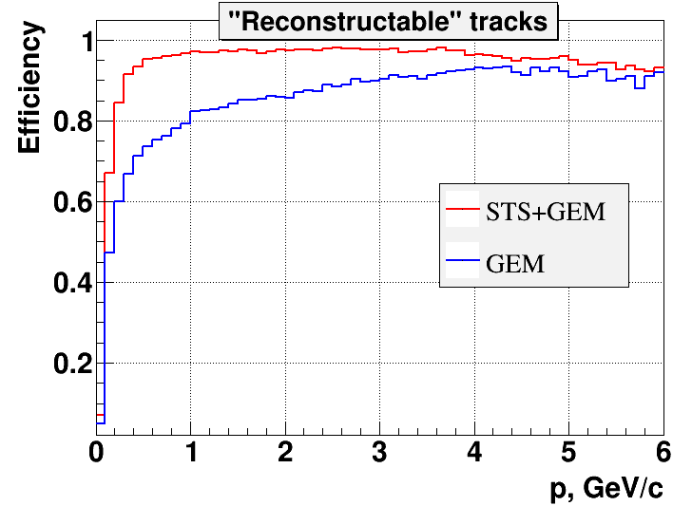
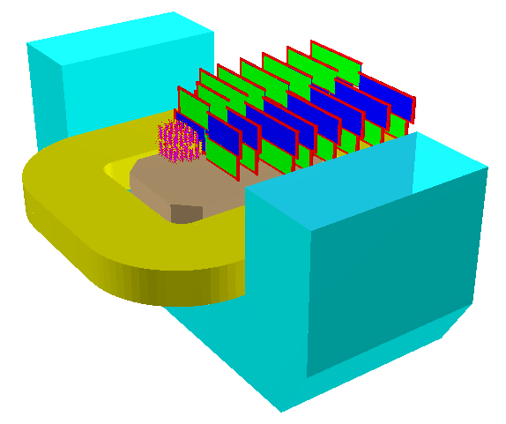
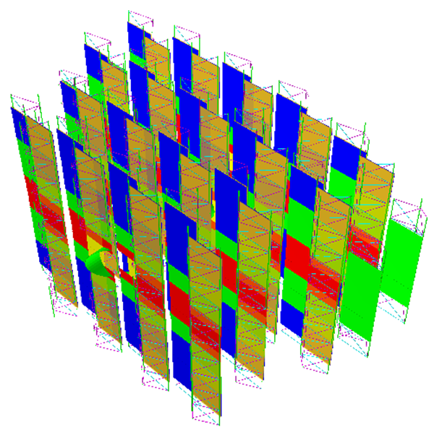
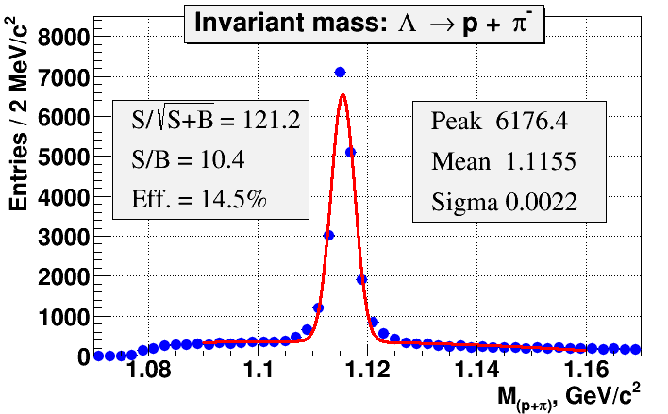
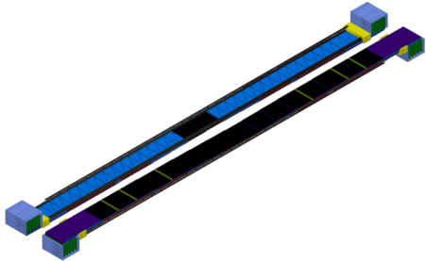
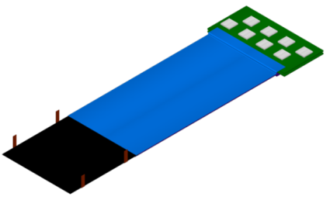
STS for BM@N experiment
Mutual interest by CBM groups from Germany and Russia to install, commission and use
4 CBM-like Silicon Tracking Stations in BM@N in 2020.
dipole magnet
STS
GEM
Δp/p ≈ 1%
25 µm single-hit spatial resolution
material budget per station ~1% X0
360 Modules
40 Ladders
~730 k Channels
Slide by J. Heuser

Slide 6
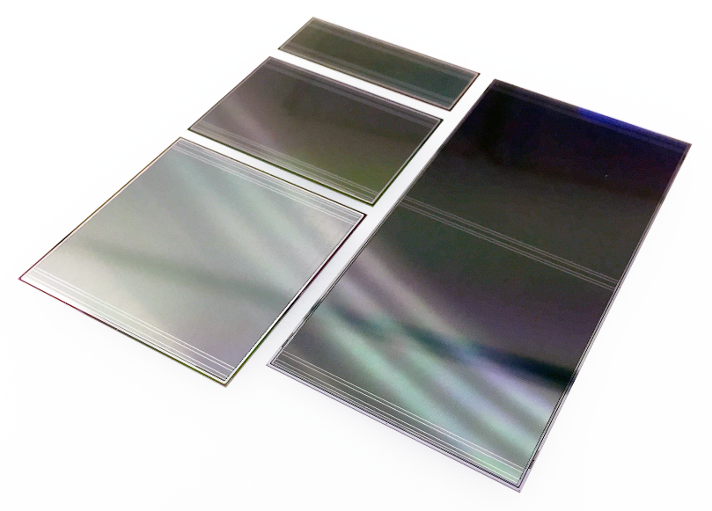
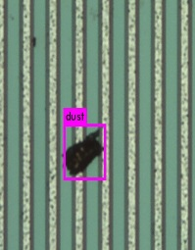
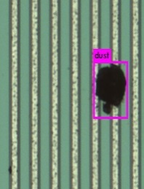
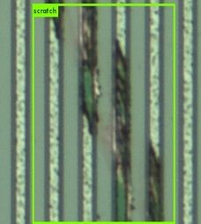
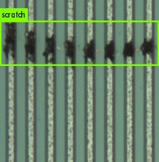
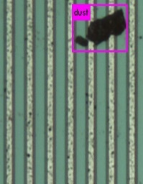
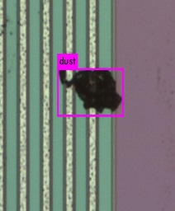
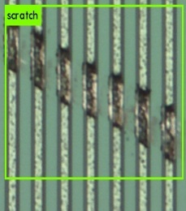
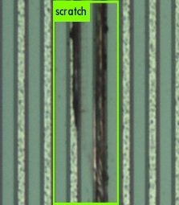
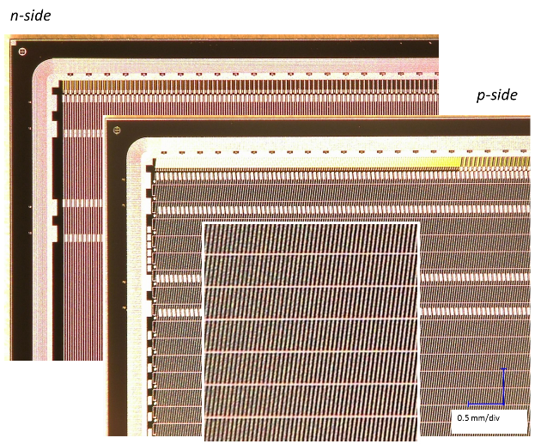
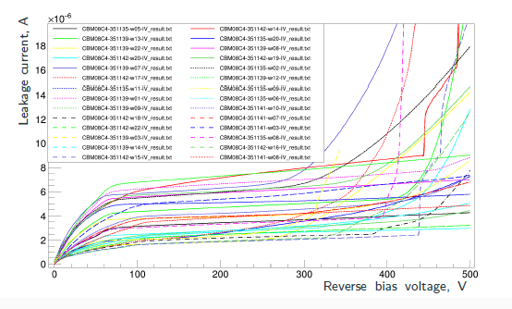
Sensors
CiS
Quality assurance of the sensors
Final product inspection at the vendors: detailed data
Quality inspection at JINR has been advanced:
  full inspection during prototyping, sample tests during series production
  sophisticated optical and electrical methods established
  charge collection tests before/after irradiation, S/N determination
6.2 x 2.2 cm²
6.2 x 4.2 cm²
6.2 x 6.2 cm²
Hamamatsu
Thickness: 300 μm
Pitch: 58 μm
Stereo angle: 7.5°
400 sensors are already ordered and arrived at JINR

Slide 7
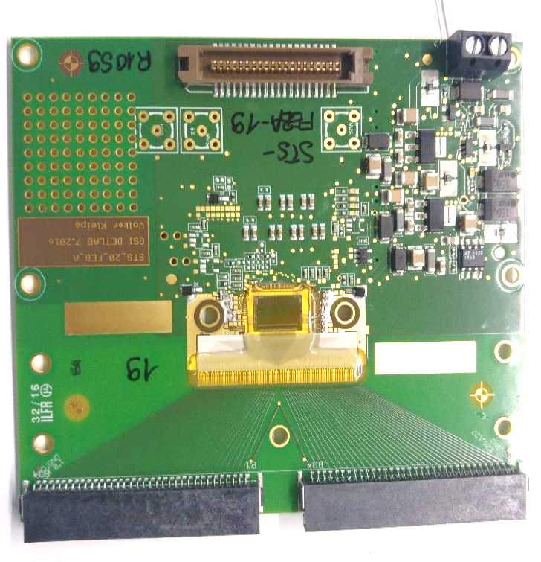
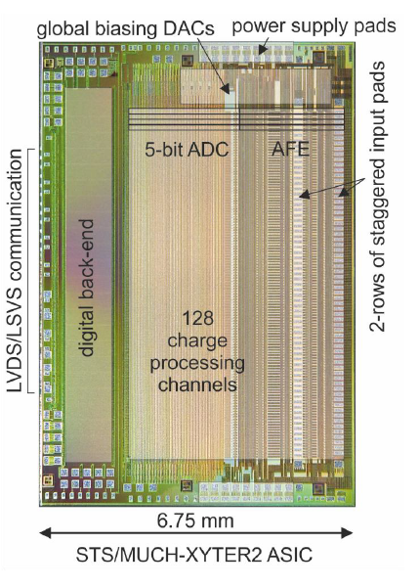
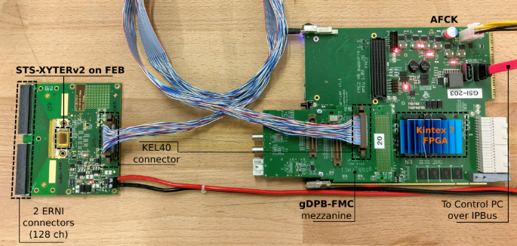

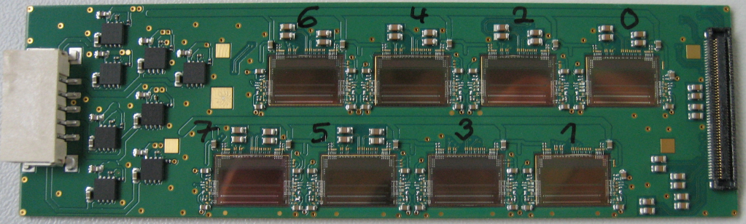
STSXYTER ASIC
produced in 9/2016
128 channels+ 2 test channels
Self triggered architecture
Maximum data rate: 250 kHz/channel
5-bit amplitude measurement
  shaper_{slow}+ ADC
time stamp measurement
  shaper_{fast} + discriminator
  Dynamic range: 16 fQ at STS mode
  Noise performance: 1000 enc at 30 pF input
  Time stamp resolution: 1 ns
FEB board with 1 STSXYTER ASIC
Test bench for characterization
of the ASIC
Test socket for the ASIC-tab-bonds
FEB board with 8 ASICs

Slide 8
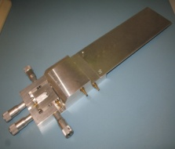
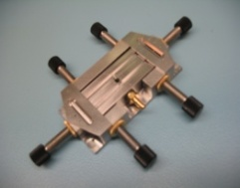
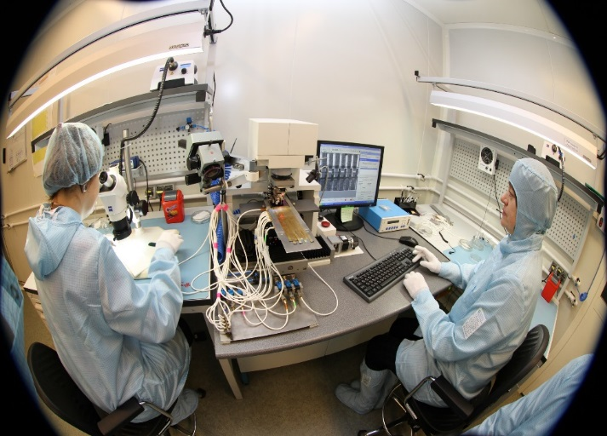
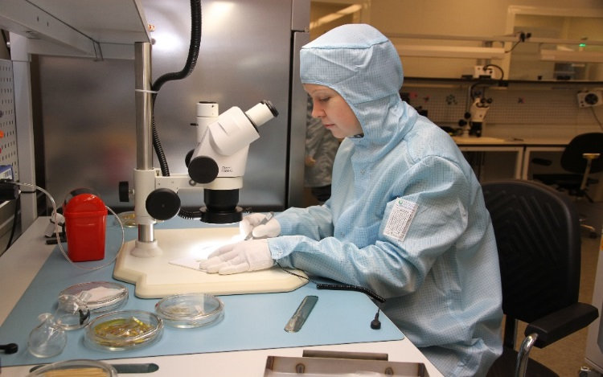
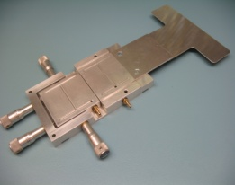
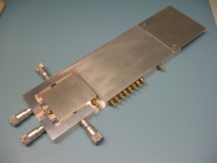
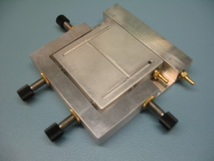
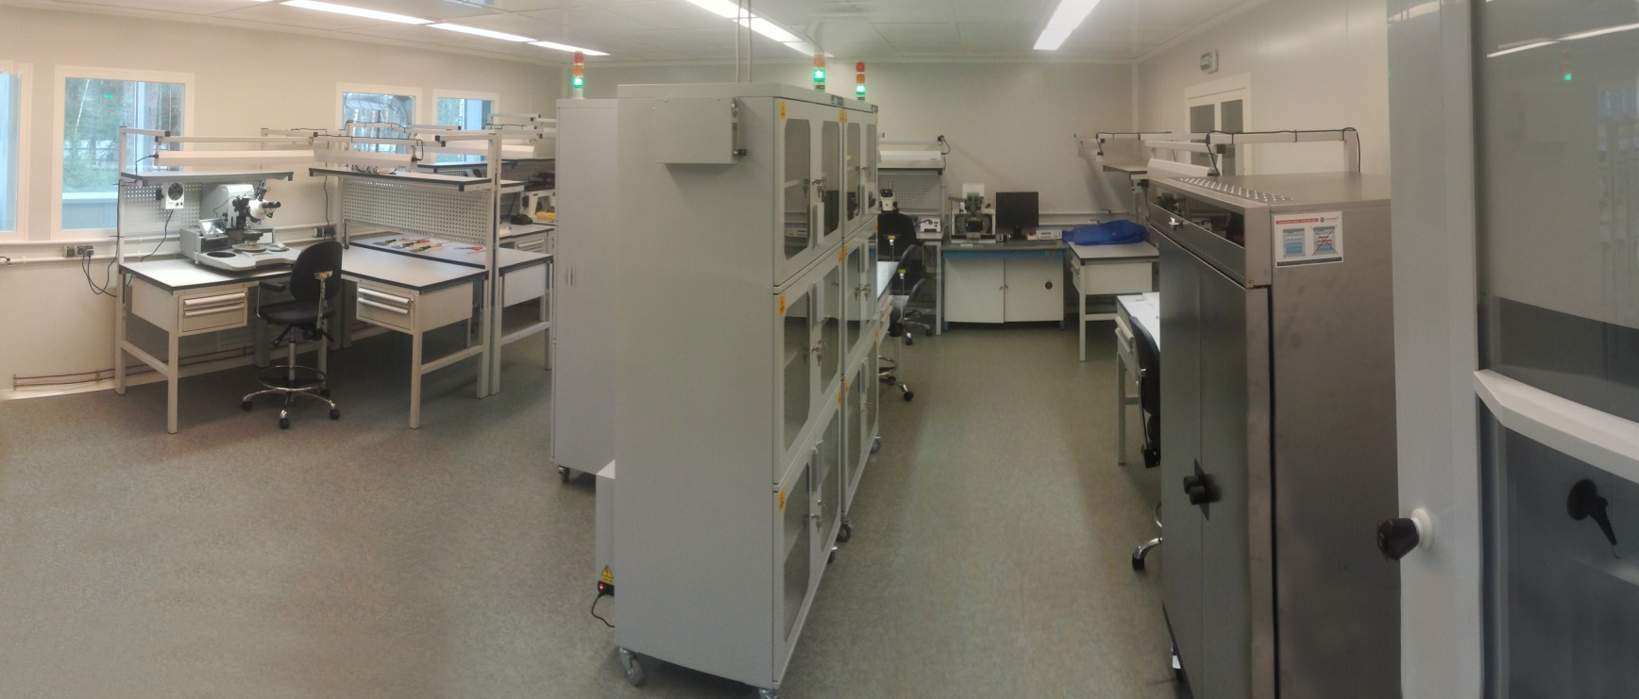
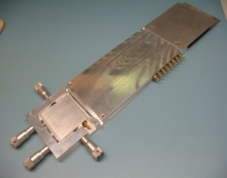
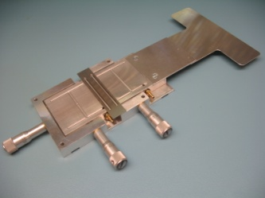
Module assembly site at JINR LHEP
The main room (90m² ) is class 7 ISO (less than 10 000 p/ft³ < 0.5 mkm)
4 technicians are currently involved in module assembling
jigs for the module assembling

Slide 9
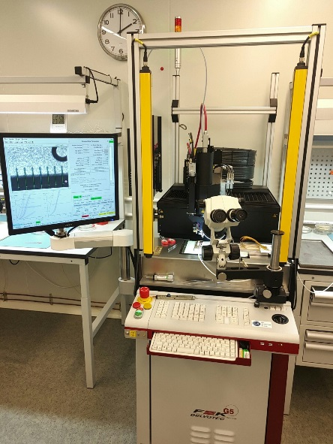
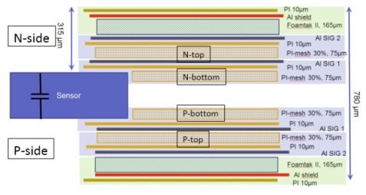
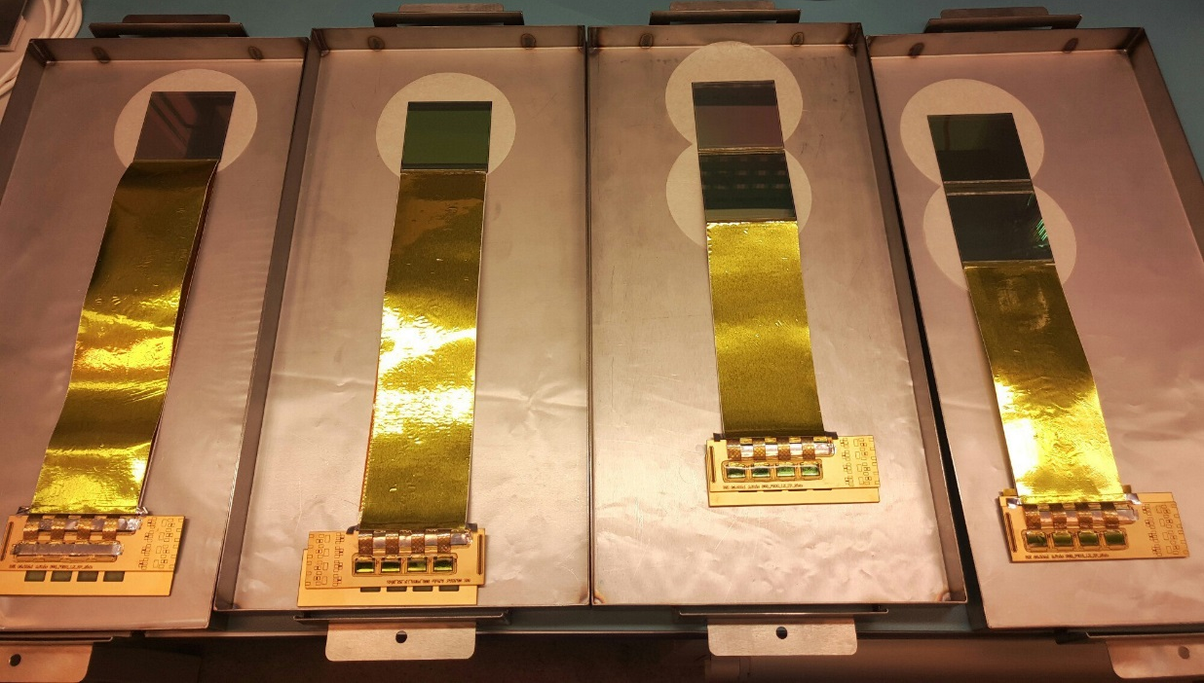
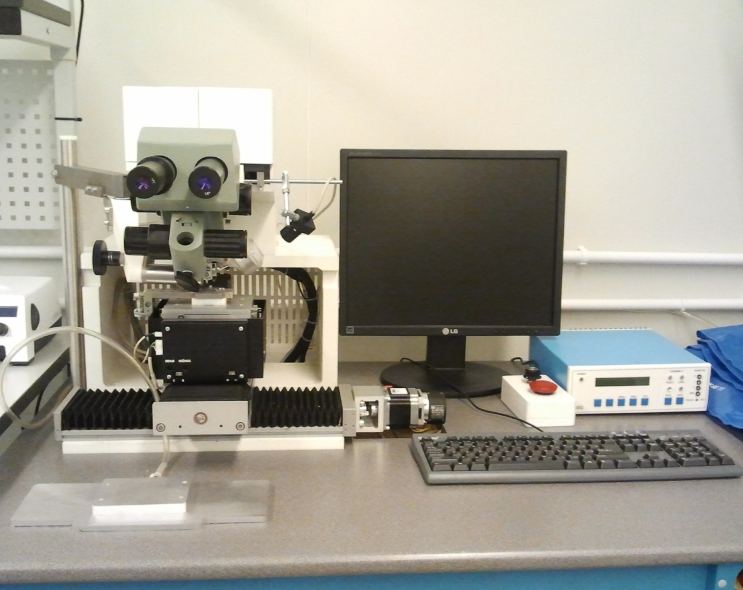

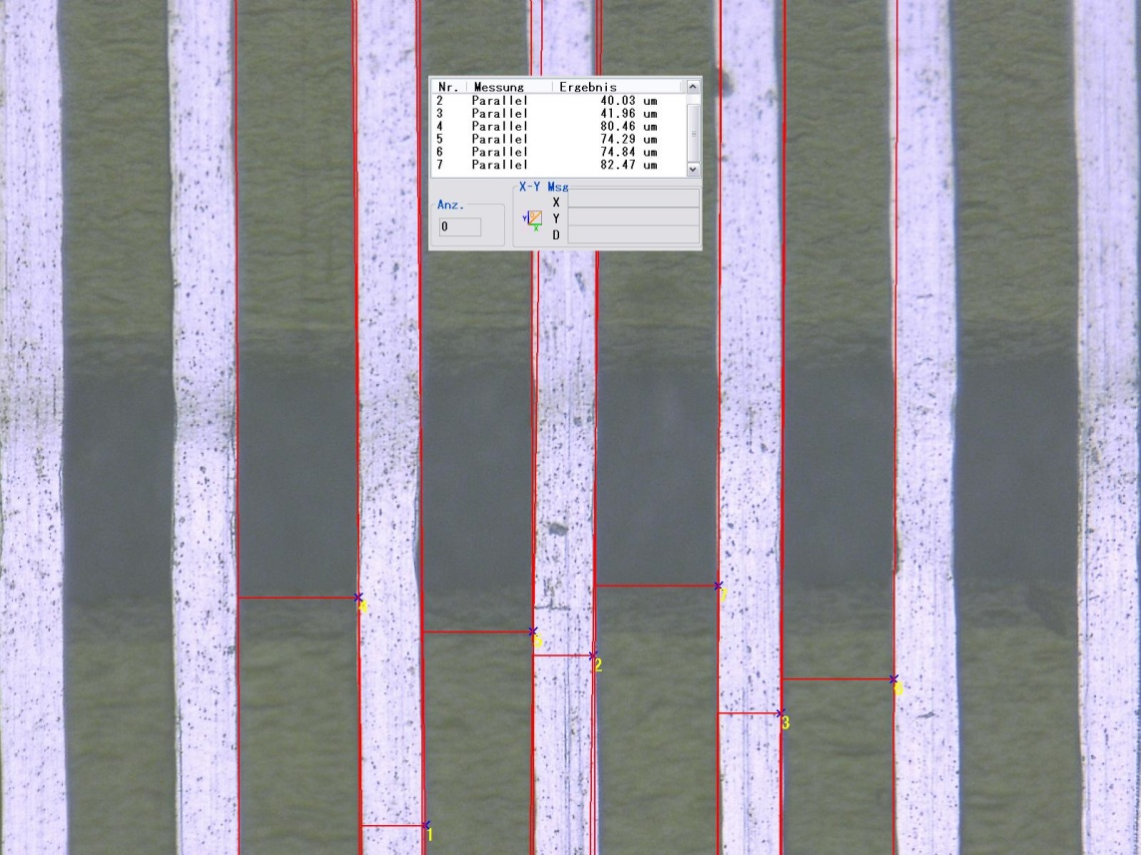
Modules
Microcables from Al-polyimide
Wirebonder F&K Delvotec G5
Measurement:
C_line = 0.38pF/cm
Mockups of the STS modules
About 420 components are in assembly process at different stages
TabBonder Planar EM-437
distance between traces varies from 74 to 82 µm

Slide 10
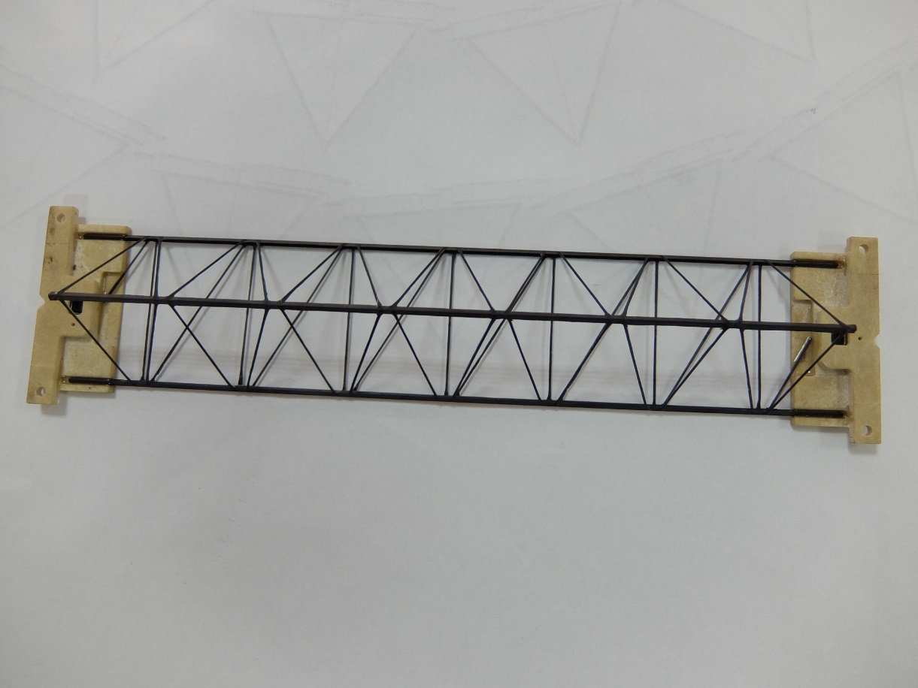
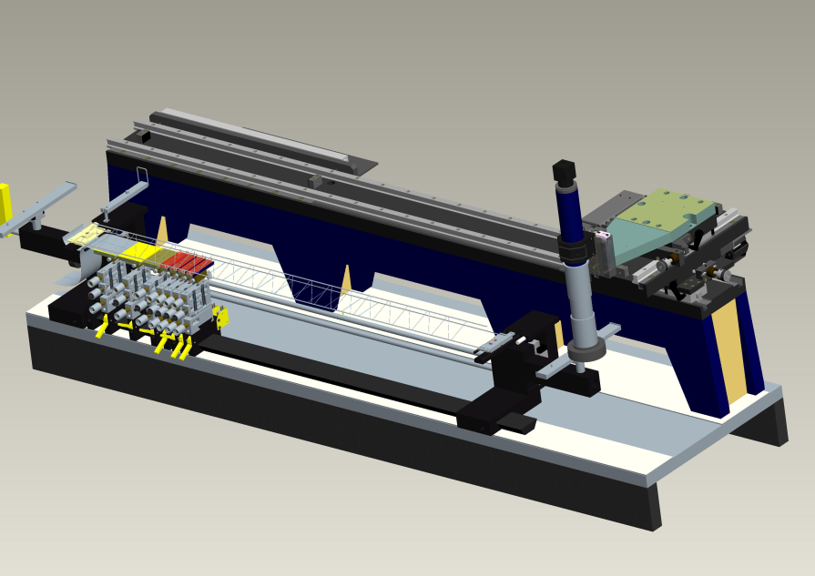
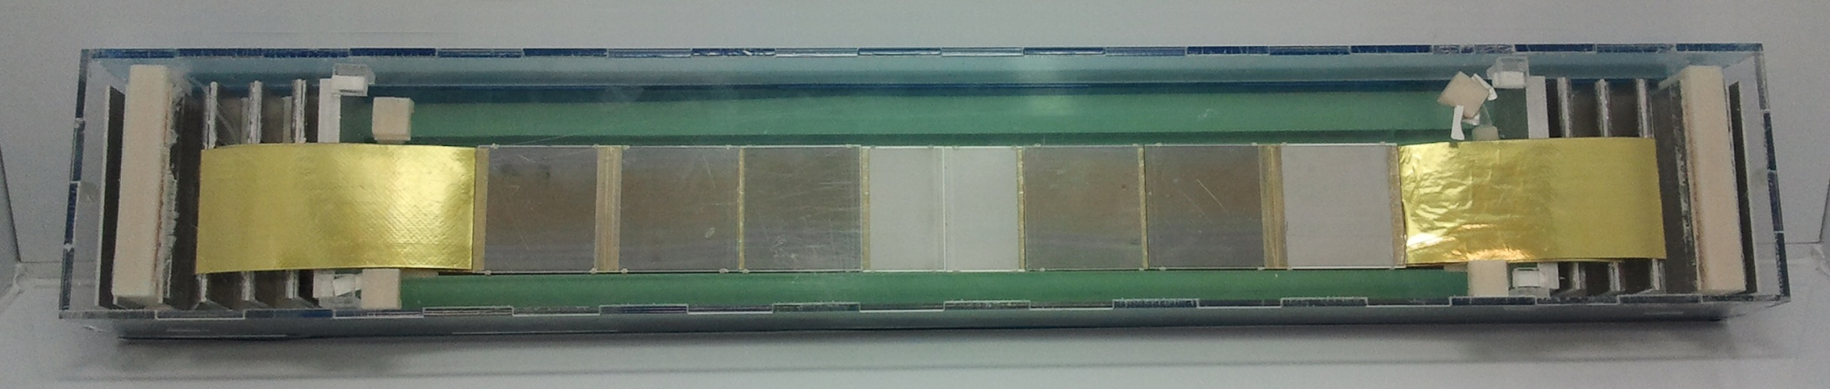
Ladder assembly
Design by S. Igolkin (CERN)
Material: CF prepreg M55J/ 334EU
Modulus of composite 32800Gpa
Total weight: 10,4 g/m
Ladder assembly device
40 CF frames were already produced (this is already enough for BM@N,
production for the CBM@FAIR is under discussion)
The precision of the sensor orientation:
X coordinate ±50 mkm
Y coordinate ±15 mkm on 1200 mm base
±12 mkm on 180 mm base
Z coordinate ±50 mkm
FEB box
Si sensors
FEB box
Mockup of the ladder

Slide 11
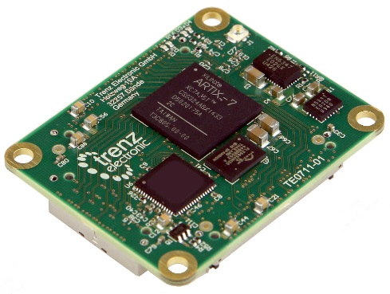
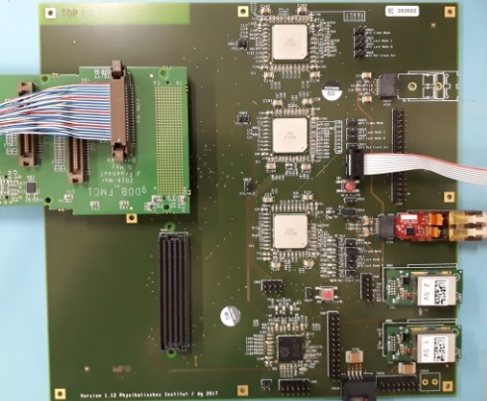


Detector readout chain
STS modules
8 STS-XYTER v2.0 on FEB-8
Common GBTx Readout Board
based on radiation hard GBT and Versatile Link components developed at CERN
→ all components purchased
fully featured prototype currently being tested and commissioned (CROB - larger than final board)
FLES IN node with FLIBs
GBTx ASIC is inaccessible
In Russia
dual-use technology
Copper
link
Longer cables (~5 m)
80 Mbit/s per link instead of 320 Mbit/s
Optical link
Xilinx Artix 7 FPGA board
on detector
off detector

Slide 12


STS integration
The CBM-STS conceptual engineering design is highly developed
Elaborated BM@N-STS engineering design in preparation
STS are compact detectors with high degree of component density
While CBM-STS uses bi-phase CO2 cooling, BM@N targets one-phase water-glycol cooling
TDR for the BM@N STS should be ready till the end of 2018
System inegration concepts for CBM STS (top) and BM@N STS (bottom panel)

Slide 13

mini-STS
Activities towards prototype station assembly, construction of mSTS for mCBM@SIS18
(GSI, 2018)
Small scale pilot version of the detector involving pre-final components – before BM@N and CBM.
Very important project requiring joint effort of all groups involved.
JINR team will provide 2 detector layers with ladders from JINR production, for runs in 2019.
mSTS system mechanical design, fully detailed

Slide 14

ITS for MPD Experiment
Stage 2: 2022-2023
Installation of ITS and thin wall Be beam pipe
JINR appeals for the Know-How transfer to build 5-layer ITS of the ALICE ITS Upgrade type with increased length of ladders to fit the NICA/MPD Interaction diamond parameters
MoU was signed
Material budget of the IB ~ 0.3% X0
of the OB~0.8% X0

Slide 15





ALPIDE – Monolithic Active Pixel Sensor
Automated machine for module assembly
Our group already ordered one machine
By L. Musa (CERN)

Slide 16


ITS for MPD Experiment
Pointing resolution
Simulations by Valery Kondratiev, SpBSU, SpB
Reconstructed Λ-hyperon invariant mass spectrum (p_{t}<0.6 Gev)
A. Zinchenko et al
5 Layers of ITS with a beam pipe diameter less than 40 mm
will allow identification of open charm particles
MPD ITS based on ALICE type staves
.

Slide 17




Test bench with pAlpide-3 sensors
Test bench for the in-beam tests
Threshold (left) and noise (right) distribution
Hits (left) and clusters (right) from 152Eu source
pAplpide-3 sensor with FPGA readout board

Slide 18
Summary
Mutual interest by CBM groups from Germany and Russia to install, commission and use 4 CBM-like Silicon Tracking Stations in BM@N in 2020
TDR for the BM@N STS should be prepared till the end of 2018
Our group is already close for production readiness for BM@N STS. Production will start at the end of 2018.
We initiated contacts with ALICE ITS Upgrade team to build 5 layers MPD ITS based on a ALPIDE sensors. MoU was signed.
Technical proposal for the MPD IT should be ready till the end of 2018

Slide 19

THANK YOU FOR YOUR ATTENTION!

Slide 20
BACKUP SLIDES

Slide 21





Test beam at Nuclotron
beam
Scintillator 2
Scintillator 1
Noise per channel distribution
Clusters amplitudes on the P side
S/N for N side 23.4±0.5
S/N for P side 24.5±0.5
Beam properties:
Deuteron beam with Ekin = 2.95 GeV/n
Intensity: $2∗{10}^{5}$ p/s
Clusters amplitudes on the N side

Slide 22



JINR STS Department
The head of the department is Yu. Murin
Quality assurance of sensors: N. Zamyatin (LHEP)+ M. Merkin (SINP)
Silicon Tracking Systems (STS+ITS)
Assembly of modules and super-modules: A. Sheremetev +4
Mechanics of Composite Materials: A. Voronin, Igolkin as a consultant (CERN)
Bench and in-beam testing group: D. Dementev + 2 students
Administration, civil construction and procurements support: V. Penkin + S. Udovenko
Industry partners: lrd. LTU (Kharkov), Planar enterprise (Minsk)

Slide 23





CBM STS Cad model
Cable Stacks
[Sandwich concept by M. Faul and W. Niebur]
Design concept update:
Cable routing
Unit disassembly
Integrated design
CF composite
Thickness: 40mm
Filler material/structure
Peripheral cabling design
Sandwich concept:
Lightweight and stiff
Parameters depend on filler material
Versatile configuration
Further development requires:
Thermal testing
Requirement summary
Coordination with industrial manufacturers
Further CAD development:
Finalize cabling concept
Schematic cable routing
Integrated design
By J. HEUSER

Slide 24
LV/HV Powering Scheme: one sensor
Outside of the box
(NO radiation+NO mag.field)
In the box (radiation+mag.field)
conv 2.5V
=12V
conv 1.5V
FLOATING!
conv 2.1V
1.8V
=12V
LDO
~ 1A
1.2V
LDO
GBTx
Opto
C
+200V
+200V
FEB:8xSTSxyter
HV PS
Ver.: April 2015 C
HV PS
C
real
ground
-200V
–200V
1.8V
GBTx
Opto
1.2V
C
HV
LDO
LDO
FLOATING!
conv 2.1V
FEB:8xSTSxyter
=12V
~ 1A
conv 1.5V
LV feedthrough
conv 2.5V
=12V

Slide 25

Physics motivation for a study of charm production at NICA
  Heavy charm quarks are produced at the very initial stage of the collision of the heavy ions to witness the CBM(NICA,FAIR) or QGP (RHIC,CERN) . C-quarks re-scattering by CBM is the right way to study CBM at NICA
  C-quarks interaction with cold nuclear matter has an exciting perspective at NICA since the estimated yields for the production of the hypothetical light supernuclei _{c}Hе³ and _{c}Hе⁴ indicated feasibility of the experimental search at NICA and not anywhere else at the moment
      From the experimental point of view production of open-charm particles in the energy range of NICA is a complete terra incognita

Slide 26


Expected yields of the C-probes
K⁻
D⁺
π⁺
π⁺
At the highest energies NICA luminosity will reach values of L=10²⁷ cm²s⁻¹ and the gold-gold collision rate of 5 kHz with the estimates for the number of registered open-charm particles in a two-week run of NICA/MPD as follows
Decay | Multiplicity | сτ, μ | BR,% | Eff,% | Number of events
D⁰->K⁺π- | 0,1 | 123 | 4 | 2 | 48 10³
Dbar⁰->K⁻π+ | 0,1 | 123 | 4 | 2 | 48 10³
D⁺->K⁺ π-π+ | 0,1 | 312 | 7 | 1,5 | 63,5 10³
D⁻->K⁻ π-π+ | 0,1 | 312 | 7 | 1,5 | 63,5 10³
D⁺_{s}-> K⁺ K⁻ π+ | 0,1 | 150 | 3 | 1,5 | 27,2 10³
Λ⁺_{c}-> pK⁺ π- | 10⁻³ | 60 | 6 | 0,1 | 363
Λbar⁺_{c}-> pbarK⁻ π+ | 10⁻³ | 60 | 6 | 0,1 | 363
_{c}Hе³-> d+pK⁺ π- | 10⁻⁴ | 60? | ? | ? | 3,6 (?)
_{c}Hе⁴-> t+pK⁺ π- | 10⁻⁵ | 60? | ? | ? | 0,36 (?)

