Slide 1
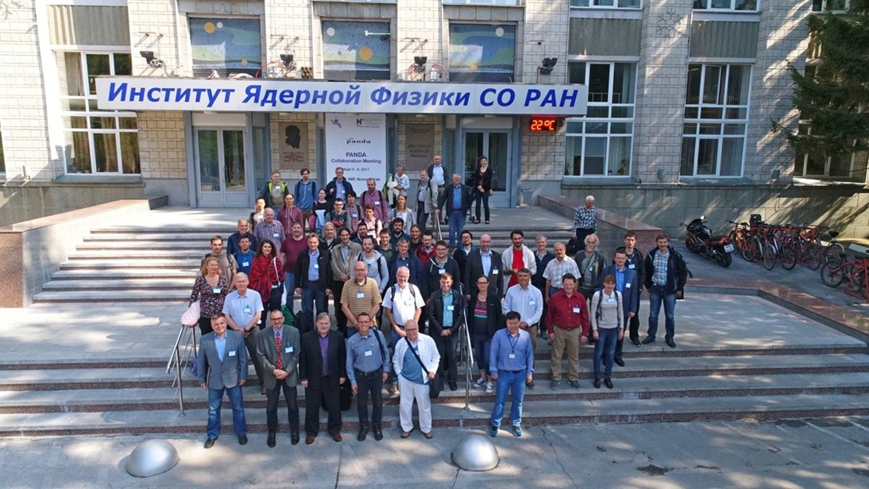
PANDA Solenoid Magnet
as a prototype for Super c-tau factory

Slide 2
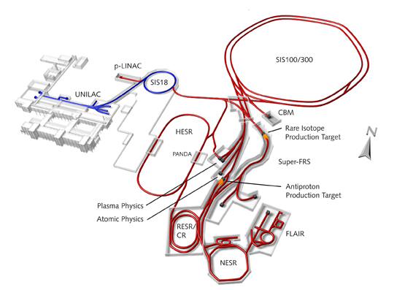
The accelerator facility FAIR and GSI

Slide 3
The main milestones of production of the PANDA solenoid magnet
The scope of delivery includes:
Magnetic and engineering design of the magnet including tools and support;
Production and delivery of the magnet (consisting of yoke, cold mass and cryostat, alignment components, proximity cryogenics, support frame and platform beams) and all tools;
Power converter and quench protection and instrumentation.
Item | Date
Start contract | 03/2017
Control assembling of the Yoke of solenoid at the BINP site | 09/2019
Magnetic tests of the PANDA solenoid including safety system and electrical components at BINP (additional contract) | 07/2020 - 05/2021
Assembling and tests at the FAIR site
Assembling of the Yoke at Darmstadt | 11/2021
Acceptant tests at FAIR | 08/2022
Installation of the PANDA solenoid magnet in beam position and start final acceptance tests | 01 - 05/2023

Slide 4
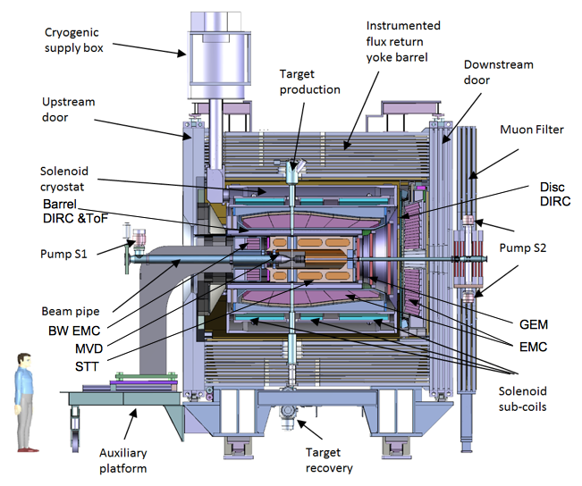
PANDA solenoid magnet
The PANDA solenoid is designed to provide a magnetic field of 2 T with a uniformity of ± 2% and radial magnetic field integral in the range 0 to 2 mm over the central tracking region. The magnet is characterized by a warm bore of 1.9 m diameter, a free length of 4 m and 22.4 MJ of stored energy.
Artistic view of the solenoid magnet including detector systems

Slide 5
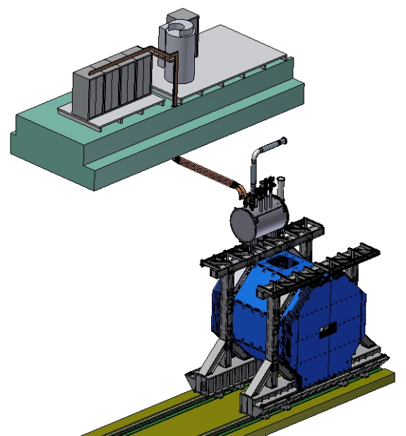
PANDA solenoid magnet, BINP responsibility
Power supply and energy extraction system
Control Dewar box
Cable channel
Solenoid and yoke
Frame of solenoid
Arrangement of the components of the PANDA solenoid.

Slide 6
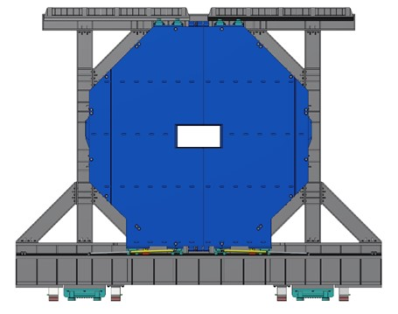
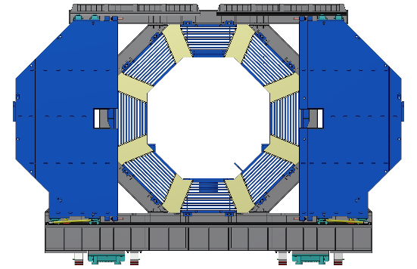
PANDA solenoid magnet posibilities
Hydraulic cylinders.
The PANDA magnet will be transported to the beam position after assembly and back for maintenance on four track-guided roller carriages placed below the platform beams. The length of moving is about 18,5 m during 4-8 hours.
The magnet poles are made in a form of doors that can be opened for access to the inner detectors. Each door consists of two wings, which are resting on the rails on the platform cornices and can slide along the rails on the roller carriages. The door opening mechanism is based on the use of hydraulic cylinders. Estimation time to dismount the door from barrel part of yoke and open the wings is 3-4 hours.

Slide 7
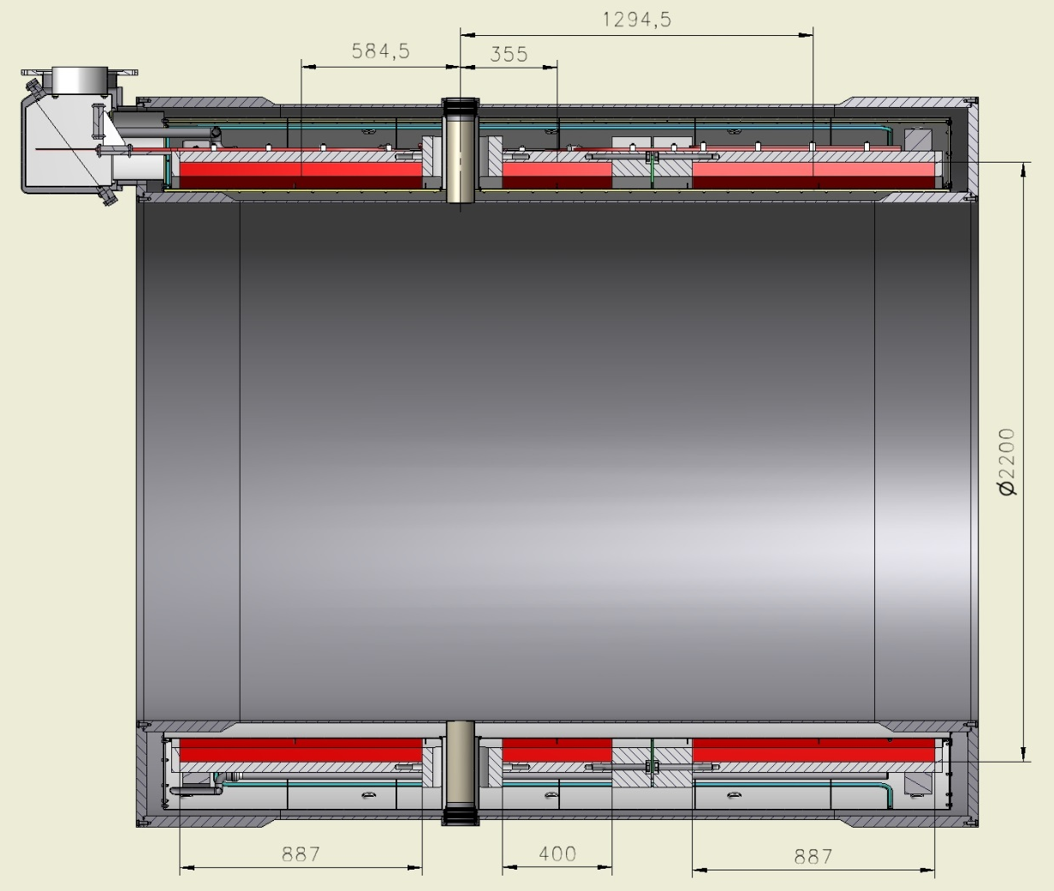
Longitudinal section of the solenoid
Holes for target pipe
Solenoid consists from 3 coils.

Slide 8
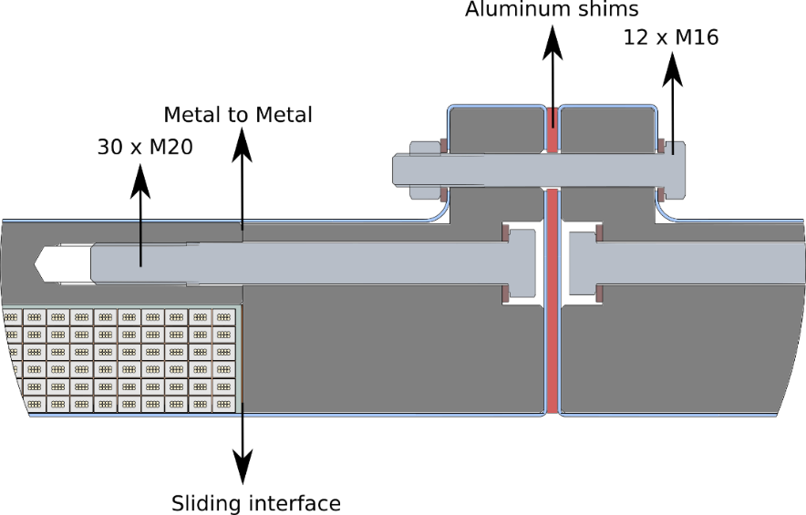
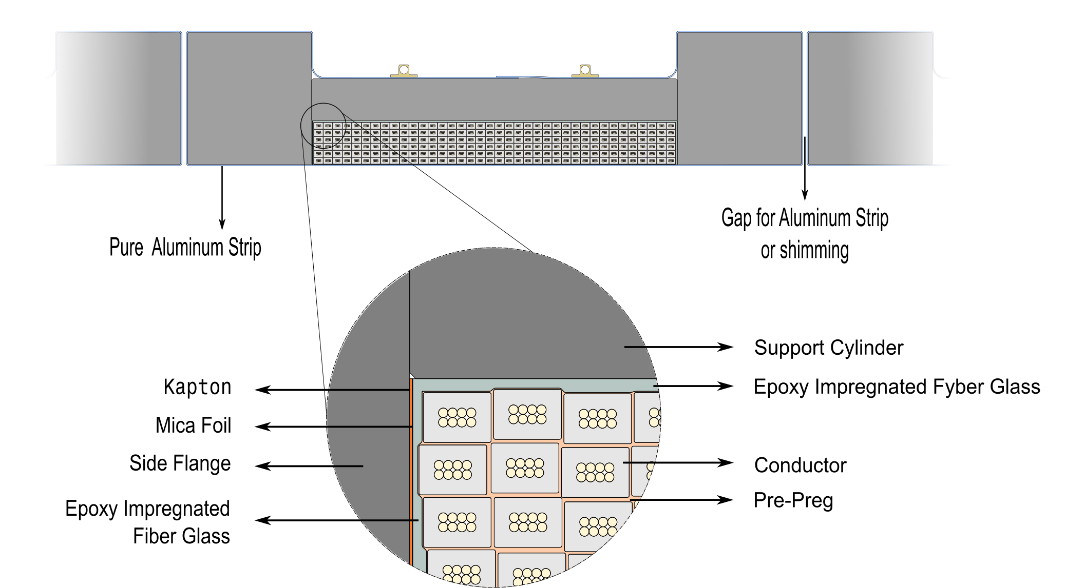
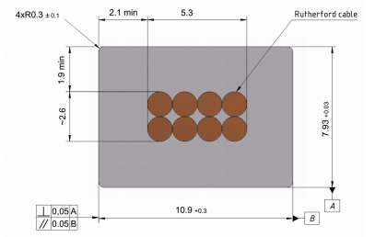
The design of Cold mass.
2 Coils - 6 layers - 78 turns (2x3300 м)
1 Coil - 6 layers - 35 turns (1500 м)
Magnetic field - 2 T
Current - 4.96 kA

Slide 9
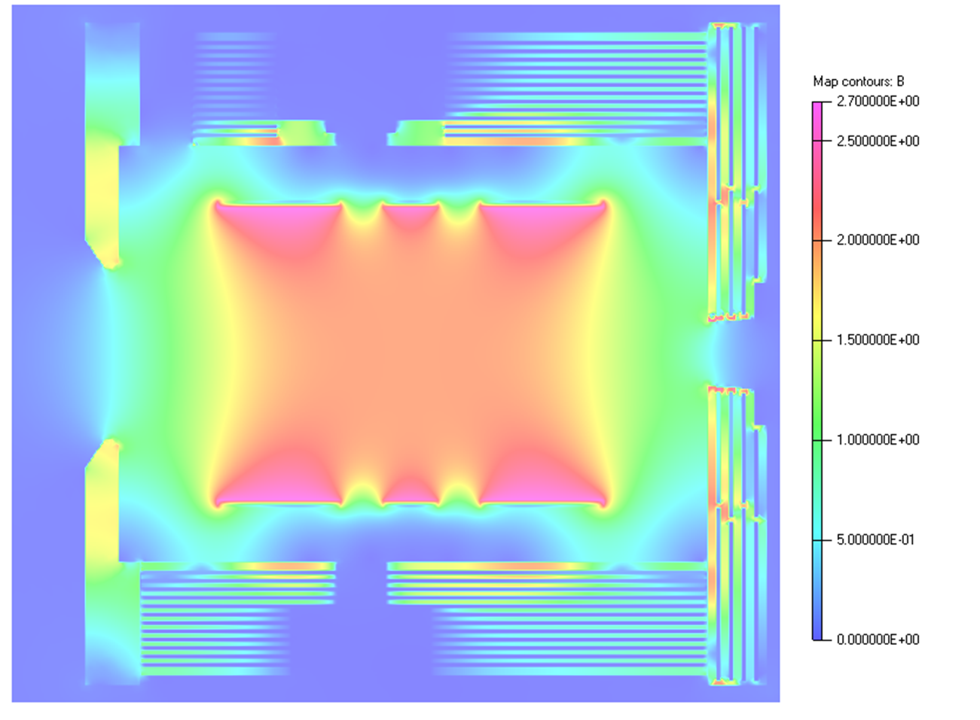
Magnetic Analysis
The PANDA solenoid is designed to provide a magnetic field of 2 T over a length of about 4 am in a bore of 1.9 m. The field homogeneity constraints over the Central Tracker volume require uniformity better than ±2% and a radial field integral ${Int}_{max}=max\left\{\left|\int_{z_{0}}^{−400}{\frac{Br(r,z)}{Bz(r,z)}dz}\right|\right\}$ below 2 mm.
The magnetic design has been validated via 3D finite element modeling in TOSCA.
Magnetic flux density distribution in the YZ-plane of the PANDA detector.

Slide 10
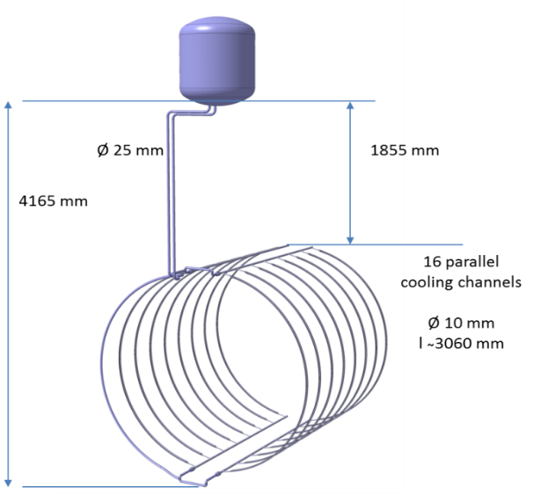
Cold Mass Thermalization
The cryogenic scheme of the PANDA solenoid relies on indirect cooling of the cold mass by circulating saturated helium at 4.5 K by natural convection. The thermo-syphon circuit consists of a bottom and top manifolds connected by 16 parallel syphon tubes attached to the outer surface of the support cylinder.
Transfer line to
helium liquefier
Control Dewar with 300l LHe vessel
Cold mass
300 l LHe vessel
T=4,5K | Thermal loads, W
Normal | 18,1
Transit regime | 29,7
T= 60K
Normal | 180,1
Transit regime | 240,6

Slide 11
Development of the PANDA solenoid magnet on today
Name of item | Status of work
Yoke and frame | Design is ready, start production
Cryostat of solenoid | Design is ready, FDR 11/2018 Technologic work, design of tools
Cold mass | Design is ready, FDR 11/2018 Technologic work, design of tools
Conductor purchasing | Development work
Control Dewar box | Design in progress
Cable channel | Start design
Power supply and energy extraction system | Design in progress, FDR 11/ 2018
Magnet safety system | Start discussing 11th week 2018

Slide 12
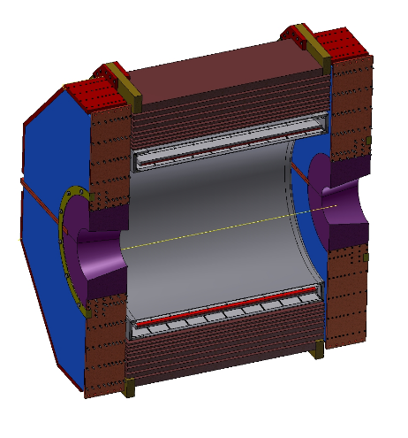
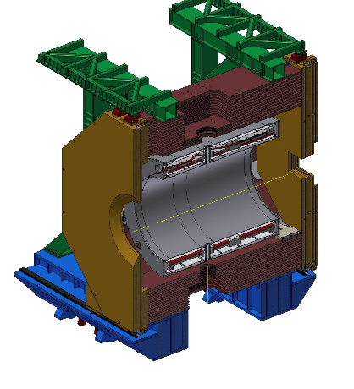
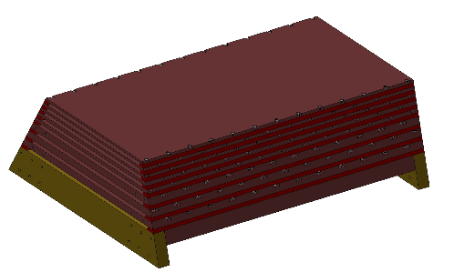
Magnets for SCTF and PANDA
SCTF requirements
Length Inner diameter Magnetic field Stored energy I, solenoid (1,5T) Weight | 4m; 3,2 m; 1 ÷ 1,2 T; 28 MJ; 4 kA; 500 t.
PANDA requirements
Length Inner diameter Magnetic field Stored energy I, solenoid Weight | 3m; 1,9 m; 2 T; 22,4 MJ; 5,1 kA; 340 t.
Longitudinal section of the
yoke with cryostat of the magnet
Octant of the yoke

Slide 13
Conclusion
Delivery PANDA solenoid magnet includes:
Engineering design of the magnet including tools and support;
Procedures assembling of the yoke with frame;
Procedures moving of the detector;
Procedures open/close the doors of the yoke;
Design of the cryostat and cold mass;
Technology production of coils;
Procedures assembling of the cold mass, installation of the cold mass to cryostat and installation of the cryostat to the yoke;
Development of the proximity cryogenics with using helium liquefier;
Procedures assembling/disassembling of the cryogenic system that moving the detector;
Development power converter 5kA, quench protection and extraction energy system;
Magnetic measurement procedures,
all these developments will be used in the design and manufacture of a magnet for SCTF.

Slide 14
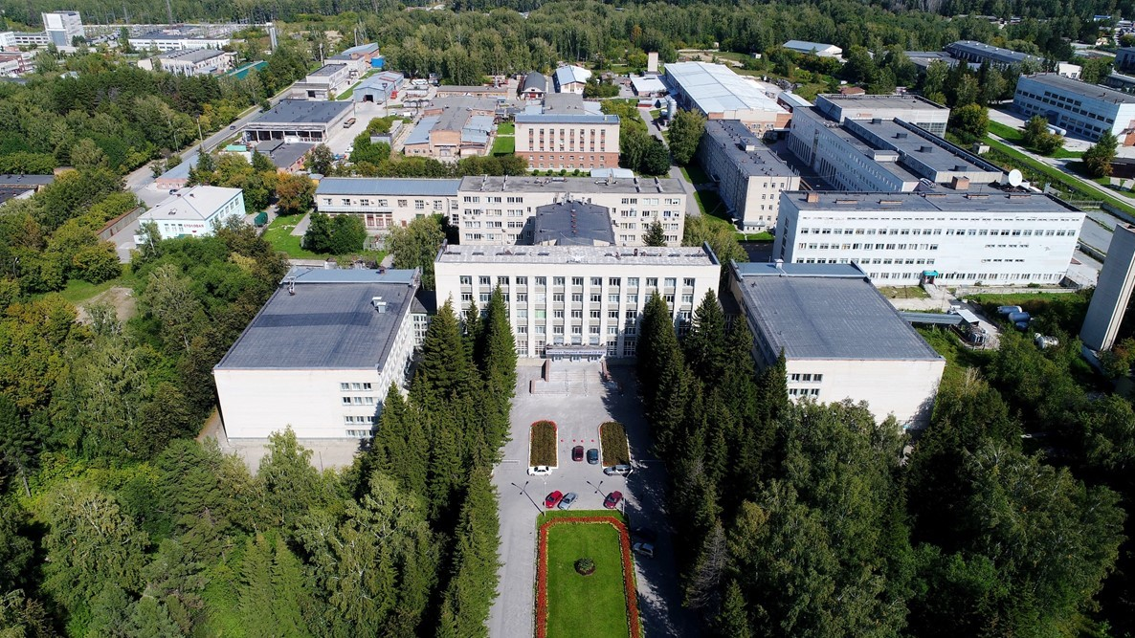
Thank you for your attention

