Slide 1


Muon Dipole Moments #1
High Precision physics in storage rings
Yannis K. Semertzidis,
IBS/CAPP & KAIST
September 17-22, 2018
Muon g-2 lessons
BINP, Novosibirsk, Russia
Storage rings: muon g-2/EDM, proton/deuteron EDM
Beam dynamics, Applications with Maxwell equations
Statistics and Systematic errors

Slide 2
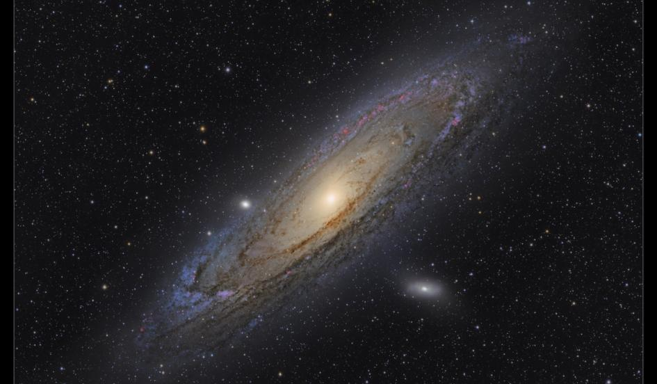
IBS/CAPP-Physics approach
Strong CP problem (Symmetry crisis in strong forces: hadronic EDM exp. Limits too small!)
Cosmic Frontier (Dark Matter axions): Improve in all possible fronts: B-field, Volume, Resonator Quality factor, Physical and Electronic noise. Check dark matter down to 10% of axion content.
Storage ring proton EDM (most sensitive hadronic EDM experiment). Improve theta_QCD sensitivity by three to four orders of magnitude!
Together with long-range monopole-dipole (axion mediated) forces probe axion Physics!

Slide 3
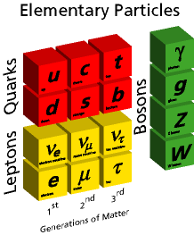
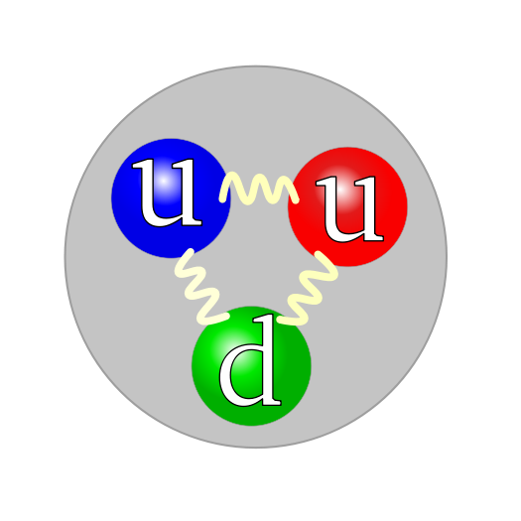
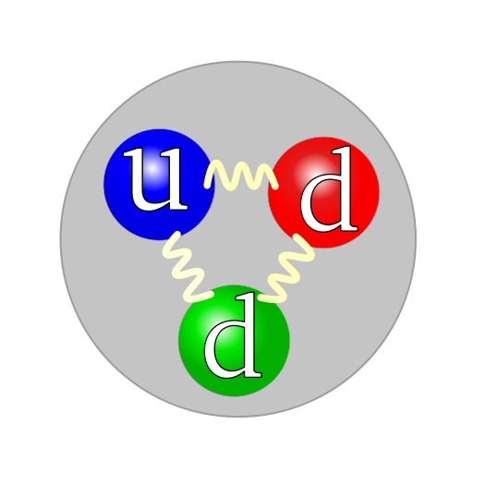
The material world consists of fermions
Protons: p
Neutrons: n
Average person: 40 kg protons, 32 kg neutrons and 22 gr electrons

Slide 4
The material world consists of fermions
For every particle there is another particle with opposite charge
e⁻ ←→ e⁺
p⁺←→ p⁻
n ←→ n
…

Slide 5
Building blocks of matter
Force carriers
Fermions
Electromagnetic
Strong nuclear
Weak nuclear
Higgs, newest addition
H

Slide 6
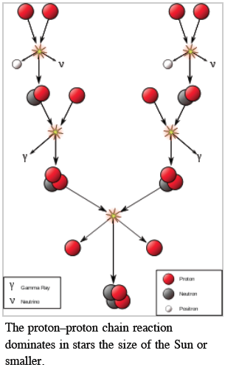
Let’s build the material world
Two protons fuse →deuteron (D)+e⁺,
D+p→ ³He,
³He+³He→⁴He
P
n
e⁺

Slide 7
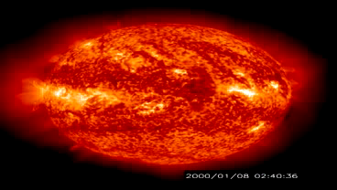
Stars: producing heavy elements
Opposites attract
Same charges repel
Classical mechanics:

Slide 8
Stars: producing heavy elements
Opposites attract
Same charges repel
Quantum mechanics:
Quantum mechanics: The particle energy is never constant but

Slide 9
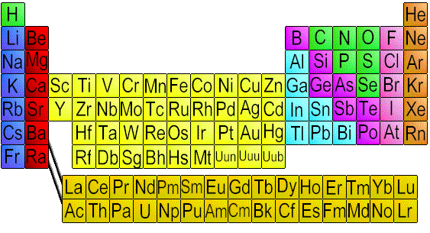
Stars: producing heavy elements
The sun produces up
to Fe

Slide 10
The sun shines! Photons take:
Sun → earth (150 million km): 8 minutes
Sun’s center → sun’s surface (0.7 million km): 10 million years!
Hence: the photons keep the sun alive!! Otherwise it would crash under its own weight fast
Dynamic equilibrium, lasts ~10 billion years, which many times it results to super-nova…

Slide 11
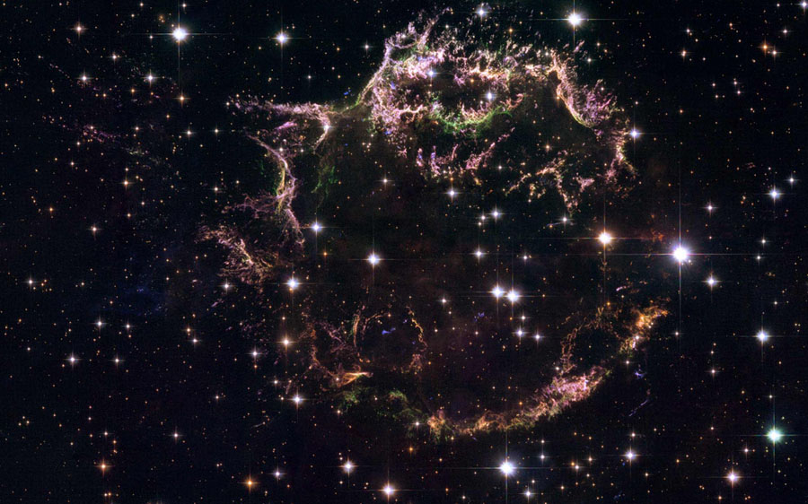
Super-nova

Slide 12
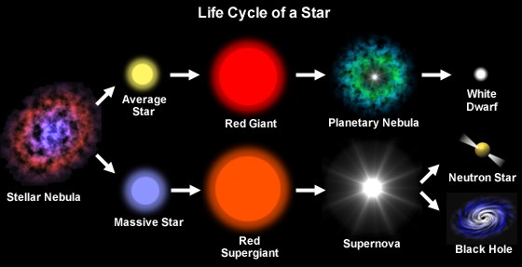
Recycling
Ladies and gentlemen: you are ALL Super-Star MATERIAL!

Slide 13
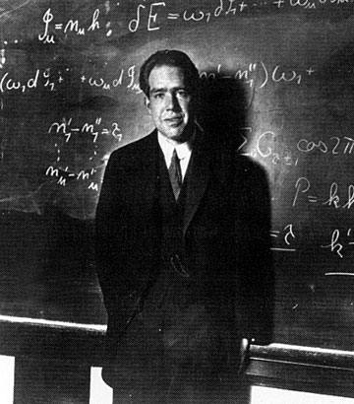
Strange Quantum-Mechanics!
Since we can’t determine exactly the energy value → vacuum is not empty… mass and anti-matter is created/destructed constantly… Furthermore, a particle is not always the same, but it transforms to another one, as much as time allows…
Niels Bohr: whoever claims that (s)he understands QM and is not disturbed by it is completely crazy…!!

Slide 14
Fundamental Questions of (Particle) Physics:
Why Matter (and not antimatter)?
  CP – Violation
Why Mass?
  The Higgs Field
What’s beyond the standard model?
  Supersymmetry or other extensions…
What is dark matter?
What is dark energy?

Slide 15
Paths to the Frontier:
The Highest Energy
  the Large Hadron Collider (LHC)
The Highest Precision
  muon (g-2)
  search for electric dipole moments
  double beta-decay with no neutrino
  lepton flavor violation (e.g. muon→electron gamma)
  …

Slide 16
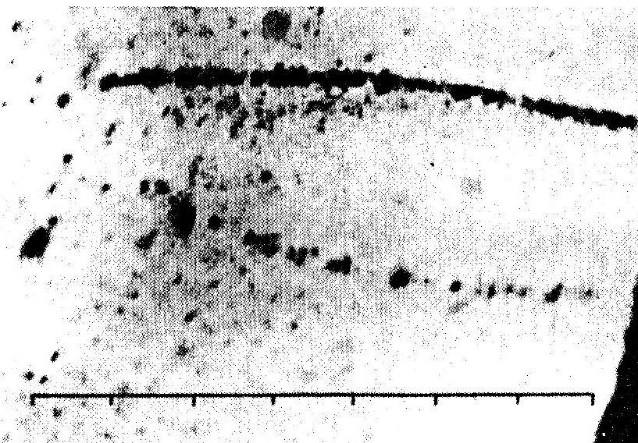
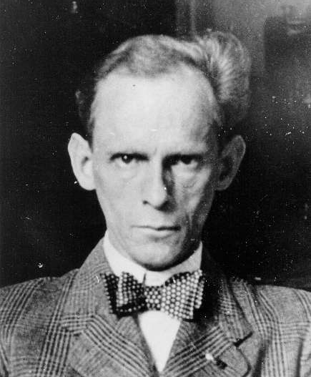
The Muon
First observed in cosmic rays in 1933
“a particle of uncertain nature”
Paul Kunze,
Z. Phys. 83, 1 (1933)

Slide 17
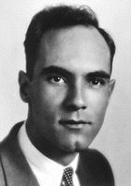
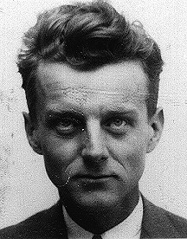
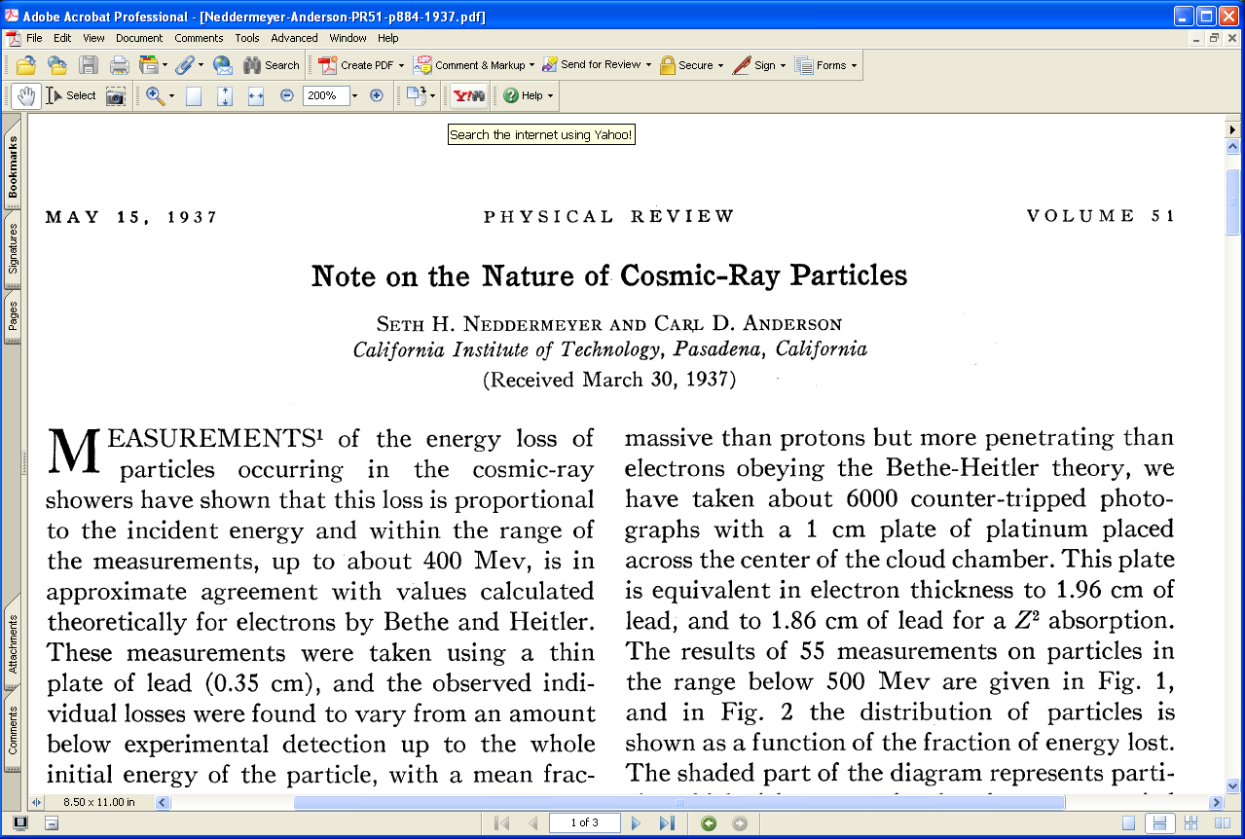
Identified in 1936
Study of cosmic rays by Seth Neddermeyer and Carl Anderson

Slide 18
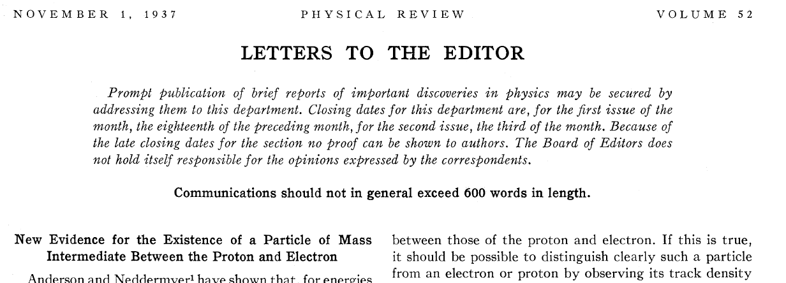
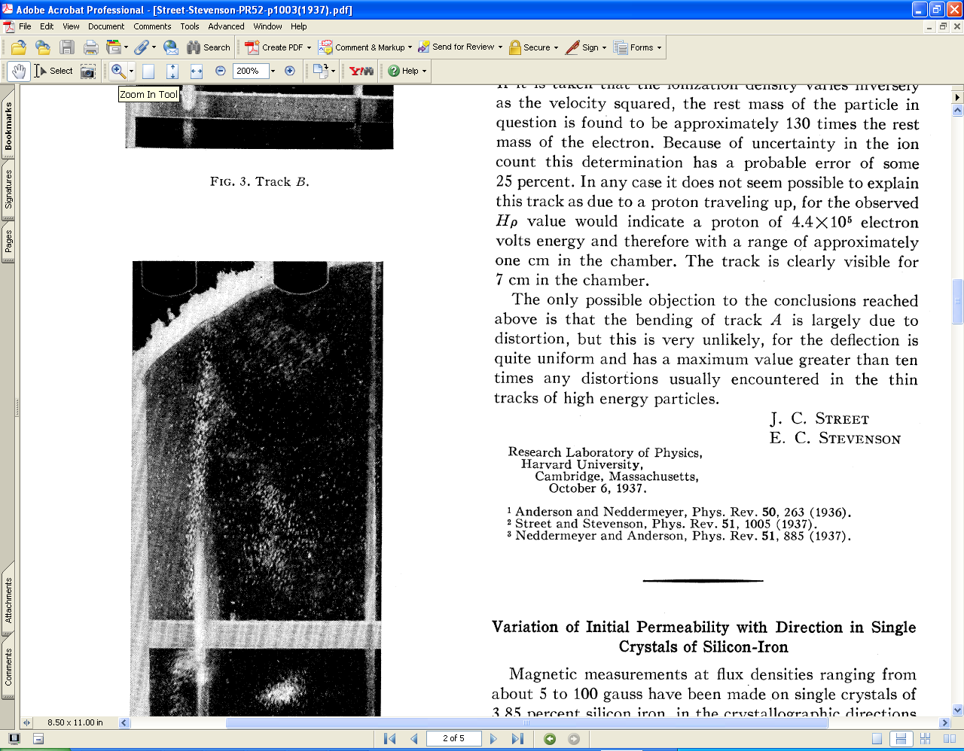
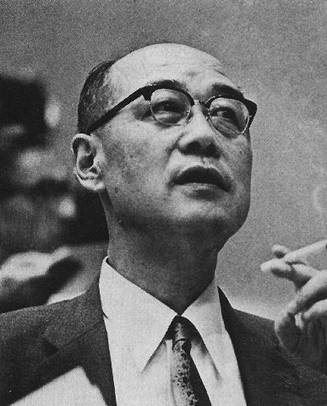
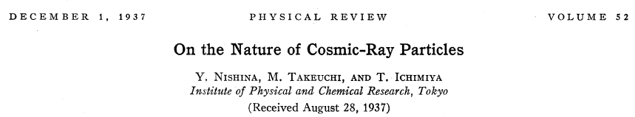
Confirmed by: Street & Stevenson, Nishina, Tekeuchi & Ichimiya
It took 10 years to conclude that the muon interacted too weakly with matter to be the “Yukawa” particle which was postulated to carry the nuclear force

Slide 19
Magnetic Dipole Moments

Slide 20
A circulating particle with charge e and mass m:
Angular momentum
Magnetic dipole moment
r
e, m

Slide 21
Precession of a Top in a Gravitational Field

Slide 22
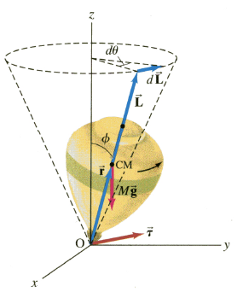
Let’s calculate it

Slide 23
For particles with intrinsic angular momentum (spin S):
In a magnetic field (B), there is a torque:

Slide 24
Definition of g-Factor
g-2 measures the difference between the charge and mass distribution. g-2=0 when they are the same all the time…
From Dirac equation g-2=0 for point-like, spin ½ particles, e.g leptons.

Slide 25
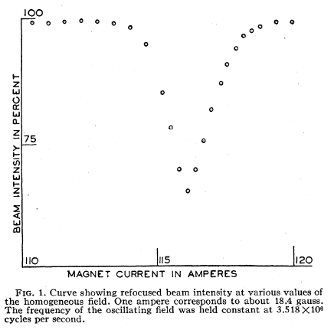
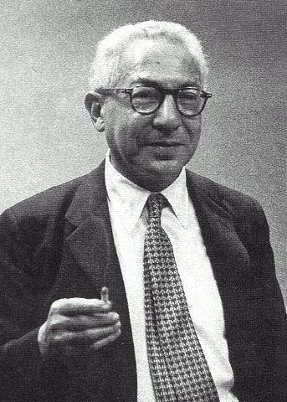
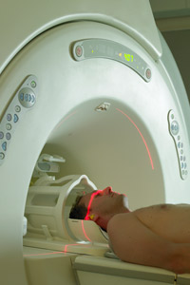
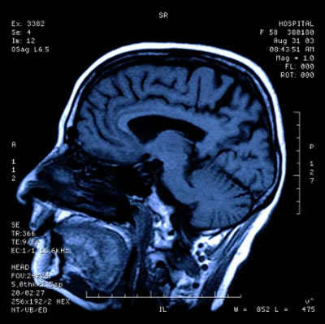
Magnetic Dipole Moments: μ
Nuclear Magnetic Resonance: a new direct method of detecting NMR, I. Rabi et al., 1938
Used in Magnetic Resonance
Imaging

Slide 26
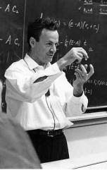
MDM can also tell us about Quantum Field Fluctuations
A “soup” of virtual particles is coming in and out of existence affecting the MDM interaction of particles with B-fields.
The interaction is estimated using Feynman diagrams.
It is expressed with the so-called g-2 factor: a = (g-2)/2, the anomaly.

Slide 27
g-factors:
Proton (g_{p}=+5.586) and the neutron (g_{n}=-3.826) are composite particles.
The ratio g_{p}/g_{n}=-1.46 close to the predicted –3/2 was the first success of the constituent quark model.
The g_{e}-2 (of the electron) is non-zero mainly due to quantum field fluctuations involving QED. A “soup” of virtual particles coming in and out of existence…
The anomalous magnetic moment of leptons can be estimated with high accuracy

Slide 28
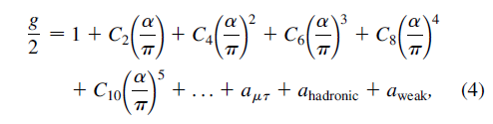
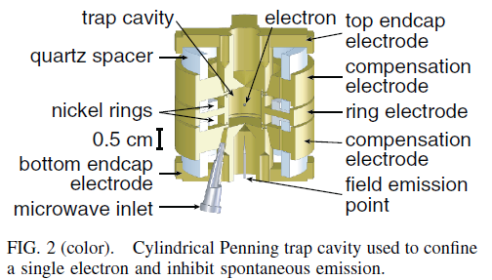
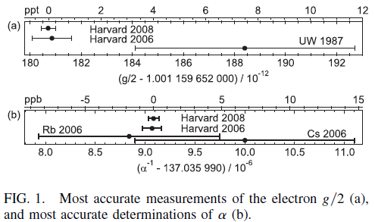
Electron Magnetic Dipole Moment
D. Hanneke, S. Fogwell, and G. Gabrielse, PRL 100, 120801 (2008)
It’s a triumph of QED!

Slide 29
g-factors: Muon case
The g_{μ}-2 is more sensitive to a class of particles than the g_{e}-2 by (m_{μ}/m_{e})²~40,000. A thicker “soup” of virtual particles coming in and out of existence…
Muons are sensitive to W, Z, and new physics, e.g. SUSY: neutralino

Slide 30
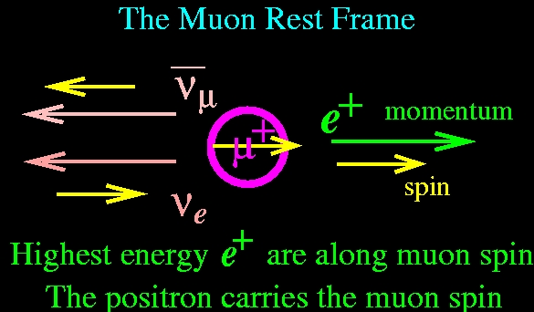
Muon decay
Decay is self analyzing
The highest energy e± from μ± decay carry information of the muon spin direction.

Slide 31
Radiative corrections change g from its Dirac value of 2. We symbolically express these corrections as Feynman diagrams
Lee B. Roberts
Dirac Stern-Gerlach
Schwinger Kusch-Foley
We have a pertubation expansion:

Slide 32
g - 2 for the muon, SM contributions
Largest contribution :
Other standard model contributions :
QED
hadronic
weak

Slide 33
Storage Ring Muon g-2:
Rigorous Test of the Standard Model

Slide 34
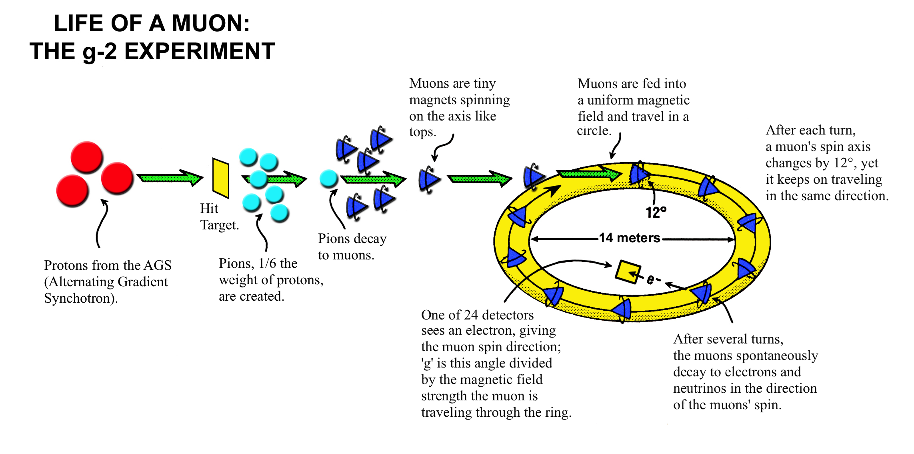
Muon g-2 experiment: major challenge to the Standard Model
E821 at BNL: 1997-2004
E989 at FNAL: first data in 2017

Slide 35
Spin Precession Rate at Rest
There is a large asymmetry in this
equation: μ is relatively large,
d is compatible with zero

Slide 36
The Principle of g-2
Spin vector
Moving: Thomas precession!
Momentum vector
• B
Independent of velocity!

Slide 37
Effect of Radial Electric Field
Spin vector
Low energy particle
…just right
High energy particle
Momentum vector

Slide 38
Effect of Radial Electric Field
Spin vector
…just right
, γ~29.3
for muons, “magic” momentum
(~3GeV/c)

Slide 39
Breakthrough concept: Freezing the horizontal spin precession due to E-field
Muon g-2 focusing is electric: The spin precession due to E-field is zero at “magic” momentum (3.1GeV/c for muons, 0.7 GeV/c for protons,…)
The “magic” momentum concept was used in the muon g-2 experiments at CERN, BNL, and now at FNAL.

Slide 40
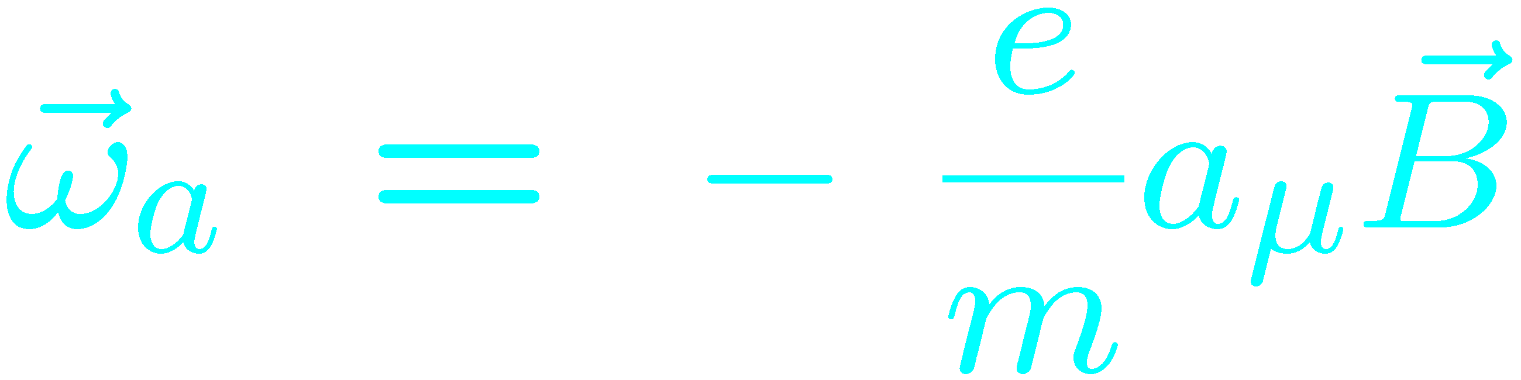
slide by B. Lee Roberts
Experimental Technique
Protons
Pions
Inflector
p=3.1GeV/c
Target
(1.45T)
Injection orbit
Muon polarization
Muon storage ring
injection & kicking
focus by Electric Quadrupoles
24 electron calorimeters
Central orbit
Storage
ring
Kicker
Modules
R=711.2cm
d=9cm
Electric Quadrupoles

Slide 41
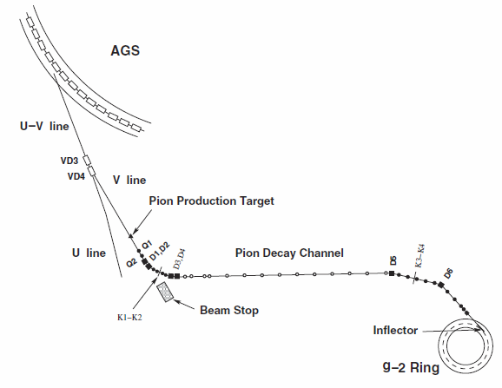
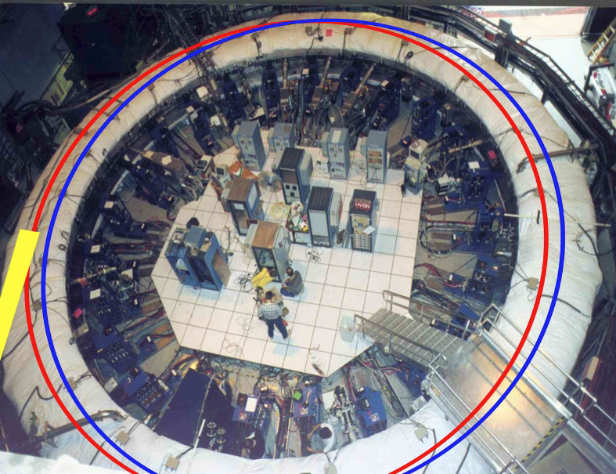
BNL E821: Muon injection and kicker
Need to kick the muons onto stable orbit
P. Winter

Slide 42
Space limitations prevent matching the inflector exit to the storage aperture
Upper Pole Piece
Lee B. Roberts

Slide 43
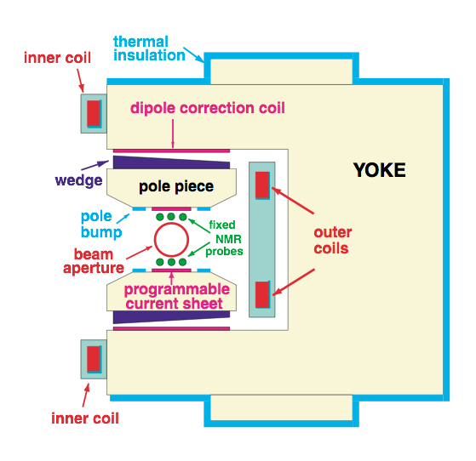
Cross section of the storage ring magnet
P. Winter

Slide 44
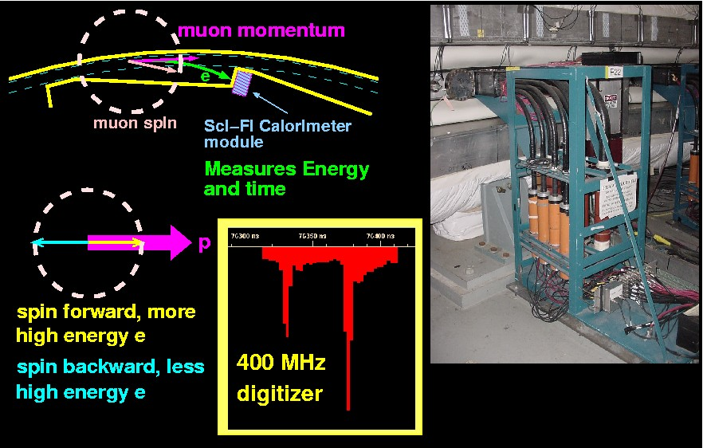
Detectors and vacuum chamber
Lee B. Roberts

Slide 45
Energy Spectrum of Detected Positrons depends on spin direction
Momentum
vector
Spin vector
Momentum
vector
Spin vector
Software Energy Threshold

Slide 46
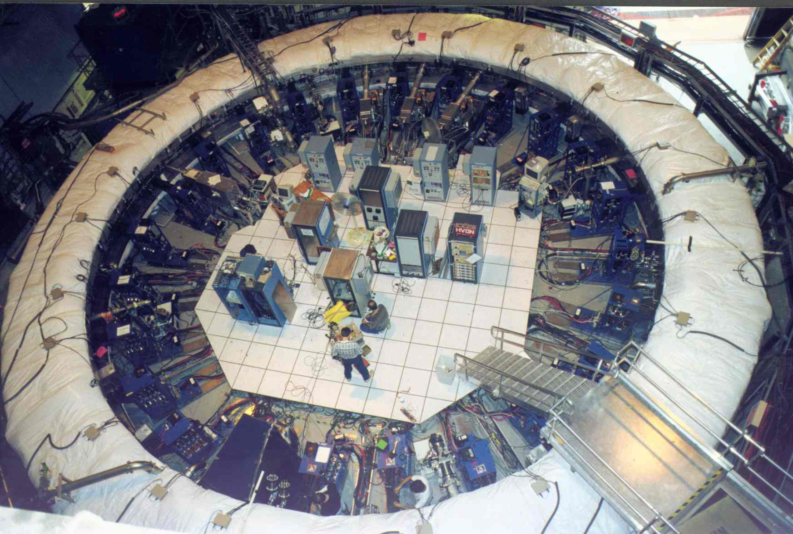
Muon g-2: Precision physics in a Storage Ring
Statistics limited… to improve sensitivity by a factor of 4 at Fermilab

Slide 47
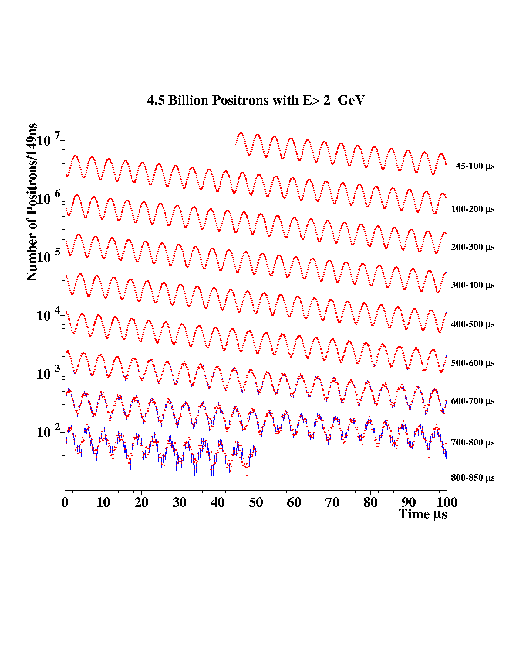
Muon g-2: 4 Billion e⁺ with E>2GeV
Sub-ppm accuracy,
statistics limited

Slide 48
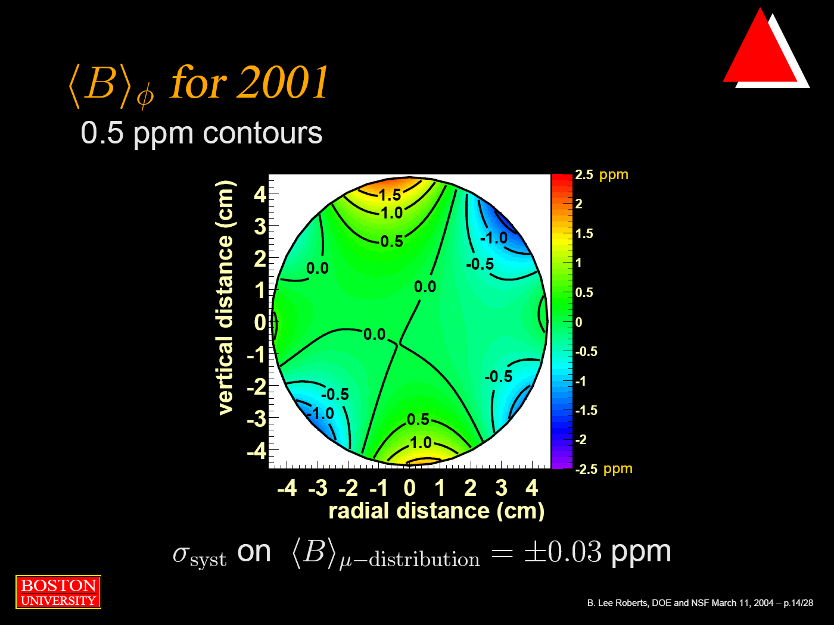
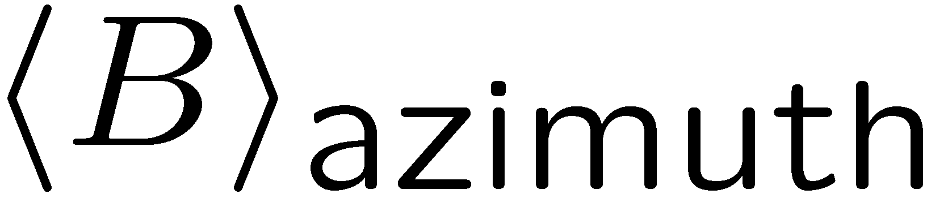
The ± 1 ppm uniformity in the average field is obtained with special shimming tools.

Slide 49
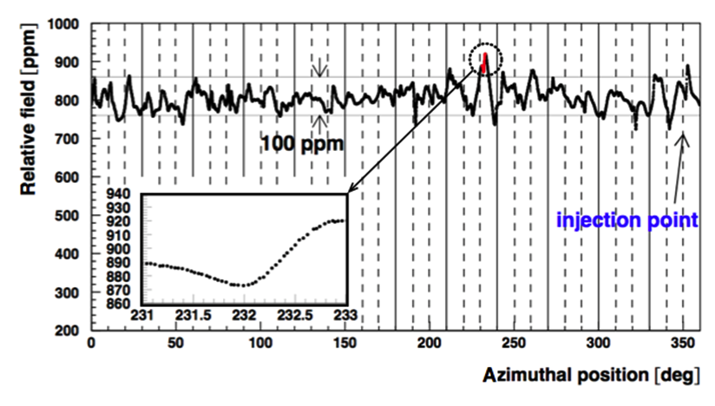
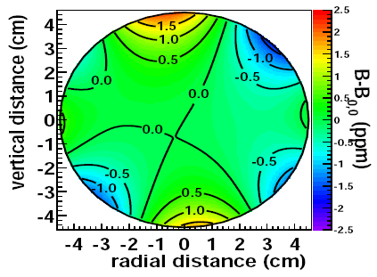
Goal for the shimming of the storage ring magnet
Azimuthally Averaged
Field vs r,z
Field vs. Azimuth
Bennett et al. 10.1103/PhysRevD.73.072003
Goal: +/- 25 ppm
Goal: +/- 0.5 ppm
P. Winter

Slide 50
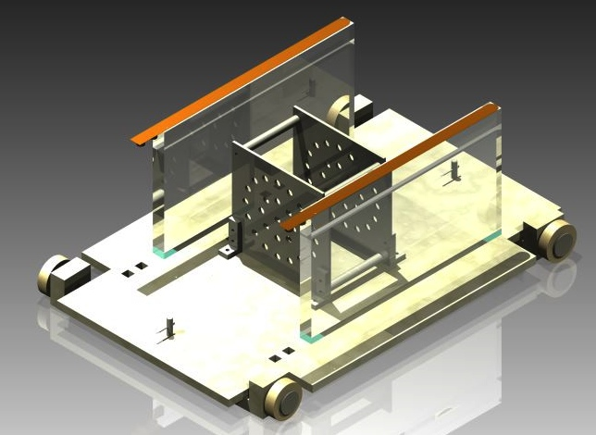
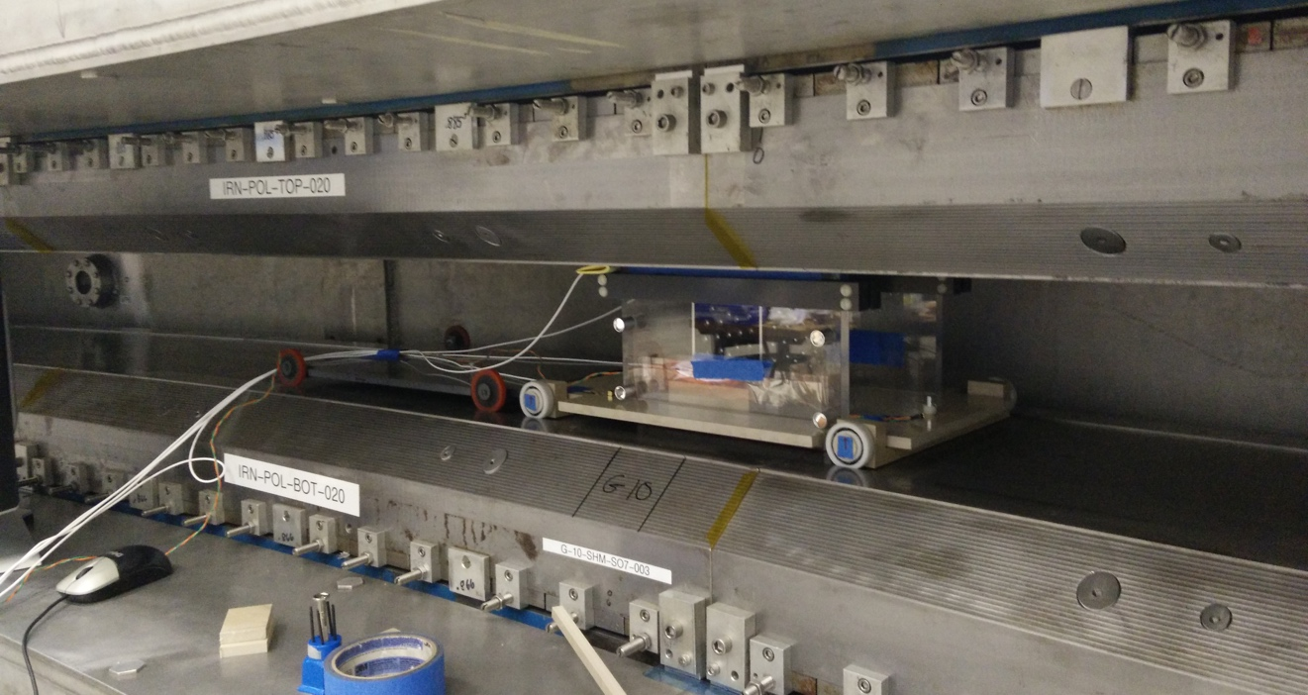
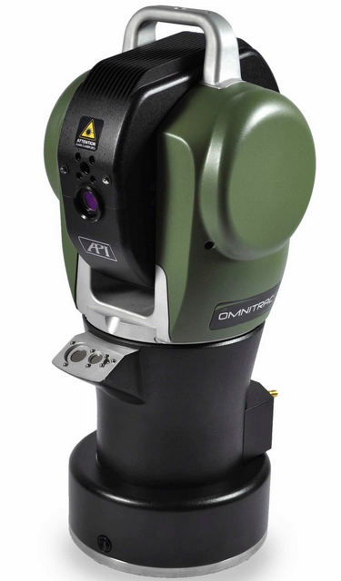
Shimming tool
Multipurpose instrument
  25 NMR Probes for field
  4 capacitive gap sensors
    Measure pole alignment
    70 nm resolution
    Few micron reproducibility
Laser tracked position with μm resolution
P. Winter

Slide 51
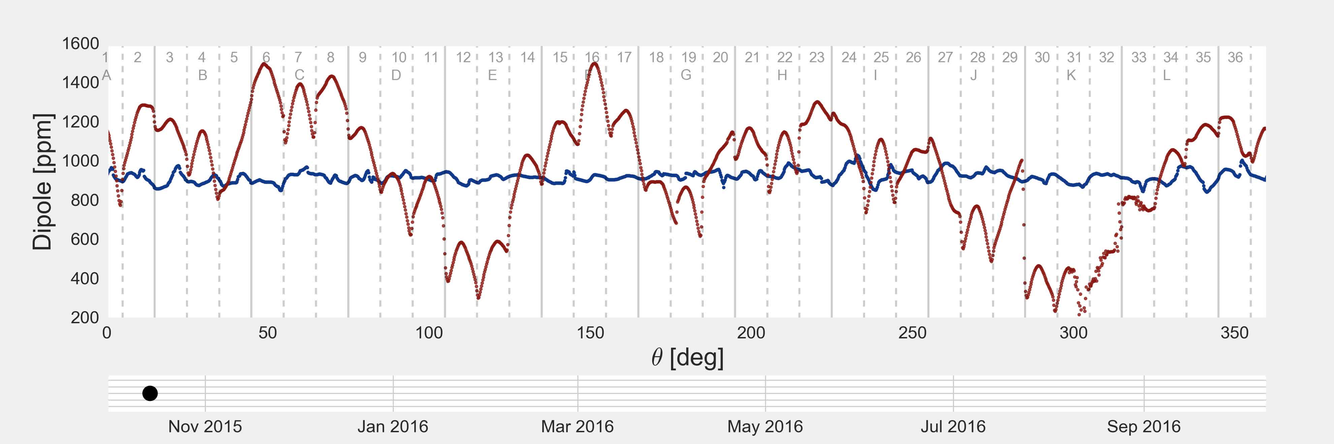
Shimming goal achieved as of September 2016:
Many improvements on entire experiment to reach 140 ppb
Precision alignment to reach dipole gradients of ΔB < ±25 ppm
  72 poles
  840 wedge shims
  9000 thin iron foils
P. Winter
Shimming completed with ΔB < ±25 ppm ✓
10 months of improving the dipole field in 1 minute...
Calibrations Poles Wedges Laminations

Slide 52
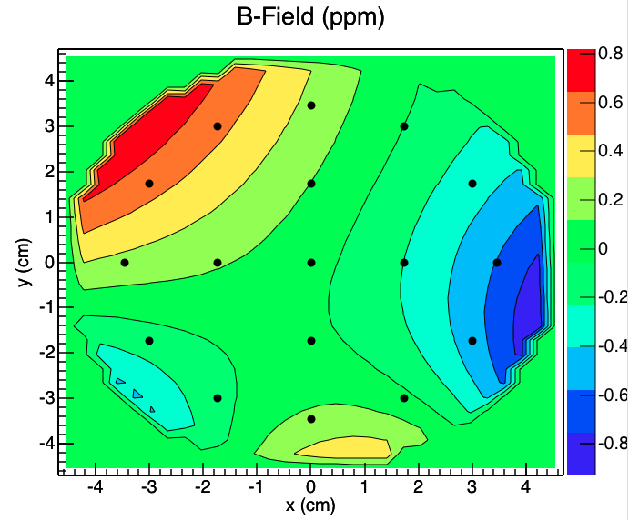
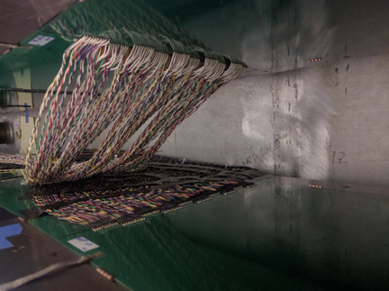
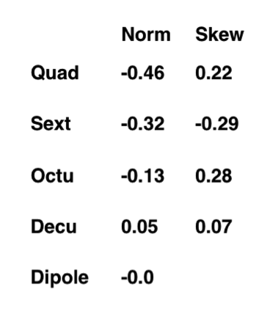
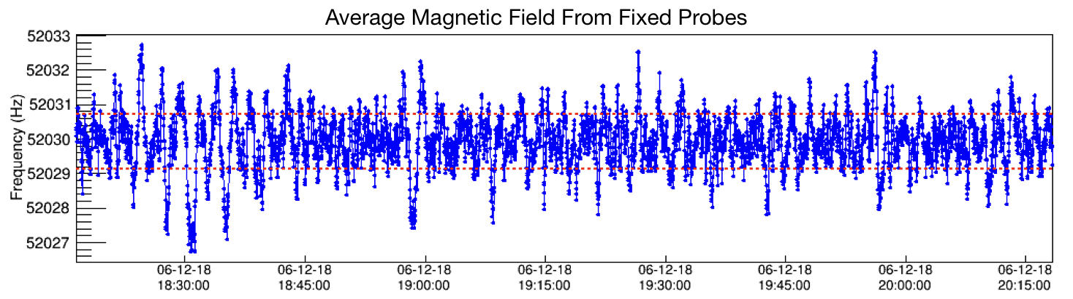
Surface coils and power supply feedback
200 continuous current traces around the ring individual tunable between +-2A
Used to cancel higher multipoles
Power supply feedback stabilizes main dipole field to ±15 ppb
September 2017 with SCC
P. Winter

Slide 53

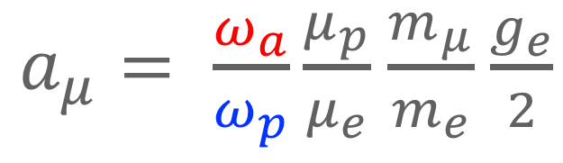
Recasting a_{μ} in fundamental constants
ω_{a} = (e/m_{μ}) a_{μ} B
➙
μ_{e} = g_{e} eħ/4m_{e}
$a_{μ}= \frac{ω_{a}}{ω_{p}}\frac{μ_{p}}{μ_{e}}$ $\frac{m_{μ}}{m_{e}}$ $\frac{g_{e}}{2}$
Δg_{e}/2 ~ 0.3 ppt
Δm_{μ}/m_{e} ~ 25 ppb
Δμ_{e}/μ_{p} ~ 8 ppb
P. Winter

Slide 54

Comparison of Theory/Experiment
The result is 3.5 s.d. away
from theory! What is it?

Slide 55

Current status of a_{μ} in Standard Model
 | Value (x 10⁻¹¹)
QED | 116 584 718.951 ± 0.009 ± 0.019 ± 0.007 ± 0.077
HVP (lo) | 6949 ± 34
HVP (ho) | -98.4 ± 0.7
HLBL | 105 ± 26
EQ | 154 ± 1
Total SM | 116 591 818 ± 43
a_{μ}^{Expt.} - a_{μ}SM = (271 ± 73) x 10⁻¹¹ (3.7 σ)
  New E989 experiment will reduce experimental uncertainty by a factor of 4 to 16 x 10⁻¹¹ (140 ppb)
  If current discrepancy remains this would yield >7σ
  Together with theory improvements could give >9σ
P. Winter

Slide 56

Hadronic vacuum polarization
  Challenging but can link to experimental data!
γ
h
μ
μ
P. Winter

Slide 57


Hadronic vacuum polarization
  Challenging but can link to experimental data!
γ
h
e⁺
γ
h
μ
μ
e⁻
P. Winter

Slide 58

Hadronic vacuum polarization
  A lot of precision data already available from many experiments
  Future improvements from VEP-2000, KLOE, BaBar, Belle, BES-III, ...
P. Winter

Slide 59
Beyond standard model, e.g. SUSY
W. Marciano, J. Phys. G29 (2003) 225

Slide 60

Muon g-2 sensitivity to the “image world” of SUSY
Mass of Neutralino!

Slide 61

Please… buckle up
Our solar system moves with velocity: 220 km/s ~0.1% of speed of light!

Slide 62

Our position in our galaxy
It takes ~250 million years for one turn around our galaxy: 4.5 Billion years means 4.5 Billion/0.250 = 18, i.e. we are all 18!

Slide 63


Our position in our galaxy
Dark matter: Axions, neutralino

Slide 64
Summary
Measuring the energy and time of the decay positrons defines the “muon g-2” frequency.
Any issues in the above parameters during storage is a potential systematic error source.
The muon g-2 experiment can probe quantum field fluctuations due to heavy particles of the SM and New Physics in a sensitive manner.

