Slide 1
Panda Forward Dipole Magnet design status International Workshop on Antiproton Physics and Technology at FAIR 16-19 November 2015 Budker Institute of Nuclear Physics

Slide 2
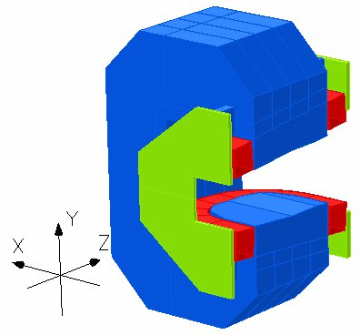
PANDA Forward Dipole Magnet
DIPOLE MAGNET MAIN PARAMETERS
Magnetic field 1 Т
Field Integral 2 Т×m
Bending variation < +/- 15%
Gap 0.8 m => 1.1 m
Height×Width×Length 5.3 × 4.2 × 1.6 m
Weight 235 tons
Power 400 kW

Slide 3
Main issues for PANDA Forward Dipole Magnet design
3D Magnetic simulations
Stress simulations
Field ramping => selection steel plate thickness
Fridge fields => to match with boundary conditions
Drawings development
Manufacturing technology development
Control system development
Assembling/disassembling

Slide 4
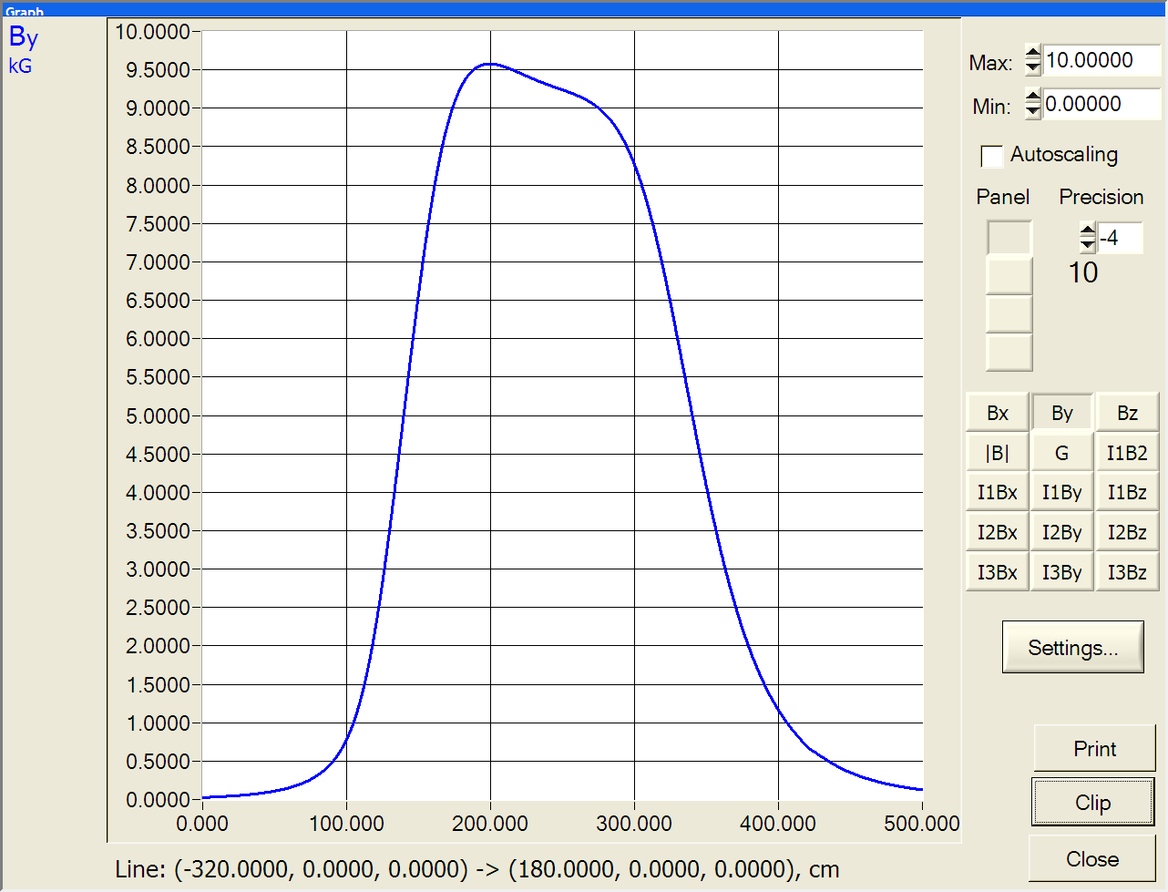
PANDA Forward Dipole Magnet Magnetic simulations
Longitudinal field distribution

Slide 5
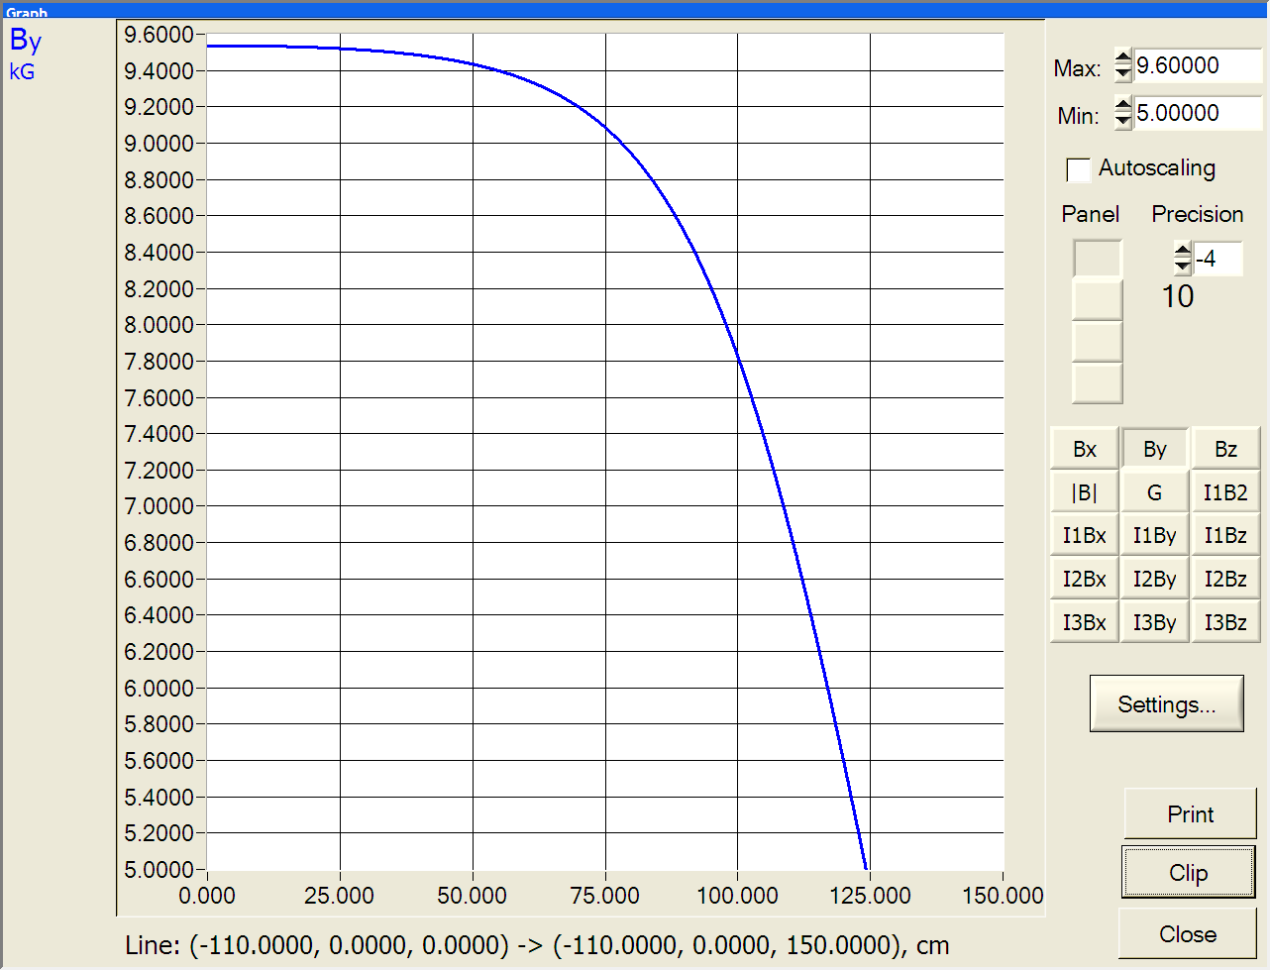
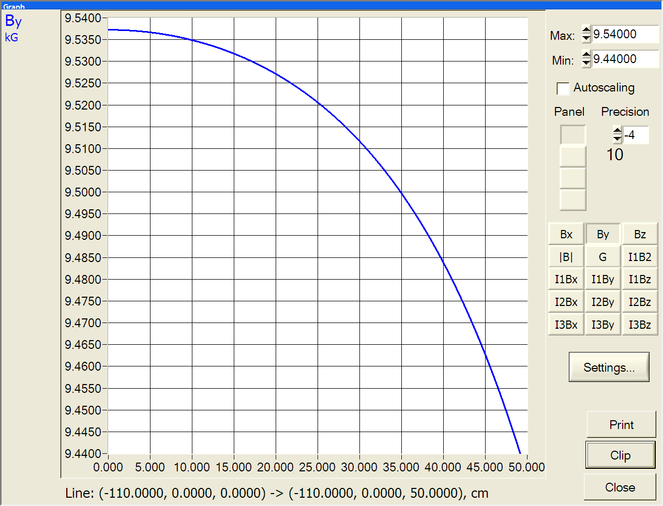
PANDA Forward Dipole Magnet Magnetic simulations
Transverse field distribution
Transverse field distribution
Field uniformity in good field region is OK
Transverse field distribution
(larger scale)

Slide 6
Fridge fields
Requirement: 25 G at RICH.
Satisfied, but difficult

Slide 7
Current ramping
The current ramp is during 60 or 120 seconds.
Steel plates thick then is 10 cm or 20 cm enough?
3D magnetic code MASTAC for current pattern changing had been developed.
Simulations shows that 20 cm plates thick is enough for 60 sec ramping

Slide 8
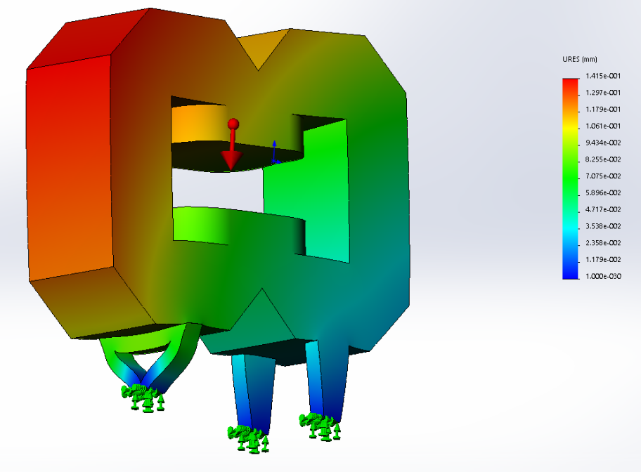
Stress simulations
Under gravity deformation is 12 microns.
ANSYS code used

Slide 9
Stress simulations
Magnetic force is about 240 tons
Under magnetic force deformation is 40 microns

Slide 10
Stress simulations
Conclusions :
Triangle support is not rigit.
Arrangement of support is OK.
Additional coil deformation due to increased gap height

Slide 11
Remaining issues
Boundary conditions outside dipole check
Detailed drawings development
Manufacturing technology development
Manufacturing coils at BINP’s workshop
Manufacturing yoke at outside workshop
Assembling coil and yoke at BINP and testing
Shipment

Slide 12
Thank you for attention!

