Slide 1

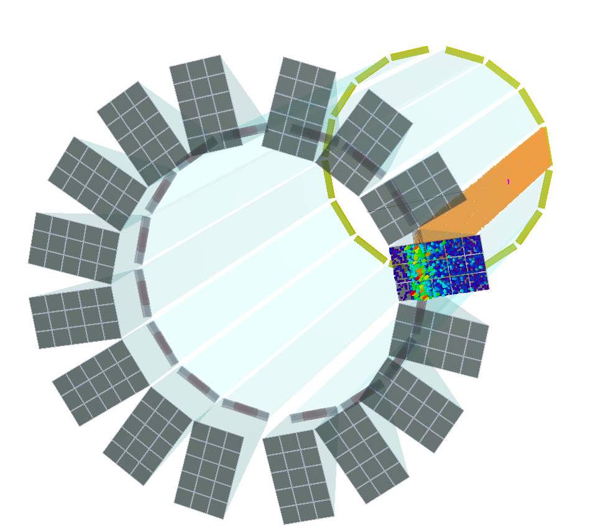


The Barrel DIRC of the
Experiment at FAIR
PANDA Experiment
DIRC Concept
Barrel DIRC of PANDA
Prelim. Test Beam Results
Georg Schepers
(GSI Darmstadt)
for the PANDA Cherenkov Group
15, Novosibirsk, 17.11.2015

Slide 2
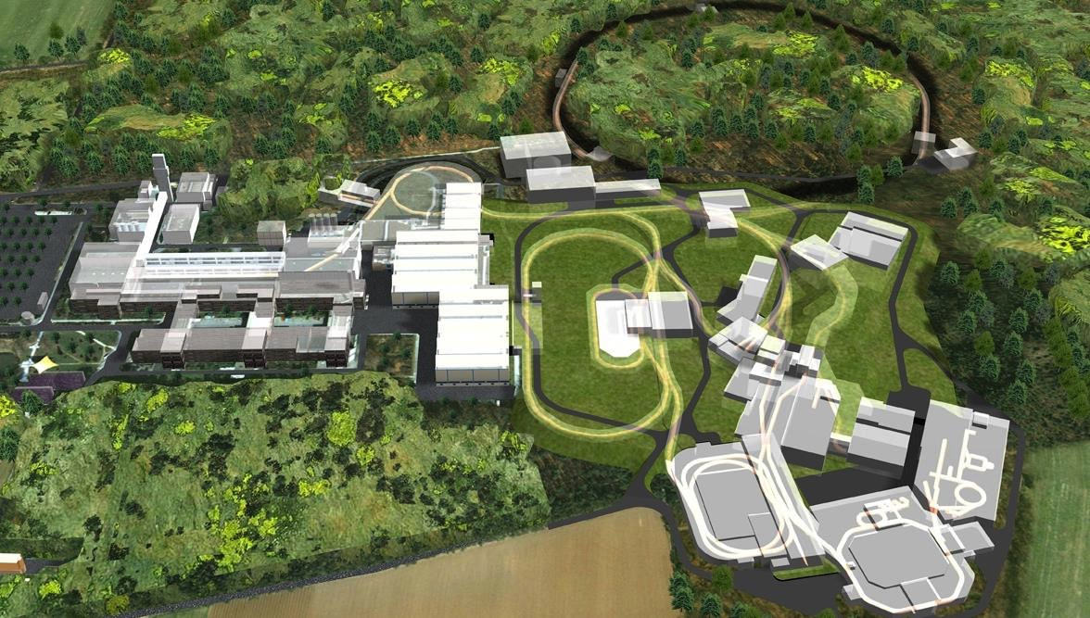
experiment

Slide 3
experiment
SIS 100/300
70 MeV
SIS18
p-Linac
30 GeV Protons
HESR
p Target
PANDA
RESR/CR

Slide 4
experiment
SIS 100/300
70 MeV
SIS18
p-Linac
30 GeV Protons
HESR
p Target
HESR
10¹¹ stored antiprotons with beam momentum of 1.5 - 15 GeV/c
Δp/p of 4 x 10⁻⁵ with 10¹⁰ stored antiprotons
PANDA
RESR/CR

Slide 5

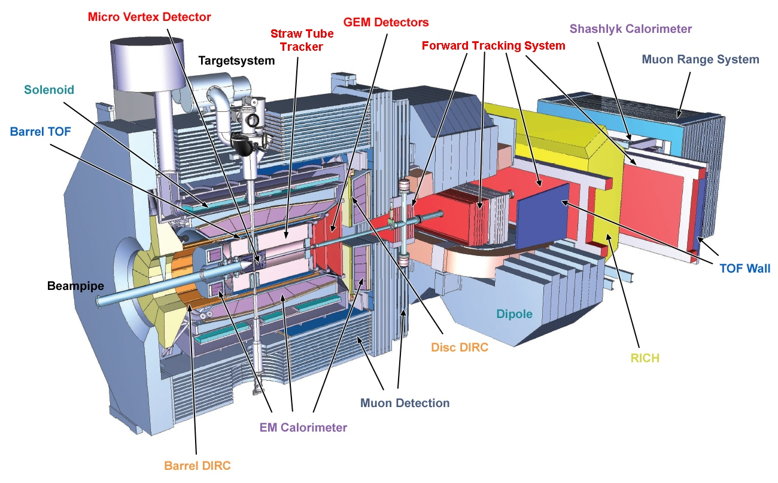

experiment
AntiProton ANihilation at DArmstadt
$$\overline{p}$$
12m
Target Spectrometer Forward Spectrometer

Slide 6
experiment
Collaboration
$$\overline{p}$$
12m
Target Spectrometer Forward Spectrometer
>500 physicists
67 institutes
19 countries

Slide 7
experiment
anti-proton beam on pellet/cluster target
$$\overline{p}$$
12m
Target Spectrometer Forward Spectrometer
Luminosity
up to 2 x 10³² cm⁻²s⁻¹
Average interaction rate up to 2 x 10⁷/s

Slide 8
experiment
Study of open issues of QCD
$$\overline{p}$$
12m
Target Spectrometer Forward Spectrometer
Hadron spectroscopy
Properties of hadrons
in matter
Nucleon structure
Hypernuclei

Slide 9
experiment
Particle identification methods
momentum range: 0.2 GeV/c – 10GeV/c
$$\overline{p}$$
12m
Target Spectrometer Forward Spectrometer
Energy loss
EM showers
Time of Flight
Cherenkov radiation

Slide 10
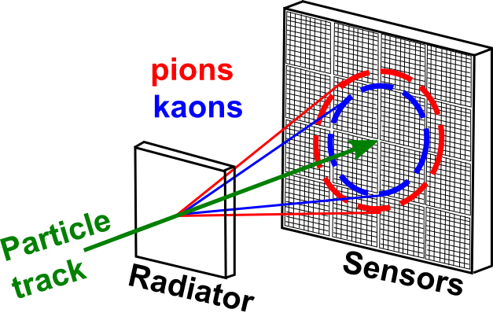
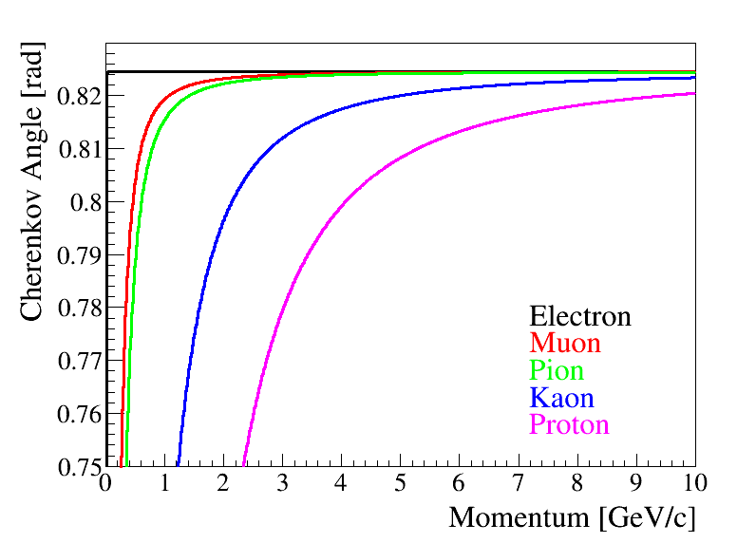
Cherenkov effect
concept
Particle velocity β = v/c > 1/n
transmitted into photon angle cos θc = 1/βn(λ)
[mrad]
momentum [GeV/c]

Slide 11
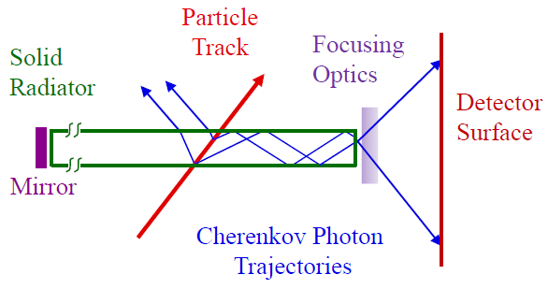
DIRC Concept
concept
Novel kind of
Ring Imaging Cherenkov Detector
Detection of Internally Reflected Cherenkov Light
B.N. Ratcliff, SLAC-PUB-6047 (Jan. 1993)

Slide 12
DIRC Concept
concept
Radiators with polished surfaces and
orthogonal sides:
For n>√2 some photons are always
totally internally reflected for β≈1 tracks
Magnitude of Cherenkov angle conserved during internal reflections
Photons exit radiator via the (optional) focusing optics into expansion region, detected on photon detector array
Novel kind of
Ring Imaging Cherenkov Detector
Detection of Internally Reflected Cherenkov Light
B.N. Ratcliff, SLAC-PUB-6047 (Jan. 1993)

Slide 13
DIRC Concept
concept
Radiators with polished surfaces and
orthogonal sides:
For n>√2 some photons are always
totally internally reflected for β≈1 tracks
Magnitude of Cherenkov angle conserved during internal reflections
Photons exit radiator via the (optional) focusing optics into expansion region, detected on photon detector array
Novel kind of
Ring Imaging Cherenkov Detector
Measurement: x, y, and time
Deduction: θc, φc, tpropagation
Information: PID-Likelihood from
hitpatterns for different
particle species
Geometrical Reconstruction: Bar to Pixel
Detection of Internally Reflected Cherenkov Light
B.N. Ratcliff, SLAC-PUB-6047 (Jan. 1993)

Slide 14
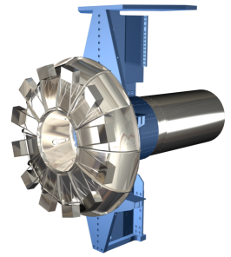
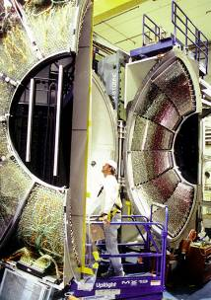
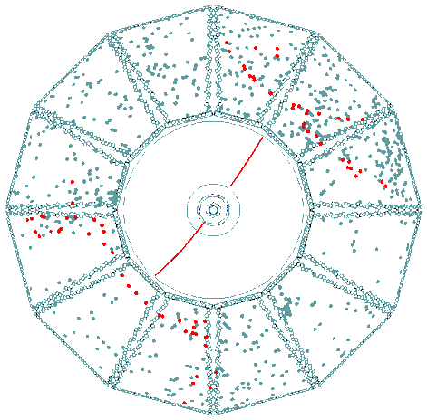
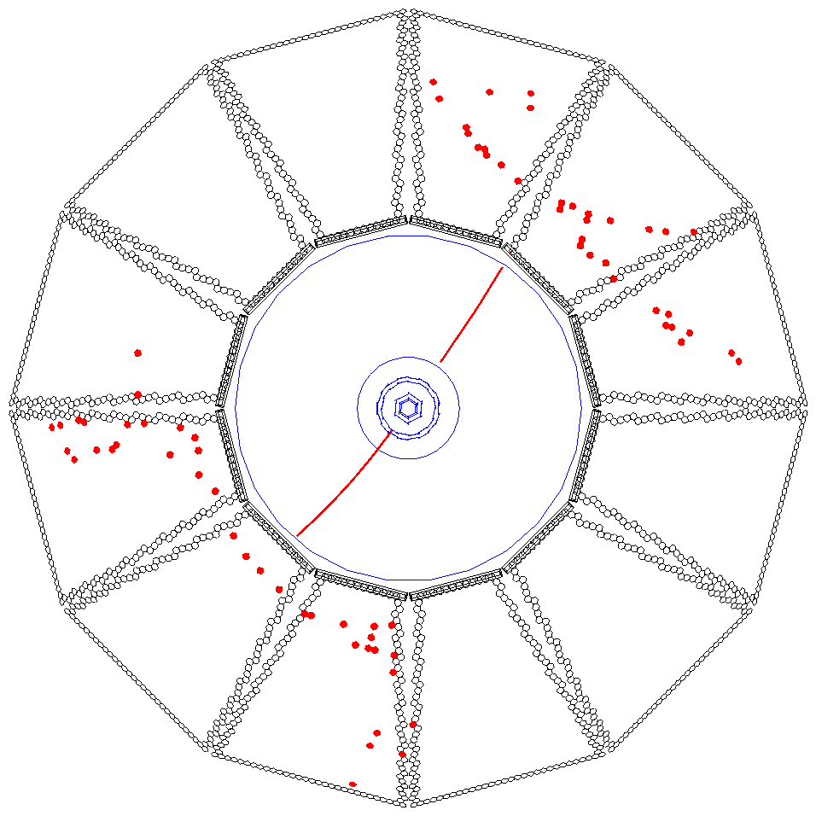
Successful BaBar DIRC
concept
500cm
Expansion Volume
common water tank
500cm
Single photon timing resolution 1.7ns
Single photon Cherenkov angle
resolution ~10mrad
Photon yield, photons per track 20 - 60
Track Cherenkov angle resolution 2.4mrad
(di-muons)
π/K separation power 4.3σ@ 3GeV/c
~3σ @ 4GeV/c
Time cut on Accelerator background
from the water tank

Slide 15
DIRC Cherenkov Angle Resolution
concept
  Correlated term:
  tracking detectors, multiple scattering
  Single photon Cherenkov angle resolution:
  bar size, pixel size, chromatic, bar imperfections
  Number of photons:
  bar size, bar imperfections, photon detection efficiency of the detector

Slide 16
DIRC Cherenkov Angle Resolution
concept
  Correlated term:
  tracking detectors, multiple scattering
  Single photon Cherenkov angle resolution:
  bar size, pixel size, chromatic, bar imperfections
  Number of photons:
  bar size, bar imperfections, photon detection efficiency of the detector

Slide 17
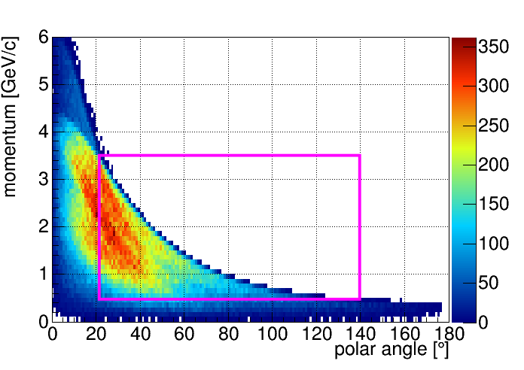
DIRCs in PANDA
panda dirc
Kaon phase space coverage for reactions with
p-bar momentum between 6 GeV/c and 15 GeV/c
Simulation

Slide 18
DIRCs in PANDA
panda dirc
Kaon phase space coverage for reactions with
p-bar momentum between 6 GeV/c and 15 GeV/c
Target Spectrometer
Simulation
Barrel DIRC
Endcap Disc DIRC
Design similar to BaBar DIRC
Polar angle coverage:
22° < θ < 140°
PID goal:
3σ π/K separation up to 3.5 GeV/c
Novel type of DIRC
Polar angle coverage:
5° < θ < 22°
PID goal:
3σ π/K separation up to 4 GeV/c

Slide 19
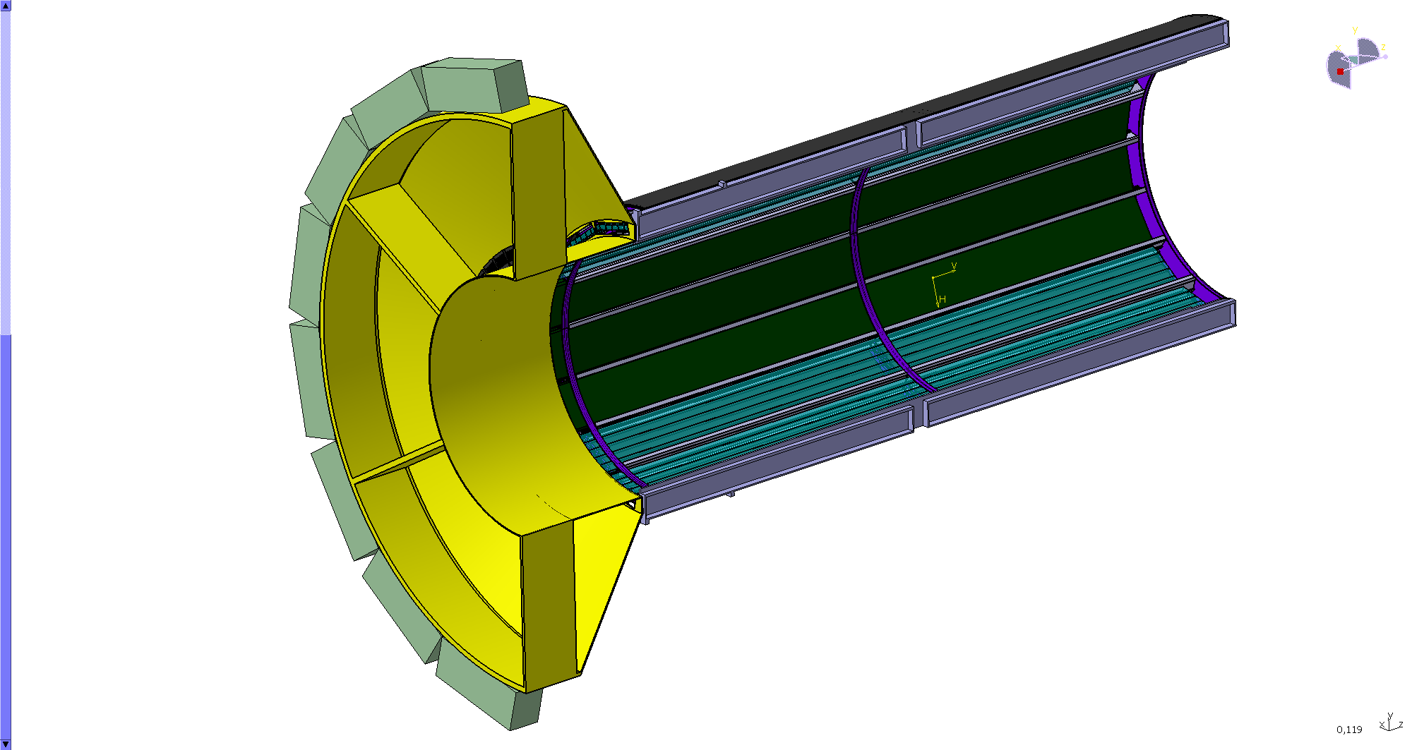
Barrel DIRC Baseline Design (BaBar-like)
panda dirc
Photon detectors
and electronics
expansion volume
240cm
100cm
Radiator bars
Focusing optics

Slide 20
Barrel DIRC Baseline Design (BaBar-like)
panda dirc
Barrel:
  radius: 47.6 cm
  80 radiator bars,
Bars:
    1.7 cm × 3.2 cm × 240 cm
  synthetic fused silica
Expansion volume:
  30 cm depth
  mineral oil
Read out:
  ~15k channels of MCP-PMT
Photon detectors
and electronics
expansion volume
240cm
100cm
Radiator bars
Focusing optics

Slide 21

Barrel DIRC Baseline Design (BaBar-like)
panda dirc
Barrel:
  radius: 47.6 cm
  80 radiator bars,
Bars:
    1.7 cm × 3.2 cm × 240 cm
  synthetic fused silica
Expansion volume:
  30 cm depth
  mineral oil
Read out:
  ~15k channels of MCP-PMT
Photon detectors
and electronics
expansion volume
240cm
100cm
Radiator bars
Focusing optics
  Single photon Cherenkov
  angle resolution: $\sim$10 mrad
  Number of detected photons
  for $β≈1$ track: > 15
Expected
performance

Slide 22
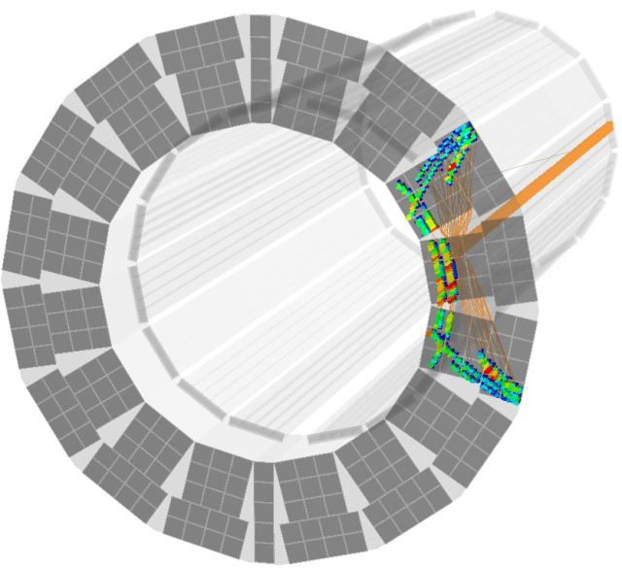
Improvement of Expansion Volume
panda dirc
Instead of one common oil tank

Slide 23
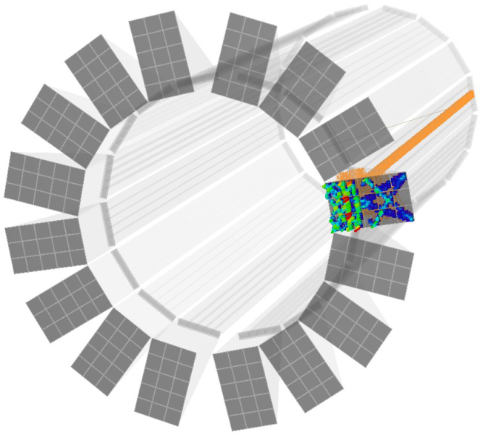
Improvement of Expansion Volume
panda dirc
Instead of one common oil tank
one synthetic fused silica prism per segment
Better optical properties
Smaller detection surface meaning fewer photon sensors

Slide 24
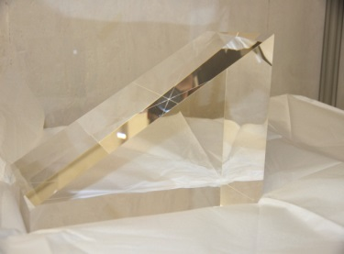
Improvement of Expansion Volume
panda dirc
Instead of one common oil tank
one synthetic fused silica prism per segment
Better optical properties
Smaller detection surface meaning fewer photon sensors
30 cm

Slide 25
Improvement of Radiator Width
panda dirc
Instead of 5 narrow bars per segment

Slide 26
Improvement of Radiator Width
panda dirc
Instead of 5 narrow bars per segment
one wide plate
Fewer pieces to be polished
Less strict requirements for optical and mechanical quality of side surfaces

Slide 27
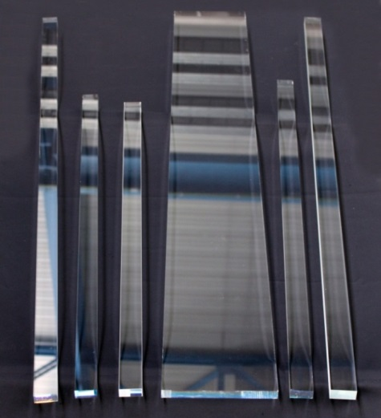
Improvement of Radiator Width
panda dirc
Instead of 5 narrow bars per segment
one wide plate
Fewer pieces to be polished
Less strict requirements for optical and mechanical quality of side surfaces

Slide 28
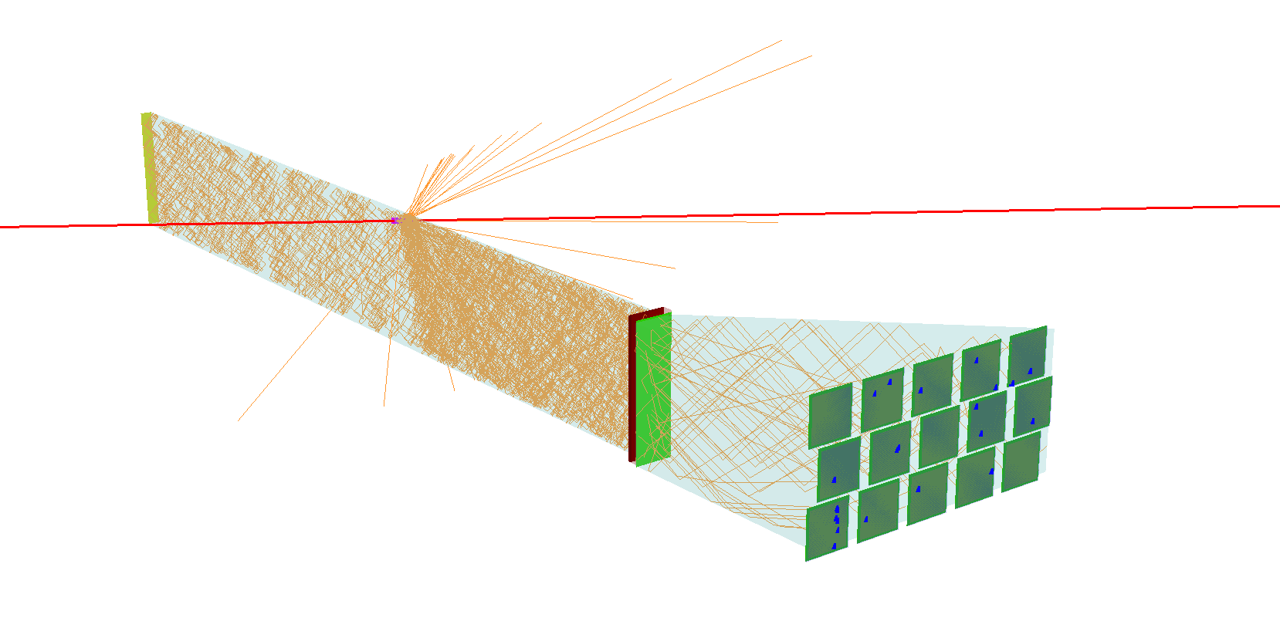
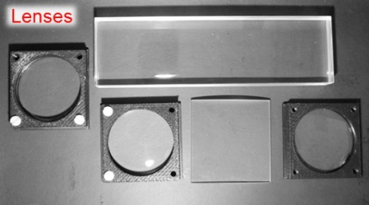
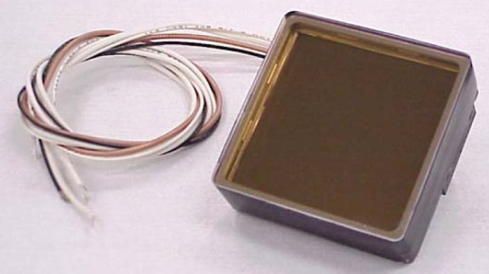
Improvement of the Optics
panda dirc
Removal of
  bar size contribution
    Focusing with mirrors or
    Lens-systems
  pixel size contribution
    Segmented Photosensors
    (MCP-PMTs)

Slide 29
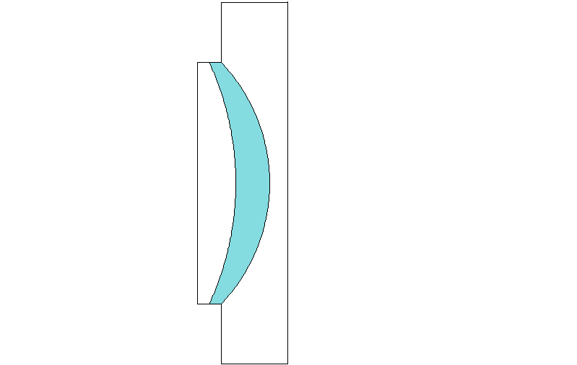
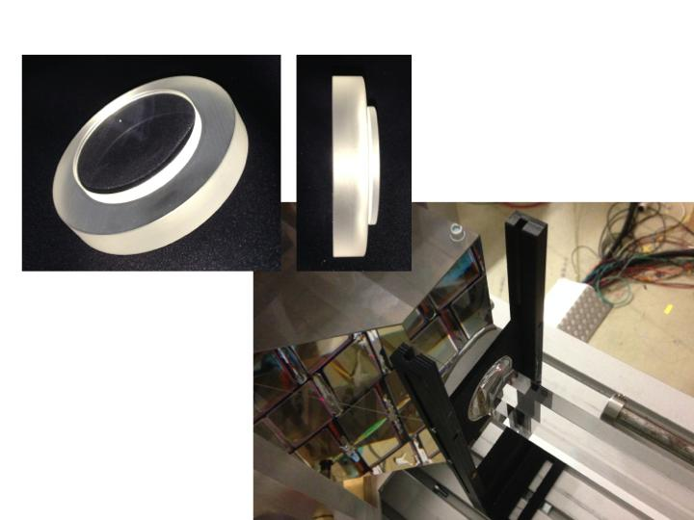
Improvement of the lens design
panda dirc
Lens design aimed for a focal plane
matching the flat photon detector plane
LaK33
SiO₂
Radiation level ~ 10 kR
PbF₂ is radiation hard, γ ~ 100 kR
Other optical radiation resistant glasses?
Afternoon, Lee Allison
29

Slide 30
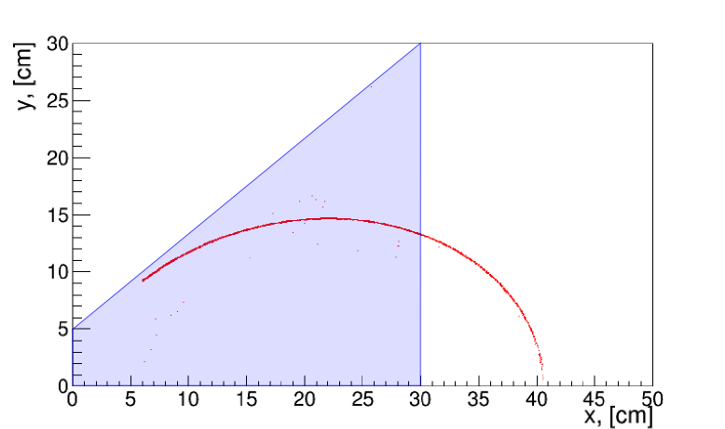
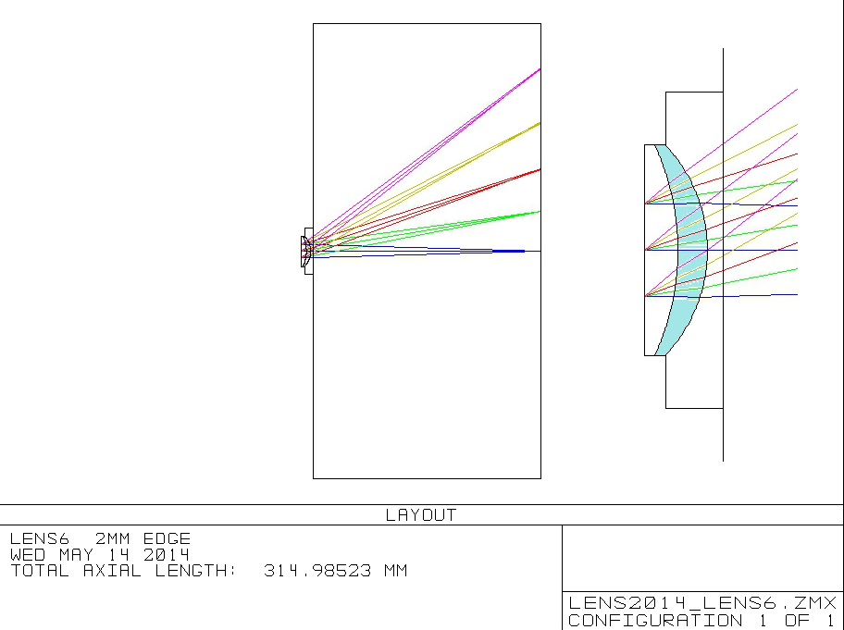
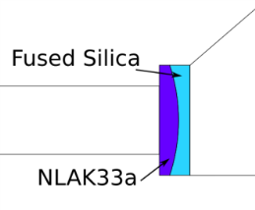
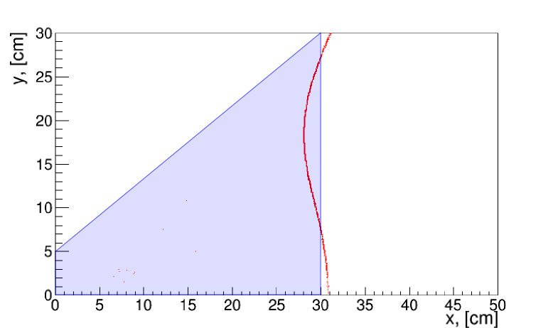
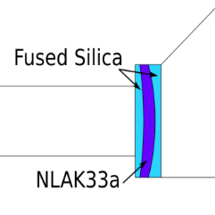


Geant
Zemax
Improvement of the lens design
panda dirc
Geant Zemax
Dispersing +
focusing lens
for flat focal plane
30

Slide 31
Improvement of photon sensors
panda dirc
Compact, fast multi-pixel sensor
  Single photon detection inside B-field with
  high gain 10⁶ at 1-2 Tesla magnetic field
Good geometrical resolution over
a large surface
Very good time resolution of
~100 ps for single photons
High detection efficiency with
low dark count rate
High rate capability with
rates up to MHz/cm²
Long lifetime with
integrated anode charge of 0.5 C/cm²/y

Slide 32
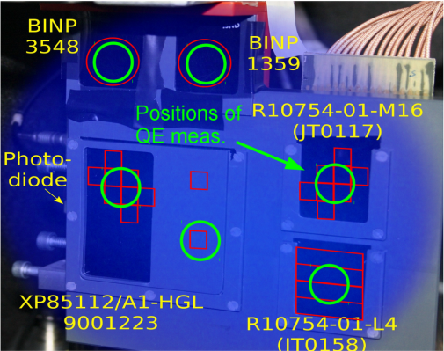
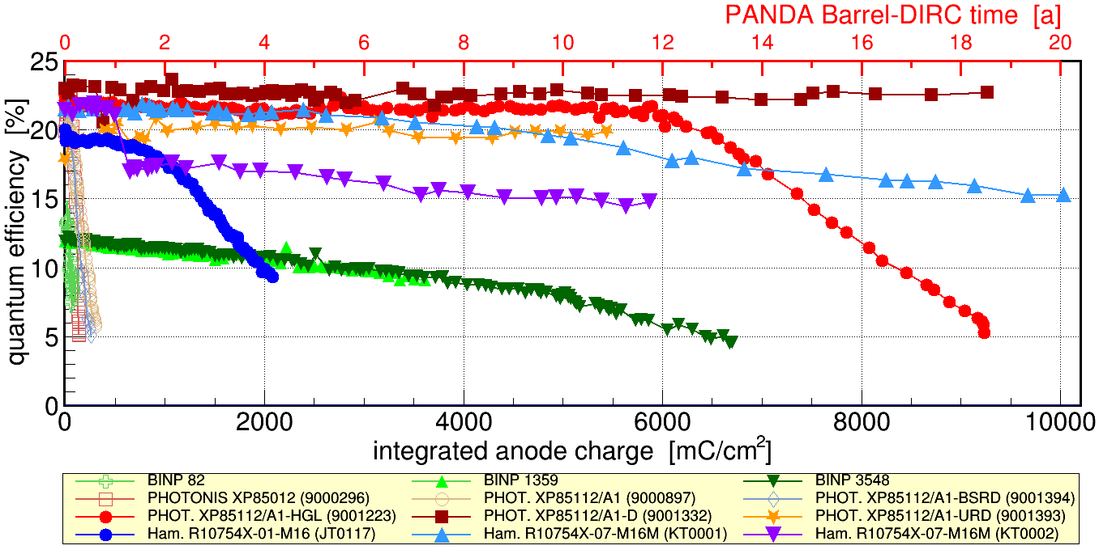
Simultaneous and continuous illumination
of all improved MCP PMT types
panda dirc
- >3 years of measurement up to now
Since 2011 life time of MCP PMTs enhanced by factor 20

Slide 33
Improvement of the FEE
panda dirc
  Fast Front End Electronics for
    Time measurement
      read out chain
      σ _{Single Photo-Electron} ~ 100 ps
      Reduction of background
  Charge determination
    Time over Threshold
    Walk correction

Slide 34
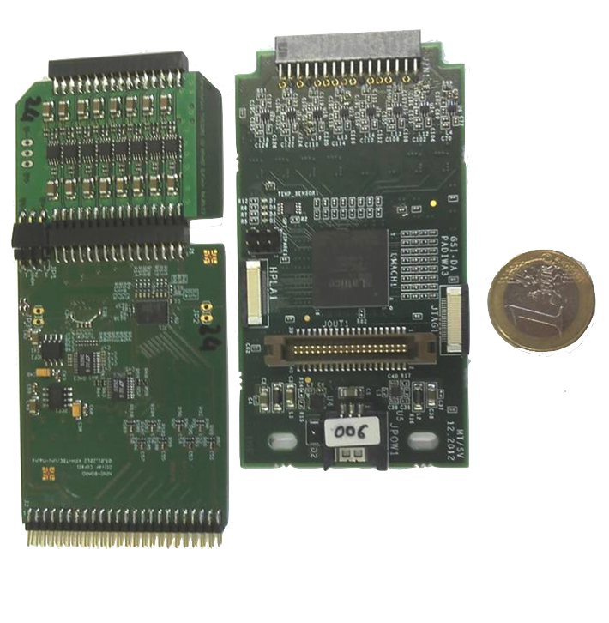
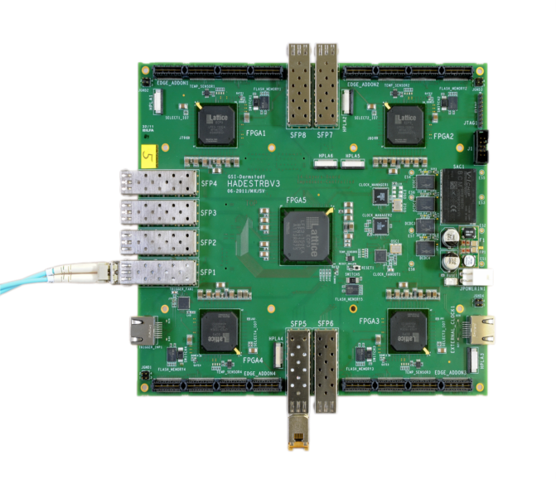
FEE Concept
panda dirc
PAndaDIrcWAsa card
(PADIWA)
FPGA discriminator (reprogrammable)
Developed at GSI
Trigger and Readout Board v3 (TRB3)
MCP PMT
input
LVDS
output
Developed at GSI
4 FPGAs programmed as TDC
10 ps RMS time precision
67 MHz max hit rate
Time over Threshold measurement

Slide 35
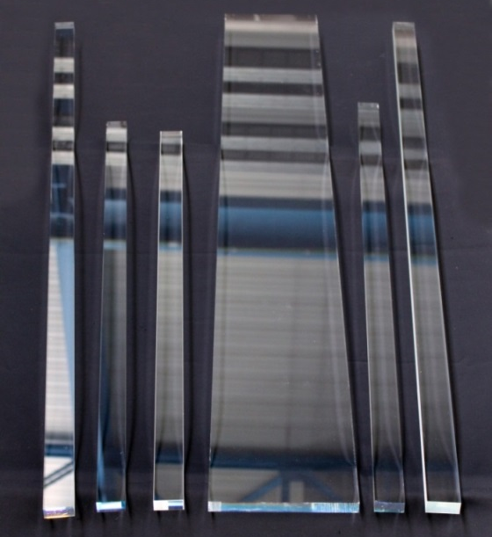

Barrel DIRC Prototype Tests
test beam
Radiators
at GSI & CERN T9 beamline
Modular configurations
Bar or plate with/without lenses
Radiators and lenses
Several bars/plates of different vendors
High-n cylindrical/spherical lenses
Wide range of beam-bar angles and positions
Readout
960 channels with PADIWA3 card and TRBv3 boards
Sensors
Photonis Planacon XP85012
Typical gain 10⁶
Rise time 0.6 ns

Slide 36





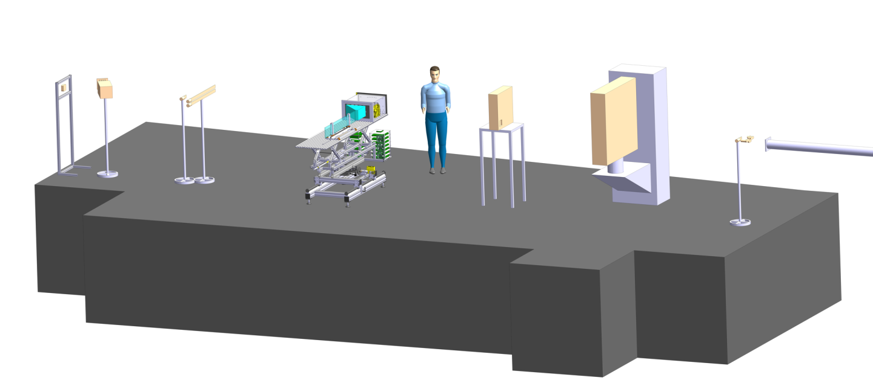
Barrel DIRC Prototype Tests
test beam
CERN T9 beamline
Barrel DIRC
TOF2
TOF1
(20m upstream)
Disc DIRC
FLASH
Trigger2/Veto2
Fiber hodoscope
Trigger1/Veto1

Slide 37
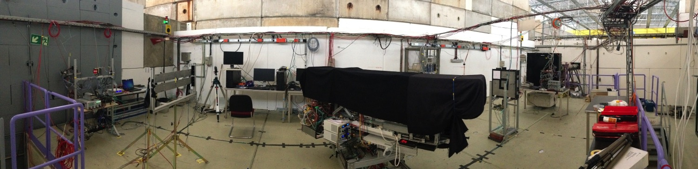
Barrel DIRC Prototype Tests
test beam
CERN T9 beamline

Slide 38
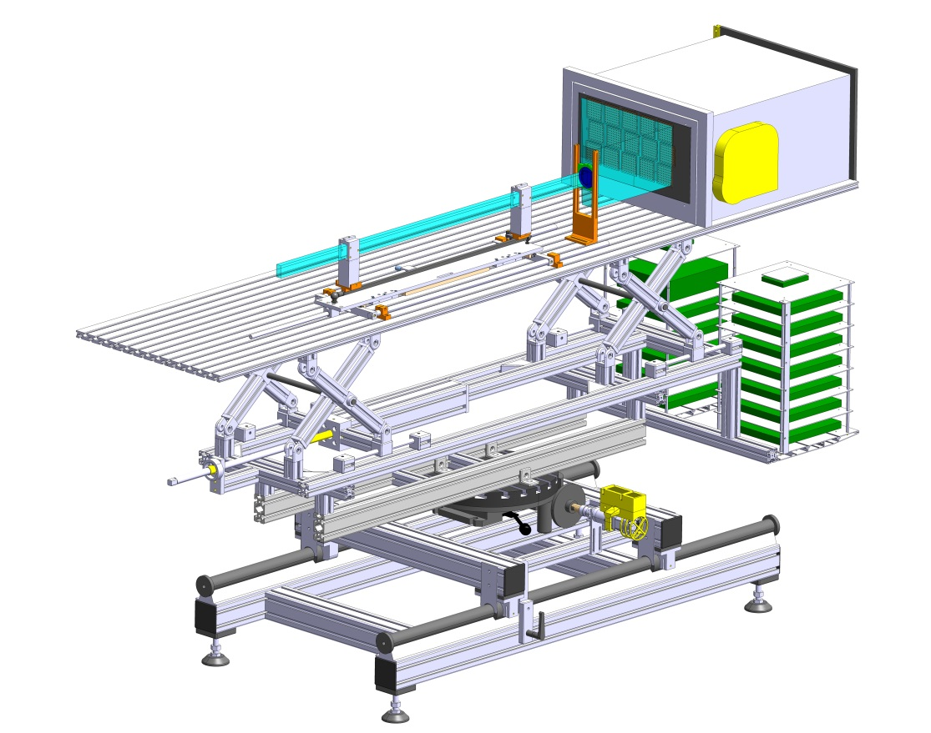
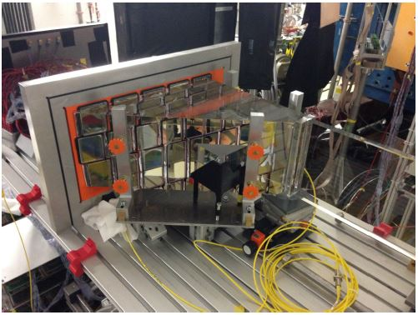
Barrel DIRC Prototype
test beam
Modular configuration
lateral displcament in x and y
change of angle remote controlled

Slide 39
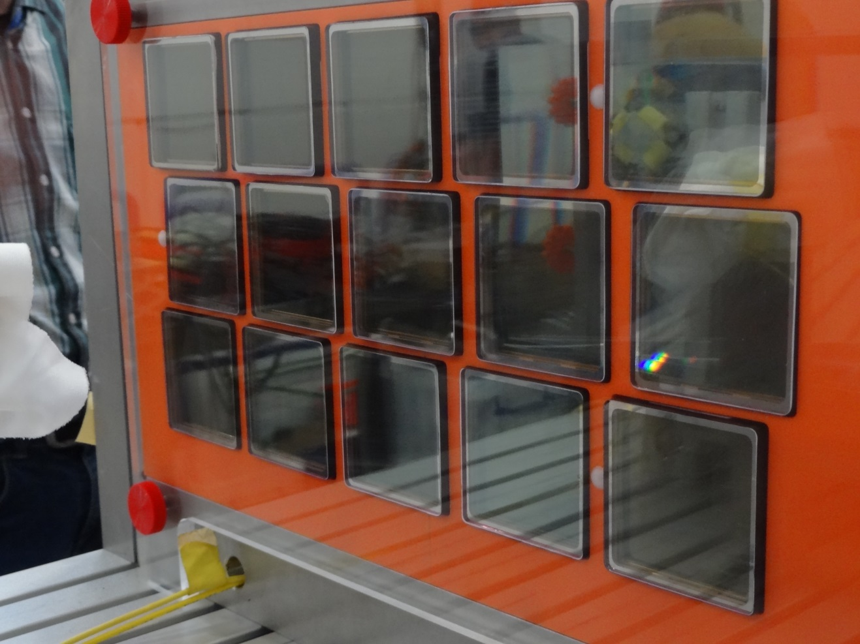
Read out plane
test beam
3 x 5 MCP PMT array (8 x 8 channels each)
Complicated hit patterns (reflections in prism)
8 x 8

Slide 40
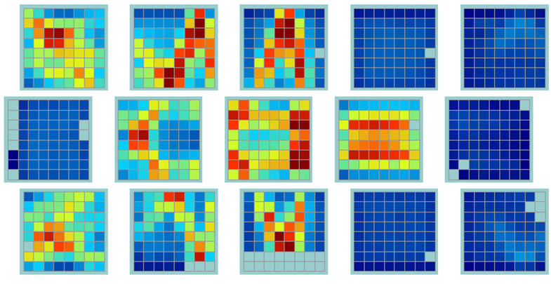
Occupancy plots
test beam
3 x 5 MCP PMT array (8 x 8 channels each)
Complicated hit patterns (reflections in prism)
Data from bar measurent @ 7 GeV/c, focussing

Slide 41
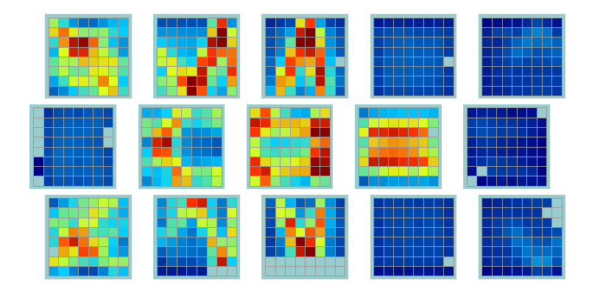
Occupancy plots
test beam
3 x 5 MCP PMT array (8 x 8 channels each)
Complicated hit patterns (reflections in prism)
Data from bar measurement for different angles @ 7 GeV/c, focussing

Slide 42
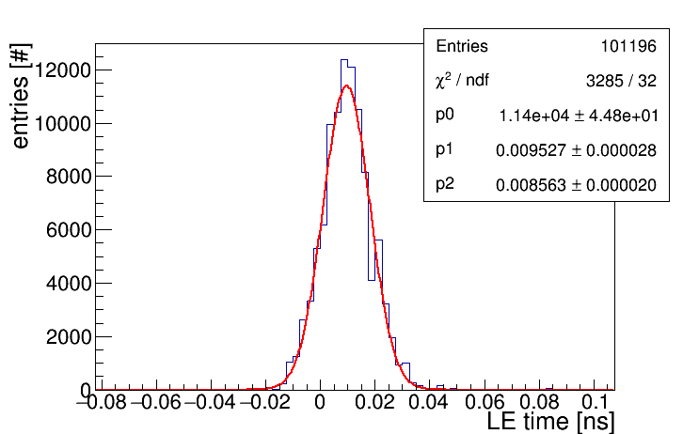
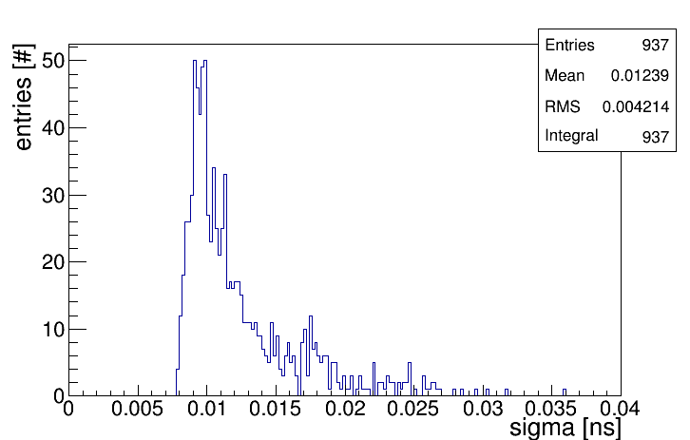
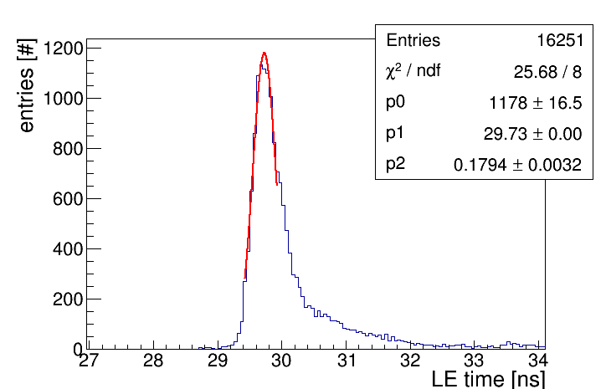
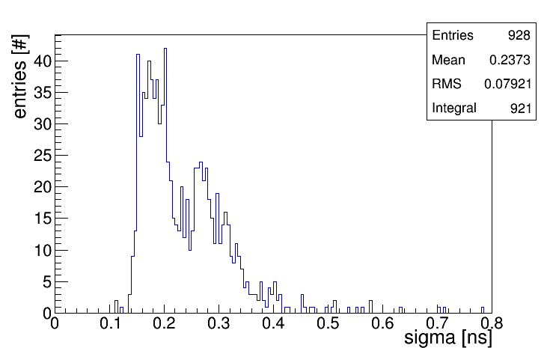
Time Resolution
test beam
Electronics (Calibration)
Picoquant laser (T₀)
8,5ps
all channels
12ps
180ps
all channels
240ps

Slide 43
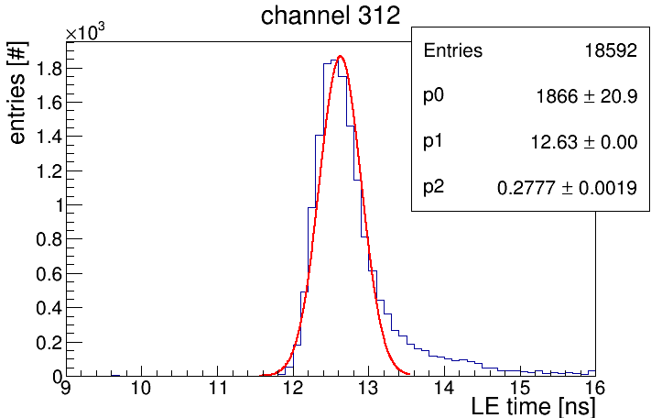

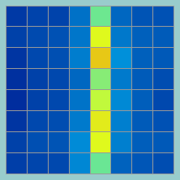
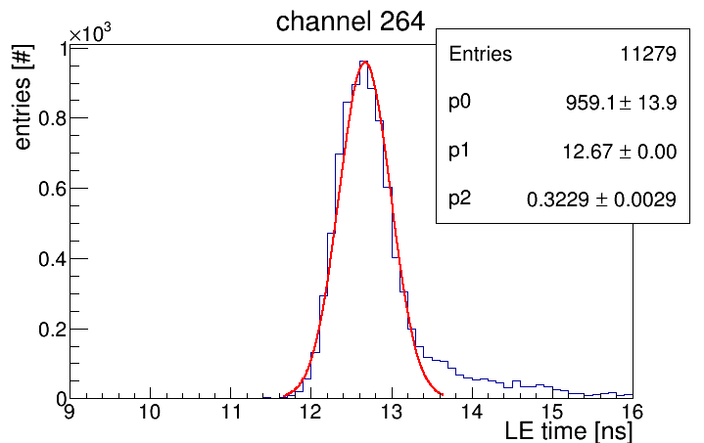
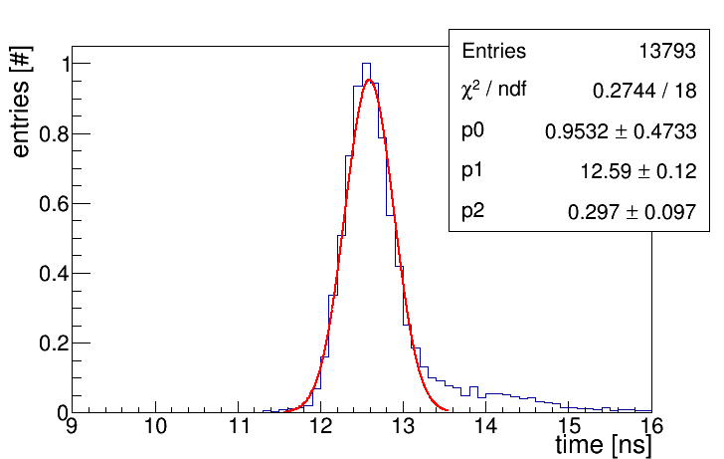

Time Resolution
test beam
Data
278ps
best
worst
$∑$₈
323ps
297ps

Slide 44
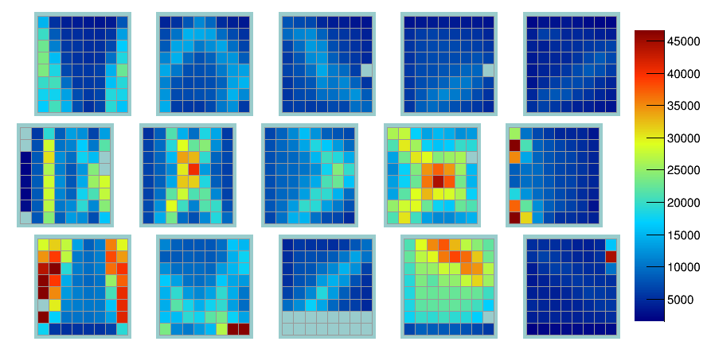
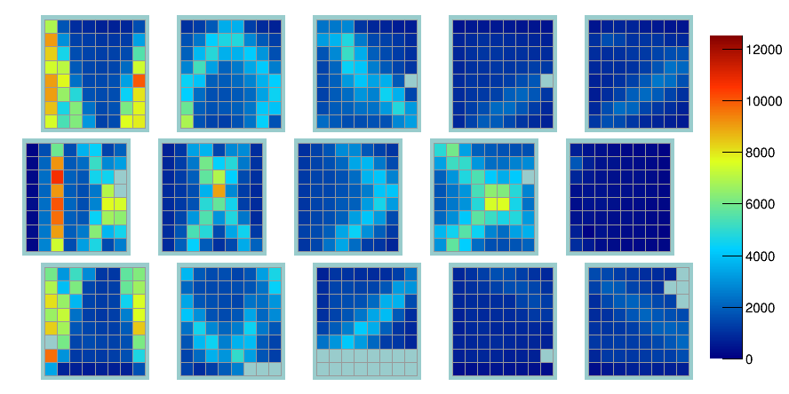
Hit and event selection
test beam
Event selection
Time cut around trigger time
(scintillator in the beam)
Hit: selection
Masking noisy pixel
For each channel timing cut
(time offset calibration
with laser data)
No selection
selection
Hit pattern for 3 component lens @ 7 GeV/c @ 50 degree

Slide 45
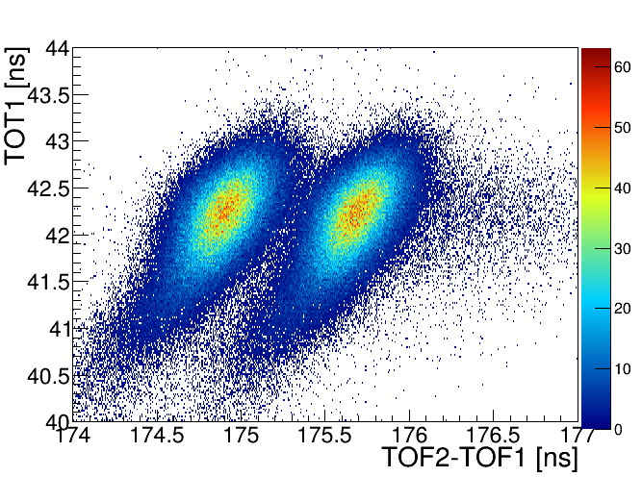

Time of Flight measurement
test beam
Two fast MCP PMT counter
Pion/Proton separation up to 10GeV/c
7GeV/c
ToF2
ToF1
29m

Slide 46



Time of Flight: Walk correction
test beam
7GeV/c
7GeV/c
184ps
142ps
before after

Slide 47


Hit Pattern Pions Protons @ 3 GeV/c
test beam
Pions
Protons
125 degree with 3-component lens

Slide 48


Hit Pattern Pions Protons @ 7GeV/c
test beam
π/K @ 3GeV/c
corresponds to
p/π @ 7GeV/c
Pions
Protons
125 degree with 3-layer lens

Slide 49

Photon Yield
test beam
photon [#]
preliminary
Photon yield for 3-component lens @ 7 GeV/c

Slide 50


Single Photon Angular Resolution
test beam
12mrad
example of
fit @ 60 degree
preliminary
3-component lens @ 7 GeV/c

Slide 51




Occupancy Plate Design
test beam
Data 2 component lens no lens
Simulation 2 component lens no lens
plate @ 55deg @ 7GeV

Slide 52


Probability Density Functions
MC
Simulation
y
π
K
x
PMT map, with 5 x 3 sensors, 64 pixels each

Slide 53

Probability Density Functions
normalized PDF for a specific pixel
MC
Simulation
π
K
p = 3.5 GeV/c
22° polar angle
y
π
K
x
PMT map, with 5 x 3 sensors, 64 pixels each
In 3 dimensions (x, y, t) hit patterns show differences between particle species
Probability density functions (pdf) can be generated with ~100k Monte Carlo tracks with same parameters and saved in histograms.
Inspired by Belle II TOP

Slide 54

Probability Density Functions
normalized PDF for a specific pixel
MC
Simulation
π
K
p = 3.5 GeV/c
22° polar angle
y
π
K
x
PMT map, with 5 x 3 sensors, 64 pixels each
In 3 dimensions (x, y, t) hit patterns show differences between particle species
π sample
K sample
Probability density functions (pdf) can be generated with ~100k Monte Carlo tracks with same parameters and saved in histograms.
Inspired by Belle II TOP
Likelihood ratio test lnL_{K}-lnL_{P}

Slide 55

Reconstruction with Probability Density Functions
In simulation this method
works over the full
phase space

Slide 56

Plate: Time distribution of a single pixel
Leading edge time for pions (light particles) and protons
DATA measured without lens @ 7GeV/c @ 55 degree

Slide 57
Sumary and Outlook
Sumary
  Baseline design of the Barrel DIRC with narrow bars and high-refractive lens index
  meets PANDA PID goals.
  Cost optimization identified two design alternatives (wide plate, solid fused silica prism)
  Prototype tests show promising results
      Number of observed photons
      Single photon angular resolution
  Plate still needs reconstruction
Outlook
  Early 2016: Decision about technology (plate vs. bar / prism vs. oil tank).
  Summer 2016: TDR
  Summer 2017 component construction
  2020 ready for beam

Slide 58
PANDA Cherenkov Group
GSI Darmstadt, JINR Dubna, Goethe University Frankfurt, University of Erlangen-Nuremberg, JLU Giessen, University of Glasgow, HIM Mainz, JGU Mainz, Novosibirsk, SMI Vienna
THANK
YOU

Slide 59
Back Up

Slide 60


Ionization and acceleration
of residual gas atoms
panda dirc
Ionbackflow causes rapid aging of photo cathode
  MCP PMTs would not survive more
  than 3 month of PANDA
ALD
Different countermeasures of manufacturors
  Al₂O₃ film to stop backflow of ions
  Improvement of vacuum
  Ultra-thin Atomic Layer Deposition

Slide 61
T9 2015 TESTBEAM DATA
Run 1 – May 2015
Barrel DIRC Prototype
Many different configurations tested, most of them
with detailed angle and/or momentum scans.

Slide 62

Cherenkov Angle Resolution
concept

