Slide 1
Neutrinoless double beta decay searches: gearing up for the tonne-scale era
Lior Arazi
Ben-Gurion University, Israel
INSTR20 conference
Budker Institute of Nuclear Physics and Novosibirsk State University,
Novosibirsk, Russia 24 - 28 February, 2020

Slide 2
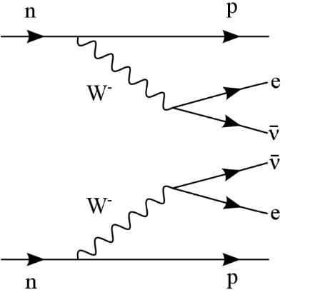
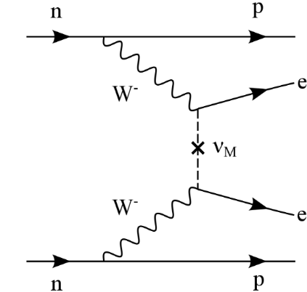

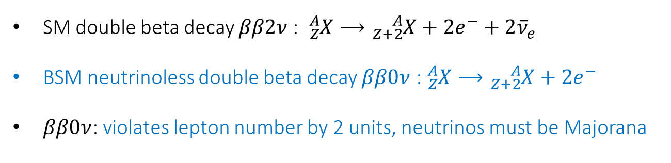



Neutrinoless double beta decay
SM double beta decay $ββ2ν$: ${}_{Z}^{A}{X⟶}{}_{Z+2}^{A}{X+2}e^{−}+2{\overline{ν}}_{e}$
BSM neutrinoless double beta decay $ββ0ν$ : ${}_{Z}^{A}{X⟶}{}_{Z+2}^{A}{X+2}e^{−}$
$ββ0ν$: violates lepton number by 2 units, neutrinos must be Majorana
$$ββ2ν$$
$$ββ0ν$$
Observed, $ΔL=0$, $T_{1/2}\sim {10}^{19}−{10}^{21} y$
Unobserved, $ΔL=2$, $T_{1/2}>{10}^{26} y$

Slide 3

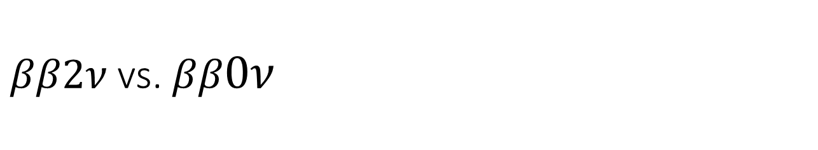


$ββ2ν$ vs. $ββ0ν$
counts
$$ββ2ν$$
Q-value shared among 4 particles
$$ββ0ν$$
Q-value shared among 2 e⁻
Total electron kinetic energy
$$Q_{ββ}$$
$ββ0ν$ can only occur in nuclei with $ββ2ν$, with $<{10}^{−5}$ relative rate

Slide 4
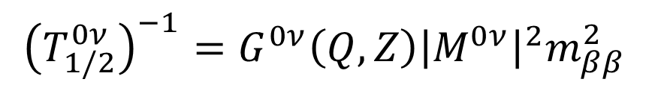
The Majorana neutrino challenge
$${\left(T_{1/2}^{0ν}\right)}^{−1}=G^{0ν}\left(Q,Z\right){\left|M^{0ν}\right|}^{2}m_{ββ}^{2}$$
Lifetime ~10²⁷-10²⁸ years. 1 signal event in a tonne of active volume per year
15 meV
Lifetime ~10³⁰ years. 1 signal event in 100 tonne of active volume per year

Slide 5
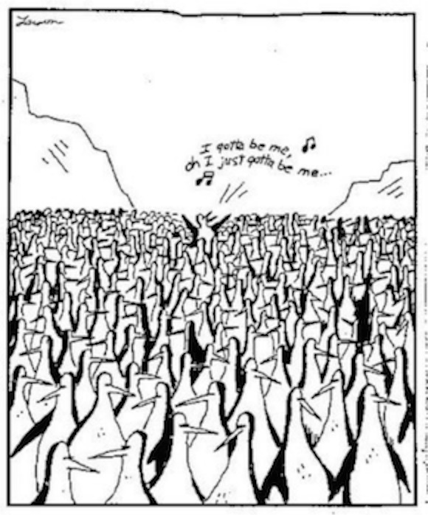

Backgrounds
Natural radioactivity
$ββ2ν$ leakage into the ROI
Cosmogenic activation
Neutrinos
Background suppression requires excellent energy resolution + additional handles

Slide 6
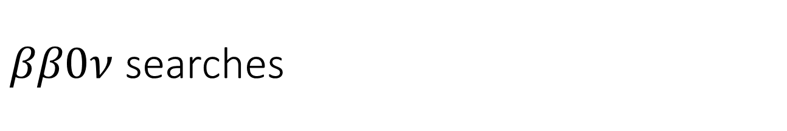
$ββ0ν$ searches
Germanium detectors
Bolometers
Loaded liquid scintillators
Liquid xenon TPCs
High-pressure gaseous xenon TPCs
(Others)
All experiments give “forward-looking” MC-based predictions about their tonne-scale expected performance

Slide 7
Germanium detectors
Majorana, GERDA, LEGEND

Slide 8
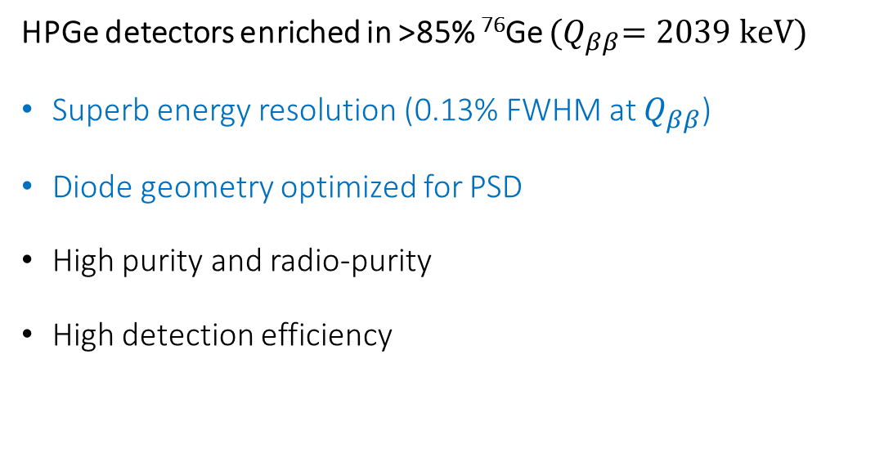

Ge diodes for $ββ0ν$ in ⁷⁶Ge
HPGe detectors enriched in >85% ⁷⁶Ge ${(Q}_{ββ}=2039 keV)$
Superb energy resolution (0.13% FWHM at $Q_{ββ}$)
Diode geometry optimized for PSD
High purity and radio-purity
High detection efficiency

Slide 9
Background suppression
Event topology + anti-coincidence between HPGe detectors + pulse shape discrimination + liquid argon veto
Detector
anti-coincidence
Pulse shape discrimination
Detector-LAr anti coincidence
Event topology
Differentiate point-like ββ topology from:
multi-detector interactions
multi-site / surface interactions
interactions with coincident energy deposition in LAr

Slide 10
Existing and future Ge experiments
+
Continues taking data

Slide 11
GERDA
Bare crystals

Slide 12
GERDA
LAr used for shielding, cooling + veto

Slide 13
GERDA

Slide 14

GERDA results
$$T_{1/2}^{0ν}>0.9×{ 10}^{26} y (90\% C.L.)$$
Background index = $5.6×{ 10}^{−4}$ counts/(keV kg y) at $Q_{ββ}$ - practically background free!
Science 365 (2019) 1445

Slide 15
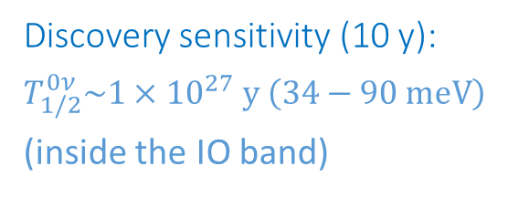
LEGEND-200
200 kg HPGe in existing (upgraded) infrastructure at LNGS
Ge detectors from Majorana and GERDA + new inverted coaxial detectors (larger mass)
Background reduction: factor 5 compared to GERDA (reduce ⁴²K, ²¹⁴Bi, ²⁰⁸Tl)
Discovery sensitivity (10 y):
$$T_{1/2}^{0ν}\sim {1×10}^{27} y \left(34−90 meV\right)$$
(inside the IO band)
arXiv:1709.01980

Slide 16
LEGEND-1t
Discovery sensitivity (10 y):$T_{1/2}^{0ν}\sim {1×10}^{28} y \left(11−28 meV\right)$- cover IO band
4 LEGEND-200 payloads
LEGEND-1t baseline design
challenging

Slide 17
Bolometers
CUORE, CUPID, AMoRE

Slide 18
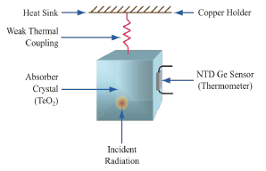
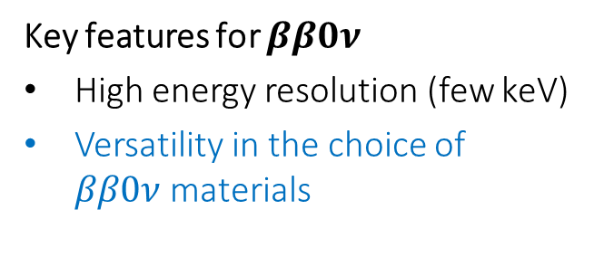
What is a bolometer?
absorber + thermometer @ 10-20 mK
Detects particle energy in the form of heat
Key features for $ββ0ν$
High energy resolution (few keV)
Versatility in the choice of $ββ0ν$materials

Slide 19
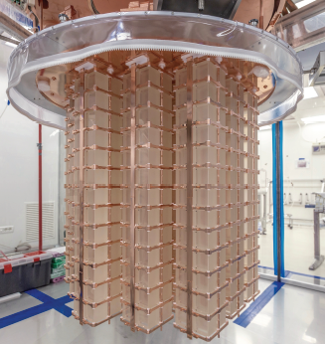
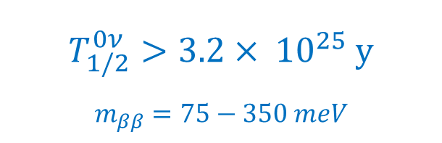
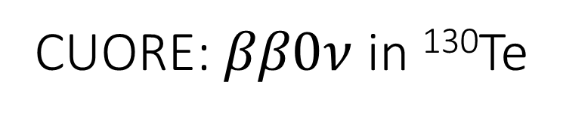
CUORE: $ββ0ν$ in ¹³⁰Te
988 ^{nat}TeO₂ (34% ¹³⁰Te) crystals @ 10-15 mK @ LNGS
“The coldest cubic meter in the universe”
⁶⁰Co
Sum peak
$$T_{1/2}^{0ν}>3.2×{ 10}^{25} y$$
$$m_{ββ}=75−350 meV$$
ΔE/E~8.7 keV FWHM (0.34%)
arXiv:1912.10966

Slide 20
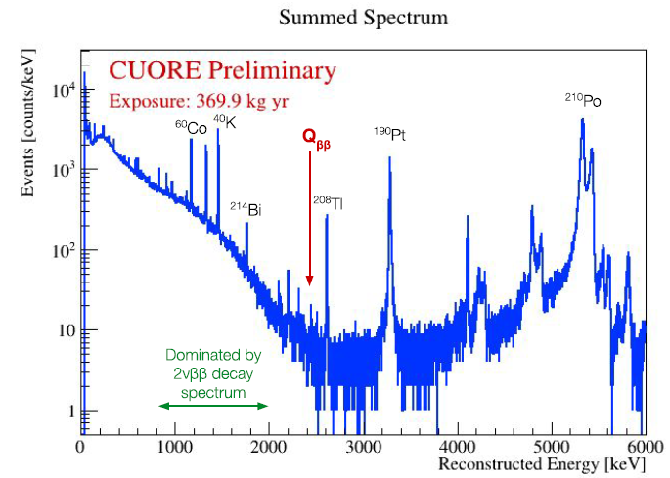
CUORE
Background dominated by α particles, 1.38 × 10⁻² c/(keV∙kg∙yr)
External γ background 10⁻³ c/(keV∙kg∙yr)

Slide 21
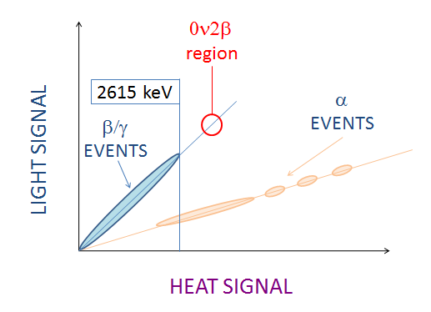
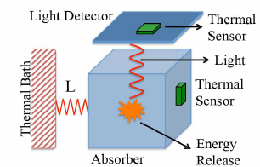
Reduction of α background: scintillating bolometers
Same as a bolometer + detector for scintillation
Particle ID by light/heat ratio → rejection of α particles

Slide 22
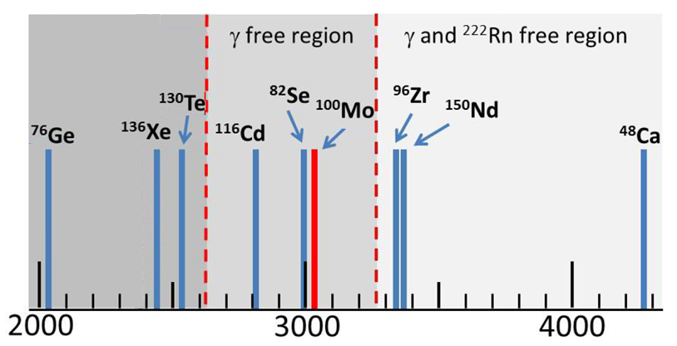
Reduction of γ background: isotopes with large $Q_{ββ}$
End point of ²³²Th γ radioactivity 2615 keV
End point of ²³⁸U β radioactivity 3270 keV
Isotope | abundance
¹¹⁶Cd | 7.5%
⁸²Se | 9.2%
¹⁰⁰Mo | 9.6%
⁹⁶Zr | 2.8%
¹⁵⁰Nd | 5.6%
⁴⁸Ca | 0.19%
E [keV]
Expensive enrichment
Preferred

Slide 23
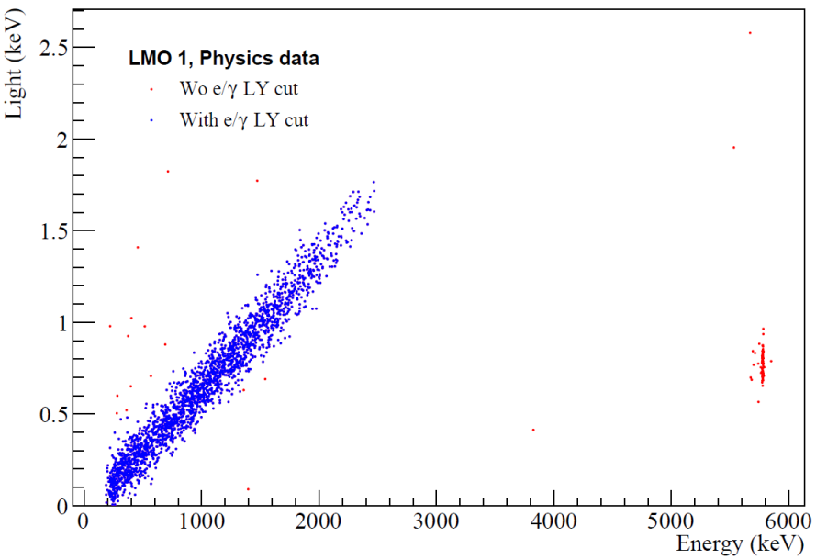


CUPID: CUORE Upgrade with Particle IDentification
Scintillating bolometers with ¹⁰⁰Mo, $Q_{ββ}=3034 keV$
Crystals: Li₂¹⁰⁰MoO₄
Sensors (baseline): neutron-transmutation-doped (NTD) germanium thermistors, for both heat and light
Current status: CUPID-Mo, 20 crystal demonstrator taking data (LSM, France)
Preliminary
$$Q_{ββ}$$
β /γ
α ²¹⁰Po
ΔE=5 keV FWHM, high radiopurity
α/γ(β) separation ~15σ
arXiv:1907.09376

Slide 24
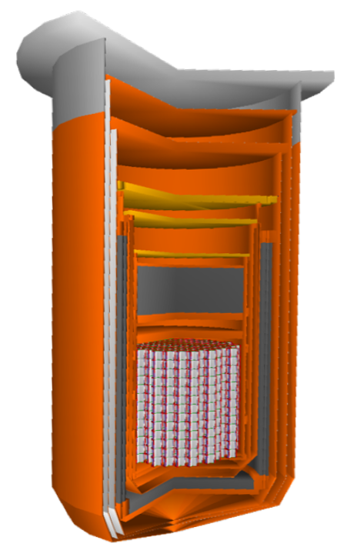
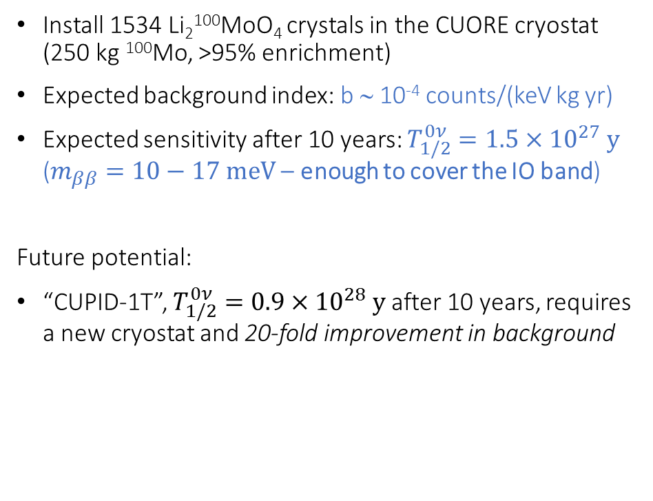
CUPID: proposed plan
Install 1534 Li₂¹⁰⁰MoO₄ crystals in the CUORE cryostat (250 kg ¹⁰⁰Mo, >95% enrichment)
Expected background index: b ∼ 10⁻⁴ counts/(keV kg yr)
Expected sensitivity after 10 years: $T_{1/2}^{0ν}=1.5×{10}^{27} y$ ($m_{ββ}=10−17 meV$– enough to cover the IO band)
Future potential:
“CUPID-1T”, $T_{1/2}^{0ν}=0.9×{10}^{28} y$after 10 years, requires a new cryostat and 20-fold improvement in background
arXiv:1907.09376

Slide 25
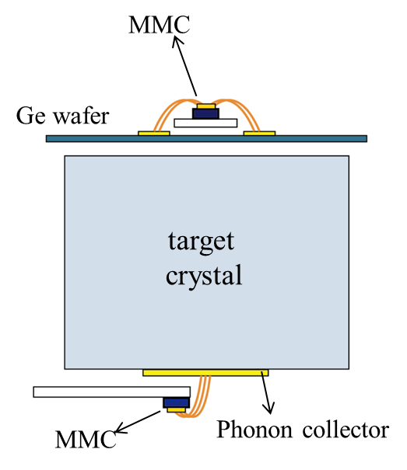
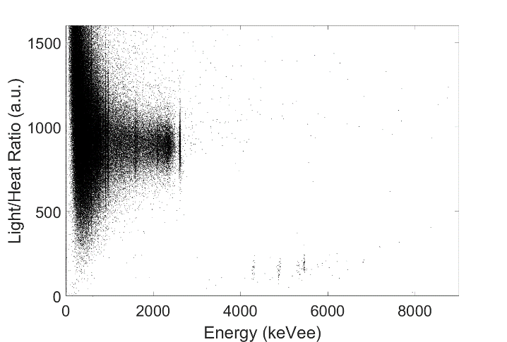
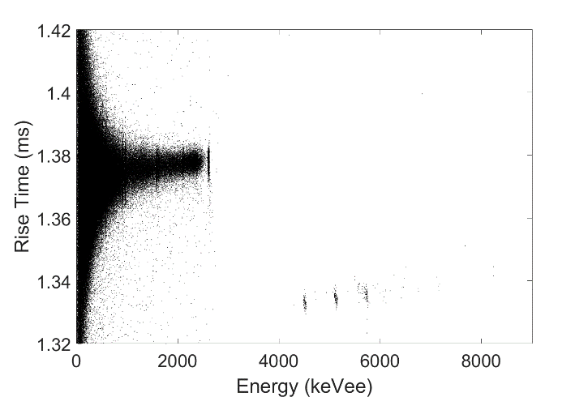
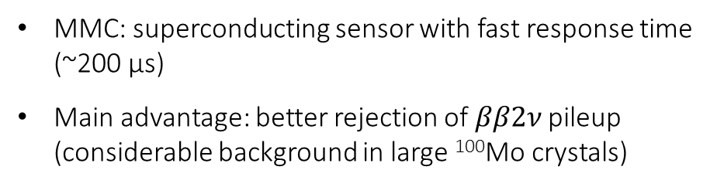
AMoRE: Advanced Mo-based Rare process Experiment
⁴⁰Ca¹⁰⁰MoO₄ (X¹⁰⁰MoO₄) + Metallic Magnetic Calorimeters (MMC)
MMC: superconducting sensor with fast response time (~200 µs)
Main advantage: better rejection of $ββ2ν$ pileup (considerable background in large ¹⁰⁰Mo crystals)
~10keV FWHM
β/γ
L/H ratio
PSD
Fast rise-time
β/γ
α
α

Slide 26
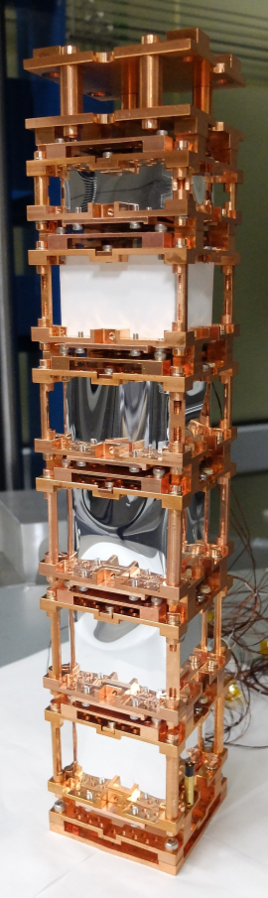
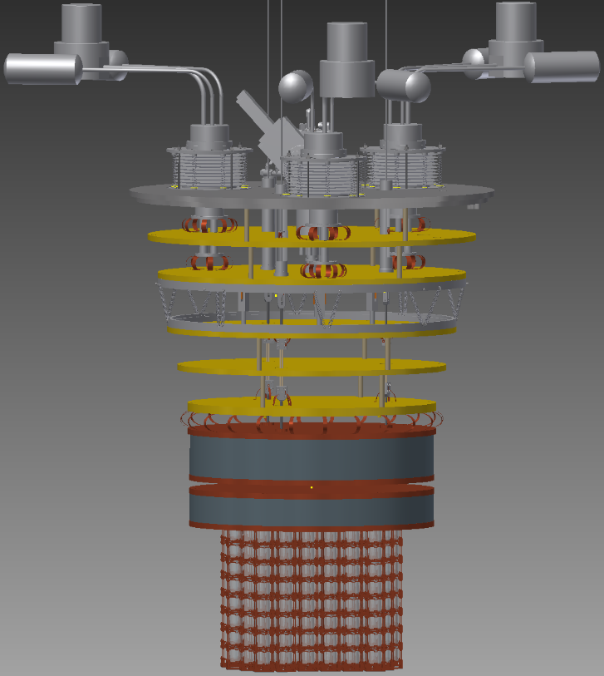
AMoRE-Pilot
AMoRE-I
AMoRE-II
MMC proof of principle
~1.5x10⁻³ ckky T_{1/2}: 10²⁵ y
~10⁻⁴ ckky
T_{1/2}: 5x10²⁶ y, m_{ββ}: 17-29 meV
Completed
2020
Phased 2022-2024, fully funded
Six ^{48dep}Ca¹⁰⁰MoO₄ crystals, ~1 kg ¹⁰⁰Mo
13 ^{48dep}Ca¹⁰⁰MoO₄ crystals + 5 Li₂¹⁰⁰MoO₄, ~3 kg ¹⁰⁰Mo
Favored Li₂¹⁰⁰MoO₄, ~100 kg ¹⁰⁰Mo
Y2L, Korea
Yemilab (new), Korea
EPJC 79 (2019) 791

Slide 27
Loaded liquid scintillators
KamLAND-Zen, SNO+

Slide 28
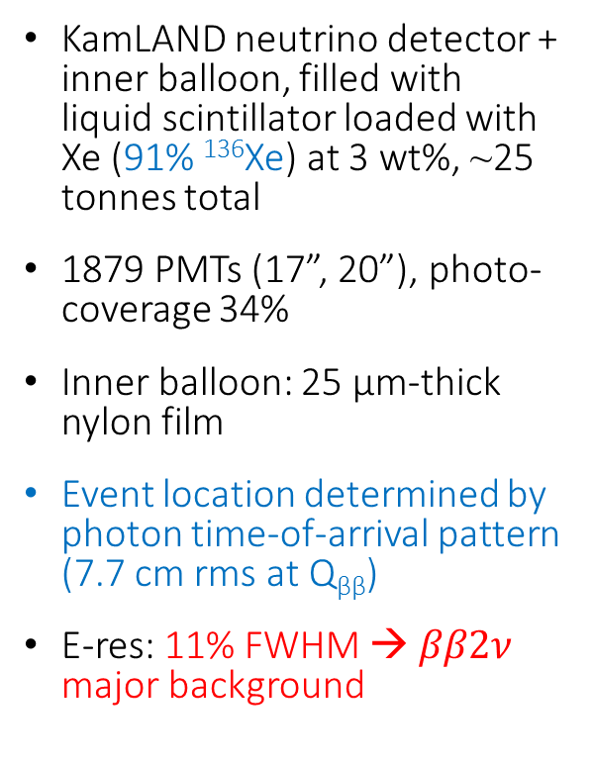

KamLAND-Zen: $ββ0ν$ in ¹³⁶Xe
KamLAND neutrino detector + inner balloon, filled with liquid scintillator loaded with Xe (91% ¹³⁶Xe) at 3 wt%, ~25 tonnes total
1879 PMTs (17”, 20”), photo-coverage 34%
Inner balloon: 25 µm-thick nylon film
Event location determined by photon time-of-arrival pattern (7.7 cm rms at Q_{ββ})
E-res: 11% FWHM → $ββ2ν$ major background

Slide 29
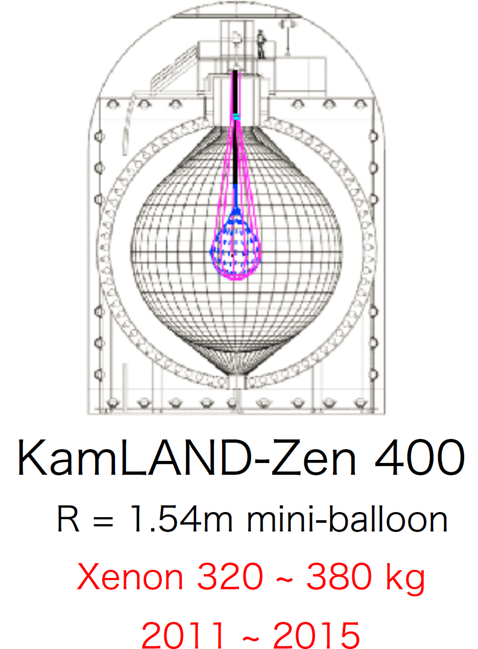
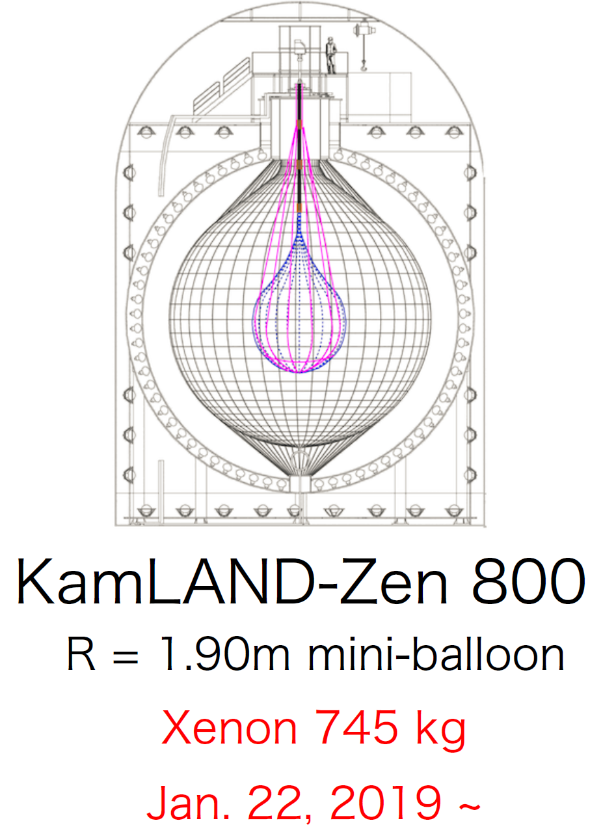
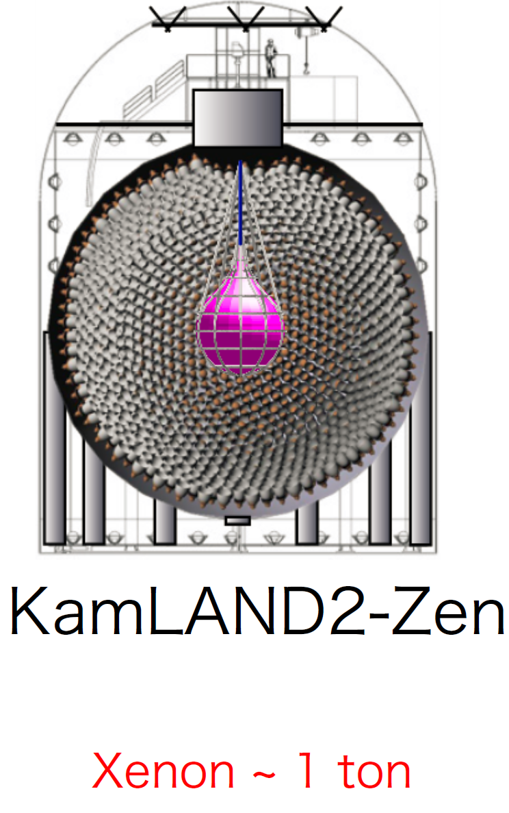



KamLAND-Zen series
PAST
ONGOING
FUTURE
Published (90% C.L.):
Expected sensitivity 5y:
Expected sensitivity 5y:
$$T_{1/2}^{0ν}>1.07×{ 10}^{26} y$$
$$T_{1/2}^{0ν}=5×{ 10}^{26} y$$
$$T_{1/2}^{0ν}=2×{ 10}^{27} y$$
PRL 117, 082503 (2016)

Slide 30
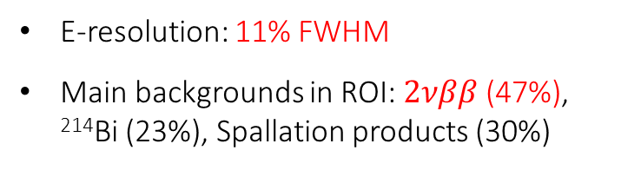
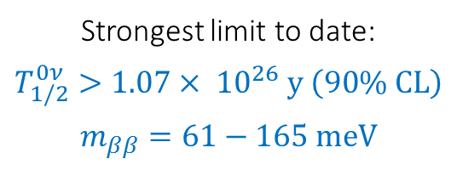
KamLAND-Zen series
E-resolution: 11% FWHM
Main backgrounds in ROI: $2νββ$ (47%), ²¹⁴Bi (23%), Spallation products (30%)
Strongest limit to date:
$$T_{1/2}^{0ν}>1.07×{ 10}^{26} y \left(90\% CL\right)$$
$$m_{ββ}=61−165 meV$$
PRL 117, 082503 (2016)

Slide 31
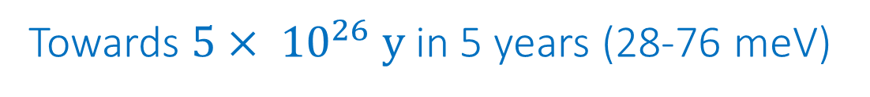
KamLAND-Zen 800 first results (132.7 live days)
²³⁸U and ²³²Th background reduction by factor ~10
Towards $5×{ 10}^{26} y$ in 5 years (28-76 meV)
TAUP 2019

Slide 32
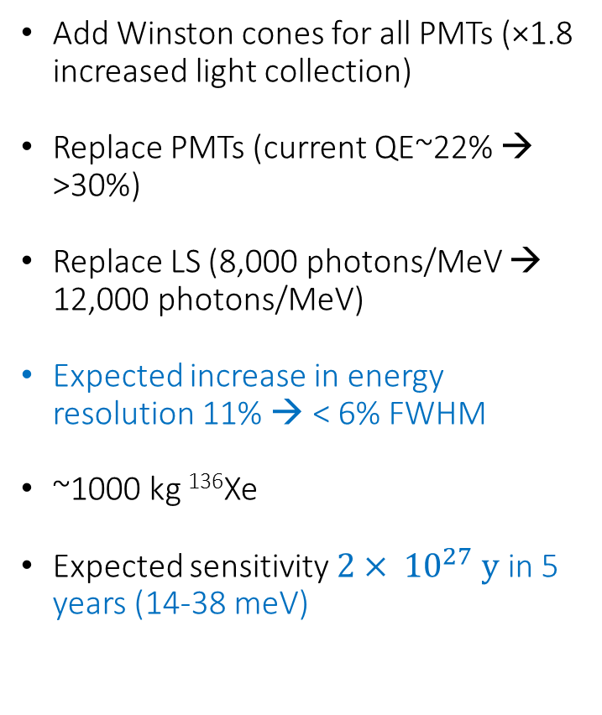
KamLAND2-Zen (future)
Add Winston cones for all PMTs (×1.8 increased light collection)
Replace PMTs (current QE~22% → >30%)
Replace LS (8,000 photons/MeV → 12,000 photons/MeV)
Expected increase in energy resolution 11% → < 6% FWHM
~1000 kg ¹³⁶Xe
Expected sensitivity $2×{ 10}^{27} y$ in 5 years (14-38 meV)
ICISE Vietnam 2019

Slide 33
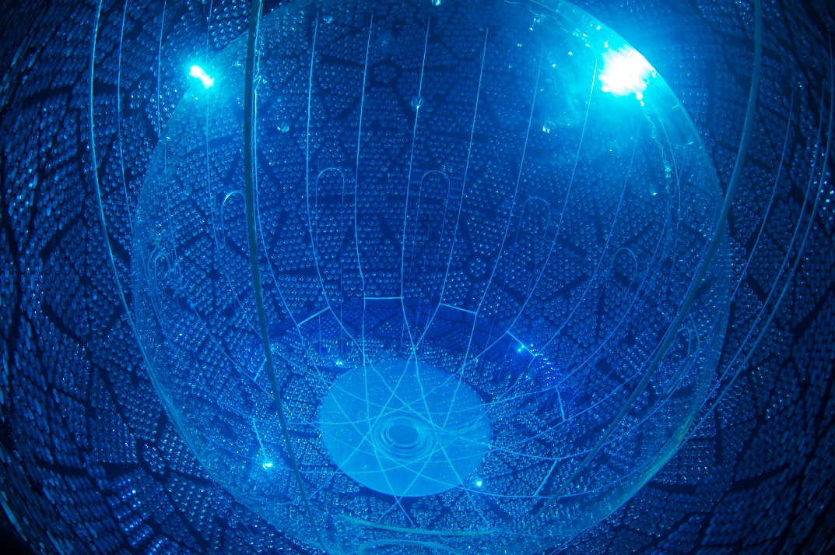
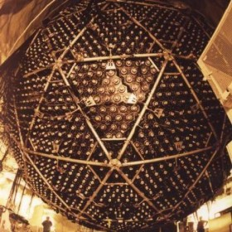

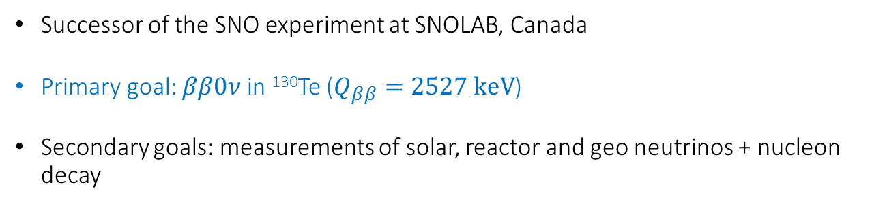
SNO+: $ββ0ν$ in ¹³⁰Te
Successor of the SNO experiment at SNOLAB, Canada
Primary goal: $ββ0ν$ in ¹³⁰Te ($Q_{ββ}=2527 keV$)
Secondary goals: measurements of solar, reactor and geo neutrinos + nucleon decay
Most photogenic detector in the field

Slide 34
Electronics and DAQ
~2 km depth, ~6 km.w.e.,
~3 muons/hour
~780 t of LABPPO scintillator + ~4 t of natural tellurium (34% ¹³⁰Te)
Holding ropes
Acrylic vessel
6 m radius, 10 cm thick
~9300 PMTs, 53% optical coverage, on St.St. support
Inner water shield (~1700 t)
Outer shield: cavity in rock ~5400 t ultrapure water

Slide 36
SNO+ expected performance
Expected energy resolution with 0.5% Te: 7.5% FWHM (188 keV)
Expected energy distribution
with nominal backgrounds
arXiv:1809.05986

Slide 37
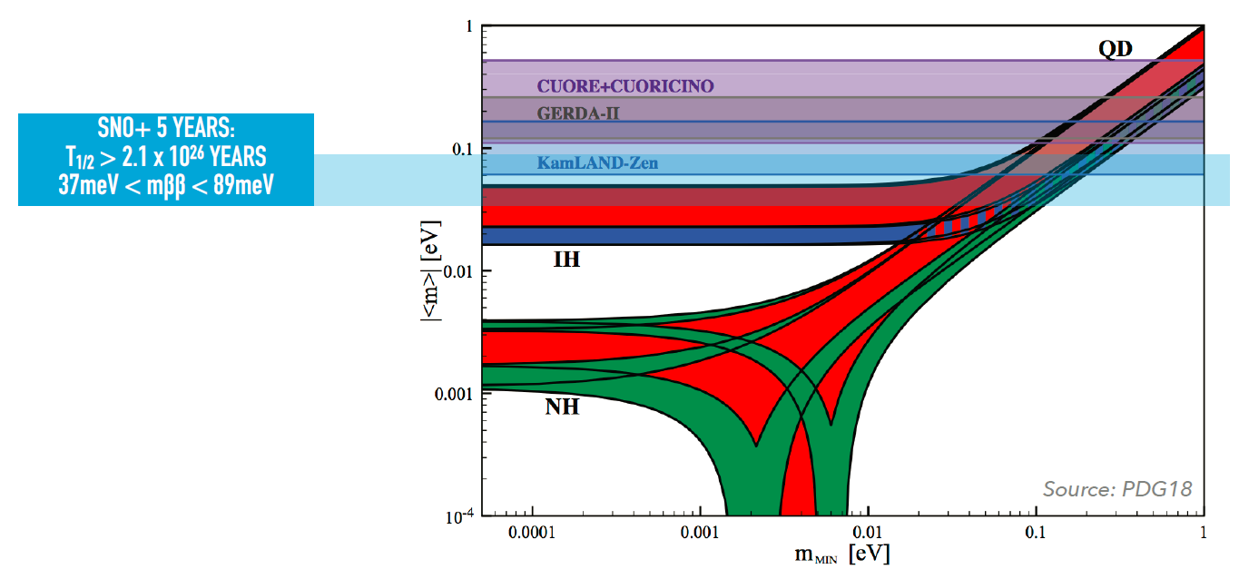
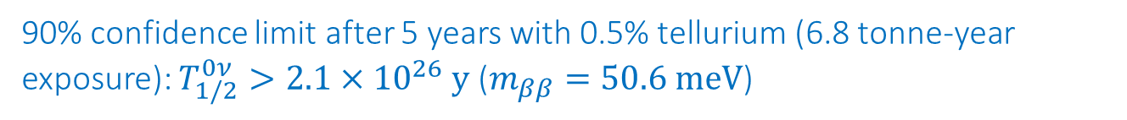
SNO+ expected sensitivity
90% confidence limit after 5 years with 0.5% tellurium (6.8 tonne-year exposure): $T_{1/2}^{0ν}>2.1×{10}^{26} y$ ($m_{ββ}=50.6 meV$)

Slide 38
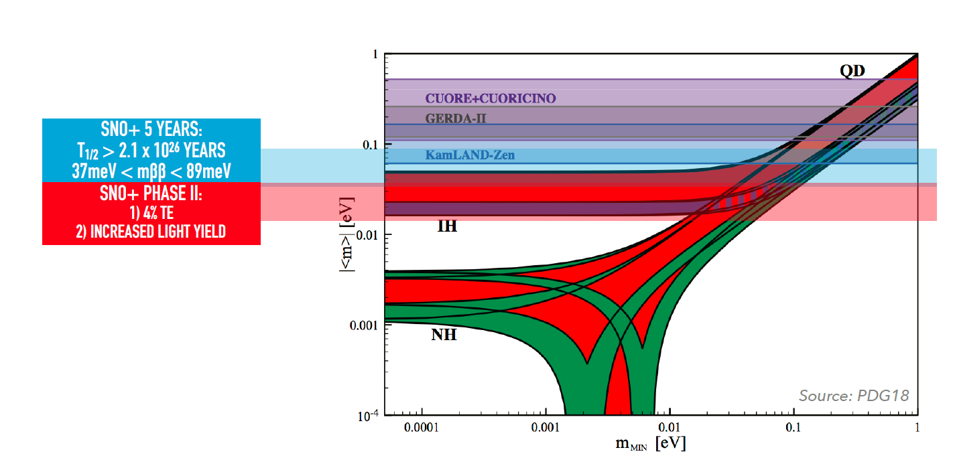
SNO+ future sensitivity
Phase II (4% Te + increased light yield):

Slide 39
Liquid xenon TPCs
nEXO (EXO-200), DARWIN

Slide 40
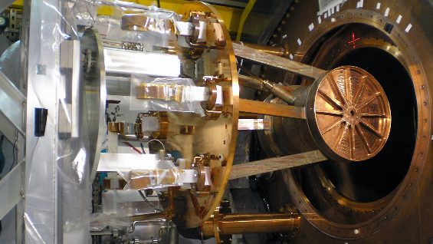
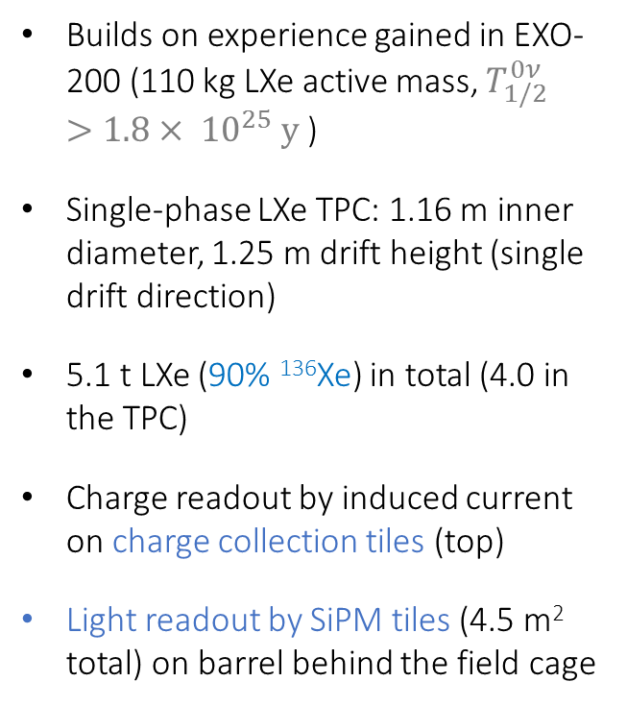

nEXO: LXe TPC for $ββ0ν$ in ¹³⁶Xe
Builds on experience gained in EXO-200 (110 kg LXe active mass, $T_{1/2}^{0ν}>1.8×{ 10}^{25} y$)
Single-phase LXe TPC: 1.16 m inner diameter, 1.25 m drift height (single drift direction)
5.1 t LXe (90% ¹³⁶Xe) in total (4.0 in the TPC)
Charge readout by induced current on charge collection tiles (top)
Light readout by SiPM tiles (4.5 m² total) on barrel behind the field cage
EXO-200 mounted in cryostat
e⁻ drift direction
arXiv:1710.05075, 1805.11142

Slide 41
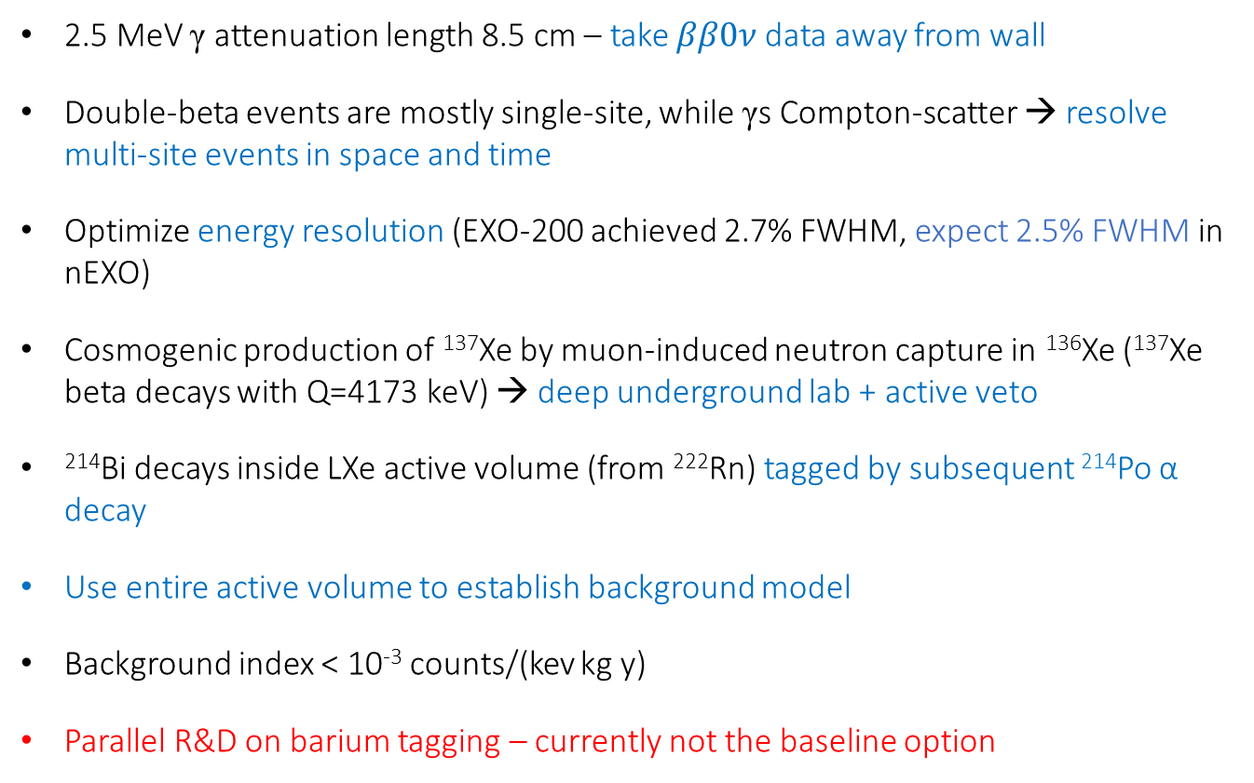
nEXO – background suppression
2.5 MeV γ attenuation length 8.5 cm – take $ββ0ν$ data away from wall
Double-beta events are mostly single-site, while γs Compton-scatter → resolve multi-site events in space and time
Optimize energy resolution (EXO-200 achieved 2.7% FWHM, expect 2.5% FWHM in nEXO)
Cosmogenic production of ¹³⁷Xe by muon-induced neutron capture in ¹³⁶Xe (¹³⁷Xe beta decays with Q=4173 keV) → deep underground lab + active veto
²¹⁴Bi decays inside LXe active volume (from ²²²Rn) tagged by subsequent ²¹⁴Po α decay
Use entire active volume to establish background model
Background index < 10⁻³ counts/(kev kg y)
Parallel R&D on barium tagging – currently not the baseline option

Slide 42
nEXO – expected sensitivity
Similar half-life sensitivity as LEGEND-1000, but better mass sensitivity because of Xe’s larger phase space factor

Slide 43
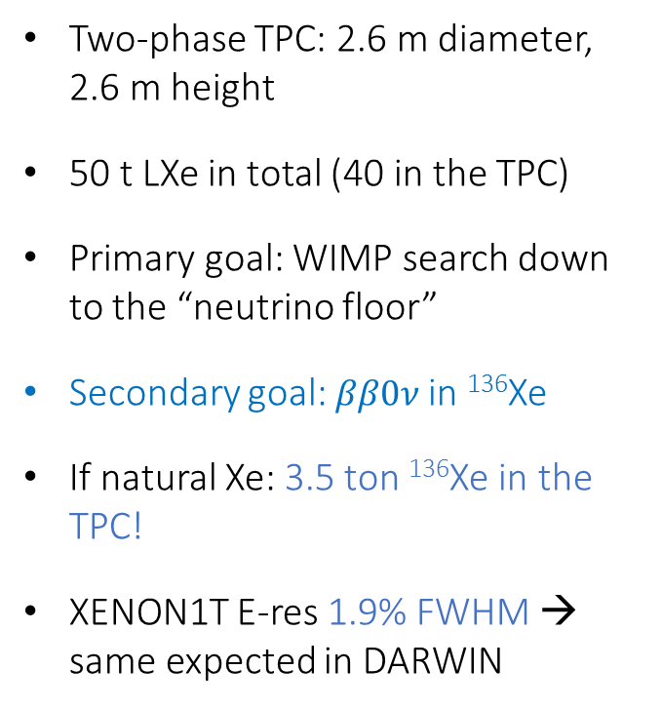
DARWIN
Two-phase TPC: 2.6 m diameter, 2.6 m height
50 t LXe in total (40 in the TPC)
Primary goal: WIMP search down to the “neutrino floor”
Secondary goal: $ββ0ν$ in ¹³⁶Xe
If natural Xe: 3.5 ton ¹³⁶Xe in the TPC!
XENON1T E-res 1.9% FWHM → same expected in DARWIN

Slide 44
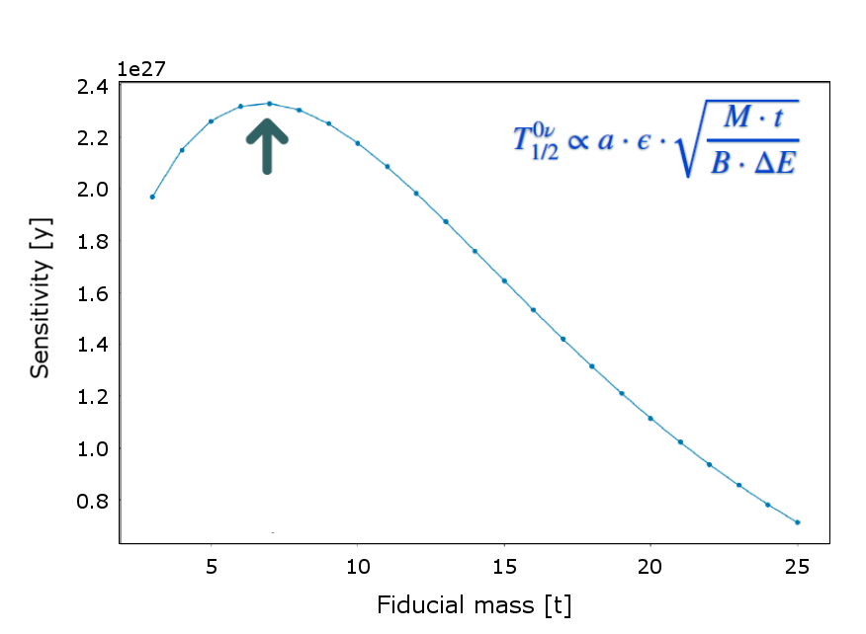
DARWIN: expected background and sensitivity
Sensitivity sweep through different fiducial masses
preliminary
Discovery sensitivity (10 y): $T_{1/2}^{0ν}\sim {2.3×10}^{27} y \left(13−36 meV\right)$- cover IO band
(Significant improvement possible in deeper site than LNGS and enhanced radiopurity)
TAUP 2019

Slide 45
High-pressure gaseous xenon TPCs
NEXT, PandaX-III, AXEL

Slide 46
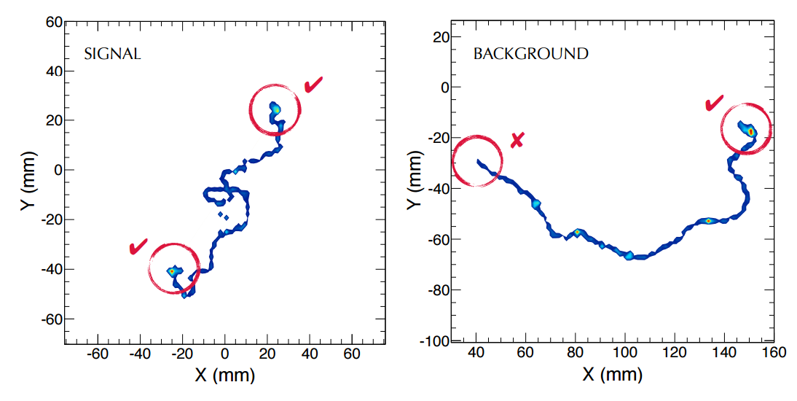
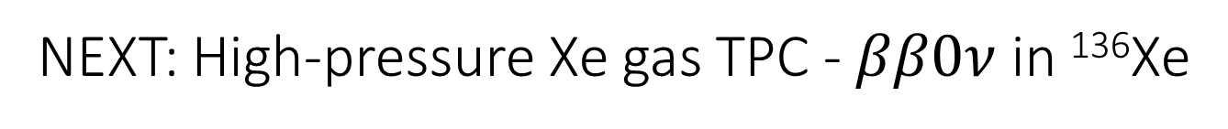
NEXT: High-pressure Xe gas TPC - $ββ0ν$ in ¹³⁶Xe
Working in high-pressure (10-15 bar) gas rather than liquid allows:
Excellent energy resolution by proportional electroluminescence (demonstrated 1% FWHM at Q_{ββ} , aim at 0.5%)
1.1% FWHM at 1.6 MeV
→ 1.0% FWHM at Q_{ββ}
Reconstruction of track topology to discriminate between background and signal
2 blobs
1 blob

Slide 47




NEXT: Mode of operation
-30kV
-8kV
S1 (PMTs) gives $t_{0}$
G
S2 magnitude by proportional EL (PMTs) gives the event energy
EL (S2)
S2 time-slice images (SiPMs) give the event topology
e⁻
Primary scintillation (S1)
$$E_{drift}\sim 0.4 kV/cm$$
$$E_{EL}\sim 13 kV/cm$$

Slide 48
NEXT-White (now)
TPC inner diameter 45 cm, drift length 53 cm, 5 kg fiducial mass at 15 bar
Running with enriched Xe since Feb 2019

Slide 49

NEXT-White: $ββ2ν$ events in data

Slide 50


NEXT-White: $ββ2ν$ events in data
XY
XZ
YZ
Sensor response
Deconvolution
2.19 MeV

Slide 51

NEXT-100 (assembly in 2020)
Main goal: technology demonstrator on the 100 kg scale
TPC: 97 kg active region, 130 cm drift length
Pressure vessel: St-St, rated for 15 bar
Tracking plane: 5600 SiPMs at 1 cm pitch
Energy plane: 60 radio-pure PMTs, 30% coverage
Inner shield: 12 cm Cu
Outer shield: lead castle with Rn-free air
Expected background index $4×{ 10}^{−4}$ counts/(keV kg y)

Slide 52

NEXT-HD (future)
1000 kg enriched Xe
Bi-directional symmetric TPC
Tracking + energy by radiopure SiPMs
Operated at low temperature (to reduce SiPM dark count rate)
Low-diffusion gas mixture (e.g., Xe/He 85/15) to further improve topology
Expected sensitivity after 10 years: $T_{1/2}^{0ν}\sim {3×10}^{27} y \left(\sim 10−30 meV\right)$
arXiv:1906.01743

Slide 53

The aggressive approach: NEXT-BOLD
Tagging the barium daughter in a $ββ0ν$ candidate event can lead to a background-free experiment

Slide 54
Single Molecule Fluorescent Imaging comes back to physics!

Slide 55

SMFI barium tagging in NEXT
Coat cathode plane with chelating molecules that selectively catch barium ions (not Xe).
The molecules are non fluorescent in isolation and become fluorescent upon chelation (or alternatively – change fluorescence color when containing barium).
Following a trigger on the event energy, scan cathode with a laser. A single molecule holding Ba appears as a bright spot.
Bicolor molecule developed at DIPC/EHU by the F. Cossio group
arXiv:1909.02782

Slide 56

SMFI barium tagging in NEXT
Development at UTA based on monocolor molecules: on/off
Enhanced fluorescence when “on”
Development at DIPC based on bicolor molecules (FBI)
Enhanced fluorescence and spectral separation

Slide 57
NEXT-BOLD sensitivity

Slide 58



Additional projects (details in backup slides)
PandaX-III: High-pressure Xe gas TPC - $ββ0ν$ in ¹³⁶Xe
  Multi-module approach (each ~100 kg) in CJPL China
  Xe-TMA – favor topology over energy resolution
  Readout by mosaic of bulk MicroMegas
  First 100 kg module to be commissioned in 2020
AXEL High-pressure Xe gas TPC - $ββ0ν$ in ¹³⁶Xe
  EL in perforated PTFE structure, with SiPM readout for individual holes
  Now operating a 4.5 kg Xe prototype with 168 channels
  To be followed by a 40 kg module
Anode
PTFE w/ holes
GND mesh
SiPM array

Slide 59




Additional projects (details in backup slides)
SuperNEMO - $ββ0ν$ in multi isotopes
  Successor of NEMO-3
  Isotope contained in a thin foil, with the outgoing $ββ$ electrons passing through a gas tracker and a calorimeter
  Ideal for characterizing the $ββ0ν$ mechanism once a discovery is made by other experiments
COBRA
  Array of CdZnTe crystals, containing five $β^{−}β^{−}$ and four $β^{+}β^{+}$ isotopes, including ¹¹⁶Cd and ¹³⁰Tl
  Crystals serve as both source and detector
  Background suppression by multi-crystal hits and PSD
  Room temperature operation with ~35 keV FHWM
  Two demonstrators with different crystal sizes taking data at LNGS (total masses 300 and 400 g).
PRC 94, 024603 (2016), NIM A 807 (2016) 114

Slide 60

Summary
The importance of $ββ0ν$ detection justifies a multi-isotope approach
Several major players, but funding for the tonne-scale is still uncertain
Tonne-scale experiments will require many tens of M€, clearly not all will make it
GERDA and Majorana demonstrated a successful merger. Can this model apply to others?
Normal-ordering appears favored by oscillation experiments, but other effects beyond light Majorana neutrinos exchange may contribute to $m_{ββ}$
$g_{A}$ quenching lurks in the dark, but advanced nuclear matrix element calculations may save the day

Slide 61


Slide 62
Backup slides

Slide 63



PandaX-III: High-pressure Xe gas TPC - $ββ0ν$ in ¹³⁶Xe
TPC: 100 kg scale high pressure TPC with charge readout
Main design features: good energy resolution and tracking capability
Traditional cuts and neural network topological studies (arXiv:1903.03979 ;1802.03489)

Slide 64



PandaX-III: readout plane
Microbulk MicroMegas films made of Copper and Kapton only
  Perfect for radio-purity purpose
  20 by 20 cm
  3 mm pitch size, 128 strip readouts
Mosaic layout to cover readout planes
$×5$2

Slide 65


PandaX-III: status and sensitivity
A 20-kg scale prototype TPC is running (arXiv:1804.02863)
1st 100-kg scale module to commission in 2020
Half-life sensitivity with 3 years of data: 9×10²⁵ yr (90% CL)

Slide 66


AXEL: High-pressure Xe gas TPC - $ββ0ν$ in ¹³⁶Xe
AXEL: A Xenon ElectroLuminescence detector to search for neutrinoless double-beta decay

Slide 67

AXEL road map

Slide 68

AXEL: 180L phase 1

Slide 69

AXEL: 180L phase 1 performance

Slide 70

SuperNEMO: overview

Slide 71

SuperNEMO: the tracker-calorimeter technique

Slide 72

SuperNEMO: demonstrator

Slide 73

SuperNEMO: future directions

Slide 74




Largest source of uncertainty: the size of axial coupling $g_{A}$
$g_{A}=1.269$ for weak interaction and decays of nucleons
Quenching effects inside the nucleus may considerably reduce $g_{A}$
Conservatively one should consider several options:
$$g_{A}=\left\{\begin{matrix}g_{nucleon} & = & 1.269 \\ g_{quark} & = & 1 \\ g_{phen.} & = & g_{nucleon}∙A^{−0.18}\end{matrix}\right.$$
The degree of $g_{A}$ quenching is unknown. The expression for $g_{phen.}$ is based on $2νββ$ half-lives and may be different for $0νββ$

Slide 75




Effect of uncertainty in $g_{A}$
$$g_{A}=g_{phen}= 0.52$$
$$g_{A}=1$$
$$g_{A}=1.269$$
KamLand-Zen + EXO-200 2015 data
For ¹³⁶Xe taking $g_{A}=g_{phen}$ pushes up the limit on $m_{ββ}$ by a factor of $≳5$

