Slide 1
Development of the ATLAS Liquid Argon (LAr) Calorimeter Readout
Electronics for the HL-LHC
Vladimir ZHULANOV, Budker INP, Novosibirsk
on behalf of the LAr Calorimeter group (ATLAS)
INSTR20, 28.02.2020

Slide 2
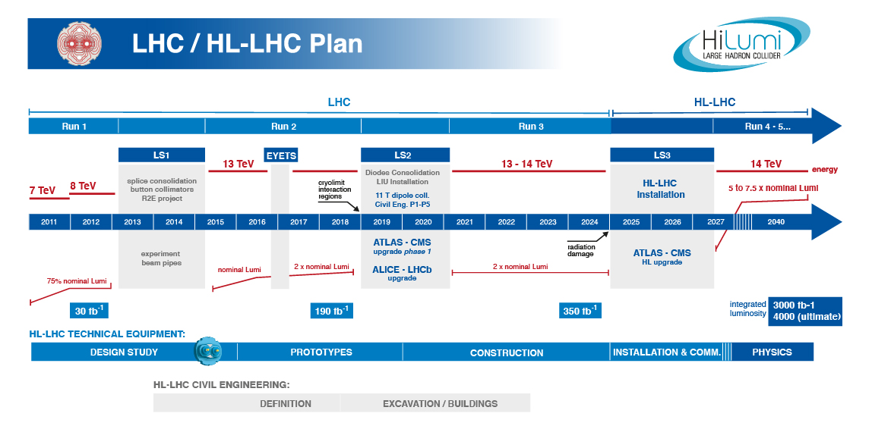


Expected: $L=2.2×{10}^{34}cm^{−2}s^{−1}, \left\langle μ\right\rangle =60$
Requirement: $\left\langle μ\right\rangle =80$
Expected: $L=5.0−7.5×{10}^{34}cm^{−2}s^{−1},\left\langle μ\right\rangle =140−200$
Requirement $\left\langle μ\right\rangle =200$
$\left\langle μ\right\rangle$ – the average number of interactions per bunch crossing – 25 ns
Trigger upgrade, electronics aging, Radiation tolerance –
the main reasons for the electronic upgrade

Slide 3
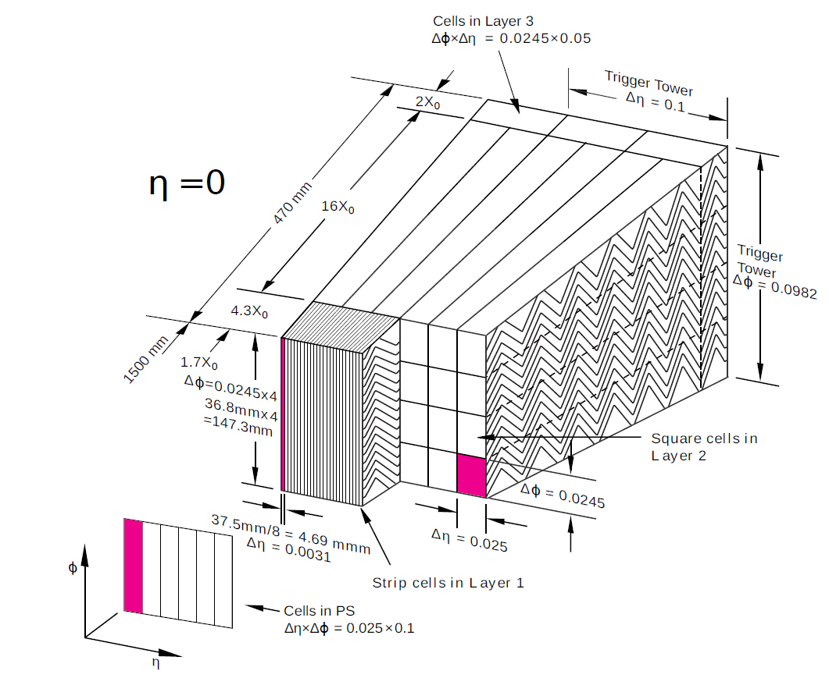
LAr Calorimeter
Active material: Liquid Argon (LAr)
Passive material: lead, copper, tungsten
182 468 channels (cells) in total

Slide 4
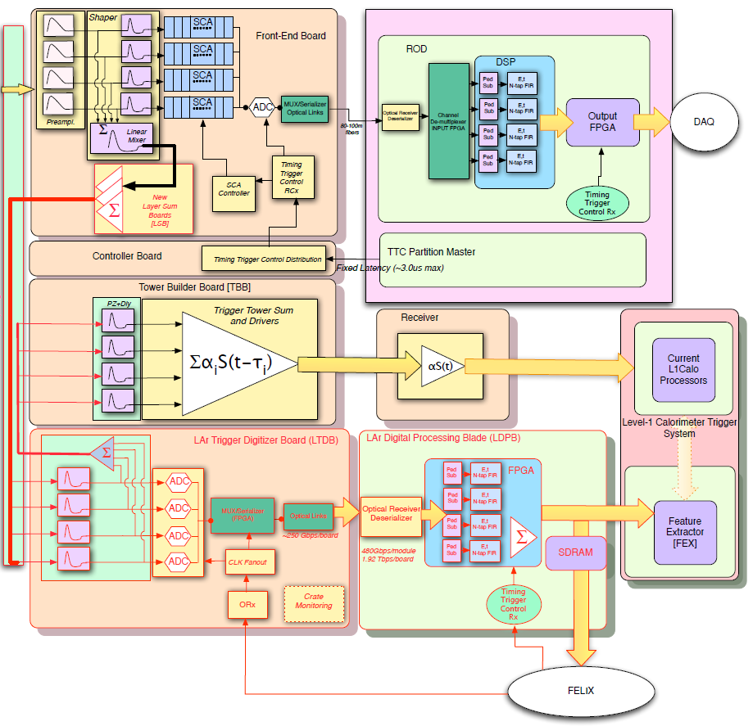
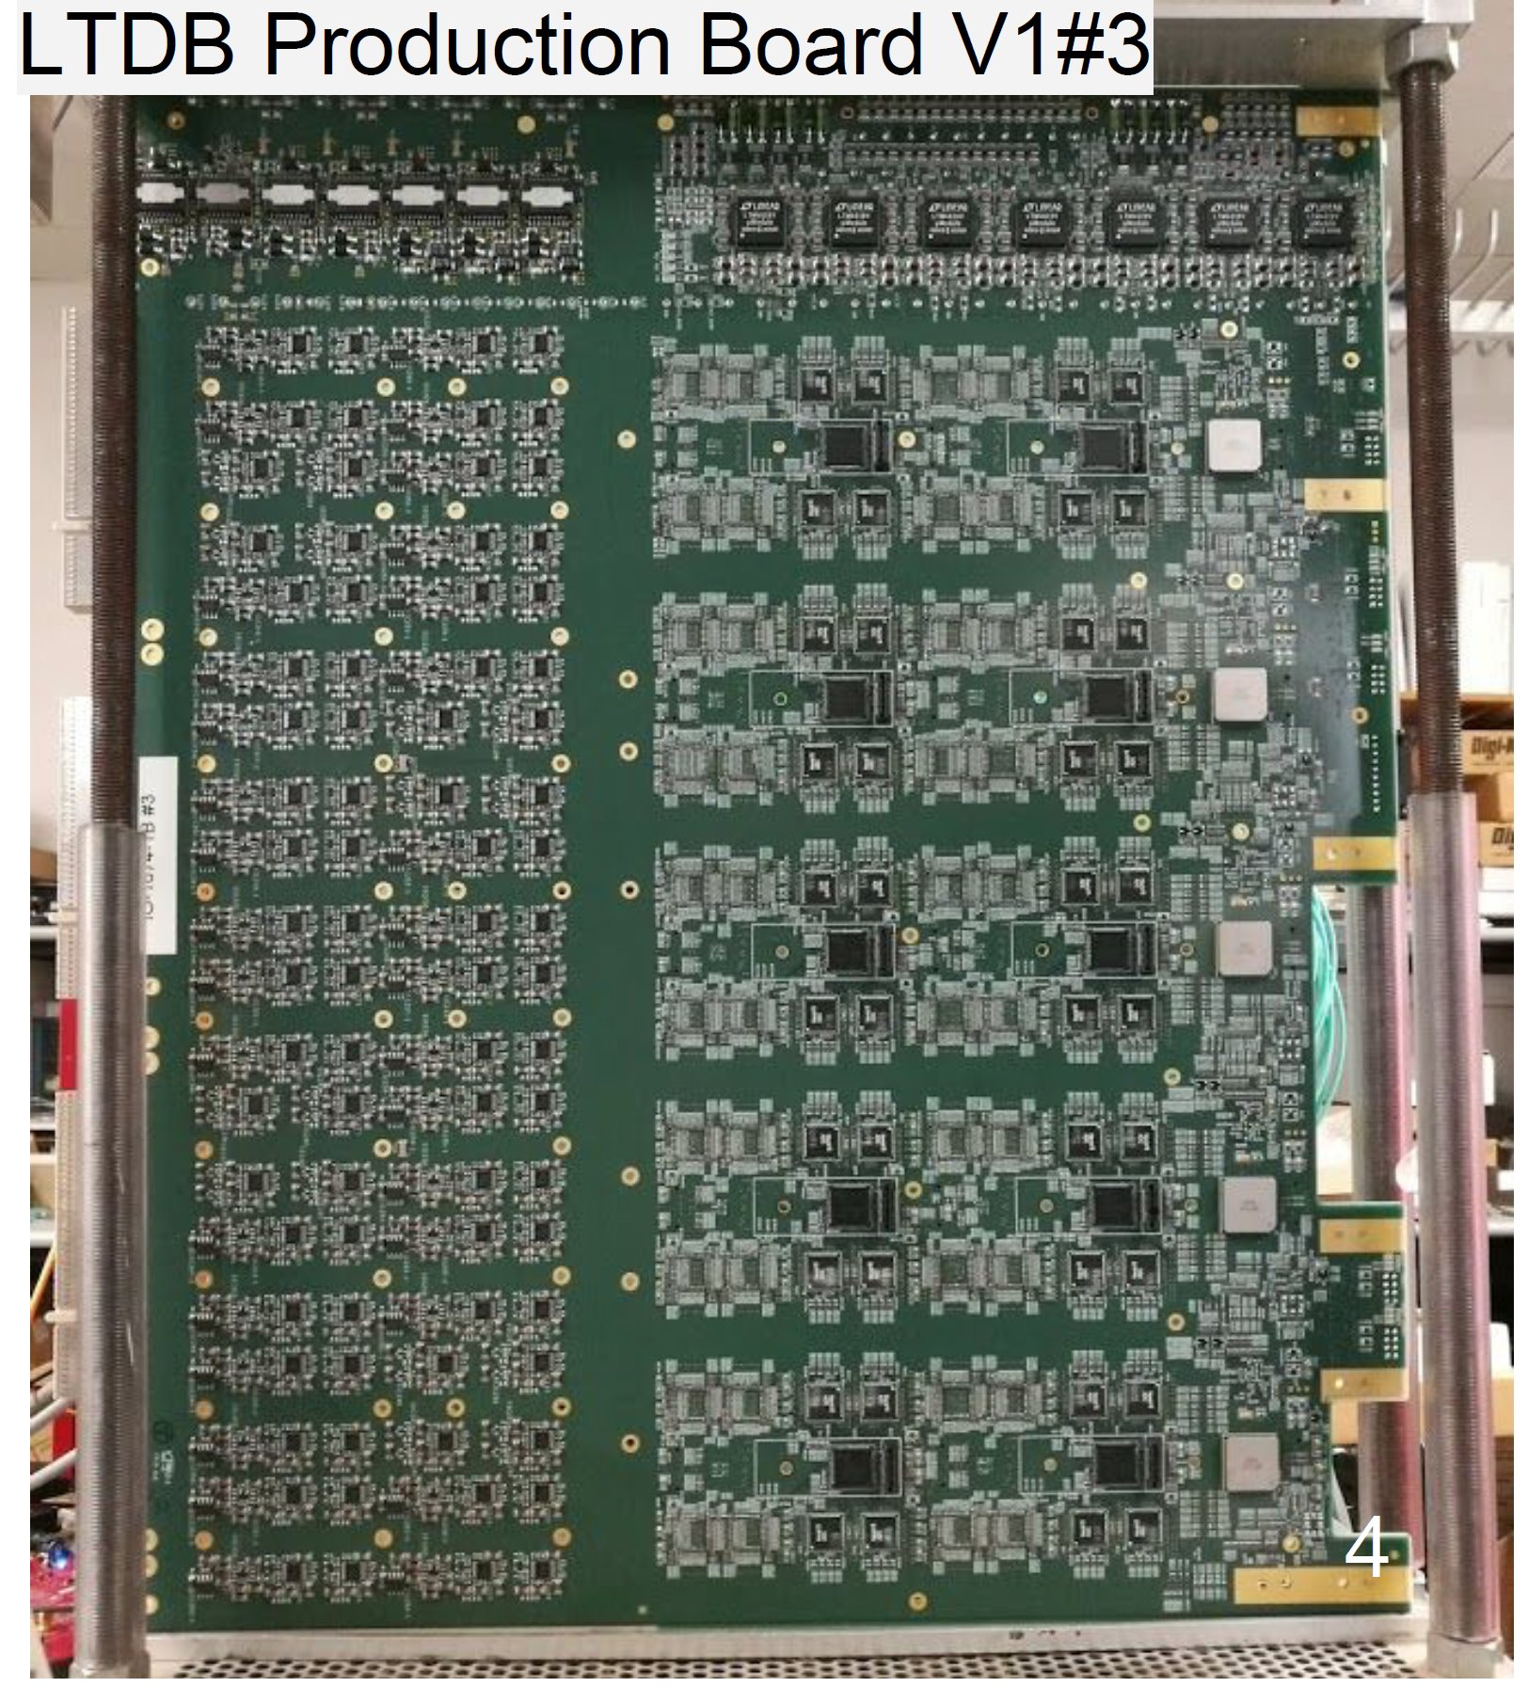
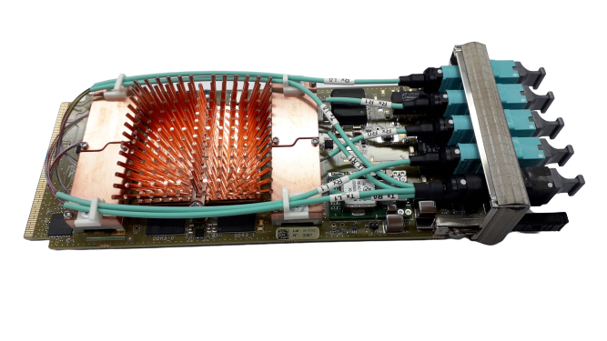
Phase 1 upgrade
Requirements:
Trigger path to be upgraded for finer granularity trigger information
Backward compatible trigger signal
LTDB
(Front-End)
LATOME
(Back-end)
Front-end
Backend-end

Slide 5
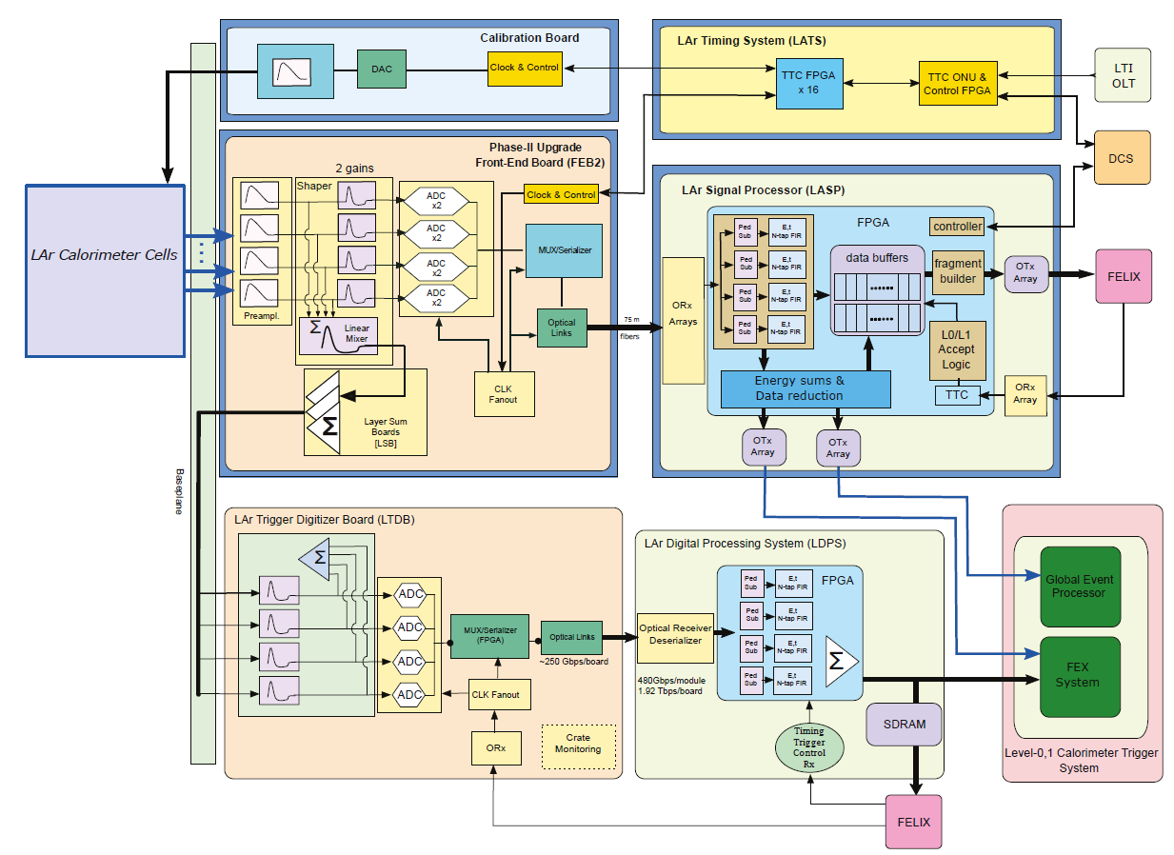
Phase 2 upgrade
Requirements:
HL-LHC TDAQ system upgrade
  Baseline:
  L0 trigger rate – 1 MHz
  8 events in 0.5 μs,
  128 events in 128 μs
  Further development option:
  L0 trigger rate 4 MHz,
  L1 trigger rate 800 kHz
  128 events in 30 μs
  Data reduction for Global trigger
  energies of all calorimeter cells which are above a few times the noise threshold should be sent to
  the Global Trigger
Radiation tolerant FE part
Front-end (FE)
Backend-end (BE)

Slide 6
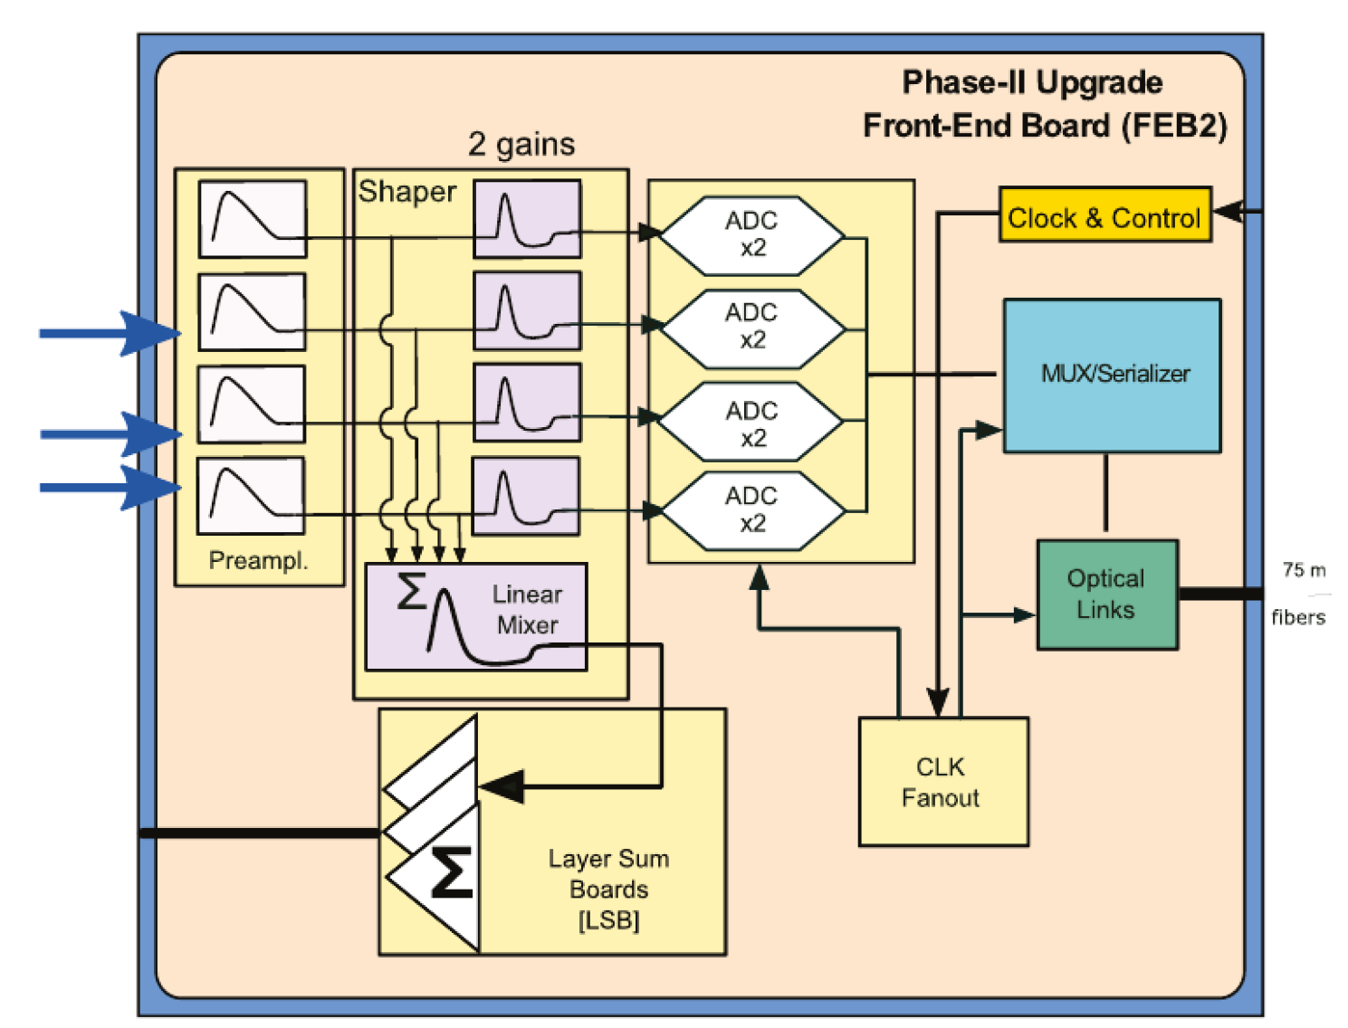
LAr Front-End Board FEB2
Functions:
128 channels:
Input termination, PreAmp, Shaper, ADC x 2 (high and low gain), data serialization and transmission to
Back-end electronics
Summing for LTDB (LAr Trigger digitizing board)
Radiation hardness upto 180 kRad
1524 FEB2 boards to be installed
ASICs are used for
  PreAmp / Shaper
  ADC
  Serializer

Slide 7
FEB2 – analog processing
Functions:
Input termination – tunable 25 or 50 Ohm
PreAmplification
2 Shapers CR-2RC with Hi/Low gains, shaping time is tunable 22 ± 5 ns
Analog sums for L0 trigger
Three variants of the chip:
LAUROC
ALFE
HPS – LAUROC2 design but PA replaced by Pre-Shaper with inverter and tunable gain (×1 or×2) to work in the HEC part of the LAr Calorimeter

Slide 8
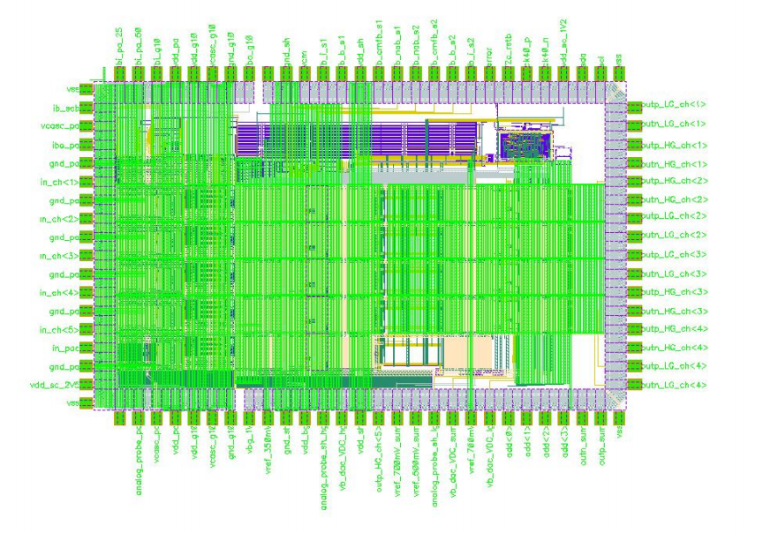
LAUROC2
130 nm CMOS - TSMC
4 FE channels (25/50 Ohm tunable)
  CR-RC2 shaper
  LG/HG outputs for each channel
integral non-linearity (INL) < 0.2 %
equivalent noise current (ENI) ~250nA
1.2V and 2.5V power supplies
128 LQFP package
I2C configuration
Tests with LAUROC2 / HPS1 started
~2 mm x 3 mm

Slide 9
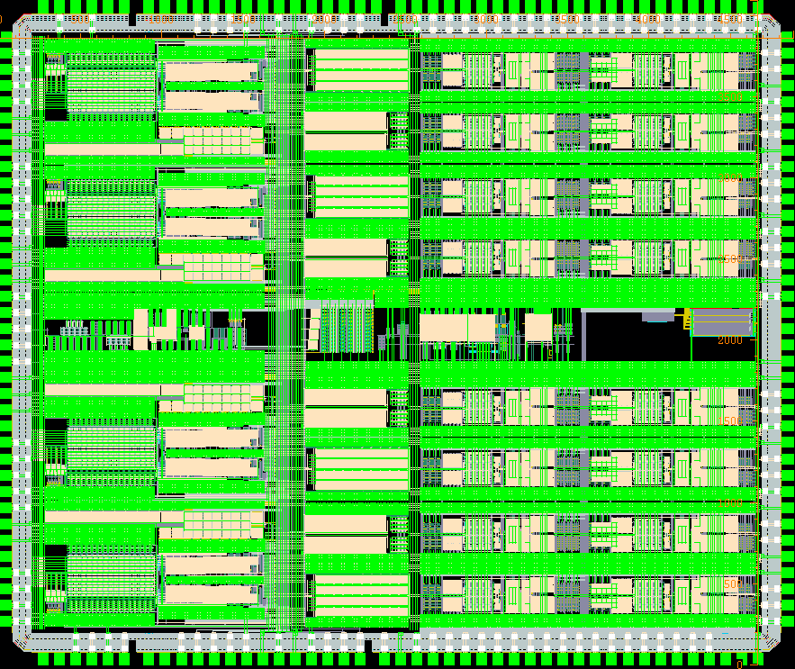
ALFE1
130 nm CMOS - TSMC
Four FE channels integrated
  CR-2RC shaper
  LG/HG outputs for each channel
Programmable input impedance and range
  25 Ohm, 10mA or 50 Ohm, 2mA
Input impedance tuning
integral non-linearity (INL) < 0.2 %
equivalent noise current (ENI) ~150nA
1.2V and 2.5V power supplies
  ~ 150 mW per channel
128 LQFP package
SPI configuration
Individual channel power down
Preamp DC level and output DC level tuning
Design submitted in Nov. 2019
Dies expected from fab at the start of March
4.1 mm
4.9 mm
4.9 mm x 4.1 mm (20 mm²)

Slide 10
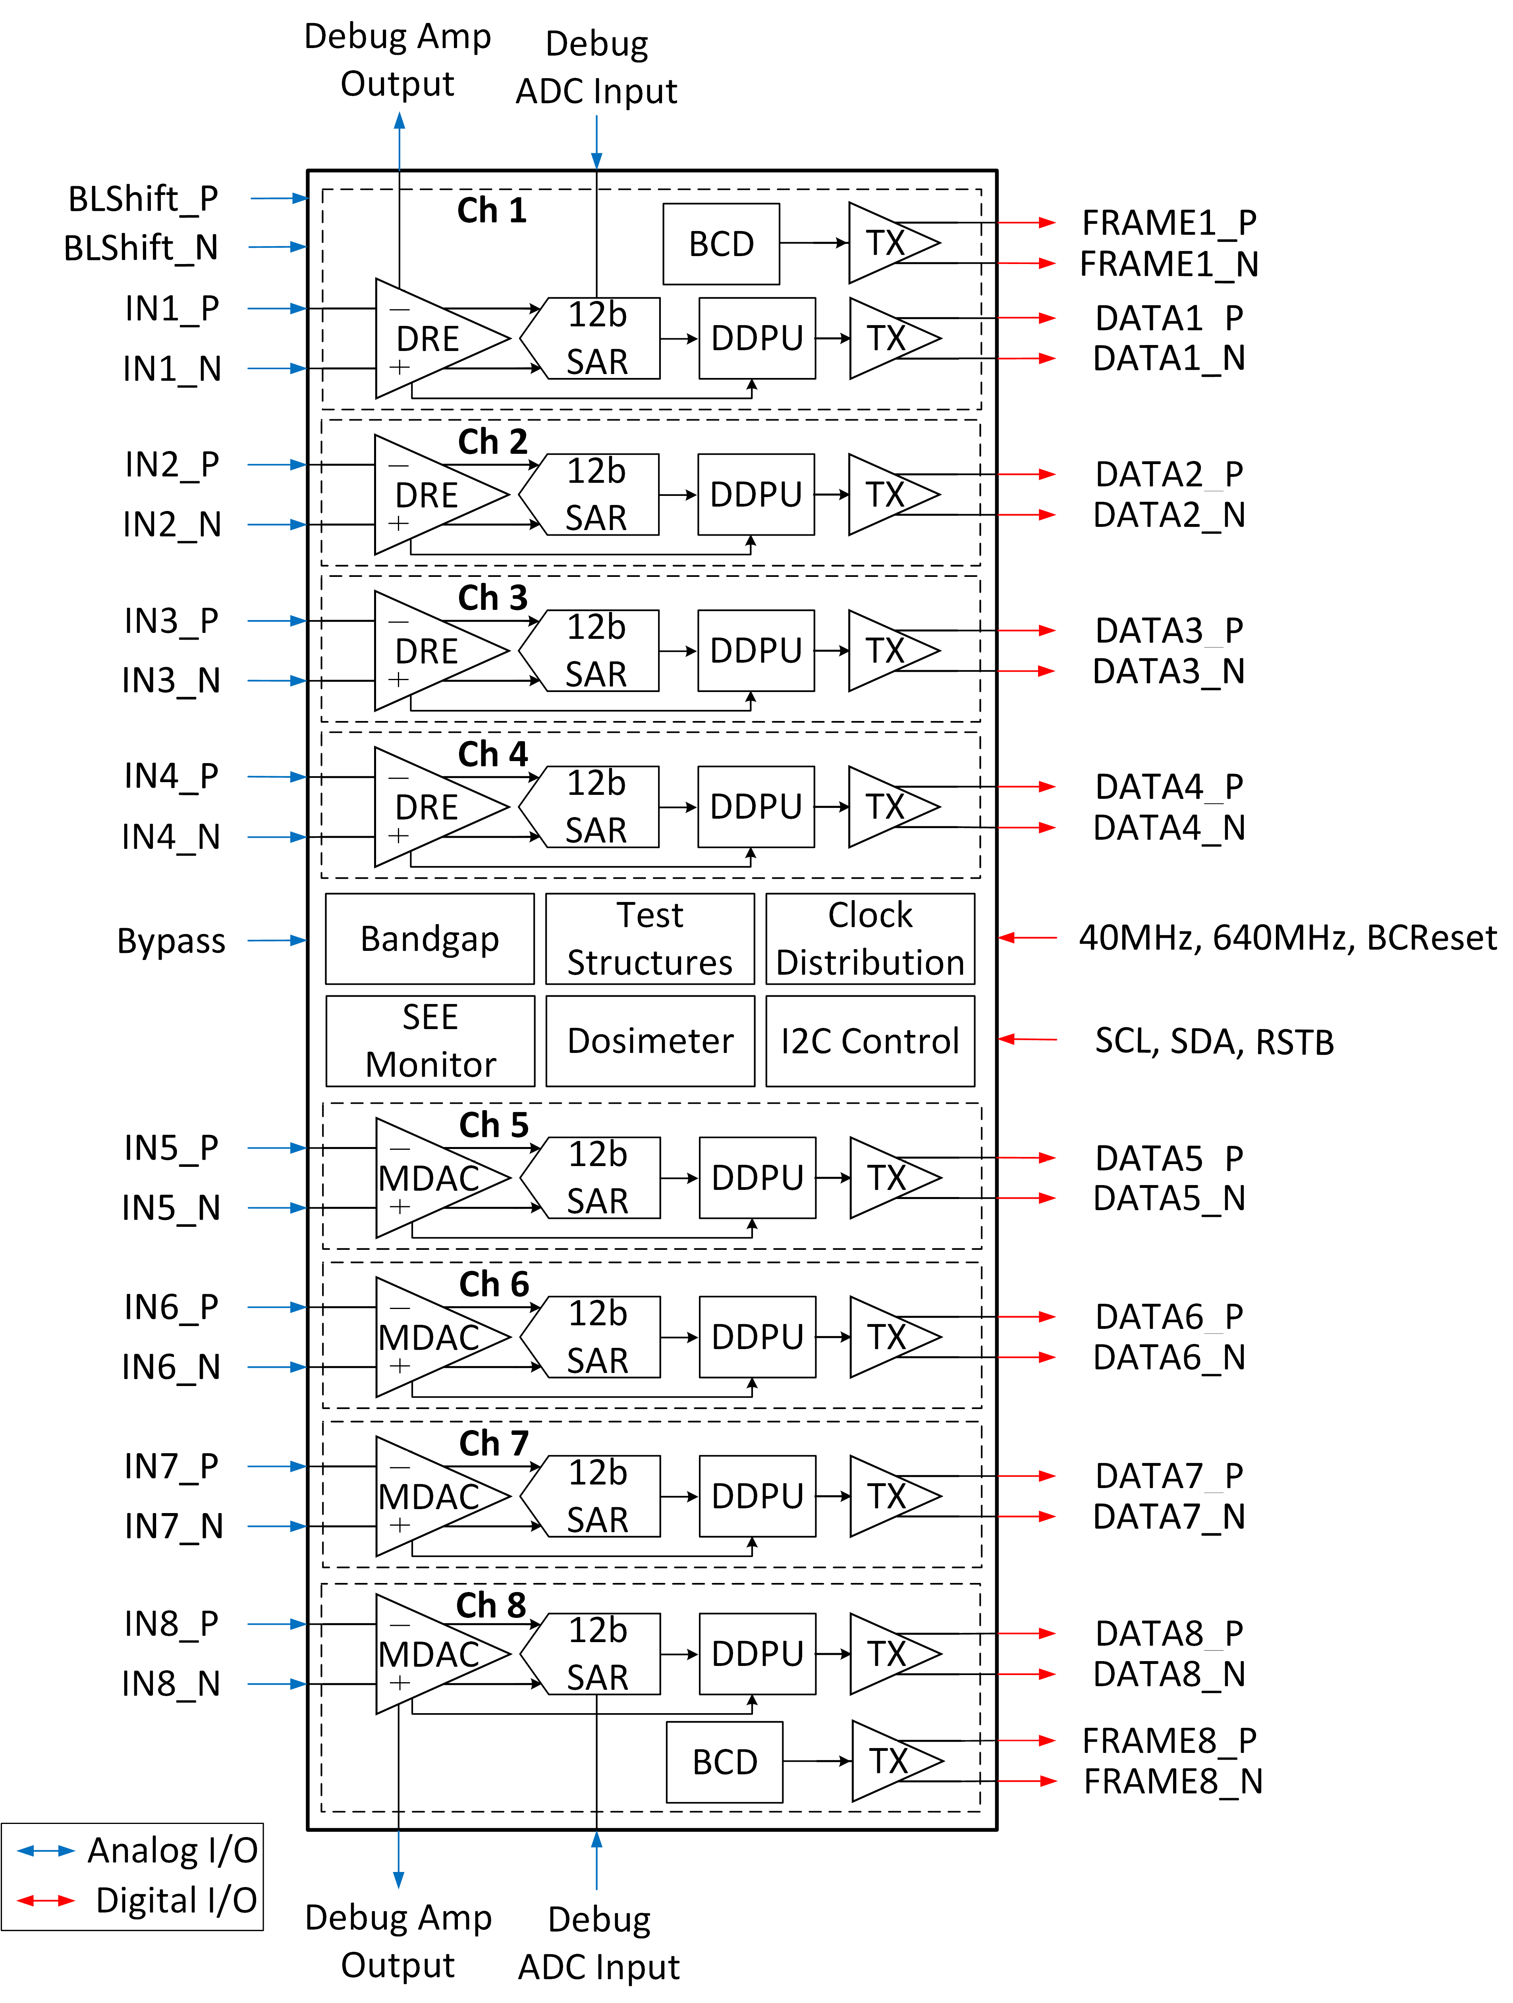
FEB2 – ADC
Requirements:
convert 2 gains x 4 chs = 8 chs / chip
sample rate 40 MSPS
14 bits with effective number of bits (ENOB) > 11 bits
Rad tolerant
Baseline solution – ASIC COLUTAv3, TSMC 65 nm, 5 mm x 5 mm
4 chs with DRE
4 chs with MDAC
Possible alternatives:
ADC IP designed for CMS - 12 bit, 160 MSPS + digital processing
COTS
To be decided in 2020
Rad. tests to be done in March
ENOB = ~11.7 (MDAC)

Slide 11
FEB2 - prototypes
Analog test board (2 channels) – made in 2019
Used to demonstrate full readout chain of
PreAmp/Shaper + ADC + optical data links
Slice test board (32 channels) – to be made in 2020
Use to demonstrate multichannel performance,
Control links, radtol power, …
➔
FEB2 part to be
covered by
Slice test board
Very good test result received
Full FEB2 prototype (128 channels) to be done in 2021-2022

Slide 12
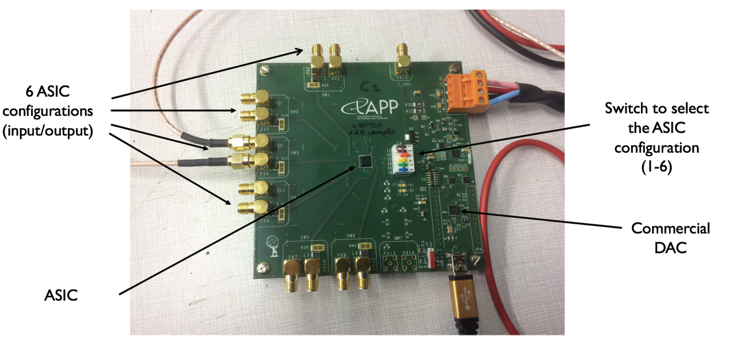
Calibration board – CLAROC ASIC
Requirements:
Integral non-linearity (INL) <0.1%
Uniformity <0.25%
Pulse rise time <1 ns
Radiation-tolerant to 180 kRad
16 bit dynamic range
CLAROC (Calibration of Liquid ARgon Output Chip) Chips v.2 received in December 2019
HV-CMOS XFAB 180 nm
No problem with radiation
13 DAC + 3 bit (current mirror factor)
Measured INL ~0.3% - higher than Requirement mainly due to DAC INL in high bits – under investigation

Slide 13
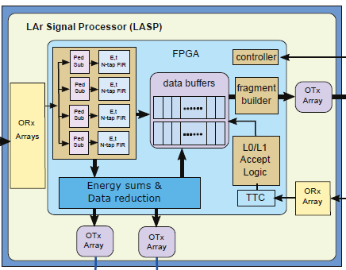
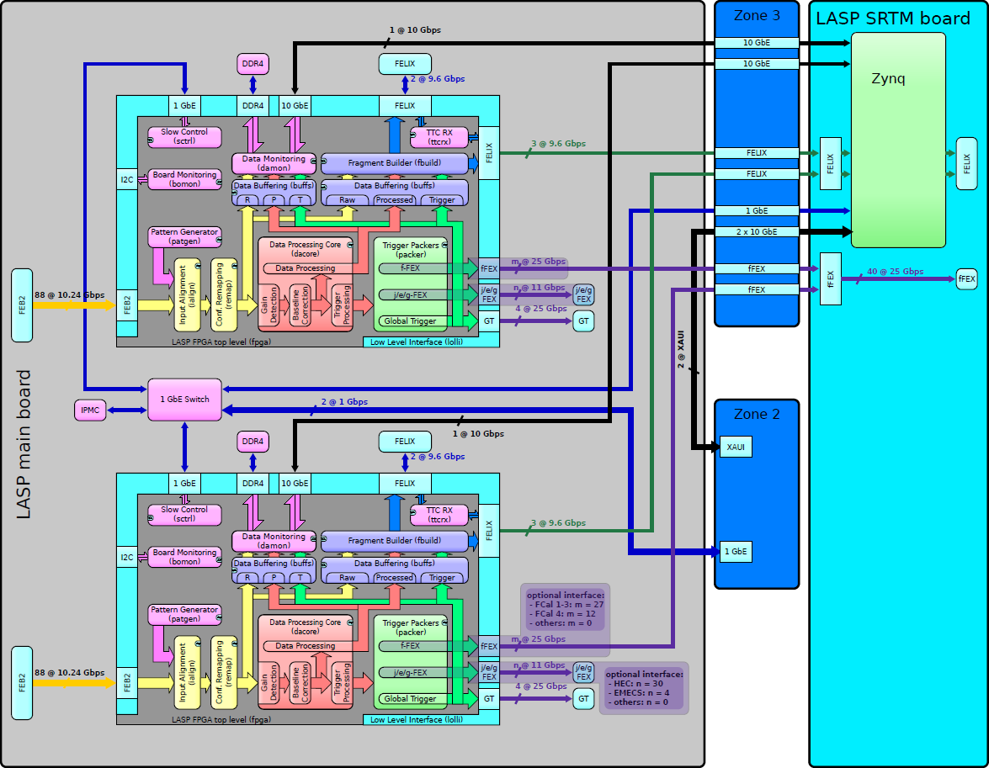
LAr Signal Processor (LASP)
LASP
Proposed LASP Design
FEB2
LAr
trigger
Global
trigger (GT)
Receive data from 2 or 4 FEB2 boards
(256 or 512 channels)
Waveform Processing of all Calorimeter cells
Buffering: 10 mks for L0 trigger, 35 mks for L1 trigger
Data reduction for Global trigger
Optional data For L1Calo trigger to substitute Phase 1 electronics for some parts of the Calorimeter
ATCA SRTM
Main Board – ATCA blade with
Intel Stratix 10 FPGAs

Slide 14
LASP boards development
Features:
Intel Stratix 10 SX (with ARM processor)
or
Intel Stratix 10 MX (with 3D stacked High-Bandwidth DRAM Memory)
88 Input links @ 10.24 Gbps / 1 FPGA
4 output links to FELIX/TDAQ @ 10.24 Gbps
4 output links to Global Trigger 4 @ 25.65 Gbps
19 output links to fFEX: @ 25.65 Gbps
30 output links to legacy FEXes: @ 10.24 Gbps
Challenges:
signals density
hi-speed links (25 Gbps)
power and cooling: ATCA shelf cooling limit = 350+50 W/slot
2 FPGAs (optimistic scenario) – 8 FEB2 boards to 1 LASP
1 FPGAs (backup scenario) – 4 FEB2 boards to 1 LASP
LASP test board routing status:
8255 / 15122 interconnections done
Layout of high-speed
parts of SRTM are ready

Slide 15
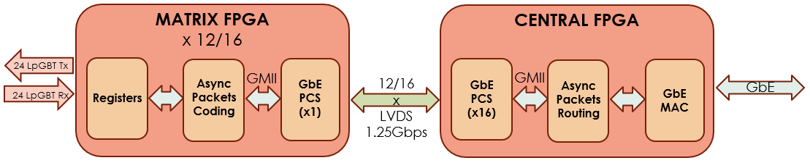
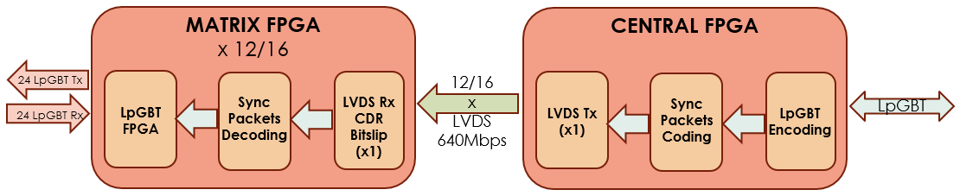
LATS – LAr Timing System
LATOURNETT - Lar Timing trigger cOntrol distribUtion and fRoNt End moniToring/configuration
ATCA blade
Early stage of design – specification ready
Firmware development ongoing on Intel Cyclone 10 DevKit
  Asynchronous commands – GbE without MAC
  Synchronous commands – LVDS @ 640Mbps
LATOURNETT board

Slide 16
Summary
HL-LHC will start operation in 2027
LAr Phase 2 electronics upgrade is going well
Several ASICs have been developed for Front-end. Tests show good resolution. Radiation tolerance meets the requirements
Designs of the back-end electronics (hardware and firmware) are well understood. Their implementation started
Thank you for your attention!

Slide 17
Backup slides

Slide 18
FEB2 – data serializer –lpGBP (Low Power GigaBit Transceiver)
Rad tolerant high-speed serializer with functions:
Timing and Trigger Control (TTC),
Data Acquisition (DAQ)
Slow Control (SC)
  Three I2C Masters
  16-bit General Purpose I/O port
  Output reset pin
  10-bit ADC (8 multiplexed inputs)
  8-bit voltage DAC
  8-bit current DAC
  Temperature sensor
Designed for radiation hardness
Total Ionizing Dose (TID): 200 Mrad
Extensive SEU protection (TMR, FEC)
Designed by lpGBT collaboration:
https://espace.cern.ch/GBT-Project/LpGBT/
Fine pitch BGA 289, 9 mm x 9 mm

