Slide 1
Impact of Operational Parameters on Single Beamlet Deflection in a Negative Ion Source for NBI Applications
Andrew Hurlbatt, Federica Bonomo, Guillermo Orozco, Riccardo Nocentini, Christian Wimmer

Slide 2
Negative Ion Sources for Fusion
Low temperature/pressure H/D plasma with Cs on surfaces for H⁻/D⁻ production
Extraction and acceleration grid system – Plasma Grid (PG), Extraction Grid (EG), Grounded Grid (GG) common to all sources
Many apertures → many ‘beamlets’ combine into one beam
Permanent magnets embedded in EG to deflect co-extracted e⁻
Alternate in polarity row-by-row
Cause of residual zig-zag deflection in beamlets, alternating left/right by aperture row
Zig-Zag deflection increases divergence of beam compared to beamlet divergence
Additional permanent magnets “ADCM” for zig-zag suppression tested on some machines
ADCM foreseen for suppression of zig-zag deflection in ITER HNB

Slide 3
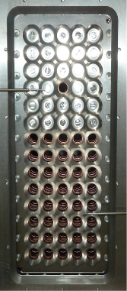
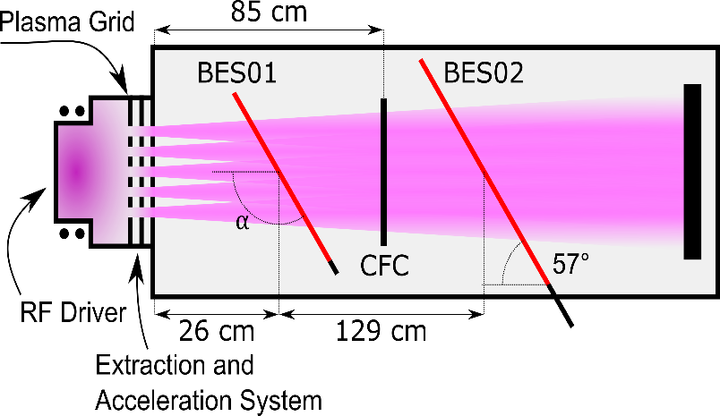
BATMAN Upgrade (BUG) Test Facility
Designed for investigating effects important for next generation of NBI-relevant negative ion beam production
Source and beam well diagnosed
Beam Emission Spectroscopy (BES) as main diagnostic
CFC tile as optional beam dump
Isolated aperture in top half during this campaign
Isolated beamlet
BES02-08
Plasma Grid
with masking
BES02-05
BES02-04
BES02-03

Slide 4
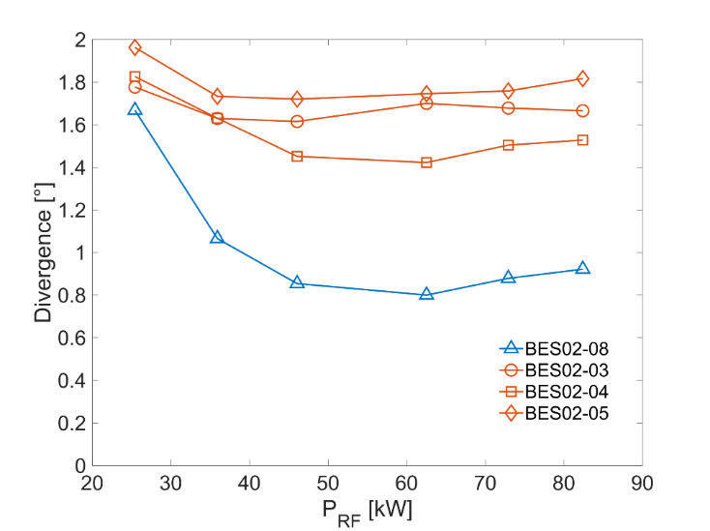
Beamlet Deflection in BES Spectra (1/2)
Defining Equation – Relativistic Doppler Shift: $λ_{D}=λ_{0}γ\left(1+β\cos{α}\right)$
Three parameters: Unshifted wavelength $λ_{0}$, particle energy (determines $γ$ and $β$), observation angle $α$
Central wavelength of Doppler peak changes with RF power
RF power should not influence particle energy
p_{fill} = 0.5 Pa, U_{extr} = 4.6 kV, U_{acc} = 31.3 kV, I_{PG} = 780 A, I_{Bias} = 4.3 A.

Slide 5
Beamlet Deflection in BES Spectra (2/2)
Difference between expected Doppler wavelength ($λ_{D}$) and measured ($λ_{D,M}$) behaves differently for different lines of sight
Possible causes of non-zero $λ_{D}−λ_{D,M}$:
Error in observation angle
Error in beam energy (HV measurement)
Misalignment of grids
Beamlet deflection
Only changes in beamlet deflection can explain behaviour of $λ_{D,M}$ from BES02-08

Slide 6
Calculating Beamlet Deflection
Difference $λ_{D}−λ_{D,M}$ can be used to calculate a relative beamlet offset angle $φ$
$$φ=\operatorname{acos}\left[\frac{λ_{D,M}−λ_{D}}{λ_{0}γβ}+\cos{α}\right]−α$$
$φ$ can only be used for relative measurements for one line of sight that is observing one row of beamlets
BES
Beamlet
$$α$$
Grids
$$φ$$

Slide 7
Expected Changes to Beamlet Deflection
For a given beam particle: $φ=\arctan{v_{⊥}/v_{∥}}$
$v_{⊥}$ can be approximated from the Lorentz Equation: $Δv_{⊥}∝\int{v×B\text{d}t}$
Changes to grid voltages change velocity of particles → change to $v×B$
Changes to electrostatic lenses will change radial distribution of particles → change to $v×B$
Has a spatial distribution!

Slide 8
Investigating Beamlet Deflection Angle (1/2)
Beamlet angle $φ$ changes as function of U_{acc}
Other parameters constant within each scan
Behaviour is different for the two scans
p_{fill}, U_{extr}, I_{PG}, I_{Bias} all change
One or more of these also impacts $φ$

Slide 9
Aside: BES – CFC Comparsion
Beamlet position on CFC can be measured with sub-mm accuracy
Uncertainties in alignment mean measurement is only relative
Beamlet particle position and velocity distributions should be strongly correlated
Excellent agreement between the two diagnostics

Slide 10
Investigating Beamlet Deflection Angle (2/2)
Beamlet angle $φ$ changes as function of U_{HV}
Changing U_{HV} changes beamlet angle by up to 0.6° (10 mrad)
Behaviour is different for the scans
p_{fill}, P/P₀, I_{PG}, I_{Bias} all change
One or more of these also impacts $φ$
Changing p_{fill}, I_{PG}, or I_{Bias} causes offset in $φ$
Curves 2 and 3 have roughly same P/P₀
Changes in incoming particle angles?

Slide 11
Conclusions
Analysis of BES Doppler peak provide relative measure of beamlet angle changes
Measurements agree with CFC tile diagnostic
Clear evidence of trends in beamlet angle when grid voltages or P_{RF} are changed
Due to changes to beam optics and particle velocities
Changes to beamlet angle from parameters that should only impact plasma properties
Source pressure, PG bias, filter field strength
Possible influence on initial particle angles and meniscus shape
Beamlet angle can change even if grid voltages are constant
Possible consequences for magnet-based suppression of zig-zag deflection
Effective operational parameter range may be reduced
Horizontal deflection can fall out of 2 mrad (0.11°) safety margin
Further systematic studies needed to identify behaviours and trends
This work has been carried out within the framework of the EUROfusion Consortium and has received funding from the EURATOM research and training programme 2014-2018 and 2019-2020 under grant agreement No. 633053. The views and opinions expressed herein do not necessarily reflect those of the European Commission.

Slide 12
Extra Slides

Slide 13
Divergence during P_{RF} scan

Slide 14
Derivation of $φ$
$$λ_{D}=λ_{0}γ\left(1+β\cos\left(α\right)\right)$$
$$λ_{D,M}=λ_{0}γ\left(1+β\cos\left(α+φ\right)\right)$$
$$λ_{D,M}−λ_{D}=λ_{0}γ\left(1+β\cos\left(α+φ\right)\right)−λ_{0}γ\left(1+β\cos{α}\right)$$
$$\frac{λ_{D,M}−λ_{D}}{λ_{0}γ}=\left(1+β\cos\left(α+φ\right)\right)−\left(1+β\cos{α}\right)$$
$$\frac{λ_{D,M}−λ_{D}}{λ_{0}γ}=β\cos\left(α+φ\right)−β\cos{α}$$
$$\frac{λ_{D,M}−λ_{D}}{λ_{0}γβ}=\cos\left(α+φ\right)−\cos{α}$$
$$φ=\operatorname{acos}\left[\frac{λ_{D,M}−λ_{D}}{λ_{0}γβ}+\cos{α}\right]−α$$
By assuming changes in Doppler peak wavelength come only from differences in angle, an expression for this offset angle can be derived by defining $λ_{D,M}$ as the measured Doppler shift, differing from Equation 1 by an additional angle $φ$
This formula can be used to determine the relative shift in a single beamlet using a single line of sight

