Slide 1
“Experimental results
of
40kW, 1 MHz Solid State High Frequency Power Supply
With Inductively Coupled Plasma”
Mr. Sandip Gajjar
ITER-India.
Contact: sandip.gajjar@iter-india.org
Session 2; 3rd Sep 20, 08:20 AM

Slide 2
Outline of Presentation
Motivation for Solid state design
Specification for 40kW SS HFPS
Topology & General Arrangement
Initiation of Plasma operations
Plasma Operations; results & observations
  Summary
  Open issues

Slide 3
Motivation for Solid State HFPS
Solid state design is already popular with Digital Radio Transmitters, offers
State of the art technology with modular design
Efficiency better than 80%
Air cooled solutions
Option of matching by frequency tuning

Slide 4
Specifications for 40kW SS RFG
S.N. | Attributes | Specifications
Input
1 | Input Voltage | 3ph, 415V ±10%, 50Hz
Output
2 | Rated Output Power | 40 kW continuous
3 | Output Power Range | 10 – 100 %
4 | Power Accuracy | 1kW
5 | Working frequency Band | (1 ± 0.1) MHz
6 | Frequency Accuracy | ± 10 kHz
7 | Output impedance | 50 Ω
8 | RF Output Connector | 3 1/8”
9 | Efficiency | >80%
10 | Cooling | Air cooled
Notes:
Output Power Range: better than 100w
Frequency Accuracy : better than 5kHz

Slide 5
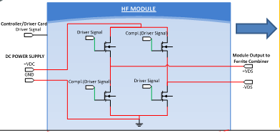
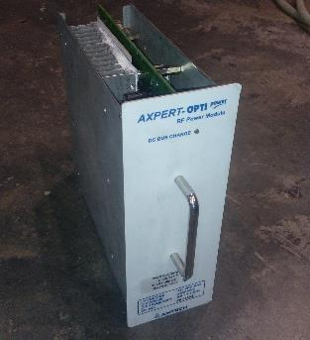
Scheme for 40kW SS RFG
Module 16
Module 8
Module 7
Module 1
40kW PS to be configured with
16 x 3kW modules
Notes:
Class D H Bridge Configuration
Shaping, Compensating network (phase difference)

Slide 6
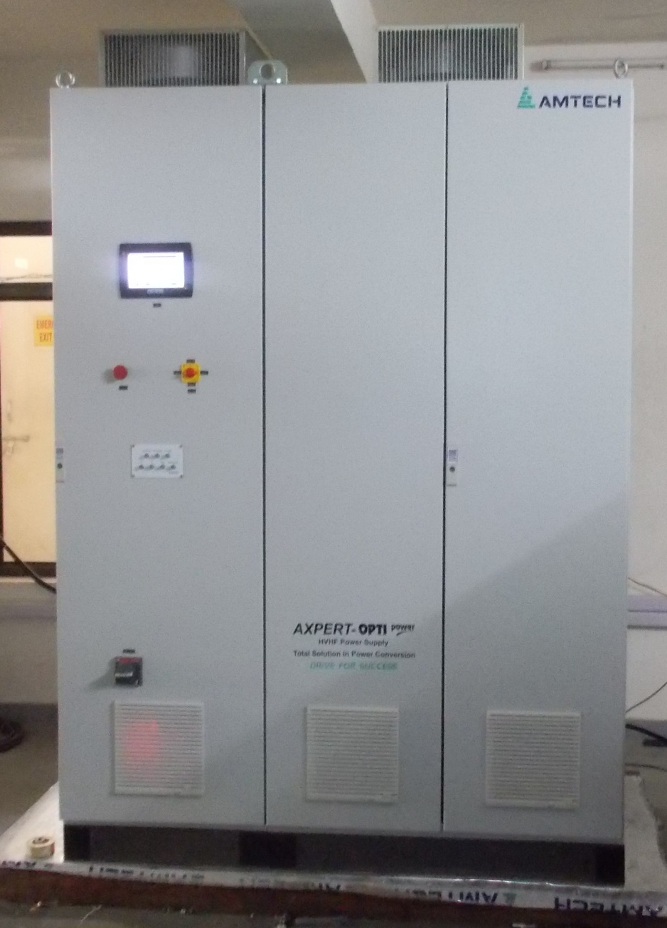
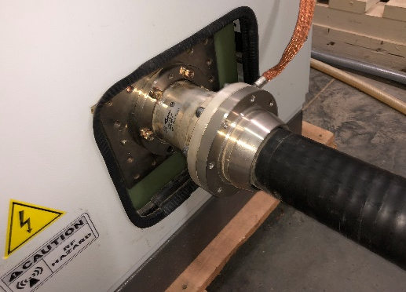
General Arrangement
Control & measurement boards
1.6(l) x 0.8(D) x 2.1(H)
RF Modules(Front)
#16 nos.
Operator Panel
Emergency Shut off
Remote/Local
3 1/8” RF Connector
DC Power Supply
LC tuning network
Notes:
Operator Panel
Emergency shut off provisions
Remote Local
DC PS, 16 RF modules, LC Tuning/Impedance mapping and wave shaping n/W

Slide 7
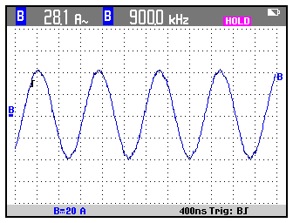
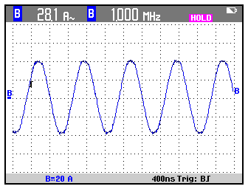
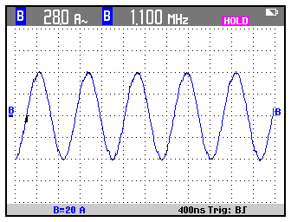
Demonstration of SS HVHF On DL
  Rated power at 50Ohm over frequency range; 900kHz, 1000kHz, 1100kHz.
  Pre Integration Activity;
  Previous operations on Source indicate operational impedance at Generator end not limited to 50 Ohm;
  SS HVHF tested for mismatch conditions;
    37 kW at 75 Ohm.
    34 kW at 25 Ohm.

Slide 8
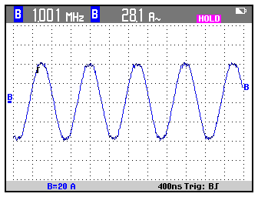
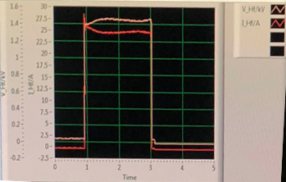
Initial Plasma operation
Source End
C series
2 nF
40kW
SS RFG
C shunt
Driver
3 nF
3:1
Matching Transformer
  Provision for Impedance matching; Cseries, Cshunt
  Frequency Tuning
36kW RF Power
  Source Pressure tuned to 1Pa to assist favorable conditions for Plasma formations.
  Optimum matching achieved at 980 kHz; Operated upto 90% Power.
1450V
25A
Frequency Resolution: 1 kHz
Notes:
CS & Cp coarse Tuning; Fine tuning we expect using the Frequency Step
Cseries : Impedance compensation
Shunt :
Driver: Combination of Inductiove & resistive component

Slide 9
Operations at improved IS pressure
Results
Shot No. | 33619 | 33635 | 33683 | 33720
Freq. | 960 kHz | 957kHz | 980 kHz | 980kHz
Power | 37 kW | 30kW | 27kW | 22kW
Pressure | 0.8 Pa | 0.7 Pa | 0.6 Pa | 0.5 Pa
Impedance | 75 ohm | 80 Ohm | 90 ohm | 105 Ohm
Observation
Stable operating scenarios are seen with load offering 65-80ohm impedance
RFG operated at 50% power for Load scenarios in range >80 Ohm.
Beyond 22kW(@110Ohm) RFG protection circuit activates and trip the generator due to threshold crossing of RF Voltage
Challenges
Source Vacuum improves → Impedance increases → Couples Less power
During ignition state; Impedance variation at generator end is very high; difficult to survive.
How to achieve max. power transfer ?
How to survive ignition condition ?
Notes:
For a given Power, higher operating frequency relates to high impedance and lower frequency to lower impedance as seen by the generator.
Counter measure to overcome impedance variation is usually frequency adjustments (achievable over short span).

Slide 10
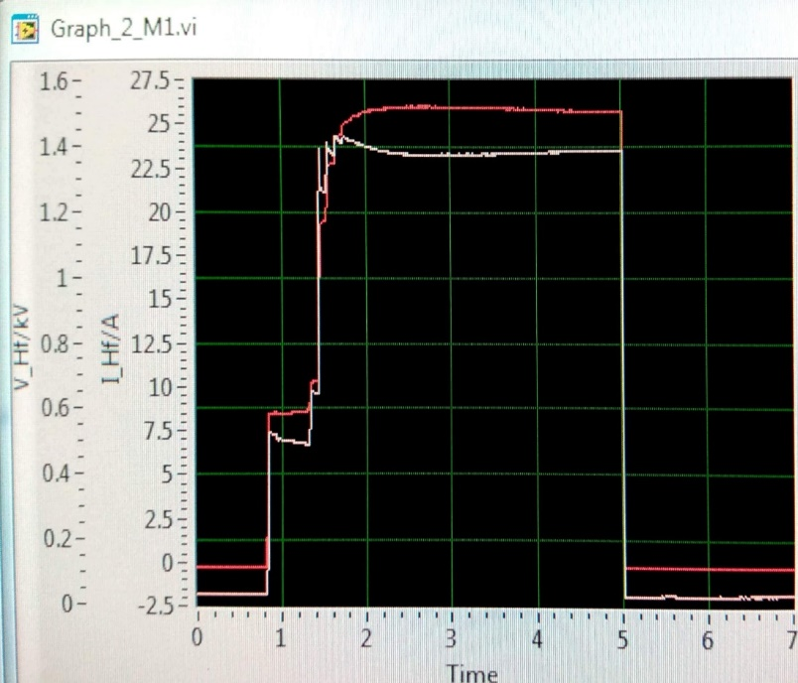
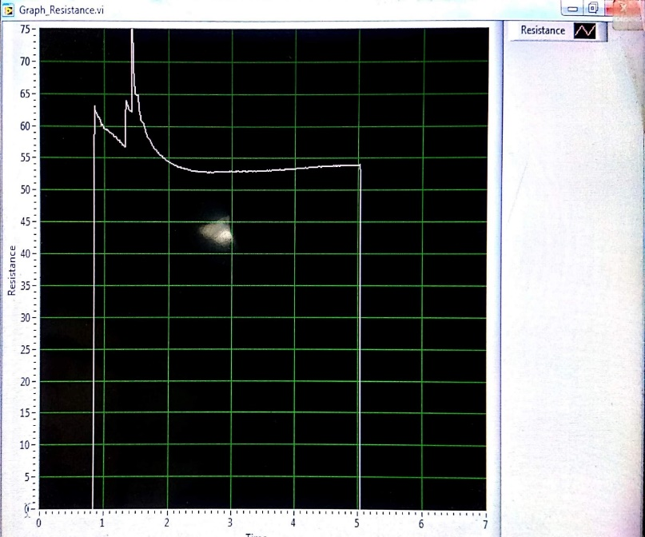
Matching improvisation & Power Ramp
In order to support the operational campaigns for higher power, provisional matching network was introduce.
Overcome Ignition condition
60 Ohm
Additional
Matching Network
Matching Network
Power Ramp up
40kW
SS RFG
110 Ohm
Driver
Additional
N/W
Results
Shot No. | 33949 | 33990
Freq. | 980 | 978
Power | 5kW(0.5s); 35kW(1.7s) | 5kW(0.5s); 34kW(1.7s)
Cos Phi | ~1 | ~1
Pressure | 0.5 Pa | 0.4 Pa
Impedance @ Gen | 62.5 Ohm | 55 Ohm
Impedance @ Pi match | Beyond 112 Ohms | Beyond 110 Ohms
Ramp Up
5kW followed by 35kW; assisted to overcome striking impedance
Provisional Matching N/W
Power Coupled increased from 22kW to 35kW at 0.5 Pa, 980kHz
Freq. Resolution
1kHz resolution assisted the operation at 0.4Pa to support 34kW

Slide 11
Summary
For the given Ion Source conditions(pressure),once the matching is achieved at lower power it continues till max. power.
Sudden Impedance variation at ignition of plasma was overcome by Power ramp.
Impedance seen by generator linearly increases with improved vacuum, which necessitates an impedance transform..
37kW
With additional matching & Freq Resolution
90 % Power

Slide 12
Open Issues
Recent Campaigns indicates the operations of SSRFG with impedance seen at generator end in the range of 100Ohm*.
For SSRFG designed for 50 Ohm conditions; should have a additional impedance transformation
Or
Redefine the impedance of the RF Generator to 100 Ohm?
Whether conditions will change as we go towards higher power(150kW)

Slide 13
Acknowledgement
Above experimental campaigns were from collaborative efforts at ROBIN(RF based negative ion source experimental facility) test stand by NNB, DNB and Power Supply group of ITER-India & IPR

Slide 14
Thanks a lot.!

