Slide 1
The 7th International symposium on Negative Ions, Beams and Sources (NIBS’20), 1 – 11 September 2020
Profile of the LHD negative ion beam source at the plasma meniscus from numerical beam calculation based on experimental observation
Jelle Slief¹, Kenichi Nagaoka^{2,3}, Masashi Kisaki^{2,4}, Yasuaki Haba³
¹Eindhoven University of Technology, the Netherlands
²National Institute for Fusion Science, Natural Institutes of Natural Sciences, Japan
³Graduate School of Science, Nagoya University, Japan
⁴SOKENDAI (The Graduate University for Advanced Studies), Japan

Slide 2
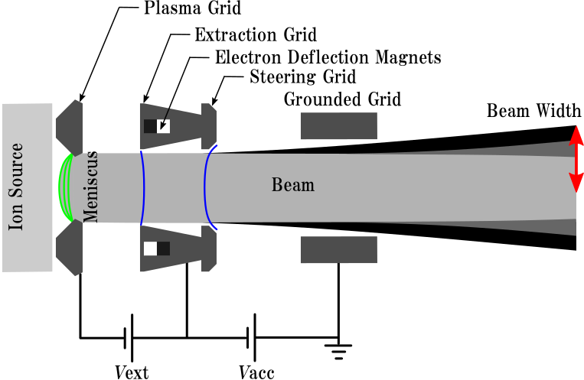
Motivation
Large Helical Device:
5 NBI’s
3 N-NBI’s
1 Neutral Beam Test Stand (NBTS)
Demonstration of negative ion-beam focusing for ITER (in progress)
Beam energy : 180 keV (H⁻ / D⁻)
Beam power : 5 MW / beamline
Beam div. angle < 10 mrad
Pulse duration : 10 sec

Slide 3
Motivation
Large Helical Device:
5 NBI’s
3 N-NBI’s
1 Neutral Beam Test Stand (NBTS)
Demonstration of negative ion-beam focusing for ITER (in progress)
Beam energy : 180 keV (H⁻ / D⁻)
Beam power : 5 MW / beamline
Beam div. angle < 10 mrad
Pulse duration : 10 sec

Slide 4
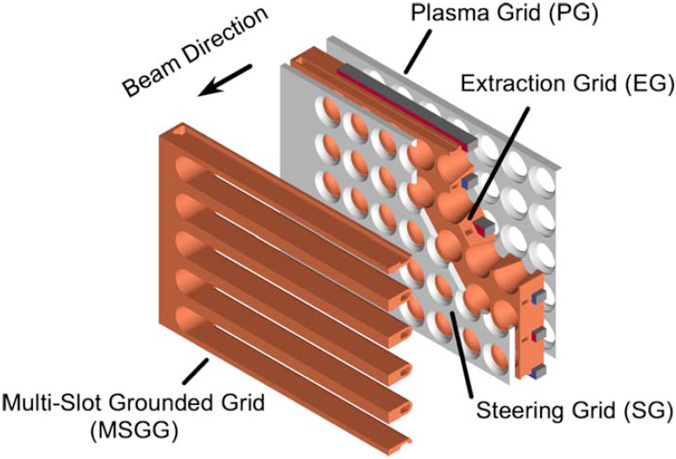
Motivation
V = V₁
E
V = V₂
Beam optics governed by two electrostatic lens effects: V_{acc}/V_{ext} ratio and meniscus formation
Meniscus is interest of this study

Slide 5
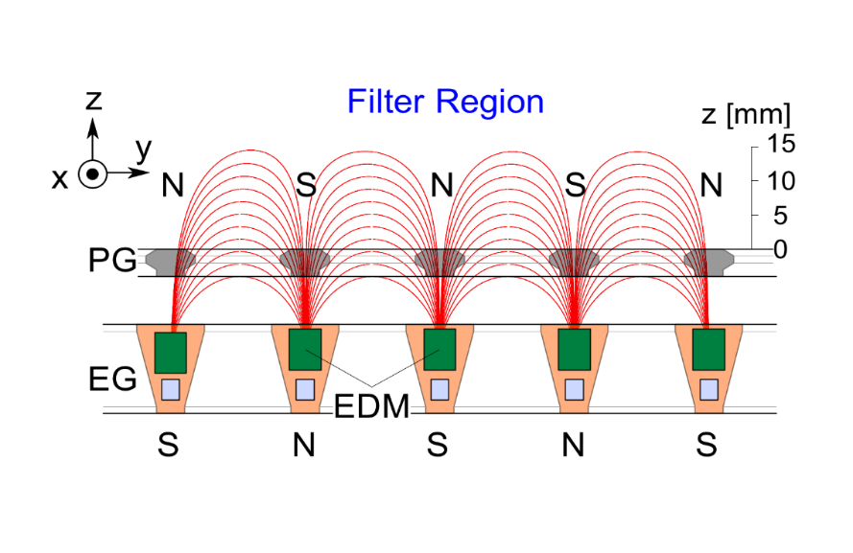
Motivation
Electron plasma
Due to filter magnets no electrons (pair-ion plasma) but also 3D magnetic field
→ No physics model of meniscus formation (like e.g. Bohm criterion for positive-ion plasma)
Characterization of Phase-Space Structure (PSS) or emittance to study the beam optics/meniscus formation
Negative-ion plasma

Slide 6
Emittance of LHD H⁻ beam
Y. Haba et al., New Journal of Physics 22, 023017 (2020)

Slide 7
Emittance of LHD H⁻ beam
Three components:
upper
center
lower
Y. Haba et al., New Journal of Physics 22, 023017 (2020)

Slide 8
Emittance of LHD H⁻ beam
Three components:
upper
center
lower
Y. Haba et al., New Journal of Physics 22, 023017 (2020)

Slide 9
Origin of splitting?
?
G. Fubiani, L. Garrigues, and J.P. Boeuf, Phys. Plasmas 25, 023510 (2018)

Slide 10
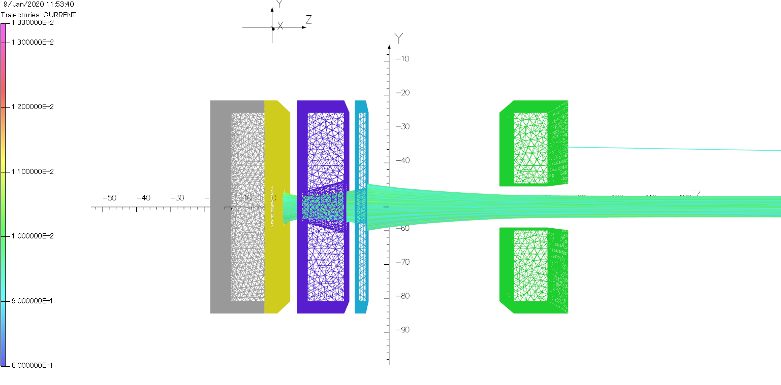
Numerical calculations
Beamline CAD model
OPERA 3d for E(x,y,z) and B(x,y,z)
Fortran particle tracking
Input measured PSS
Investigate beam at meniscus
PG
EG
SG
GG
Source chamber

Slide 11
Numerical calculations
Beamline CAD model
OPERA 3d for E(x,y,z) and B(x,y,z)
Fortran particle tracking
Input measured PSS
Investigate beam at meniscus
Simulation direction
PG
EG
SG
GG
Source chamber

Slide 12
Defining the inputs
Inputs
Measurements
x - direction
Input location
Simulation start
y - direction

Slide 13
Simulation input
$$v_{z}= \sqrt{\frac{2(V_{ext}+V_{acc})}{m_{H^{−}}}}$$
3 inputs

Slide 14
Results - scatter
Location: PG exit

Slide 15
Results - scatter
PG aperture
Confirmed: different components, different locations
Location: PG exit

Slide 16
Results – particle density map
Upper
Center
Lower
Location: PG exit

Slide 17
Results – particle density map
Upper
Center
Lower
Location: PG exit

Slide 18
Results – phase space
Location: PG exit

Slide 19
Results – phase space

Slide 20
Results – phase space

Slide 21
Conclusions
Different components from different locations

Slide 22
Conclusions
Different components from different locations
Most beam particles from meniscus edge

Slide 23
Conclusions
Different components from different locations
Most beam particles from meniscus edge
Meniscus aberrations → splitting

Slide 24
Outlook
Verify simulation
Different components from different locations
Most beam particles from meniscus edge
Meniscus aberrations → splitting

Slide 25
Outlook
Different components from different locations
Most beam particles from meniscus edge
Meniscus aberrations → splitting
Investigate edge localization

Slide 26
Outlook
Different components from different locations
Most beam particles from meniscus edge
Meniscus aberrations → splitting
Develop model

Slide 27
New supporting evidence
Emitter region
Plasma grid
Extraction grid
Recent work
Particle rays launched from emitter surface
↓
Opera calculates meniscus shape following Child-Langmuir law with iterative method.
Usually, negative ion density at meniscus assumed uniformly distributed.
→Here, nonuniformity taken into account.
→Emitter surface divided into three regions in horizontal direction
Particle direction

Slide 28
Multiple emitter
Current through each region equal
Consistent with experimental observation
Current density at peripheral region higher than in central part
2
7
2

Slide 29
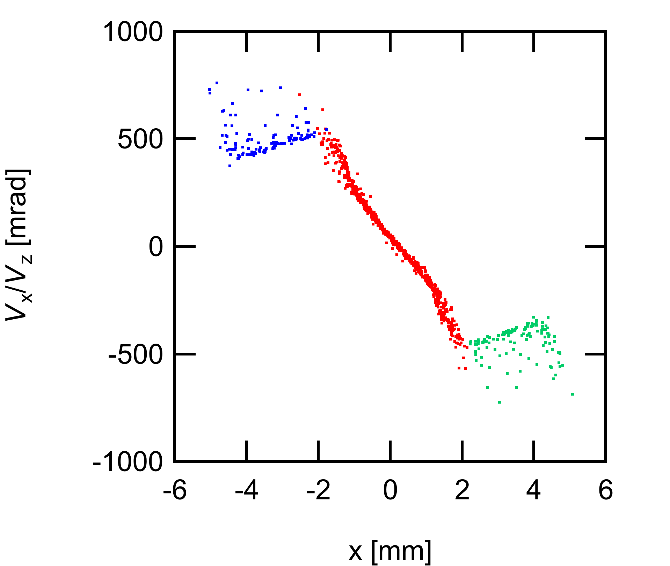
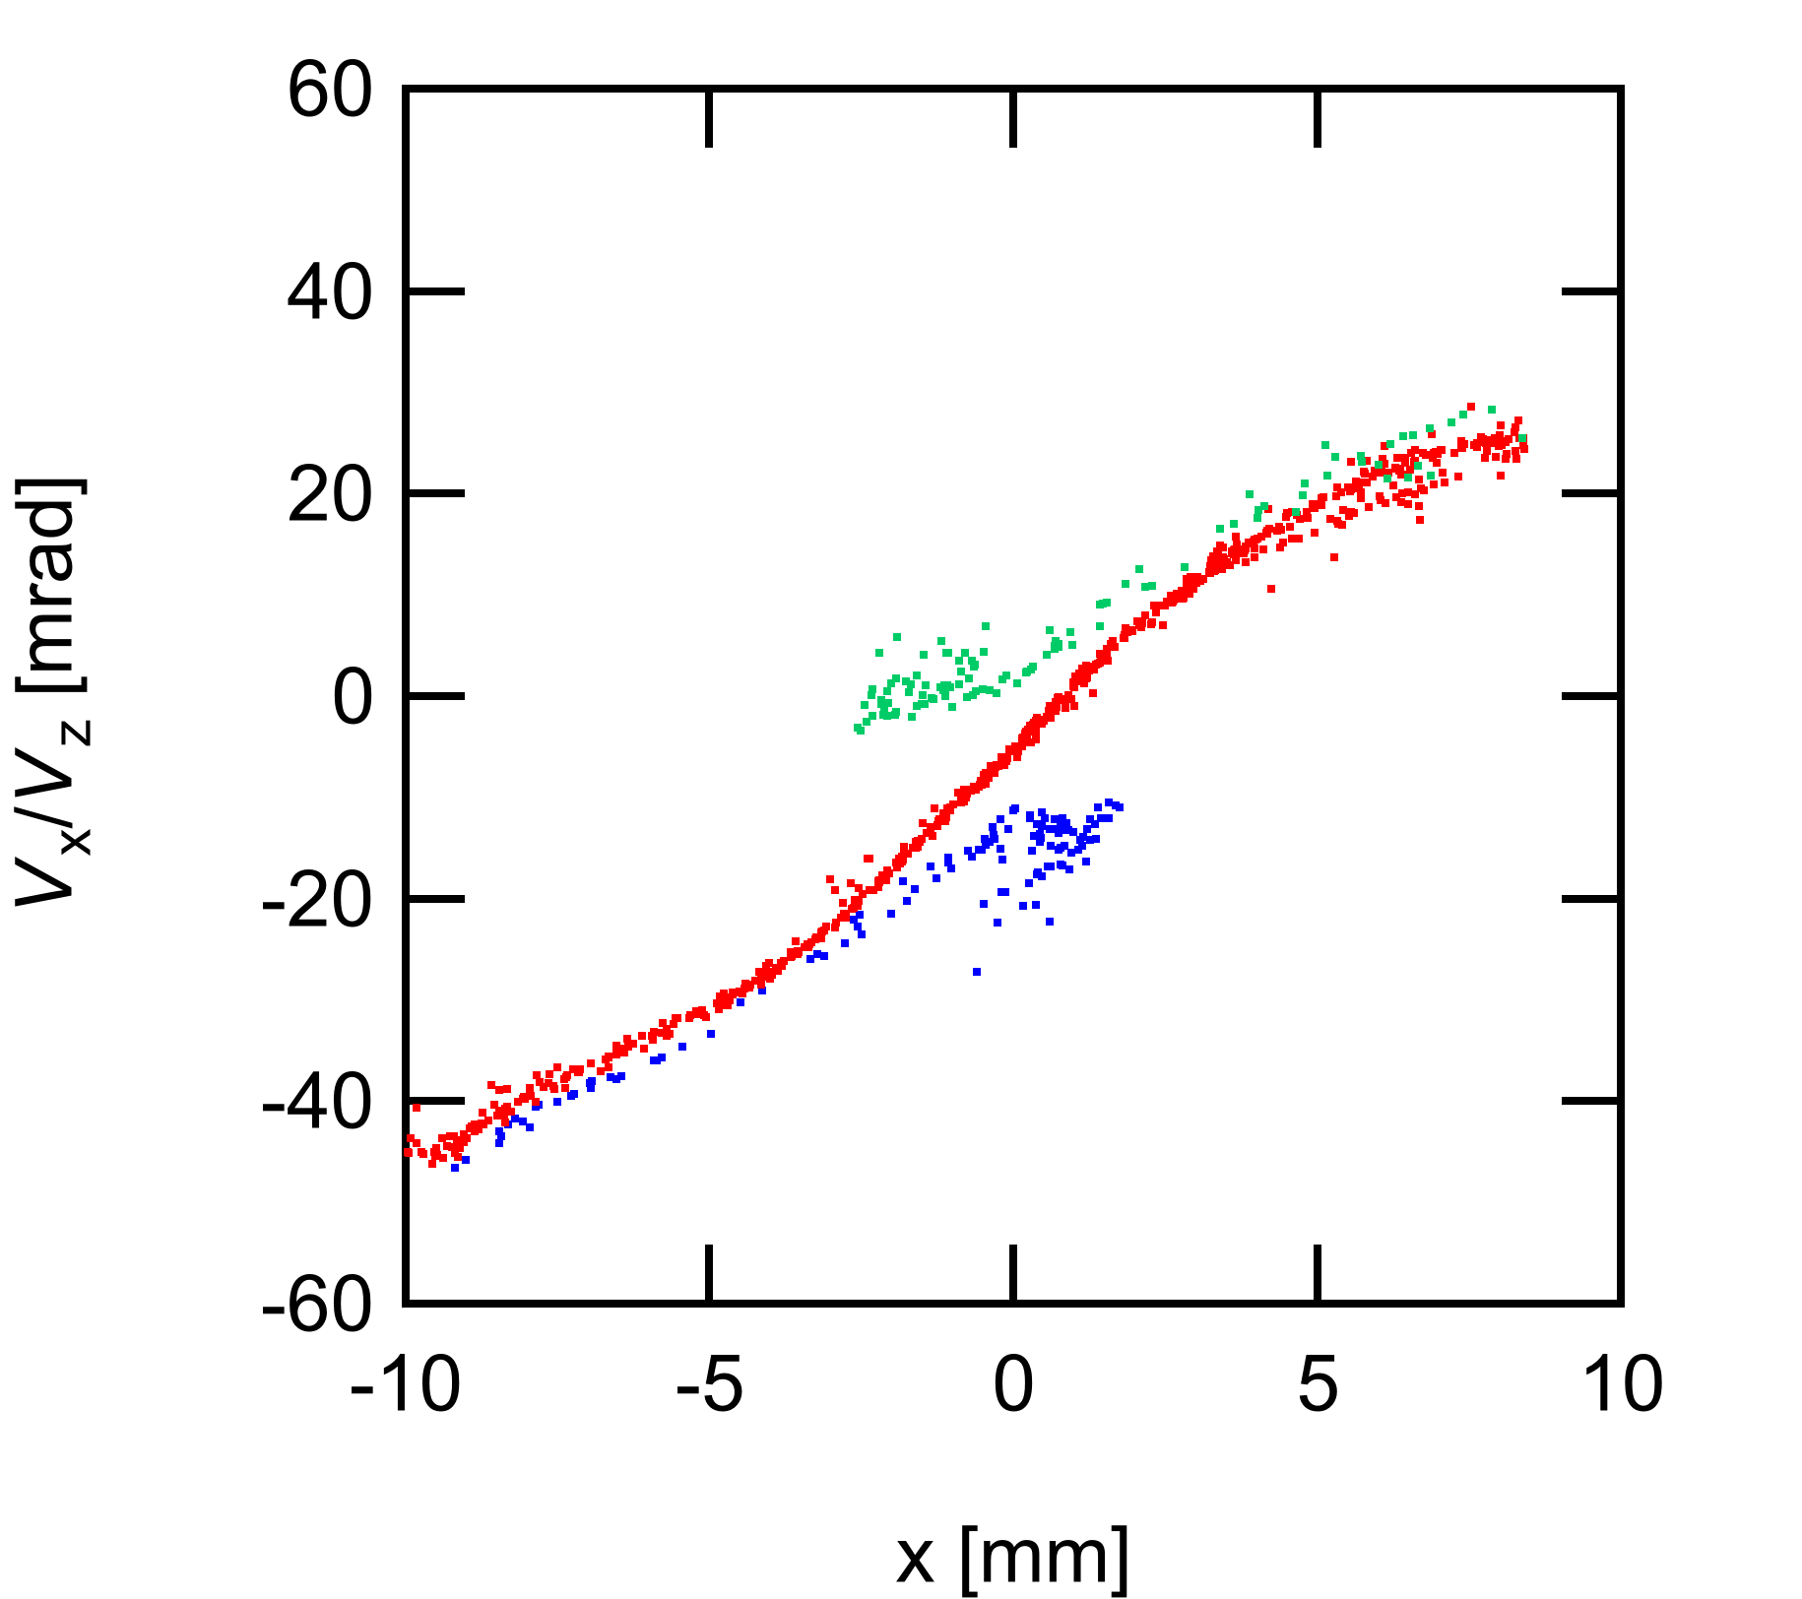
Three emitters case
V_{ext} = 3.1 kV
V_{acc} = 47.43 kV
Result at z = 200
Result at z = 0 (PG exit)
Three components are observed in phase space as observed in experiment.

Slide 30
Additional slides

Slide 31
Motivation (more numbers)
ITER NBI requirements [2] :
1 MeV H⁰/D⁰ beam
max divergence 5-7 mrad
15% of power in halo with max divergence of 30 mrad
Horizontal, vertical misalignment ≤ ±2 , ±4 mrad
Max tilt ≤ ± 10 mrad

Slide 32
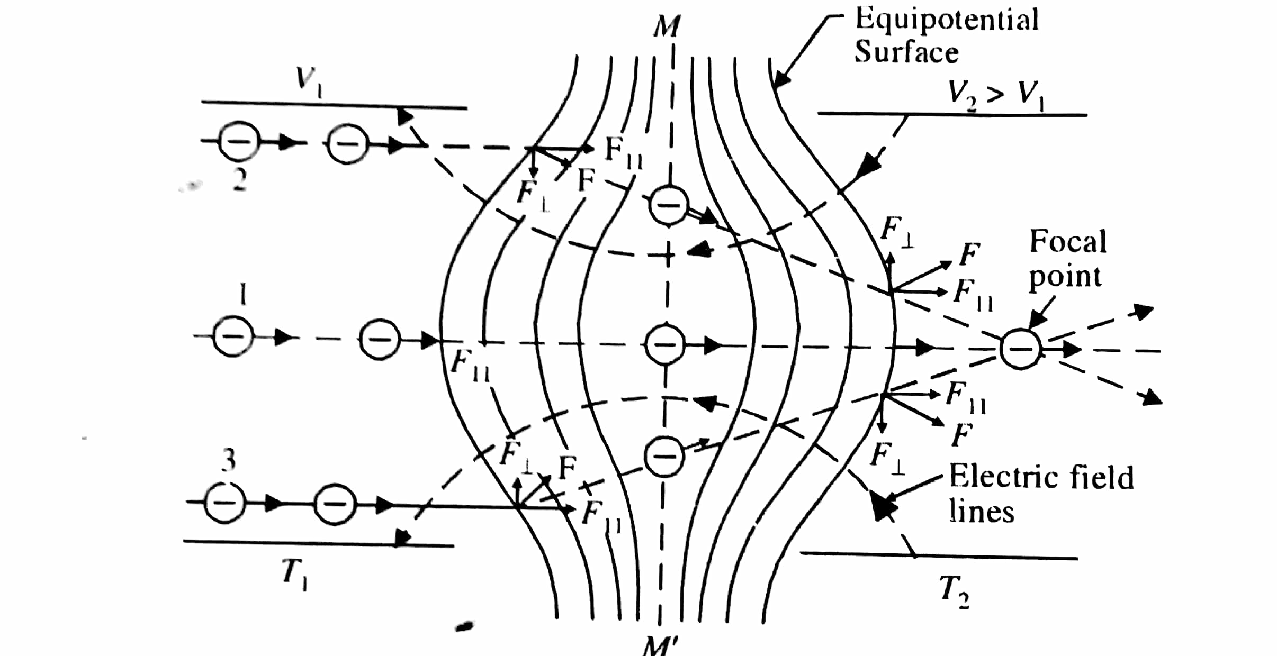
Electrostatic lens – detailed

Slide 33
Analysis of measurements

Slide 34
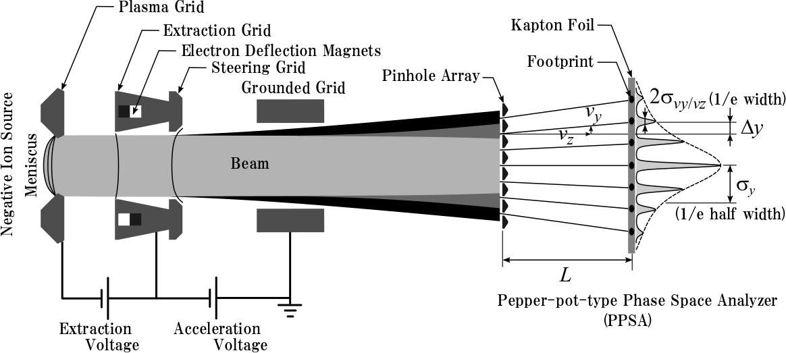
Concept of Pepper-pot type phase space analyzer

Slide 35
Concept of Pepper-pot type phase space analyzer
$$\frac{v_{y}}{v_{z}}=\frac{Δy}{L}$$

Slide 36
Scan of P_{arc}
62 mm
A
B
C
110 mm
P_{arc} = 36 kW
V_{acc}/V_{ext}～ 15.9
P_{arc} = 55 kW
V_{acc}/V_{ext} ～ 15.8
P_{arc} = 75 kW
V_{acc}/V_{ext} ～ 16.0
Notes:
The arc power was scanned over three values, from 36 to 75 kilowatts and the resulting phase space structures in x and y direction were analyzed
Explain what the figures represent? Is it a grid on the beam? Or a other matrix? Why is the location of the cross between the two red rectangles different ?

Slide 37
Modeling of PSS in y-direction
One dimensional footprint profile is modelled by
Good agreement with experiment
=> Uniform velocity dispersion => Diverging with single focal point
Peak amplitude profile agrees with
=> Beamlet profile is Gaussian
Beam optical property in y-direction: Diverging Gaussian beam
Nagaoka & Haba et al., 2019

Slide 38
Modeling of PSS in y-direction
beamlet center
One dimensional footprint profile is modelled by
velocity
dispersion
slope
Good agreement with experiment
=> Uniform velocity dispersion => Diverging with single focal point
1/e beamlet width
Peak amplitude profile agrees with
=> Beamlet profile is Gaussian
Beam optical property in y-direction: Diverging Gaussian beam
Nagaoka & Haba et al., 2019

Slide 39
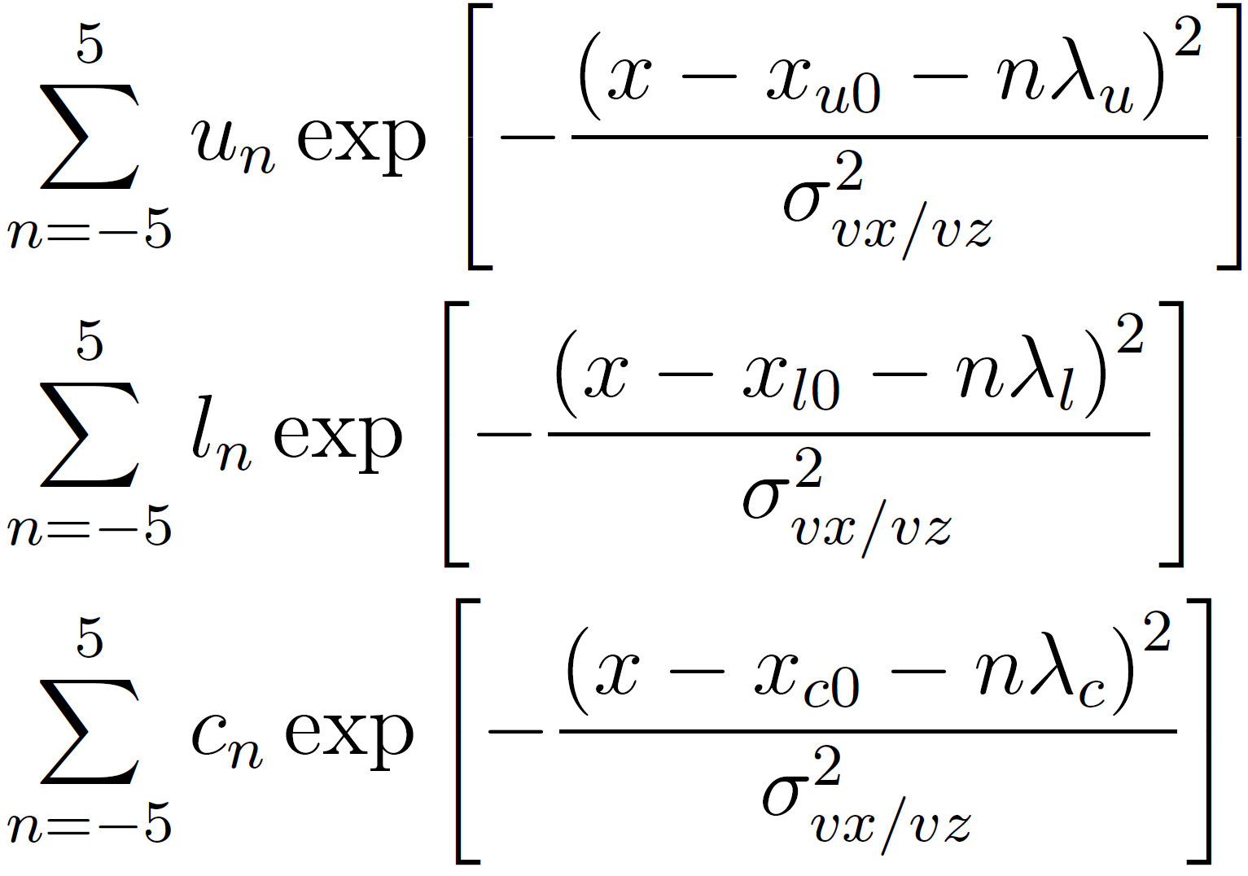
Modeling of PSS in x-direction
One dimensional footprint profile is modelled by
Additional assumption;
Velocity dispersion is common
Only 3-component-model shows good agreement with experiment
=> Decomposed by three components with different beam axis

Slide 40
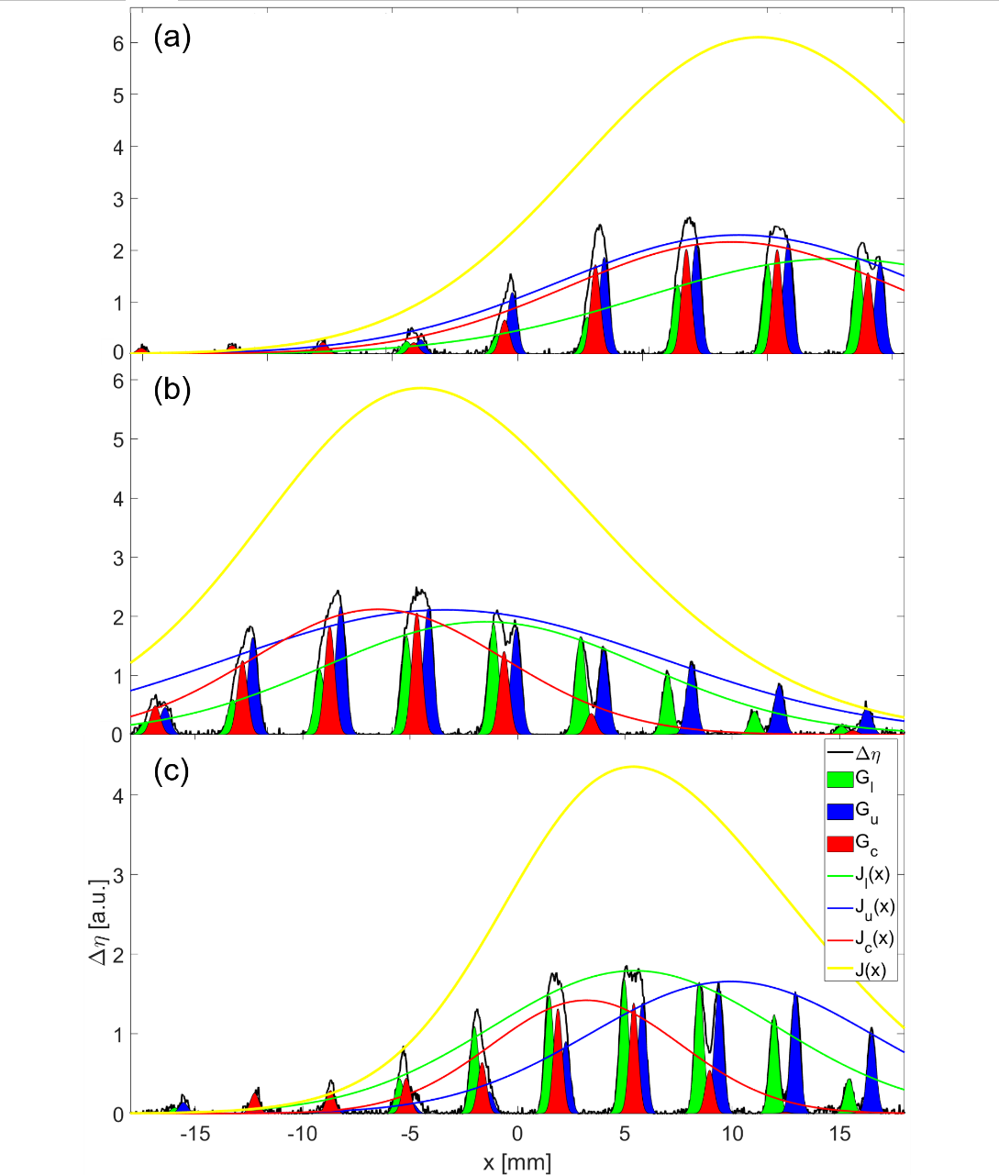
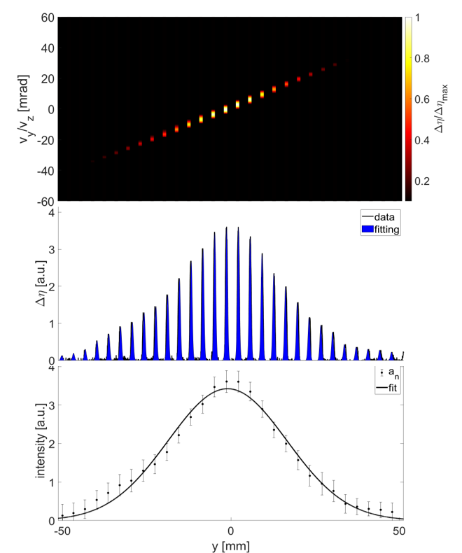
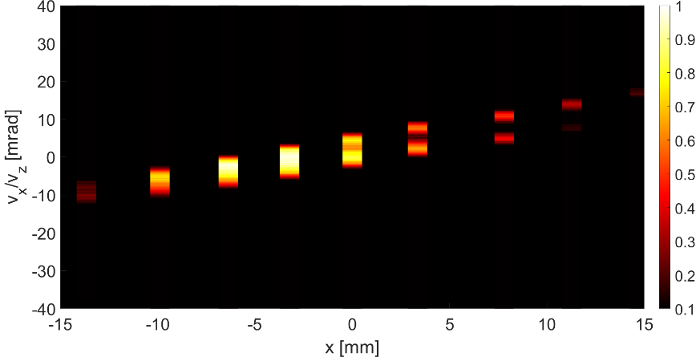
Results for P_{arc} scan

Slide 41
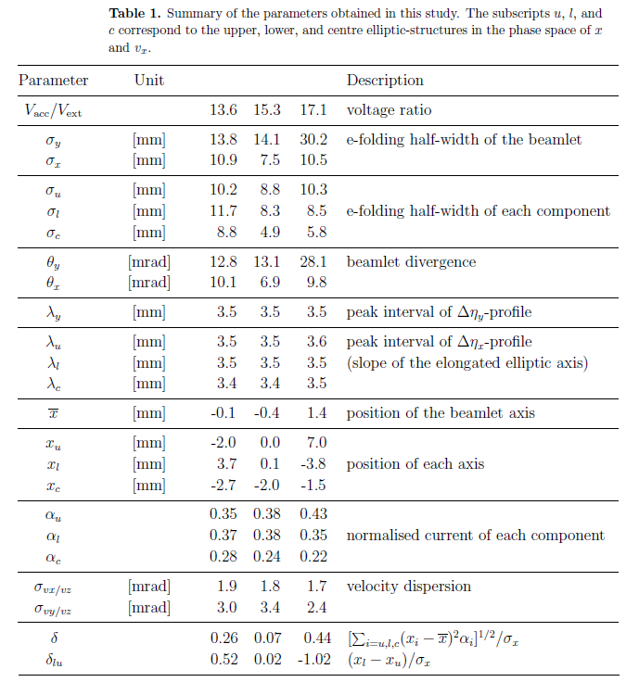
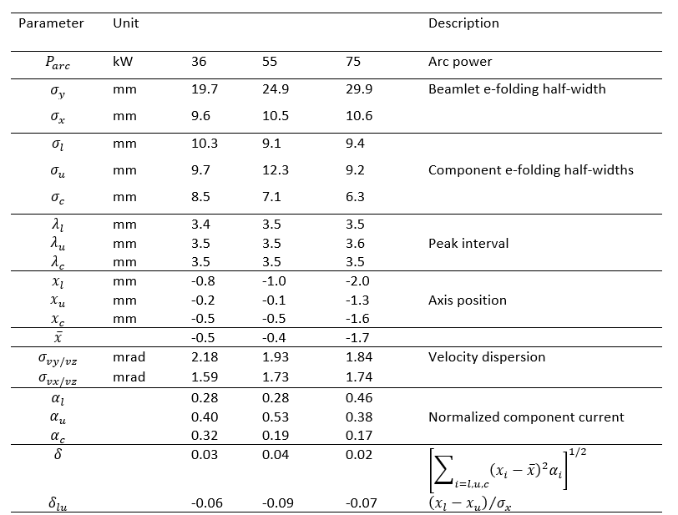
Fitting parameters

Slide 42
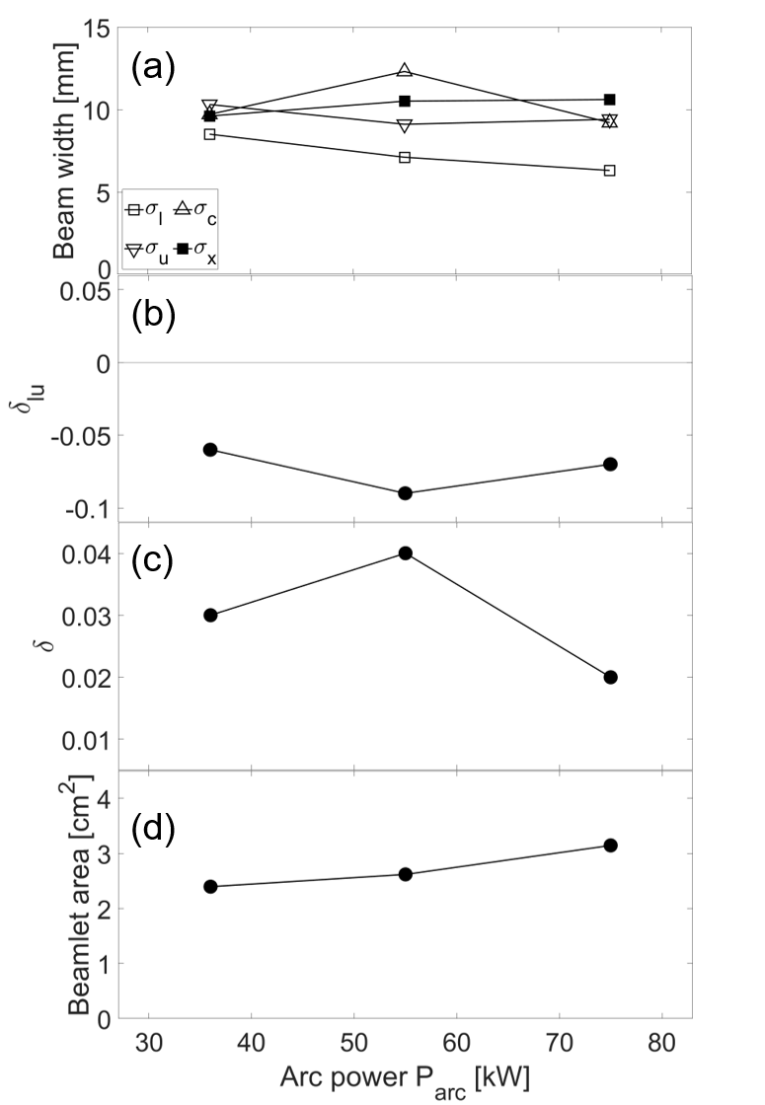

Slide 43
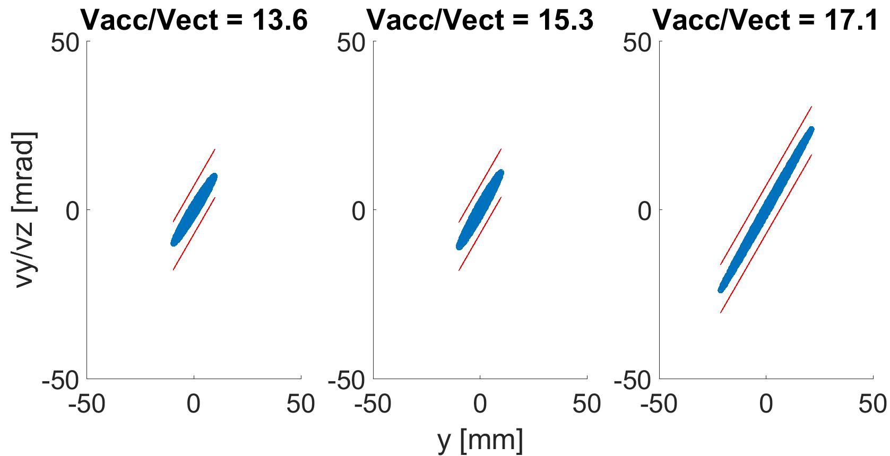
Simulation input
9 inputs

Slide 44
Results - scatter
Vacc/Vext = 13.6
Vacc/Vext = 15.3
Vacc/Vext = 17.1
Location: PG exit

Slide 45
Results – density map
Upper
Center
Lower
Vacc/Vext = 13.6
Vacc/Vext = 15.3
Vacc/Vext = 17.1

Slide 46
Results – phase space
Vacc/Vext = 13.6
Vacc/Vext = 15.3
Vacc/Vext = 17.1

Slide 47
Filter magnets
View from
Y direction
350 mm
230 mm
Electron plasma
Magnetic field induced by filter magnets
Negative-ion plasma

Slide 48
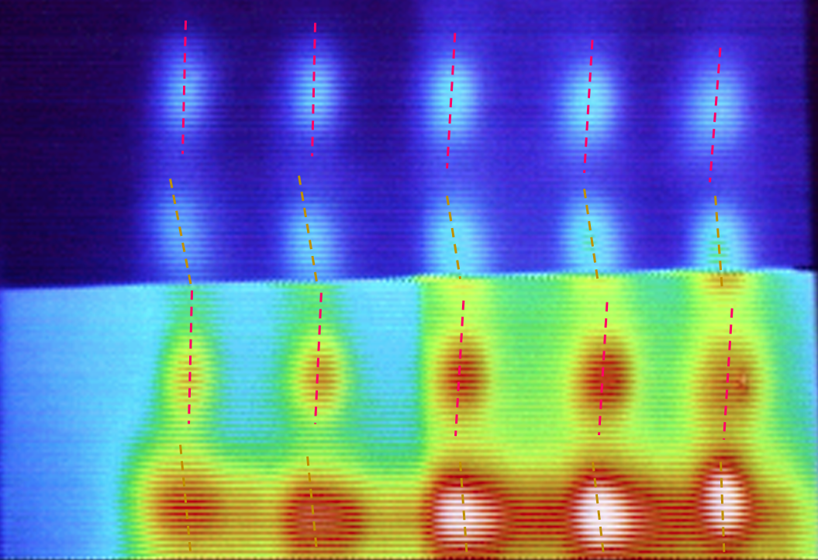
Accelerator on LHD negative NBI
Typical parameters for neutral beam injection (NBI) based on a negative ion source in LHD:
P = 6.4 MW, V = 190 kV
Image of negative ion beams obtained with IR camera
■ Good beam focus：
θ_{h}=4.1 mrad, θ_{v}=6.1 mrad
K. Tsumori 2010
Demonstration of beam focusing of negative ion source for ITER is still in progress

Slide 49
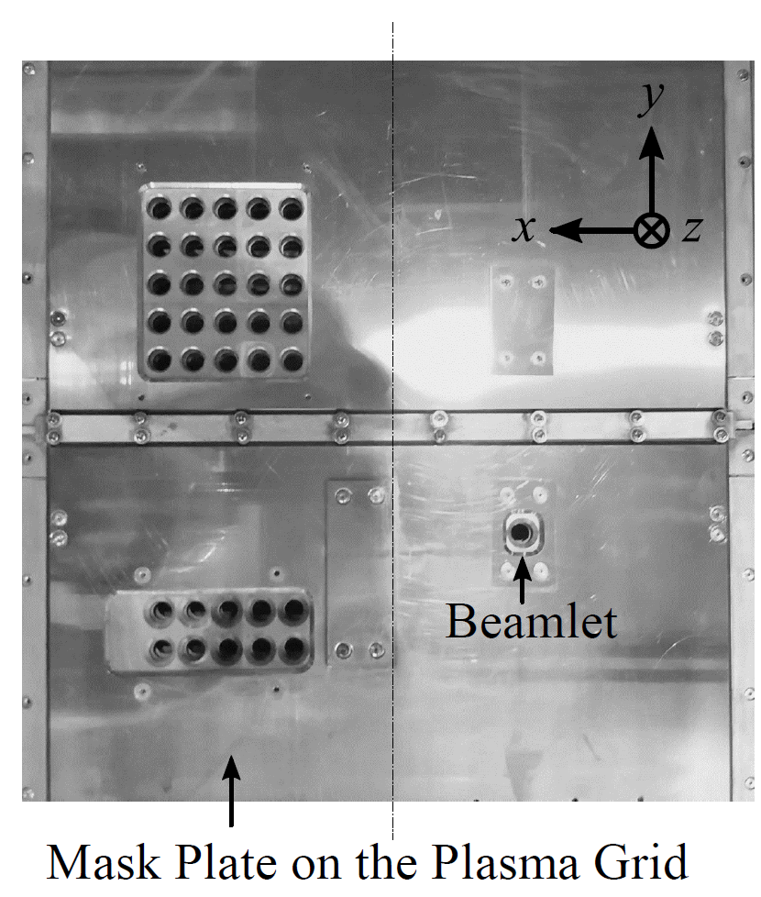
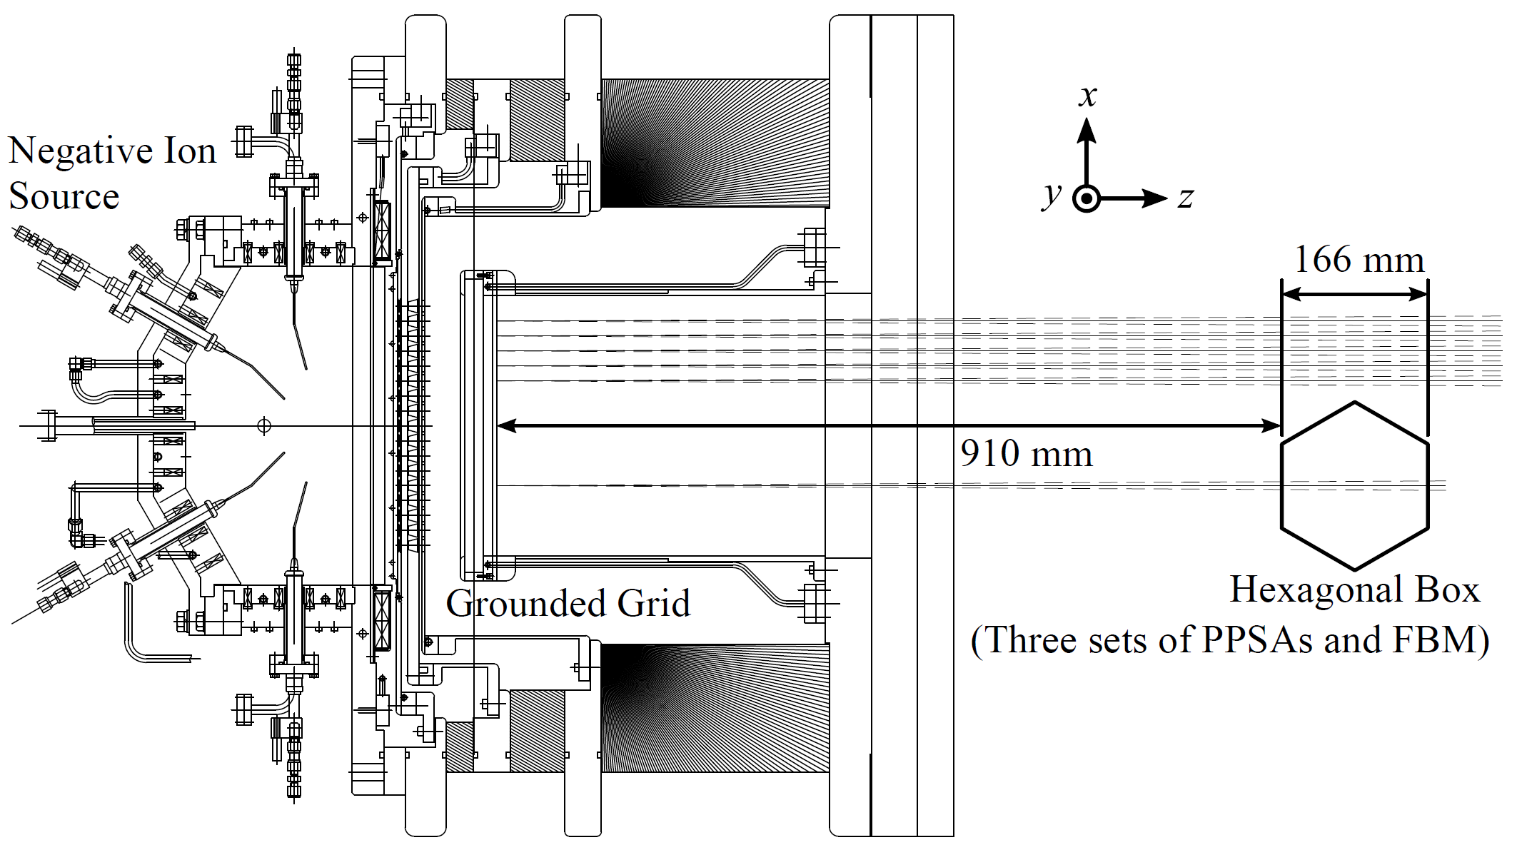
Experiments in NIFS-NBTS with RNIS and FBM
Neutral beam test stand at National Institute for Fusion Science (NIFS-NBTS)
Filament-arc-type negative ion source; Research and development negative ion source (NIFS-RNIS)
PG mask is installed to produce single beamlet
PPSA is installed at 910 mm downstream from GG

Slide 50
Beam interface
Divergence angle: $θ=\frac{1}{4}\frac{2a}{d}\left|1−\frac{5}{3}\frac{P}{P_{c}}\right|$
Where P is given by:
$$P=\frac{I_{i}}{V_{ex}^{3/2}}$$
"Charged Particle Beam Optics" Junzo Ishikawa
Beam Lead-out interface
$$d$$
$$a$$
$$θ$$
（perveance）
Plasma source
In other words, the beam drawer interface (meniscus) is determined only by the perveance and aspect ratio.
Divergence angle$θ$
Perveance：$P=\frac{I_{i}}{V_{ex}^{3/2}}$
Immersion of the electric field v.s. Electric field shielding
$$0$$
$$P (perveance)$$

Slide 51
Bibiliography
[1] M. Bacal and M. Wada. Negative hydrogen ion production mechanisms. Applied Physics Reviews, 2(2):021305, jun 2015. 1, 18
[2] R. S. Hemsworth, D. Boilson, P. Blatchford, M. Dalla Palma, G. Chitarin, H. P.L. De Esch, F. Geli, M. Dremel, J. Gracea, D. Marcuzzi, G. Serianni, D. Shah, M. Singh, M. Urbani, and P. Zaccaria. Overview of the design of the ITER heating neutral beam injectors, feb 2017. 1, 2
[3] https://public.kitware.com/open regate/index.php/BeamLineModeling
Yasuaki Haba et al 2020 New J. Phys. 22, 023017 (2020)
[5] G. Fubiani, L. Garrigues, and J.P. Boeuf, Phys. Plasmas 25, 023510 (2018)

