Slide 1
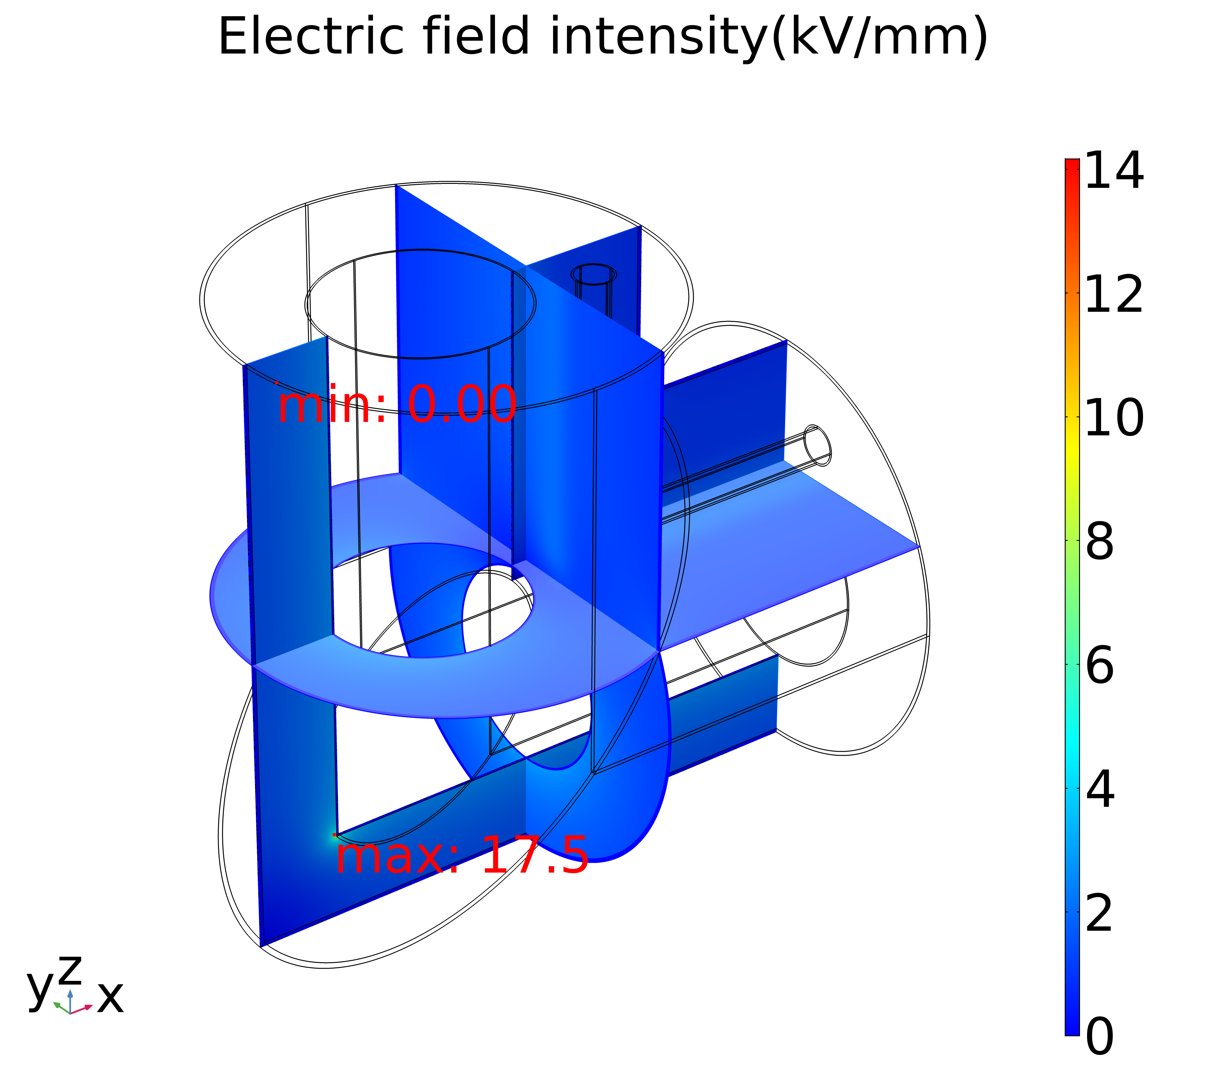
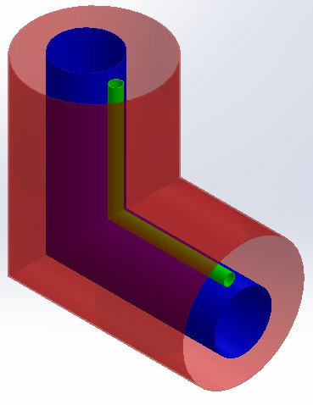
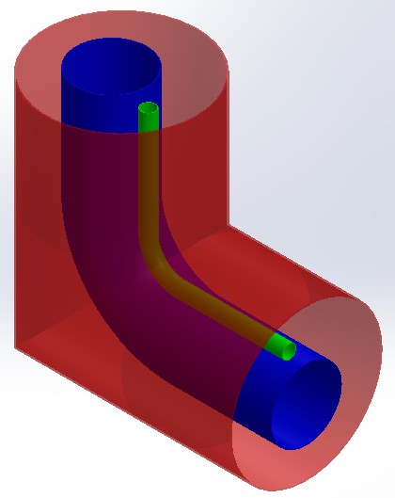
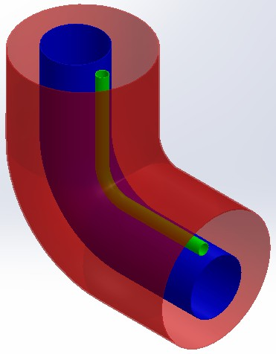
Electrostatic Simulation and Analysis of Transmission Line Corner Section for the CRAFT NNBI test platform
RiXin Wang ^{a,b} , CaiChao Jiang ª, YongJian Xu ^{a*},YaHong Xie ª , YuanLai Xie ª , ChunDong Hu ª
ª Institute of Plasma Physics, Chinese Academy of Sciences, Hefei 230031, P.R.China
^{b} University of Science and Technology of China, Hefei 230026, China
As a reliable heating method with the clearest physical mechanism in the auxiliary heating of magnetic confinement fusion device so far, the Neutral Beam Injection (NBI) system is essential for the China Fusion Engineering Test Reactor (CFETR).
Institute of Plasma Physics, Chinese Academy of Sciences (ASIPP) will establish a NBI test platform based on Radio Frequency (RF) negative ion source to carry out in-depth research of NBI system towards the Comprehensive Research Facility for Fusion Technology (CRAFT), which is the pre-research platform of the CFETR.
The high voltage transmission line is the link between the power supply and the RF negative ion source.
The high voltage of up to -400kV is transmitted through the gas-insulated transmission lines (GIIL),which use insulating gases (such as ${SF}_{6}$) as insulating media, hard metal materials as current transmission conductors, and thin-walled metal grounded shell to shield electromagnetic fields and withstand the pressure of insulating media.
The corner section, which is inevitable in the GITL, is easy to discharge if the design is unreasonable, so the insulation design should be considered in the design of the corner section.
Scheme One: Electrostatic Simulation and Analysis
The electric field is mainly concentrated in the 45° diagonal welds of Acceleration Grid (AG) conductor, Extraction Grid (EG) conductor and the grounding shell, which is due to the formation of discharge tip at these places.
Therefore, all conductors and the grounding shell need to be smoothed to avoid the formation of discharge tips.
In this case, the $E_{max}$ (17.52 $kV/mm$) is much larger than the designed electric field intensity of the gas insulation in the corner section of the GITL (5 $kV/mm$), so it is not recommended to use this scheme.
Insulation Schemes
Cloud map of the electric field distribution
Scheme one: the grounding shell and all conductors are welded at 45° diagonal angles;
Scheme two: the grounding shell is welded at 45° diagonal angles and all conductors are treated with bends;
Scheme three: the grounding shell and all conductors are treated with bends.
Scheme Two: Electrostatic Simulation and Analysis
The electric field distribution in the corner section of the GITL has been greatly improved.
The $E_{max}$，the $E_{sur}$ and the $f$ change irregularly with the increase of corner radius, but the $C_{eq}$ decreases.
When the corner radius is 100 $mm$, although the $E_{max}$ is 4.66 $kV/mm$, which is less than the designed electric field intensity of gas insulation, the $E_{sur}$ is 2.00 $kV/mm$, which exceeds the designed electric field intensity of the initial motion of conductive particles (1.8 $kV/mm$), so it does not meet the design requirements, either.
In the case of other parameters of corner radius, from the point of view of the $E_{max}$ or the $E_{sur}$, it can not meet the design requirements. Therefore, it is recommended not to adopt this scheme, either.
Scheme one
Scheme two
Scheme three
Design Indexes and Standards
Maximum electric field intensity of the corner section of the GITL ($E_{max}$): Not exceed 5 kV/mm;
Maximum electric field intensity of the inner surface of the grounding shell ($E_{sur}$): Not exceed 1.8 kV/mm;
Non-uniformity coefficient of electric field ($f$): As small as possible on the premise of meeting the insulation requirements, but no more than 4;
Equivalent distributed capacitance ($C_{eq}$): As small as possible on the premise of meeting the insulation requirements
Cloud map of the electric field distribution
The influence of corner radius
Scheme Three: Electrostatic Simulation and Analysis
Principle and Method
The electric field distribution in the corner section of the GITL has been further improved.
When the corner radius is 0, the $E_{max}$ is 6.33 $kV/mm$, which exceeds the designed electric field intensity of the gas insulation, so it is recommended not to use this parameter.
However, when the corner radius increases slightly, the $E_{max}$ and the $E_{sur}$ decrease sharply.
When the corner radius continues to increase, the change trends of the $E_{max}$ and the $E_{sur}$ tend to be smooth.
No matter how the corner radius changes, the $f$ is greater than 2 but less than 4, that is, the type of electric field is between slightly non-uniform electric field and extremely non-uniform electric field.
The $E_{max}$，the $E_{sur}$ and the $f$ are basically not affected by the corner angle. However, no matter how the corner angle changes, it can meet insulation requirements.
Because the length of the corner section of the GITL increases with the increase of corner radius or corner angle, the $C_{eq}$ increases linearly.
Method: Finite Element Method (FEM);
Laplace equation of three-dimensional electrostatic field:
$$∇^{2}u=\frac{∂^{2}u}{{∂x}^{2}}+\frac{∂^{2}u}{{∂y}^{2}}+\frac{∂^{2}u}{{∂z}^{2}}=0$$
The first kind of boundary value conditions:
$$\left\{\begin{aligned}u_{AG conductor}=u_{1} \\ u_{EG conductor}=u_{2} \\ u_{Grounding Shell}=0\end{aligned}\right.$$
The electric field intensity ($E$):
$$E=−∇u$$
The electric field non-uniformity coefficient ($f$):
$$f=\frac{E_{max}}{E_{av}}$$
The equivalent distributed capacitance ($C_{eq}$)：
$$C_{eq}=\frac{2W_{e}}{u^{2}}$$
$∇^{2}$: Laplace operator
$u_{1}$ = -200kV
$u_{2}$ = -400kV
$∇$ : Hamiltonian operator
$E_{max}$ : The maximum electric field intensity
$E_{av}$ : The average electric field intensity
$W_{e}$ : The total electric storage energy
$$u=u_{2}$$
Comparison and Selection of Insulation Schemes
Scheme three is superior to scheme one and scheme two, so scheme three is selected as the design scheme of the corner section of the GITL.
The preliminary design parameters of the corner section: the radius of the corner section can change from 50 $mm$ to 150 $mm$ and the angle of the corner section is chosen as 90°. In this case, the maximum electric field strength of the GITL decreases from 3.18 $kV/mm$ to 3.06 $kV/mm$, the maximum electric field strength of the inner surface of the grounding shell decreases from 1.08 $kV/mm$ to $0.73 kV/mm$, the electric field non-uniformity coefficient decreases from 2.21 to 2.15 and the equivalent distributed capacitance increases from 82.12 $pF$ to 94.70 $pF$.
Cloud map of the electric field distribution
Cross section of $xOz$
The influence of corner radius
The influence of corner angle
Cloud map of the electric field distribution (45° section)
Conclusion
Acknowledgement
Design parameters and design indexes of scheme three
Through the finite element analysis, only scheme three can meet the design requirements. And the corner radius is recommended as from 50mm to 150mm, which provide a theoretical basis for the engineering design of the corner section of the GITL.
This work was supported by Comprehensive Research Facility for Fusion Technology Program of China under Contract No. 2018-000052-73-01-001228 and National key R&D Program of China (2017YFE300101).
*Y.J. Xu, et al, 7th International Symposium on Negative Ions, Beam and Sources, 1st-11th September, Online Tel: 86-551-65595662 Fax: 86-551-65593146 E-mail: yjxu@ipp.ac.cn

