Slide 1

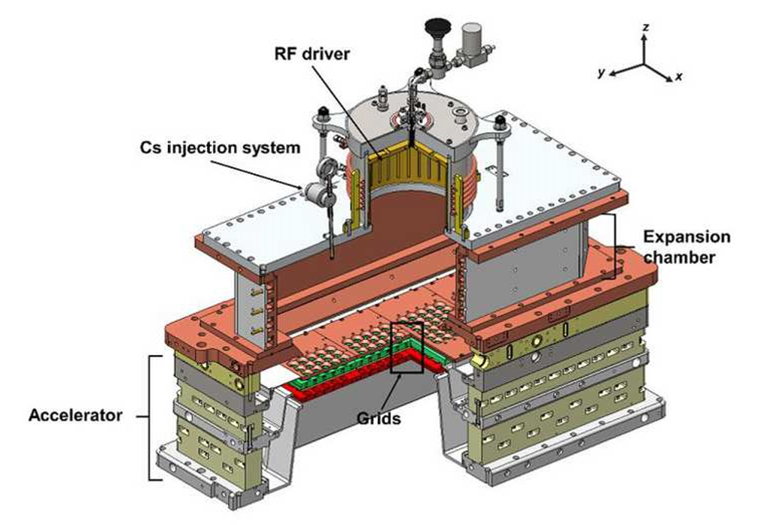
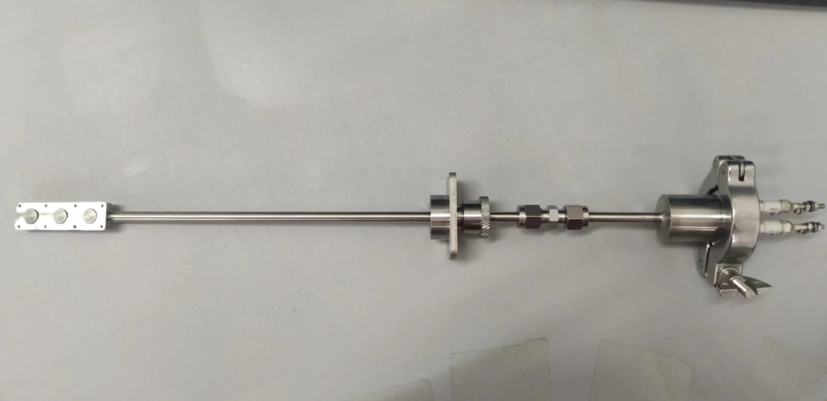
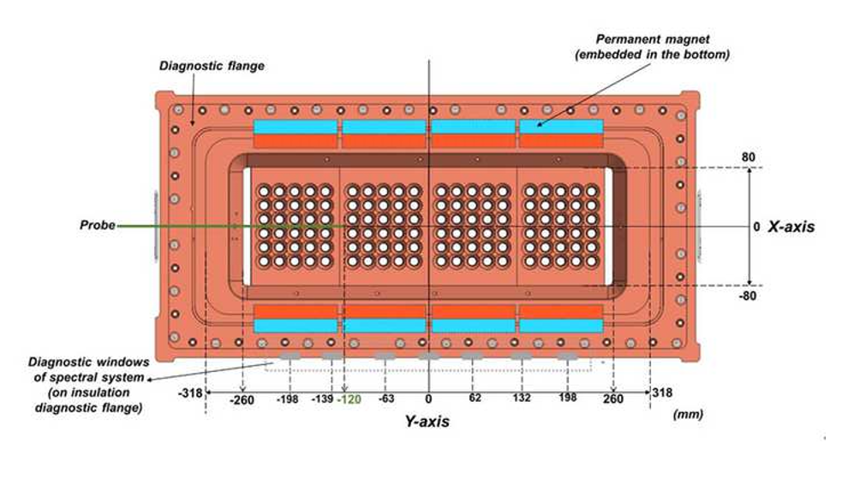
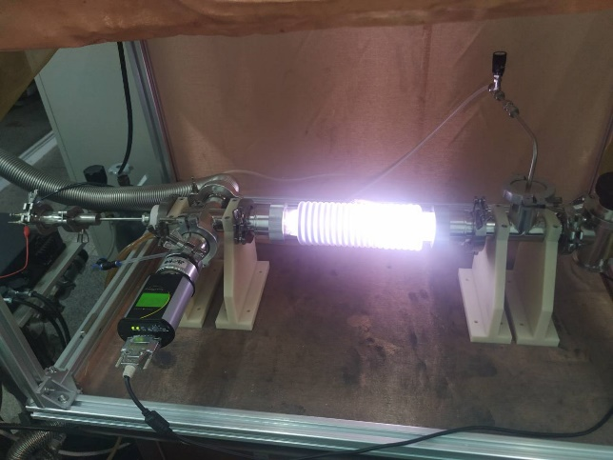
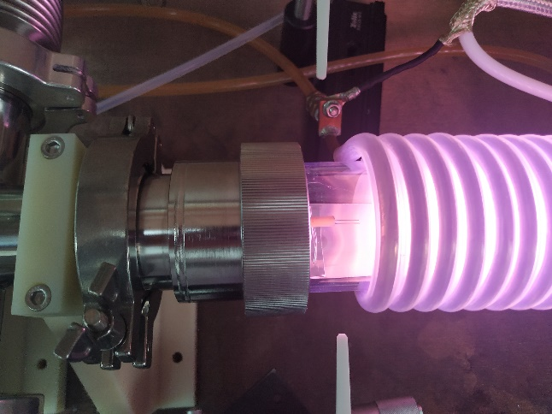
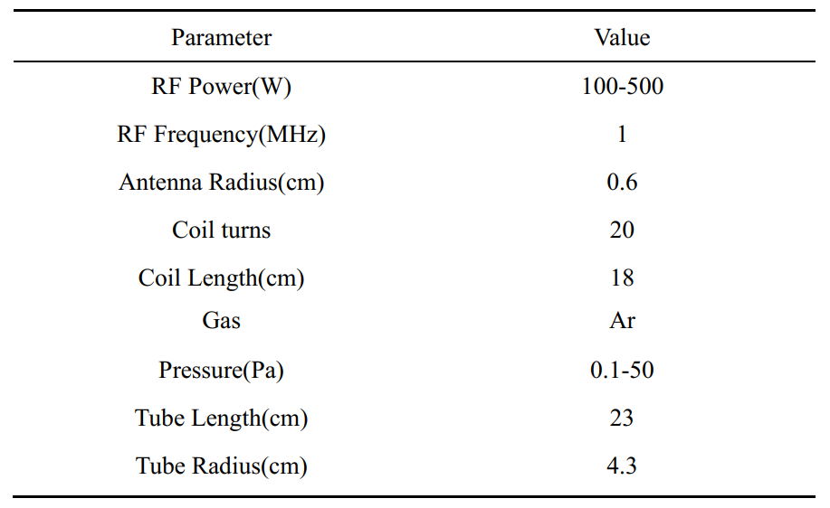
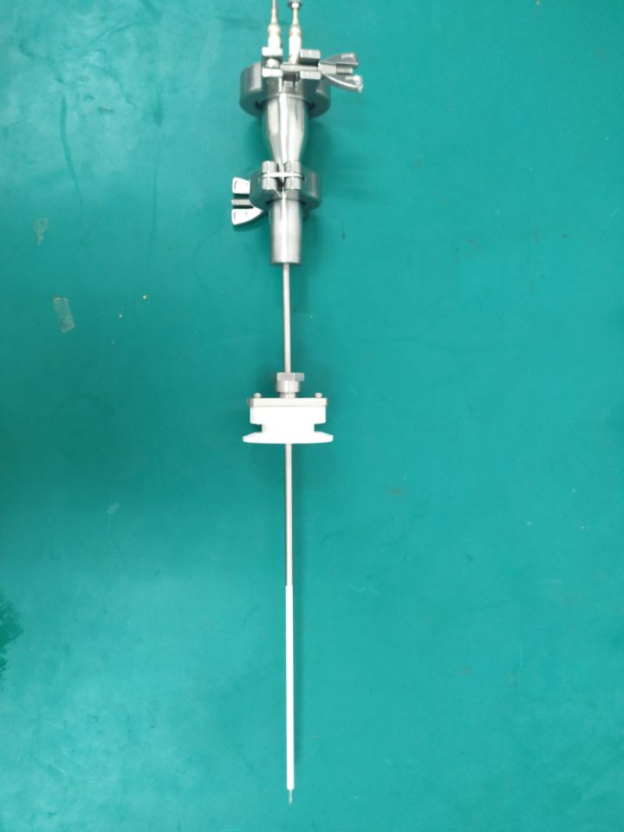
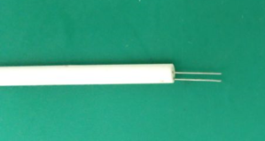
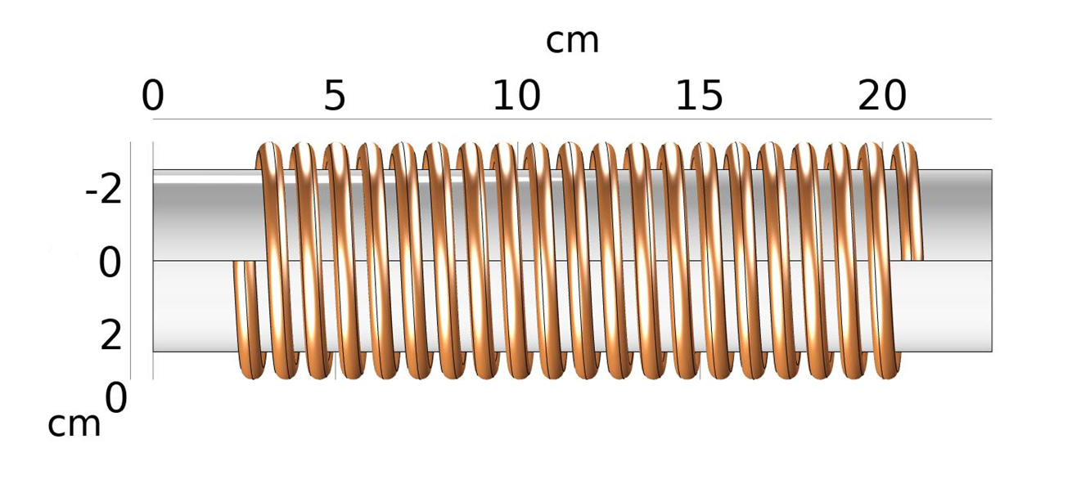



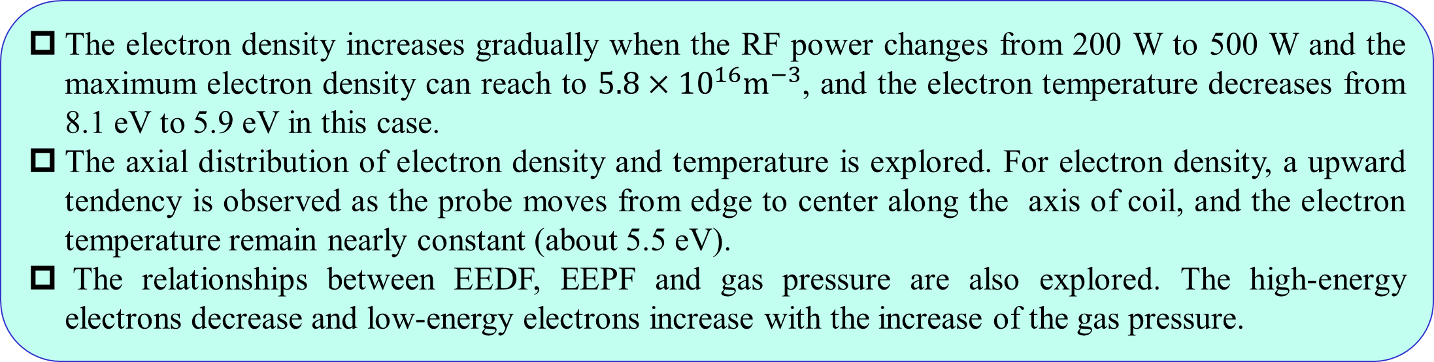
Analysis of plasma characteristics of high-power radio frequency negative ion source based on Langmuir probe
Yongjian Xu ^{a*}, Xufeng peng ^{a, b}, Ling Yu ª, Wei Liu ª, Yahong Xie ª, Chundong Hu ª, Yuanlai Xie ª
ª Institute of Plasma Physics, Chinese Academy of Sciences, Hefei 230031, P.R.China
^{b} Institute of Physical Science and Information Technology, Anhui University, Hefei 230601, China
The plasma parameters of the radio frequency (RF) negative ion source, which directly affect the density of negative ion and the uniformity of the plasma in the extraction area, are important for the optimization of the ion source.
In order to measure these plasma parameters, a set of Langmuir probe system (plate probe and cylindrical probe) will be developed and tested on the RF ion source test facility at the Institute of Plasma Physics, Chinese Academy of Sciences (ASIPP).
For verifying the accuracy of probe system, a probe test platform is built and all the probes are tested on it. Test results show that this Langmuir probe system can meet the requirement of plasma diagnosis for the radio frequency (RF) negative ion source.
These probes are also tested in RF negative ion source and preliminary result are obtained. The results show that the plasma parameters present better uniformity and the electron temperature is maintained at a lower level (about 0.8eV) due to the influence of the filter magnet field in the extraction area and the electron density can reach to $6×{10}^{16}m^{−3}$ at the 55kW RF power. Considering the production of negative ions in the extraction area, the Electron Energy Distribution Functions（EEDF) and the Electron Energy Probability Functions (EEPF) are also given at different operational parameters.
This article helps us to understand the plasma characteristics and provides technical support for experimental study of negative ion production and extraction.
High-power radio frequency ion source test platform
probe
Cylindrical probe
High-power RF negative ion source test platform
The main parameters of the RF negative ion source
Probe installation position
The plane probe
Probe Test Platform
In order to ensure the probe can work properly on the high power ion source with 1 MHz RF frequency, some preliminary tests and analyses are carried out on a probe test bench with 1 MHz RF power supply.
The RF source is mainly composed of the RF power supply, the matching impedance, the RF coil, the vacuum chamber, the vacuum pump, the water cooling system, etc.
The material of the probe tip is a tungsten wire with 3mm diameter and 10mm length. And the sampling resistance is taken as 100Ω.
Cylindrical probe
Physical map of plane probe
Probe installation position
Taking the long side direction of the Plasma Grid (PG) as the X axis, the short side direction of the PG as the Y axis, and the vertical upward direction as the Z axis to establish a 3-D spatial coordinate system.
The spatial coordinates of the short side probe are (0, y, 2.87), the spatial coordinates of the long side probe are (x, -1.4, 2.87), and the spatial coordinates of the top probe are (17.3, 0, z).
Vacuum Gauge
Probe test results
The figure of probe test platform
Main parameters of RF plasma source
X-axis
probe
Plasma parameter distribution in the x-axis direction
Plasma parameter distribution in the y-axis direction
Probe installation position
Probe test results
Plasma parameter distribution in the z-axis direction
Plasma parameters change with the power
Changes in electron temperature and density with power
Changes in electron temperature and density with position
The EEPF versus electron energy for different pressures
The behavior characteristics of plasma in the extraction region are studied. The electron temperature is about 0.8 eV, and the distribution of the electron density in the extraction area shows good uniformity (about $2\sim 3×{10}^{16}m^{−3}$) due to the filtered magnetic field (see Fig.a and Fig.b) when the RF power is 50 kW.
The behavior characteristics of plasma in the vertical direction of expansion chamber are studied. The electron temperature (from 6.2eV to 1.8eV) and the electron density (from $9.3×{10}^{16}$ $m^{−3}$ to $1.3×{10}^{16}$ $m^{−3}$) gradually decrease with the change of the position of the expansion chamber from the top to the bottom (see Fig.c). It is consistent with the simulation results in our previous research.
The electron density and the electron temperature dependence on RF power in the extraction region are also explored. The electron density presents obvious trend of rising with the increase of power and the electron temperature shows slight increase in this case (see Fig.d).
The relationships between EEDF and gas pressure is explored. The change of EEDF is not obvious because of limited range of gas pressure. The electron energy is mainly distributed as lower end $\left(<2eV\right)$, it is favorable to production of negative ions (see Fig.e and Fig.f) .
The EEDF versus electron energy for different pressures
The EEPF versus electron energy for different pressures
The electron density increases gradually when the RF power changes from 200 W to 500 W and the maximum electron density can reach to $5.8×{10}^{16}m^{−3}$, and the electron temperature decreases from 8.1 eV to 5.9 eV in this case.
The axial distribution of electron density and temperature is explored. For electron density, a upward tendency is observed as the probe moves from edge to center along the axis of coil, and the electron temperature remain nearly constant (about 5.5 eV).
The relationships between EEDF, EEPF and gas pressure are also explored. The high-energy electrons decrease and low-energy electrons increase with the increase of the gas pressure.
Conclusion
Acknowledgement
The self-made probes can be used a diagnostic tool for accurate analysis of plasma parameters and it is helpful for experimental research of RF negative ion source. The next step is to make a probe array to further measure and analyze plasma uniformity in the extraction area.
This work was supported by Comprehensive Research Facility for Fusion Technology Program of China under Contract No. 2018-000052-73-01-001228 and Collaborative Innovation Program of Hefei Science Center, CAS (2020HSCCIP016).
*Y.J. Xu, et al, 7th International Symposium on Negative Ions, Beam and Sources, 1st-11th September, Online Tel: 86-551-65595662 Fax: 86-551-65593146 E-mail: yjxu@ipp.ac.cn

