Slide 1

Toward the next generation of high-peak-power lasers:
compression after compressor approach
V.N. Ginzburg, I.V. Yakovlev, A.S. Zuev, A.P. Korobeinikova, A.A. Kochetkov,
A.A. Kuz’min, S.Yu. Mironov, A.A. Shaykin, I.A. Shaykin, E.A. Khazanov
Institute of Applied physics of Russian Academy of Science
Motivation
Compression after Compressor Approach (CafCA)
  Small-scale self-focusing suppression in powerful laser beams
Experimental results
Conclusions

Slide 2
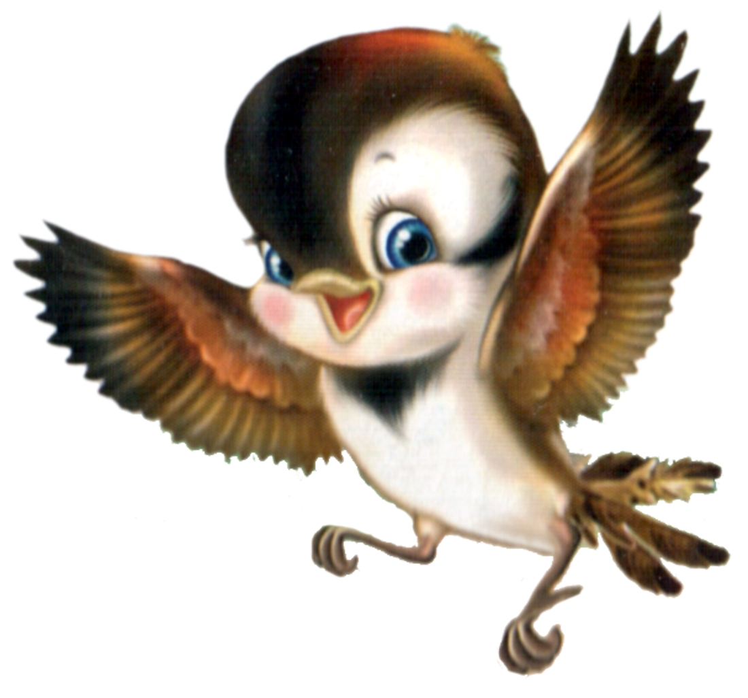
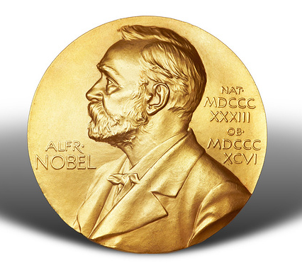
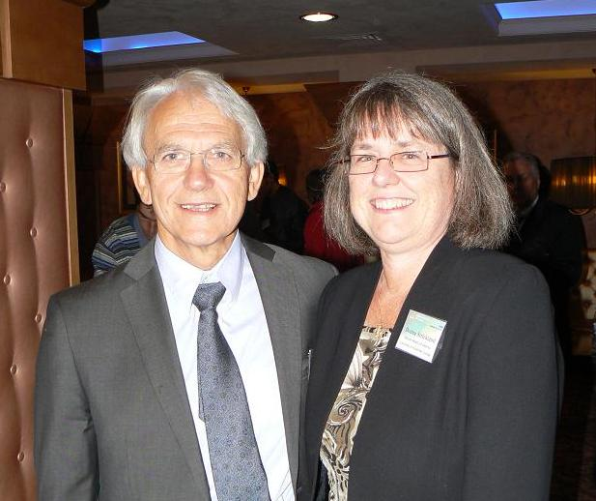
Chirped Pulse Amplification
CPA
I(t)
I
I
б
g
I(t)
g
I(t)
S
I(t)
I(t)
I
C
NE
A
a
DM
t
t
t
t
t
S(ω)
φ(ω)
S(ω)
φ(ω)
S(ω)
φ(ω)
S(ω)
φ(ω)
S(ω)
I
φ(ω)
I(t)
m
ω
ω
ω
ω
ω
S – stretcher,
A – laser amplifier,
C – compressor,
NE – nonlinear element,
DM – dispersion mirror;
I_{a} , I_{g} – breakdown threshold of the amplifiers, diffractions gratings.
DM
t
S(ω)
φ(ω)
ω

Slide 3
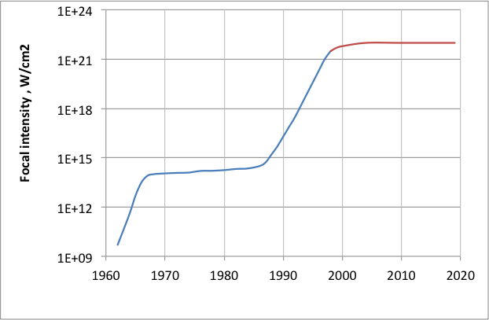
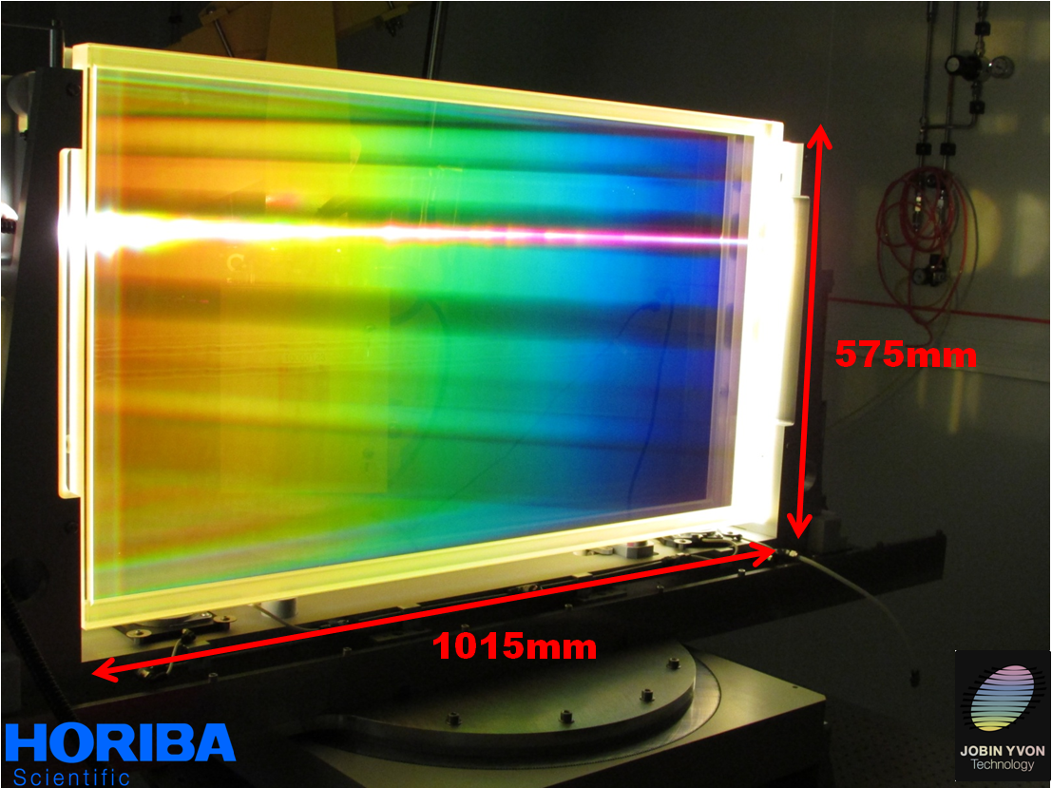
New idea is wanted for the next jump
amplifier
damage threshold
grating
damage threshold
energy
pulse duration

Slide 4
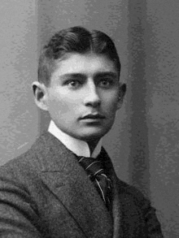
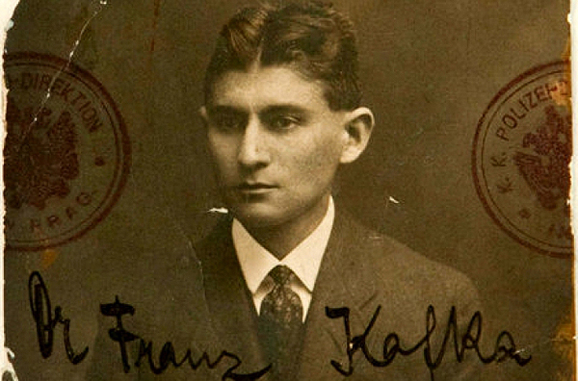
Compression after Compressor Approach
Compression after Compressor Approach
CafCA
chirped pulse
I(t)
I_{g}
I(t)
nonlinear
element
I_{g}
chirped
mirror
t
S(ω)
I_{m}
φ(ω)
S(ω)
I(t)
φ(ω)
ω
ω
Self-phase modulation
FTL pulse
t
FTL pulse
S(ω)
chirped
mirror
φ(ω)
CafCA
ω

Slide 5
CPA + CafCA
CPA
I(t)
I
I
g
I(t)
g
CafCA
I(t)
S
I
C
NE
I(t)
A
I(t)
a
CM
t
t
t
t
t
S(ω)
φ(ω)
S(ω)
φ(ω)
S(ω)
φ(ω)
S(ω)
φ(ω)
S(ω)
I
φ(ω)
I(t)
m
ω
ω
ω
ω
ω
S – stretcher,
A – laser amplifier
C – compressor
NE – nonlinear element
CM – chirped mirror
I_{a} , I_{g} and I_{m}– breakdown threshold of the amplifiers, diffractions gratings and chirping mirrors.
CM
t
S(ω)
φ(ω)
ω

Slide 6
Motivation
Compression after Compressor Approach (CafCA)
  Small-scale self-focusing suppression in powerful laser beams
Experimental results
Conclusions

Slide 7
CafCA theory basics
nonlinear
element
a=E(t,z)/E(0,0) : electric field
Z=z/L : normalized distance
η=(t-z/u)/τ_{pulse}, : normalized time
τ_{pulse} : pulse duration
z
z=0
z=L
B=n₂IkL=L/L_{nonlinear}
D=k₂L(τ_{pulse})²=L/L_{dispersion}<<1
F_{spectra}= 1+0.9B(1-1.5D^{1/2})
F_{pulse} = 1+0.6B(1-1.25D^{1/2})
F_{power} = 1+0.5B(1-1.2D^{1/2})

Slide 8
CafCA theory basics
F_{spectra}
F_{pulse}
F_{power}
D=0
D=0.02
D=0.05
D=0
D=0.02
D=0.05
D=0
D=0.02
D=0.05
F_{power} ≈ 1+B/2
F_{spectra} = 1+0.9B(1-1.5D^{1/2})
F_{pulse duration} = 1+0.6B(1-1.25D^{1/2})
F_{power} = 1+0.5B(1-1.2D^{1/2})

Slide 9
CafCA hystory from nJ to mJ
nJ
mJ
Fisher, R.A., Kelley, P.L., and Gustajson, T.K., "Subpicosecond pulse generation using the optical Kerr effect " Applied Physics Letters 14(4), 140-143, 1969.
idea
Laubereau, A., "External frequency modulation and compression of picosecond pulses," Physical Letters 29A(9), 539-540, 1969.
liquid
Nakatsuka, H., Grischkowsky, D., and Balant, A.C., "Nonlinear Picosecond-Pulse Propagation- through Optical Fibers arith Positive Group Velocity Dispersion," Physical Review Letters 47(13), 910-913, 1981.
fiber
Rolland, C. and Corkum, P.B., "Compression of high-power optical pulses," Journal of the Optical Society of America B 5(3), 641-647, 1988.
focused beam
Nisoli, M., Silvestri, S.D., and Svelto, O., "Generation of high energy 10 fs pulses by a new pulse compression technique," Applied Physics Letters 68(20), 2793-2795, 1996.
hollow core fiber

Slide 10
CafCA hystory from nJ to J
CafCA hystory from nJ to J

Slide 11
CafCA hystory from nJ to J
CafCA hystory from nJ to J

Slide 12
Motivation
Compression after Compressor Approach (CafCA)
  Small-scale self-focusing suppression in powerful laser beams
Experimental results
Conclusions

Slide 13
CafCA scaling problems and solutions
B=n₂IkL
Power scaling
Physical problems : Solutions:
small-scale self-focusing free space beam filtering
non flat-top beam shape negative lens
Technological problem: Solutions:
very high aspect ratio 1:100+ plastic instead of glass

Slide 14
Small-scale self-focusing basics
B=n₂IkL
Instability if
L, n₂
k_{noise}
θ=k⊥/k
k
z
k_{noise}
V.I. Bespalov and V.I. Talanov, "Filamentary structure of light beams in nonlinear liquids," JETP Letters, 3, 307-310 (1966).

Slide 15
Small-scale self-focusing basics
B=n₂IkL
K(θ=0)=1+4B²
K_{max}=exp(2B)/2
Rozanov, N.N. and Smirnov, V.A., "Small-scale self-focusing of laser radiation in amplifier systems," Soviet Journal of Quantum Electronics 10, 232-, 1980

Slide 16
Small-scale self-focusing basics
B<2…3
F_{power}≈1+B/2
F_{power}<2…2.5

Slide 17
Small-scale self-focusing suppression
The technique of beam filtering depends on the intensity level
For ns laser beams intensities I ~ 1÷10GW/cm² θ_{max}=0.73÷2 mrad
Vacuum spatial filters
D
F
F
d
F>>D
How laser beam can be filtered at the intensity ~ 1TW/cm²?

Slide 18
Beam self-filtering
The technique of beam filtering depends on the intensity level
For ns laser beams intensities I ~ 1÷10GW/cm² θ_{max}=0.73÷2 mrad
For fs laser beams intensities I ~ 1÷10TW/cm² θ_{max}=20÷50 mrad
y
D
d
θ_{v}
θ
Free space propagation leads to beam self-filtering
I=1TW/cm², d=100mm: the safety distance D>1.6m

Slide 19
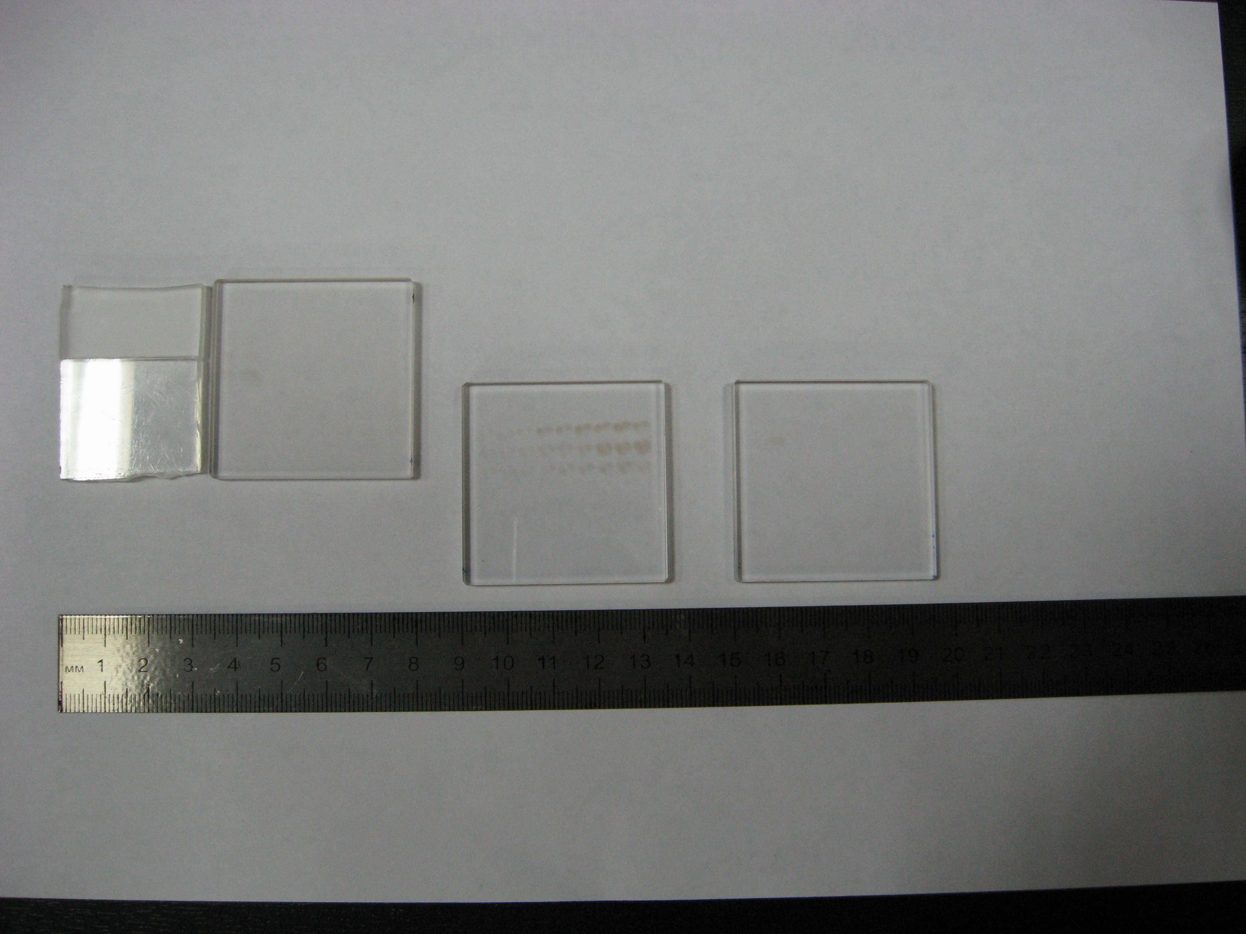
Beam self-filtering
100 shots were made in each point
B-intergal
Distance from the mirror
S.Y. Mironov, V.V. Lozhkarev, V.N. Ginzburg, I.V. Yakovlev, G. Luchinin, A.A. Shaykin, E.A. Khazanov, A.A. Babin, E. Novikov, S. Fadeev, A.M. Sergeev, and G.A. Mourou,
IEEE Journal of Selected Topics in Quantum Electronics 18, 7-13 (2012).

Slide 20
Beam self-filtering
Beam self-filtering may be used not only for CafCA but for any transparent optical element:
λ/2, λ/4 plates
polarizers
beam splitter
second harmonic generation
window
XPW generation

Slide 21
Motivation
Compression after Compressor Approach (CafCA)
  Small-scale self-focusing suppression in powerful laser beams
Experimental results
Conclusions

Slide 22
CafCA in experiments
Example 1: at the output of the PEARL front-end
Ø 20mm, W=20mJ, T_{pulse}=66fs -> 30fs, L_{plastic}=3mm, B~2
ACF w/o SPM and
after SPM & chirped mirrors
Spectra before and after SPM
ACF
ACF
30.5 fs
pulse
93fs
43fs
V. N. Ginzburg, A. A. Kochetkov, I. V. Yakovlev, S. Y. Mironov, A. A. Shaykin, E. A. Khazanov, Influence of the cubic spectral phase of high-power laser pulses on their self-phase modulation Quantum Electronics, 46, 106, 2016

Slide 23
CafCA in experiments
Example 2: at the output of the PEARL
Ø 100mm, W=6J, T_{pulse}=56fs -> 24fs, L_{plastic}=0.5mm, B~3
ACF w/o SPM and
after SPM & chirped mirrors
Spectra before and after SPM
ACF
ACF
24 fs
pulse
S.Y. Mironov, V.N. Ginzburg, I.V. Yakovlev, A.A. Kochetkov, A.A. Shaykin, E.A. Khazanov, and G.A. Mourou, Quantum Electronics 47, 614-619 (2017).

Slide 24
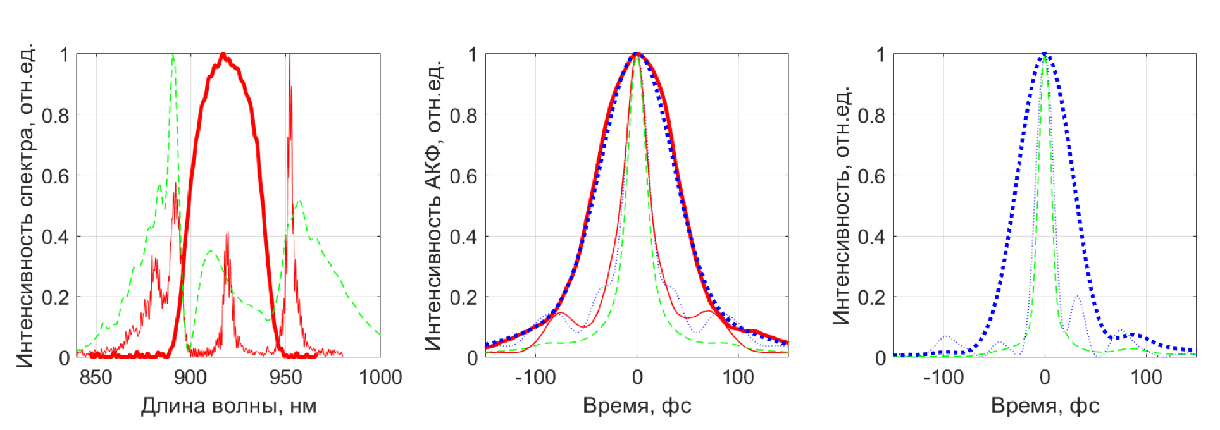
CafCA in experiments
Example 3: at the output of the PEARL
Ø 160mm, W=12J, T_{pulse}=63fs -> 21fs, L_{glass}=3 mm, B~6
Intensity, a.u.
ACF, a.u.
Intensity, a.u.
wavelength, nm
time, fs
time, fs
V. N. Ginzburg, I. V. Yakovlev, A. S. Zuev, A. A. Korobeinikova, A. A. Kochetkov, A. A. Kuz'min, S. Y. Mironov, A. A. Shaykin, I. A. Shaykin, and A. E. Khazanov,
"Compression after compressor: threefold shortening of 200-TW laser pulses," Quantum Electronics, 49, 299, 2019.

Slide 25
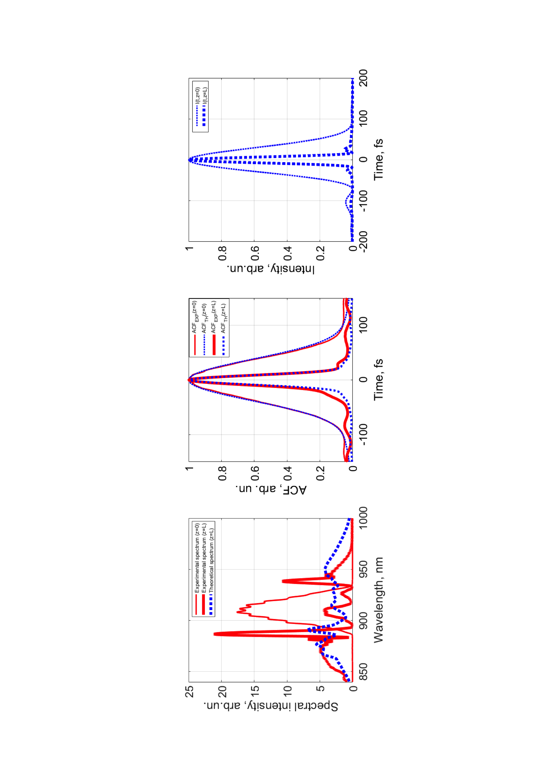
Fresh new results
Ø 160mm, W=17J, T_{pulse}=70fs -> 14fs, L_{glass}=3 mm, B~7.5
PRA, 101, 013829 2020

Slide 26
Fresh new results
Ø 160mm, W=17J, T_{pulse}=70fs -> 14fs, L_{glass}=3 mm, B~7.5

Slide 27
Fresh new results
Ø 160mm, W=17J, T_{pulse}=70fs -> 14fs, L_{glass}=3 mm, B~7.5
КЭ, 50,(4),331–334 (2020)

Slide 28

Instead of conclusion
CafCA is simple, robust and cheap recipe:
just add free space, glass plate and chirp mirror(s)
any high power laser
1TW ... 10+PW
15fs … 1ps
mJs … kJs
1 m²… 1000+m²
100k$ ... 1G$
I(t)
I_{g}
I(t)
I_{g}
I(t)
I_{m}
free
space
beam
self-
cleaning
glass
plate
self-
phase
modulation
chirped
mirror(s)
pulse
compression
t
S(ω)
φ(ω)
S(ω)
φ(ω)
ω
ω
t
S(ω)
φ(ω)
ω
CafCA
E.Khazanov, S. Mironov, and G.Mourou
"Nonlinear compression of high-power laser pulses: compression after compressor approach,” Phys. Usp., accepted, (2019)

Slide 29
Thank you

Slide 30
Conclusions
The peak power of present-day lasers is limited by the breakdown threshold of the optical compressor diffraction gratings.
The Compression AFter Compressor Approach (CafCA) is one of the most promising ways for overcoming this barrier.
The pulse spectrum is broadened thanks to the self-phase modulation in a medium with Kerr nonlinearity and then the pulse is compressed after reflection at dispersion mirrors.
CafCA possesses undoubted merits:
  simplicity and low cost
  negligibly small energy loss
  applicability to any high-power laser
Fivefold pulse shortening is demonstrated at 250 TW laser power

Slide 31
Defocusing lens for uniform SPM
S.Y. Mironov, V.V. Lozhkarev, E.A. Khazanov, and G. Mourou,
Quantum Electronics 43, 711-714 (2013).
S. Mironov, P. Lassonde, J.C. Kieffer, E. Khazanov, and G. Mourou,
European Physical Journal-Special Topics, 223, 1175-1180 (2014).
Lassonde, S. Mironov, S. Fourmaux, S. Payeur, E. Khazanov, A. Sergeev, J.-C. Kieffer, and G. Mourou,
Laser Physics Letters, 13, 075401 (2016).
B=n₂IL
PW laser
chirped
mirror(s)
Self-Phase Modulation (SPM)

Slide 32
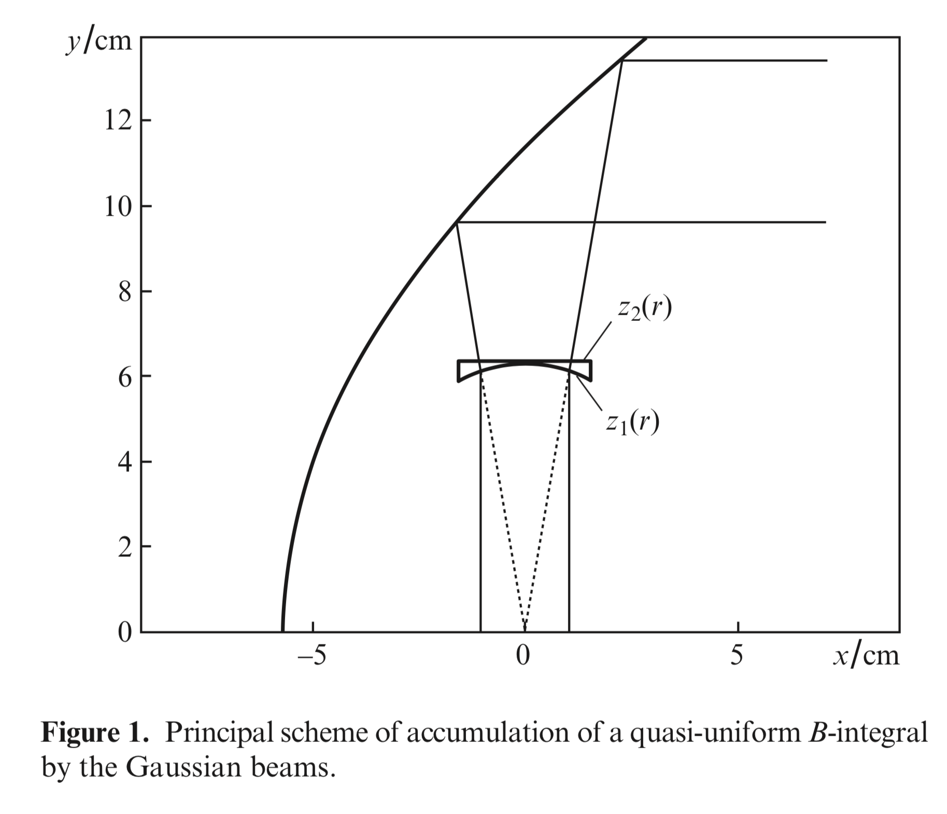
Defocusing lens for uniform SPM

Slide 33
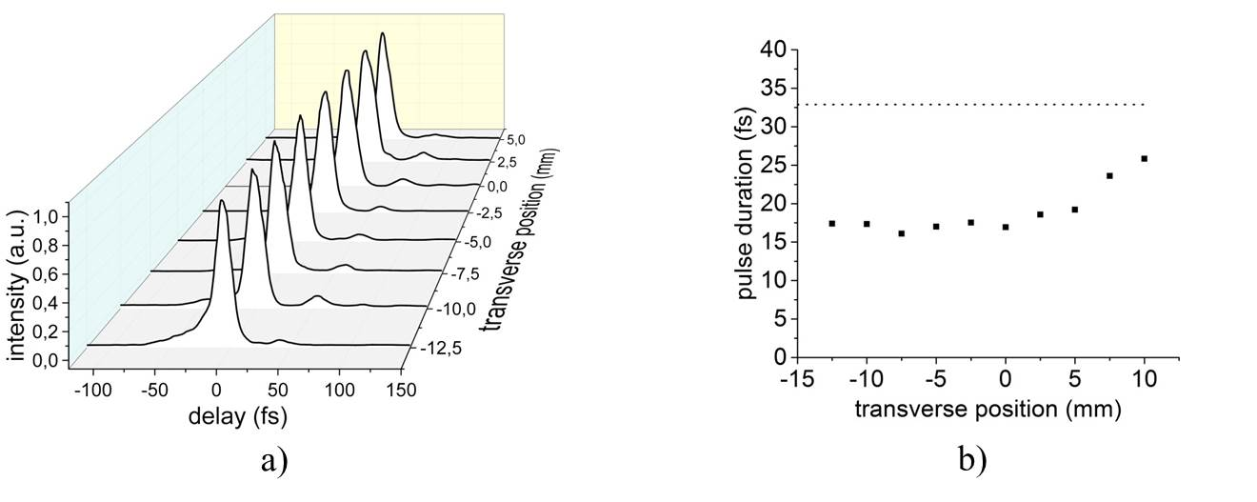
CafCA in experiments
Example 1: at ALLS, Canada, in defocussing lens
Ø 38mm, W=170mJ, T_{pulse}=33fs ->16fs, L_{lens}=0.3mm, B~5, -220fs²
16 fs
pulse
P. Lassonde, S.Mironov, S.Fourmaux, S.Payeur, E.Khazanov, A.Sergeev, J.-C.Kieffer, G. Mourou, "High energy femtosecond pulse compression," Laser Physics Letters, 13, 075401, 2016.

Slide 34
Plastic – unlimited aperture and aspect ratio
G. Mourou, S. Mironov, E. Khazanov, and A. Sergeev,
European Physical Journal-Special Topics, 223, 1181-1188 (2014).
B=n₂IL
PW laser
chirped
mirror(s)
Self-Phase Modulation (SPM)

Slide 35
Plastic (polyethylene terephthalate)
G. Mourou, S. Mironov, E. Khazanov, and A. Sergeev, "Single cycle thin film compressor opening the door to Zeptosecond-Exawatt physics,"
European Physical Journal-Special Topics, vol. 223 , 1181–1188, 2014.

Slide 36
Small-scale self-focusing suppression
in powerful laser beams
S.Y. Mironov, V.V. Lozhkarev, V.N. Ginzburg, I.V. Yakovlev, G. Luchinin, A.A. Shaykin, E.A. Khazanov, A.A. Babin, E. Novikov, S. Fadeev, A.M. Sergeev, and G.A. Mourou,
IEEE Journal of Selected Topics in Quantum Electronics 18, 7-13 (2012).
S. Mironov, V. Lozhkarev, G. Luchinin, A. Shaykin, and E. Khazanov,
Applied Physics B, 113, 147-151 (2013).
V.N. Ginzburg, A.A. Kochetkov, A.K. Potemkin, E.A. Khazanov,
Quantum Electronics 48 (4) 325 – 331 (2018)
B=n₂IL
PW laser
chirped
mirror(s)
Self-Phase Modulation (SPM)

Slide 37
Experimental Results
diameter/distance
z
W
Theoretical curves: logarithm of noise power.
Experimental points: black, gray and white circles correspond to high, small and zero transmission reduction due to optical damage

Slide 38
CafCA in experiments
S Yu Mironov, V N Ginzburg, E I Gacheva, D E Silin, A A Kochetkov, Yu A Mamaev, A A Shaykin, E A Khazanov, and G A Mourou
Laser Phys. Lett. 12, 025301 (2015)
V.N. Ginzburg, A.A. Kochetkov, I.V. Yakovlev, S.Y. Mironov, A.A. Shaykin, and E.A. Khazanov
Quantum Elrctronics, 46, 106-108 (2016).
P. Lassonde, S. Mironov, S. Fourmaux, S. Payeur, E. Khazanov, A. Sergeev, J.-C. Kieffer, and G. Mourou
Laser Physics Letters, 13, 075401 (2016).
S.Y. Mironov, V.N. Ginzburg, I.V. Yakovlev, A.A. Kochetkov, A.A. Shaykin, E.A. Khazanov, and G.A. Mourou,
Quantum Electronics 47, 614-619 (2017).
B=n₂IL
PW laser
chirped
mirror(s)
Self-Phase Modulation (SPM)

Slide 39
а
б
НЭ
в
г
НЭ
НЭ
НЭ
НЭ
CafCa
второй каскад CafCa

Slide 40
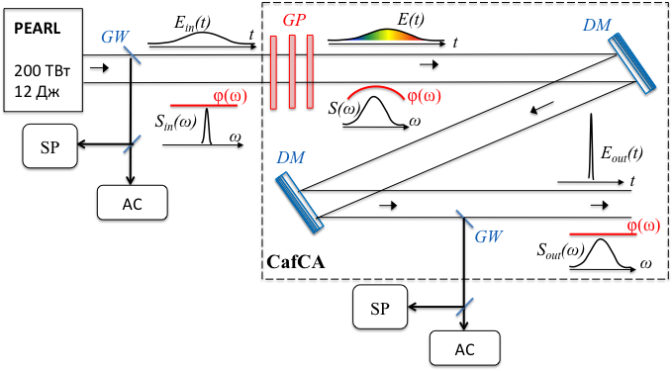
CafCA scaling problems and solutions
Example 4: at the output of the PEARL front-end

Slide 41
CafCA: double-stage
1st stage CafCA
E₀(t)
NP
E₀(t)e^{-iγ}₁^{│E0(t)│2}
CM
t
t
in
S₀(ω)
R=e^{iα1ω2}
S₁(ω)
ω
ω
T
BC
E₁(t)
k﬩
out 1
t
S₁(ω)
ω
E₁(t)
NP
2nd stage CafCA
CM
E₁(t)e^{-iγ}₂^{│E1(t)│2}
t
t
S₁(ω)
R=e^{iα2ω2}
S₁(ω)
ω
ω
E₂(t)
out 2
t
S₂(ω)
ω

