Slide 1
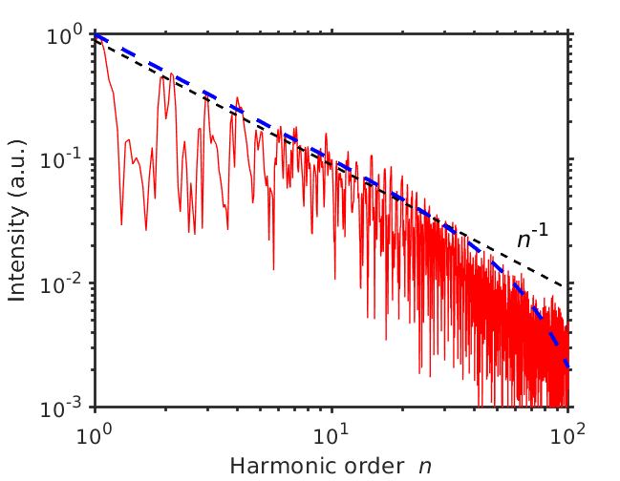
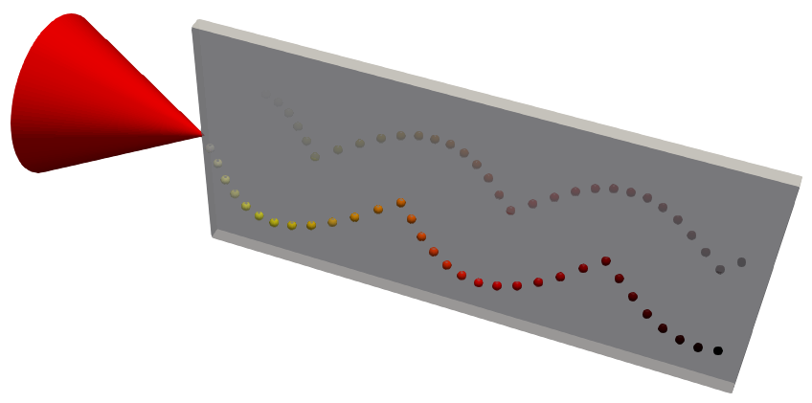
High-order Harmonic Generation: Synergistic synchrotron emission
Shen, Pukhov, Qiao https://arxiv.org/abs/2009.12918
Alexander Pukhov
Xiaofei Shen
pukhov@tp1.hhu.de

Slide 2
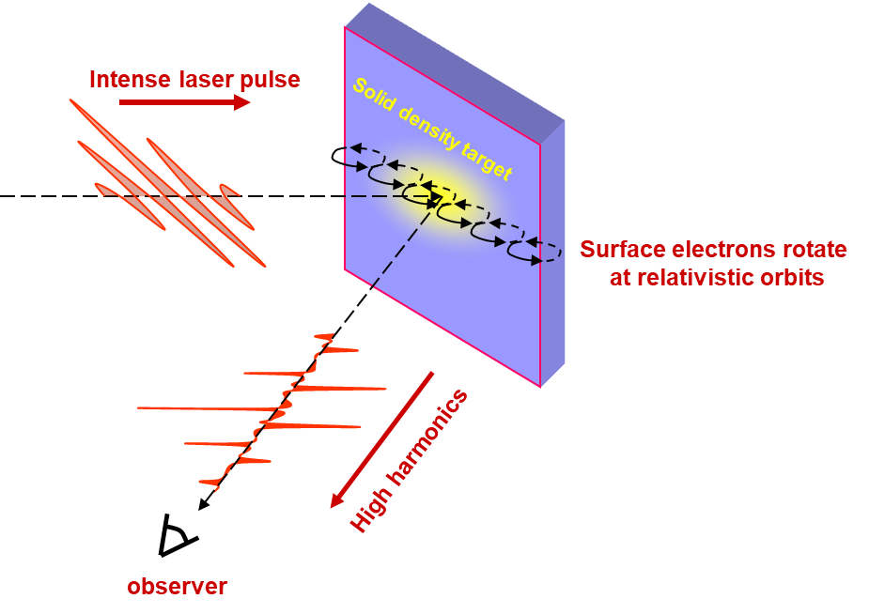
Relativistic High Harmonics

Slide 3
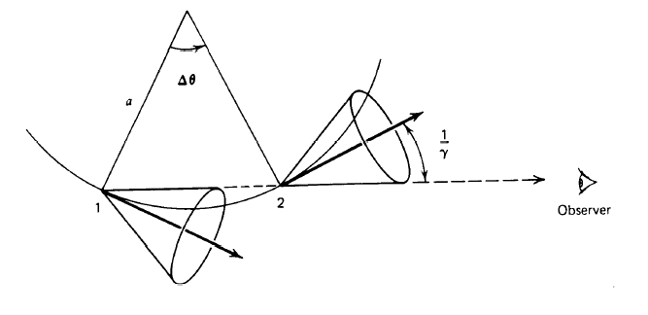
Radiation by relativistic electrons
Electron moving on a circular orbit in the ultrarelativistic limit emits synchrotron radiation (high harmonics) when Δθ>1/γ.

Slide 4
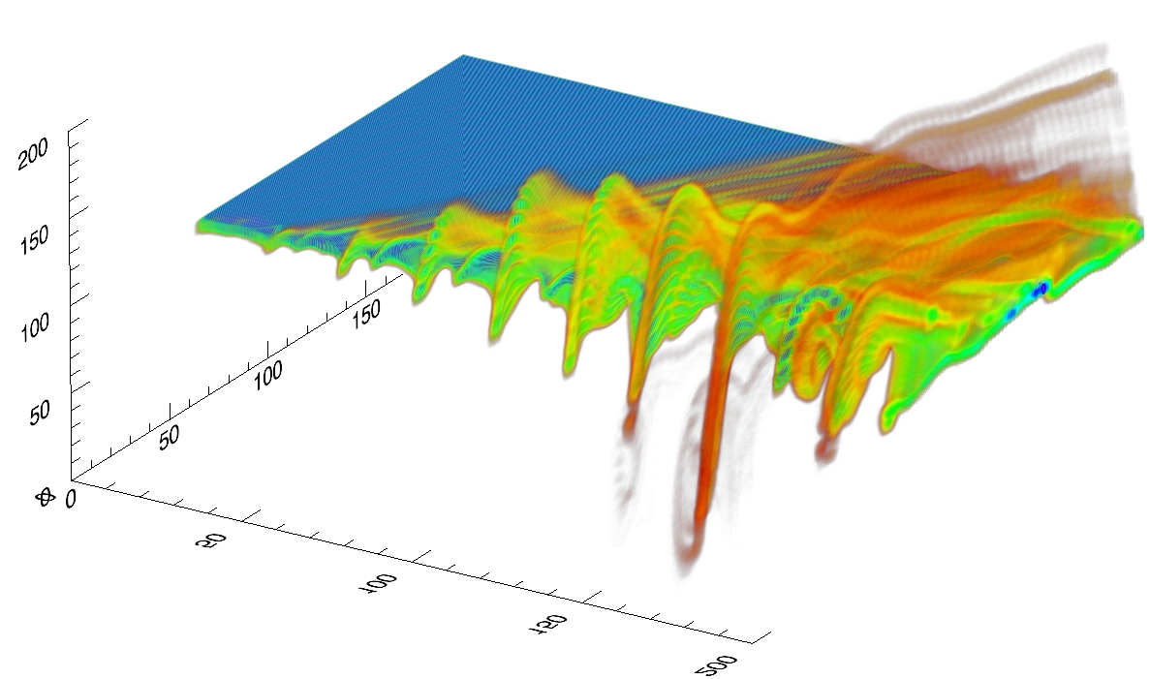
Plasma Surface Oscillates
p_{x} /m_{e}c
20
10
X / λ
0
0 1 2
-10
-20
2 3 4 5 6 7
f(t,x,p_{x}), a.u.
ωt /2π
0
1

Slide 5
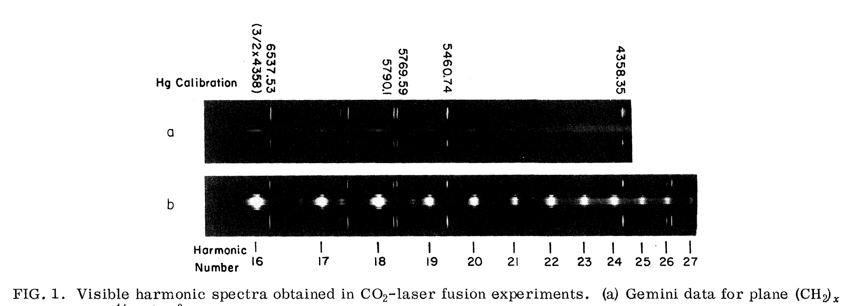
Relativistic HHG: long story
The first observation of HHG from plasma (CO2 laser): Carman, Forslund, Kindel, Phys. Rev. Lett. 46, 29 (1981)

Slide 6
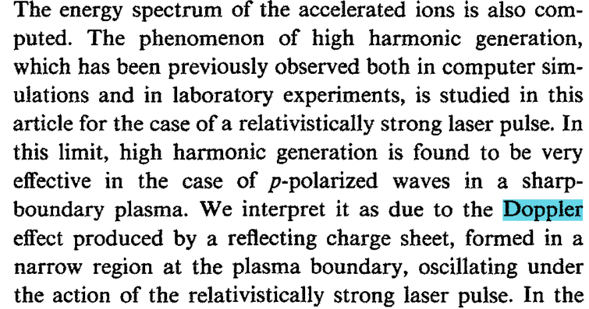
The first mention of Doppler effect
Bulanov, Naumova, Pegoraro, Phys. Plasmas 1, 745 (1994)

Slide 7
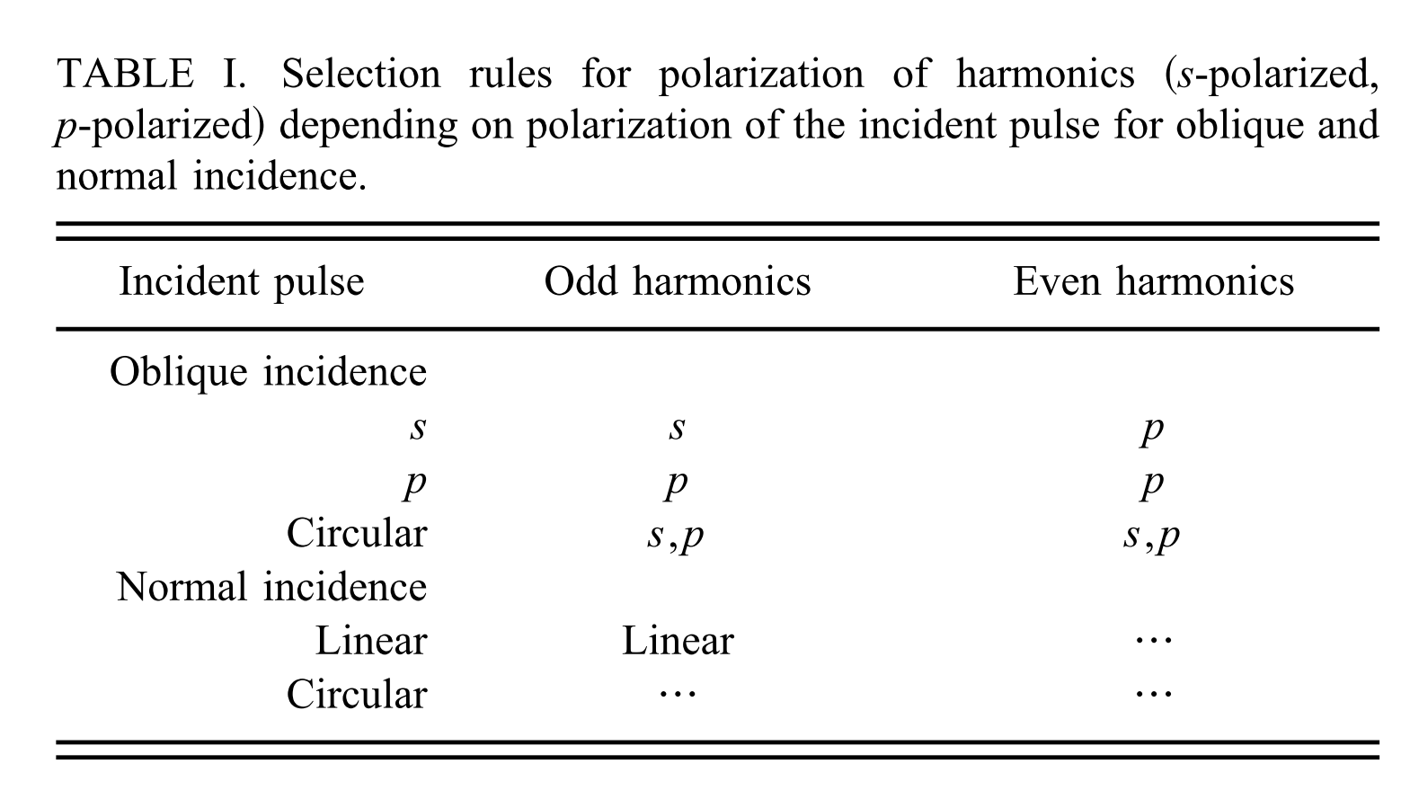
Selection rules
Lichters, Meyer-ter-Vehn, Pukhov Phys. Plasmas 3, 3425 (1996)

Slide 8
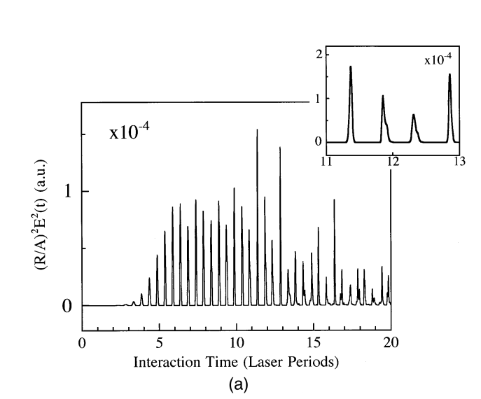
Attosecond pulses
Plaja, Roso, Rzazewski, Lewenstein, J. Opt. Soc. Am. B, 15, 1904 (1998)
HHG are in fact train of subfemtosecond pulses

Slide 9
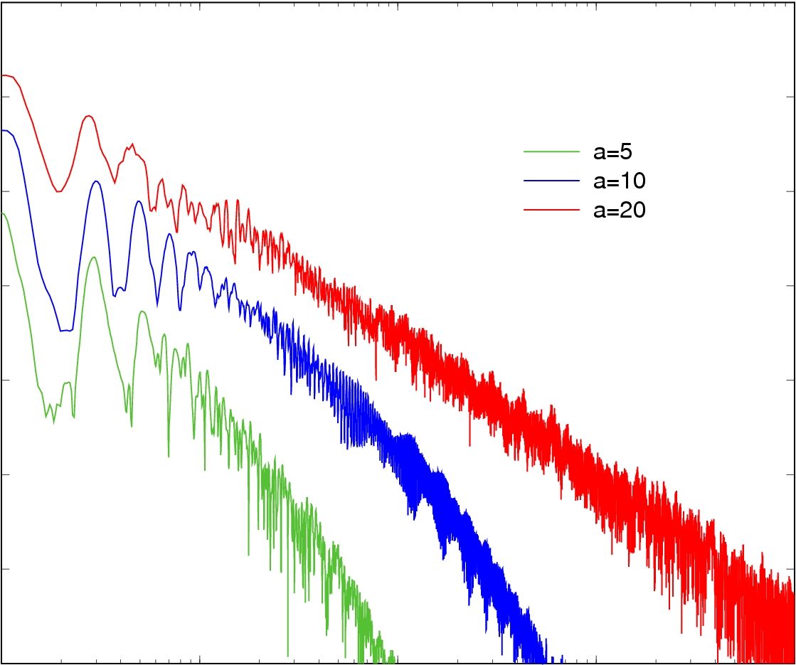
The universal -8/3 power spectrum
Baeva, Gordienko, Pukhov, Phys. Rev. E, 74 046406 (2006)
10¹²
a₀=20
Ι ∼ ω^{-8/3}
a₀=10
10¹⁰
a₀=5
10⁸
10⁶
Intensity, a.u.
10⁴
10²
1
10
100
1000
ω_{n}/ω₀

Slide 10
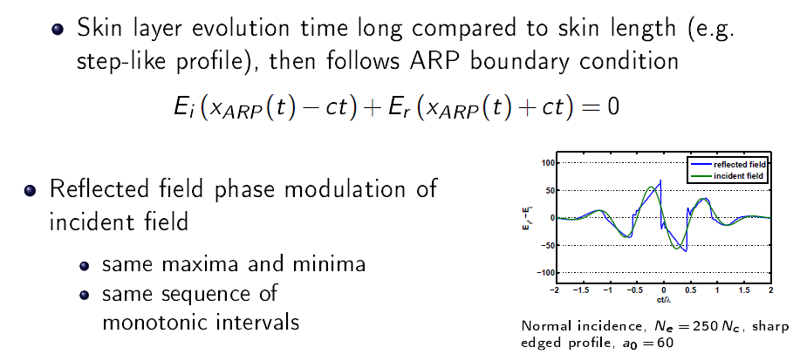
The boundary condition
Baeva, Gordienko, Pukhov, Phys. Rev. E, 74 046406 (2006)

Slide 11
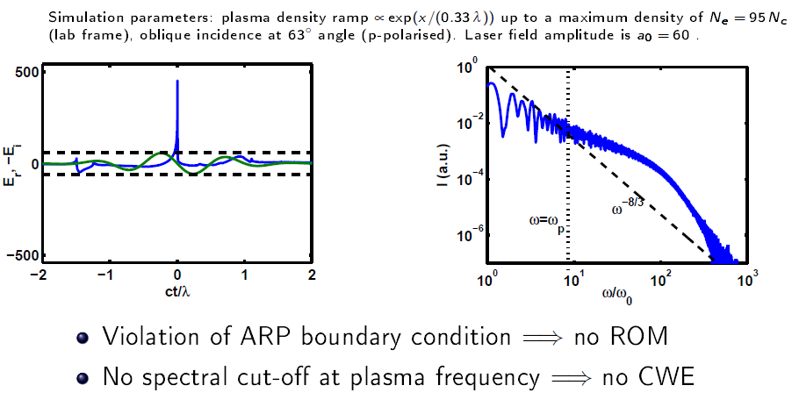
Violation of the boundary condition
An der Brügge, Pukhov, Phys. Plasmas 17, 033110 (2010)

Slide 12
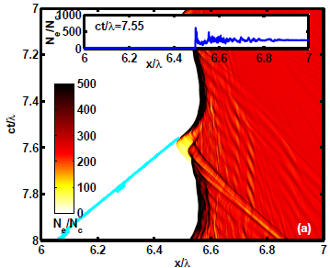
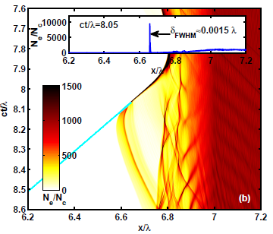
Nanobunching
An der Brügge, Pukhov, Phys. Plasmas 17, 033110 (2010)

Slide 13
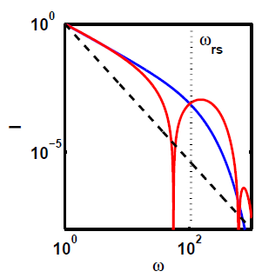
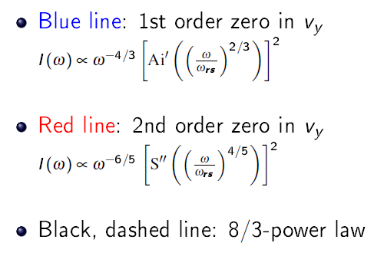
Coherent Synchrotron Emission
An der Brügge, Pukhov, Phys. Plasmas 17, 033110 (2010)

Slide 14
Violation of the boundary condition
An der Brügge, Pukhov, Phys. Plasmas 17, 033110 (2010)

Slide 15
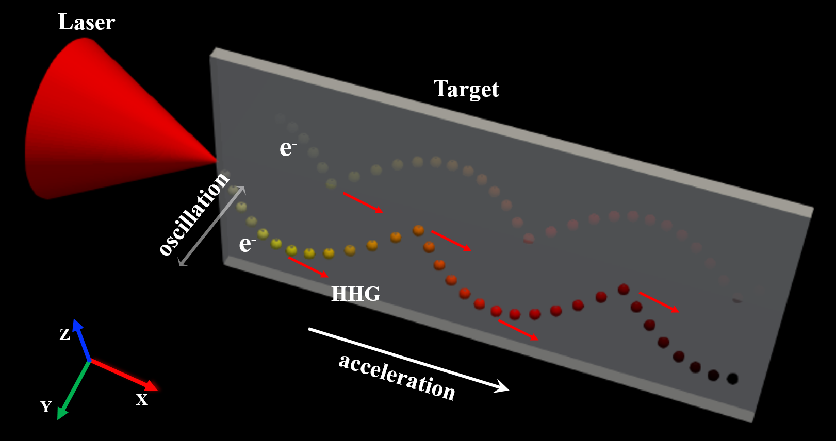
Synergistic Longitudinal Acceleration and Transverse Oscillation for HHG
Shen, Pukhov, Qiao https://arxiv.org/abs/2009.12918
Laser:
a₀=20, r=3 λ, $τ_{L}=8$fs
(~ 200 TW)
Plate/Nanowire (x,y): 28 λ×1 λ n_{e}=30n_{c}
Preplasma: 1 λ in the front surface and 0.25 λ in the lateral surfaces.
Notes:
The transverse profile of the laser pulse is Gaussian and the longitudinal is cosine.

Slide 16
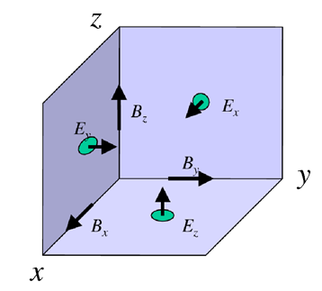
3D PIC simulation by VLPL3D
Pukhov, Journal of Computational Physics, 109622 (2020)
3D Yee lattice reduced to a 2D (YZ) plane
Yee
RIP
E_{y},B_{z}
E_{x}
E_{y},B_{z}
B_{x}
E_{z},B_{y}
B_{x}
E_{y},B_{z}
E_{x}
E_{y},B_{z}
E_{x}
E_{y},B_{z}
E_{x}
E_{z},B_{y}
B_{x}
E_{z},B_{y}
B_{x}
E_{z},B_{y}
E_{y},B_{z}
E_{x}
E_{y},B_{z}
E_{z},B_{y}
Notes:
The transverse profile of the laser pulse is Gaussian and the longitudinal is cosine.

Slide 17
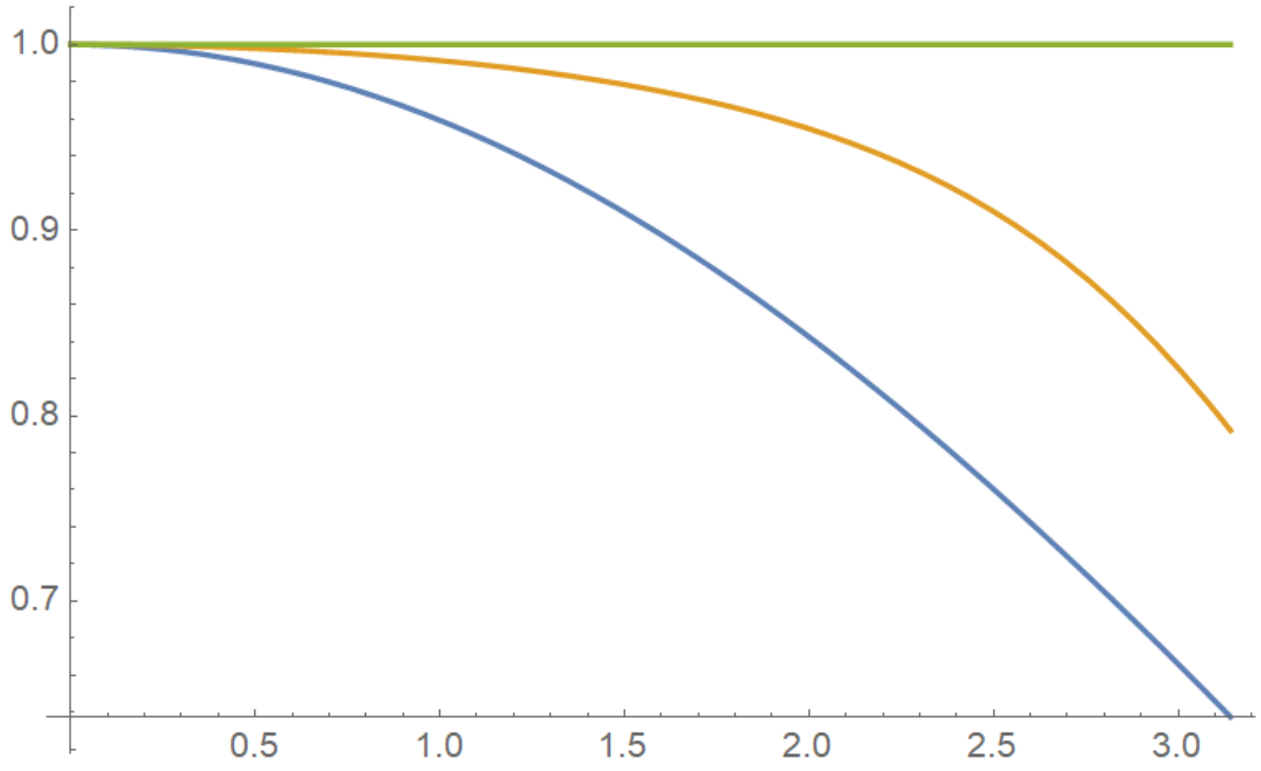
Numerical dispersion RIP vs Yee Maxwell solver
Pukhov, Journal of Computational Physics, 109622 (2020)
RIP, for any h_{x}
V_{ph}/c
Yee cτ = 0.9h
Yee
cτ = 0.1h
kh_{x}/2
Notes:
The transverse profile of the laser pulse is Gaussian and the longitudinal is cosine.

Slide 18
Laser Quasi-Resonance with Surface Plasma Wave (SPW)
Efficient conversion from Laser to SPW at the plate front edge
ω
ω_{p}/2^{1/2}
Laser in vacuum
SPW
0
k||
Dephasing length between laser and SPW L_{deph} ~ 15 μm

Slide 19
Evolution of the laser field distribution
$$E_{y}/E_{0}$$
Notes:
t=0 represents the time when the peak intensity of the laser reaches the front edge of the plate.

Slide 20
Strong Surface Plasma Wave excited
$$E_{x}/E_{0}$$

Slide 21
High-density nanobunches are peeled off by the laser field
$$n_{e}/n_{c}$$

Slide 22
Extremely narrow high-density nanobunches are generated
Notes:
Here the laser field Ey multiples a factor of 2. The cut is along y=0.705 lambda.

Slide 23
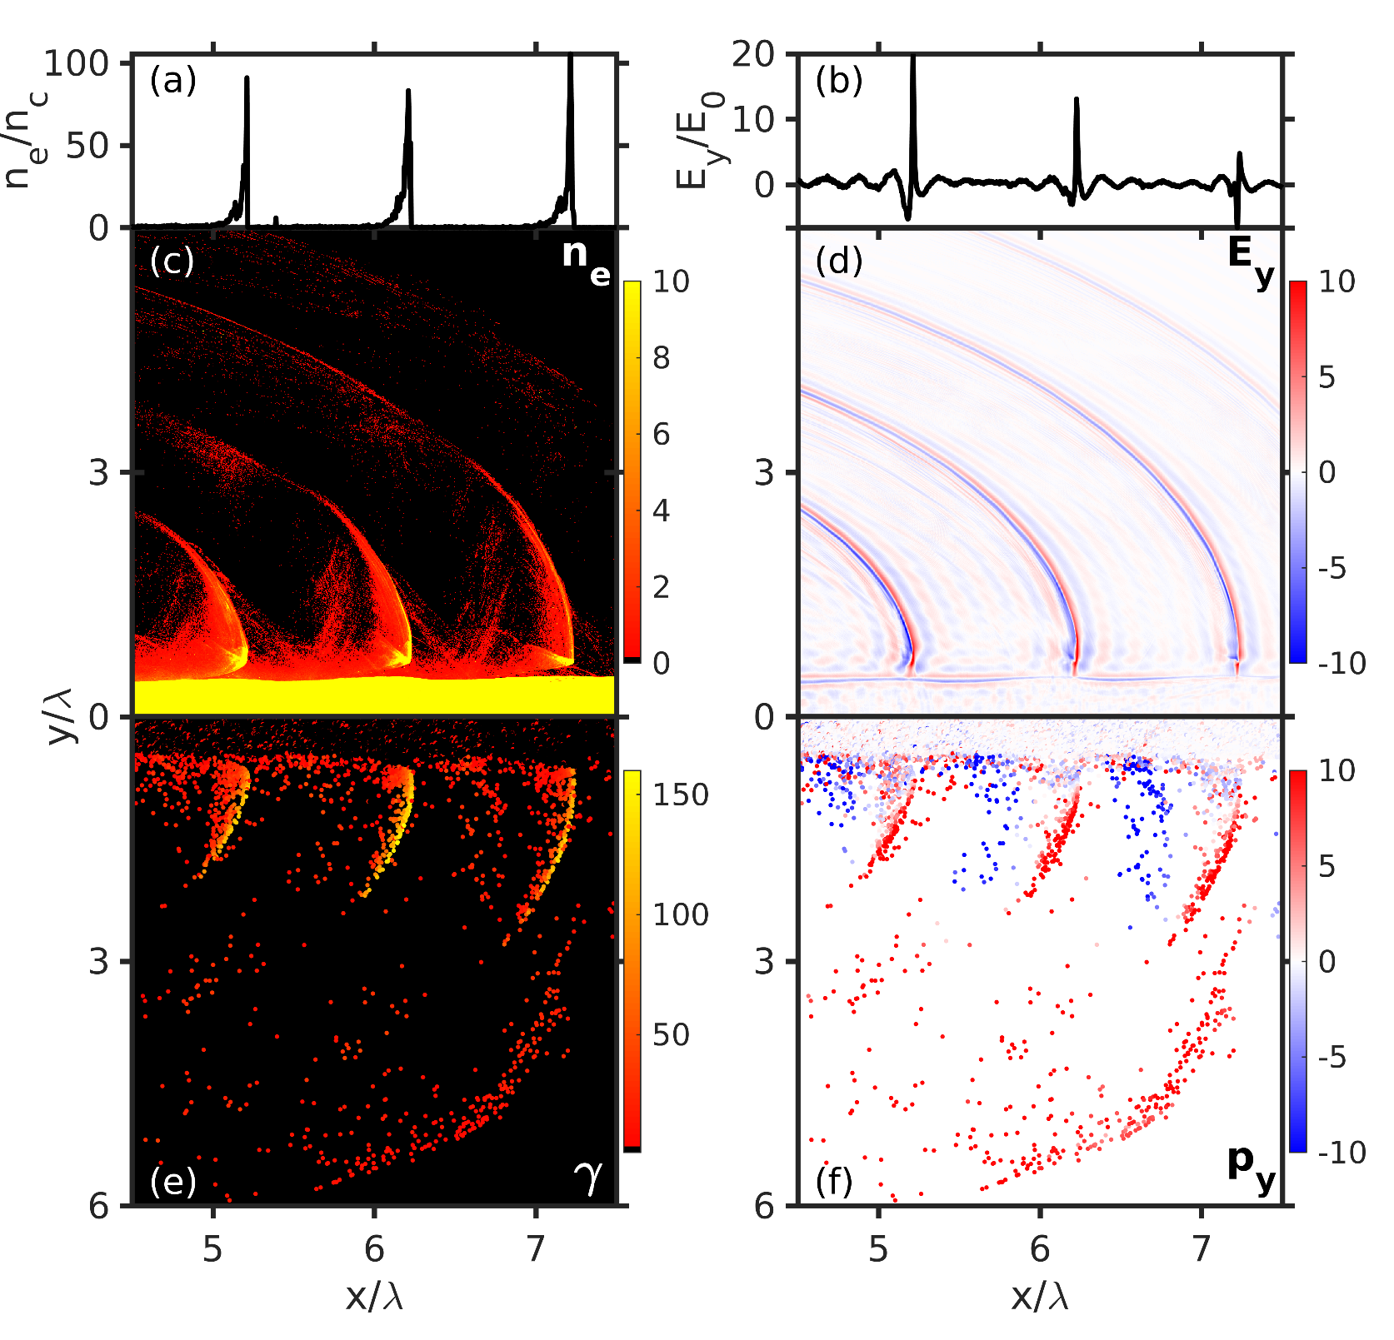
Distributions of electron density and laser field after filtering
Here the densities of the nanobunch are about 100nc and
the smallest width is only about ~0.0033λ.
Notes:
For Ey, the low-frequency components below 5 \omega have been filtered out. Only half of the transverse box is shown here.

Slide 24
Distributions of electron energy and transverse momentum
The transverse current changes sign at the stationary phase point.

Slide 25
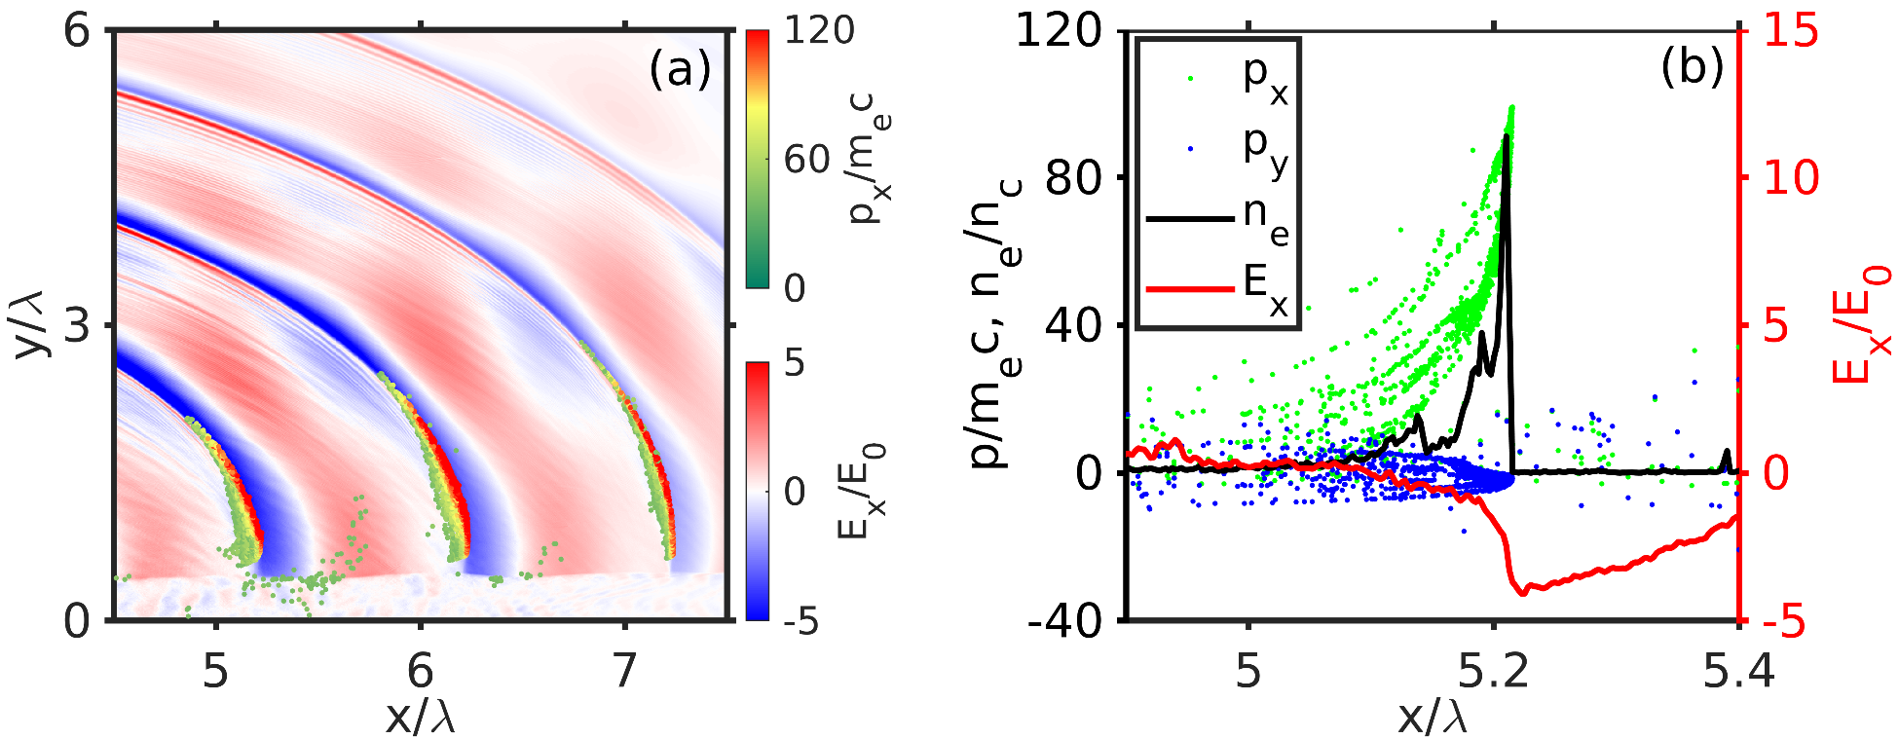
Electrons are constantly accelerated by the longitudinal field
Notes:
In (a), the color dots represent electrons and the color scale (green-red) represents p_x of electrons.

Slide 26
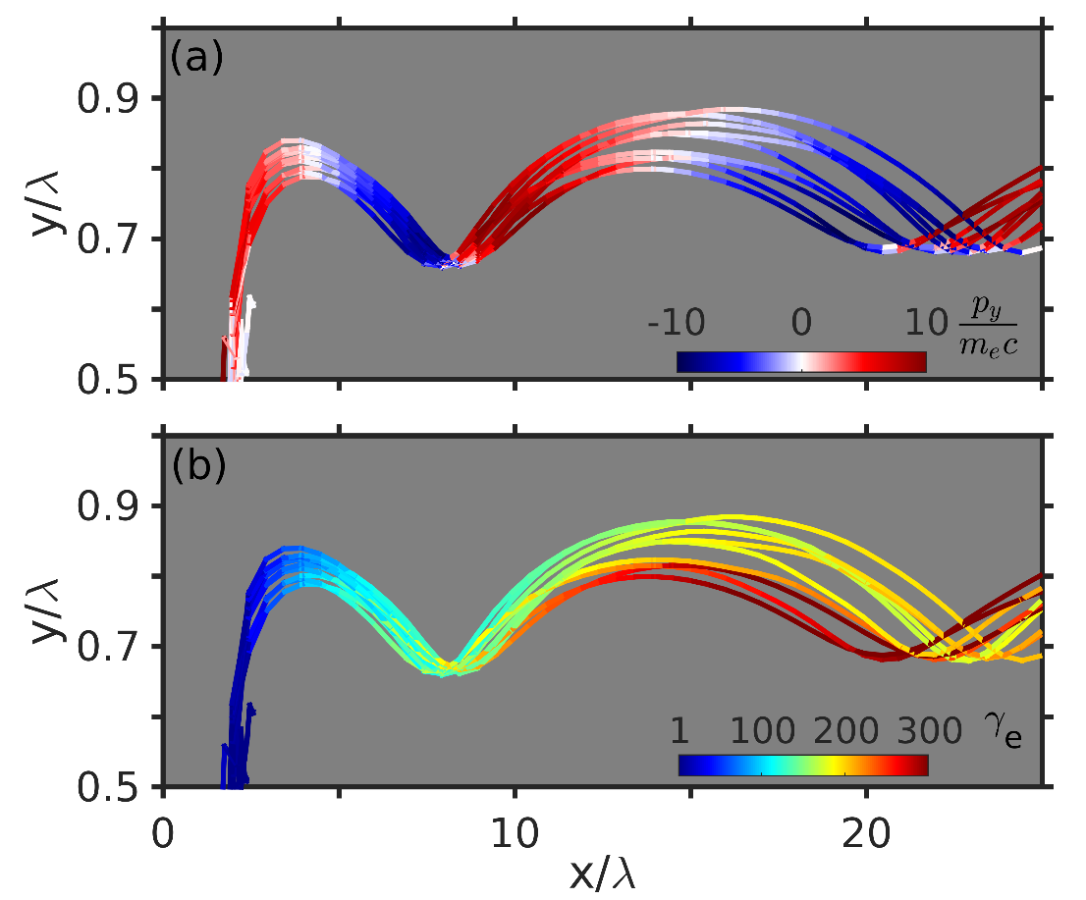
Trajectories of selected electrons
Electrons are constantly accelerated during the transverse oscillating, which leads to stronger radiation, since $P∝γ_{e}^{4}$.
Notes:
The left figures show the evolution of p_y and \gamma of the selected electrons. The right figure represents the evolution of the maximum electron gamma.

Slide 27
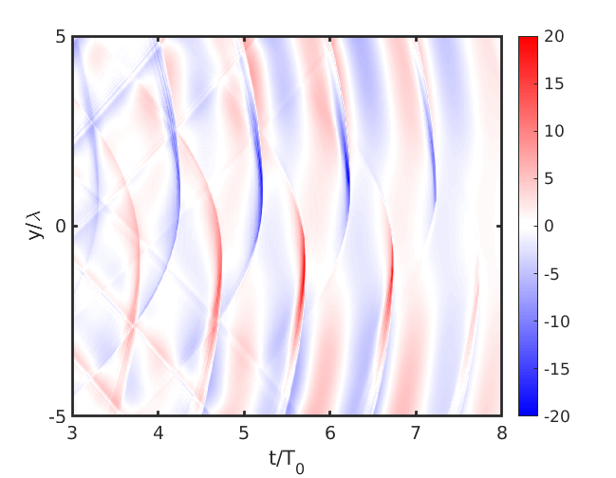
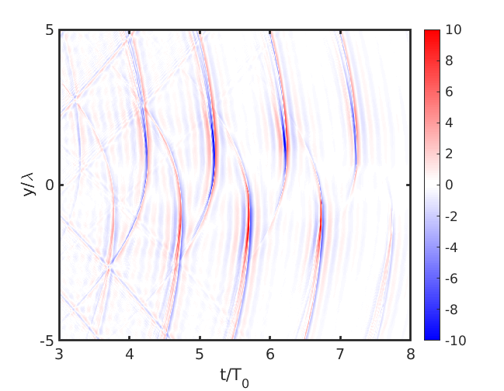
Strong HHG are obtained
Before filtering
After filtering
The field of HHG is very strong. Even after filtering $ω<5ω_{0}$, it is beyond 4×10¹³ V/m.
Notes:
The field is that registered at the right boundary. In the right figure, the low-frequency components below 5 \omega have been filtered out.

Slide 28
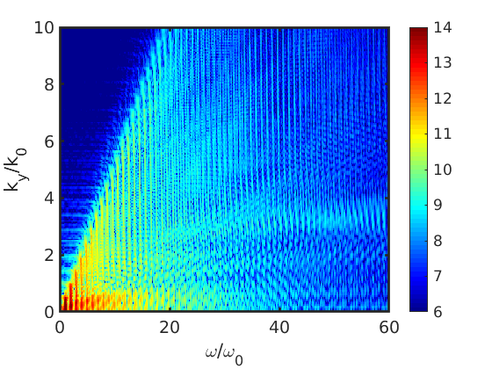
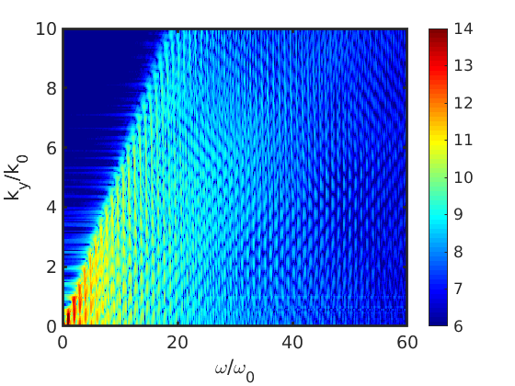
Comparison of HHG spectra
l=28λ
l=2λ
a.u.
a.u.
The amplitude of HHG increases with the longer plate.
Notes:
Here the colorbar values are logarithmic. The fields are registered at the same propagation lengthto exclude the effects of vacuum propagation.

Slide 29
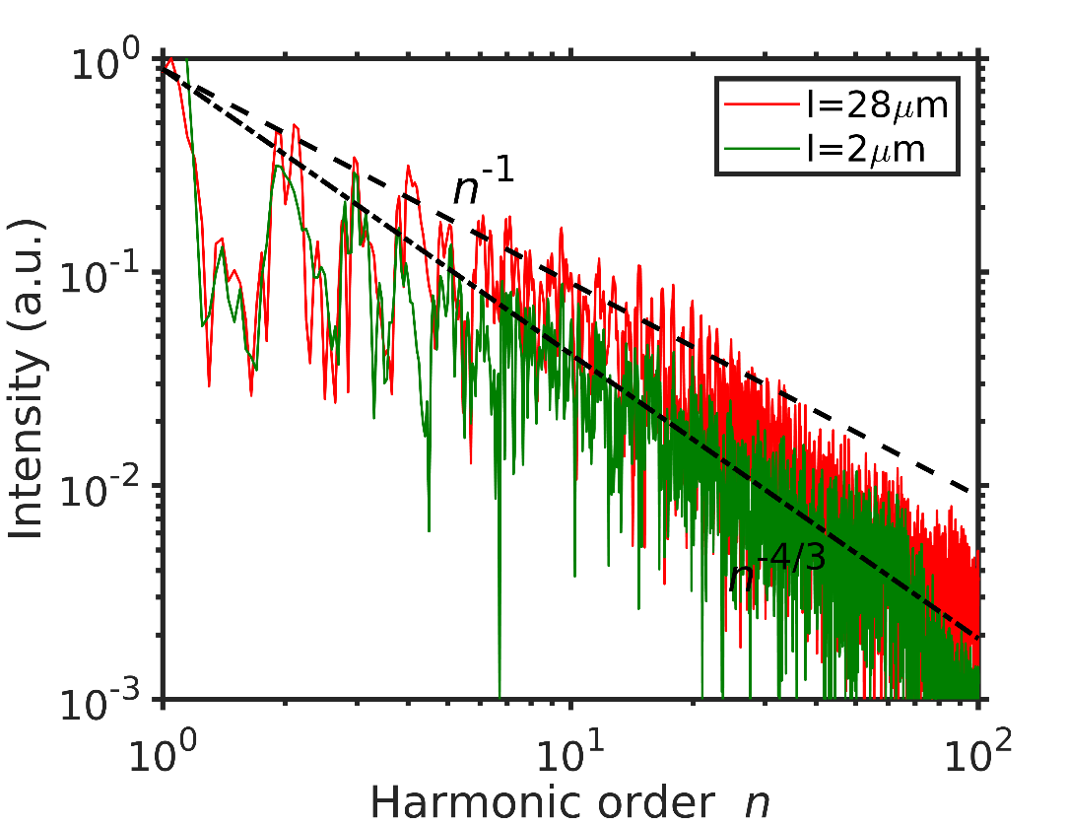
Comparison of HHG spectra

Slide 30
General description of HHG
The radiation field generated by 1D current:
$$E_{sy}\left(t,x\right)=\frac{2π}{c}∫j\left(t+\frac{x−x^{′}}{c},x^{′}\right)dx′$$
After Fourier transform, we have:
$$\tilde{E_{sy}}\left(ω\right)=\frac{2π}{c}\tilde{f}\left(ω\right)j\left(t\right)exp∫\left\{−iω\left[t+\frac{x_{el}\left(t\right)}{c}\right]\right\}dt$$
Around the stationary phase point, we can Taylor expand:
$j\left(t\right)=α_{0}t$, $x_{el}\left(t\right)=v_{0}t+α_{1}t^{2}$
Then we can get the spectral envelope:
$$I\left(ω\right)∝{\left|\tilde{f}\left(ω\right)\right|}^{2}ω^{−1}$$

Slide 31
Comparison with simulation results
If we assume the Gaussian profile of the nanobunch $f\left(x\right)=\exp{[−{\left(\frac{x}{δ}\right)}^{2}]}$, after Fourier transform
$${\left|f\left(ω\right)\right|}^{2}=\exp\left[−{\left(\frac{ω}{ω_{rf}}\right)}^{2}\right]$$
If we take $δ=0.0028λ$, the theory fits very well with the simulation results.
Notes:
The blue dashed line represents the theoretical prediction.

Slide 32
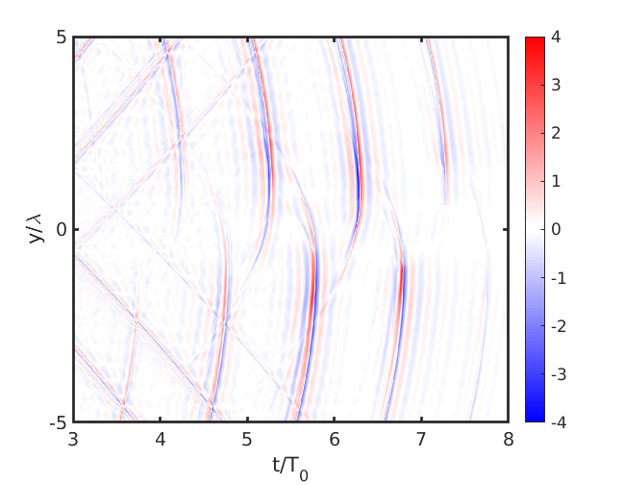
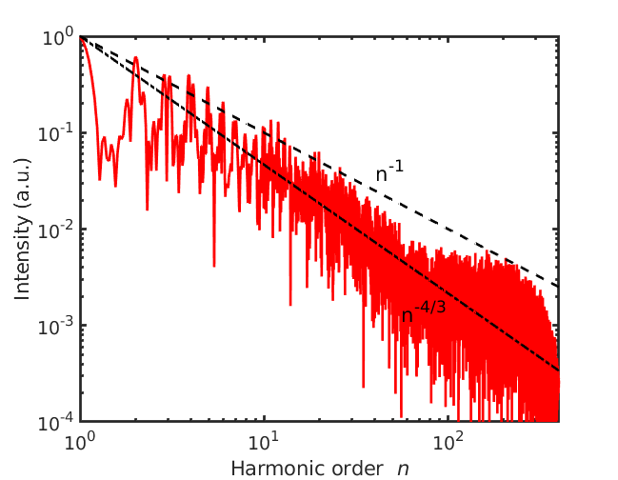
With higher electron density
Here $a_{0}=10$, $n_{e}=200n_{c}$ and the resolution along x-direction is $dx=λ/800$.

Slide 33
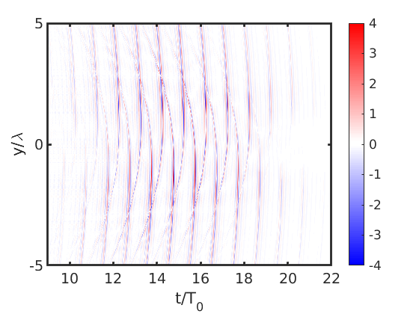
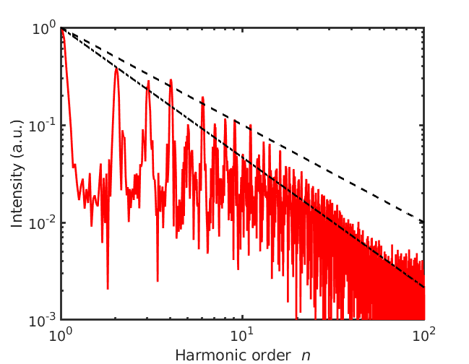
With longer pulse duration
Here $a_{0}=10$, $n_{e}=30n_{c}$, $τ_{L}=20$ fs and the resolution along x-direction is $dx=λ/400$.

Slide 34
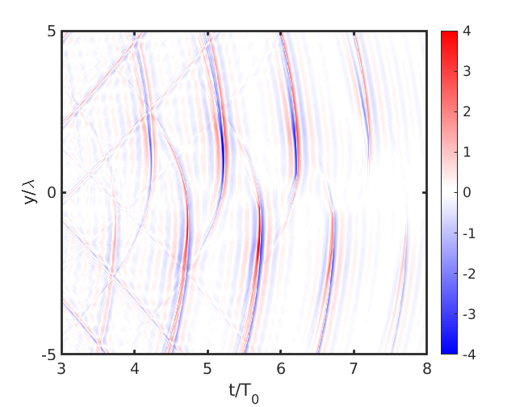
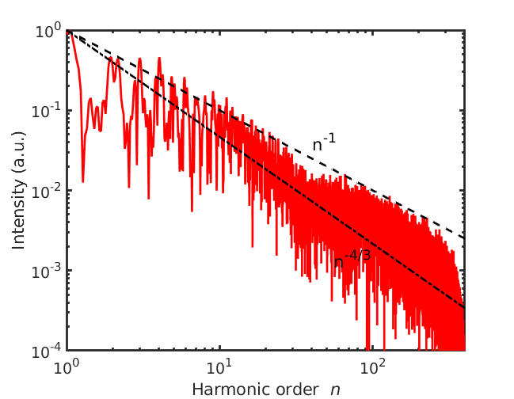
With higher resolution
Here $a_{0}=10$ and the resolution along x-direction is $dx=λ/800$.

Slide 35
Summary
Shen, Pukhov, Qiao https://arxiv.org/abs/2009.12918
Laser is in quasi-resonance with SPW when incident parallel to a microplate
Extremely narrow electron nanobunches due to SPW
Efficient electron acceleration and oscillation leading to stronger attosecond burst
Extending the HHG theory to explain

