Slide 1

Proton acceleration from thin foils by extremely short PW laser
pulse
A.V. Brantov, V. Yu. Bychenkov
2021

Slide 2
Outline
Motivation:
enhancing laser power and intensity through decreasing the pulse duration [Phys. Rev. A 101, 013829 (2020); Sci. Rep. 11, 151 (2021)]
-- high-gradient ion acceleration?
-- interplay between pulse shortening and focusing?
Theoretical model :
-- transition of plasma expansion from isothermal regime to the adiabatic one
PIC simulation
-- optimal target thickness to maximize proton energy

Slide 3

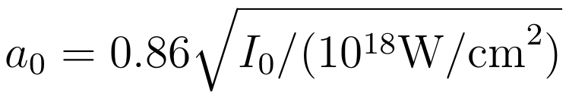

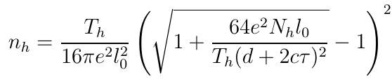

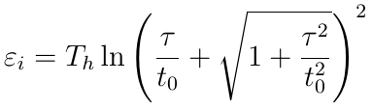
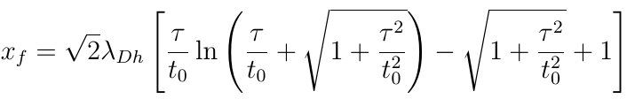





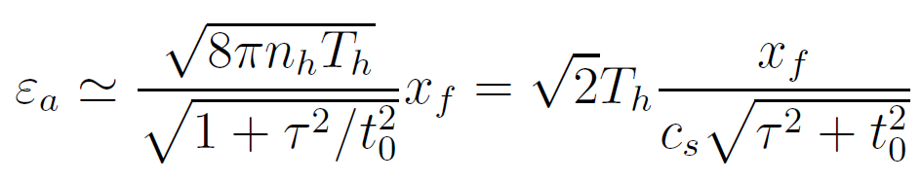


Theoretical model - description
Isotherm expansion
Adiabatic expansion

Slide 4


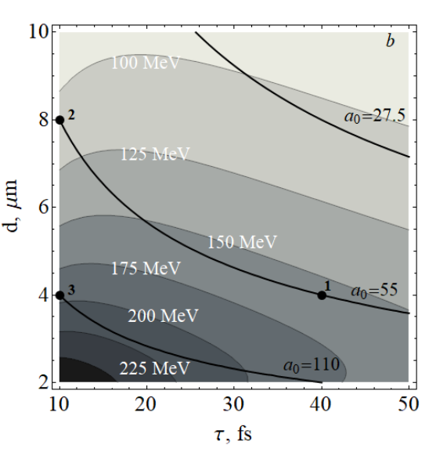
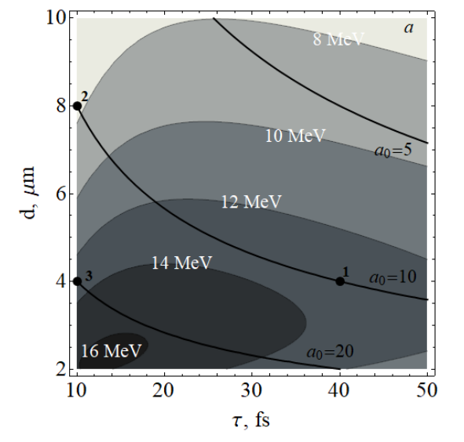
Theoretical model - results
1 - 13.1 MeV
2 - 7.6 MeV 3 – 14.6 MeV
1 - 157 MeV
2 - 108 MeV 3 – 187 MeV

Slide 5



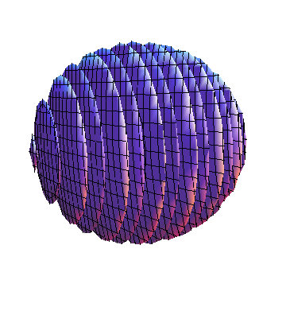
PIC code for simulation of laser-plasma interaction
Laser pulse
ρ
target
z
τ
30 J,
4.1×10²¹ -1.7×10²² W/cm²
τ = 10 fs - 40 fs
ρ = 4 μm - 8 μm
Linear polarization
y
x
l ~ 0.01 – 0.2 μm
Target
CH₂ foil
(n_{e}=200 n_{c} )
electrons
heavy ions
light ions (protons)
x × y × z = 20 λ × 20 λ × 20 λ
Δx × Δ y × Δ z = λ/200 × λ/20 × λ/20

Slide 6
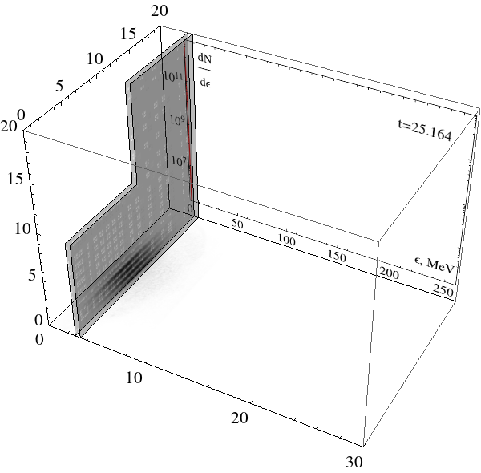
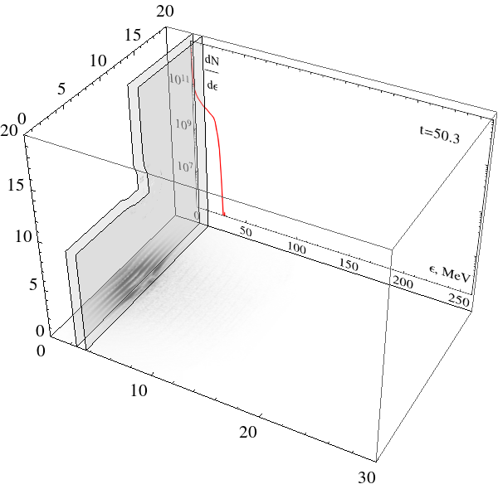
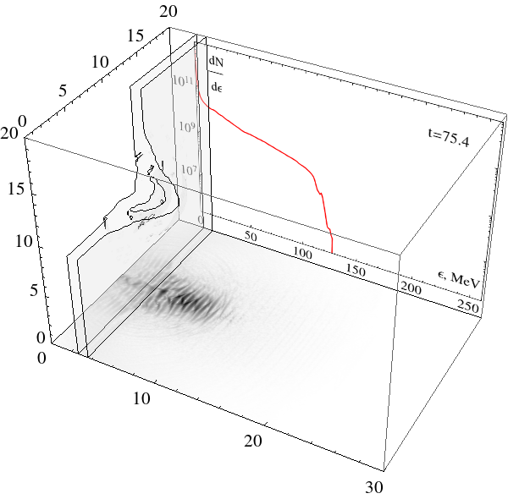
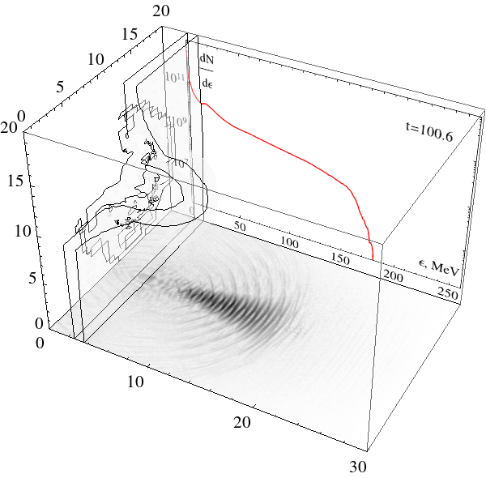
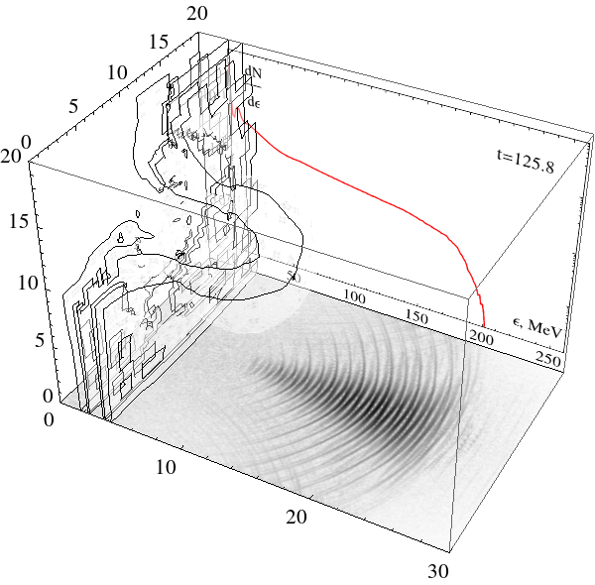
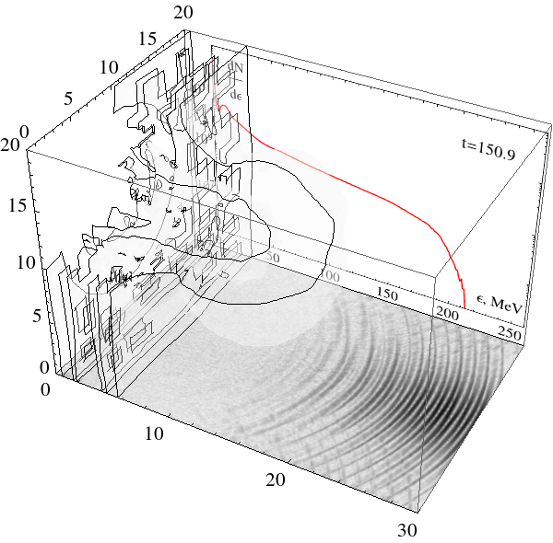
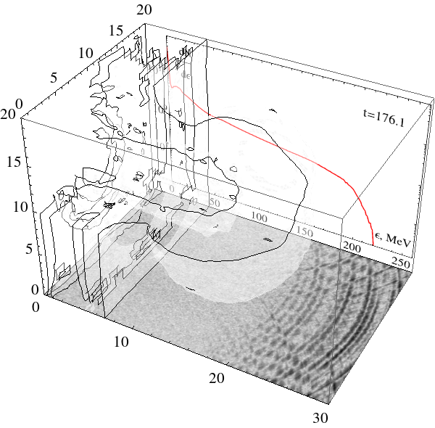
3D proton acceleration by 30 J laser pulse
I =5 10²¹ W/cm² , τ = 30 fs, focus spot 4 μm (FWHM)
Target – CH₂ foil 0.1 μm (n_{e}=200 n_{c} )

Slide 7
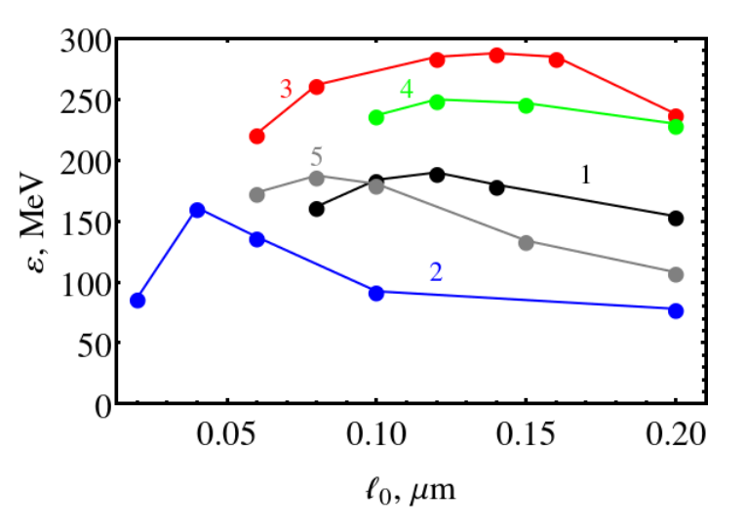
Simulation results
1 40 fs 4 µm
10 fs 8 µm
10 fs 4 µm
20 fs 4 µm
10 fs 6 µm
For ℓ₀ = 0.2 µm : 1 - 154 MeV 2 - 80 MeV 3 – 224 MeV

Slide 8
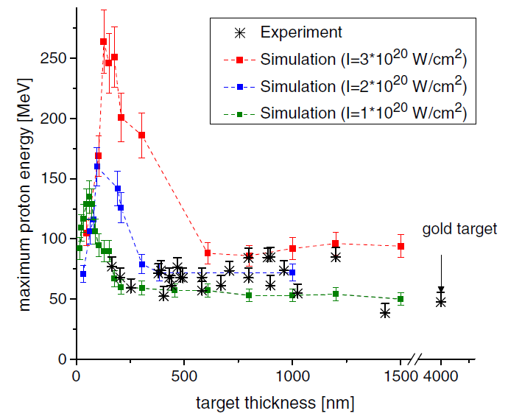
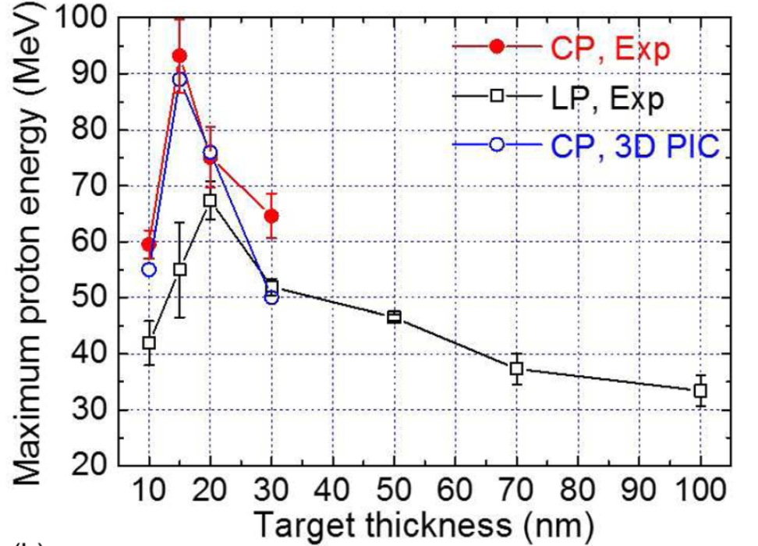
Experiments on proton acceleration
F. Wagner et.al PRL 116, 205002 (2016)
I. J. Kim et.al PoP 23, 070701 (2016)
Laser: ~160-200J; 500-800 fs;
I ~ (0.7-2.6)×10²⁰ W/cm²
Laser: ~1 PW; 27J; 30 fs;
8.5 J on target, 6.1×10²⁰ W/cm²
Polymethylpentene foil,
thickness165-1400 nm,
gold foil, 4 μm
Polymer foil, thickness of 15 nm, (2.5° from normal)
Proton energy 85 МэВ
Proton energy 93 МэВ
Notes:
8

Slide 9

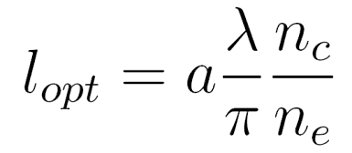
Optimal target thickness
Proton energy from
double-layered target
2D PIC
simulation
Proton energy from
foil target
n_{e} =100 n_{c}
500 TW
n_{e} =400 n_{c}
300 TW
150 TW
There is optimal thickness for given density and laser intensity !
Coulomb field
Laser field
Condition of plasma transparency
Notes:
9

Slide 10
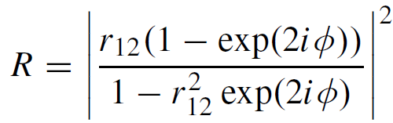
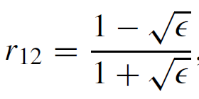
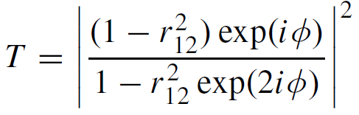
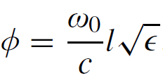
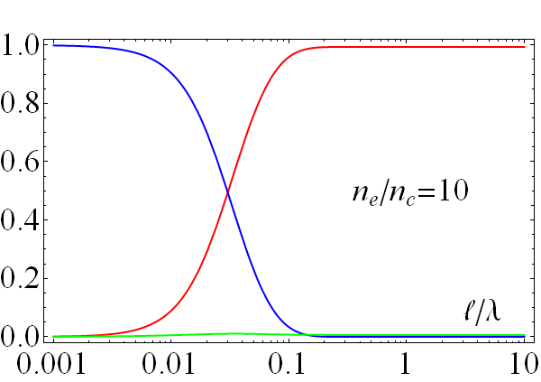
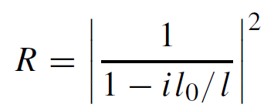
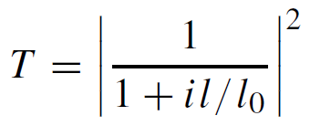


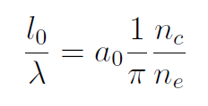
Problem of laser light transmission through plasma layer
L.D. Landau & E.M. Lifshitz Electrodynamics of Continuous Media
reflection
transmission
A=1- R –T absorption
T
R
A

Slide 11
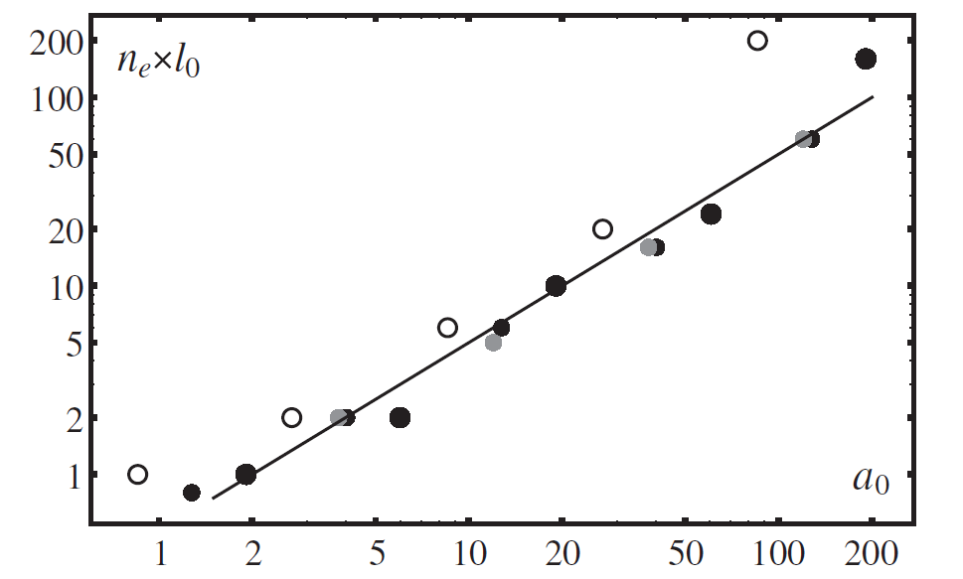






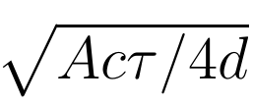
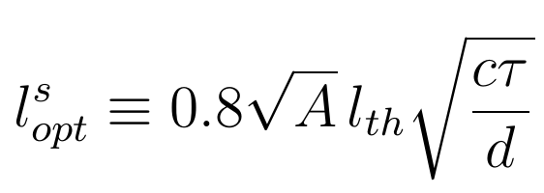
Optimal target thickness
Phys. Rev. STAB 18, 021301 (2015)
1 - ℓ_{opt} = 0.12 µm 2 - ℓ_{opt} = 0.04 µm 3 - ℓ_{opt} = 0.13 µm
Coulomb energy
Absorbed laser energy
Notes:
11

Slide 12
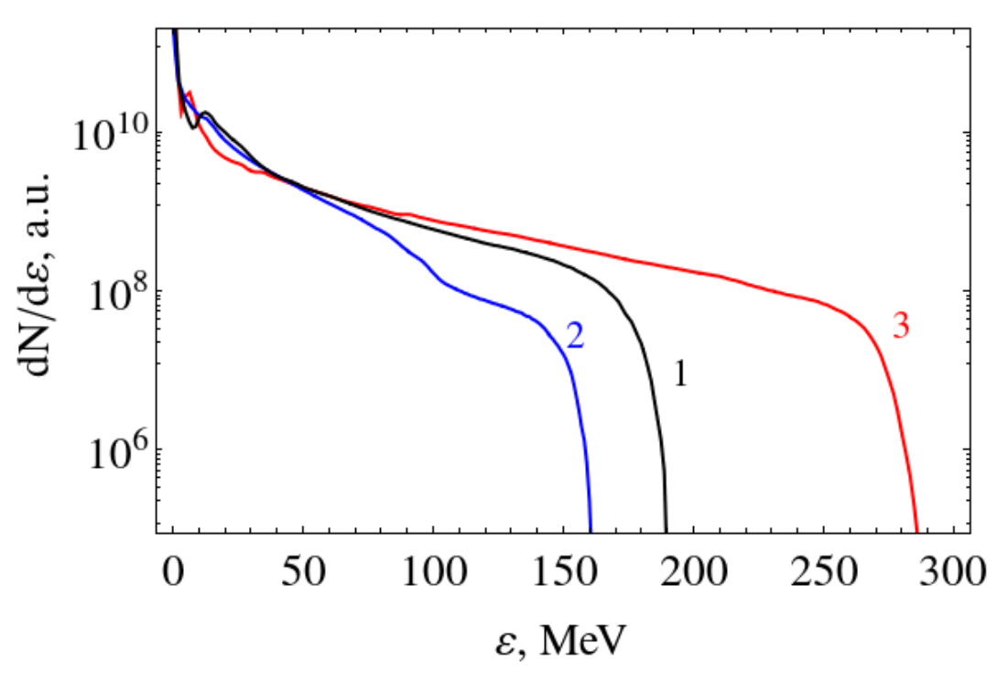
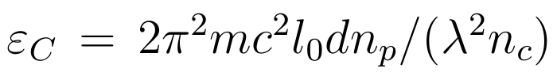
Proton spectra
9%
5%
7%
Notes:
12

Slide 13
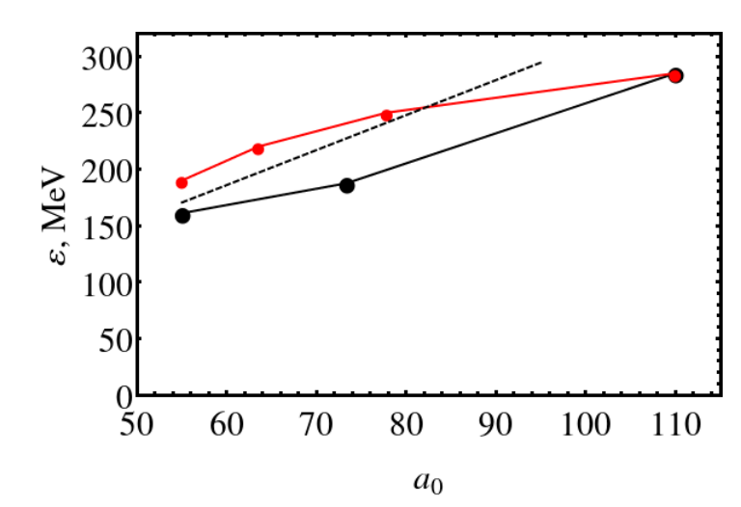

Proton energy scaling with laser intensity
20 fs
30 fs
10 fs, 4 µm
40 fs
6 µm
8 µm
Thank you for attention
Notes:
13

