Slide 1
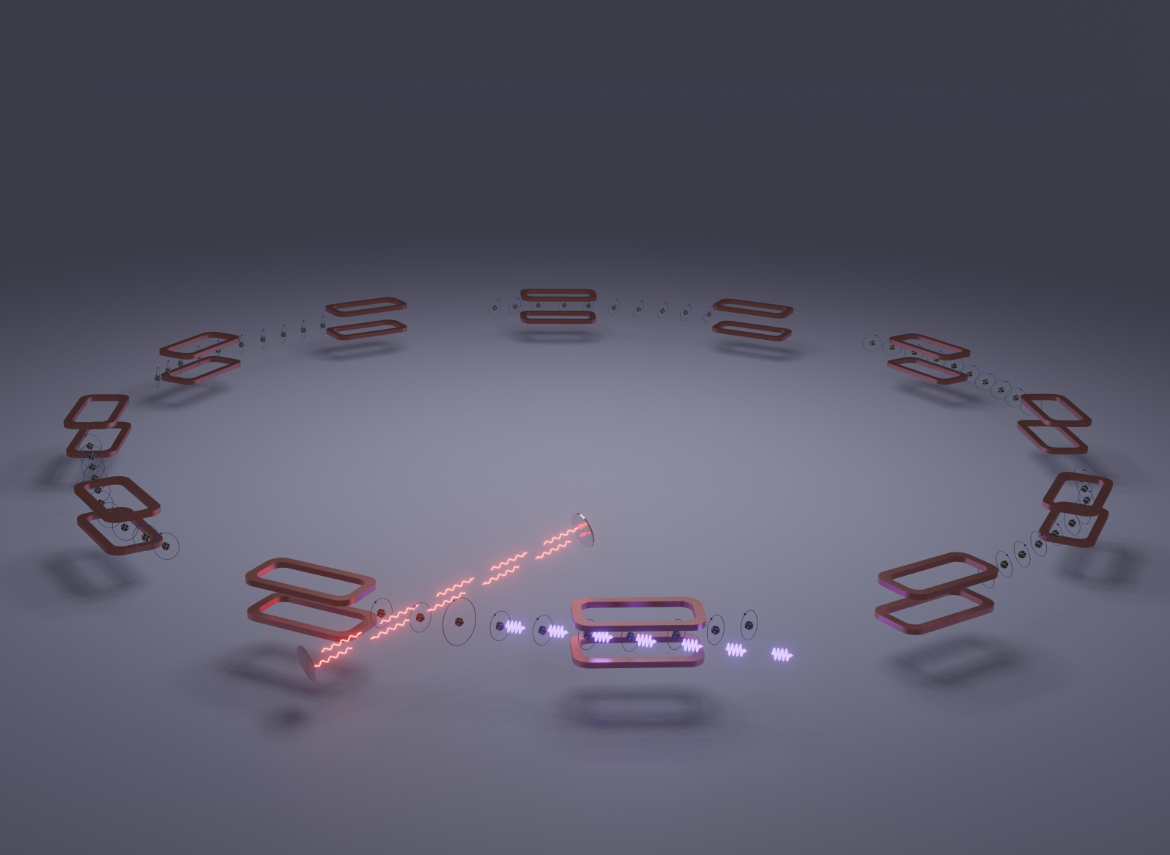
Лазерное охлаждение ультрарелятивистских ионов и проект Гамма-Фабрики в ЦЕРНе
Алексей Петренко, ИЯФ СО РАН, 09.12.2021
онлайн-семинар «Новые методы ускорения частиц и экстремальные состояния материи»

Slide 2
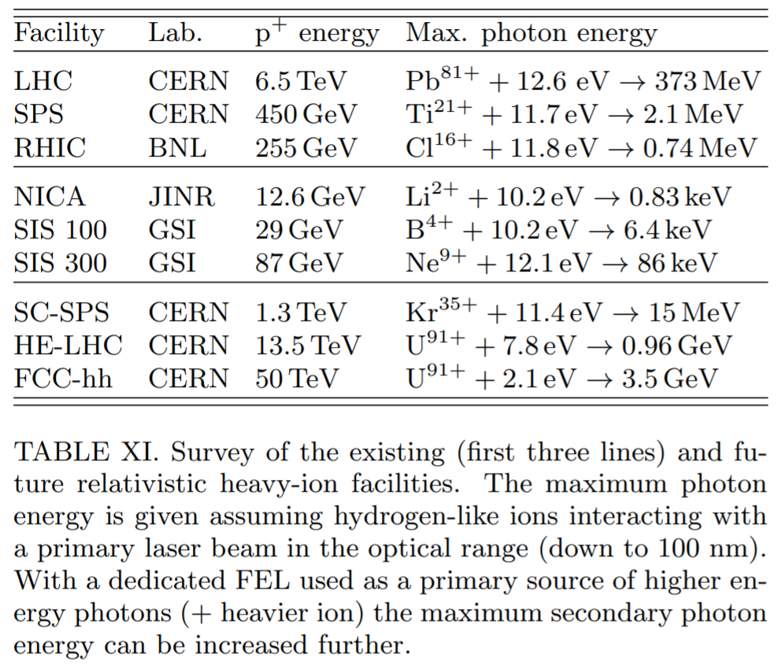
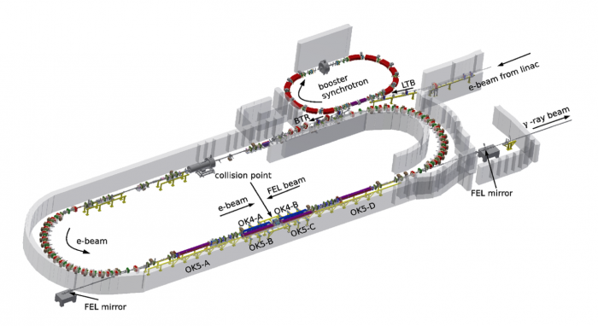
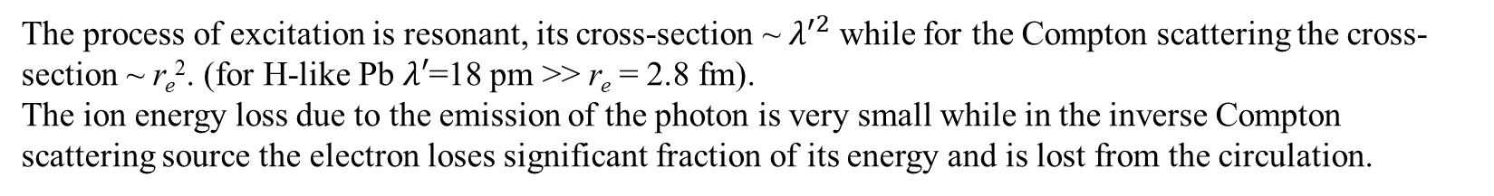
The process of excitation is resonant, its cross-section ~ $λ^{′2}$ while for the Compton scattering the cross-section ~ r_{e}². (for H-like Pb$λ′$=18 pm >> r_{e} = 2.8 fm).
The ion energy loss due to the emission of the photon is very small while in the inverse Compton scattering source the electron loses significant fraction of its energy and is lost from the circulation.
The fluxes are limited mainly by the ring RF power and can be ~10¹⁷ photons/sec (3 MW at 200 MeV) -- direct conversion of RF power into gamma radiation.
Typical max. fluxes of existing gamma sources based on inverse Compton scattering ~ 10⁹ photons/sec.
Duke Univ. gamma-source:
Expanding Nuclear Physics Horizons with the Gamma Factory. D. Budker et al.

Slide 3
The full-scale Gamma Factory will extract MWs of gamma radiation from the LHC beam in a single interaction point. (By the way, the beam energy loss due to SR in LEP was 11 MW).
H-like Pb in the LHC example: Ion charge Z = 81, mass A = 208, γ = 2928, p_{z} = 567 TeV/c, ℏω′ = 69 keV (Lyman-alpha line), laser ℏω = 12 eV, emitted gamma ℏω_{1,max}= 402 MeV,
typical angle of emission θ₁ ~ 1/γ ~ 0.3 mrad.
Typical transverse kick due to gamma emission:
p_{x}/p_{z}~ ℏω′/p_{z}c ~ 69 keV/567 TeV ~ 10^{‒7} mrad.
Typical transverse beam parameters at the LHC interaction point for example: Transverse beam size = 0.026 mm, angular spread = 0.026 mrad (10⁵ times higher).
Typical energy spread in the beam is Δp/p ~ 10^{‒4}, while the average δp_{z} due to the photon emission is 200 MeV/c => δp_{z} / p_{z} = 200 MeV / 567 TeV = 3.5· 10^{‒7} => Δp/δp ≈ 300, even with one scattering per turn the longitudinal effects will be significant in 100s of turns.
Expanding Nuclear Physics Horizons with the Gamma Factory. D. Budker et al.

Slide 4

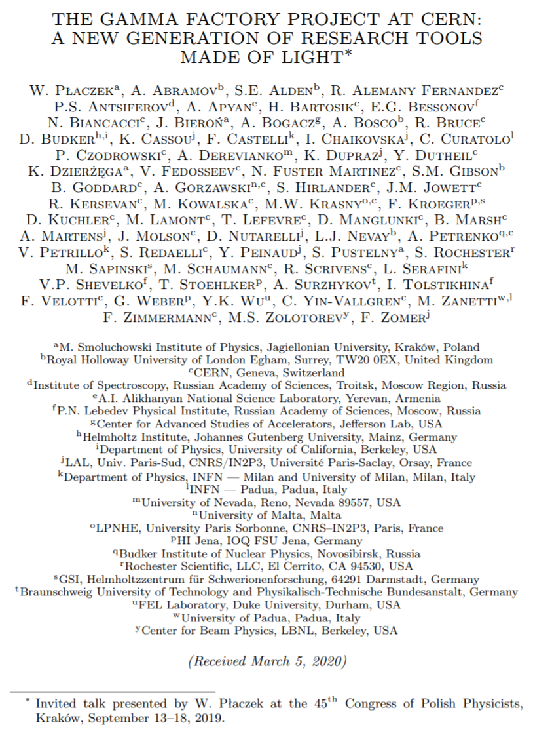
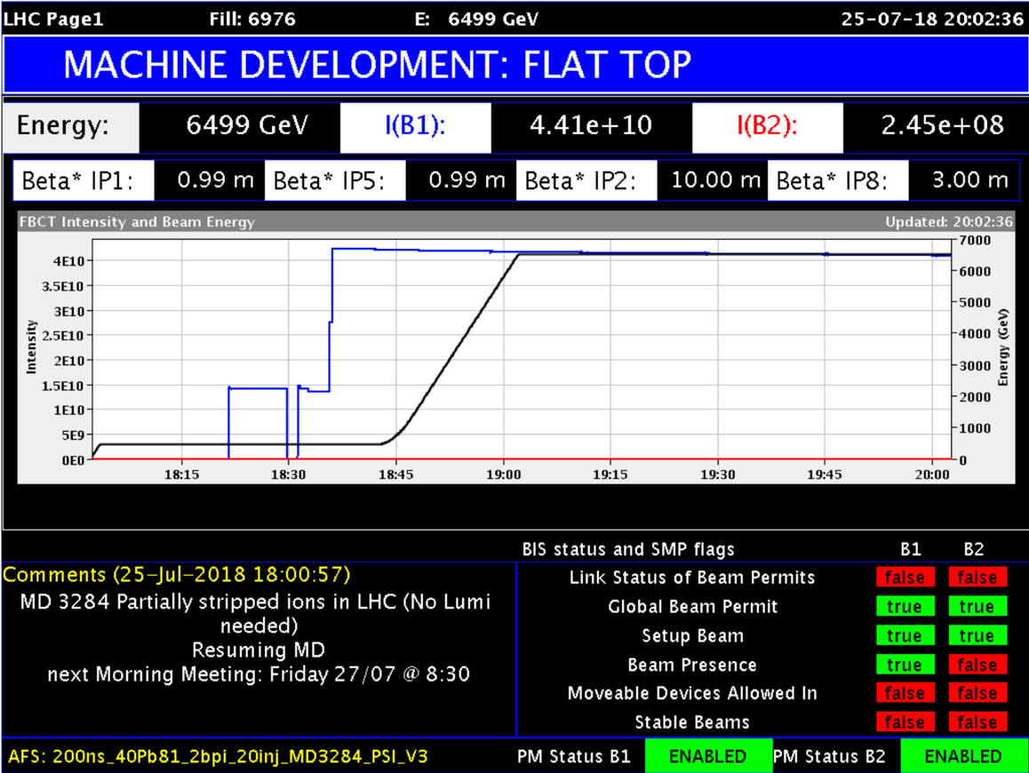
Recent short review of the Gamma Factory Project in general:
CERN homepage:
https://pbc.web.cern.ch/gfpop-mandate
Recent papers:
Expanding Nuclear Physics Horizons with the Gamma Factory
Atomic Physics Studies at the Gamma Factory at CERN
Probing ALPs at the CERN Gamma Factory
Radioactive ion beam production at the Gamma Factory
High-luminosity Large Hadron Collider with laser-cooled isoscalar ion beams
Gamma Factory Searches for Extremely Weakly-Interacting Particles
Vacuum birefringence at the Gamma Factory
Local Lorentz invariance tests for photons and hadrons at the Gamma Factory
Resonance photoproduction of pionic atoms at the proposed Gamma Factory
Collimation of partially stripped ions in the CERN Large Hadron Collider
First Partially Stripped Ions in the LHC (H-like Pb):

Slide 5
Beam cooling/heating is an effect of multi-turn laser-ion interaction
Since the ion is losing only a tiny fraction of its energy the laser-ion interaction can happen over multiple turns (while in the Compton gamma source electron is lost due to recoil).
Longitudinal cooling: because energy loss grows with the ion energy.
Transverse cooling: because all components of ion momentum are lost due to the photon scattering but only the longitudinal component is restored in the RF resonator.
Longitudinal heating: because the ion energy loss is random (defined by the random angle of photon emission in the ion’s frame of reference).
Energy of laser photons is distributed uniformly and match all ion energies:
Longitudinal cooling can be much faster with a sharp edge in the photon spectrum:
Time of cooling is the time to radiate full energy E.
Time of cooling is the time to radiate energy spread ΔE.
E. G. Bessonov and K.-J. Kim. Radiative Cooling of Ion Beams in Storage Rings by Broad-Band Lasers, PRL, 1996.
E. G. Bessonov, R. M. Feshchenko Stimulated Radiation Cooling. RuPAC’2008.

Slide 6
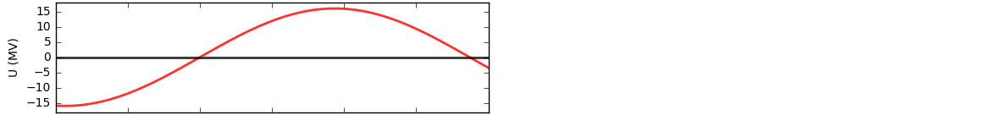
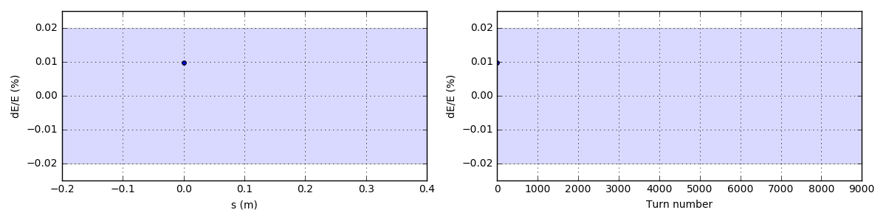
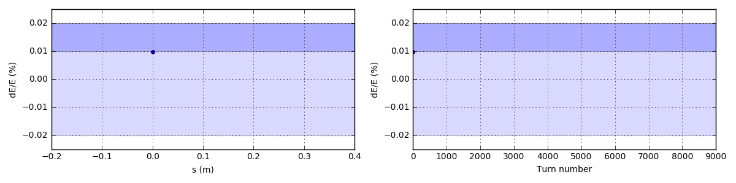
Longitudinal laser cooling is important to stabilize the ion motion:
The important effect of photon emissions on ion beam dynamics is in the energy loss of the partially stripped ion. This energy loss is randomly distributed from 0 to 400 MeV in this case of Pb ion with one remaining electron in the LHC. This randomness excites uncontrolled growth of synchrotron oscillations leading to a loss of ion from the RF-bucket:
4.0 scatterings
per ion
per turn
The synchrotron oscillations can be stabilized by a small change in the spectral distribution of the laser beam (or by adding another low-power laser):
4.4 scatterings
4.0 scatterings
per ion
per turn
Simulation details: http://www.inp.nsk.su/~petrenko/misc/ion_cooling/animations/

Slide 7
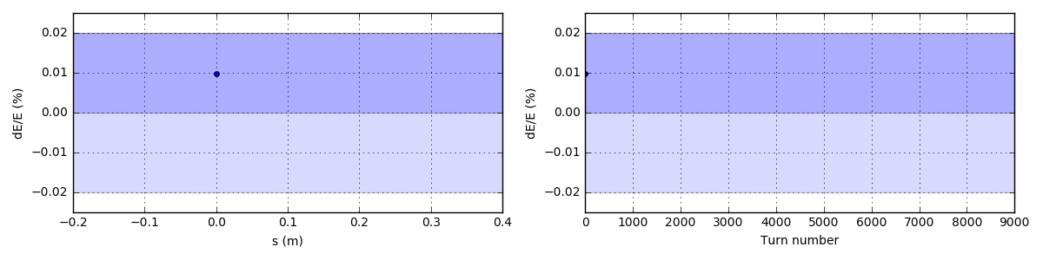
Fast longitudinal cooling
4.4 scatterings
4.0 scatterings
per ion
per turn
Fast longitudinal cooling idea: E. G. Bessonov, R. M. Feshchenko Stimulated Radiation Cooling. RuPAC’2008.

Slide 8
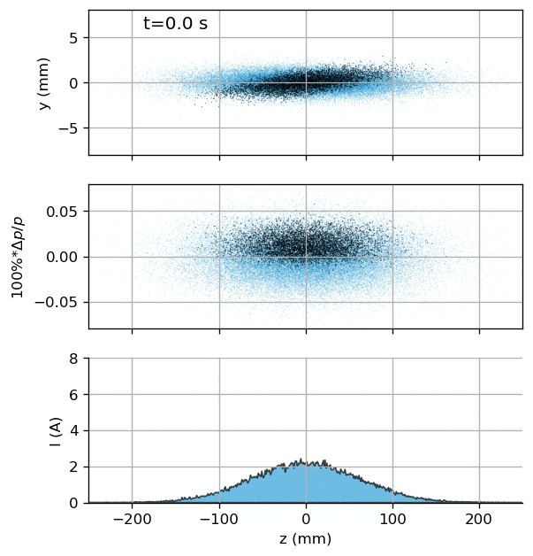
We would like to test this idea with a Li-like Pb beam in the SPS:
Laser pulse
Excited ions marked by black
Laser frequency distribution is optimized to excite preferably ions with Δp > 0
Simulation details.
Gamma Factory Proof-of-Principle Experiment. Letter of Intent. CERN, 2019.

Slide 9
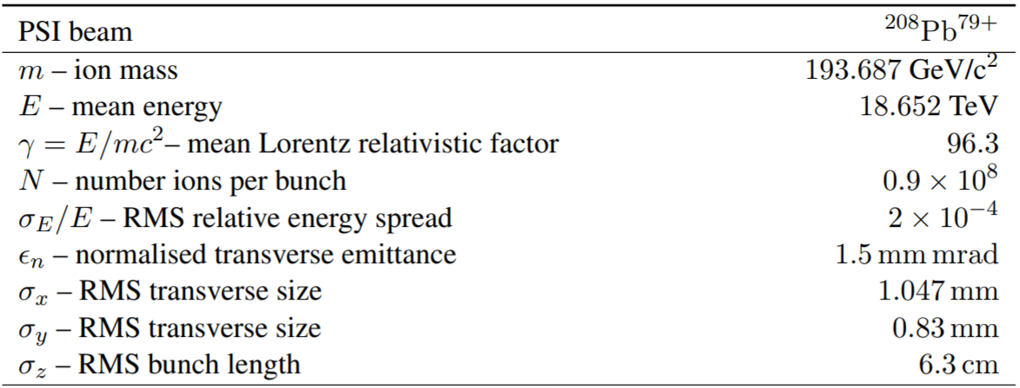
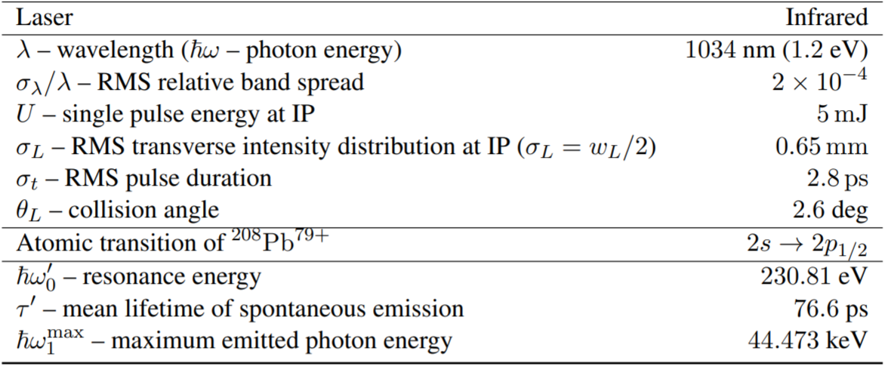
Gamma Factory Proof-of-Principle Experiment at the SPS:
From a recent presentation at Physics Beyond Colliders meeting: https://indico.cern.ch/event/1089151/contributions/4620320/
Demonstrate integration and operation of a laser and a Fabry-Perot cavity in a hadron storage ring
  Laser commercially available but limited experience in hadron ring
  Operation compatible with other ring users
Benchmark simulations of atomic excitation rates
  Modelling of laser-ion collisions requires new numerical tools
Control of ion and photon bunches
  Control of spatial, time and spectral overlap
Demonstrate laser cooling of relativistic beams and
investigate different approaches
  Models show different cooling regimes depending on collision scheme
Investigate feasibility of relativistic atomic physics measurements
  Accurate and absolute measurement of deep electronic transition energies
  are highly relevant to fundamental physics
Breakthrough in accelerator physics
Breakthrough in atomic physics
Gamma Factory Proof-of-Principle Experiment. Letter of Intent. 2019.

Slide 10
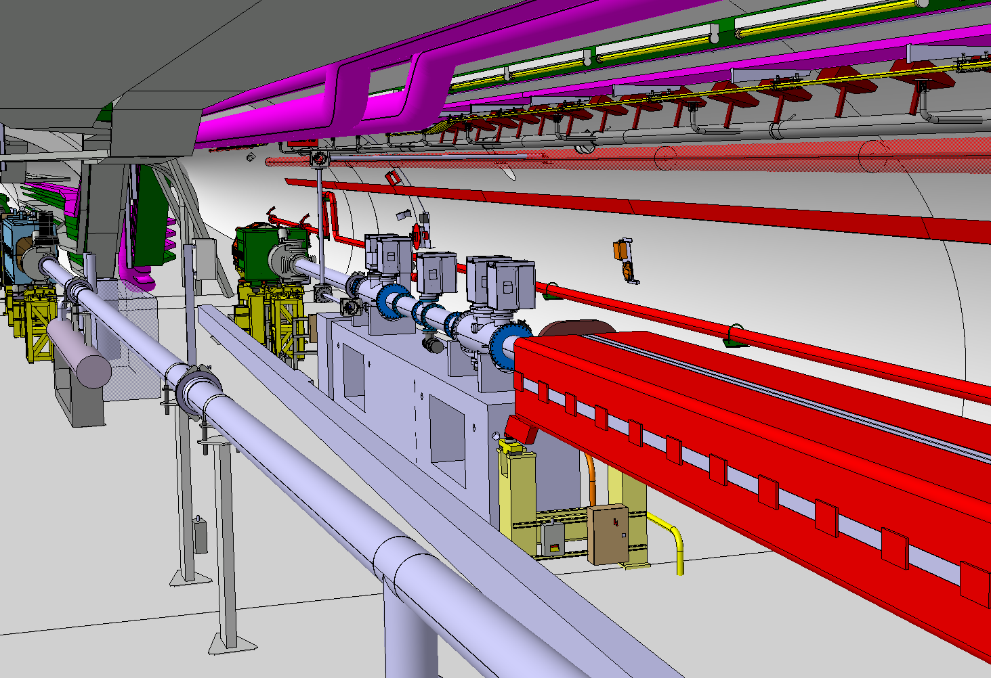
Gamma Factory Proof-of-Principle Experiment at the SPS:
From a recent presentation at Physics Beyond Colliders meeting: https://indico.cern.ch/event/1089151/contributions/4620320/
Laser transport line
X-rays detector
Laser cavity
SPS extraction towards LHC and HighRadMat
Li-like Pb beam
Upstream dipole
Gamma Factory Proof-of-Principle Experiment. Letter of Intent. CERN, 2019.

Slide 11
Transverse cooling via dispersive coupling:
(I’ve rearned about this experiment after reading the Lewin Eidam’s PhD Thesis which was sent to me by W. Krasny)

Slide 12
Transverse cooling of Li-like Ca beam in the SPS:
High-luminosity Large Hadron Collider with laser-cooled isoscalar ion beams. M. W. Krasny, A. Petrenko, W. Placzek. Progress in Particle and Nuclear Physics 114 (2020) 103792.
Simulation details: https://anaconda.org/petrenko/li_like_ca_in_sps_transv

Slide 13
There are several ways to cool high-energy hadron beams
1. Synchrotron radiation cooling
For protons and ions occurs naturally at very high energies. Takes hours. Probably practical only starting from the energy of High-Energy LHC (a project to upgrade LHC to 12-16 TeV).
2. Optical stochastic cooling
Was seriously considered for the Tevatron. Can be applied for protons in the LHC (for luminosity leveling and beam halo control). The test experiment with electrons is under construction at Fermilab. For details see: V. Lebedev. Optical Stochastic Cooling (2012).
V. Lebedev and A. Romanov. Optical Stochastic Cooling at IOTA Ring (2015).
E. Bessonov, M. Gorbunkov, A. Mikhailichenko. Enhanced optical cooling system test in an electron storage ring (2008) – fast version of optical stochastic cooling.
4. Coherent electron cooling V. Litvinenko and Ya. Derbenev, PRL 102, 114801 (2009).
3. Laser cooling of partially stripped ions
Well-developed at low-energy. Cooling is faster at high energy because the energy radiated by the ion grows as γ² (assuming different ions/transitions are used). Never tested above few 100 MeV/u.
The only low-cost option without large infrastructure investments.

Slide 14
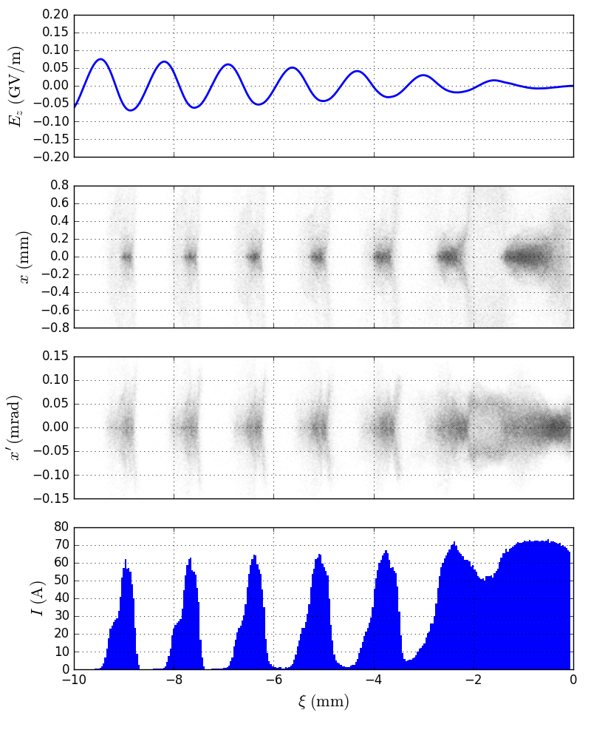
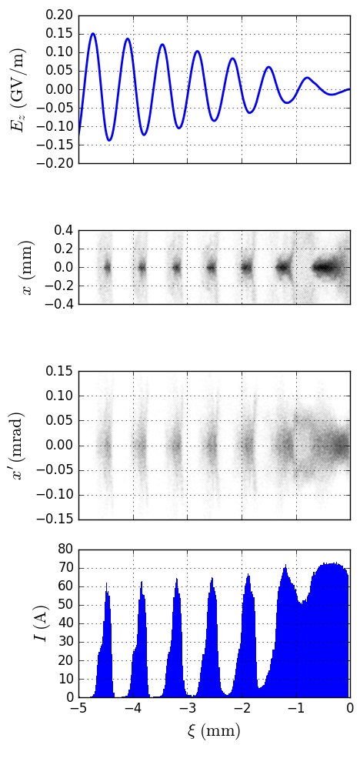
Why ion cooling is interesting for plasma wakefield acceleration: general scaling of PWFA:
n_{plasma} = 7∙10¹⁴ cm⁻³
n_{plasma} = 4x(7∙10¹⁴ cm⁻³)
2x higher wakefield
2x smaller transv. size => 4x higher beam density.
The same angular spread => 2x lower beam emittance required.
The same current => 2x less particles needed to drive 2x higher wake.
(Also 2x less
accelerated particles).
10x less particles with 10x lower emittance and the same current can potentially drive 10x higher wakefield.
Maximum plasma density is essentially defined by the transverse beam emittance.
Higher peak current is needed to reduce the number of micro-bunches => less strict tolerances on plasma density.

Slide 15
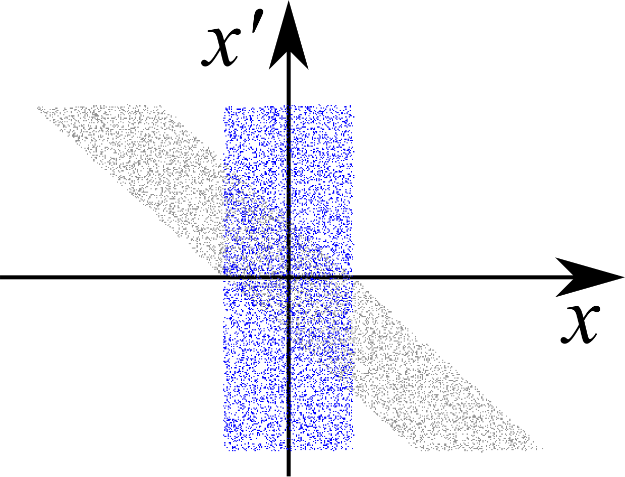
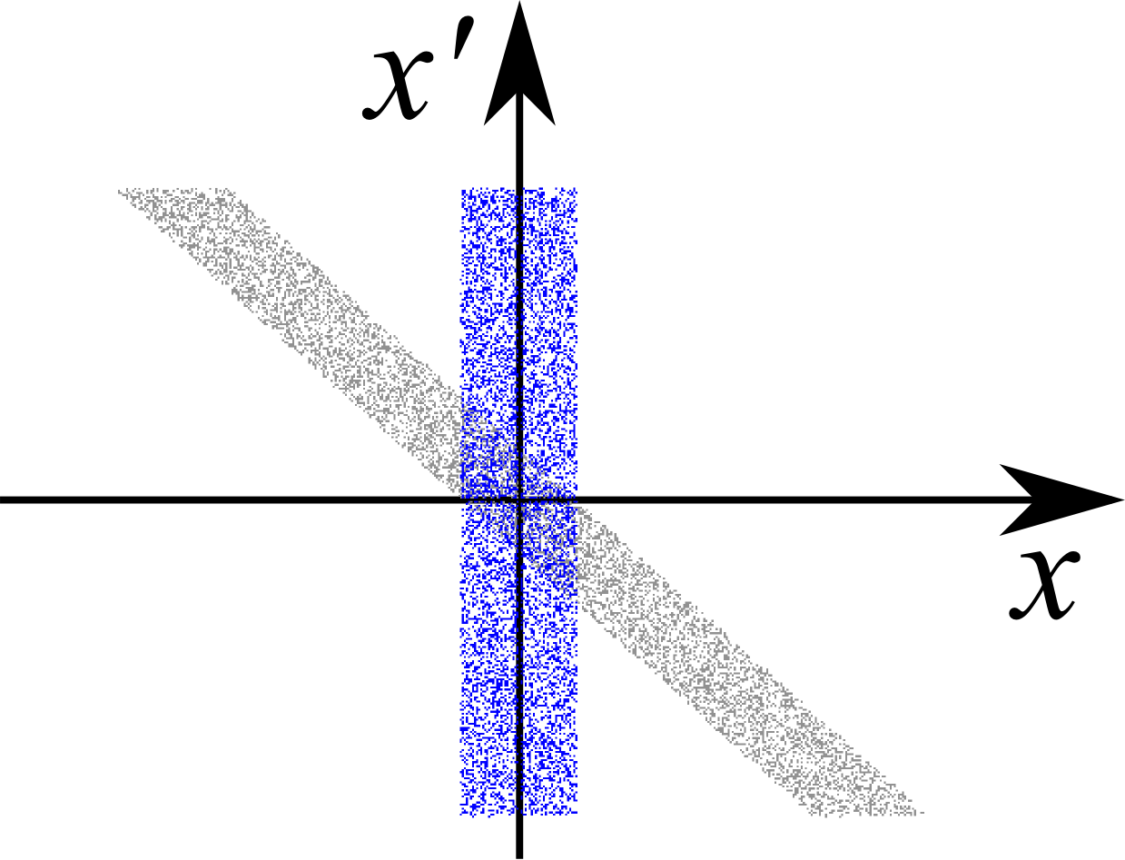

The beam size at the focal point is linearly proportional to the beam emittance (for properly matched beam):
At the focal point
At the focal point
After the lens
After the lens
(per unit length)
Aperture and strength of the final focus lens remains the same.
The same scaling applies to a witness beam. This is good for collider luminosity:
f ― frequency of collisions; N₁, N₂ ― number of particles in the colliding beams; σ_{x}, σ_{y} ― transverse sizes of the colliding beams (both beams have the same size).
Consider the electron-proton/ion collider for example. If the energy of colliding protons and electrons are the same then electrons will have 2000x higher gamma-factor (and much smaller beam size than colliding protons/ions). Therefore we can assume that the colliding beam size is defined by the proton/ion beam size. In this case 10x smaller emittance (hence 10x smaller size) proton/ion beam will produce 100x higher luminosity. Cooling is also important for the target proton/ion beam.
The gain in luminosity can be even higher since at low intensity the beam in the ring can be accelerated as a long train of bunches and then extracted bunch-by-bunch. At the high single bunch intensity the number of bunches limited by coupled bunch instabilities.
With a selective fast cooling it might also be possible to cool the bunches one-by-one → first accelerate the maximum possible charge in the SPS/LHC as a long train of bunches and then select small amount of charge from the circulating beam, cool it to the required parameters, and extract the short single bunch towards the high-density plasma accelerator.

Slide 16
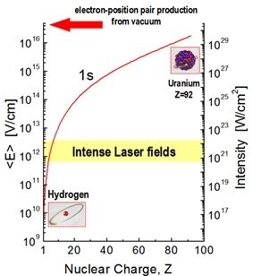
Lorentz boost of the laser field:
Lorentz boost of the laser field to the ion rest frame at the LHC:
The plot from T. Stohlker's website. (2018)

Slide 17
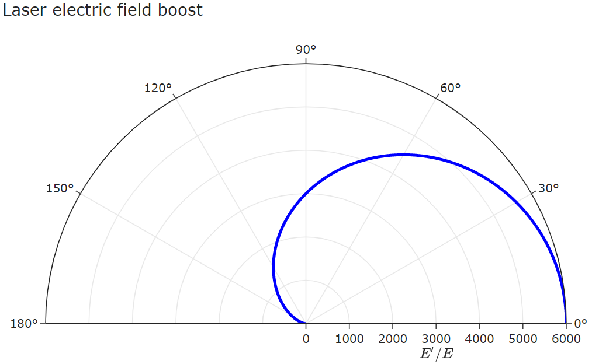
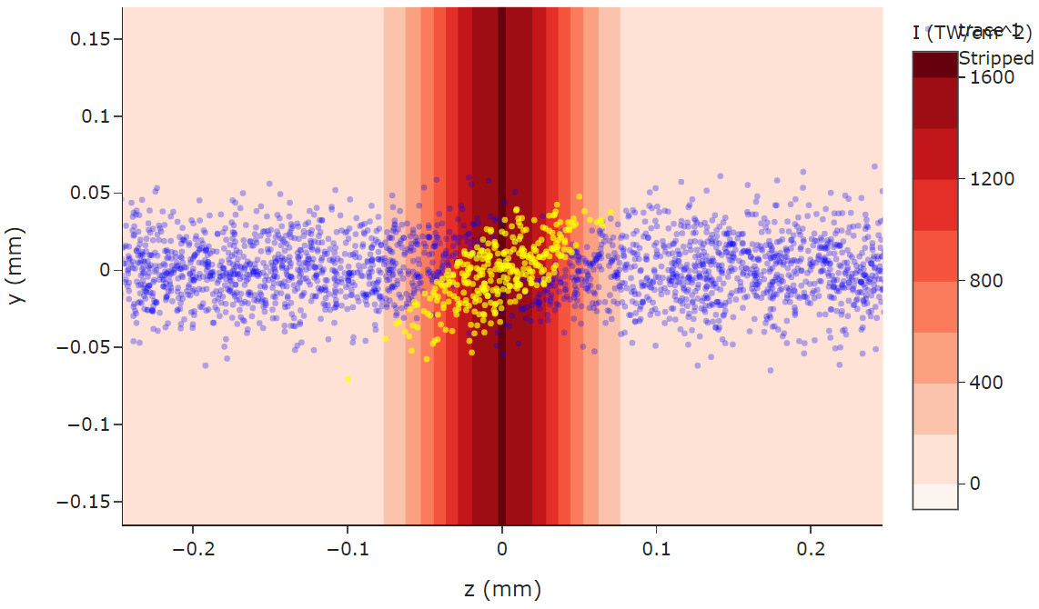
Ion bunch slicing with a short laser pulse:
50 fs long,18 mJ laser pulse focused to w₀ of 75 μm ionizing H-like Ca beam in the LHC at 90-degree angle:
Sequence of such short ion bunches can drive different (plasma / dielectric / metal) wake-field accelerators:
Laser pulse path
H-like Ca
Stripped Ca ions

Slide 18
Thanks!

Slide 19
Back-up slides

Slide 20

PWFA-motivation
LHC nominal beam parameters:
(2808 bunches)*(1.15e11 protons)*(7 TeV) = 360 MJ
Fully loaded A320 (80 t) at take-off speed (300 km/h)
carries similar amount of kinetic energy (280 MJ).
(However the momentum of the airplane is ~ c/v ~ 10⁶ times larger
than the LHC beam momentum)
Single LHC proton bunch (7 TeV, 1.2e11 protons) carries 130 kJ
Single SPS proton bunch (0.4 TeV, 3e11 protons) carries 19 kJ
Single ILC electron bunch (0.5 TeV, 2e10 e+/e-) carries 1.6 kJ
Average design beam power of ILC (11 MW) is only about 10-20 times higher than that of SPS (0.8 MW) and LHC (360 MJ/1000 sec = 0.4 MW).
Can we use LHC/SPS beam as a driver to obtain TeV-level (e-/e+/muons) in a single stage?
Such an accelerator probably can’t compete with the ILC or CLIC in terms of luminosity but maybe there is some interesting physics at high energy but low luminosity:
A. Caldwell. Collider physics at high energies and low luminosities. Eur. Phys. J. (2014).
A. Caldwell, M. Wing. VHEeP: a very high energy electron–proton collider. Eur. Phys. J. (2016).
-- some electron-proton cross sections grow with energy.
20

Slide 21
Link to Padua seminar presentation on high-energy laser cooling:
Beam stability and cooling aspects for the partially stripped ions in the storage rings, Padua, 2017

Slide 22
Transverse cooling of Li-like Ca beam in the SPS:
The configuration is very similar to the Gamma Factory Proof-of-Principle experiment.
Many thanks to Aurelien Martens for checking the laser parameters!

Slide 23
Transverse cooling of Li-like Ca beam in the SPS:
First laser transfers betatron oscillations into energy oscillations (synchrotron oscillations)
Second laser cools the beam in energy (longitudinally)

Slide 24
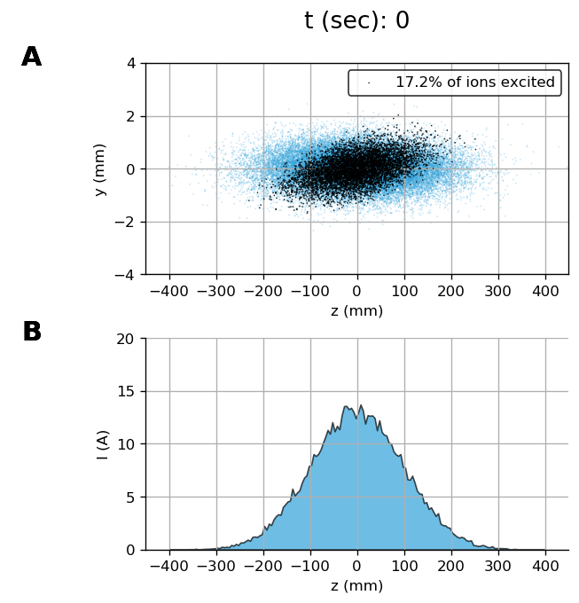
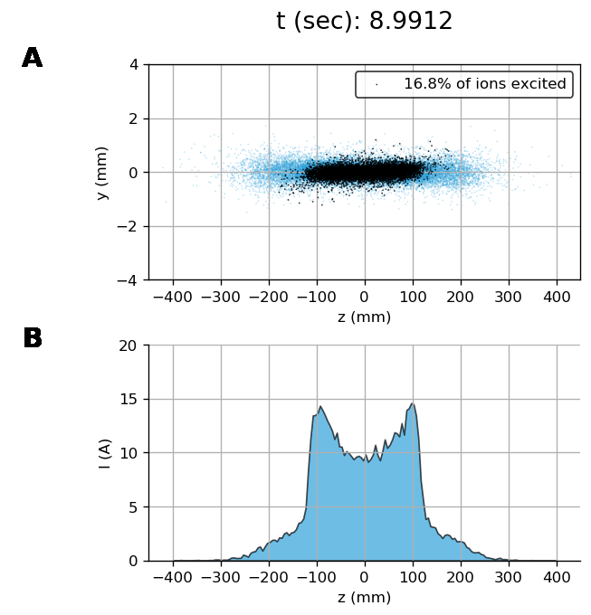
Transverse cooling of Li-like Ca beam in the SPS:
Simulation details: https://anaconda.org/petrenko/li_like_ca_in_sps_transv

Slide 25
Transverse cooling of Li-like Ca beam in the SPS:
Betatron oscillations are fully coupled via the coupling resonance.
https://cds.cern.ch/record/300856/files/p43.pdf
https://indico.cern.ch/event/856751/

Slide 26
Partially stripped ions in the SPS
D. Manglunki et al. CERN's Fixed Target Primary Ion Programme. IPAC’2016.
J. Wenninger et al. Energy Calibration of the SPS with Proton and Lead Ion Beams. PAC’2005:
(fully str.)
100x less than in AWAKE.
Maybe could be optimized for high beam charge.
Number of charges: 9·10¹⁰ 3.2·10¹⁰ 2.5·10¹⁰
Less than in AWAKE 3x less 10x less 10x less
Production efficiency for partially stripped ions can be higher than for the fully stripped ions.
Possible variant: Xe⁴⁷⁺ (7 electrons left, N-like). γ = 162. Atomic excitation ⁴S_{3/2} → ⁴P_{3/2}. Krypton laser: 647 nm (1.87 eV) will be converted to gamma-photons with E_{max} = 196 keV. I_{sat.} = 1.7·10⁸ W/cm² , decay length = 3.4 cm => with a 1 mm wide beam to have one interaction per turn we need a single laser pulse energy ≈ 1.7·10⁸ W/cm² · 0.1·0.1 cm² · 3.4 cm / (3·10¹⁰ cm/sec) ≈ 0.2 mJ => Average laser power ~ 0.2·10⁻³ J / (7000 m / 3·10⁸ m/sec) ~ 10 W.
(Xe⁴⁷⁺ suggested by Bessonov and Kim PRL’1996 and in W. Krasny’s proposal for gamma-factory test at SPS).

Slide 27
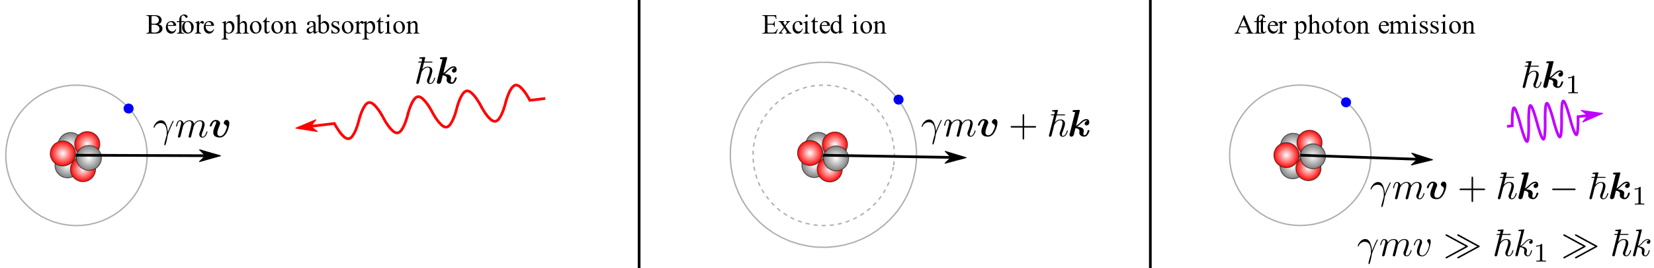

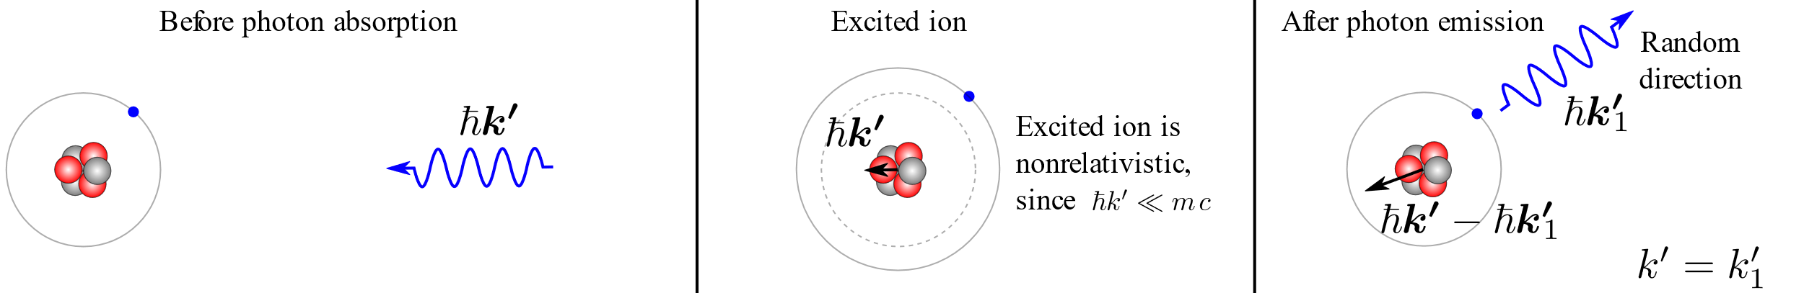
Laser-ion interaction kinematics
In the lab frame:
In the ion’s frame:
Longitudinal cooling: because energy loss grows with ion energy:
Transverse cooling: because all components of ion momentum are lost due to the photon scattering but only the longitudinal component is restored in the RF resonator.
Heating: because angle of photon emission in the ion’s frame is random.
We would like to find an equilibrium between the cooling and heating processes.

Slide 28

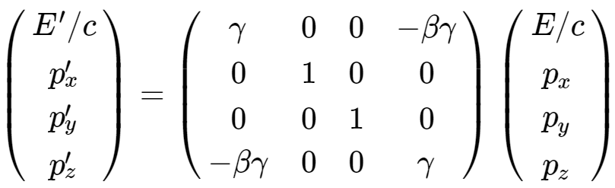
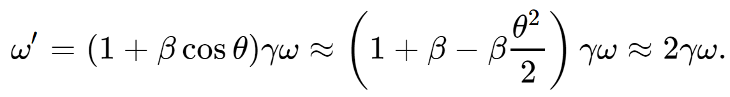
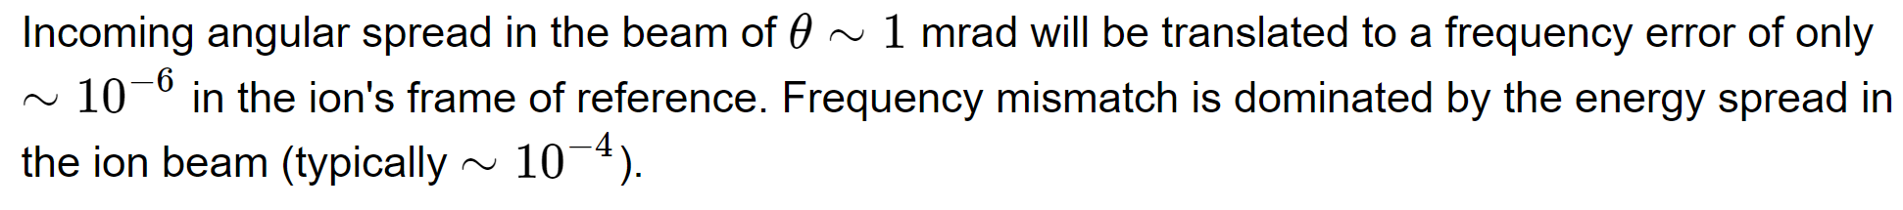
Photon absorption
4-vector Lorentz transformation:

Slide 29
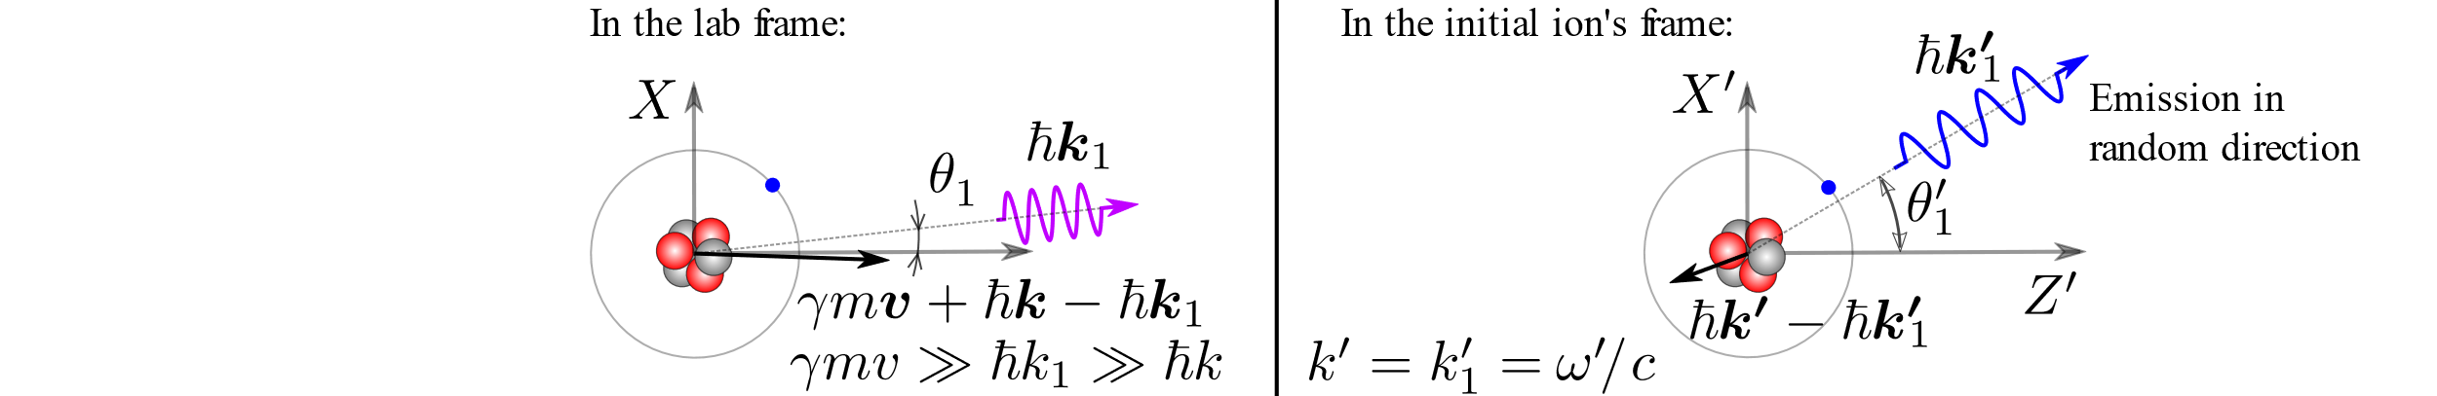
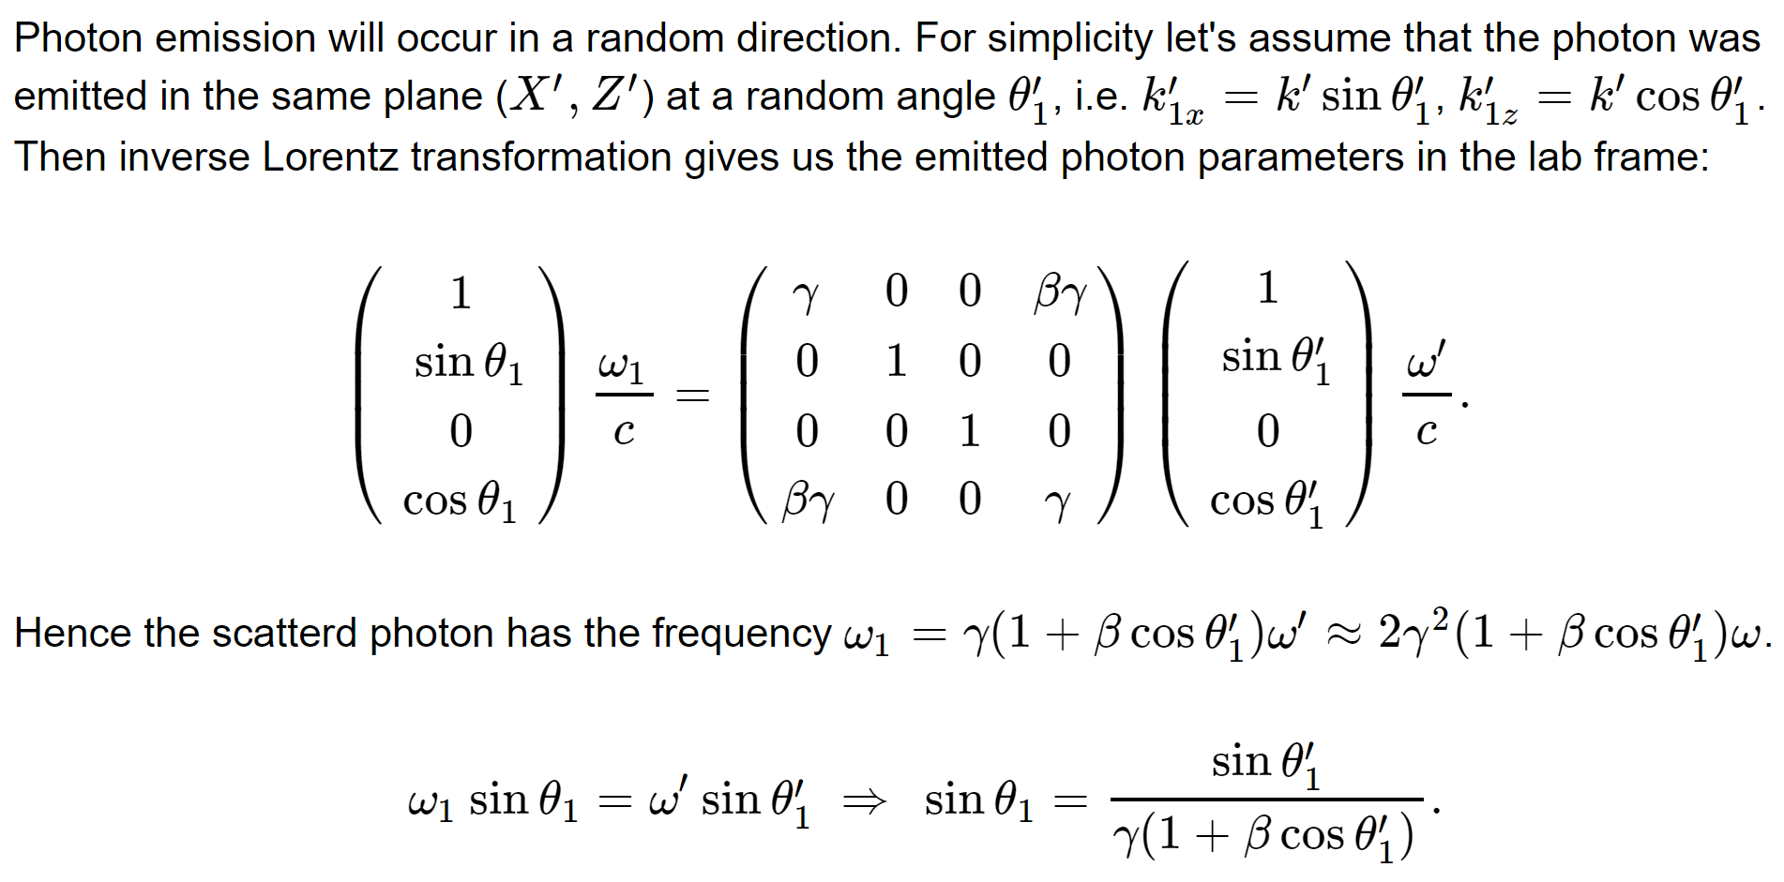
Photon emission

