Slide 1
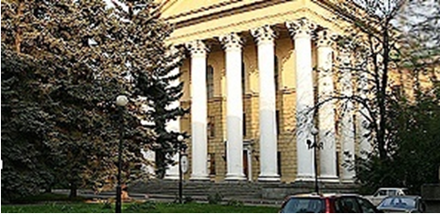
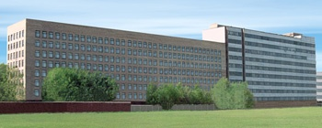
Laser based source of electrons/ions for nuclear medicine and nuclear waste transmutation
A. V. Brantov, M. G. Lobok, O. E. Vais, S. G. Bochkarev, V. Yu. Bychenkov
P. N. Lebedev Physics Institute, Russian Academy of Science, Moscow, Russia
Center for Fundamental and Applied Research, VNIIA, ROSATOM, Moscow, Russia

Slide 2
Outline/summary
Self-trapping regime of laser pulse propagation in sub-ctritical plasma is optimal for effective electron beam generation with multi-nC charge. Such beams opens a way to high-yield production of gammas and photonuclear particles.
4 J femtosecond laser with a repetition rate of 10 Hz, which is already commercially available can provide therapeutic amount of certain medical radioisotopes.
Low efficiency of transmutation in pure LLFP targets will require the next generation continuously operating high-repetition laser systems (MHz range rep-rate and tens of joules).
M G Lobok A V Brantov and V Yu Bychenkov
2022 Plasma Phys. Control. Fusion 64 054002

Slide 3
Nuclear medicine
(Single Photon Emission Computed Tomography)
SPECT
(Positron Emission Tomography)
PET

Slide 4
Medical cyclotrons
Clinical Nuclear Medicine ed H Ahmadzadehfar, H J Biersack, L Freeman and L Zuckier (Cham: Springer) 2020.

Slide 5
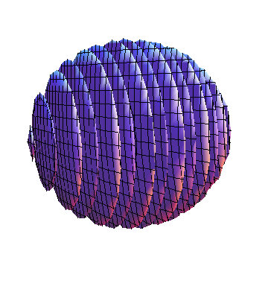
Electron acceleration from low-density target
Laser pulse
2 R_{L}
laser
target
gamma-rays
z
electron bunch
2 τ
x
y
converter
~4 J
8×10²⁰ W/cm²
τ = 30 fs
2 R_{L} = 5 μm
linear polarization
L = 10 - 200 λ
GEANT-4
electrons
heavy ions
Target
PIC code
Vsim (Vorpal)
Collect all electrons behind target with energy more than 1 MeV
Moving window
x × y × z = 58 λ × 25 λ × 25 λ
Δx × Δ y × Δ z = λ/50 × λ/10 × λ/10

Slide 6
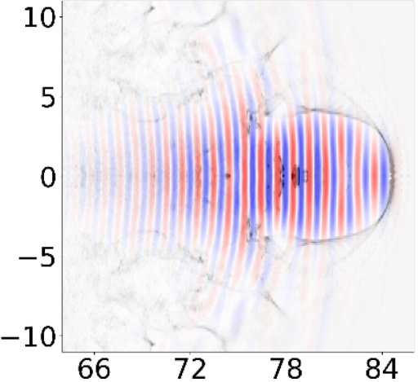
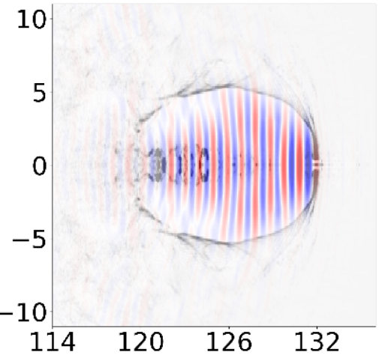
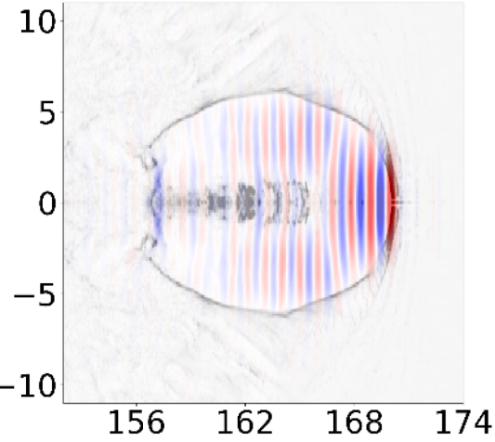
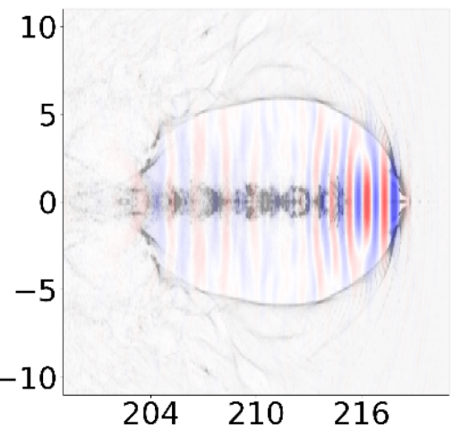




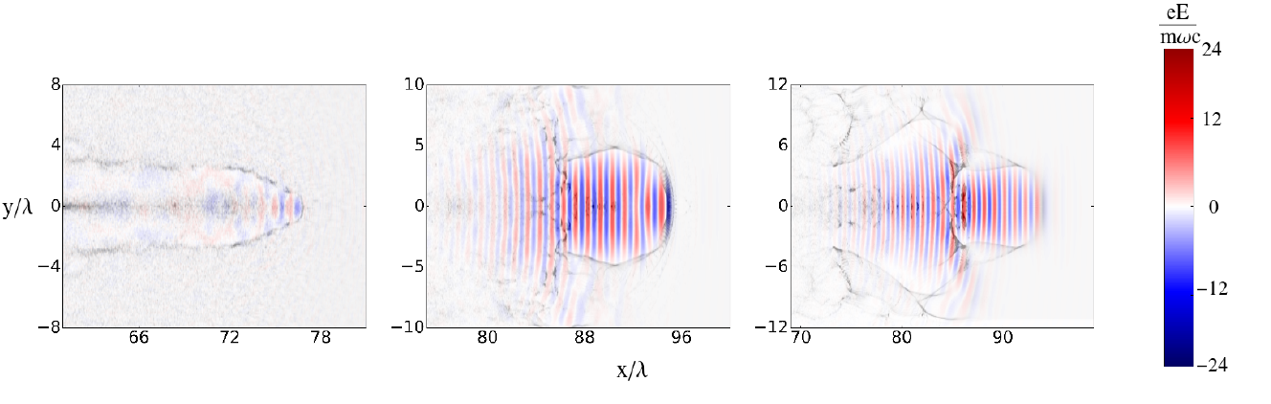



Laser bullet acceleration regime
Propagation over ∼ 10 Rayleigh lengths
Stable propagation only for matched conditions !
α - numeric factor ~ (1-2)
R
R (n, I) - matching

Slide 7
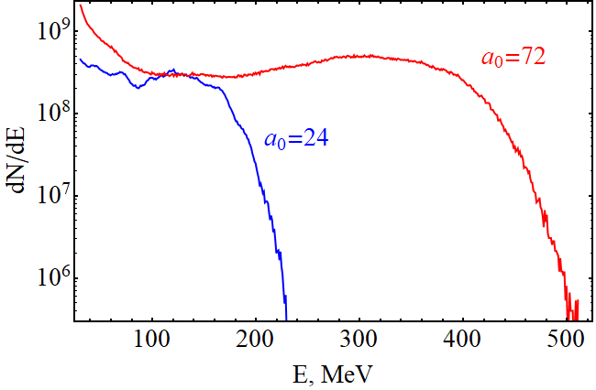
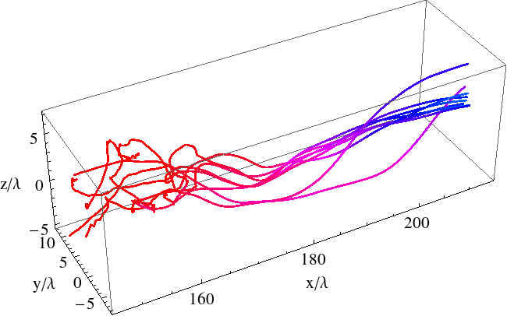
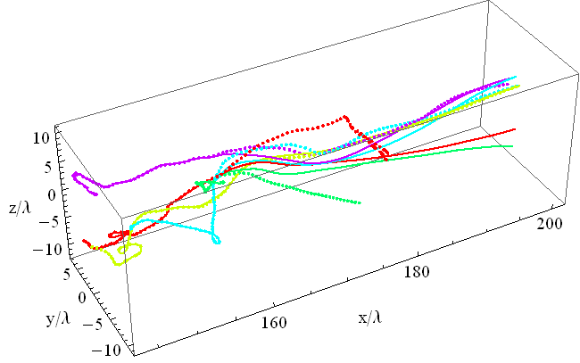
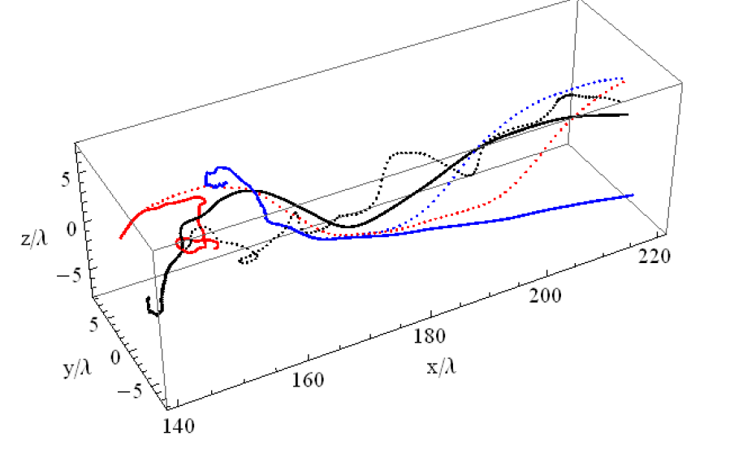

Electron acceleration from near-critical targets
Flat-top electron spectra
Stochastic electron injection
Modification of electron trajectories due to small electron momentum perturbations

Slide 8
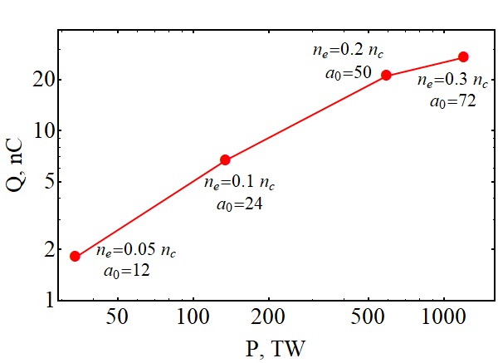
Electron acceleration from near-critical targets
T_{e}=210 MeV
T_{e}=97 MeV
Laser - electron beam conversion efficiency ~15 %
M. G. Lobok et al., Plasma Phys. Control. Fusion.Vol. 60. P. 084010 (2018)
V. Yu. Bychenkov et al., Plasma Phys. Control. Fusion. Vol. 61.P.124004 (2019)

Slide 9
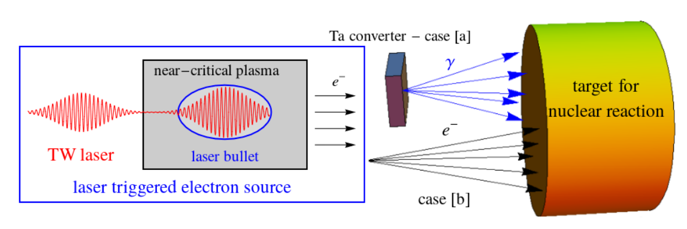
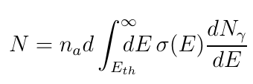
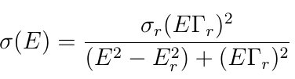
Photonuclear reaction
Main contribution from Giant resonance

Slide 10
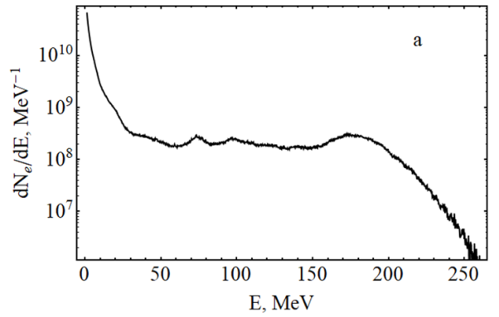
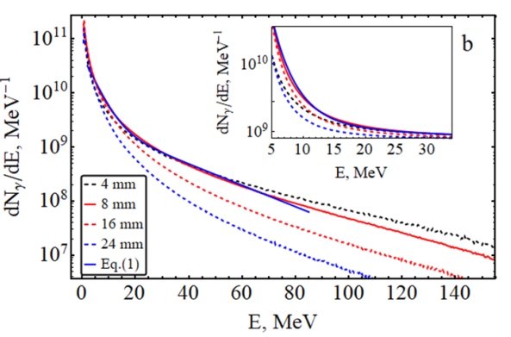





Laser-triggered gamma-ray source for nuclear reactions
Electrons
Spectrum of electrons accelerated by a 135 TW laser
Corresponding gamma spectra for the Ta-converters

Slide 11


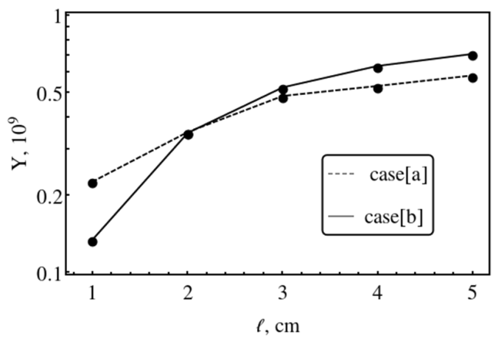
Medical isotopes production
used in brachytherapy as a seed or a stent.
SPECT diagnostics – ^{99m}Tc
⁹⁹Mo (66 hours ->) ^{99m}Tc
SPECT diagnostics – ¹¹¹In, ¹²³I
PET diagnostics – Cu isotopes
The use of direct electron beam irradiation has the advantage of simplifying the photonuclear production of isotopes.

Slide 12
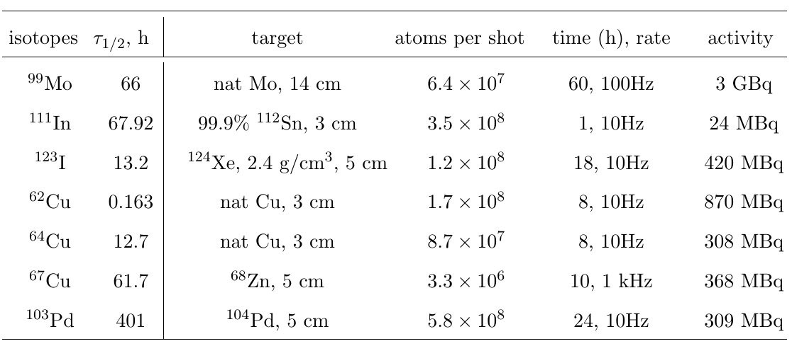
Photo-nuclear production of medical isotopes
Therapeutic amounts of some medical radioisotopes can be produced with 4J 10 Hz laser system, while creating, e.g., (⁹⁹Mo^{99m}Tc)-generator will require 100 Hz laser.
The same amount of ⁶⁴Cu and ⁶²Cu medical isotopes can be produced with the three times less in energy laser as reported earlier. The ⁹⁹Mo isotope yield per one electron is comparable to that obtained at PW-class Bella laser system [i.e.∼ 2×10⁻³ atoms per electron].

Slide 13
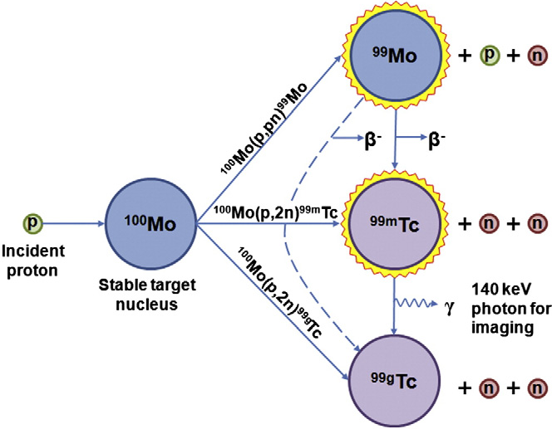
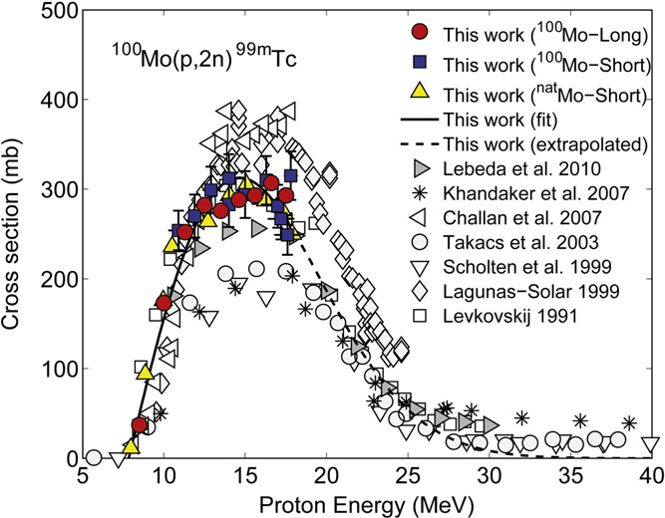
SPECT isotopes (^{99m}Tc) production
The era of nuclear reactors in the production of isotopes is over ???
The medical ^{99m}Tc isotope production through a particle
accelerators ?  ¹⁰⁰Mo(p,2n)^{99m}Tc
Production of ^{99m}Tc with cyclotrons is widely discussed
Protons with
energy of ~30 МэВ
↓
I~10²¹W/cm²

Slide 14
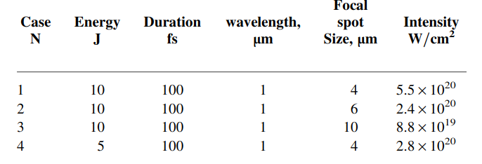
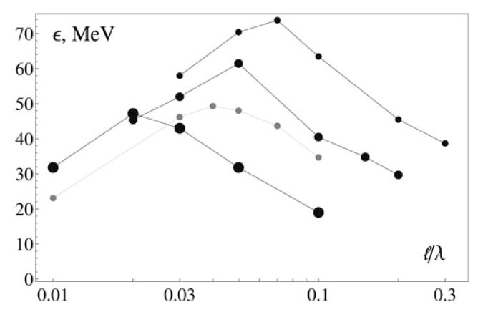
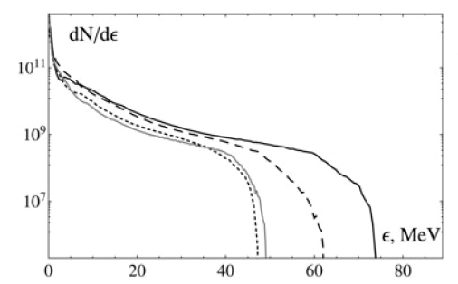
Proton acceleration for Tc-99m production
V. Y. Bychenkov, A. V. Brantov, G. Mourou, Laser and Particle Beams (2014), 32, 605.
1
2
4
3
1
3
2
4

Slide 15
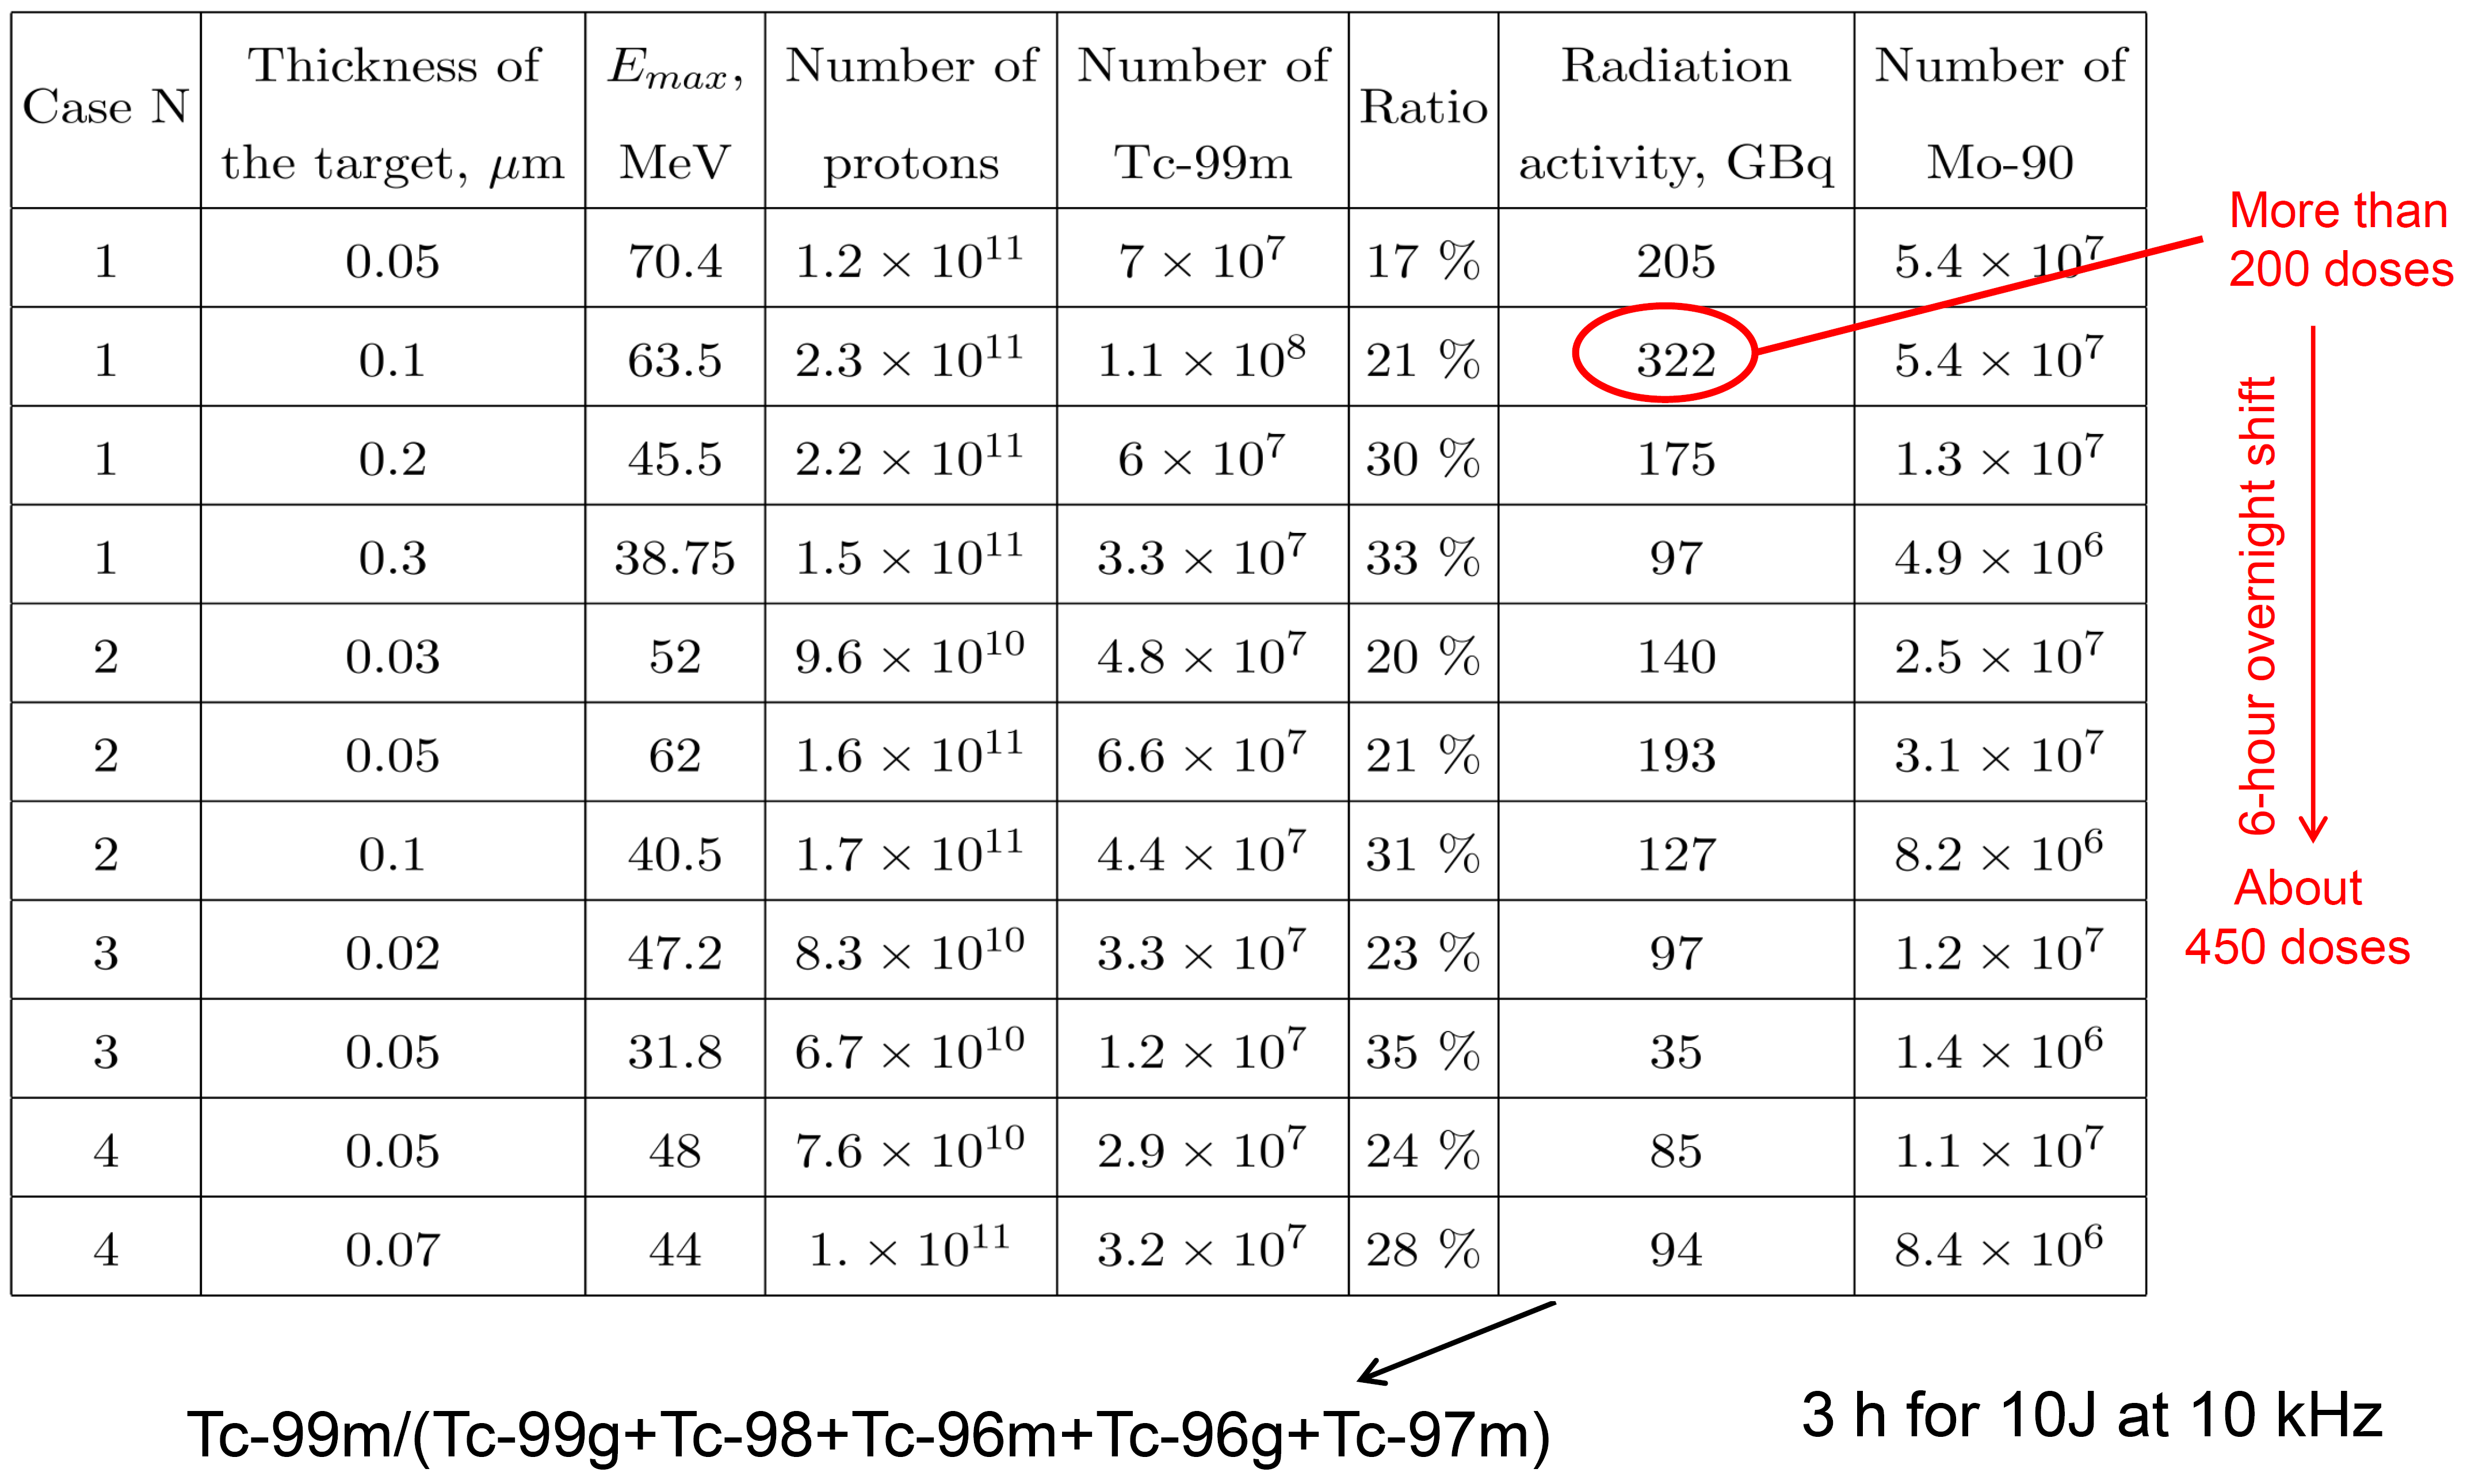
The Tc-99m production versus irradiation condition and target thickness

Slide 16
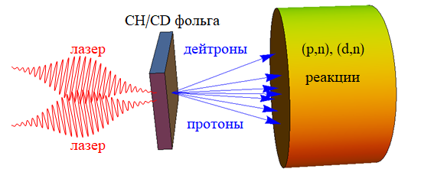
Laser triggered protons/deuterons acceleration from thin foil for medical PET isotope production
foil
laser
deuterons
reaction
3 J, 30 fs
R=10 λ
protons
laser
3D PIC MANDOR
GEANT4

Slide 17
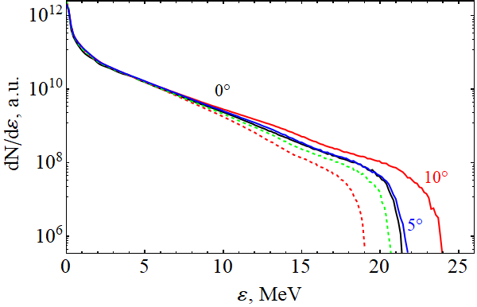
Proton acceleration from thin foil (different incident angels)
Spectra of protons accelerated from СН₂ foil with thickness of 0.02 λ at instant of 386 fs
р-polarization
Change of incident angle up to 10° has rather negligible effect on ion acceleration
s-polarization
Spectra have exponential form ~ exp[-ε/T_{h}] with “temperature” T_{h}= 2.7 MeV and energy cut-off at 21 MeV -25 MeV.

Slide 18
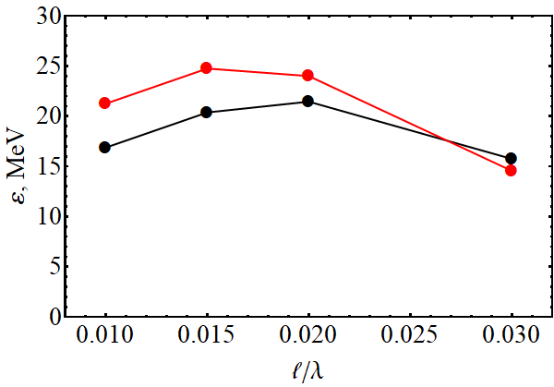
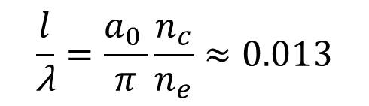
Proton acceleration from thin foil (different target thickness)
Incident under angle of 10°
$$\frac{l}{\text{λ}}=\frac{a_{0 }}{π}\frac{n_{c}}{n_{e}}≈0.013$$
Normal incident
2×10¹¹ protons with energy in excess 1 MeV
Total bunch energy 110 mJ
Conversion efficiency 3.7%.

Slide 19
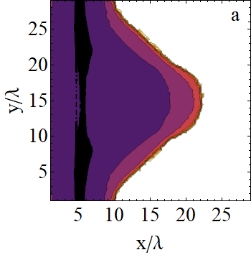
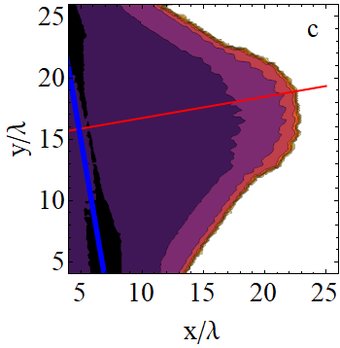
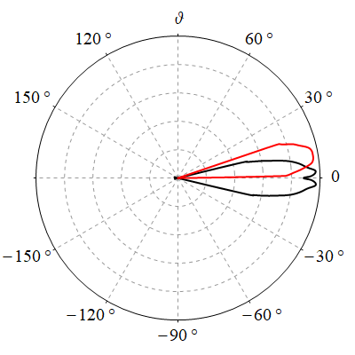
Proton acceleration from thin foil (bunch directionality)
Oblique
incident at 10°
Normal
incident
TNSA –like acceleration

Slide 20
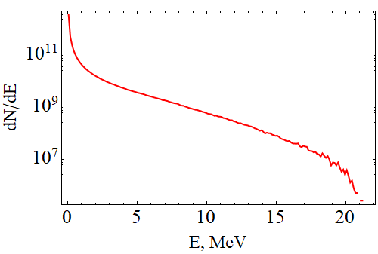
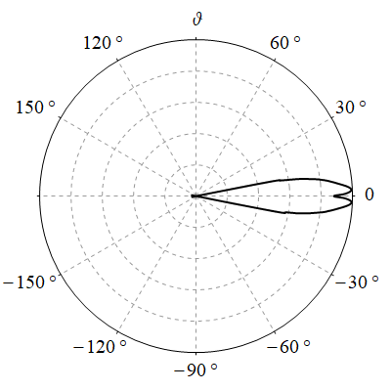
Deuteron acceleration from thin foil
5.5×10¹⁰ deuterons with energy in excess of 1 MeV
full bunch energy ~ 30 mJ
conversion efficiency ~ 1%.
Relatively small total number of accelerated deuterons leads to small number of produced medical isotopes.

Slide 21
Laser triggered PET production
Reaction | Isotope, τ_{1/2} | Atoms per shot | Activity 10 Hz | Irradiation time | Required activity
¹⁴N(p,α)¹¹C | ¹¹C, 20.4 min | 8×10⁶ ¹¹C | 78 MBq | 2 h | 500 MBq
¹⁵N(p,n)¹⁵O | ¹⁵O, 2 min | 7×10⁶ ¹⁵O | 67 MBq | 10 min | 350 MBq
¹⁸O(p,n)¹⁸F | ¹⁸F, 110 min | 1.5×10⁷ ¹⁸F | 130 MBq | 5.5 h | 250 MBq
¹⁶O(p,α)¹³N | ¹³N, 10 min | 2.6×10⁶ ¹³N | 25 MBq | 45 min | 370 MBq
⁶⁶Zn(p,n)⁶⁶Ga | ⁶⁶Ga, 8.5 h | 1.8×10⁷ ⁶⁶Ga | 174 MBq | 40 h | 350 MBq
⁶¹Ni(p,n)⁶¹Cu | ⁶¹Сu, 3.3 h | 10⁷ ⁶¹Сu | 100 MBq | 19 h | 300 MBq
For medical dose production (~ 300 MBq) of PET isotopes laser system with energy of several J and repetition rate of 100 Hz is required
To reach activity comparable with cyclotrons (~ 100 GBq) the repetition rate should be ~ 10 kHz.

Slide 22
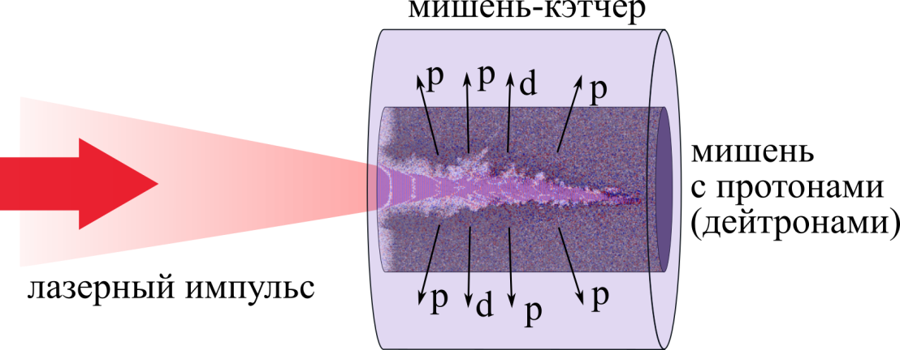
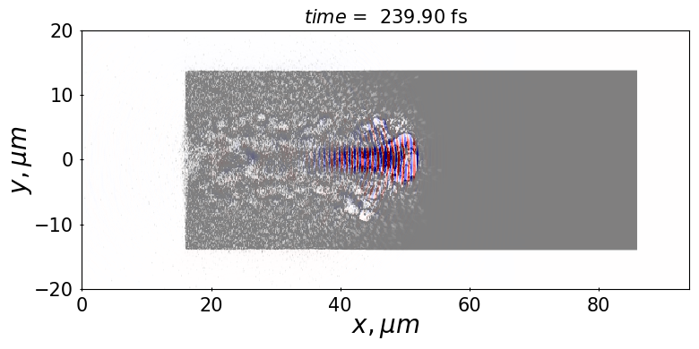
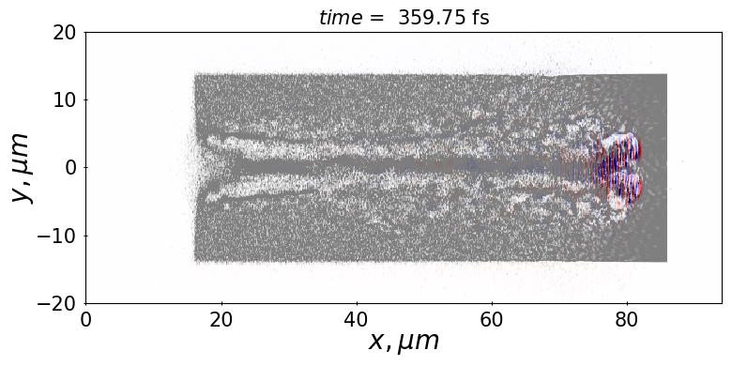
Laser triggered protons/deuterons acceleration from near-critical targets for medical PET isotope production (fs laser pulse)
5 J, 30 fs
R=4 λ, I=9×10²⁰ W/cm²
nuclear target
laser target
with protons (deuterons)
Laser pulse

Slide 23
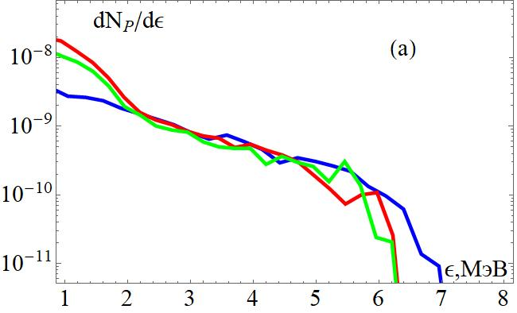
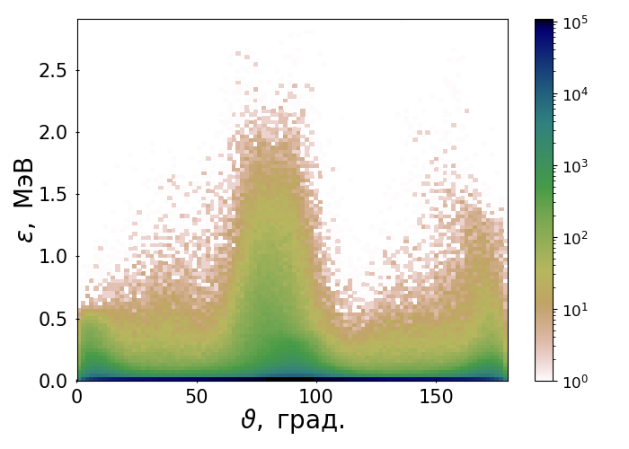
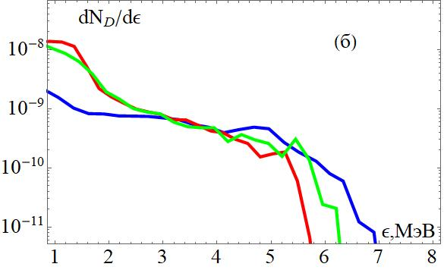
Transversal ion acceleration from near-critical target
Protons
Spectral - angular distribution of proton accelerated from target with density of 2.0n_{с}.
ε, MeV
Deuterons
ε, MeV

Slide 24
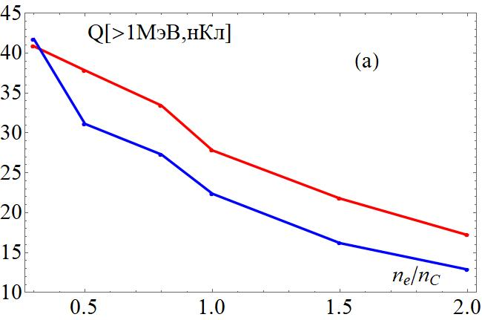
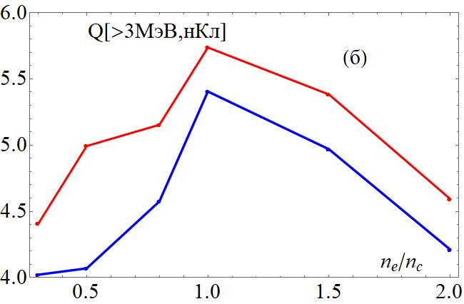
Transversal ion acceleration from near-critical target
Q , nC
> 1 MeV
Maximum bunch charge (nC) of protons (red line) and deuterons (blue line) vs. target density
¹⁵N(p,n)¹⁵O, ¹⁴N(d,n)¹⁵O for production β+ activity atoms ¹⁵O
¹⁸O(p,n)¹⁸F, ²⁰Ne(d,α)¹⁸F
for production β+ activity atoms ¹⁸F
¹⁴N(p,α)¹¹C for production β+ activity atoms ¹¹С
Q , nC
.
> 3 MeV

Slide 25
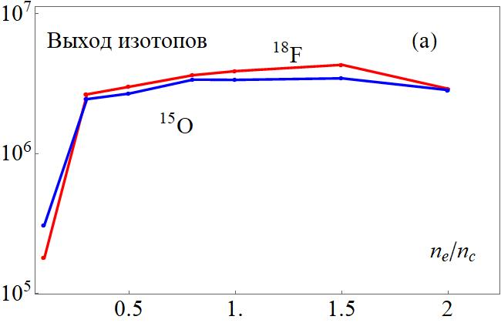
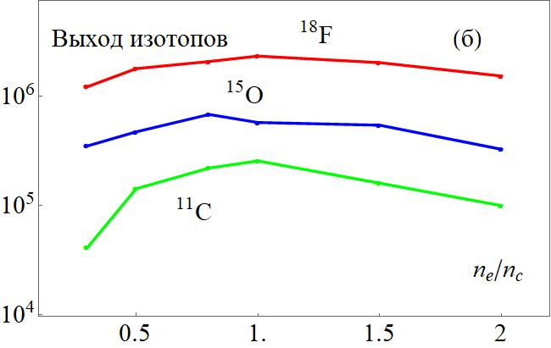
Laser triggered PET production (5 J, 30 fs)
Atoms per shot
deuterons
Required irradiation condition for medical dose production
¹⁸F (activity ~200 MBq )
– 100 h, 100 Hz
GEANT4 - calculation
¹⁵O (activity~350 МБк)
- 10 min, 1 kHz
¹¹C (activity ~ 500 MBq)
– 2 h, 2 kHz
Atoms per shot
protons
Does not any improvement in comparison with thin foils

Slide 26
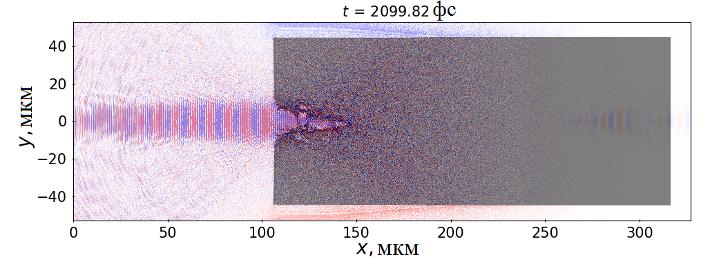
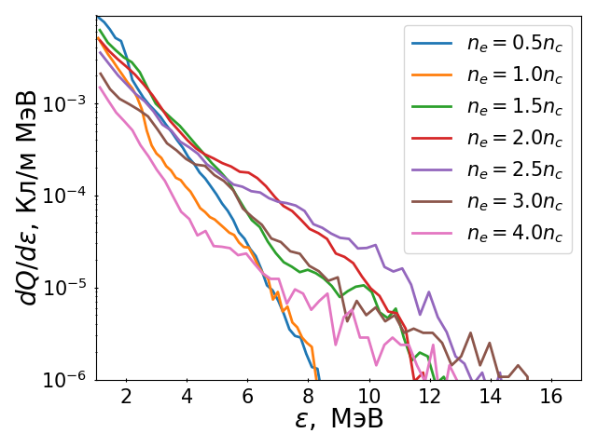
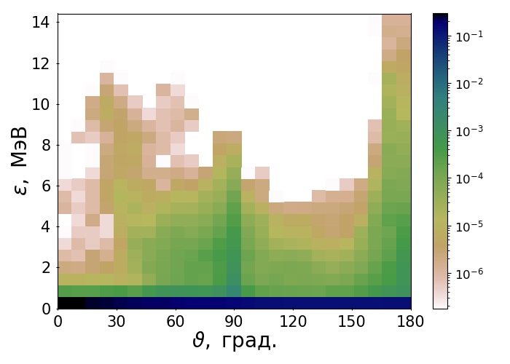
Laser triggered protons acceleration from near-critical targets for medical PET isotope production (sub ps laser pulse)
E = 30 J, λ = 1.055 µm , τ = 500 fs,
∅ = 10 µm, I = 5х10¹⁹ W/cm²
proton from target with (n_{e} =1.5n_{с})

Slide 27
Laser triggered PET production (30 J, 500 fs)
Reaction | Isotope, τ_{1/2} | Atoms per one shot | Maximum activity (for Hz) | Repetition rate for med. dose
¹⁸O(p,n)¹⁸F | ¹⁸F, 110 min | 3.1×10⁷ | 30.9 MBq | 5 Hz
¹⁵N(p,n)¹⁵O | ¹⁵O, 2 min | 1.3×10⁷ | 13.1 MBq | 26 Hz
¹⁴N(p,α)¹¹С | ¹¹С, 20 min | 1.3×10⁷ | 12.7 MBq | 40 Hz
Irradiation time >> τ_{1/2} . Optimal concentration : n_{e} = 2.5 n_{cr}
In comparison with fs laser pulse
¹⁸F yield for 1 J of laser pulse increases 2 times
¹⁵O yield for 1 J of laser pulse increases 4 times
¹¹C yield for 1 J of laser pulse increases 8.5 times

Slide 28
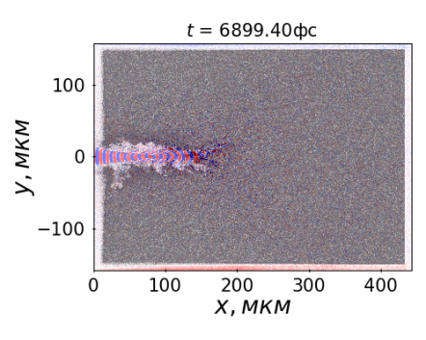
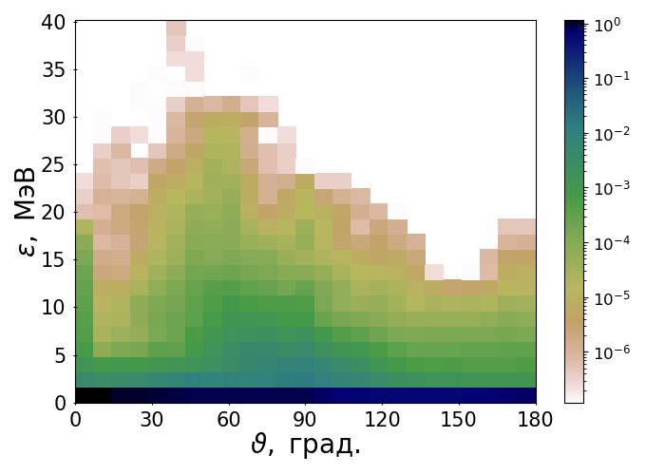



Laser triggered protons acceleration from near-critical targets for medical PET isotope production (2 ps laser pulse)
E = 0.5 kJ, λ = 1.055 µm, τ = 2 ps, ∅ = 10 µm, I = 2х10²⁰ W/cm²
3n_{c}
n_{c}
0 150мкм
protons
deuterons
~3х10¹³

Slide 29
Laser triggered PET production (0.5 kJ, 2 ps)
Reaction | Isotope, τ_{1/2} | Atoms per one shot | Maximum activity (for 1 Hz) | Repetition rate for med. Dose
¹⁸O(p,n)¹⁸F | ¹⁸F, 110 min | 4.6×10⁸ | 460 MBq | 0.4 Hz
^{nat}Ne(d,x)¹⁸F | ¹⁸F, 110 min | 5.3×10⁸ | 530 MBq | 0.4 Hz
¹⁵N(p,n)¹⁵O | ¹⁵O, 2 min | 1.8×10⁸ | 180 MBq | 2 Hz
¹⁴N(d,n)¹⁵O | ¹⁵O, 2 min | 8.6×10⁸ | 860 MBq | 0.4 Hz
¹⁴N(p,α)¹¹С | ¹¹С, 20 min | 1.7×10⁸ | 170 MBq | 3 Hz
Irradiation time >> τ_{1/2} . Optimal concentration : n_{e} = n_{cr}
Isotope productions for 1 J are the same as in the case of sub-ps 30 J laser

Slide 30
Summary
Certain medical radioisotopes production is possible with 4 J femtosecond laser with a repetition rate of 10 Hz.
Laser -> electrons>gammas ->isotopes it seems more perspective than laser->protons->isotopes for production of high-Z radioisotopes.
Radial proton acceleration from near-critical targets for isotope generation are not effective for modern laser systems.

Slide 31
Major long-lived nuclides in spent nuclear fuel

Slide 32
Scheme of transmutation technology
Oigawa H 2015 JPS Conf. Proc. 6 010004

Slide 33




Photo-nuclear nuclear waste transmutation
Composition of sludge
No effect of transmutation !
Distribution of gamma photons in the converter and sludge
Energy deposition of gammas in sludge

Slide 34


Photo-nuclear nuclear waste transmutation

Slide 35

Gamma based nuclear waste transmutation

Slide 36

Yield of photonuclear reaction per one laser shot vs. target thickness
A cylindrical target with the radius of 0.5 cm and the length(3-5) cm is the best candidate for most effective transmutation
To reach noticeable reduction of overall activity (∼ 10%) the 10-years continues irradiation by laser produced gammas of 10 g LLFP by using 100 kHz laser system is required.

Slide 37
Summary
Self-trapping regime of laser pulse propagation in sub-ctritical plasma is optimal for effective electron beam generation with multi-nC charge. Such beams opens a way to high-yield production of gammas and photonuclear particles.
The efficiency of photonuclear reactions is not inferior to the efficiency of ion-neutron reactions, despite the fact that photonuclear cross sections are smaller than typical nuclear cross sections due to the electromagnetic nature of the interaction.
4 J femtosecond laser with a repetition rate of 10 Hz, which is already commercially available can provide therapeutic amount of certain medical radioisotopes.
Low efficiency of transmutation in pure LLFP targets will require the next generation continuously operating high-repetition laser systems (MHz range rep-rate and tens of joules).

