Slide 1









Интенсивные лазерные источники ультрарелятивистских частиц
и гамма квантов для междисциплинарных исследований
Н.Е. Андреев, И.Р. Умаров, В.С. Попов
Объединенный институт высоких температур РАН, Москва;
Московский физико-технический институт (государственный университет)
In collaboration with
GSI Helmholtzzentrum für Schwerionenforschung Darmstadt,
Goethe University, Fankfurt,
Heinrich-Heine-Universität Düsseldorf
ITEP SRC
Lebedev Physical Institute of RAS
Institute of Applied Physics of RAS
онлайн-семинар «Новые методы ускорения частиц
и экстремальные состояния материи»
17 ноября, 2022,

Slide 2
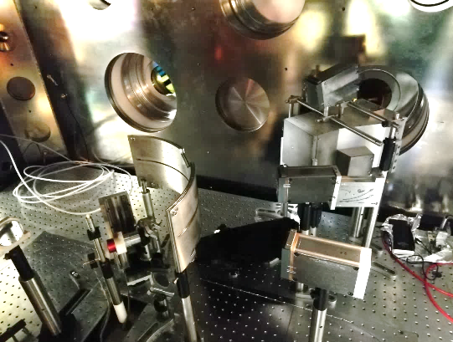
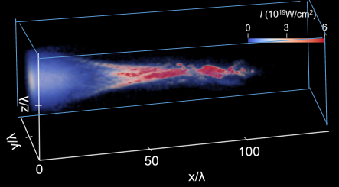
In collaboration with
Experiment:
O.N. Rosmej,
M. M. Günther, S. Zähter, P. Boller, T. Kuehl (GSI Darmstadt)
PhDs: M. Gyrdymov, P. Tavana, N. Zahn (Goethe University, Frankfurt)
N. G. Borisenko (Lebedev Physical Institute, Moscow)
A. Skobliakov, A. Kantzyrev (ITEP, Moscow)
N. Bukharskii, P. Korneev (MEPhI, Moscow)
J. Cikhardt (FEE CTU in Prague)
F. Consoli, M. Salvadori, M. Scisciò (ENEA, Frascati)
Theory and simulations:
V.S. Popov, L.P. Pugachev, I.R. Umarov, M.E. Veysman
(Joint Institute for High Temperatures, Moscow)
A. Pukhov, X. Shen (Heinrich Heine University, Düsseldorf)
S. Gys´kov, R. Yakhin, G.A. Vergunova (Lebedev Physical Institute, Moscow)
09.11.2022
НВ-2022 andreev@ras.ru

Slide 3
Publications 2019-2022
O N Rosmej et al, Interaction of relativistically intense laser pulses with long-scale NCD plasmas for optimisation of laser based sources of MeV electrons and gamma-rays, New J. Phys. 21(2019) 043044
O N Rosmej et al, High-current laser-driven beams of relativistic electrons for high energy density research,
Plasma Phys. Control. Fusion 62 (2020) 115024 (15pp)
X. F. Shen et al, Bright betatron x-rays generation from picosecond laser interactions with long-scale near critical density plasmas, Appl. Phys. Lett. 118, 134102 (2021)
O. N. Rosmej et al, Ultra-bright betatron radiation based on direct laser acceleration of electrons in plasma of near critical density, Matter Radiat. Extremes 6, 048401 (2021)
M. M. Günther et al., Forward-looking insights in laser-generated ultra-intense gamma-ray and neutron sources
for nuclear applications and science, Nature Communications 13, 170 (2022)
N.E. Andreev et al,. Efficiency improvement of the femtosecond laser source of superponderomotive electrons and X-ray radiation due to the use of near-critical density targets, Quantum Electronics 51 (11) 1019 – 1025 (2021)
X. F. Shen et al, Cross-Filament Stochastic Acceleration of Electrons in Kilojoule Picosecond Laser Interactions with Near Critical Density Plasmas, arXiv:2210.05435v1 [physics.plasm-ph] 11 Oct 2022; accepted to PRApplied

Slide 4
OUTLINE
Motivation:
Approach to enhance performance of laser-based sources of MeV particles
and radiation for HED research
Generation of super-pondreromotive electrons at sub-ps and fs laser facilitates:
  Direct Laser Acceleration in NCD plasma
  Production of sub-mm long NCD plasma with foams
  Experiments on generation of high-current well-directed beams of super-ponderomotive electrons
  3D PIC simulations for PHELIX-up-grade, PEAR and XSELS
Application of foams for interdisciplinary research with lasers:
  Production of ultra-bright tens of MeV BS sources
Summary
28.06.2022
EPS48 o.rosmej@gsi.de
17.11.2022
andreev@ras.ru
Notes:
my talk I will start with a need of improved performance of laser-driven sources of particles and radiation at large KJ PW-class lasers
dedicated for HED-reserch
then I will continue with the discussion of experimental results obtained in two experimental compaigns at the PHELIX-laser at GSI
on …….
The current beam-time was finished just two weeks ago, so please consider results that aI would like to discuss with you as very preliminary.
At the end of my presentation I will show you 3D PIC-siulations made for PHELIX-up-grade (200J focused energy instead of 20J ) and for 7J 30 fs PERAL laser system in Nizhnii Novgord.

Slide 5
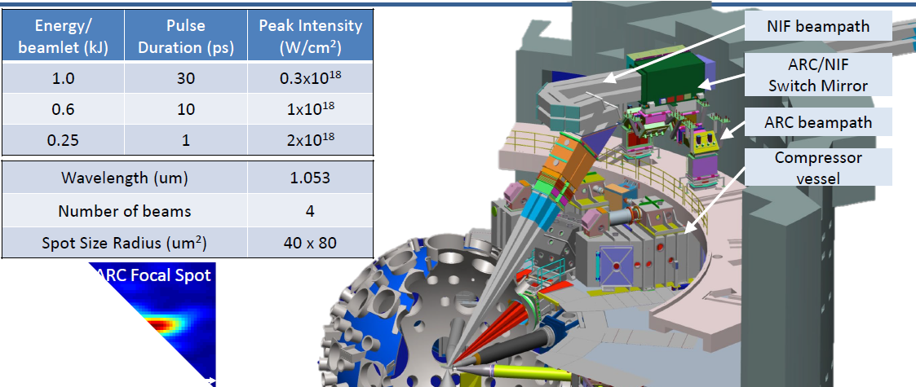
NIF’s short pulse laser, the advanced radiographic capability (ARC)
(ARC)
Largest amount of available short pulse energy in the world (up to 4 kJ)
but is delivered at quasi-relativistic intensities (I_{L} < =10¹⁸ W/cm²)
From: Development of a Self-Modulated Laser Wakefield Accelerator Platform with a 10 keV to 1 MeV Hyper Spectral Photon Source for HEDS. PI: C. Joshi

Slide 6
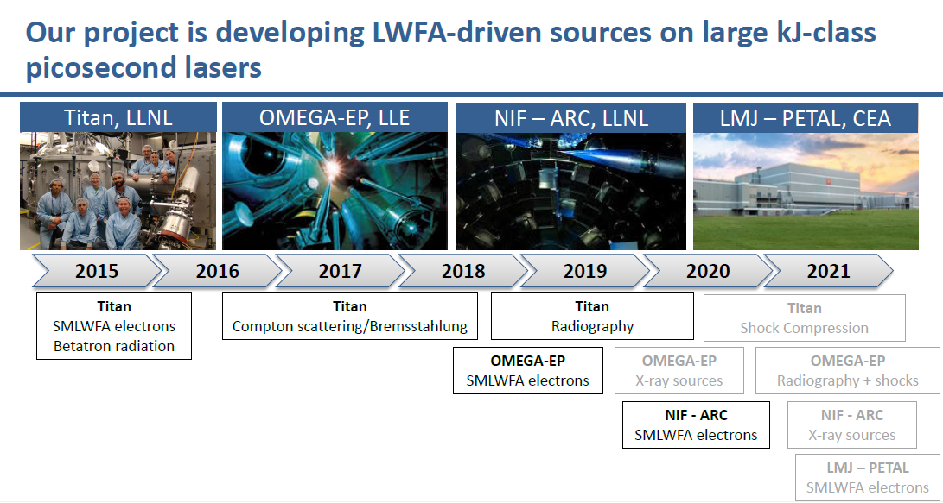
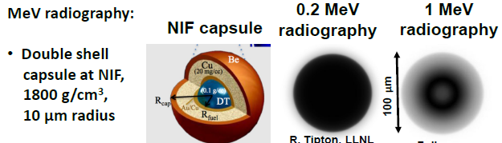
Development of a Self-Modulated Laser Wakefield Accelerator Platform with a 10 keV to 1 MeV Hyper Spectral Photon Source for HEDS PI: C. Joshi, NIF

Slide 7

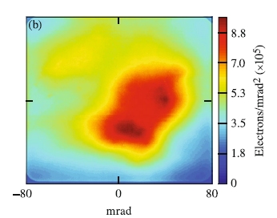
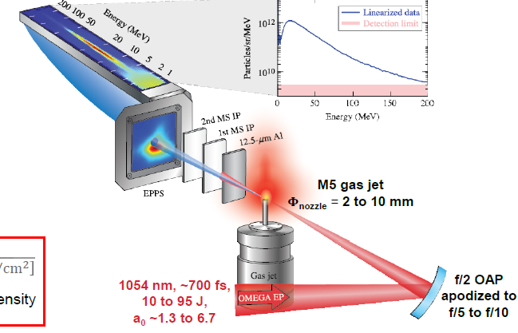
OMEGA EP
SM-LWFA-based LPA
50% charge in 0.1 rad
E_{e} > 0.9 MeV
MS IP after 37 μm Al
Results for a_{o}= 6.6
n_{e}=8x10¹⁸ cm⁻³, Φ_{nozzle}= 6 mm
P/P_{c}= 3-4
Charge 700±420 nC (1-200 MeV)
conversion efficiency (18 MeV) ~ 11%
(He)
~ 50 cm
J. Shaw et al, Sci. Reports 2021

Slide 8
Problems of reproducibility
The nature of SMLWFA means that there is variation in the reproducibility of the electron beam quality.
The divergence of the electron beams will be affected by the plasma density profile and uniformity, the laser focal spot quality and size, the phase front of the laser, and the interaction between the laser and the plasma, including the coupling of the laser into the plasma and the subsequent laser evolution (modulation and self-focusing).
For all but three of the 23 high-plasma-density (n_{e} > 1.9 × 10¹⁹ cm⁻³) shots in this experiment, the produced electrons did not form a defined beam, and instead, the transverse charge profile was distributed across the entire solid angle collected by the EPPS.
For those three shots, all were produced in 10-mm nozzles, which suggests that having longer plasmas, and therefore longer distances for laser evolution, may help maintain the transverse beam profile.
For the remainder of the 49 shots with charge ≥ 50 nC, the shots were either single-peaked with higher
divergence or had multiple peaks.

Slide 9
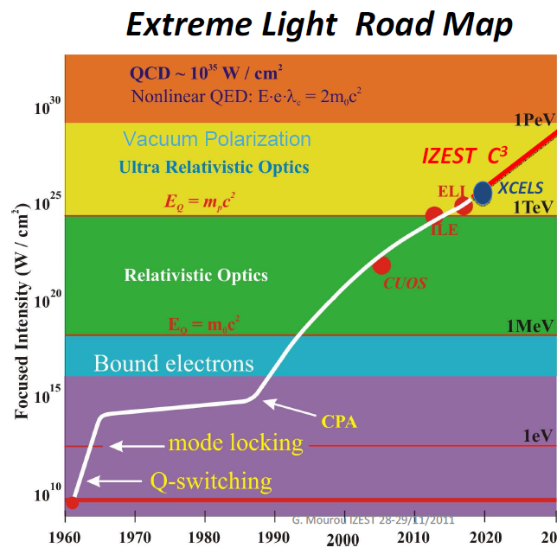
Laser Acceleration of Electrons
At 10²³ W/cm² , E = 0.6 PV/m,
it is SLAC (50GeV, 3km long) on 10 μm
The size of the Fermi PeV accelerator
will only be one meter
(accelerator will go around the globe,
based on conventional technology).

Slide 10
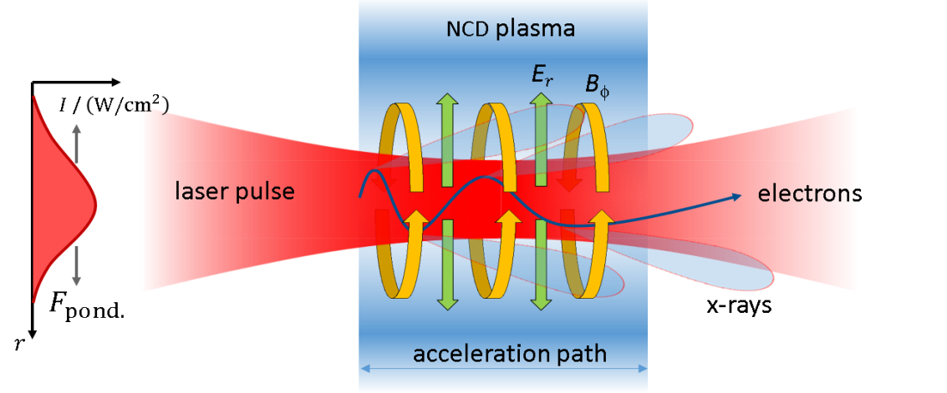
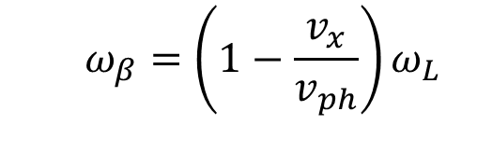
Direct Laser Acceleration in long-scale NCD Plasmas
Sub-mm length of NCD plasma provides a long acceleration path
A. Pukhov et al., PoP 6, N7 (1999)
  $$ω_{β}=\left(1−\frac{v_{x}}{v_{ph}}\right)ω_{L}$$
self-focusing : P_{L}> P_{c}=17 GW × n_{c} / n_{e} ~ 17 GW in NCD (high aspect ratio channel)
ponderomotive force expels background plasma electrons from the laser channel
quasi-static radial E-field is produced that has a focusing polarity for electrons
current of relativistic electrons generates a quasi-static B azimuthal that traps electrons in the plasma channel
electrons undergo transversal betatron oscillations and gain energy from laser field if coming in resonance.
28.06.2022
EPS48 o.rosmej@gsi.de 4
17.11.2022
andreev@ras.ru
Notes:
Our aproach is based on generation of dLA electrons in long-scale NCD plasma.

Slide 11

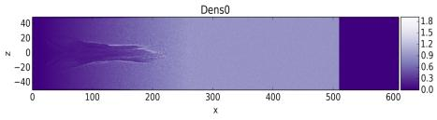
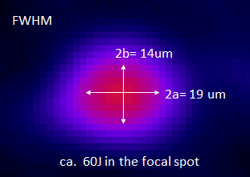
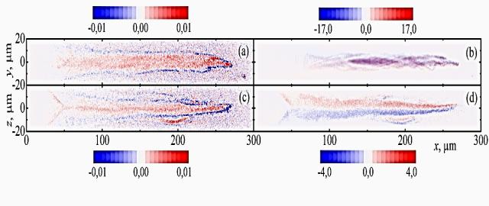
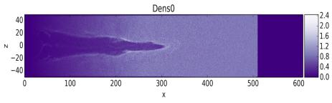
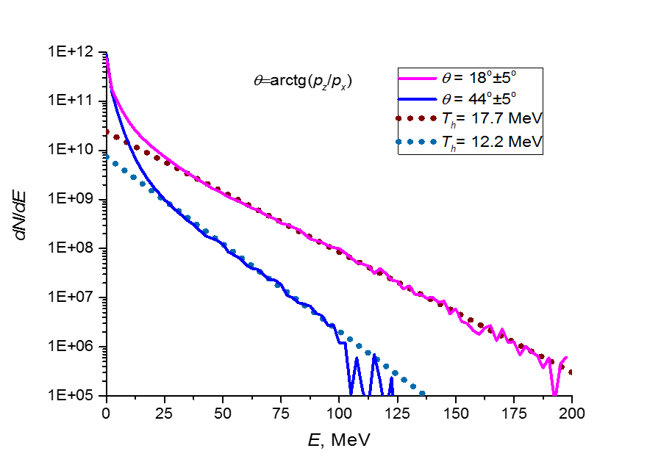
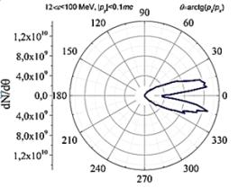
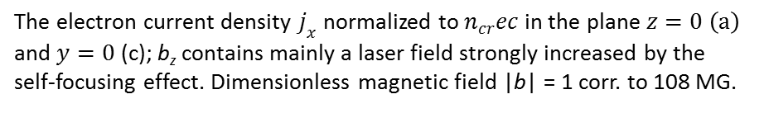
FULLY RELATIVISTIC 3D PIC-SIMULATIONS (VLPL)
PIC with real experimental conditions of P138
Laser: 4.4×10¹⁹ W/cm² (a_{L} = 5.67), 50 J
target: fully ionized CHO plasma 4x10¹⁹cm⁻³, x=500μm
t=500fs
electron current density jx
Bz (las.)
ct = 250 μm
t=1.8 ps
Bϕ quasi-static
NCD of 500um thickness
L. P. Pugachev, N. E. Andreev, P. R. Levashov, O.N. Rosmej. NIM A 829 (2016) 88–93.
Pugachev and Andreev N, J. of Phys. Conf. Series 1147 (2019) 012079
Snapshots of electron density distributions in the plane XOZ at the time ct = 150 and 550 μm (at t = 0 laser pulse maximum at the target front side). Electron density is presented in n_{e}/n_{e-cr}.
The electron current density $j_{x}$normalized to $n_{cr}ec$ in the plane $z=0$ $\left(a\right)$ and $y=0$ (c); b_{z} contains mainly a laser field strongly increased by the self-focusing effect. Dimensionless magnetic field |b| = 1 corr. to 108 MG.
3D PIC code VLPL A. Pukhov
electron angular distribution in a horizontal plane
Current of super-ponderomotive
electrons (Е > 3 MeV) reaches 2 MA, charge 2 μC,
Magnetic field in a plasma channel 200 MG
super ponderomotive
electrons (E>12 MeV)

Slide 12
The number, charge and energy of accelerated electrons which leaved the target with p_{x} > 0 at ct = 550 mm
Energy range, MeV | Number of electrons | Charge of electrons, μC | Percent of laser energy
(0.5, ∞) | 3.22 × 10¹³ | 5.15 | 40%
(3, ∞) | 1.15 × 10¹³ | 1.84 | 31%
(3, 12) | 9.09 × 10¹² | 1.45 | 14.8%
(12, ∞) | 2.38 × 10¹² | 0.381 | 16.3%
(30, ∞) | 4.85 × 10¹¹ | 0.078 | 6.4%
O N Rosmej, N E Andreev, S Zaehter, N Zahn, P Christ, B Borm, T Radon, A Sokolov, L P Pugachev, D Khaghani, F Horst, N G Borisenko, G Sklizkov, V G Pimenov. 2019 New J. Phys. 21 043044

Slide 13
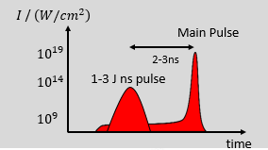
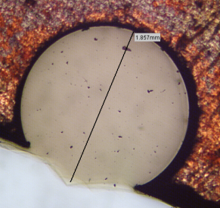
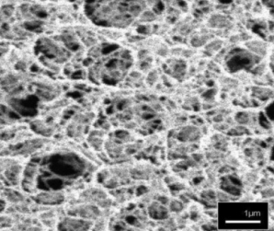
Generation of NCD plasma in interaction of ns-laser pulse with polymer foam
foam ionization is triggered by well-defined ns-pulse with parameters adjusted to the foam density and thickness
CHO: 2 mg/cc (2×10²⁰ at/cm³)
3D aerogel structure
50-100 nm solid ( 0.1g/cc)+ ca. 1 μm evacuated pore
sub mm thick foam provides increased interaction path
> 500 µm thick NCD plasma “target” (Ne ≲ 0.7 x 10²¹ cm⁻³ ) is created by a 10¹³-10¹⁴ W/cm² ns pulse.
O. N. Rosmej et al, New J. Phys. 21(2019) 043044
O. N. Rosmej et al Plasma Phys. Control. Fusion 62 (2020) 115024
17.11.2022
andreev@ras.ru

Slide 14
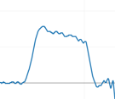
Nanosecond pulse forerunning the main relativistic pulse is used to ionize foams
Main pulse:
focal spot: 13x15 um FWHM,
E_{main}= 65-80 J before compressor,
E_{on target} = 15-20 J in FWHM of the focal spot
1.e19 W/cm2
750±250 fs
ns pulse
E(ns)=1-5% E_{main}
delay ps-ns: 5 ns
(values depend on foam density and thickness)
Main pulse
delay
designation: 5%, 5ns means
energy of ns pulse is 5% of E_{main} and 5 ns delay
ns-pulse
3.5 ns
for 8 mg/cc CHO: 5%, 5ns
2 mg/cc 1mm CH: 1% - 2.5%, 5 ns
4 mg/cc 0.5 mm: 2.5%, 5 ns

Slide 15
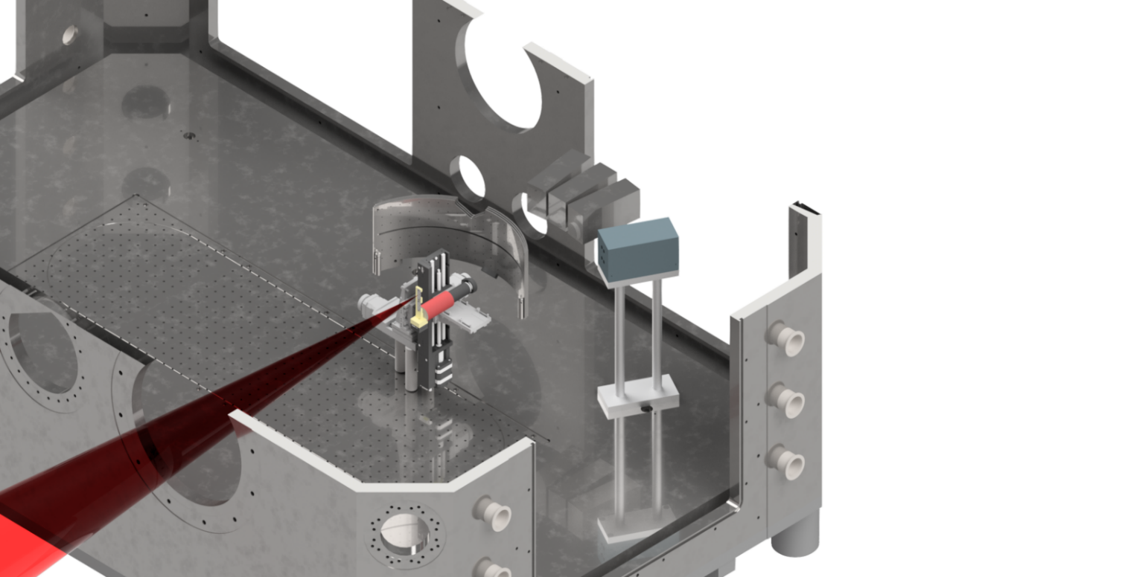
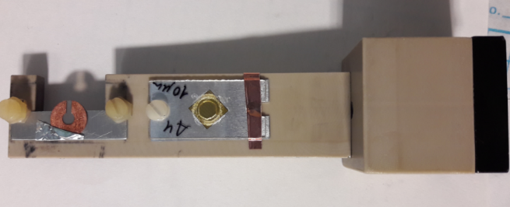
PHELIX beam-time P176, 2019
PHELIX system:
Nd:glass λ=1.053μm, s-polarized
main pulse:
τ=700± 250 fs
10¹⁹ W/cm² (20J , d=15 µm)
10²¹ W/cm² (40J , d=3 µm)
ns contrast better than 10⁻¹¹
1-2×10 ¹⁹ W/cm²
150 cm focusing parabola
ns pulse: 1 J, 1.5 ns , Δt=2-3 ns
Targets:
10 μm thin Ti, Au-foils
mm-thick Au convertor
low density polymer foams
ρ=2 mg/cc (1.7 × 10²⁰ at/cm³)
combination foam+foil
Detailed measurements of the angular distribution of energy and the number of electrons using an multilayer IP cylinder
17.11.2022
andreev@ras.ru
6

Slide 16
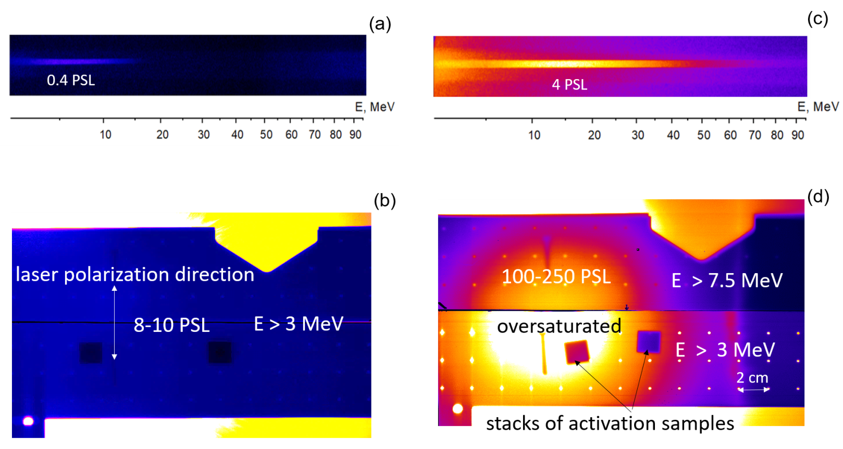
DLA in pre-ionized foam: raw electron spectra from PHELIX 20J, 10¹⁹W/cm²
Shot 40: 700 fs, 10¹⁹ W/cm²
Target: Au foil 10 um
Shot 42: 700 fs, 10¹⁹ W/cm²
Target: Au foil 10 um+ 325 um 2 mg/cc TAC
0° to laser axis
0° to laser axis
directed electron beam
E > 3 MeV,
θ_{FWHM} = 160 msr
17.11.2022
andreev@ras.ru

Slide 17
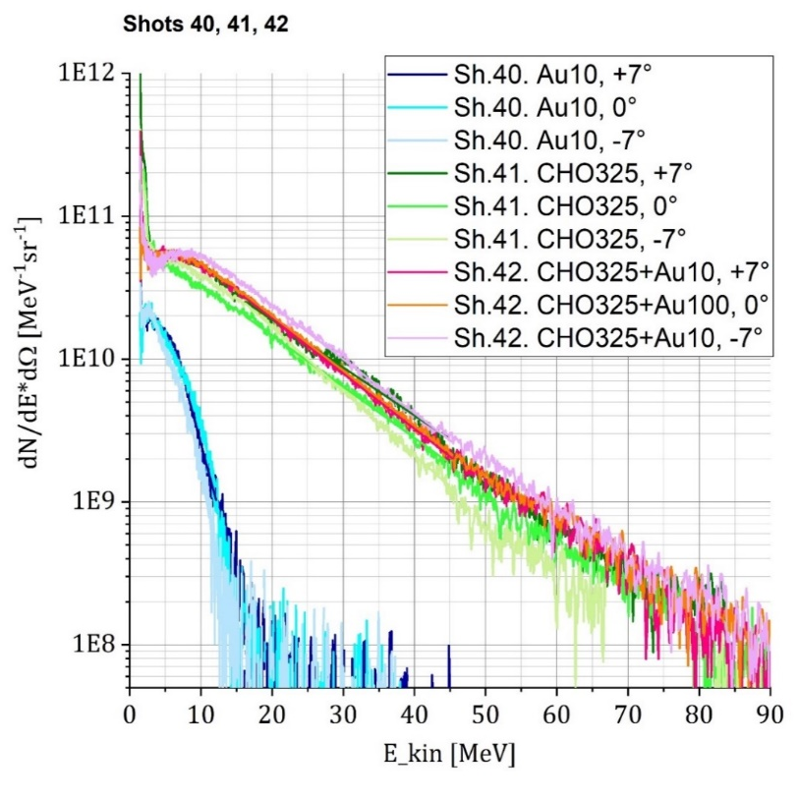
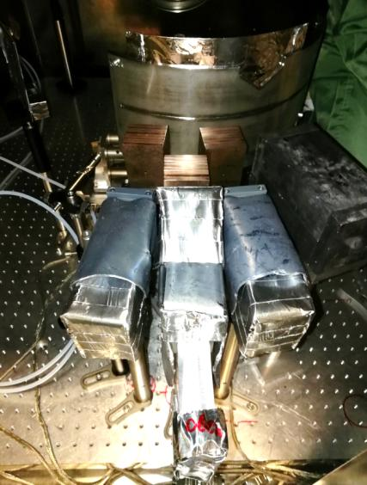
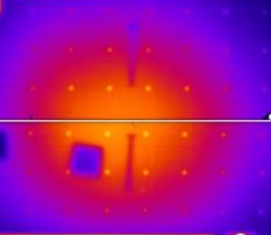
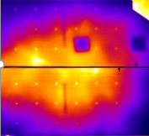
Energy and number of MeV-electrons inside the divergence cone
+7°
-7°
foam+foil
cylinder
7°
0°
-7°
foam
T_{hot}=11.5-13.2 MeV
T_{hot}=1.7-2.3 MeV
+7°
0°
55 % current is in filaments
M. Gyrdymov
17.11.2022
andreev@ras.ru
9

Slide 18
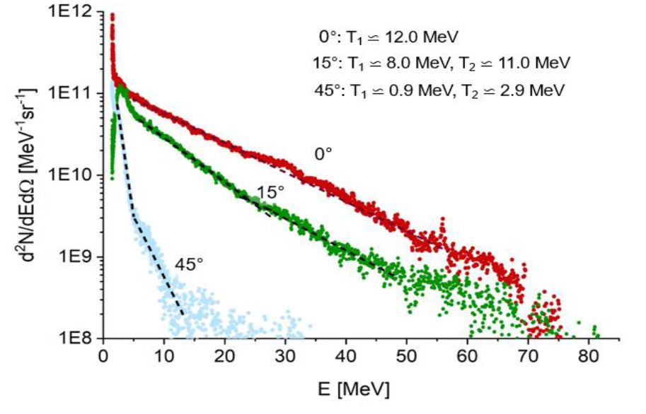
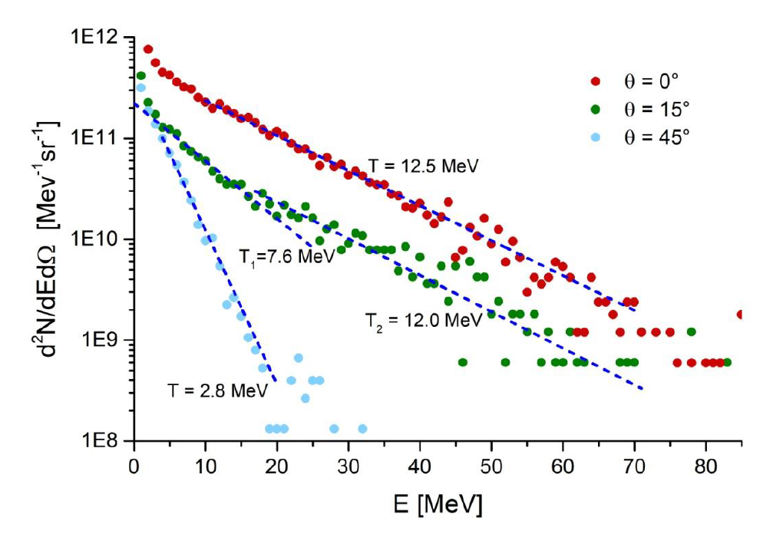
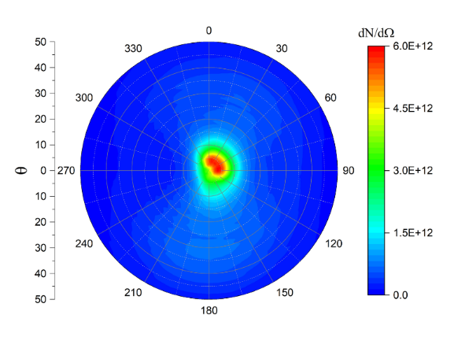
3D PIC Simulations (VLPL) for PHELIX and Comparison with experiment:
Measured angular dependent
energy distributions
Angular distribution
of electrons with E > 7 MeV
Modeled angular dependent
energy distributions
½ θ at FWHM ~ 10°
(experiment ~ 13°)
measured for a shot onto the pre-ionized foam layer at 2×10^19 W cm^-2 laser intensity
leave the simulation box at t = 2.5 ps
O. N. Rosmej, M Gyrdymov, M M Günther, N E Andreev, P Tavana, P Neumayer, S ZЁahter, N Zahn, V S Popov, N G Borisenko, A Kantsyrev, A Skobliakov, V Panyushkin, A Bogdanov, F Consoli, X F Shen, and A Pukhov. Plasma Phys. Control. Fusion 62 (2020) 115024

Slide 19
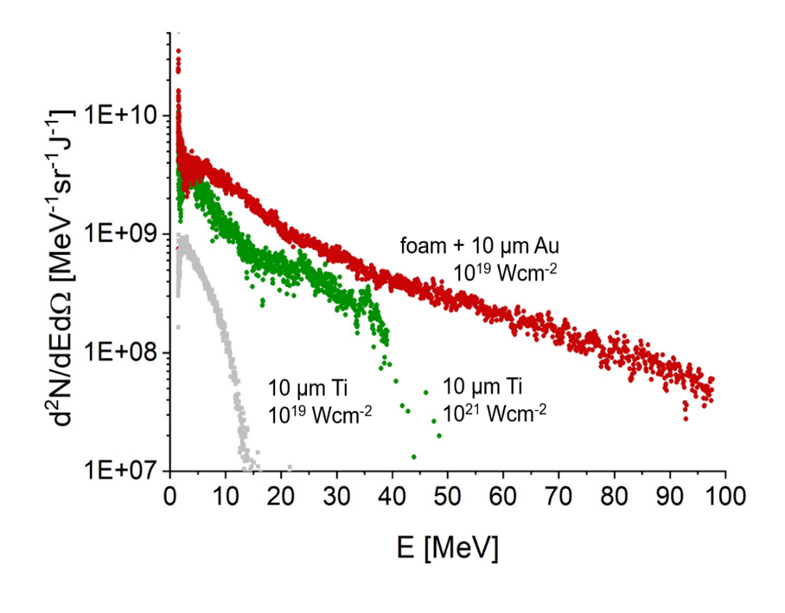
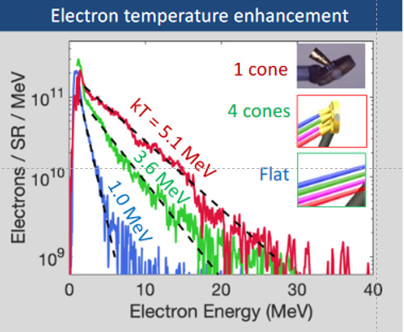
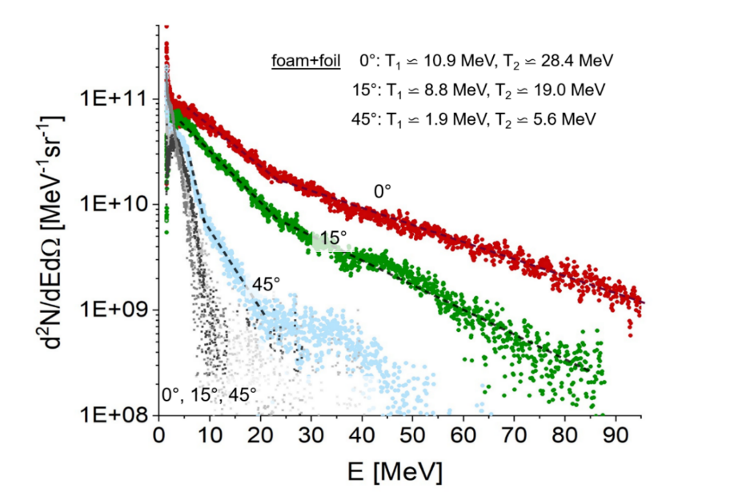
ARC at NIF versus PHELIX at GSI-FAIR
ARC: 4 kJ, 10¹⁸ → 10¹⁹ W/cm²
PHELIX: 80 J (20 J), 10¹⁹ W/cm²
gold foil target coupled with a CPC
gold foil attached to a foam (NCD plasma)
Measured angular dependent
energy distributions
10²¹ W/cm²
10¹⁹ W/cm²

Slide 20
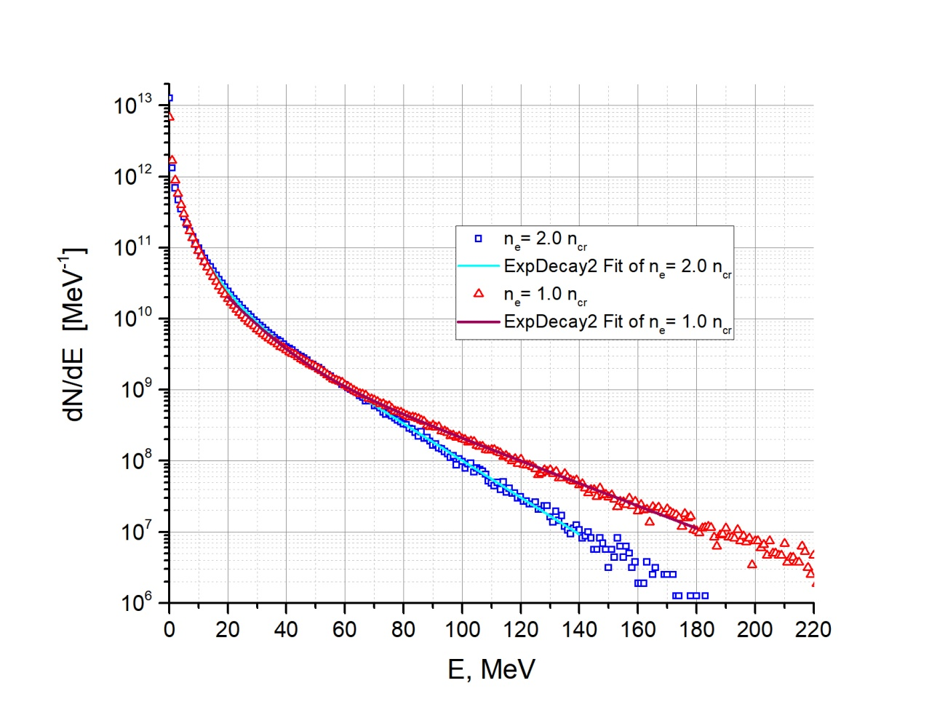
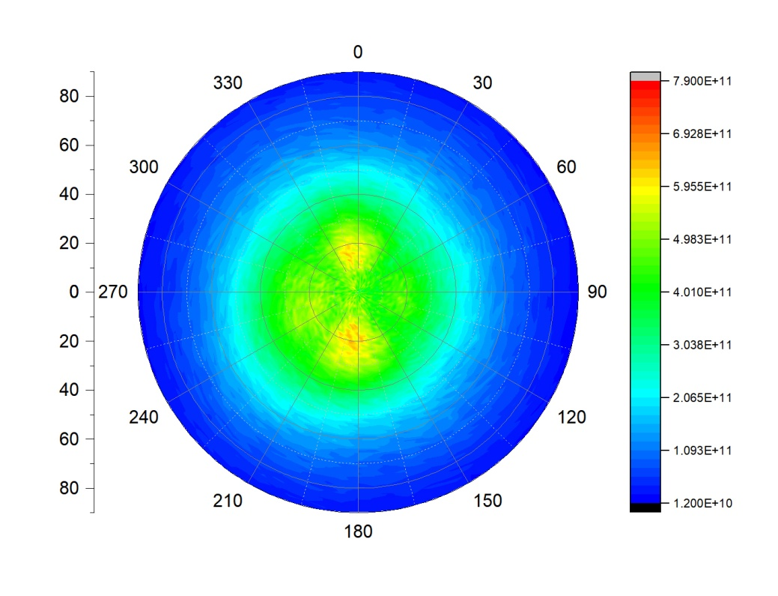
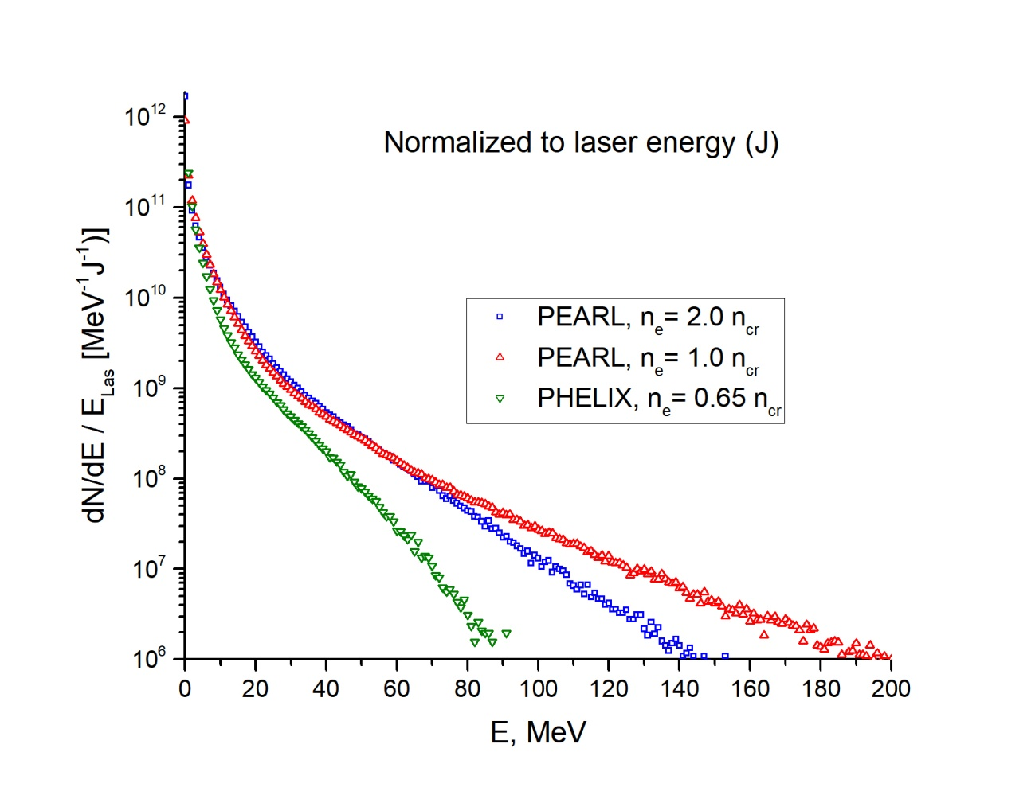
Direct Laser Acceleration by ultraintense fs laser pulses in NCD plasmas
at PEARL (for experiment at IAP, November 2022)
E_{L} =7.5 J in D_{FWHM} = 4.12 μm, τ_{FWHM} = 60 fs, I₀ = 1.2×10²¹ W/cm², a₀ = 30
n_{e} = 1.0 n_{cr} : T₁ ≈ 9 MeV, T₂ ≈ 27 MeV
n_{e} = 2.0 n_{cr} : T₁ ≈ 6 MeV, T₂ ≈ 17 MeV
angle distribution for E > 7 MeV
PEARL, Ne = 2.0 n_{cr}
Energy spectra of electrons per 1 J laser energy
for PEARL and PHELIX
N.E. Andreev, V.S. Popov, O.N. Rosmej, A.A. Kuzmin, A.A. Shaykin, E.A. Khazanov, A.V. Kotov, N.G. Borisenko, M.V. Starodubtsev, A.A. Soloviev. Efficiency improvement of the femtosecond laser source of superponderomotive electrons and X-ray radiation due to the use of near-critical density targets. Quantum Electronics 51 (11) 1019 – 1025 (2021) https://doi.org/10.1070/QEL17648

Slide 21
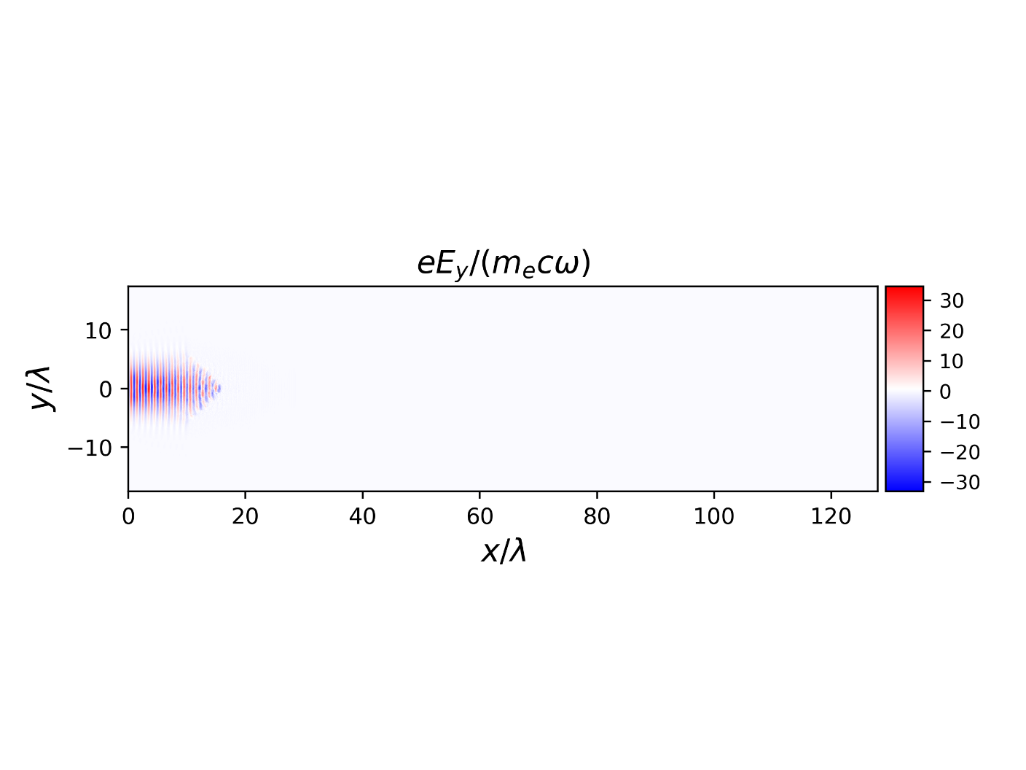
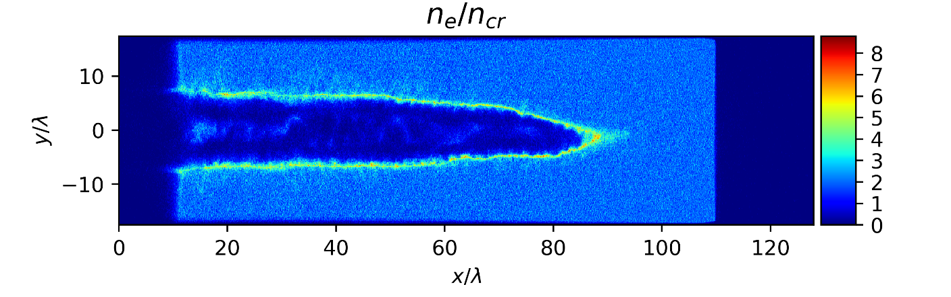
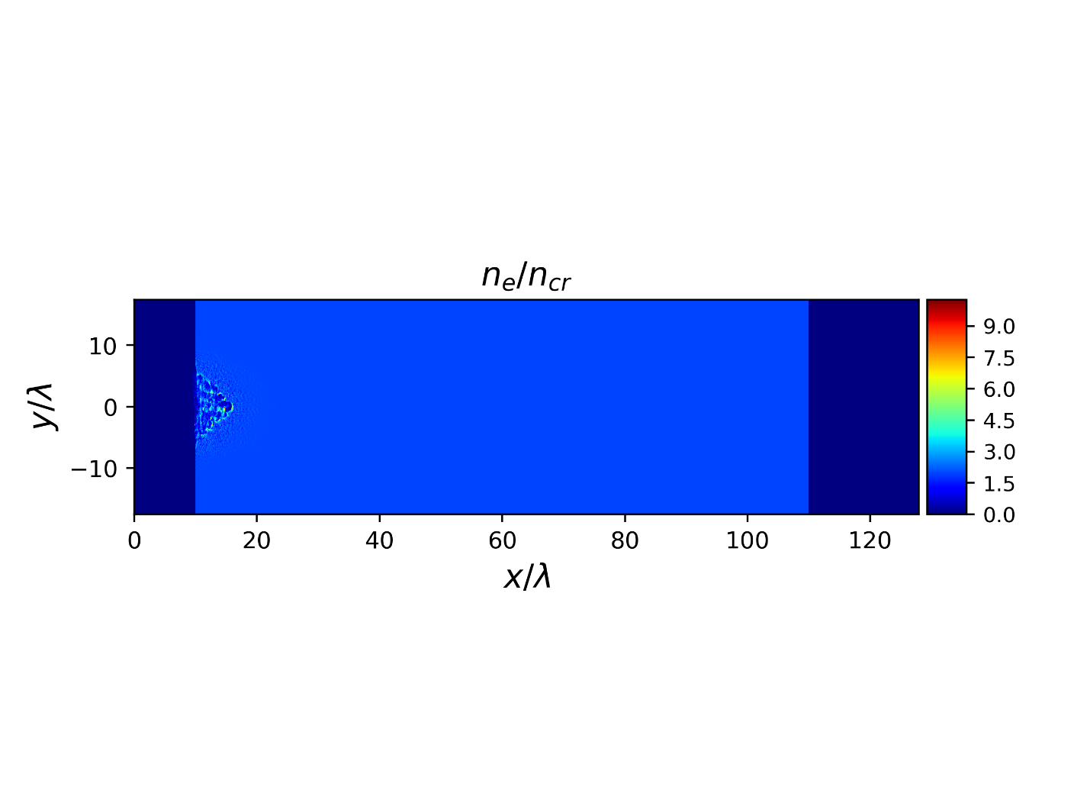
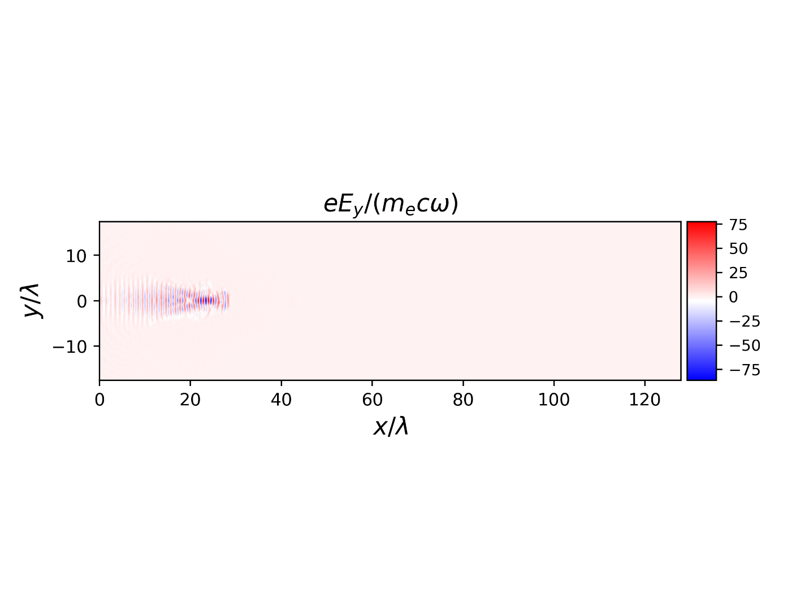
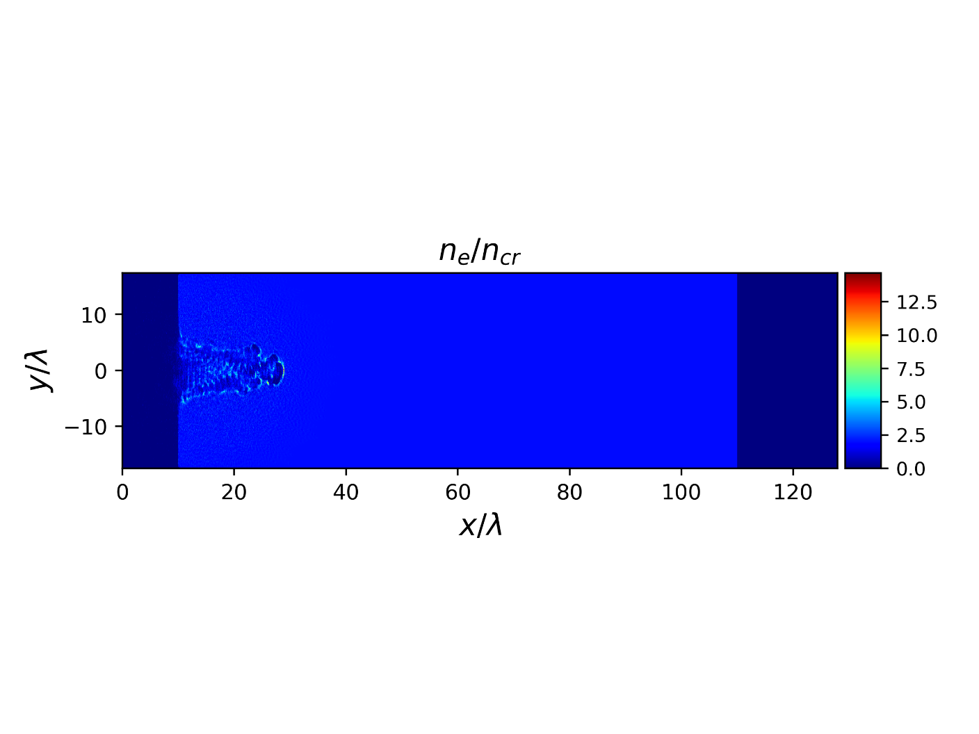
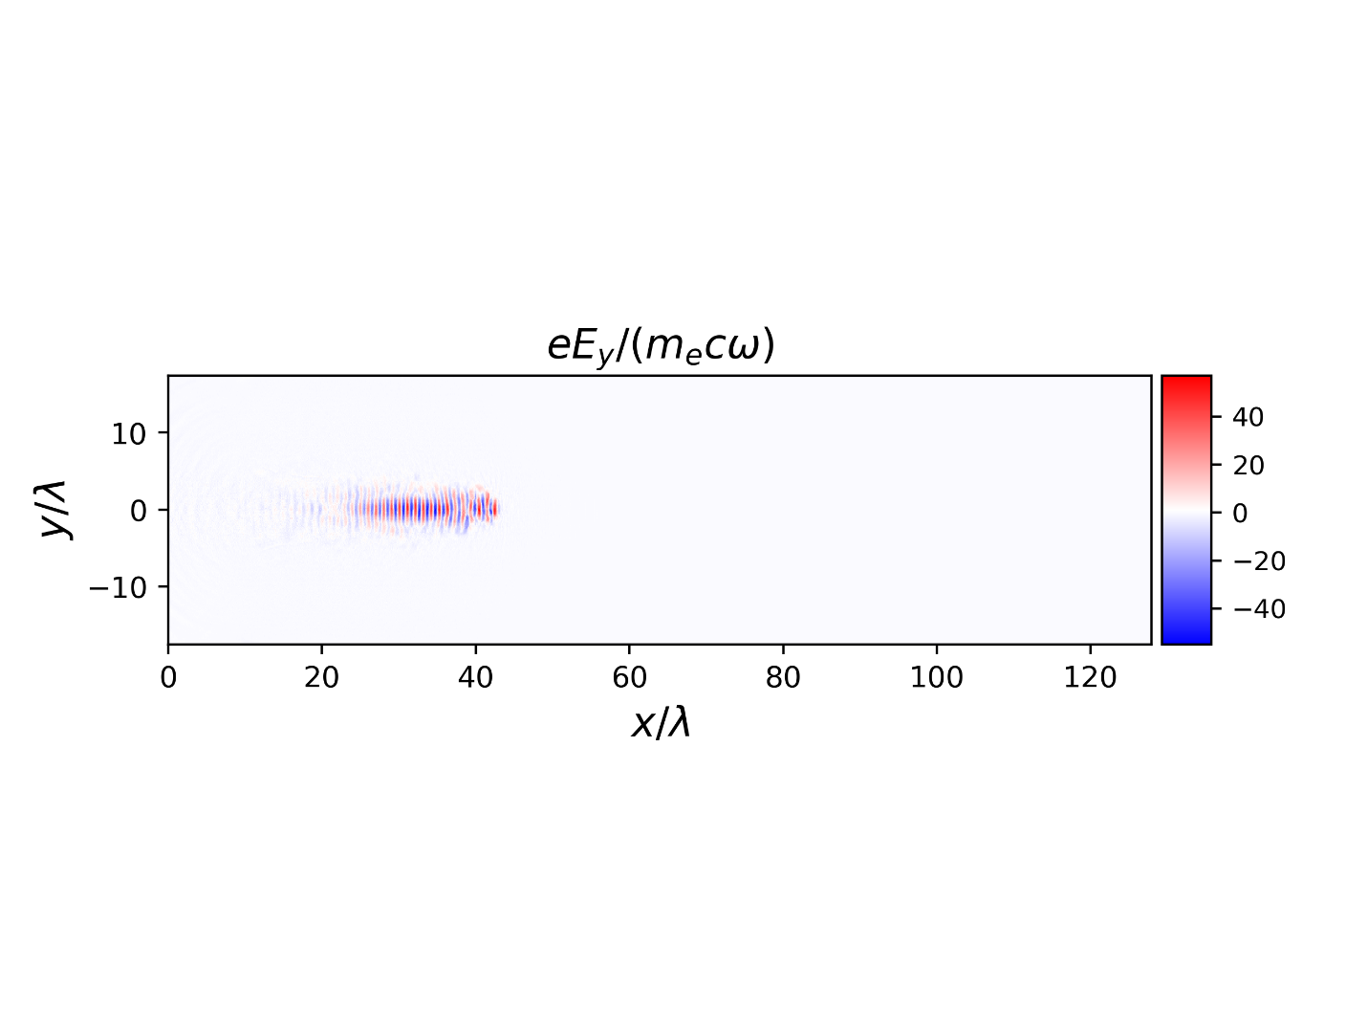
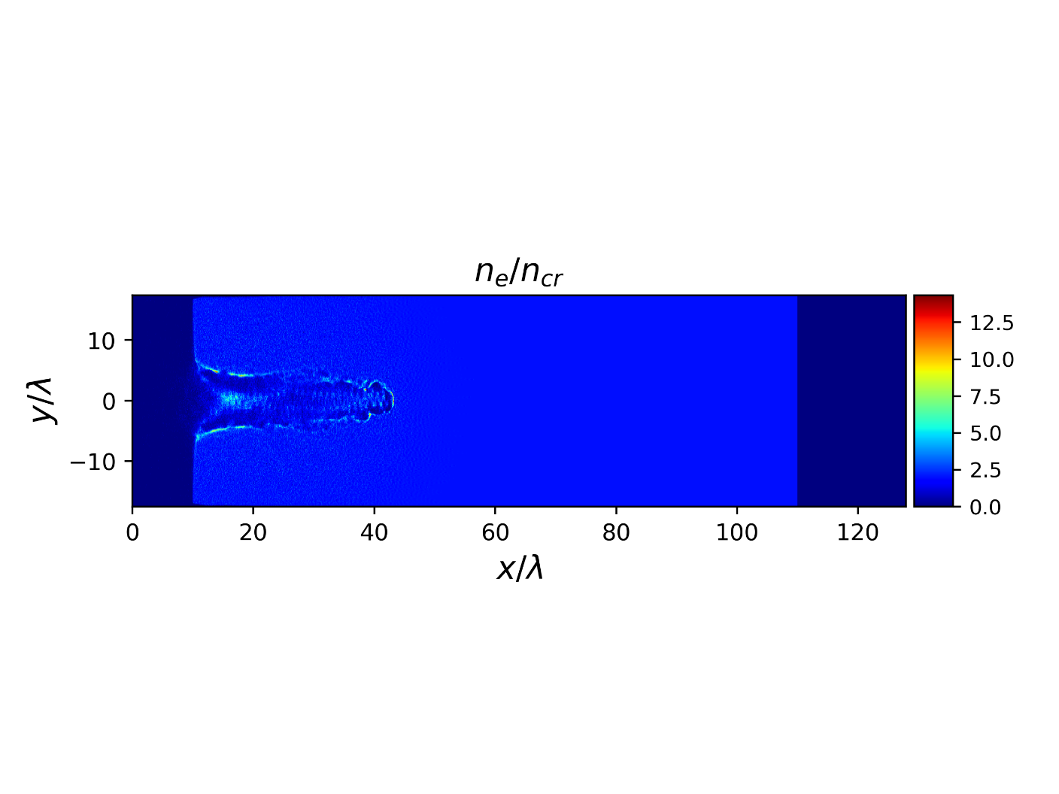
Direct Laser Acceleration by ultraintense fs laser pulses in NCD plasmas
at PEARL (for experiment at IAP, November 2022)
PEARL, Ne = 2.0 n_{cr}
E_{L} =7.5 J in D_{FWHM} = 4.12 μm, τ_{FWHM} = 60 fs, I₀ = 1.2×10²¹ W/cm², a₀ = 30
N.E. Andreev, V.S. Popov, O.N. Rosmej, A.A. Kuzmin, A.A. Shaykin, E.A. Khazanov, A.V. Kotov, N.G. Borisenko, M.V. Starodubtsev, A.A. Soloviev. Efficiency improvement of the femtosecond laser source of superponderomotive electrons and X-ray radiation due to the use of near-critical density targets. Quantum Electronics 51 (11) 1019 – 1025 (2021) https://doi.org/10.1070/QEL17648

Slide 22
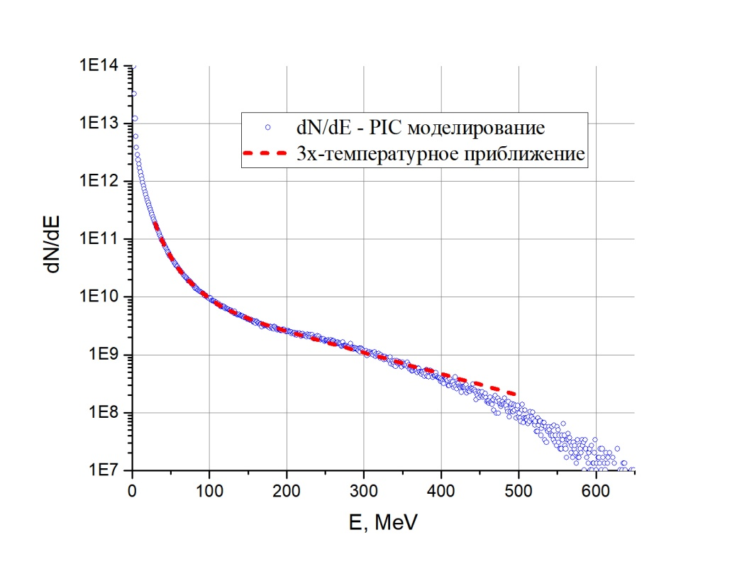
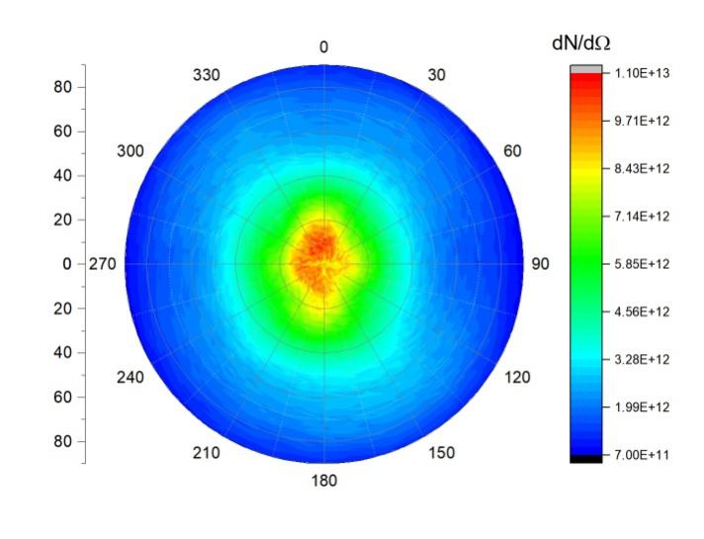
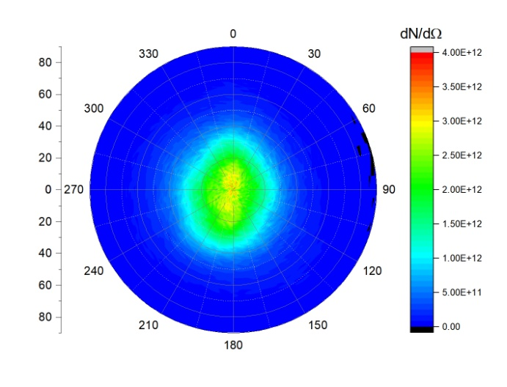
Direct Laser Acceleration of electrons by ultraintense fs laser pulses in NCD plasmas at XCELS
E_{L} =150 J in D_{FWHM} = 10 μm, τ_{FWHM} = 60 fs, I₀ = 4.1×10²¹ W/cm², a₀ = 55
3 – temperature approximation:
T₁ = 8.3, T₂ = 22.7, T₃ = 118 MeV
Angular distributions of accelerated electrons with energies
E > 7 MeV E > 40 MeV
N. E. Andreev, I.R. Umarov, V. S. Popov, Quantum Electronics, in press (2022)

Slide 23
Direct Laser Acceleration of electrons by ultraintense fs laser pulses in NCD plasmas at PEARL and XCELS
PEARL: E_{L} =7.5 J in D_{FWHM} = 4.12 μm, τ_{FWHM} = 60 fs, I₀ = 1.2×10²¹ W/cm², a₀ = 30
XCELS: E_{L} =150 J in D_{FWHM} = 10 μm, τ_{FWHM} = 60 fs, I₀ = 4.1×10²¹ W/cm², a₀ = 55
Parameters | Energy range of accelerated electrons (MeV) | PHELIX (17.5 J) n_{e} = 0.65 n_{cr} | PEARL (7.5 J) n_{e} = 2.0 n_{cr} | PEARL (7.5 J) n_{e} = 1.0 n_{cr} | XCELS (150 J) n_{e} = 1.0 n_{cr}
Number of electrons per 1 J laser energy | E>3 | 1.96×10¹¹ | 3.4×10¹¹ | 3.5×10¹¹ | 3.1×10¹¹
 | E>7 | 0.72×10¹¹ | 1.7×10¹¹ | 1.5×10¹¹ | 1.4×10¹¹
 | E>30 | 0.62×10¹⁰ | 1.7×10¹⁰ | 1.7×10¹⁰ | 2.5×10¹⁰
 | E>100 | 0 | 2.3×10⁸ | 7.5×10⁸ | 5.0×10⁹
 | E>300 | 0 | 0 | 0 | 6.5×10⁸
Full charge (nC) | E>3 | 510 | 408 | 420 | 7340
 | E>7 | 187 | 203 | 180 | 3374
 | E>30 | 15 | 22 | 20 | 592
 | E>100 | 0 | 0.3 | 0.9 | 120
 | E>300 | 0 | 0 | 0 | 16
Conversion efficiency of laser energy | E>3 | 27% | 57% | 56% | 68%
 | E>7 | 17% | 44% | 41% | 56.5%
 | E>30 | 3.6% | 13% | 13.5% | 31%
 | E>100 | 0 | 0.43% | 1.6% | 15.6%
 | E>300 | 0 | 0 | 0 | 3.9%
PHELIX: 2.5×10¹⁹ W/cm² (a₀ = 4.28), 17.5 J

Slide 24
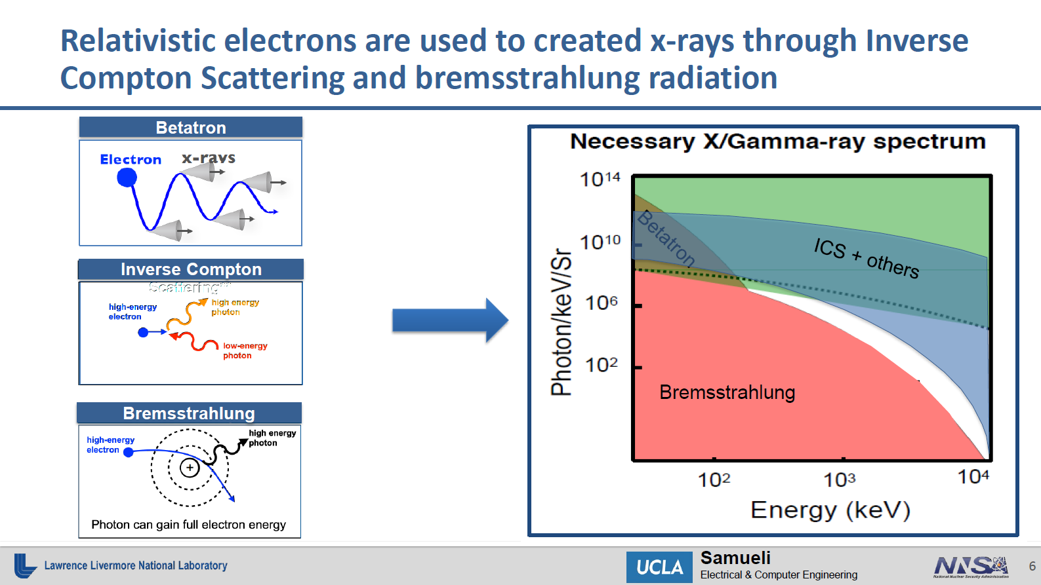

Slide 25
Applications:
Ultra-bright sources of MeV BS and neutrons

Slide 26
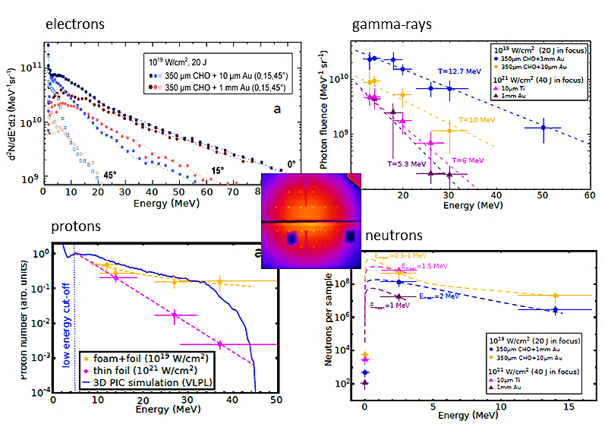
Forward-looking insights in laser-generated ultra-intense gamma-ray and neutron sources
for nuclear applications and science
Nat Commun 13, 170 (2022)
M. M. Günther, O.N. Rosmej, P. Tavana, M. Gyrdymov, A, Skobliakov, A. Kantsyrev, S. Zähter, N.G. Borisenko, A. Pukhov, and N.E. Andreev.
Enhanced generation of
MeV electrons, protons,
gamma-rays and neutrons
at 10¹⁹ W/cm² intensity
by irradiation of low density
polymer aerogels.
09.11.2022
НВ-2022 andreev@ras.ru

Slide 27
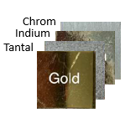


Gamma-rays: Ultra-high conversion efficiency in GDR region ≥ 7 MeV
Electrons propagate in high Z converter and generate BS with 10´s of MeV photon energy
10¹²/sr photons with E > 7.5 MeV, T_{eff} =10 -13 MeV
Nuclear activation-based diagnostics:
takes use of resonances in γ,n reactions
in different materials. The yields of the produced isotopes are used to evaluate
BS spectrum.
Record-breaking conv. eff. into BS > 7.5 MeV
Giant Dipole Resonance
PHELIX, 10¹⁹ W/cm² : 1.7±0.4% (GDR)
VULCAN at 10²⁰ W/cm²: 0.2 % (GDR)
¹⁹⁷Au(g, 5n)¹⁹²Au
¹⁹⁷Au(g, 5n)¹⁹²Au
10¹⁹ W/cm² with foam vs. 10²¹ W/cm² foil: two times higher effective temperature and 10 times higher photon number (Eγ > 7 MeV)
09.11.2022
НВ-2022 andreev@ras.ru

Slide 28





Nuclear Diagnostics: activation by gamma-rays in GDR and autoradiography
PHELIX 2022
set-up for generation and measurements
of BS radiation caused by DLA -electrons
in GDR-photon energy region
example of the target set-up
for gamma-ray production:
foam + W2mm+Au1mm+In1mm
100 um Cu-foil for autoradiography
placed 4 cm from TCC
nuclear
diagnostics
+170°
laser
foam+convertor
-80°
-5°
set of activation probes
for photo-nuclear reactions
+5°
09.11.2022
НВ-2022 andreev@ras.ru

Slide 29






Effective 15-20 MeV gamma-rays production using foam in front of convertor
PHELIX 2022
Cu63 + γ (15-20 MeV) -> Cu62 (9.67 min) +1167 keV + β⁺ (0-2.9 MeV)
sh. 37 4 mg/cc, 0.5mm + W2mm +ns-pulse
Cu-foil 27 mm from TCC
sh. 41 Direct shot on W2mm + ns-pulse
0.27 sr
0.8 sr
Cu-foil 40 mm from TCC
10 x more 15-20 MeV gammas and 3x higher directionality in case of foam+W2mm + ns-pulse comp. to shot on W2mm +ns-pulse

Slide 30

PIC (DLA electrons in NCD plasma) and GEANT4 (gamma-rays) modeling in GDR – comparison with experiment
17.11.2022
andreev@ras.ru

Slide 31
Generation of MeV- bremsstrahlung radiation at different laser facilitates
LASER, target | e-source | convertor | gammas | conversion
VULCAN, 10¹⁹ W/cm² Pb [Norreys, PoP 1999] | pondertomotive E_{e}=1-13 MeV | Pb, 3mm | 10¹⁰ E > 10 MeV E_{mean}~ 13 MeV nuclear activation | 20 mJ 0.2% > 10 MeV (GDR)
NOVA LLNL 3x10²⁰W/cm² Au [Stoyer, RSI 2001] | ponderomtive + super-ponderomotive tail with E≤ 100 MeV | Au , 1mm | 8-25 MeV T_{bs} =5.3 MeV, 2x10¹¹/MeV/sr > 25 MeV T_{bs} = 9.5 MeV, 10⁹/MeV/sr div. angle= 105° nuclear activation | 0.18 % > 10 MeV (GDR)
PHELIX ~ 10¹⁹W/cm² CHO-foam [NatComm_2022] | DLA super-ponder. T_{hot} ~ 14 MeV E_{e} ≤ 100 MeV | Au , 1mm | > 7.5 MeV ~ 2x10¹¹ T_{bs} ~ 10-12 MeV div. angle= 40° nuclear activation | 1.7±0.4% > 10 MeV (GDR)

Slide 32


Gamma-bremsstralung XCELS (PIC+GEANT4 , QE_2022)
XCELS: E_{L} =150 J in D_{FWHM} = 10 μm, τ_{FWHM} = 60 fs, I₀ = 4.1×10²¹ W/cm², a₀ = 55
Пространственное распределение гамма-квантов
с энергией больше 7 МэВ
Спектры гамма-квантов, генерируемых DLA-электронами
Диапазон энергий | количество гамма квантов | конверсия лазера в гамма излучение | расходимость гамма излучения (1/2 θ_{FWHM})
E > 1 MэВ | 1.1×10¹³ | 5.22% | ≈ 26°
E >7 MэВ | 1.6×10¹² | 2.63% | ≈ 20°
E >30 MэВ | 1.3×10¹¹ | 0.73% | ≈ 15.5°
E >100 MэВ | 7.8×10⁹ | 0.12% | ≈ 12°
E>300 MэВ | 1.2×10⁸ | <0.01% | --

Slide 33



Production of positron at XCELS (PIC+GEANT4 , QE_2022)
XCELS: E_{L} =150 J in D_{FWHM} = 10 μm, τ_{FWHM} = 60 fs, I₀ = 4.1×10²¹ W/cm², a₀ = 55
Пространственное распределение позитронов с энергией больше 1 МэВ, генерируемых в конверторе из золота в зависимости от его толщины
Спектры позитронов, генерируемых DLA-электронами
в золотых пластинах разной толщины z = 5 - 20 мм
Фокусировка на низкоплотную мишень нескольких 10 ПВт лазерных импульсов XCELS (без необходимости жесткой синхронизации по времени и области фокусировки) позволит увеличить интенсивность источников частиц и квантов жесткого излучения пропорционально суммарной энергии лазерных пучков. В частности, как следует из приведенных результатов моделирования, используя 10 пучков XCELS, можно получить пучок позитронов с рекордным зарядом в 1 мкКл.
Общее число позитронов при толщине конвертора z = 5 мм достигает 6.5×10¹¹, а заряд 104 нКл.
Даже без учета TNSA постускорения, преобразование энергии лазерного импульса в энергию пучка позитронов достигла 1%.
Это в 10 раз выше, чем эффективность преобразования, полученная при моделировании QED-PIC в случае сверхинтенсивного лазерного импульса 10 ПВт класса (4×10²³ Вт/см² (a₀ = 540), E_{L}= 60 J, t_{L} = 15 fs)
[Bake, M. A. & Elaji, A. Plasma Science and Technology 23, 045001 (Apr. 2021)].

Slide 34



New level of interdisciplinary research with sub-kJ, sub-PW lasers
Application of foams provides a strong boost of the parameters of laser driven sources of particles and radiation
Universal character of foam targets:
No high laser contrast, no ultra-high laser intensity, no pointing stability,
no changes in the experimental set-up are required.
Plasma Physics, HED-research:
foam and foam stacked with thin foil:
Ultra-intense betatron and THz radiation,
Well-directed beams of super-ponderomotive electrons
Protons: enhanced TNSA
Nuclear Physics:
foam stacked with thick high Z convertor or thin foil:
High yield (γ,n) and (p,n) reactions in GDR region (Isotope production)
High fluence/ flux MeV gamma sources and gamma /proton-driven neutron sources with record breaking conversation efficiency
Biophysics:
Ultra-high dose-rate (20-50 TGy/s) of ionizing radiation for investigation of the FLASH-effect
09.11.2022
НВ-2022 andreev@ras.ru

Slide 35


With thanks for collaboration to all participants of the
Project "Interaction of relativistic laser pulses with near critical plasma for optimization of the laser based sources of photons and particles"
Olga Rosmej, Marc Günther and Students of the Plasma Physics Group Helmholtzzentrum GSI Darmstadt and Goethe University Frankfurt, Germany
Thank you for your attention!
participants:
L.P. Pugachev, V.S. Popov, I.R. Umarov (JIHT), N. G. Borisenko (LPI), S. Zähter, M. Gyrdymov, N. Zahn, P. Tavana (GU), A. Kantzyrev, V. Panyshkin, A. Skobliakov, A. Bogdanov (ITEP, MEPhI), A. Pukhov (HHU),
F. Consoli, M. Salvadori, M. Sciscio (ENEA, Italy), A. Soloviev & PEARL-team(IAP) and the PHELIX-team (GSI).

Slide 37






3D PIC simulations for 200 J PHELIX up-grade
electron density in plasma channel,
XY and XZ -planes
angular distribution of electrons
with E > 7.5 MeV
λ=1 µм
700 fs
waist 25 µм (FWHM)
200 J (FWHM)
pulse length 178. µм
foam length 500 µm
a₀=7.44
ct = 390 µм
ct = 690 µм
ct = 690 µм
$${\frac{1}{2}θ}_{FWHM}= {6.8}^{°}$$
filamentation and hosing of the laser pulse
and electron current
V. Popov, N. Andreev, JIHT, Moscow
3D VLPL A. Pukhov
Experiment, PHELIX 20 J:
5% of the current is in filaments

Slide 38


Limitations on Transport of accelerated electrons in vacuum
N _{super-pond} in NCD plasma grows with E_{las} and I_{las}
compensated electron beam transport is limited
by the Alfven current: γ×17.5 kA, with γ= Ε/mc²
Charge of electrons with > 7.5 MeV (γ=15) is limited by 260nC (1ps)
3D PIC 200J: expected T_{hot} ~ 21 MeV,
simulated T_{hot} ~ 16 MeV
 | E > 2 МэВ |  | E > 7 МэВ
 | 4.5e+12/ 0.7 µC in 2π |  | 1.2e+12/ 0.2 µC in 2π
 | 6.4e+13/ 10 µC in 2π Only 3% propagates in ½ θ=7° |  | 1.9e+13/ 3 µC in 2π 10% propagates in ½ θ=7°
200 J
Solution: vacuum-less contact between NCD plasma and foil/convertor

Slide 39


FLUKA simulations of ultra-bright source of MeV-photons via
interaction of DLA electrons with Au-convertor
20 J PHELIX
200 J PHELIX
FLUKA
FLUKA
CE ~ 10%
CE ~ 4.4%
Number of bremsstrahlung photons for different aplications: E < 1 MeV – radiography of HED matter;
E > 1 MeV – e-e+ pair producton; E > 7.5 MeV (GDR) gamma-driven nuclear reactions, isotope production, neutrons

Slide 40


Increase of the laser intensity (5×10²⁰ W/cm²⁾
E_{FWHM}= 56 J, 700fs, 5×10²⁰ W/cm²
d=4 µm; 350 μm NCD-plasma
GDR
5x 101
2-4 ×10¹⁹ W/cm²
5×10²⁰ W/cm²
More charge (up to 0.9 μC) can be transported
increase of the betatron ω_{c} ~ γ² .
higher energies of bremsstrahlung gammas
no win in the neutron production by GDR
T_{eff} ~ 33 MeV
T_{eff} ~ 10 MeV
γ-n reaction yield caused by electrons propagating in 1x1x1cm³ Au
Isotope (max GDR) | Yield, 5x10²⁰ W/cm², 60 J | Yield, 2x10¹⁹ W/cm², 20J
196Au (14 MeV) | 3,00E+09 | 1,10E+09
194Au (32 MeV) | 4.62E+07 | 7,62E+06
192Au (50 MeV) | 4.44E+06 | 5,80E+05
Pugachev L P and Andreev N E
2019 J. Phys.: Conf. Ser. 1147 012080
GEANT4 , A. Skobliakov, ITEP

Slide 41
Applications:
Ultra-intense betatron radiation

Slide 42


Betatron Radiation: PHELIX: a₀= 2.5, 20 J, E_{c} = 5 keV , 7×10¹¹ photons with E = 1-30 keV
PETAL 1 kJ , SM-LWFA (a₀= 7.5, n_{e}= 10¹⁸ cm⁻³, E_{e}~ 1 GeV) 7×10¹¹ photons with E_{c} = 10 keV,
Ferri et al, PHYS. REV. ACCELERATORS AND BEAMS 19, 101301 (2016)
Broad spectrum, large photon number:
6×10¹¹ (1-10 keV), ~ 10¹¹ (10-30 keV)
opening angles: 360 mrad (y, laser polarization)
and 270 mrad (z) RMS (root mean square)
source size: 3,5µm - 4µm (RMS)
PIC code VLPL, A. Pukhov
E_{c} = 5 keV
Ultra-bright betatron radiation based on direct laser acceleration of electrons in plasma of near critical density
O. N. Rosmej, X. F. Shen, A. Pukhov, L. Antonelli, F. Barbato, M. Gyrdymov, M. M. Günther, S. Zähter, V. S. Popov, N. G. Borisenko, and N. E. Andreev , Matter Radiat. Extremes 6, 048401 (2021)

Slide 43


Betatron radiation (PHELIX): trajectories of DLA electrons in plasma channel
L.P. Pugachev, VLPL code A. Pykhov
09.11.2022
НВ-2022 andreev@ras.ru

Slide 44









Measurements of the betatron radiation at PHELIX 2021
Set of Ross-filters + IP (spectral distribution)
fast X-rays diode + Osci (absolute photon number)
1.20 m from TCC
J. Cikhardt,
M. Gyrdymov
0.99 T
BS
BS
doublet structure
of x-ray signal
+170°
Signal on IP and x-ray diode was dominated by protons
oversaturated
0.99 T
0.99 T
+10°
-10°
BS
BS
triplet structure
of x-ray signal
betatron

Slide 45




Measurements of the betatron radiation at PHELIX 2022
M. Gyrdymov, U-Frankfurt
Spatial separation of electron, proton, BS and betatron sources in magnetic spectrometer
7 Ross-filters
09.11.2022
НВ-2022 andreev@ras.ru

Slide 46


Experiment P-21-00005
Nuclear Excitation and Fission Studies with Short Pulsed Laser-Driven High Energy Gamma Rays
PHELIX 2022
Thank you!
Participants:
1. Pascal Boller (Tu-Darmstadt)
2. Dieter Schneider (LLNL)
3. Mikhail Gyrdymov (GU-GSI)
4. Parysatis Tavana (GU-GSI)
5. Alessandro Tentori (GSI)
6. Jakub Cikhardt (FEE CTU Prague)
7. Philipp Beloiu (GU)
8. Sebastian Busch (GU)
9. Thomas Kuehl (GSI)
10. Olga Rosmej (GSI)
20.09.2022
ECLIM2022 o.rosmej@gsi.de
20

Slide 47


Slide 48



High yields of Au and In isotopes
(γ,n) 10 MeV
Au 1mm, 4 cm from TCC
(γ,3n) 30 MeV
Au 196
(γ,5n) 50 MeV
(γ,5n) 50 MeV
Au 196
Au 194
Au 196
Au 194
Au 196
Au 192
Au 194
Au 192
Target/convertor
(foam+ W2mm, Au1mm, In1mm)
Au 196
neutron capture
Au 194
112 In
113m In
Au 192
115m In
112m In
116m In
20.09.2022
ECLIM2022 o.rosmej@gsi.de
20
18

Slide 49
Modelling of ultra-bright source of MeV-photons via
interaction of DLA electrons with Au-convertor
20 J PHELIX
200 J PHELIX
FLUKA
FLUKA
CE ~ 10%
CE ~ 4.4%
Number of bremsstrahlung photons for different aplications: E < 1 MeV – radiography of HED matter;
E > 1 MeV – e-e+ pair producton; E > 7.5 MeV (GDR) gamma-driven nuclear reactions, isotope production, neutrons

Slide 50

High Stability of DLA-Process
Experiment P176, PHELIX 2019

Slide 51
Summary: Super-Ponderomotive Electrons at PHELIX
High-current, well-directed beams of multi-MeV electrons were generated in NCD-plasma at moderate relativistic laser intensities:
Very robust acceleration mechanism
Effective temperature above 10 MeV ( x10 of ponderomotive potential)
Max energy up to 100 MeV (10²¹ W/cm²-> foil: ~ 40 MeV)
Electrons with E > 3 MeV propagate in ½ θ at FWHM ≤ 13°
High charge: up to 1 µC for E_{e} > 2 MeV (23%) ; > 50 nC (6%) E_{e} > 7.5 MeV
Ultra-bright sources of particles and radiation for multi-disciplinary research
Betatron source in keV photon energy range
Hard x-ray , gamma and positron sources
High yield (p,xn), (g,xn) nuclear reactions in
Giant Dipole Resonance (GDR) region
Gamma and proton driven neutron sources

Slide 52


Conclusion on hot electrons generation by
PW-class laser systems in NCD plasma
JIHT of RAS
Very robust acceleration mechanism of high current, well-directed beams of multi-MeV electrons in NCD-plasma was demonstrated
Theoretical analysis confirms the experimentally obtained at PHELIX values of the hot electron temperatures, angular distributions and the numbers of accelerated electrons
Hot electrons generated in near-critical density targets provide the high current sources with the charge of tens of nC of electrons accelerated to energies above 30 MeV
  These results open new perspectives for the laser driven particle acceleration, warm dens matter diagnostics and nuclear photonics using NCD targets

Slide 54

Plot of the maximum charge of the electron beams produced by laser-plasma accelerators at different facilities
10 µC
E=2-120 MeV
30%
10
(DLA, > 2 MeV, produced)
PHELIX (200J)
PHELIX (20 J)
0.7 µC
700 nC
E=1-200 MeV
11%
(DLA, > 2 MeV, propagate)
0.1 µC
PHELIX (20J)
(DLA, > 3 MeV, experiment)
J. Shaw et al,
Sci. Reports 2021
facilities

Slide 55



FILAMENTATION OF THE ELECTRON CURRENT
Observed filamentation is predicted by PIC-simulations
15°V
sh. 28 TAC 350 μm
15° H
electron density
45° H
electron current density jx
Bϕ quasi-static
sh. 26 TAC 325 μm
L. P. Pugachev, N. E. Andreev, P. R. Levashov, O.N. Rosmej.
NIM A 829 (2016) 88–93.

Slide 56



Experiment P176, PHELIX 2019
Interaction of relativistic laser pulses with long scale near critical density (NCD) plasma
for optimisation of the laser based sources of photons and particles
Set-up at the PHELIX laser-bay (P176, 2019)
PHELIX system:
Nd:glass λ=1.053μm, s-polarized
main pulse:
τ=700 fs
10¹⁹ W/cm² (20J , 15 µm)
10²¹ W/cm² (40J , 3 µm)
ns contrast better than 10⁻¹¹
150 cm focusing parabola
1-2.5×10 ¹⁹ W/cm²
500 μm
ns pulse: 1-3 J, 1.5 ns , Δt=2-3 ns
Targets:
10 mm thin Ti, Au-foils
mm-thick Au convertor
low density polymer foams
r=2 mg/cc (1.7 × 10²⁰ at/cm³)
combination foam+foil

