Slide 1
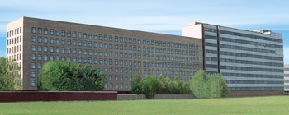
Лазерное ускорение ионов с использованием мишеней низкой плотности
Брантов А. В., Быченков В. Ю., Глазырин С. И., Ракитина М. А.
ФИАН
ВНИИА

Slide 2
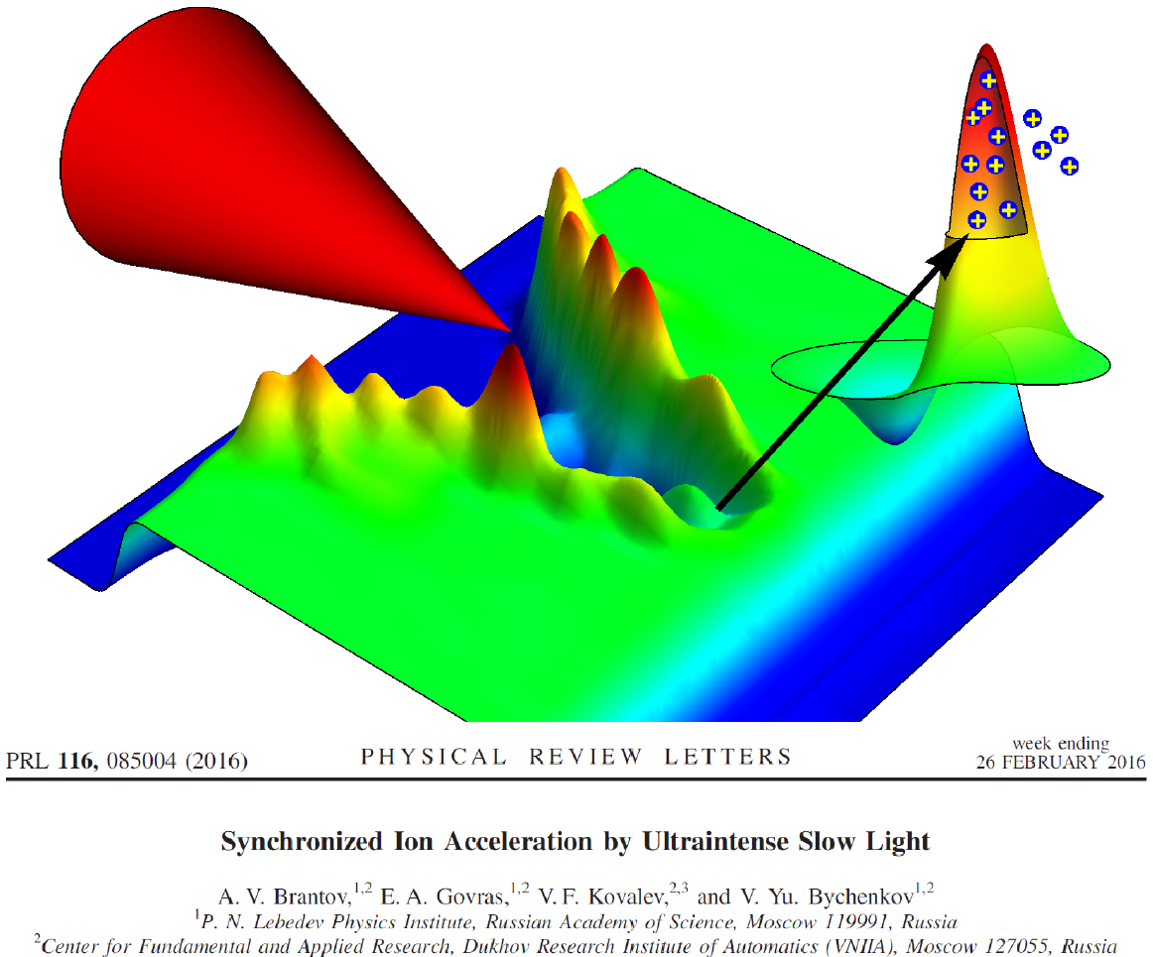
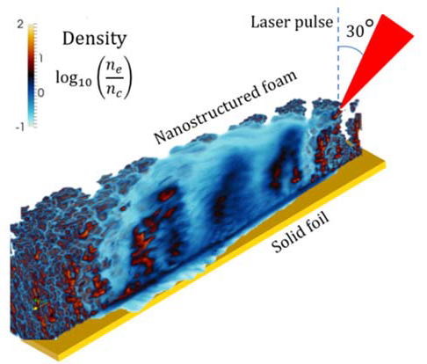
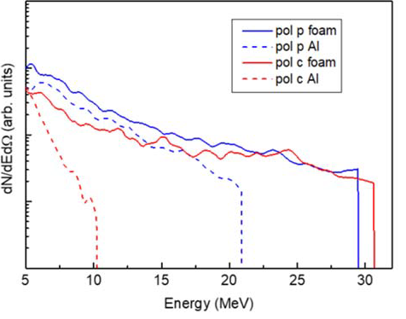
Ion acceleration from near-critical target
M Passoni et al 2020 Plasma Phys. Control. Fusion 62 014022

Slide 3
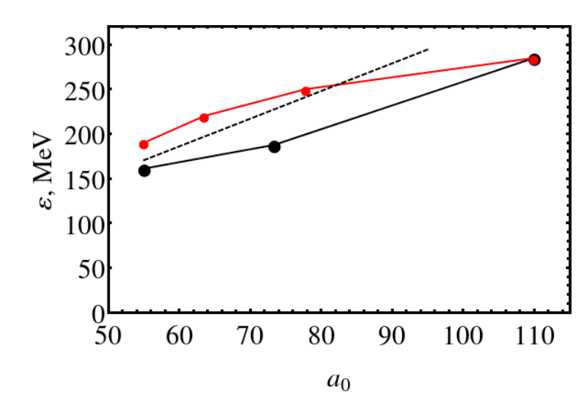
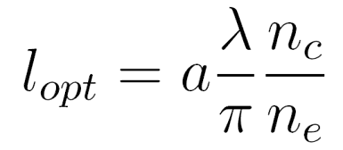
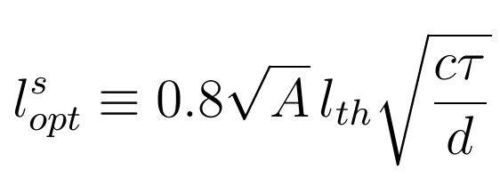
Effect of pulse duration on proton acceleration
Proton acceleration by 30 J laser pulse from thin foils with optimal thickness.
Proton energy increases with pulse duration decrease.
20 fs
30 fs
10 fs, 4 µm
40 fs
A Brantov, V Bychenkov 2021 Phys. Plasmas 28 063106
6 µm
8 µm
Is it the same for near-critical target?

Slide 4
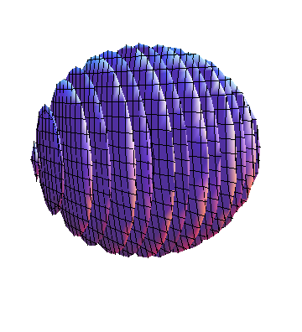
Ion acceleration from near-critical target – problem setup
Laser pulse
target
z
ρ
30 J,
4.1×10²¹ -1.7×10²² W/cm²
τ = 10 fs - 40 fs
ρ = 4 μm
Linear polarization
τ
y
x
l ~ 4 – 10 μm
Target CH₂
(n_{e}=12 - 28 n_{c} )
electrons
heavy ions
light ions (protons)
x × y × z = 20 λ × 20 λ × 20 λ
Δx × Δ y × Δ z = λ/100 × λ/20 × λ/20

Slide 5
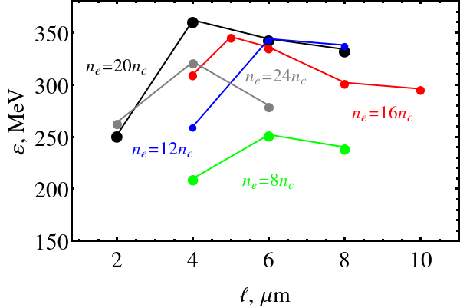
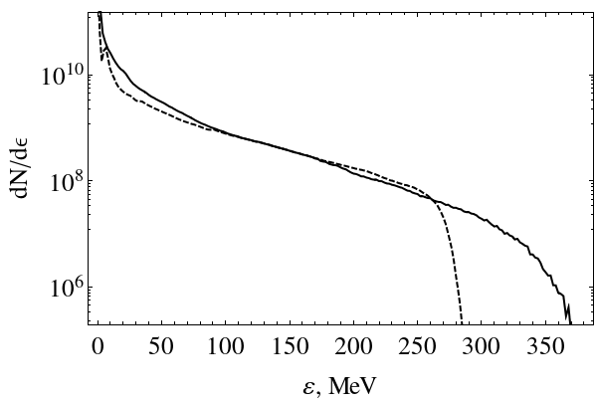
Ion acceleration from near-critical target - effect of pulse duration
near-critical target
thin foil

Slide 6
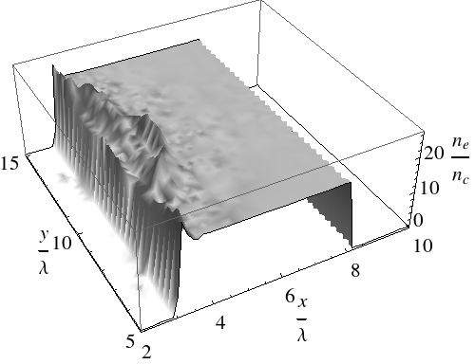
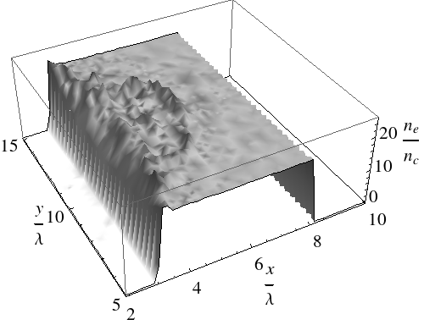
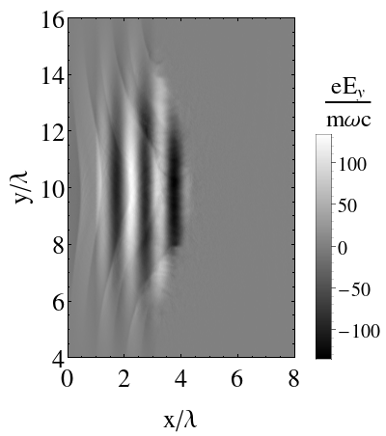
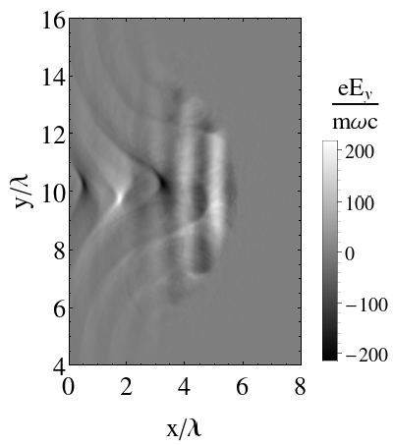
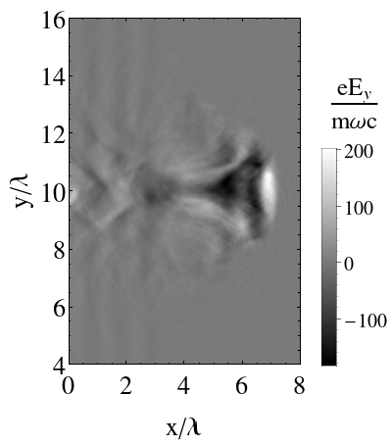
Ion acceleration from near-critical target

Slide 7
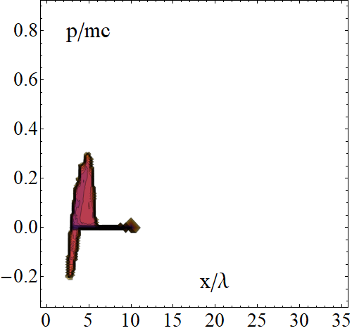
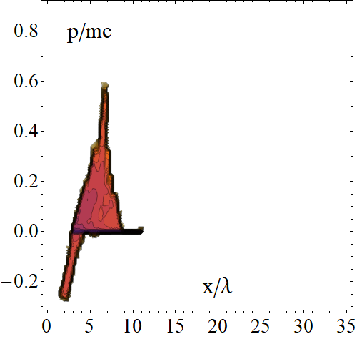
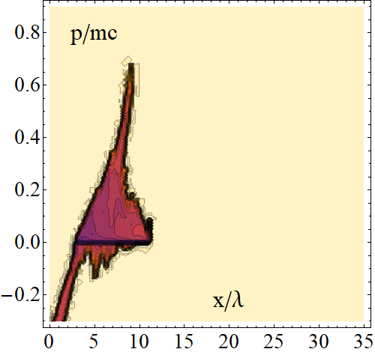
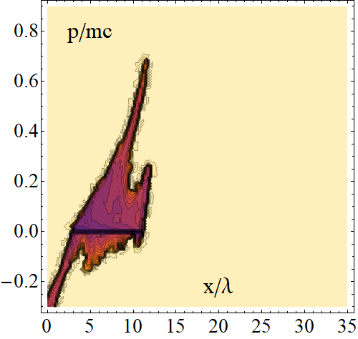
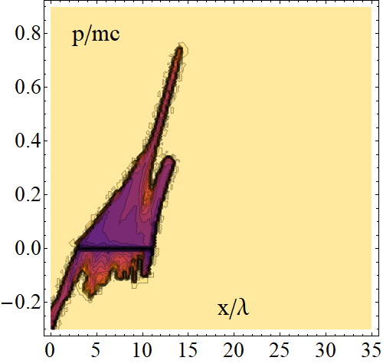
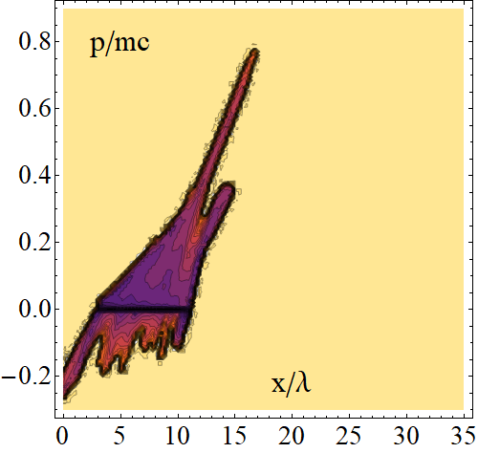
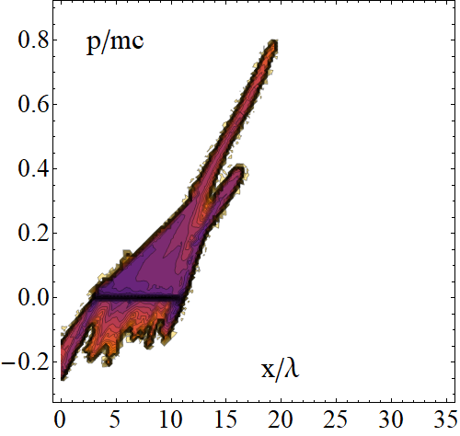
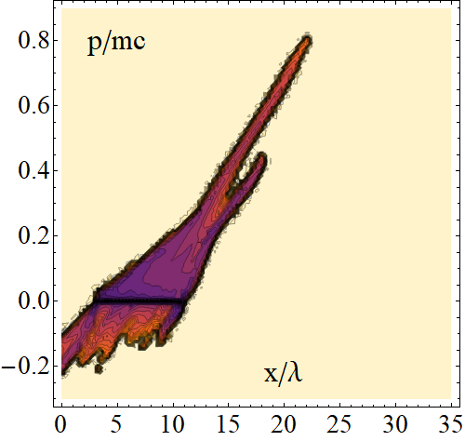
Ion acceleration from near-critical target –phase space
t=45 fs
t=60 fs
t=76 fs
t=91 fs
t=106 fs
t=121 fs
t=137 fs
t=152 fs

Slide 8
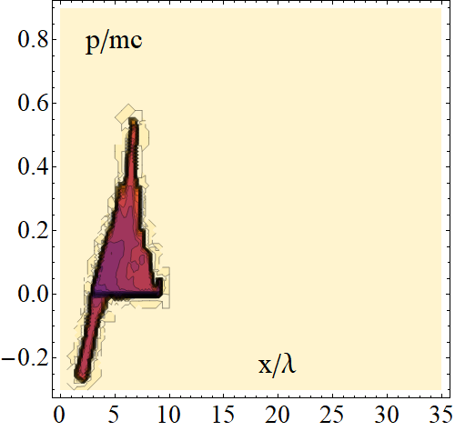
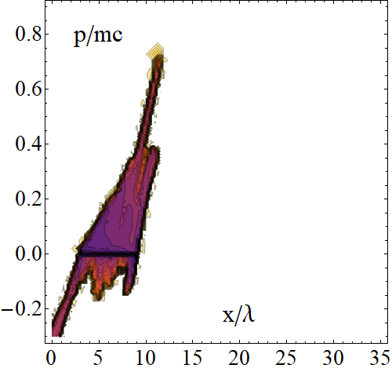
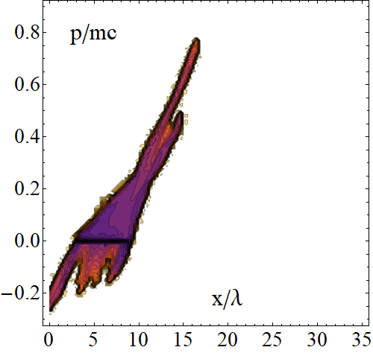
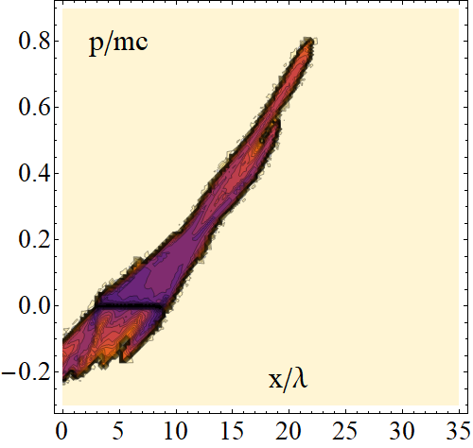
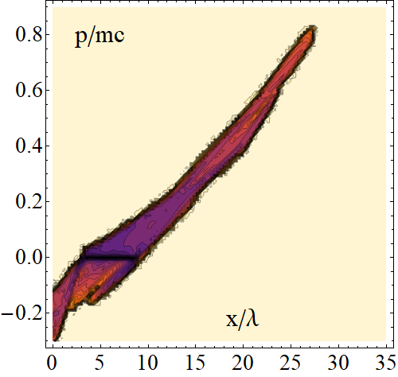
Ion acceleration from near-critical target –phase space
t=60 fs
t=91 fs
t=121 fs
t=152 fs
t=182 fs

Slide 9
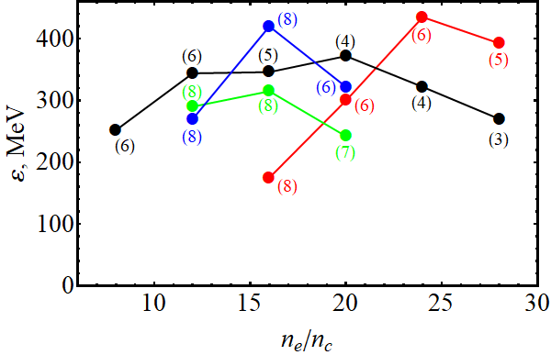
Ion acceleration from near-critical target - effect of pulse duration
60 fs
30 fs
20 fs
10 fs
10 fs is not optimal !

Slide 10
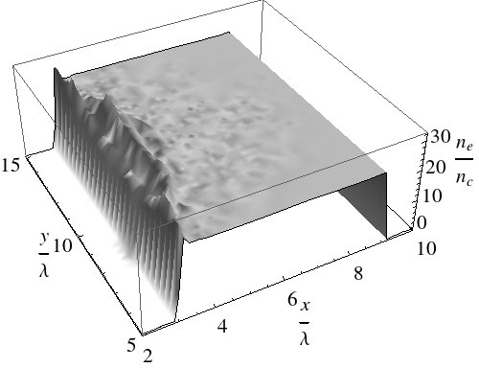
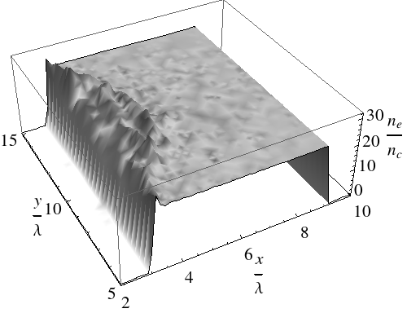
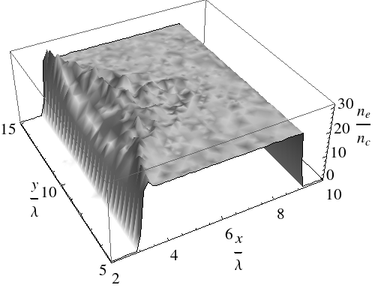
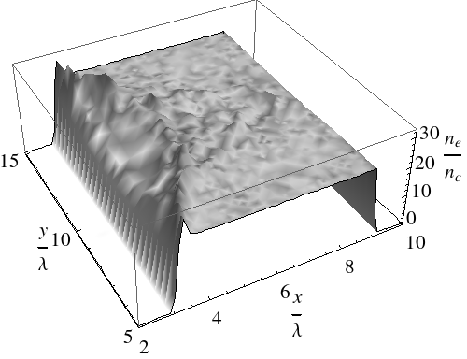
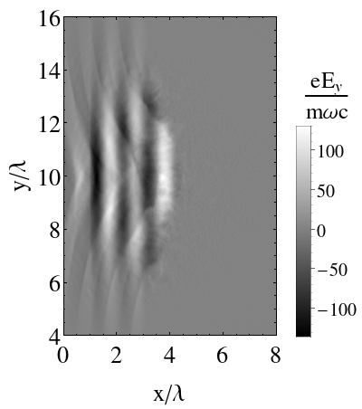
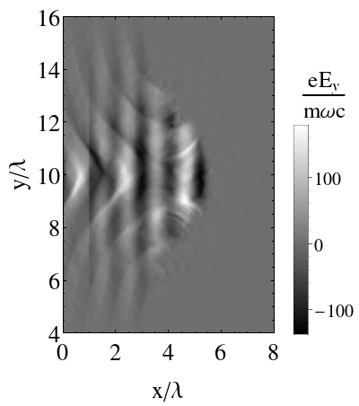
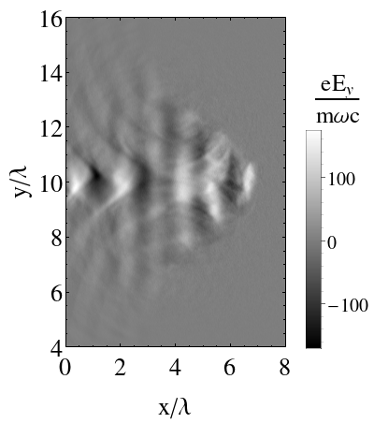
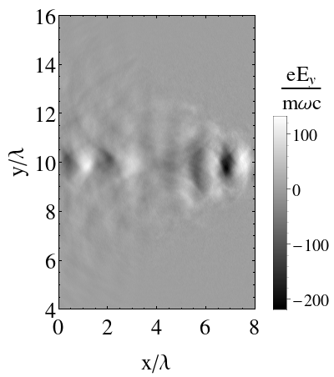
Ion acceleration from near-critical target

Slide 11
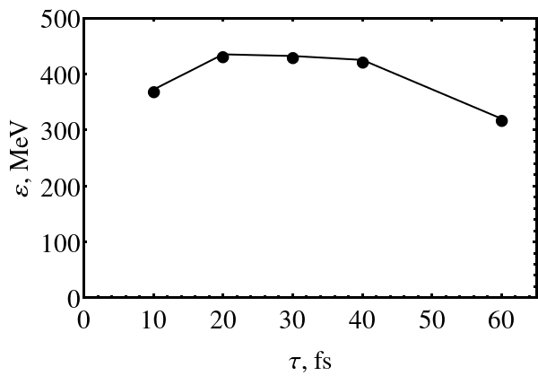
Ion acceleration from near-critical target - effect of pulse duration
10 fs – too short to increase acceleration time.
60 fs – intensity decreases + ponderomotive potential drops
optimal duration from 20 fs to 40 fs
A. V. Brantov, V. Yu. Bychenkov, Plasma Phys. Rep. 2022. V. 48 P. 585

Slide 12
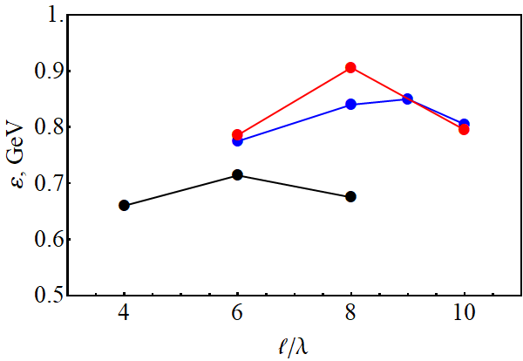
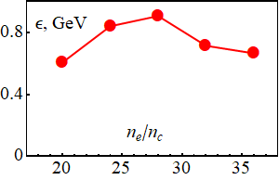
Ion acceleration from near-critical target – powerful XCELS laser pulse
I = 2×10²² W/cm² (a₀ =120)
τ = 25 fs ρ = 8 μm
P ~ 14 PW
E ~ 370 J
n_{e}=28 n_{c}
n_{e}=24 n_{c}
n_{e}=32 n_{c}

Slide 13
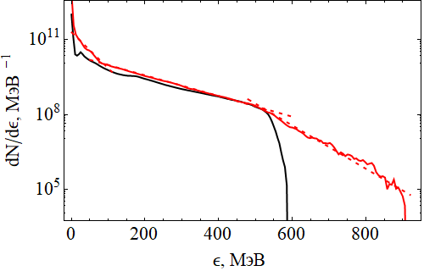
Ion acceleration from near-critical target – powerful XCELS laser pulse
T ~ 30 MeV
T = 105 MeV
10¹² protons (> 100 MeV)
T ~ 50 MeV
E_{p} =32 J
η= 9%

Slide 14
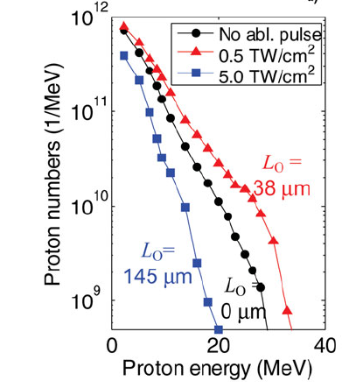
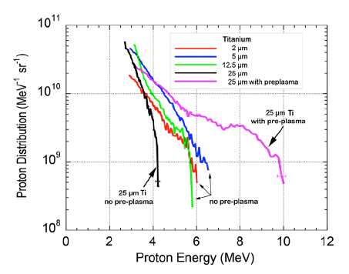
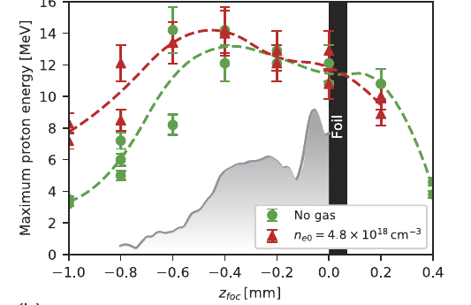
Preplasma effect on ion acceleration (experiment)
Mckenna P. et al Laser and Particle Beams (2008), 26, 591
L. A. Gizzi, Scientific Reports (2021) 11:13728
D Levy et al New J. Phys. 22 (2020) 103068

Slide 15
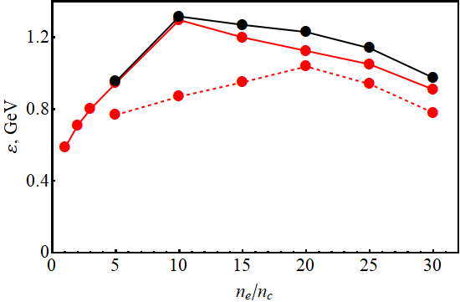
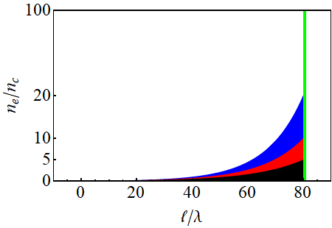
Preplasma effect on ion acceleration for XCELS laser (2D simulations)
$n_{\text{min}}=0.05$
$n_{\text{min}}=0.1$
$$a_{0}=120,$$
$$25 fs$$
Focusing in 8 λ
$n_{\text{e}}\sim e^{−x/L}$
L ~ 10 - 30 μm

Slide 16
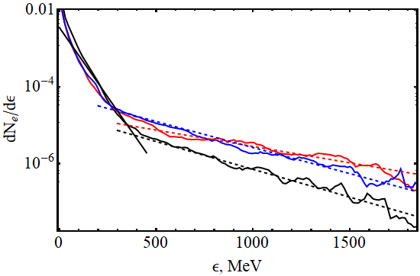
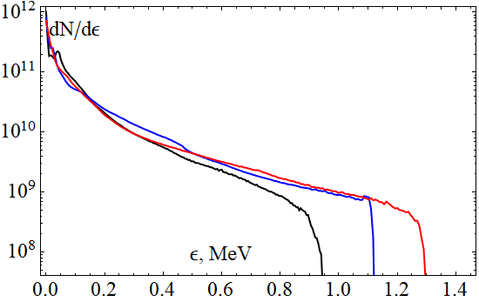
Preplasma effect on ion acceleration
$n_{\text{max}}=10, T_{e}=500 MeV$
$n_{\text{max}}=20, T_{e}=320 MeV$
$n_{\text{max}}=5, T_{e}=300 MeV$
$n_{\text{max}}=20 , L≈13λ$
$n_{\text{max}}=10, L≈15λ$
$n_{\text{max}}=5, L≈17λ$

Slide 17
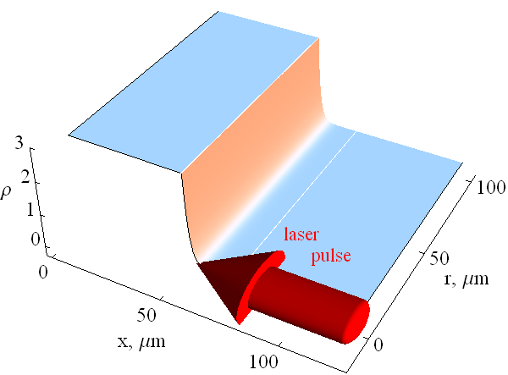
Hydrodynamic simulation of target expansion

Slide 18
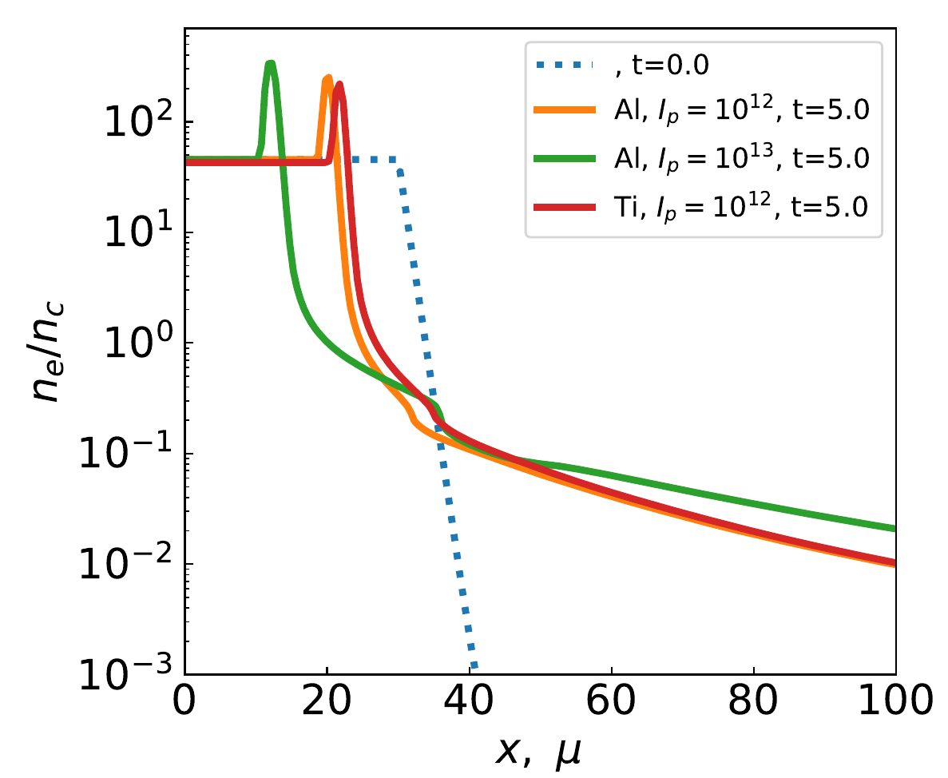
Hydrodynamic simulation of target expansion

Slide 19
Hydrodynamic simulation of target expansion
10 μm
5 μm
5 mJ
0.05 mJ

Slide 20
Hydrodynamic simulation of target expansion
For I $≳{10}^{10}$ W/${сm}^{2}$ the plasma density profile is independent of the target material
The plasma density profile can be approximated by exponential functions with several characteristic gradients
The plasma density profile is define by fluence for $≳{10}^{3}$ J/${сm}^{2}$
The characteristic value of the gradient describing the profile of the low-density plasma plume tail (with a density below 0.1-0.2 critical densities) saturates (about 2 mm) at the values ​​of the energy flux density $≳{10}^{3}$ J/${сm}^{2}$

