Slide 1
Development of the DLA platform at the ARC/NIF
with PHELIX as a testbed
Разработка платформы DLA на ARC/NIF с использованием
PHELIX в качестве испытательного стенда
Olga Rosmej, Nikolay Andreev, Nataliya Borisenko
Mikhail Gyrdymov, Parysatis Tavana, Jakub Cikhardt,
PHELIX, and NIF -teams
Новые методы ускорения частиц и экстремальные состояния материи, 15.02.2024

Slide 2
NIF Discovery Science project: Platform development.
Ultra-bright MeV photon sources driven by direct laser accelerated (DLA) electrons with ARC/NIF.
Expected impact and the need for NIF:
The development of the DLA platform at NIF promises a 10 -fold increase in the conversion efficiency from laser to MeV directional Bremsstrahlung (BS) compared to the application of the Compound Parabolic Concentrator (CPC).
Experimental approach:
Direct laser-accelerated electron generation in interaction of a 1ps/10 ps,
ARC pulse with pre-ionized low-density polymer foams (CHO, CH).
A nanosecond NIF beam is used to trigger supersonic ionization inside the foam, creating mm long NCD plasma .
Supporting team:
Hui Chen, chen33@llnl.gov
Andreas Kemp, kemp7@llnl.gov
Shaun Kerr, kerr24@llnl.gov
Dean Rusby, rusby1@llnl.gov
Dieter Schneider, schneider2@llnl.gov
Scott Wilks, wilks1@llnl.gov
Oral Presentation (web-conference) of top proposals (by invitation) on November 9th.

Slide 3
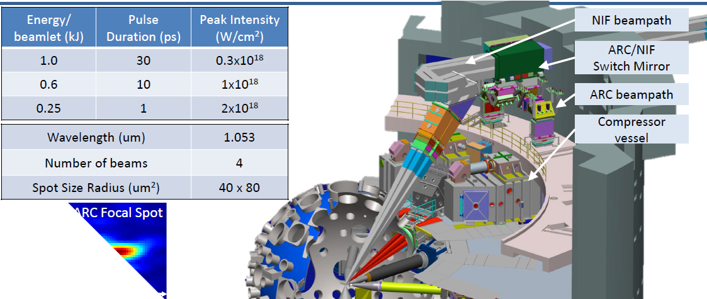
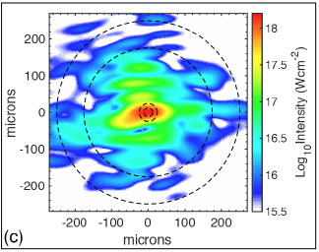
NIF’s short pulse laser, the Advanced Radiographic Capability (ARC)
Largest amount of available short pulse energy in the world (up to 4 kJ)
but intensity remains quasi-relativistic (I_{L} < =10¹⁸ W/cm²) -> low fraction of MeV particles and photons

Slide 4
Need for broadband x-ray and gamma sources for HEDS

Slide 5
Report of the Lawrence Livermore National Laboratory 2020
Self Modulated LWFA is a main platform to produce laser-driven sources of MeV particles and radiation.

Slide 7
LWFA for X-rays and gamma-rays production

Slide 8
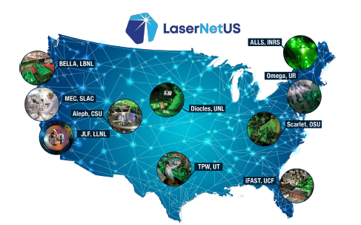
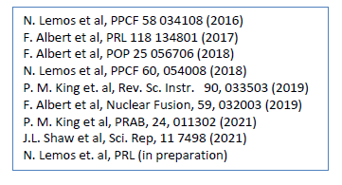
LWFA-driven sources on large kJ-class ps lasers

Slide 10
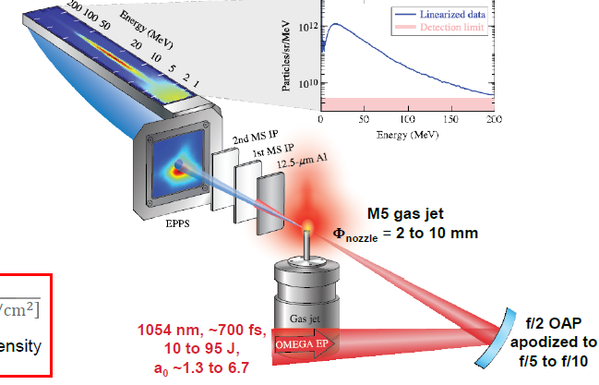
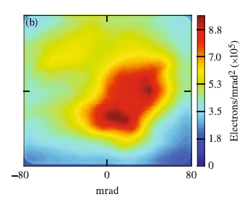
OMEGA EP
SM-LWFA-based LPA
50% charge in 0.1 rad
MS IP after 37 μm Al
E_{e} > 0.02 MeV
E_{e} > 0.9 MeV
Results for 0.7 ps, a_{o}= 6.6
n_{e}=8x10¹⁸ cm⁻³, Φ_{nozzle}= 6 mm
Charge 700±420 nC
(≤700 kA current)
weighted average electron energy 17.9 MeV
(Alfven current ( γ=40) = 700 kA)
~ 50 cm
J. Shaw et al,
Sci. Reports 2021

Slide 11
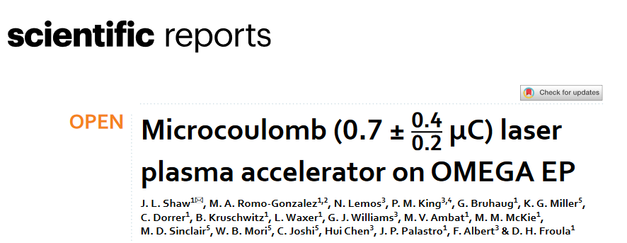
SM-LWFA at high electron densities show unstable for electron acceleration
(2021) 11:7498

Slide 12
Direct laser acceleration (DLA) as an effective way toward ultra-bright sources of MeV particles and radiation at near-relativistic laser intensity and above.

Slide 13
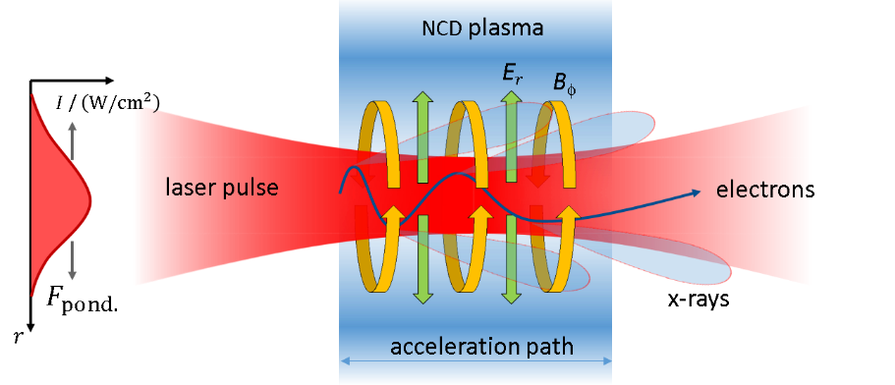
Direct laser acceleration of relativistic electrons at betatron resonance
A. Pukhov, Z.- M. Sheng, and J. Meyer-ter-Vehn, V6, N7, PoP 1999
NCD > 100 × higher plasma density than for LWFA and SM-LWFA -> higher charge of super-ponderomotive electrons but with lower energies
$$ω_{β}=\left(1−\frac{v_{x}}{v_{ph}}\right)ω_{L}$$
3D PIC for PHELIX, 10¹⁹ W/cm²
self-focusing: laser peak power P_{L}(500 TW) >> P_{c}=17 GW × n_{c} / n_{e} ~ 17 GW
ponderomotive force expels background plasma electrons from laser channel
generation of quasi-static radial E-field that has a pinching polarity for electrons.
self-generated quasi-static B azimuthal (≥100 MG) that traps electrons in the plasma channel
transversal betatron oscillations of electrons where they gain energy from laser field.
X. F. Shen et al, Appl. Phys. Lett. 118, 134102 (2021);
Notes:
All the more astonishing that DLA appears to be a very stable process

Slide 14
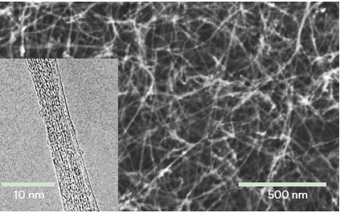
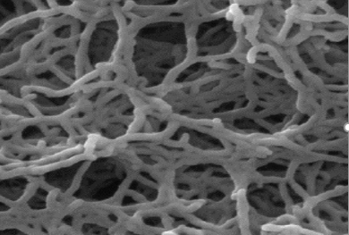
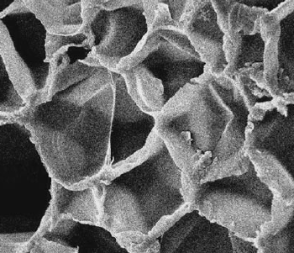
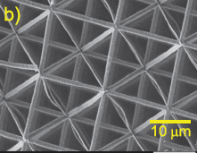
Variety of foams for generation of long-scale NCD plasma
near-critical
over-critical
O. S. Jones
W Ma Nano Lett 2007
J H Bin PRL 2018
W.J. Ma PRL 2019
Y Shou NatPhot 2022
O S Jones PoP 2021
P. Wang HPLS 2021
T. Wiste J. App. Phys.2023
NG Borisenko, J. Phys. 2020
O Rosmej, PPCF 2015 2020
S Chaurasia, PoP 2017
NG Borisenko et al,
LPB26 (04) 2008
Additive manufacturing
C-nano foams (CNF)
CHO (TAC)
Polystyrol
AM foams C₈H₉O₃
GSI
pore size ~ 10 nm
pore size ~ 1 μm
pore size ~ 20 μm
pore size ≥10 μm
Stochastic 3D nano-network,
2 mg/cc-> 0.4 ncr
bundle thick. < 5-10 nm,
Uniform NCD after 400fs
sharp (0.4 µm) vacuum-plasma boundary
Stochastic 3D micro-network,
2 mg/cc-> 0.65 ncr
bundle thick. ≥ 40 nm,
Uniform NCD: ps (1 keV) and some of ns (10 eV)
Stochastic 3D micro-network,
closed pore, 20-30 µm,
3-4 µm thick walls.
Demands ns-time scale for
homogenization
Regular 3D nano-network,
12-93 mg/cc,
bundle thick. ~ 0.1 - 1 μm,
Uniform after 70 ps (1.5 keV) and some of ns (100 eV)
super-critical plasma (green)

Slide 15
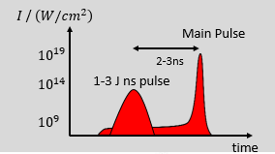
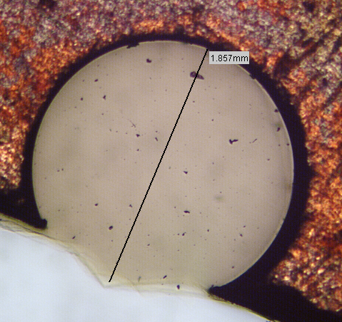
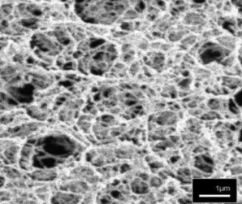
Generation of NCD plasma in interaction of ns-laser pulse with foam
foam ionization is triggered by well-defined ns-pulse with parameters adjusted to the foam density and thickness
1013-10-14 W/cm2
advantage of foam: it absorbs up to 90% laser energy
CHO: 2 mg/cc (2×10²⁰ at/cm³)
3D aerogel structure
50-100 nm solid ( 0.1g/cc)+ ca. 1 μm evacuated pore
sub mm thick foam provides increased interaction path
> 500 µm thick NCD plasma “target” (Ne ≲ 0.7 x 10²¹ cm⁻³ ) is created by a 10¹³-10¹⁴ W/cm² ns pulse.
Ionization wave velocity ~ (1-2)x10⁷ cm/s. Main pulse interacts with NCD plasma with a delay of 3-5 ns.
O. N. Rosmej et al, New J. Phys. 21(2019) 043044
O. N. Rosmej et al Plasma Phys. Control. Fusion 62 (2020) 115024

Slide 16
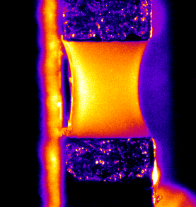
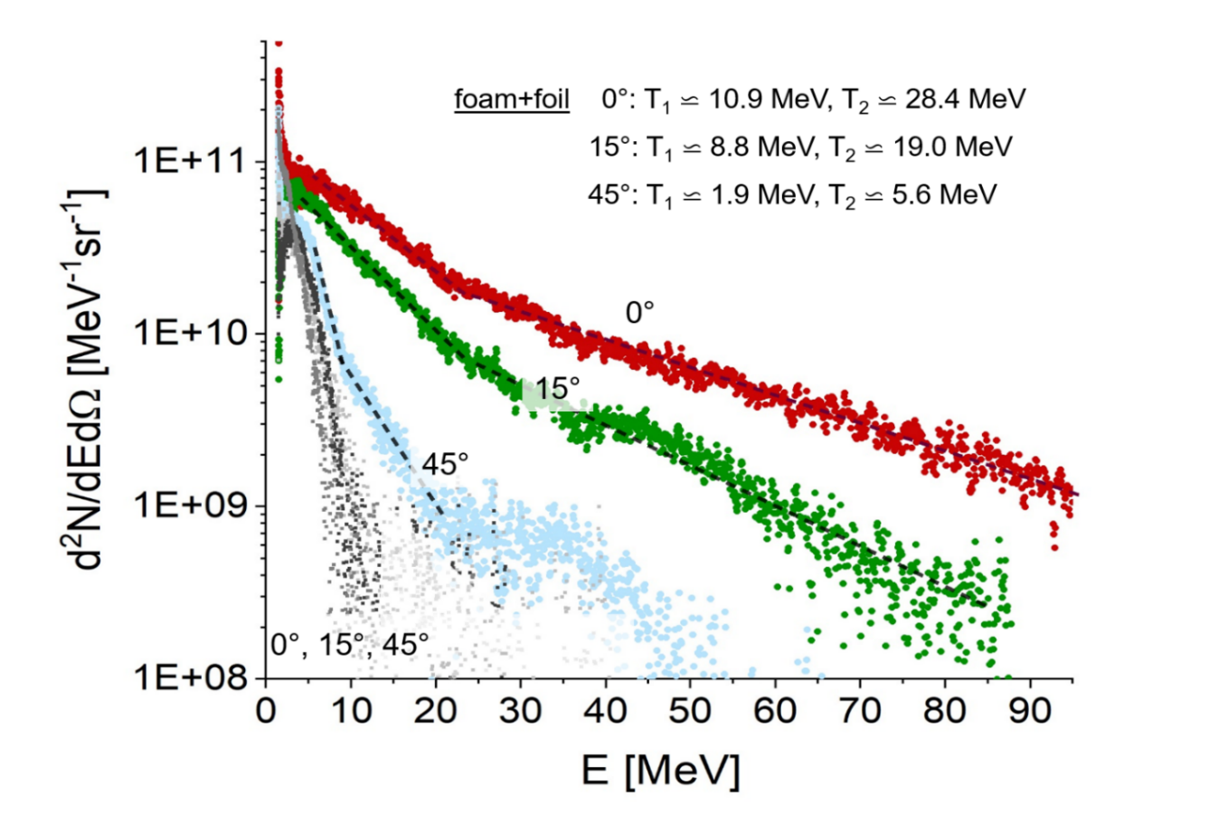
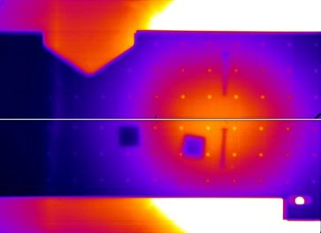
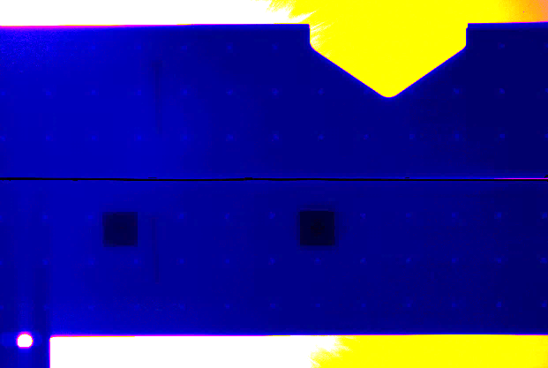
Well-directed high-current beams of super-ponderomotive electrons (PHELIX)
Most fraction of electrons is accelerated
along laser axis; E_{max} = 100 MeV, T _{eff} > 10 MeV
PHELIX: 10¹⁹ W/cm², 1 μm,
0.7 ps, 20 J FWHM, a₀= 3.5
laser
foam
foil
shot on foil
electron angular distribution
shot on foil
shot on foam+foil
> 3.5 MeV
> 3.5 MeV
isotropic
collimated e-beam
$θ$½ =13°
O. N. Rosmej et al, New J. Phys. 21(2019) 043044
O. N. Rosmej et al Plasma Phys. Control. Fusion 62 (2020) 115024

Slide 17
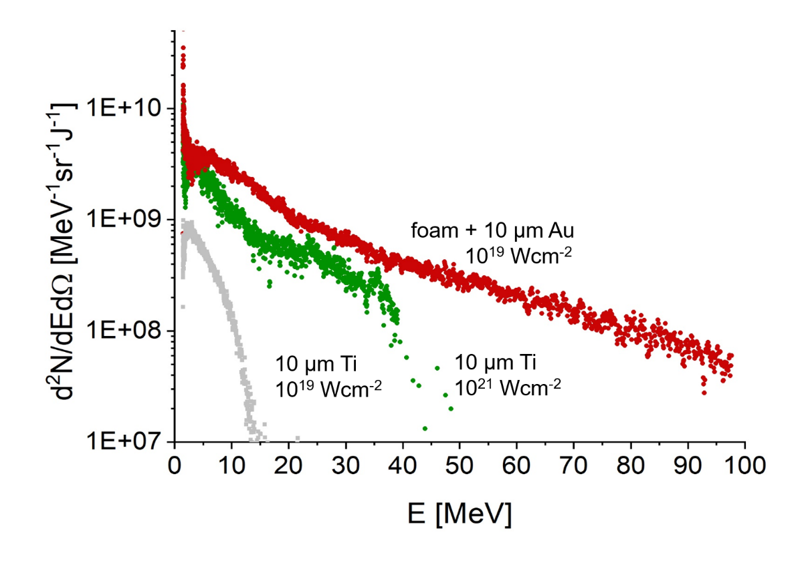
100× increase of laser energy coupling to MeV electrons using foams
spectra measured along laser axis (0°)
10²¹ W/cm²
10¹⁹ W/cm²
More high energy electrons ( > 30 MeV) in case of foam+foil at 10¹⁹ W/cm² (red) than in shot with 10²¹ W/cm² on foil (green)
O. N. Rosmej et al Plasma Phys. Control. Fusion 62 (2020) 115024

Slide 18
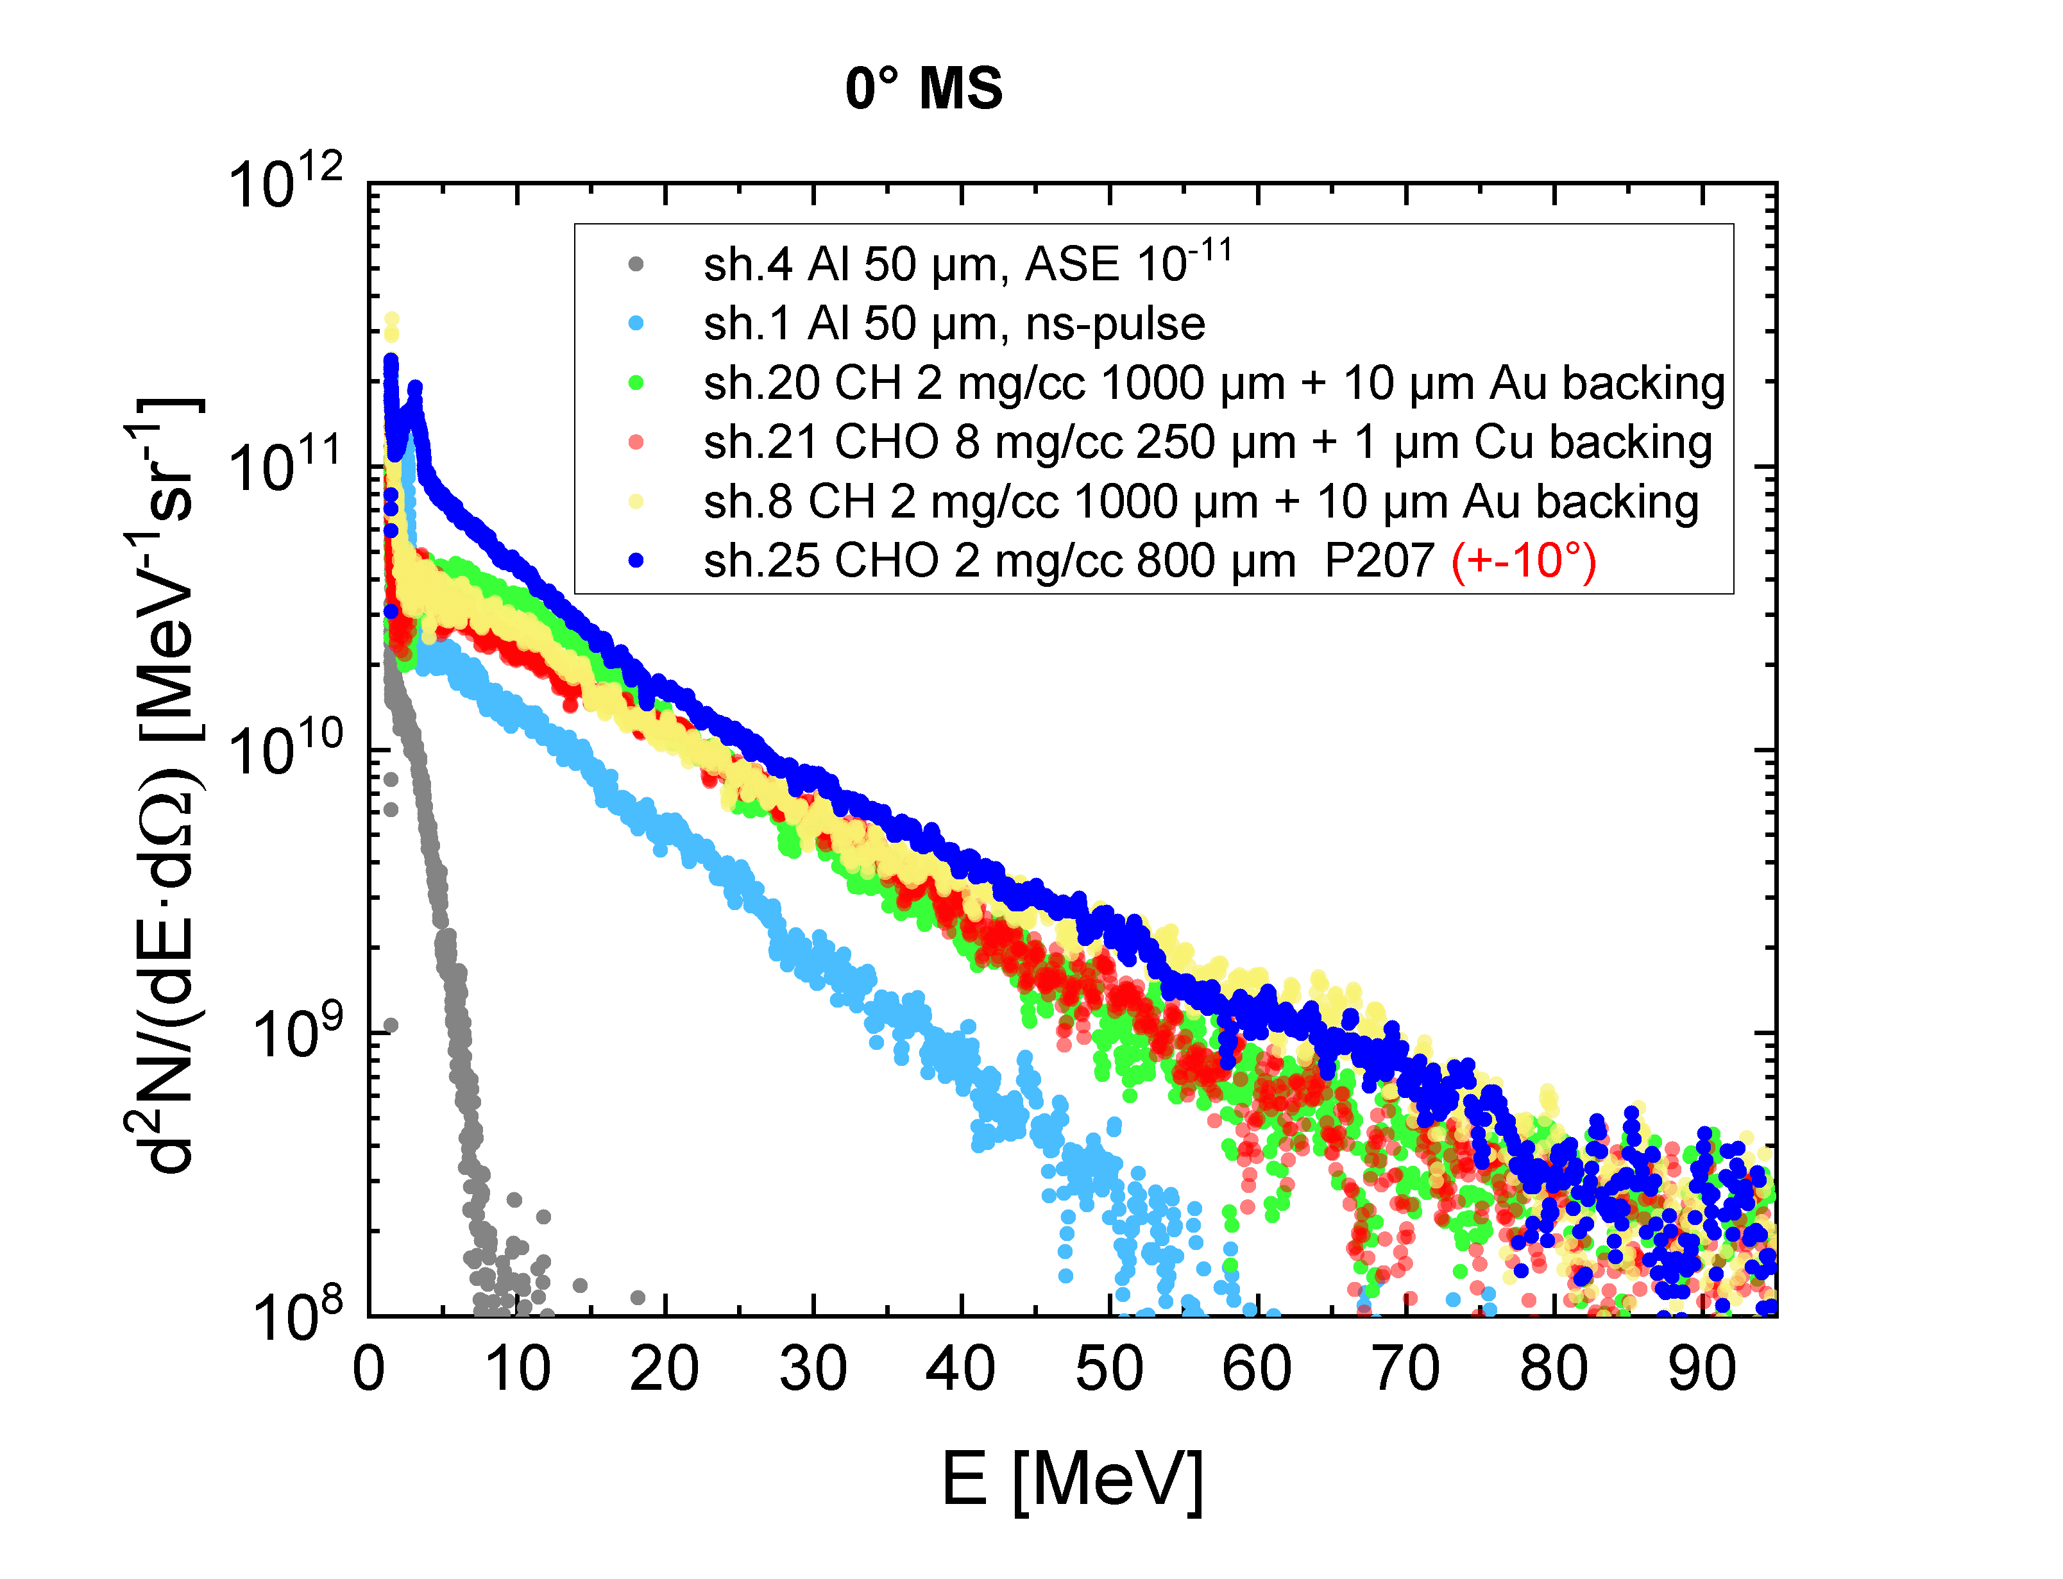
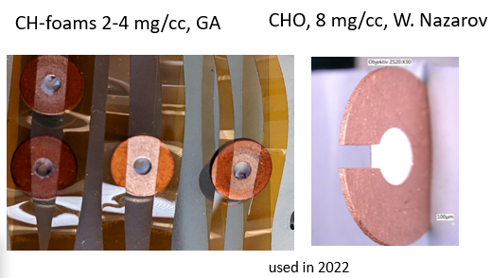
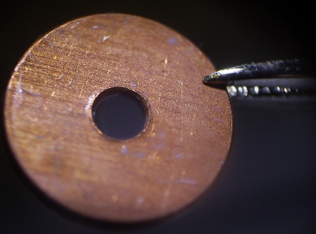
Stability of the DLA process by appl. of different foams and ns-pulses
foam + ns
Foams are produced using different technologies:
CHO (N. Borisenko, LPI) PHELIX 2017-21
CH (General Atomics, US) PHELIX 2022-23
CHO (W. Nazarov, Scotland) PHELIX 2022-23
densities: near critical and over-critical 2-8 mg/cc
areal densities: 0.16-0.2 mg/cm²
ns pulse: ~ 10¹³ – 3x10¹⁴ W/cm², 3- 5 ns delay
T_{h} ~ 15-17 MeV
Al + ns
Al high contrast
PhD M. Gyrdymov, GU-Frankfurt

Slide 19
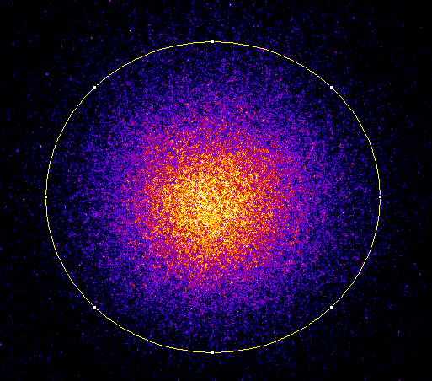
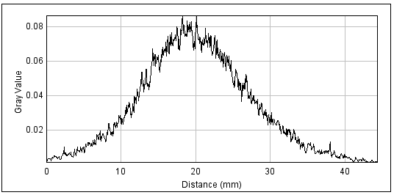
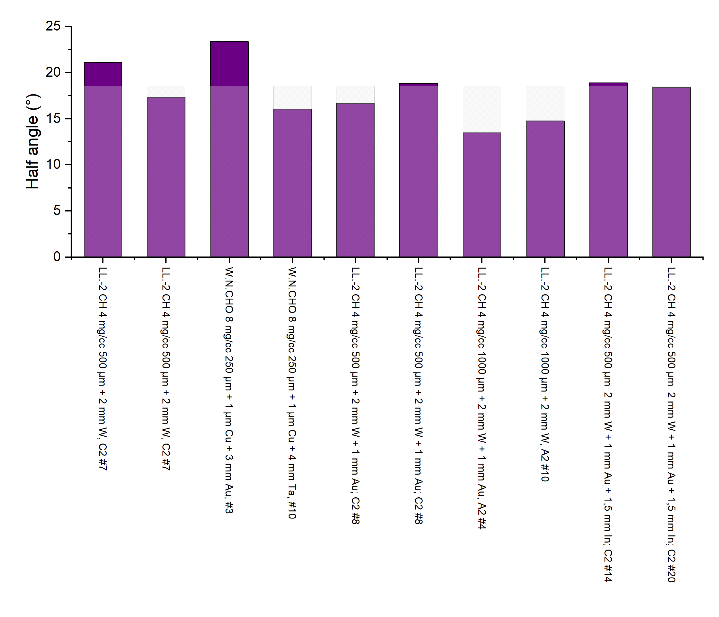
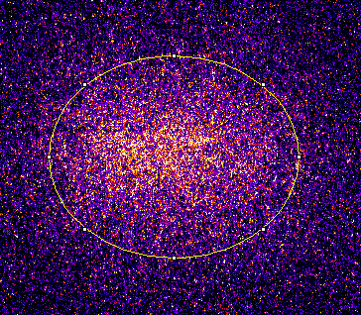
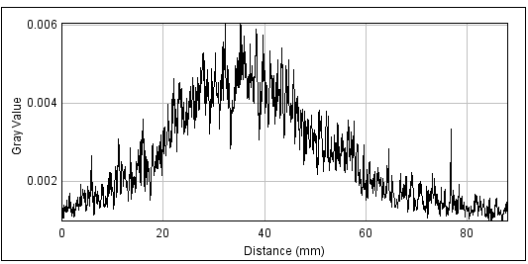
10-times less 10 MeV photons in direct shot on W-converter with ns-pulse
Visualization of the gamma-rays angular distribution using autoradiography
sh. 37 Foam 4 mg/cc, 0.5mm + 2mm W +ns-pulse
$θ_{1/2}$ = 18$°$
Cu-foil -27 mm from TCC
$θ_{1/2}$ = 15$°$-19$°$
for convertor thickness 2-4 mm
(E$γ$>10 MeV)
sh. 41 Direct shot on 2mm W + ns-pulse
$θ_{1/2}$ = 25$°$
Cu-foil 40 mm from TCC

Slide 20
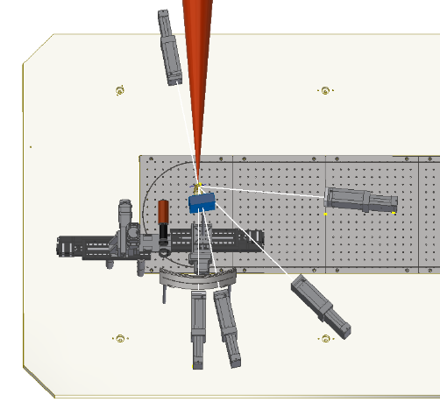
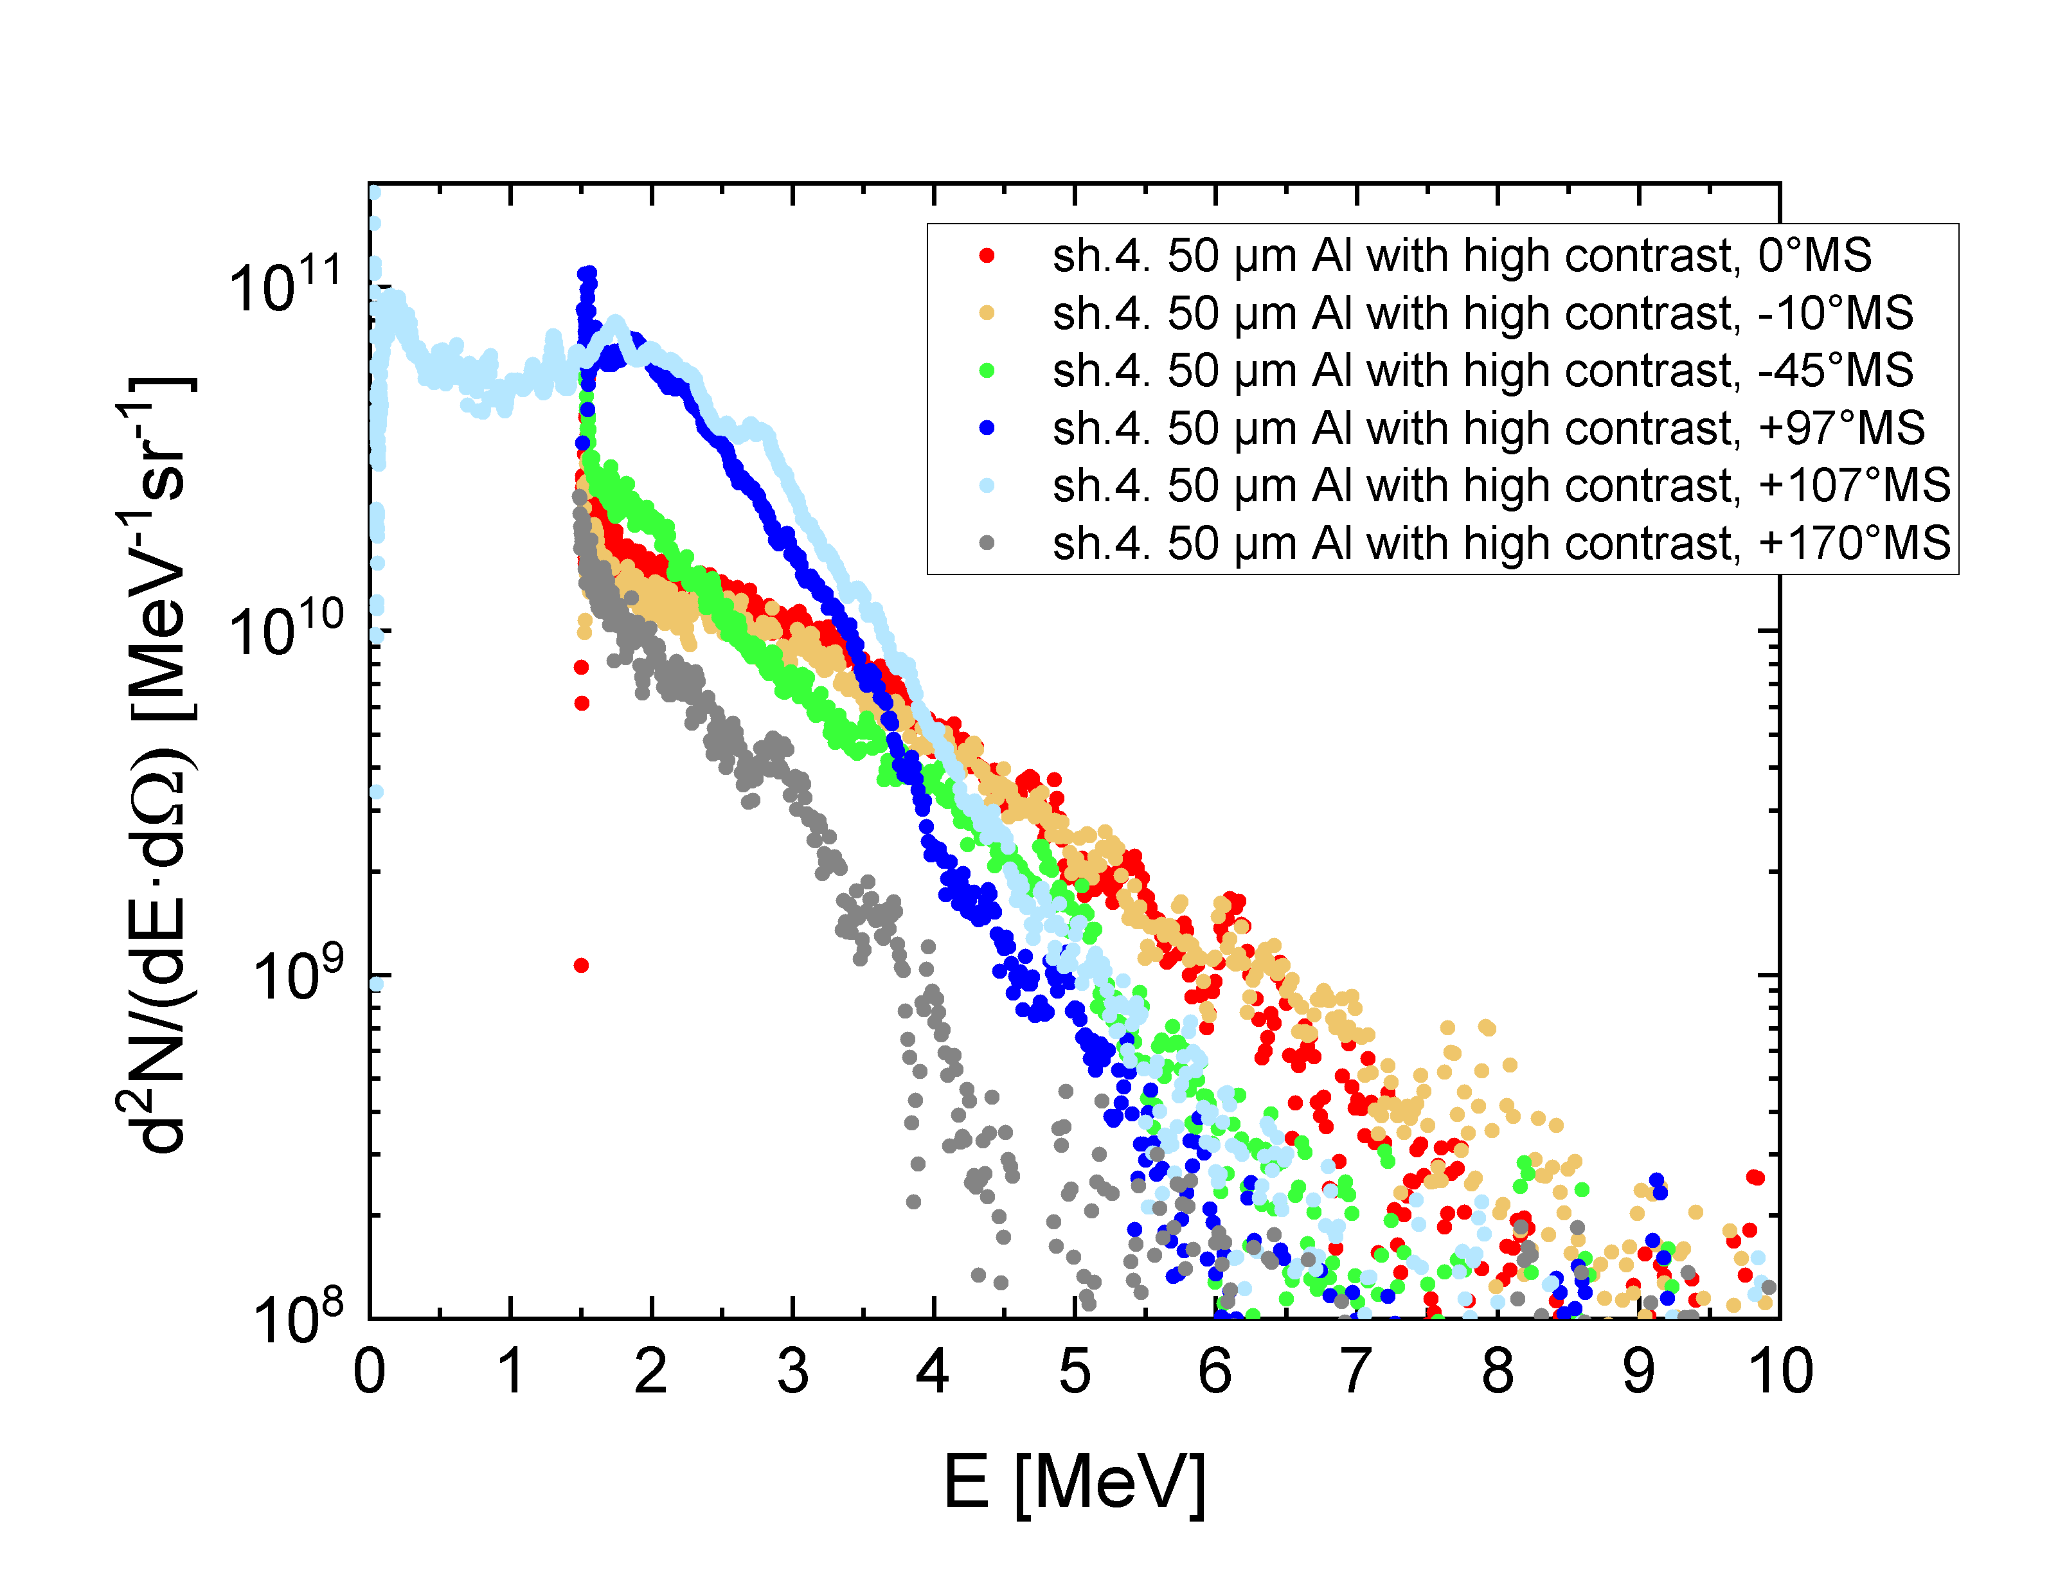
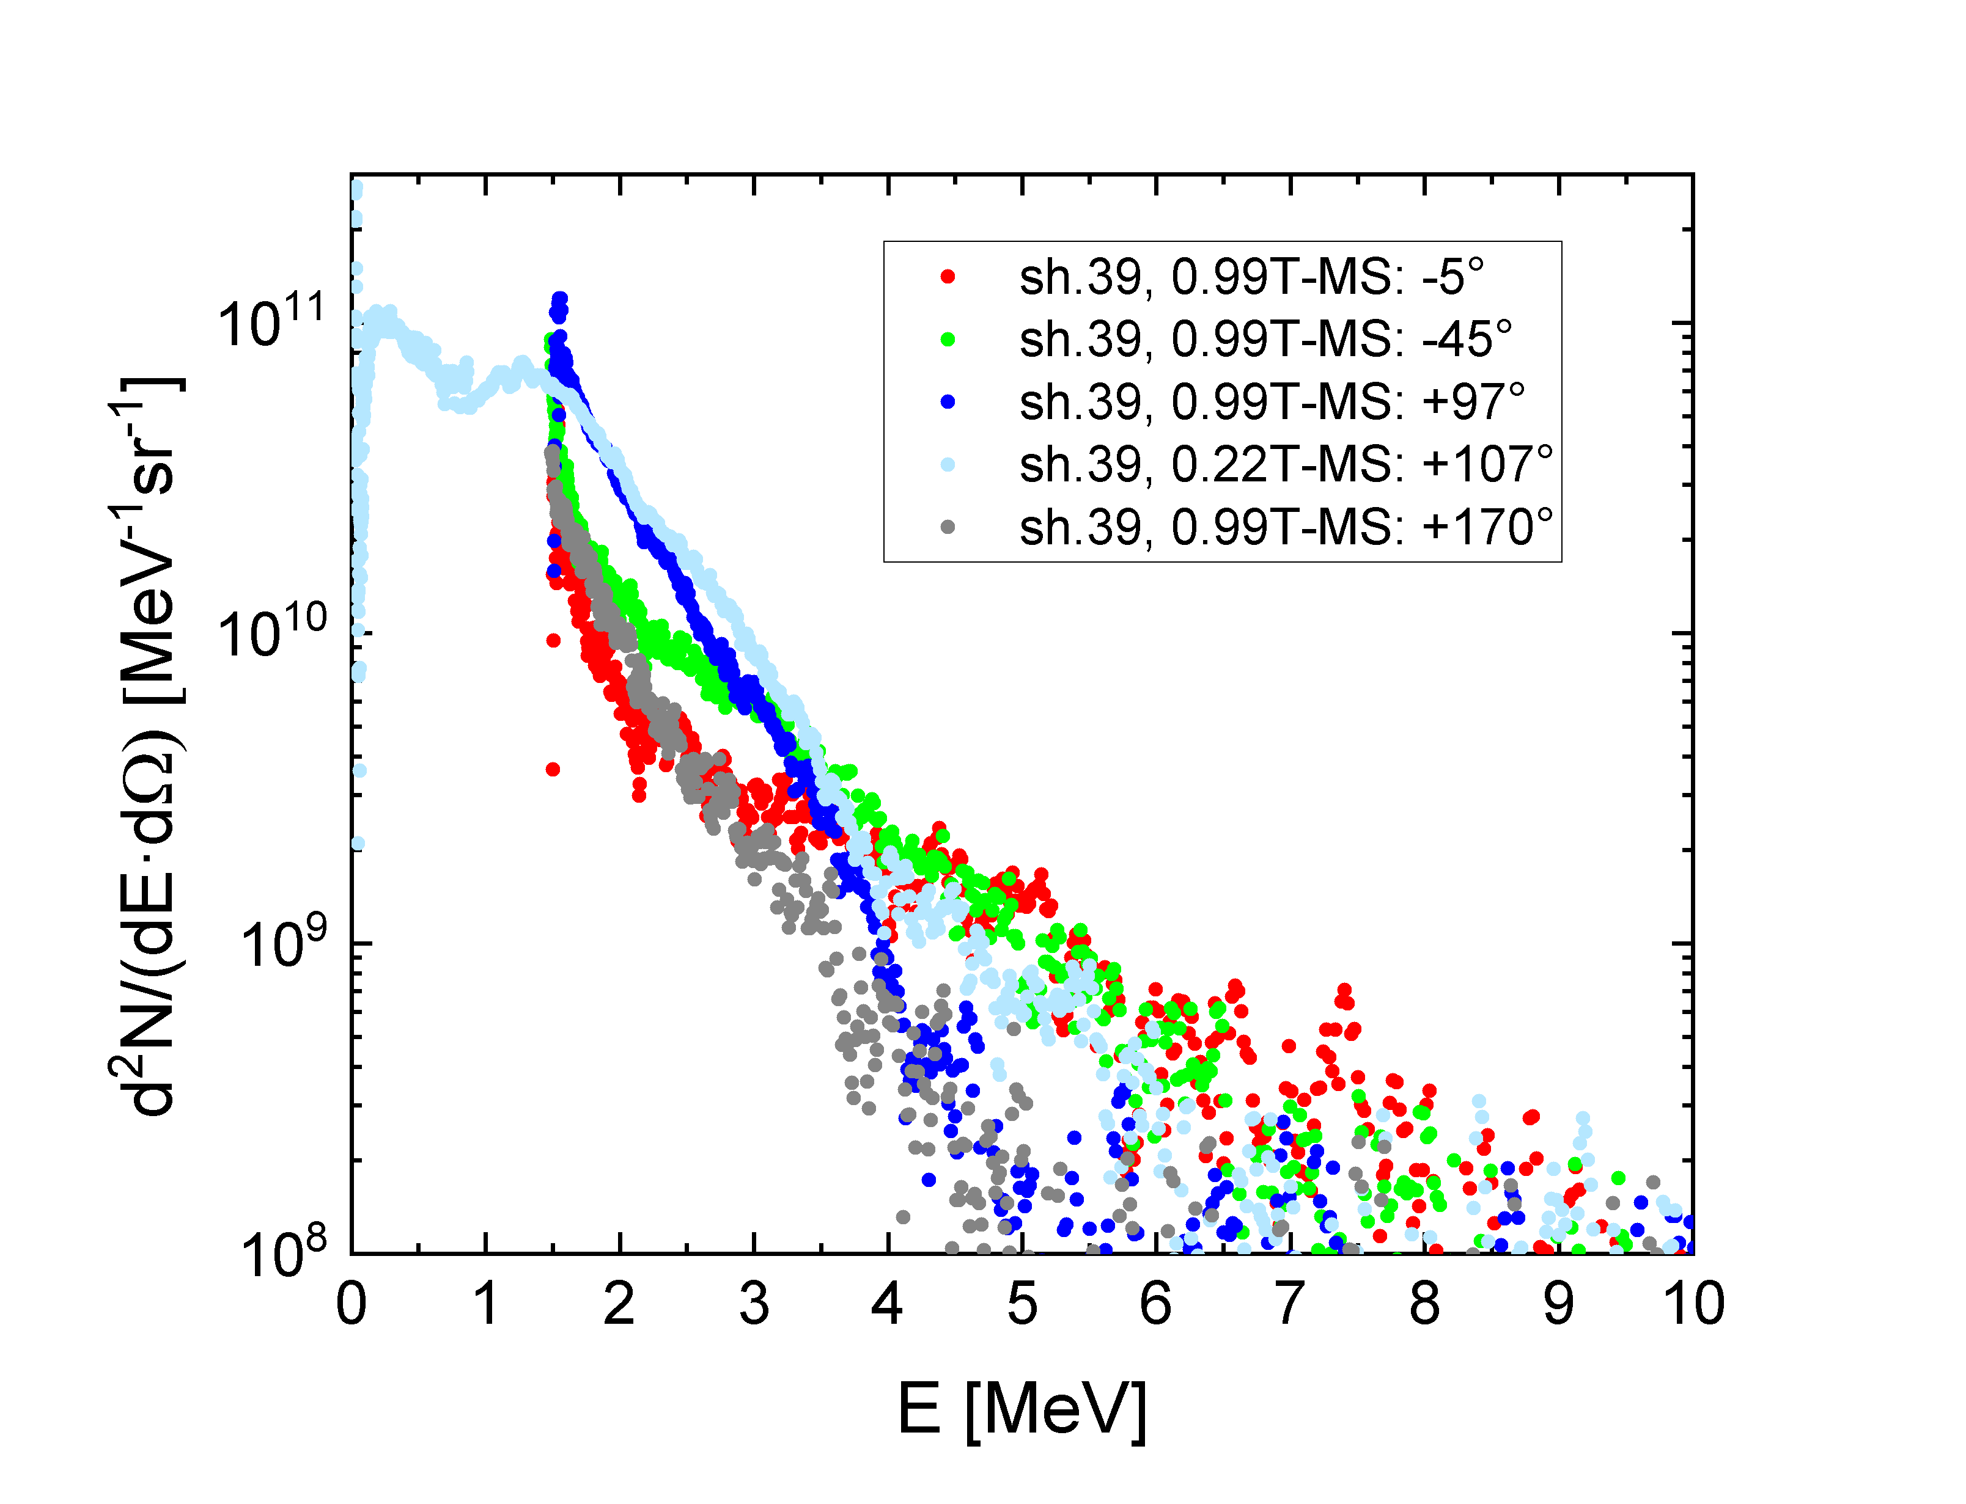
No DLA electrons were observed in interaction with foams w/o pre-ionization by ns-pulse
No difference in electron spectra for foil and foam at high laser contrast
Al-foil, high contrast (10⁻¹¹) shot
Polymer foam, high contrast shot
Ponderomotive electrons from foam and foil w/o ns-pulse
T_{eff}=1.2 MeV
forward
accelerated
electrons
electron angular distribution
backward
and to the side
M. Gyrdymov

Slide 21
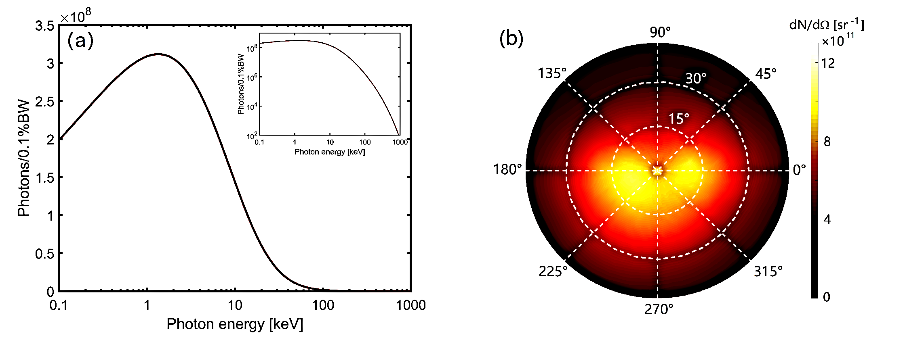
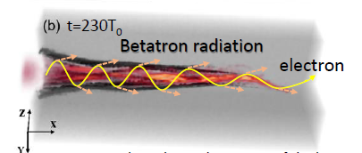
Ultra-bright betatron radiation produced by DLA electrons
PETAL 1 kJ , SM-LWFA (a₀= 7.5, n_{e}= 10¹⁸ cm⁻³, E_{e}~ 1 GeV) 7×10¹¹ photons with E_{c} = 10 keV,
Ferri et al, Phys,. Rev. Accelerators and Beams 19, 101301 (2016)
3D PIC for PHELIX (a₀=2.5)
X.F. Shen, A. Pukhov
Broad spectrum, large photon number: 7×10¹¹ (1-30 keV) with E_{c} = 5 keV,
X. F. Shen et al, Appl. Phys. Lett. 118, 134102 (2021), O. N. Rosmej et al, Matter Radiat. Extremes 6, 048401 (2021)
Notes:
by the electrons.
F is the transverse force felt by the electrons. ~ Ne
is the transverse force felt

Slide 22
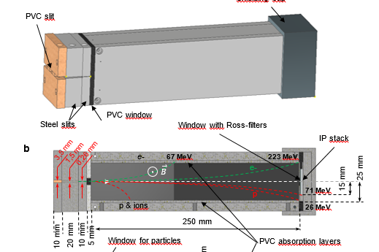
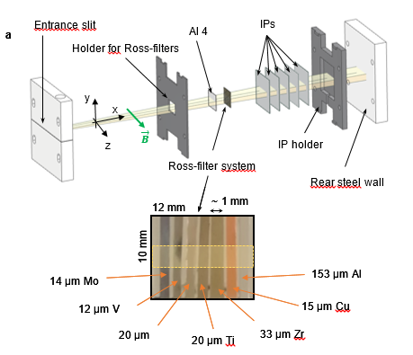
Modified magnetic spectrometer for X-rays (X-MS)
Mikhail Gyrdymov, Goethe University, Frankfurt, GSI

Slide 23
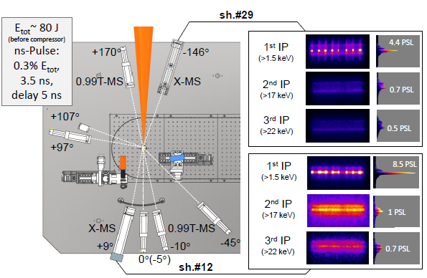
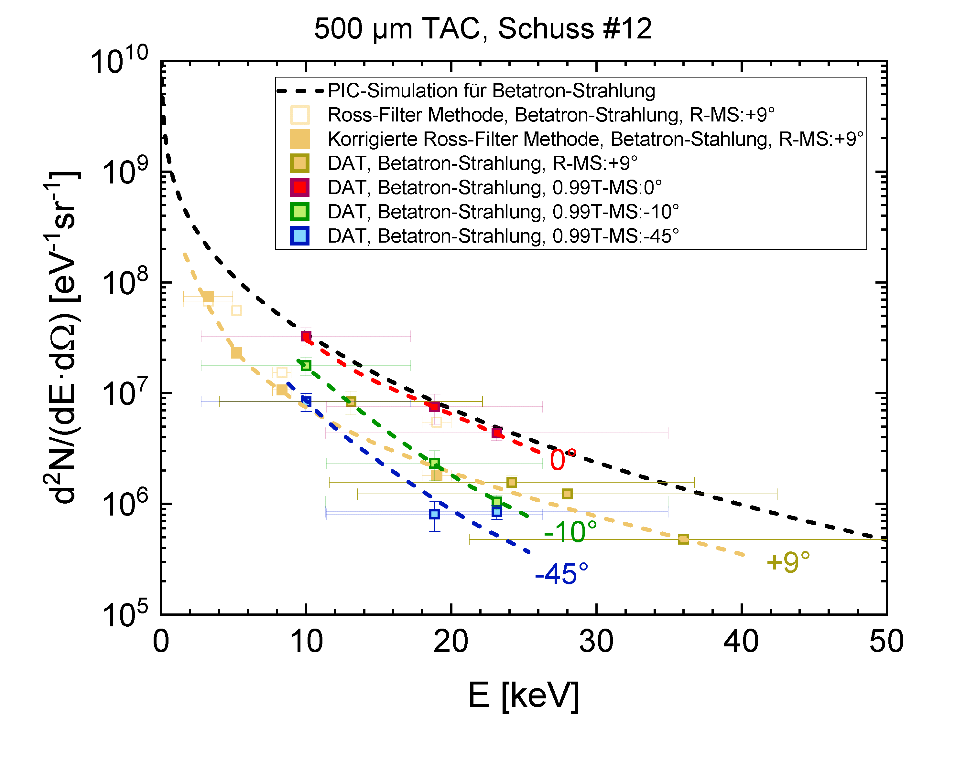
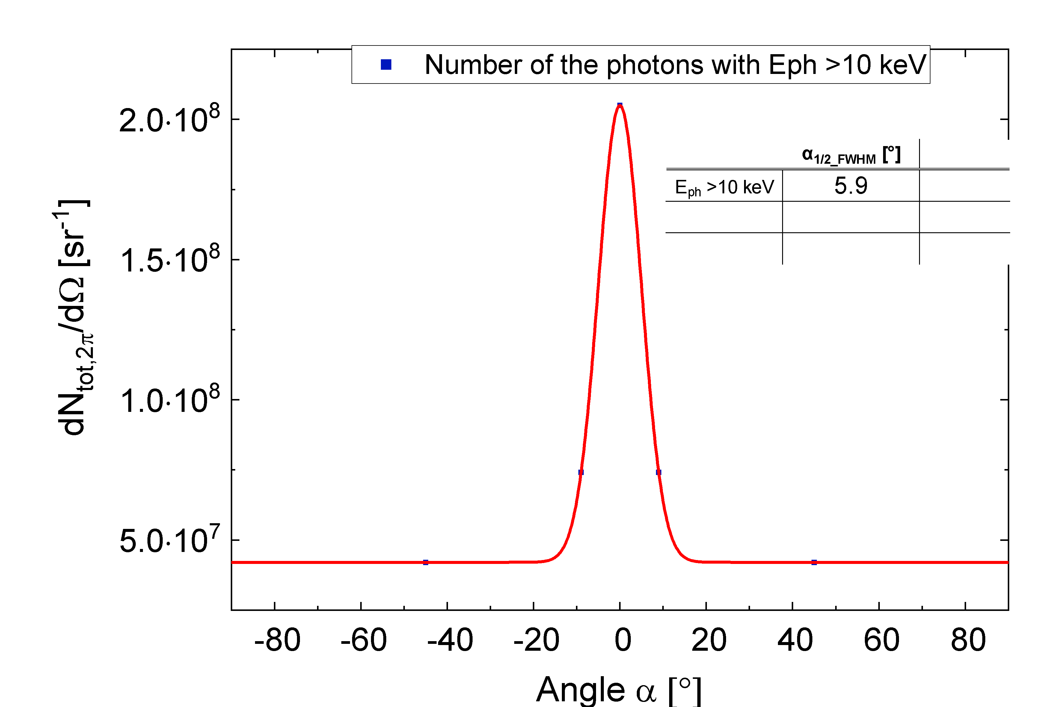
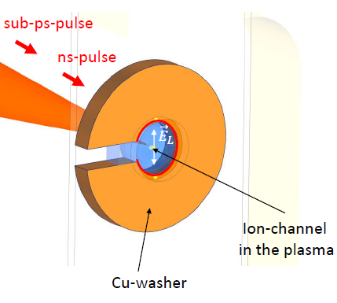
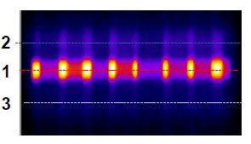
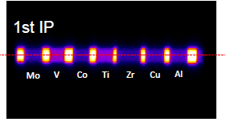
Measurements of betatron radiation produced by DLA electrons (PHELIX 2021-22)
α_{1/2}= 6° (E_{ph}> 10 keV)
100 mrad
Cu-washer
10¹⁰ (10-30 keV), div=100 msr -> fluence 3×10¹¹ ph/sr
Brilliance: ≥ 2x10²⁰ photons/s/mm²/mrad²/0.1%BW
experiment
Au-foil
Cu-washer
PhD, M. Gyrdymov
Notes:
protons and electrons can falsify signal

Slide 24
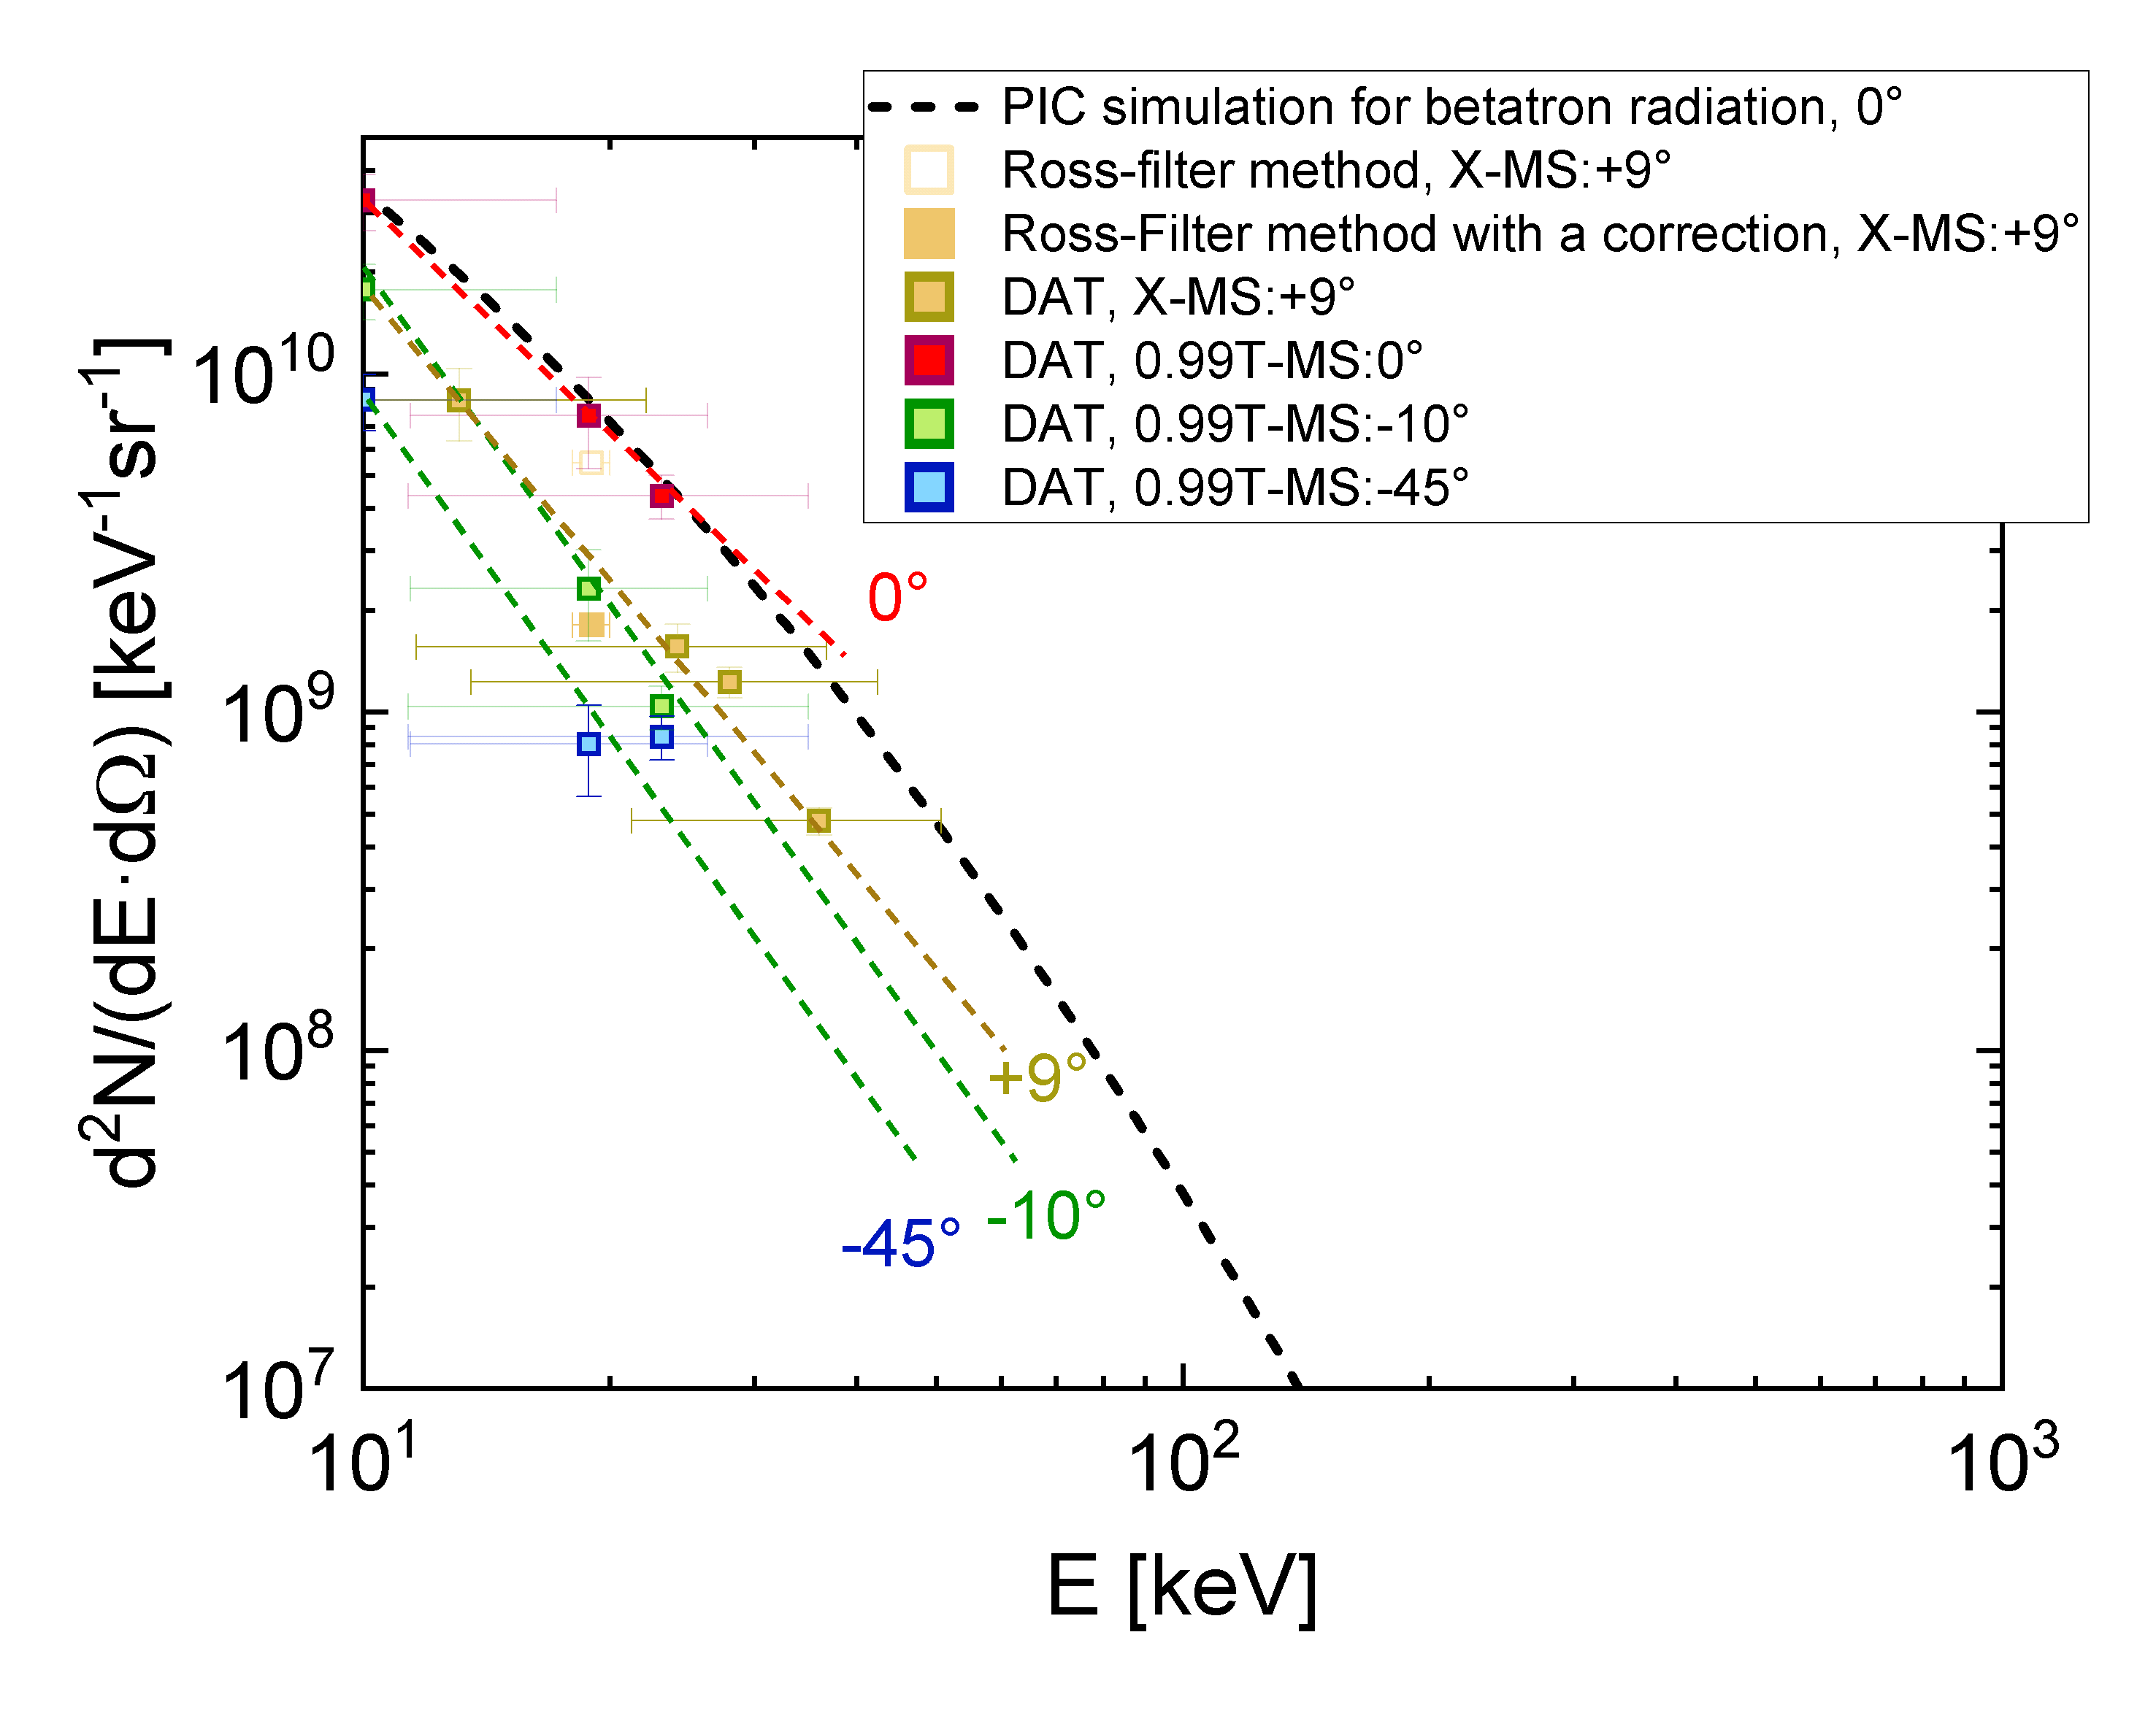
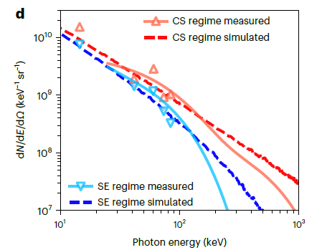
Betatron from CHO-foam at 0.7 ps, 10¹⁹ W/cm² vs. CNF at 20 fs, 10²¹ W/cm²
PHELIX at 10¹⁹ W/cm², 0.7 ps, w=15 um
E_{las} (after comp.) =60J, WFHM=20 J
CHO (TAC) 2 mg/cc 400 um thickness
CoReLS, Korea: Ti:Sa laser at 10²¹ W/cm²
E_{las}=20J, 20 fs, w=7 um
Carbon nano-foams 2 mg/cc, 80 um thickness
Nature Photonics 2022, Y. Shou, …W. Ma
More about DLA-based betatron measurements on PHELIX by Mikhail Gyrdymov, PP seminar, on November 7th, 2023
,
pre-ionized CHO
CNF
≥ photons/J 10-40 keV
simulations (X. Chen)

Slide 25
Nuclear Reactions for Investigation of MeV Bremsstrahlung
generated by DLA Electrons in high-Z Materials.
Record breaking conversion efficiency of 2% of directed BS in GDR
$θ_{1/2}$ = 18$°$

Slide 26
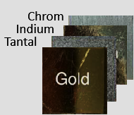
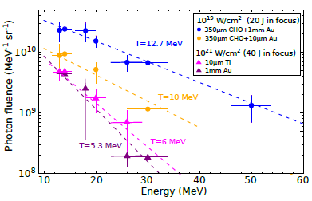
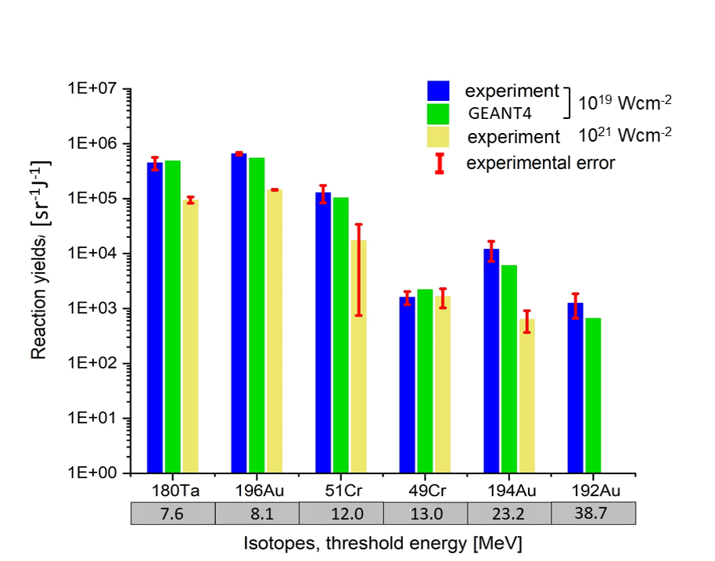
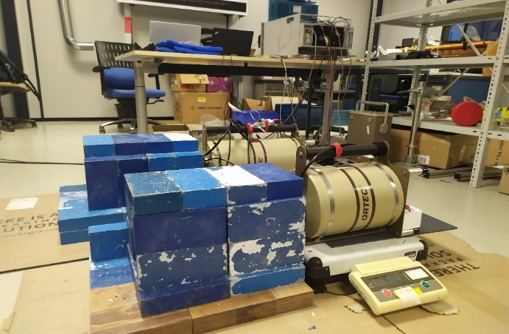
Record breaking efficiency of generation of MeV bremsstrahlung in the GDR-range
DLA-electrons propagate in high Z converter and generate BS with 10´s of MeV photon energy
foam
10¹²/sr photons with E > 8 MeV, T_{eff} = 13 MeV with divergence of 0.2 sr
Record conversion efficiency laser-BS of 2% (GDR) (Vulcan laser: 0.2%)
laser
Au-converter
(γ, xn) photo nuclear reactions
$θ_{1/2}$ = 18$°$
Au 192
experiment
Measured isotope yields (up to Au 192 (γ, 5n) at 50 MeV)
E _{gamma}=10-20 MeV
DLA at 10¹⁹ W/cm² vs 10²¹ W/cm²: 10 × higher photon number and twice higher T_{eff}.

Slide 27
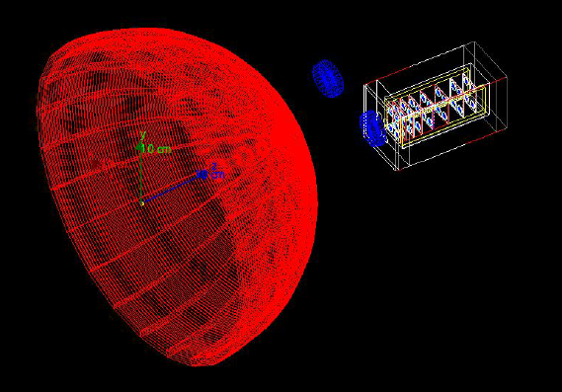
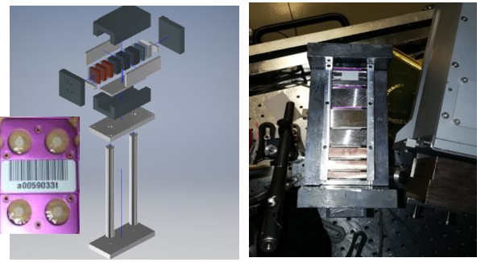
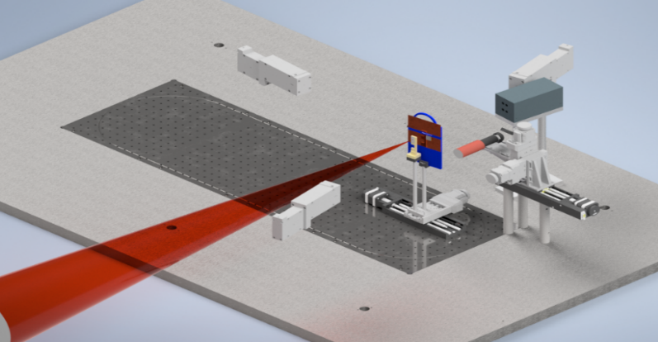
Wide-range diagnostic of 0.1 MeV-100 MeV $of BS$radiation
8-channel in vacuum TLD spectrometer at PHELIX
GEANT 4 simulation of the shot 30 (PHELIX 2022)
0.99T-MS
0.99T-MS
TLD Spectrometer
0.99T-MS

Slide 28
Reconstructed BS spectrum: 8-channel TLD spectrometer and nuclear diagnostics
10¹²/sr collimated gammas with 2% conv. efficiency of laser energy into BS > 8 MeV
$${}_{79}^{196}{Au}$$
$${}_{79}^{194}{Au}$$
$${}_{79}^{192}{Au}$$
T_{eff} = 16 MeV
Record breaking conversion efficiency compared to Vulcan, Nova (0.2% in GDR)

Slide 29
Gamma-driven Isotope production at 10¹⁹ W/cm²: up to Au190 ( γ,7n) with E_{peak} ~ 70 MeV
P. Tavana

Slide 30
Efficient laser energy coupling in electrons using foam + converter at 10¹⁹ W/cm²
PHELIX: 10¹⁹ W/cm² , 20 J (FWHM) 0.7 ps, focus=15 um
Crater in Ta-converter after PHELIX shot
Direct laser shot on Ta at high laser contrast
After 1000 um 2 mg/cc, LPI (2021)
before and after shot
1 mm
to laser
crater depth: 500 µm
directed part of DLA beam
Nuclear diagnostic:
No Ta-isotopes
Nuclear diagnostic:
up to 175 Ta (γ, 6n) at E_{γ} > 48 MeV

Slide 31
DLA platform for generation of ultra-bright sources
of MeV particles and radiation
M. M. Günther, O.N. Rosmej, P. Tavana, M. Gyrdymov, A, Skobliakov, A. Kantsyrev, S. Zähter, N.G. Borisenko, A. Pukhov, and N.E. Andreev.
Forward-looking insights in laser-generated ultra-intense gamma-ray and neutron sources
for nuclear applications and science, Nature Communications 13, 170 (2022)

Slide 32
ARC with Compound Parabolic Concentrator ( CPC)
versus PHELIX with foams at 10¹⁸ W/cm²
Au 1mm
15 mg/cc
5 mm

Slide 33
1 ps ARC beam performance
Note that the four ARC beams all have different levels of performance, and that these graphs are for the best performing beam, 353A (highest intensity, smallest focal spot). The variation can be large: on this shot the worst performing beam, 354A, had only 5% of energy at >1e18, vs. 22% for 353A.
.
total 260 J
50 J (22% > 10¹⁸ W/cm²)
ARC beam 353A
-200 µm
0
200 µm
Shaun Kerr, 01.09.2023

Slide 34
Can we produce relativistic electrons using sub-relativistic intensities?
ARC 10 ps, 600 J /beam
focal spot 50% = 120 µm
≥ 10¹⁸ W/cm² - 5 J (0.72 %)
≥ 10¹⁷ W/cm² - 300 J (47%)
10¹⁶ W/cm² - 10¹⁷ W/cm² ~ 200 J

Slide 35
Enhanced laser-target coupling at near-relativistic intensities using CPC at ARC
Compound Parabolic Concentrator (CPC) at the Advanced Radiographic Capability laser system:
large fraction of energy contained in the wings of the beam (80%) is repointed towards the central beam spot
HD and PIC simulations show that the increase in the coupling laser-to target is due to a combination of the longer scale length plasma and the enhanced acceleration mechanism driven by laser turbulence that develops from reflections from the cone walls.
Order of magnitude increase in laser-target coupling at 10¹⁸W/cm² using CPC (G.J. Williams et al)
Notes:
PRE2021, Williams:
In summary, we demonstrate that CPC cones can be used as robust target components to increase the conversion efficiency into MeV electrons by nearly an order of magnitude and electron temperature by >3× compared to flat targets. Hydrodynamic and PIC simulations reveal that the increases in conversion efficiency are primarily due to additional preformed plasma at the cone tip, whereas the temperature increase is due to a combination of the longer scale length plasma and the enhanced acceleration mechanism driven by laser turbulence that develops from reflections from the cone walls.

Slide 36
ARC-results on electron acceleration using CPC
6 MeV
Cone
Cone
Flat
The increased performance is primarily due to the presence of turbulent laser fields from light reflecting from the cone walls
as well as increased NCD plasma volume confined in the cone-> conditions for generation of super-ponderomotive electrons.

Slide 37
ARC- results on MeV bremsstrahlung production using CPC
Converter: 0.5-1 mm Au
CPC: low directionality
of gamma rays (FWHM115°)
1.6 x10¹⁸ W/cm², 10 ps

Slide 38
CPC-approach is not compatible with gas jet/gas tank
due to turbulent character of the laser field in the cone exit
SM-LWFA can be driven only at 10¹⁸ W/cm² ARC intensity only
N. Lemos, F. Albert
NIF
4 mm
NIF

Slide 39
Can a large focal spot ( ≥ 50 µm ) make DLA less effective?
ARC, PETAL
Large focal spot -> simulation for PETAL (1 kJ, 50 μm, 0.7 ps)
filaments only partially merge together: no joint channel for DLA;
instead, Cross-Filament Stochastic Acceleration
X.F. Shen, A. Pukhov et al, Cross-Filament Stochastic Acceleration of Electrons in Kilojoule
Picosecond Laser Interactions with Near-Critical-Density Plasmas Phys. Rev. Appied18, 064091 (2022)
PETAL-conditions
Longer laser pulse improves the situation
ARC: 1 ps, 250 J , 22% (50J) with ≥ 10¹⁸ W/cm²;
ARC: 10 ps, 600 J, 0.7% (only 4J) with ≥ 10¹⁸ W/cm²

Slide 40
Experimental setup P22-48 October 2023
Front view
PHELIX: 0.65 ps, 10¹⁹ W/cm²
Laser
TP
(+160°)
MS
(+138°)
Cylinder (3X3 mm)
MS
(-45°)
Neutrons
CHO 2 mg/cc
300-800 um
MS
(+15°)
MS
(-10°)
X-rays
Ross

Slide 41
Results with CHO-foam: no DLA at high ns contrast, but with ns -pulse
PHELIX, October 2023
Target: 0.5 mm CHO + Cu-foil + ns
Target: 0.8 mm CHO + Cu-foil + ns
E > 10 MeV
~ 23 MeV
0.16 sr
DLA-beam is mostly centered
best focus
M. Gyrdymov

Slide 42
TITAN experiments on DLA in expanding plasmas

Slide 43
Great international team of P22-48
GSI, Friedrich-Schiller University, Goethe-Universität Frankfurt, Czech Technical University, ENEA Frascati, Xi’an Jiaotong University, Chinese Academy of Sciences, Extreme Light Infrastructure (ELI NP)

