Slide 1
QUARZ and GEM-PIC-RZ
SEMINAR · DÜSSELDORF / ONLINE
Two cylindrical PIC codes for plasma accelerators:
1. Quasi-static wakes on non-uniform grids
2. The laser carrier resolved without a Courant limit
Alexander Pukhov
Institut für Theoretische Physik I, Heinrich-Heine-Universität Düsseldorf
QUARZ
GEM-PIC-RZ
with T. C. Wilson (QUARZ, JUWELS/JUPITER runs)
Notes:
Welcome, also to Konstantin Lotov's group online. In the next 40 minutes: two open-source codes from our group, both in cylindrical geometry with azimuthal modes and both built on non-uniform grids. QUARZ is a quasi-static code for beam- and laser-driven wakes, in the spirit of LCODE. GEM-PIC-RZ is an electromagnetic code that keeps the laser carrier but has no Courant limit. I will show the method, the benchmarks against established codes, the limits, and where I think each code is useful for your problems.

Slide 2

Terminator 2: Judgment Day (1991)
SkyNet Awakening
Notes:
The basic problem is the scale separation. The laser wavelength is a micron; the plasma wavelength is tens of microns for LWFA and up to a millimetre for AWAKE; the accelerator is millimetres to metres. A full electromagnetic PIC code must resolve the laser wavelength and obey the Courant condition, so the number of steps is the length divided by a fraction of a micron. Two different answers today: QUARZ drops the carrier altogether and is quasi-static; GEM-PIC-RZ keeps the carrier but removes the Courant limit. Both also use non-uniform grids.

Slide 3


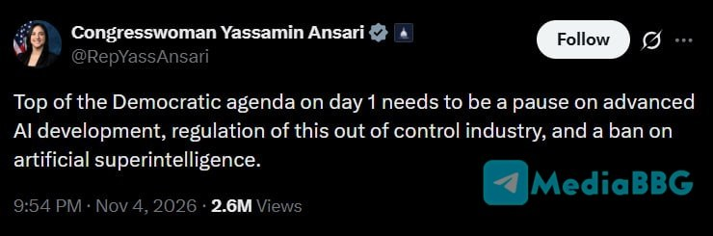

Slide 4
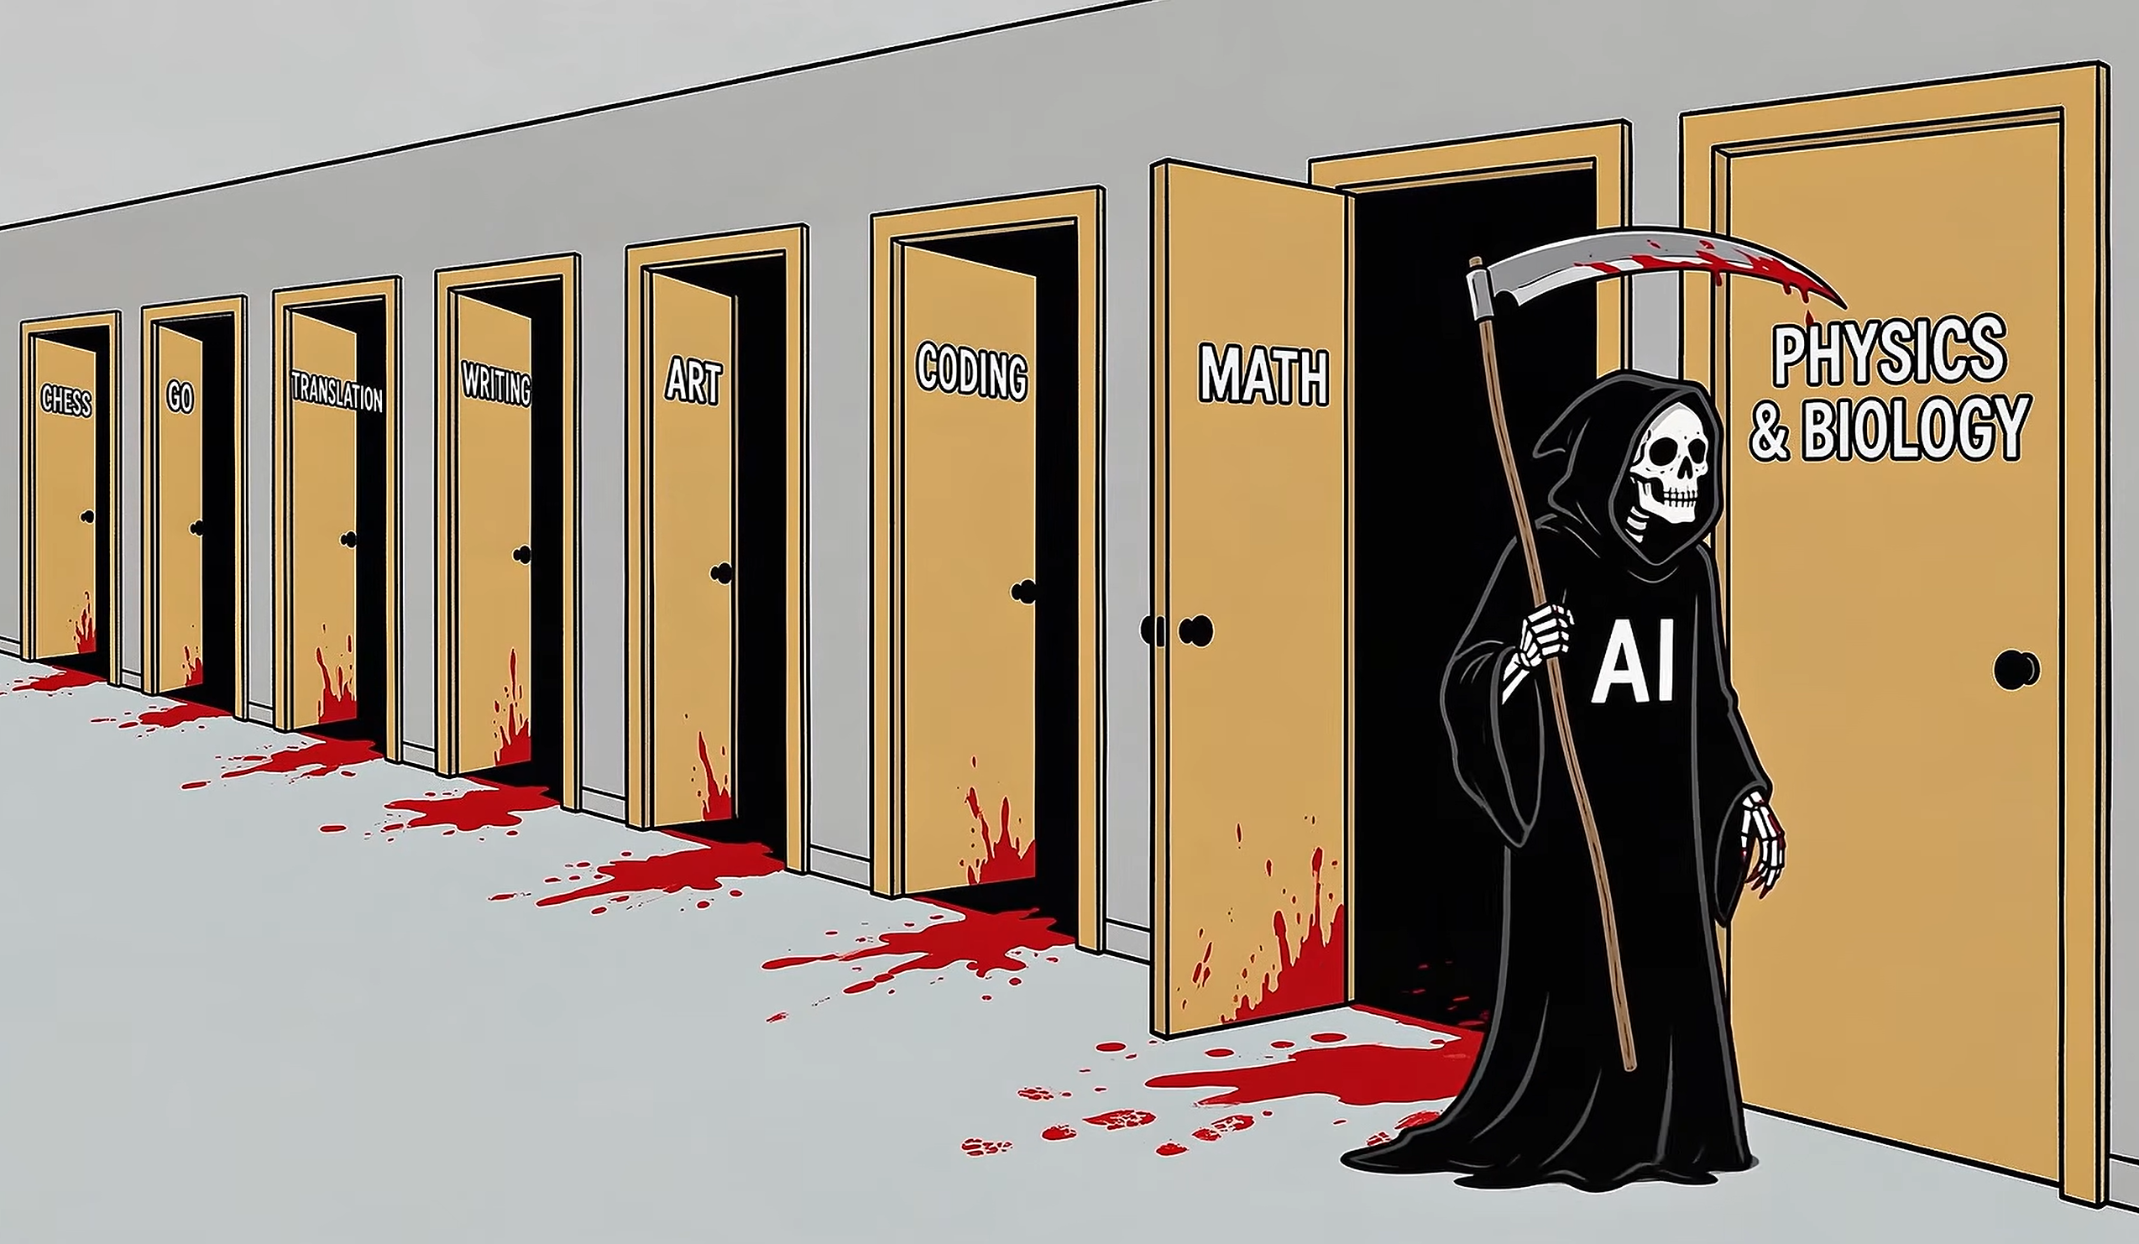
Math is cooked. Physics follow

Slide 5
Plasma accelerators: a multi-scale problem span over six orders of magnitude
MOTIVATION
~1 µm
10–1000 µm
mm – 10 m
Laser wavelength λ₀
Plasma wavelength λₚ
Acceleration length
Ionization in the instantaneous field, few-cycle pulses, redshift, harmonics, undulator radiation
Bubble, wake, witness at 10⁻² c/ωₚ radius pulling ions onto the axis
Depletion, dephasing, self-modulation of a proton bunch (AWAKE), FEL gain
Full PIC pays for λ₀ at every step: the Courant condition sets c·δt < δz ≈ λ₀/30, so a 1 cm stage costs ~4·10⁵ steps.
Both codes in this talk remove that cost in different ways, and both put resolution only where the physics needs it.
QUARZ & GEM-PIC-RZ · A. Pukhov
2
Notes:
The basic problem is the scale separation. The laser wavelength is a micron; the plasma wavelength is tens of microns for LWFA and up to a millimetre for AWAKE; the accelerator is millimetres to metres. A full electromagnetic PIC code must resolve the laser wavelength and obey the Courant condition, so the number of steps is the length divided by a fraction of a micron. Two different answers today: QUARZ drops the carrier altogether and is quasi-static; GEM-PIC-RZ keeps the carrier but removes the Courant limit. Both also use non-uniform grids.

Slide 6
A ladder of models, and where the two codes sit
MOTIVATION
model | what it resolves | step set by | codes
Full EM PIC | everything: carrier, backward waves, overdense targets | Courant, c·δt < δz | EPOCH, VLPL, WarpX, FBPIC (RZ)
Galilean EM PIC | forward carrier: diffraction, depletion, redshift, ADK in the real field | evolution of laser and plasma, Δ ≈ 100 c·δt | GEM-PIC (3D), GEM-PIC-RZ
Quasi-static | wake; laser as a ponderomotive envelope | betatron period, diffraction | LCODE, QuickPIC, QPAD, HiPACE++, Wake-T, QUARZ
Boosted frames cut the step count or the Cherenkov instability, but the Courant limit stays.
Quasi-static codes remove it by dropping all slow-time derivatives;
GEM-PIC drops them only where they sit next to a much larger ∂/∂ζ.
QUARZ & GEM-PIC-RZ · A. Pukhov
3
Notes:
Here is the ladder. At the top, full PIC: it can do everything, including solid targets and TNSA, but pays for it. At the bottom, quasi-static codes: LCODE, QuickPIC, HiPACE++ and others; QUARZ belongs here. The laser enters only as an envelope. In between there is a gap: you want the carrier, because ionization injection depends on the instantaneous field and few-cycle pulses deplete and redshift strongly, but you do not want the Courant limit. That gap is what GEM-PIC fills; GEM-PIC-RZ is its cylindrical version.

Slide 7
The two codes at a glance
OVERVIEW
QUARZ
GEM-PIC-RZ
Quasi-static PIC in (r, θ, ξ), modes m = 0 and 1
Any monotone radial grid, 2nd order, exact Gauss law
Beam drivers; laser envelope; ADK and impact ionization
C++17 / Kokkos: CPU, CUDA, HIP; MPI pipeline in ξ
Pukhov & Wilson, arXiv:2610.16910
Galilean electromagnetic PIC, any number of modes
Laser carrier resolved, no Courant limit on the step
Free-hand non-uniform grids in r, ζ and z
LWFA, ionization injection, undulators and FEL
C++17, OpenMP / CUDA, MPI;
A. Pukhov, arXiv:2610.31622
Both open source (BSD-3) on GitHub, with all input decks, benchmark data and test suites;
openPMD output on the native non-uniform nodes.
QUARZ & GEM-PIC-RZ · A. Pukhov
4
Notes:
Two codes, one philosophy. QUARZ: quasi-static, LCODE-like, on arbitrary radial grids, CPU and GPU through Kokkos. GEM-PIC-RZ: electromagnetic with the carrier, cylindrical modes, non-uniform grids in all three directions. Both are public, with the decks of every figure I will show. Both were also written in an unusual way, by an AI agent under my direction; I will come back to that at the end, because it matters for how much you should trust them.

Slide 8

QUARZ
PART 1
Quasistatic Arbitrary-resolution RZ:
a quasi-static PIC code whose radial grid can be any monotone set of nodes
Notes:
Part one, QUARZ. For Lotov's group: this is a code in the spirit of LCODE-2D, with plasma rings advanced in xi and a beam pushed with a large time step. What is new is mainly the field solver and the grid.

Slide 9

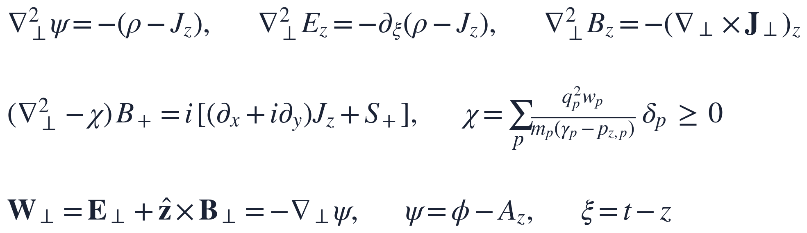
Quasi-static fields, with an explicit B⊥ solve
QUARZ · MODEL
The unknown $∂_{ξ}J_{⊥}$ is taken from the particle equations of motion (Baxevanis & Stupakov, PRAB 2018). Its part $∝B_{⊥}$moves into the operator: $χ≥0$, so the Helmholtz problem is negative definite and needs no iterations for m = 0.
QUARZ & GEM-PIC-RZ · A. Pukhov
6
Notes:
Standard quasi-static set in normalized units, xi = t − z. Psi, E_z and B_z are Poisson problems. The transverse magnetic field is the hard one, because it needs the xi-derivative of the transverse current, which is not known on the current slice. LCODE and QuickPIC iterate here; we follow Baxevanis and Stupakov, like HiPACE++'s explicit solver: express d J_perp / d xi through the equations of motion, move the part proportional to B into the operator. Chi is a sum of positive terms, so the operator stays negative definite, and one tridiagonal solve per slice gives B_perp. No predictor-corrector over the slice.

Slide 10
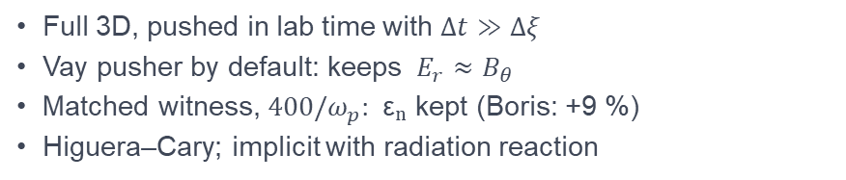
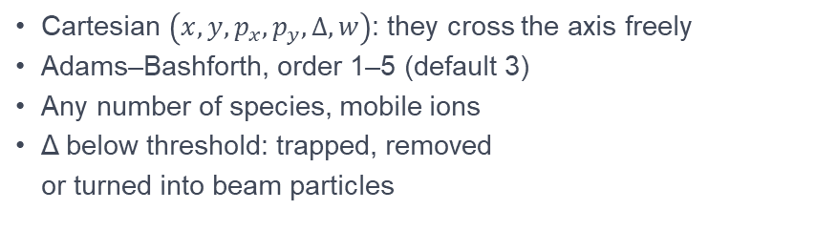
Plasma in ξ, beams in t
QUARZ · MODEL
Plasma macro-particles
Beam macro-particles
Cartesian $\left(x,y,p_{x},p_{y},Δ,w\right)$: they cross the axis freely
Adams–Bashforth, order 1–5 (default 3)
Any number of species, mobile ions
Δ below threshold: trapped, removed
or turned into beam particles
Full 3D, pushed in lab time with $Δt≫Δξ$
Vay pusher by default: keeps $E_{r}≈B_{θ}$
Matched witness, $400/ω_{p}$: εₙ kept (Boris: +9 %)
Higuera–Cary; implicit with radiation reaction
QUARZ & GEM-PIC-RZ · A. Pukhov
7
Notes:
Plasma particles carry Delta = gamma − p_z, which is conserved in a static potential, and are integrated in xi with Adams–Bashforth. They are Cartesian in the transverse plane, so the axis needs no special treatment. Beam particles are full 3D and pushed in lab time with a large step. The default is the Vay pusher: in a relativistic beam the self-fields nearly cancel, and Boris does not keep that cancellation. In our matched-witness test Boris gave a 9 percent spurious emittance growth over 400 inverse plasma frequencies; Vay keeps it exactly.

Slide 11
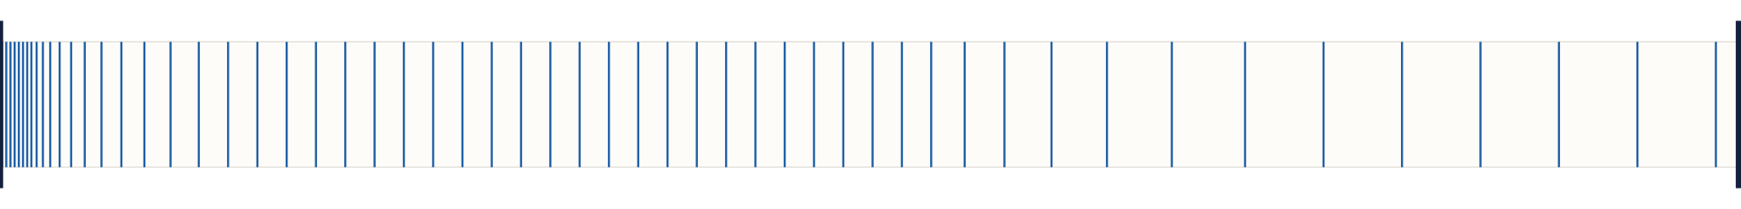
Multiscale in r: fine on the axis, coarse outside
QUARZ · GRID
r
axis: h₀ = 5·10⁻⁴ c/ωₚ
pinched witness, σᵣ = 0.01
0.01 c/ωₚ
bubble and sheath
0.05 c/ωₚ → conducting wall
neighbour ratio ≤ 1.05
512 cells
16 000 cells
stretched grid, same axis cell as …
… a uniform grid. Same fields, 30× less time.
QUARZ & GEM-PIC-RZ · A. Pukhov
8
Notes:
Why a non-uniform radial grid. A low-emittance witness can be focused to 10^-2 c/omega_p and pulls the ions onto the axis. The wake extends over several c/omega_p and the wall has to be farther still. A uniform grid resolves the smallest scale everywhere. In RZ there is a simple alternative to mesh refinement: one radial grid with smoothly varying spacing. The grid is built from regions with given spacings joined geometrically with a growth ratio of at most 5 to 10 percent per cell. The number of nodes grows only logarithmically with the ratio of largest to smallest cell. Headline: 512 stretched cells reproduce a 16000-cell uniform grid with the same axis cell, 30 times faster.

Slide 12
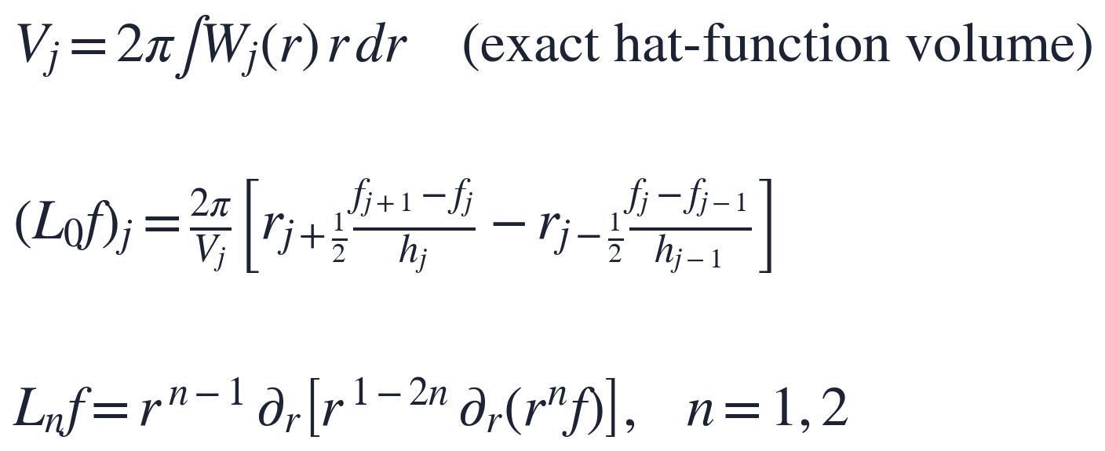
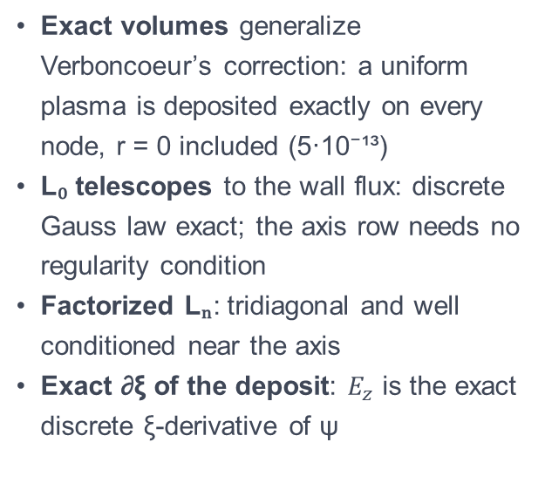
Discretization on arbitrary radial nodes
QUARZ · GRID
Exact volumes generalize Verboncoeur’s correction: a uniform plasma is deposited exactly on every node, r = 0 included (5·10⁻¹³)
L₀ telescopes to the wall flux: discrete Gauss law exact; the axis row needs no regularity condition
Factorized Lₙ: tridiagonal and well conditioned near the axis
Exact ∂ξ of the deposit: $E_{z}$ is the exact discrete ξ-derivative of ψ
Measured order vs manufactured solutions: 1.98–2.0 for L₀, L₁, L₂. Per slice: ~12 kernels and 5 tridiagonal solves (Thomas on CPU, Thomas/PCR partition on GPU).
QUARZ & GEM-PIC-RZ · A. Pukhov
9
Notes:
Three ingredients. First, the volume of a node is the exact integral of its hat function; with these volumes rings placed at the volume centroid of each sub-cell deposit a uniform density exactly, also on the axis. Mid-point loading gives about 10 percent density error on the axis. Second, the m = 0 Laplacian is a lumped-mass finite element that equals the conservative flux form; the sum telescopes, so Gauss's law is exact. Third, the operators for the vector components and m = 1 are written in factorized form, which keeps them tridiagonal and well behaved at the axis. And the source of E_z is not differenced between slices: each particle deposits the exact xi-derivative of its own deposit. Second order on smooth stretched grids; abrupt jumps in spacing drop locally to first order.

Slide 13
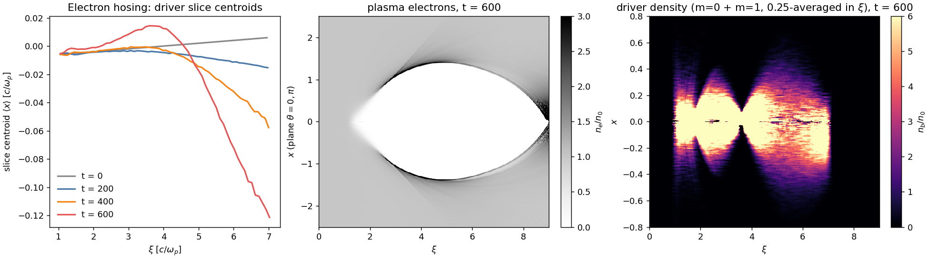
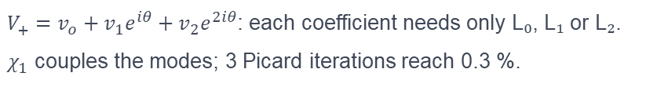
Mode m = 1: offsets, tilts and the onset of hosing
QUARZ · ASYMMETRY
$V_{+}=v_{o}+v_{1}e^{iθ}+v_{2}e^{2iθ}$: each coefficient needs only L₀, L₁ or L₂.
$χ_{1}$ couples the modes; 3 Picard iterations reach 0.3 %.
Tilted driver: the beam centroid is x_c = 0.002 (ξ − ξ₀),
so the head and tail sit on opposite sides of the axis;
flat-top electron beam, n_b = 5 n₀ (blowout), σ_r = 0.25, γ = 500.
QUARZ & GEM-PIC-RZ · A. Pukhov
10
Notes:
An optional m = 1 mode, as in QPAD. Scalars are f0 + 2 Re f1 e^{i theta}; for transverse vectors the complex combination V_plus has three coefficients, each with one of the operators from the previous slide. The only new difficulty is chi times B: the m = 1 part of chi couples neighbouring coefficients; we keep chi_0 in the operator and iterate the rest, three Picard iterations are enough. Plasma particles stay Cartesian; each ring is split into 8 azimuthal particles. To keep sampling noise from seeding a spurious m = 1, beams can be loaded with an n-fold rotational quiet start or deposited analytically. The figure is electron hosing of a driver. Truncation at m = 1 means small offsets: onset of hosing and misalignment, not nonlinear hosing or flat beams.

Slide 14
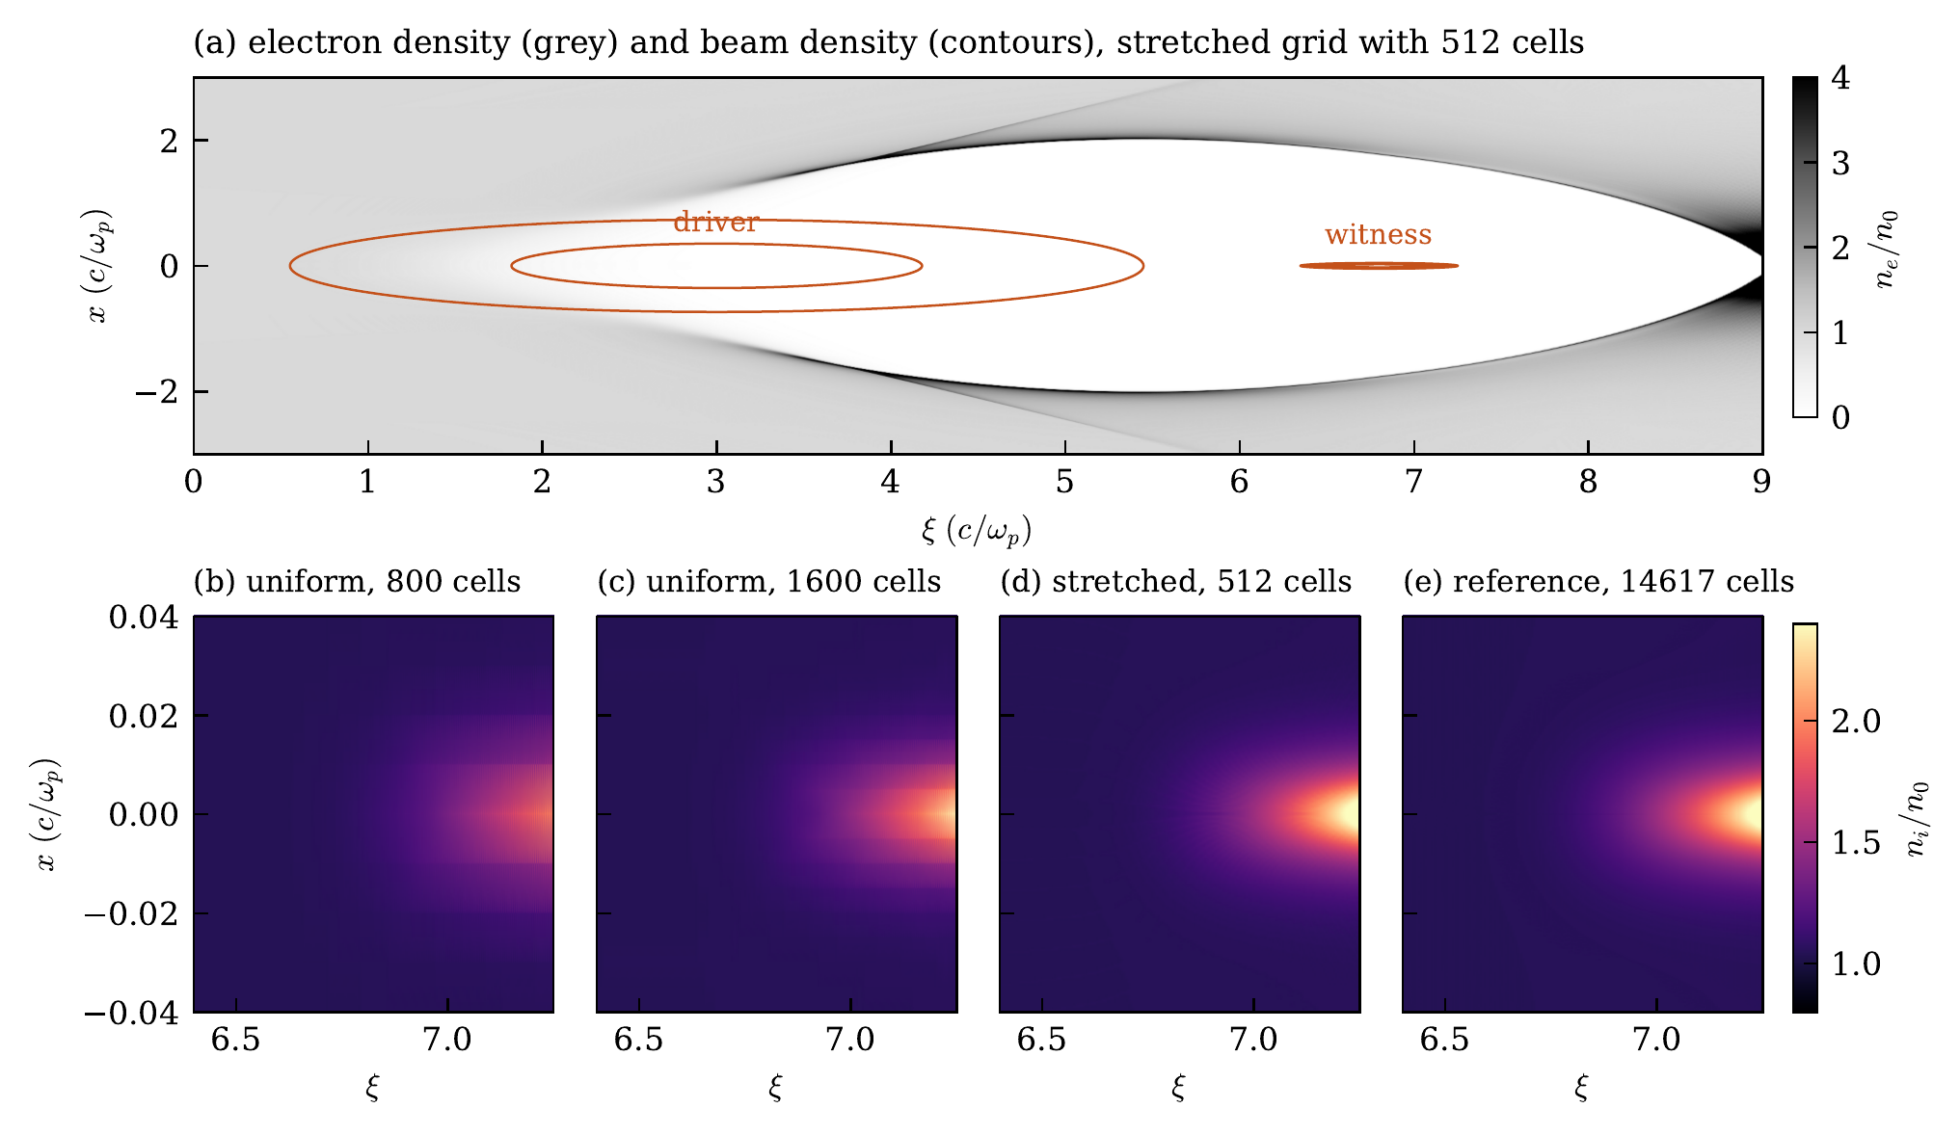
Pinched witness with mobile hydrogen ions
QUARZ · BENCHMARK
Driver n_b = 10, σᵣ = 0.3;
witness σᵣ = 0.01, εₙ = 0.01, γ = 2·10⁴.
Ions on the axis reach 2.3 n₀; focusing 0.88 instead of 0.5.
grid | cells | s/sweep | nᵢ(0) err.
uniform 0.01 | 800 | 2.0 | 20 %
uniform 0.005 | 1600 | 4.1 | 8.4 %
stretched | 512 | 1.4 | 0.10 %
uniform 5·10⁻⁴ | 16 000 | 36.6 | 0.094 %
QUARZ & GEM-PIC-RZ · A. Pukhov
11
Notes:
This is the case the grid is designed for. A blowout driver in hydrogen, conducting wall at R = 8, and a witness of radius 0.01 c/omega_p that pulls the ions in: the ion density on the axis rises to 2.3 n0 and the focusing gradient at the witness radius is 0.88 instead of 0.5. To separate grid errors from sampling noise both beams are deposited analytically and we compare one quasi-static solve. On uniform grids of 800 and 1600 cells the ion spike is smeared over the first cells and its peak is too low, 20 and 8 percent. The 512-cell stretched grid is indistinguishable from the reference, and so is a uniform grid with the same axis cell, which needs 16000 cells and 36 seconds per sweep instead of 1.4.

Slide 15
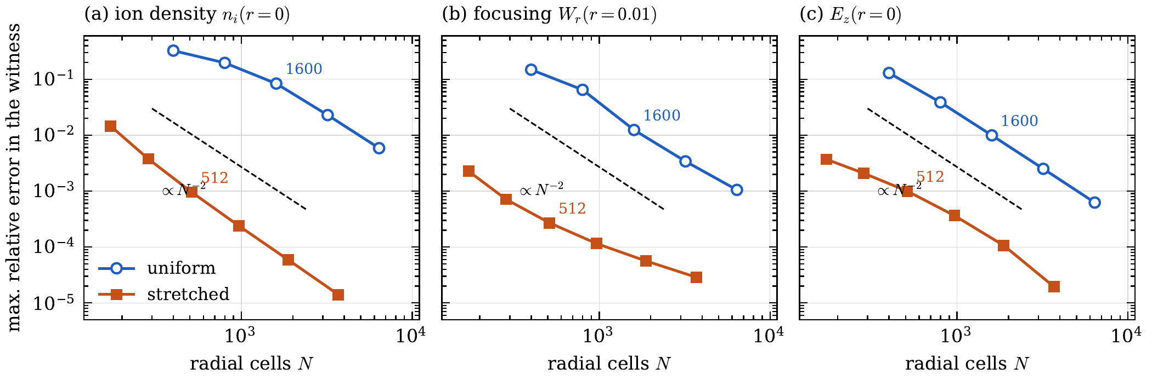
Stretched grids: same order, 10–100× smaller error
QUARZ · BENCHMARK
stretched: < 300 cells, 0.9 s, i.e. 20× fewer cells, 17× less time
For 10⁻³ in the focusing field: uniform 6400 cells, 15.2 s per sweep
QUARZ & GEM-PIC-RZ · A. Pukhov
12
Notes:
Grid study. Uniform family from 400 to 6400 cells, stretched family obtained by scaling all spacings of the 512-cell grid, from 172 to 3697 cells. Reference: the stretched family at 1/32, about 14600 cells, which agrees with a 32000-cell uniform grid to 2e-4. Both families converge at second order, as the analysis says, but the stretched curves lie one to two orders of magnitude lower. With randomly sampled beams instead of analytic ones, the error of the 512-cell grid is set by beam sampling noise, 0.3 percent in the focusing field: fine cells near the axis need enough beam particles there, or a quiet start.

Slide 16
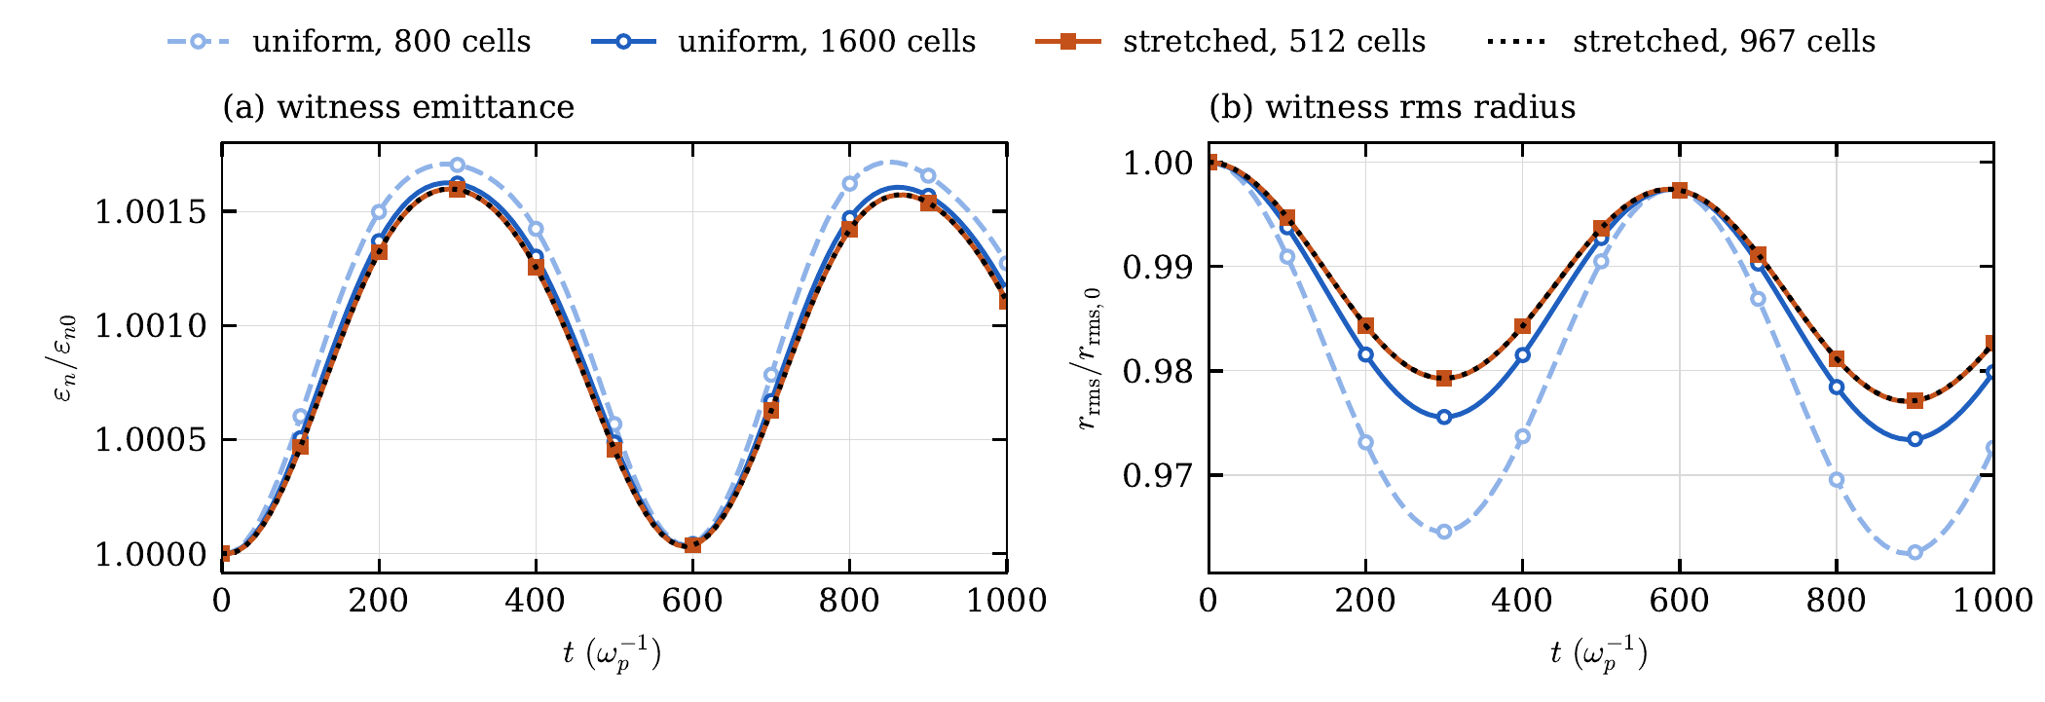
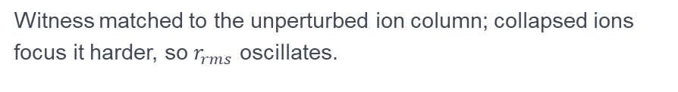
Field errors carry over into the beam dynamics
QUARZ · BENCHMARK
Witness matched to the unperturbed ion column; collapsed ions focus it harder, so $r_{rms}$ oscillates.
Uniform 800 / 1600 cells overestimate the amplitude by 64 % / 16 %. Stretched 512 cells: within 0.1 % of 967 cells.
QUARZ & GEM-PIC-RZ · A. Pukhov
13
Notes:
Does it matter for the beam? We follow the witness, 2e5 macro-particles, for 100 steps of 10 behind a rigid driver, with mobile ions. The witness was matched to the unperturbed column, so in the collapsed ions its radius oscillates. The uniform grids overestimate the oscillation by 64 and 16 percent; the 512-cell stretched grid agrees with one twice as fine to 0.1 percent, and is three times faster than the 1600-cell uniform grid. Energy gain: uniform grids 1.2 and 0.3 percent too low, stretched within 0.07 percent.

Slide 17
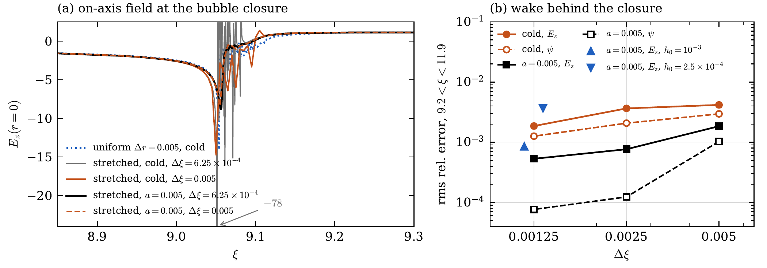
A fine axis exposes the bubble-back caustic
QUARZ · BUBBLE CLOSURE
Cold: peak −15 → −78 as Δξ → 6·10⁻⁴.
With a = 0.005: −8.3…−8.8 for all Δξ and axis cells;
wake behind converges to 0.05 %.
QUARZ & GEM-PIC-RZ · A. Pukhov
14
Notes:
This will be familiar to Konstantin: in a cold plasma with an exactly axisymmetric driver the returning sheath electrons all cross the axis in a short interval and form a caustic; Lotov described this fine structure in 2003. A uniform grid hides it by smoothing over one cell. Our 5e-4 axis cell removes the hidden smoothing, and the spike grows without bound as Delta xi shrinks: from −15 to −78. The wake behind it still converges, but slowly and irregularly. So we make the regularization an explicit physical length a, independent of the grid: all plasma sources are filtered with (1 − a² Laplacian)^-1, a K0 kernel per ring. It conserves charge, leaves a uniform plasma unchanged, and keeps E_z the exact xi-derivative of psi. With a = 0.005 the closure is resolved and the wake converges cleanly; the model changes at the 0.4 percent level behind the closure and 2e-4 in the witness. Cost 10–25 percent of the sweep. The same idea reappears in GEM-PIC-RZ.

Slide 18
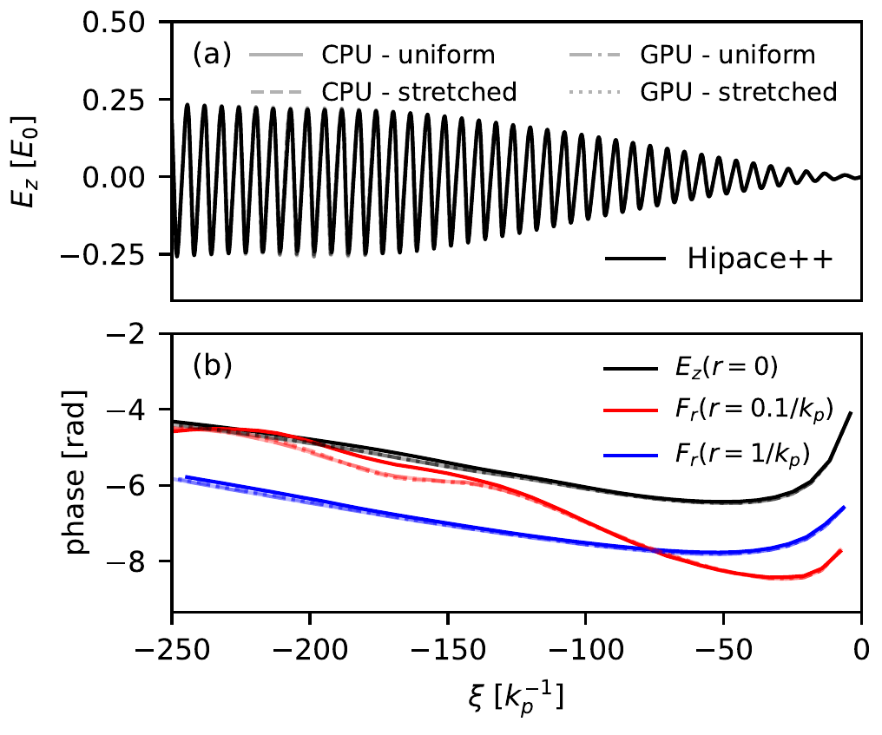
AWAKE Run 2 self-modulation vs HiPACE++
QUARZ · BENCHMARK AT EXPERIMENTAL SCALE
n₀ = 7·10¹⁴ cm⁻³, 3·10¹¹ p⁺ at 400 GeV, σ_z = 254 k_p⁻¹, sharp cut seeds SSM; +3.5 % density step
Box 1000 k_p⁻¹, 64 064 slices, 2·10⁷ beam particles, Δt = 200
Uniform 3840 cells or stretched 403 cells; CPU and GPU
E_z(0) grows to 0.23 E₀; phase of E_z(0) and F_r(1) agrees with HiPACE++ to ~0.1 rad over 40 wavelengths.
F_r(0.1) differs by up to 0.4 rad at the tearing bunch front; all four QUARZ runs agree with each other, so not a resolution effect: likely 3D, non-axisymmetric sampling noise.
QUARZ & GEM-PIC-RZ · A. Pukhov
15
Notes:
A benchmark at experimental scale: the first plasma cell of AWAKE Run 2, following the code comparison of John Farmer and colleagues. The bunch is cut one sigma ahead of its centre; the sharp front seeds the self-modulation. Box of 1000 k_p^-1 with 64 thousand slices. Thomas Wilson ran HiPACE++ with the same transverse cell. The on-axis field and the phases of E_z and of the transverse force at one k_p^-1 agree to about 0.1 rad over 40 wavelengths. Close to the axis the force phase differs by up to 0.4 rad in a window behind the head, where the front of the bunch is torn apart by the nonlinear near-axis focusing. Our four runs, uniform and stretched, CPU and GPU, agree with each other, so we think this is the 3D description of the near-axis protons, whose noise is not axisymmetric. An open question; it may also relate to the clustering issue on the next slides.

Slide 19
Pipelined in ξ, on CPUs and GPUs
QUARZ · PERFORMANCE
s per sweep · cores / GPUs | 1 / 1 | 6 / 2 | 12 / 4 | 24 / 8 | 48 / 16
CPU cores, 1 MPI rank each (JUWELS) | 1519 | 246 | 125 | 64 | 35
GPUs, GH200 (JUPITER) | 25 | 13 | 6.5 | 3.4 | 1.8
60×
ideal
5–11 min
one GH200 vs one CPU core; 1.4× a full 48-core node
GPU scaling to 16 devices;
90 % on a CPU node
12 m of AWAKE on 16 GPUs
(stretched / uniform)
Each rank holds a block of slices and passes one message per step downstream; speed-up PN/(N+P−1). MPI = serial bit for bit unless particles cross ranks (then 10⁻¹⁰).
QUARZ & GEM-PIC-RZ · A. Pukhov
16
Notes:
Parallelization is pipelining along xi, as in QuickPIC and HiPACE++: the box is split into blocks of slices; rank r can sweep step n only after rank r−1 has done it, but r−1 starts step n+1 meanwhile. One message per step: the plasma particles leaving the block with their Adams–Bashforth history, B_plus of the last slice, the beam source, and slipping beam particles. Kokkos gives one source for OpenMP, CUDA, HIP. Numbers from Thomas Wilson on JUWELS and JUPITER: one GH200 does a sweep in 25 s, 60 times a single core; ideal GPU scaling to 16 devices. The whole 12 m AWAKE run takes 5 to 11 minutes on 16 GPUs. With many CPU ranks the pipeline fill limits efficiency for a few hundred steps.

Slide 20
Beyond the beam-driven wake
QUARZ · PHYSICS MODULES
Laser envelope
Ionization
Trapping → beam
Complex Crank–Nicolson per slice on the same grid. a₀ = 4 LWFA: 100 MeV → 0.94 GeV over 10.6 mm in 77 s on 2 cores.
ADK field ionization and impact ionization by beams (AWAKE), Monte Carlo per slice, NIST level tables.
Electrons at the quasi-static limit become beam particles: Trojan-horse injection, H = γ − p_z − ψ kept exactly.
Spin and radiation
Coulomb scattering
Practical
Thomas–BMT spin precession; Landau–Lifshitz radiation reaction in the implicit pusher.
Multiple scattering of beams on the plasma, on by default with a physical density.
Two-stage runs (stiff driver, soft witness), adaptive Δt and sub-slicing, restart, openPMD, parsed profiles.
QUARZ & GEM-PIC-RZ · A. Pukhov
17
Notes:
Beyond the paper, QUARZ has a set of physics modules, each validated against an independent reference. A laser envelope solver on the same non-uniform grid, for LWFA; the example accelerates a witness to almost 1 GeV in about a minute on a laptop-class machine. Field and impact ionization. Trapped plasma electrons can be converted into beam particles and followed: Trojan-horse injection is a test, and the Hamiltonian invariant is kept exactly. Spin precession, radiation reaction, multiple Coulomb scattering. And practical things: a two-stage mode where a stiff proton driver and a soft witness far behind are pushed with different steps.

Slide 21

GEM-PIC-RZ
PART 2
Galilean electromagnetic PIC in azimuthal modes:
the laser carrier is resolved, the step is not tied to the cell
Notes:
Part two. GEM-PIC-RZ is the cylindrical version of the Galilean electromagnetic PIC scheme we published in 3D. The question it answers: how to keep the laser carrier, so that ionization, depletion, redshift and radiation are correct, without the Courant condition.

Slide 22

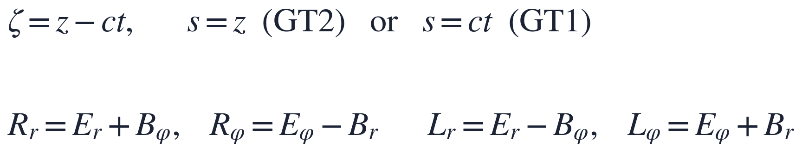
Split the field into forward and backward parts
GEM-PIC-RZ · IDEA
Forward field R: keep ∂ₛ
L, E_{z}, B_{z}: drop ∂ₛ next to ∂ζ
The laser: fast in ζ (λ₀), slow in s (Rayleigh and depletion lengths). It propagates, diffracts, depletes and redshifts self-consistently.
They vary on the ζ-scales of their sources, which move with v ≈ c. Not a quasi-static approximation of the laser.
3D scheme: A. Pukhov, N. Elkina, T. Wilson, J. Comput. Phys. 567, 115331 (2026); reproduced a 31.8 cm ionization-injection LWFA run with FBPIC.
QUARZ & GEM-PIC-RZ · A. Pukhov
20
Notes:
The idea of GEM-PIC. Go to Galilean coordinates zeta = z − ct and a slow coordinate s, either the lab position (GT2) or time (GT1). Combine the transverse fields into characteristics: R is the forward wave, L the backward one. A wave travelling forward at c has L = 0 and depends only on zeta. For R we keep the slow derivative: that is the laser, which changes on the Rayleigh length and the depletion length. For L and the longitudinal fields we drop the s-derivative only where it appears next to the zeta-derivative, which is much larger because their sources move with nearly c. So this is not quasi-static: the carrier is there. But the field update is semi-implicit, and there is no Courant condition. In 3D we showed this reproduces a 32 cm FBPIC run with ionization injection.

Slide 23
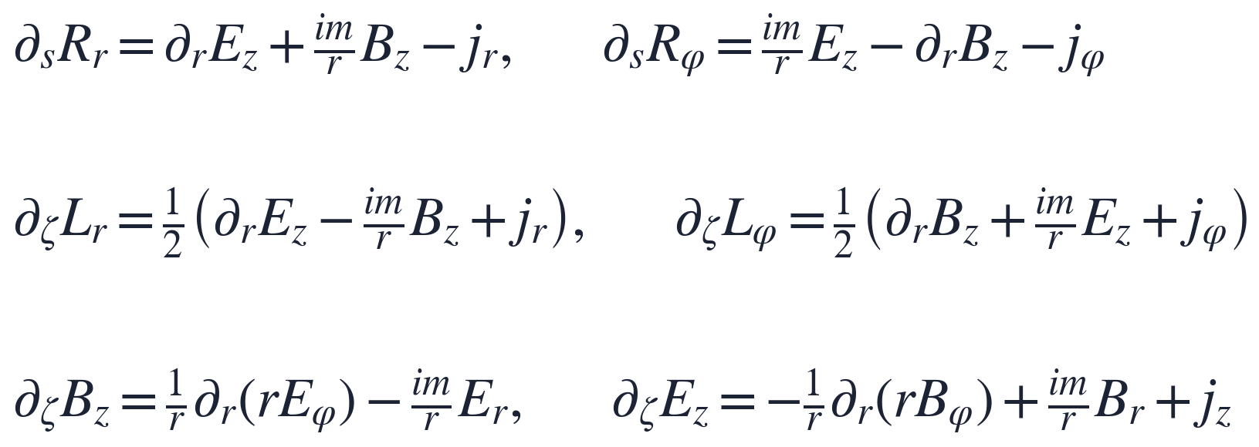
The reduced system in azimuthal mode m
GEM-PIC-RZ · MODEL
Integrated from the front of the window (L = E_{z} = B_{z} = 0) to the rear. Laser in m = 1, wake in m = 0. Vacuum: ω ≈ k⊥²/2κ, the paraxial limit of √(κ² + k⊥²) − κ; no backward wave.
QUARZ & GEM-PIC-RZ · A. Pukhov
21
Notes:
In azimuthal modes, the system is: two evolution equations in s for the forward components, driven by the longitudinal fields and the currents; and four equations in zeta for L, B_z and E_z, which are integrated from the front of the window, where everything is zero, towards the rear. They are term by term the cylindrical form of the universal 3D system. A linearly polarized laser lives in m = 1, the wake in m = 0. In vacuum the dispersion is the paraxial one; the backward branch is not described, which is the main physical limitation: no Raman backscatter, no reflection from overdense plasma.

Slide 24
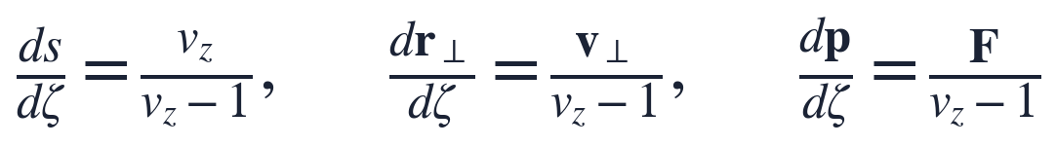
Two particle lists, exchanged without loss
GEM-PIC-RZ · PARTICLES
Streaming (in ζ)
Beam (in s)
Plasma electrons, ions, freed electrons
Fresh layer at the front each step, quiet start
Two-pass Boris over dt = hₙ/(1 − v_{z})
Bunches and trapped electrons
Vay pusher, sub-steps ≤ Δz_{max}
Self-consistent co-moving initial field
Trapped (reaches the next plane inside the window) and v_{z} ≥ 0.9 → beam; beam slower than 0.8 → streaming. No particle is deleted.
QUARZ & GEM-PIC-RZ · A. Pukhov
22
Notes:
Particles follow the characteristics of the Vlasov equation in GT2. A plasma particle at rest keeps its z and crosses the whole window within one level, exactly as in the lab. Those are the streaming particles: a fresh layer is loaded at the front each step and pushed slice by slice with zeta as the independent variable. A particle that reaches the next plane while still inside the window is trapped; once it is fast, the push in zeta becomes stiff, so it moves to the beam list and is pushed in s with the Vay pusher, like the bunches. Slow beam particles go back. Nothing is deleted, so the charge is conserved, and unlike a quasi-static code, injection is followed self-consistently.

Slide 25
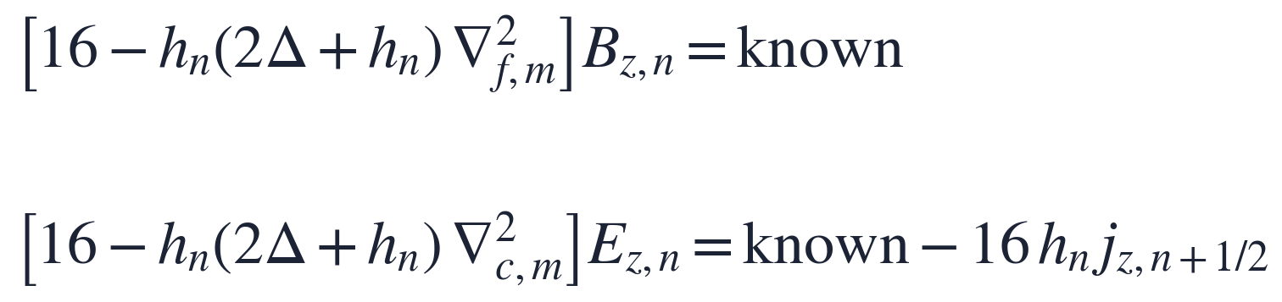
One step = a march in ζ, two solves per slice
GEM-PIC-RZ · DISCRETIZATION
R: trapezoidal in s; L, E_{z}, B_{z}: trapezoidal over the half-cell
Exact discrete curl·grad = 0 on any grid
decouples E_{z} and B_{z}
Staggered finite volumes
Predictor–corrector
Free-hand grids
Faces carry R_{r}, L_{r}, B_{z}; centres R_{φ}, L_{φ}, E_{z}. Gauss law exact; uniform plasma deposited exactly on stretched grids.
Predict slice n from the old level, push and deposit, solve; repeat (2 passes). Matrices factorized once per hₙ and Δ.
Step tables in r, ζ and z. Fine only at driver and witness: ¼ of the slices, 10⁻³ accuracy, 3.6× faster.
QUARZ & GEM-PIC-RZ · A. Pukhov
23
Notes:
How a step works. Fields on slices, currents on the half-cells between them. We march from the front slice to the rear. R is advanced with the trapezoidal rule in s, the other components with the trapezoidal rule in zeta. R and L are linear in the unknown E_z and B_z of the slice; inserting them, the exact discrete identities curl grad = 0 in both staggerings remove E_z from the B_z equation and vice versa. What remains are two independent tridiagonal systems per mode. Since the currents of the half-cell depend on the fields being computed, a predictor-corrector with two passes. The radial operators are staggered finite volumes on any grid, and the same step-table mechanism gives non-uniform grids in r, zeta and z: for a driver–witness pair, fine slices only at the two bunches reproduce the fine uniform grid to 1e-3 with a quarter of the slices.

Slide 26
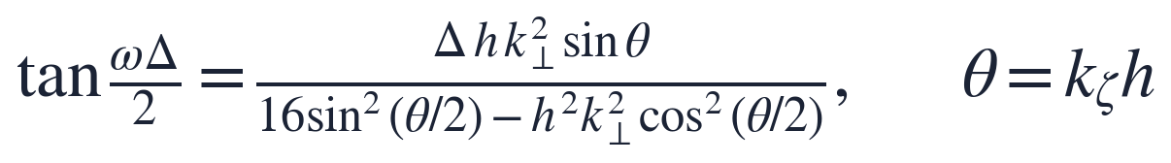
No Courant condition, shown not assumed
GEM-PIC-RZ · STABILITY
ω real
Δ.h ≤ 4/ωₚ²
100×
for all k_{ζ}, k⊥, Δ, h in vacuum: no growing modes, Δ independent of the cells
practical limit in plasma; ωₚ² = 10⁻³,
h = 0.25 allows Δ ~ 10⁴ k₀⁻¹
the FBPIC time step in the LWFA benchmarks (Δ = 2.5 µm)
The step is set by accuracy: diffraction, plasma and betatron evolution, or the undulator period.
QUARZ & GEM-PIC-RZ · A. Pukhov
24
Notes:
Because the step is meant to be orders of magnitude larger than the cell, stability has to be shown. For a vacuum Fourier mode on a uniform zeta grid the scheme gives this relation; omega is real for all wavenumbers, steps and cells, so there are no growing modes and no Courant condition. In plasma the phase passes pi/2 when the denominator changes sign, which gives the practical limit Delta h ≤ 4/omega_p². In typical LWFA parameters that is a step of ten thousand inverse laser wavenumbers. In practice the step is set by accuracy: in the benchmarks I will show, 100 FBPIC time steps.

Slide 27
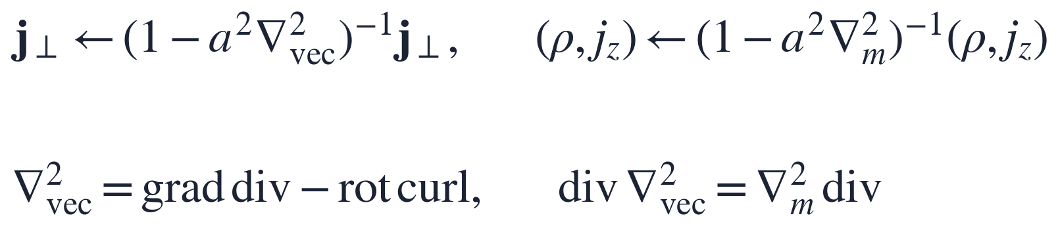
Two spurious modes, removed at the source
GEM-PIC-RZ · NUMERICAL MODES
Numerical Cherenkov
Bubble-closure resonance
At the ζ-Nyquist wavenumber ω = 0 for every k⊥: an odd–even mode stationary in the window, driven resonantly by the shot noise of a relativistic bunch.
The reduced system has a resonance at κ = ωₚ/2; the singular closure density moves it to resolved scales, and period-two modes appear.
Fix: QUARZ-type source smoothing, now built from the staggered operators so it commutes with the divergence:
Fix: (1,2,1)/4 filter on the beam current only. 1 pC, γ = 1000, 1000 steps: Nyquist energy 8.6·10⁻² → 1.3·10⁻⁴.
QUARZ & GEM-PIC-RZ · A. Pukhov
25
Notes:
The dispersion relation also shows two defects, both found when tests failed. First: at the zeta-Nyquist wavenumber, theta = pi, omega is zero for every transverse wavenumber. This odd-even mode is stationary in the window, just like a relativistic bunch, so the macro-particle noise of the bunch drives it resonantly: a numerical Cherenkov radiation behind the bunch, which a smaller step does not cure. A 1-2-1 filter on the beam current only, whose response vanishes at theta = pi, removes the source; the wake is unchanged. Second: the reduced equations have a resonance at kappa = omega_p/2, the remnant of the backward branch. In a uniform plasma it lies at long wavelengths, but at the bubble closure the density is singular and moves it to resolved scales. As in QUARZ we remove the singularity: radial smoothing of the plasma sources. Here the vector filter is built from the discrete grad, div and curl, so it commutes with the divergence and charge conservation is kept. Cost below 1 percent.

Slide 28
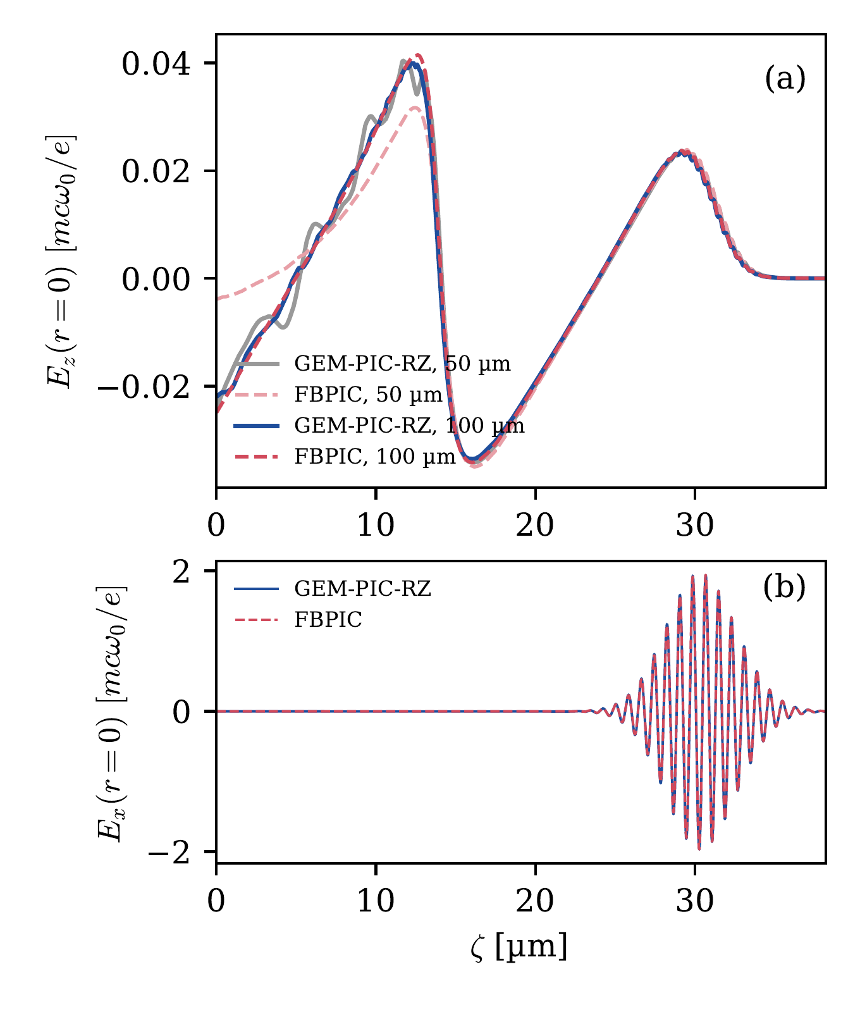
The wake in the bubble regime
GEM-PIC-RZ VS FBPIC · 1
100-TW class: λ₀ = 0.8 µm, a₀ = 2, w₀ = 8 µm, 10.6 fs, 3.5·10¹⁸ cm⁻³;
FBPIC with 2 modes, δz = λ₀/32.
GEM-PIC-RZ: 100 radial cells (0.3 → 3 k₀⁻¹), h = 0.25 k₀⁻¹,
Δ = 2.5 µm = 100 FBPIC steps.
after 100 µm | GEM | FBPIC
min E_{z} | −0.0335 | −0.0342
laser peak field | 1.969 | 1.954
first period, rms dev. | 1.9 % | —
CPU time, 1 core | 1.7 min | ~1.5 h
QUARZ & GEM-PIC-RZ · A. Pukhov
26
Notes:
Now the comparison with full PIC, FBPIC, for the standard problems. First the bubble wake of a typical 100-terawatt laser. GEM-PIC-RZ uses a step of 2.5 microns, 100 FBPIC time steps. After 100 microns the first wake period agrees to 1.9 percent rms, the minimum of E_z and the laser peak field to about one percent, and the laser carrier itself lies on top of FBPIC. At 50 microns, in the up-ramp, the curves differ by representation: our level is one plane z = s, while an FBPIC snapshot is one time, at which the wake sits at smaller z and lower density. 1.7 minutes against 1.5 hours on one core.

Slide 29
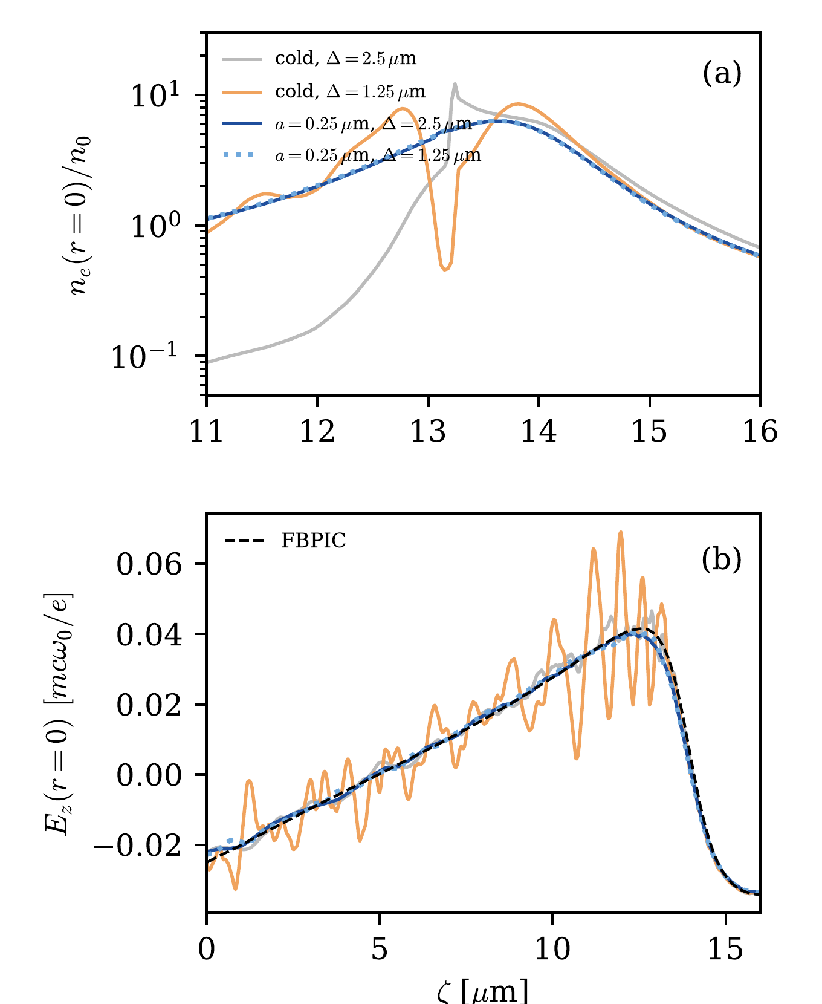
Bubble closure: converge the wake behind it
GEM-PIC-RZ VS FBPIC · 2
Cold plasma: the closure density is a spike whose shape depends on Δ; λ₀-scale oscillations behind it do not converge (rms vs FBPIC 1.8 → 9.8·10⁻³ when Δ is halved). At Δ = 5 µm the density alternates 70 ↔ 10⁴ n₀ between steps.
a = 2 k₀⁻¹ = 0.25 µm (≈ axis cell, 0.09 c/ωₚ): 0.7·10⁻³ for both steps;
closure stays at 5–40 n₀.
Price: E_z at the bubble back 0.047 → 0.040 (FBPIC 0.042).
QUARZ & GEM-PIC-RZ · A. Pukhov
27
Notes:
Zoom into the back of the bubble, where injection happens and where a witness would sit. In the cold plasma the fine axis cells expose the caustic, the singular density moves the resonance to resolved scales, and the wake behind carries laser-scale oscillations that do not converge with the step; at a coarse step the closure density jumps between 70 and ten thousand n0 from step to step, the signature of period-two modes. Smoothing with a quarter micron, about the axis cell, gives a finite peak, removes the oscillations and the two steps agree. The criterion is that the fields behind the spike converge, not the height of the spike. The price is a model change of order a at the bubble back: 0.040 instead of 0.042 in FBPIC.

Slide 30
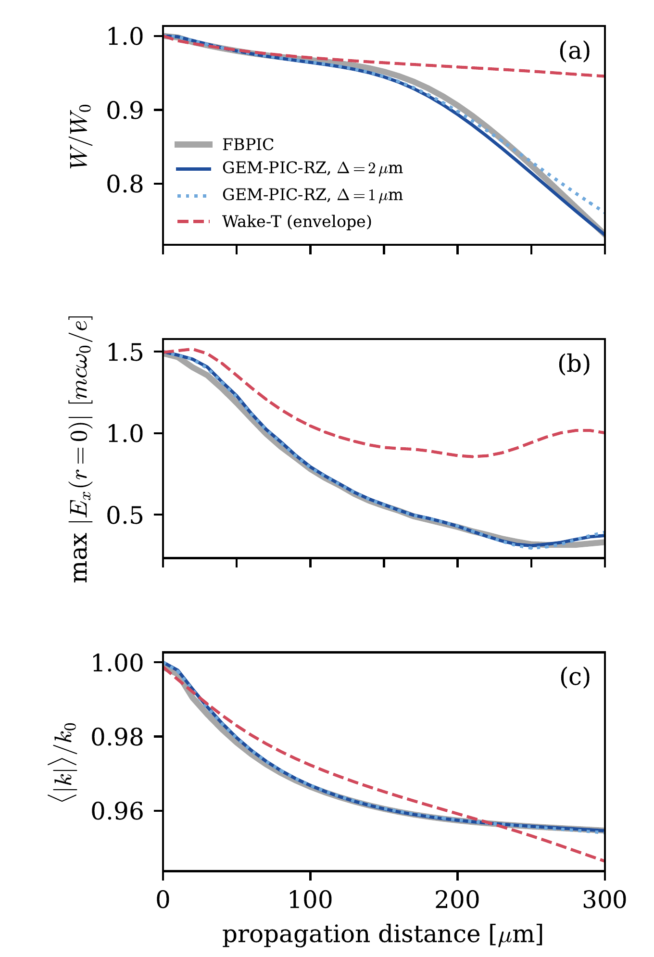
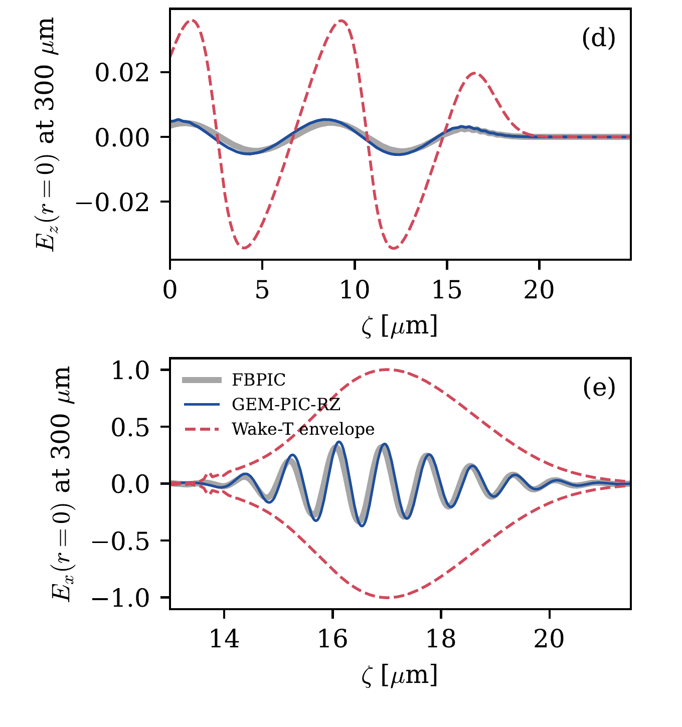
Few-cycle pulse: depletion and redshift
GEM-PIC-RZ VS FBPIC VS WAKE-T · 3
a₀ = 1.5, 6.8 fs (2.5 cycles), w₀ = 3.6 µm, 0.01 n_c (1.7·10¹⁹ cm⁻³), 300 µm = 6 z_R
Energy to 0.013 W₀, redshift to 0.002 k₀; carrier phase 0.4 rad after 12 rad of plasma slip
6.7 min on 1 core vs 3.7 h on 2 cores
QUARZ & GEM-PIC-RZ · A. Pukhov
28
Notes:
This is the case GEM-PIC was designed for, and the one most relevant for kHz, few-cycle lasers. A 2.5-cycle pulse at a0 = 1.5 in a dense plasma, followed for six Rayleigh lengths. It diffracts, loses a quarter of its energy to the wake and is redshifted by 4.5 percent. GEM-PIC-RZ, grey and blue, agrees with FBPIC over the whole distance in energy, peak field and spectral centroid, and the carrier itself: after 12 radians of plasma phase slip our on-axis field is shifted by 0.4 radians, lambda over 16. Halving the step changes the energy by less than 3 percent of W0. Red is the envelope code Wake-T.

Slide 31
For a 2.5-cycle pulse the envelope model underestimates depletion fivefold
WHY THE CARRIER MATTERS
27 %
5.5 %
4.5 %
energy lost to the wake in FBPIC and GEM-PIC-RZ over 300 µm
in the envelope code Wake-T: the pulse stays focused and drives a far stronger wake
redshift of the spectral centroid, followed to 0.002 k₀
QUARZ & GEM-PIC-RZ · A. Pukhov
29
Notes:
The take-home of that comparison. For a few-cycle pulse in a dense plasma the slowly-varying-envelope assumption breaks: in Wake-T the pulse loses only 5.5 percent of its energy instead of 27, stays focused and drives a much stronger wake, and refining the resolution does not change that. GEM-PIC-RZ follows the full-PIC result at about 2 percent of the CPU cost. This is the regime of kHz lasers and of secondary sources driven by few-cycle pulses.

Slide 32
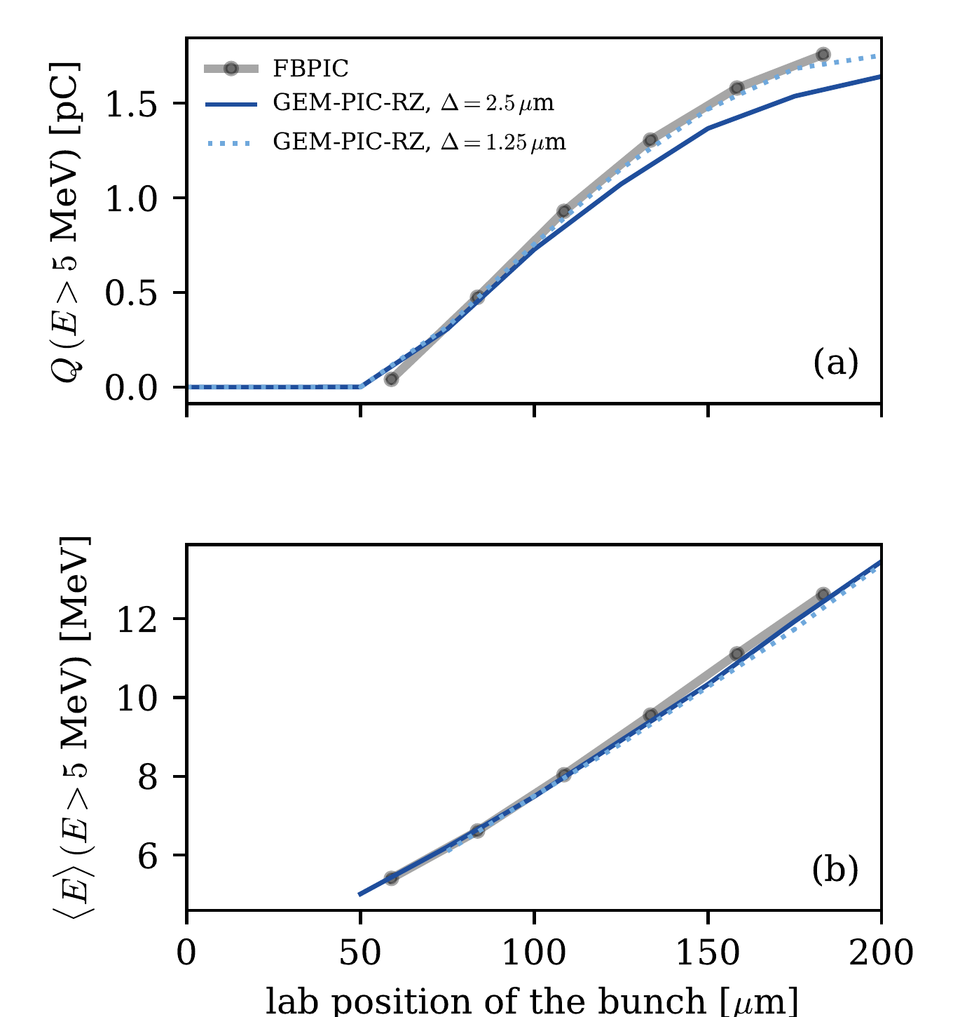
Ionization injection from a nitrogen dopant
GEM-PIC-RZ VS FBPIC · 4
a₀ = 2.3, 0.002 n_{c}, 1 % N⁵⁺ → N⁶⁺, N⁷⁺ by ADK in the instantaneous field (envelope codes need averaged rates).
z = 183 µm | GEM | FBPIC
Q (> 5 MeV) | 1.58 pC | 1.76 pC
mean energy | 12.4 MeV | 12.6 MeV
rms spread | 5.2 MeV | 5.4 MeV
N⁶⁺ / N⁷⁺ behind laser | 3.1 / 0.3 % | same
Energy and spectrum robust; charge carries ±15 % from the smoothing length.
8.5 min (1 core) vs 3.4 h (2 cores).
QUARZ & GEM-PIC-RZ · A. Pukhov
30
Notes:
Ionization injection, the most common way to load a laser wake. The inner-shell electrons of nitrogen are released near the peak of the laser field, inside the bubble, and trapped. This depends on the instantaneous carrier field, which we resolve. Both codes ionize to the same fractions; the injected bunch agrees in charge, energy, spread and spectrum. Below 4 MeV FBPIC holds more electrons: untrapped sheath electrons that we stream through the window. The charge depends on the smoothing length, because trapping is decided at the closure, where the smoothing acts: read it with a 15 percent model uncertainty. Energy and spectrum do not depend on it.

Slide 33
Sharp down-ramp injection is not yet reproduced
GEM-PIC-RZ · OPEN PROBLEM
a₀ = 1.8; plateau 2n₀ drops to n₀ over 10 µm; bubble back moves through the window at ~0.5 c.
Hypothesis: the GT2 frame
trapped charge > 2 MeV | 150 µm
FBPIC | 51.0 pC
Δ = 2.5 µm | 9.9 pC
Δ = 1.25 µm | 20.9 pC
Δ = 0.5 µm | 12.2 pC
Δ = 0.25 µm | 14.2 pC
In GT2 a level is a plane z = s. Trapping is decided in the fields of one plane, while the bubble back moves by a large fraction of its length between planes.
GT1 (a level = an instant, as in FBPIC) should follow it, but imprints stripes where particles reach the next level inside the window.
Until fixed: do not trust self-injection in sharp transitions quantitatively.
Qualitatively right (trapping starts at the ramp, none on a plateau); not convergent in Δ, not caused by the smoothing.
QUARZ & GEM-PIC-RZ · A. Pukhov
31
Notes:
A caution, which we also put in the paper. Shock-front or blade down-ramp injection: the plasma wavelength grows, the bubble back slows down and overtakes and traps background electrons. Both codes start trapping at the ramp, and on a constant plateau we trap nothing, so the physics is qualitatively right. But FBPIC traps 51 pC and we trap between 10 and 28, depending on the step without converging; stronger smoothing, a finer step in the ramp alone, other thresholds do not fix it. Our hypothesis is the GT2 frame of the particles: a level is a plane, and the trapping decision is made in the fields of one plane while the bubble back moves fast through the window. GT1 should describe it but has its own artefact. A combined scheme is the next piece of work. So: ionization injection yes, sharp down-ramp self-injection not yet.

Slide 34
Every benchmark repeated for a = 0…4 k₀⁻¹ and Δ/2
GEM-PIC-RZ · HOW FAR TO TRUST IT
Robust
Bounded by a
Sensitive
Wake to the bubble back: 1.6–2.1 %
Laser energy ±0.016 W₀,
redshift ±0.0012 k₀
Energy of injected electrons
Wake behind the closure needs a minimum a
Take the smallest a that converges in Δ, then vary ×2
Denser plasma, larger a (0.2 c/ωₚ at 0.01 n_{c})
Injected charge: ±15 %,
a threshold decided at the closure
Down-ramp: 10–22 pC vs 51 for every a and Δ
The smoothing length stands for thermal spread and asymmetry of the returning sheath, but it is not derived from them: results that may depend on it are checked, not assumed.
QUARZ & GEM-PIC-RZ · A. Pukhov
32
Notes:
Since the smoothing length is a numerical parameter, a result is only as good as its independence of it. We repeated every benchmark with a from 0 to 4 and with half the step. Three classes. Robust: the wake up to the back of the first bubble, the laser energy and redshift, and the energy of the injected electrons. Bounded: the wake behind the closure needs a minimum a; we take the smallest that converges and vary it by a factor of two. Sensitive: the injected charge, plus or minus 15 percent; and the down-ramp discrepancy is there for every a, so it is not caused by the regularization.

Slide 35
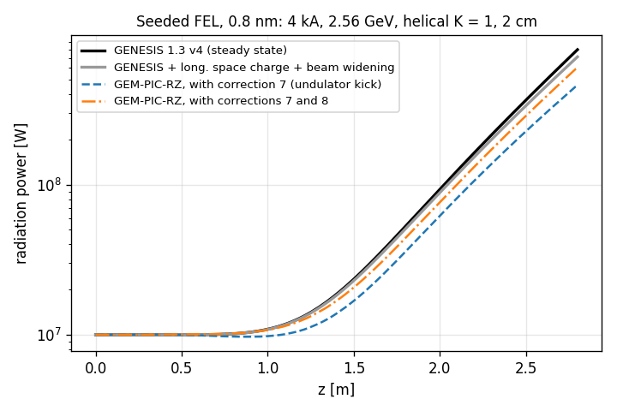
Undulator radiation and FELs, same equations
GEM-PIC-RZ · SECONDARY RADIATION
A.Pukhov (2026) https://arxiv.org/abs/2611.01640
The wiggling beam drives R through j⊥;
radiation stays at fixed ζ while electrons slip back λᵣ per period. Full space charge, no period averaging.
test | agreement
Coherent spontaneous emission vs radiation integral | 2–4 % in energy
SASE gain length vs Ming Xie | 6.3 vs 6.4 periods
Seeded, 10 nm / 0.8 nm vs GENESIS 1.3 | 4 % / 0.6 %
Goal: plasma stage, transport and FEL in one code.
QUARZ & GEM-PIC-RZ · A. Pukhov
33
Notes:
For those interested in secondary radiation sources: because the carrier is resolved, the same equations describe the radiation of the accelerated beam. Add a static undulator field acting on the particles; nothing else changes. The transverse current drives the forward field, and the radiation acts back through the gather. So spontaneous and coherent emission and the FEL interaction are in the model, with the full space-charge fields. The zeta grid resolves the radiation wavelength, the step resolves the undulator period. Tests: coherent spontaneous emission against the far-field radiation integral, SASE gain length against the Ming Xie fit, seeded amplifiers at 10 and 0.8 nm against GENESIS; this benchmark also found two numerical errors in the undulator coupling, now fixed. The goal is a start-to-end simulation: plasma accelerator, transport, FEL, in one code. Betatron radiation from the bubble is the natural next diagnostic.

Slide 36
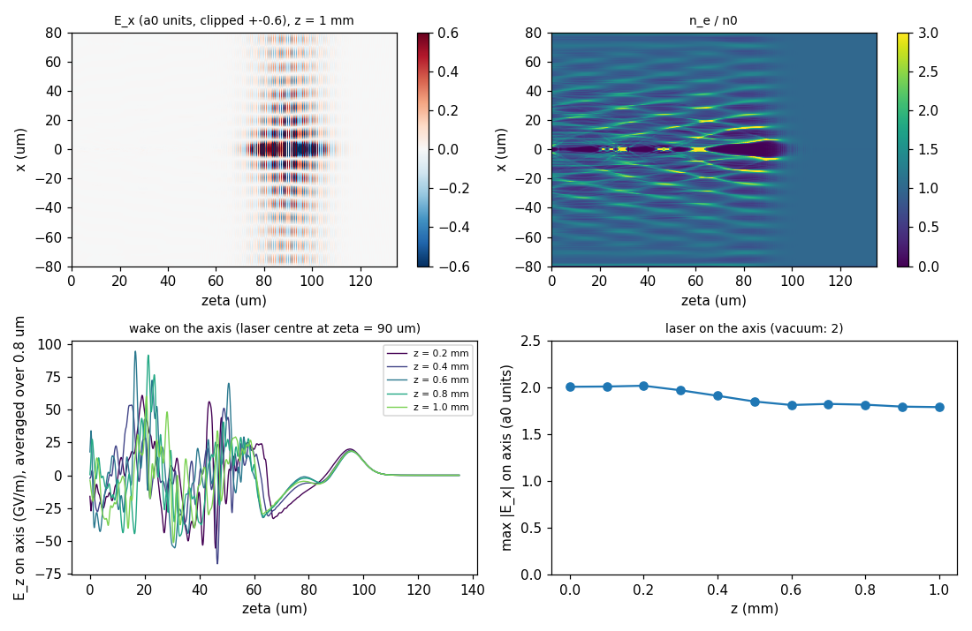
Flying focus: a luminal Bessel driver
GEM-PIC-RZ · WORK IN PROGRESS
Converging conical wave, peak moving at c: a₀ = 2, 50 fs, 50 mrad, injected through the radial absorber (total-field / scattered-field).
Vacuum, 2 mm: amplitude within 2 %, envelope at c to 0.07 µm.
Plasma 10¹⁸ cm⁻³, 1 mm: first wake period stationary; behind it the wakes of the Bessel rings cross.
Preliminary, unpublished
QUARZ & GEM-PIC-RZ · A. Pukhov
34
Notes:
A glimpse of ongoing work, building on our Plasma 2023 paper on luminal drivers. A flying focus, here the ideal luminal focus-wave mode: a converging conical wave whose on-axis peak moves at c, so dephasing-free acceleration becomes possible. Such a pulse cannot be put in the box at t = 0; it is fed in through the radial absorber layer, the total-field/scattered-field method. In vacuum the on-axis amplitude stays within 2 percent over 2 mm and the envelope moves at c. In a preformed plasma the first wake period becomes stationary in zeta after 0.4 mm, the on-axis amplitude settles at 1.8; behind the first period the wakes of the Bessel rings cross. These are first tests, not results.

Slide 37
GPUs and the MPI pipeline on JUPITER
GEM-PIC-RZ · PERFORMANCE
GH200 GPUs | 1 | 4 | 16 | 64
LWFA, s per step | 0.371 | 0.105 | 0.035 | 0.020
speed-up | 1 | 3.5 | 10.6 | 18.1
FEL, s per step | 2.15 | 0.84 | 0.28 | 0.11
All 35 tests pass on GPU; 1–4 GPUs reproduce the serial run (regression, FEL, flying focus).
One 4-GPU node: 2.6× (LWFA) and 1.4× (FEL) a 288-core CPU node.
Limits: host–device copies per step; ~19 slices per rank at 64 GPUs ends strong scaling.
QUARZ & GEM-PIC-RZ · A. Pukhov
35
Notes:
Performance. Within a step the march is sequential in zeta, so parallelism comes from particles and the radial grid within a slice, on threads or a GPU, and from pipelining over steps with MPI, one GPU per rank. Thomas Wilson ran it on JUPITER a few days ago: all tests pass, and the MPI pipeline on GPUs reproduces the serial code. Strong scaling of the LWFA case to 64 GPUs gives a factor 18; at that point each rank has only about 19 slices, and the whole-block host–device copies dominate. That is the next optimization. The single-GPU numbers are what matters for parameter scans: a 200-step LWFA run in about a minute on one GPU.

Slide 38
Which code for which problem
GUIDE
problem | use | why
PWFA, AWAKE, ion motion, pinched witness | QUARZ | stretched r grid, GPU, m = 1
LWFA scans with multi-cycle pulses | QUARZ (envelope) | cheapest per stage
Few-cycle / kHz lasers, depletion, redshift | GEM-PIC-RZ | carrier resolved
Ionization injection | GEM-PIC-RZ | ADK in the real field
Undulator radiation, FEL after a plasma stage | GEM-PIC-RZ | radiation in the model
Sharp down-ramp self-injection | full PIC, for now | open problem (GT2)
TNSA, solid targets, backscatter, surface harmonics | full PIC | backward waves, overdense
Nonlinear hosing, flat or tilted beams | 3D codes | needs m ≥ 2
QUARZ & GEM-PIC-RZ · A. Pukhov
36
Notes:
To make it practical for this audience. Beam-driven wakes, AWAKE, ion motion around a tight witness: QUARZ. Cheap scans of LWFA stages with ordinary multi-cycle pulses: QUARZ with its envelope. Few-cycle pulses, depletion, ionization injection, and radiation of the accelerated beam: GEM-PIC-RZ. And let me be clear about what neither does. Both codes are for underdense plasmas with forward-going drivers: TNSA, solid targets, reflection, surface harmonics, backscatter need a full PIC code, and so does sharp down-ramp injection for now. Strong asymmetry needs a 3D code.

Slide 39
Zero-touch development: the tests are the contract
Нерукотворный код: Доверяй, но проверяй!
HOW THE CODES WERE BUILT
AI agent (Claude)
Physicist
The rule
Wrote every line of source, tests, benchmark scripts and documentation, with a compiler, a shell and the test suite.
Chose problems and methods, conventions, convergence criteria; interpreted results. Did not write or edit code.
No feature is done before it passes an independent analytic or numerical reference; every change reruns the suite.
Zero-touch development is agentic engineering applied to scientific software under two stricter conditions:
no line of code is written or edited by a human, and acceptance rests on validation against
references independent of the agent, such as analytic solutions and other codes, under physical criteria set by the scientist.
QUARZ & GEM-PIC-RZ · A. Pukhov
37
Notes:
Now the unusual part. Both codes are what we call zero-touch: every line of code, tests and documentation was written by an AI agent, Claude, working with a compiler, a shell and the test suite. I directed the work and did not write or edit a single line. My contributions were the ones that need physical judgment: the GEM-PIC formulation, which methods, which conventions, which benchmarks and what counts as converged. Correctness does not rest on line-by-line review but on a fixed rule: nothing counts as done until it passes an independent reference, and every change reruns the whole suite. Several of the numerical problems I showed you were found exactly that way. All commits are public and record the session, so you can check this, and I am happy to discuss what works and what does not in this way of working.

Slide 40
SUMMARY
QUARZ
GEM-PIC-RZ
Quasi-static RZ on any radial grid, exact Gauss law, 2nd order
Same near-axis fields with 30× fewer cells and time
Agrees with HiPACE++ on AWAKE; 12 m in minutes on 16 GPUs
Laser carrier resolved, step 100× the full-PIC step
Wake, few-cycle depletion, ionization injection match FBPIC at ~2 % of the CPU time
Undulators and FEL in the same equations
github.com/AlexMPukhov/QUARZ · arXiv:2610.16910
github.com/AlexMPukhov/GEM-PIC-RZ · arXiv:2610.31622
All codes are Open Source and we welcome collaboration:
adding new physics and features has never been that fast and convenient!
Notes:
To summarize. QUARZ: a quasi-static code that runs on any radial grid without losing the properties that make uniform-grid codes robust, which buys an order of magnitude or more for multiscale near-axis problems, and agrees with HiPACE++ for AWAKE. GEM-PIC-RZ: the laser carrier without the Courant limit, matching FBPIC for the bubble wake, few-cycle depletion and ionization injection at about 2 percent of the cost, and extending naturally to radiation and FELs. Both are open, with all decks. And the open problems, especially the declustering, where Konstantin's group has the experience, are where I would welcome collaboration. Thank you.

