Slide 1
CREMLINplus WP5 General Meeting
TASK 2: Status at IJCLab
Walid KAABI
IJCLab-IN2P3/CNRS

Slide 2
Introduction:
Task 5.2: Joint development of accelerator equipment by IJCLab-CNRS and BINP groups.
Deliverable:
D5.1: Report on joint development of collider technologies for lepton colliders (M36)
Milestone:
M3: Prototyping and measurements of key elements (M42)

Slide 3
Introduction to PERLE
PERLE: A proposed 3 turns ERL, based on SRF technology, to serve as testbed for studying, testing and validating a broad range of accelerator phenomena & technical choices for future projects.
Particularly, design challenges and beam parameters are chosen to enable PERLE as the hub for technology development (especially on injector and SRF) for the Large Hadron Electron Collider (LHeC) ^{[1]}
Target Parameter | Unit | Value
Injection energy | MeV | 7
Electron beam energy | MeV | 500
Normalised Emittance γε_{x,y} | mm mrad | 6
Average beam current | mA | 20
Bunch charge | pC | 500
Bunch length | mm | 3
Bunch spacing | ns | 25
RF frequency | MHz | 801.58
Duty factor |  | CW
[2] J.L. Abelleira Fernandez et al, “ A Large Hadron Electron Collider at CERN: Report on the Physics and Design Concepts for Machine and Detector “, J.Phys. G39 (2012) 075001, arXiv:1206.2913

Slide 4
PERLE in the global ERL landscape
legacy, decommissioned
Operating (SC, NC)
planned
potential future machine
PERLE
cERL-KEK

Slide 5
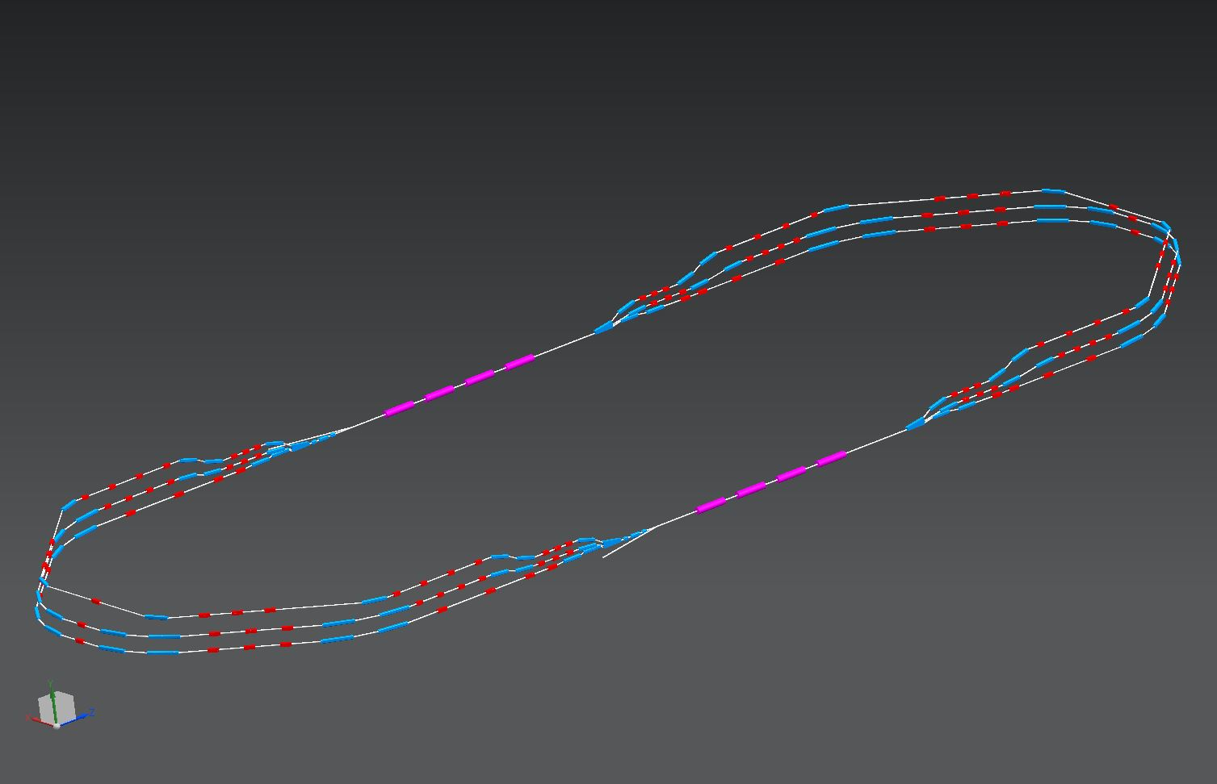
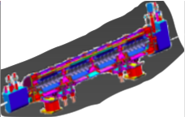
PERLE Configuration
2 Linacs (Four 5-Cell 801.58 MHz SC cavities)
3 turns (160 MeV/turn)
Max. beam energy 500 MeV
1 : 3 : 5
DE = 80 MeV
injector
7 MeV
DE = 80 MeV
2 : 4 : 6
7 MeV
dump
DC = l_{RF}/2

Slide 6
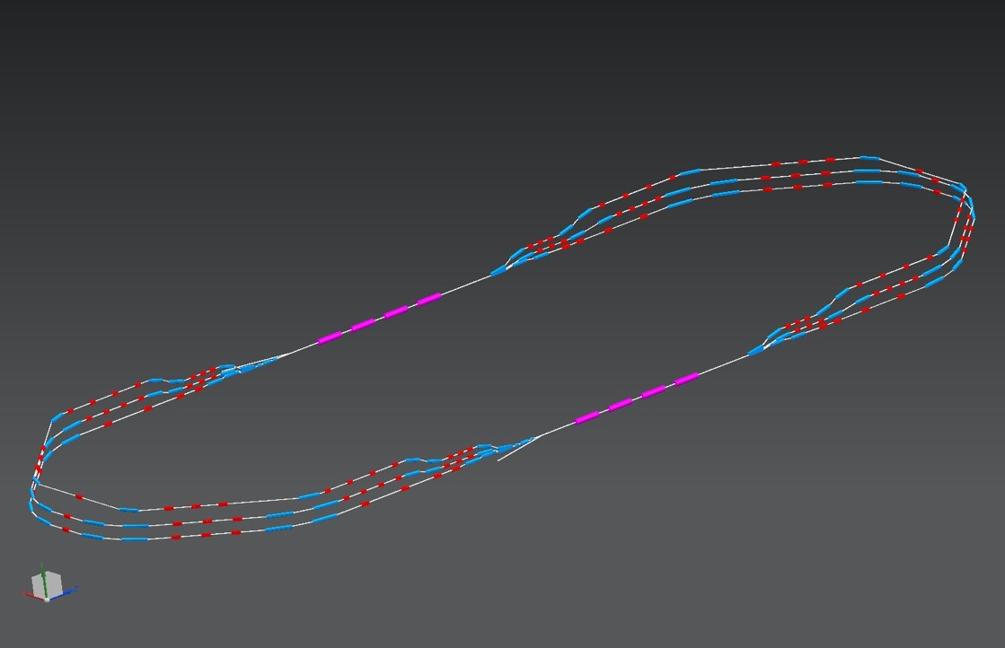
PERLE Configuration
Three passes ‘up’ to reach the maximum energy
1 : 3 : 5
ΔE = 80 MeV
injector
7 MeV
ΔE = 80 MeV
2 : 4 : 6
7 MeV
dump
ΔC in arc 6 = λ_{RF}/2
Electron beam at maximum energy could be used for:
Elastic electron-proton scattering with polarised beam (Particle physics)
Exploration of proton densities in exotic nuclei by electron scattering (Nuclear physics)
Gamma ray production between 0.2 and 5 MeV (wide applications in Photo-nuclear physics),

Slide 7
PERLE Configuration
Three passes ‘down’ for energy recovery
1 : 3 : 5
ΔE = 80 MeV
injector
7 MeV
ΔE = 80 MeV
2 : 4 : 6
7 MeV
dump
Several benefits from this manipulation:
The required RF power (and its capital cost and required electricity) is significantly reduced to that required to establish the cavity field and make up minor losses.
The beam is constantly renewed: never reach equilibrium state --> provides flexibility to adapt beam properties for specific applications.
The beam power that must be dissipated in the dump is reduced by a large factor.
Journées FCC France - LPNHE, 15 novembre 2019

Slide 8
Transport optics
Appropriate recirculation optics are of fundamental concern in a multi-pass machine to preserve beam quality. The design comprises different regions:
The Spreader optics: The beams need to be directed into the appropriate energy dependent arc. Spreaders separate vertically beams and match optics functions to arcs.
The Arc optics: Disturbing effects on beam space charge such us cumulative emittance and momentum growth have to be counteracted through a pertinent choice of the basic optics cell
The Re-combiner optics: Re-combiners and spreader are mirror symmetric.

Slide 9
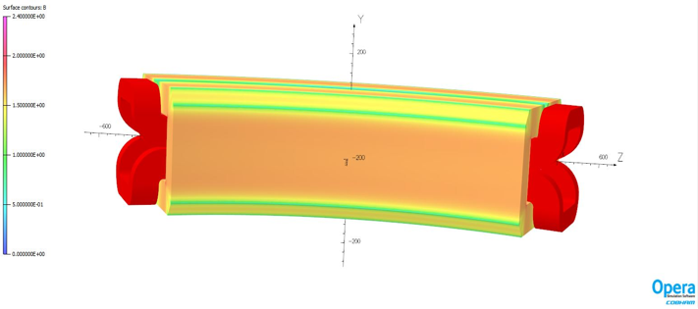
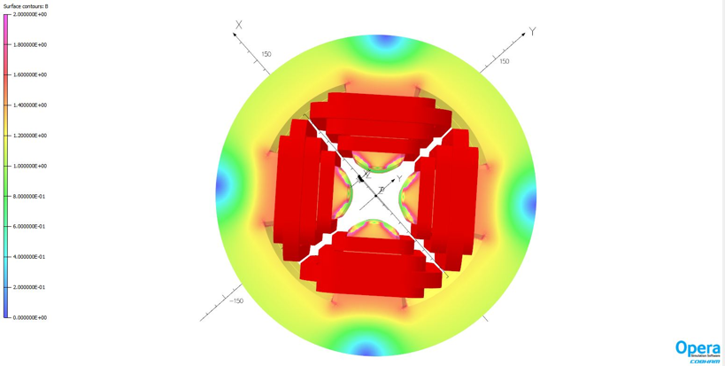
Baseline Lattice Design
Courtesy to A. Bogacz and C. Vallerand

Slide 10
Baseline Lattice Design
Studies and next steps foreseen within CREMLINplus program:
Linear lattice optimization and initial magnet specs
Momentum acceptance and longitudinal match
Study of optics tolerances
Correction of non-linear aberrations with multipole magnets
Final magnets specifications
Prototyping of critical magnets
→ A post-doc will be hired starting from November 2020 to strengthen the team at IJCLab.

Slide 11
PERLE injection line
Courtesy to B. Hounsell
PERLE injection line consist of:
A DC photoemission electron gun (The ALICE DC gun to be upgraded).
A bunching and focusing section: 401 MHz normal conducting buncher cavity placed between two solenoid.
A superconducting booster with five 802 MHz cavities individually supplied and controlled on amplitudes and phases.
Merger to transport the beam into the main LINAC.
Beam diagnostics to be placed between components.
Photocathode gun
Buncher
SRF booster
Light box
Focusing solenoids
Photocathodes choice:
Sb-based photocathodes (unpolarized electrons) operated at 350 kV
GaAs photocathodes (polarized electrons) operated at 220 kV
Photocathode laser choice:
Nd:YAG laser (532 nm) or Ti:Sapphire laser (400 nm).

Slide 12
PERLE injection line
The PERLE injector must deliver a beam of sufficient quality and at high average current.
The beam quality in an ERL is source limited which means that it is never better than it is at the cathode. The goal of the injector is to preserve this emittance as much as possible.
The injector breaks down into three subcomponents
350 kV DC electron gun
Injector (Gun to booster exit)
Merger
 | PERLE Parameters
Injection energy | 7 MeV
Bunch charge | 500 pC
Bunch repetition rate | 40.1 MHz
Unpolarised current | 20 mA
RMS bunch length | 3 mm
Emittance | < 6 π∙mm∙mrad
Uncorrelated energy spread | < 10 keV
Electron gun
Merger
Injector to booster exit
Main linac

Slide 13
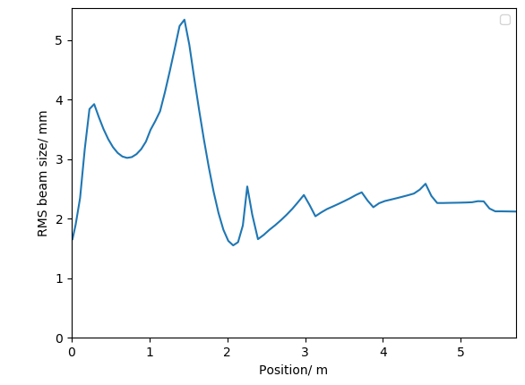
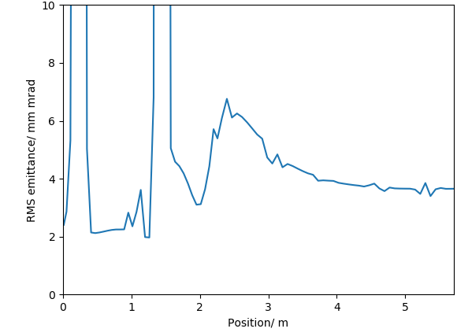
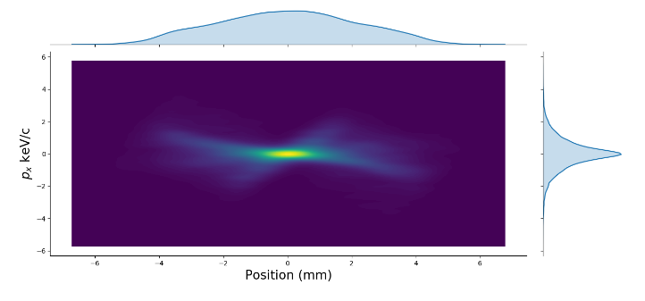
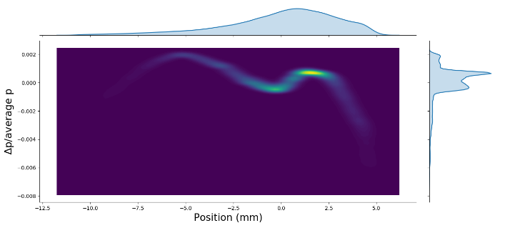
PERLE injection line
Achieved bunch parameters
Transverse emittance | 3.7 mm mrad
Bunch length | 3.0 mm
Energy | 7.0 mm
Electron source to booster exit optimisation:
The ALICE electron gun electrode geometry has been re-optimised for PERLE’s new requirements.
An optimisation was done with a 5 cavity booster linac from the cathode to the booster exit. The results can be seen on the right.
The current optimisation meets the specification at this point.
It is likely the booster design will be switched to a 4 cavity design.
Both the gun and injector to booster exit will probably be iterated at least once more.

Slide 14
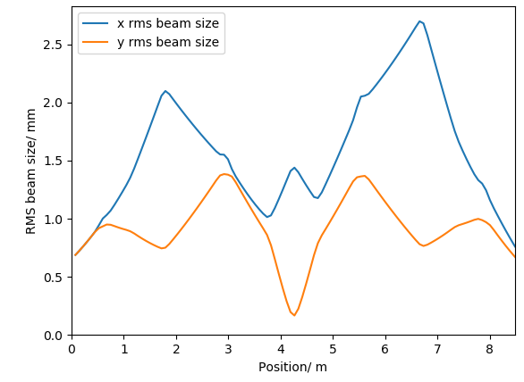
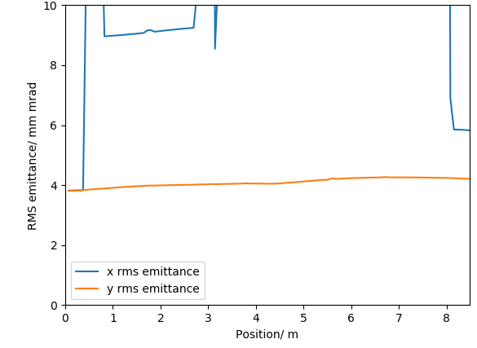
PERLE injection line
The merger study:
The merger is the current area of development at the moment.
It is the section which transports the 500 pC beam at 7 MeV to the main loop.
Space charge is still significant and will need to be managed to prevent significant degradation to the emittance.
4 dipole schemes are currently being investigated as they have the potential to mitigate the effects of space charge on the dispersion and the consequent emittance growth.

Slide 15
Thank you for your attention!

