Slide 1
TPC Simulation
Andrey Sokolov
Budker INP - Novosibirsk State University

Slide 2
Participants
Budker INP:
Lev Shekhtman
Andrey Sokolov
Timofey Maltsev
NSU:
Vijayanand KV (PhD student)

Slide 3
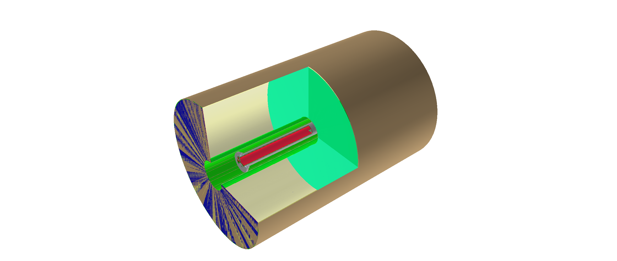
AURORA simulation framework
TPC is implemented in Aurora framework;
We can now work with G4 hits only;
Zero level RECO is exist – it use the helix fit with a constant radius.

Slide 4
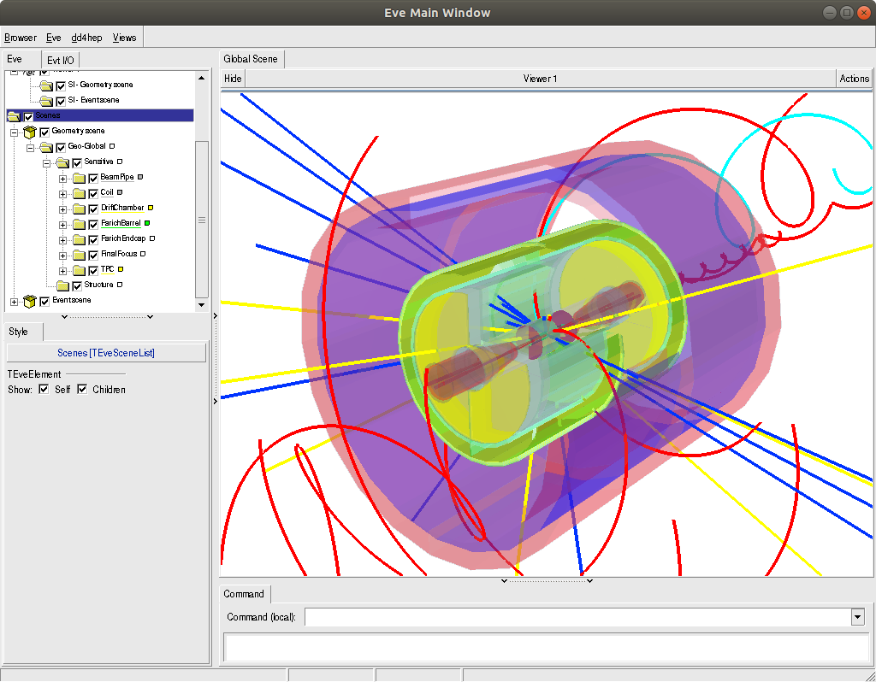
Aurora Event Display

Slide 5
Physics background simulation
by Lev Shekhtman
Simulation of background particles fluxes is performed with FLUKA package with FLAIR interface (http://www.fluka.org)

Slide 6
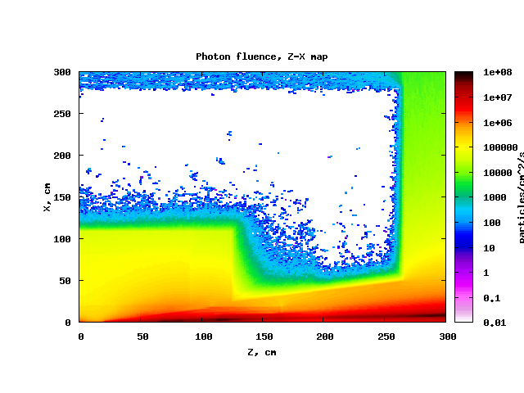
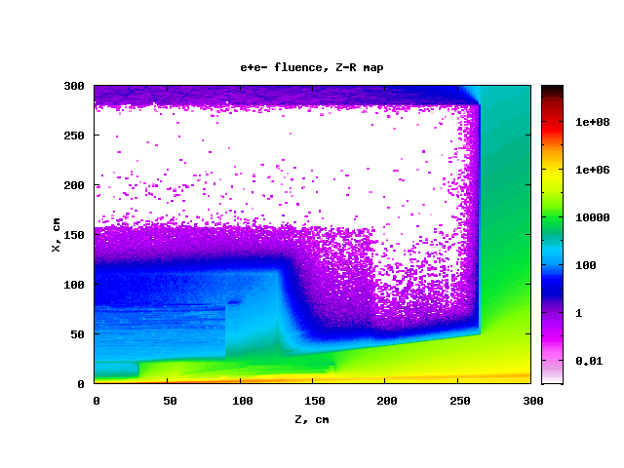
Simulation of the physics background
by Lev Shekhtman
TPC

Slide 7
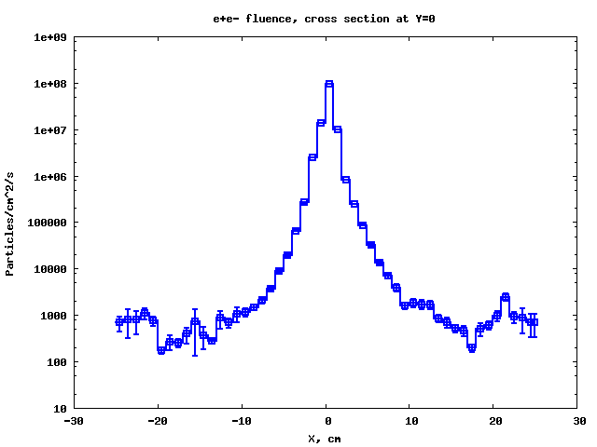
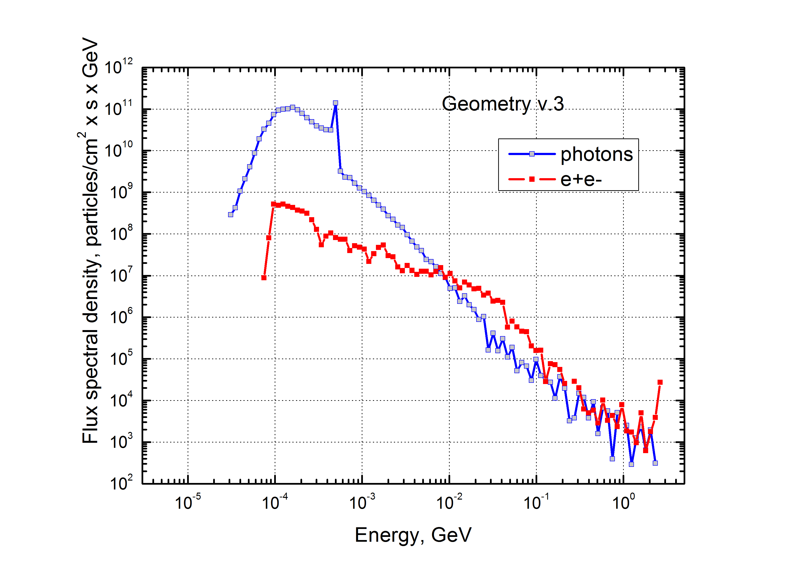
Background in IT region
by Lev Shekhtman
The expected number of tracks from e+e- background are 50-100 within 6 μs. It corresponds ~1000 bunch crossings.

Slide 8
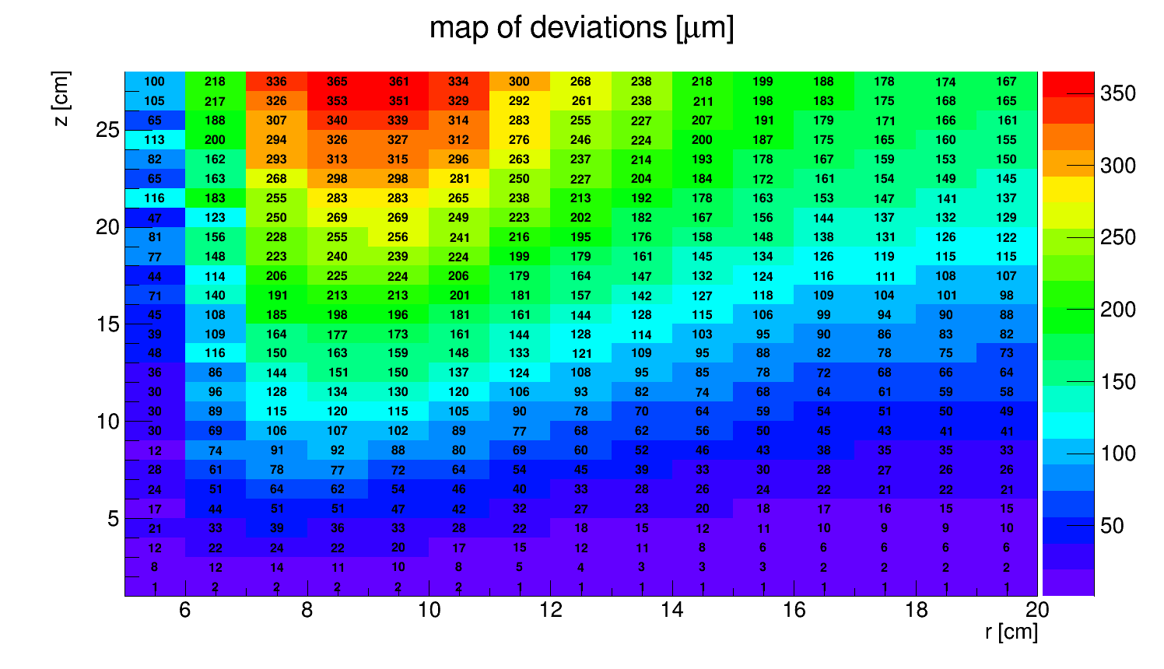
Track distortion along drift path in Ne+10%CO₂
by Timofey Maltsev
365 μm
Beam direction
IP
radial direction

Slide 9
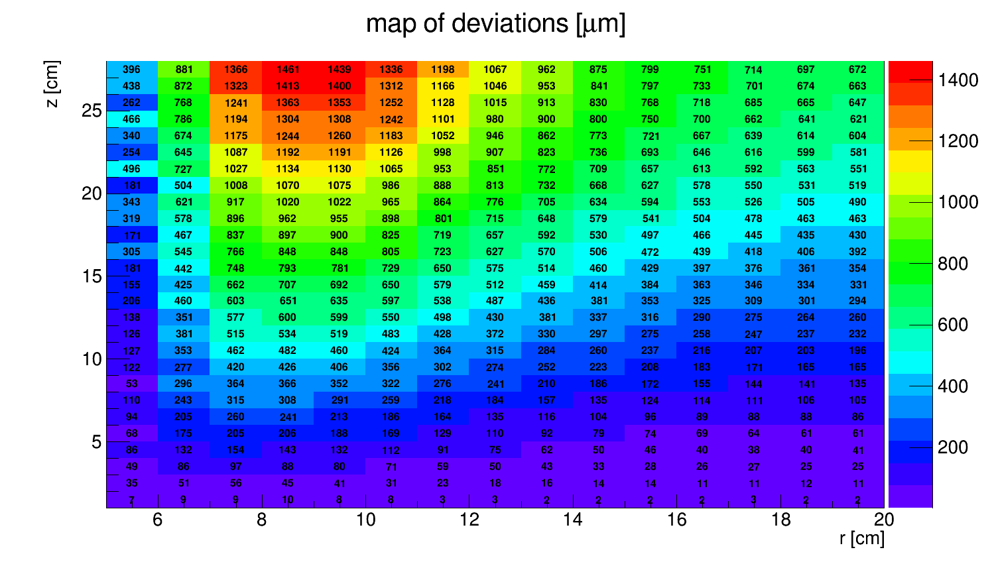
Track distortion along drift path in Ar+10%CO₂
1461 μm
by Timofey Maltsev
Beam direction
IP
radial direction

Slide 10
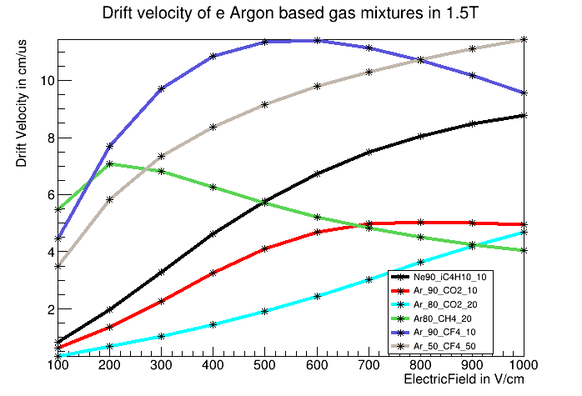
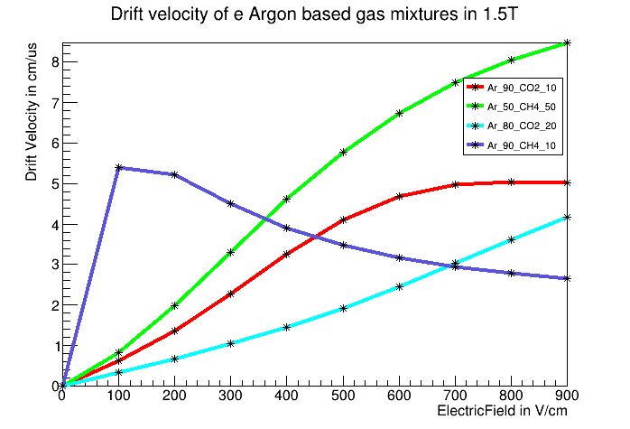
GARFIELD++ simulation of the TPC gas medium
by Vijayanand KV
The Ar+CO₂ (80:20), Ar+CF₄ (90:10) and Ar+CH₄ (90:10) look promising

Slide 11
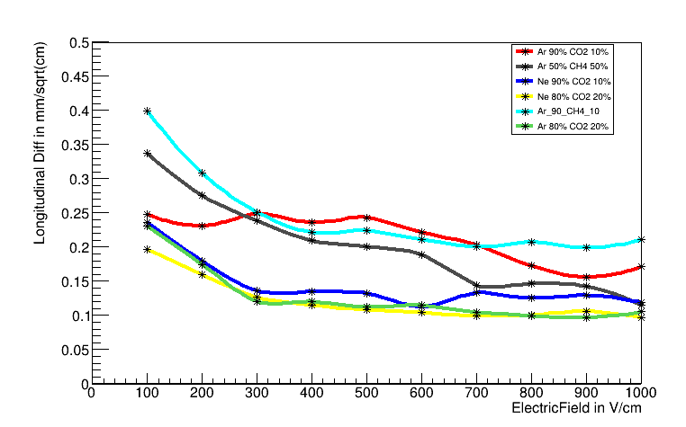
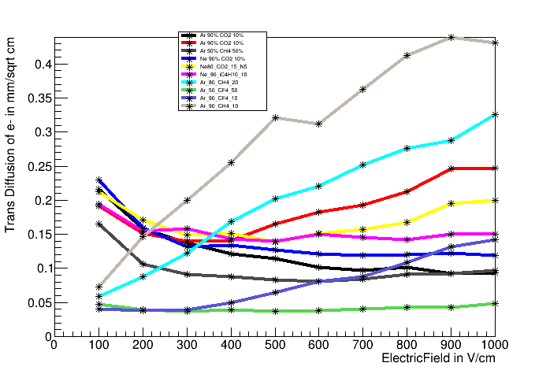
GARFIELD++ simulation of the TPC gas medium
by Vijayanand KV

Slide 12
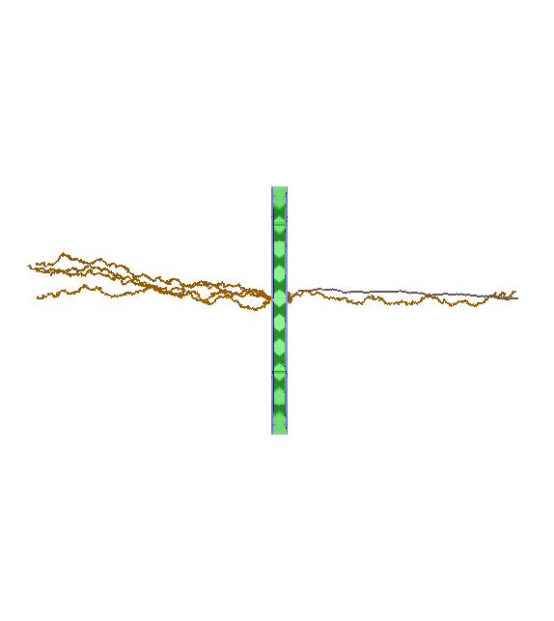
Simulation of the gas avalanche in GEM
by Vijayanand KV and Andrey Sokolov
We started the 3D GEM simulation in order to estimate the size of the avalanche and ion back flow after quadruple GEM.
After triple GEM the size of the avalanche already simulated by Timofey Maltsev. The σ of the avalanche is about 300 μm.

Slide 13
Parametric simulation of the TPC spatial resolution
by Andrey Sokolov
Based on results of GARFIELD++ and HEED simulation;
The main idea to estimate the TPC spatial resolution for different gas mixtures and readuot pad sizes;
The algorithm will be used for the cluster digitization stage in Aurora framework.

Slide 14
Summary
The TPC simulations are ongoing;
The TPC geometry is implemented in Aurora framework;
The default reconstruction is available;
The background simulation is done;
The ion back flow doesn’t lead to strong distortions of the drift field. The track distortions can be compensated;
The gas and drift field choice will be based on results of GARFIELD++ and parametric simulation.

Slide 15
Outlook
We have to implement the event mixer, pattern recognition and reconstruction to Aurora framework.
We have to finalize the choice of the gas mixture and pad size.

