Slide 1
Measurement of the phase space of proton beam in BINP accelerator based neutron source
Iaroslav Kolesnikov
AFAD 2021, 17th March

Slide 2
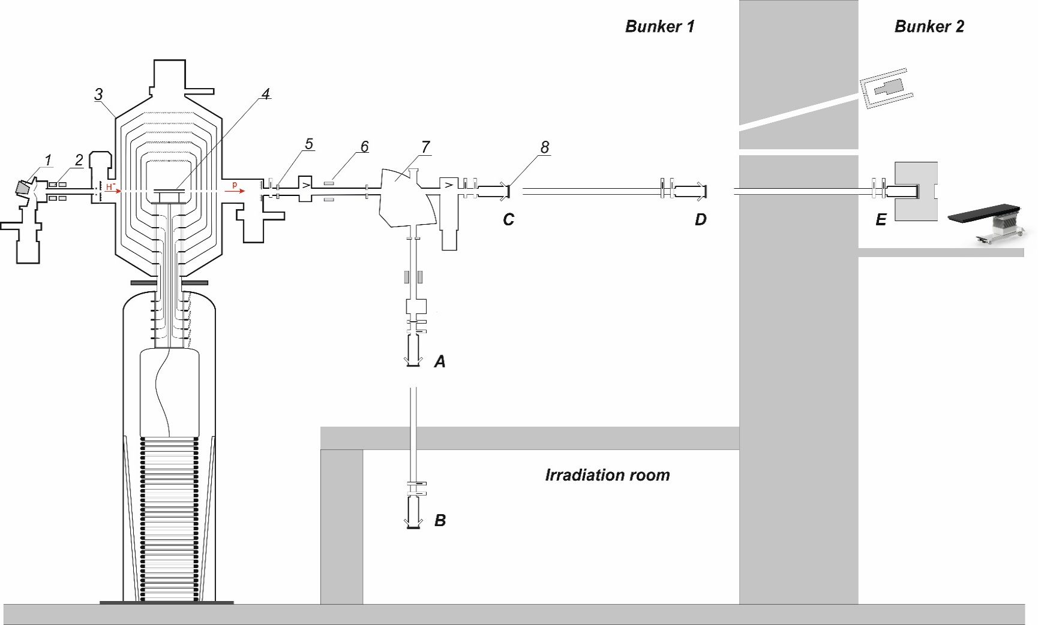
Scheme of the BINP accelerator based neutron source
H⁻ source
Magnetic lenses
Accelerator
Gas stripper
Cooled apertures
Current transformer (Bergoz Instrumentation)
Bending magnet
Lithium target
Usual therapy destination
Irradiation room for fast neutrons
Usual destination in the horizontal transport channel
Destination of the target before wall
Destination for the future therapy

Slide 3
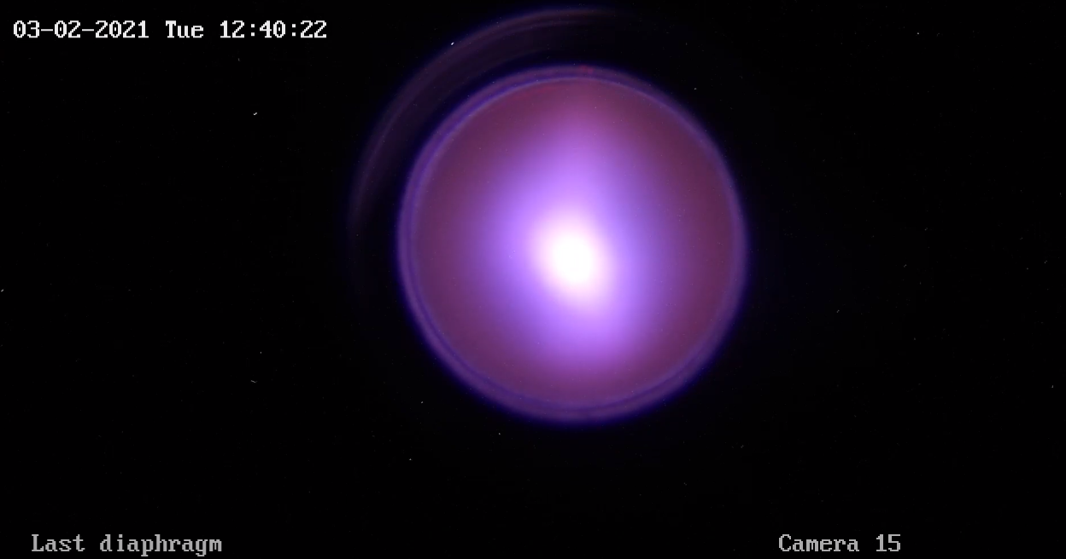
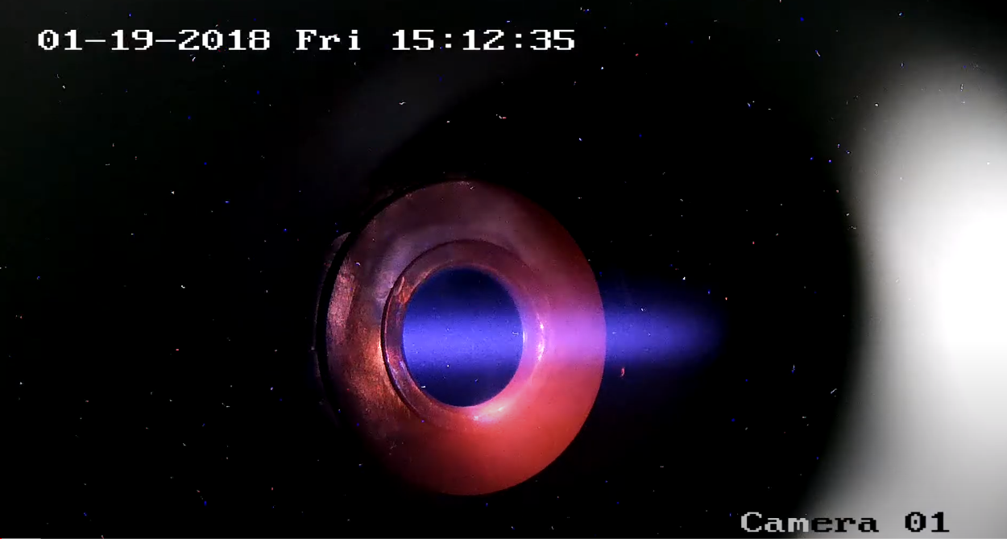
Vacuum conditions in the tandem accelerator
Usual irradiation/experiment – 1-2 mPa inside the accelerator
Many scientists believe, that this vacuum level too bad
But.. We literally see our beam

Slide 4
Experiment setup
1
2
3
4
5
1 – Current transformer
2 – 1 mm diameter cooled diaphragm on the 3D vacuum manipulator
3 – Bending magnet
4 – D-Pace wire scanner
5 – Lithium target

Slide 5
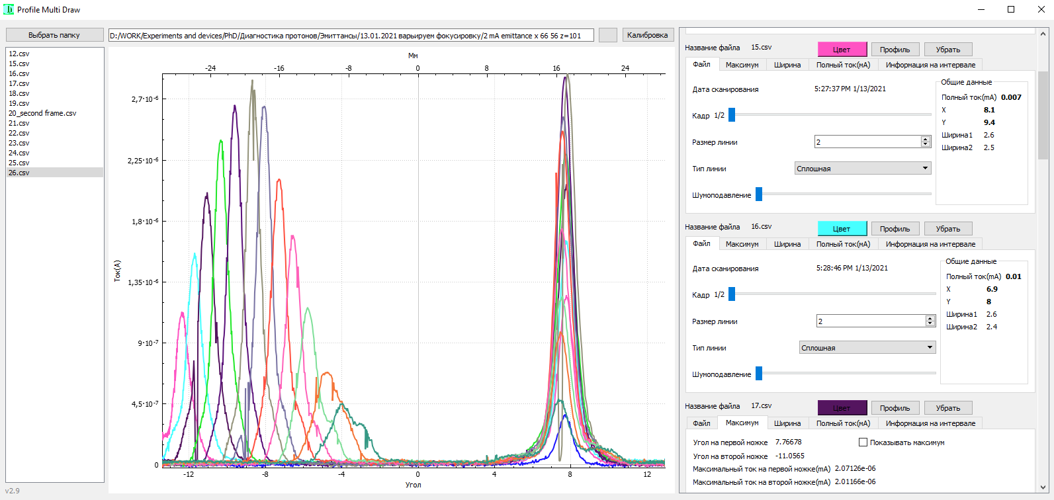
Primary data

Slide 6
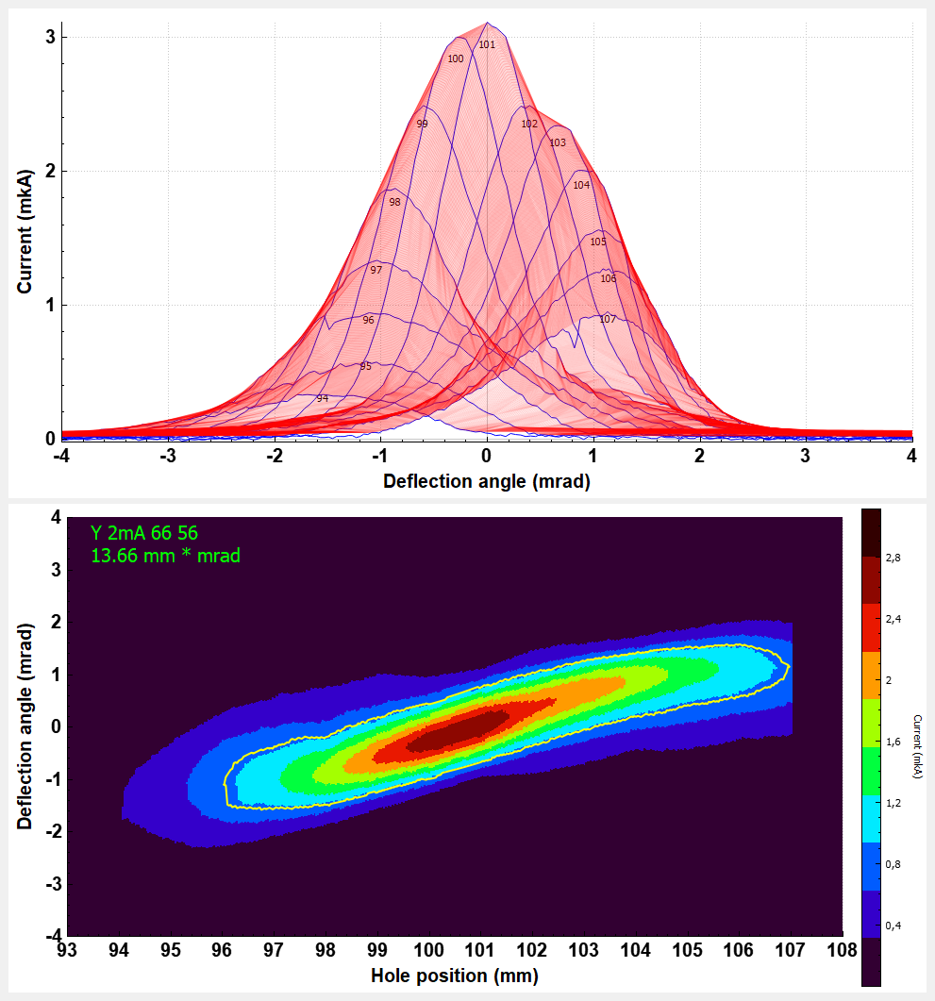
Experiments results

Slide 7
Experiments results
28 mm
38 mm
11±1,5
20 mm
15±8
23 mm
55 mm

Slide 8
Experiments results
Narrow optimal focusing range of the magnetic lenses ±1.5 %
Optimal invariant normalized emittance of the 2/3 of the beam in the horizontal transporting channel is 0.27π mm∙mrad, it’s size is 11 mm with angular deviation 3 mrad
Size of the beam in the vertical transporting channel is 15 mm with it’s angular deviation 16 mrad
Beam can be transported to the future therapy room and fast neutrons irradiation room!

