Slide 1
High intensity beam commissioning in CSNS/RCS
Shouyan Xu
CSNS AP Group, IHEP Mar. 16, 2021
Asian Forum for Accelerators and Detectors (AFAD-2021)

Slide 2
Contents
1
Introduction to CSNS/RCS
2
Challenges in high intensity commissioning
3
Beam commissioning process
4
Upgrade plan
5
Summary

Slide 3
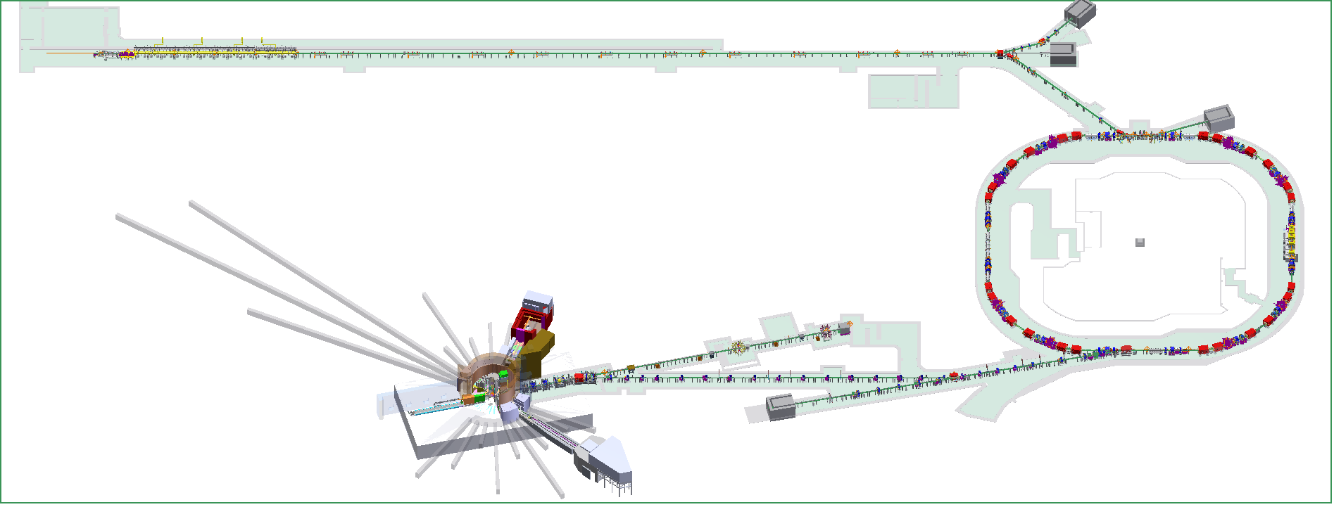
Introduction to CSNS/RCS
80MeV H⁻ linac
RCS，
1.6GeV, 25Hz
Target，Tungsten
100-kW

Slide 4
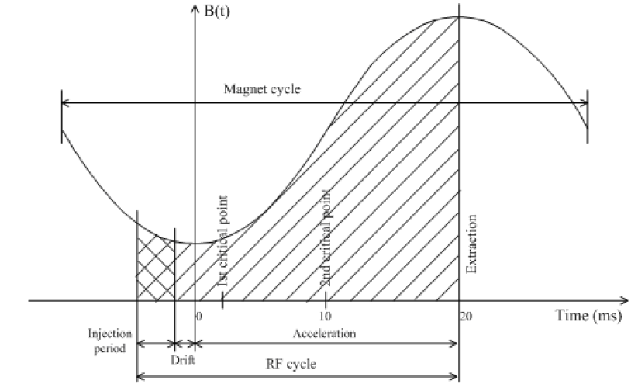
Introduction to CSNS/RCS
1.6-GeV
B, 0.9876T
f, 2.444MHz
80-MeV
B, 0.1645T
f, 1.022MHz
25Hz
Parameters | Values
RF Freq. (MHz) | 1.022~2.444
Harmonic | 2
Beam Power | 100 kW
Protons per pulse | 1.56E13
Space Charge Tune shift | -0.28

Slide 5
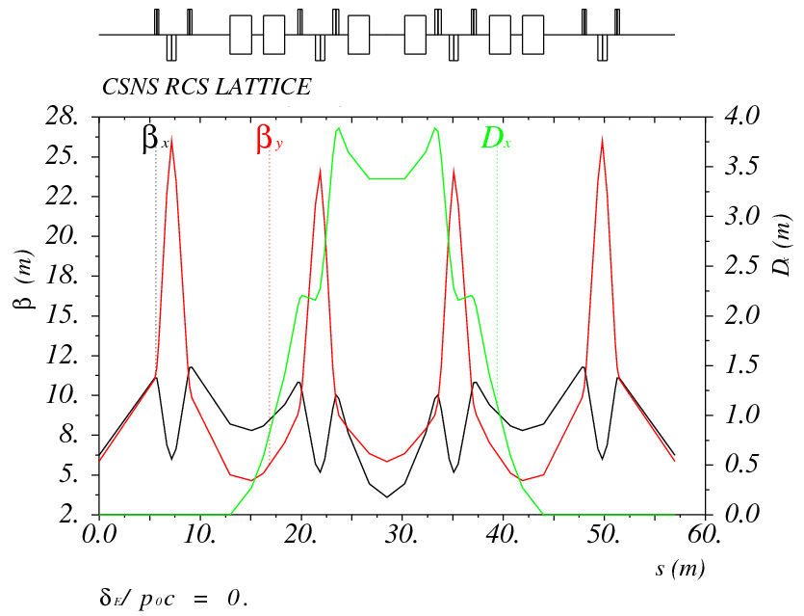
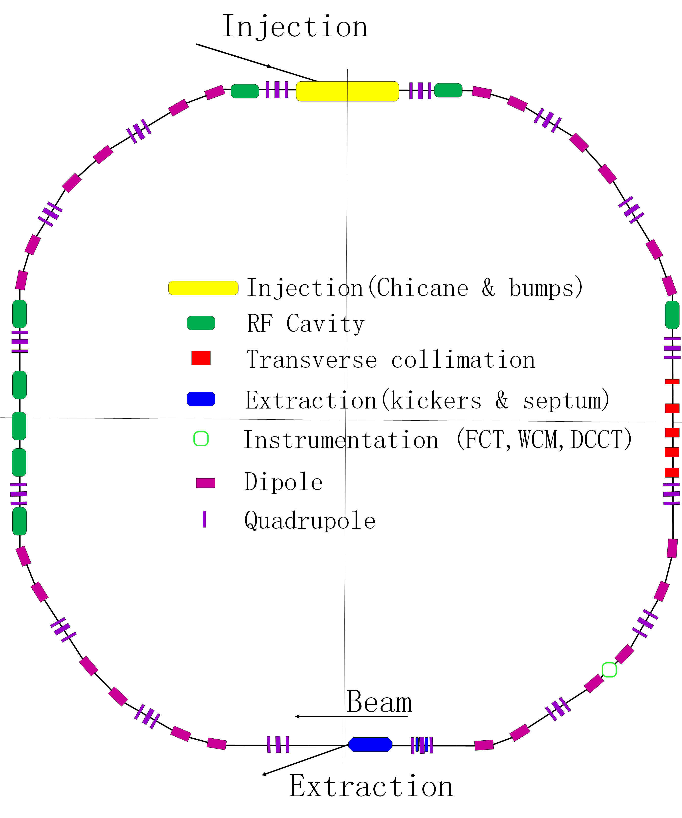
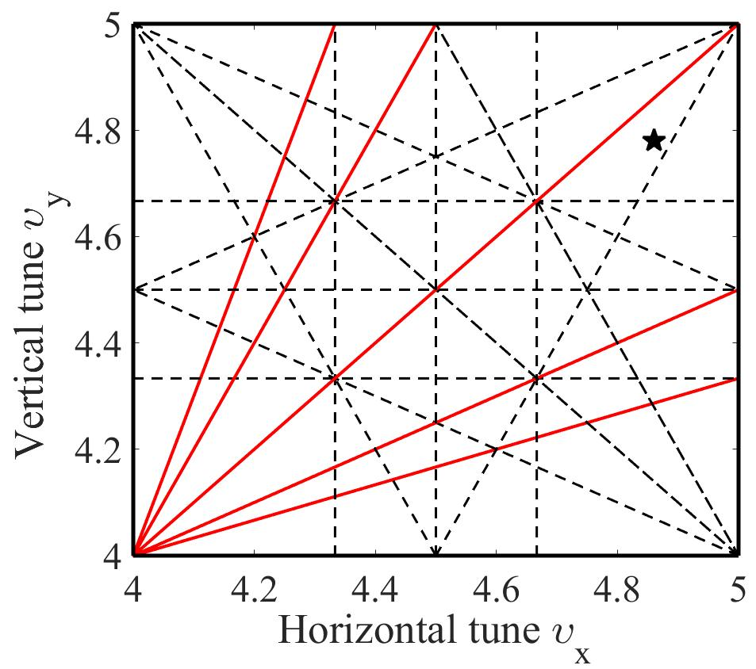
Introduction to CSNS/RCS
Lattice of 4-fold symmetry, triplet.
227.92m circumference.
Four long straight sections for injection, acceleration, collimation and extraction.
24 main dipoles with one power supply.
48 main quadrupoles with 5 power supplies.
Ceramic vacuum chambers for the AC&pulsed magnets.
8 RF ferrite loaded cavities to provide 165 kV.
Design tunes are (4.86, 4.78)

Slide 6
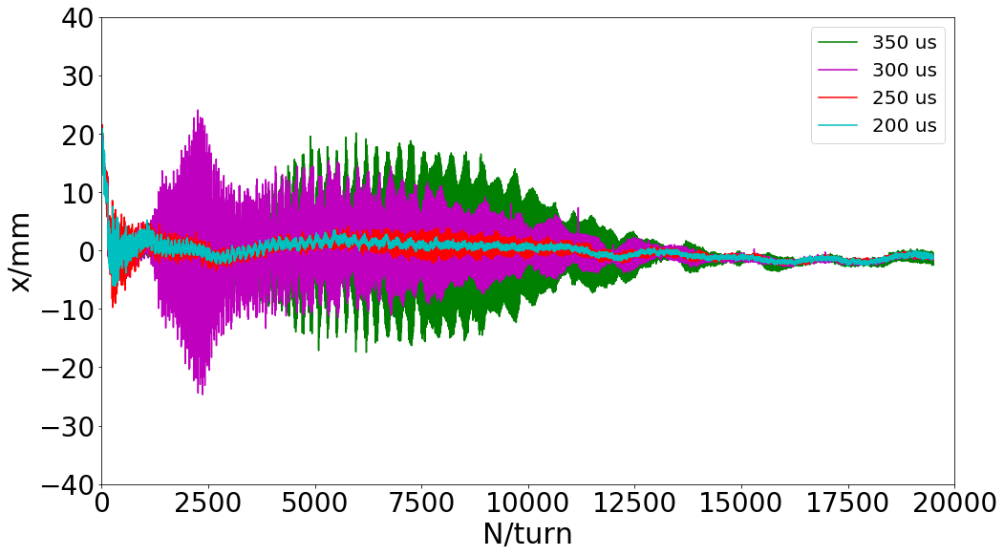
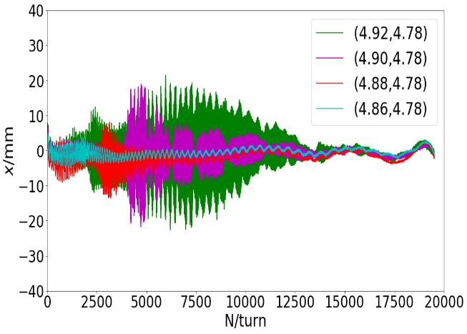
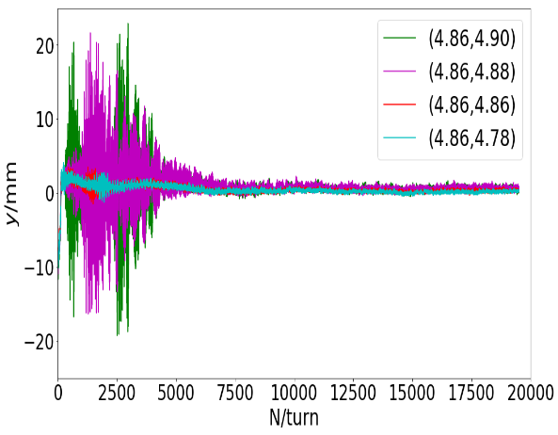
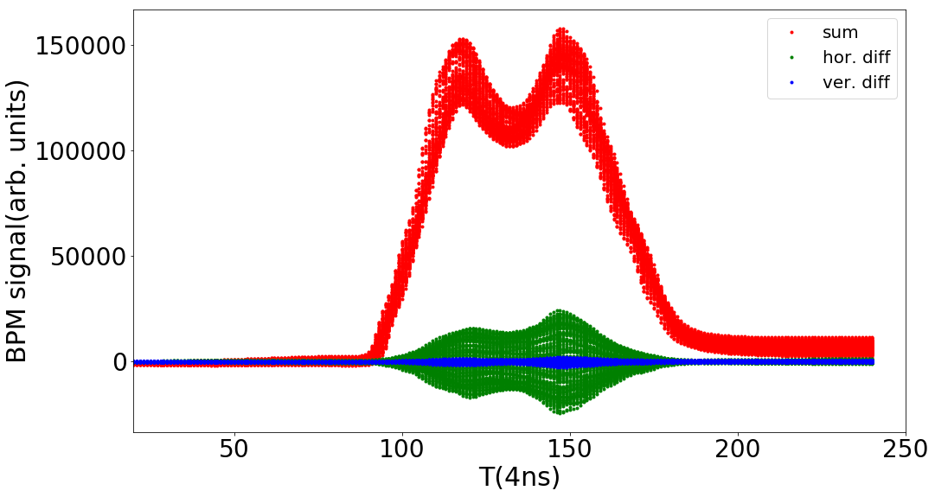
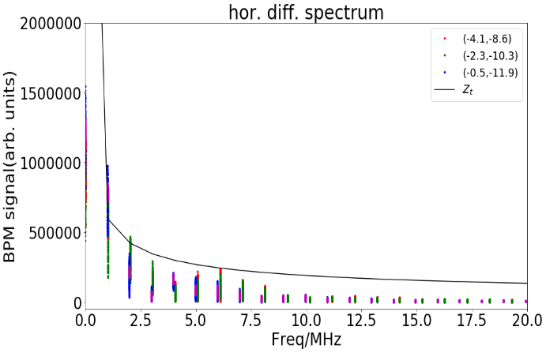
Challenges in high intensity
Coherent oscillation appears design mode of (4.86, 4.78) when the beam power is bigger than 50 kW (7.8E12 ppp)
It depends on circulated beam power, horizontal tune and chromaticity.
The coherent oscillation in horizontal plane is dominant, but it also appears in vertical plane with special vertical tune and chromaticity.
The headtail mode is also detected through BPM waveform
The beam spectrum is consistent of resistive wall impedance

Slide 7
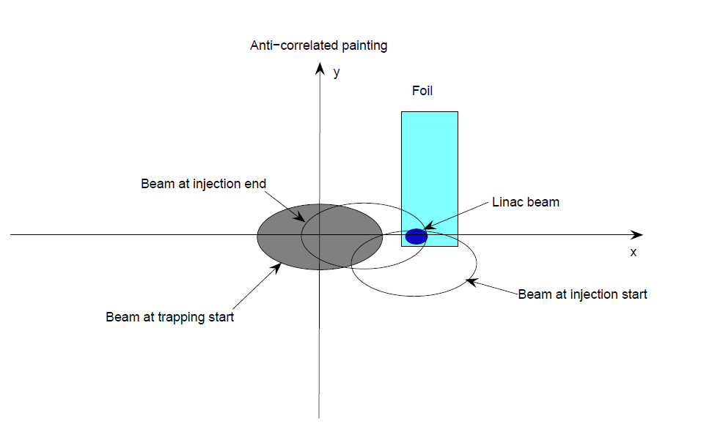
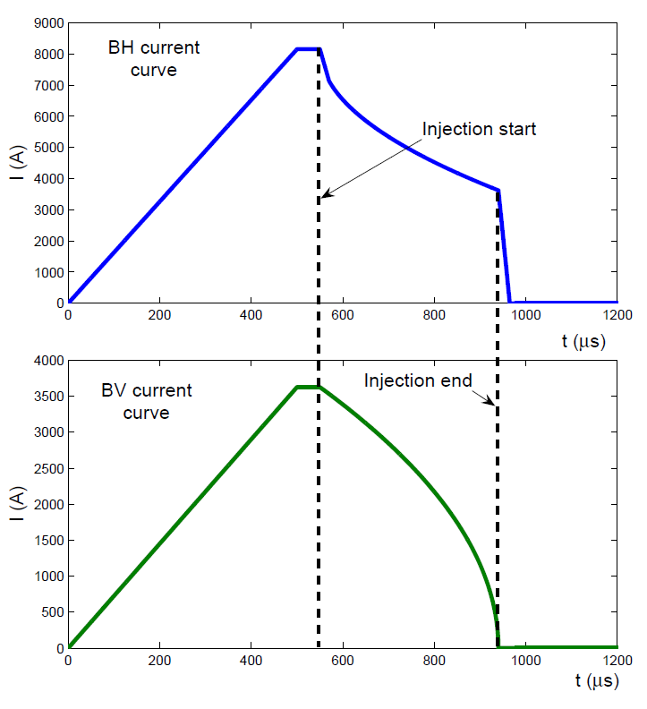
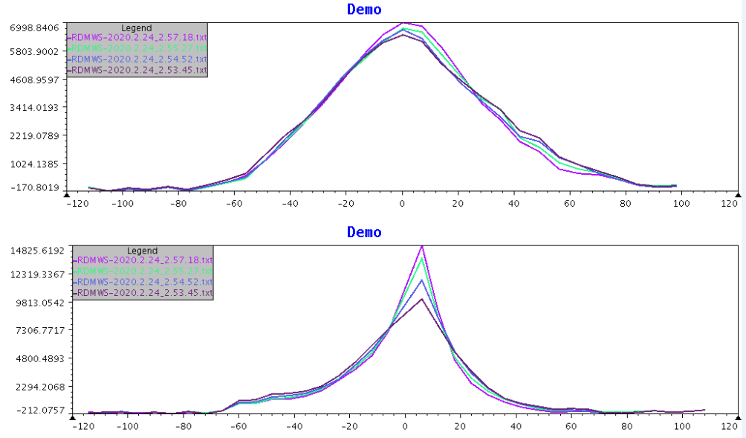
Challenges in high intensity
Horizontal
The designed injection painting scheme is anti-correlated painting, and the emittance is painted from large to small in the vertical direction.
The painted beam intensity is large in vertical phase space, and the emittance growth was serious during acceleration
Vertical
Measured profile on multi-wire scanners

Slide 8
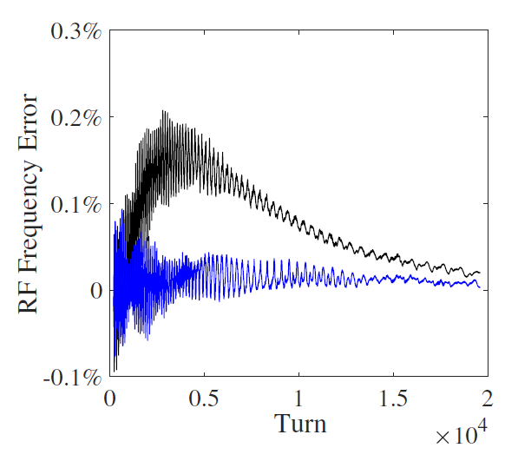
Beam commissioning process
The synchronicity between the dipole magnetic field and the RF frequency pattern
The mismatch between the rf frequency and the dipole magnetic field can cause the deviation of the horizontal beam position in arcs
8 BPMs are adopted to perform the matching between the rf frequency ramping function and the dipole field pattern
The phase advance of the BPMs in each arc 0.98π
The rf frequency was tuned to match the dipole field pattern.
$$f= f_{0}−\frac{η}{D}f_{0}∆x,$$

Slide 9
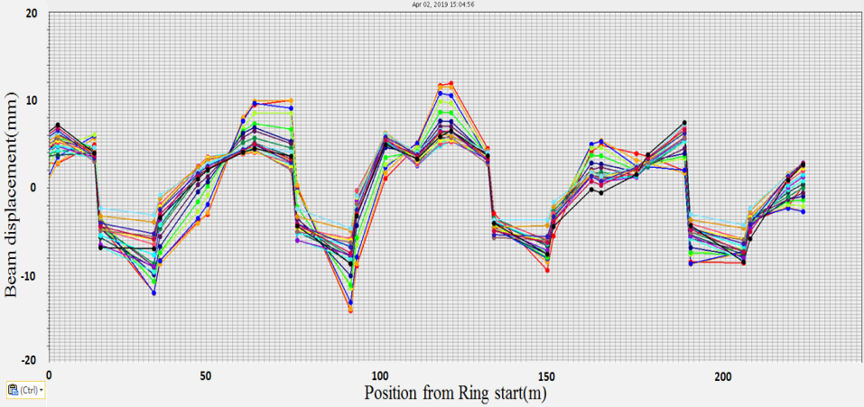
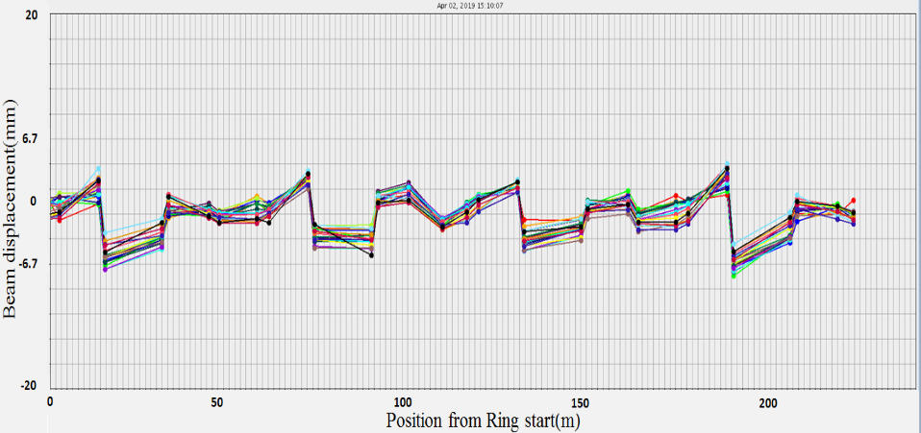
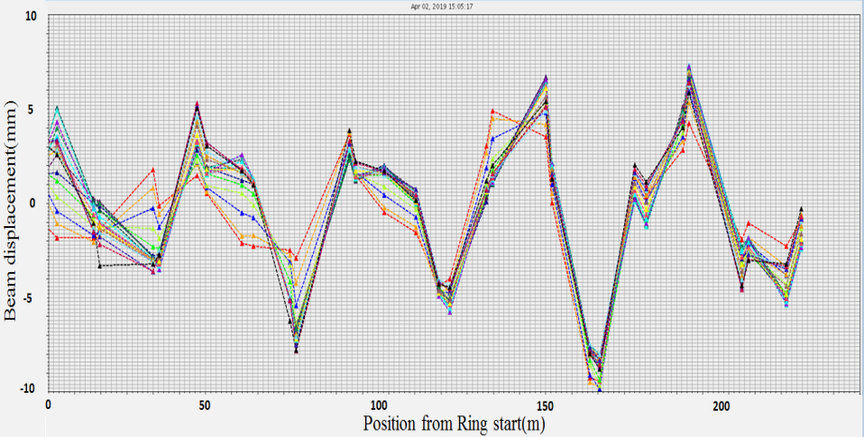
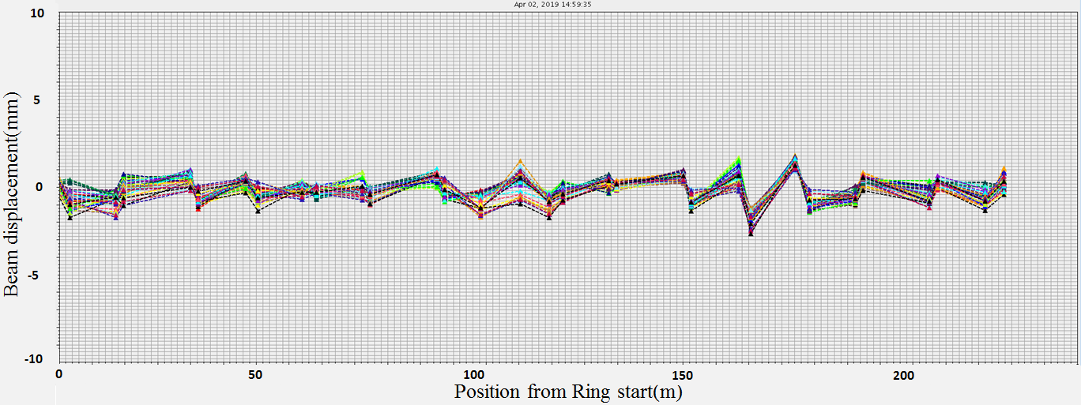
Beam commissioning process
COD Correction
x-before
x-after
±15mm
±5mm
y-before
y-after
±10mm
±2mm

Slide 10
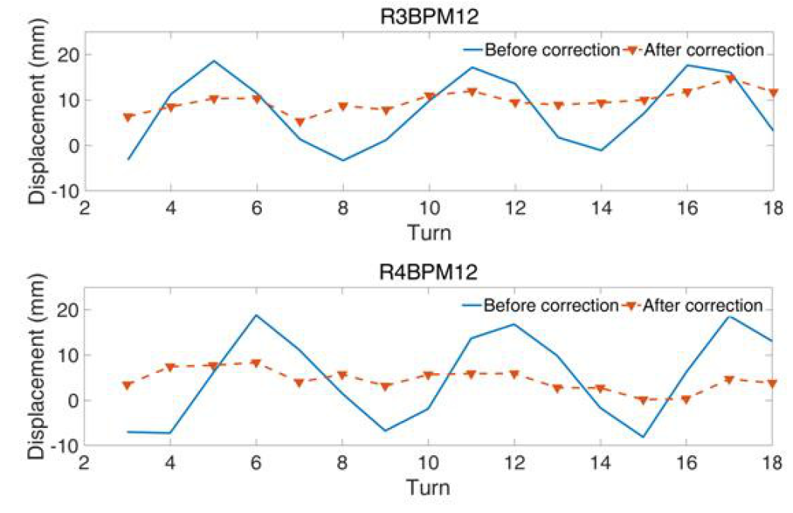
Beam commissioning process
The orbit match between the injection line and the central trajectory in the RCS:
It is important for reconstructing the phase space footprint and painting optimization.
The injection line was corrected to match the central trajectory in the RCS
The comparison of the measured Betatron oscillation in CSNS/RCS before and after the correction for the injection beam.

Slide 11
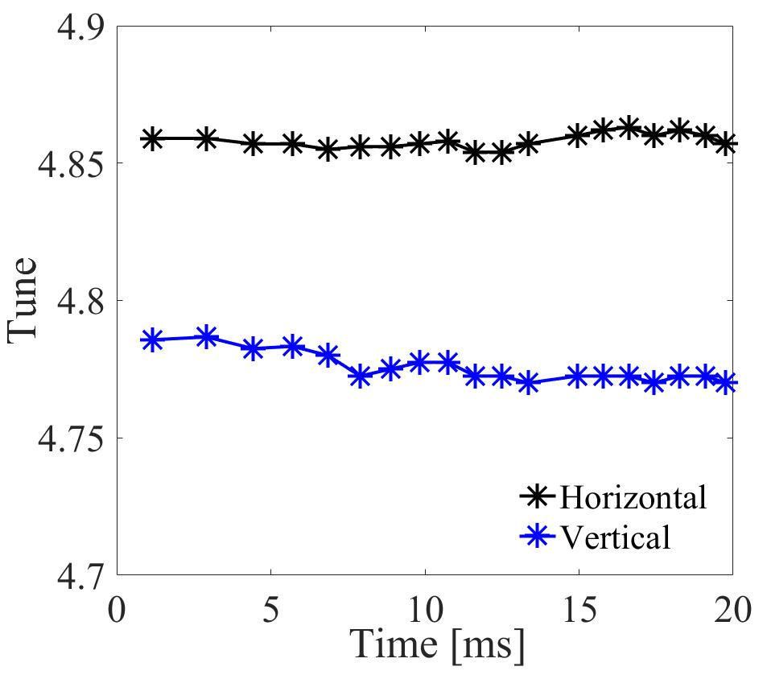
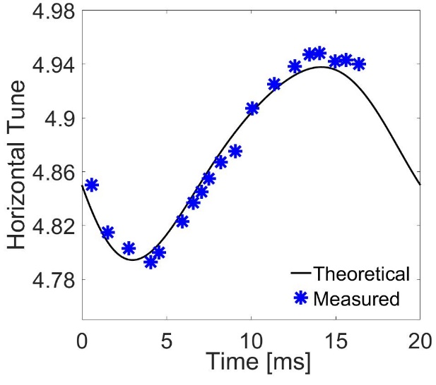
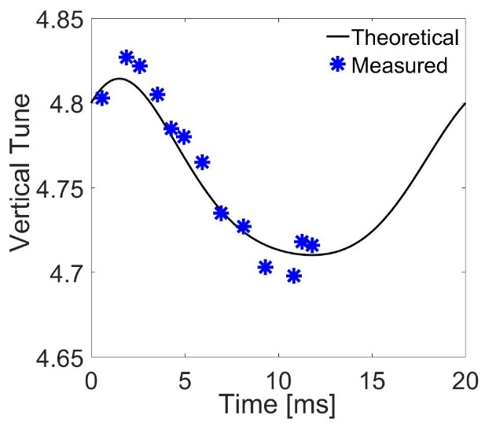
Beam commissioning process
Tune correction
Harmonic compensation on magnets was used for tune correction.
Harmonic compensation
Because of the magnetic saturation and the eddy current effects, the magnetic field tracking between different magnets is an important issue
By performing Harmonic compensation, the tune variation during the beam acceleration process was accurately controlled

Slide 12
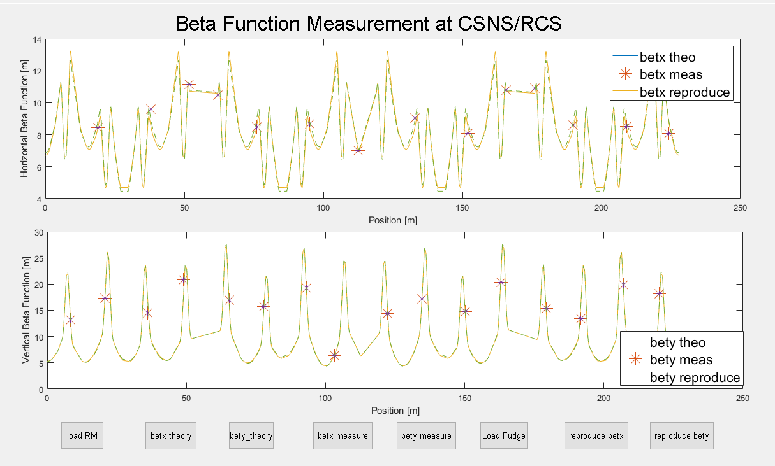
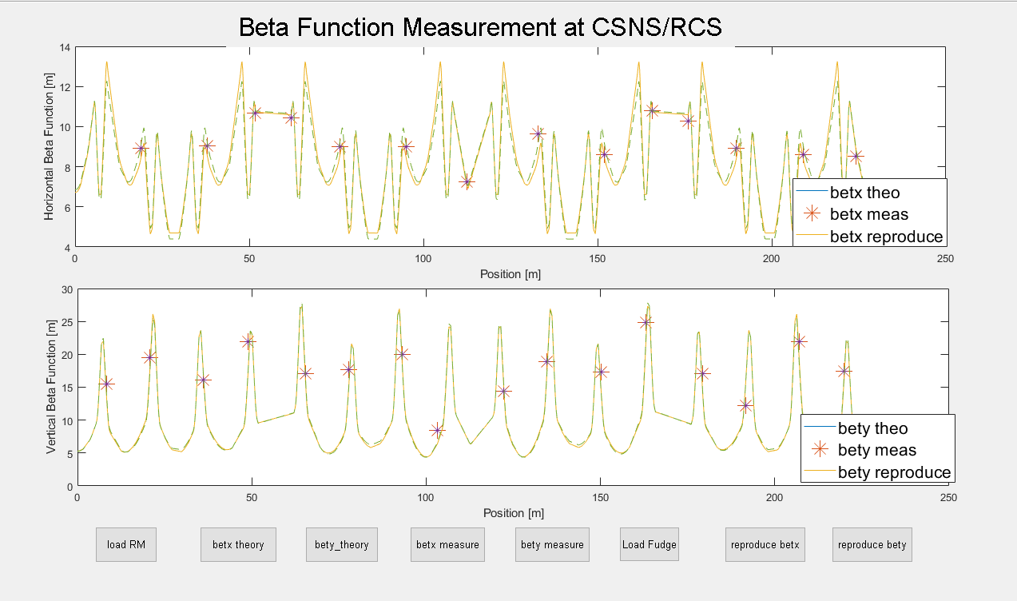
Beam commissioning process
Betatron functions were measured by using the Closed Orbit Distortion formula.
$$u\left(s\right)=θ\frac{\sqrt{β_{0}β\left(s\right)}}{2\sin{πν}}\cos\left(πν−\left|\left.ψ\left(s\right)−ψ(s_{0}\right)\right|\right)$$
Closed Orbit
Corrector
Beta function @ 1ms
Beta function @ 10ms
The COD correction, Lattice calibration, the match between the dipole field and RF frequency
during the acceleration process, and the tuning of the injection beam were performed by using a low-intensity beam.

Slide 13
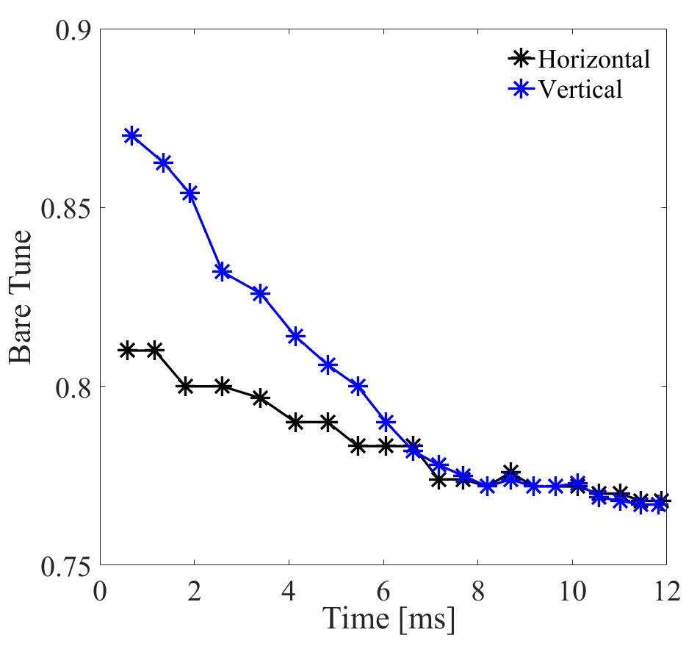
Beam commissioning process
Tune optimization at high-intensity beam commissioning
The tunes at injection were set at (4.81, 4.87) to reduce space charge induced beam loss
The tunes were moved downward to suppress the beam instability
The horizontal chromaticity was corrected from -4 to -8 to suppress the instability in horizontal direction
The vertical chromaticity was corrected from to reduce the chromatic tune spread in vertical direction
Operation TbT
The oscillation in RCS operation is depressed using the new tune pattern.

Slide 14
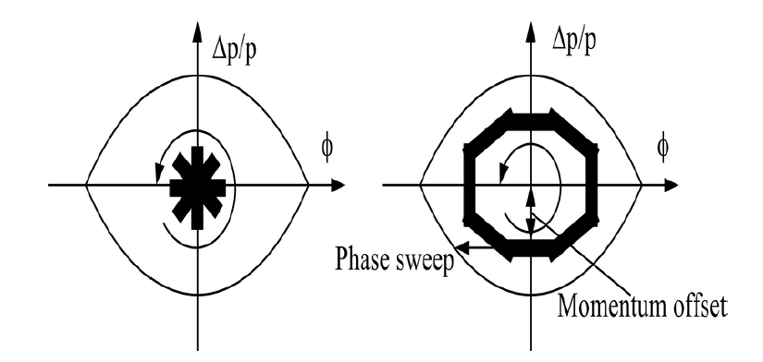
Beam commissioning process
Bunching factor optimization
Bunching factor should be increased to mitigate the space charge effects
makes use of a controlled momentum to the rf bucket to increase the bunching factor
injection without momentum offset
injection with momentum offset

Slide 15
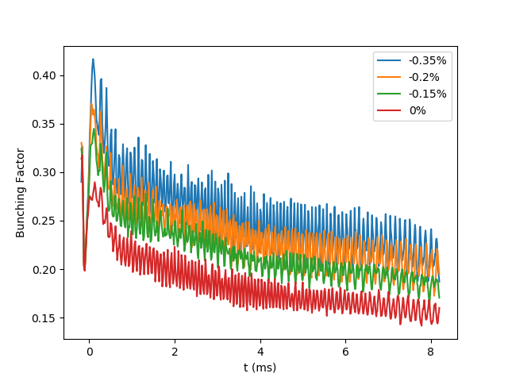
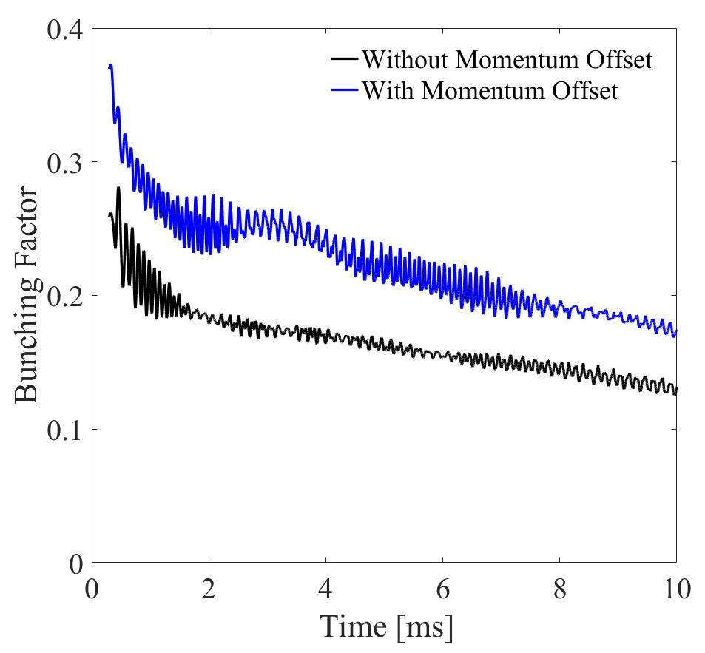
Beam commissioning process
Simulation results
Measured bunching factor
0.2% Momentum offset
Bunching factor with different injection momentum offset
With the increasing of injection momentum offset, the bunching factor increases

Slide 16
Beam commissioning process
Reconstructed beam distribution in longitudinal phase space
Distribution without momentum offset
Distribution with 0.2% momentum offset

Slide 17
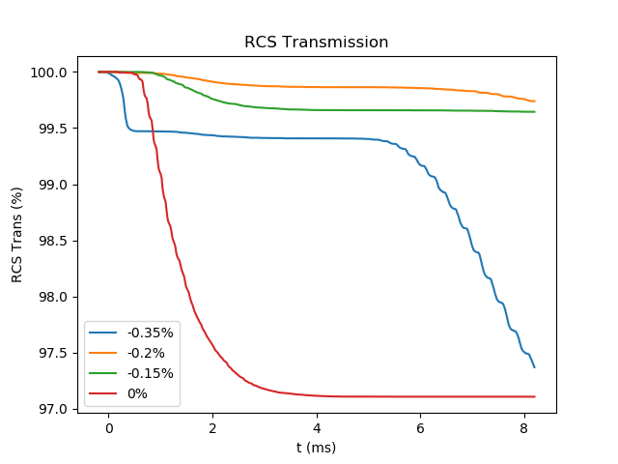
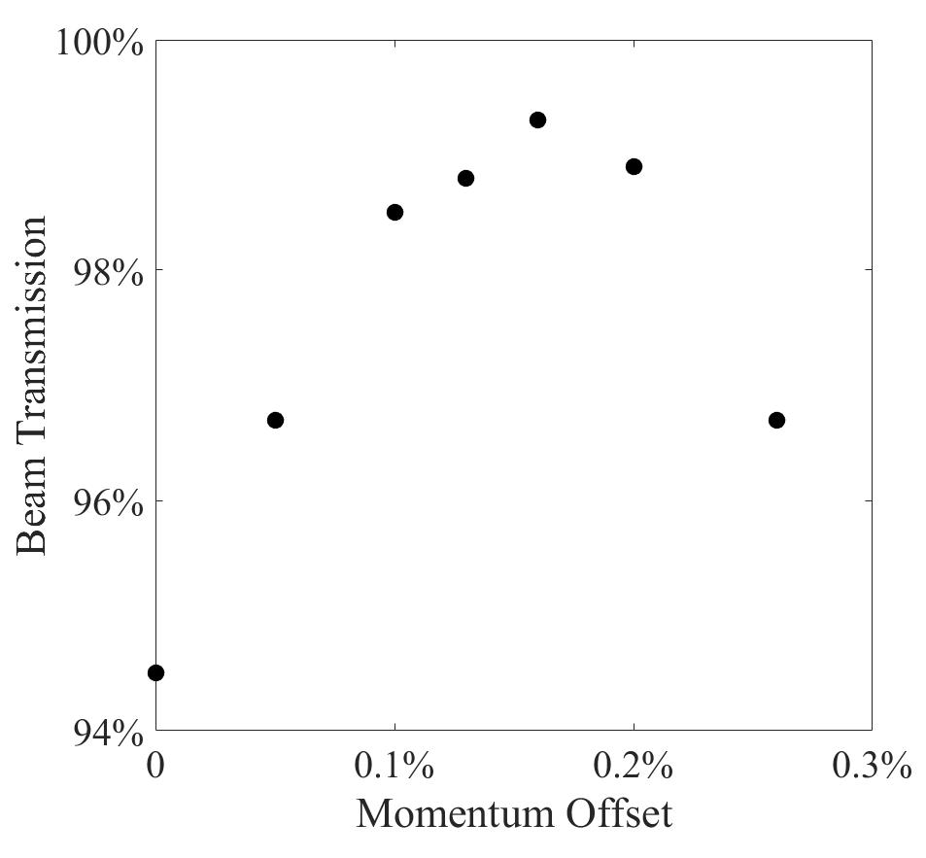
Beam commissioning process
Simulation results
Measured results
bucket becomes small
beam capture
Beam transmission with different injection momentum offset
With the increasing of injection momentum offset, the beam transmission increases
When the injection momentum is too large, beam transmission decreases.

Slide 18
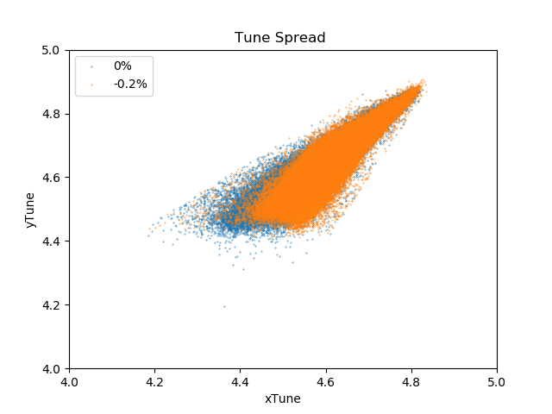
Beam commissioning process
Simulated tune spreads without (blue) injection momentum and with (orange) 0.2% momentum offset
Tune spread with injection momentum offset is smaller than that without injection momentum offset
The space charge effects was mitigated

Slide 19
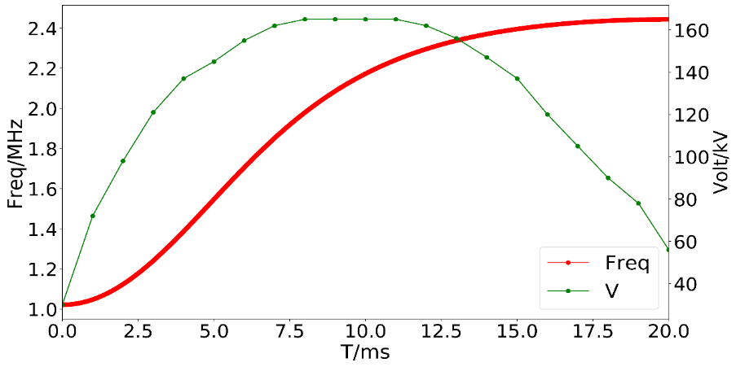
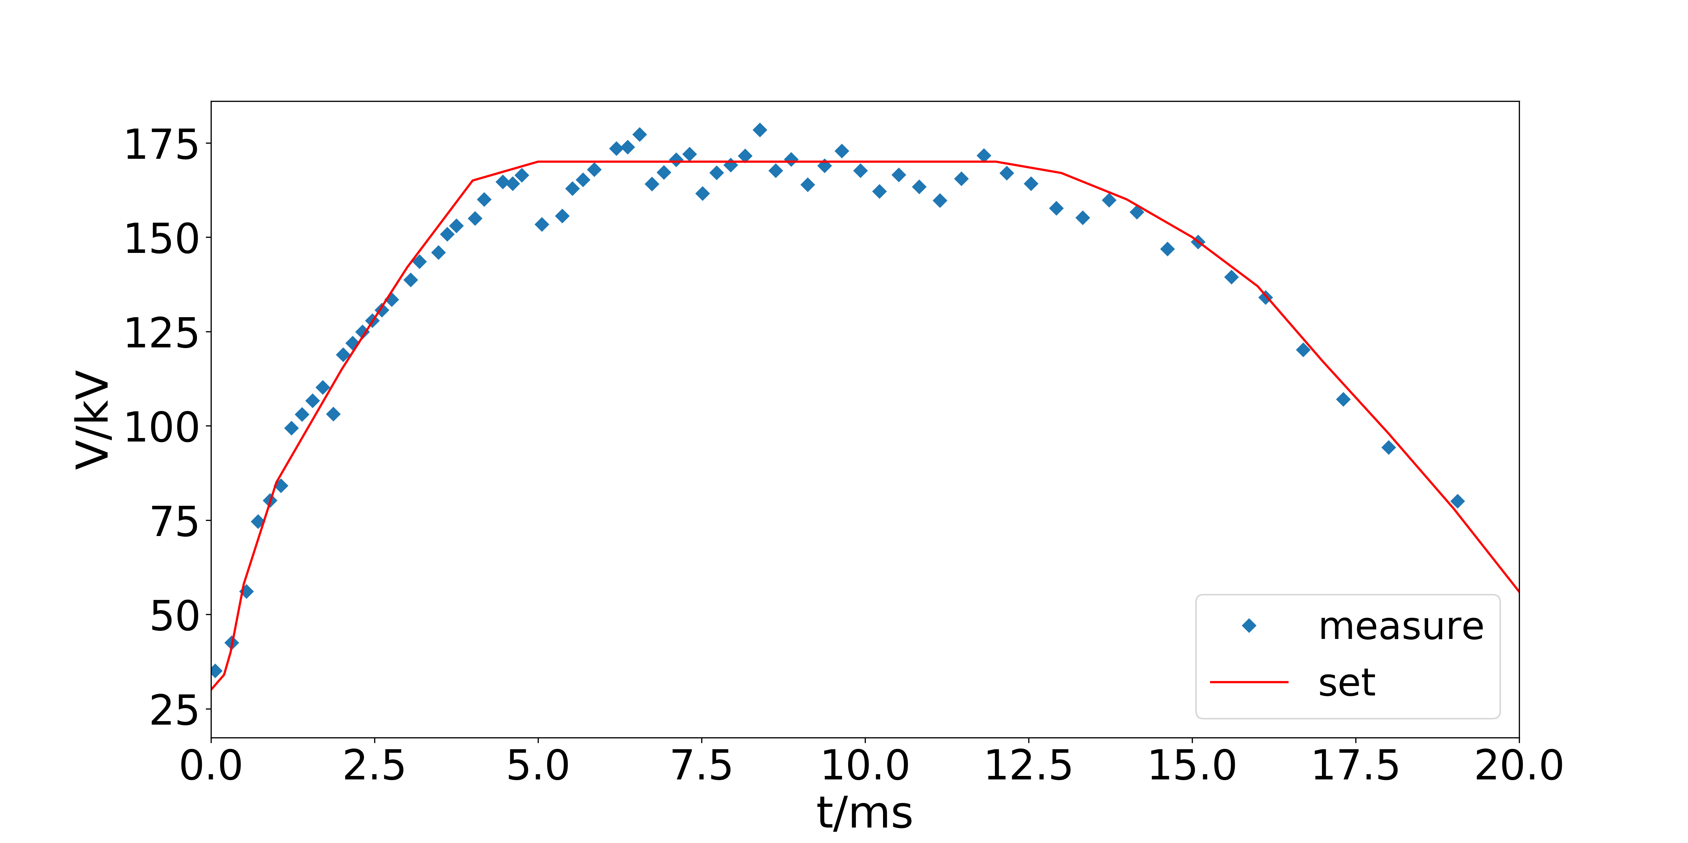
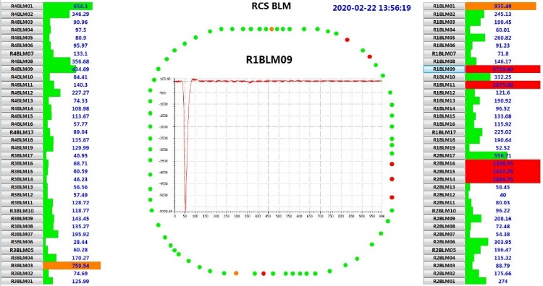
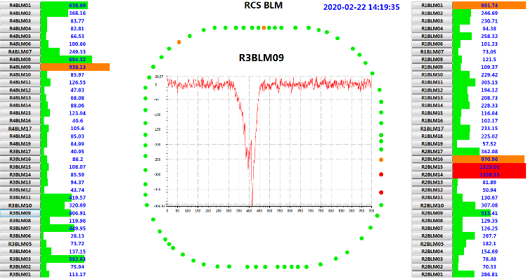
Beam commissioning process
Cavity voltage was measured and optimized
The synchronous phase increases and the bucket decreases.
The RF voltage rises faster to reduce the beam loss during 5ms~10ms
$$V= \frac{2πβ^{2}E_{s}Q_{s}^{2}}{ehη \cos{φ_{s}}}$$
The voltage is low and flat, and there is beam loss during the beam capturing;
The RF voltage is increased rapidly in the beginning.
Beam loss at 8ms
Beam loss at 1ms

Slide 20
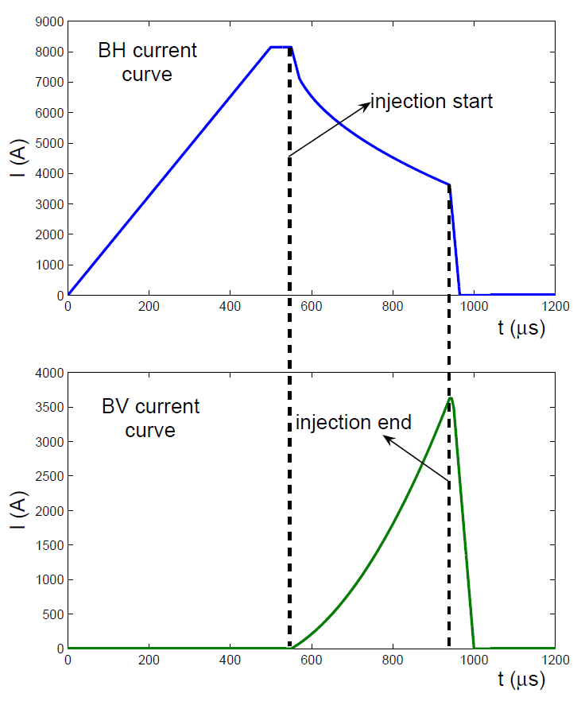
Beam commissioning process
A new methods was proposed to perform the correlated painting
The beam intensity in vertical phase space is effectively mitigated

Slide 21
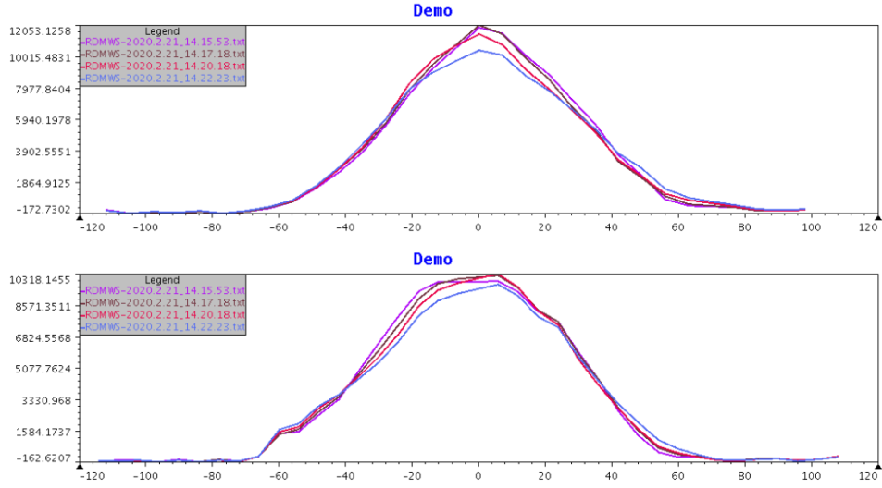
Beam commissioning process
Correlated
Anti-correlated
Horizontal
By correlated painting:
Beam loss is well controlled
Beam distribution is much better
Vertical

Slide 22
Beam commissioning process
Stripping efficiency of the stripping foil
For the single-layer structure stripping foil, there may be some holes in the stripping foil, and the H⁻ particles may pass directly through the hole not being stripped.
The double-layer structure stripping foil was used to increase the stripping efficiency.
The beam loss in the injection area was effectively reduced.

Slide 23
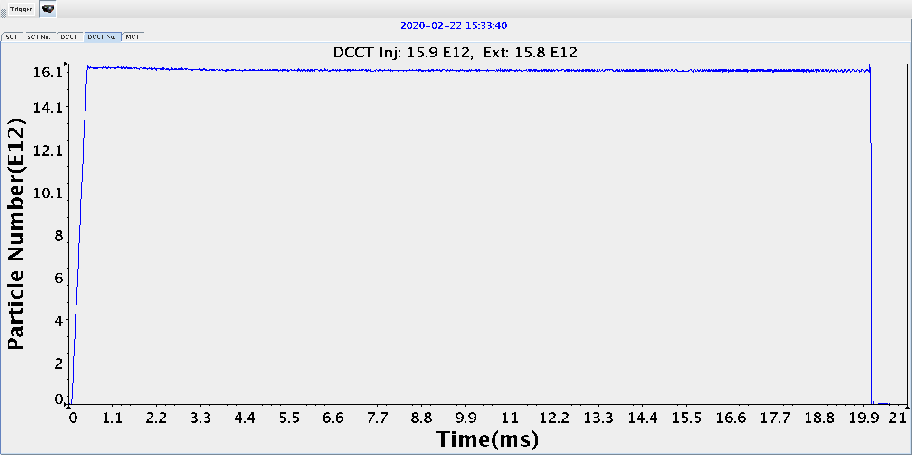
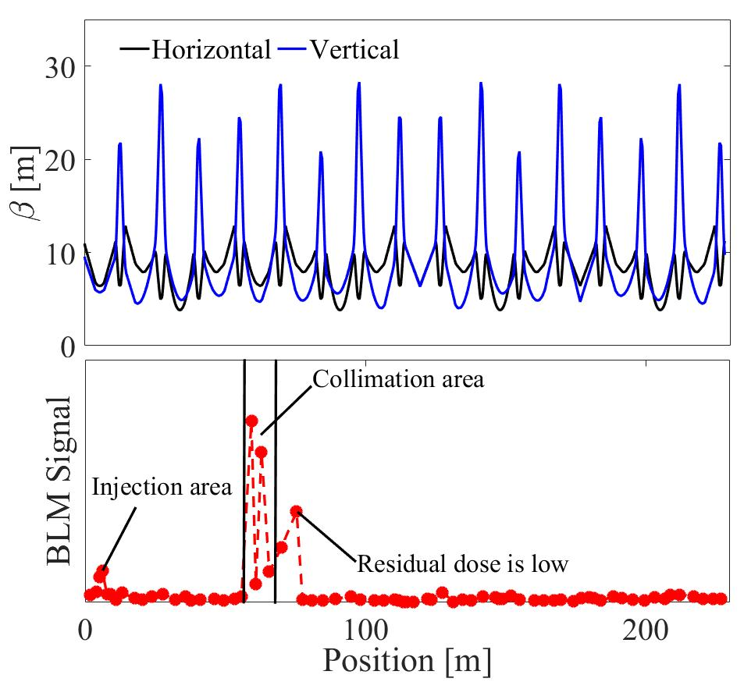
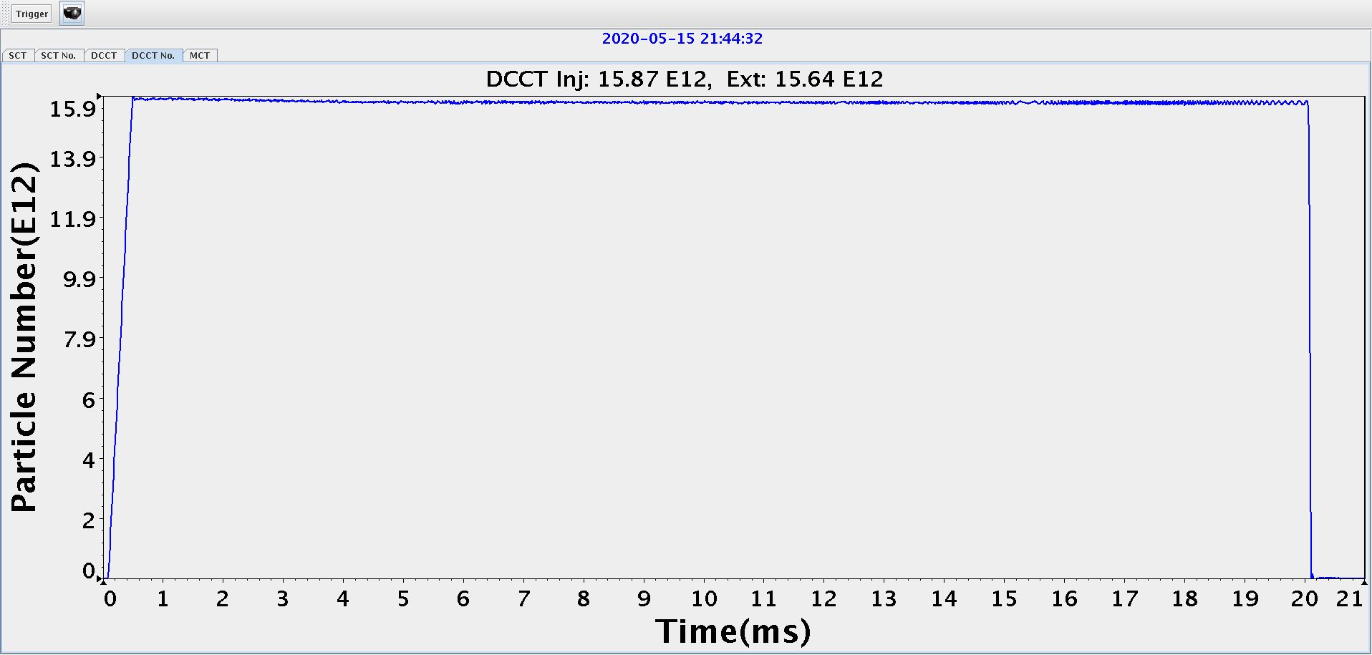
Beam commissioning process
In February, 2020, the CSNS/RCS beam power achieved the design value of 100-kW at a low beam loss level.
BLM signals along the RCS
The beam transmission was about 99.5% with collimators open.
The beam transmission was about 98.5% after collimators were enabled.
Most of remaining beam loss is well localized at the collimator section;

Slide 24
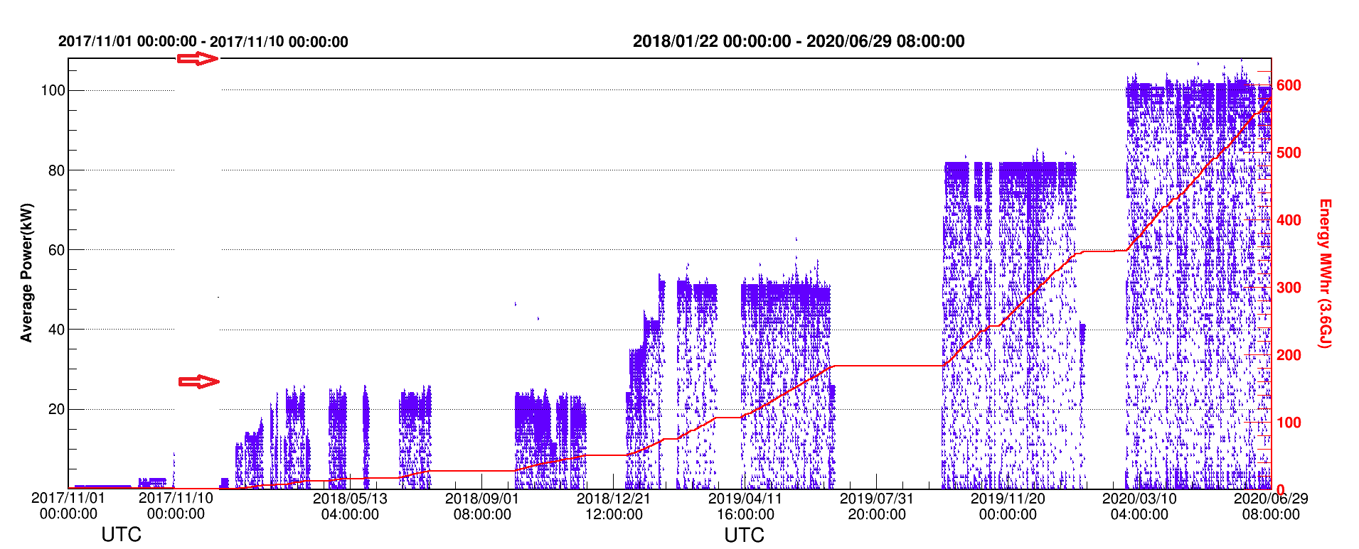
Historical Curve of Beam Power
Nov., 2017, First 10kW beam strike on target for a short while;
Mar. 2018, beam power over 20 kW in the test operation;
Jan. 2019, after 4 weeks beam commissioning , beam power was gradually increased to 50kW+ with well controlled beam loss.
Sep. 2019, based on the 6 weeks beam commissioning, the beam power in user operation was increased to 80 kW step by step.
The beam power was increased to 100kW in the end of Feb. 2020.

Slide 25
Upgrade plan
Install the pulse Trim-Qs to shape the tune curves, and to reduce the beta-beating
Install the AC sextupoles to control the coherent oscillations, and reduce the chromatic tune spread in the low-energy region
Re-install the injection components to realize the real correlated painting scheme

Slide 26
Summary
The beam commissioning in CSNS/RCS has been successfully done, reached design goal of 100kW beam power after two and half years beam commissioning.
A low-intensity beam was first used to perform orbit and lattice correction in CSNS/RCS.
Bunching factor and injection painting were optimized to mitigate the space charge effects.
Tunes were optimized to suppress the instability and to reduce the space charge induced beam loss.
Upgrading for high beam power will start in near future.

Slide 27
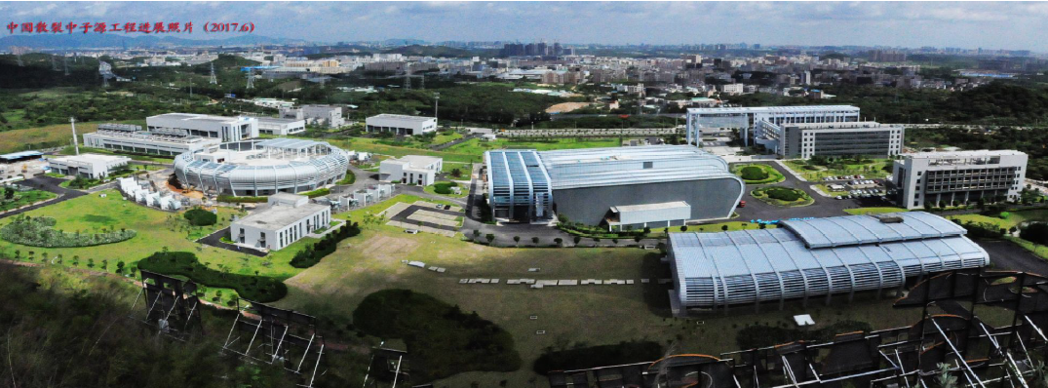
Thank you !

