Slide 1
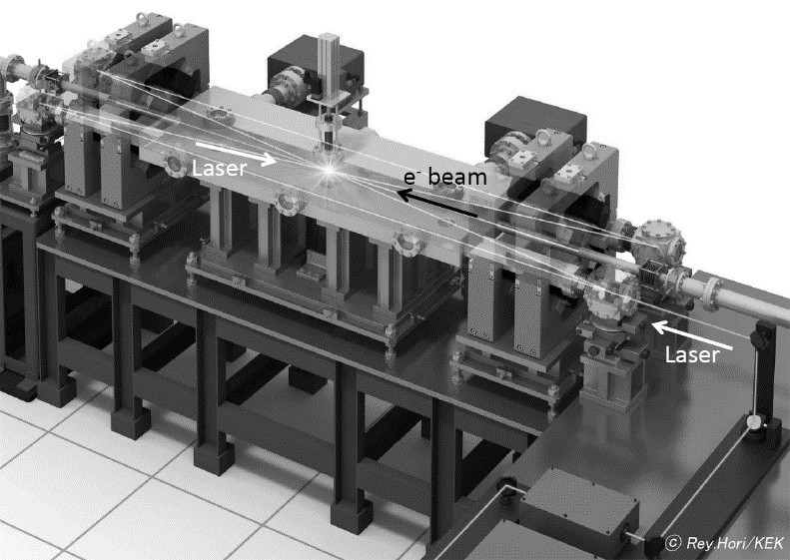
High intensity X-ray source using large optical cavity and the future
Junji Urakawa (KEK), WG-1 presentation, 2021.3.17 afternoon session
Abstract
We are developing relatively large 2D 4-mirror optical cavity to reduce the crossing angle between electron bunch train and laser pulse train. Total length of first 2D 4-mirror optical cavity is 7.56m and it includes 9 laser pulse train to realize the crossing angle of 8 degrees between electron beam in Linear accelerator and the laser pulse train in the optical cavity [1]. Second 2D 4-mirror optical cavity is under design and the total length of planed cavity is 16.6m in which 18 laser pulse train can circulate and we have the possibility to realize the crossing angle of 2 degrees.
I will report the performance of first 2D 4-mirror optical cavity and the experimental plan on 2D 4-mirror optical cavities. Below photo shows 1.9m long 2D 4-mirror optical cavity which is operating to generate X-ray. We hope it will be installed into Super-conducting Linear accelerator (STF) to generate high brightness γ-ray in the future.
2-mirror vs 4-mirror optical cavity
*4-mirror is 100 times stable system.
*4-mirror is more flexible in the following points.
Laser injection, feedback to stabilize the resonance
and monitoring the laser profile and intensity in the
Optical cavity.
[1] Kazuyuki Sakaue et al., “Stabilization of an optical enhancement cavity using a counter propagating mode” REVIEW OF SCIENTIFIC INSTRUMENTS 89, 023305 (2018).

Slide 2
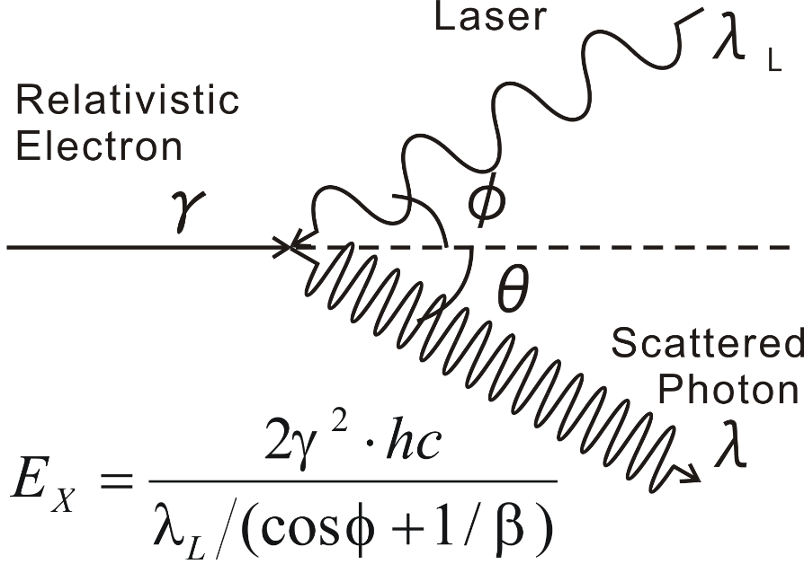
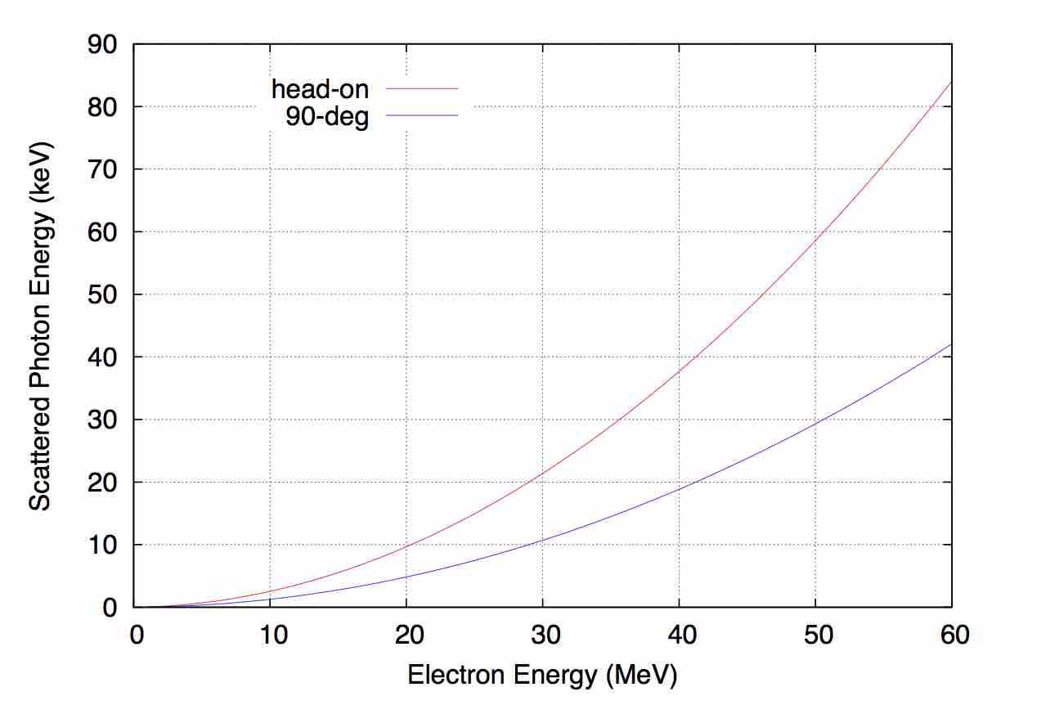
Laser Compton Scattering (LCS)
1. LUCX (Laser Undulator Compact X-ray)
Inverse Compton Scattering
Laser
Several 10 MeV electron beam
  (Small accelerator)
Several 10 keV X-ray
(like as large SR accelerators)
Property of LCS X-ray
small source point
monochromatic by collimation
Tunable Energy
short pulse (ps, fs)
(Exam.)
Laser 800 nm
0°scattering
Head-on collision
90°collision

Slide 3
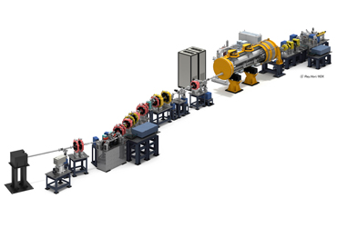
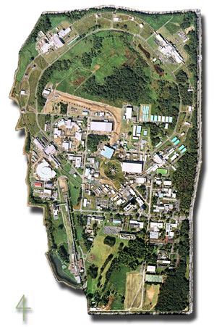
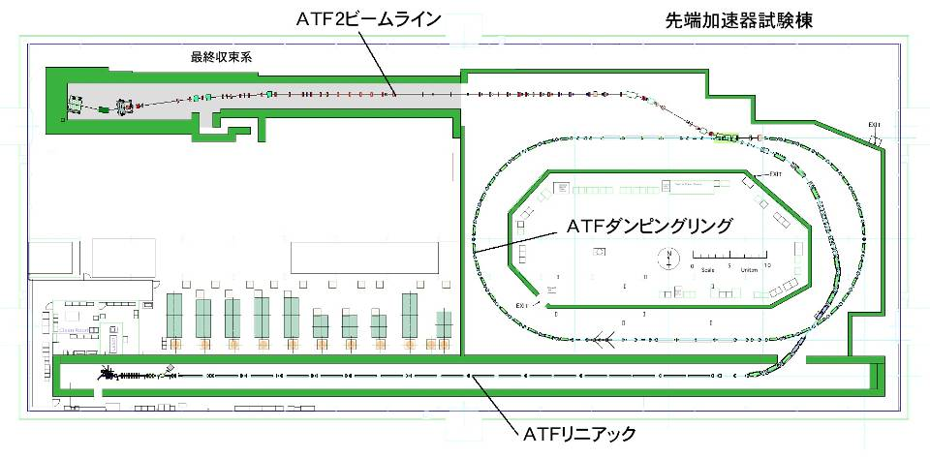
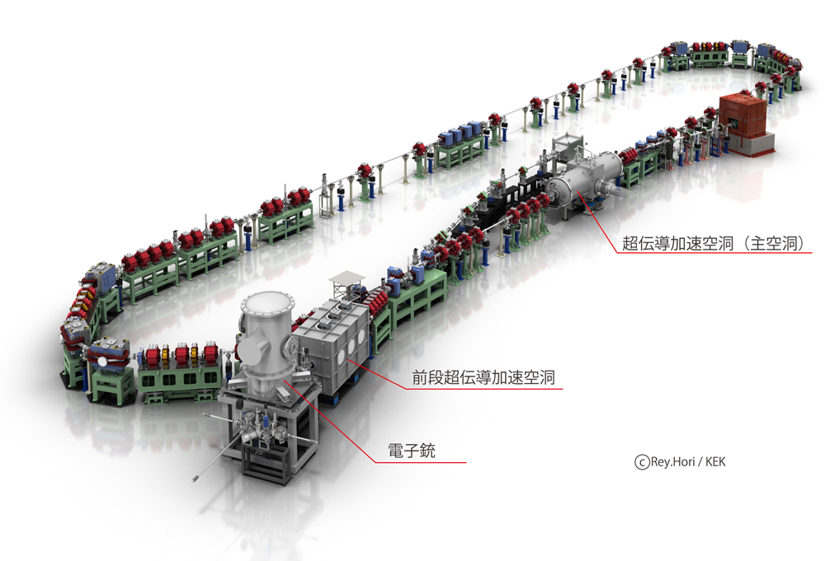
Electron Accelerators in KEK used for LCS R&D and experiments to develop technologies
ATF
STF
Electron beam: 1.3 GeV
Intensity: ~2x10¹⁰ e/bunch,
1 ~ 20 bunches/train, 3.12 Hz
  ε_{x/y} ~ 1.5nm/4pm
Superconducting RF
Pulsed beam:
1.3 GHz, 1 ms
Higher energy:
60 MeV → 300 MeV
Plan to restart in 2018
Cs₂Te
Photocathode RFgun
マルチバンチ電子ビーム生成
Damping Ring
低エミッタンスビーム
S-band Linac (1.3 GeV)
LUCX
cERL
Normal conducting RF
Pulsed beam: 357 MHz - 1000 bunches/pulse
1.2MW pulse laser stacking in optical cavity as the peak
24 MeV-32MeV
Superconducting RF
CW beam 100 uA → 10 mA
20 MeV-35MeV
Notes:
KEK constructed the Accelerator Test Facility (ATF) and the Superconducting Accelerator Facility (STF) for ILC R&D and operates them for educating and training young researchers. Also, Compact Energy Recovery Linac (cERL) and Laser Undulator Compact X-ray source (LUCX) for developments to the application were constructed and are operated. From many experiences based on the construction and the operation in these four facilities, I would like to explain how to design and construct the advanced electron accelerator in the energy range of 3MeV to 30MeV as extremely useful facility with some application examples.

Slide 4
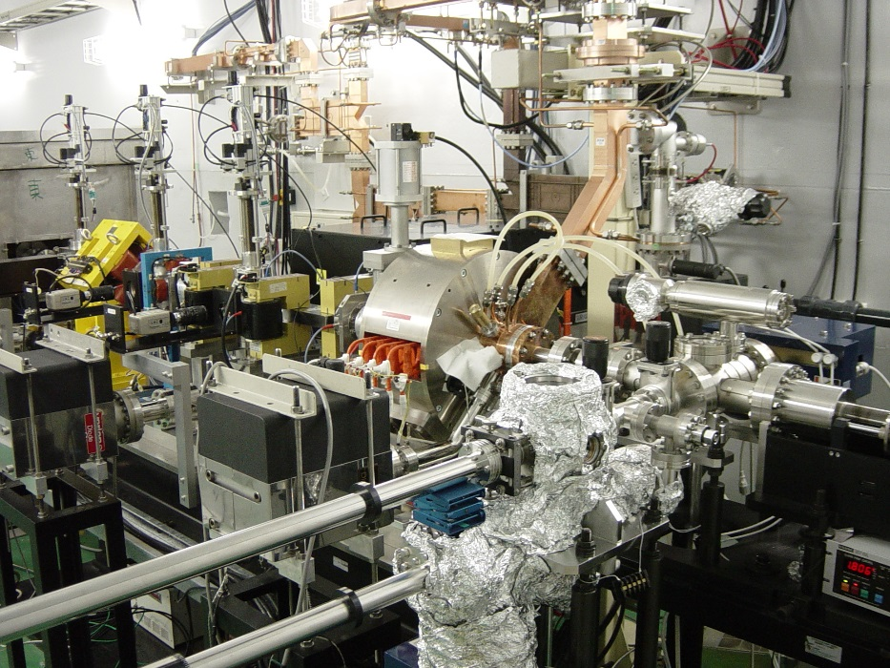
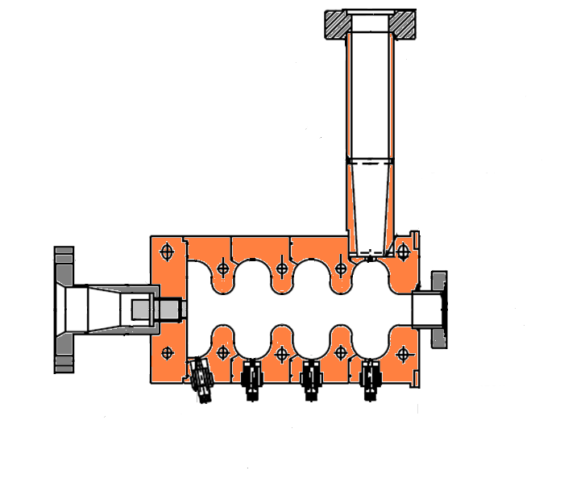
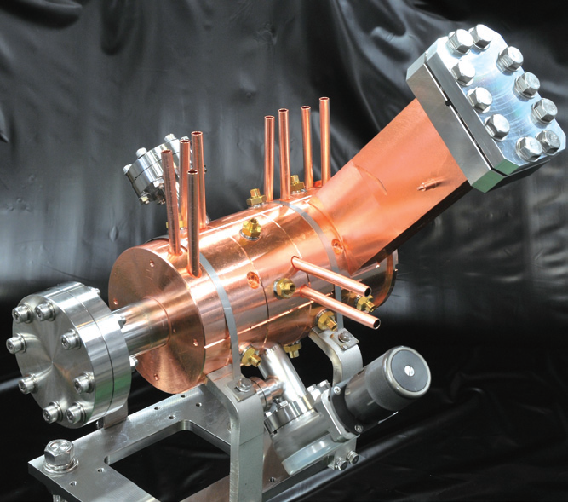
LUCX and ATF electron source: 3.6-cell RF gun
Frequency (π-mode) 2856 MHz
Qvalue 15000
Coupling β 0.99
R/Q 395Ω
Mode separation (π-2π/3) 2.8 MHz
RF Input
Waveguide
Cs₂Te photocathode
e⁻ beam
UV laser
(266nm)
Tuner
100mm

Slide 5
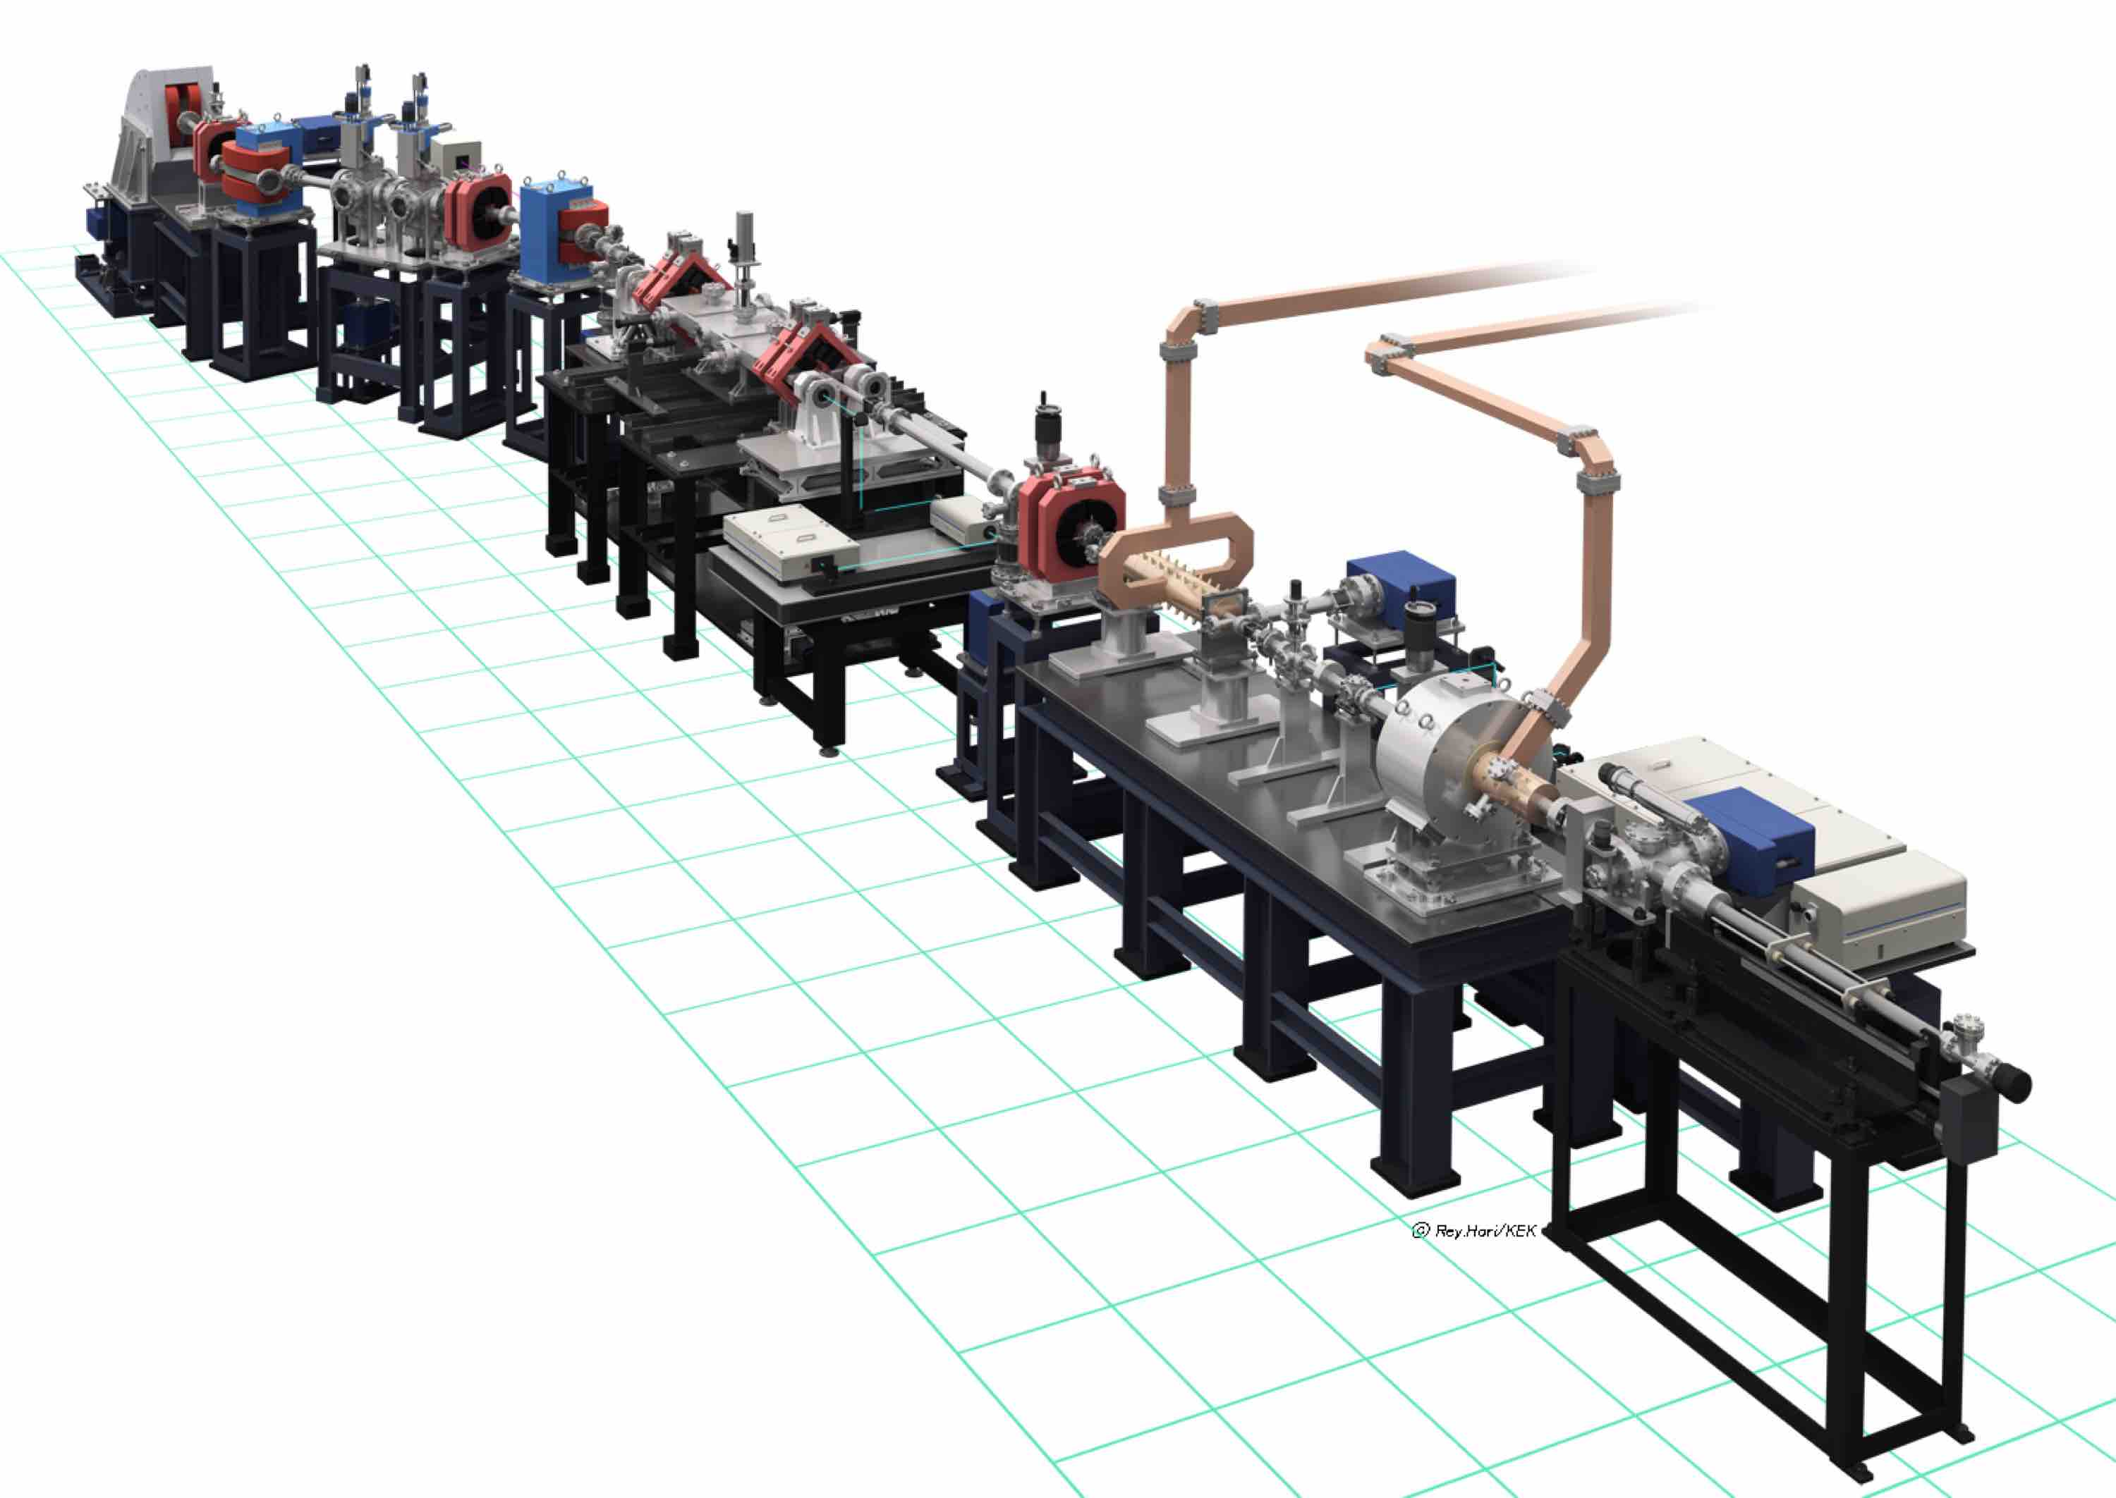
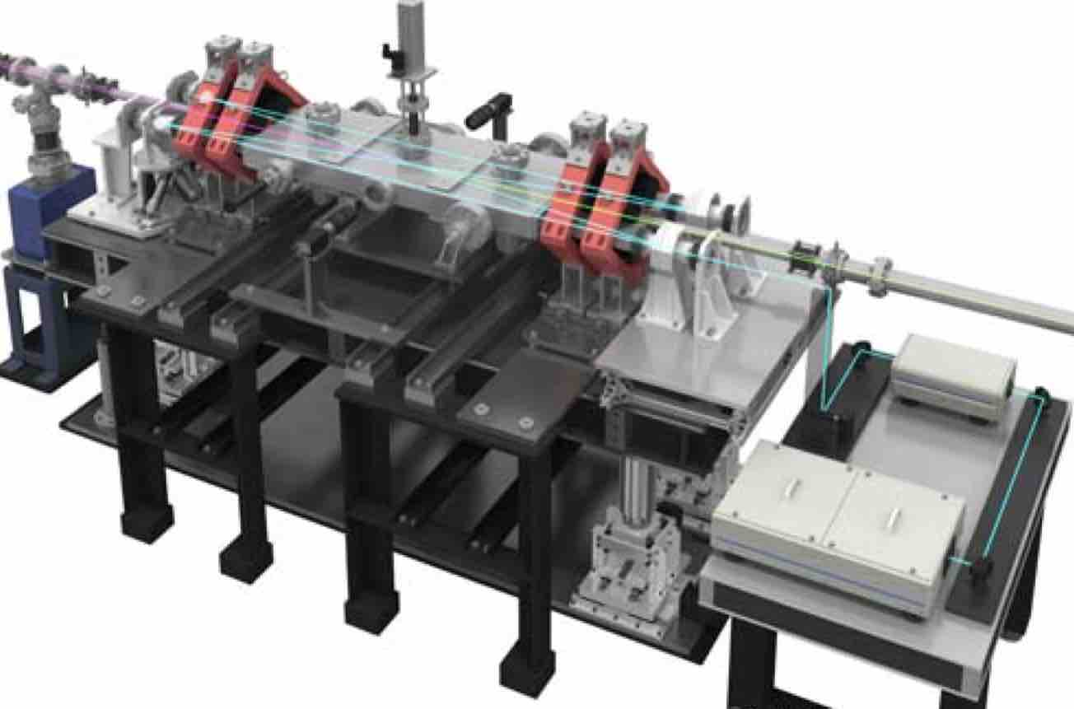
LUCX accelerator
LCS X-ray
Optical Cavity:
LCS X-ray source
12-cell Booster
electron source
Photocathode RF gun
Optical Cavity

Slide 6
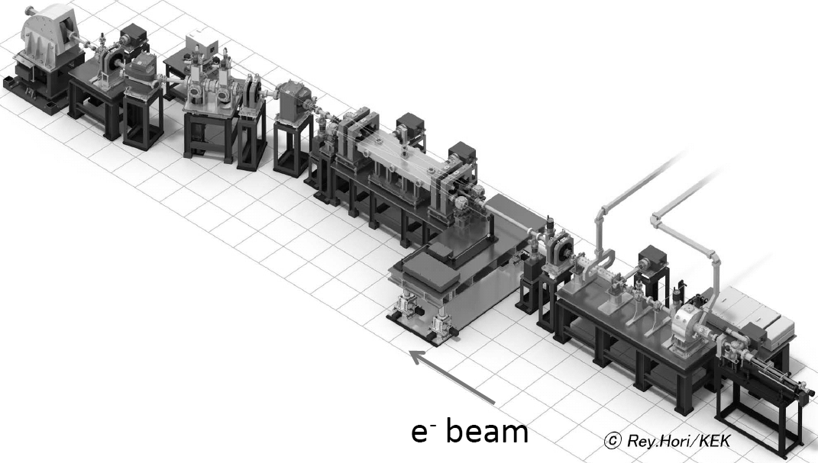

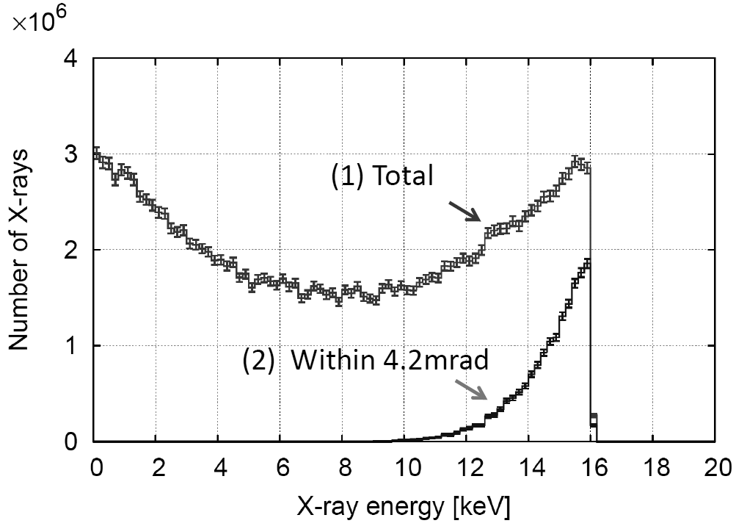
Application to novel light sources
Energy | 30MeV
Intensity | 0.4nC/bunch
Number of bunch | 1000
Beam size at the collision point (1σ) | 33μm ×33μm
Bunch length | 10ps
Bunch spacing | 2.8ns
My colleagues got the X-ray
Flux of 10⁷ at 12.5Hz.
Still we have problem
on cavity rigidity.
We need the improvement
of table and installation of
high reflectivity mirrors.
Energy | 1.17eV(1064nm)
Intensity | 8mJ/pulse
Waist size(1σ) | 55μm ×25μm
Pulse length | 7ps
Calculation
Brightness 10¹²
Photons/sec/mm^{2/}mrad² in 0.1%b.w.
Photon flux more than 10⁸ per second
Several second is enogh to get X-ray imaging.

Slide 7
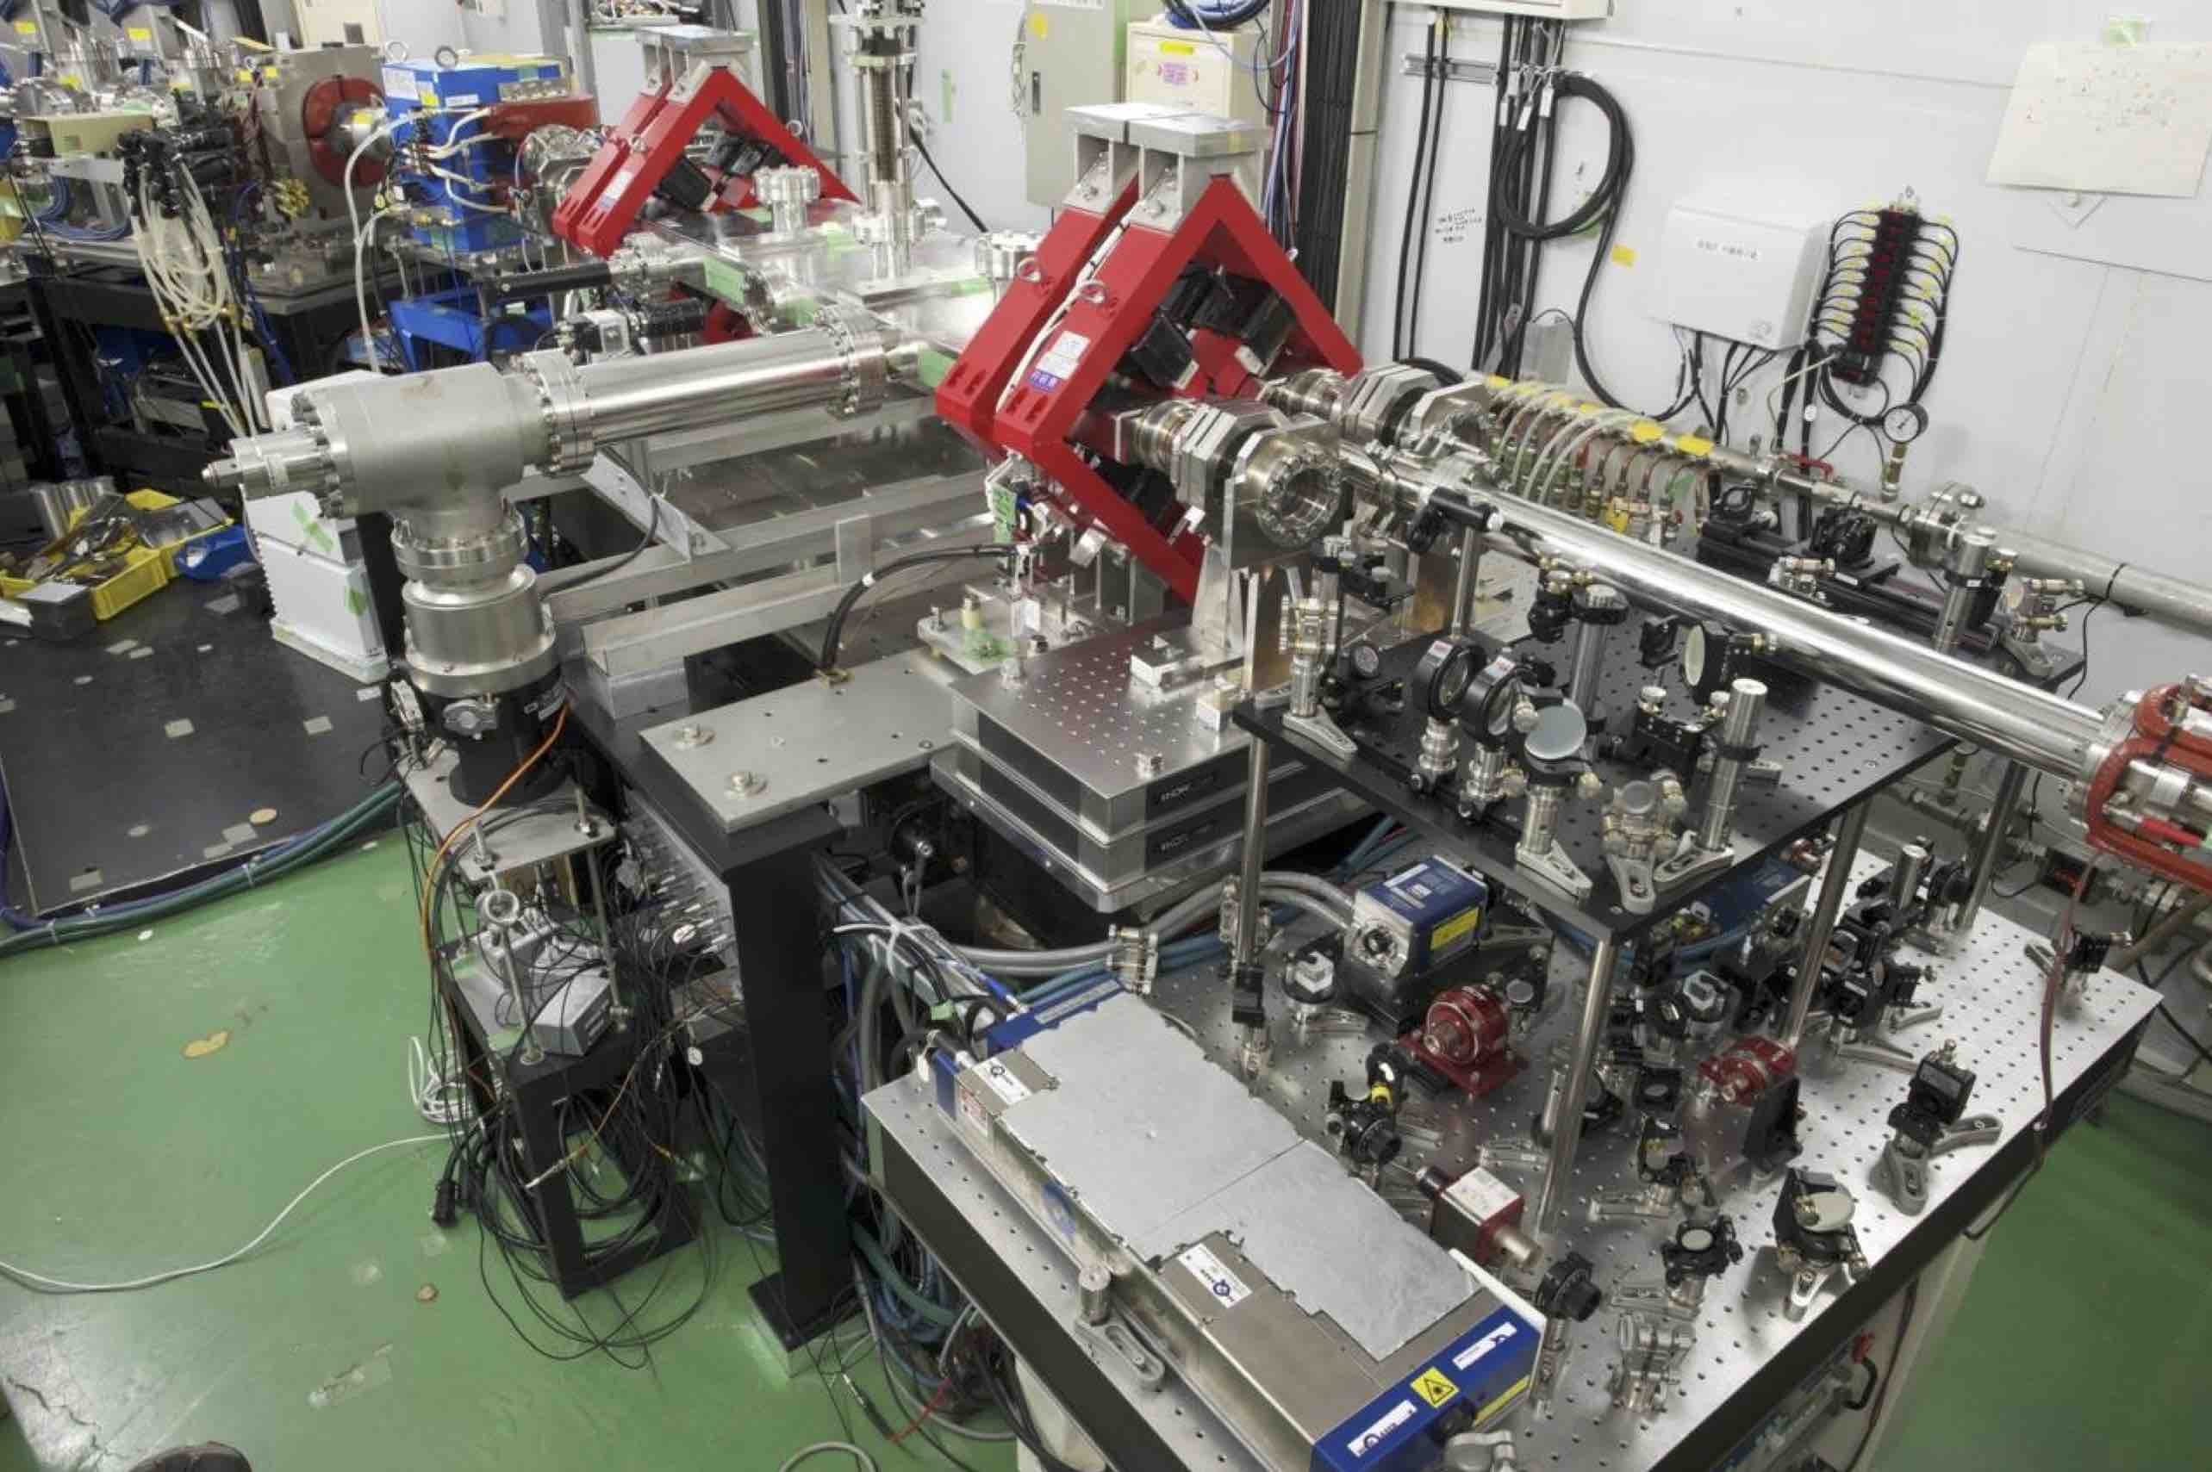
LUCX Optical cavity and Laser system
2. Laser Pulse Accumulation with Burst Amplification

Slide 8
K. Sakaue (Waseda univ.)

Slide 9
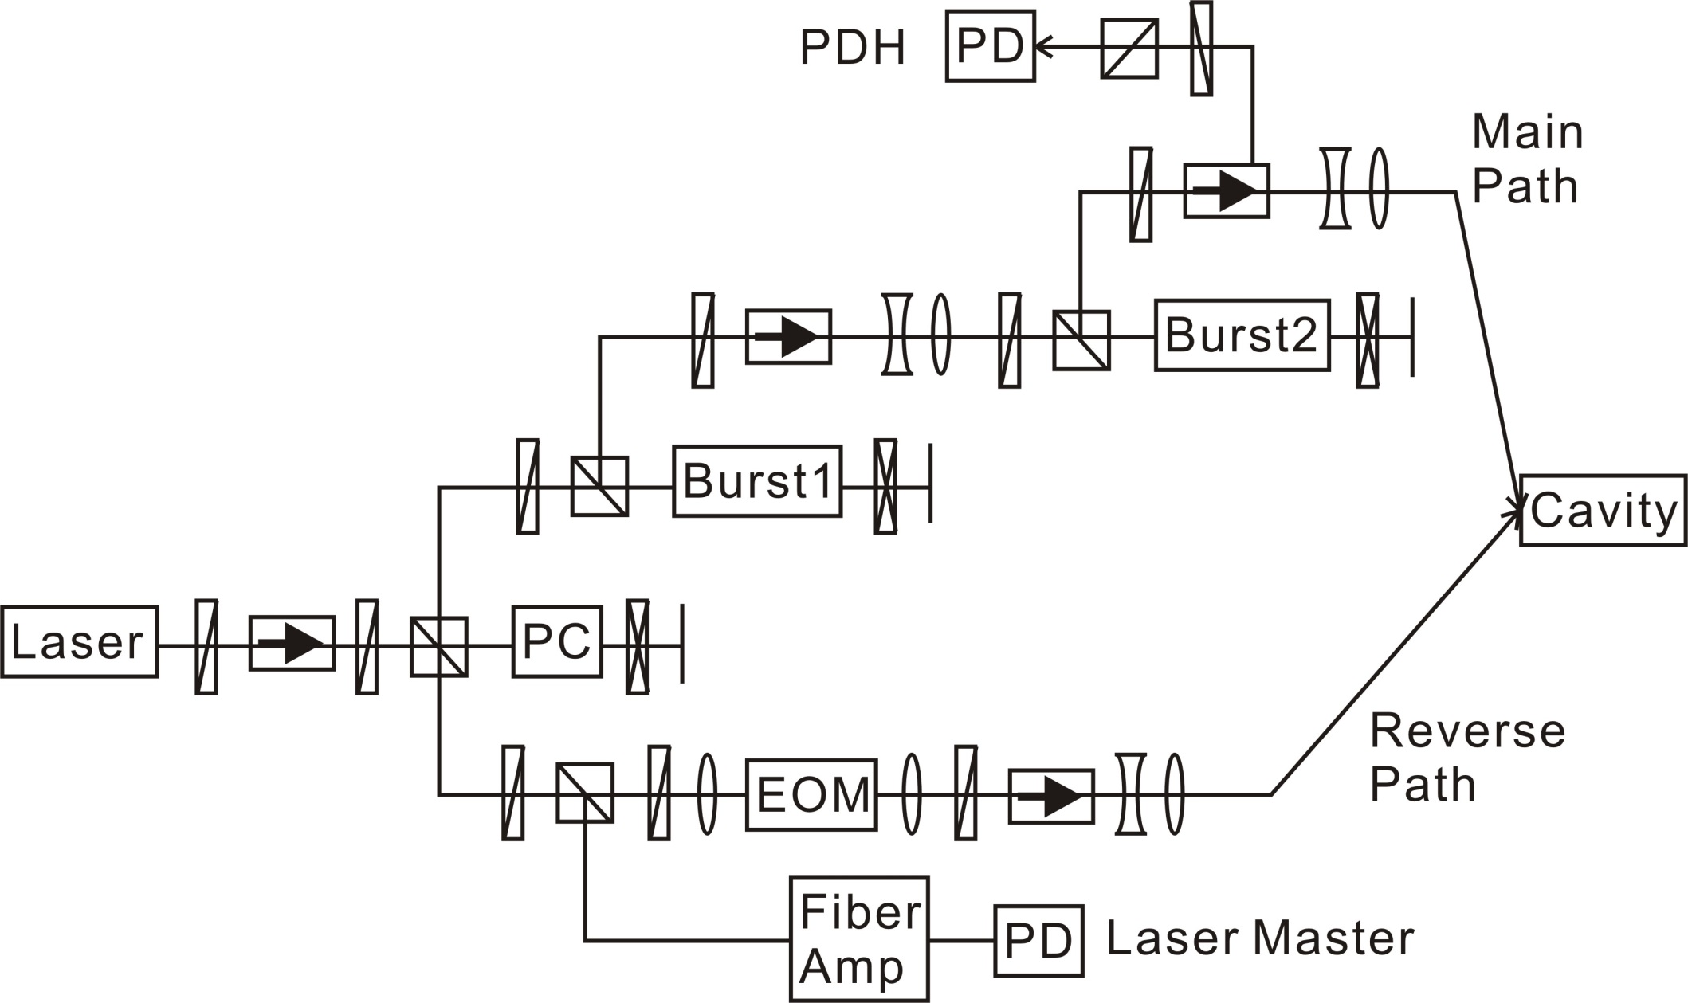
We installed the Pockels cell in order to collect the amplification
power at the electron beam timing.
30kW burst amplified pulse
3W picked up pulse
3W

Slide 11
Laser power stability in the optical cavity
Stability of stored pulse intensity: 15% rms
About 0.2nm accuracy of cavity length adjustment was not achieved two years ago.
Stability of stored pulse intensity: 3.5% rms
About 0.2nm accuracy of cavity length adjustment is achieved now.
Optical cavity is not stable due to the vibration and laser
injection optics drift.
2.8mJ/pulse

Slide 12
Development of multi-bunch e⁻ beam at LUCX
LUCX beam target：
30 MeV, 357 MHz
bunch spacing 2.8 ns
more than 1000 bunches/pulse,
beam size less than 100mm
X-ray detector
LCS
Collision point
RF cavity
Electron Bunch Charge
Number of bunches (1000)
Electron beam stability :0.2%(in σ)
2012： 150 bunches, 90 nC
2013： 300 bunches, 380 nC
2014：1000 bunches, 600 nC, 24 MeV
Energy compensation by RF amplitude modulation

Slide 13
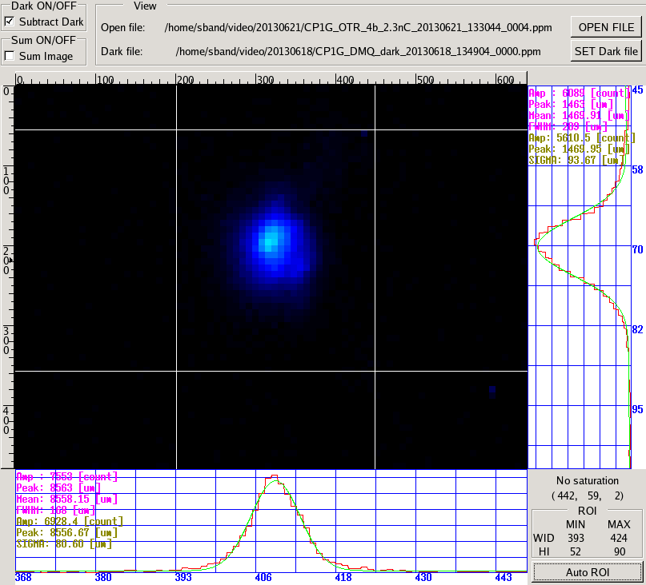
Laser pulse
Energy in the
Optical cavity
Total charge
per train
40μm×70μm
Summary of Laser-Electron Beam Parameters at the photon-electron collision point
LASER
Wavelength | Repetition | Power | Pulse energy
1064nm | 357MHz | 1MW | 2.8mJ
Size(H) | Size(V) | Pulse duration | Col. angle
60um | 25um | 7ps | 7.5°
9keV LCS X-ray Energy
ELECTRON
Energy | Repetition | Charge | N. bunch
22MeV | 357MHz | 0.6nC | 1000
Size(H) | Size(V) | Bunch length | Emi (H) | Emi (V)
40um | 70um | 15ps | 5πmmmrad | 6πmmmrad

Slide 14
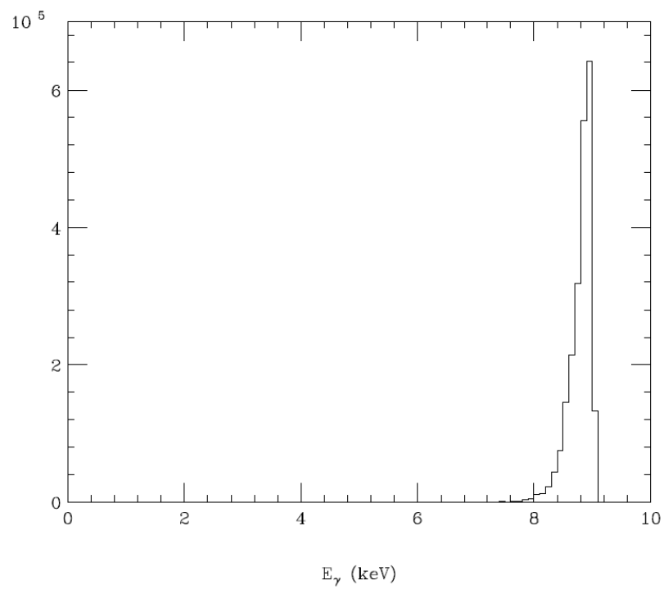
Measured X-ray intensity distribution and the comparison with CAIN simulation
CAIN Simulation assumed following measured values.
Number of X-ray: 3.6x10⁷ Photons/sec
X-ray Energy: 9keV
Source size: 60um x 25um
X-ray energy distribution at the HyPix-3000
Number of X-ray:
1.2x10⁷ Photons/train
Rep. Rate: 3.13Hz
Energy band width(FWHM): ~4%
X-ray flux at the HyPix-3000:
11.83 photons/sec/pixel
This pixel size is 100um x 100um.
12.5Hz
Calculated by CAIN

Slide 15
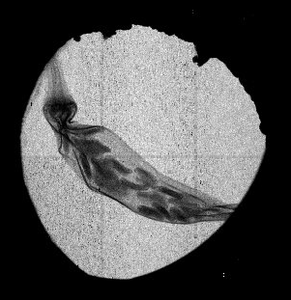
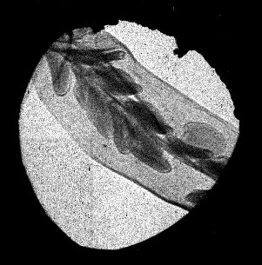
LCS X-ray imaging at LUCX
small source dimensions
clear expansion of image
edge contrast enhancement by refraction
detector
LCS
point
detector
Chili pepper
300 sec
Chili pepper
280 sec

Slide 16
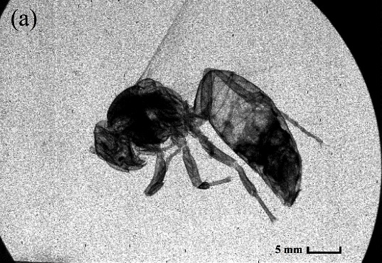
Evaluation of present LCS performance
SR X-ray (PF-AR)
30 msec exposure
for angiography
Assume the angiography by LCS X-ray,
need 100 improvement
intense electron beam
intense laser pulse
smaller beam size
increase repetition rate
…
small crossing angle
higher e- beam energy
…
integrate challenges!
LCS X-ray (LUCX)
10 sec exposure
at 10⁷ photons/sec
still improving…
LCS X-ray (cERL)
100 sec exposure
at 10⁷ photons/sec

Slide 17
70mm
3. How to increase the photon yield?
*Reduce the crossing angle, then we need a large optical cavity. (8 to 2 degrees increases ~10 times.)
30φ electron beam duct
~4m
*Multi-optical cavity system is possible, then we have to develop multi-fiber laser system with acceptable cost. (increases ~10 times)
2m
2m
Electron beam
X or γ-ray
Electron beam
laser beam
Concave mirror

Slide 18
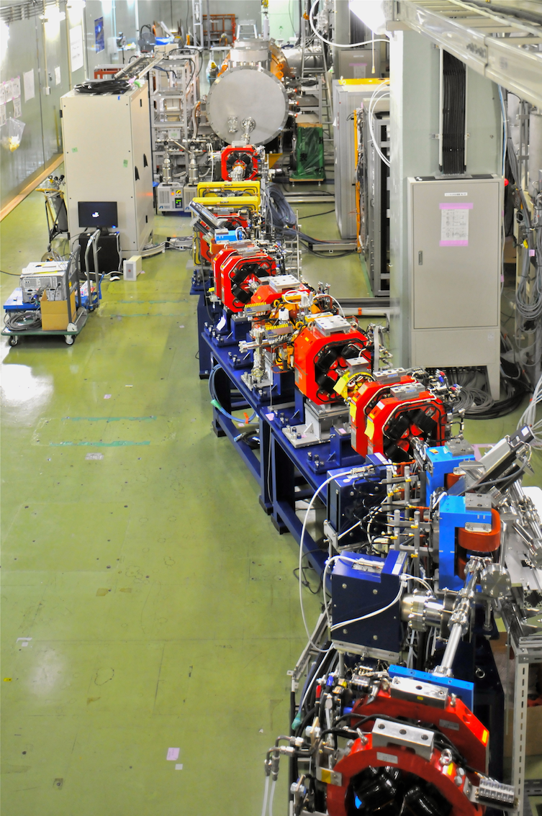
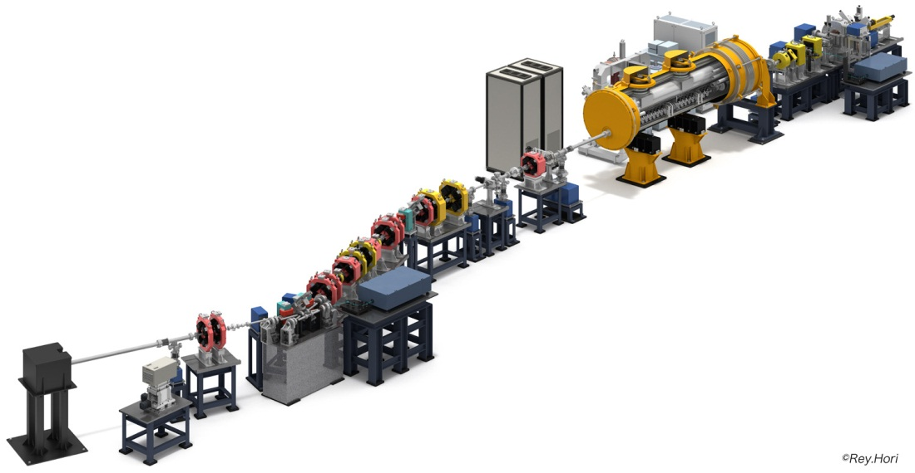
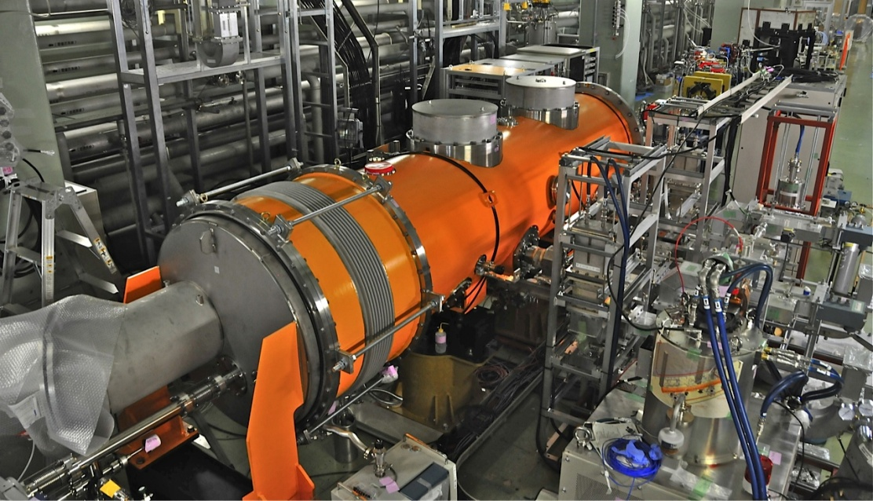
*Increase electron beam current, then we have to use super-conducting linear accelerator. (increases ~1000 times)
Beam Dump
2D four mirror cavity to generate X-ray with two cylindrical lenses.
View from Beam Dump
X-ray Detector
Development for Next Generation Compact High Brightness X-ray
Source using Super Conducting RF Acceleration Technique

Slide 19
4. Summary
Possible mode-lock laser system
for photocathode
YDF
6/125 PM
DC YDF
12/125 PM
DC YDF
40/200 PZ
LD
LD
LDs
Compact Fiber Laser Oscillator with 4 mirror optical cavity
Fibered Stretcher
Isolator
Isolator
Free Space Compressor
1st Pre-amplifier
2nd Pre-amplifier
Power Amplifier
We can select the repetition rate of the laser pulse which is 162.5, 325 or 650MHz.
For example, 0.3μJ/pulse x 325MHz <100W, so we can use fiber rod for power
amplification.
It is a fundamental technology development to realize a compact X and γ-ray source ,which energy is several tens of keV or MeV, where a wide variety of application is expected.
Compact LCS X and γ-ray source can be small to fit in universities, industrial labs and hospitals, then will contribute to improve our life.

Slide 20
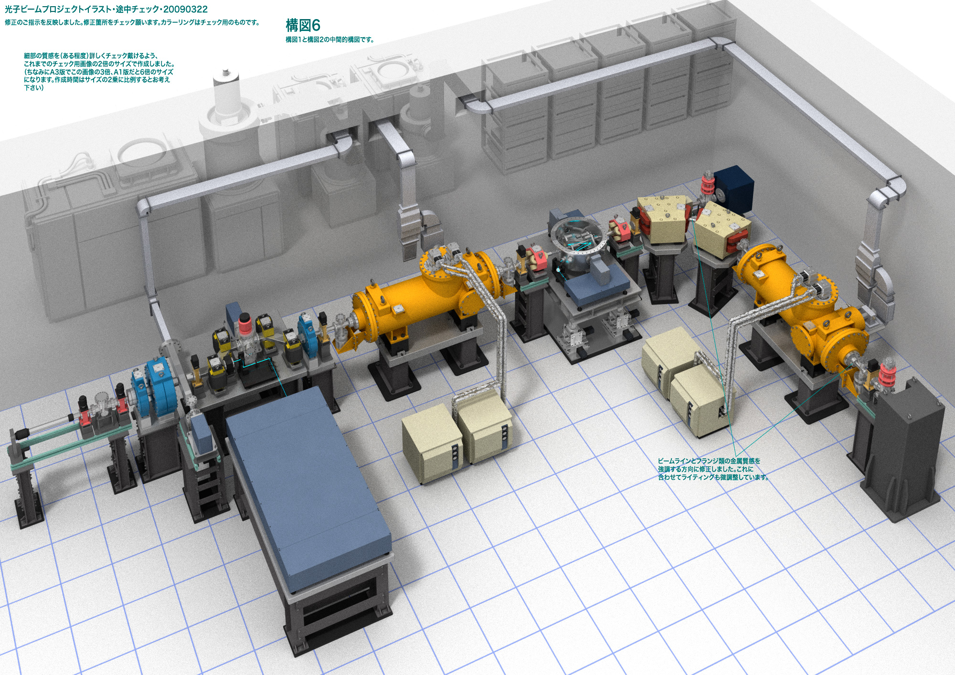
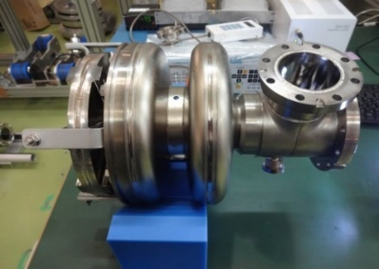
To get clear X-ray imaging every second, we have to increase
the X and γ-ray flux by factor ~ 100, which is 10⁹ photons/sec.
High brightness X and γ-ray facility
Super-conducting accelerator system for compact high
brightness X and γ-ray under design
Decelation for beam dump and energy recovering.
Thank you for your attention!
<50cm
We can generate 10¹³ to 10¹⁶ photons/sec by LCS X and γ-ray source using long 4-mirror multi-optical cavity system and super-conducting linear accelerator.

