Slide 1


B I N P
Commissioning of High-Power Linear Induction Accelerator (LIA) for X-Ray Flash Radiography
Danila Nikiforov on behalf LIA team
Budker Institute of Nuclear Physics
(Siberian Branch of the Russian Academy of Sciences, SB of RAS)
AFAD 2021
15 March - 18 March 2021

Slide 2
Outline
B I N P
Introduction and motivation
General layout of radiographic complex
LIA-5
LIA-20
LIA-2 injector parameters and it’s electron-optical system
High intensity electron-beam dynamics in LIA:
High-current beam transport tuning
Orbit correction
BBU suppression
Experiments with targets
Electron beam from LIA for THz generation
Conclusion

Slide 3
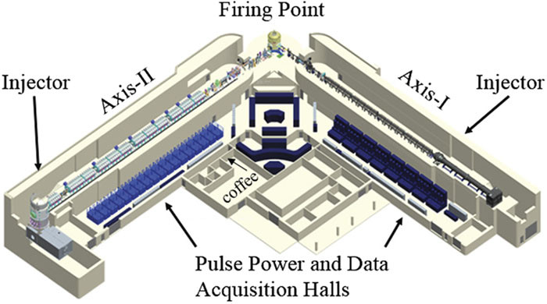
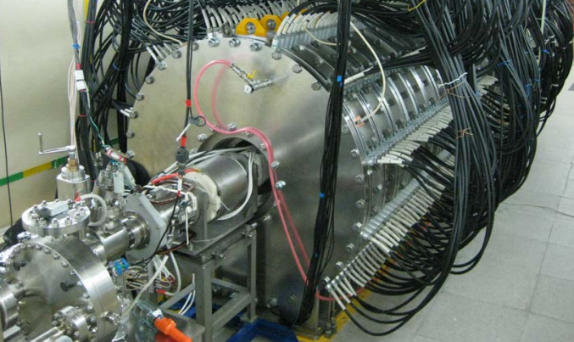
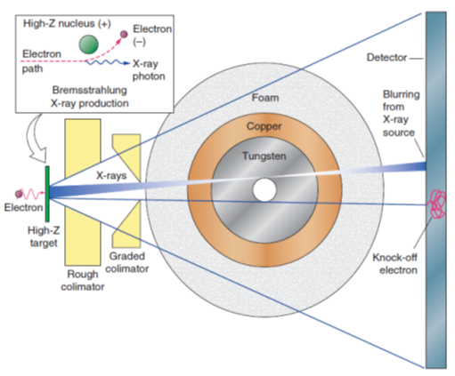
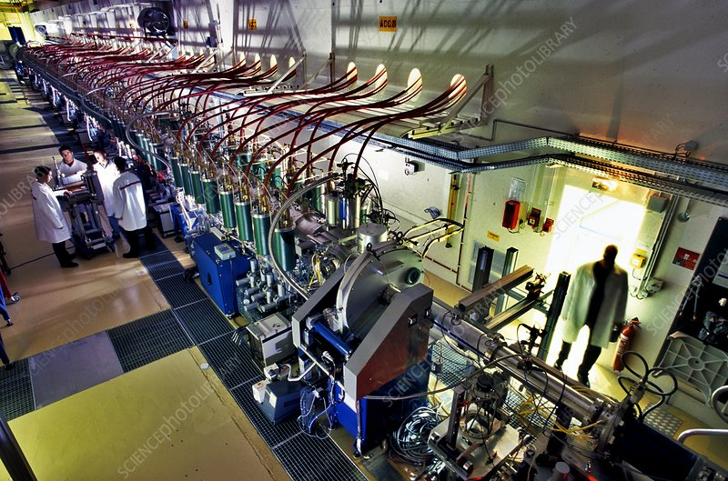
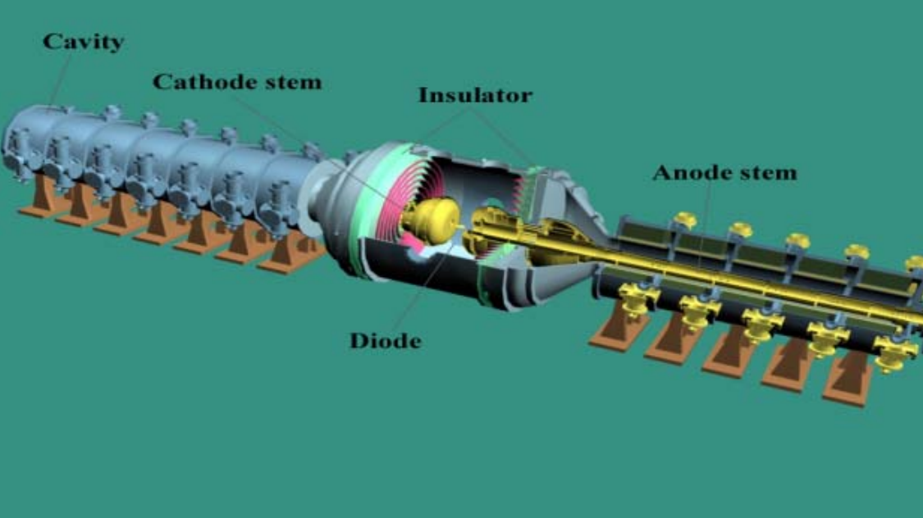
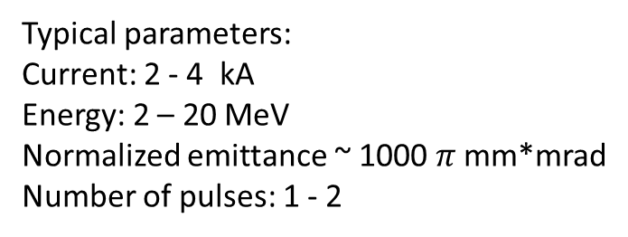
Introduction (Radiography)
High-current electron beam in linear induction accelerator (LIA) is one of the most efficient tools for the production of point-like X-ray sources for pulsed X-ray imaging.
B I N P
DARHT
LIA-2
Typical parameters:
Current: 2 - 4 kA
Energy: 2 – 20 MeV
Normalized emittance ~ 1000 $π$ mm*mrad
Number of pulses: 1 - 2
AIRIX
Dragon-I
* Cunningham G. S., Morris C.
Flash Radiography. "Historical Origins." (2003)

Slide 4
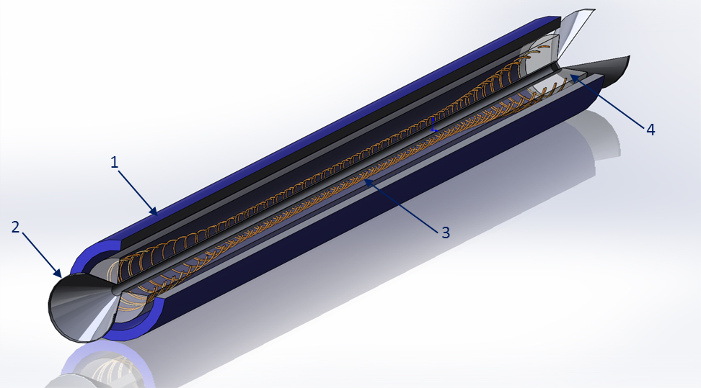
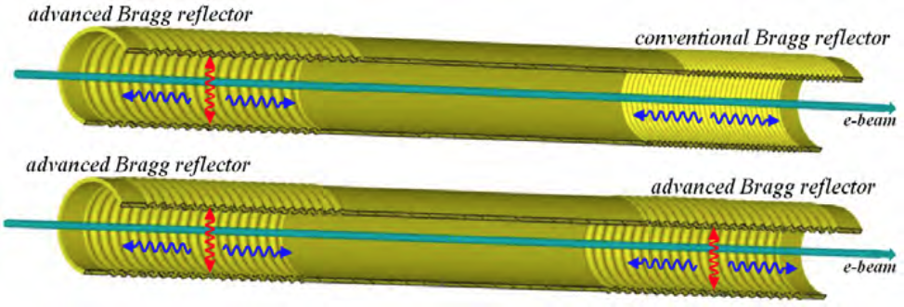
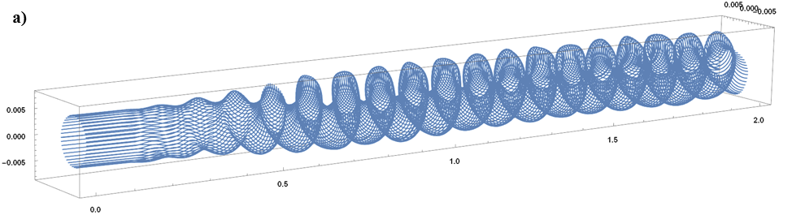
Introduction (FEL)
Electron beam from LIA can be applied to generate a terahertz radiation flux in frame of the scheme of a free electron laser (FEL). Using an induction accelerator makes it possible to have a beam current in a FEL with a pulse duration of 100 - 200 ns. In the case of the injection of a beam from such LIA into the FEL structure, one can generate the terahertz radiation with a pulse duration about of 100 ns.
B I N P
It is required to compress the beam from LIA to the diameter of ~ 10 mm and ~ 3 - 5 mm for operation in the 0.3 THz and 1 THz ranges, respectively;
General scheme of the helical ondulator with a period of 10 cm for a beam of circular cross-section: 1- pulse solenoid of the beam compression system, 2- vacuum channel of the beam drift, 3- ondulator windings in the form of bifilar spiral, 4- cylindrical frame made of fiberglass for mounting the ondulator windings.
Andrey V. Arzhannikov, Naum S. Ginzburg, Andrey M. Malkin et al. “Powerful Long-pulse THz-band Bragg FEL based on Linear Induction Accelerator” 2019 44th International Conference on Infrared, Millimeter, and Terahertz Waves (IRMMW-THz)

Slide 5
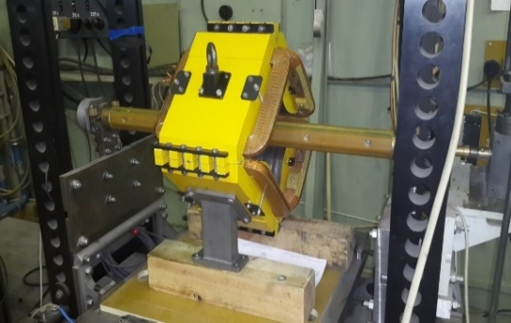
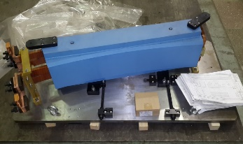
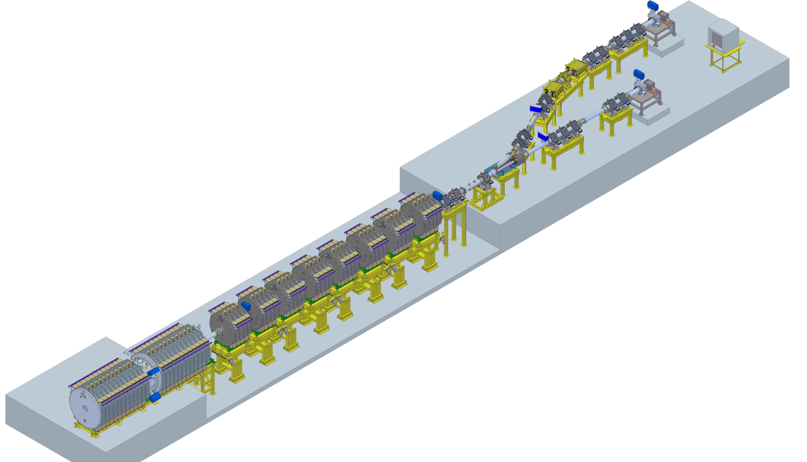
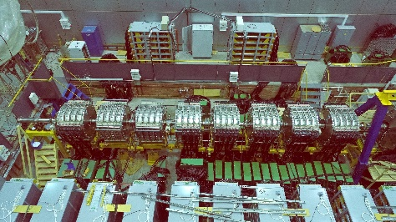
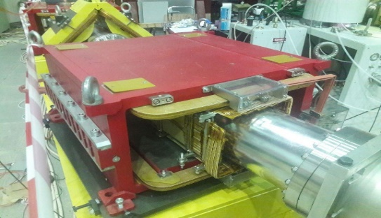
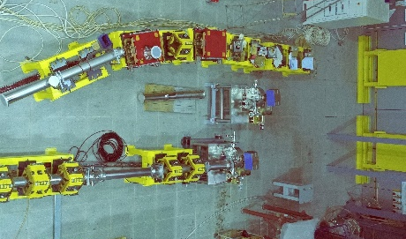
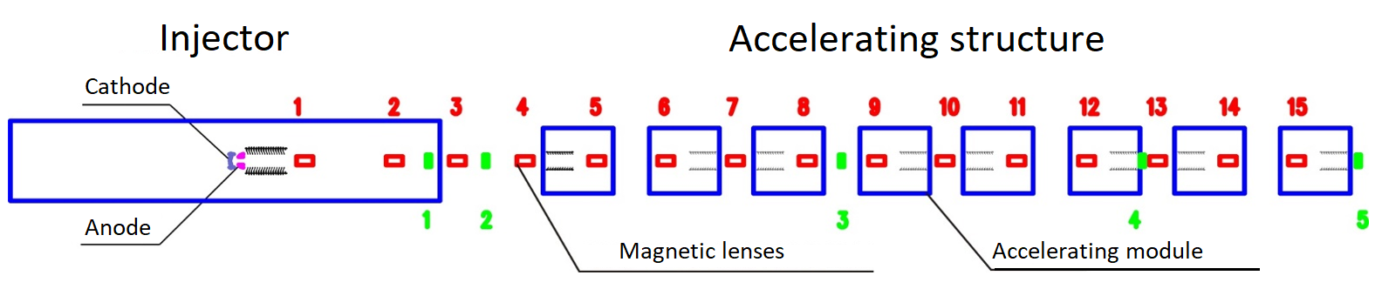
General Layout of Radiographic Complex LIA-5
B I N P
Septum magnet
Accelerating modules
Injector
Transport channels
E-beam parameters at linac exit
Maximum energy | 5 MeV
Maximum current | 2kA

Slide 6
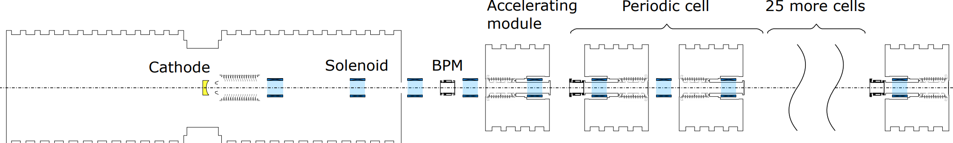
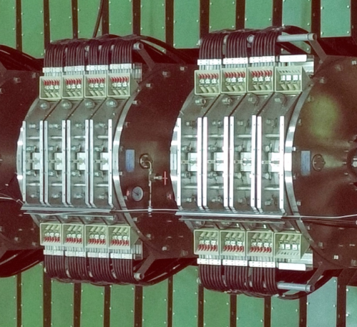
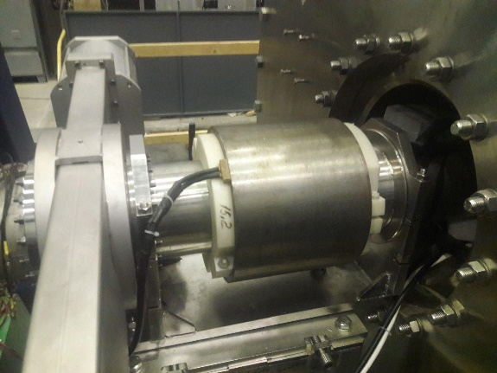
20-MeV linear accelerator
B I N P
To target
Injector
Accelerating modules
Pulsed magnetic lens

Slide 7
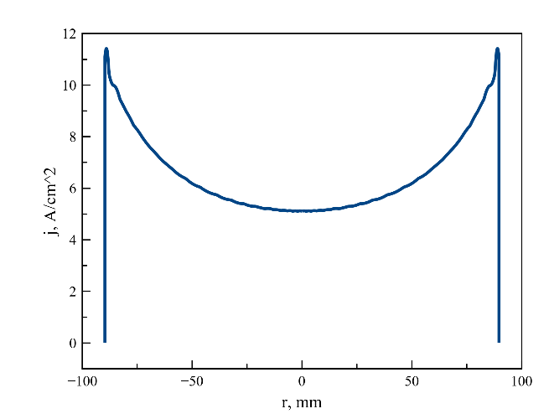
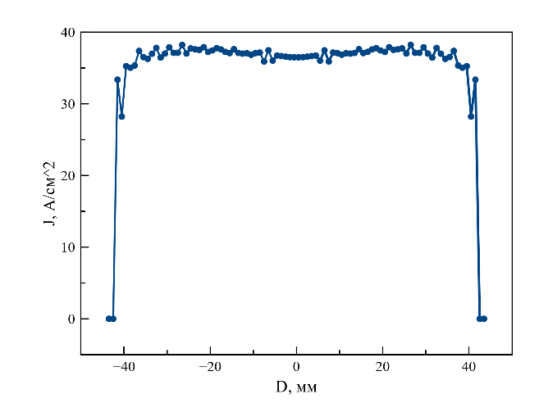
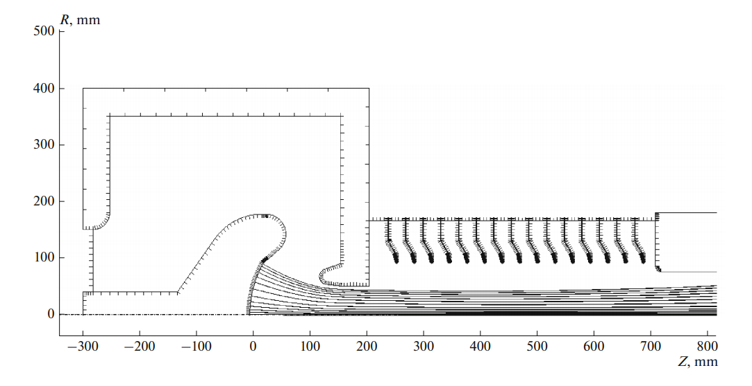
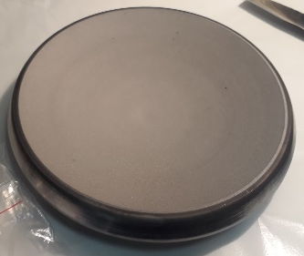
LIA-2 Injector
The injector produces an electron beam with a current of 2 kA and an energy of 2 MeV. An oxide dispenser cathode 180 mm in diameter is used for beam production.
B I N P
Injector Key Parameters
Maximum energy | 2 MeV
Maximum current | 2kA
Cathode heating power | 3kW
Pulse duration | 200 ns
Max repetition rate | 0.1 Hz
Current density
on the cathode
Current density
after accel. tube
UltraSAM

Slide 8
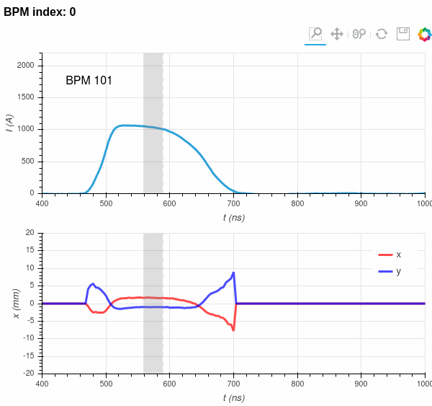
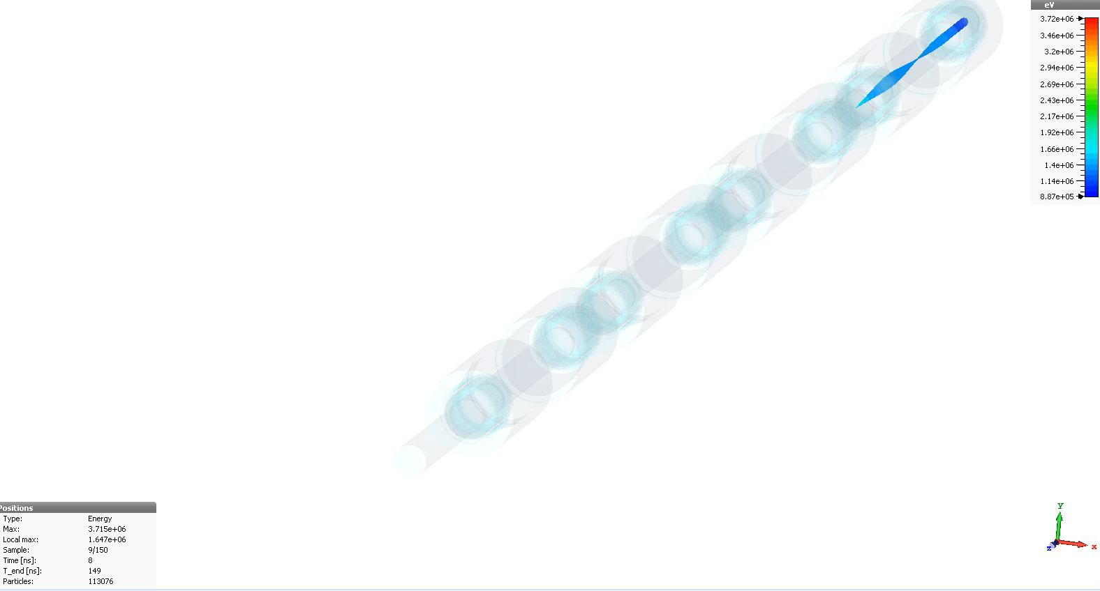
High intensity electron-beam dynamics in LIA
The beam dynamics in the LIU are determined in many ways by the following aspects:
Beam envelope matching and transport tuning
Corkscrew motion (driven by chromatic aberration and misalignments of the focusing system)
Beam breakup instability (BBU) (determined by the interaction of the beam with the dipole modes of the accelerating modules)
B I N P
Time resolved (4 ns) BPMs measurements:
Example of BBU simulations in LIA-5 using CST :

Slide 9
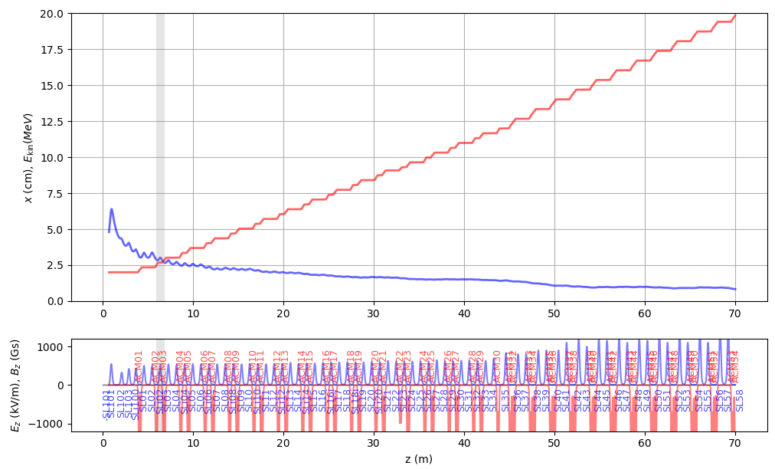
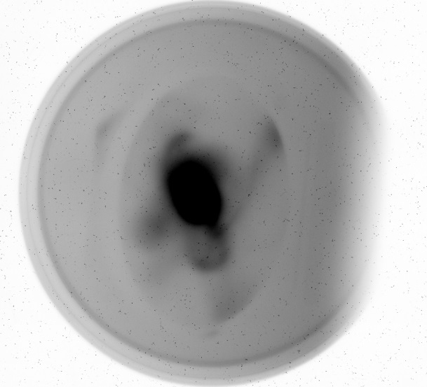
High-Current Beam Transport Tuning
B I N P
Codes available for beam dynamics modeling:
K-V envelope code (BINP)
UltraSAM (BINP, method of boundary integral equations, PIC)
Redpic (BINP, relativistic difference scheme, PIC)
CST (PIC)
WARP (rz + 3D PIC)
OTR
K-V envelope code, fast tuning
Initial conditions - R0,R’0
Beam envelope
Redpic, WARP, etc.

Slide 10
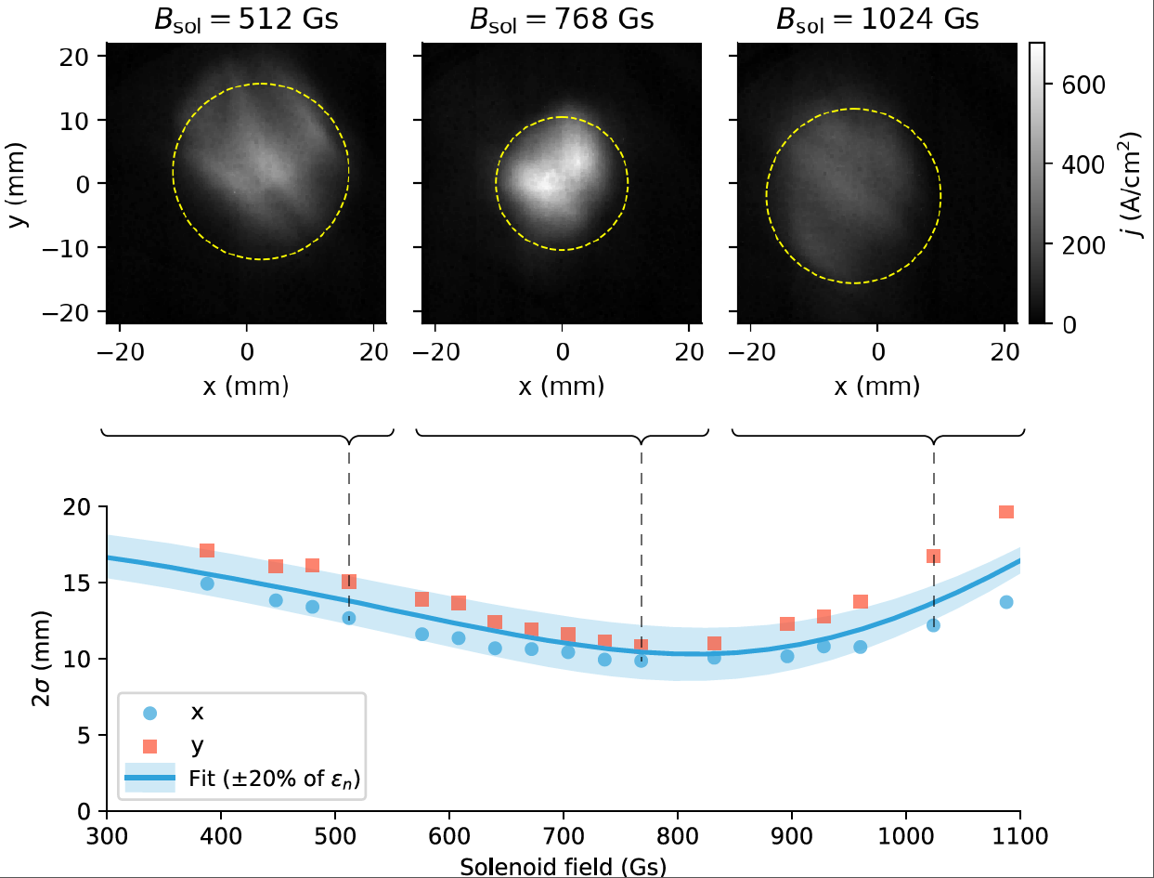

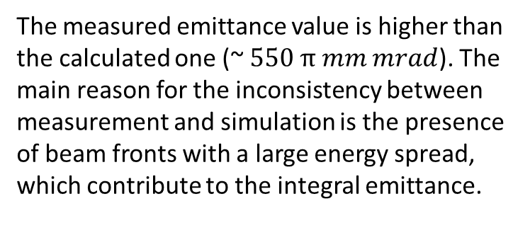

High-Current Beam Transport Tuning (Emittance Estimation)
B I N P
The beam emittance was measured by varying the beam size as a function of the strength of the solenoidal lens followed by the minimization of the residual:
$$ε_{nx}= 4βγ\sqrt{\left\langle x^{2}\right\rangle \left\langle x^{′2}\right\rangle −{\left\langle xx′\right\rangle }^{2}}$$
$$\sim 1100 π mm mrad$$
The measured emittance value is higher than the calculated one (~ $550 π mm mrad$). The main reason for the inconsistency between measurement and simulation is the presence of beam fronts with a large energy spread, which contribute to the integral emittance.
In the near future there are plans to time resolved emittance measurements.

Slide 11
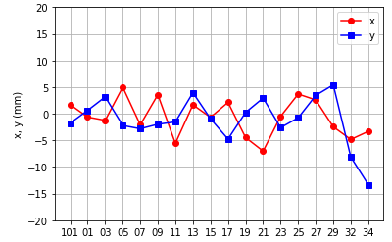
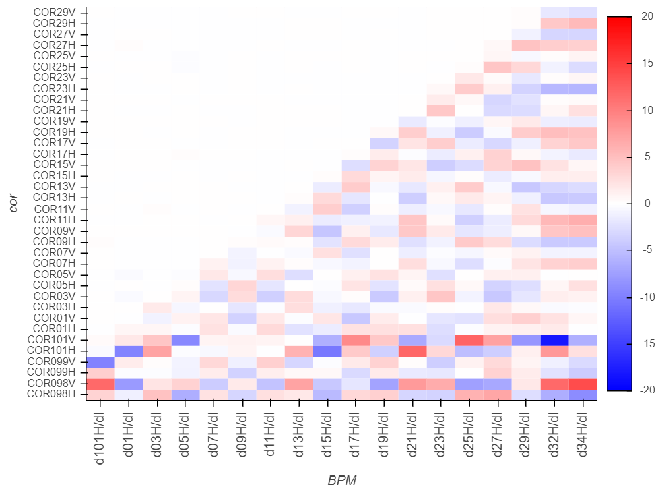
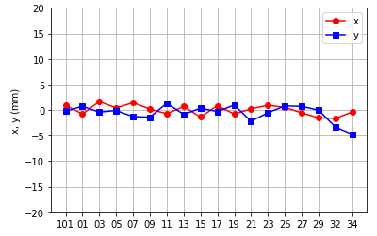
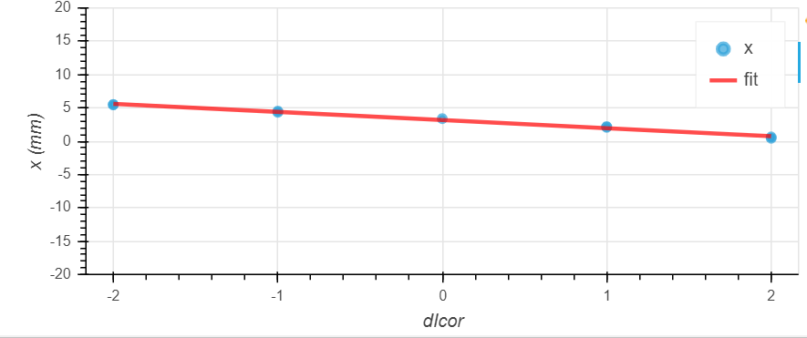
Orbit correction using response matrix
Response matrix entries of the orbit system in LIA
Before correction: Orbit deviation ±5 mm
B I N P
After correction: Orbit deviation ±1 mm
Example of one BPM response on the corrector:

Slide 12
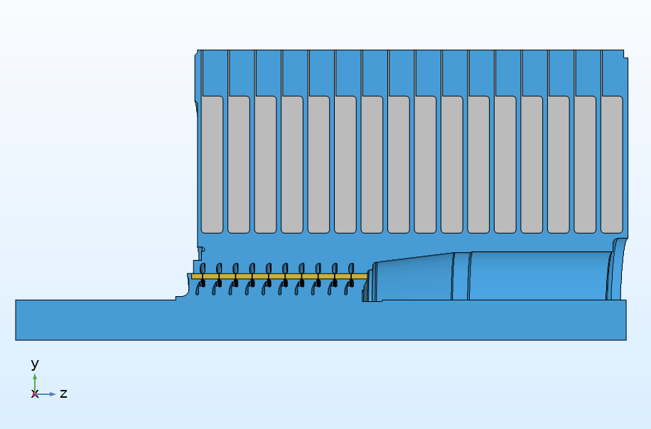
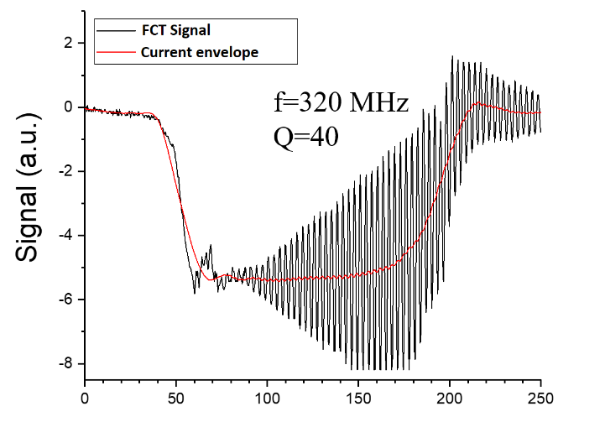
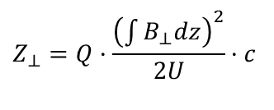
BBU Suppression 1
B I N P
Oscillations of the beam centroid with a frequency of 320 MHz and an amplitude of several millimeters were observed.
The amplitude of the oscillations grew rapidly from module to module.
Accelerating module
Inductors
The mechanism of this instability is determined by the interaction of the beam with the dipole modes of the accelerating modules. Under the action of the fields of dipole modes, the beam centroid oscillates with an exponentially increasing amplitude along the accelerator.
Accelerating tube
V. K. Neil, L. S. Hall and R. K. Cooper “Further theoretical Studies of the Beam Breakup Instability”, Particle Accelerators, 1979, Vol. 9, pp. 213-222.
E-beam shifting in LIA due to BBU development:
$$Z_{⊥}=Q·\frac{{\left(\int{B_{⊥}dz}\right)}^{2}}{2U}·c$$

Slide 13
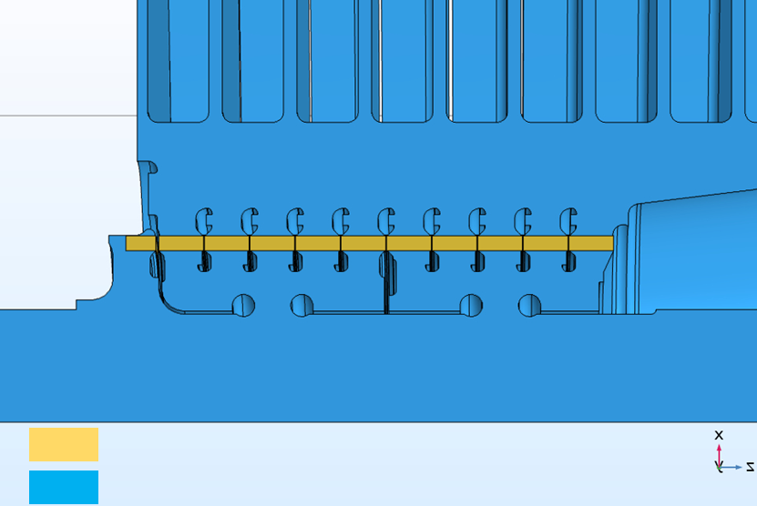
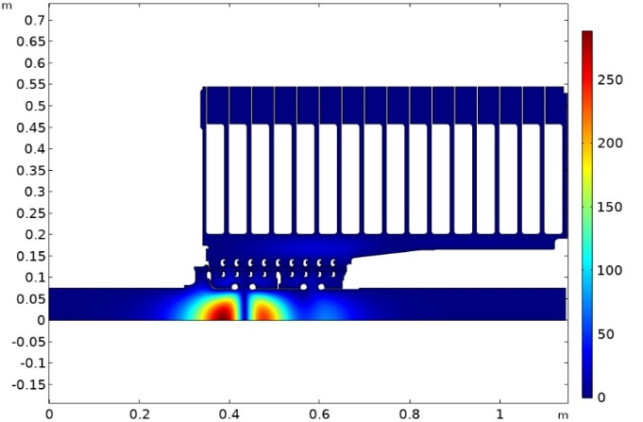
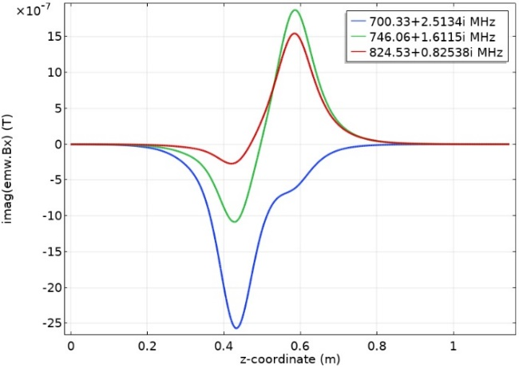


BBU Suppression 2
For better absorption of the oscillation energy, the resistances of the divider resistors between the gradient rings was reduced from 500 Ohm to 100 Ohm.
To reduce the coupling coefficients of natural oscillations with the beam that excites these modes, shielding electrodes are introduced into the QUM geometry.
B I N P
Modified AM:
Eigenmodes calculation:
Magnetic field structure:
Electric field (V/m), f=700.33 MHz
Inductors
Magnetic field, Bx (T)
Shielding electrodes
-ceramics $(ε=10)$
-vacuum
Cold measurements
z-coordinate (m)
Methods Intended for BBU Suppression used for LIA:
Decreasing the coupling coefficient of the beam with the modes by reducing the accelerating gap;
Reducing the Q-factor of modes by inserting special absorbers into the accelerating module;
Increasing the average magnetic field
Shifting the frequency for identical "dangerous" dipole modes through a change in the geometry of various accelerator modules.
$$Q\sim 80$$
755
822
938
713
330
472
635
Electrodynamic System of the Linear Induction Accelerator Module E. Sandalov, S. Sinitsky et.al, IEEE TRANSACTIONS ON PLASMA SCIENCE, be published.

Slide 14
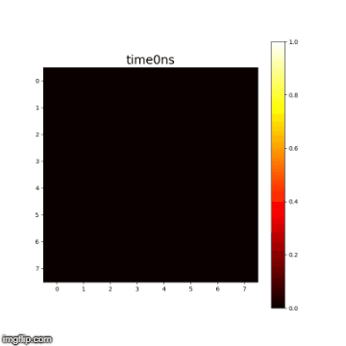
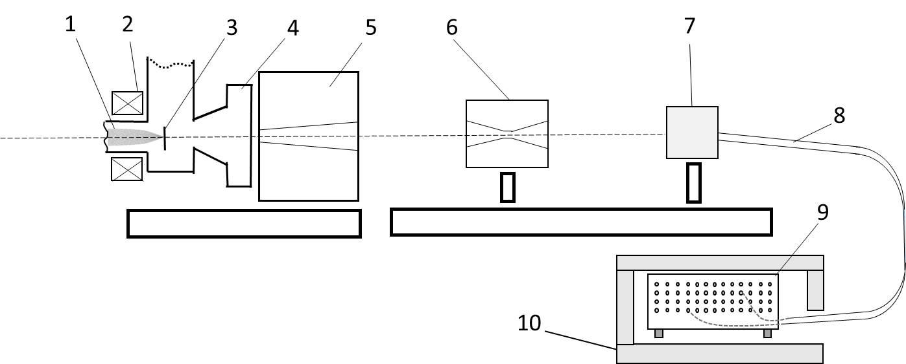
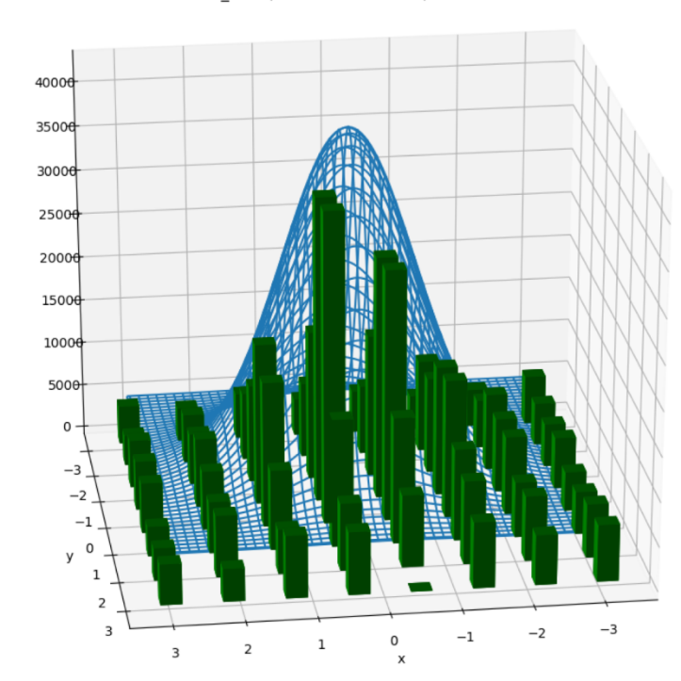
Experiments with Targets: Beam Spot Dynamics on the LIA-5 Target
B I N P
1 – LIA electron beam, 2 – final solenoid lens, 3 – target, 4 – output window of target chamber, 5 – lead collimator, 6 – pinhole camera made of tungsten, 7 – scintillation detector (8x8 pixels), 8 – bundle of transport optic fibers, 9 – registration system (DAQ), 10 – screen box with lead shielding.
FWHM 1.5 mm
(I~ 1kA, E~4.5 MeV).
Bend channel
Integral picture for
bend channel
FWHM 1.5 mm
(I~ 1.8kA, E~4.5 MeV).
Straight channel

Slide 15
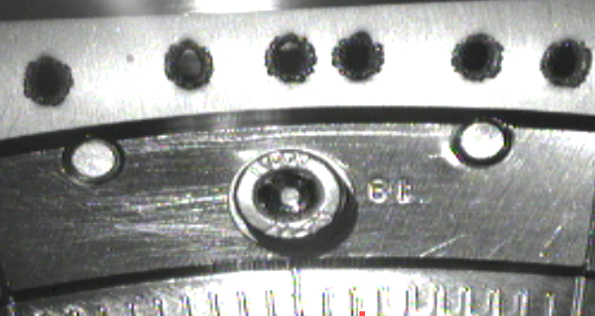
Experiments with Targets: Focusing the beam on the target
B I N P
Target after interaction with the beam (17.5 MeV, 550 A)
Сonversion target
Beam hole
Focal spot < 1mm

Slide 16
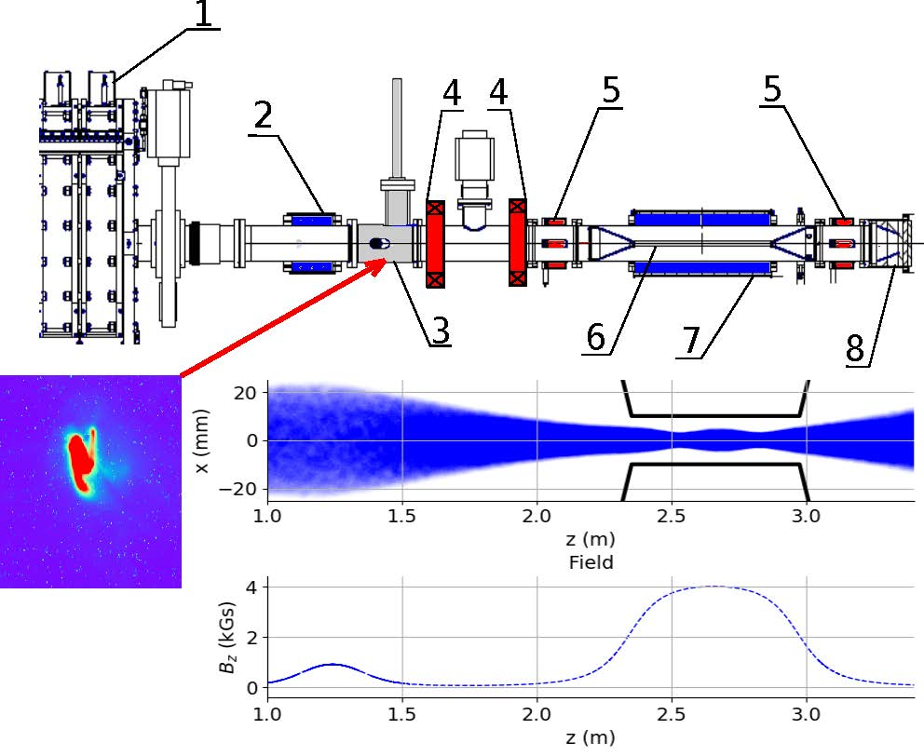
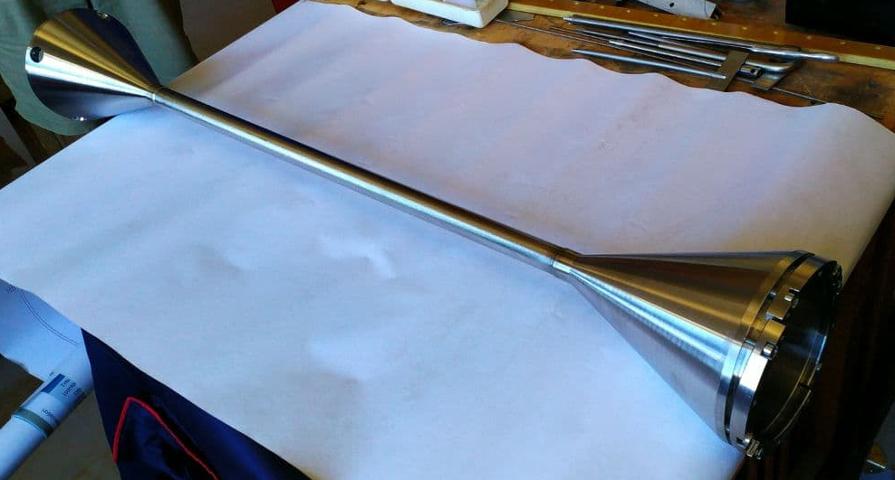
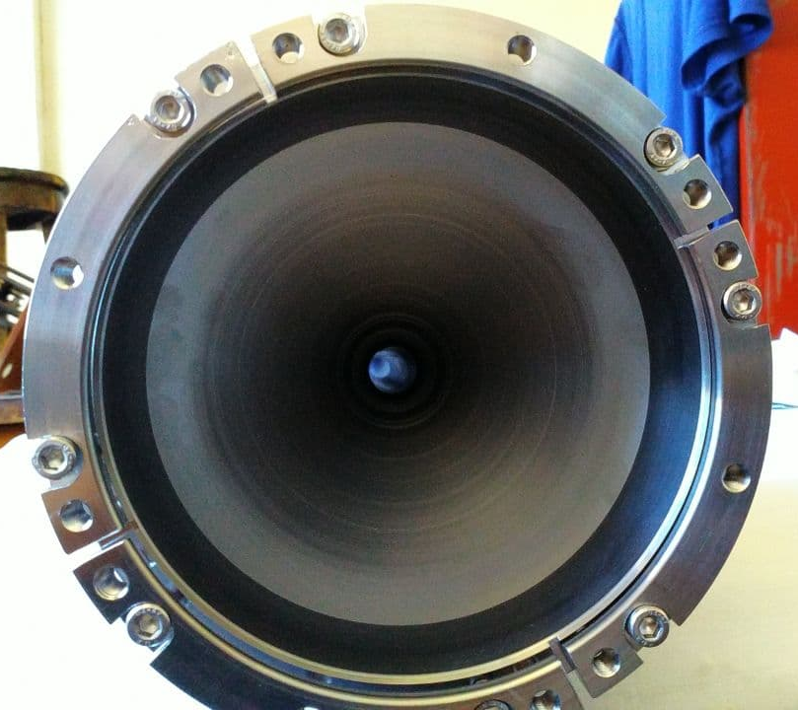
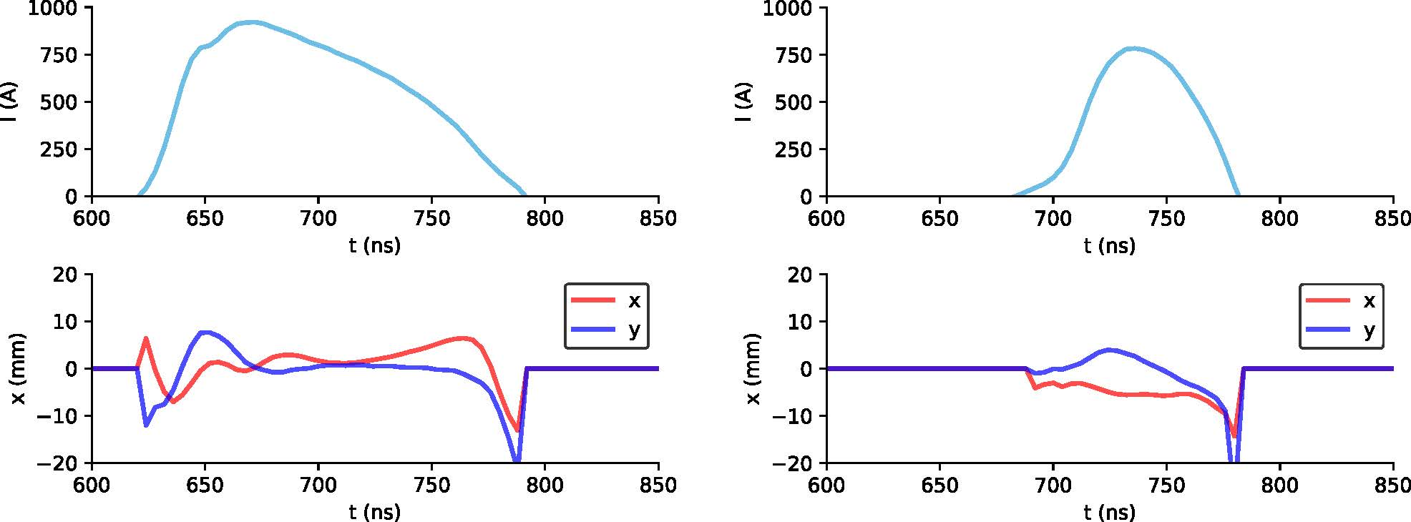
Beam compression
Vacuum chamber of the compression system: Regular section is 20 mm in diameter and 600 mm long, cones sections are 150 mm long
B I N P
General scheme of the beam compression experiment, including the following elements: 1 - 30th accelerating module, 2 - matching pulse magnetic lens, 3 - transient radiation sensor, 4 - dipole correctors, 5 - beam position sensors, 6 - vacuum chamber of compression system, 7 - long pulse solenoid, 8 - beam receiver.
Сomplete current transfer through the compression system has been limited by beam corkscrew motion!
Signals from current transformers (top) and beam position monitors (bottom) Left column - before compression system, right column - after compression system. Result: it was possible to pass 85 - 90% of the beam current

Slide 17
Conclusion
B I N P
A linear induction accelerator (LIA) was created and tested at BINP for the purposes of X-ray flash radiography.
Codes were developed to study beam dynamics and tuning beam transport.
Developed and successfully applied the methods of BBU suppressing
A series of experiments on beam compression on the target was performed and high beam quality on the target converter was obtained
Beam transverse dynamics on the target was studied.
Experiments on beam compression and transport in the FEL system were performed
The reported study was funded in part by RSF, project number 19-12-00212.
The reported study was funded in part by RFBR, project number 19-32-90057.

Slide 18
Thank you for your attention

Slide 19
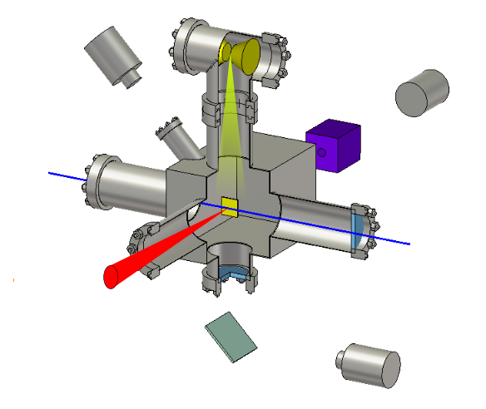
Experiments with Targets: Diagnostics of Beam-Target Interaction
B I N P
CCD-camera
Z-pinch
Fast scintillator
Pinhole
Two-color interferometer
e-beam
Target
CCD-camera
Pinhole - beam spot dynamics;
Two-color interferometer – plasma density; and
Soft x-ray radiography – density of the tantalum jet from the target.

Slide 20
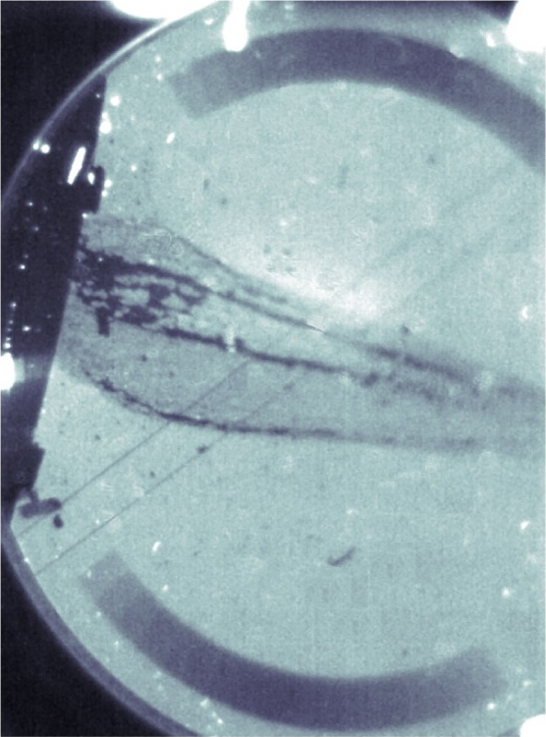
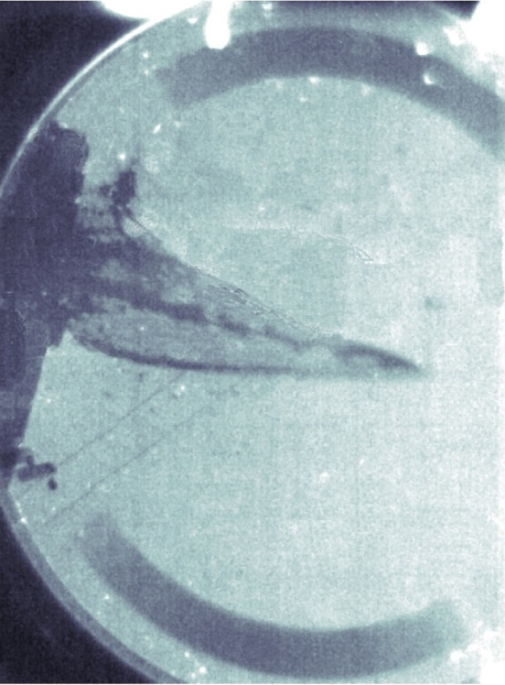

Experiments with Targets: Soft X-Ray Radiography
Beam parameters:
I ~ 300 A (melting and evaporation of target material);
Beam spot size ~ 3 mm. The wedge is made of tantalum. The tantalum absolute density is derived by comparing blackness density.
E - 3 MeV;
B I N P
2 cm
t = 50 μs;
t = 70 μs;
Max. velocity: ~ 1 km/s;
Density: ~ 10¹⁷ cm⁻³;
Target
t = 20 μs;

Slide 21






Space Charge Effects in Bending Magnet and Emittance Growth
(Lee-Chen Theory)
B I N P
Bending magnet effects involve self electric and magnetic fields of a curved high-current beam in a curved vacuum channel (Lee-Chen theory).
Due to the curvature of the chamber and the beam, an additional radial electric field appears $E_{r}=−\frac{φ}{R}.$
All particles of a round beam with a uniform distribution of 𝜌 and j, having different kinetic energies due to the sagging of the potential, turn in a uniform magnetic field with the same radius of rotation.
Due to nonlinear forces associated with beam self-fields, an additional emittance: $∆ε_{n,x}=∆ε_{n,y}=4x_{rms}x_{rms}^{′}=\frac{\sqrt{2}}{8}\frac{I_{b}}{I_{A}β_{θ}}\frac{r_{b}^{2}}{R}α_{b}\sim 1π mm∙mrad$, ($β_{θ}≈1$, $α_{b}=0.2 rad−$ bending angle, $I_{A}=17 kA,$ $R=3.2 m$ $−$ radius of curvature).
$B_{y}$,T
Magnetic field on the central axis, $B_{y}$
Model of bending magnet
Transition parts
Z, m
E.P.Lee. «Cancellation of the centrifugal space charge force». Particle accelerators, 1990, v 25 B.R.Polle, Y.-J.Chen. «Particle simulations of a long pulse electron beam in a bend». 20 Int. Linac Conf., 2000.

Slide 22
Experiments with Targets: Diagnostics of Beam-Target Interaction
B I N P
CCD-camera
Z-pinch
Fast scintillator
Pinhole
Two-color interferometer
e-beam
Target
CCD-camera

Slide 23


Space Charge Effects in Bending Magnet and Emittance Gain
(Aberrations Effects)
B I N P
Bending magnet effects also involve aberrations at the edges of the bending magnet.
Exit from magnet
The given problem requires 3D beam modelling in dipole magnet fields. For this purpose, CST Studio Suite was used.
When modelling a beam with a current of 2 kA in CST, a cumbersome significant numerical increase in emittance was revealed in the model problem of expanding beam with uniform charge distribution within the tube. To reduce contribution of CST self-fields calculation errors into the emittance, one would have to substantially decrease the discretization step that would make the problem resource-intensive and time-consuming. The following algorithm was used to overcome this challenge:
CST calculation of the beam transport with a current of 2 kA for determining
beam shape;
COMSOL calculation of self electric and magnetic fields of the uniformly charged curved cylinder reproducing the beam shape (given in step 1)
Particle tracking in calculated beam self- fields in the presence of bending magnet external fields.

Slide 24






BBU Suppression 3
An example of the beam centroid oscillations
Program Suite for BBU Calculation:
Field structures in LIA
B I N P
B_{z}, Т
Magnetic field
Module for calculating accelerating fields in LIA;
Module for calculating focusing fields in LIA;
Module for calculating eigenmodes (Sturm-Liouville problem) $\overline{A}\left(\overline{r},t\right)=\sum{σ_{l}(t) A_{l}(\overline{r})}$
Module for calculating BBU development (joint solution of the equations of motion and the oscillatory equation with a driving force for the amplitude coefficients of the modes $σ_{l}(t)$)
0.1
Accelerating field
0.05
2
4
6
8
10
12
14
z, m
Calculated increments $lnK_{0}$
for mode fields in a few frequency ranges ($I_{b}=2kA,E_{e}≈5 MeV$)
Electrodynamic System of the Linear Induction Accelerator Module E. Sandalov, S. Sinitsky et.al, IEEE TRANSACTIONS ON PLASMA SCIENCE, be published.
$$σ(Ng)=σ_{0}·exp⁡(N_{g}·lnK_{0})$$
Examples of the beam shots
f (MHz) | $$300÷500$$ | $$500÷600$$ | $$600÷700$$ | $$700÷800$$ | $$900÷1000$$
$$Q=100$$ | 0.71 | 0.4 | 0.1 | 0.75 | 1.01
$$Q=20$$ | 0.35 | 0.21 | 0.075 | 0.5 | 0.38
Methods Intended for Further BBU Suppression:
Decreasing the coupling coefficient of the beam with the modes by reducing the accelerating gap;
Reducing the Q-factor of modes by inserting special absorbers into the accelerating module;
Increasing the average magnetic field
Shifting the frequency for identical "dangerous" dipole modes through a change in the geometry of various accelerator modules.

