Slide 1

High robustness NEA activation of GaAs cathode for polarized electron beam generation from RF
M. Kuriki, K. Masaki, S. Obora, Z. Liptak,
N. Kosugi^{A)}, L. Guo^{A)}, M. Takashima^{A)}
Hiroshima University
A)Nagoya University
ALLPPT.com _ Free PowerPoint Templates, Diagrams and Charts

Slide 2
Contents
Introduction,
NEA Activation with Cs-K-Te
NEA Activation with Cs-K-Sb
Summary.

Slide 3
Introduction

Slide 4
NEA GaAs cathode
NEA (Negative Electron Affinity) GaAs cathode
The vacuum state is lower than the lowest conduction band state.
Because the emitted electron is thermalized, the beam has only the thermal emittance, 300K: The low emittance cathode.
The spin polarized electron is obtained with the circularly polarized laser : The polarized cathode.
p-type GaAs
PEA
Vacuum
Conduction
Band
NEA
Vacuum
Fermi level
Cs-O
Valence
Band

Slide 5
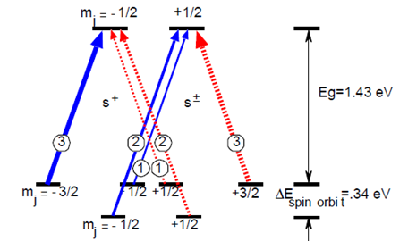
Cs-O NEA-GaAs Photo-cathode
p-type GaAs
PEA
Vacuum
Conduction
Band
NEA
Vacuum
Electrons excited by circularly polarized laser with energy selection.
The polarized electron can be extracted to vacuum by the NEA surface.
Fermi level
Cs-O
Valence
Band

Slide 6
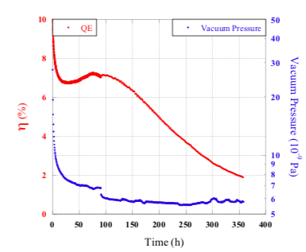



Degradation of Cs-O NEA surface
Thermal desorption
Gas adsorption
Ion Feedback
Cs
$H_{2}$O
NEA
GaAs
heat
Cs
+
NEA
GaAs
NEA
GaAs
Cs
$$O_{2}$$
+
Cs
$${CO}_{2}$$
1/e lifetime
3.0 – 4.0 x 10⁻⁴ Pa.sec
C. Shonaka, Master thesis, Hiroshima U. (2009)

Slide 7
Robust NEA GaAs cathode
Cs-O NEA GaAs has a limited robustness.
  Requires UHV (<1.0e-9 Pa).
  Only compatible with DC biased electron gun, ~5 MV/m.
  Limited bunch intensity, long bunch, large emittance.
If a robust NEA surface on GaAs is developed,
  Less requirement on vacuum.
  Compatible with RF electron gun, ~ 100 MV/m.
  High bunch intensity, short bunch, small emittance.

Slide 8
NEA Activation with Cs-K-Te

Slide 9
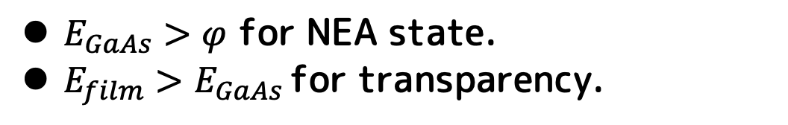
NEA surface with Hetero Junction
Surface
film
p-type GaAs
vacuum
Conduction
Band
E_{GaAs}
Φ
E_{film}
Fermi
level
Valence
Band
e
$E_{GaAs}>φ$ for NEA state.
$E_{film}>E_{GaAs }$for transparency.

Slide 10
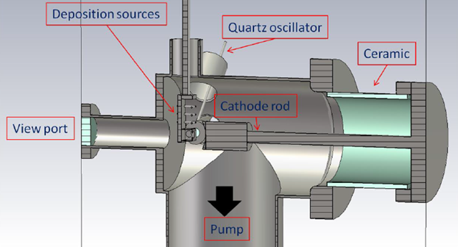
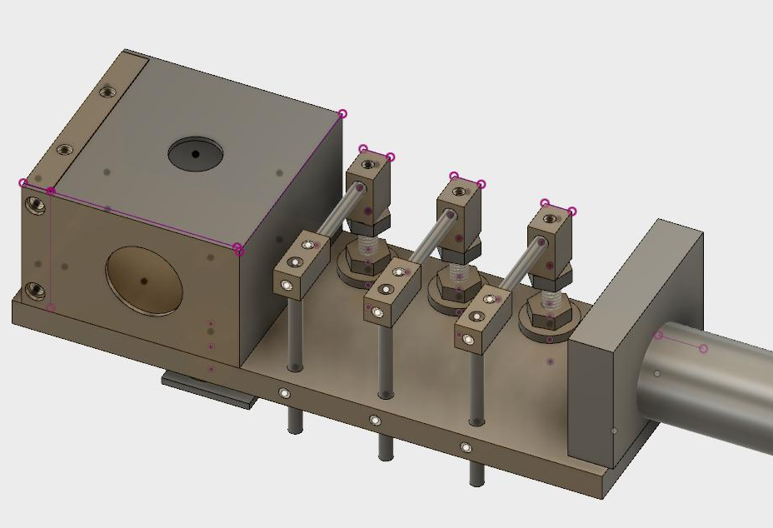
Apparatus
Te
K
Cs2
Cs1
Chamber
Evaporation head
Chemically polished SUS chamber with NEA and Ion pumps. Typical vacuum pressure is1.5e-8 Pa.
Cs, K, and Te evaporation.
Heater for cleaning.
Quartz thickness monitor.
Quantum efficiency measurement with Xe lump.

Slide 11
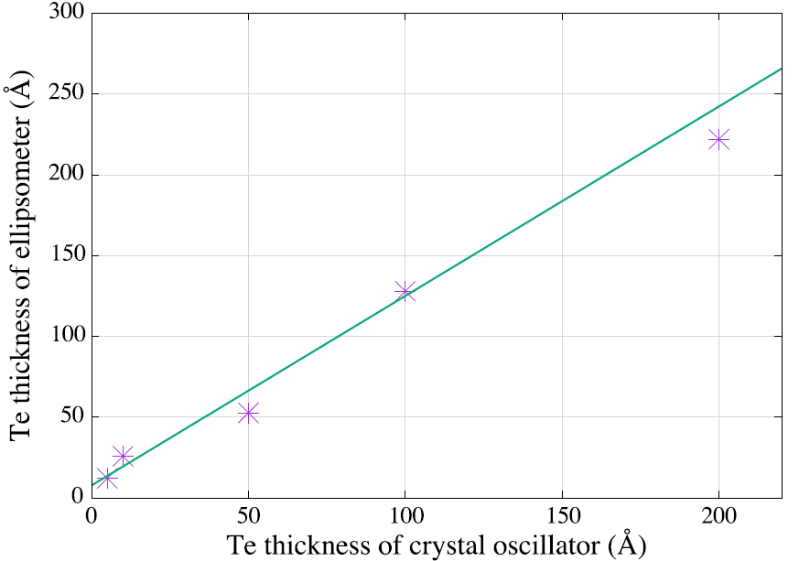
Calibration of Te thickness
Several samples of Te evaporated on GaAs substrate.
Calibrated with Ellipsometry measurement.
Use the thickness with the ellipsometry for further analysis.

Slide 12
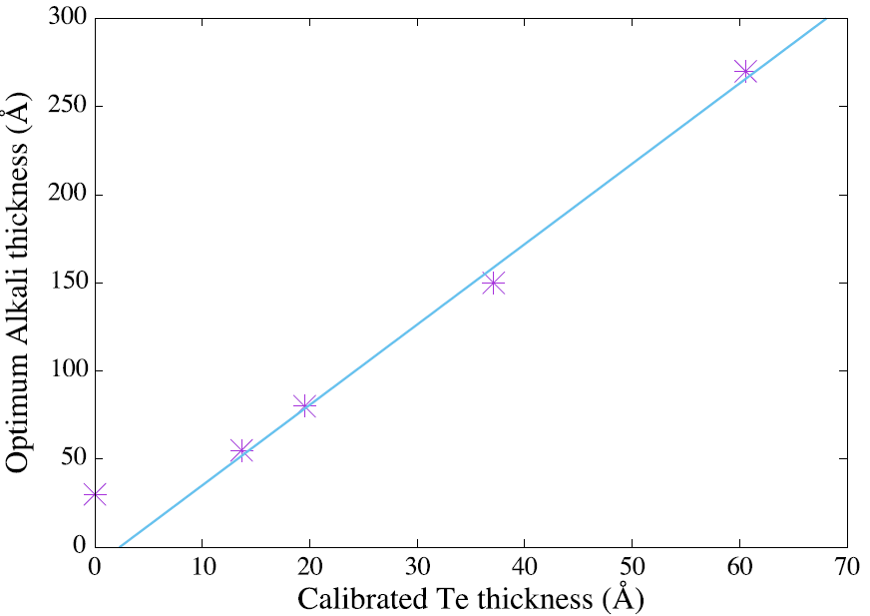
Experiment
Evaporate Te until the decided thickness.
Evaporate K and Cs repeatedly.
Measure the QE spectrum after each K and Cs evaporation.
The optimum thickness of Cs and K is defined as that giving the maximum QE at 4.9 eV.
Emission with 1.4.9 eV photo is from CsKTe
Te 13.6Å
1.43 eV

Slide 13
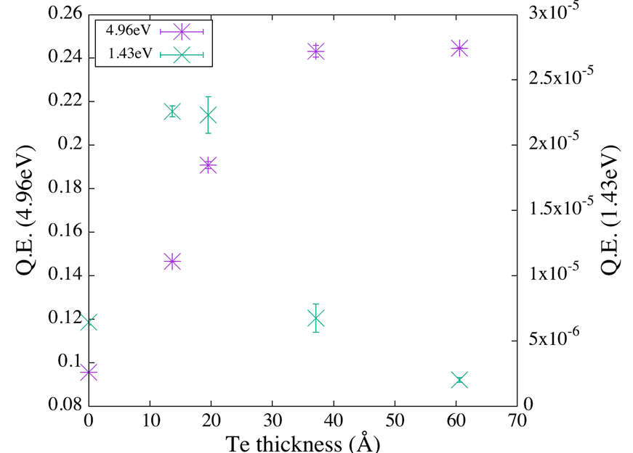
Thickness VS. QE
QE (4.96 eV)
QE (1.43V)
Te 13.6Å
QE at 4.96 eV is saturated with more Cs-K and Te.
QE at 1.43 eV is peaked at some Te and Cs-K thickness.
These results are consistent that electron emissions with 4.96 and 1.43 eV photon are from CsKTe and GaAs,
respectively.

Slide 14
Cathode Degradation Model
η₀: Initial value
P(t): Pressure (Pa)
J(t): Current density (A/m²)
α:Dark life (Pa.t)
β:Charge Life(A/m².Pa.t)
Electron
beam
Residual gas
+
Positive ion
+
+
Cathode
正イオン化

Slide 15
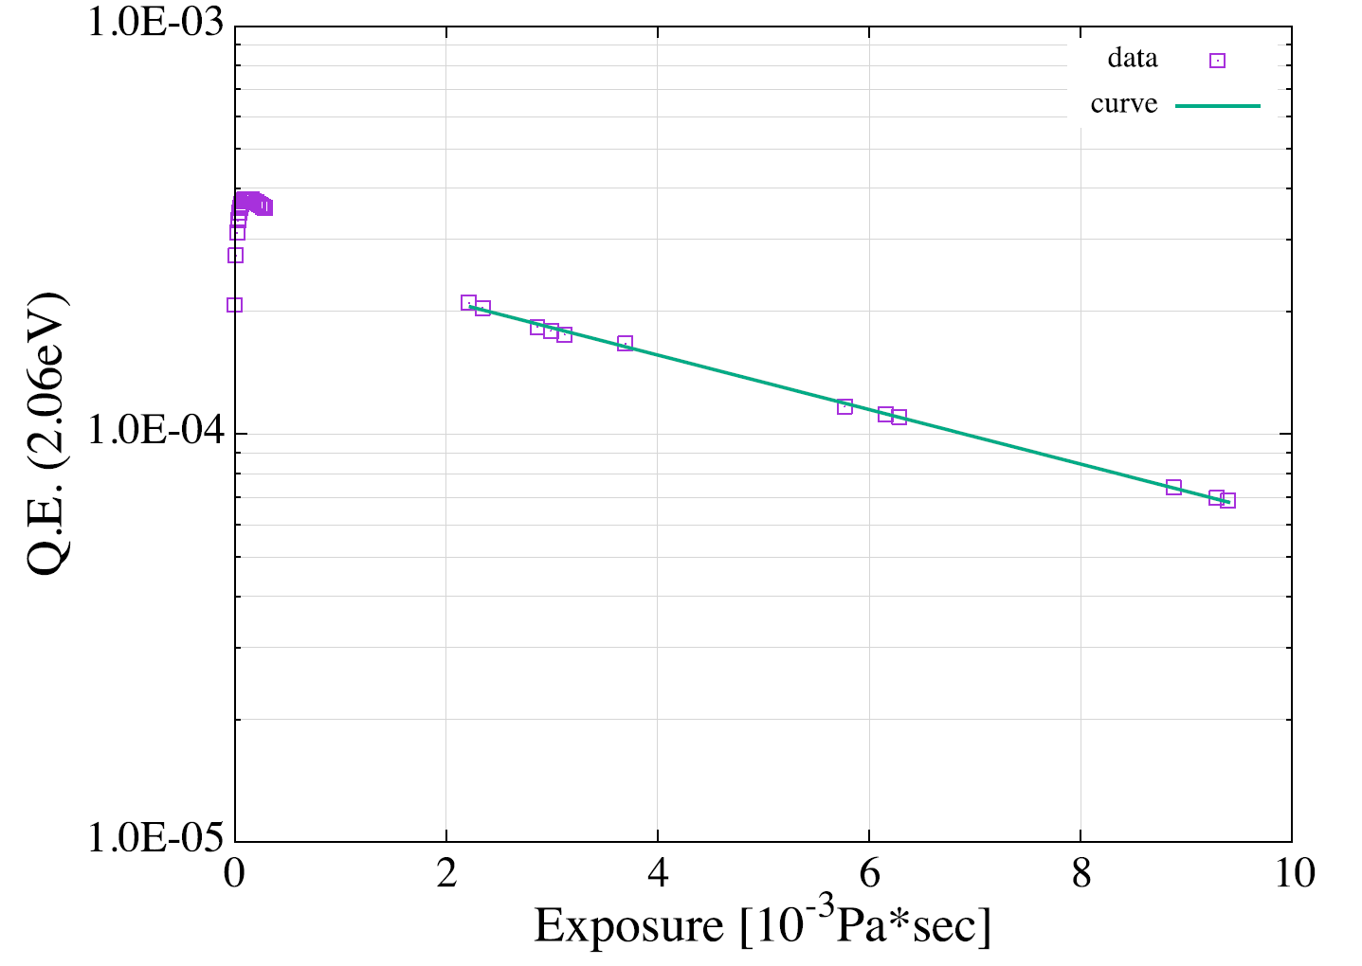


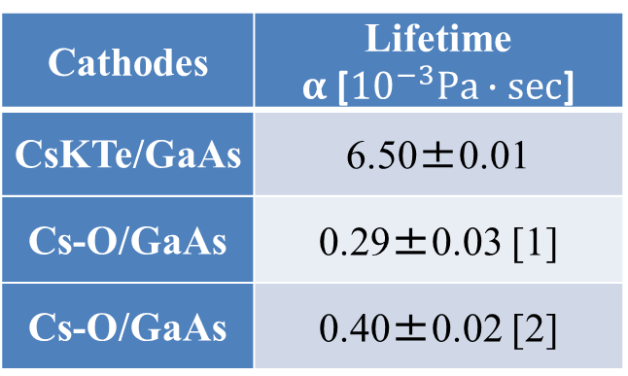
Lifetime of CsKTe NEA GaAs
$$η\left(P∙t\right)=η_{0}\exp\left(−\frac{\int{Pdt}}{α}\right)$$
Cathodes | Lifetime $α$[${10}^{−3}Pa∙sec$]
CsKTe/GaAs | 6.50±0.01
Cs-O/GaAs | 0.29±0.03 [1]
Cs-O/GaAs | 0.40±0.02 [2]
α= (6.50±0.01)$×{10}^{−3}Pa∙sec$
[1]K. Miyoshi, M. Thesis, Hiroshima U. (2013)
[2]G. Lei, M. Thesis, Hiroshima U. (2014)
E-Gun | Pressure[Pa] | Life[h]
DC-gun | 5.0×10⁻¹⁰ | 1535.6
RF-gun | 1.0×10⁻⁷ | 7.7

Slide 16
NEA Activation with CsK₂Sb
CsK₂Sb is a semiconductor cathode formed as a thin film by evaporation in vacuum.
It has a long operational life time.
It is a candidate of the robust NEA activation with the hetero junction.

Slide 17
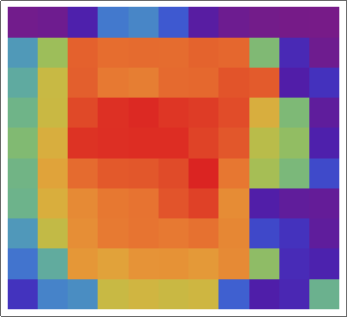

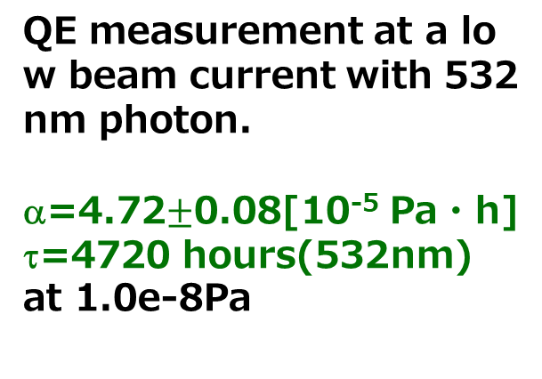
CsK₂Sb cathode (dark life)
33mm
10%
8%
30mm
6%
4%
2%
0%
QE distribution
QE measurement at a low beam current with 532nm photon.
α=4.72$±$0.08[10⁻⁵ Pa・h]
τ=4720 hours(532nm)
at 1.0e-8Pa

Slide 18
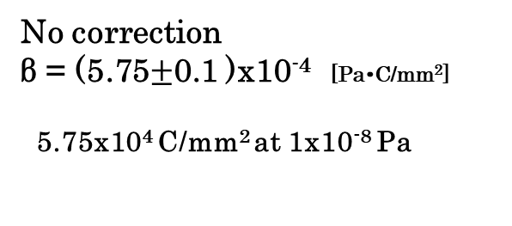
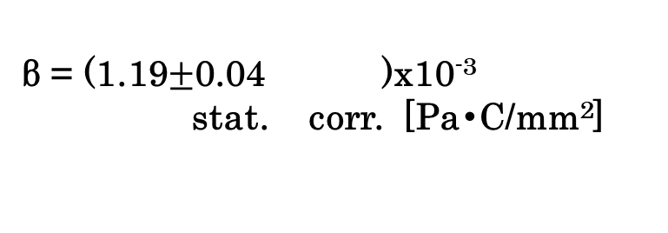
CsK₂Sb Beam life
Continous beam emission with 6.3 μA/mm².
Correction by dark-life.
β = (1.19$±$0.04 )x10⁻³
stat. corr. [Pa・C/mm²]
+0.03
-0.02
●：measured
■：corrected
1.19 x10⁵ C/mm² at 1x10⁻⁸ Pa
No correction
β = (5.75$±$0.1 )x10⁻⁴ [Pa・C/mm²]
5.75x10⁴ C/mm² at 1x10⁻⁸ Pa

Slide 19
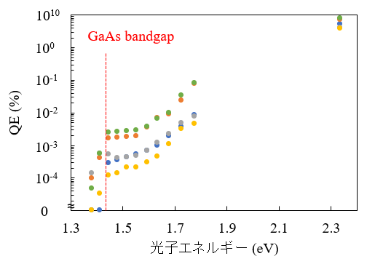
Quantum efficiency spectrum
1.43eV
3e-3%
CsK₂Sb thickness：25 nm
Photon energy
NEA activation is confirmed.
Low quantum efficiency.
Robustness will be examined.
N. Kosugi, G. Lei, et al, 14pX1-3, JPS annual meeting, March, 2021.
Notes:
ここから実験結果と考察になります。
まずNEA活性化の評価です。ここではCsK2Sb膜厚を25nmとしてQEを測定しました。
5回試験した結果、どの試料でも1.4eVからQEが立ち上がることが確認できました。
GaAsのバンドギャップは1.43eVであり、NEA活性化されてなけらば、この光子エネルギーでQEは測定できないため、NEA活性化できていると判断できます。
cまたQEスペクトル全体を見ると1.4eVからの立ち上がりと、1.7eV付近からの2段階でQEが上昇していることが分かります。
これはCsK2Sbからの電子放出と考えられ、計算モデルと一致していしていることが確認できました。
一方で赤外線領域でのQEは最大で10-3台でありCs-O型と比較すると1～２桁低い結果となり、改善の必要があると考えています。

Slide 20
CsK₂Sb Thickness dependence
CsK₂Sb thickness 15，25，37.5，50 nm, 3-6 times activation for each thickness
10⁻²
Emission fromCsK₂Sb
Emission from GaAs
10⁻³
10⁻⁴
QE (532 nm, 2.3 eV)
QE (860 nm, 1.4 eV)
10⁻⁵
0
~
~
A stable CsK2Sb layer is formed with >25 nm.
Maximized at 25 nm. For thicker layer, photon and/or electron are absorbed.
N. Kosugi, G. Lei, et al, 14pX1-3, JPS annual meeting, March, 2021.
Notes:
続いてCsK2Sb膜厚条件を変化させてQEを測定した結果になります。ここでは膜厚を15から50nmとして各3～6回測定を行いました。
左は532nm、右は860nmのQEを示しており、それぞれCsK2Sbの結晶性とGaAsからの電子放出、NEA活性化の指標と捉えることができます。
まず一番薄い15nmはどちらのQEも低く、これは薄すぎるため結晶性の閾値を満たすことができなかったと考えられます。
それ以上の膜厚では532nmのQEが同程度であっても、860nmではより薄い25nmが最も良いQEとなっていることが分かります。
これは膜厚が薄いほど価電子帯に再結合する割合が減少するためであると考えられ、電子放出モデルとも一致します。
以上より逐次蒸着によるCsK2Sb膜厚の最適値は25nmであると考えられます。

Slide 21
Summary
We found that GaAs is activated with CsKTe.
QE was 2.0~3.0e-4 with 15-20 Å Te thickness.
Thicker Te gave less QE.
We found that the CsKTe GaAs has a longer lifetime (darklife) than that of Cs-O GaAs cathode.
It is operable in RF gun, even a frequent cathode activation is needed.
NEA activation with CsK₂Sb was confirmed with QE 3e-5.
The lifetime will be measured.

Slide 22
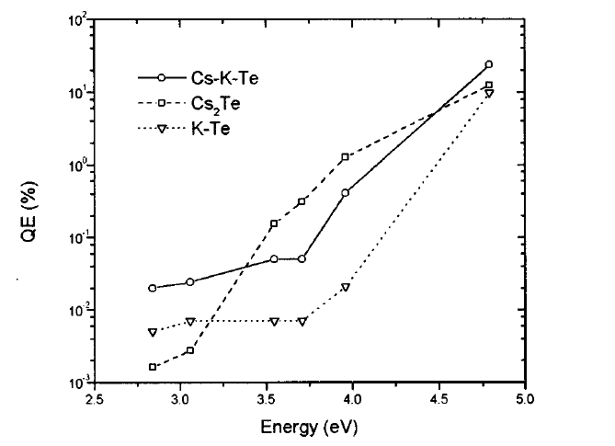
NEA Activation with CsKTe
Thin film photo-cathode by evaporation.
High quantum efficiency at 4.75 ～ 3.0 eV.
Work function and band gap?
Fig : Quantum effiency of Cs-K-Te, Cs₂Te, K-Te : Appl. Phys. Lett. 70, 1491 (1997)
D. Bisero and B. M. van Oerle et al., “High efficiency photoemission from Cs–K–Te“)

Slide 23

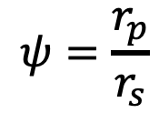


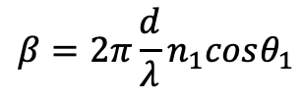


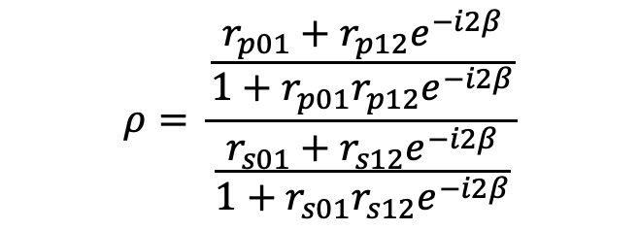





Ellipsometry
Reflectivity and phase difference for S and P polarization is measured.
$$θ_{i}$$
$$θ_{j}$$
$$ρ=tan(ψ)e^{iΔ}$$
$$ψ=\frac{r_{p}}{r_{s}}$$
$$Δ=φ_{p}−φ_{s}$$
Injection
Reflection
$$θ$$
$$ρ= \frac{\frac{r_{p01}+r_{p12}e^{−i2β}}{1+r_{p01}r_{p12}e^{−i2β}}}{\frac{r_{s01}+r_{s12}e^{−i2β}}{1+r_{s01}r_{s12}e^{−i2β}}}$$
$$r_{01}$$
$$n_{0}$$
film
$$n_{1}$$
$$r_{12}$$
d
substrate
$$n_{2}$$
r : reflectivity
d : thickness
$$β=2π\frac{d}{λ}n_{1}cosθ_{1}$$

Slide 24
P dependence
24
●：405 nm
●：532 nm
真空圧力を変化させτを測定.
真空容器の温度、ＩＰのon/offで圧力を変化
測定されたαを平均圧力で除してDark Life timeτを求めた。
概ね、τは圧力に逆比例。

Slide 25
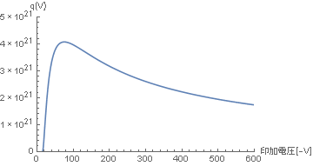
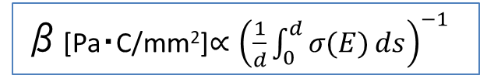
Bias Voltage Dependence
β[Pa・C/mm²]$∝{\left(\frac{1}{d}\int_{0}^{d}{σ(E)}ds\right)}^{−1}$
σ(E)[m²]:イオン化断面積
E: Beam Energy
d:電極間隔
青点：405 nm
赤点：532 nm
バイアス電圧[-V]
Θ=3.1×10⁶[C/mm²](532 nm) at -150kV, 1.0e-8Pa
100 mAで約1年間の連続運転が可能

