Slide 1
Upgrade options for the Australian Synchrotron light source
Dr. Rohan Dowd
Manager, Accelerator Physics, Australian Synchrotron, ANSTO

Slide 2
Background of the Study
Long term strategy of Synchrotron Science to look at the options in the ~15 years time when facility is nearing end of life.
“When the AS has reached end of life, should we upgrade the lattice in the existing tunnels or build an entirely new ring?”
CDR has explored the feasibility of a lattice upgrade using the existing infrastructure of the Australian Synchrotron as much as possible.
A feasibility study on possible 600 and 450 metre ring options has also been conducted.

Slide 3
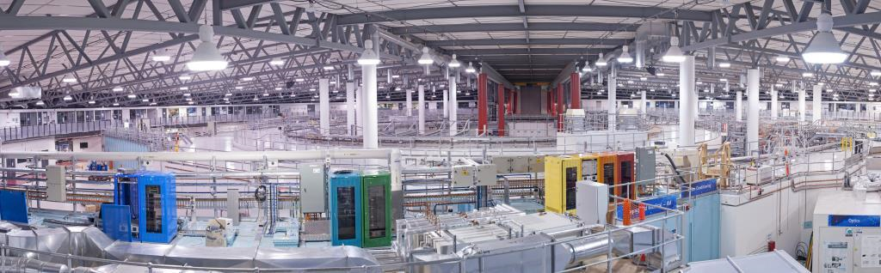
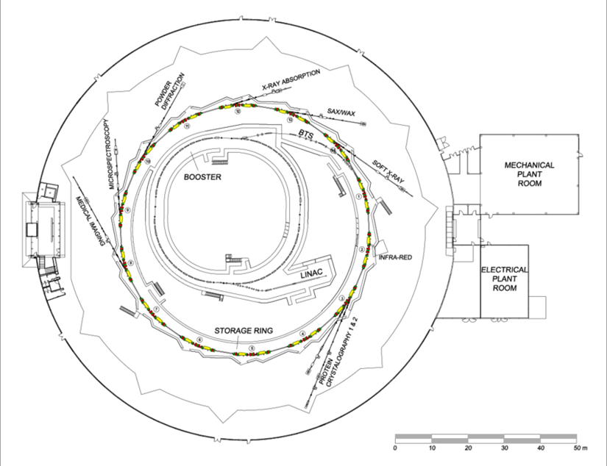
Australian Synchrotron
100 MeV linac
  S-band TW linac, 1 Hz repetition, 1-75 bunches per pulse train,
0.1-3 GeV booster synchrotron
  Up to 2 mA of electrons delivered to storage ring per cycle
3 GeV storage ring (216m)
  3rd Generation Light Source DBA lattice, 10 nm Hor. Emittance. 9+8 Beamlines
  200 +/- 0.5 mA nominal current with top up

Slide 4
Constraints and Assumptions
Base constraints for lattice upgrade:
  Reuse current tunnels and shielding
  Little or no change to the injector
  No existing Beamline is worse off (in flux and spectrum)
  Significant increase in brightness (factor ~10+)
  Beamline source points cannot move significantly
Constraints for new ring study
  Reuse injection system and existing infrastructure
  Situate on-site with minimal disruption to current ring operation.

Slide 5
Current state of play for Light Sources
4th generation LS implies an order of magnitude emittance decrease.
Multi Bend Achromat lattices.
Ring Circumference dictates minimum achievable emittance

Slide 6
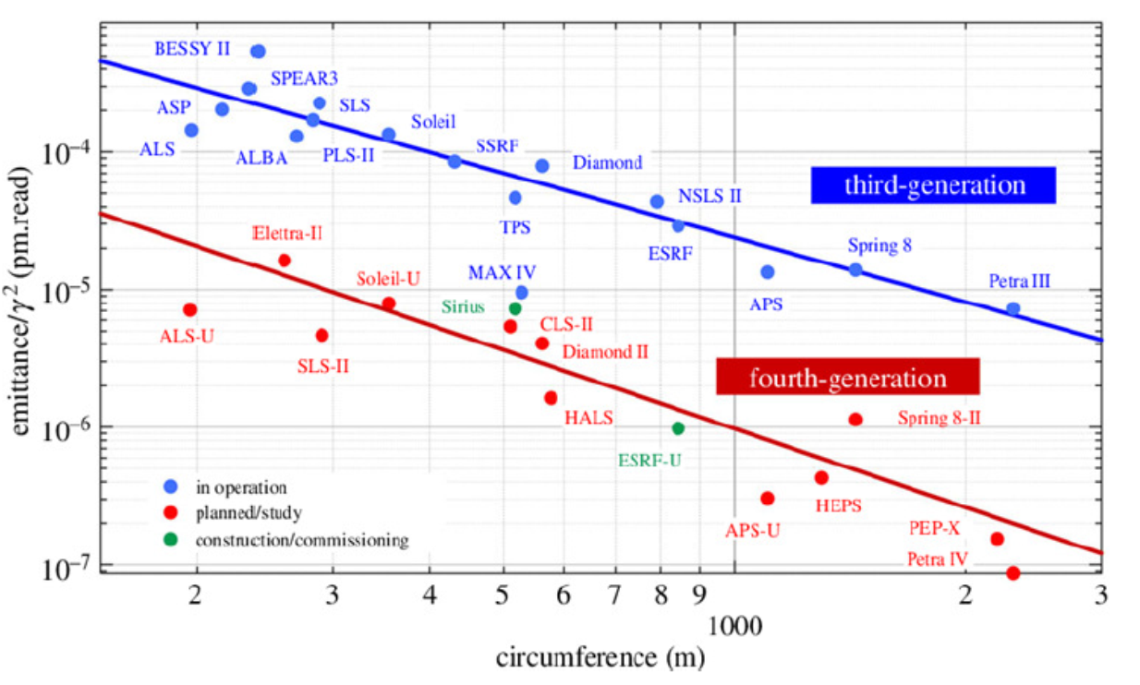
Lattice design – 4BA with reverse bends
Design follows SLS-2 approach and uses ‘reverse bends’ as well as gradient dipoles
Parameter | Current DBA | 4BA at 3.0 GeV | 4BA at 2.5 GeV
Hor. Emittance (nm.rad) | 10.5 | 0.308 | 0.214
E Loss Per Turn (KeV) | 932 | 1946 | 938
Energy Spread (%) | 0.1027 | 0.1624 | 0.1353
Bunch Length [ps] | 29.36 | 9.19 | 6.49
Tousheck Lifetime (hrs) | 22 | 16.7 | TBD
Coupling (%) | 1 | 5 | 6
Dipole Critical Energy (KeV) | 7.7424 | 16.6 | 9.7472
Straight σx [um] | 322.75 | 19.115 | 15.928
Straight σy [um] | 17.464 | 5.317 | 4.431
Straight Length (m) | 4.5 | 3.0 | 3.0

Slide 7
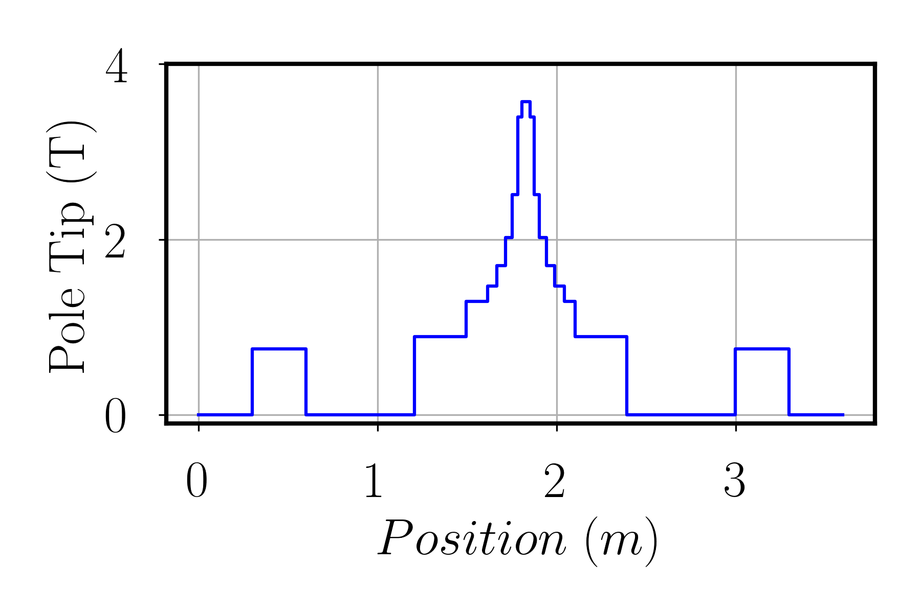
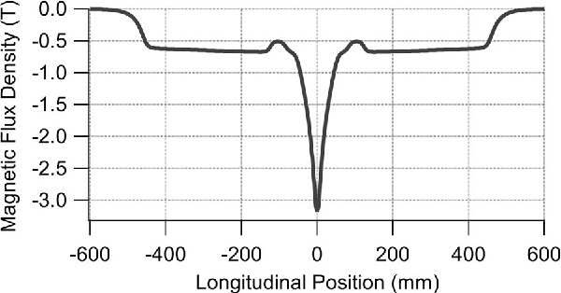
Longitudinal Gradient Dipoles
Bending field changes along the length of the magnet. Peak field almost 4 Tesla.
Will require some R&D to generate desired field. Sirius 3.2 T superbend used as a starting point.
Sirius Superbend
AS-U superbend Design
Longitudinal gradient dipoles of the SLS design

Slide 8
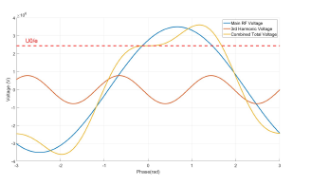
RF Systems for 3GeV
Re-use existing NC HOM damped cavities.
Power budget – Will be twice the current lattice for 3 GeV beam. Beam loading from 250kW -> 500kW
  Go from 4 to 6 Cavities, use 3 cavities in each RF straight 180 kW klystrons
  Need more LCW capacity and power infrastructure
Landau cavities
  Stretches the beam longitudinally for better stability and lifetime. Require an additional, 2x1m cavity systems.
Longitudinal kicker (Feedback system)
  Maintains longitudinal stability, requires additional kicker.

Slide 9
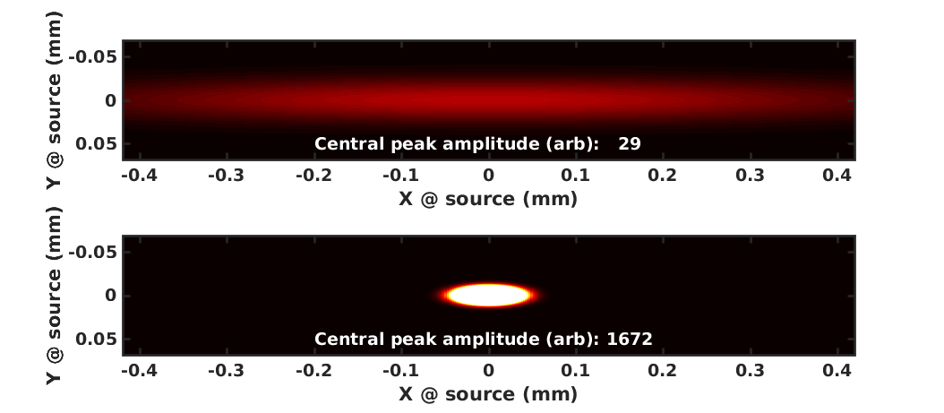
Benefit to Beamlines
Undulators, flux density and brightness.
Blue– AS, Red 3GeV AS-U, Green 2.5 GeV AS-U

Slide 10
Benefits to Beamlines
Wigglers Flux Density (largely driven by Beam energy):
  Blue – AS, Red 3GeV AS-U, Green 2.5 GeV AS-U
Dipoles flux density (largely driven by bend field):

Slide 11
Other Ring options
Assumptions:
  A new 4th generation storage ring light source is required
  We will have the ability to expand the site southward onto the current Monash university overflow carpark
  A beam energy of 3 GeV will be used in the new storage ring
  The existing facility will be refreshed to extend its operational lifetime
Constraints:
  Use as much existing infrastructure as possible, including the existing accelerator injector system.
  Minimise disturbance to the operation of the current facility and beamlines
  Have room for several new long beamlines (~150m) from the new ring
  Traffic and emergency access to existing site must be maintained.

Slide 12
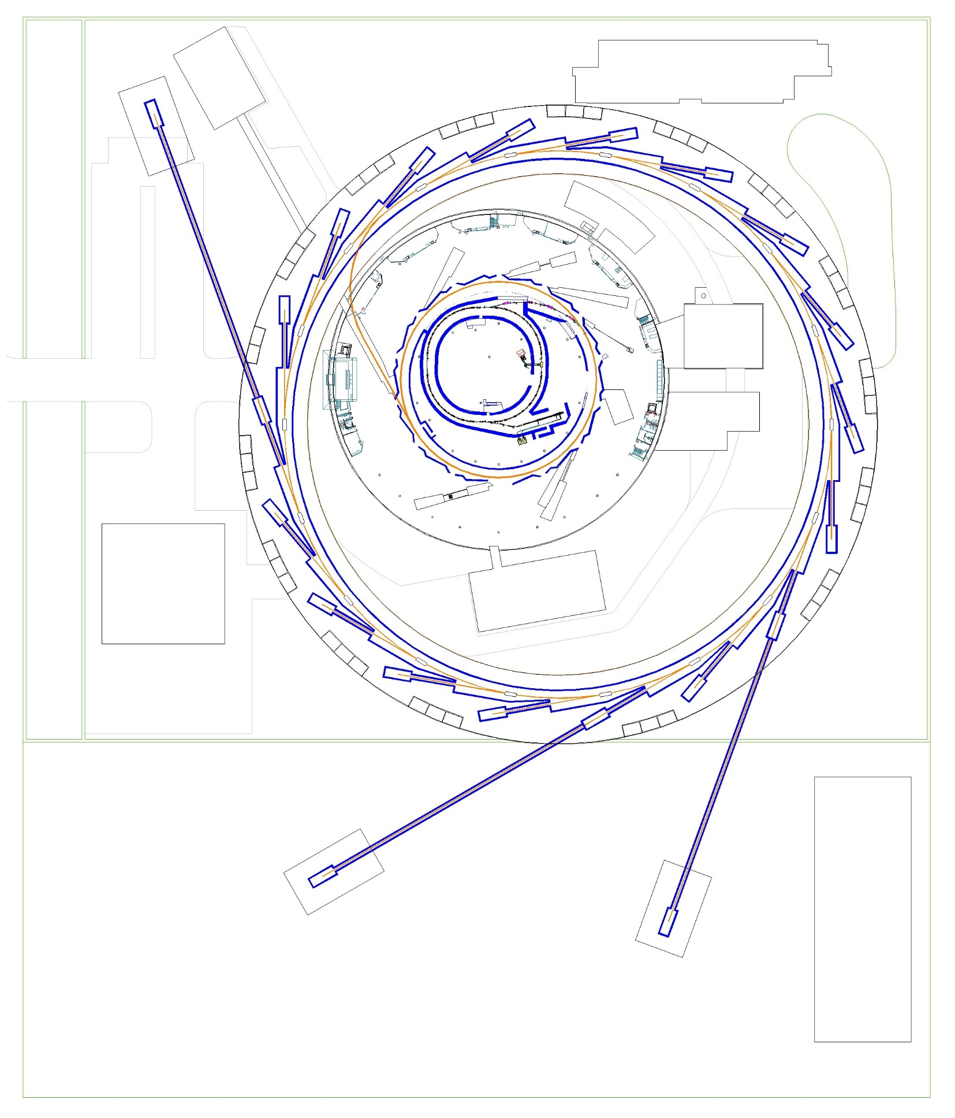
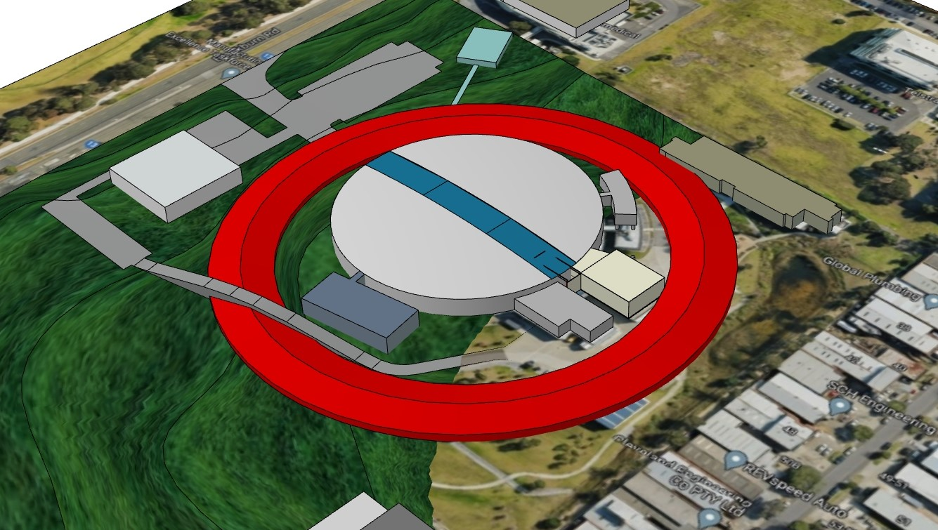
600m ‘Ring Around Ring’
9BA lattice using same design approach
  Can achieve very low emittance <0.05 nm.rad
  lower RF requirements.
  24 sectors, 6m straights
Retains most beamlines and existing buildings
Close proximity to existing infrastructure
Beamlines up to 200m long are possible
Overpasses or underpasses for site access
Long transfer line from existing storage ring.
Cuts across the path of existing and planned long beamlines.
Requires a large amount of excavation on the West side.
Preliminary cost estimate: $400m + $170m for 10 beamlines

Slide 13
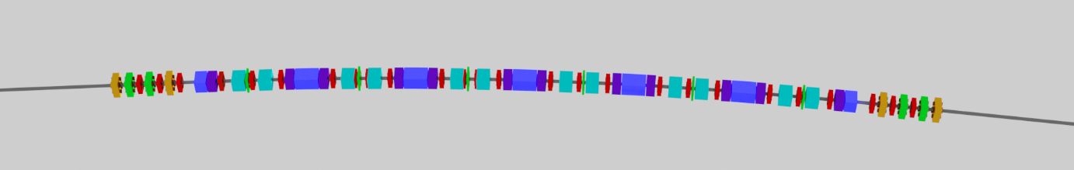
600m ring beam parameters
9 Bend Achromat gradient dipoles and reverse bends.
Preliminary design.
Parameter | Current DBA | 4BA at 3.0 GeV | 9BA at 3.0 GeV
Hor. Emittance (nm.rad) | 10.5 | 0.308 | 0.017
Circumference (m) | 216 | 216 | 600
Number of sectors | 14 | 14 | 24
E Loss Per Turn (KeV) | 932 | 1946 | 577
Energy Spread (%) | 0.1027 | 0.1624 | 0.0874
Natural Bunch Length (ps) | 29.36 | 9.19 | 0.96
Momentum Compaction | 0.0021 | -0.00135 | -2.85 x10⁻⁶
Straight length (m) | 4.5 | 3.0 | 6.0

Slide 14
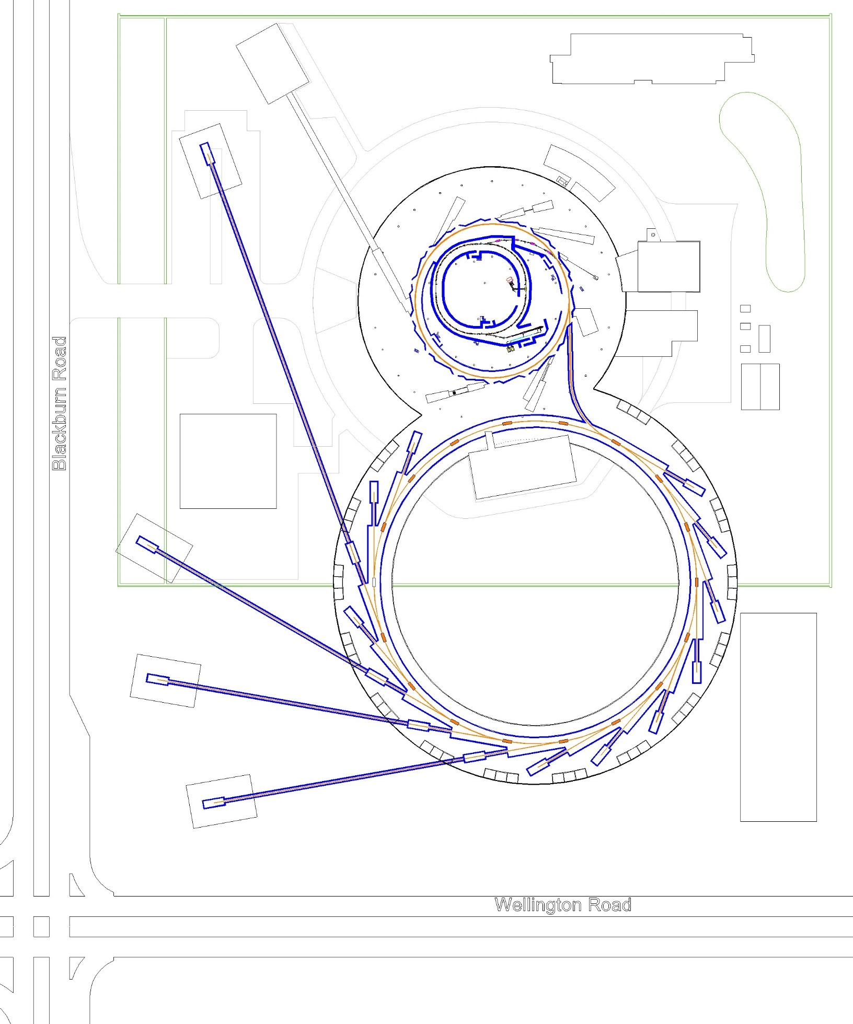
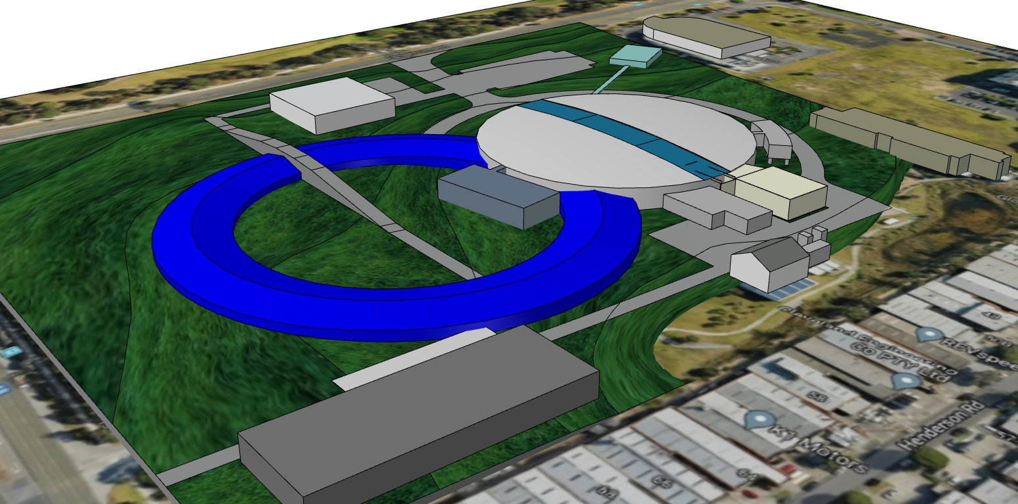
450m Ring Option
9BA lattice
  >0.1 nm.rad emmitance
  18 Sectors, 6m straights
  Similar RF requirements
Less impact to existing buildings
Encircles only one major building
Less excavation and impact to site drainage
Footprint extends into Monash University overflow carpark.
Over/underpass required for access to engineering
Proximity to Roads
  Length of new long beamlines restricted.
  Vibrations
Transfer line impact on existing beamlines.
Preliminary cost estimate: $300m + $170m for 10 beamlines

Slide 15
Other Accelerator development activities at the AS

Slide 16
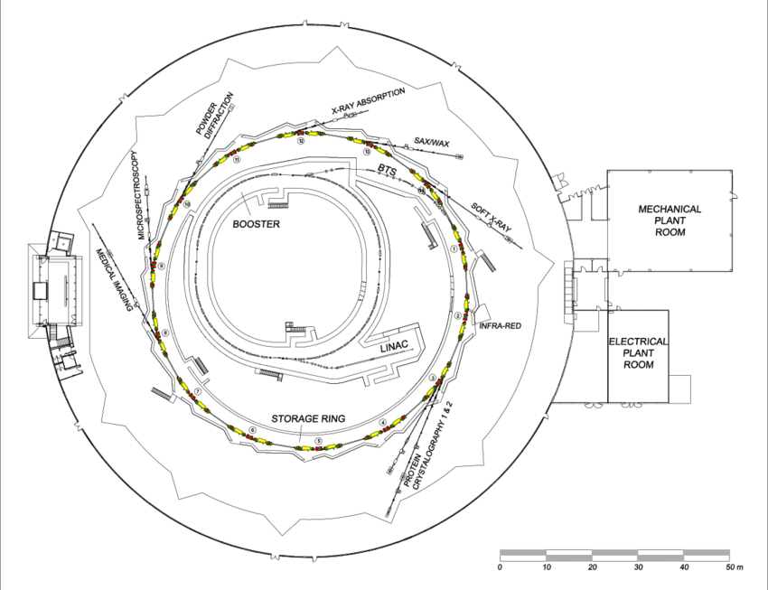
Australian Accelerator Test Facility
ANSTO is developing an on site accelerator test infrastructure for the later stages of development into a Compton Source
Will provide a ‘Hands-on’ lab that will enable substantial accelerator R&D without being tied to the needs of the Light source.
Aiming to work in parallel with X-LAB lab to progress towards a Compton source, but will be a flexible facility.

Slide 17
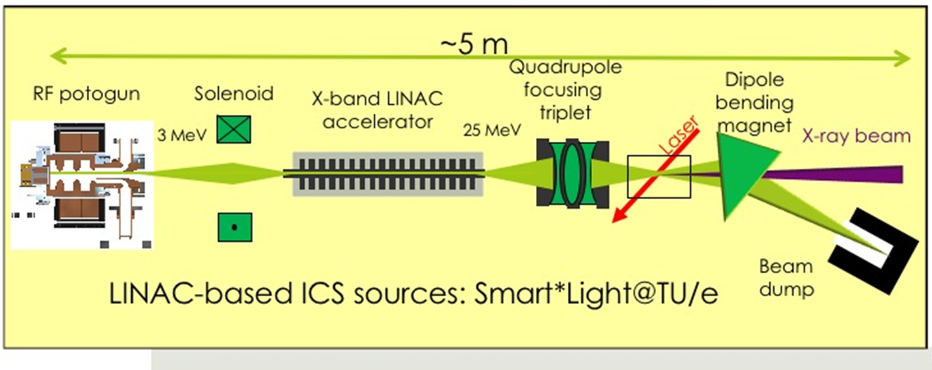
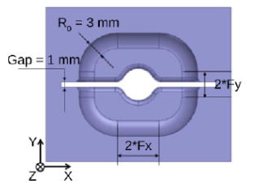
AATF compact light source development
AATF will develop technologies for compact light source development
Work closely with X-Lab at University of Melbourne to develop a compact Light source based on X-Band acceleration
First stage will be fabrication and testing of a novel X-band Gun, based on split halves production design (https://arxiv.org/abs/2009.00270)
First operation of facility expected in 2023

Slide 18
Pulsed Energetic Electrons for Research (PEER)
Our injector Linac is the only source of 100 MeV electrons in Australia.
PEER stage 1:
  Create a test area for exploring new areas of research utilising a pulsed beam of 40 - 100 MeV electrons.
  Develop a particle simulator model (GEANT and FLUKA) for PEER
  Make preliminary dose and dose rate measurements.
Areas of Research
Very High Energy Electron (VHEE) radio therapy
  100 MeV to 250 MeV electrons,
  Up to 1 Gy/pulse (150 ns) at 100 MeV and 3 nC.
As an irradiation facility
  Study of radiation damage to electronics/materials
Space environment radiation studies
  Mimicking the space environment to understand how human exploration in to space (manned and unmanned) can be improved.

Slide 19
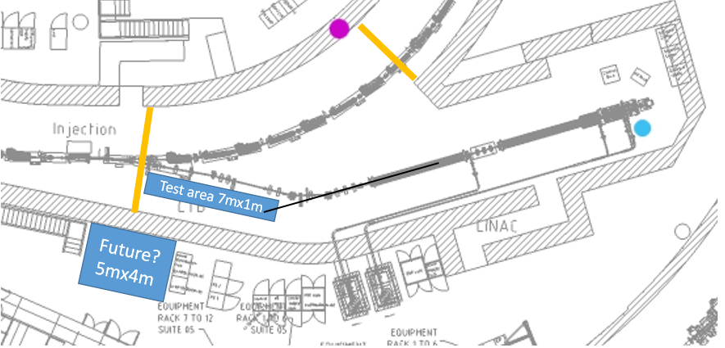
Proposal for PEER: Linac Bunker
PEER

Slide 20
Summary
A ‘competitive’ design using our current ring tunnels appears possible (AS-U)
  however we need to further investigate options for lowering the beam energy loss while preserving low emittance
  Preliminary design and costings indicate ~$AUD 300m, 2--2.5 years dark time.
Preliminary design and costings have been conducted for two larger ring options (AS2.0)
  Can achieve much smaller emittances and many more beamlines
  Prelim cost $AUD 470-580m. Disruption to existing facility less than AS-U rebuild.
  Both designs have logistical challenges in maintaining operation of AS during construction but considered manageable with appropriate planning.
New Research initiatives in Compact Light Sources and VHEE radiotherapy are being pursued

