Slide 1
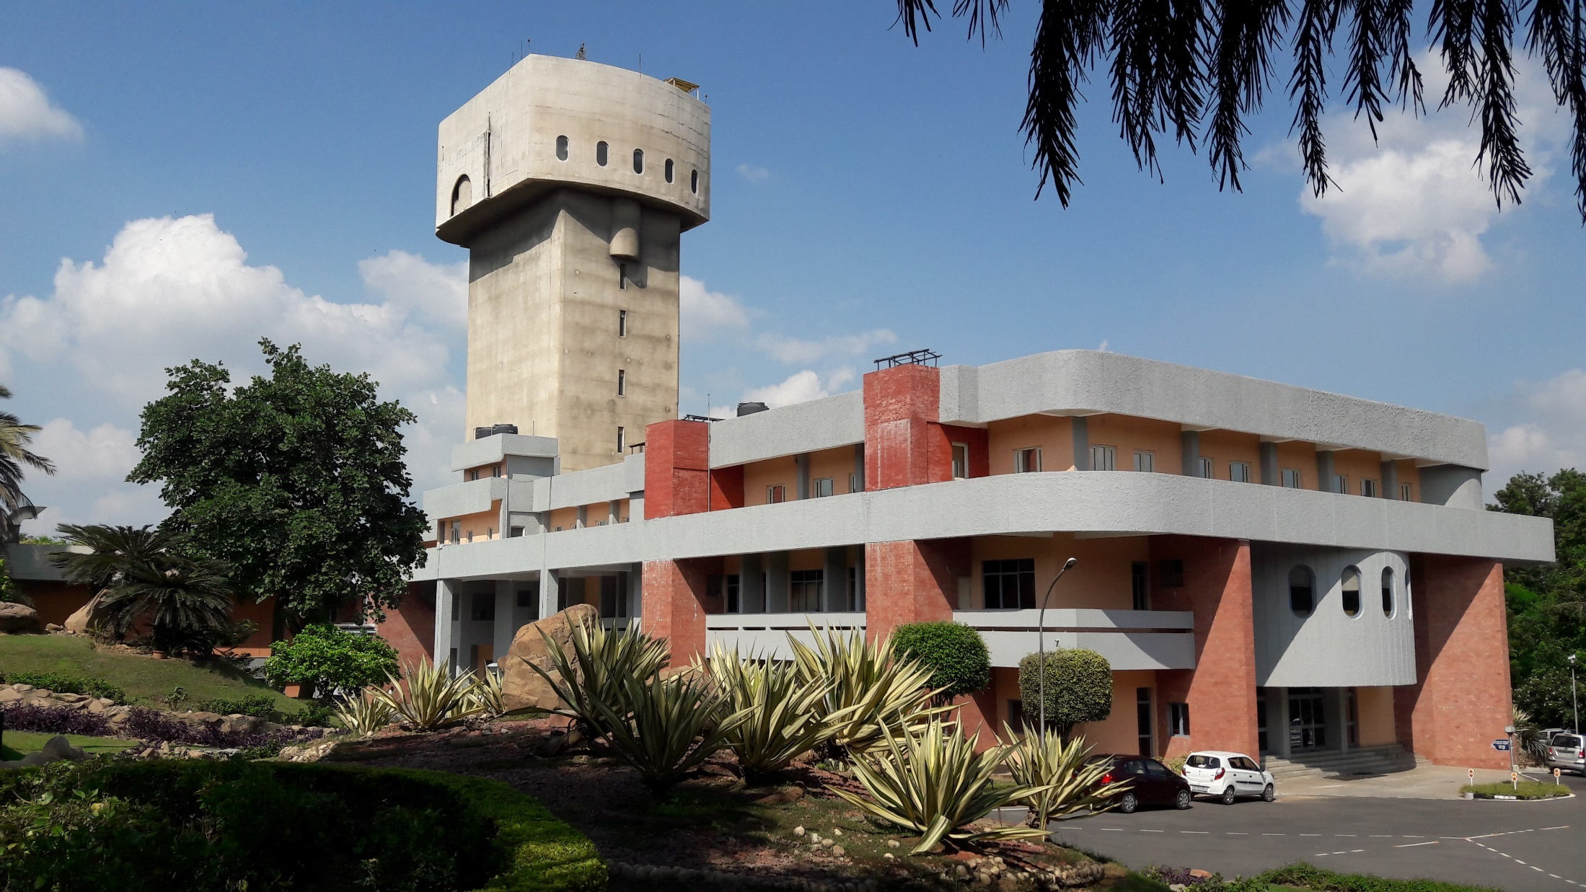
Compact FEL-THz facility at IUAC – commissioning and initial testing of the sub-systems
(Project is supported by IUAC and DAE-BRNS)
Subhendu Ghosh. Inter University Accelerator Centre, New Delhi, India
S.Ghosh, B.K. Sahu, P. Patra, J. Karmakar, B.Karmakar, A. Sharma, S.R. Abhilash, S. Tripathi, P. Barua, A. Kothari, S.K.Saini, S. Kumar, G.O. Rodrigues, M. Aggarwal, V. Joshi, R. Kumar, S.K. Suman, M. Kumar, S. Sahu, S.V.Ramanan, P.Singh, N. Madhavan, R.K. Bhandari, D. Kanjilal and A.C. Pandey, Inter University Accelerator Centre (IUAC), India
A. Aryshev, J. Urakawa, High Energy Accelerator Research Organization, KEK, Japan
S. Tripathi, Diamond Light Source Ltd, Diamond House, Didcot, Oxfordshire, UK
M. Tischer, Deutsches Elektronen-Synchrotron (DESY), Germany
V. Naik, Variable Energy Cyclotron Center, Kolkata, India
V. Teotia, E. Mishra, J. Itteera, K. Singh, S. Malhotra,
Bhabha Atomic Research Center, Mumbai, India
T. Rao, Brookhaven National Laboratory, USA

Slide 2

Plan of Presentation
Outline of the Compact FEL facility
Commissioning status of various sub-components
Deliverables from Delhi Light Source
Conclusion

Slide 3
Design parameters of the FEL-THz facility (DLS)
S. No. | Parameters | Max | Min
1. | Radiation Frequency | 3.0 THz | 0.18 THz
2. | Electron energy | 8.2 MeV | 4.0 MeV
3. | Acc. Field (2.6 cell 2860 MHz, Cu cavity) | 112 MV/m | 59 MV/m
4. | Electron beam FWHM at Photocathode | 200 fs | 200 fs
5. | Photocathode material | Cu and CsTe
6. | Number of microbunches | 16 | 2
7. | Max charges in a single microbunch | 15 pC | 15 pC
8. | Peak current at Undulator entrance | 75 Amps | 20 Amps
9. | Undulator type | Planer Undulator
10. | Undulator period length and total numbers | 48 mm and 33
11. | Magnetic field (K-value) | 0.09 T (0.41) | 0.6 T (2.79)
12. | Undulator length | ~ 1.7 m
13. | Klystron and Modulator | 25 MW / 5 kW (peak / average power)
14. | Operating Frequency, Bandwidth | 2860 MHz, ± 1 MHz
15. | RF pulse duration | 4.0 μsec. | 0.4 μsec.
16. | THz Power, pulse duration | 1.7 MW, 15 ps | 1.9 kW, 195 ps

Slide 4
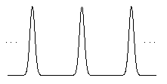
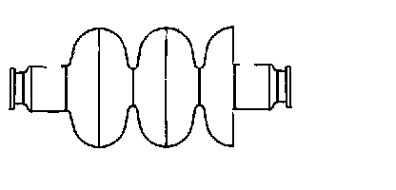
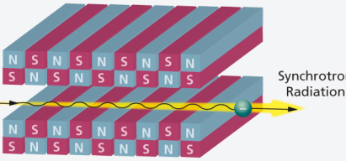

Major components Pre-bunched FEL – Our case
10 Hz
Solenoid
Laser
Laser
beam
0.375 fs – 6.6 ps
Electron
beam
Undulator Magnet
Solenoid
An electron gun – laser operated PC & a resonator powered by klystron/modulator
A laser system – produce the electron bunches – single pulse is split into many
3. Photocathode – Copper and Cs₂Te (Deposition system)
Solenoid, other electromagnets – focus/steer electron beam – Cavity to Undulator
5. Undulator – to produce THz radiation
6. Beam diagnostic and e.m. radiation detector systems
7. Electronics and Control system
$$γ=\frac{E}{E_{o}}=\frac{8}{0.5}=16$$
λ_{U} – Undulator wavelength
B_{U} – Undulator mag field

Slide 5
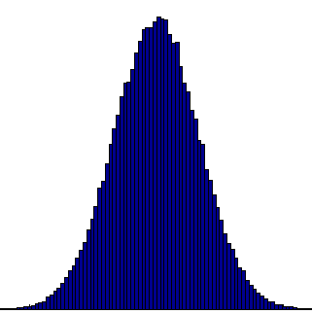

Tuning of THz frequency in FEL of IUAC
½ w plate rotates S-wave by 45º.
Polarizing beam splitter makes S-wave & P-wave by reflection & transmission.
16 micro bunched laser within 6-7 psec.
5 MHz
Solenoid
Laser
Laser
beam
0.333-6.6 ps
f ~ 3 – 0.18 THz
T = 333 fs to 6.6 ps
λ = 100 μm to 2 mm
Electron
beam
Laser pulses as well
Electron bunches
Solenoid
$$γ=\frac{E}{E_{o}}=\frac{8}{0.5}=16$$
λ_{U} – Undulator wavelength
B_{U} – Undulator mag field

Slide 6
Scheme of production of Electron
Micro-bunches

Slide 7
Production of electron beam microbunches -
Multi-bunch train of THz
~ 3 μs (RF width)
Total no. of laser
pulses (5 MHz)
are 15
1
15
200 ns
3 μs – nominal RF pulse width
6.25 Hz – Klystron/Mod freq.
Laser Osc. Frequency – 5 MHz
Laser splitting freq. – 3 / 0.18 THz
160ms (6.25 Hz)
~ 6 ps
1
16
333 fs (3 THz)
1
200 ns
2
15
3 μs
So total no. of laser micropulses/e-bunches/THz pulses 15 × 16 × 6.25 = 1500 pulses/sec

Slide 8
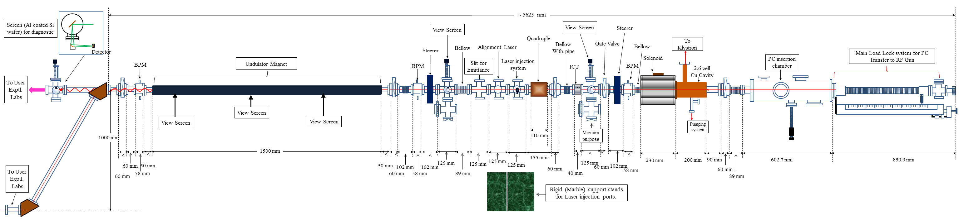

Beam line of DLS

Slide 9
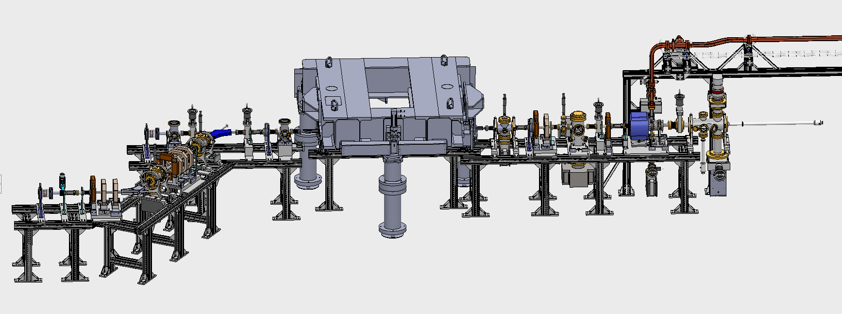
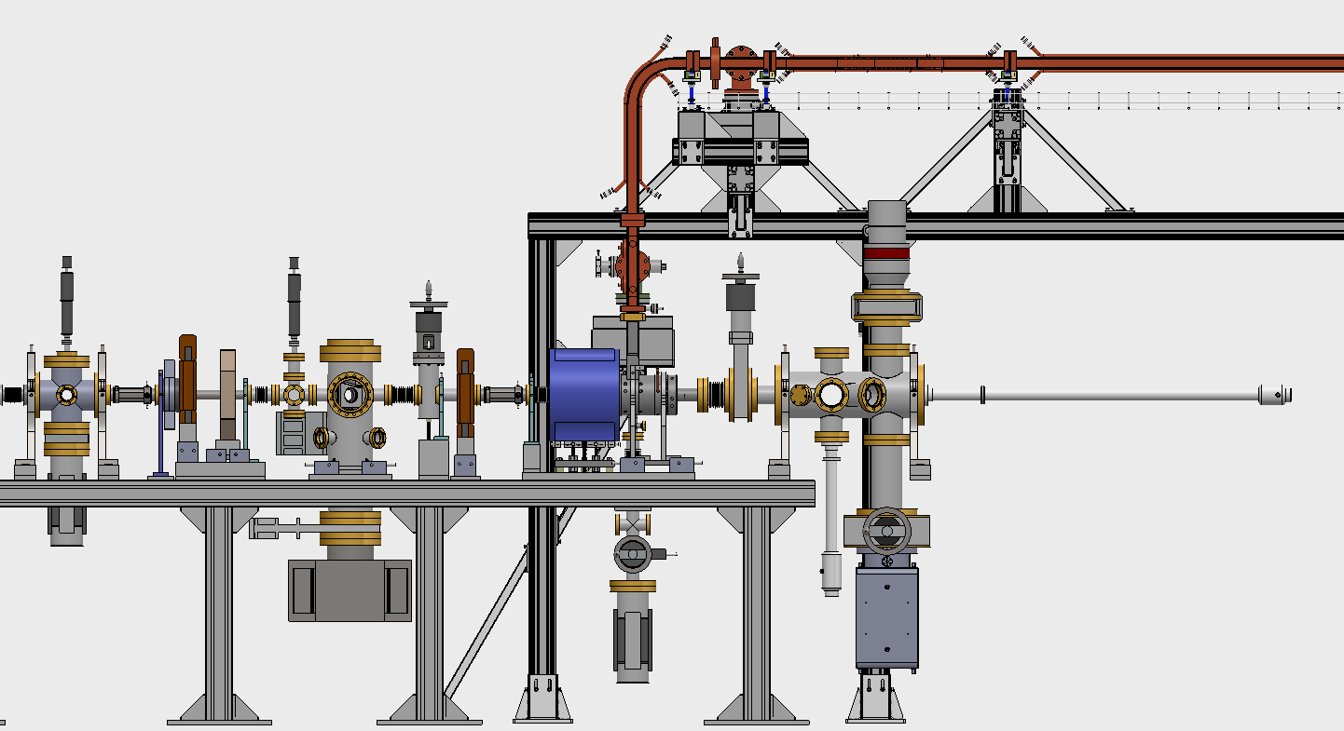
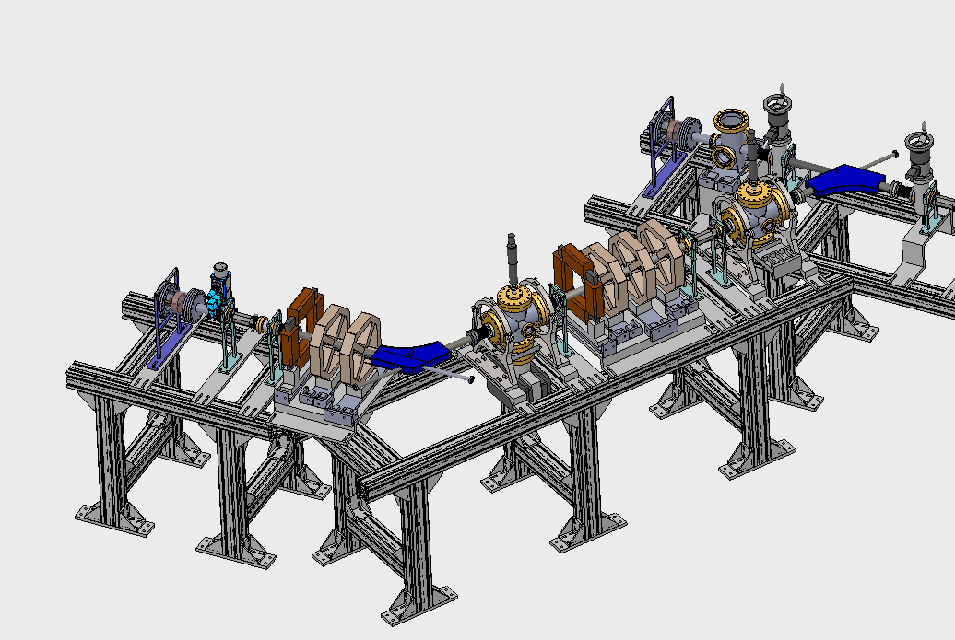
Beam Line
Based on beam optics designs - Beam line design was completed
Wave Guide
DN40 Gate Valve
Radiation extraction Chamber
Undulator
CTR Chamber
BPM
Post-Undulator Section
FCT
400 l/s Ion Pump
Pre-Undulator Section
Beam Viewer-3
Bending Magnet-1
QP triplet
DN40 Gate Valve
DN160 all metal GV
Beam Viewer-2
Beam Viewer-1
Solenoid
Beam Viewer-4
Laser Reflection Chamber
Steerer-4
QP
BPM
Turbo Pump
BPM
QP doublet
BPM
PC Insertion Chamber
Gate Valve
Bending Magnet-2
RF Cavity
Magnetic Manipulator
Steerer-3
Gate Valve
FCT
Steerer-2
Steerer-I
Ion Pump
Ion Pump
Ion Pump

Slide 10
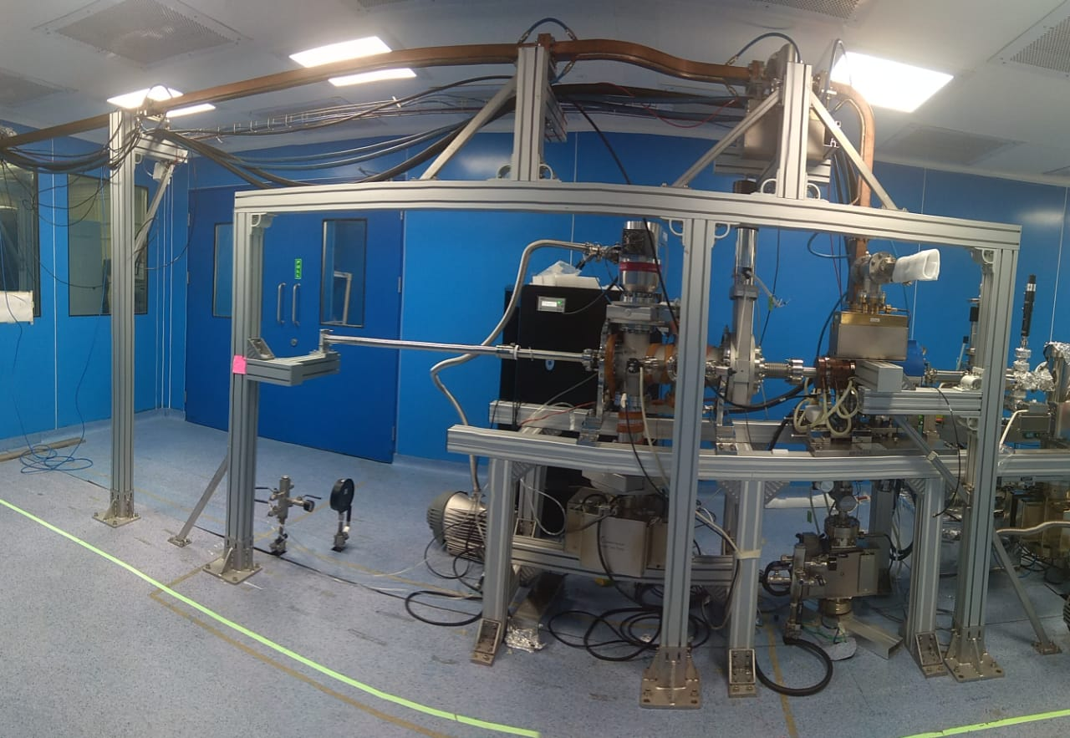
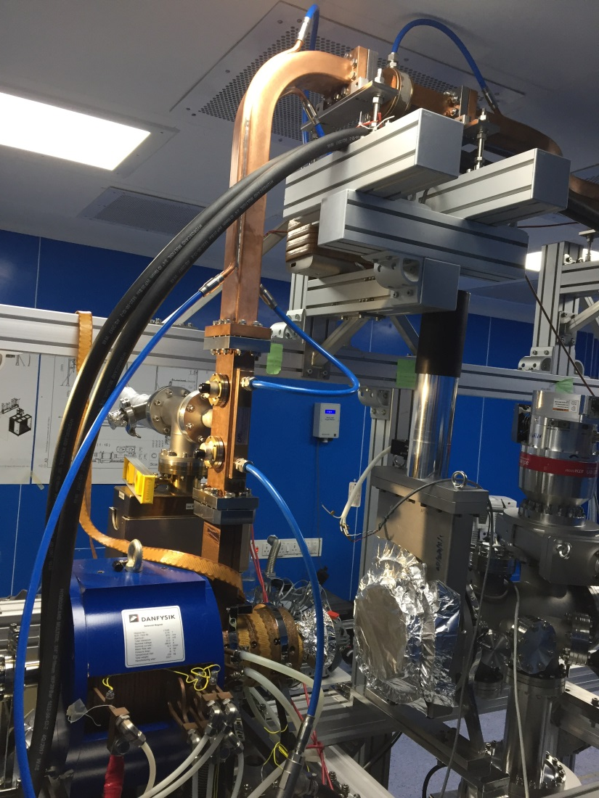
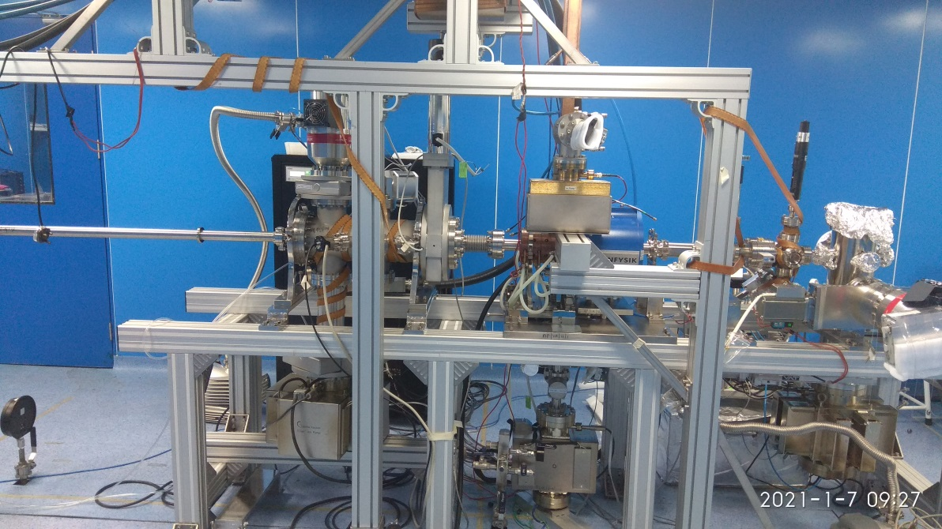
Beam Line completed till Dec. 2020
Wave Guide is connected to the electron gun
Directional coupler
Magnetic manipulator
Turbo pump
BPM
Laser Reflection chamber
FCT
Electron Gun
Electron Gun
Beam Viewer
PC insertion chamber
Ion Pump
Solenoid magnet

Slide 11
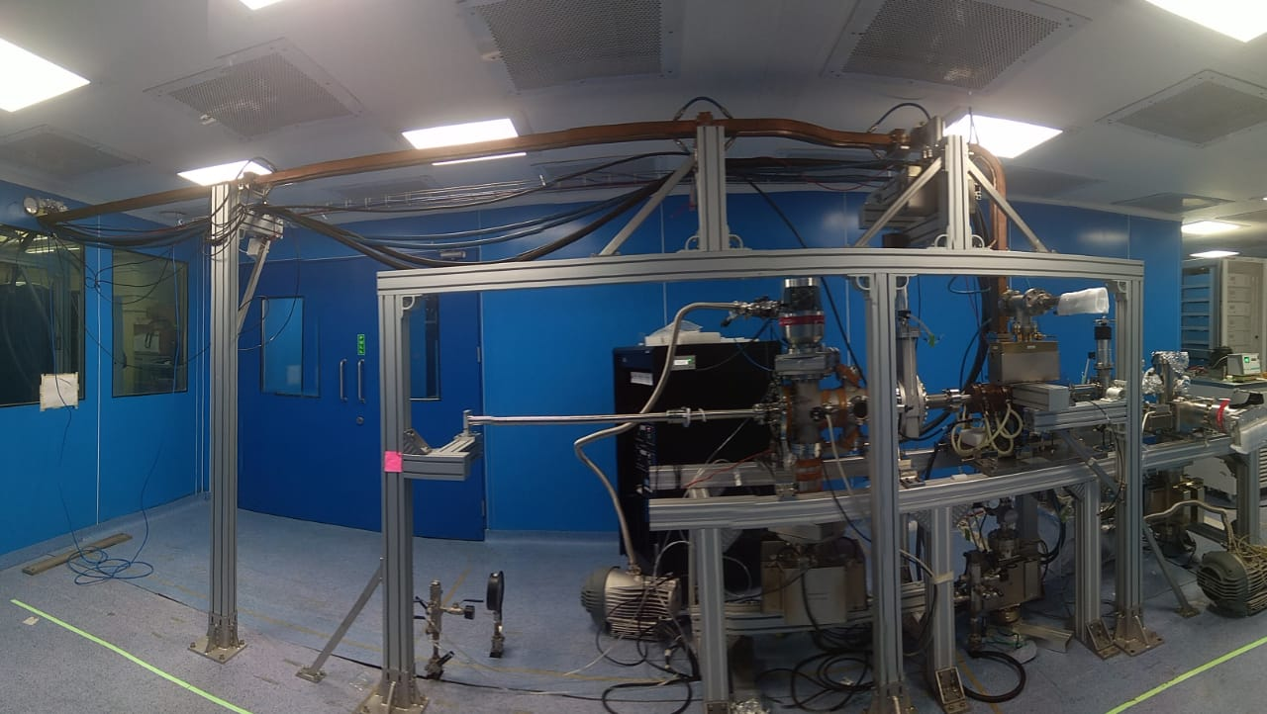
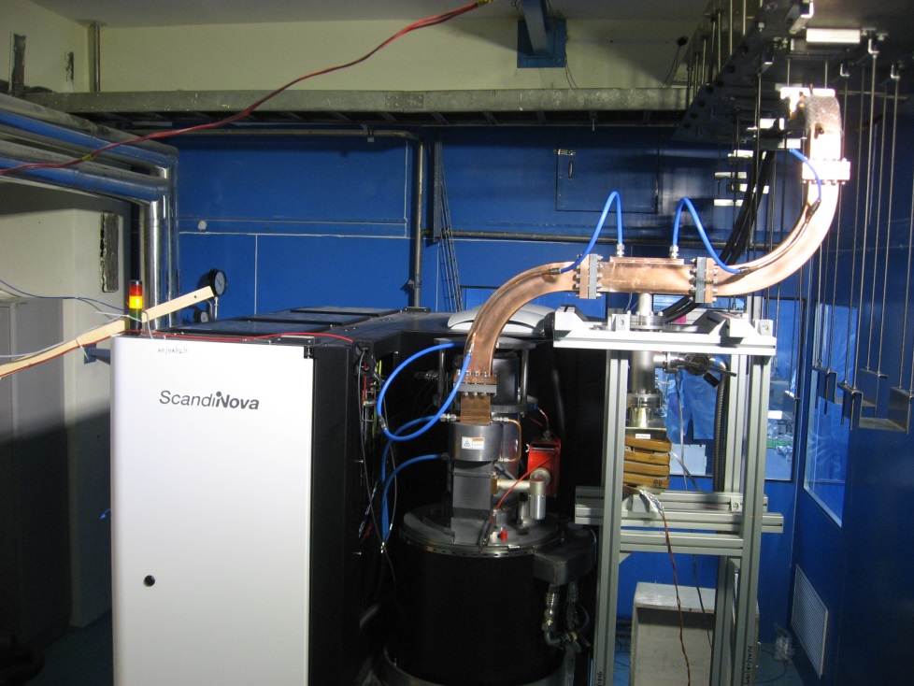
High power RF system, Wave Guide and electron gun
RF system: fully conditioned w load in Oct. ’20
RF system connected w Cavity: Nov.-Dec. ’20
Cavity Conditioning started: Jan. ’21 – going on

Slide 12
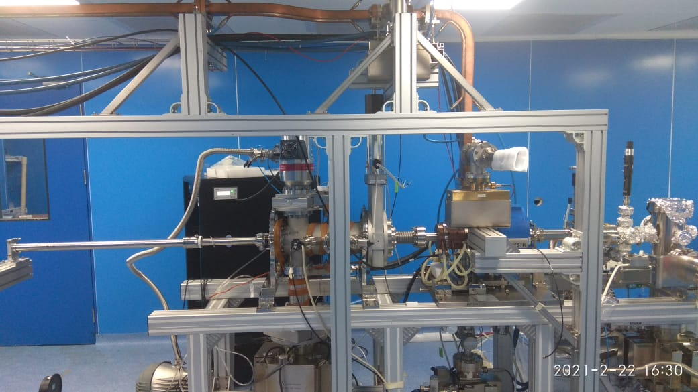
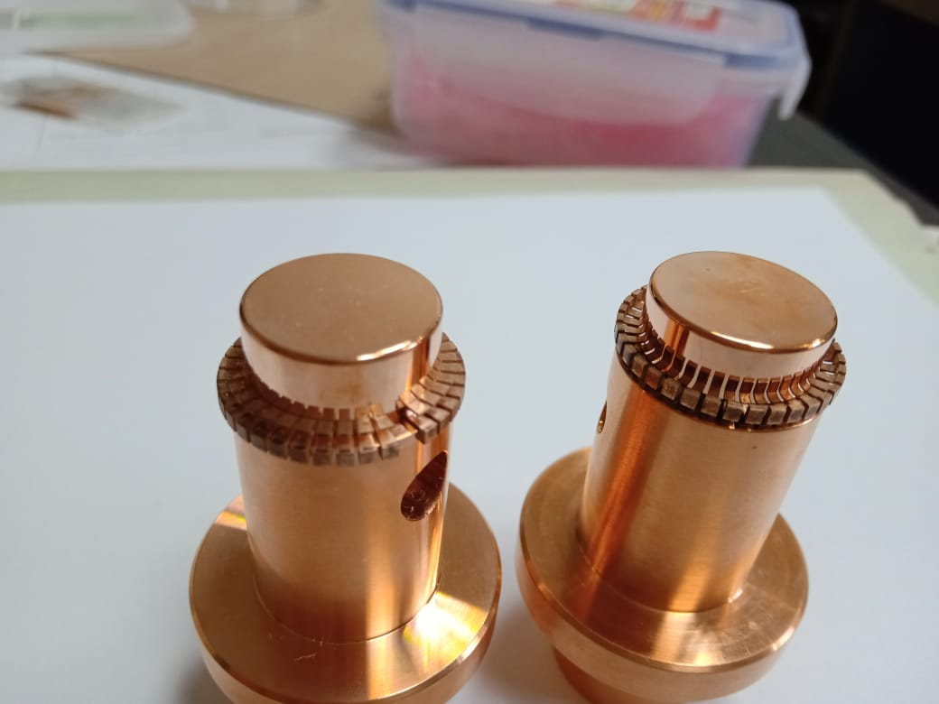
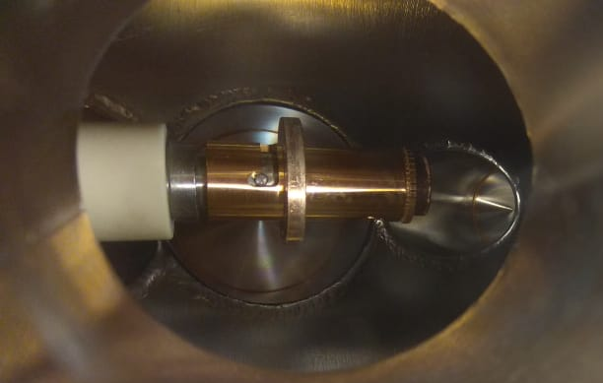
Photocathode, Insertion chamber and electron gun
Cu-Be Spring for RF contact

Slide 13
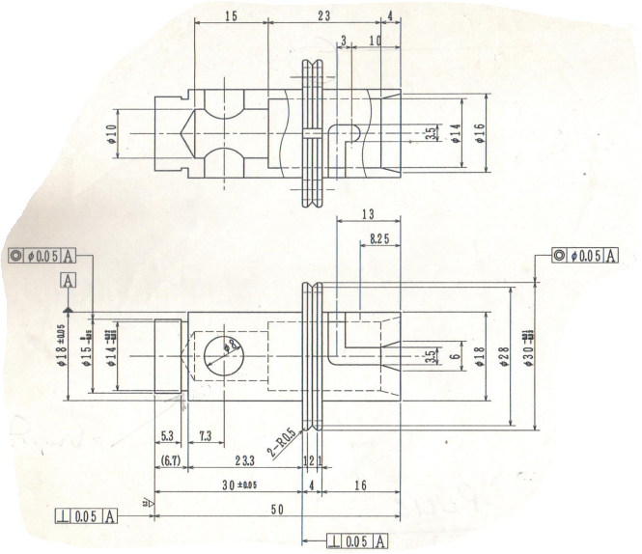
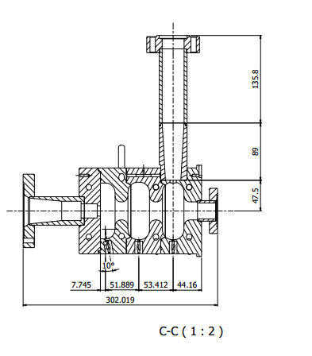
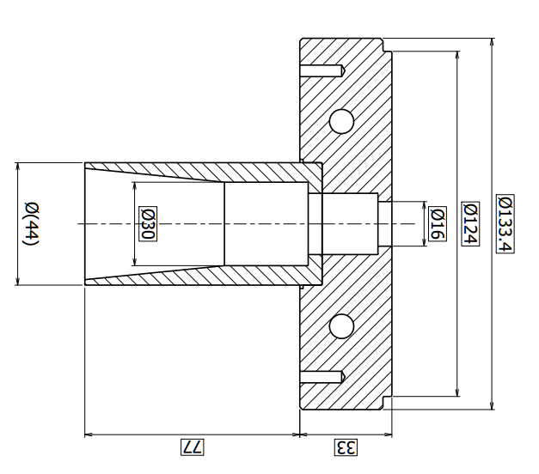
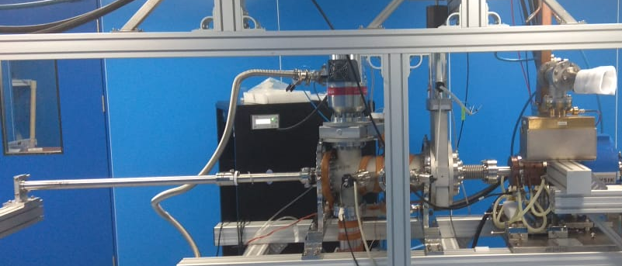
Mechanism to insert the PC
plug into the RF cavity
Cu-Be Spring for RF contact
Magnetic manipulator

Slide 14
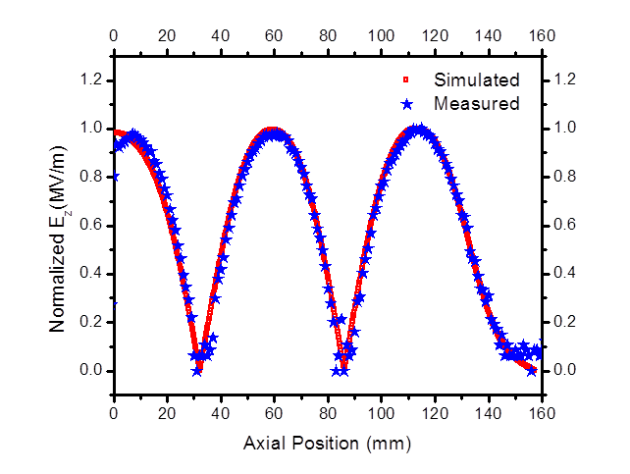
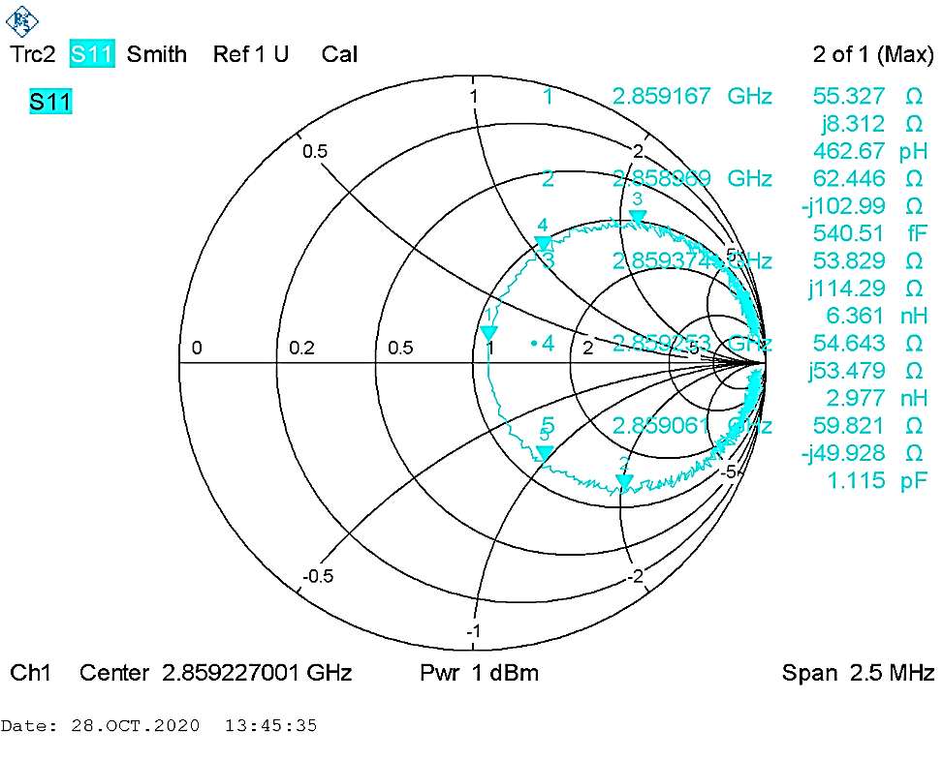
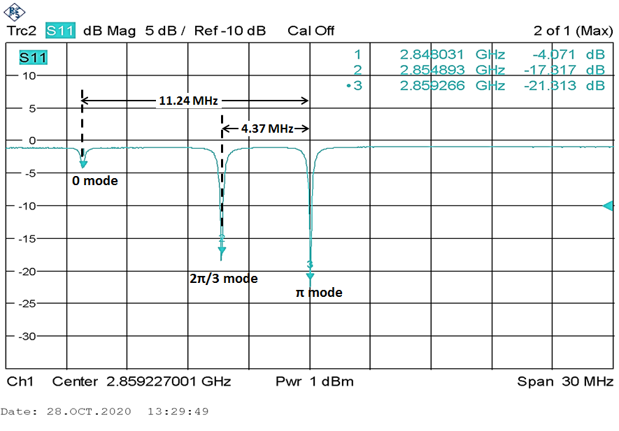
RF Measurements of RF Gun
Parameters | KEK (after fabrication) | IUAC (after installation)
Loaded Q-factor | 7988 | 7060
External Q-factor | 16822 | 14892
Unloaded Q-factor | 15211 | 13424
Coupling Coeff. β | 0.904 | 0.901
Mode Sep (0 and π) | 11.17 MHz | 11.24 MHz
Mode Sep (2π/3 and π) | 4.17 MHz | 4.37 MHz
Accelerating Field profile Measured
( bead pull) & simulation

Slide 15
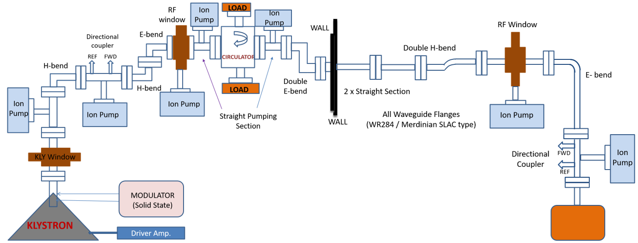
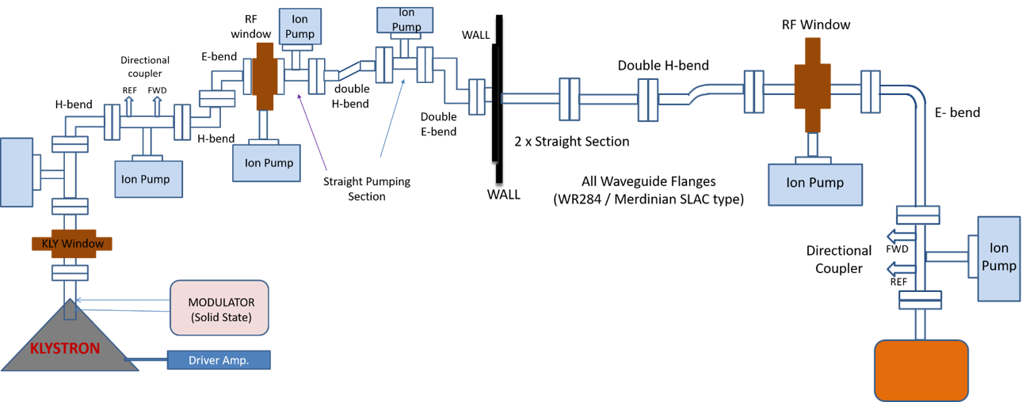
High Power RF System
Original Plan
Cavity
Present status
Cavity

Slide 16
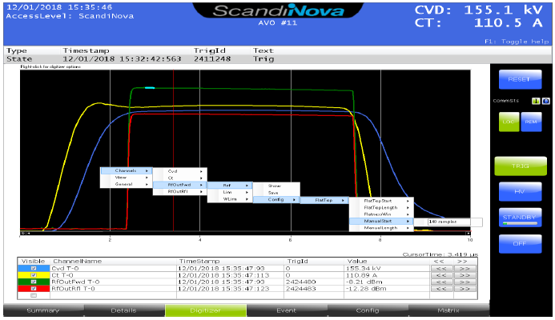
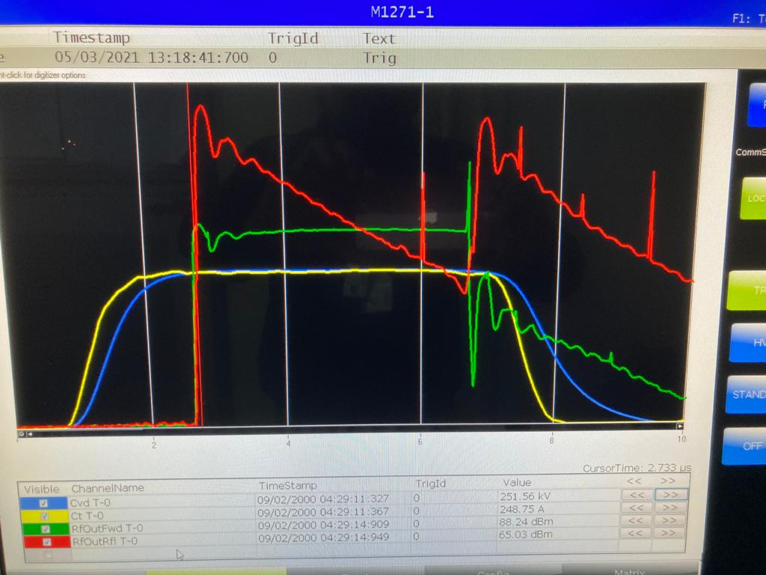
RF Conditioning
FORWARD
With Dummy load
REFLECTED
4 μsec RF On
With Cavity
REFLECTED
FORWARD
4 μsec RF On

Slide 17
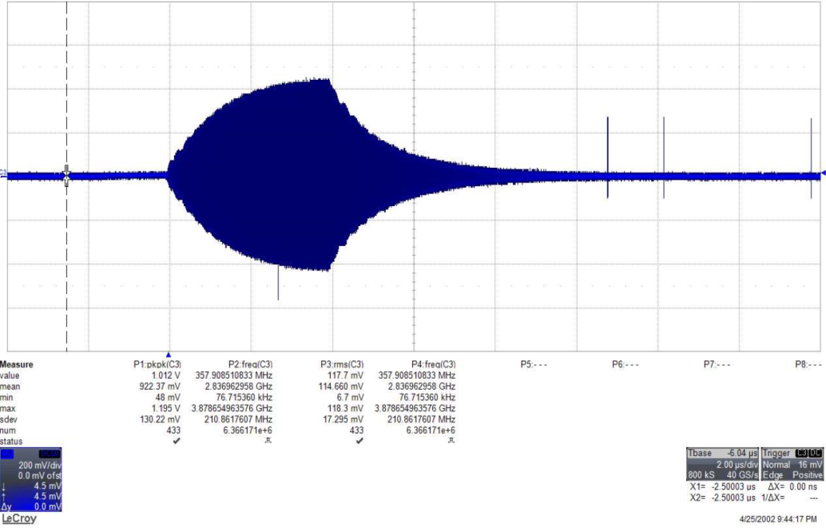
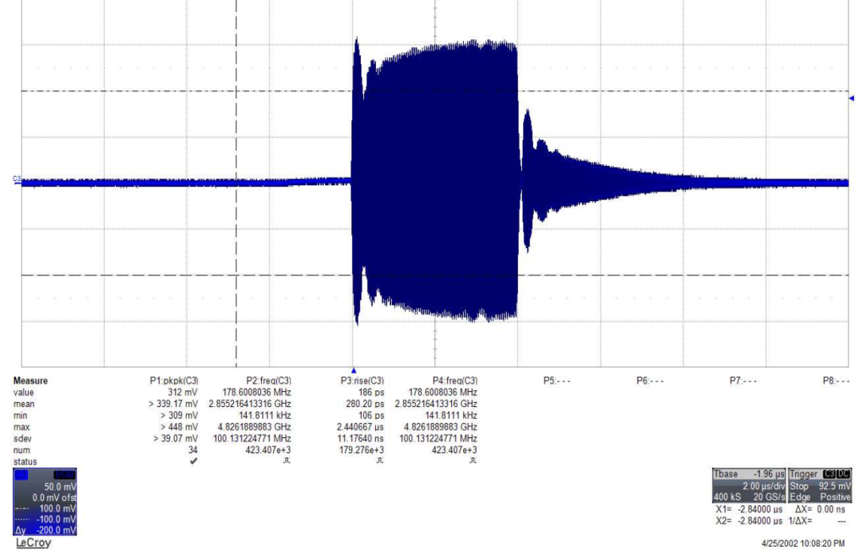
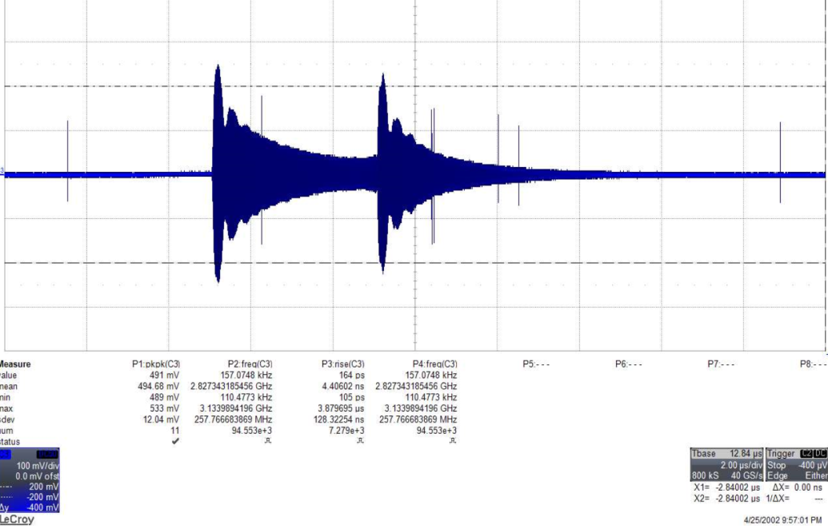
RF Conditioning of Cavity
Pick up
4 μs
Forward
Reflected
4 μs
4 μs

Slide 18
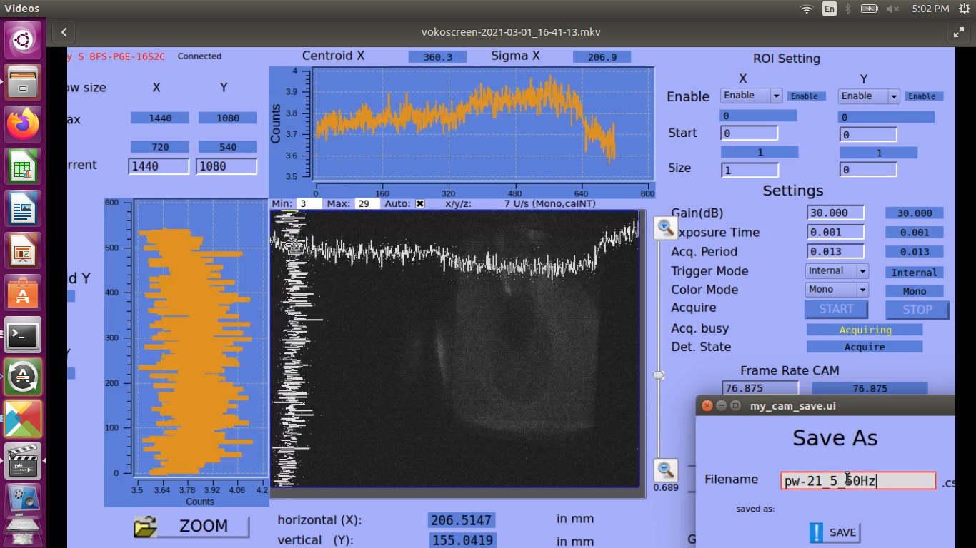
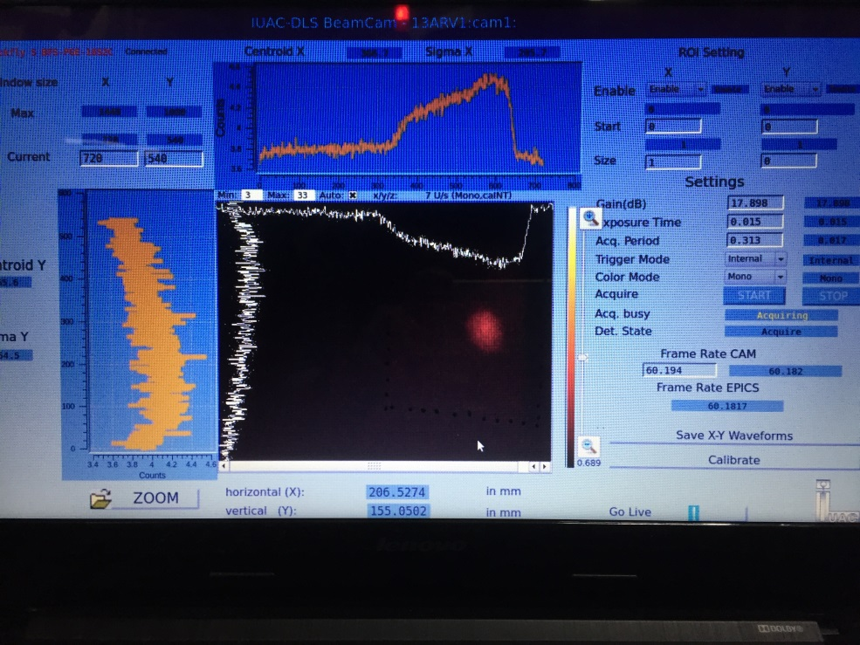
First signature of electron beam at IUAC – Dark Current
March 01, 2021

Slide 19
Doubts ?
Why cavity filling time is > 2μs?
How to reduce filling time and minimize the reflected power?
Do we need frequency tracking during conditioning?
Role of variation in photocathode position during conditioning?

Slide 20
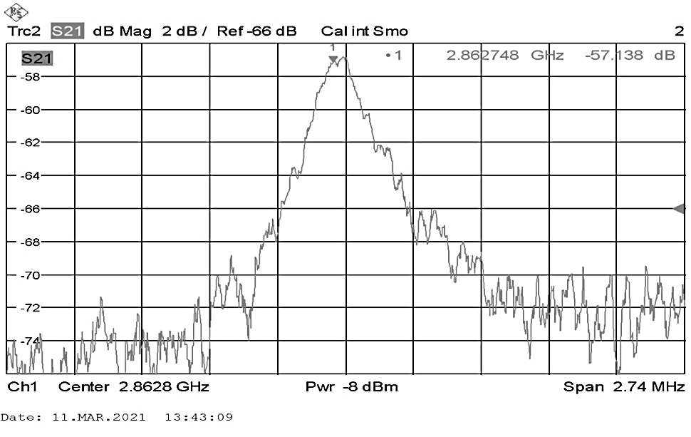
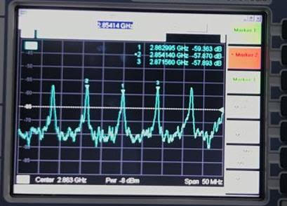
Measurement through Directional Coupler near cavity
Span: 2.74 MHz
Port 1: FWD port of Directional Coupler through 1 W amplifier (28 dBm max.)
Port 2: REF port of Directional Coupler
Plot of S21 shows peak at 2862.7 MHz
Expected frequency = 2860 MHz
Details of Directional Coupler
  FWD Coupling = 57 dB
  REF Coupling = 60 dB
  Directivity = 30 dB
Span: 50 MHz

Slide 21
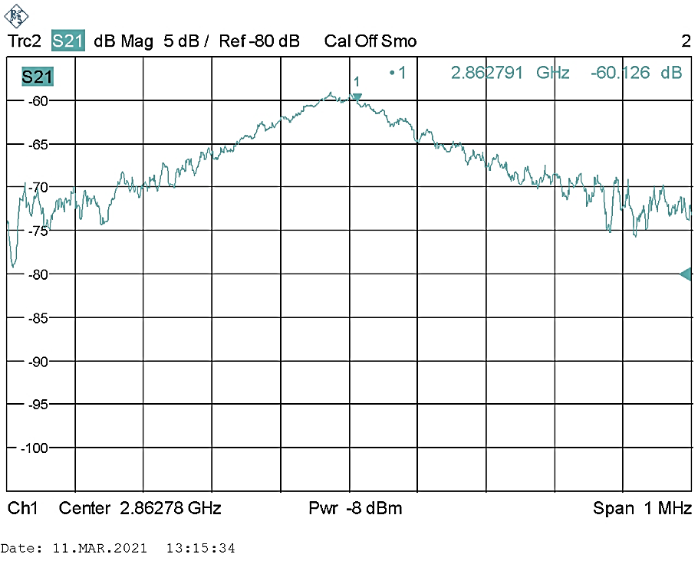
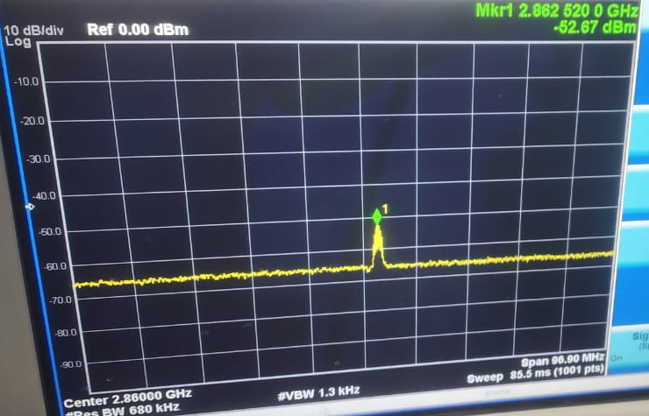
Measurement through Directional
coupler near Klystron
Port 1: FWD port of Directional Coupler through 1 W amplifier (28 dBm max.)
Port 2: REF port of Directional Coupler
Plot of S21 shows peak at 2862.7 MHz
Expected frequency = 2860 MHz
Spectrum Analyzer Ouptut at FWD port of DC near cavity = 2862.5 MHz
Details of Directional Coupler
  FWD Coupling = 58 dB
  REF Coupling = 59 dB
  Directivity = 30 dB

Slide 22
Doubts??
Why peak appears at 2862 MHz and not at 2860 MHz? Because when feeding with klystron power, cavity gives maximum output around 2860 MHz.
Is the power actually going into cavity? Is the method correct?
Is the VNA plot showing actual Reflection from cavity?
Or is there a new cavity formed between two directional couplers as the waveguide offers < 1 dB attenuation while the directivity is > 30 dB for directional couplers.

Slide 23
Energy budget (16 microbunches) and Energy available
Case | Copper PC | Cs₂Te PC
Charge/μbunch (pC) | 15 | 15
No. electrons/μbunch | 9.38e+07 | 9.38e+07
Q.E. of PC | 1.0 e-05 | 1.0 e-03
No. photons required | 9.38 e+12 | 9.38 e+10
Photon energy required | 7.3 μJ | 72.6 nJ
BUDGET
AVAILABLE
Stages | Energy
Pre-Amp output | 25 nJ, IR
Output of Amp-1 (48 dB), ~ 260 times | 6.5 μJ, IR
Output of Amp-2 (48 dB), ~ 260 times | 1.69 mJ, IR
After 4th harmonic, 20% eff. | 338 μJ, UV
After splitting, 16 pulses, 3.1% eff. | 10.5 μJ

Slide 24
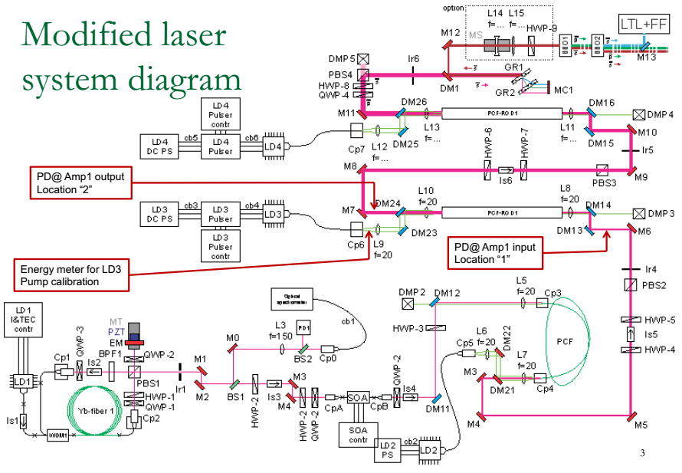
Fibre Laser system
2nd.
stage
of
Amp.
1st
stage
of
Amp.
Pulse Picker by
Semiconductor Optical
Amplifier: 130 to 5/10 MHz
Pre-Amplifier
Pump (LD2): CW
Oscillator: 130 MHz
Pump (LD1): CW

Slide 25
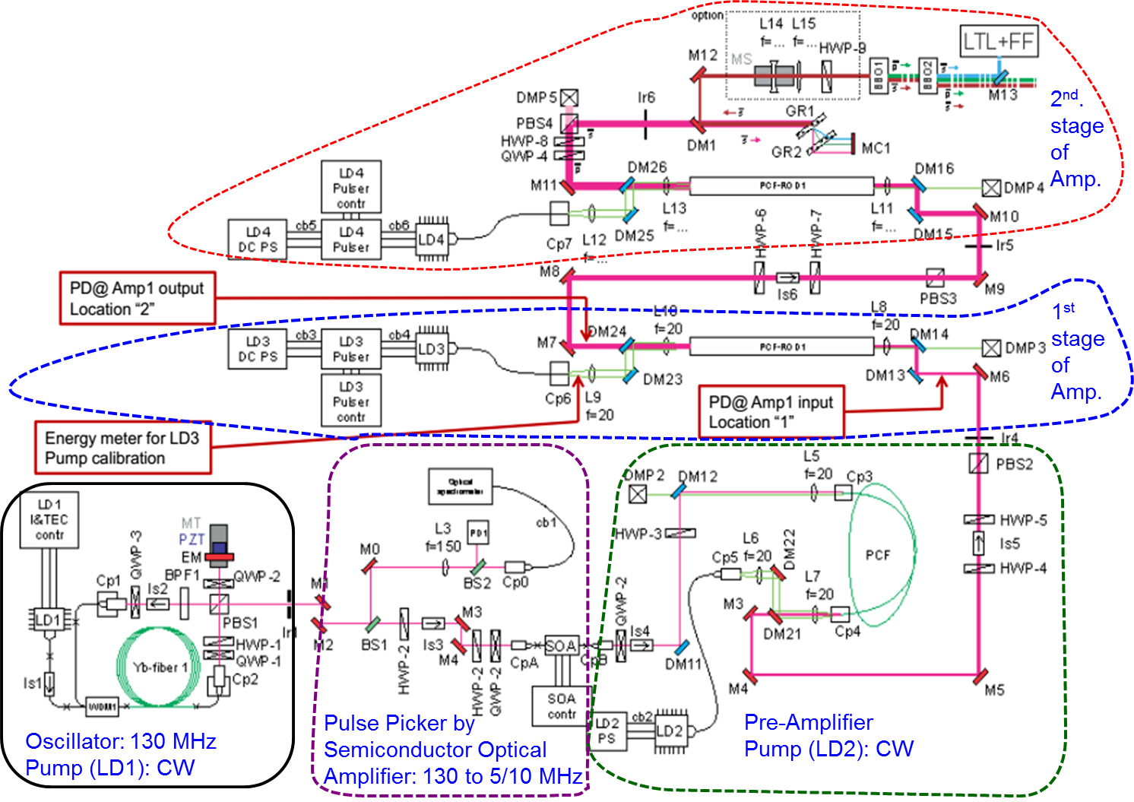
Fibre Laser system
Completed sections:
Oscillator
Pulse picker
Pre-Amplifier
Amplifier-1
Amplifier-2
Pulses is compressed upto ps
– working to compress further from ps to fs
Power after FHG is still low – working to improve the power
Single laser pulse will be split in to many.

Slide 26
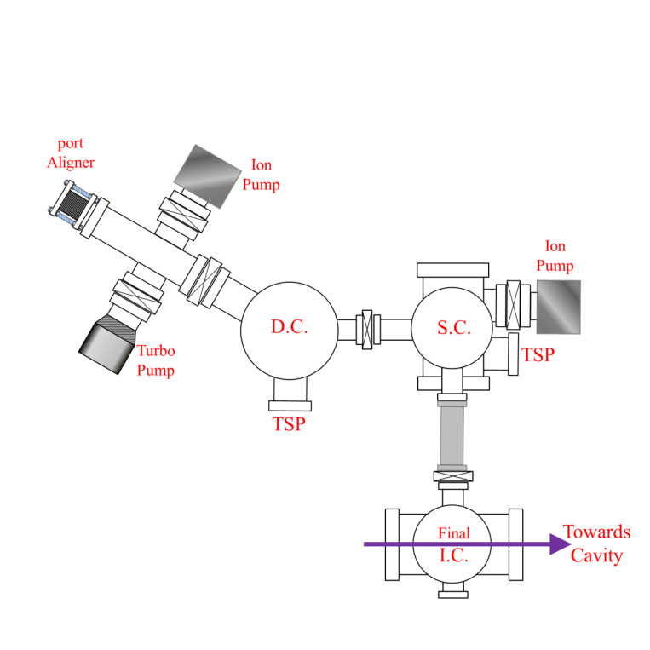
Photocathode: Deposition system for semiconductor PC
TOP VIEW SCHEMATIC
Initial loading chamber

Slide 27
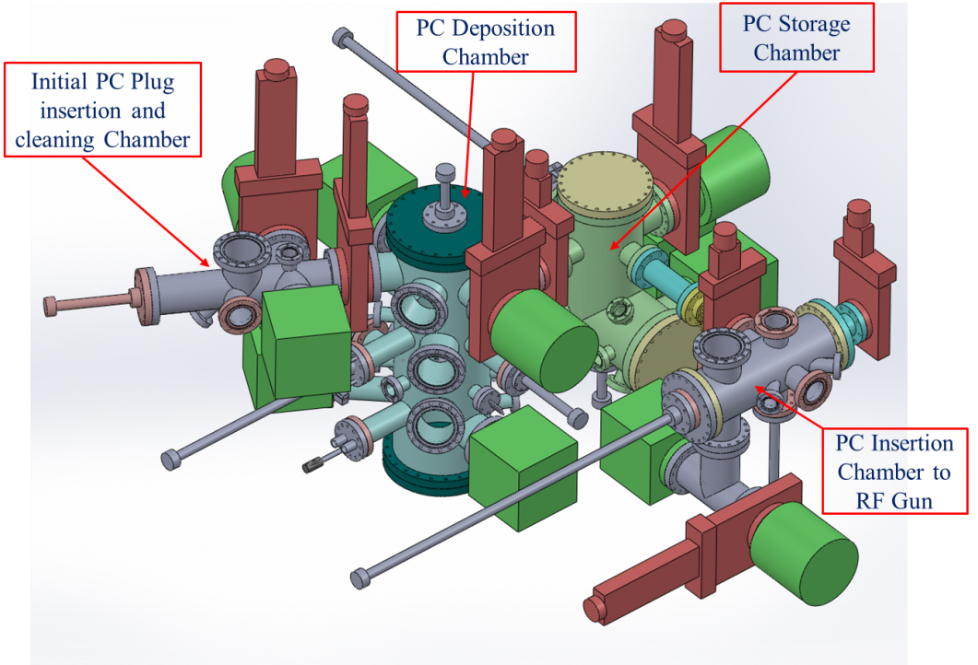
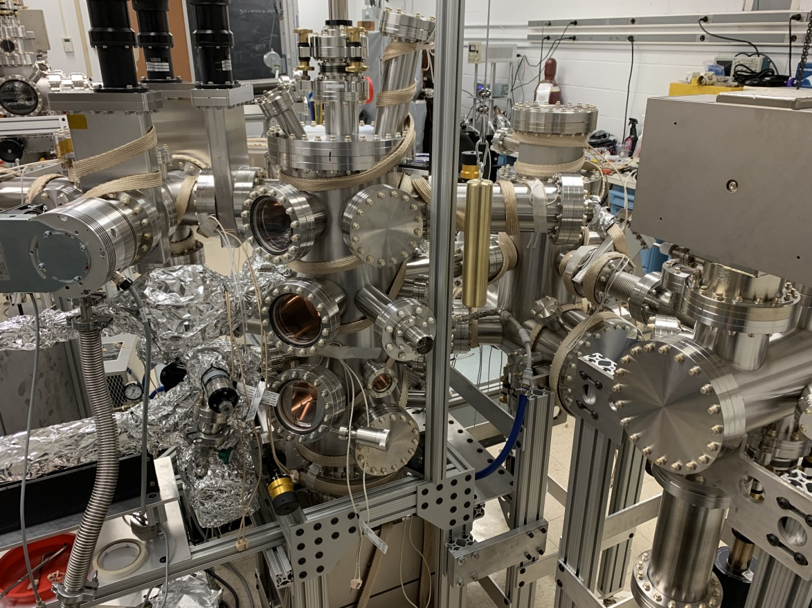
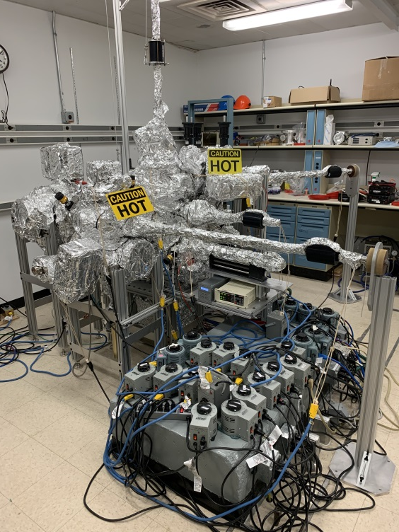
Photocathode Deposition System
Present status:
Te evaporation was demonstrated succesfully
~ 2 ½ weeks of baking @ 150⁰C.
Vacuum = 8.9X10⁻¹¹ torr was achieved
Final Demonstration, Dismantling:
in presence of IUAC’s personnel
Planning to be shipped by April ’21 by sea

Slide 28
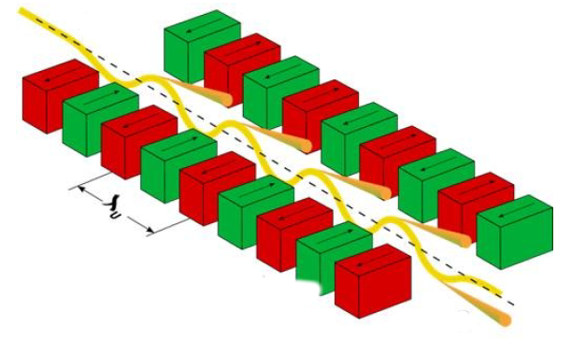
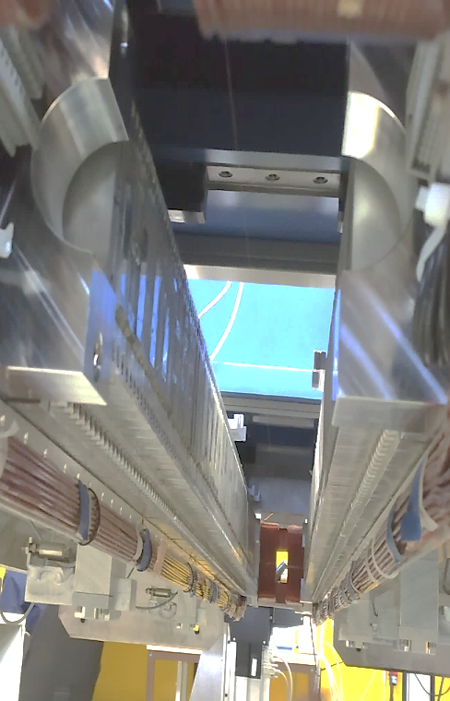
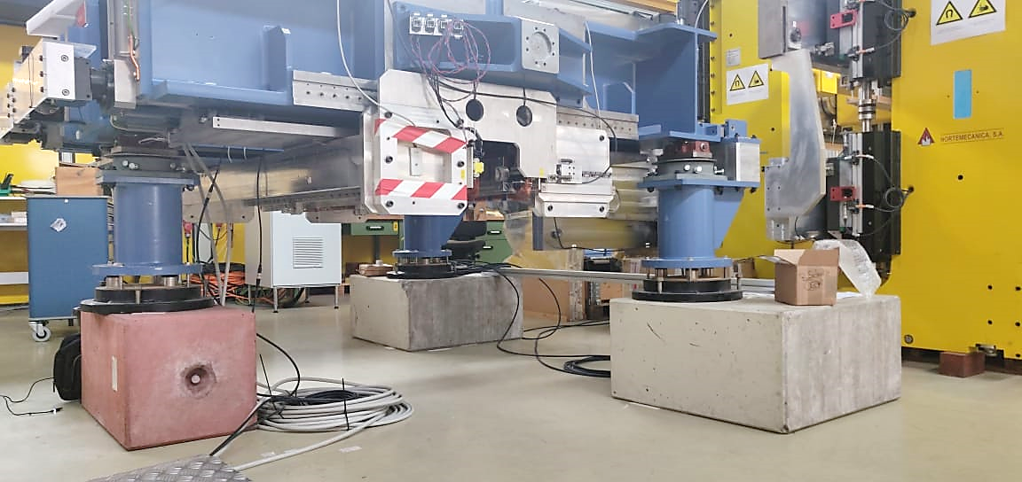
Undulator: Quick Introduction
y
Table: Specifications of U48
Undulator is a periodic arrangement of magnets in such a way that the particle passing along its axis experience a sinusoidal varying magnetic field.
x
1. | Undulator | U48 ( U-> undulator, 48-> undulator period)
2. | Undulator Period | 48 mm
3. | Number of periods | 33
4. | Length of undulator | 1584 mm (magnet structure) Total length along with structure ~ 2400 mm
5. | Undulator Technology | Pure Permanent Magnet (PPM) , Symmetric undulator
6. | Magnet material | NdFeB
7. | Individual magnet dimensions | 70 mm (y) x 22 mm (z) x 12 mm (x)
8. | Undulator gap: working range | 16 mm (min) – 45 mm (max) {open gap: 140 mm}
9. | Measurements performed | Hall probe (BESSY) Stretched wire (DESY)
z
Magnet Structure
λ_{u} =48 mm; N= 33

Slide 29
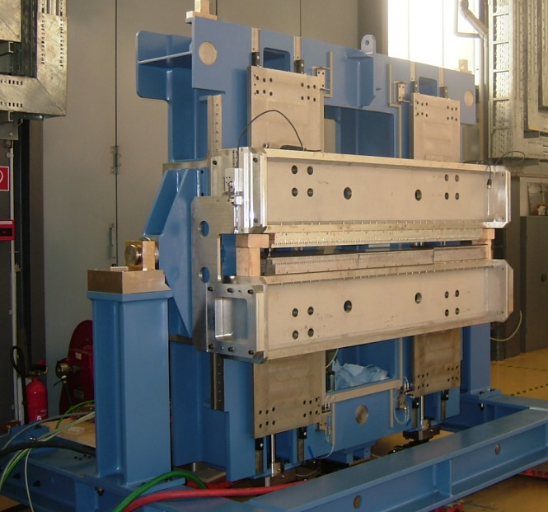
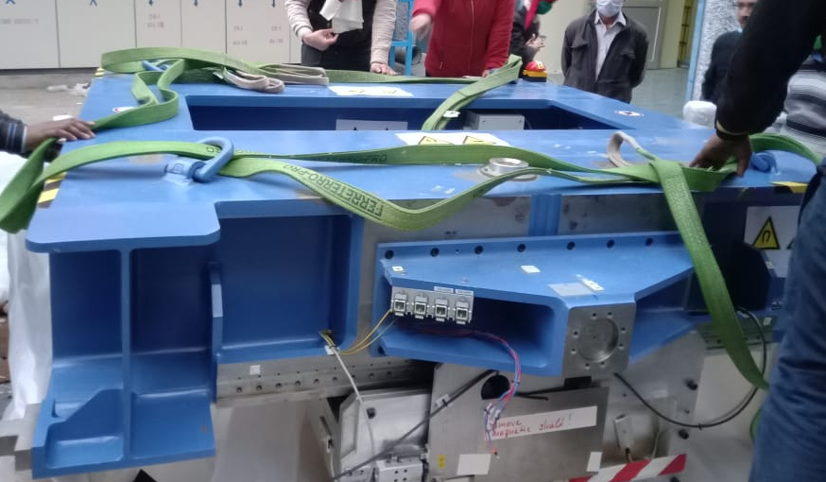
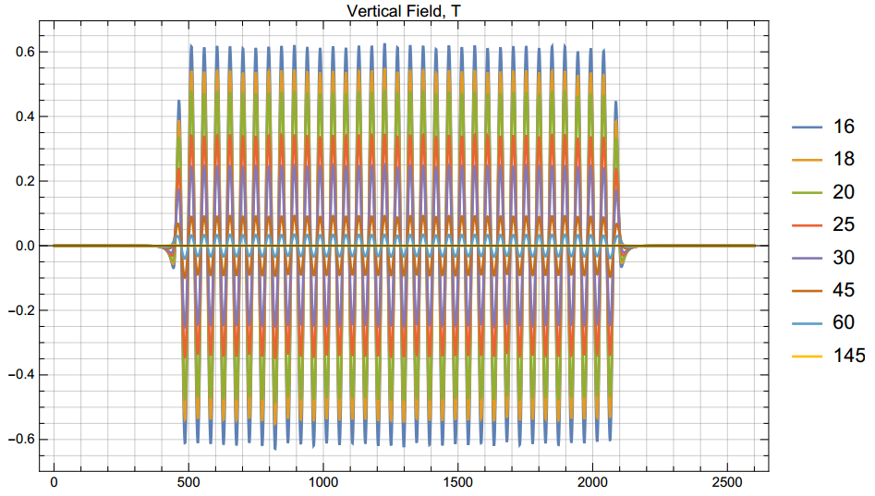
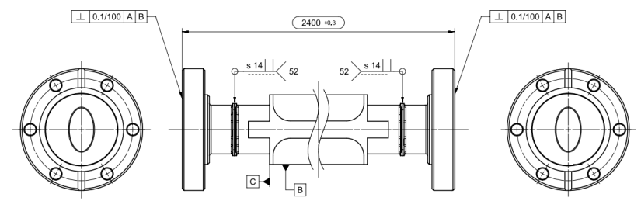



Undulator
Spare Undulator was donated by HZB, Germany – estimated cost ~ 6 crores
Refurbished at DESY – 3 IUAC personnel were trained in the measurement, operation
Magnetic field measurements were done at HZB followed at DESY
Vacuum chamber & Various correction coils were designed and mounted/to be mounted
Transported to basement in last Jan. 2021, soon will be moved / installed in the beam line

Slide 30








Undulator: Current Status
The undulator was expected to come to IUAC in April/ May, however due to COVID-19 situation, it got delayed.
Subsequently, U48 along with its other accessories reached IUAC on 25th December, 2020.
Current Status: The magnet is now in the basement area of FEL and sitting on three original legs and three indigenously fabricated in IUAC (for height extension).
DESY
IUAC

Slide 31



Fabrication, testing of BM, Quads and Steering magnets
2 BMs, 7 Quads, 5 steering magnets
are designed and developed at
Electromagnetic Applications
and Instrumentation Division,
BARC in record time.
They have arrived at IUAC &
are waiting to be installed
In the beam line.
P.S. of all the magnets - IUAC

Slide 32

THz from source to experiments:
Extraction, Detection and Transportation of THz

Slide 33


Terahertz Transportation and Detection
Electron Beam Path-1 (to experimental stations)
THz Extraction Chamber with Titanium foil
CTR Chamber with Aluminium foil
(Future plan)
Undulator Magnet
FCT
BPM
Bellow
Bellow
Bending magnet
Beam Dump
Undulator Vacuum Chamber
Electron Beam + Undulator THz
Reflected THz
Electron Beam Path-2
CTR THz
Schematic of THz beam line after the undulator
OAP: Off-axis parabolic mirror, FM: Flat mirror, TL: THz lens
After undulator, THz radiation will be emitted along with electron beam.
The radiation is reflected, the electron beam passes through Ti-foil
Pyroelectric detector for power detection: procurement in progress

Slide 34




Coherent Transition Radiation (CTR) simulation
CTR chamber
Two THz source: Undulator based (narrow band) and CTR based (Broad band).

Slide 35
Design and Calculations on various sub-systems
Correction scheme for Undulator field roll-off effect.
Simulations of Dark current detection.
Radiation simulations for THz power calculations.

Slide 36
Control scheme
New control room is being constructed
Control scheme are being developed for
  Vacuum control and interlock system
  Photo Cathode deposition System
  Beam line magnets control
  Beam Diagnostics
  Undulator
  THz detection and transportation
  Radiation safety and interlock

Slide 37

Deliverables: THz radiation and electron beam
Freq (THz) | λ(mm) | T_pulse (simulation) (ps) | Peak power @fwhm | Δf fwhm (THz)
0.18 | 1.667 | ~195 | ~ 1.9 kW | 0.0078
3.0 | 0.1 | ~15 | ~1.7 MW | 0.2786
Time width | No. of electrons | Total electron current
~ 200 fs | 9.3 × 10⁷ | 75 A
~ 6 ps | 1.5 × 10⁹ | 40 A
~ 3 μs | 2.25 × 10¹⁰ | 1.2 mA
1 sec. | 1.4 × 10¹² | 22.5 nA

Slide 38
Conclusion
A compact FEL-THz facility named as Delhi Light Source is under construction.
It is a Pre-bunched FEL - microbunch structure will be produced @ photocathode.
First signature of electron beam from dark current was observed.
Photocathode based RF electron gun will produce quality e-beam (~ 4 – 8 MeV)
Electron beam to be injected in to a compact undulator to produce THz (0.18 to 3.0)
THz radiation & Electron beam to be used for experiments in multidisciplinary Sc. in fundamental and applied areas.

Slide 39
Acknowledgement
Dr. K.K. Pant, RRCAT, Indore, India
Dr. Abhay Deshpande, SAMEER, Mumbai, India
Dr. Ulf Lehnert, ELBE facility, HZDR, Germany
Prof. Xijie Wang, SLAC, USA
Dr. Jinfeng Wang, Osaka University, Japan
Dr. Siriwan Krainara, Kyoto University, Japan

Slide 40

Thank you for your attention

