Slide 1
Budker INP
Detectors for dynamic experiments at Synchrotron Radiation beams at Budker INP
L.I.Shekhtman
Budker Institute of Nuclear Physics
Novosibirsk State University

Slide 2
Synchrotron radiation generation
?
SR
wiggler
Storage ring VEPP-3:
Fast
Detector
Storage ring VEPP-4:
Period – 1200 ns
2 bunches – interval 600 ns
train
interval – 25 ns – 100 ns
Exposure - 0,07 ns
Period – 250 ns
Interval – 250 ns (1 bunch)
Interval* – 125 ns (2 bunches)
Exposure 1 ns

Slide 3
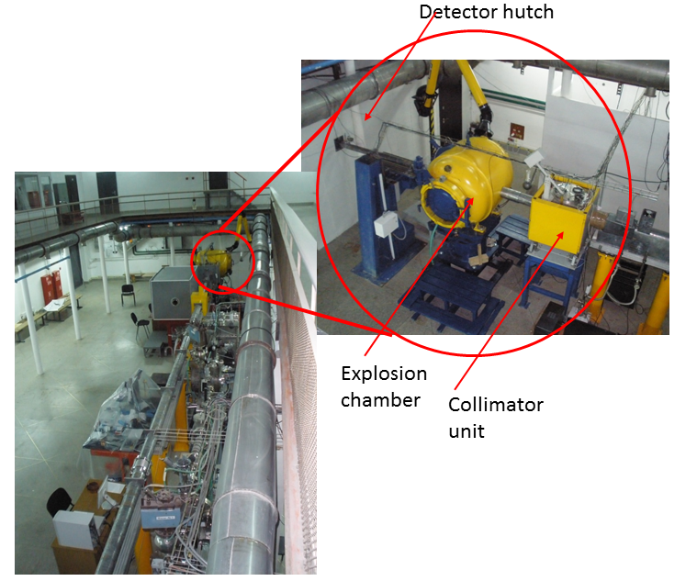
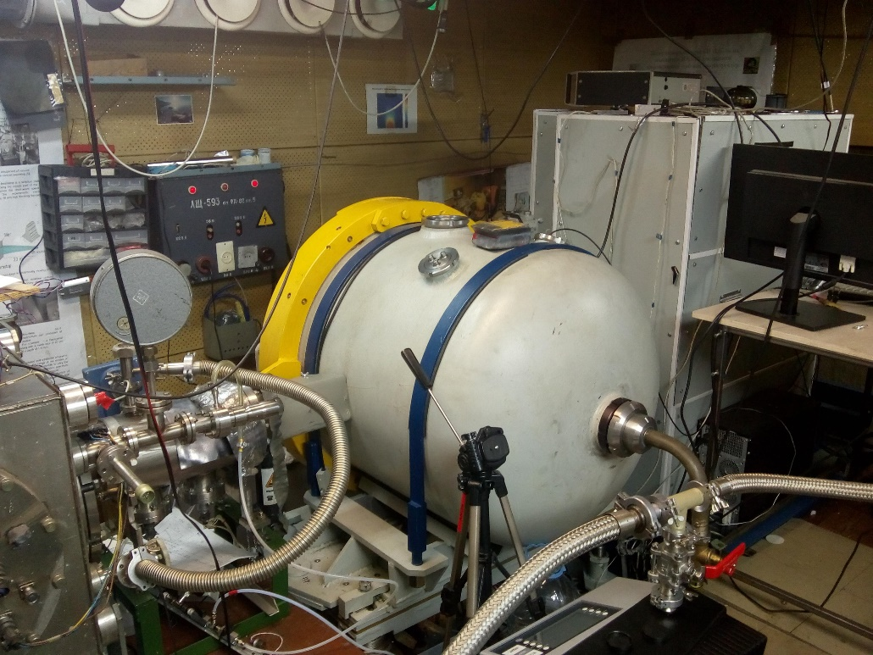
Detector for Imaging of Explosions (DIMEX) is successfully used at beam line 0 at VEPP3
and at beam line 8 at VEPP-4M for more than 15 years.
VEPP-4M, beam line 8
VEPP-3, beam line 0
Collimator unit
Detector hutch
Explosion chamber

Slide 4
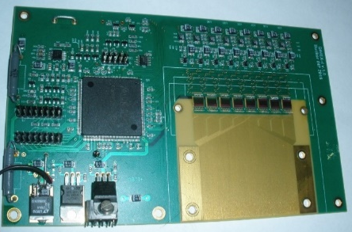
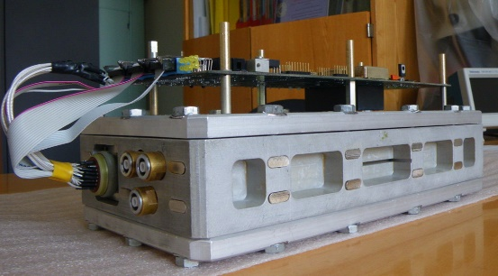
DIMEX-G
Gaseous 1D detector with new front-end ASIC DMXG64B(A)
Max frame rate - 10 MHz
Number of frames – 100
Maximum signal(electronics) – 2x10⁶ e (~3500 photons, 20 keV)
Noise - <~4000 e ~ 7 photons 20 keV (GEM attenuation)
Channel pitch – 100 μm
Number of channels - 512
Spatial resolution – 250 μm (FWHM, for 20 keV photons)
DQE ~ 40% (for 20 keV photons)
Maximum detected photon rate - ~1200 photons/chan x bunch (20 keV photons)
Main limitations of DIMEX-G
Maximum detected rate – limited to ~1000-2000 photons/channel x bunch due to space charge of ions in gas
Maximum frame rate – limited due to longitudinal diffusion of electrons and electronics
Spatial resolution – limited due to transverse diffusion of electrons

Slide 5
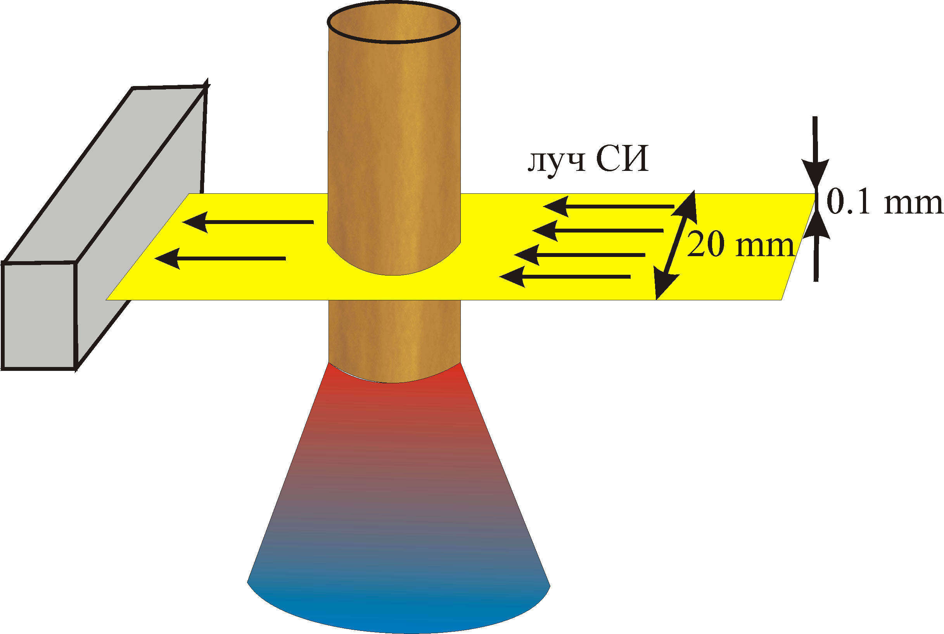
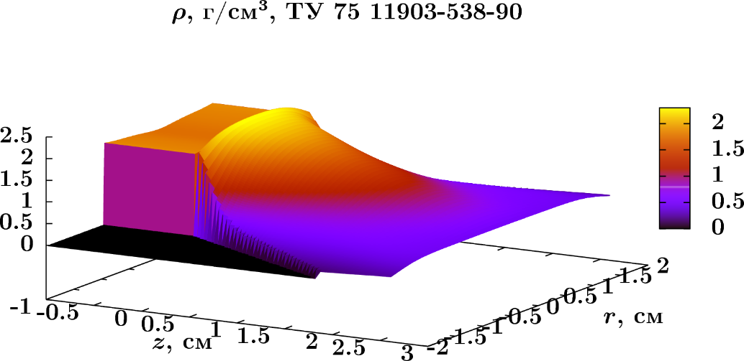
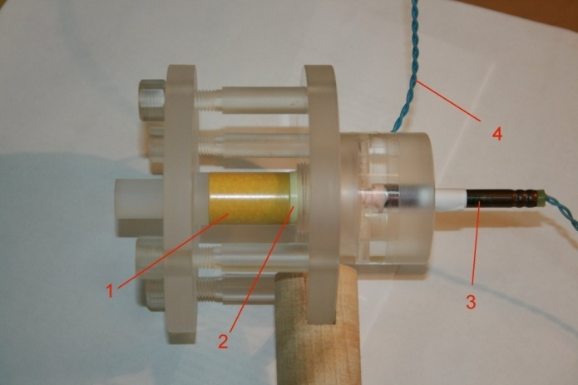
Tomography of samples with axial symmetry
Front profile of TATB
Layout of the experiment of X-ray tomography of axially symmetrical sample in order to restore density distribution in a flow inside the wave of stationary detonation.
Experimental assembly
3D density distribution in TATB

Slide 6
Shock wave experiment
1-coordinate
detector

Slide 7
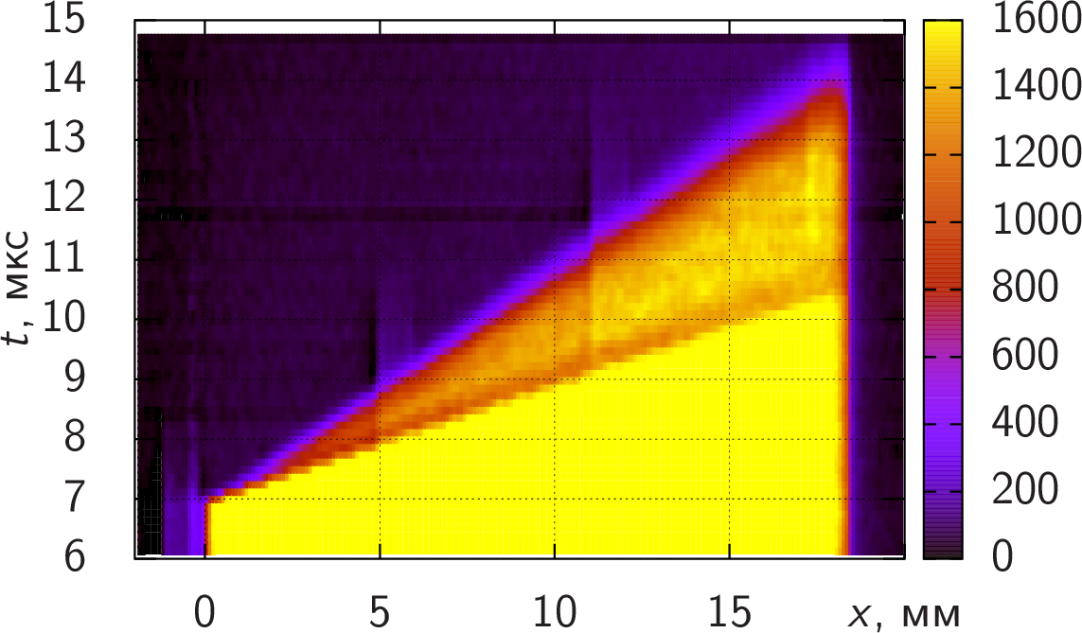
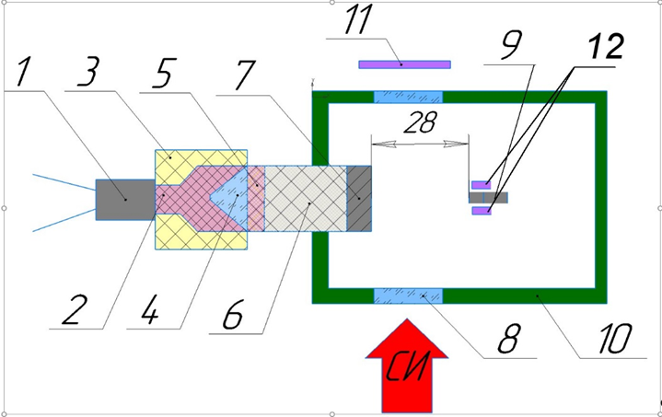
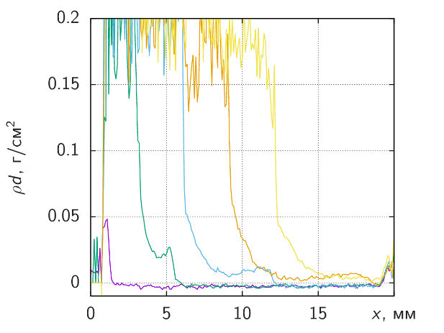
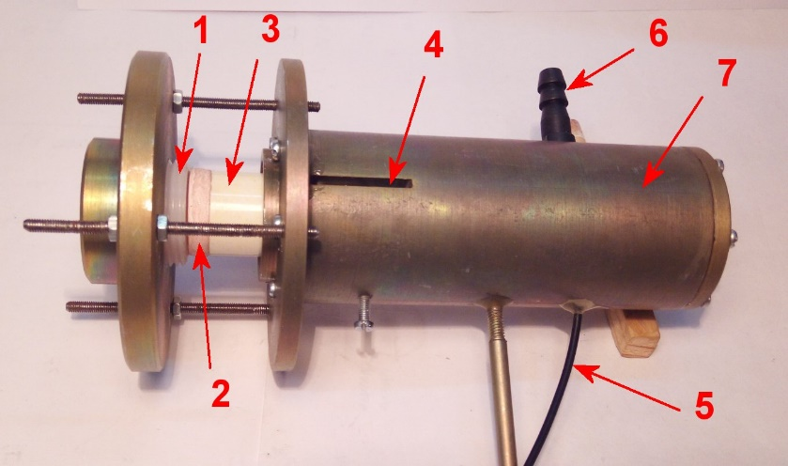
Study of ejection of micro-particles (“dusting”) at the interaction of a shock wave with free surface
Layout of the experimental assembly: 7 – tim disc ∅26×3 mm; 8 – mylar film 0,2 mm; 9 – piezoelectric sensor; 10 – metal body; 11 – detector DIMEX; 12- collimators PDV
Dynamics of SR intensity
Dynamics of dust density distribution
General look of the assembly. 1 – explosion lense, 2 – intermediate charge, 3 – main charge(HMX, 20 x 20 mm), 4- slit for SR beam, 5 – cable for piezo-sensor, 6 – pipe for filling with helium, 7 – steel body

Slide 8
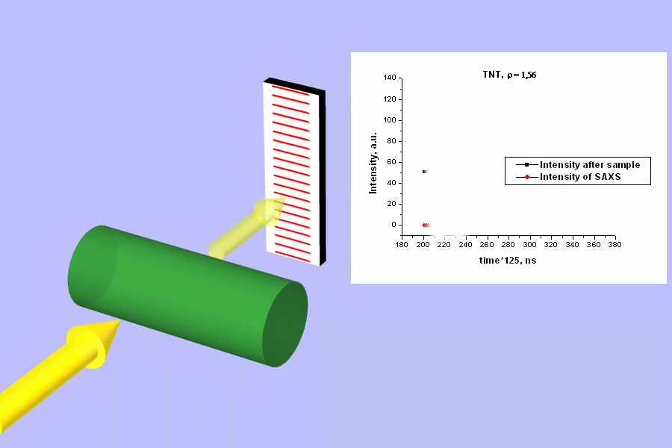
Detonation and shock waves investigation

Slide 9
DIMEX-G

Slide 10
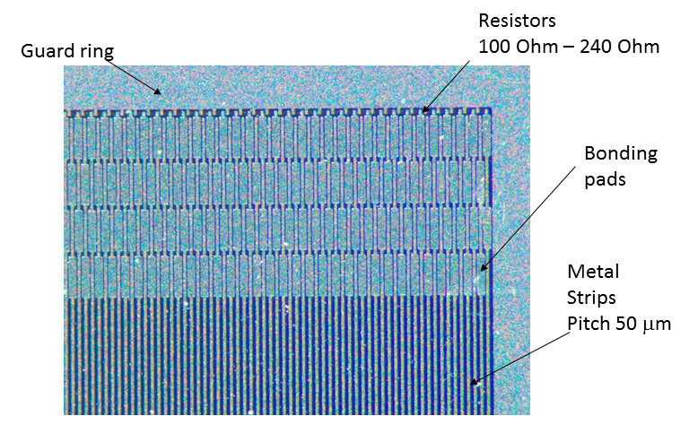
DIMEX-Si
Si microstrip sensors produced by
Hamamatsu Photonics
p-in-n technology
DC coupled metal strips
polysilicon resistors between each strip
and guard ring
wide guard ring
30 mm long strips
50 μm strip pitch
320 μm sensor thickness
Sensor position in the
final detector

Slide 11
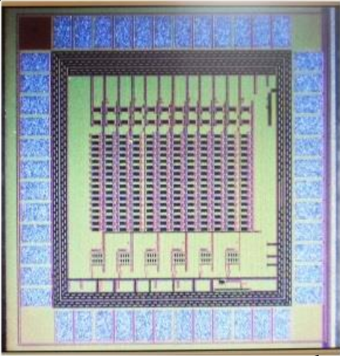
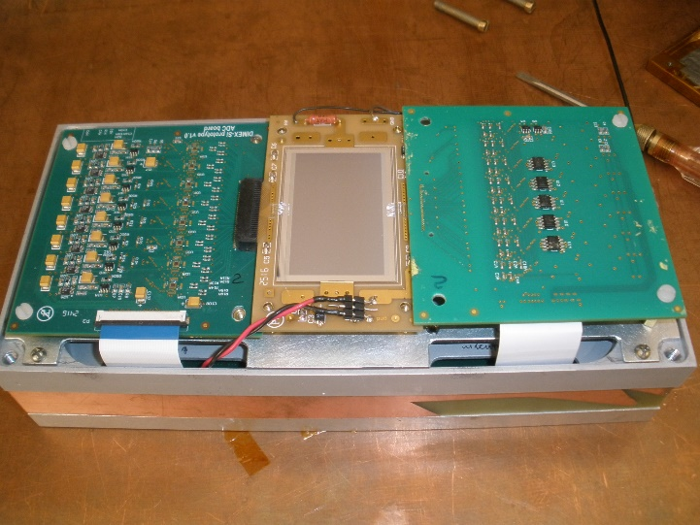
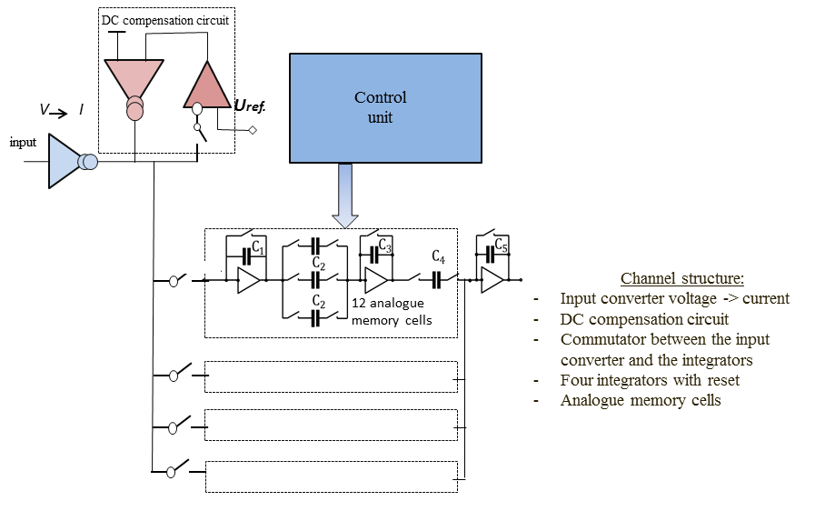
DIMEX-Si
DMXS6A
8
96 channel prototype mounted

Slide 12
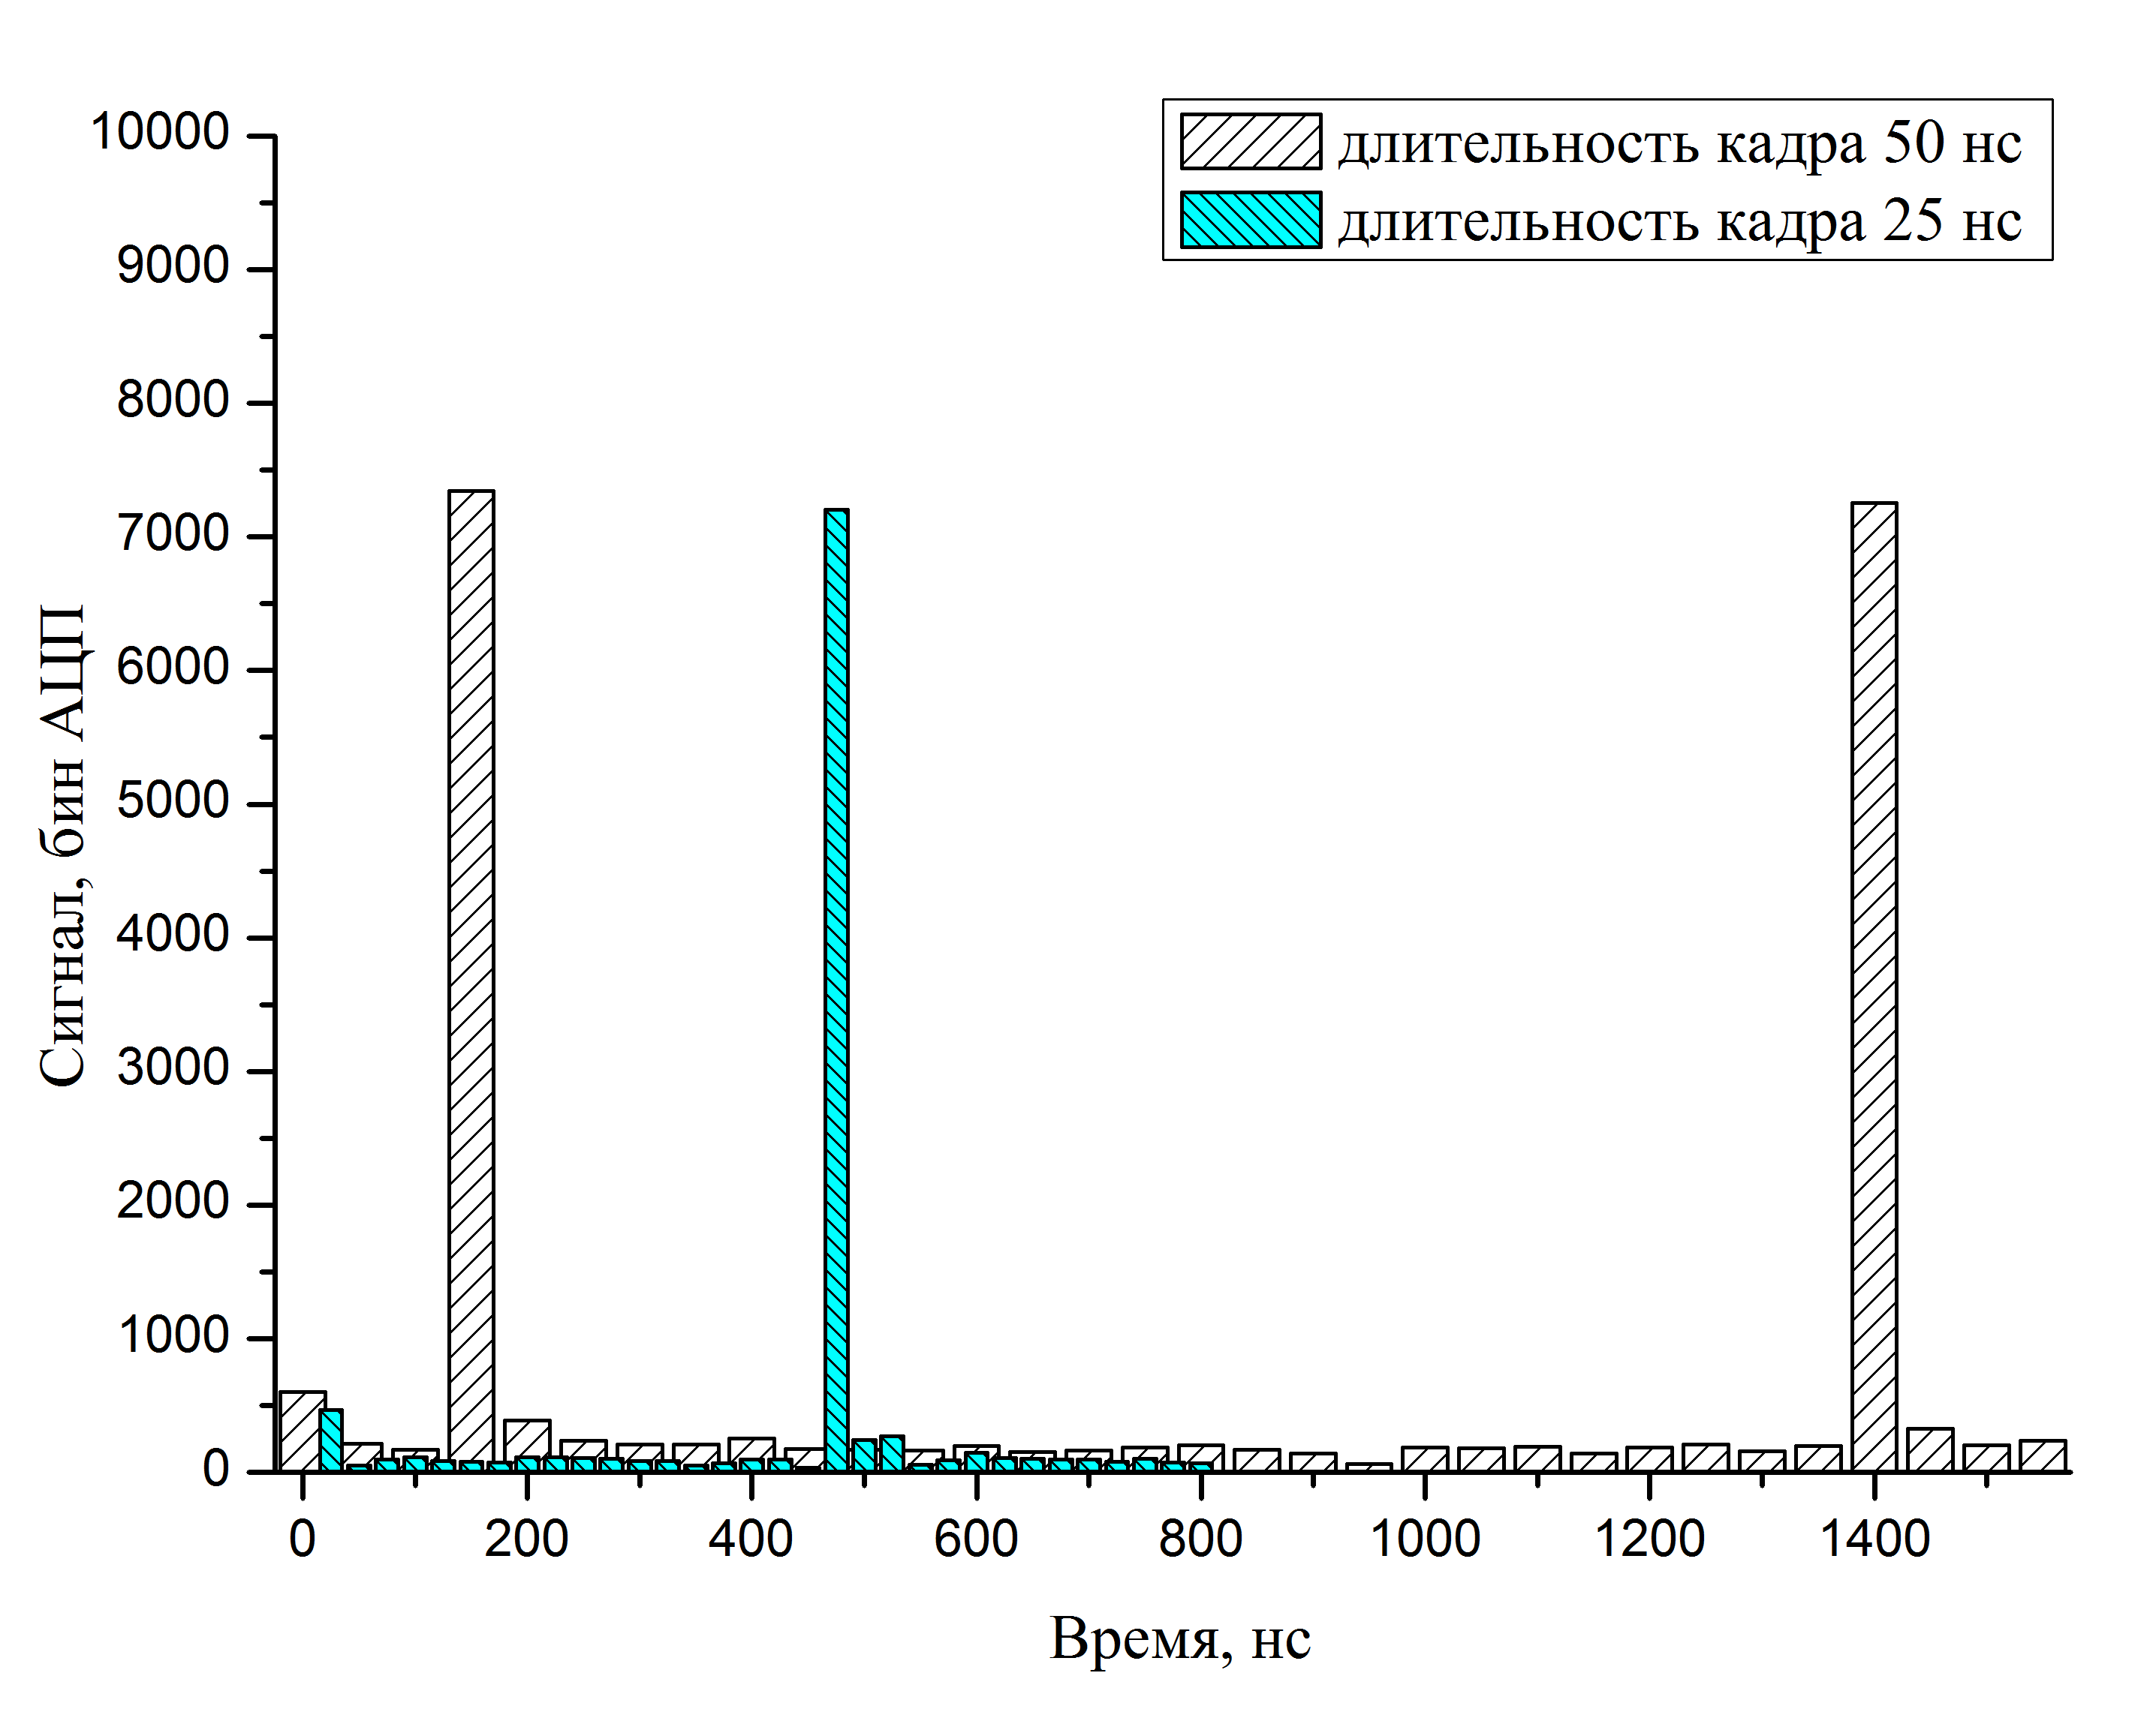
DIMEX-Si
VEPP-4M
1 bunch
Signal as a function of time in one channel

Slide 13
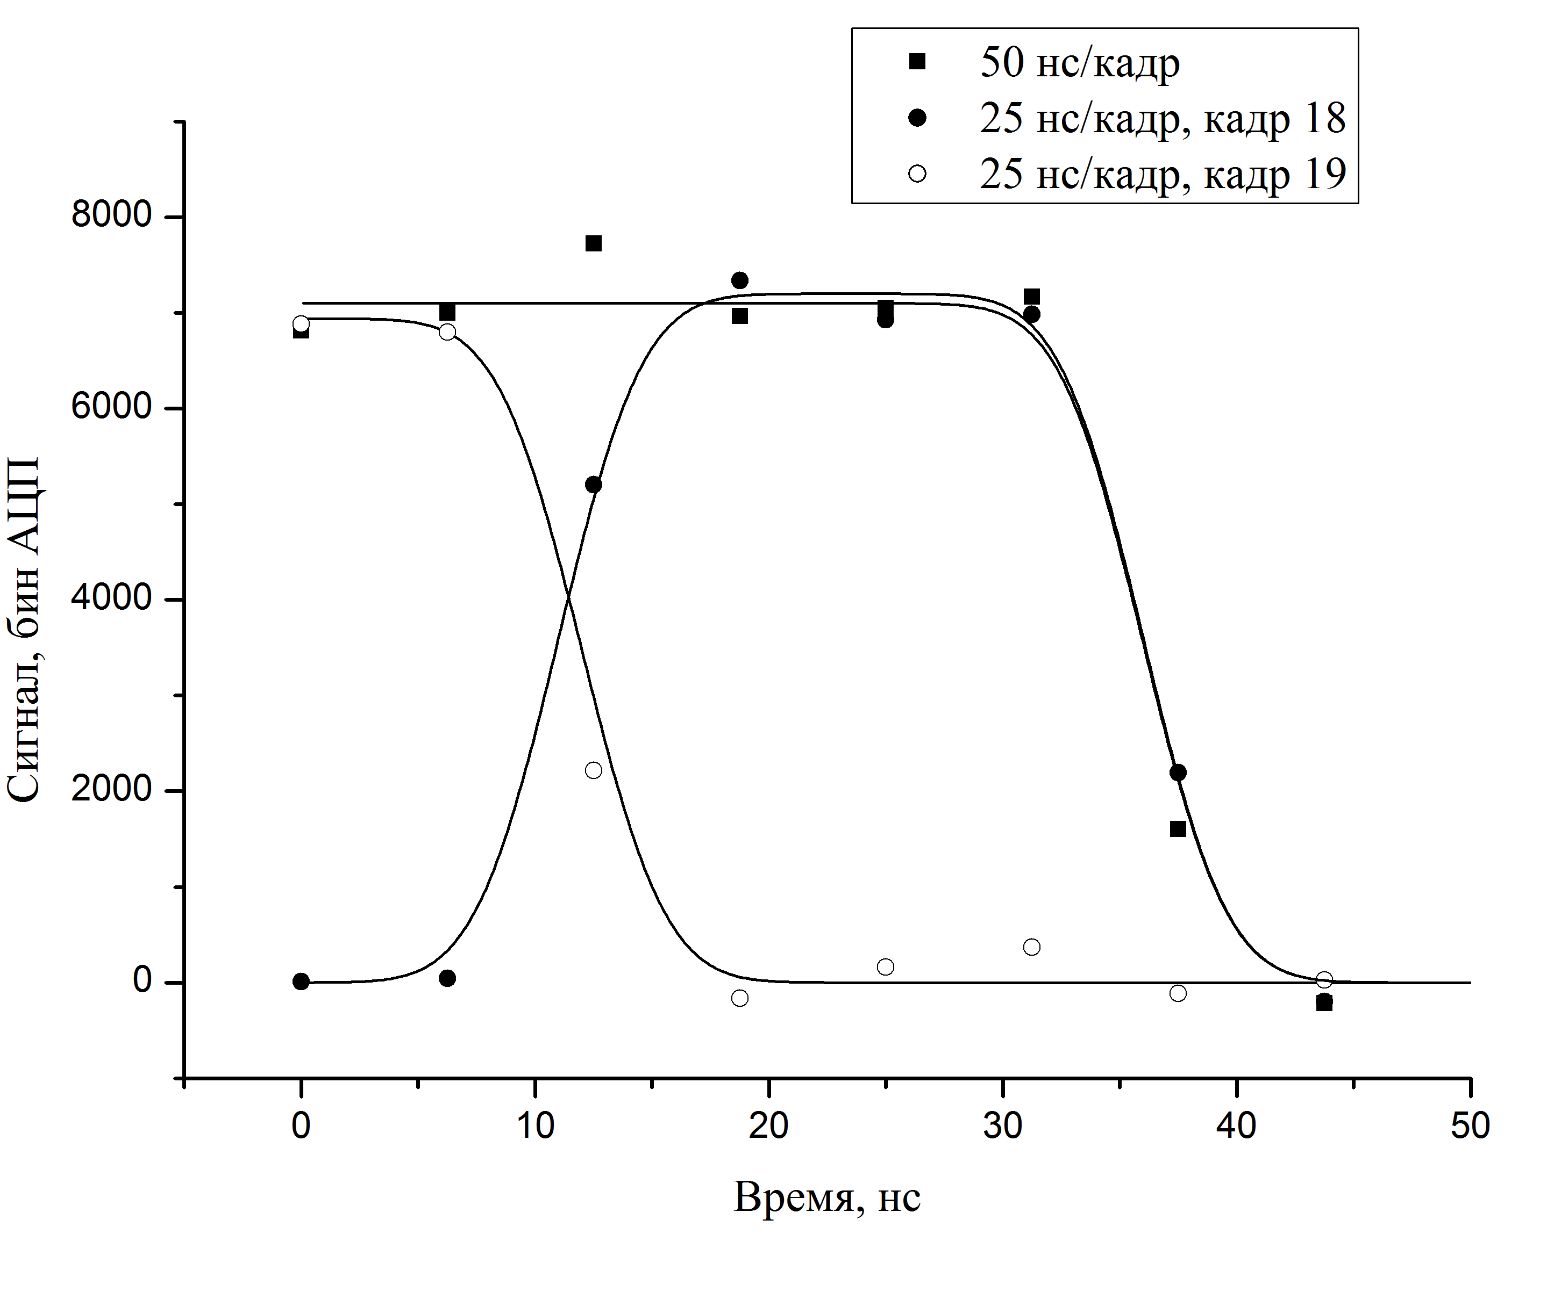
DIMEX-Si
τ ∼ 7 ns
Signal as a function of time shift between bunch crossing and detector clock

Slide 14
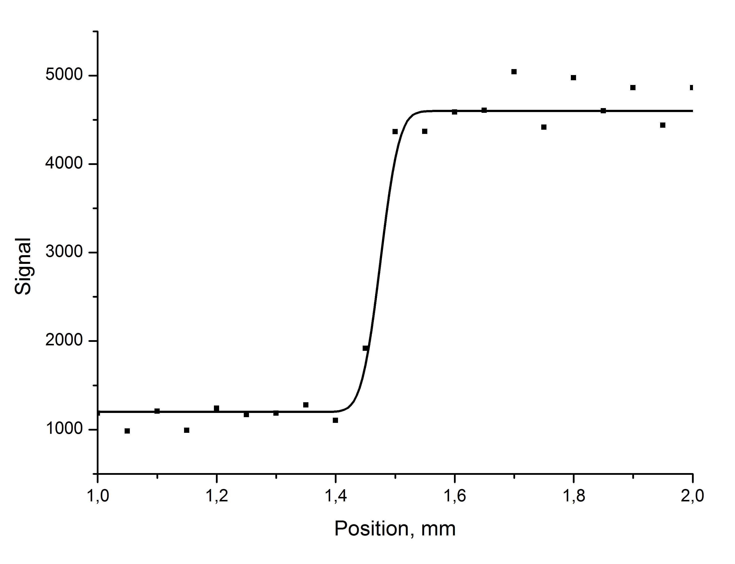
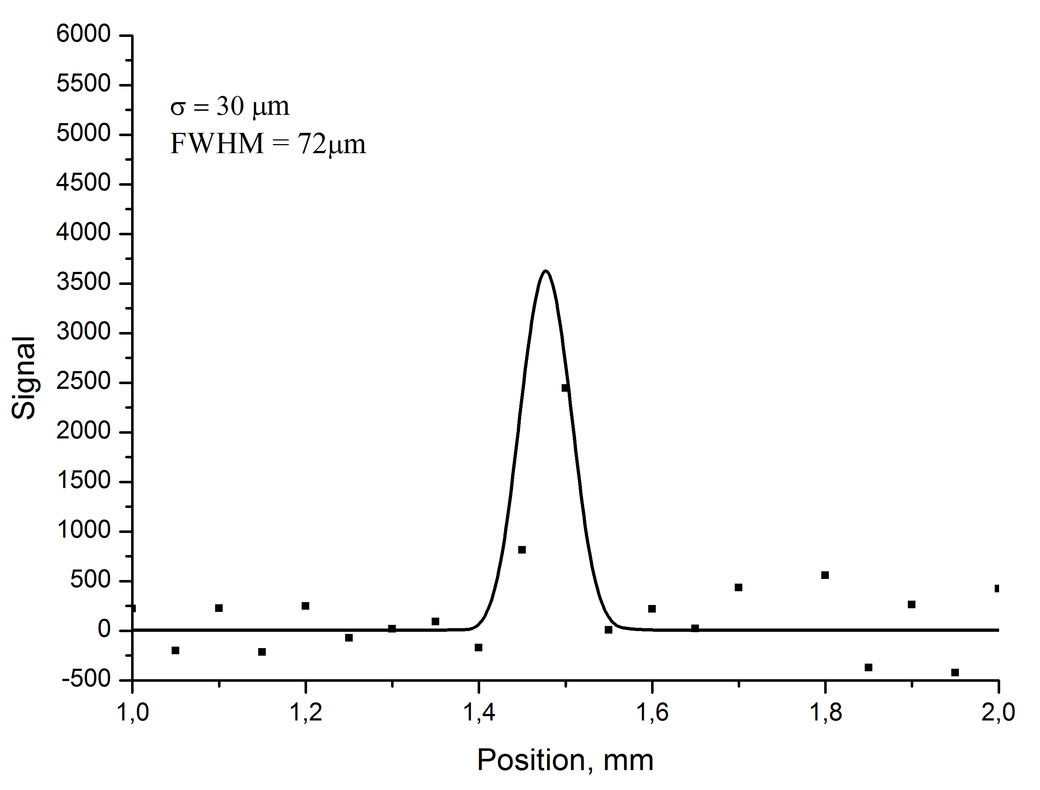
DIMEX-Si
Spatial resolution
Image of sharp edge (3mm steel) fitted with erf. St.dev. - 30 μm
Derivative of the fit and exp. Data
FWHM ~ 72 μm.

Slide 15
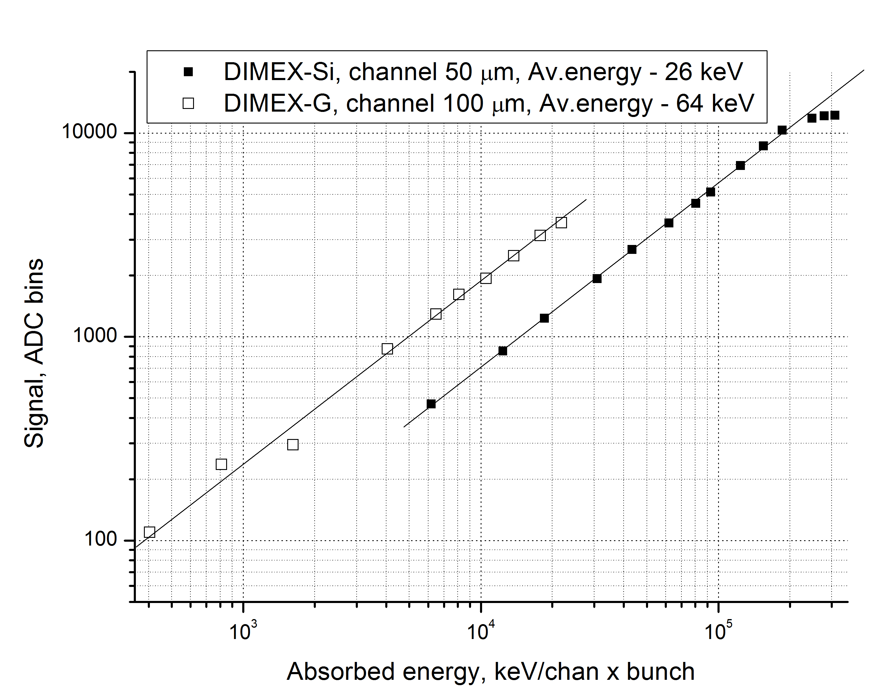
DIMEX-Si
Signal as a function of absorbed power for the prototype of DIMEX-Si and DIMEX-G
Maximum absorbed power density for DIMEX-SI is 20 times higher than for DIMEX-G

Slide 16
Summary
Prototype of the Si detector with 16 DMXS6A ASICs (6 channels and 32 memory cells
in each channel) is put in operation and tested at the VEPP-3 and VEPP-4M.
DIMEX-Si prototype demonstrated maximum absorbed power density ~20 times higher
than in DIMEX-G, spatial resolution ~3.5 times better (72 μm vs 250 μm), time resolution ~7 times better (7 ns vs 50 ns) and frame rate 5 times higher (40 MHz vs 8 MHz)
Main problem of the DIMEX-Si prototype is noise of the DMXS6A ASIC that is going to be solved in the next version of the chip
First attempts with multi-bunch regime in VEPP-4M showed that new synchronization scheme is necessary between the detector and the experimental set-up

