Slide 1
Ion detector for Accelerator Mass Spectrometry
based on low-pressure TPC with THGEM readout
A. Bondar, A. Buzulutskov, E. Frolov, V. Parkhomchuk,
A. Petrozhitskiy, T. Shakirova (speaker), A. Sokolov
Budker Institute of Nuclear Physics
Novosibirsk, Russia
Asian Forum for Accelerators and Detectors

Slide 2
Outline
Accelerator mass spectrometry
SRIM simulation
Experimental setup
Measurements of energy spectra using semiconductor detector
Measurements of track ranges using TPC

Slide 3
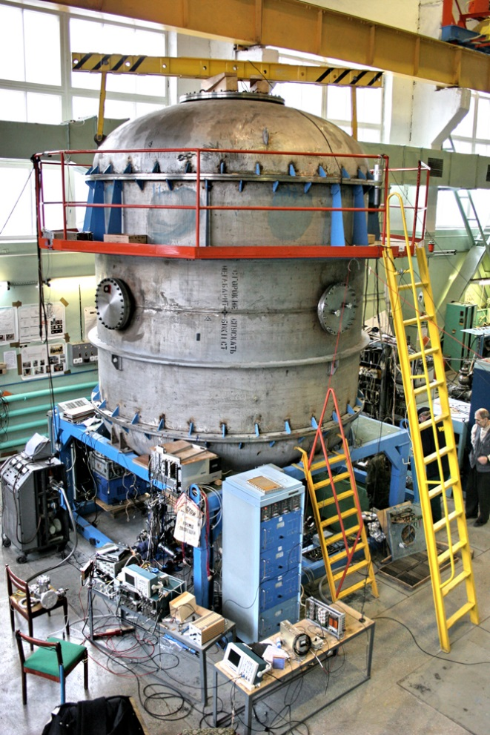
Accelerator mass spectrometry
Accelerator mass spectrometry (AMS) is an ultra-sensitive method of counting individual atoms. Usually it is the rare radioactive atoms with a long half-life. The archetypal example is ¹⁴C which has a half-life of 5730 years and an abundance in living organisms of 10⁻¹² relative to stable ¹²C isotope.
AMS facilities operate in more than 100 physical laboratories worldwide, one of which is located in Novosibirsk at Geochronology of the Cenozoic Era Center for Collective Use.

Slide 4
Isotopes used in AMS
Analyzed isotopes | Half life | Stable isotopes | Stable isobars
¹⁰Ве | 1,39 million years | ⁹Be | ¹⁰B
¹⁴C | 5730 years | ^{12,13}С | ¹⁴N
²⁶Al | 717 thousand years | ²⁷Al | ²⁶Mg
³⁶Cl | 301 thousand years | ^{35,37}Cl | ³⁶Ar, ³⁶S
⁴¹Ca | 102 thousand years | ^{40,42,43,44}Ca | ⁴¹K
¹²⁹I | 15,7 million years | ¹²⁷I | ¹²⁹Xe
In the current AMS BINP setup the time-of-flight technique is used for the isotope separation. But that technique there is a serious problem of separating the isobars - different chemical elements having the same atomic mass. The typical example are radioactive isotopes ¹⁰Be and ¹⁰B.

Slide 5
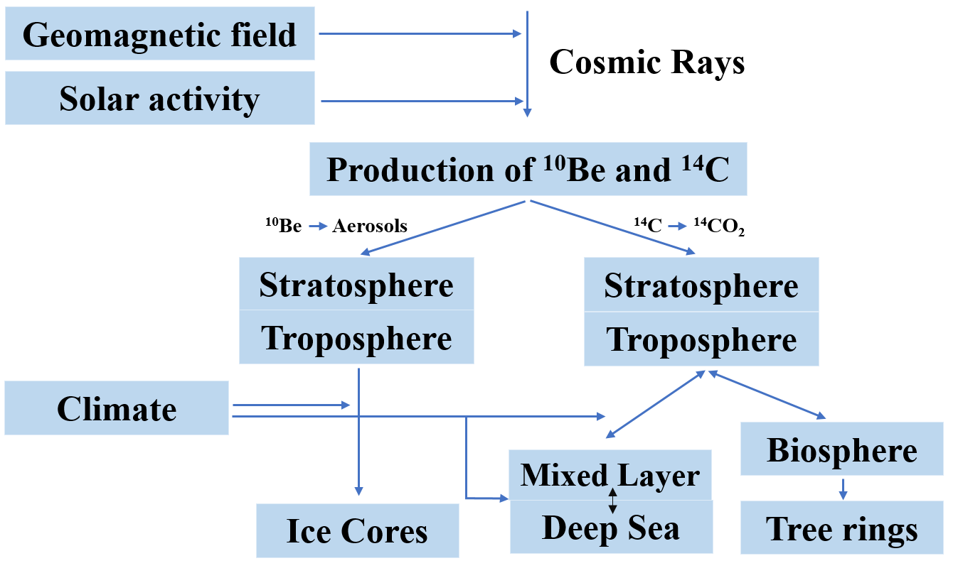
Formation and application ¹⁰Be
Application in-situ and
meteoric 10Be:
exposure dating to identified the growths and decays of the Antarctic ice sheet;
understanding ice shelf collapse history;
paleomagnetic excursions history reconstructions using ice cores;
understanding the erosion rates using depth profiles of mid latitudes outcrops;
identifying the timing of formation of the impact crater and so forth.
Time intervals of dating:
¹⁴C from 300 years to 40-60 thousand years
¹⁰Be from 1 thousand years to
10 million years

Slide 6
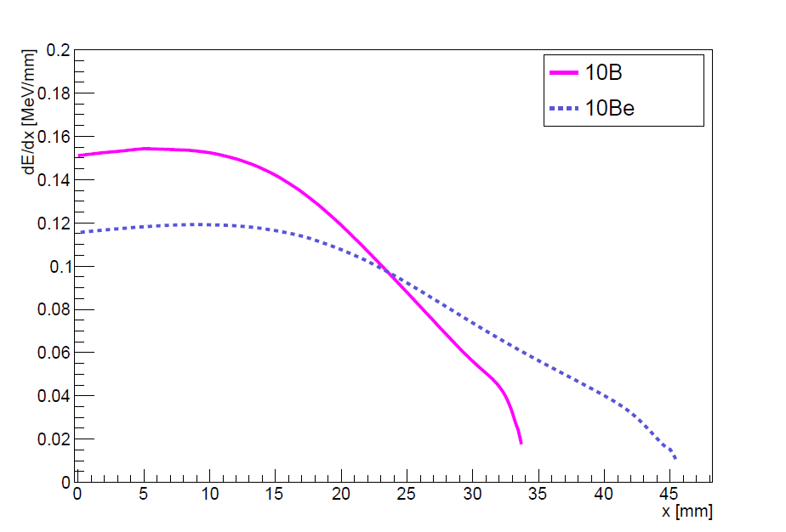
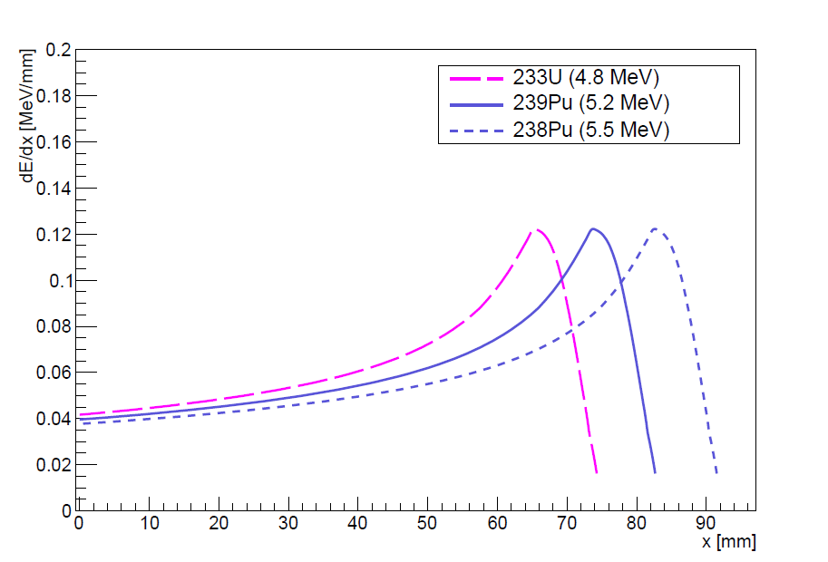
SRIM simulation
*SRIM - The stopping and range of ions in matter
Energy loss as a function of distance in Isobutane for ¹⁰B and ¹⁰Be with an energy of 4.025 MeV at 50 Torr
Energy loss as a function of distance in Isobutane for alpha particles with different energy at 120 Torr
Ionization losses and track ranges are different for boron and beryllium, so they can be separated with good accuracy.
To study the method of isobars separation used a triple alpha particle source.

Slide 7
Principle of operation
Cathode
Field shaping rings
Shaping amplifiers
Ion beam from AMS
Ion track
Ionization
Charge-sensitive
preamplifiers
Thin film window or alpha particle source
THGEM
Anode
Oscilloscope
Schematic layout of the low-pressure TPC

Slide 8
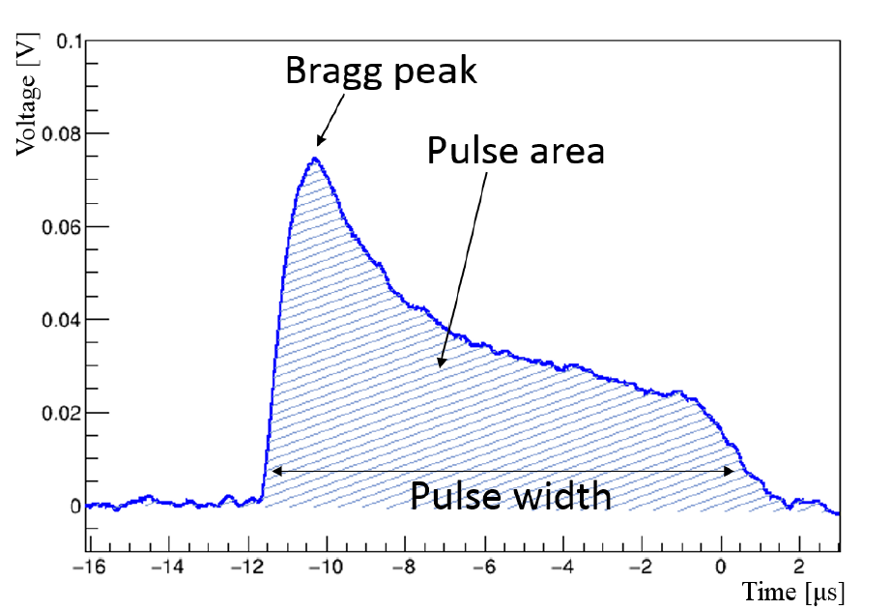
Principle of operation
Typical waveform shape of the signal from the alpha particle in low-pressure TPC
pulse width $\sim$ track range
pulse area $\sim$ energy

Slide 9
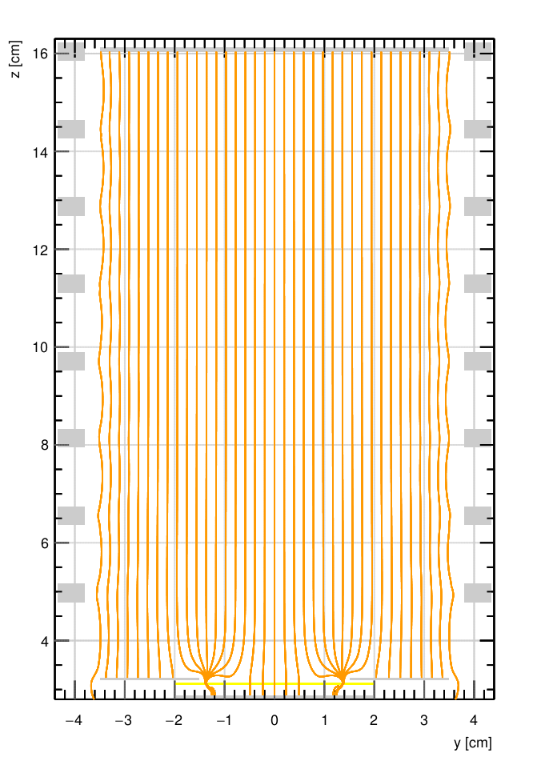
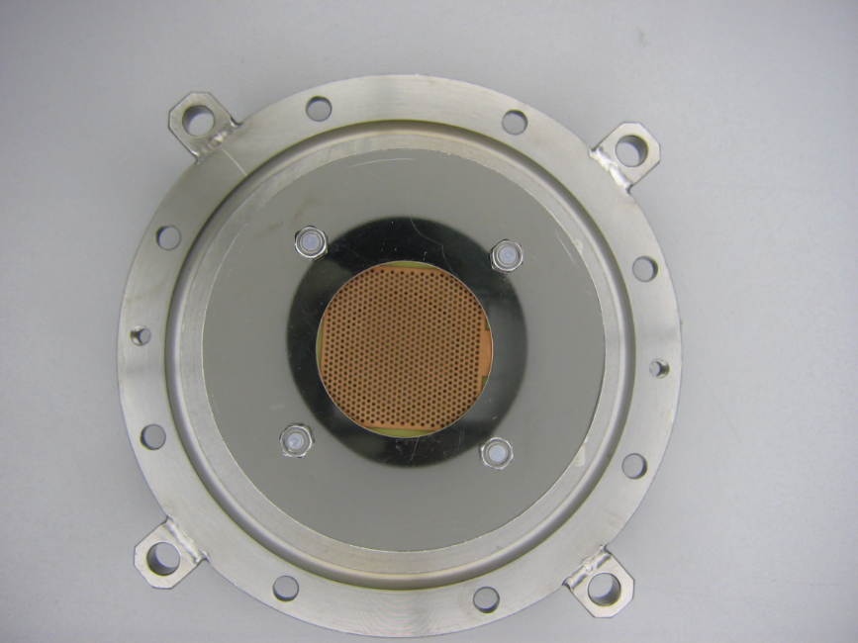
Electric field simulation
To simulate an electric field inside the low-pressure TPC, the following programs were used: Gmsh, Elmer and Garfield++.
Simulated electric field lines in low-pressure TPC
Figure of the lower flange with installed THGEM

Slide 10
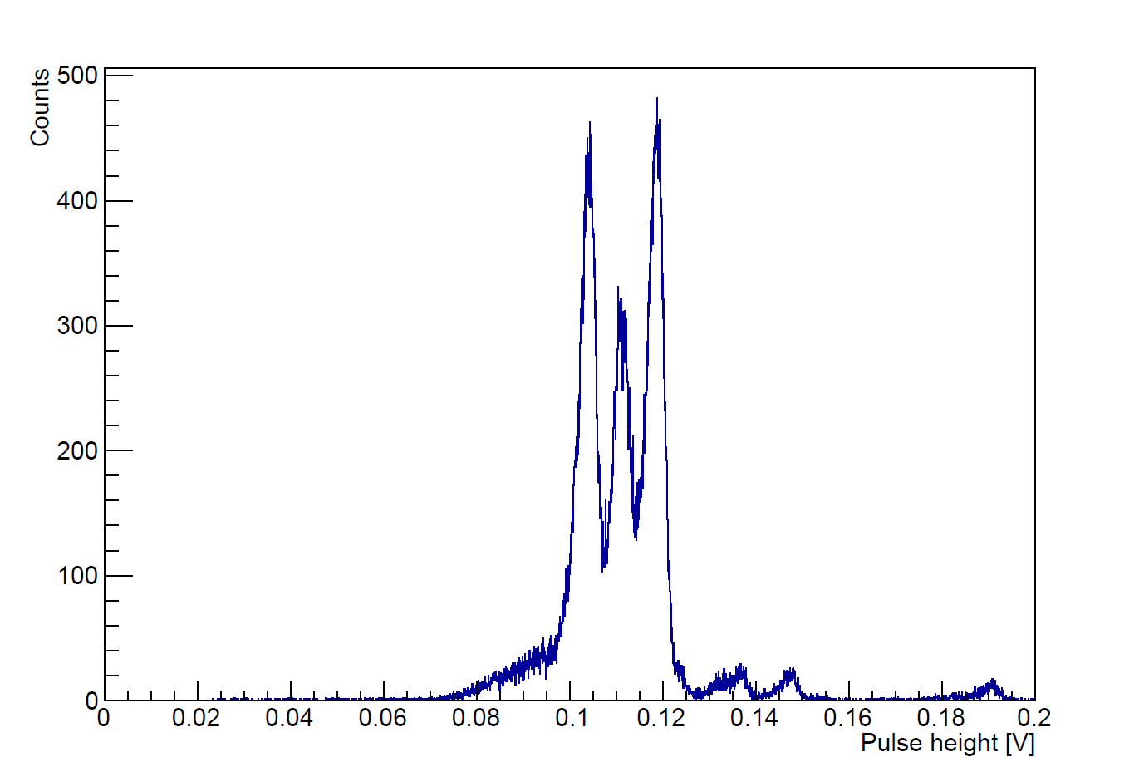
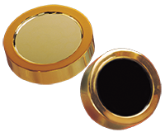
Measurements of energy spectra using semiconductor detector
Alpha particle source– ²³³U, ²³⁸Pu, ²³⁹Pu
$$E_{α}=4,816 МэВ E_{α}=5,499 МэВ E_{α}=5,157 МэВ$$
Si Charged Particle Radiation Detectors for Alpha Spectroscopy
Energy spectrum of alpha particles from ²³³U (4.8 MeV), ²³⁹Pu (5.2 MeV) and ²³⁸Pu (5.5MeV) sources, measured using semiconductor detector

Slide 11
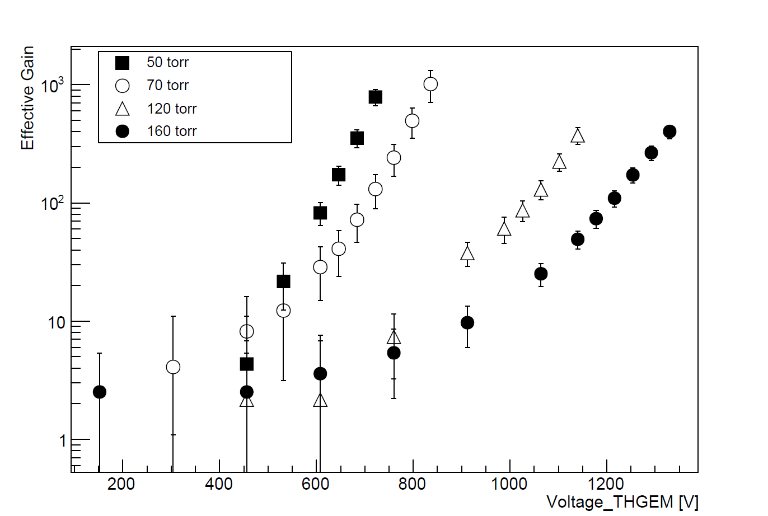
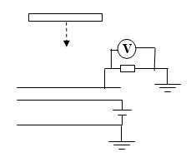
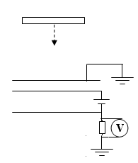
Effective gain of THGEM
THGEM effective gain as a function of the voltage in Isobutane at pressures varying from 50 to 160 Torr in the low-pressure TPC
The scheme of effective gas gain measurement

Slide 12
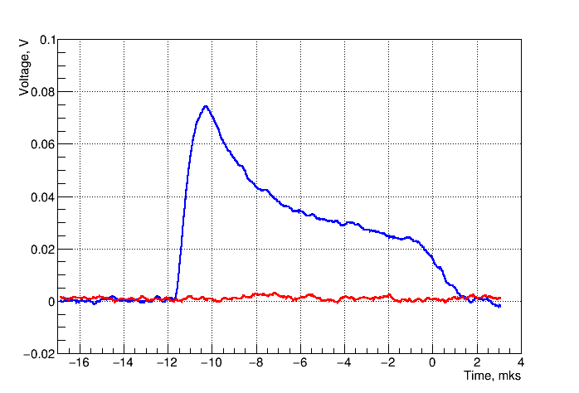
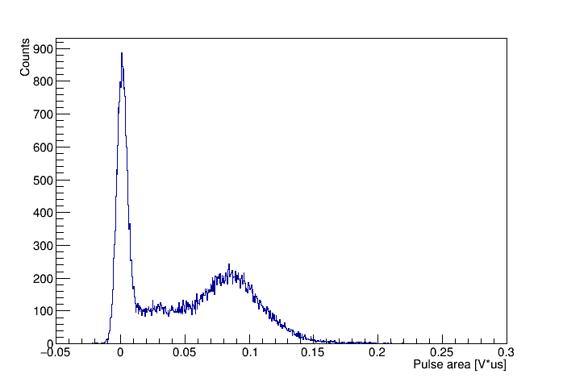
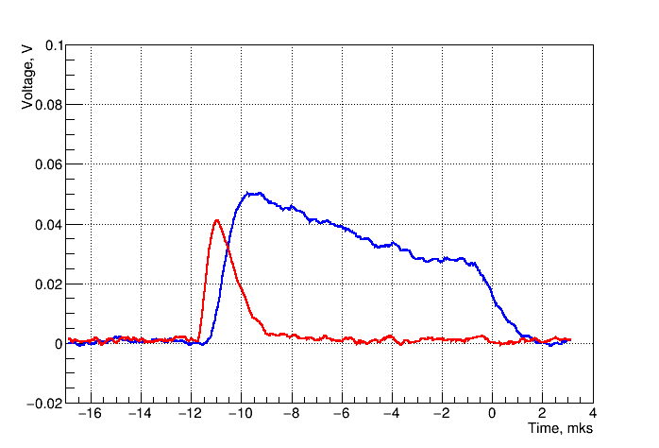
Selecting orthogonal anode tracks
Typical signal waveform from alpha particle
----- signal from the central part of the anode
----- signal from the external part of the anode
(p=120 торр, U=1200 В)
Pulse area spectrum of alpha particles from ²³³U (4.8 MeV), ²³⁹Pu (5.2 MeV) and ²³⁸Pu (5.5 MeV) sources from external part of the anode, measured in low-pressure TPC in Isobutane at 120 Torr

Slide 13
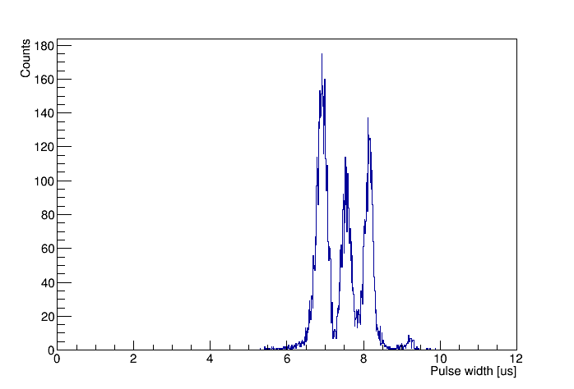
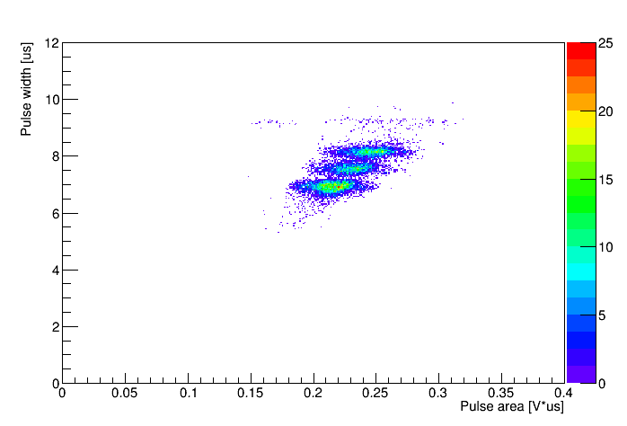
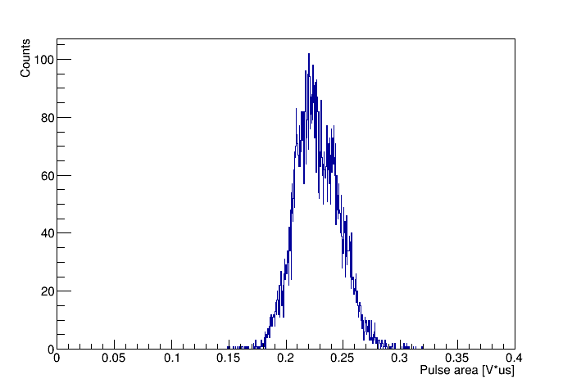
The measurement of track ranges
The alpha-particle source – ²³³U, ²³⁸Pu, ²³⁹Pu ${ E}_{α}=4,816 МэВ E_{α}=5,499 МэВ E_{α}=5,157 МэВ$
Pressure = 120 Torr Gain = 60 Shaping time = 200 ns
2D plot of pulse width versus pulse area and their axis projection spectra for alpha particles from ²³³U (4.8 MeV), ²³⁹Pu (5.2 MeV) and ²³⁸Pu (5.5 MeV) source, measured in low-pressure TPC in Isobutane at 120 Torr and THGEM gain of 60. The pulse width and pulse area spectra reflect those of the track range and energy.

Slide 14
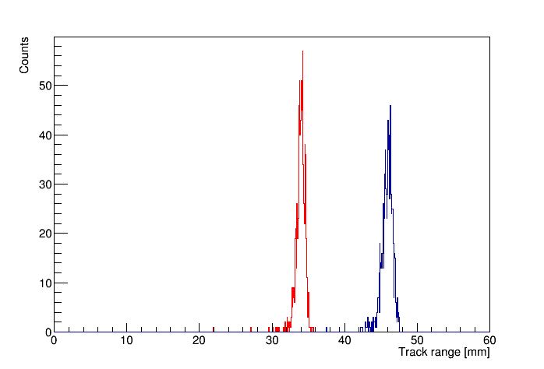
Results
Source | Shaping time | Gain | Pressure | Sigma/Range, % | Separation in sigma between two peaks
3 isotopes | 500 ns | 40 | 120 Torr | 3.2 | 3
3 isotopes | 200 ns | 40 | 120 Torr | 2.2 | 4
3 isotopes | 200 ns | 60 | 120 Torr | 1.3 | 6
¹⁰B
¹⁰Be
Using these results and SRIM code simulation, we see that the isobaric boron and beryllium ions (having range difference of 32%) can be effectively separated at the level exceeding 10 sigma
Spectra of track ranges for ¹⁰B and ¹⁰Be with energy 4.025 MeV in Isobutane at 50 Torr simulated

Slide 15
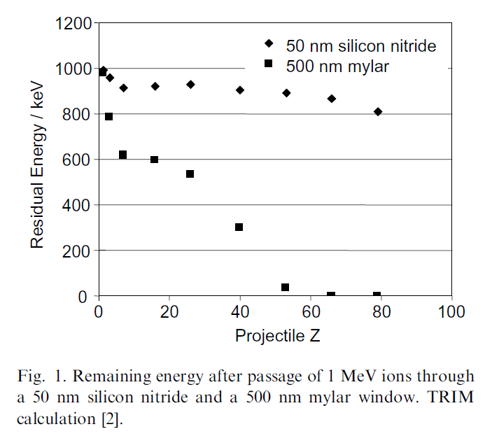
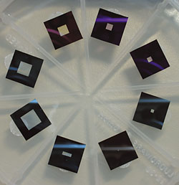
Silicon nitride membrane windows
Figure of silicon nitride membrane windows
M. Dobeli et al., Nucl. Instr. and Meth. B, 219-220 (2004) 415-419 doi:10.1016/j.nimb.2004.01.093

Slide 16
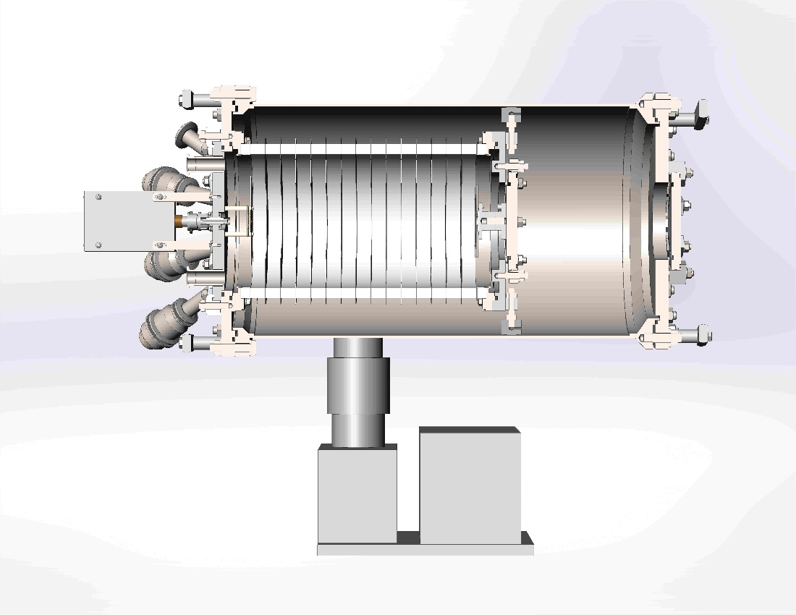
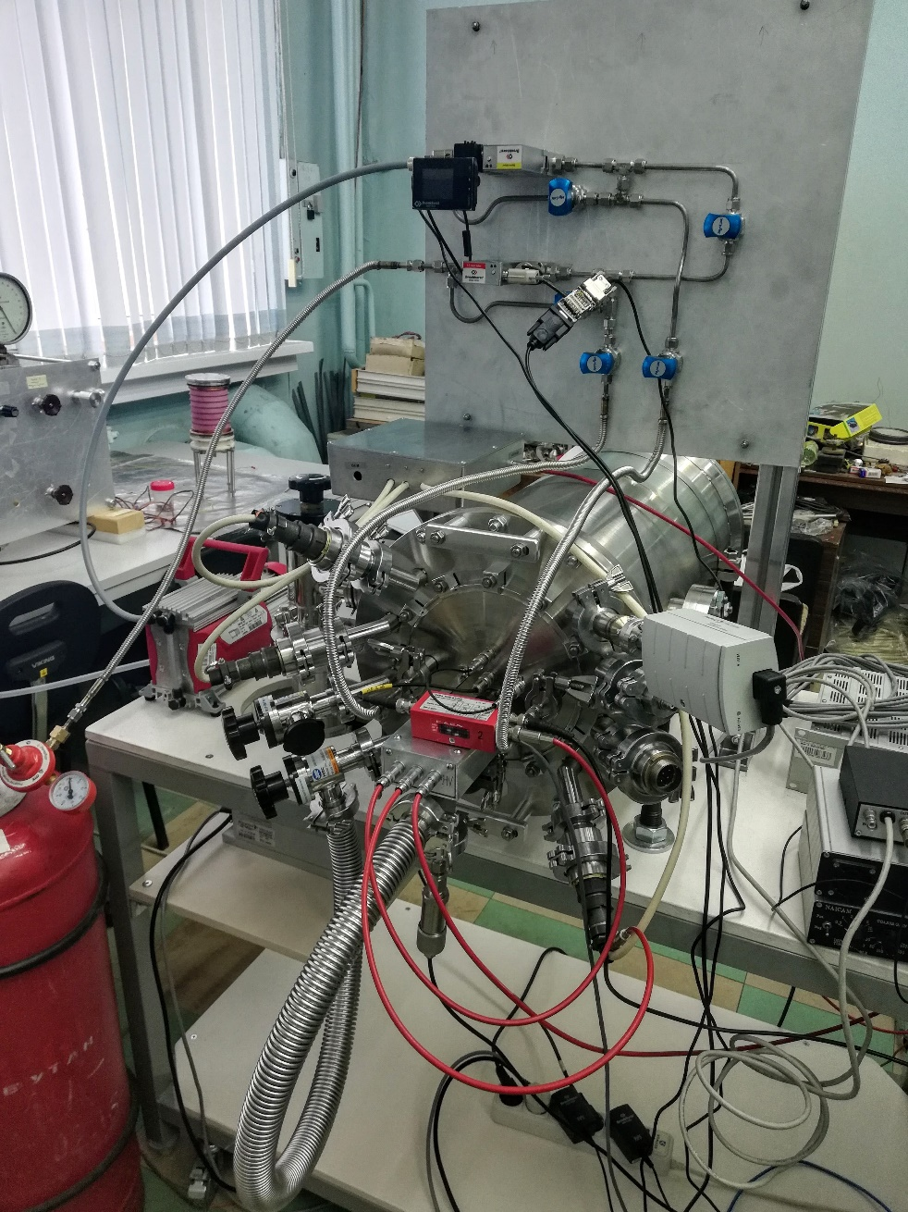
New TPC configuration
Diameter – 178 mm
Length – 300 mm

Slide 17
Summary
The low-pressure TPC with THGEM readout was developed and successfully tested in our laboratory.
The track ranges of alpha-particles were measured in the TPC with a rather high accuracy, reaching 1.3%. Based on these results and SRIM code simulations, one may conclude that the isobaric boron and beryllium ions (having range difference of 32%) can be effectively separated in AMS, at the level exceeding 10 sigma, by measuring the ion track ranges.
This technique is expected to be applied in the AMS facility in Novosibirsk for dating geological objects, in particular for geochronology of Cenozoic Era.

Slide 18
Thanks for your attention!

Slide 19
Backup slides

Slide 20
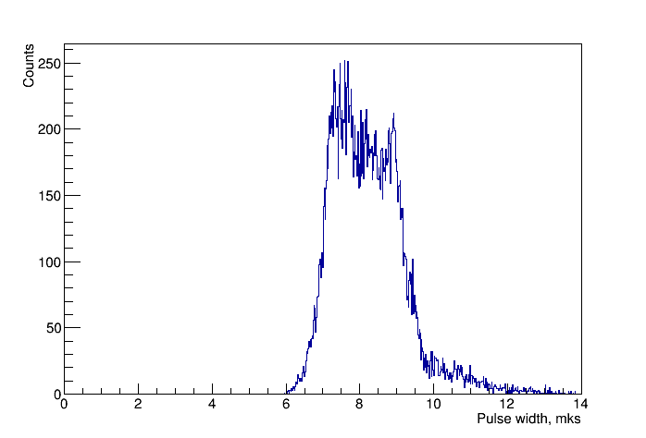
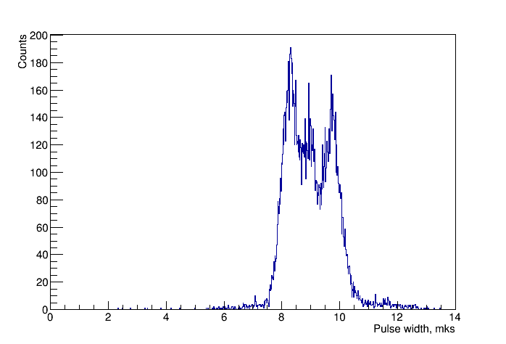
The measurement of track ranges with different gain
The alpha-particle source – ²³³U, ²³⁸Pu, ²³⁹Pu
$$E_{α}=4,816 МэВ E_{α}=5,499 МэВ E_{α}=5,157 МэВ$$
Pressure = 120 Torr Shaping time = 500 ns
Gain = 2
Gain = 40
The lines of alpha particles are worse separated with less effective gain of THGEM and longer shaping time of amplifier

Slide 21
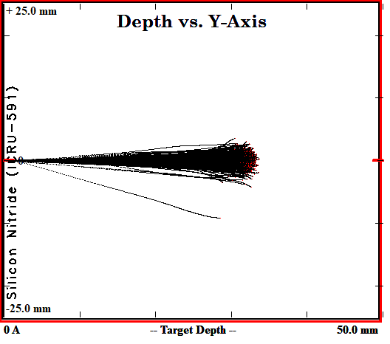
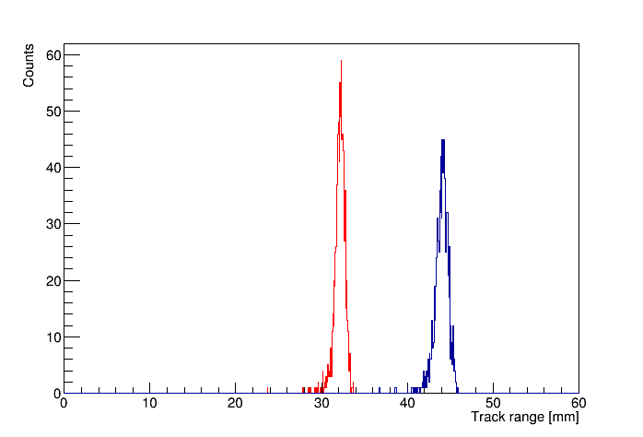
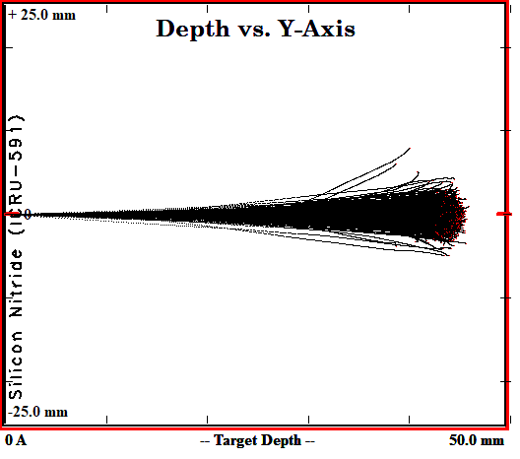
SRIM simulation
*SRIM - The stopping and range of ions in matter
¹⁰B
¹⁰Be
Spectra of track ranges for ¹⁰B and ¹⁰Be with energy 4.025 MeV in 200 nm silicon nitride and Isobutane at 50 Torr

Slide 22
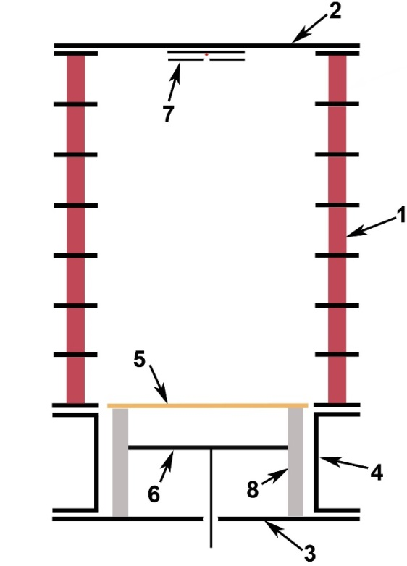
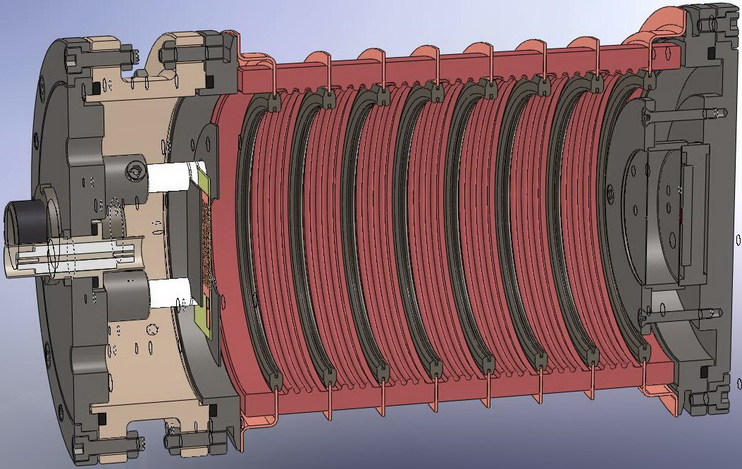
Construction
Diameter 76 mm
Length 130 mm
TPC construction: 1 – field shaping rings, 2 – removable top flange,
3 – removable bottom flange, 4 – transitional gap, 5 – THGEM, 6 – sectioned anode, 7 – alpha particle source,
8 – caprolon rods

Slide 23
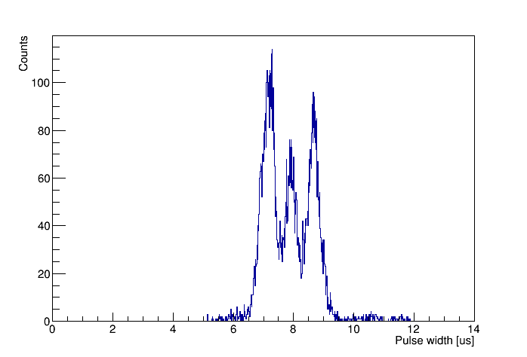
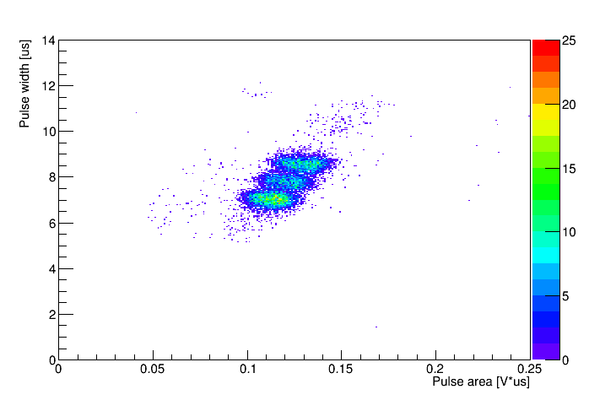
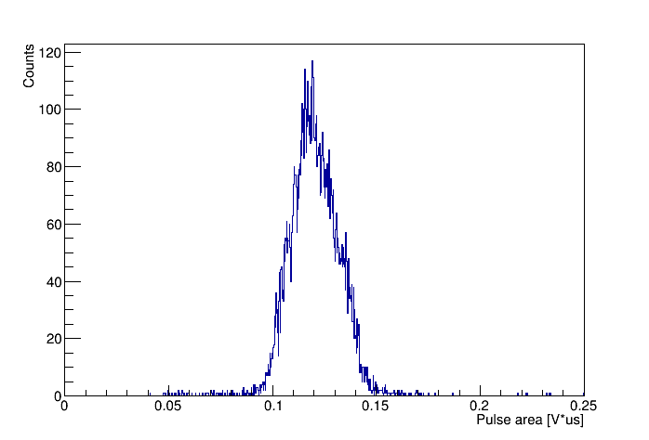
The measurement of track ranges
The alpha-particle source – ²³³U, ²³⁸Pu, ²³⁹Pu $E_{α}=4,816 МэВ E_{α}=5,499 МэВ E_{α}=5,157 МэВ$
Pressure = 120 torr Gain = 40 Shaping time = 200 ns
2D plot of pulse width versus pulse area and their axis projection spectra for alpha particles from ²³³U (4.8 MeV), ²³⁹Pu (5.2 MeV) and ²³⁸Pu (5.5 MeV) source, measured in low-pressure TPC in Isobutane at 120 Torr and THGEM gain of 40. The pulse width and pulse area spectra reflect those of the track range and energy.

Slide 24
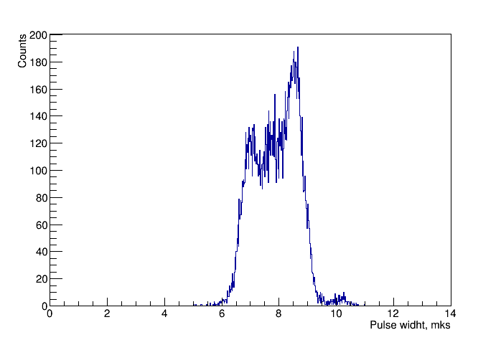
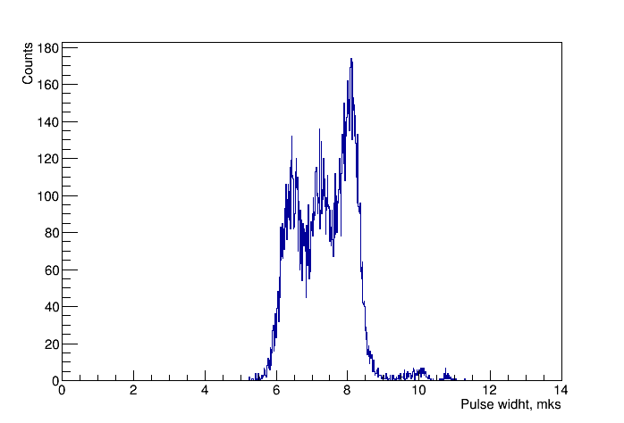
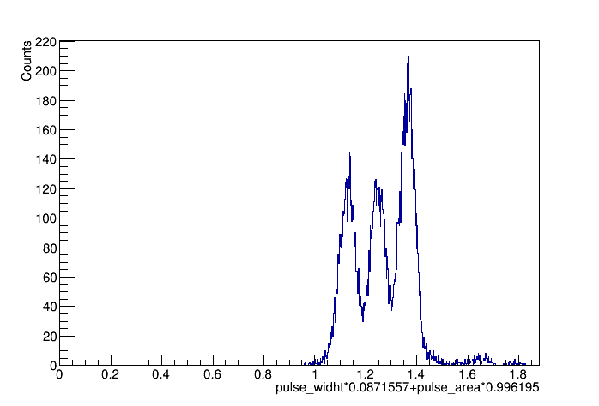
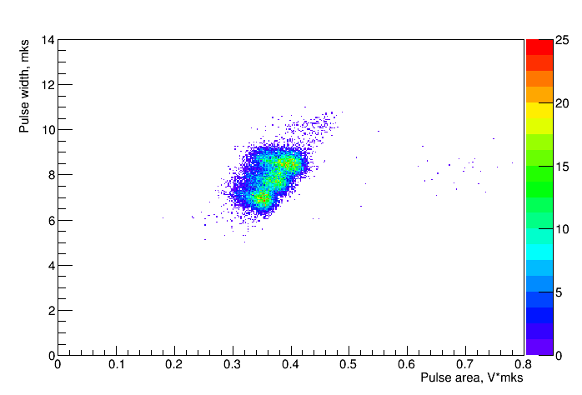
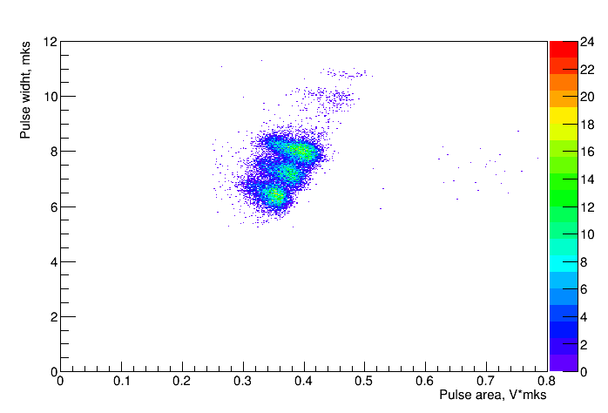
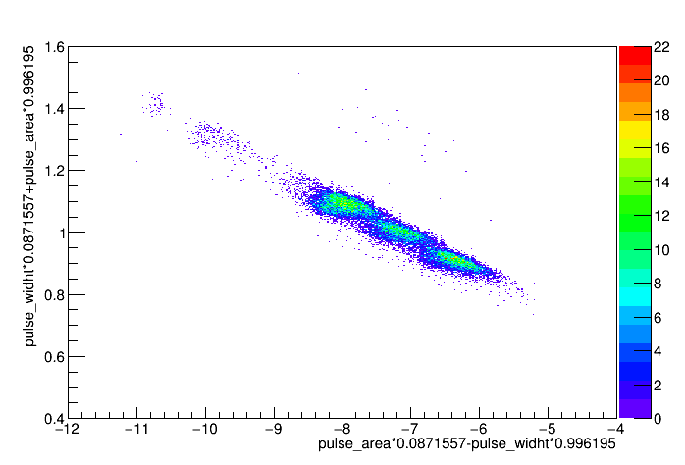
The measurement of track ranges
Источник α – частиц – ²³³U, ²³⁸Pu, ²³⁹Pu
Pressure = 120 torr Gain = 220 Shaping time = 200 ns
Fixed threshold
Constant fraction threshold
Rotation 83⁰

