Slide 1
Water purification using SRF electron gun
Junji Urakawa (KEK), WG-1 presentation, 2021.3.16 afternoon session
Water purification project related CLEAN GANGA using Electron Accelerator, Conceptual Prototype of the Purification System at IITB and BHU – 1 to 5 MeV, 100-200 kW SC Linac, KEK is preparing the proposal of SATREPS (Science and Technology Research Partnership for Sustainable Development) with IITB.
Abstract
We are developing 1.5 cell SRF (Superconducting RF) 1.3GHz electron gun to realize the generation of high intensity electron beam for compact water purification system. In the first stage, we manufactured Nb 1.5 cell RF gun and tested it at 2K¹⁾. Next planned step is to generate Nb₃Sn layers with thickness of a few um on the surface of Nb superconducting cavities for 4.2K operation. Then, we will research the performance of 4.2K Nb₃Sn SRF electron gun with CW pulsed laser system.
Important research issues are the operation of 4.2K Nb₃Sn SRF cavity, photo-cathode at 4.2K and the generation of high intensity electron beam. I will report the plan with many advantages over present utilized facilities by establishing the water purification project using the SRF electron gun²⁾. It will take at least 5 years to establish the technologies with the budget which is requesting funding agencies now.
1) T. Konomi of KEK mainly made this study.
2) R. Varma of IITB in India mainly proposed this project around 2018.

Slide 2
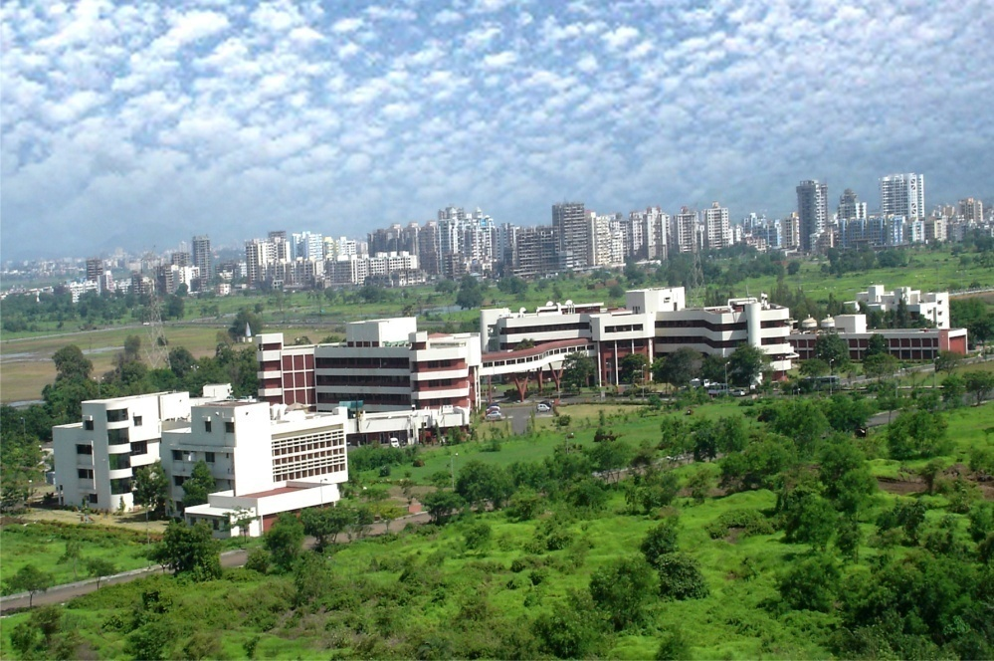
Two Indian new projects with KEK staff’s contribution under evaluation by Indian Gov. or JST and JICA in JFY 2021
1. Energy Sweep Compact Rapid cycling Therapy (ESCORT) project at Tata Memorial Hospital
Advanced Centre for Treatment,
Research & Education in Cancer
(ACTREC), KEK staffs (K. Takayama) are
contributing to write the proposal.
ESCORT project is under
evaluation by DAE.
In detail, to the presentation of T. Dixit
2. Water purification project related CLEAN GANGA using Electron Accelerator, Conceptual Prototype of the Purification System at IITB and BHU – 1 to 5 MeV, 100-200 kW SC Linac, KEK is preparing the proposal of SATREPS (Science and Technology Research Partnership for Sustainable Development) with IITB.

Slide 3
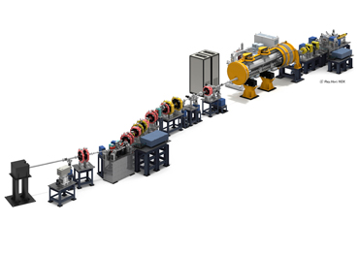
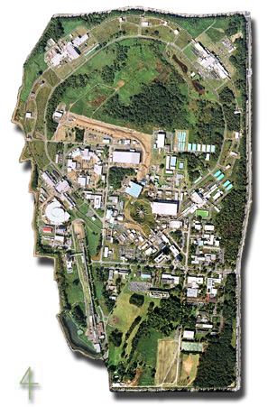
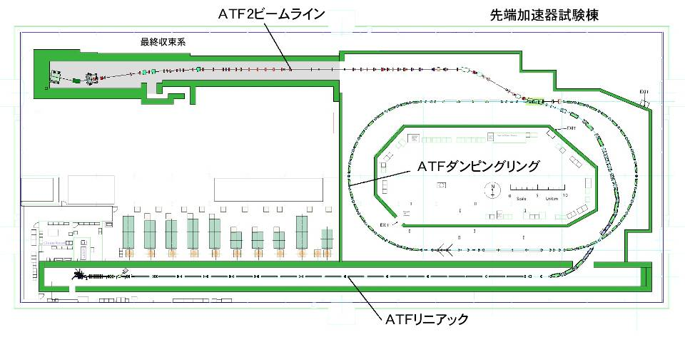
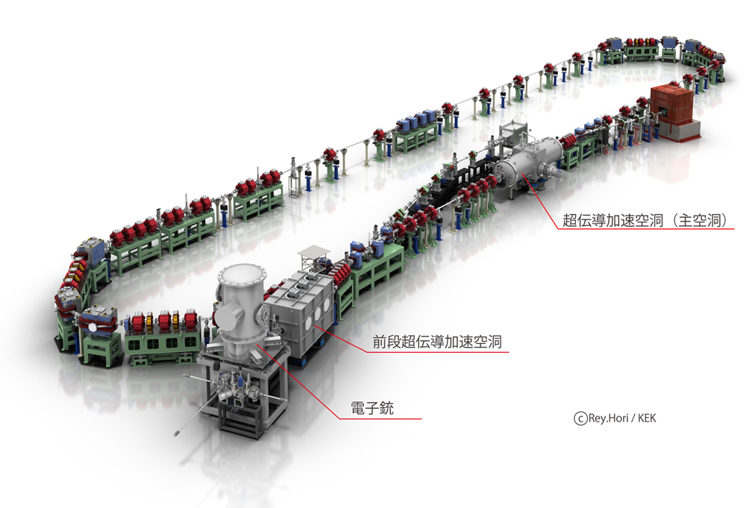
Electron Accelerators in KEK used for LCS R&D and experiments to develop technologies
ATF
STF
Electron beam: 1.3 GeV
Intensity: ~2x10¹⁰ e/bunch,
1 ~ 20 bunches/train, 3.12 Hz
  ε_{x/y} ~ 1.5nm/4pm
Superconducting RF
Pulsed beam:
1.3 GHz, 1 ms
Higher energy:
60 MeV → 300 MeV
Plan to restart in 2018
Cs₂Te
Photocathode RFgun
マルチバンチ電子ビーム生成
Damping Ring
低エミッタンスビーム
S-band Linac (1.3 GeV)
LUCX
cERL
Normal conducting RF
Pulsed beam: 357 MHz - 1000 bunches/pulse
1.2MW pulse laser stacking in optical cavity as the peak
24 MeV-32MeV
Superconducting RF
CW beam 100 uA → 10 mA
20 MeV-35MeV
Notes:
KEK constructed the Accelerator Test Facility (ATF) and the Superconducting Accelerator Facility (STF) for ILC R&D and operates them for educating and training young researchers. Also, Compact Energy Recovery Linac (cERL) and Laser Undulator Compact X-ray source (LUCX) for developments to the application were constructed and are operated. From many experiences based on the construction and the operation in these four facilities, I would like to explain how to design and construct the advanced electron accelerator in the energy range of 3MeV to 30MeV as extremely useful facility with some application examples.

Slide 4
Published in 2017
Schematic layout of the 1 MeV, 1 MW, CW SRF electron accelerator for wastewater and flue gas treatment. The estimated overall length of the accelerator is 6m.

Slide 5
cERL RF Source for the injector

Slide 7
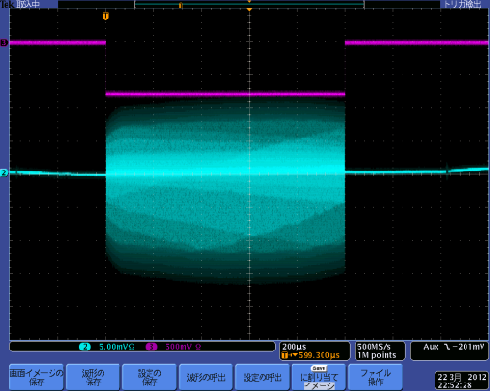
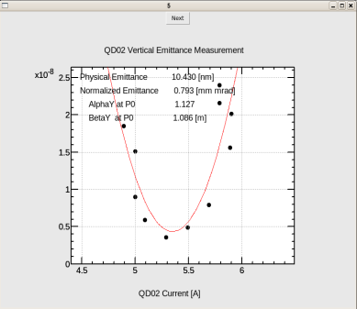
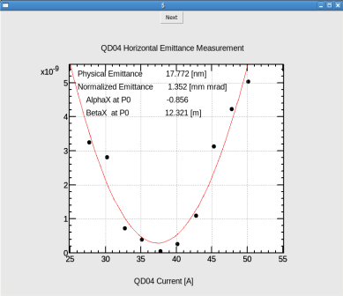
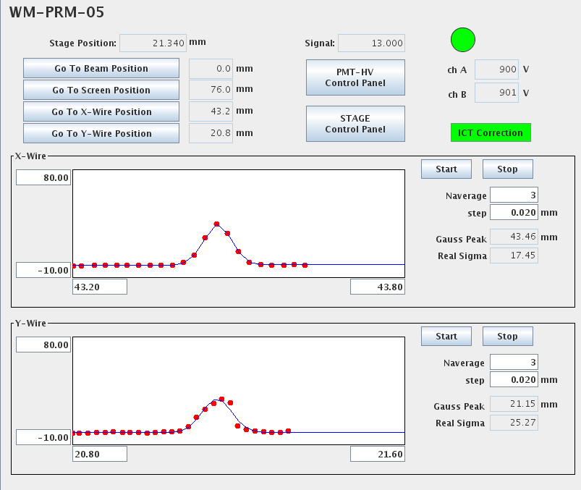

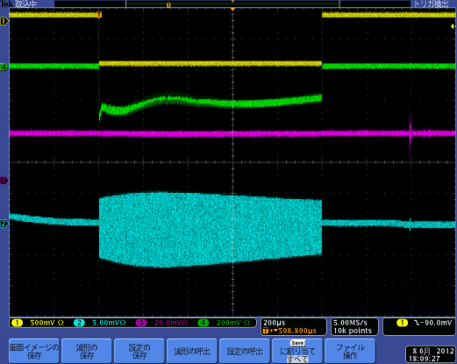
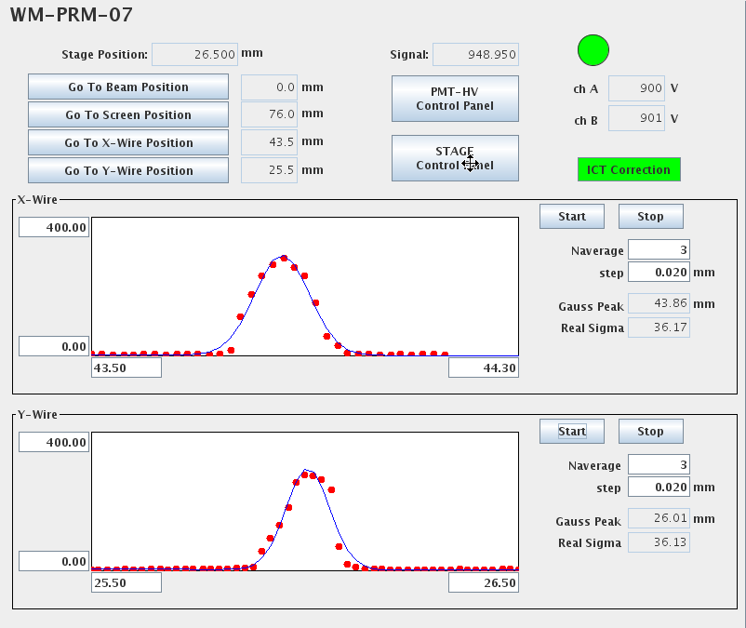
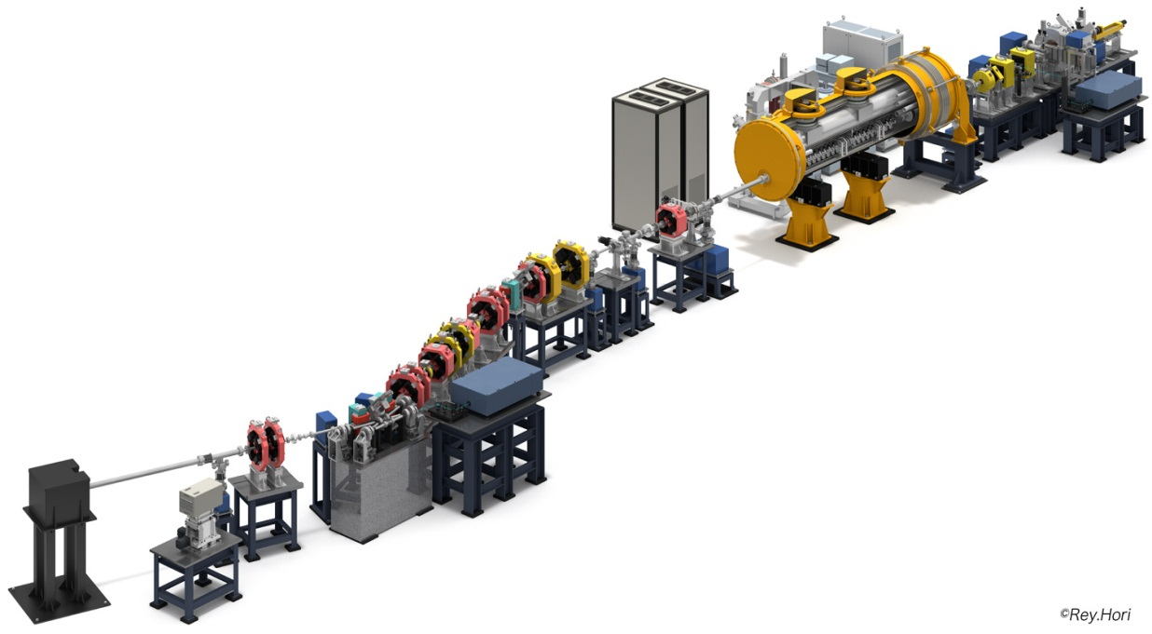
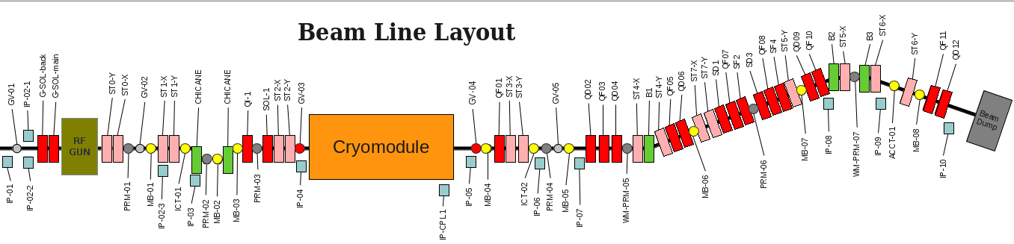
Achieved beam at STF for QBT project
1ms beam from L-band RF Gun
Min. emittance so far
Min. beam size＠WM-PRM-05
WM-PRM-05
WM-PRM-05で一番小さく
絞れた時。
ただし、WM-PRM-07では
大きかった。
WM-PRM-05
σx: 17.5[µm]
σy: 25.3[µm]
このとき、
WM-PRM-07
σx: 55.8[µm]
σy: 29.3[µm]
(ログブックのデータのみ
画像データなし)
σx: 17.5[µm]
2012/07/04測定
σy: 25.3[µm]
(RF feedback ON) 03.22.2012
50pC/bunch
Measurement of beam emittance by wire
scanner 06.13.2012
07.04.2012
Accelerated 1ms beam
Min. beam size＠WM-PRM-07
Dispersion measurement
@WM-PRM—05, -07, dispersion measurements
SC phase 240deg 40.58 MeV/c (B1 150.20A)
SC phase 250deg 40.02MeV/c (B1 148.10A)
⊿x ηx ⊿y ηy
WS-PRM-05 85um 6.2mm 14um 1.0mm
WS-PRM-07 42um 3.1mm 14um 1.0mm
(07.04.2012）
σx: 36.2[µm]
σy: 36.1[µm]
07.04.2012
1ms beam acceleration (15pC/bunch)
(Gun/SCRF RF feedback ON) 06.08.2012
Swap
Target size : 10μm
07.04.2012
WM-PRM-05
WM-PRM-07
Laser beam size : about 80μm
Target : less than 20μm
Background level is acceptable.
X-ray signal does not detected so far.
This experiment is under going.

Slide 8
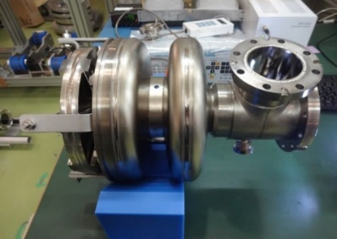
Planned system
<50cm
<350cm
Advantages
Since high energy electron beam (1 to 5 MeV) is used, survival chance of bacteria is minimal.
System is very compact and requires much smaller footprint.
Since no use of chemicals like Chlorine and Ozone used in current technologies, it is easy to handle and is environmentally ‘clean’.
The average life is very long and recurring costs are moderately low.
We have a possibility to establish feasibility of large scale water treatment facility in India.

Slide 9
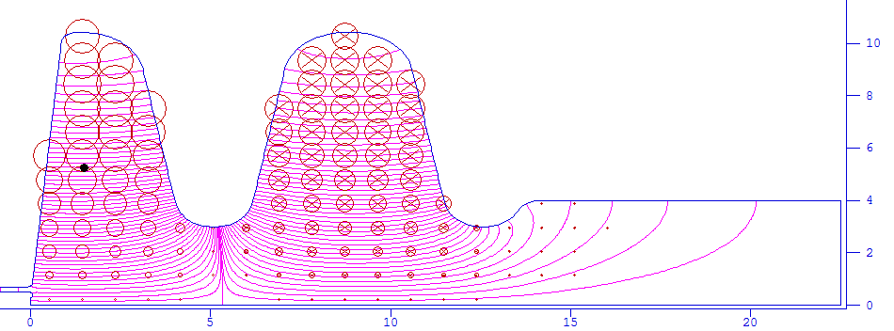
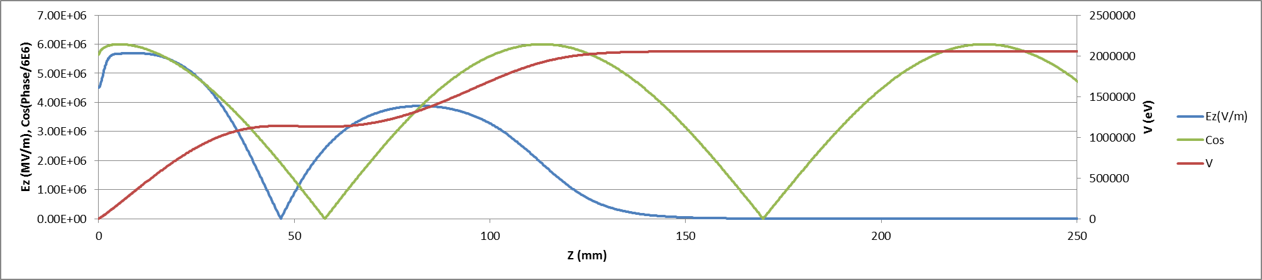
Superconducting RF Gun cavity design
The KEK gun cavity was designed for KEK ERL and application to electron microscope.
Cell number is 1.5 cell because input power is 2 MeV x 100mA =200kW by using two input couplers.
Surface peak electric and magnetic field are about half of ILC target.
The cavity shape was designed with only gun cavity without booster cavities etc.
It is necessary to compensate emittance and energy spread at same time.
Hp
Designed by MHI
Ep
Parameter | Value
RF frequency | 1.3 GHz
Beam energy | 2 MeV
Projected emittance | 0.6 mm.mrad
Projected energy spread | 0.09%(1.84 keV)
Peak electric field | 41.9 MV/m
Peak magnetic field | 95.2 mT
RF phase | 55°
Geometrical Factor | 135.6 Ω (TESLA 270 Ω)
Target surface resistance | 30 nΩ (ILC target)
Target Q value | 4.5×10⁹
Target cavity loss | 8 W
Emittance compensation
Energy compensation
Notes:
This is the gun design parameters.
Number of the cell is one and half.
Beam energy at gun exit is 2 MeV and beam current is 100mA so the beam power is 200 kW.
The cavity shape was designed with only gun cavity without booster cavities etc.
It is necessary to compensate emittance and energy spread at same time.
It will achieve better value with adding boosters and bunchers.

Slide 10
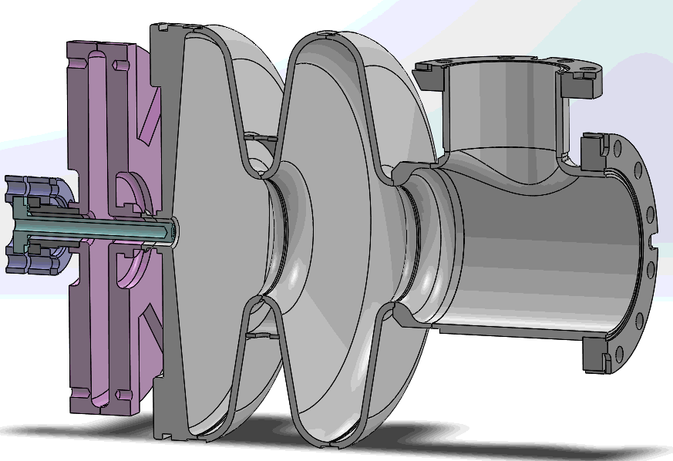
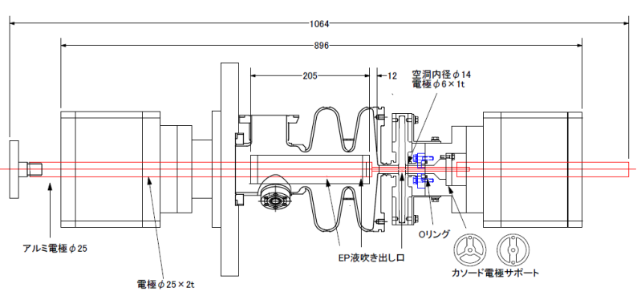
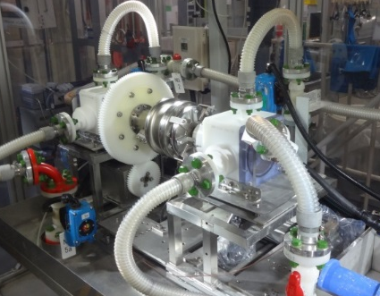
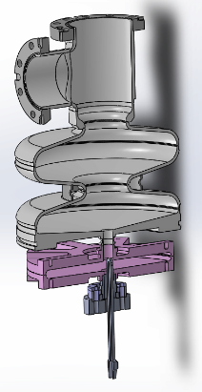
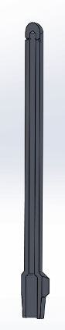
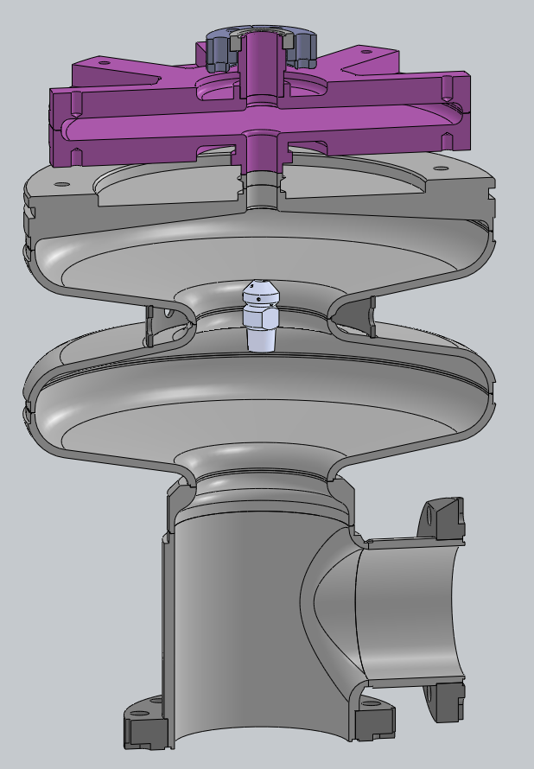
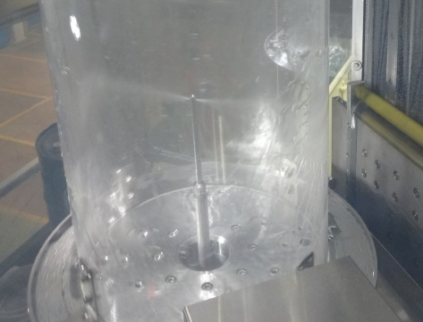
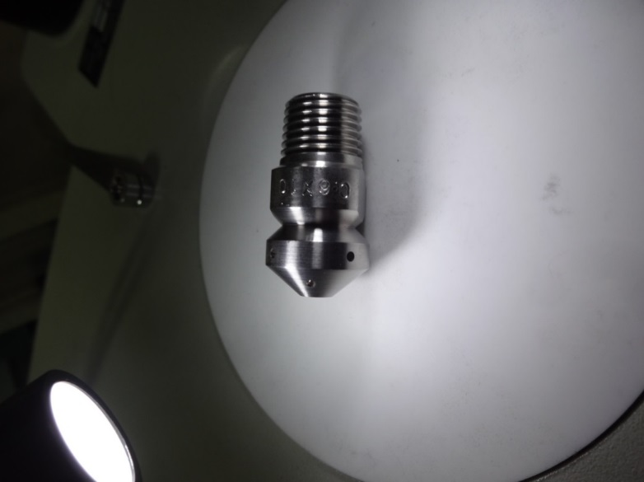
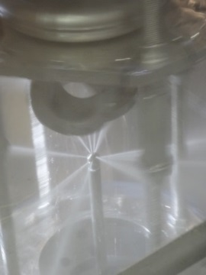
Prototype gun cavity #1
We established the cavity treatment procedure by using cavity #1.
Choke cell is parallel shape to make HPR easily.
EP rod and HPR nozzles were modified for KEK SRF gun cavity.
Choke cell
Acc. cell
Cathode
rod
EP
HPR nozzle for choke cell
HPR nozzle for Acc. cell
5º
70º
90º
110º
Notes:
The surface treatment is followed with ILC standard recipe.
We modified the setup little for the gun
EP cathode is modified shorter and smaller to be able to insert to the cathode hole.
And We prepared two types of HPR nozzle. One is for the accelerating cell and one for the choke cell.
During HPR, we turned the cavity upside down several times.

Slide 11
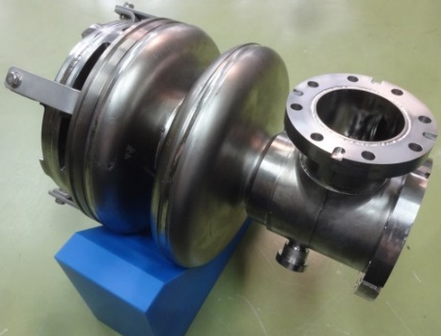
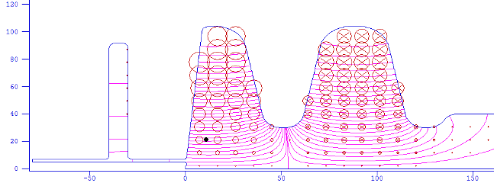

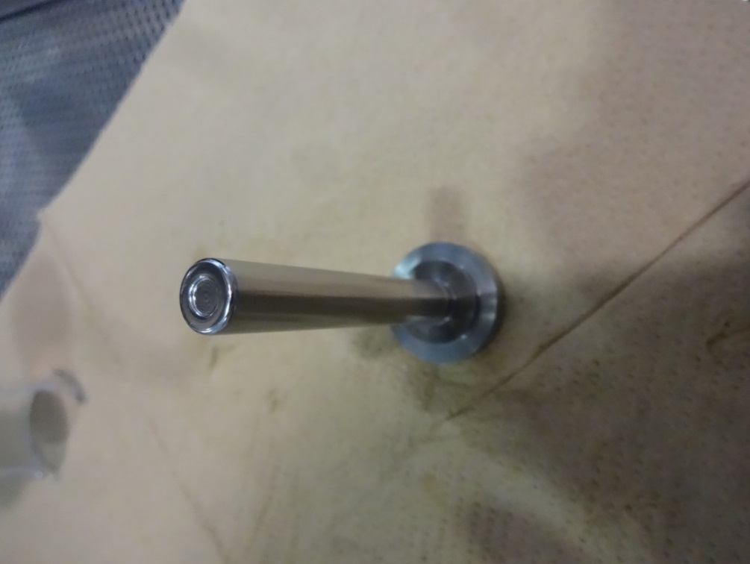
Performance of prototype #1 cavity
It is important to apply HPR to the cathode rod.
Peak magnetic field (Hsp)
Peak electric field (Esp)
1st cell
2nd cell
5º
70º
90º
110º
Notes:
This is the vertical test results. The horizontal axis is not Eacc but surface peak electric field.
Because Eacc is difficult define for the gun because beat is gaudery increase. And surface peak of the cathode can be changed by the insertion position.
Finally the gradient reached to the 75 MV/m. There is no X-ray observed.
The most important thing we understand from KEK SRF gun #1 is.
If we did not apply HPR to the cathode rod, the result is red curve.
Field emission onset is 35 MV/m and Q degreed.
I think field emission is the not allowed for the gun cavity. Because the photocathode is very week to the damage.
From this result We understand the keep the cathode rod clean to achieve the high gradient without field emission.

Slide 12
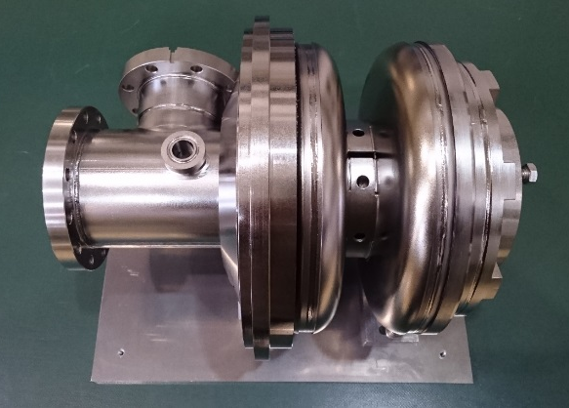
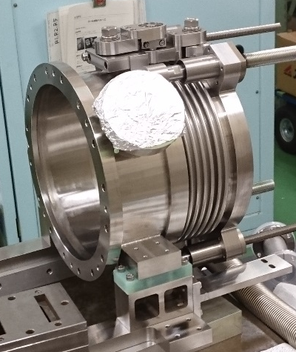
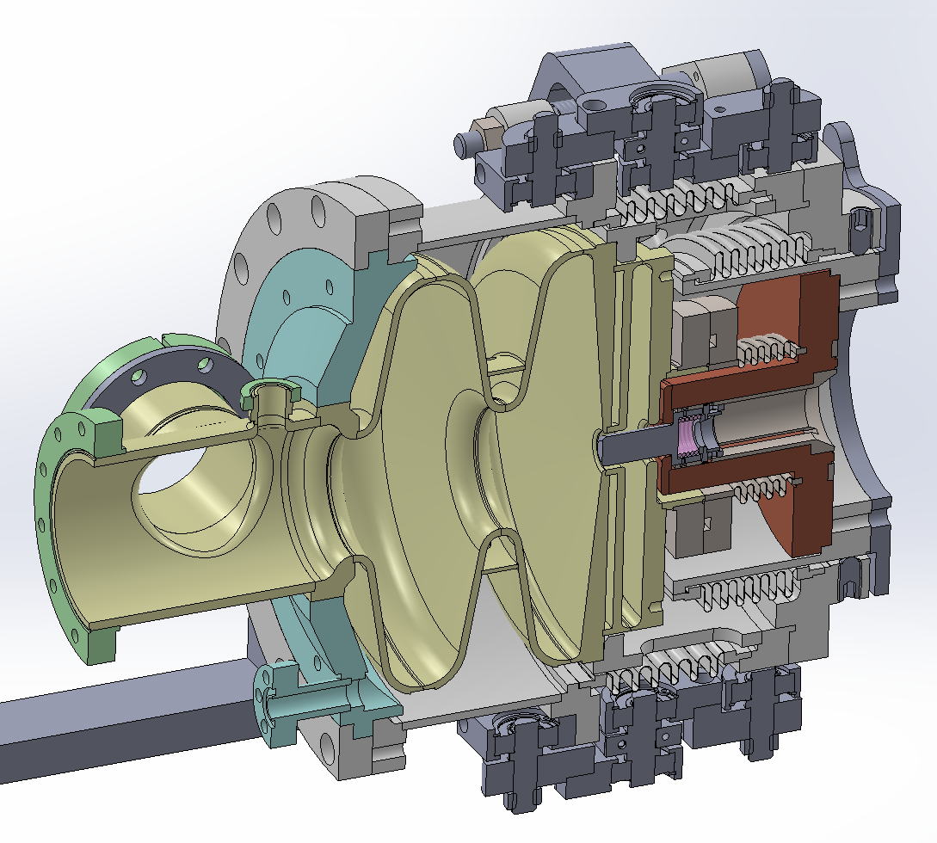
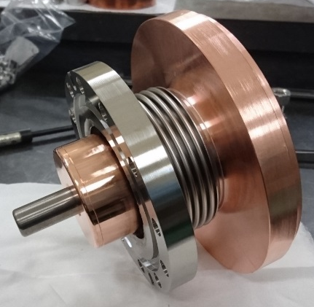
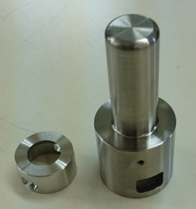
Fabrication of Gun cavity #2
#2 cavity was modified from #1 to add the helium jacket for beam test.
The cathode rod was mounted on the cathode holder to remove from the cavity.
Cathode rod
Cathode holder
1.5 cell cavity
Cavity #2
Cathode holder
Helium jacket
Helium jacket
Cathode rod
Notes:
Now let me talk about KEK SRF gun #2
The RF design is same as #1. The difference is #2 cavity has the helium jacket base plate and cathode rod can be removed.
In future we will test the transparent photocathode. But now we prepared bulk niobium cathode rod.
We will deposit alkali metal photocathode on the mirror polished niobium cathode rod.

Slide 13
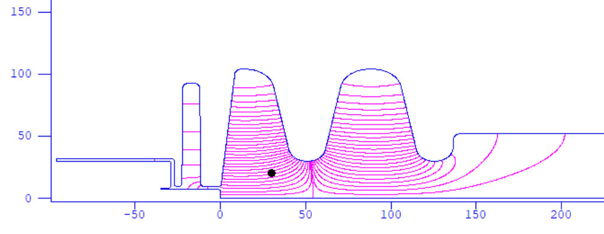
RF design of Gun cavity #2
RF design of Gun cavity #2 is same as cavity #1 except choke area.
The cathode rod was designed as possible as short for the heat path shorter.
RF heat load on the cathode rod is ideally 240 mW at 2K
240mW
@cathode rod
Esp=42MV/m

Slide 14
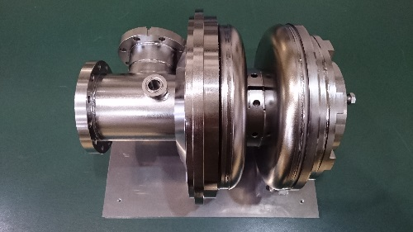
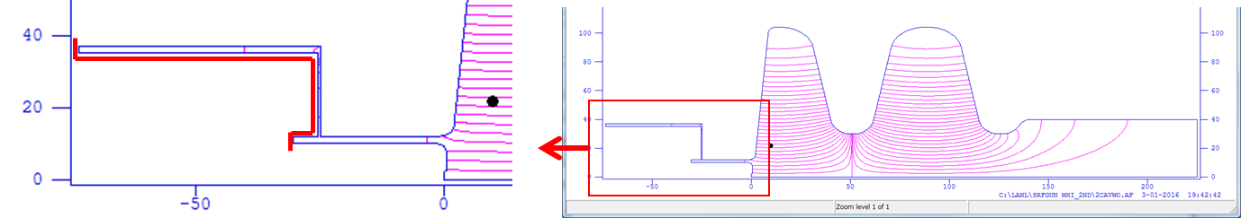
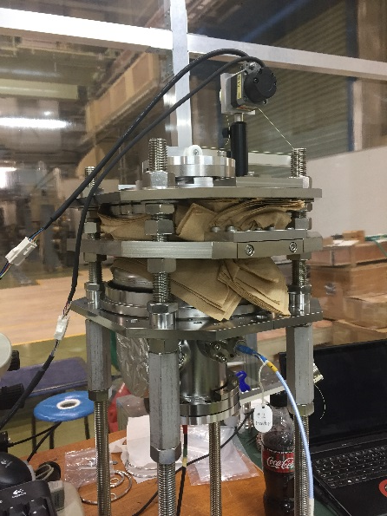
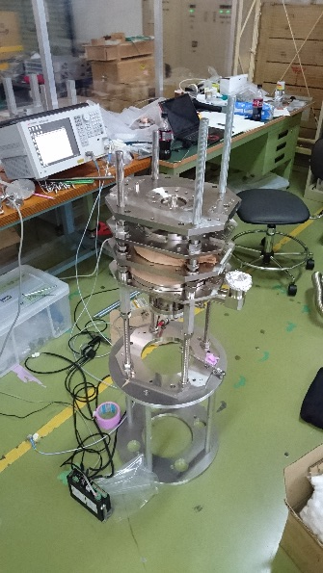
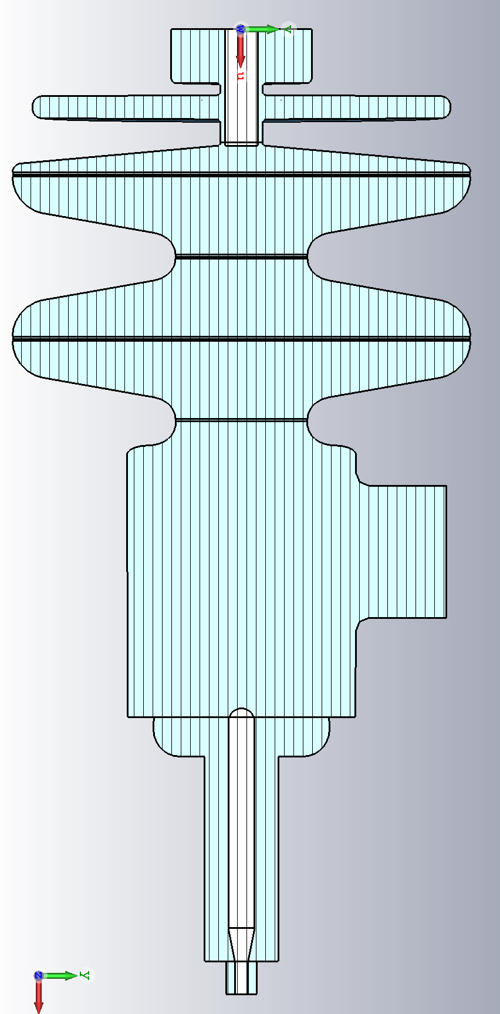
Preparation for vertical test
The surface treatment was followed with the experience of the gun cavity # 1.
  EBW in KEK
  EP 100 um
  Anneal 800Cx3h
  Field tuning
  Final EP 20um
  USR, HPR
  Assembly
Loss Q at cathode rod and holder is 5x10⁹ if there is no choke filter.
Target attenuation of choke filter is 30dB for 1% loss.
The choke attenuation was adjusted to be minimum.
Stainless steel
copper
Q_{loss}=5x10⁹
Choke cell tuning
Dummy rod for pick up
Acc. cell tuning
Adjust this length
Acc. Cell freq.
target
Input
Choke freq.
Notes:
This slide shows the preparation of the vertical test.
The surface treatment was followed with the experience of the gun cavity # 1.
The difference from the #1 is Choke tuning. Because the cathode rod is shorter than the #1 to cool down the cathode rod more effectively.
So the cathode position is close to the accelerating cell.
if there is no choke fileter Qloss at cathode rod and holder is 5 10 to 9th
Target attenuation of choke filter is 30dB for 1% loss.
This is the setup of the choke tuning. Dummy rod with N-type RF feed though was inserted from the back side of the choke.
Choke frequency was tuned to accelerating cell frequency at room temperature. But after that the choke frequency is about -20 dB
So The adjusted choke attenuation is 10 times higher than the target.
The reason we suspect that the cathode rod length is not enough long. If the cathode rod is not in the prefect center. TEM mode converted to the TE mode in the
But I think 0.8W additional heat load is acceptable for the cooling ability for the cathode holder

Slide 15


Vertical test of the 1.5 cell type SRF gun
The maximum gradient without cathode rod reached to target value.
Target
We can shift the main target to cathode rod and holder development
・Effective cooling structure to keep the cathode rod around 2K.
・Particle free cathode transport method.
Notes:
This is the vertical test result. in this vertical test cathode rod is not included.
The gun cavity itself can be reached to the 75 MV/m with small field emission.
Field emission onset is higher than the target frequency.
We can shift the main target to the cathode and holder development
The key point is effective cooling structure to keep the cathode rod around 2K
And particle free transport method.
Now we are trying to overcome the cathode cooling issue.

Slide 16
Vertical test with cathode rod (4th VT)
The maximum gradient without cathode rod reached to target value.
However the Q value is dropped at 15 MV/m with cathode rod.
We suspect it is because the thermal contact resistance between cathode rod and holder is higher than expected.
Rres increased due to the error of the choke tuning.
Target

Slide 17
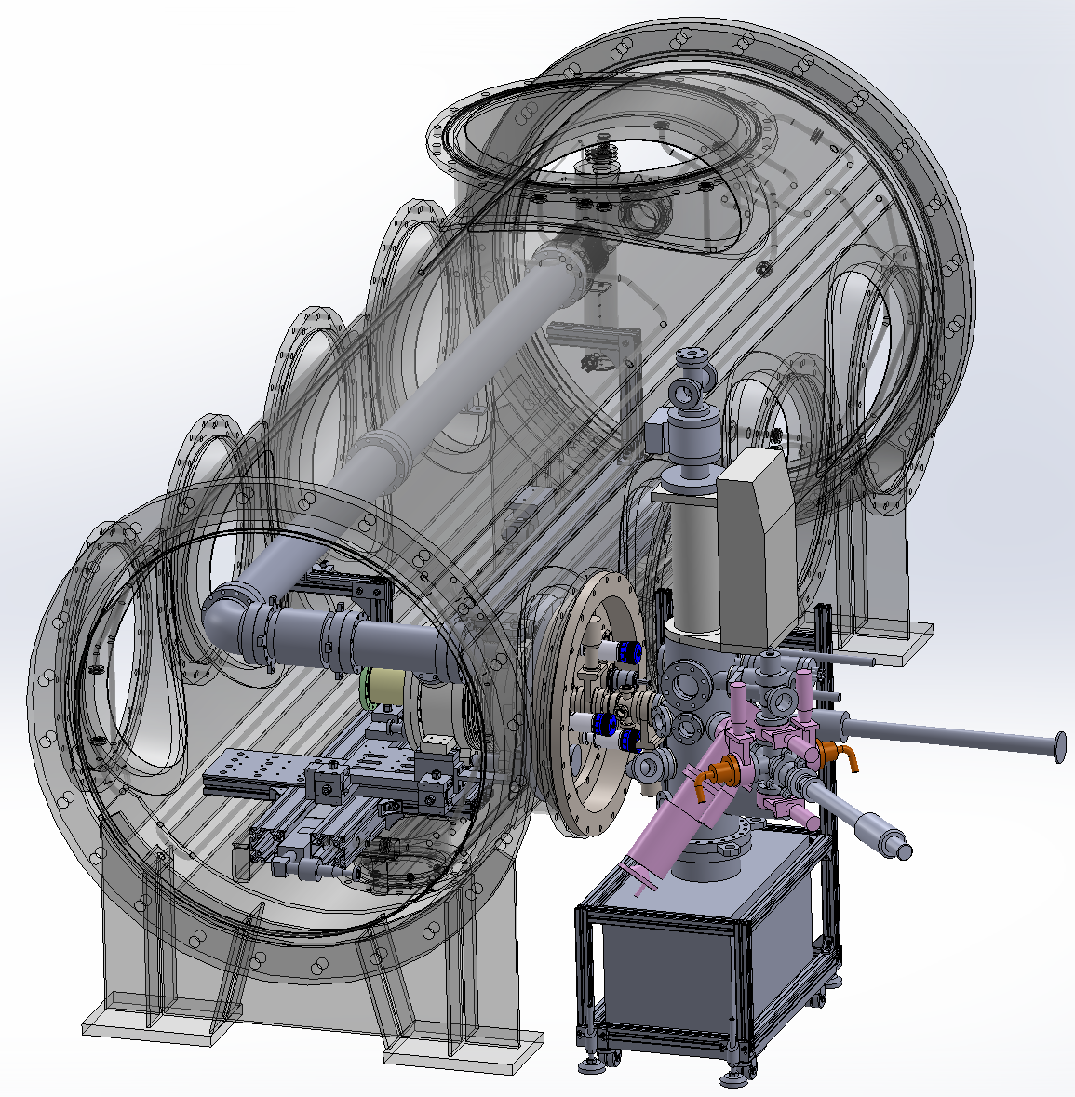
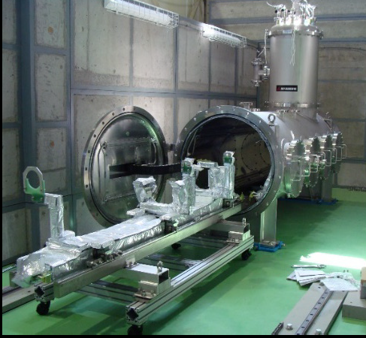
Plan for horizontal test
We are planning beam test with small current in the
horizontal test cryostat.
Support Jigs to install cavity are under fabrication.
Short diagnostic (beam energy and emittance) line
will be designed.
Cooling test
Heat loss of cathode rod adjuster.
High voltage test
Particle free cathode rod transportation.
Q-E curve with cathode rod.
Small current beam test
Dark (and beam) lifetime of the photocathode.
Measure the RF field distribution error.
Assembly
We checked the fitting of gun assembly.
Almost all the parts for the cooling test are prepared, except for Helium 2 phase line and magnetic shield.

Slide 18
RF design
Parameter | Value
Beam energy | 2 MeV
Beam current | 100mA
Bunch charge | 80 pC
Laser length (uniform) | 10ps
Projected emittance | 0.6 mm.mrad
Projected energy spread | 0.09% (1.84 keV)
Peak electric field | 41.9 MV/m
Peak magnetic field | 95.2 mT
RF phase | 55°
Geometrical Factor | 135.6 Ω (TESLA 270 Ω)
Target surface resistance | 30 nΩ (ILC target)
Target Q value | 4.5×10⁹
Target cavity loss | 8 W

Slide 19
4.2K operation is essential for industrial application, so we can use commercially available conduction cooling system.
So, Next planned step is to generate Nb₃Sn layers with thickness of a few μm on the surface of Nb superconducting cavities for 4.2K operation. Then, we will research the performance of 4.2K Nb₃Sn SRF electron gun with CW pulsed laser system.
Important research issues are the operation of 4K Nb₃Sn SRF cavity, photo-cathode at 4.2K and the generation of high intensity electron beam.
In the case of 1.3GHz single cell, S. Posen
and D. L. Hall, Supercond. Sci. Technol.
30 (2017) 033004 (17pp)
S. Posen 19th Int. Conf. on RF Superconductivity SRF2019, Dresden, Germany
Notes:
This is the gun cavity design.
Choke cell is the quarter wave structure to reflect the RF leakage though the cathode rod.
Qloss at chode rod is about 10 to 7th . so requirement of the choke attenuation is more than 30 dB.

Slide 20
Superconducting Photocathode R&D
Bulk Nb Cathode Plug is selected by DESY recently, QE<0.01%?
Thin films of Cs₂Te Cathode on Nb substrates (or Nb₃Sn substrates) is studied by ANL,
220 A Te thickness, QE ~11% -13% at 248nm is confirmed, like Cs₂Te Cathode
on Mo substrates. High residual QE ~6% is also confirmed with Te layer as thin as 15 A.
An increased operational lifetime is expected regarding an ultrathin, semiconducting
Cs₂Te layer.
A replaceable, superconducting plug cathode would be particularly attractive for a compact
SRF linac as it has a simple design. Recent advances in Nb based SRF cavities, including
record high Q values at 15–20 MV=m via a nitrogen doping process, as well as the
successful in situ growth of higher T_{C} Nb₃Sn on the inside surface suggests that a
compact electron linac operating at 4.2 K is feasible in the future.
High peak current is more easily obtained with semiconductor cathodes such as cesium
telluride (Cs₂Te). It has a QE as high as 20% and has consistently produced a QE > 1%
during normal accelerator operations over a period of at least a year, providing a relatively
large bunch charge per laser pulse, and has been shown to be robust in a photoinjector
environment. It has been used as an electron source in SRF photoinjectors, but only as a
normal-state photocathode. This requires a more complex engineering design to isolate
the cathode from the rest of the superconducting cavity.
Furthermore, since the photoelectrons are most likely originating from the ultrathin Cs₂Te,
the resulting bunch charge might be expected to be quite narrow temporally, possibly
competing with metal photocathodes.

Slide 21
Cs₂Te films cannot withstand exposure to air. Thus a future photocathode plug would have
to incorporate some type of vacuum transport and assembly mechanism. Another
possibility, given the robust QE found on such films, is to consider some type of protective
layer which might allow the hybrid photocathode to be transported in air. There are
numerous possibilities, including an insulating oxide or nitride coating to serve as a suitable
protective layer.
The ultrathin photocathode layer may make it mostly transparent to rf fields of ∼1 GHz
frequency, and thus it may not significantly alter the Q value of an SRF cavity with the
introduction of such a cathode. All of these point to a compelling argument that very
thin Cs₂Te on Nb might make for a viable superconducting photocathode for an SRF
photoinjector. However, technical challenges remain for incorporating such a hybrid
structure in an SRF injector. Future work will involve testing of such cathodes in an SRF
gun and testing of coating layers to allow exposure of the film to air.
Possible mode-lock laser system
for photocathode
YDF
6/125 PM
DC YDF
12/125 PM
DC YDF
40/200 PZ
LD
LD
LDs
Compact Fiber Laser Oscillator with 4 mirror optical cavity
Fibered Stretcher
Isolator
Isolator
Free Space Compressor
1st Pre-amplifier
2nd Pre-amplifier
Power Amplifier
We can select the repetition rate of the laser pulse which is 162.5, 325 or 650MHz.

Slide 22
Summary
KEK SRF Gun cavity #1 reached to Esp=75 MV/m with cathode rod at 2K.
KEK SRF Gun cavity #2 itself reached to Esp=75 MV/m with FE at 2K.
  Gun cavity #1 and #2 are same RF design.
  Gun cavity #2 can be connected to helium jacket.
We are preparing for horizontal test.
Next gun cavity of Nb₃Sn will has no cathode rod and Nb or Nb₃Sn will be low QE cathode.
4.2K operation with CW laser system (325MHz or 162.5MHz)
Future gun cavity of Nb₃Sn with the cathode rod will be tested for the generation of 100mA at 4.2K.
Finally total system will be tested for the measurement of the performance in India.

