Slide 1

KEK, High Energy Accelerator
Research Organization
Particle Physics Program at KEK
March 16, 2021
AFAD Meeting
M.Yamauchi
KEK

Slide 2
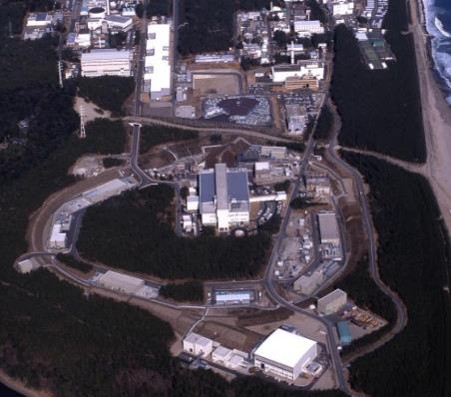
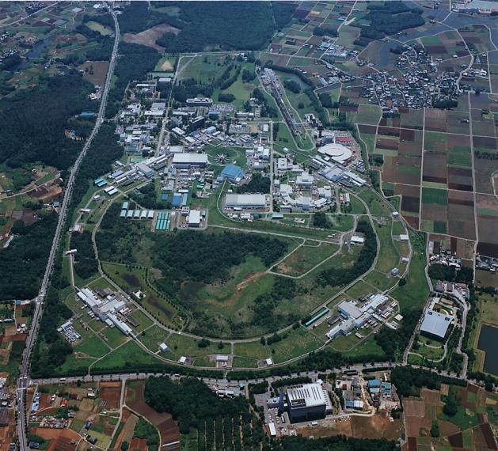
KEK Geography
KEK Tsukuba: SuperKEKB, PF, ATF
J-PARC: high intensity proton accelerator complex jointly operated by KEK and JAEA
Candidate site for ILC
Tsukuba
Tokai
Tsukuba
KEK covers diverse field of accelerator based science making full use of the electron machines in Tsukuba and the proton machines in Tokai.

Slide 3
Impact of the COVID-19 pandemic on KEK
Daily trend in the number of infected people in Japan
Total number of infected people
= 426k
Total number of deaths = 7600
Three KEK staff members were infected. No infected people have appeared in KEK users.
We requested 70% of the staff members to work remotely for 1.5 months in April/May in 2020. Otherwise, most of the people have worked as usual.
SuperKEKB and J-PARC accelerators have been operated normally. The number of domestic/international users decreased terribly.
The Japanese government is still requesting visitors to be quarantined for two weeks, and the number of users from overseas is expected to be limited for the time being.

Slide 4
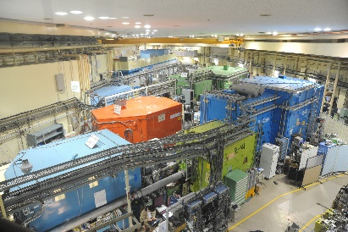

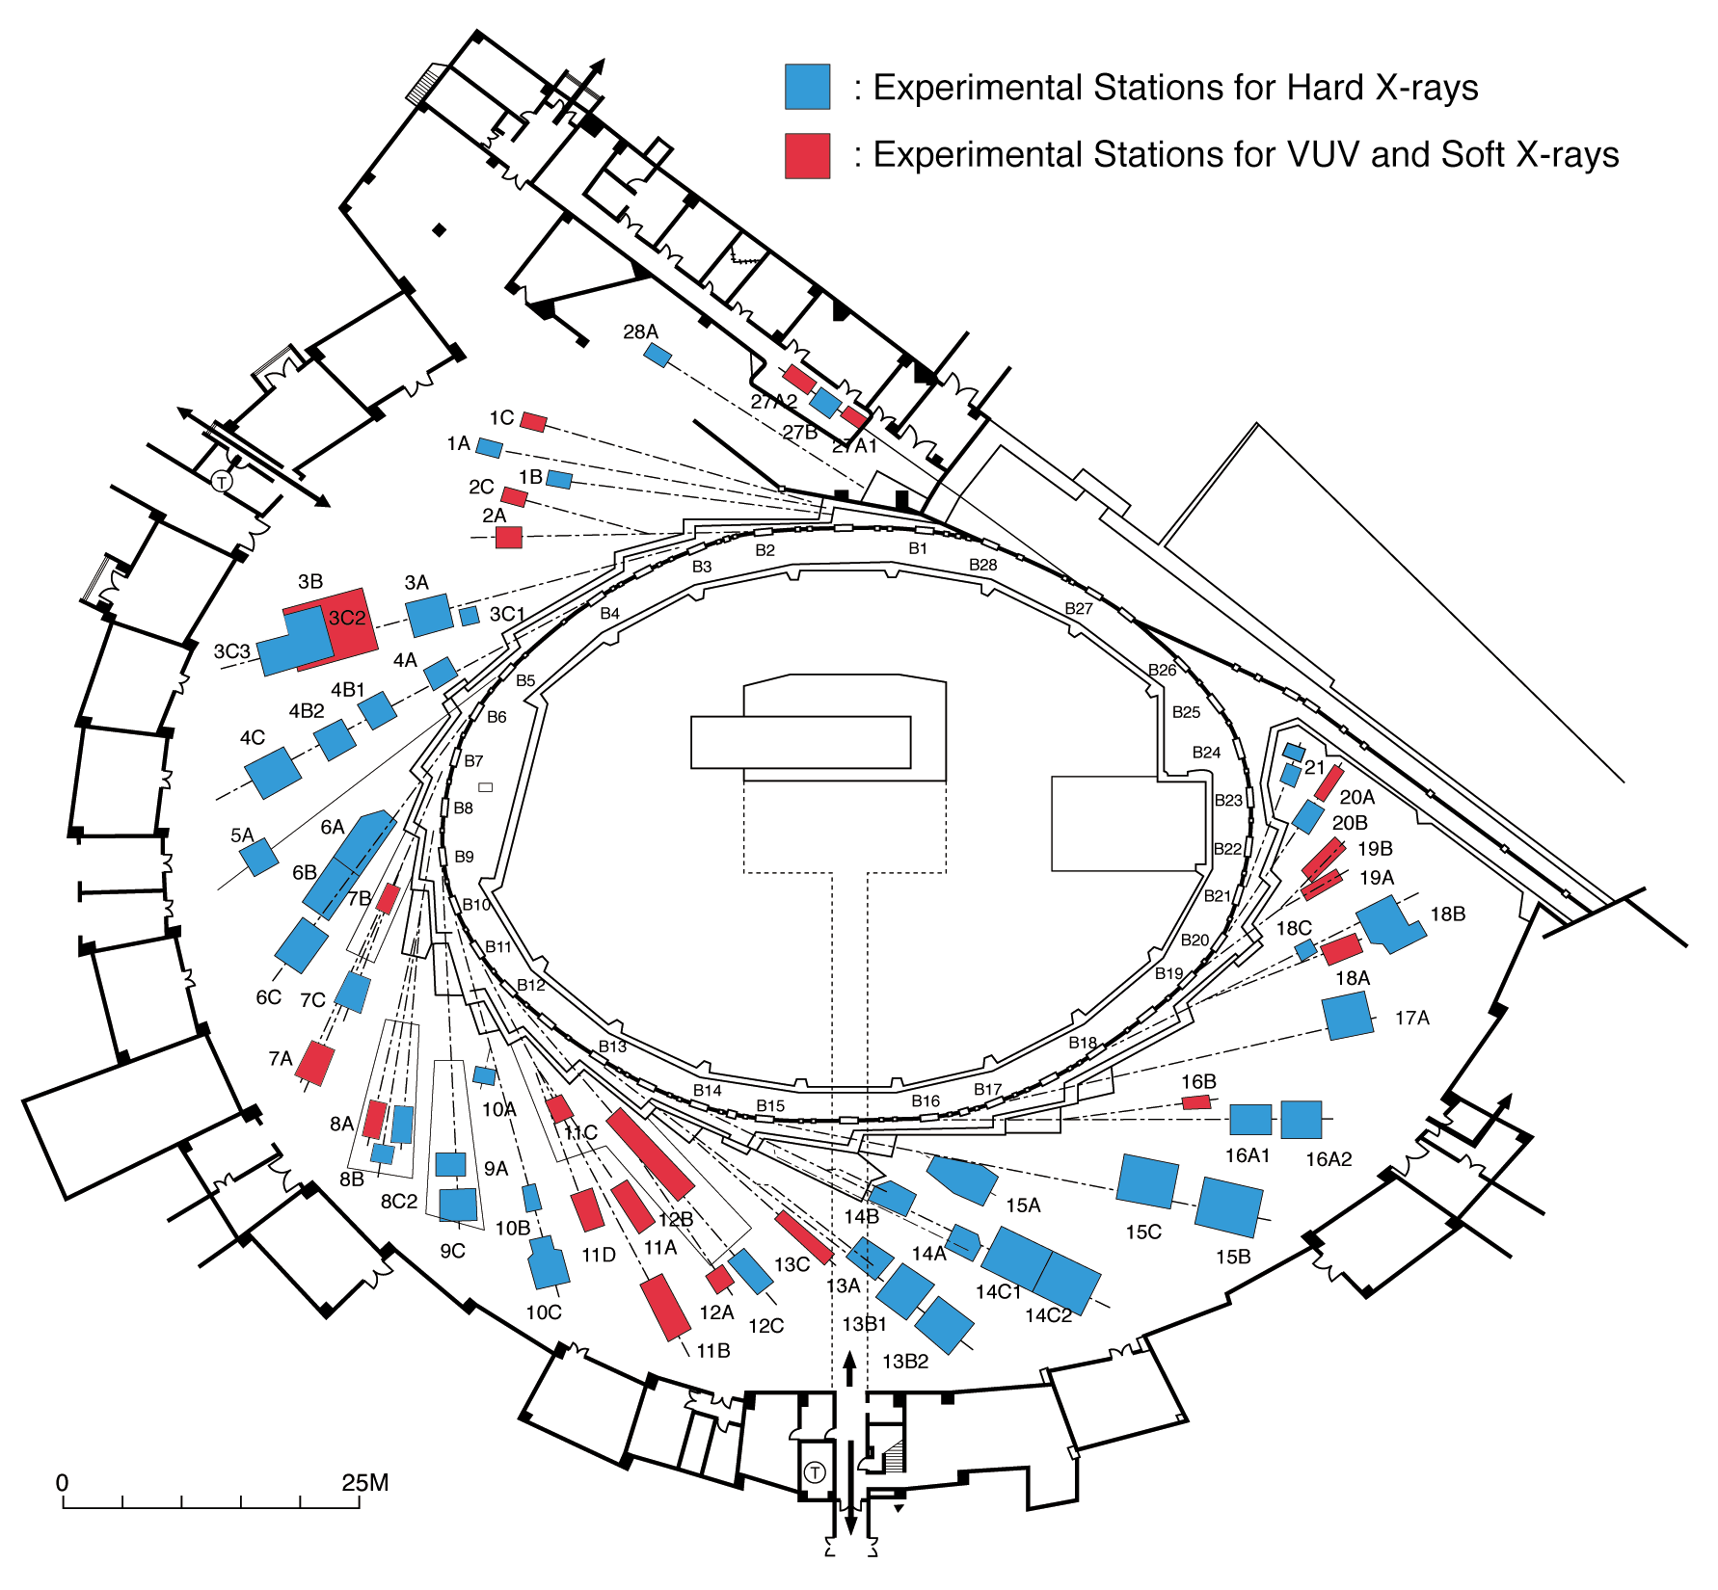
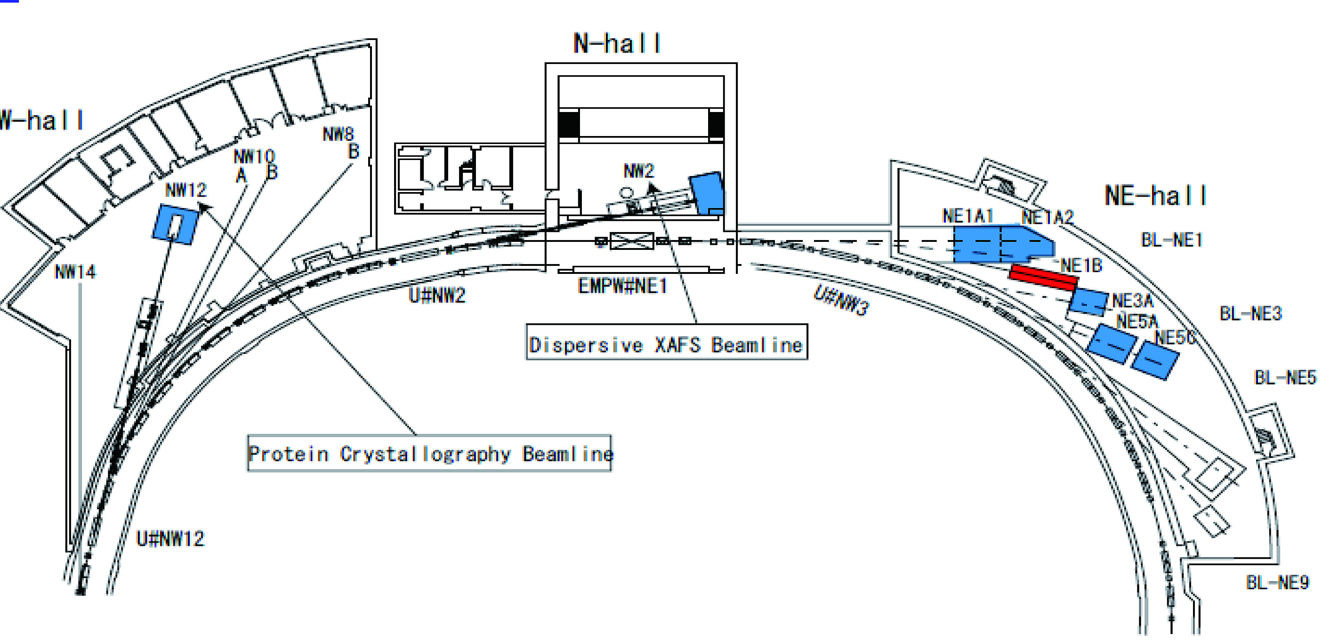
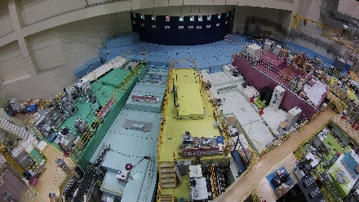
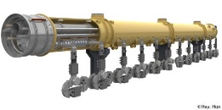
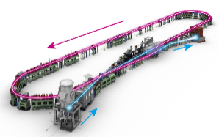

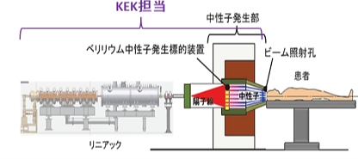
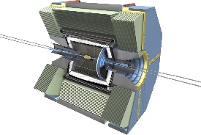
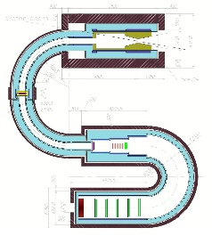
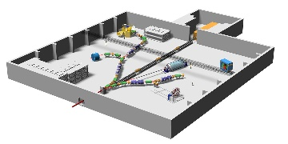
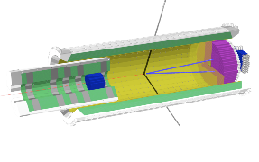
Diversity in accelerator based sciences
Pursuing fundamental laws of nature
Pursuing origin of function in materials
Basic science
Material science
and its applications
Photon factory
X-ray as a probe
KEK
Technical development
and its applications
技術の波及
J-PARC MLF
neutron and μ
as a probe
Superconducting
accelerator
T2K neutrino exp.
Energy recovery linac
SuperKEKB
and Belle II
Accelerator-
based BNCT
COMET
J-PARC
Hadron hall

Slide 5
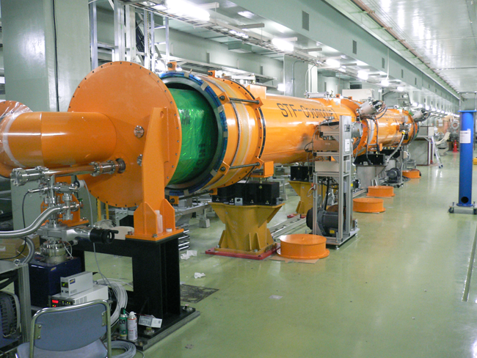
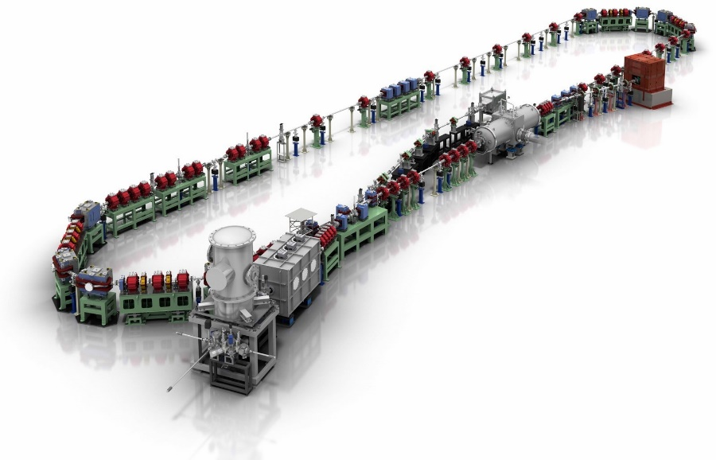
Accelerators at KEK
STF for ILC R&D
cERL
→ R&D for high current SC acc.

Slide 6
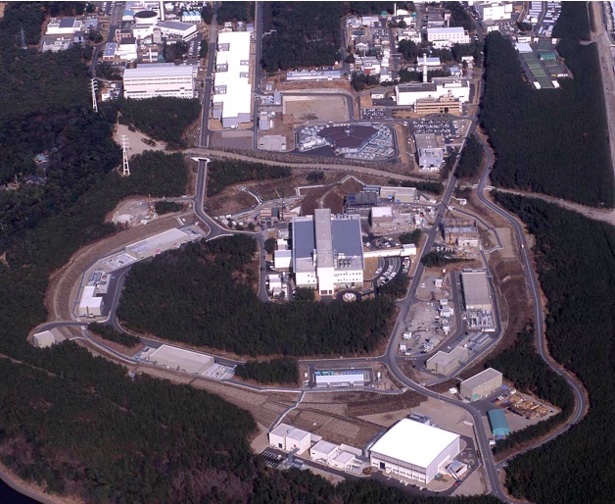





J-PARC
High Intensity Proton Accelerator Complex operated jointly by KEK and JAEA
Hadron hall:
Particle and nuclear physics experiments with
fixed target
Neutrino facility:
Neutrino beamline for T2K and upgrade
program for HyperKamiokande
MLF:
Material and life science experiments with
neutron and muon probes
3GeV RCS
ν
30GeV MR
MLF
SX beam
Hadron Hall

Slide 7
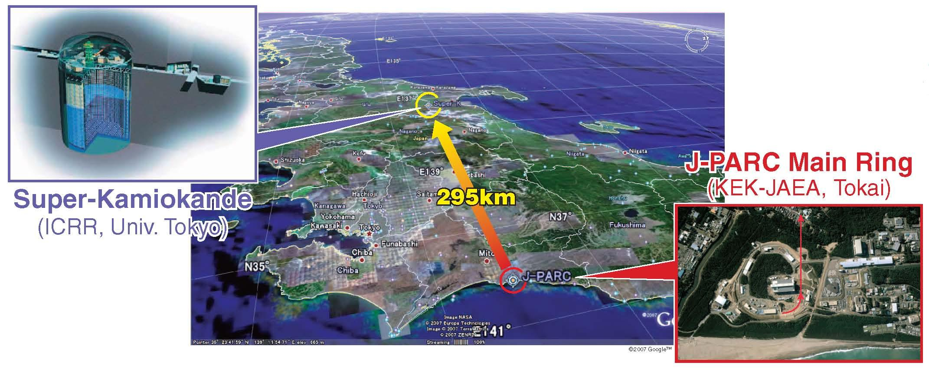
T2K (Tokai to Kamioka) experiment
2010~ (Running)
High intensity ν_{μ} beam from J-PARC MR to Super-Kamiokande
Observation of ν_{μ} → ν_{e} (2013)
Updated goals
  Precise measurement of ν_{e} appearance
  Precise meas. of ν_{μ} disappearance
  ➔ Measure CPV phase, contribution to mass hier. determ.

Slide 8











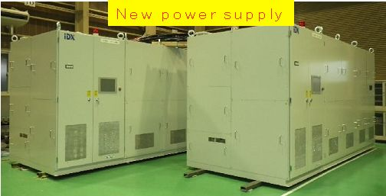

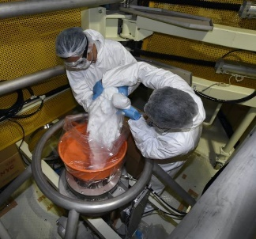
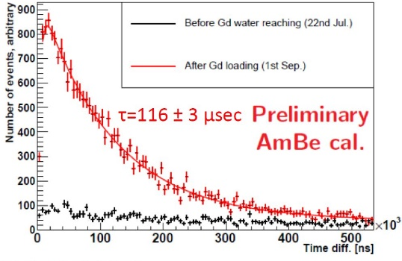
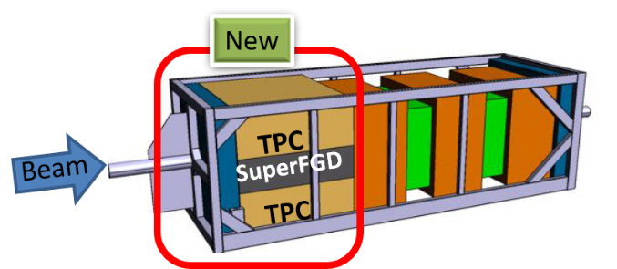
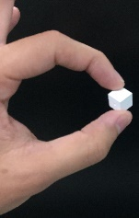
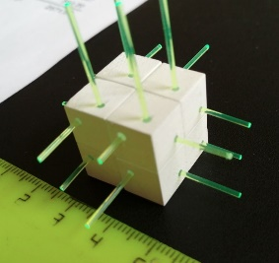
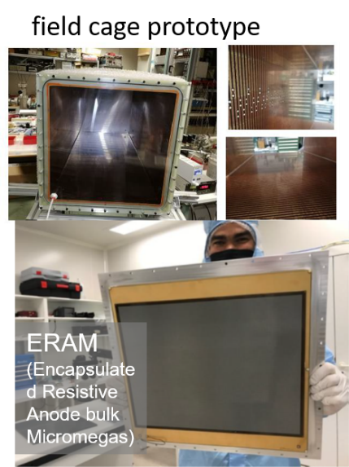
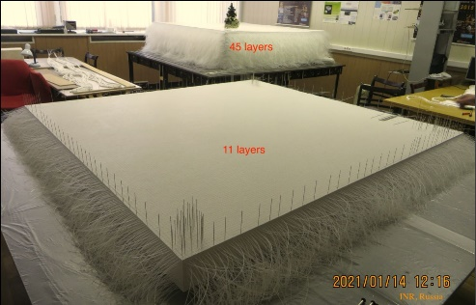
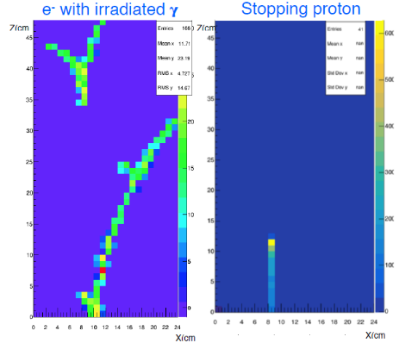
T2K upgrade is going on.
Beam power upgrade
Super-K upgrade
~500 members, 69 Institutes, 12 countries
Started measurement of
SuperK with 0.02%Gd₂(SO₄)₃ loaded for neutron tagging
Upgrade of MR power supply for doubled rep. rate will complete in 2022
Horn cooling upgrade
Near detector upgrade
Plan to complete in 2022
n-capture sig. time dist.
New Horn w/ cooling upgrade
SuperFGD
New TPC
SFGD Prototype test beam @ CERN
TPC Prototype test
4GeV electron event
(Test Beam 2019 @DESY)
Total Accumulated: 3.64×10²¹ POT = 47% of J-PARC PAC endorsement (ν:ν̅ = 54.7% : 45.3%)
2.1 million cubes were produced and assembled
(Jan.2021@INR, Russia)

Slide 9
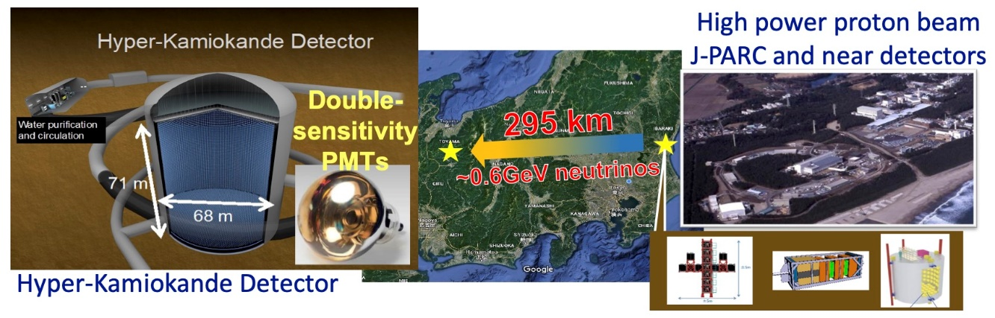


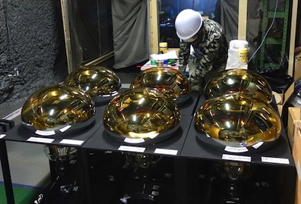
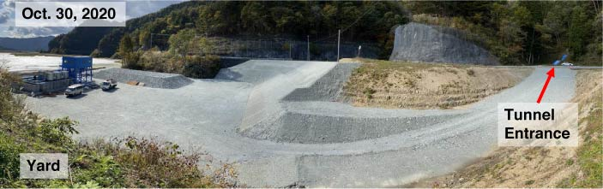



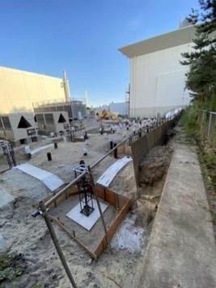
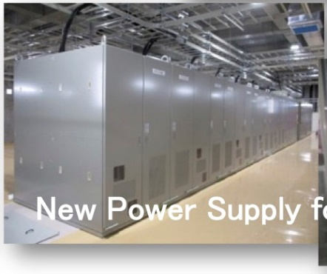
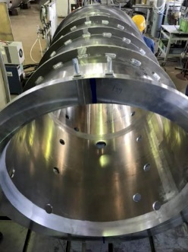
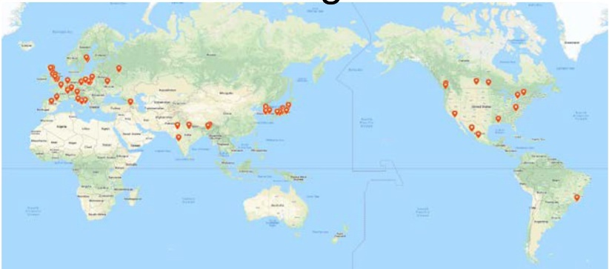
Hyper-Kamiokande (HK) project
Project
  190kt-FV Hyper-Kamiokande Detector (UT)
  Upgrade of J-PARC to 1.3MW (KEK)
Physics goals
  CPV in neutrino sector
  Search for proton decay
  Atm-nu, solar-nu and supernova nu
International project hosted by U.Tokyo & KEK
Funding approved and construction started in 2020
  Preparation of cavern excavation, production of PMTs started
  J-PARC upgrade on-going
Aiming to start operation in 2027.
Preparation for excavation
Delivered PMT for HK
Beamline facility and
component upgrade
~430 members
from 19 countries
MoU exchanged, May 25,2020

Slide 10
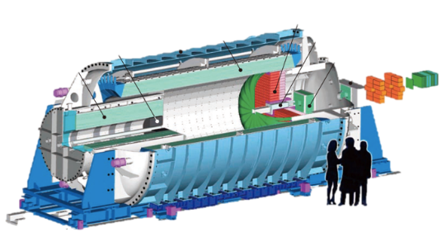
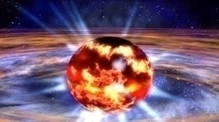

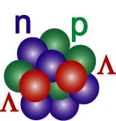

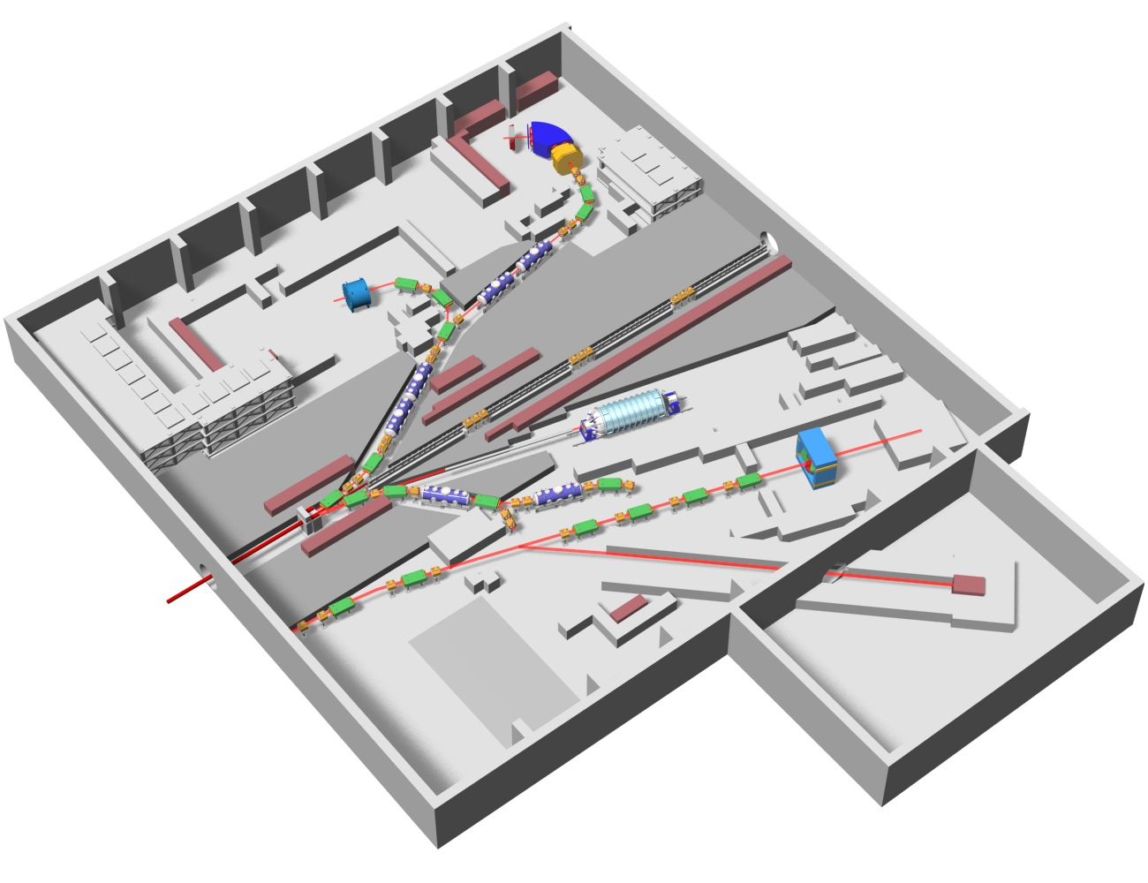
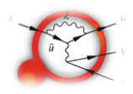

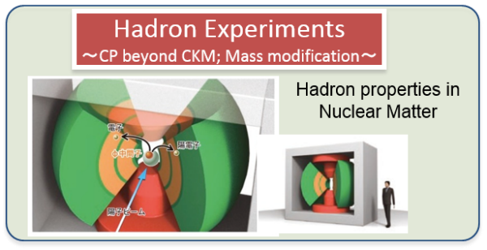
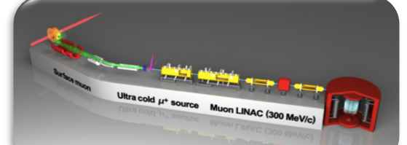
Flavor and nuclear physics at J-PARC
Hyper-nuclear physics
Neutron star
Flavor physics
KOTO to search for
COMET to search for μ to e transition
g_{μ}-2/μEDM (exp. at MLF)
Nuclear and hadron physics experiments
Hypernuclei
Hadron physics
CPV beyond CKM
Strangeness in Nuclei
30GeV p
g_{μ}-2/μEDM
COMET

Slide 11

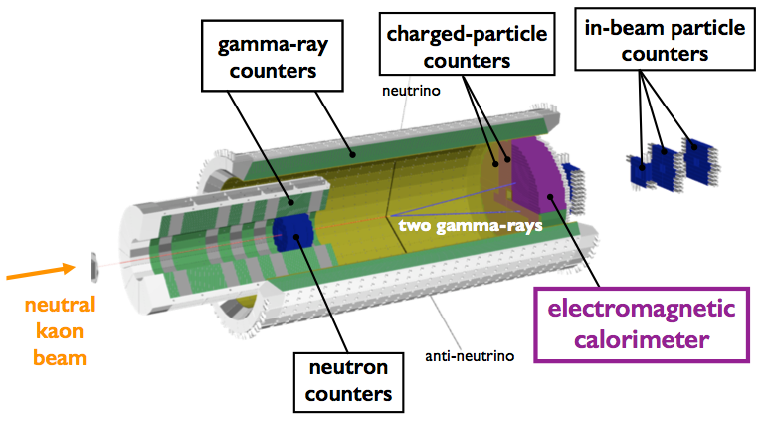
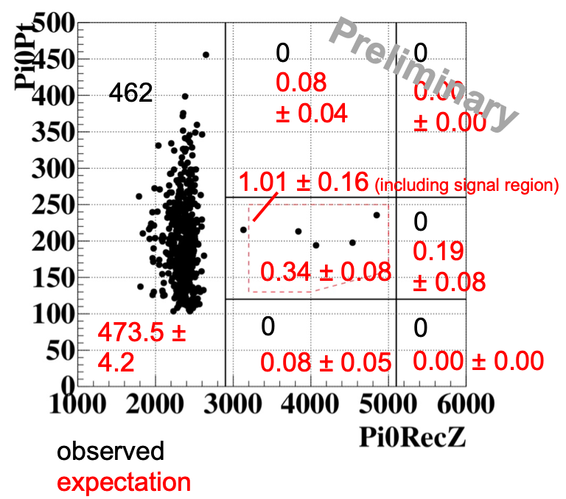
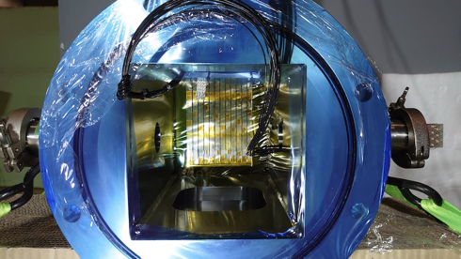
KOTO: Search for
new K⁺ counter
in 2020
transverse
momentum
(MeV/c)
four candidate events in 2016-18 data,
with the sensitivity of 7 x 10⁻¹⁰
reported
at
KAON2019,
J-PARC PAC
decay vertex position (mm)
- directly CP-breaking decay
- rare in the SM: 3.0 x 10⁻¹¹
- sensitive to New Physics,
including K_{L}→π⁰X⁰ ( light dark boson ）
Possible background from K⁺ in the KL beam
- Now measuring K⁺ flux in the KL beam
- Planning to improve the detector
to suppress
the background.
no candidate event in 2015 data;
upper limit 3.0 x 10⁻⁹ (90% CL)
US: DAQ upgrade for higher data rate

Slide 12
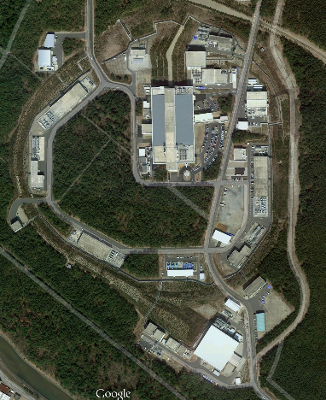
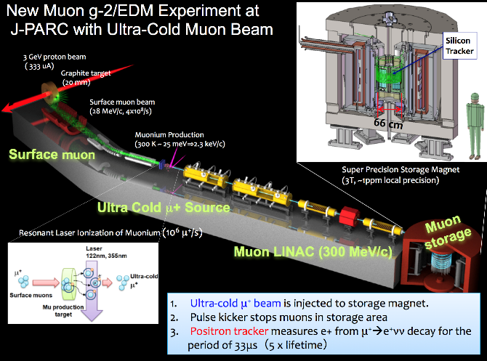
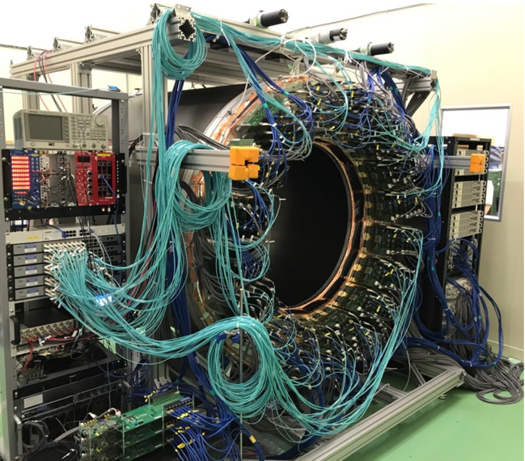
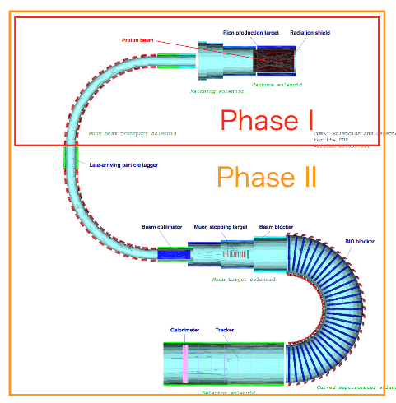
The μ program at J-PARC
COMET at Hadron hall
g-2/EDM at MLF
  Search for μ⁻+(A,Z)→e⁻+(A,Z)
  by measuring delayed monochromatic e⁻
Staging approach
  Phase-I (2022~): BR < 10⁻¹⁴
  with 8GeV 3.2kW beam x 150 days
  Phase-II: BR <10⁻¹⁶
New principle of measurement
Goal
g-2 : 0.5 ppm → 0.1 ppm
EDM:< 1.8 x 10 ⁻¹⁹ e cm ➔ 2 x 10 ⁻²¹ e cm

Slide 13
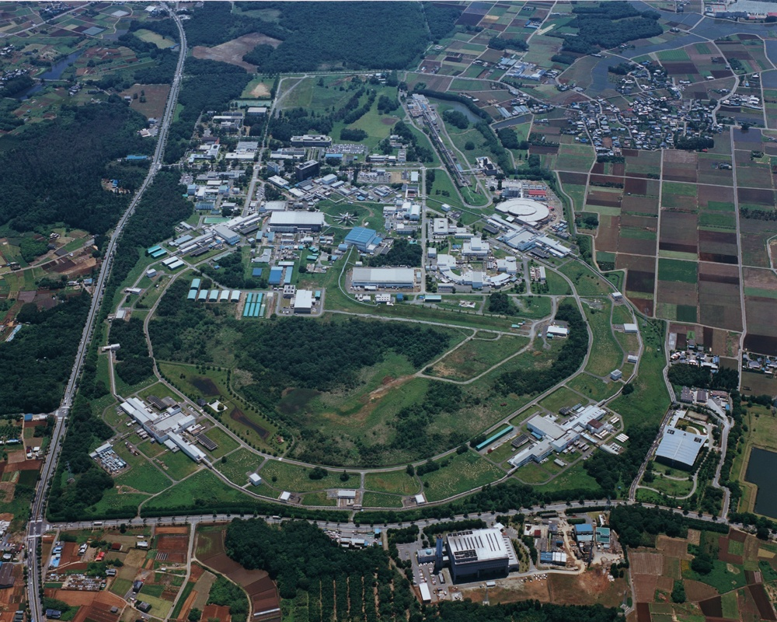
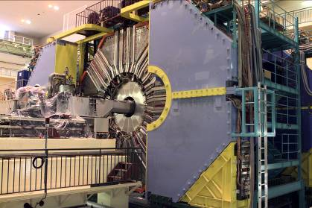
KEKB and Belle
SuperKEKB and Belle II

Slide 14

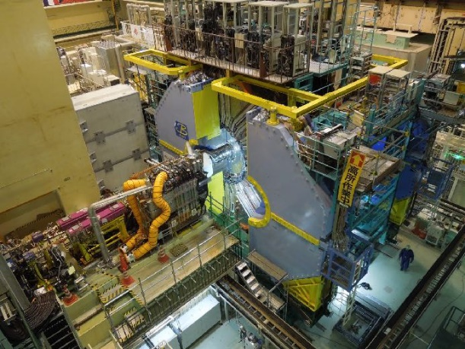




SuperKEKB and Belle II
3km circ.
e⁻($\sim 2.0$A)
Peak luminosity achieved so far
~ 2.4 x10³⁴ (World Record)
SuperKEKB
Belle II
e⁺($\sim 2.8$A)
Damping ring for low emittance positron
injection
Asymmetric e⁺e⁻ collider at ϒ(4s) with target $L\sim 6×{10}^{35}cm^{−2}s^{−1}$
$\sim {10}^{11}$B, D and τ measured with vertex reconstruction and PID
Physics run started March 2019.

Slide 15




Belle II collaboration
Belle II has grown up to be a collaboration of 1055 members from 26 countries.
↑ One of collaboration meetings
before COVID-19
← Belle II Control Room under COVID-19
More automatized, more remote system, and more dedication of local collaborators enabled highly efficient data taking.

Slide 16


Physics Potential of Belle II
Searches for NP through quantum effects in b, c, t decays give access to:
~10TeV SUSY, Extra Dimension,
Charged Higgs, Leptoquark, ...
World highest lumi, more data, more results
Searches for Dark Sector particles in clean e⁺e⁻ collisions
Instantaneous Luminosity
Integrated Luminosity
R(D) VS R(D*)
B→K^{(*)}νν
5σ discovery
3σ evidence
Re(C₇’)
R_{K}
R_{K*}
R(D*)
φ₃
Studies of Exotic 4 quark states
Z_{b}(10610)
Z_{b}(10650)
Time-Dependent CPV in b→sqq
Ultimate understanding of Unitarity Triangle

Slide 17


Physics at Belle II
>>analyses LHCb is good at
>>analyses Belle II is good at
SUSY, charged Higgs
Only electrically charged particles (muons) in the final states
Model-indep. NP
Inclusive analysis
LHCb@CERN
B gK*ll
b→ s/d γ
Belle II
Bs, Λ_{b}
Model-indep. NP
b→ u l ν
A(K π)
Bs →μμ
LUV
Neutral particles (γ, ν K_{S} etc.) in the final state
new CPV
b gsqq
B→ K_{S} π⁰ γ
SUSY, Charged Higgs
new CPV
B→h ν ν , τ ν
B→D* τν
B→D⁰ τν
D⁰ CPV
Charged Higgs
Right-handed weak interaction
LUV
tau
τ→μγ
Charged Higgs
LFV
17

Slide 18








(HL-)LHC/ATLAS Activities by KEK/Japan
Major role in maintenance and operation of TGC and silicon pixel/strip detectors
HL-LHC IP region
strip tracker long-term monitoring
Prototype of beam separation dipole in construction
TGC operation
R&D to mass-production for HL-LHC
prototype muon electronics for HL-LHC
assembly of Pixel module for HL-LHC
×10 faster, finer, rad-harder detectors for HL-LHC
prototype silicon strip sensor for HL-LHC

Slide 19


International Linear Collider
RF Distribution
ILC has been proposed by the international HEP community and recommended by European strategy, US P5, etc. Its design has been conducted by the initiative of ICFA.
Cryomodules
RF Power Source
e- Source
Damping Ring
e+ Main Linac
Item | Parameters
C.M. Energy | 500 GeV
Length | 31 km
Luminosity | 1.8 x10³⁴ cm⁻²s⁻¹
Repetition | 5 Hz
Beam Pulse Period | 0.73 ms
Beam Current | 5.8 mA (in pulse)
Beam size (y) at FF | 5.9 nm
SRF Cavity G. Q₀ | 31.5 MV/m Q₀ = 1x10 ¹⁰
250GeV
e+ Source
20 km
20km
e- Main Linac
Key Technologies
Nano-beam Technology
SRF Accelerating Technology

Slide 20



ILC development at KEK
ATF: Technology to handle nano-
size beam
STF: Technology to assemble
and operate superconducting
cavities
CFF: Technologyto manufacture
superconducting cavities
20

Slide 21



Accelerator Test Facility for ILC
Goal 1: Establish technology
for small beam
Goal 2: Stabilize beam position
Achieved 40 nm beam size equivalent to 6 nm at ILC.
Final Focus Test Beamline
Damping Ring (~140m)
Low emittance electron beam
1.3 GeV S-band Electron LINAC (~70m)

Slide 22



Superconducting Accelerator Test Facility

Slide 23
Stepwise realization of ILC
IDT is formed under ICFA. KEK serves as its host.
Stage 1 International Development Team (~1.5 years)
ILC Pre-Lab. is established by MOU’s among the laboratories.
Stage 2 ILC Pre-Laboratory (4 years)
ILC Lab. is established by governmental agreement.
Stage 3 ILC Laboratory (10 years for construction)
Stage 4 Experiment at ILC!

Slide 24














Symphonic use of photon, neutron, and muon
KEK・Institute of Materials Structure Science
Structural Biology Research Center
Condensed Matter research Center
Photon
Neutron
Muon
Positron
Tsukuba Campus
Tokai Campus
Photon &
slow positron
at PF and PF-AR
Neutron & muon
at J-PARC
Slow positron
Surface structure
Muon
Comprehensive understanding
of materials structure
Synchrotron
Local magnetic moment
Crystal structure
Electronic structure
Neutron
Magnetic structure
Excitations

Slide 25




Industrial application of superconducting accelerator
Next generation lithography with EUV-FEL
cERL
20MeV x 10mA
Bio-ethanol production from wood
⁹⁹Mo production
-> ^{99m}Tc
High purity ⁹⁹Mo was extracted in the initial test.
Collaboration with AIST

Slide 26
Summary and Conclusions
Particle physics program at KEK
  Long baseline neutrino program at J-PARC/SuperKamiokande
  Flavor physics at J-PARC: K_{L} and μ
  High precision measurements of B, D and τ decays with SuperKEKB and Belle II
  >100 Japanese physicists are involved in ATLAS. KEK takes a role of supporting them.
KEK is also working on next step in particle physics.
  Upgrade of J-PARC MR for HyperKamiokande
  Contribution to HL-LHC and the ATLAS upgrade
We have a strong hope to play a leading role in realizing ILC!

