Slide 1
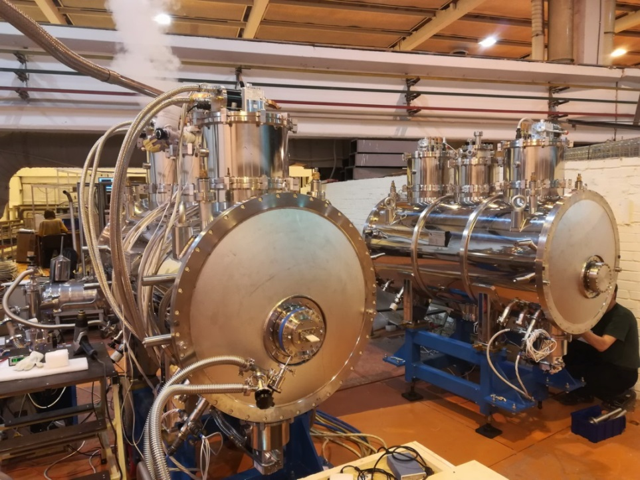
Cryogenic system of superconducting wigglers and undulators developed by BINP
Shkaruba Vitaliy
On behalf of the SuperConduction ID Laboratory
Budker Institute of Nuclear Physics, Novosibirsk
16.03.2021, AFAD, BINP

Slide 2
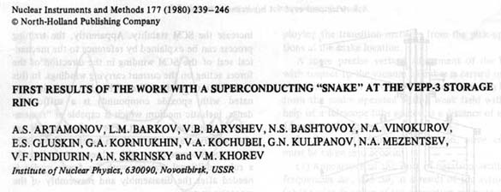
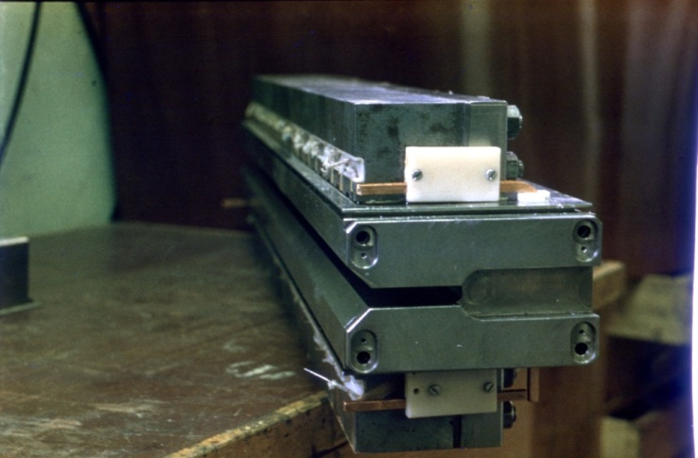
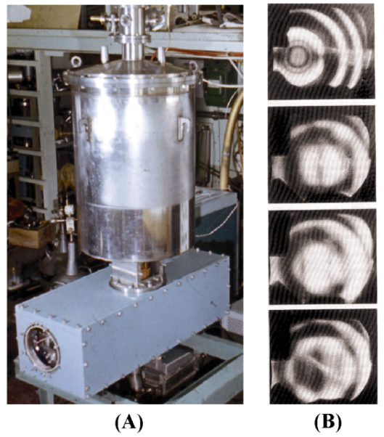
Cryogenic system of superconducting wigglers and undulators
Superconducting ID is multi-pole magnet (wigglers and undulators), which are inserted into the straight section of the storage ring to generate synchrotron radiation.
The first SC 20-pole 3.5 T wiggler with the period of 90 mm was installed on the 2 GeV storage ring VEPP-3 in 1979.
The main parameters of first SCW:
Pole number | 20
Pole gap, mm | 15
Period, mm | 90
Magnetic field amplitude, T | 3.5
Vertical beam aperture, mm | 7.8
Photo of the wiggler magnet
The wiggler cryostat with using of liquid nitrogen and liquid helium consumption of ~ 4 l/h.
The wiggler cryostat with magnet
Design of the wiggler cryostat
16.03.2021, AFAD, BINP
2/18

Slide 3
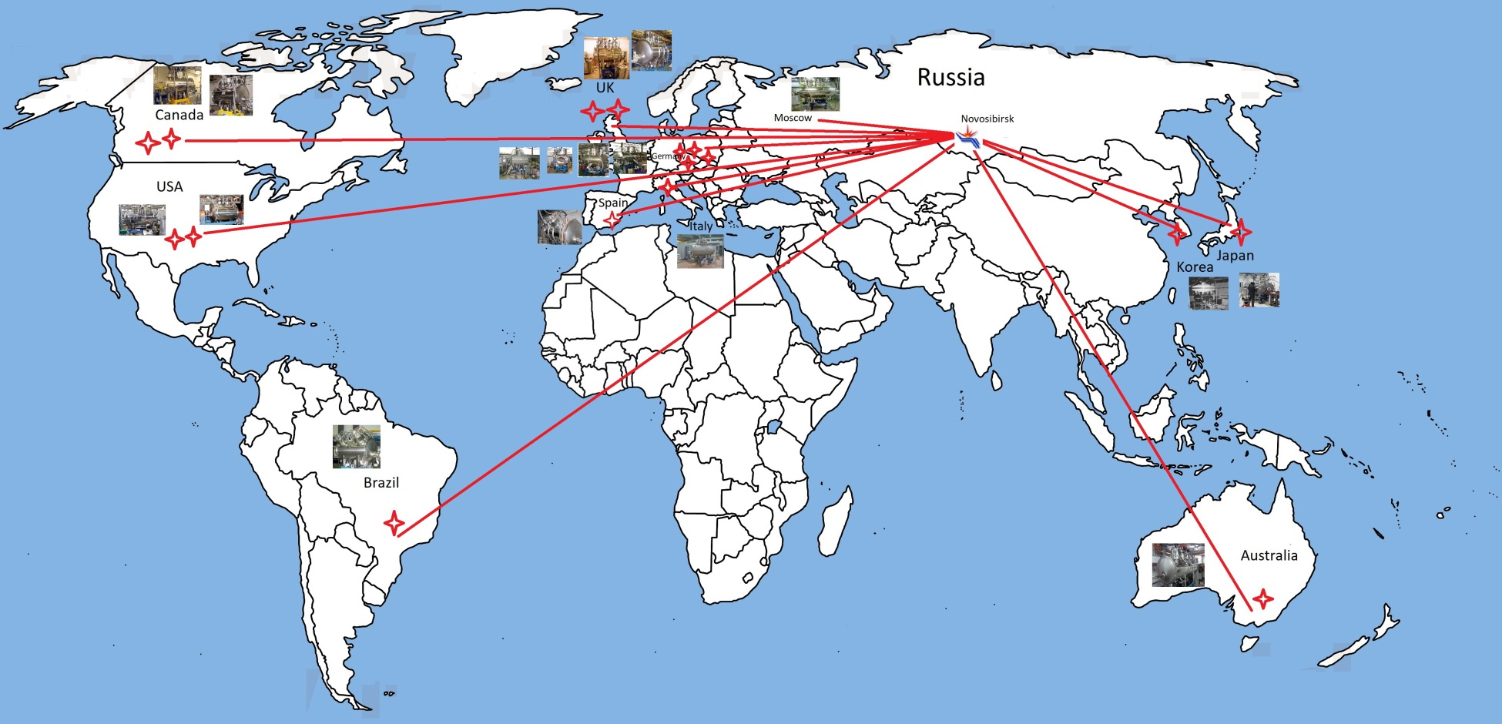
Cryogenic system of superconducting wigglers and undulators
Since 1995 > 20 SC ID was created in BINP for more then 10 SR sources:
16.03.2021, AFAD, BINP
3/18

Slide 4
Cryogenic system of superconducting wigglers and undulators
SC ID created in BINP for SR sources:
Storage ring, location | Year | Magnetic field, (B_{Max}) B_{work}, T | Poles number (main + side) | Pole gap/beam gap, mm | Period mm | LHe consumption, l/hour
3.5T wiggler BINP, Russia | 1979 | 3.5 | 20 | 15 | 90 | 4
7.0T shifter PLS, Korea | 1995 | (7.68) 7.5 | 1+2 | 48(26) | - | 2
7.0T shifter LSU-CAMD, USA | 1998 | (7.55) 7.0 | 1+2 | 51(32) | - | 1.5
10.0T shifter SPring-8, Japan | 2000 | (10.3) 10.0 | 1+2 | 40(20) | - | 0.6
7.0T shifter BESSY-II, Germany | 2000 | (7.5) 7.0 | 1+2 | 52(32) | - | 0.6
7.0T shifter BESSY-II, Germany | 2001 | (7.5) 7.0 | 1+2 | 52(32) | - | 0.6
7.0T wiggler BESSY-II, Germany | 2002 | (7.67) 7.0 | 13 + 4 | 19(13) | 148 | 0.5
3.5T wiggler ELETTRA, Italy | 2002 | (3.7) 3.5 | 45 + 4 | 16.5(11) | 64 | 0.4
2.0T wiggler CLS, Canada | 2005 | (2.2) 2.0 | 61 + 2 | 13.5(9.5) | 34 | <0.03
3.5T wiggler DLS, England | 2006 | (3.75) 3.5 | 45 + 4 | 16.5(11) | 60 | <0.03
7.5T wiggler SIBERIA-2, Russia | 2007 | (7.7) 7.5 | 19 + 2 | 19(14) | 164 | <0.03
4.2T wiggler CLS, Canada | 2007 | (4.34) 4.2 | 25 + 2 | 14.5(10) | 48 | <0.03
4.2T wiggler DLS, England | 2009 | (4.25) 4.2 | 45 + 4 | 13.8(10) | 48 | <0.03
4.1T wiggler LNLS, Brazil | 2009 | (4.19) 4.1 | 31 + 4 | 18.4(14) | 60 | <0.03
2.1T wiggler ALBA-CELLS, Spain | 2009 | (2.27)2.1 | 117 + 2 | 12.6(8.5) | 30 | <0.03
4.2T wiggler AS, Australia | 2012 | (4.5) 4.2 | 59+4 | 15.2(10) | 50.5 | <0 (0.7 bar)
7.5T wiggler CAMD LSU, USA | 2013 | (7.75) 7.5 | 11+4 | 25.2(15) | 193.4 | <0 (0.5 bar)
2.5T wiggler KIT, Germany | 2013 | (2.85) 2.5 | 36+4 | 19(15) | 46.9 | <0 (0.3 bar)
7T wiggler DELTA, Germany | 2018 | (7.25) 7.0 | 18+4 | 16.5(10) | 128 | <0 (0.2 bar)
16.03.2021, AFAD, BINP
4/18

Slide 5
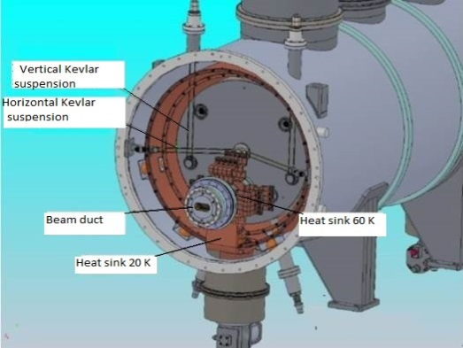
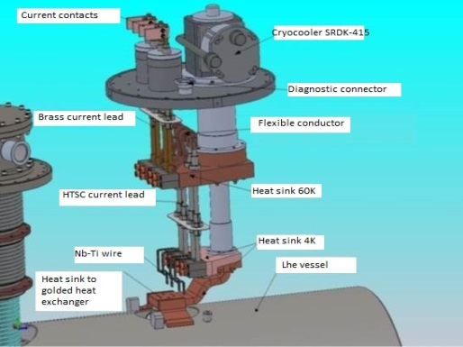
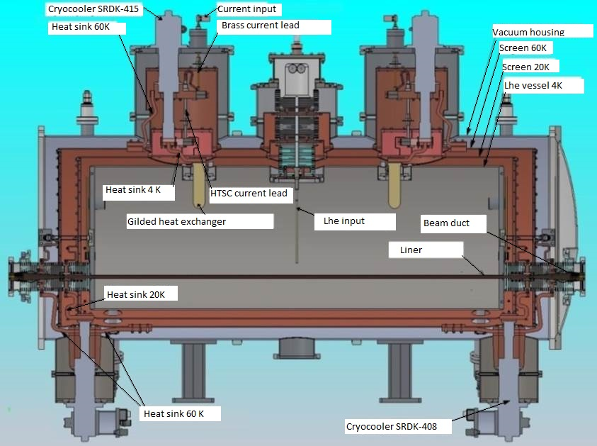
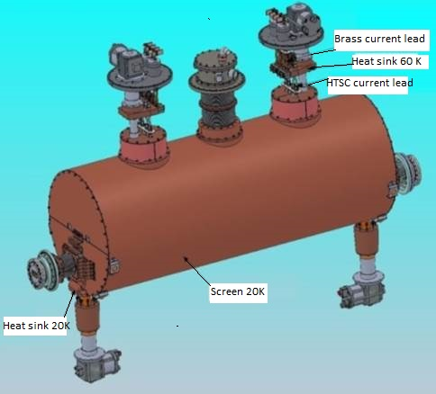
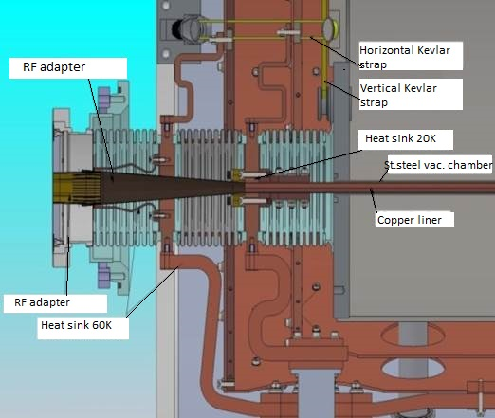
Cryogenic system of superconducting wigglers and undulators
Cryogenic system of CSW with zero LHe consumption
Specificity of SCW cryostat:
Additional heat load from image currents from electron beam and SR; While it is necessary to increase magnetic gap for lower heat load and to decrease gap for high field;
Main concept: Complete interception of heat in-leaks to Lhe in critical points onto 60K, 20K and 4K cryo-coolers stages to prevent Lhe evaporation;
Kevlar suspensions
(power to Lhe ~10 mW)
Power inleak from outside ~0.3W
Power of Joule heating ~0.3W
Cross-section of zero boil off cryostat for SCW
Radiation screens 20K and 60K with superinsullation (power to Lhe ~10 mW),
Total cooling power at 60K ~180W
Power inleak through bellows ~ 40mW
16.03.2021, AFAD, BINP
5/18

Slide 6
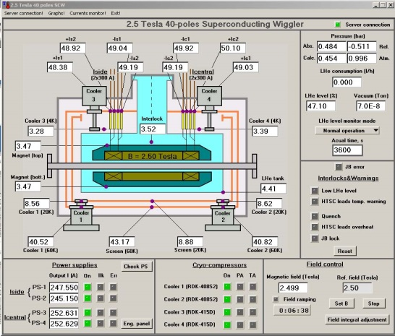
Cryogenic system of superconducting wigglers and undulators
Cryogenic system of CSW with zero LHe consumption
Heat budget of zero boil off cryostat for SCW:
 | Outer screen (60 K), W | Inner screen (20 К), W | Lhe vessel (4 К), W
Thermal radiation | 8 | 0.05 | 0.0002
Central throat | 2.5 | 0.3 | 0.06
Bellows of vacuum chamber | 5.3 | 0.25 | 0.04
Suspension system | 0.5 | 0.1 | 0.01
Current leads (thermal conductivity) | 50 | 0 | 0.3
Current leads (Joule heating) | 50 | 0 | 0.3
Diagnostic wires | 5 | 0.1 | 0.01
Liner | 10 | 10 | 0.2
Total | 131.3 | 10.8 | 0.92
Cooling power | 180 (at 50 К) | 15 (at 20 К) | 3 (at 4.2 К)
Temperature distribution at zero boil off cryostat
Heat budget: The total cooling power of all cryocooler stages exceeds the corresponding heat inleaks;
The cooling power of 4K stages exceeds (in factor 3) the heat inleaks. Excess power capacity goes to the overcooling of helium vessel with SC magnet and a decrease pressure relative to the atmosphere;
Prevention of helium losses during a quench due to additional buffer volume, recondensation and increase of LHE level in SCW cryostat.
Save compressor life due to minimal heat load.
Overcooling of Lhe down to ~3K and shifting of field-current parameters of SC Nb-Ti wire (for tens of amperes) give the opportunity to increase magnetic field on ~ 5 %.
16.03.2021, AFAD, BINP
6/18

Slide 7
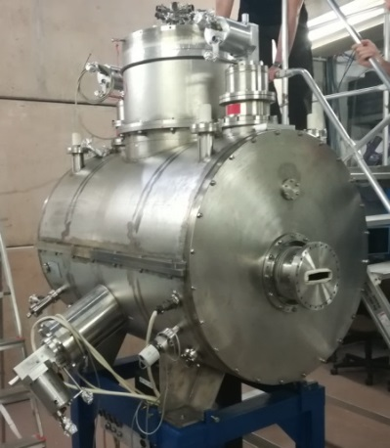
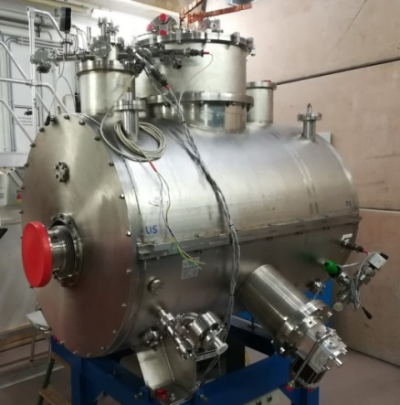
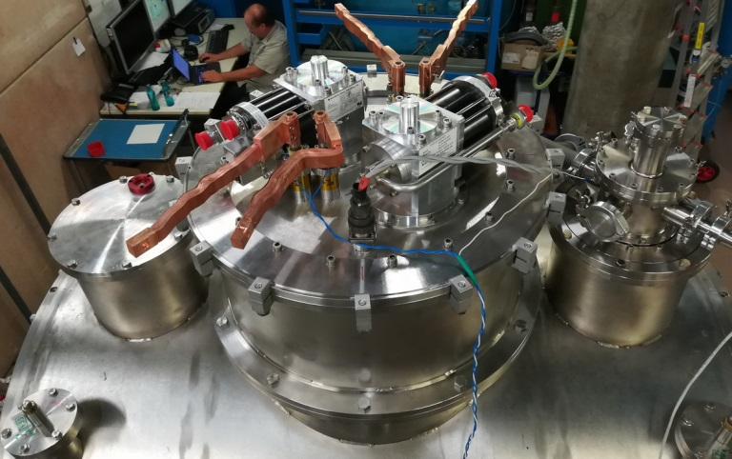
Cryogenic system of superconducting wigglers and undulators
Upgrade of Cryogenic System of BESSY-II WLSs for zero LHe consumption (2018):
In BESSY-II are operated two 7T WLS (created in 2000) with Lhe consumption of~1 l/h.
Upcoming BESSY VSR Upgrade (Variable Storage Ring) implies shortening of bunch length and therefore increasing heating of beam pipe of WLS by image currents.
To meet the requirement of short beam and to extend the life time of IDs it was carried out the upgrade of cryogenic system for zero LHe consumption.
Upgrade experience: LSU-CAMD 7T WLS (2009), HMI 7T MPW (2012), ELETTRA 3.5T MPW (2012), two DLS MPW (2011). But it was transferred only the magnet to Novosibirsk and returned inside of new cryostat;
Upgrade was curried out directly on BESSI site during shutdown to save users time;
The idea: use maximum of old WLS details with complete re-arrangement of key elements.
Upgrade of Cryogenic System of BESSY-II WLSs for zero LHe consumption:
BESSY WLS 2000
BESSY WLS 2019
16.03.2021, AFAD, BINP
7/18

Slide 8
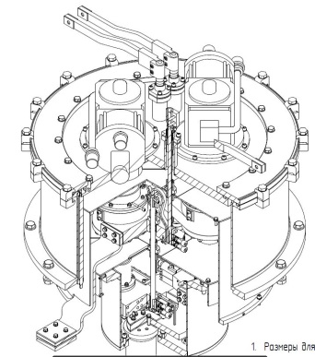
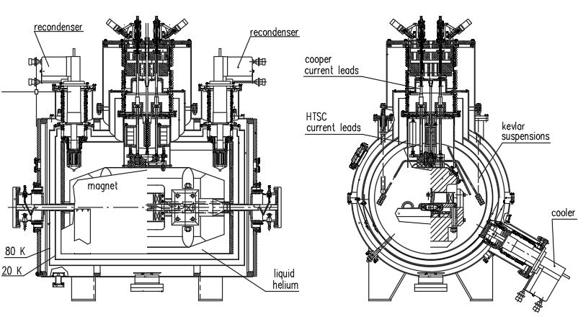
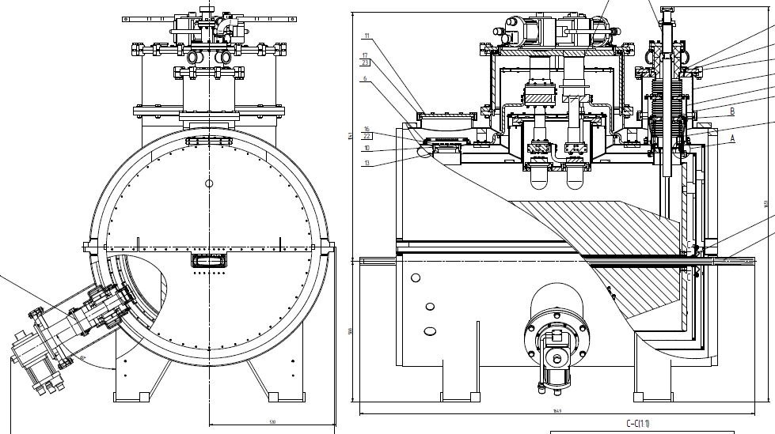
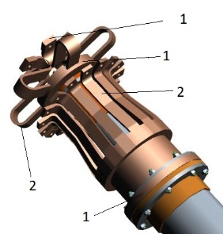
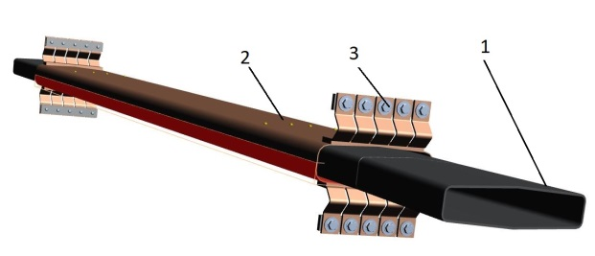
Cryogenic system of superconducting wigglers and undulators
Upgrade of Cryogenic System of BESSY-II WLSs for zero LHe consumption:
The upgrade included:
Moving of Current Leads (the main source of heating) from helium vessel to safety vacuum;
Installation of gilded 4K heat exchanger to Helium vessel;
Replacement of cryocooler from Leybold 1W with Sumitomo 1.5W;
New Stainless beam vacuum chambers covered by copper for decrease image currents heating;
Completely new thermo sensors and monitoring system.
16.03.2021, AFAD, BINP
8/18

Slide 9
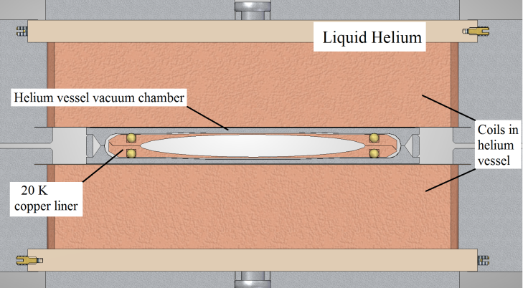
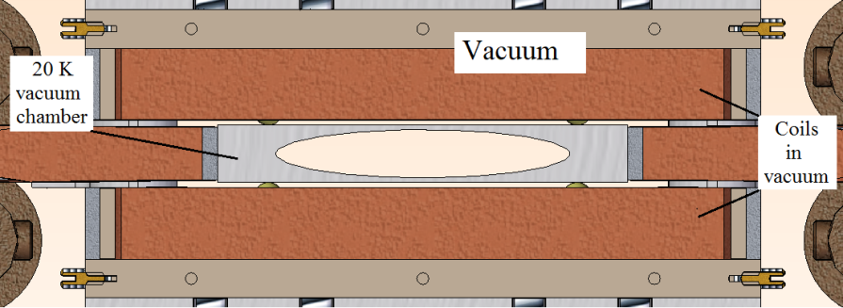
Cryogenic system of superconducting wigglers and undulators
Indirect cooling magnets:
Magnetic gap of SCW magnet immersed to Lhe has large size (inside of gap are placed beam chamber and vacuum chamber of helium vessel simultaneously).
Removing one of the vacuum chamber (wall of helium vessel) - the possibility to increase of magnetic field level due to decreasing of the magnetic gap.
Cross-section of SCW magnet
immersed to LHe
Cross-section of SCW magnet
with indirect cooling
16.03.2021, AFAD, BINP
9/18

Slide 10
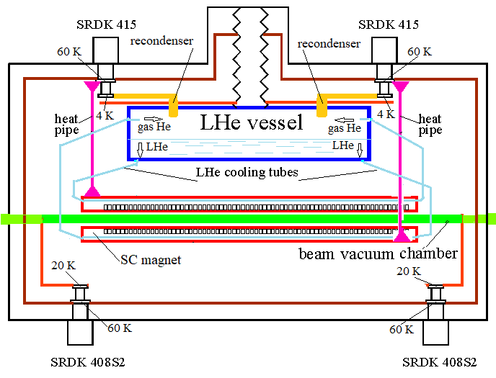
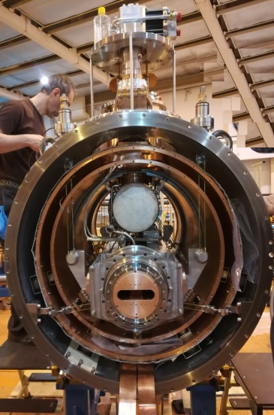
Cryogenic system of superconducting wigglers and undulators
Indirect cooling magnets:
The SC magnet is located in vacuum and are cooled with Lhe circulating through the inner channels inside of the magnet body.
Helium is cooled and re-condenses by 4K heat exchangers inside of closed small helium vessel located in vacuum of the cryostat outside the magnet.
Full interception of heat in-leaks to cryostat in the critical points onto 60K, 20K and 4K cryo-coolers stages prevent LHe evaporation.
Vacuum chamber is cooled by 20 K stages and can remove the heat power ~ 20 W from beam heating (by SR and image currents)
Assembling of indirect cooling SCW for KSRS, (March 2019)
16.03.2021, AFAD, BINP
10/18

Slide 11
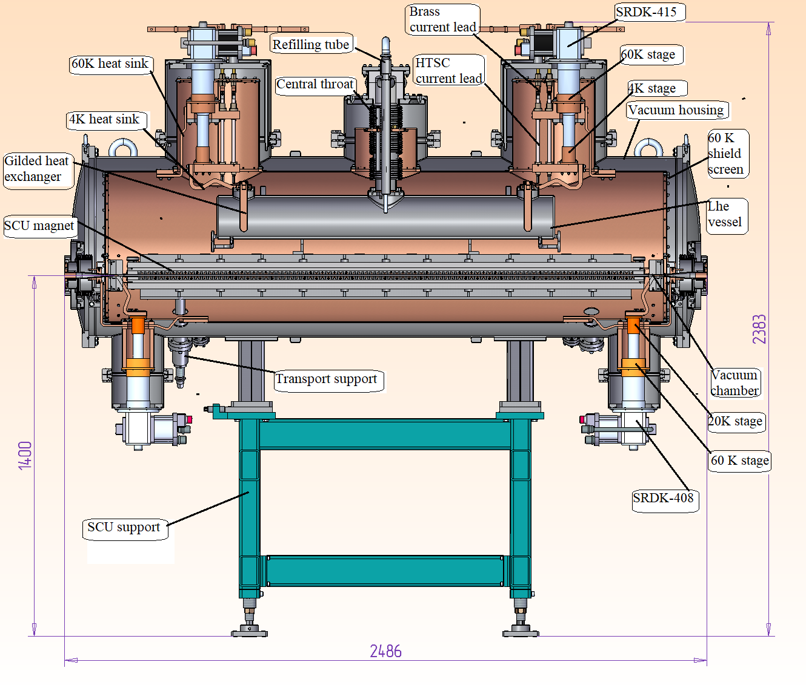
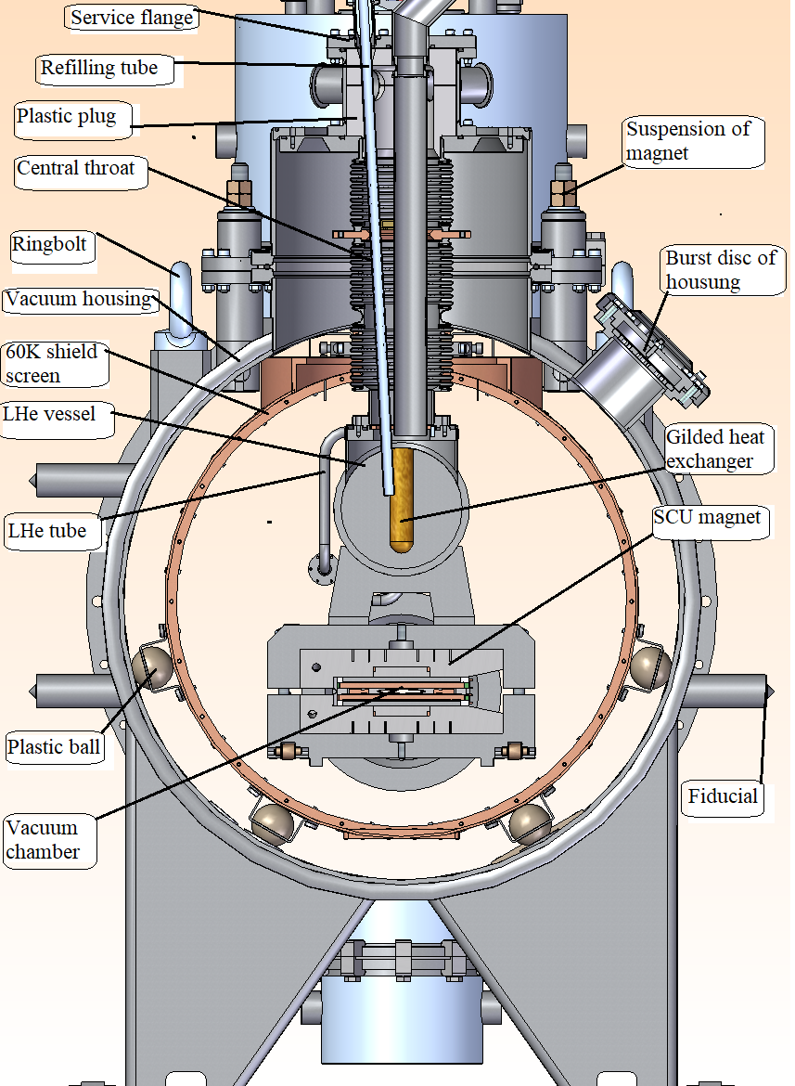
Cryogenic system of superconducting wigglers and undulators
Indirect cooling magnets
16.03.2021, AFAD, BINP
11/18

Slide 12
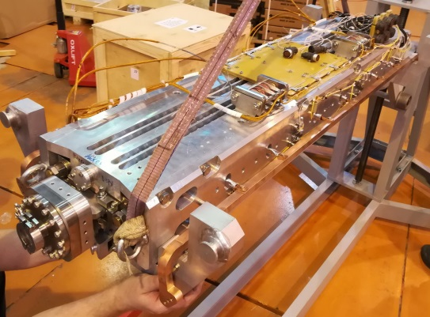
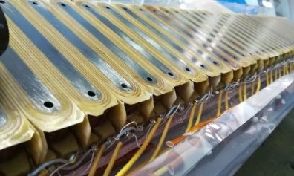
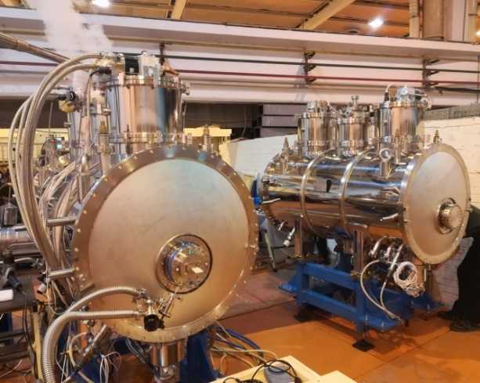
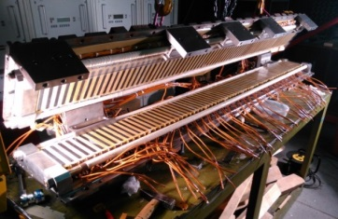
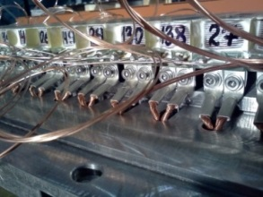
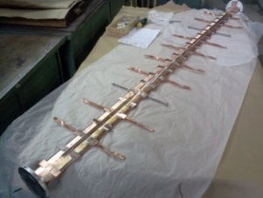
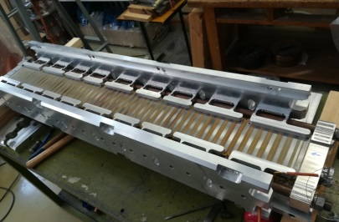
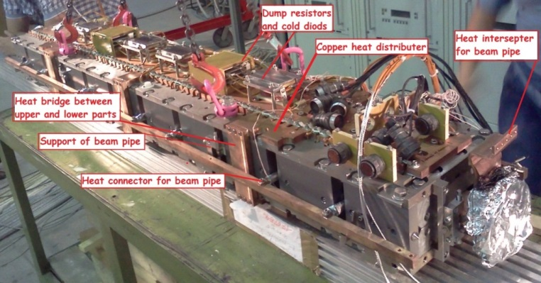
Cryogenic system of superconducting wigglers and undulators
Indirect cooling magnets
Storage ring, location, year | CLIC dumping ring (ANKA, Germany), 2015 | Kurchatov SRS, Moscow, 2019
Magnetic Field, T | 3 | 3.5
Period, mm | 51 | 48
Magnetic gap, mm | 18 | 14
Vacuum gap, mm | 13 | 10
Number of poles | 68+4 | 50+4
Cold mass, kg | 700 | 700
Ramping time, min | < 5 | <5
Beam heat load (acceptable), W | 50 | 50
72-pole indirect cooling 3Tesla wiggler for CLIC dumping ring (2015)
54-pole indirect cooling 3.5Tesla wiggler for KSRS, (March 2019)
16.03.2021, AFAD, BINP
12/18

Slide 13
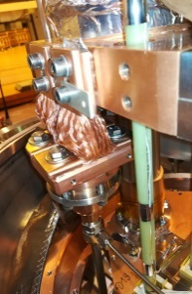
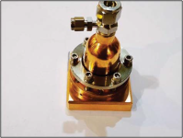
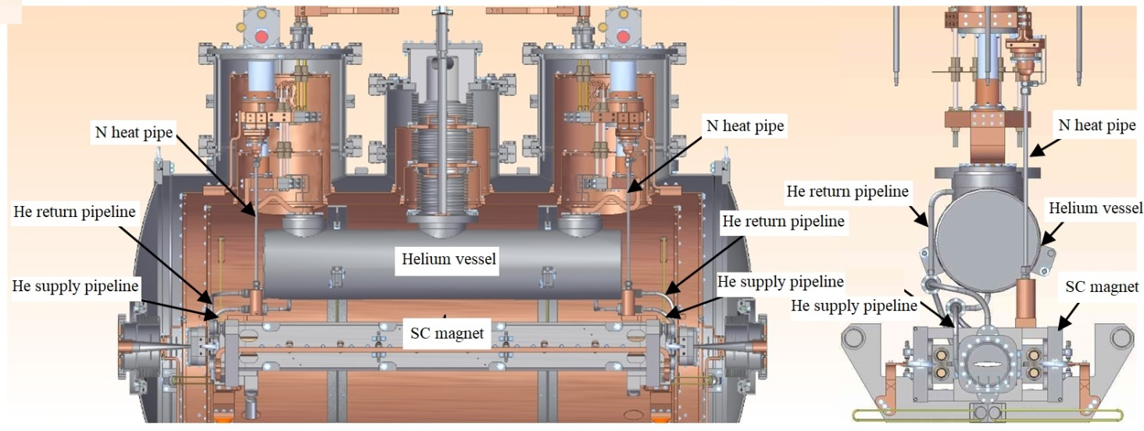
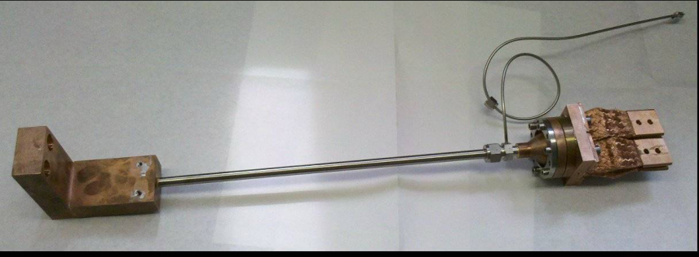
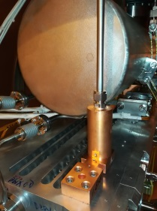
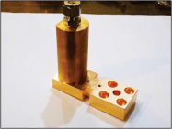
Cryogenic system of superconducting wigglers and undulators
Indirect cooling magnets: Precooling down of SC magnet with N2 thermo- siphon heat pipe
Nitrogen thermo- siphon heat-pipe is used as heat conductor between 60K stage of the cryo-coolers and the magnet.
Heat-pipe consists of recondenser (attached to 60k stage), evaporator (on SC magnet), transport tube with nitrogen ~100 bars at room temperature and two phase nitrogen at low temperature.
The heat pipe is operated as a “thermal switch” and automatically disconnected from magnet at nitrogen freezing point (64K).
Maximal extracted power ~100W for one pipe. It takes ~ 5 days to cool the ~ 1000 kg magnet down to LHe temperature.
Additionally appears the possibility not use Lhe from Dewar during cooling down. Gas helium is sucked into helium vessel from Dewar or from a cylinder during cooling down process, cooled here and begins to liquefy and accumulate automatically.
Recondenser
Transport
tube
Design of indirect cooling system cryostat
Evaporator
16.03.2021, AFAD, BINP
13/18

Slide 14
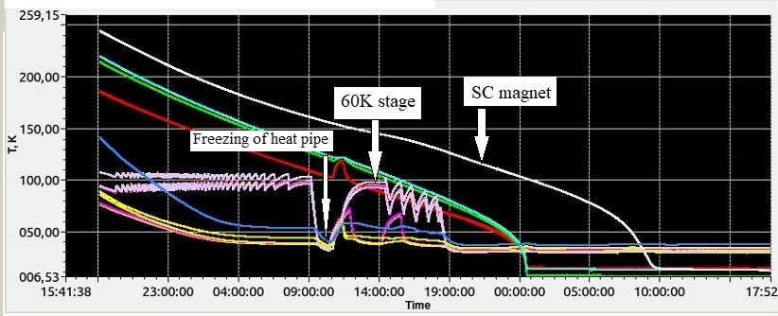
Cryogenic system of superconducting wigglers and undulators
Indirect cooling magnets: Precooling down of SC magnet with N2 thermo- siphon heat pipe
The problem: High cooling power of all four 60K stages (~200W) leads to early freezing of Nitrogen. For prolongation of cooling needed to heat 60K stages to melt N2.
Heating with resistors is not convenient;
New approach: automatically switch off and on the compressors of cryocoolers for heating for heating of 60 K stages.
16.03.2021, AFAD, BINP
14/18

Slide 15
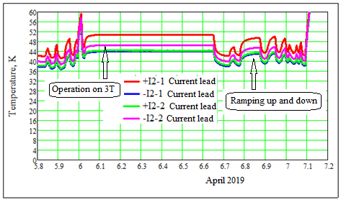
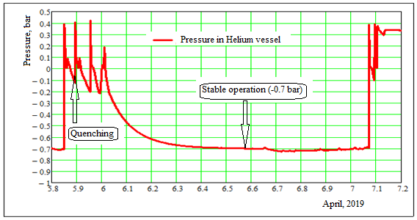
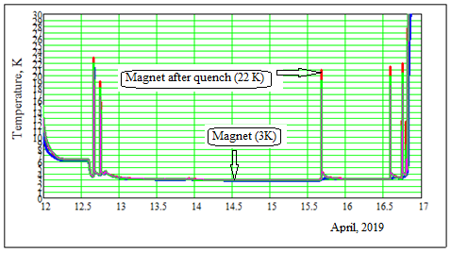
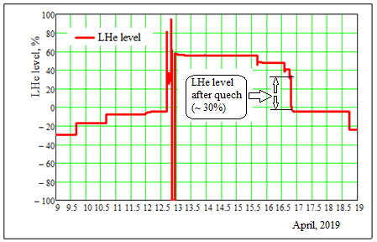
Cryogenic system of superconducting wigglers and undulators
Performance of cryogenic system of indirect cooling magnets
Test results of SC indirect cooling wigglers in Kurchatov SRS (2019)
Temperature behavior of current leads (36K – without current, 52K – stable operation on 3 T)
Pressure in helium vessel behavior (reduced relative to external pressure -0.7 Bar )
Temperature behavior SC magnet (~ 3K – stable operation on 3 T, increase up to 22 K after quench)
Lhe level behavior (~ 30% for one quench)
16.03.2021, AFAD, BINP
15/18

Slide 16
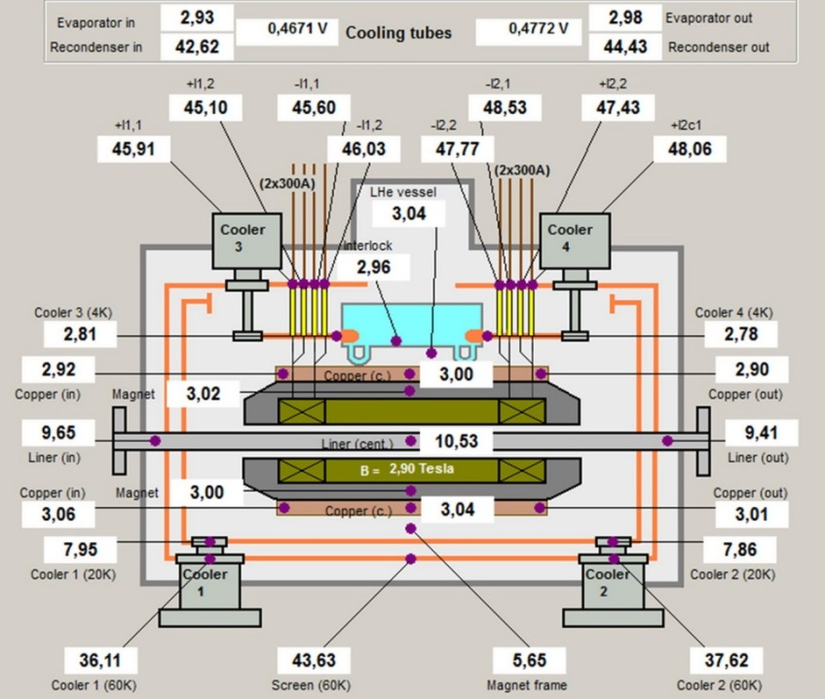
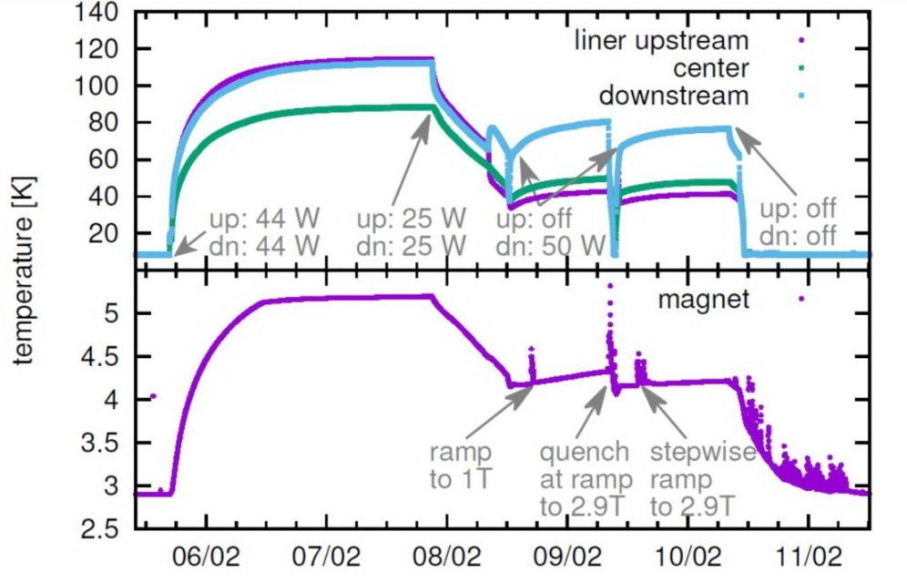
Cryogenic system of superconducting wigglers and undulators
Performance of cryogenic system of indirect cooling magnets
Test results of SC indirect cooling wigglers for CLIC (2016)
The minimal temperature reaches ~3K on the magnet and ~10K on the beam pipe.
In the damping rings the heat load from synchrotron radiation on beam pipe from upstream wigglers expected up to ~50W.
So heat load test with ~90W was conducted by simulation of heating using resistive heaters attached to the beam pipe.
The temperature was stabilized at ~100 K at beam pipe and ~5K at the magnet (with full field and without quench)
- Temperature on beam pipe and on magnet during of heat load test. (A. Bernhard et al, ProcIPAC-2016)
Temperature distribution of indirect cooled CLIC dumping wiggler prototype (the field of 2.9T )
16.03.2021, AFAD, BINP
16/18

Slide 17
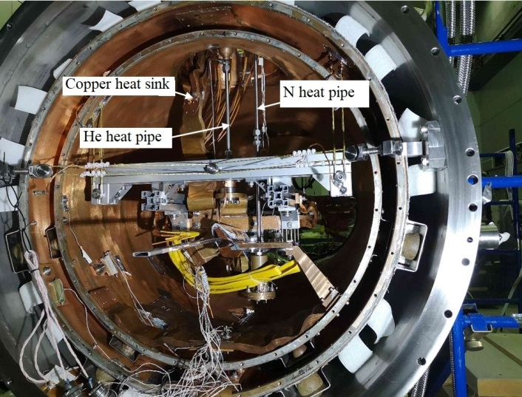
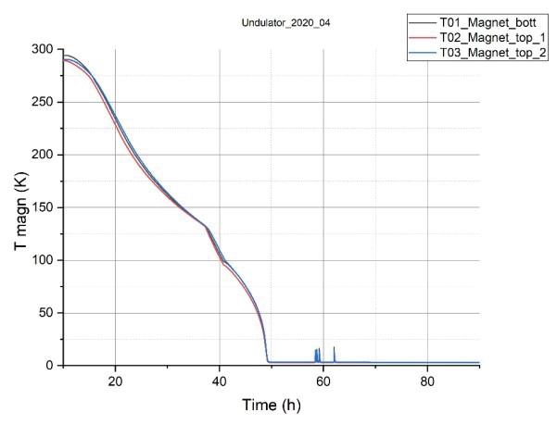
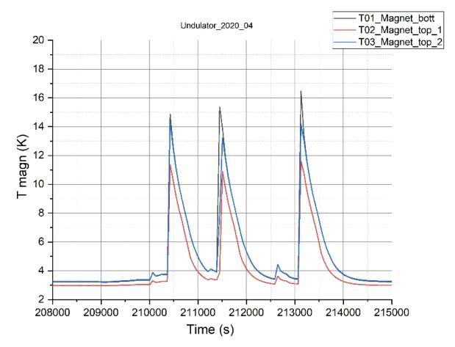
Cryogenic system of superconducting wigglers and undulators
Indirect cooling system with completely excluded liquid helium.
It is used He heat pipe connected magnet to 4 К cryocooler stage.
It is used 3 cooling line simultaneously:
N heat pipe for pre-cooling magnet from а room temperature down to 64 K
He heat pipe
Additional copper heat sink in parallel to He heat pipe improves the cooling efficiency at a temperature low than 64 K after the nitrogen cooling system is switched off. Then the temperature of the magnet decreases, the efficiency of copper heat sink goes down but He heat pipe comes into operation.
Experimental cryostat prepared for testing with undulator prototype
Cooling down of 90 kg undulator prototype using nitrogen and helium heat pipes during ~ 48 hours.
Recovery of magnet temperature after quench from 16 K down to 3K for ~ 10 min.
16.03.2021, AFAD, BINP
17/18

Slide 18
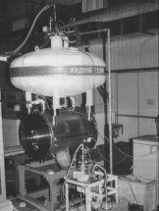
7.5 PLS-WLS,
Korea, 1995
10.3 T Spring-8 WLS,
Japan , 1999
7.5 T PSF- WLS,
BESSY-II, Germany, 2002
7.5 T LSU-CAMD WLS,
USA, 1998
7.5 T BAM- WLS,
BESSY-II, Germany, 2000
BESSY, Germany, 2002,
17-poles,7.5 T
CLS,Canada,2004
63-pole 2 T
Moscow, Siberia-2, 2007
21-pole 7.5 T
ELETTRA,Italy,2002
49-pole 3.5 T
DLS,England,2006
49-pole 3.5 T
CLS,Canada,2007
27- poles 4 T
LNLS, Brazil,2009
35-pole 4.2 T
AS, Australia, 2012
63-pole 4.2 T
DLS, England,2008
49-pole 4.2 T
ALBA, Spain, 2010
119-pole 2.1 T
LSU-CAMD,USA, 2013
15-pole 7.5 T
ANKA-CATACT, Germany,
2013, 40-pole 2.5 T
DELTA,Germany, 2018,
22-poles,7 T
Thanks for attention
16.03.2021, AFAD, BINP
18/18

