Slide 1
Innovative accelerator techniques in Novosibirsk
Konstantin Lotov
Budker Institute of Nuclear Physics
Novosibirsk State University
Institute of Laser Physics

Slide 2
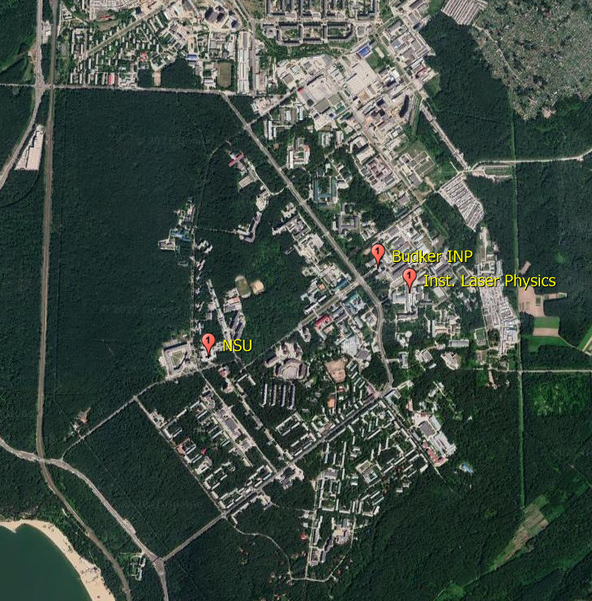
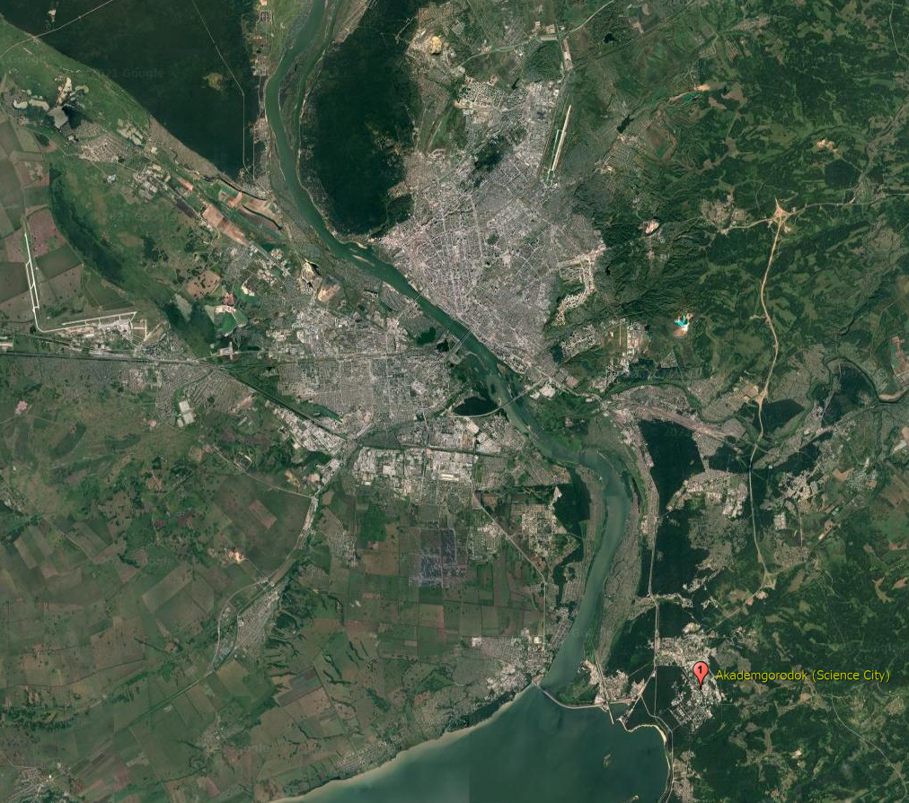
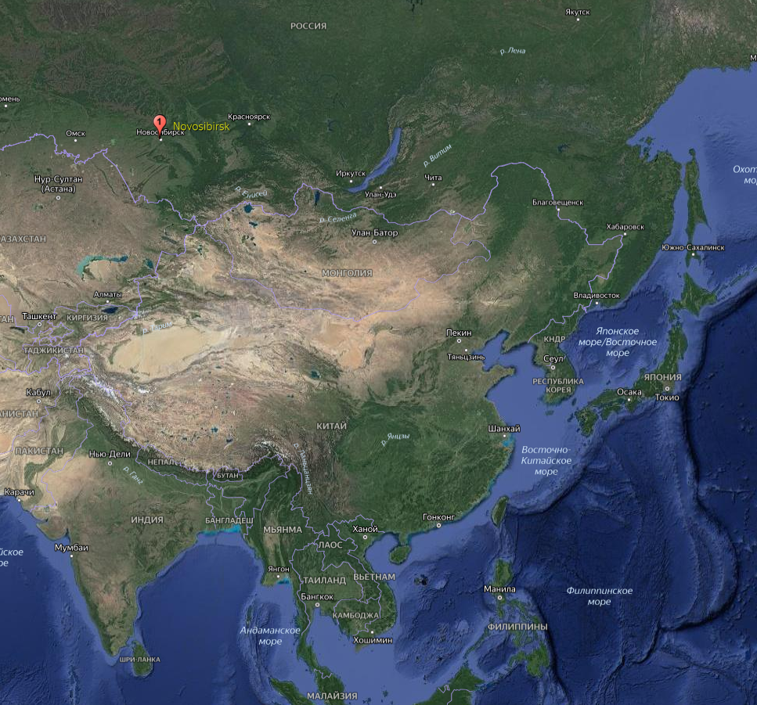
K. Lotov, AFAD-2021, 17.03.2021, p. 2 of 17
Where we are?
City with 1.6 M population (No. 3 in Russia)
> 30 Institutes and University
Novel accelerator studies in:
Budker Institute of Nuclear Physics
Institute of Laser Physics
Almost all researchers are also with Novosibirsk State University
(that’s why dual affiliations)

Slide 3
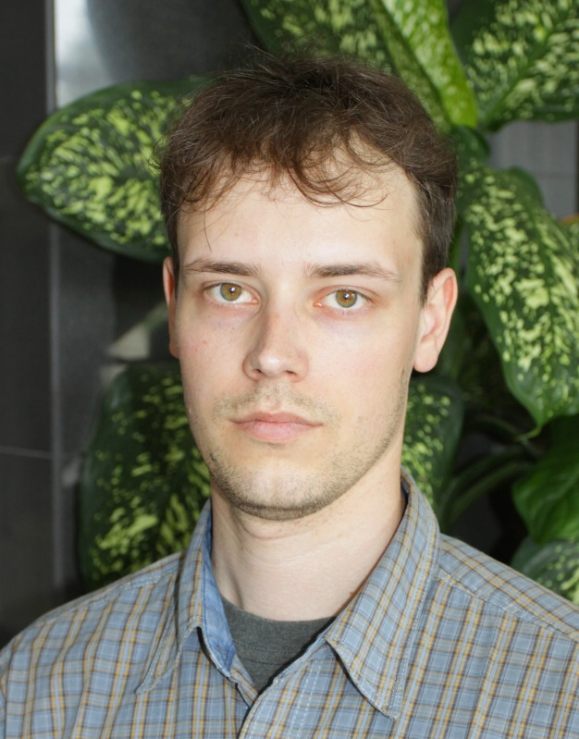
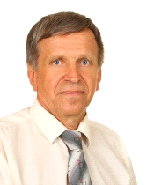
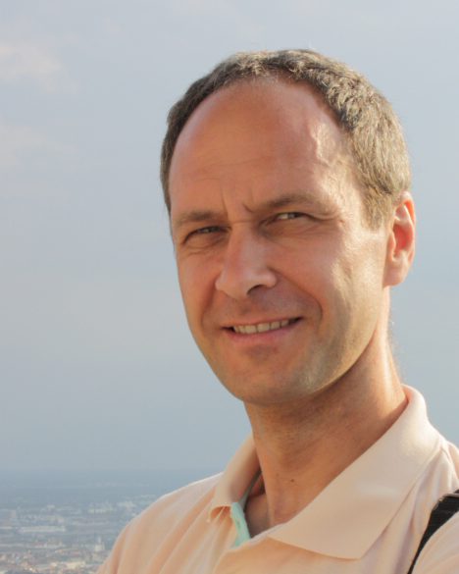
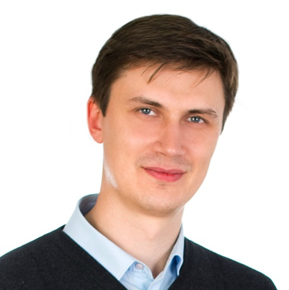
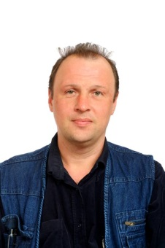
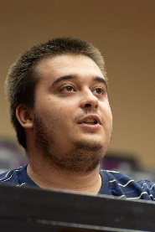
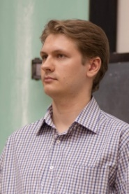
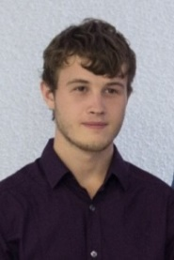
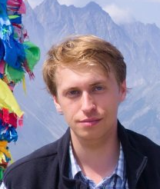
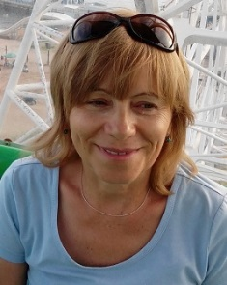
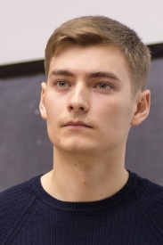
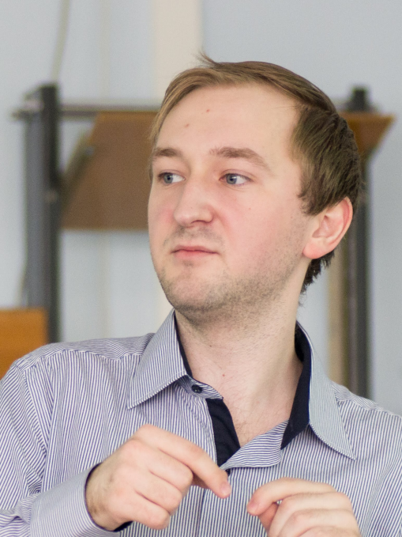
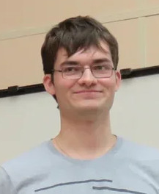
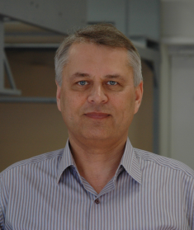
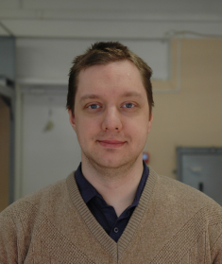
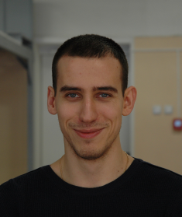
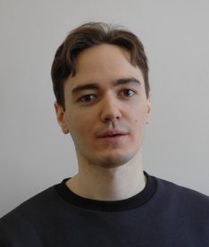
K. Lotov, AFAD-2021, 17.03.2021, p. 3 of 17
Research groups at BINP and ILP
LCODE Team: theory and simulations of
PWFA & LWFA
Radiation from beams and plasmas
Novel
W-band structures
Laser-plasma experiments
Dr. Sc. Igor Timofeev
Dr. Alexey
Levichev
Dr. Vladimir
Trunov
Prof. Konstantin Lotov
Vladimir Minakov
Roman Spitsyn
Petr Tuev
(PhD student)
Dr. Evgeny
Berendeev
Dr. Vladimir
Annenkov
Mariya Arsentyeva
(PhD student)
Dr.Sc.Svetlana
Avtaeva
Dr. Konstantin
Gubin
Stanislav Frolov
Alexander Gorn
(PhD student)
Mikhail
Baistrukov (MS)
Ivan Kargapolov
(MS)
Evgeniia Volchok
(PhD student)
Vladimir
Glinskiy (MS)
Dr. Victor Petrov
Gleb Kuptsov (MSc)
Vladimir Petrov
(MSc)
Nikita
Okhotnikov
(BS)
Vlada
Yarygova
(BS)
Dmitri
Schvydkoy
(PhD student)
Vladislav
Kurshakov (BS)

Slide 4
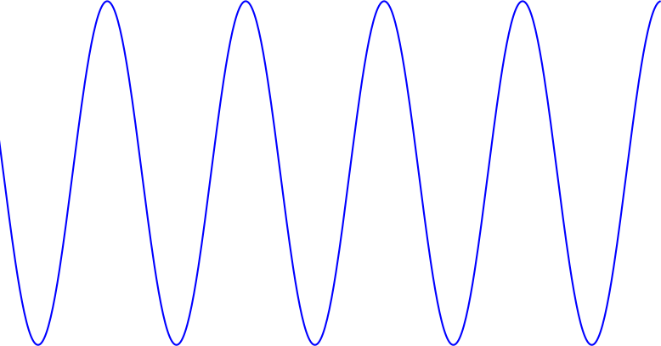
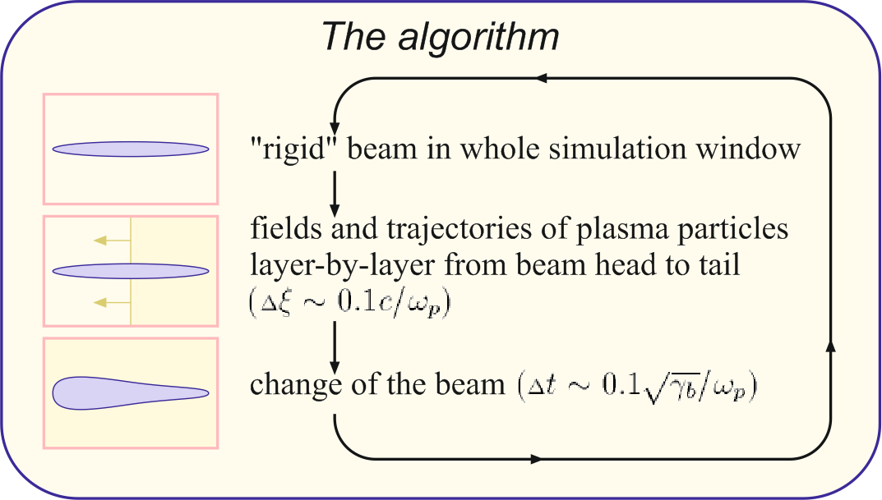
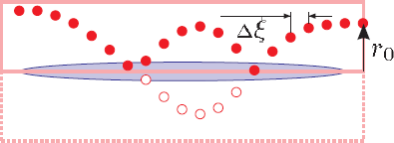
K. Lotov, AFAD-2021, 17.03.2021, p. 4 of 17
LCODE Team: theory and simulations of PWFA & LWFA, (mostly) using a quasi-static code
LCODE Team: theory and simulations of
PWFA & LWFA
Quasi-static approximation is good for plasma wakefield acceleration, which has too different time and length scales
(numerical example for n₀=10¹⁶см⁻³ and 500 GeV (γ=10⁶) final energy)
Prof. Konstantin Lotov
accelerating structure size c/ω_{p}≈50 μm
driver wavelength
λ≈0.8 μm
betatron period,
up to $\sqrt{\text{γ}}$ c/ω_{p}~5 cm
Acceleration length,
γc/ω_{p}~50 m
10⁶
~10⁸
Moving window: beam changes slowly,
all plasma particles started from r₀ with p₀ (almost) copy the motion of each other
LCODE:
quasi-static,
2d (axisymmetric/plane) freely available (https://lcode.info/),
3d under development,
well tested for long simulation windows, long propagation distances and charged drivers
The team not only develop the code, but also make theoretical studies
Any kind of collaboration is welcome
Vladimir Minakov
Roman Spitsyn
Petr Tuev
(PhD student)
Co-moving coordinate ξ =z-ct
Particle parameters: x, y, z, p_{x}, p_{y}, p_{z}
Depend on: t ξ
Simulation domain: x, y, z
Trajectory parameters: x, y, p_{x}, p_{y}, p_{z}
Depend on: ξ
Simulation domain: x, y
Alexander Gorn
(PhD student)
Mikhail
Baistrukov (MS)
Nikita
Okhotnikov
(BS)
(beam energy/mc²)^{1/2} (window length / grid step) times faster
Vlada
Yarygova
(BS)
long time step for beam
-1 dimension
up to 10⁹ for AWAKE baseline (compared to PIC)

Slide 5
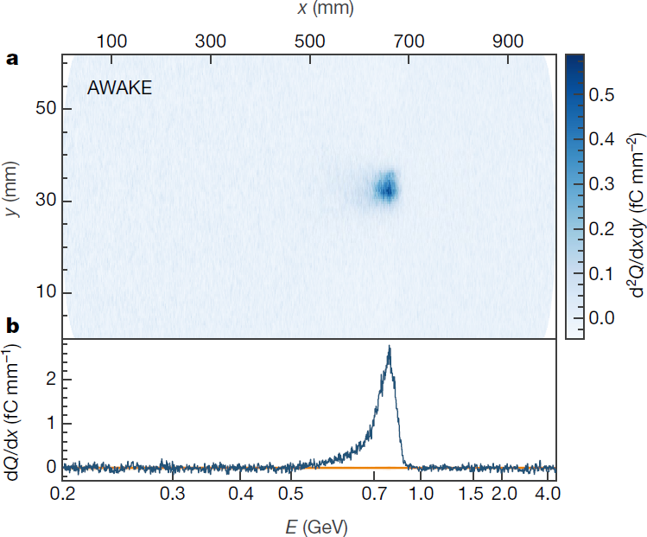
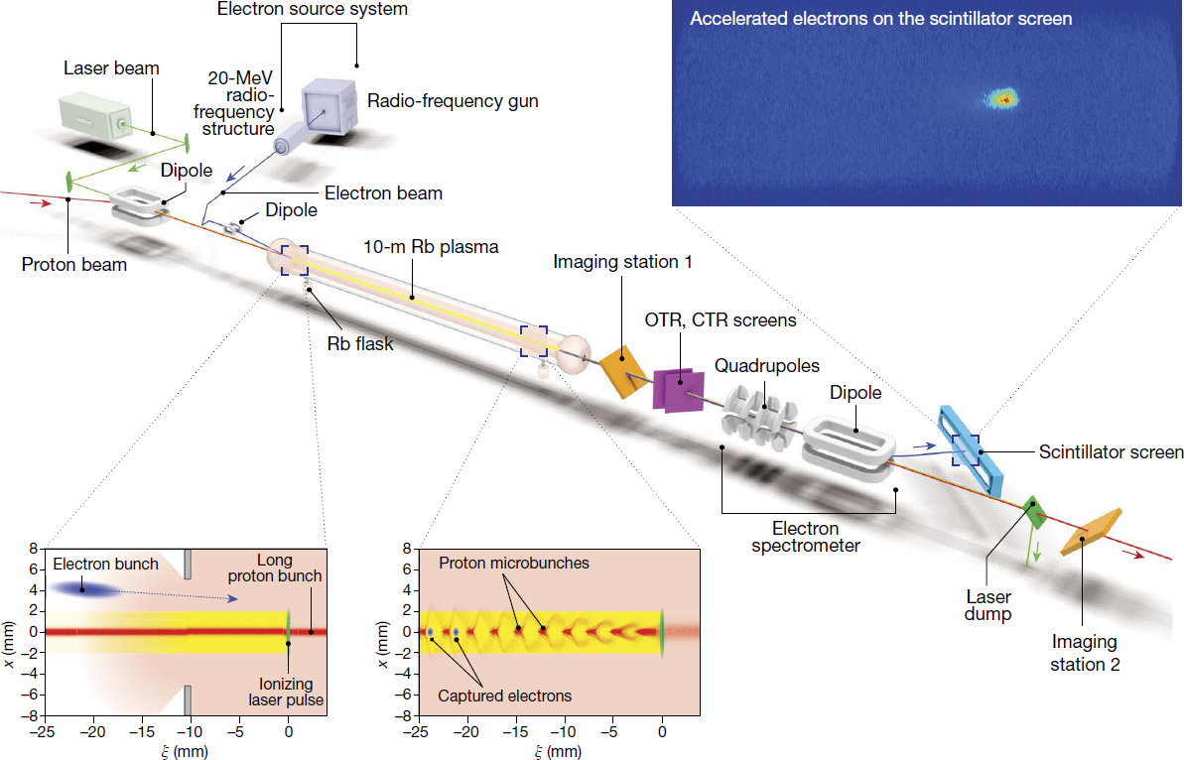
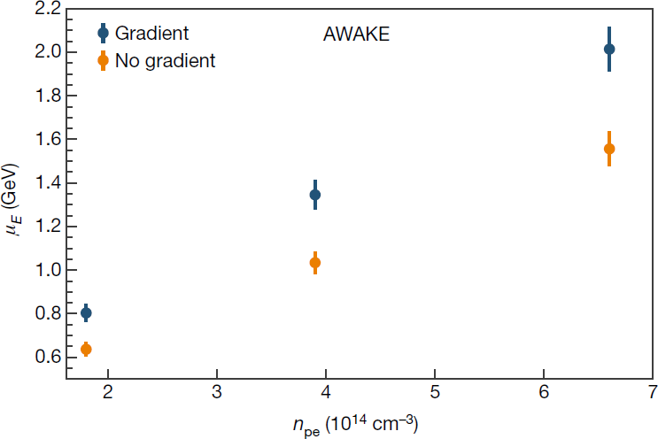
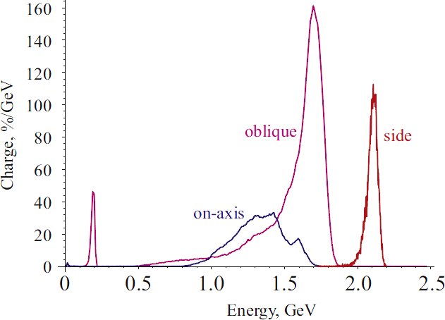
K. Lotov, AFAD-2021, 17.03.2021, p. 5 of 17
LCODE Team: Recent studies: AWAKE simulations (proton-driven PWFA)
Ti:Sapphire, 780 nm,
120 fs, 450mJ
20 MeV, 650 pC,
15 mm mrad, 2 ps
10¹⁴–10¹⁵ cm⁻³
400 GeV
σ_{z}~7 cm
σ_{r}~0.2 mm
ε_{n}~3 mm mrad
The measured spectrum shape and energy gain (2 GeV) are consistent with predictions.
from E.Adli et al. (AWAKE Collaboration), Nature 561, 363 (2018)
from A.Caldwell et al (AWAKE Collaboration),
Nuclear Instr. Methods A 829, 3 (2016).

Slide 6
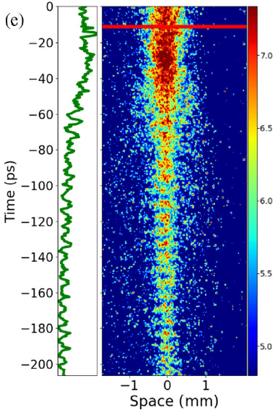
K. Lotov, AFAD-2021, 17.03.2021, p. 6 of 17
LCODE Team: Recent studies: AWAKE simulations (proton-driven PWFA)
F. Braunmüller et al., PRL 125, 264801 (2020).
Ti:Sapphire, 780 nm,
120 fs, 450mJ
20 MeV, 650 pC,
15 mm mrad, 2 ps
10¹⁴–10¹⁵ cm⁻³
Proton beam micro-bunching: predicted in 2010 (N.Kumar, et al., Phys. Rev. Lett. 104, 255003),
measured in 2018
400 GeV
σ_{z}~7 cm
σ_{r}~0.2 mm
ε_{n}~3 mm mrad
from E.Adli et al. (AWAKE Collaboration), Phys. Rev. Lett. 122, 054802 (2019).
from E.Adli et al. (AWAKE Collaboration), Nature 561, 363 (2018)

Slide 7
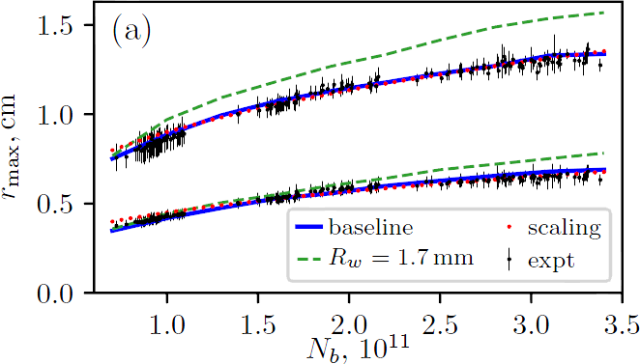
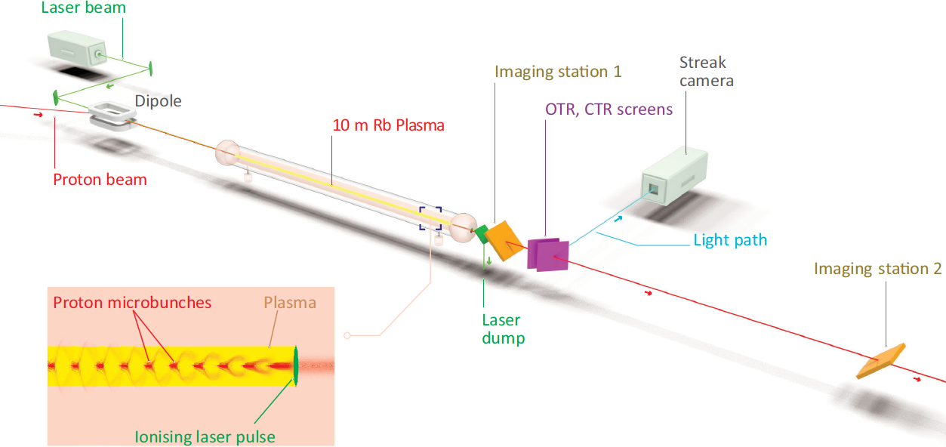
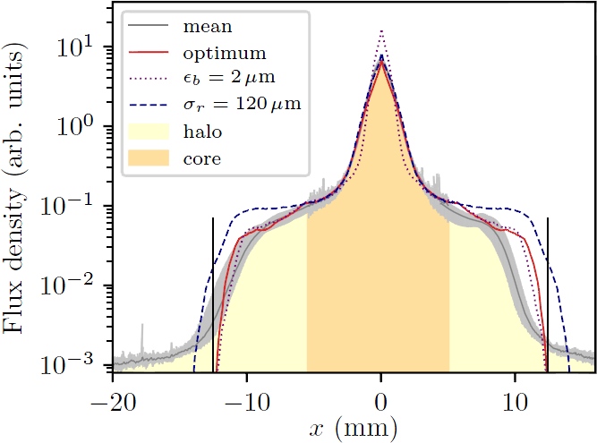
K. Lotov, AFAD-2021, 17.03.2021, p. 7 of 17
LCODE Team: Recent studies: AWAKE simulations (proton-driven PWFA) – quantitative agreement
Maximum radius of deflected protons: simulations (2d axisymmetric LCODE) agree with measurements. In beam population scans, the difference is below 5% without fitting parameters (all input data are taken from measurements).
A.A.Gorn et al. (AWAKE Collaboration), Plasma Phys. Control. Fusion 62, 125023 (2020).
Simulated with LCODE.

Slide 8
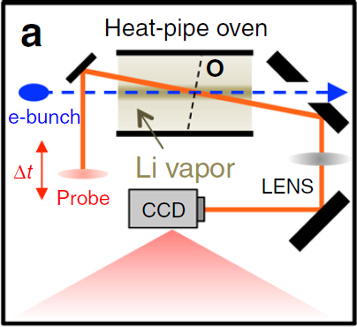
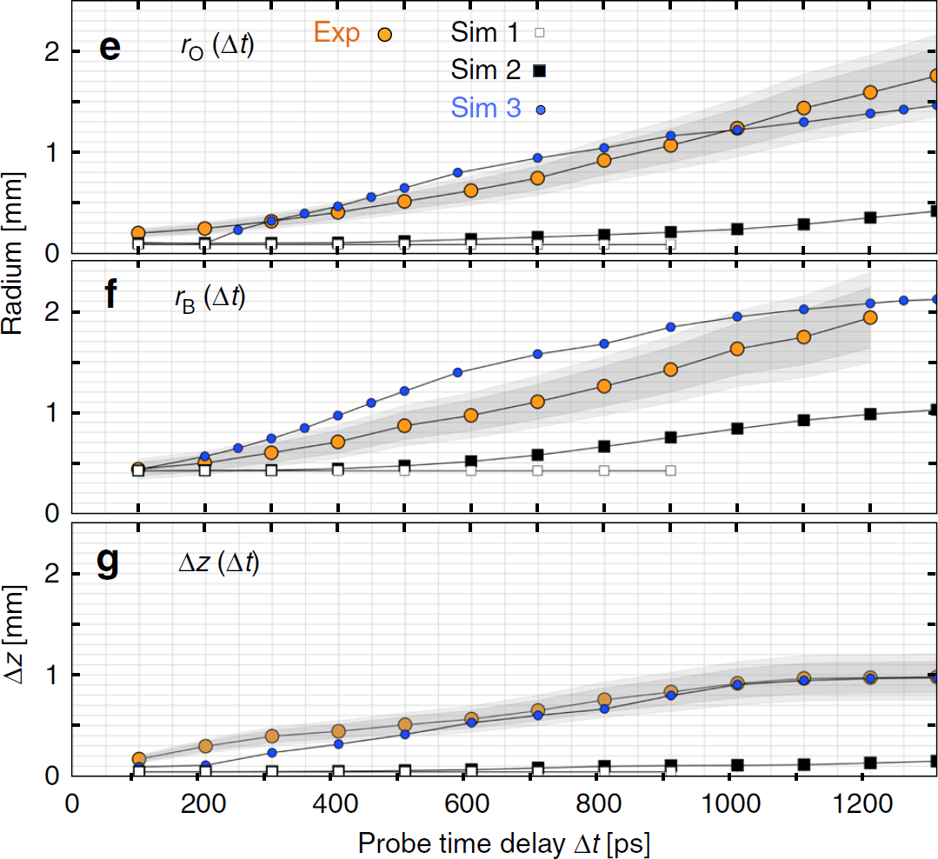
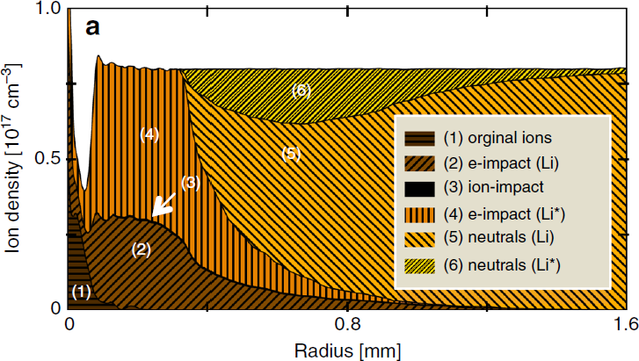
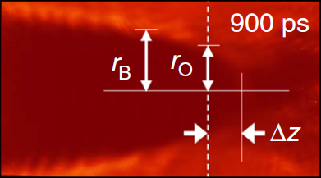
K. Lotov, AFAD-2021, 17.03.2021, p. 8 of 17
LCODE Team: Recent studies: FACET simulations (electron-driven PWFA)
Wakefield evolution up to 3000 wave periods (world record) taking into account Coulomb collisions and impact ionization of the surrounding gas (for the first time), quantitative agreement with measurements.
It turned out that a long chain of events takes place after the beam passes through the plasma:
Wavebreaking occurs
Wave energy goes to a small fraction of fast electrons
Fast electrons escape from plasma, plasma becomes positively charged
Electric field accelerates ions radially
Ions impact-ionize a small fraction of surrounding neutrals
Emerging electrons (dragged by ions or appeared due to ionization) continue ionizing the gas, the plasma density increases exponentially, the main channel is two-step ionization (via excited states)
Plasma radius grows rapidly
R.Zgadzaj, T.Silva, V.K.Khudyakov, A.Sosedkin, J.Allen, S.Gessner, Z.Li, M.Litos, J.Vieira, K.V.Lotov, M.J.Hogan, V.Yakimenko, and M.C.Downer, Dissipation of electron-beam-driven plasma wakes. Nat. Comm. 11, 4753 (2020).
Scheme of the experiment, plasma image, and comparison with simulations.

Slide 9
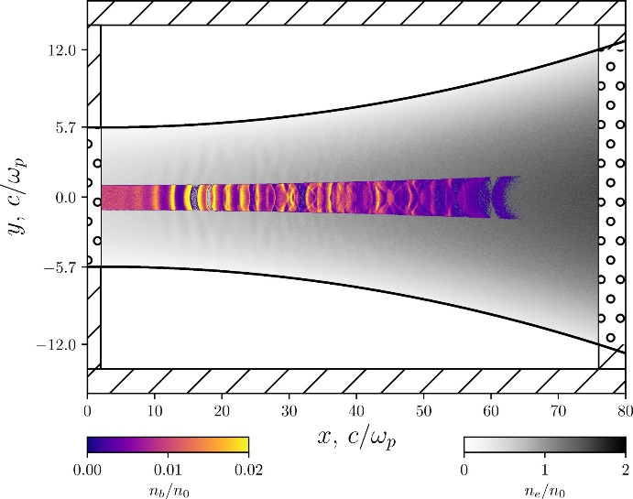
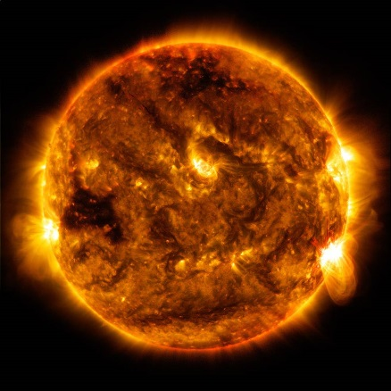
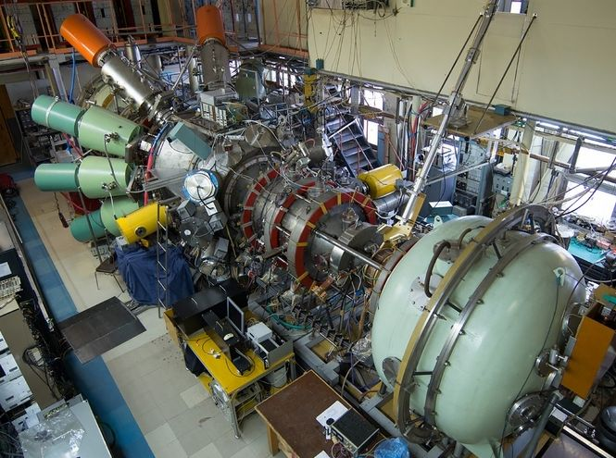
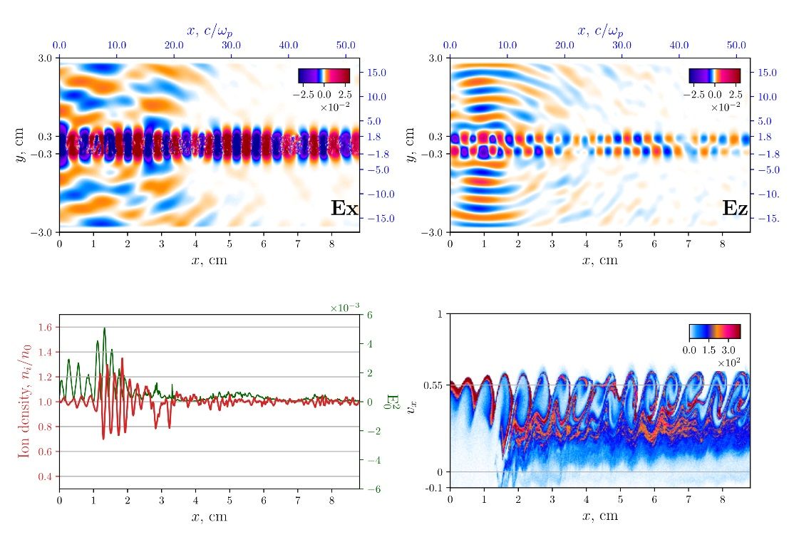
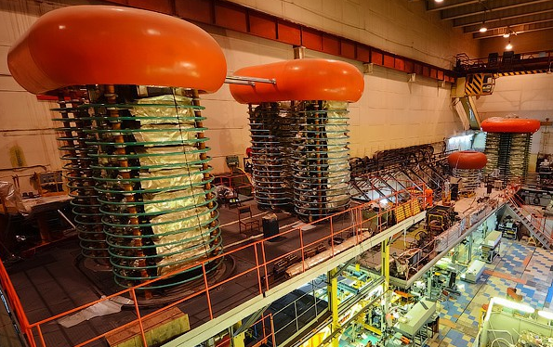
K. Lotov, AFAD-2021, 17.03.2021, p. 9 of 17
Beam-plasma discharge
Radiation from beams and plasmas: Problems
Theoretical and numerical study of the beam-plasma interaction
peculiarities. In particular, in the context of experiments at open
magnetic traps for plasma confinement.
Astrophysical problems
Radiation from beams and plasmas
Solar radio bursts:
Electron beams generated during magnetic
reconnection, solar flares and coronal mass
ejections provide free energy for wide variety of
different radio emission processes.
Dr. Sc. Igor Timofeev
Source: Nasa/SDO
Gas dynamic open trap
Dr. Evgeny
Berendeev
Dr. Vladimir
Annenkov
THz radiation sources
System “plasma – electron beam/laser pulse”
as a radiation source.
Search and study of new mechanisms
of radiation generation.
Plasma as a nonlinear medium supports long-
lived oscillations with extremely large electric
fields which provides a fairly narrow radiation
spectrum and high conversion efficiency.
The radiation frequency can be tuned by a
simple change of plasma density.
Evgeniia Volchok
(PhD student)
Vladimir
Glinskiy (MS)
Vladislav
Kurshakov (BS)
GOL-PET experiment

Slide 10
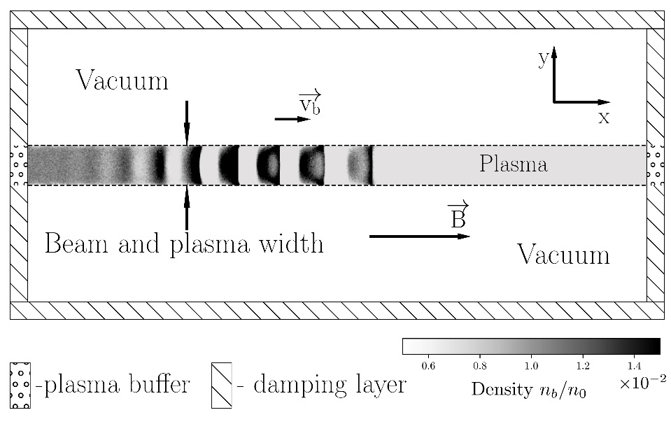
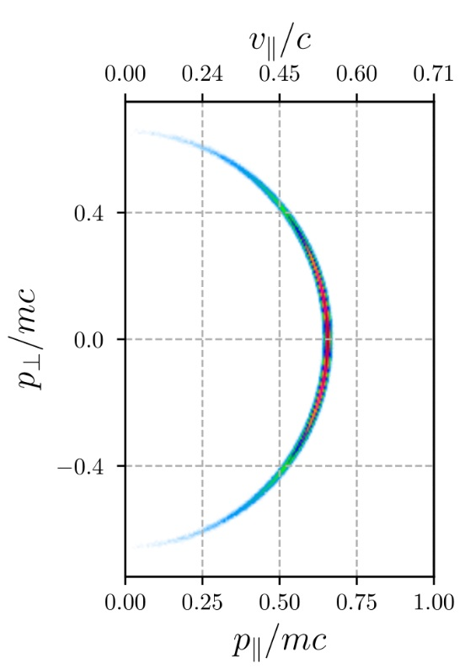
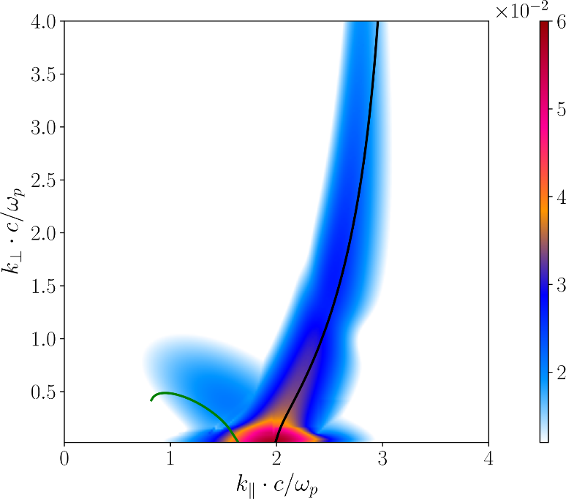
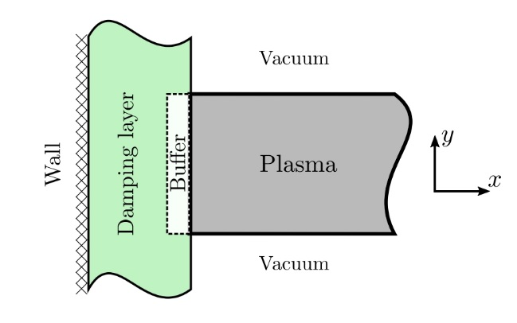
K. Lotov, AFAD-2021, 17.03.2021, p. 10 of 17
Radiation from beams and plasmas: Key instruments
To find the whole unstable spectrum, the algorithm for solving
the dispersion equation within the framework of the exact
relativistic kinetic theory, taking into account a finite magnetic
field, has been developed. The algorithm allows one to find the
growth rate of instability of a beam-plasma system with an
arbitrary distribution function of its components.
Timofeev I.V., Annenkov V.V. Phys. Plasmas, 20(9), 092123 (2013)
b
To study collective beam-plasma interaction PIC code with open
boundary conditions has been developed. This formulation of the
problem makes it possible to correctly reproduce the process of continuous injection of particles into the plasma.
V. V. Annenkov et al. Phys. Plasmas 25, 113110 (2018)
Special plasma buffers delete the outgoing particles, create particles that would have to pass through its boundary in the case when there was a real plasma behind them, and also maintain the correct current values in the boundary cells of the simulated plasma.
a
(a) Particle distribution of the beam after transportation to the strong magnetic
field. (b) The growth rate for the instability of a beam with the
distribution function shown in (a).

Slide 11
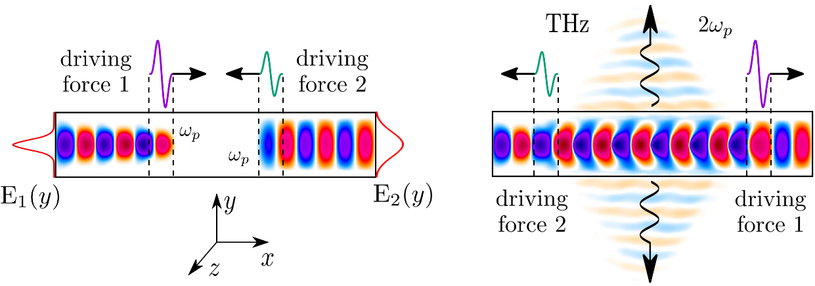
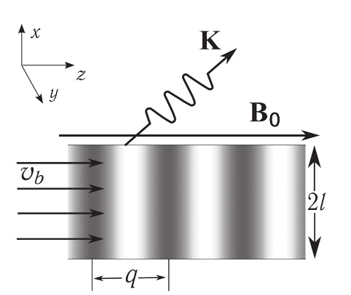
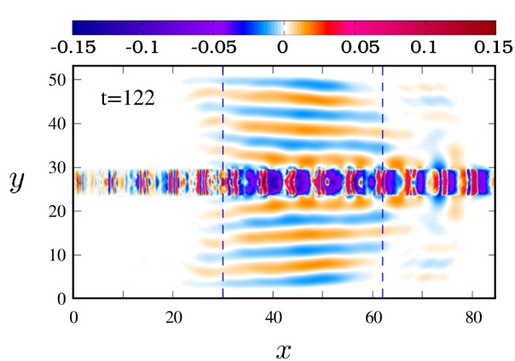
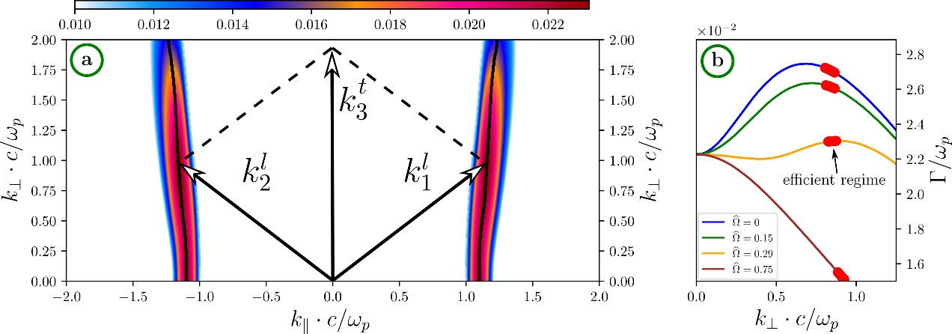
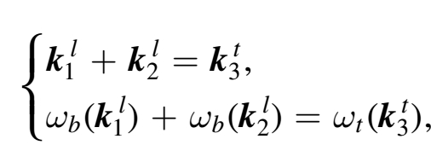
K. Lotov, AFAD-2021, 17.03.2021, p. 11 of 17
Radiation from beams and plasmas: Radiation mechanisms
Nonlinear interaction of counter propagating
plasma waves
Beam-plasma antenna
V. V. Annenkov Plasma Phys. Control. Fusion 58, 045009 (2016)
A thin plasma column with a longitudinal density
modulation works like a plasma antenna in
which an electron beam can excite a
superluminal wave of electric current. The current
can be converted in electromagnetic radiation at
plasma frequency harmonics.
Radiation conditions for the 1st harmonic
Colliding plasma waves with differing profiles of electrostatic potential can be an efficient mechanism for generating high-power THz emission at
Radiation angle
I. V. Timofeev et al. Phys. Plasmas 24, 103106 (2017)
Three wave interaction
Generation of electromagnetic radiation during the coupling of oblique
oscillations excited in a plasma by counter streaming electron beams.
V. V. Annenkov et al 2020 ApJ 904 88

Slide 12
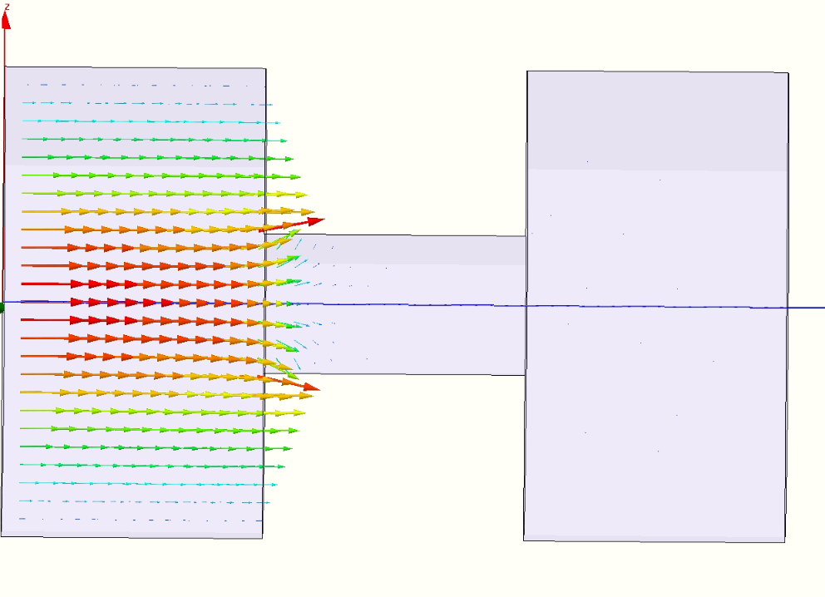
K. Lotov, AFAD-2021, 17.03.2021, p. 12 of 17
Novel W-band structures: between conventional RF structures and plasmas in size and fields
Novel
W-band structures
The W-band structure is to be fed by the train of electron bunches from the SKIF linear accelerator
Operating frequency | 85 GHz
Bunch charge | 0.3 nC
Bunch distance | 5.6 ns
RMS bunch duration | 2.5 ps
Number of cavities in the structure | 100
Lost energy | up to 5 MeV
Induced electric field | up to 25 MV/m
Dr. Alexey
Levichev
2.7 mm
0.8 mm
1.75 mm
1.75 mm
Mariya Arsentyeva
(PhD student)
The structure to be manufactured
(shown here is electric field excited by the electron beam)
First prototype of the structure

Slide 13
K. Lotov, AFAD-2021, 17.03.2021, p. 13 of 17
Novel W-band structures: between conventional RF structures and plasmas in size and fields
The W-band structure is to be fed by the train of electron bunches from the SKIF linear accelerator
Operating frequency | 85 GHz
Bunch charge | 0.3 nC
Bunch distance | 5.6 ns
RMS bunch duration | 2.5 ps
Number of cavities in the structure | 100
Lost energy | up to 5 MeV
Induced electric field | up to 25 MV/m
2.7 mm
0.8 mm
1.75 mm
1.75 mm
W-band structure
Faraday cup
Spectrometer
SKIF accelerator structure

Slide 14
K. Lotov, AFAD-2021, 17.03.2021, p. 14 of 17
Laser-plasma experiments at ILP: Two channel multiterawatt laser system based on OPCPA
Laser-plasma experiments
Features
Dr. Vladimir
Trunov
Low beam pointing instability
(the ability of experiments with narrow hollow waveguides)
High contrast of compressed pulses
Precise time synchronization between channels
(better than 100 as )
High space quality (M²<1.1)
(high focusibility)
532nm 90 ps
0.6J, 10Hz per
pump channel
up to 30-50TW (20fs)
ps pump
Dr.Sc.Svetlana
Avtaeva
Dr. Konstantin
Gubin
Stanislav Frolov
Dr. Victor Petrov
Gleb Kuptsov (MSc)
Vladimir Petrov
(MSc)
Laser Phys. Lett. 11, 095301, 2014
Dmitri
Schvydkoy
(PhD student)
beam pointing
distributions
contrast of compressed pulses in the 1st channel (a) and the 2nd one (b)
Intensity >5*10¹⁸ W/cm²

Slide 15
K. Lotov, AFAD-2021, 17.03.2021, p. 15 of 17
Laser-plasma experiments at ILP: Pulse propagation through narrow capillaries
Capillary: triangular-shaped, height ~60 μm, length 2 cm produced by engraving triangular grooves on a polished copper plate; another (not grooved) plate closes the capillary gap between the plates < 0.5 μm
Laser: 850 nm, up to 30 mJ (0.6 ТВт), 50 fs, contrast 10⁻⁸, angular instability 2 μrad (1.5 μm fluctuations at the entrance) best transmission observed with the focal spot of 35 μm in diameter at the entrance almost no focal spot changes as the energy increases
Camera (VC): 10⁻⁶ Bar, diameter 5.5 cm, length 76 cm on the five-dimensional stage (3 coordinates and 2 angles).
20 mm length
K.V.Lotov, et al., Phys. Plasmas 22, 103111 (2015).
K.V.Gubin, et al., J. Appl. Phys. 120, 113103 (2016).
Capillary transmission:
is high
Reason: high reflectivity of metals at these parameters
A problem:
capillary degradation
What happens?
entrance
transmitted energy
energy falling into the hole
relative = -----------------------------------
transmitted energy
pulse energy
Reduction of the absolute transmission with the number of transmitted pulses for different pulse energies.
Plugs (~1 mm long) at the distance of 2–4mm from the entrance are observed, because of matter re-distribution. Plugs block the capillary completely.
absolute = -------------------------

Slide 16
K. Lotov, AFAD-2021, 17.03.2021, p. 16 of 17
Laser-plasma experiments at ILP, plans: LWFA at moderate intensities, Compton γ-source, THz generation
Radiation generation by counter propagating laser pulses:
proof-of-principal experiment
Schematic of the experiment
PM: parabolic mirrors
PD: photodiode detector
PC: personal computer
1 – laser beams, 2 – supersonic gas jet, 3 – electron beam, 4 – collimator, 5 – phosphor screens, 6 – magnet dipole,
7 – Faraday cap, 8 – CCD.
Parameters:
laser system: 10 Hz, 100÷300 mJ, ~20 fs, 810 nm;
acceleration area: diameter ~ 10÷15 μm, length ~ 0.5 mm;
supersonic He jet: diameter ~1.2 mm, gas density 10¹⁸÷10¹⁹ cm⁻³, Mach number 3.5÷4, gas backpressure 5÷10 atm
Special features:
aimed at quantitative agreement with simulations
two laser pulses (Compton scattering, THz radiation)

Slide 17
Thank you

