Slide 1
The introduction of the compact laser-driven proton therapy system at Peking University
K. Zhu K.D.Wang M. Easton X.Q Yan
Peking University

Slide 2
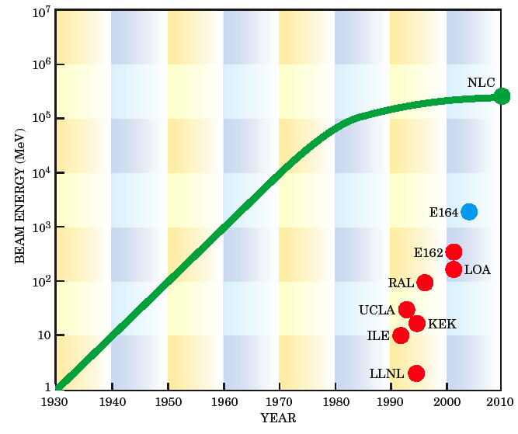
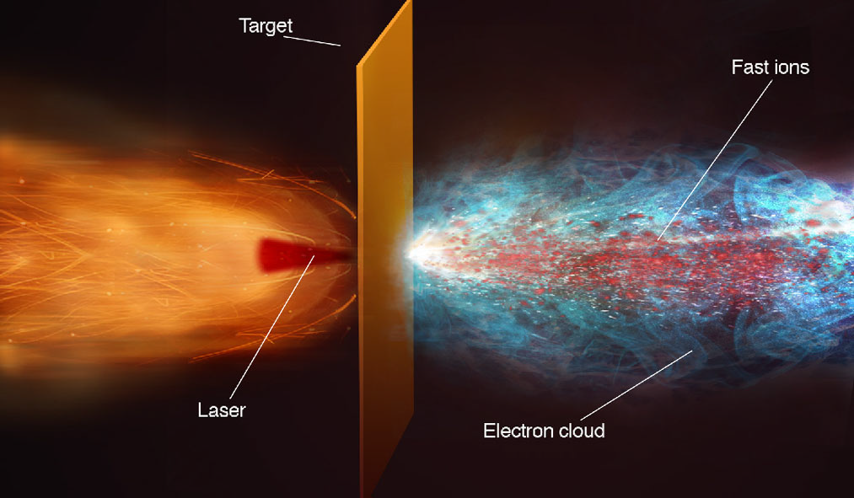
Background information
OncoRay: National Center for Radiation Research in Oncology, Dresden, Germany（2012-2017）
Queens University Belfast Consortium, UK
(2013-now)
ELIMED: Prague
KPSI: JAEA in Japan
(2012-now)
SAPHIR: Laboratoire d’Optique Appliquée, LOA, France
LBL
RAL
MAP, CALA: Munich, Germany（2012-now）
Medical laser proton accelerator has been developed in the world
K. W. D. Ledingham, P. R. Bolton, N. Shikazono, and C. M. C. Ma, Appl Sci-Basel 4, 402 (2014).

Slide 3
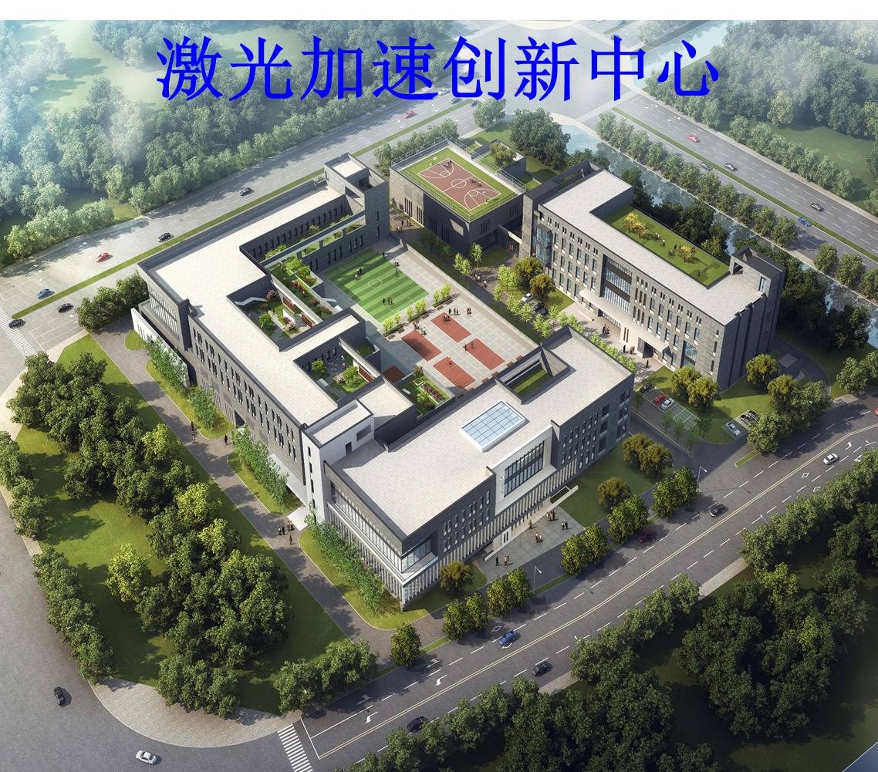
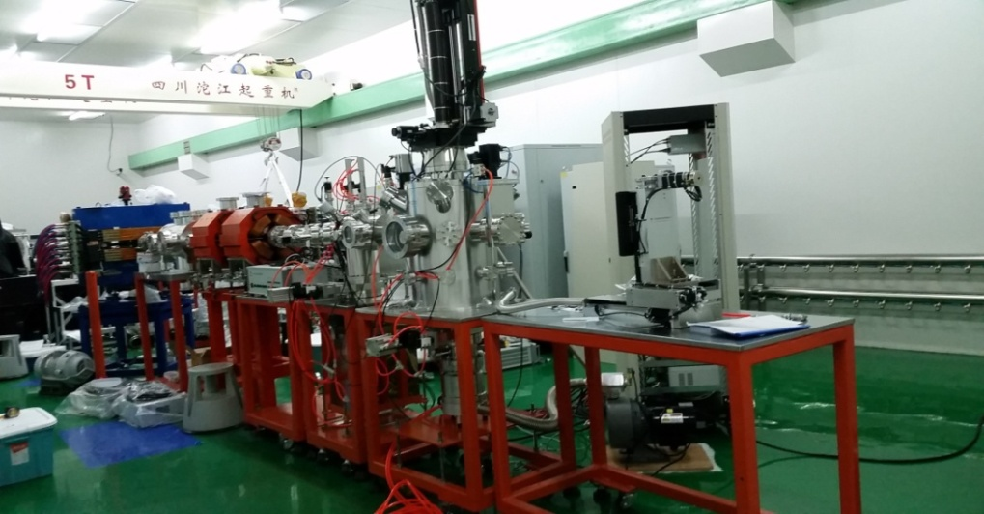
CLAPA-I
CLAPA-II (CLAPA-T)
Laser Accelerated Innovation Center
Total funds allocated by the State：5.19 B
Project Time: 2019-2030
Supported by China's Ministry of Science and Technology
Location: Huai Rou Science City, Beijing
2012 to 2017

Slide 4
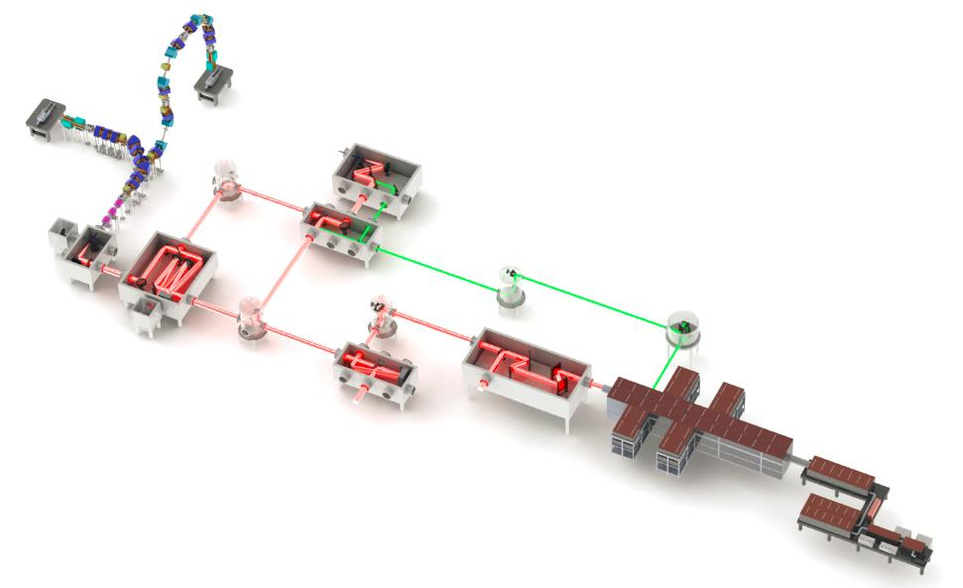
CLAPA-II (CLAPA-T)
Laser proton beam acceleration and diagnostic system:
Completed laser shooting target
Produces a beam of high-energy protons
PW Laser system
High contrast frontend,
Amplification system
Compression system
Multi-pass amplification technology
Four granting compressing system
Consisting of XPW and OPCPA in the frontend
Proton Beam Transmission System:
Developed a stable and reliable laser-driven proton therapy system.
Developed the transmission system that can deliver the desired therapeutic beam
The transverse envelope growth of the beam is controlled by achromatic transmission technique.

Slide 5
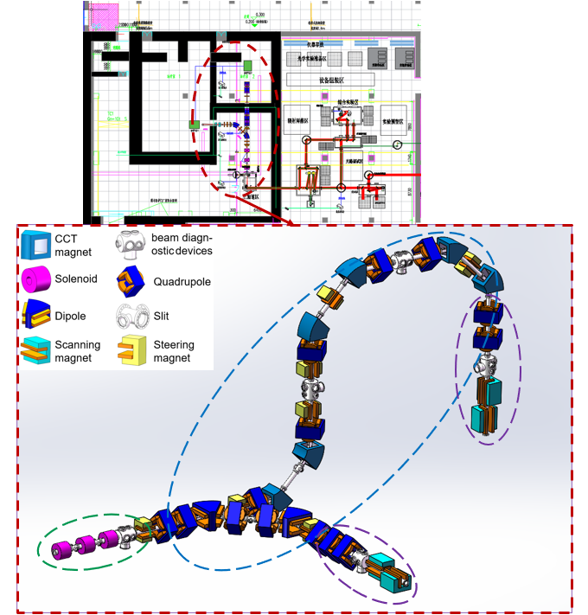
Compact Laser Proton Accelerator for Therapy (CLAPA-II)
The laser system will be a 2-PW, 1-Hz titanium sapphire system, 30-fs duration, 10¹⁰ contrast.
Transmission System Requirements：
Broad energy spectrum
High peak flux
Short temporal duration
Energy level of multi-hundred MeV.

Slide 6
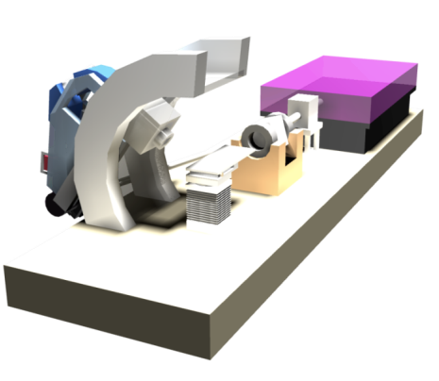
Design objectives
Staged implementation：
Proton beams with energy in the range 40-100 MeV can be transmitted;
Proton beams with energy in the range 100-200 MeV can be transmitted;
Beam spot with energy dispersion of less than 5%
Beam spot diameter is less than 15 mm.

Slide 7
Target to beam line transition
In order to design the laser accelerated beam transmission system, we analyze the initial particle distribution of the laser accelerated beam.
Conventional accelerators:
Laser-driven protons:
Narrow energy band
Gaussian energy spectrum
Small acceptance angle
Continuous or relatively long pulse
High reproducibility
Wide energy spread
Exponential energy spectrum
Large divergence
Short pulse time
High shot-to-shot variation
An initial macro-particle library for simulating laser accelerated beam transmission is established
Initial proton collection simulations for CLAPA-T | Dr Matt Easton

Slide 8
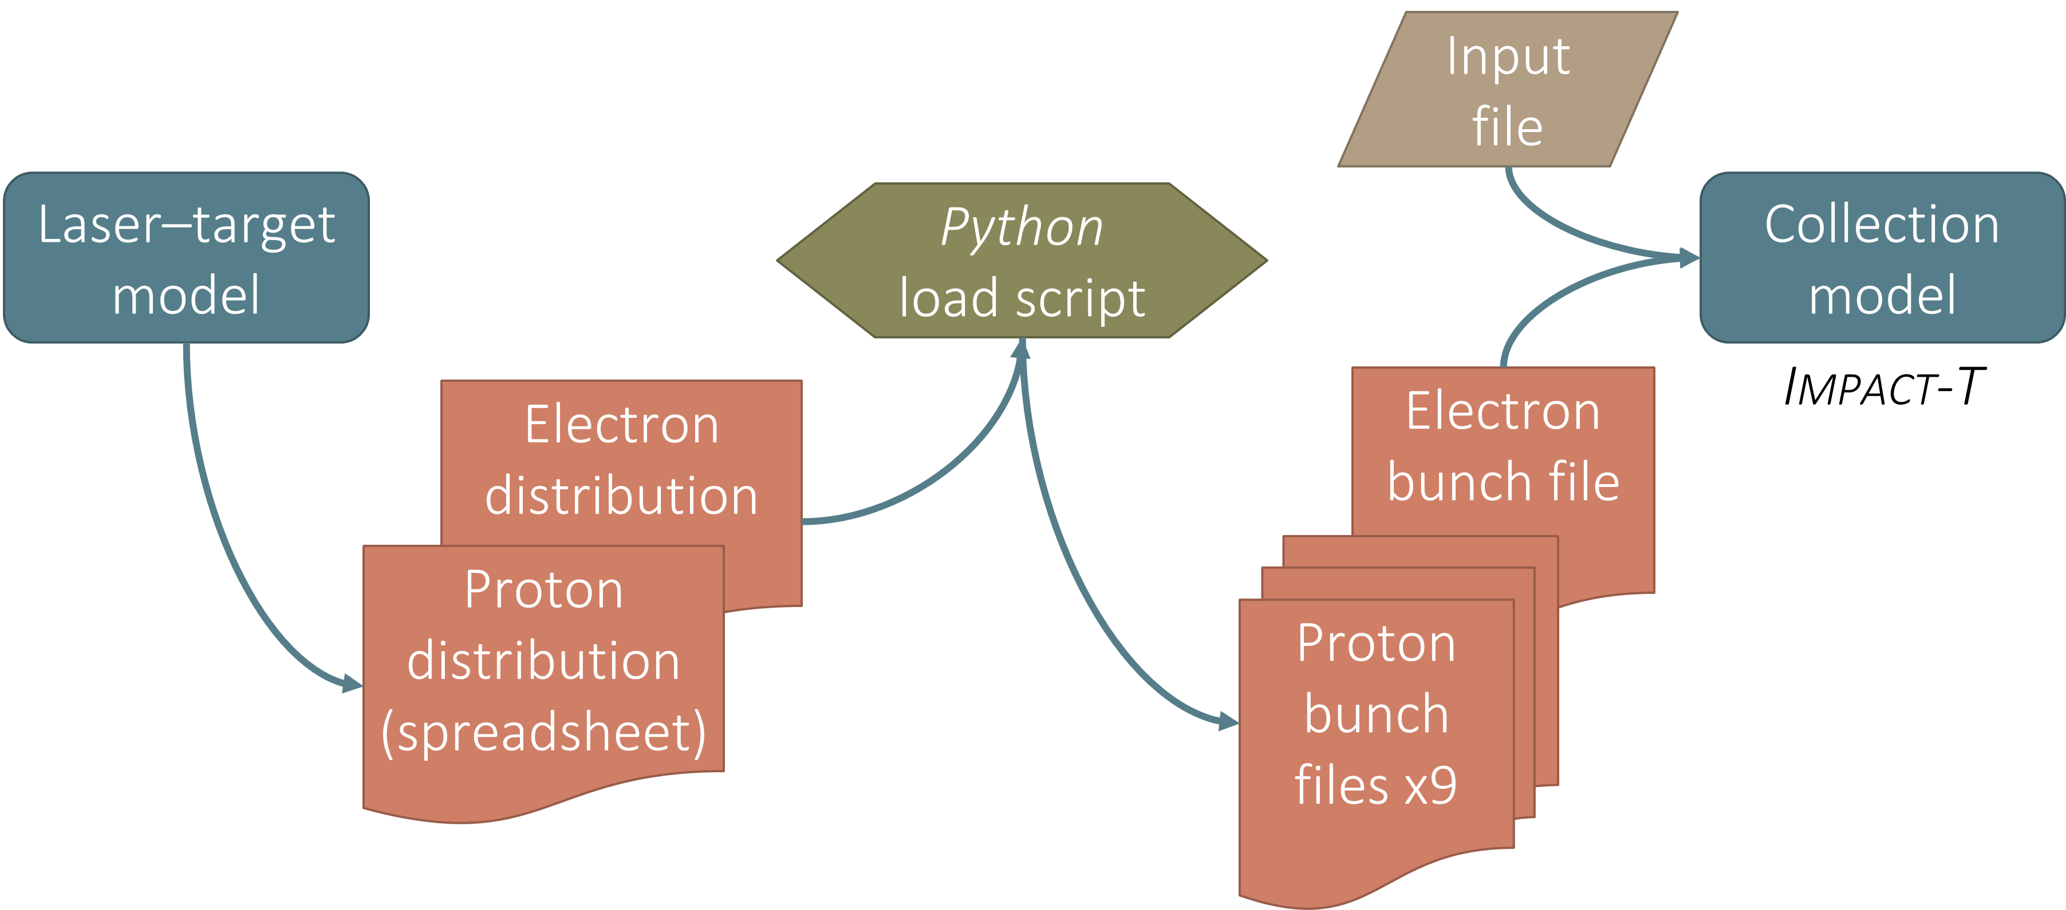
Initial macro library generation program
Laser Plasma Researchers provided

Slide 9
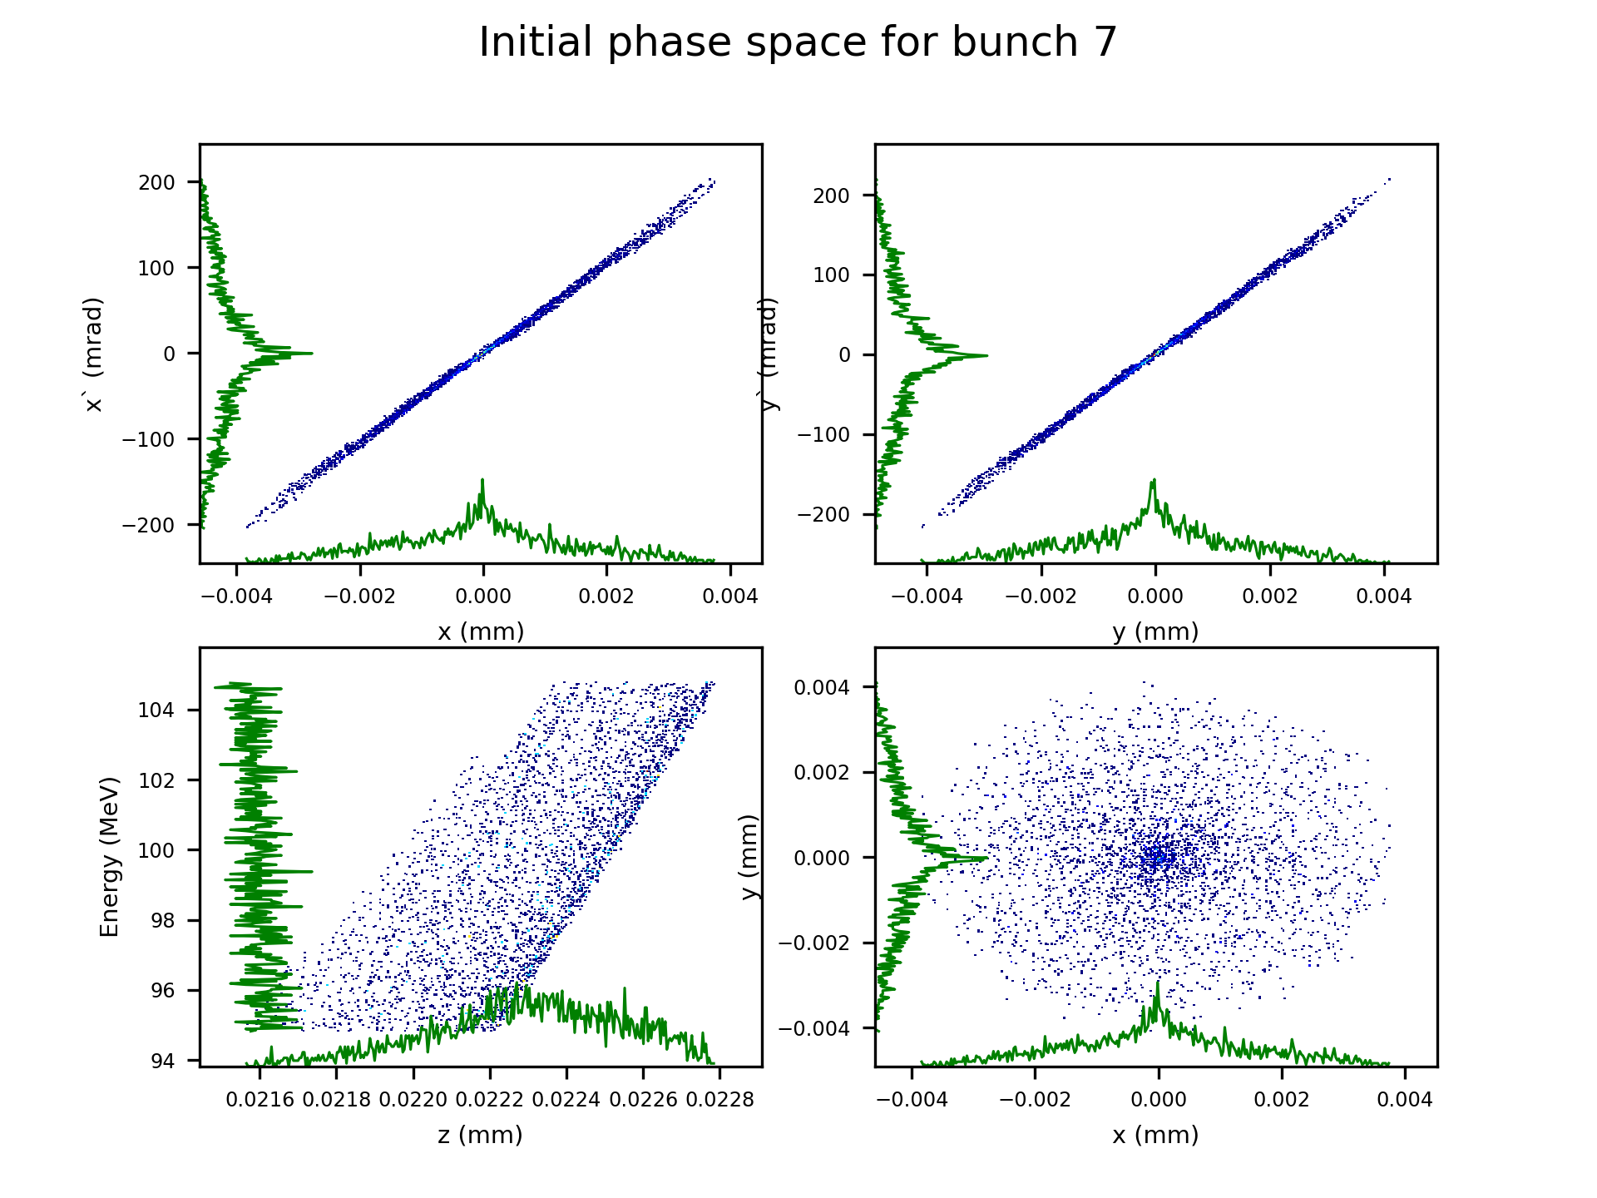
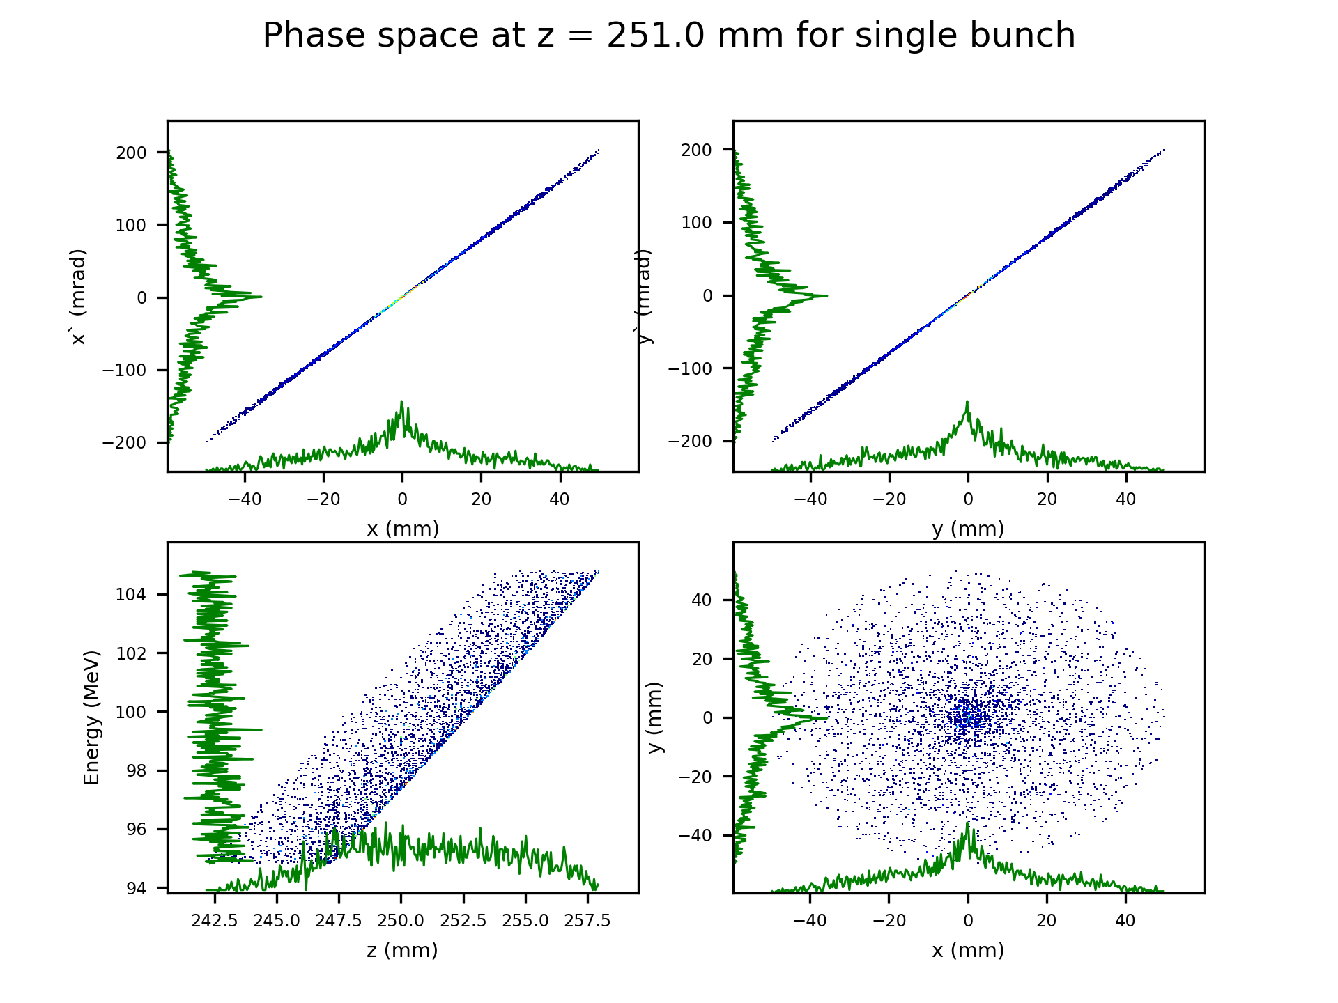
Laser
Solenoid
Target
Multibunches tracking in IMPACT-T
Multi-bunch simulation for wide energy spread with exponential energy spectrum
Full cross-bunch space-charge interactions
Proton beam tracking from target to solenoid entrance

Slide 10
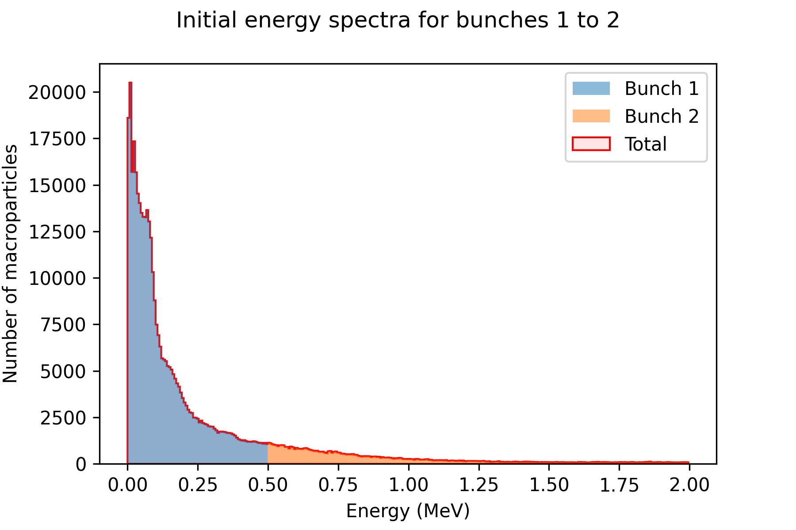
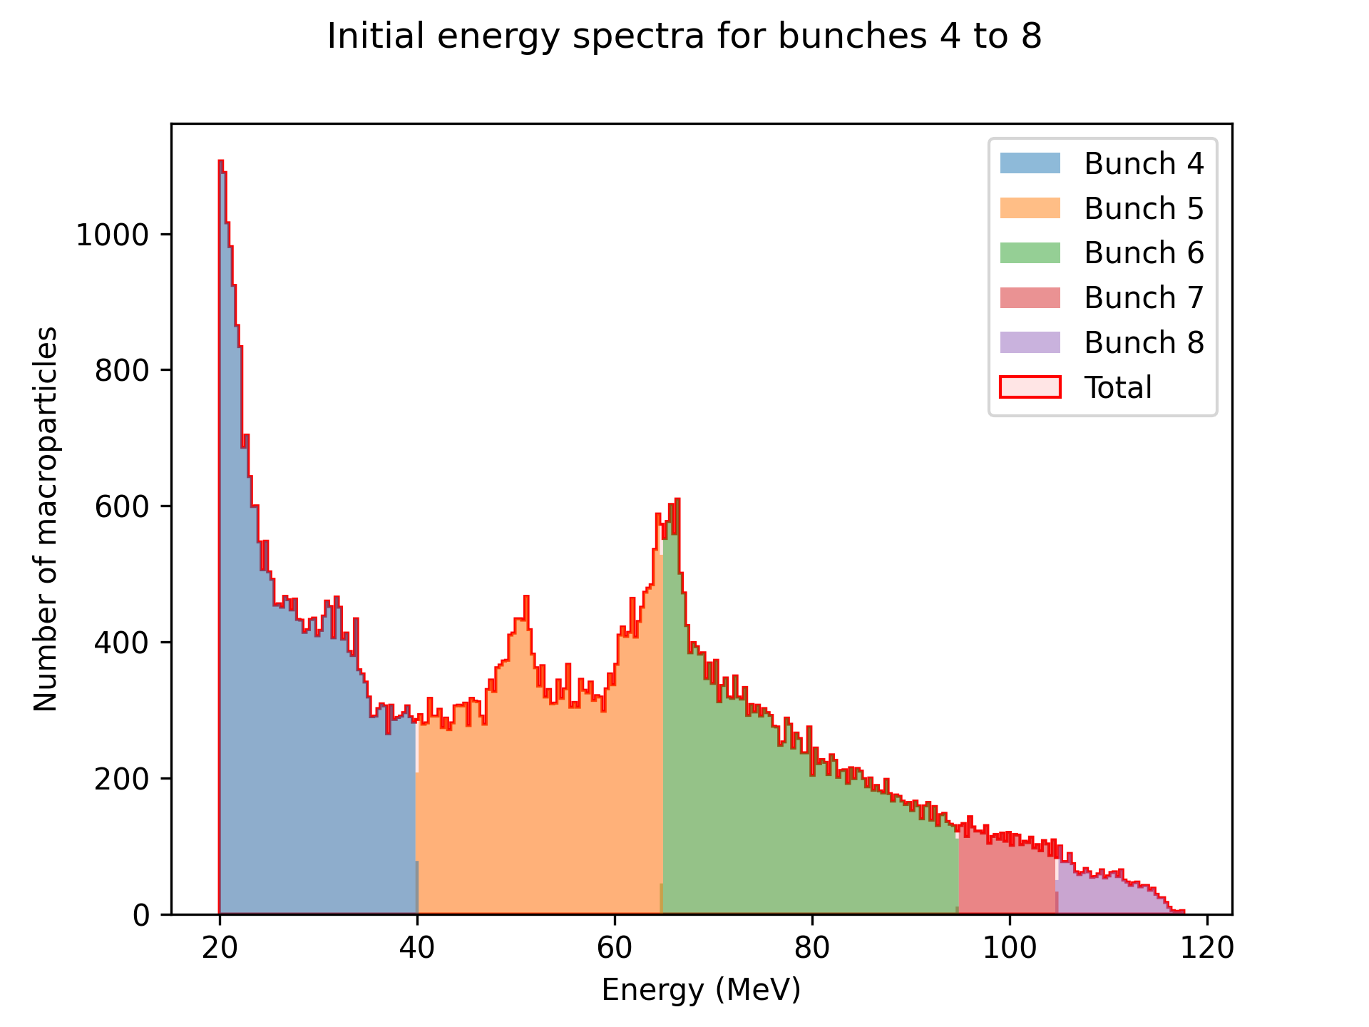
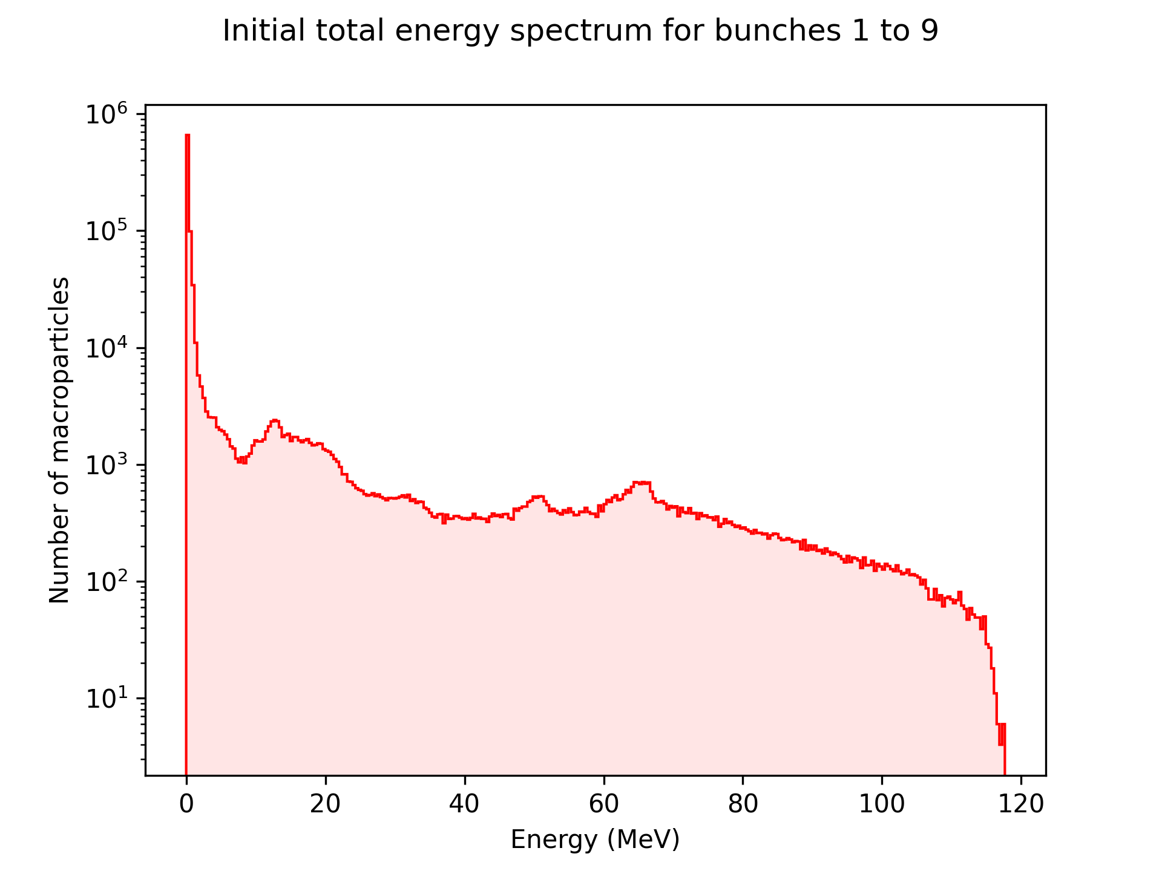
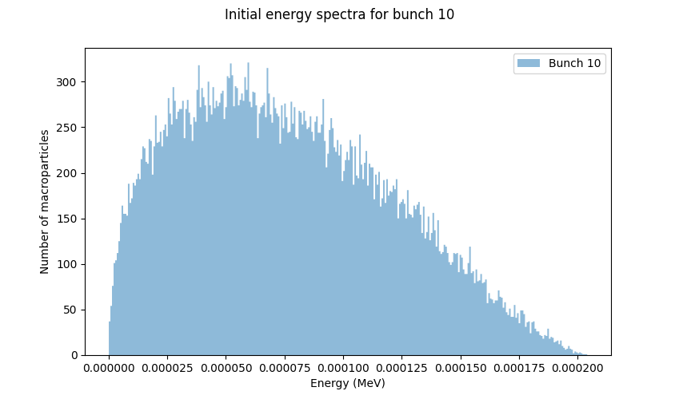
Partition of particles into bunches by energy range
Low energy beam bunch
Bunch 7 is the target energy range 100 MeV ±5%
Particles with ±5% energy dispersion near the center energy can be extracted as data for simulation.
Electron bunch

Slide 11
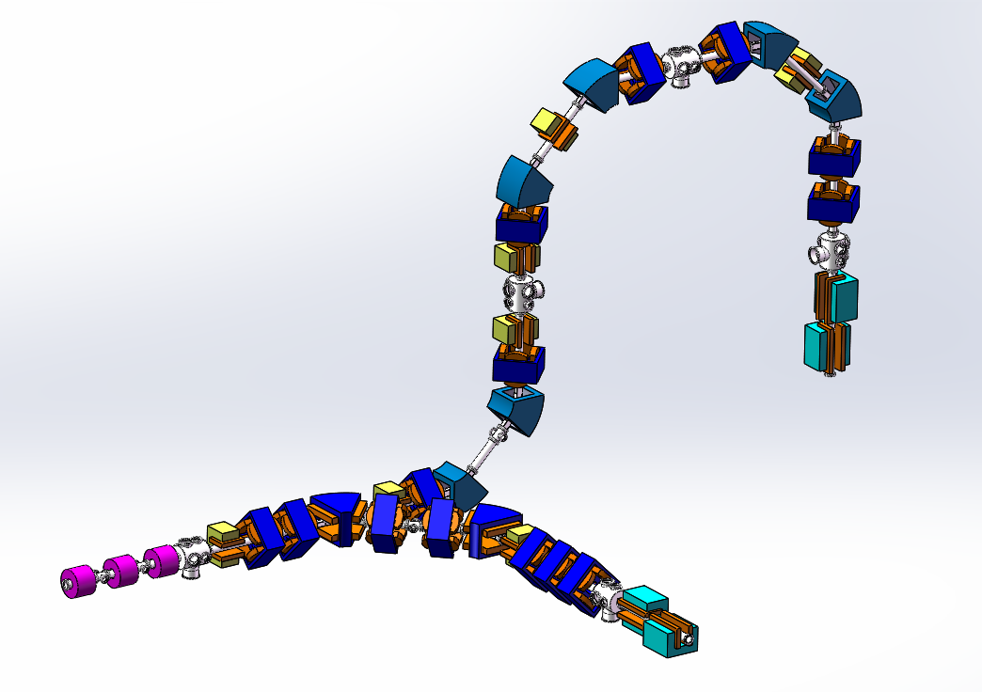
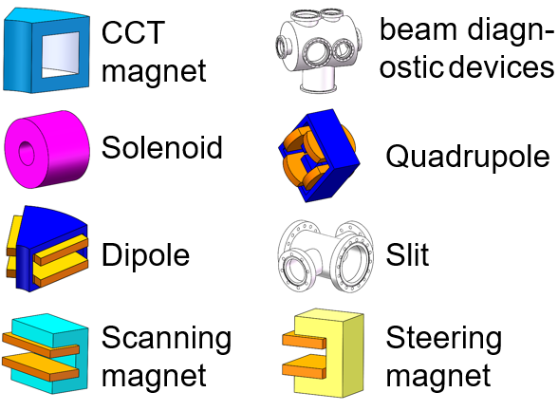
Beam line structure
Novel magnets with mixed magnetic field is used
Deflection and Energy Selection (DES) section
Provides vertical beam for irradiation
Collection section
Application section
Beam from the laser target
Provides horizontal beam for irradiation
Achromatic beamline design for a laser-driven proton therapy accelerator | K. D. Wang , K. Zhu*，et.al

Slide 12
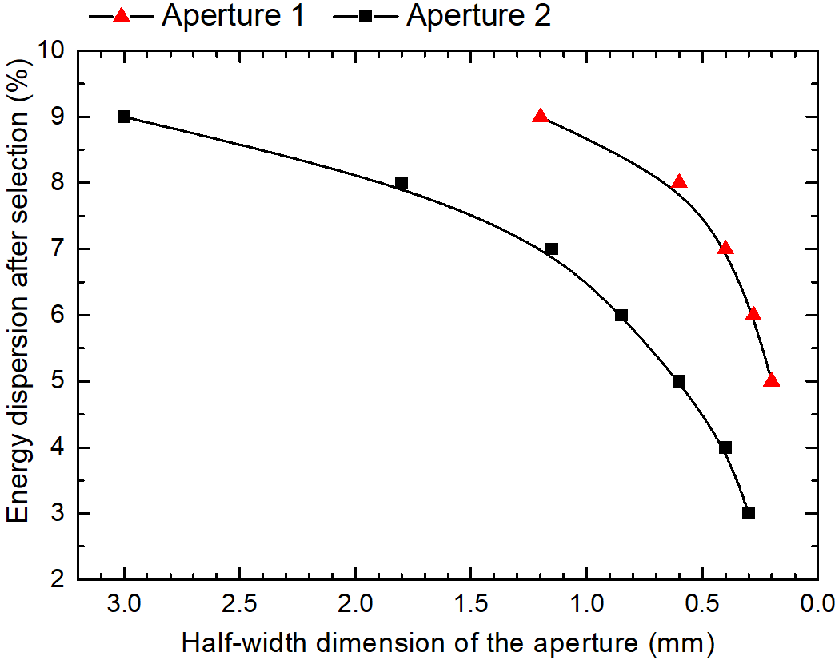
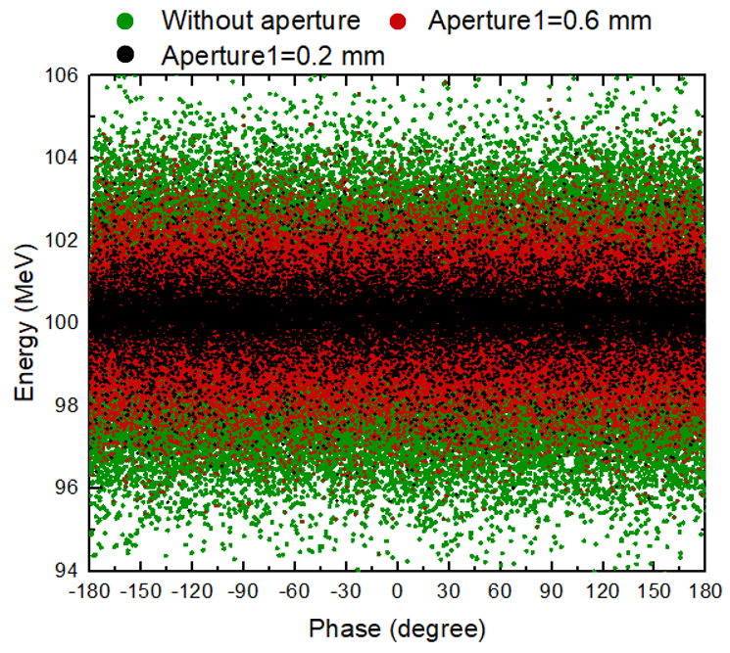
Collection section
Three superconducting high-field solenoids
Two adjustable apertures between the three solenoids

Slide 13
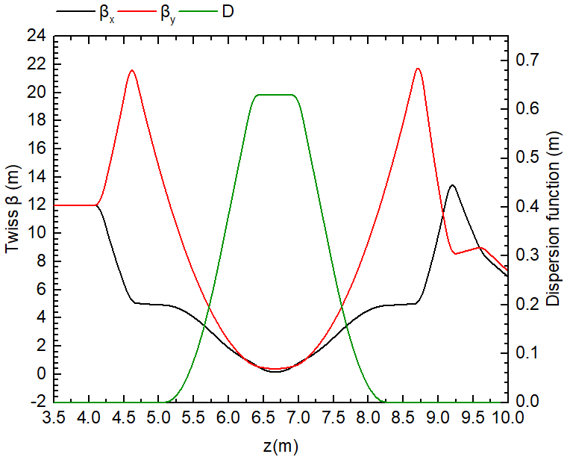
Deflection and Energy Selection (DES) section
Accurate energy selection
Removed uncharged particles
The achromatic lattice design is used.
$$a_{x}=\sqrt{a_{x,0}^{2}+{(D_{x}\frac{∆o}{p})}^{2}}$$
$$D^{,,}+\left[\frac{1}{ρ^{2}}\frac{2p_{0}−p}{p}+\frac{B^{,}}{Bρ}\frac{p_{0}}{p}\right]D=\frac{1}{ρ}$$

Slide 14
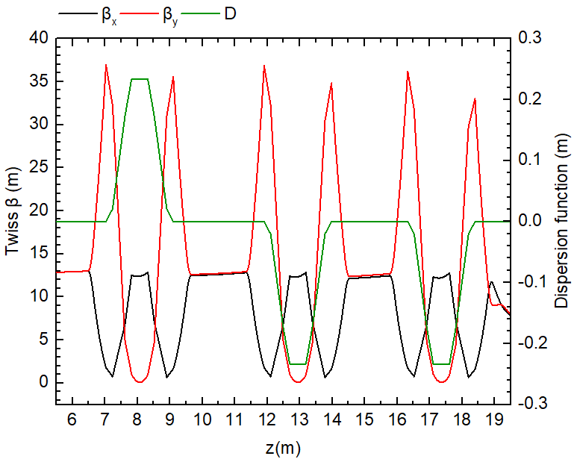
Deflection and Energy Selection (DES) section
Canted-cosine-theta (CCT) magnet is used
It use multiple nested coil pairs to produce a hybrid field of dipole and quadrupole components
The achromatic lattice design is used.

Slide 15
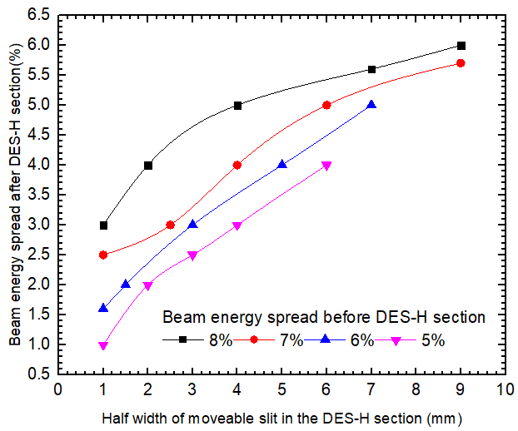
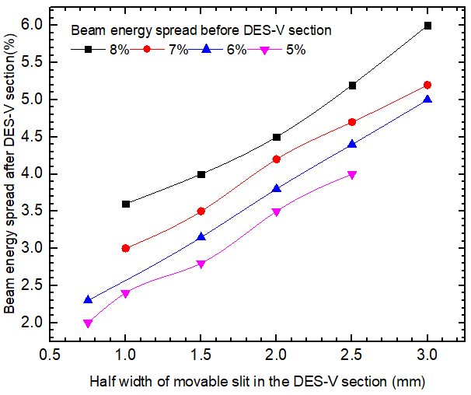
Deflection and Energy Selection (DES) section
The moveable slit set between DES section remove particles with energy deviation and neutral stray particles produced by laser acceleration.

Slide 16
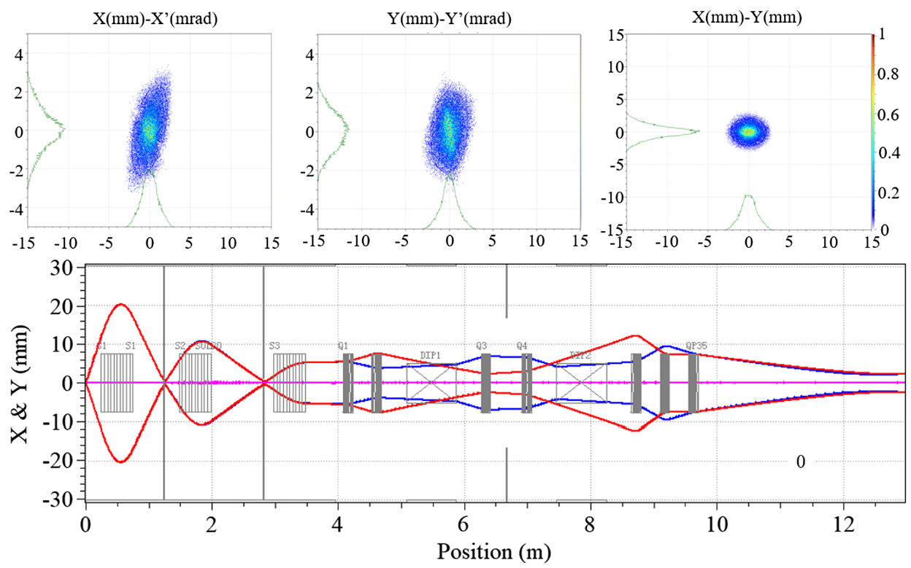
Application section-horizontal

Slide 17
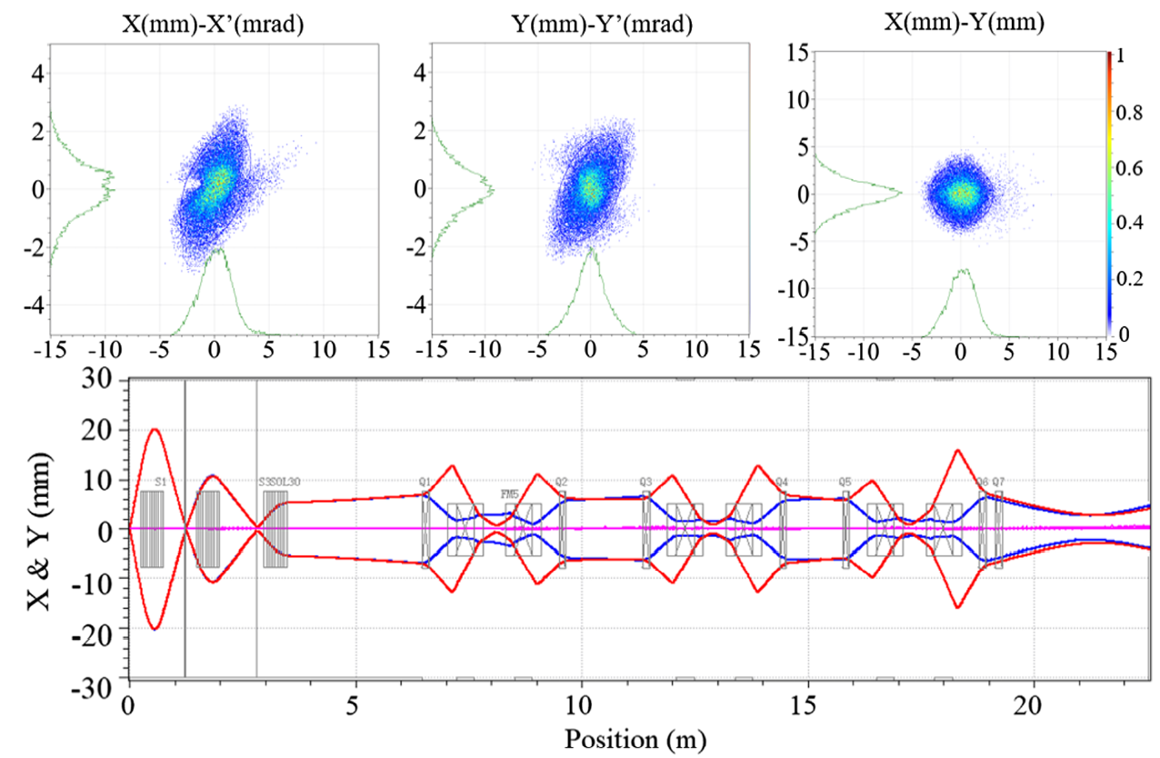
Application section-vertical

Slide 18
Section | Beamline | Length (mm) | Radius (mm) | Maximum magnetic flux density
Collection section | Solenoid 1 | 500 | 30 | 9.05 T
 | Solenoid 2 | 500 | 30 | 8.23 T
 | Solenoid 3 | 500 | 30 | 6.51 T
DES-H section | DES-H-Q 1-4 | 150 | 36 | 11.45 T/m
Application-H section | APP-H-Q 5 | 150 | 36 | 14.11 T/m
 | APP-H-Q 6 | 150 | 36 | 15.07 T/m
 | APP-H-Q 7 | 150 | 36 | 3.17 T/m
DES-V section | DES-V-Q 1-5 | 150 | 36 | 9.25 T/m
Application-V section | APP-V-Q 6 | 150 | 36 | 12.47 T/m
 | APP-V-Q 7 | 150 | 36 | 1.78 T/m

Slide 19
动力学误差分析
After finished beam dynamics design, the errors analysis has been finished
Error analysis is mainly for laser parameters ：
Angle offset
Position offset
Effect of laser target position offset on beam transmission
Influence of generating beam initial directivity on beam transmission

Slide 20
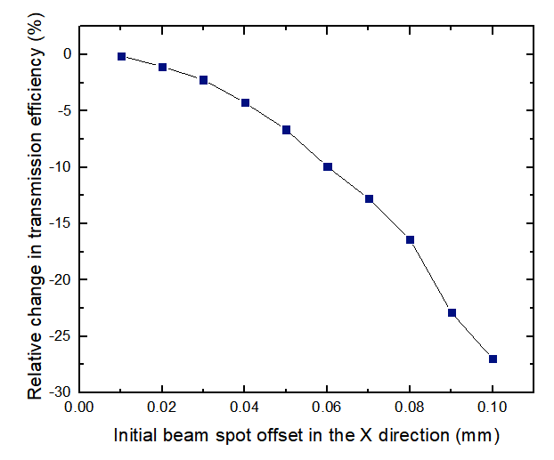
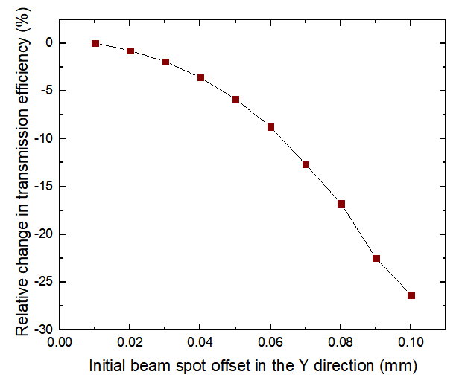
动力学误差分析
Research of the impact of the initial beam spot offset:
transmission efficiency is taken as the main consideration
The influence of spot size and distribution is used as a reference index
Relative efficiency change=$\frac{{Eff}_{err} − Eff}{Eff}$

Slide 21
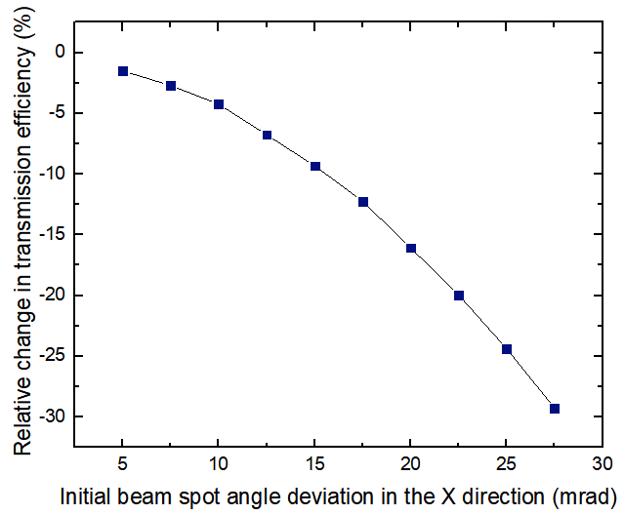
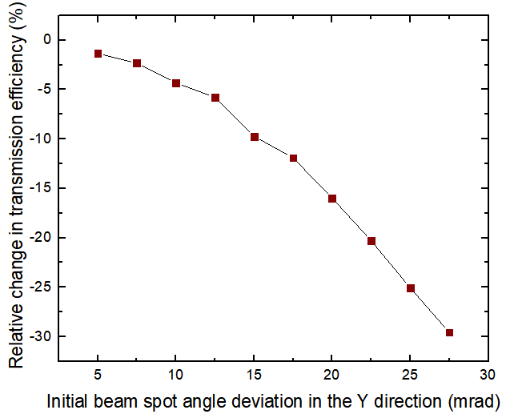
动力学误差分析
Research of the impact of the initial directivity on beam transmission:
transmission efficiency is taken as the main consideration
The influence of spot size and distribution is used as a reference index
Relative efficiency change=$\frac{{Eff}_{err} − Eff}{Eff}$

Slide 22
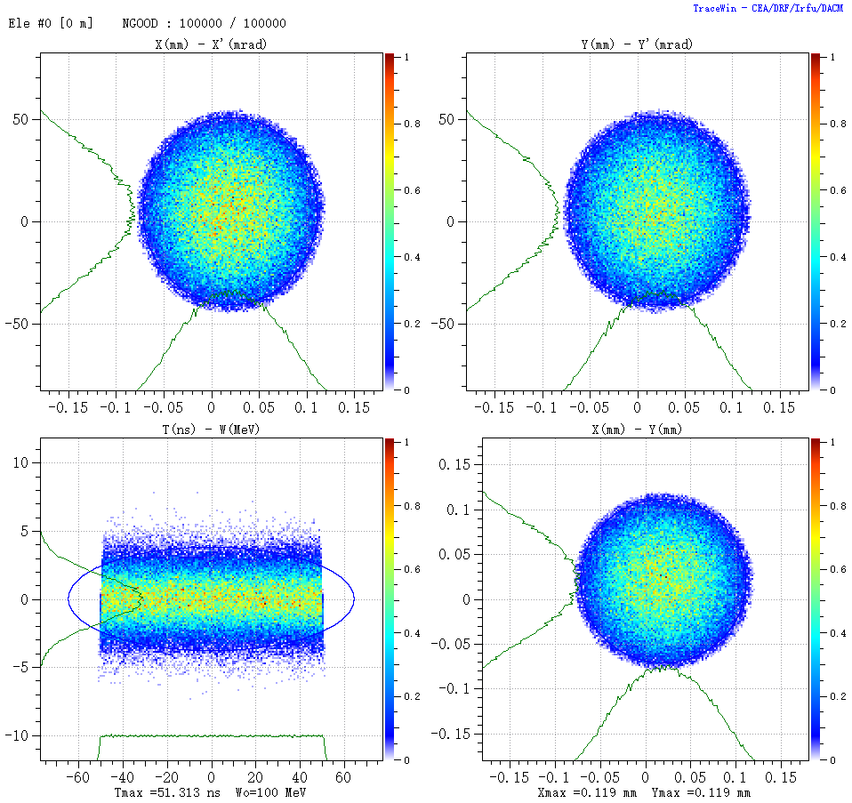
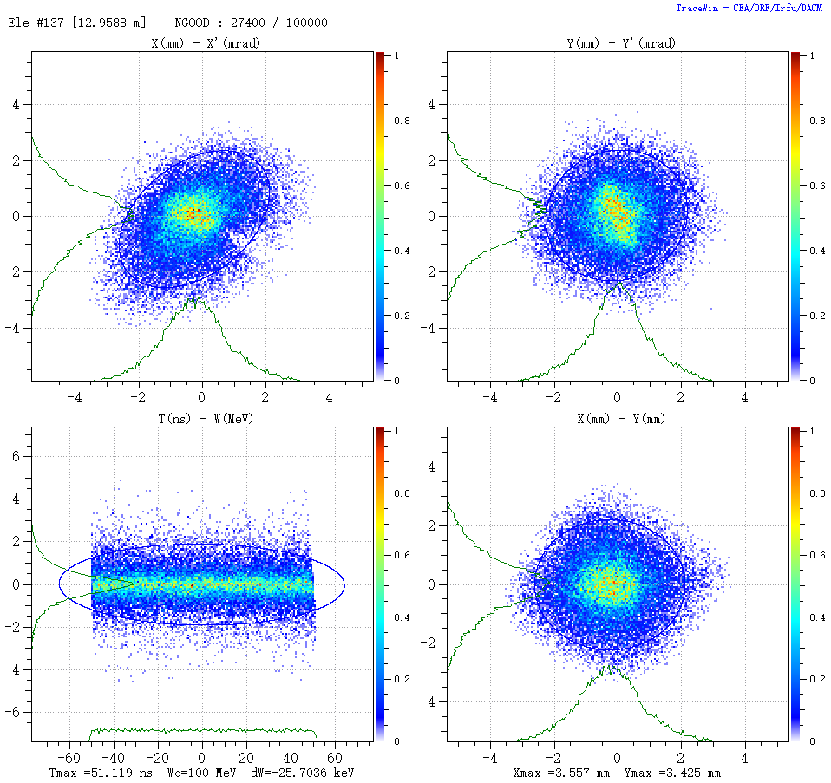
动力学误差分析
The effects of spot offset and directivity are considered together
Parameters | Value
Dx | ±0.02 mm
Dy | ±0.02 mm
Dxp | ±5 mrad
Dyp | ±5 mrad

Slide 23
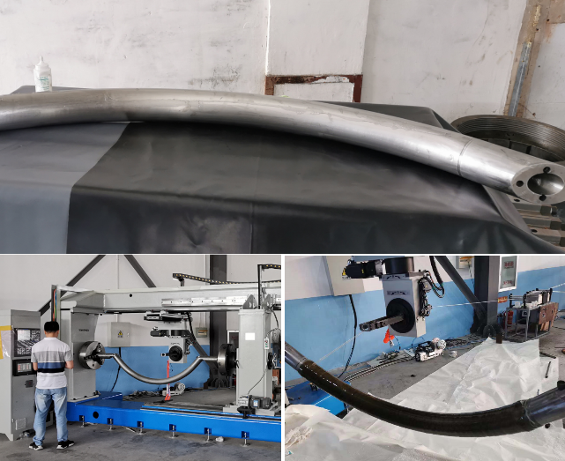
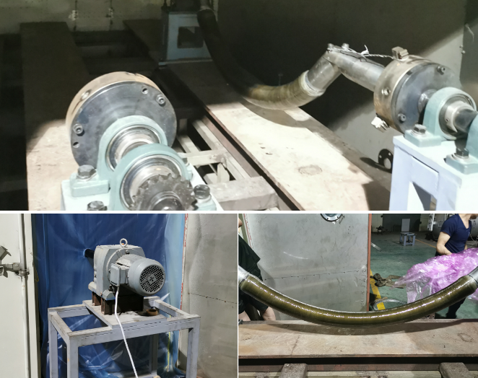
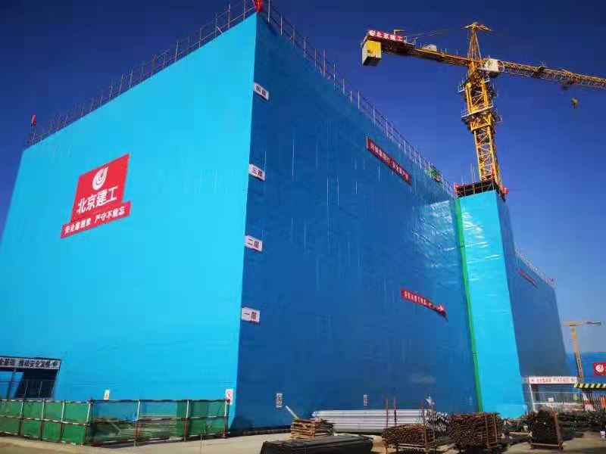
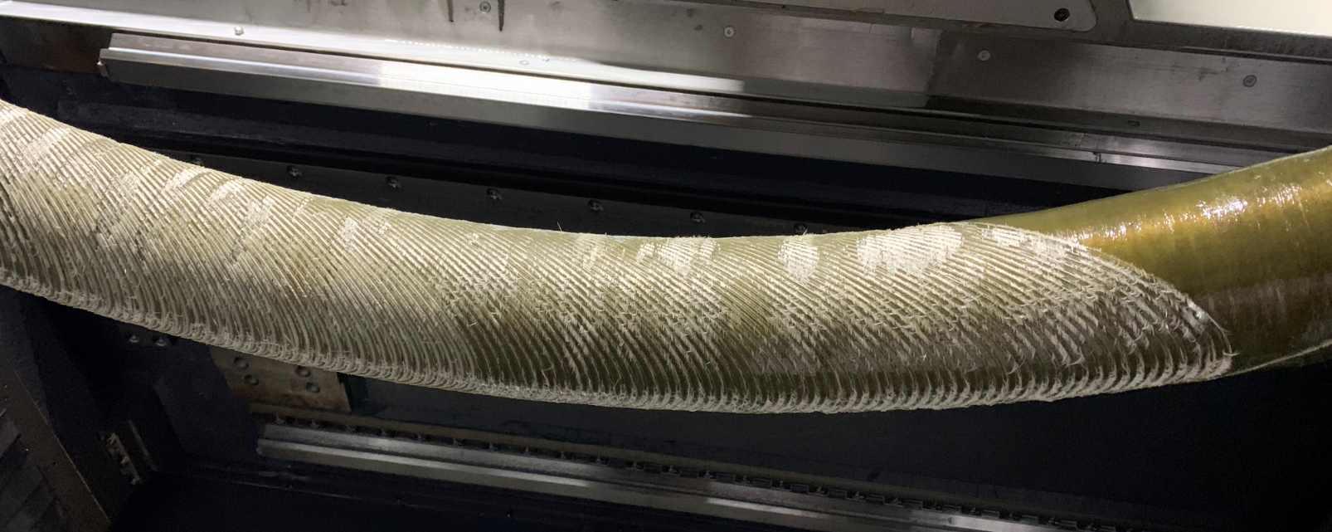
Core technology： CCT magnets
The machining difficulty of curved superconducting dipole magnet is solved.
The production process prototype processing is completed.
Construction of infrastructure:
Affects by epidemics partly
All the work is on track and the building is expected to complete in June 2021

Slide 24
Summary
Laser accelerate beam initial macro library generation program is written
Achromatic beam line is design to transport large energy spread beam, effectively control the beam envelope.
40-100MeV proton beam can be transmitted
The project progresses according to the time node

Slide 25
Thank you
Suggestion is welcome

